Slide 1
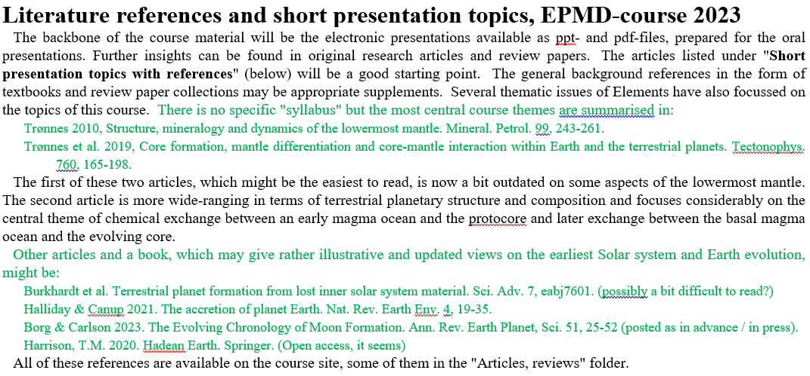
Suggestions, information
- Identify yourself with proper name in your Zoom-window
- You are welcome to (even encouraged to) show your picture/video, esp. during question-discussion periods
- I encourage you to unmute yourself and break in with questions or comments during my presentations.
If I think there are too many interruptions, I will suggest we defer questions to the next break
- Four-hour sessions: about 2 breaks of about 10 min each?
- Ming Geng, Univ. of Oslo (the next-door office to me) and Justin Leung, Univ. of Oxford will record most of the
March and May sessions, respectively and make them available to the participant group

Slide 3
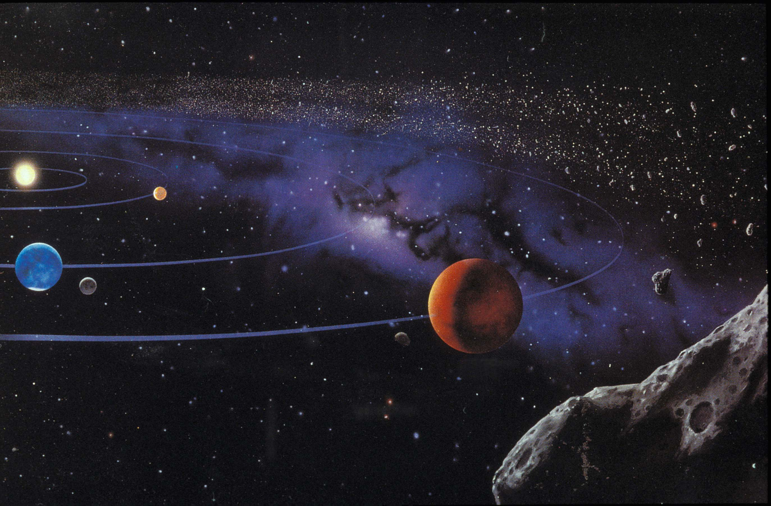
Structure and composition of the Solar system,
Star evolution and nucleosynthesis
Asteroid belt
Mercury
Venus
Earth-Moon
Mars

Slide 4
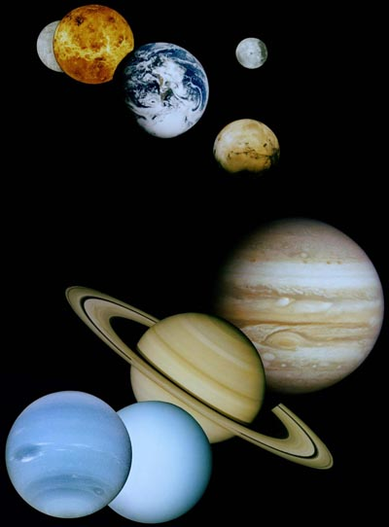
Focus this week:
Terrestrial planets
metal and rock
Venus
Earth
Moon
Mercury
Mars
Jupiter
Gas giants:
H, He
Saturn
Neptune
Ice giants:
ice + gas
Uranus

Slide 5
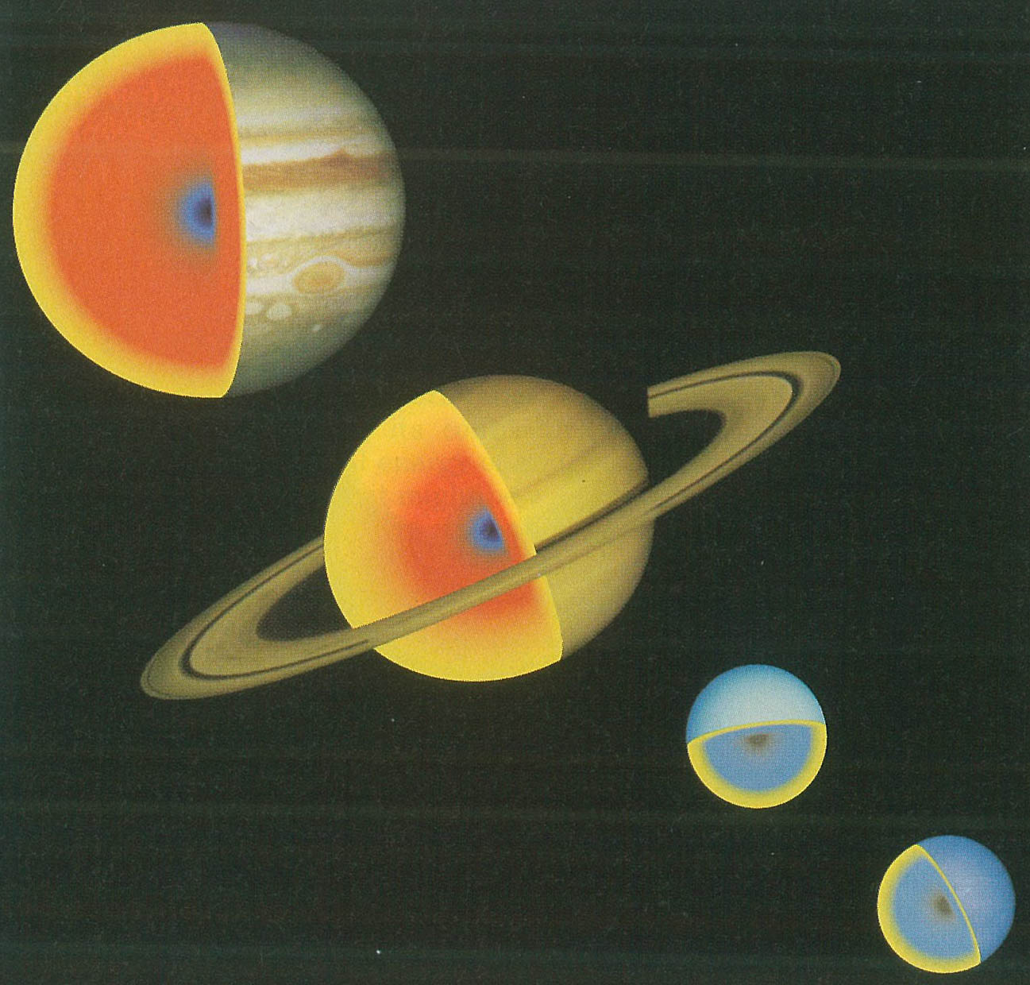
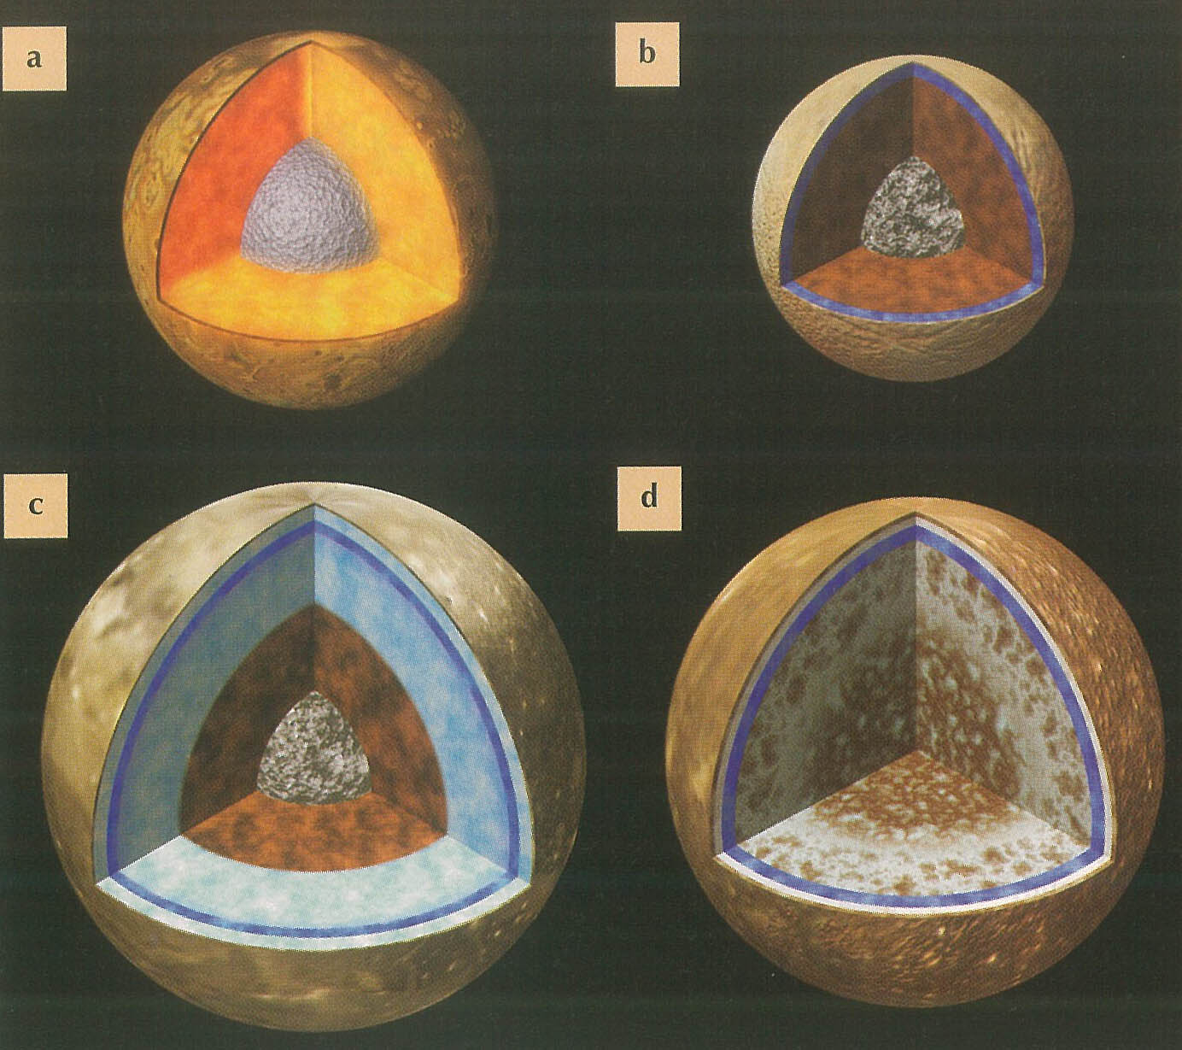
Outer-SS planets have also cores silicate and Fe-dominated metal alloys
Caveat: Jupiters core is "fuzzy and diluted" by hydrogen
Stevenson, 2020: Jupiter’s Interior as revealed by Juno. AREPS 48, 465-489
Jupiter
Europa
Io
Saturn
Ganymede
Callisto
Uranus
Neptune

Slide 6
Stevenson,
2020, AREPS

Slide 7
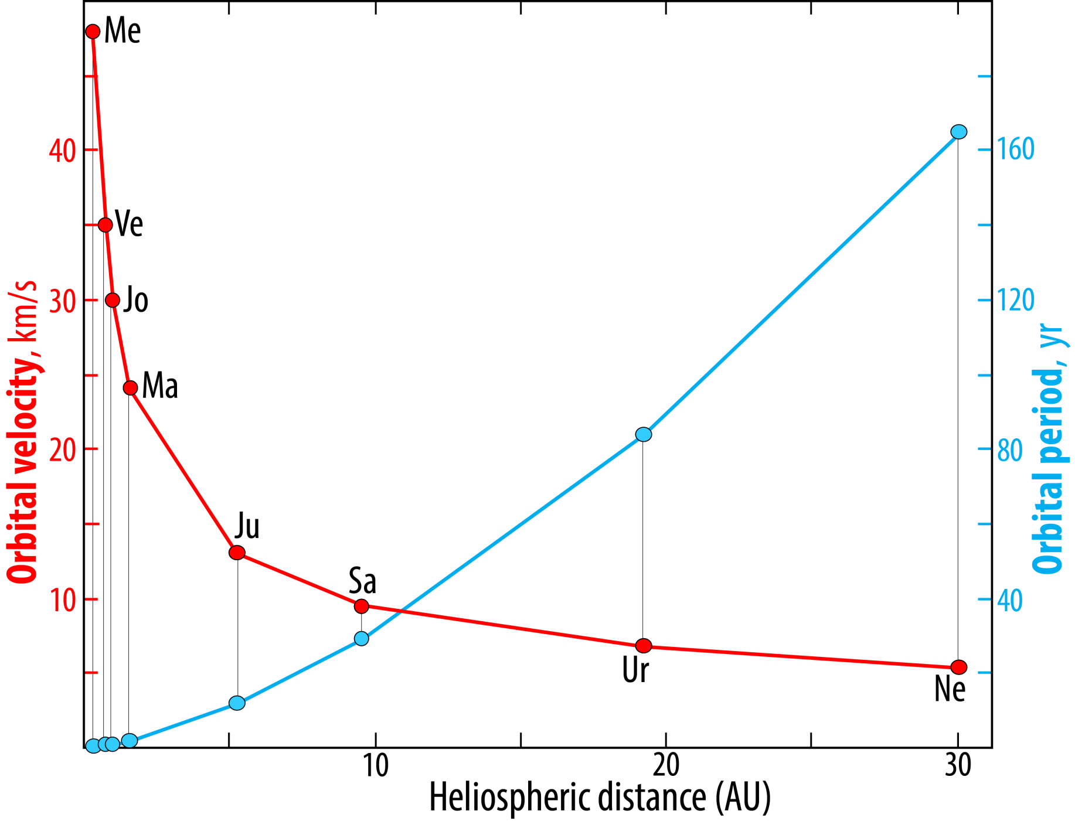
Ea
Distance Period
AU yr .
Me 0.39 0.24
Ve 0.72 0.62
Ea 1.00 1.00
Ma 1.52 1.88
Ju 5.20 11.9
Ne 30.1 163.7

Slide 8
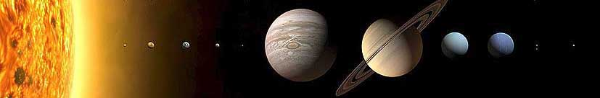
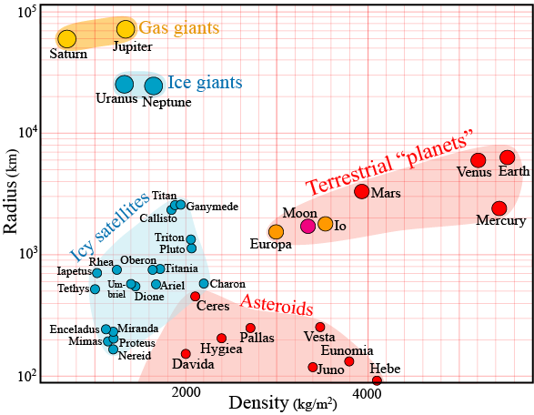
Solar system: general zoning from metal and silicates to gas and ice
Terrestrial planets:
metal and rock
Gas giants:
H, He
Ice giants:
ice + gas
Kuiper belt:
ice
Compression effect

Slide 9
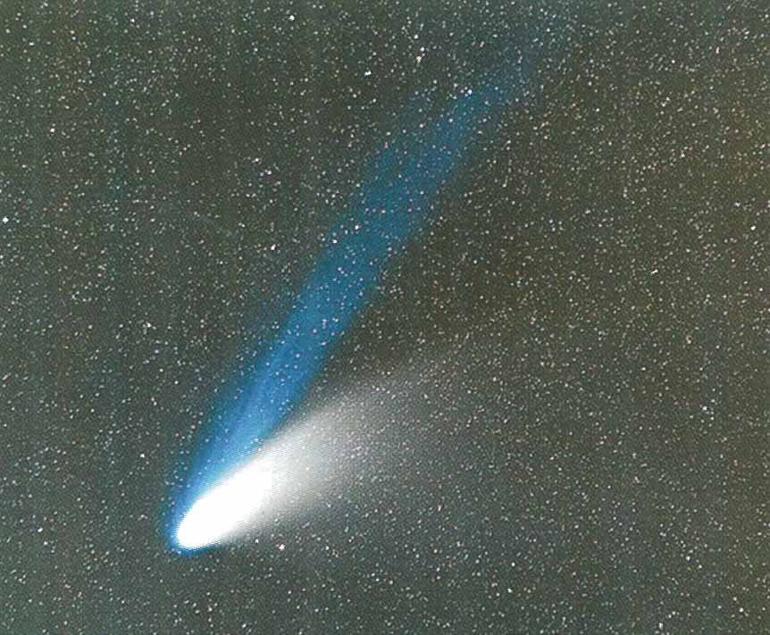
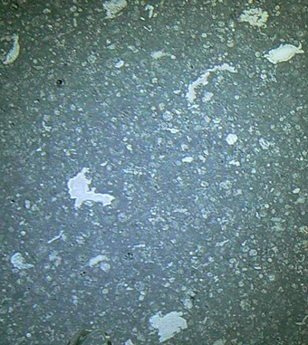
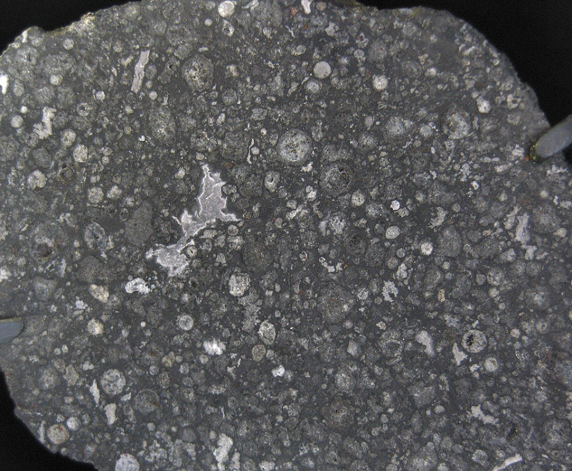
Materials
Hale Bopp comet
- discovered July 23, 1995
- perihelion: April 1 1997
Primitive solar syst. material
Interplanetary dust particles
chondrites, esp. carbonaceous chondr.
plasma tail
Differentiated samples
Meteorites
Vesta (HED - howardites, eucrites, diogenites)
Achondrites (Fe-met., angrites, aubrites, --)
Mars (SNC-met.)
Moon (basalt, anorthosite, breccia)
Planetary samples
Earth
Moon (Apollo/Luna missions)
dust tail
Allende, CV3
carbonaceous chondrite
Extremely important fall:
Feb. 5, 1969, Chihuahua, Mexico
Chondrules
Ca-Al-inclusions, CAI

Slide 10
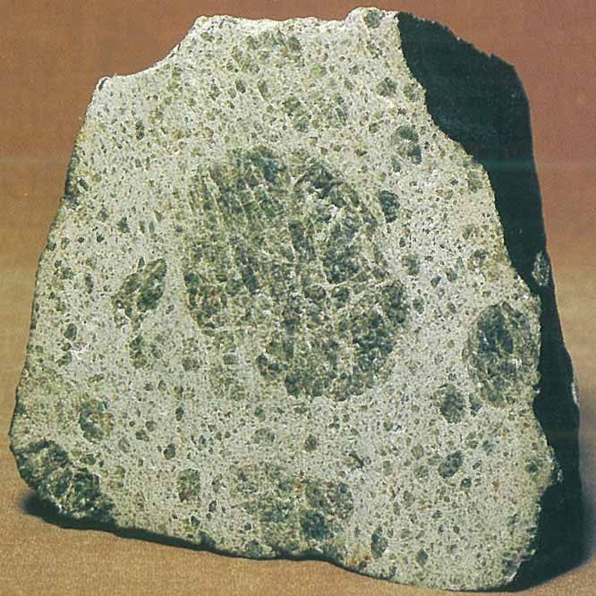
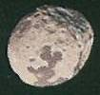
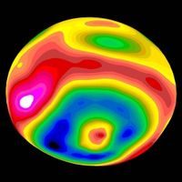
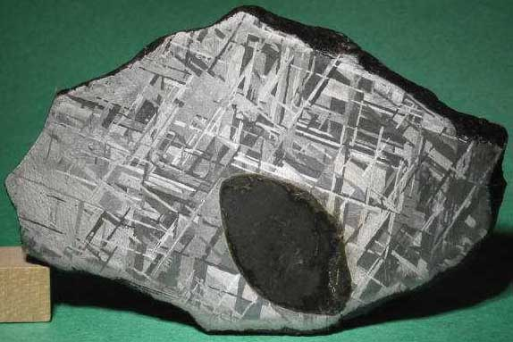
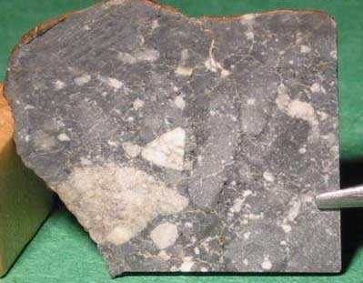
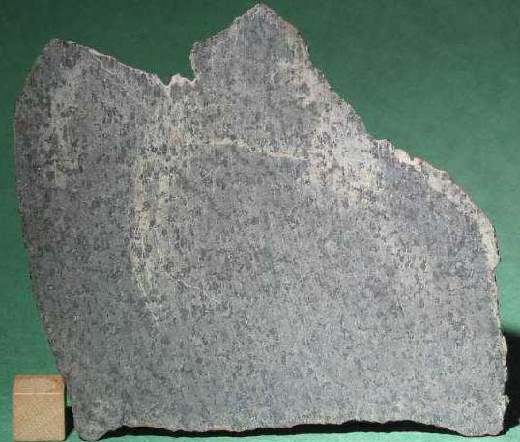
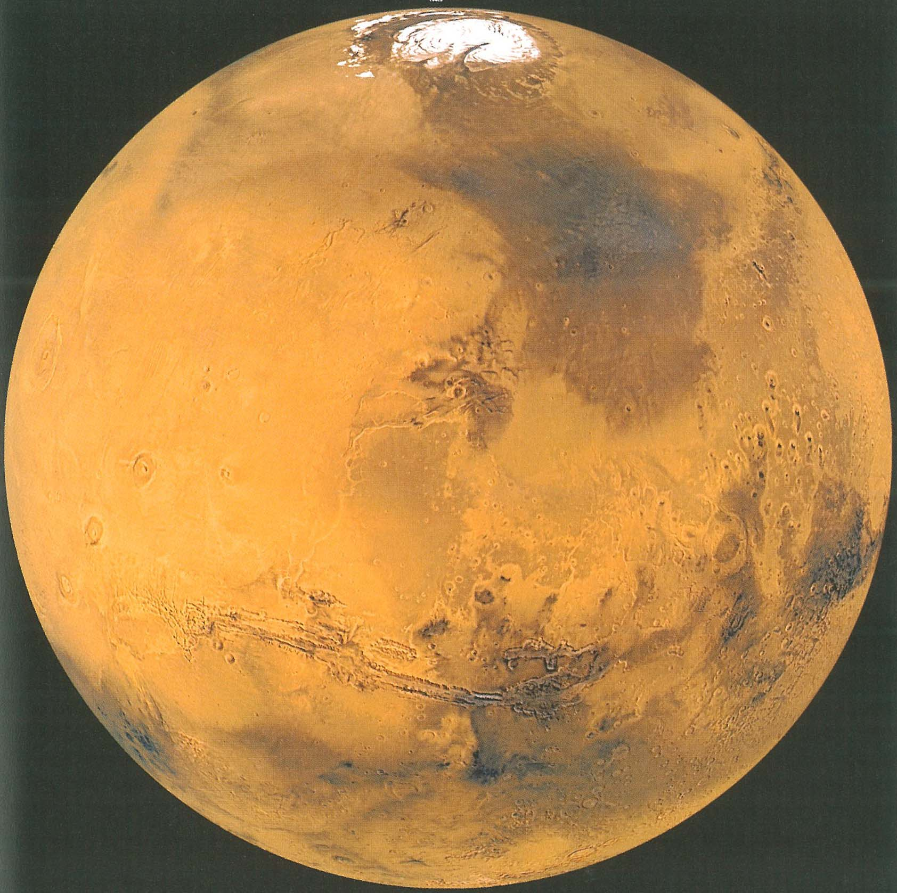
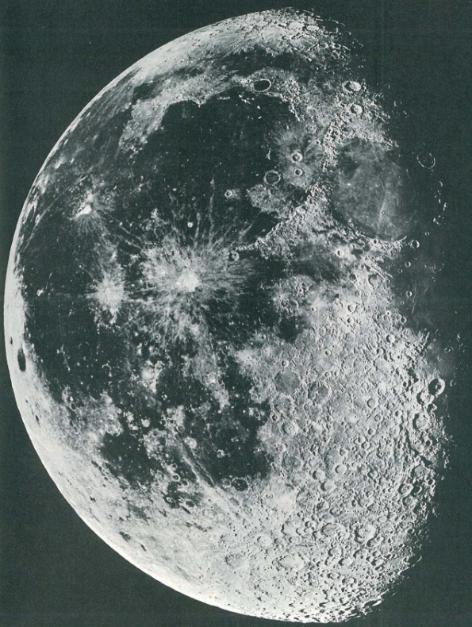
Differentiated meteorites
Diogenite – Vesta
(HED-group)
Fe-meteorite
Lunar
breccia
Shergottite
(basalt)

Slide 11
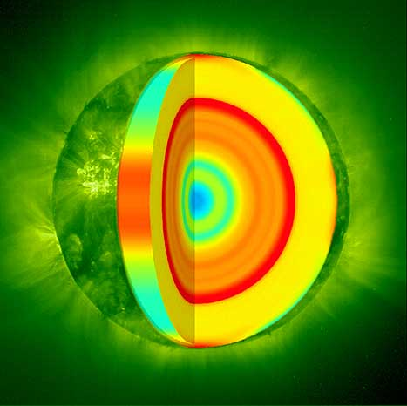
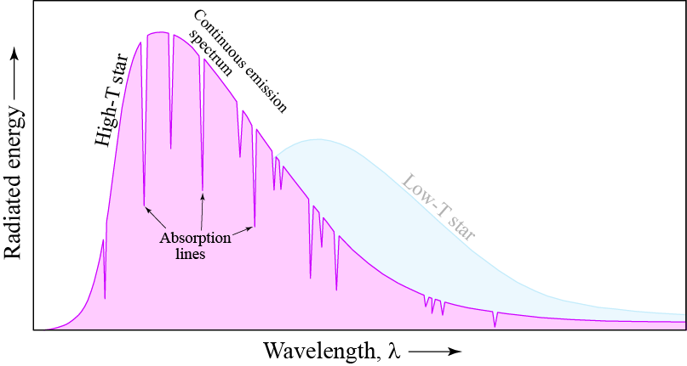
Compositional spectroscopy
Solar photosphere
emmision spectrum (atomic absorption)
ultimate elemental SS-composition

Slide 12
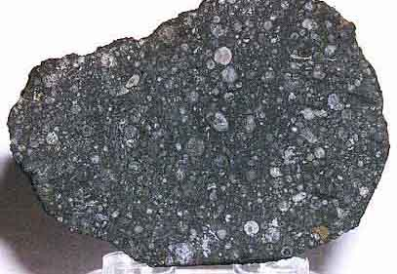
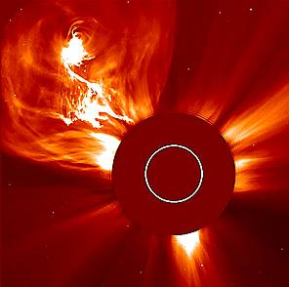
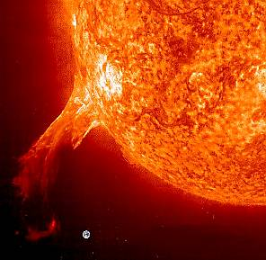
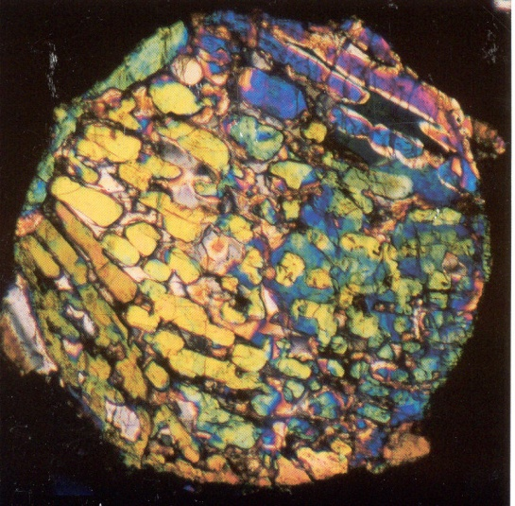
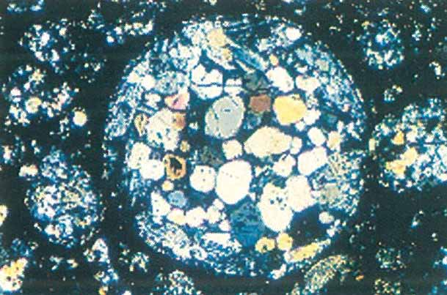
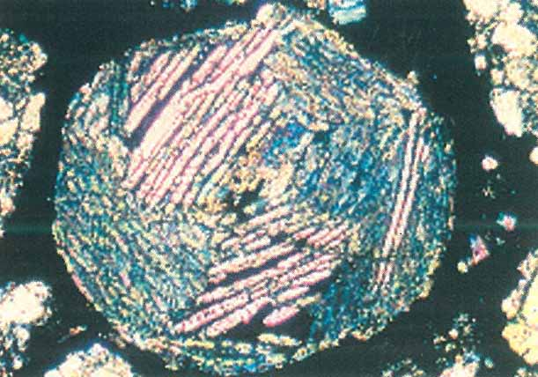
Refractory inclusions and chondrules
evaporation and condensation of dust ⇒ CAI
flash melting and solidification ⇒ chondrules
Strong magnetic fields from early Sun (T-Tauri phase)
Microscope images of chondrules

Slide 13
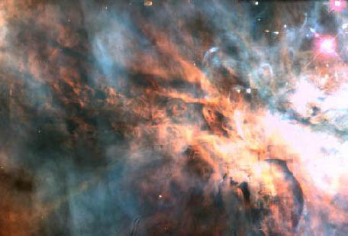
Quick review of star-planet formation
Molecular gas clouds, Orion nebula
Star nursery

Slide 14
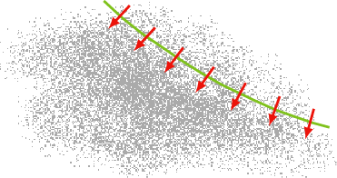
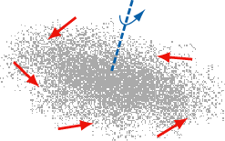
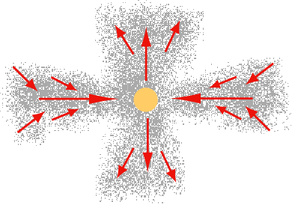

Shock wave from supernova
⇒ molecular cloud contraction
(our solar nebula was affected by several
neutron-star mergers and supernovae –
short-lived radioactive isotopes)
Increasing contraction and rotation
- birth of star
equatorial in-flow:
bipolar outflow
Planetary accretion from solar nebula

Slide 15
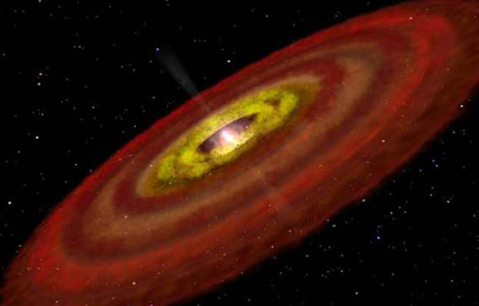
Young star with nebula

Slide 16
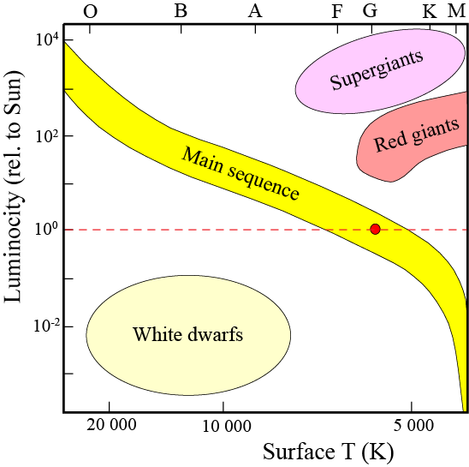
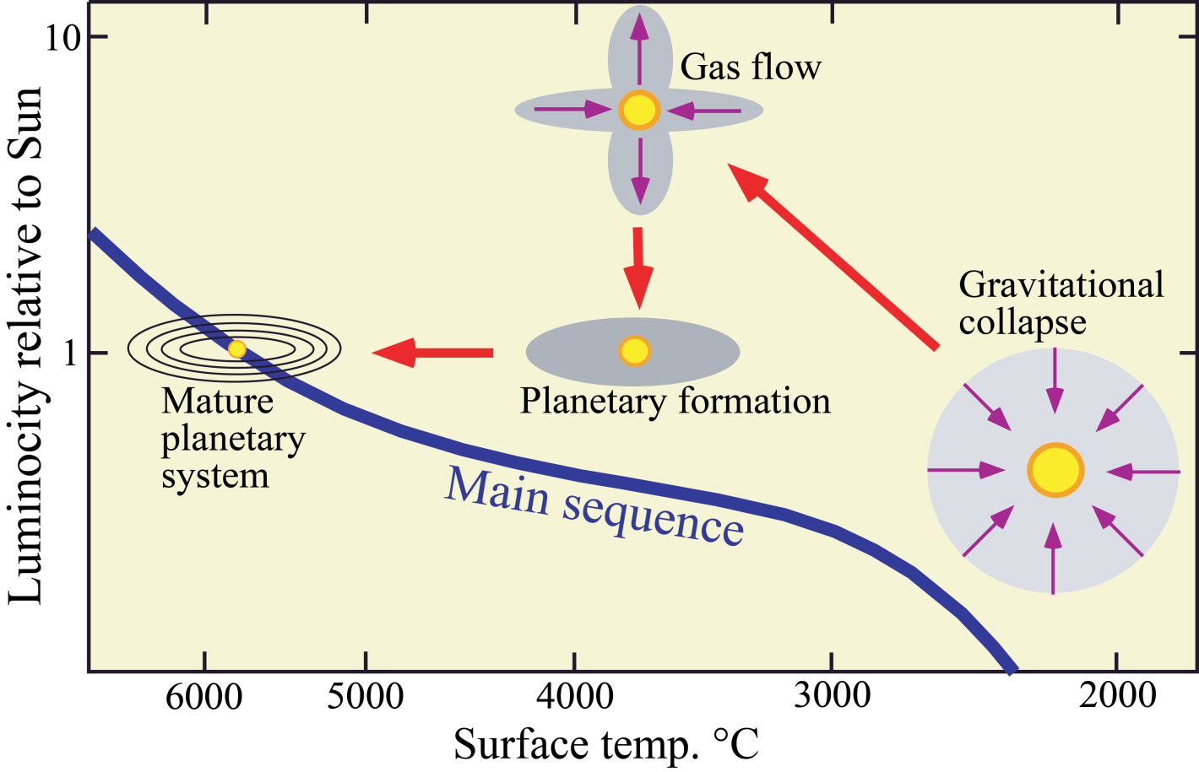
Herzprung-Russel
diagram

Slide 17
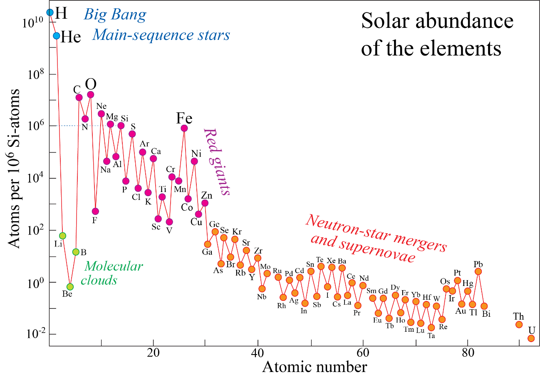
Nucleosynthesis
Burbidge EM, Burbidge GR, Fowler WA, Hoyle F, 1957: Synthesis
of the elements in stars. Rev. Modern Phys. 29, 547–650. "B²FH"
Johnson JA, 2019: Populating the periodic table: Nucleosynthesis of
the elements. Sci. 363, 474. In a special section on the 150th
anniversary of the periodic table (Mendeleev 1869, Zeitschr. Chemie)
- Big Bang nucleosynthesis: H, He, Li
- Stellar fusion: Main sequence stage: He
  Red giant /supergiant stages: up to Fe-Zn
- Explosive nucleosynthesis: Supernovae: all the heavier elements
Cosmic ray spallation
cosmic ray fragmentation of C, N, O
in molecular clouds
³He, Li, Be, B

Slide 18
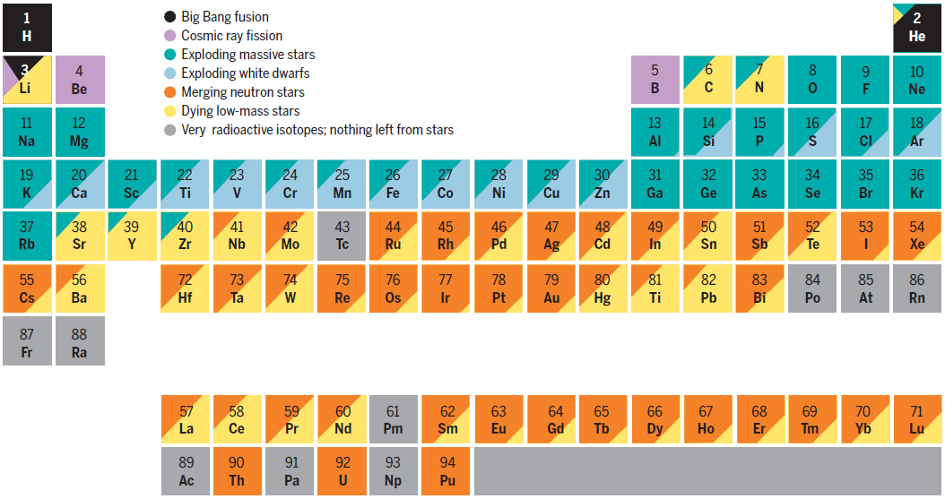

Slide 19
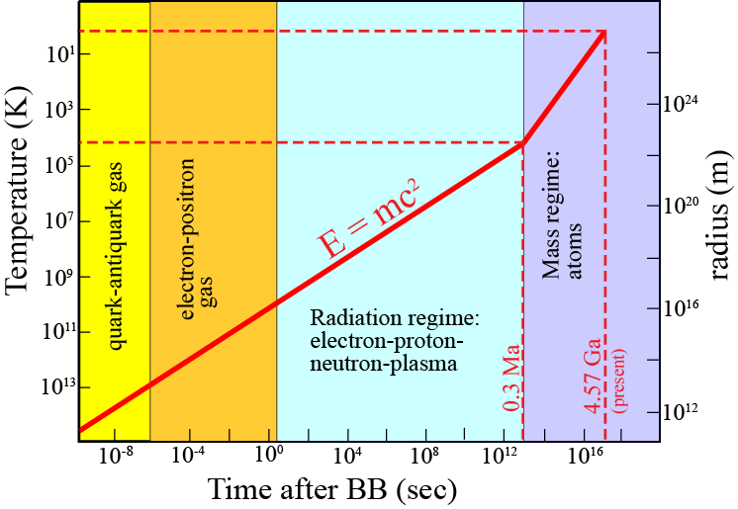
Big Bang nucleosynthesis: H, He, Li
From energy to mass: E = mc²
1-10 K
10-30 kK
Neutrons
- required to produce heavier elements
- free neutrons are radioactive (n → p⁺ + e⁻ + anti-neutrino), T_{h} ≈10 min
- therefore: few neutrons around in the immediate BB-aftermath

Slide 20
Star evolution
Hertzsprung-Russel diagram
Stellar lifetime
prop. to mass/luminosity
10⁵
10⁴
m/l = 0.001
10³
Rel. luminosity
10²
10¹
1
m/l =1
2
5
10
20
1
Rel. mass
Very large luminocity range
⇒ stellar lifetime: inversely prop. to mass
Lifetime of:
Sun: 10 Ga
(~ 2nd generation star, average)
10*Sun: 10 Ma
20*Sun: 2 Ma

Slide 21
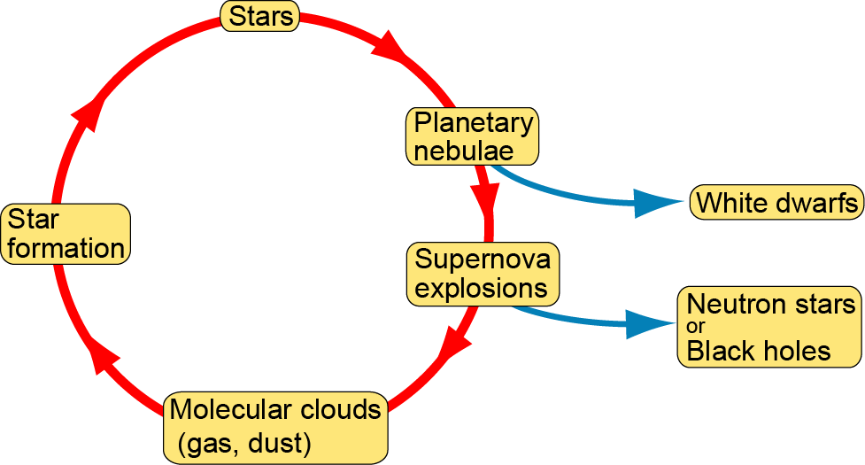
Reprocessing of stellar material
May be involved in later
mergers and supernova
explosions
Several different types of supernovae,
including stellar core collapse
(e.g. Johnson, 2019, Sci.)

Slide 22
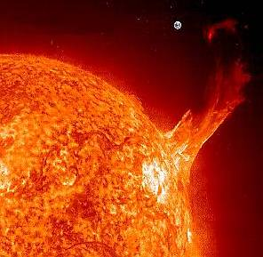
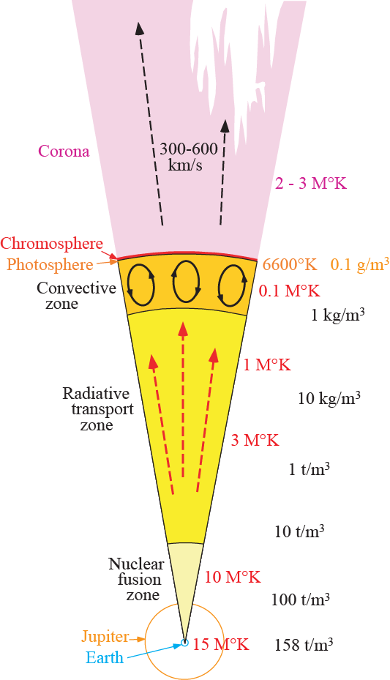

Slide 23
Nucleosynthesis by fusion
Fuel Product T (MK) ρ (t/m³)
H He 20 10
He C N O 45 700
C O to Mg 90 10⁵
Ne O to Mg 160 4*10⁶
O Si (Mg to S) 230 10⁷
Si Fe Ni 400 3*10⁷

Slide 24
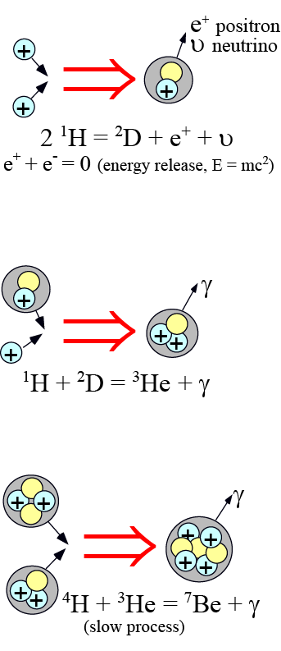
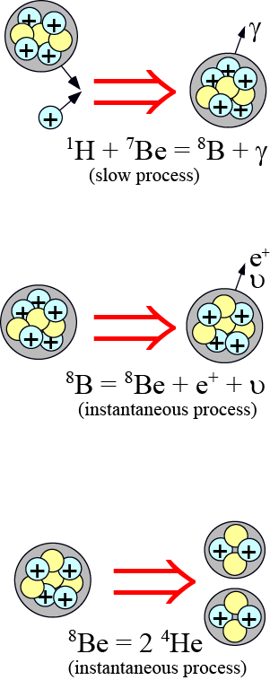
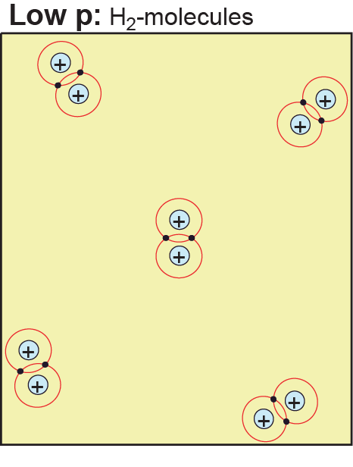
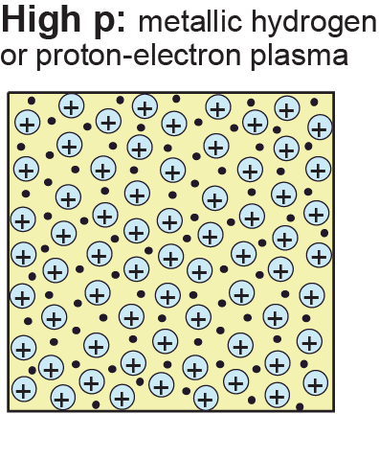
H-fusion
e

Slide 25
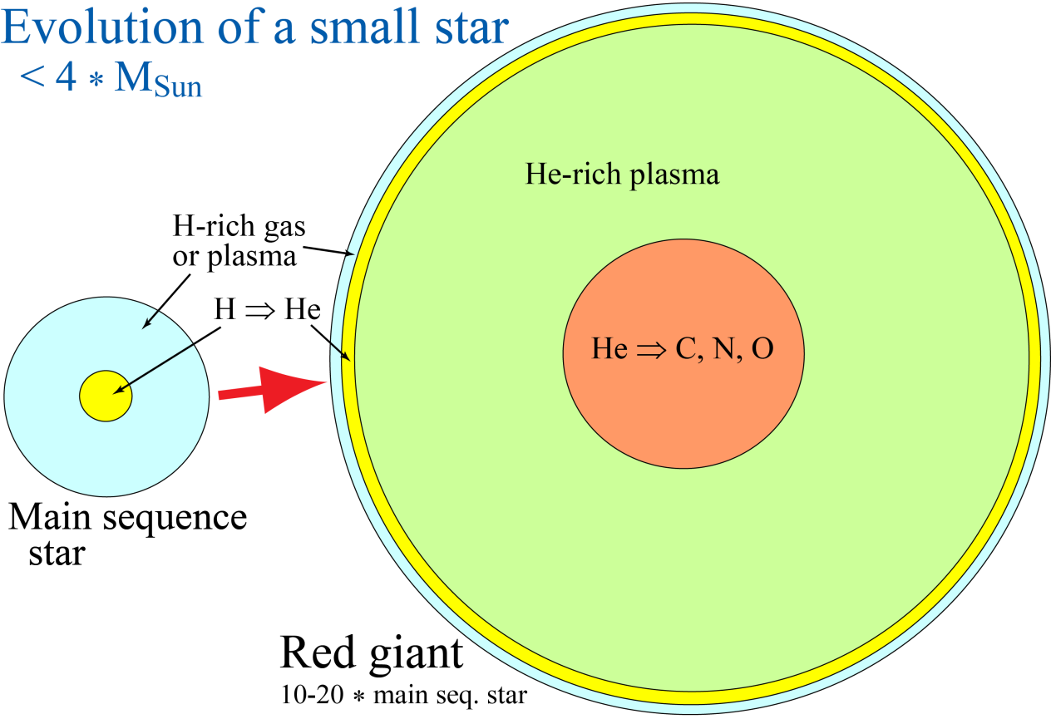
Sun: Half-way through its life
Red giant in about 5 Ga – extending to about 1 AU,
lasting for 1-100 Ma, before expulsion of the outer
layers and conversion to a white dwarf.
Cyclic core fusion ("burning") of C, N, O (CNO) and Si:
When all the fuel is exhausted, the core contracts
→ increasing p-T
→ ignition of new product(s) → another fusion cycle
Fusion reactions, examples
He-burning
⁴He + ⁴He → ⁸Be + γ
⁸Be + ⁴He → ¹²C + γ
C-O-burning
¹²C + ¹²C → ²⁰Ne + ⁴He + γ
¹⁶O + ¹⁶O → ²⁸Si + ⁴He + γ
¹²C + ¹⁶O → ²⁴Mg + ⁴He + γ

Slide 26
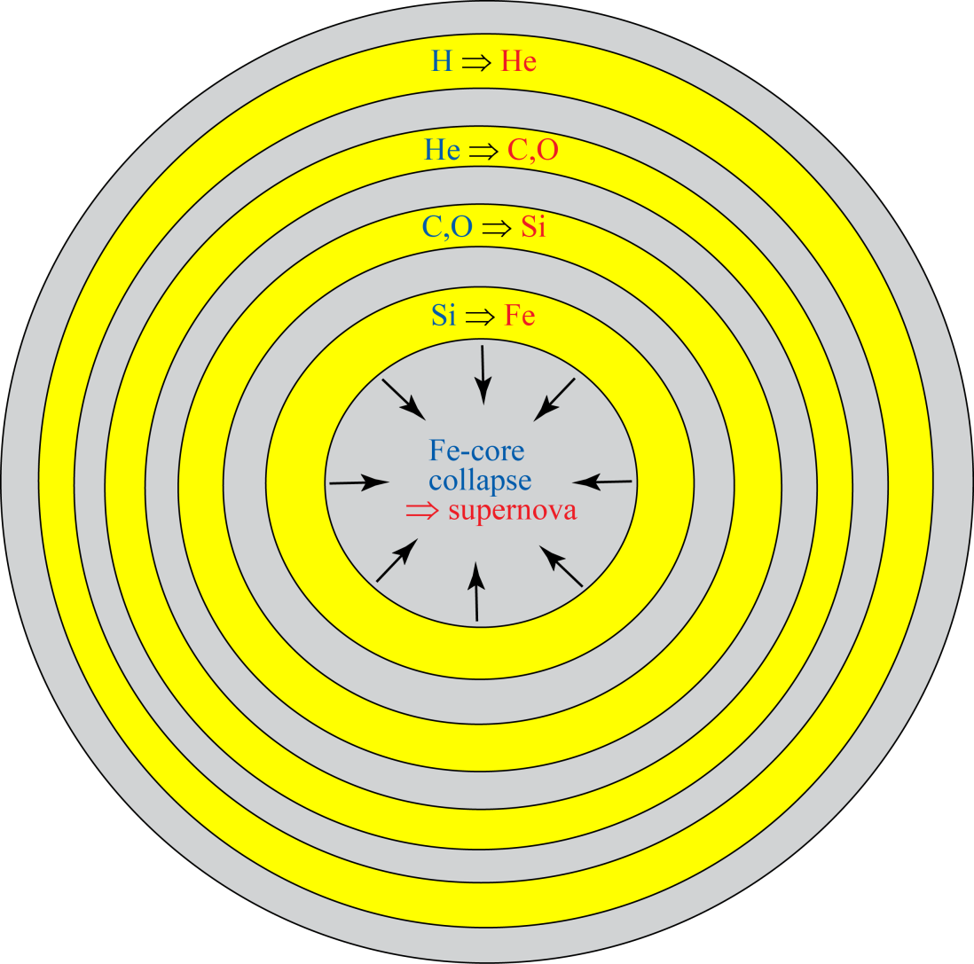
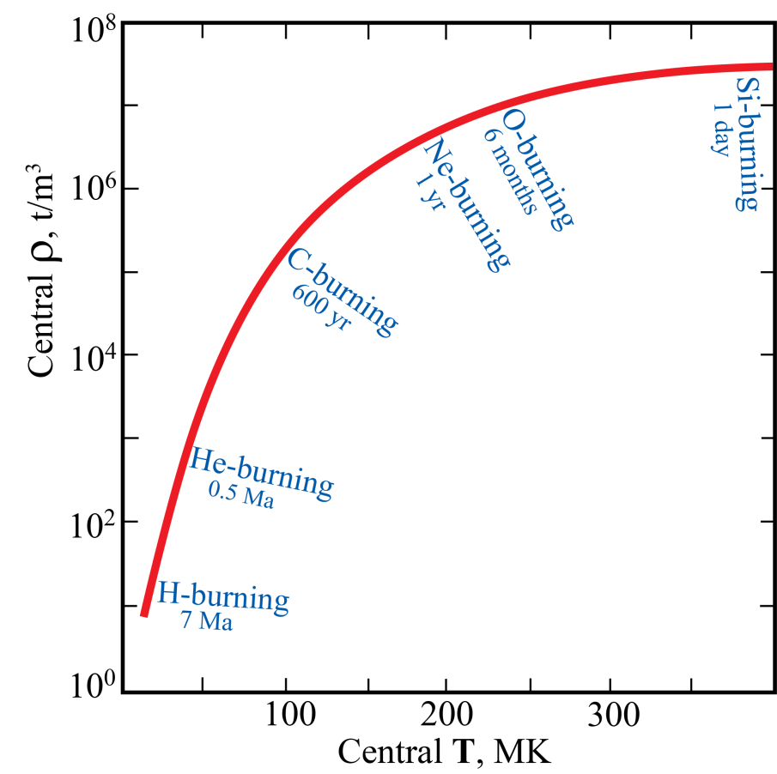
Evolution of large stars (> 10 m_{Sun})
Supergiant fusion shells,
can ultimately lead to Fe-core collapse supernova
Fusion conditions: ρ-T-time
WM White (2006): Geochemistry
(early manuscript version)
J Johnson (2019, Sci.)

Slide 27
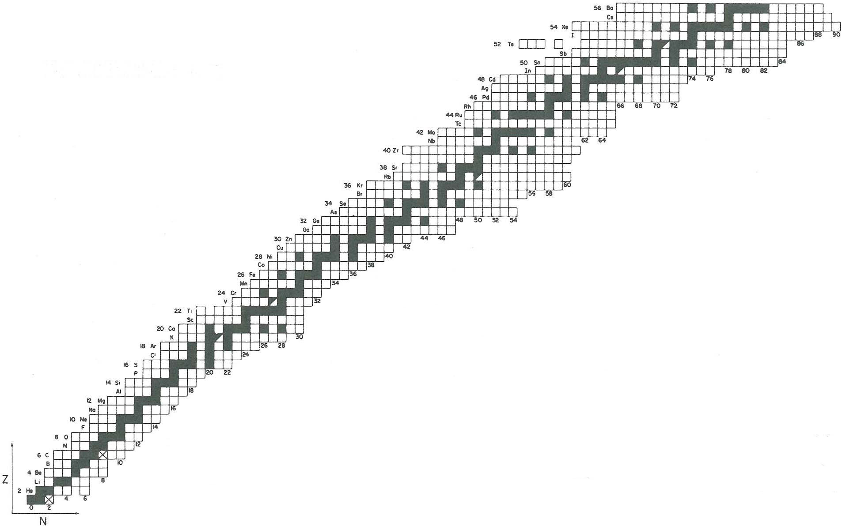
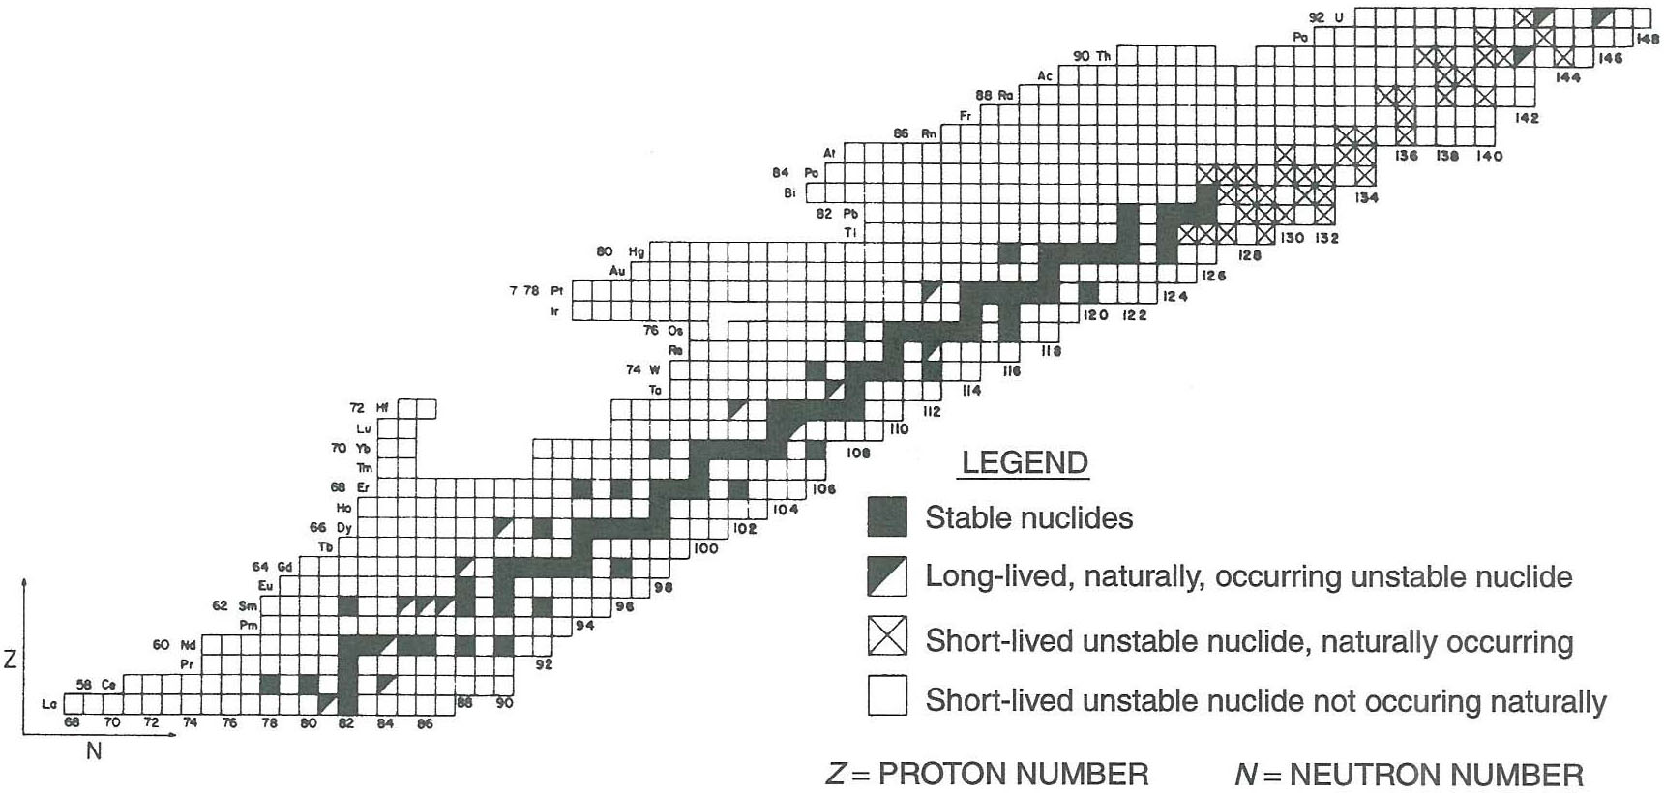
Chart of nuclides
¹³⁷Ba, neutron excess: 25
1:1
Fe: 26 protons (atomic no.: 26)
⁵⁴Fe
⁵⁶Fe
⁵⁷Fe
⁵⁸Fe
Neutrons:
28
30
31
32
²³⁸U, neutron excess: 52
²³²Th
²³⁵U
²³⁸U
1:1
1:1
2
³He
⁴He
1
¹H
²D
³T
0
1
2
¹³⁹La, neutron
excess: 25
¹³⁹La

Slide 28
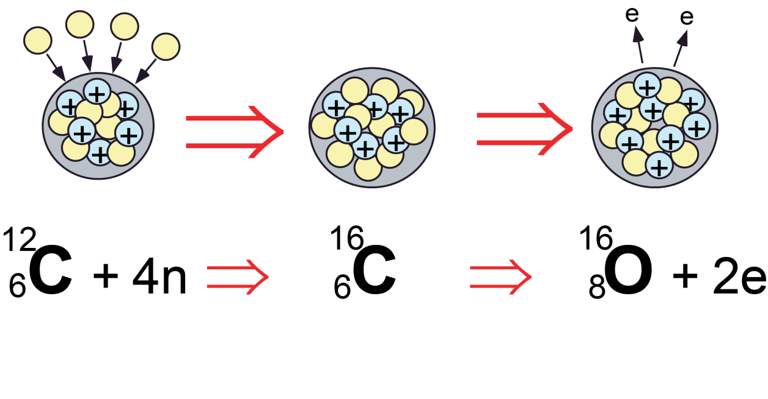
Neutron capture and β-decay
Z (protons)
β (e⁻) decay
neutron capt.
N (neutrons)
β-decay:
converts neutrons to protons
Simplified example:

Slide 29

Neutron capture processes
Z (protons)
β (e⁻) decay
neutron capt.
N (neutrons)
Slow: s-process
largely red giant phase
Rapid: r-process
Neutron-star mergers, supernovae,
stellar mass > 8*solar
Unstable nuclides
T_{h}: hrs to seconds
s-process
Highly unstable
nuclides
r-process

