Slide 1
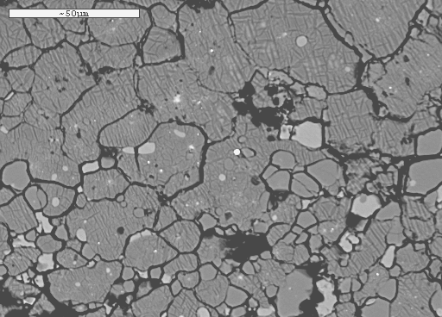
Deep Earth melting relations - possible consequences for
the structure and dynamics of the lowermost mantle

Slide 2
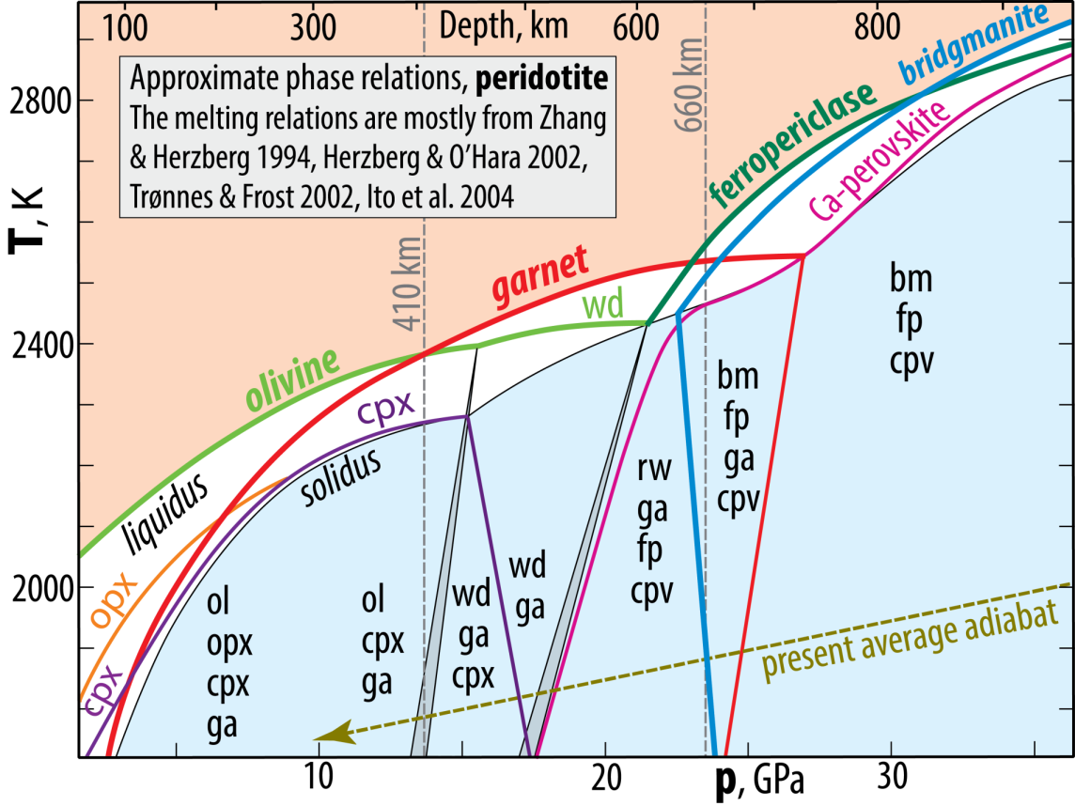
Melting relations, transition zone and uppermost lower mantle

Slide 3
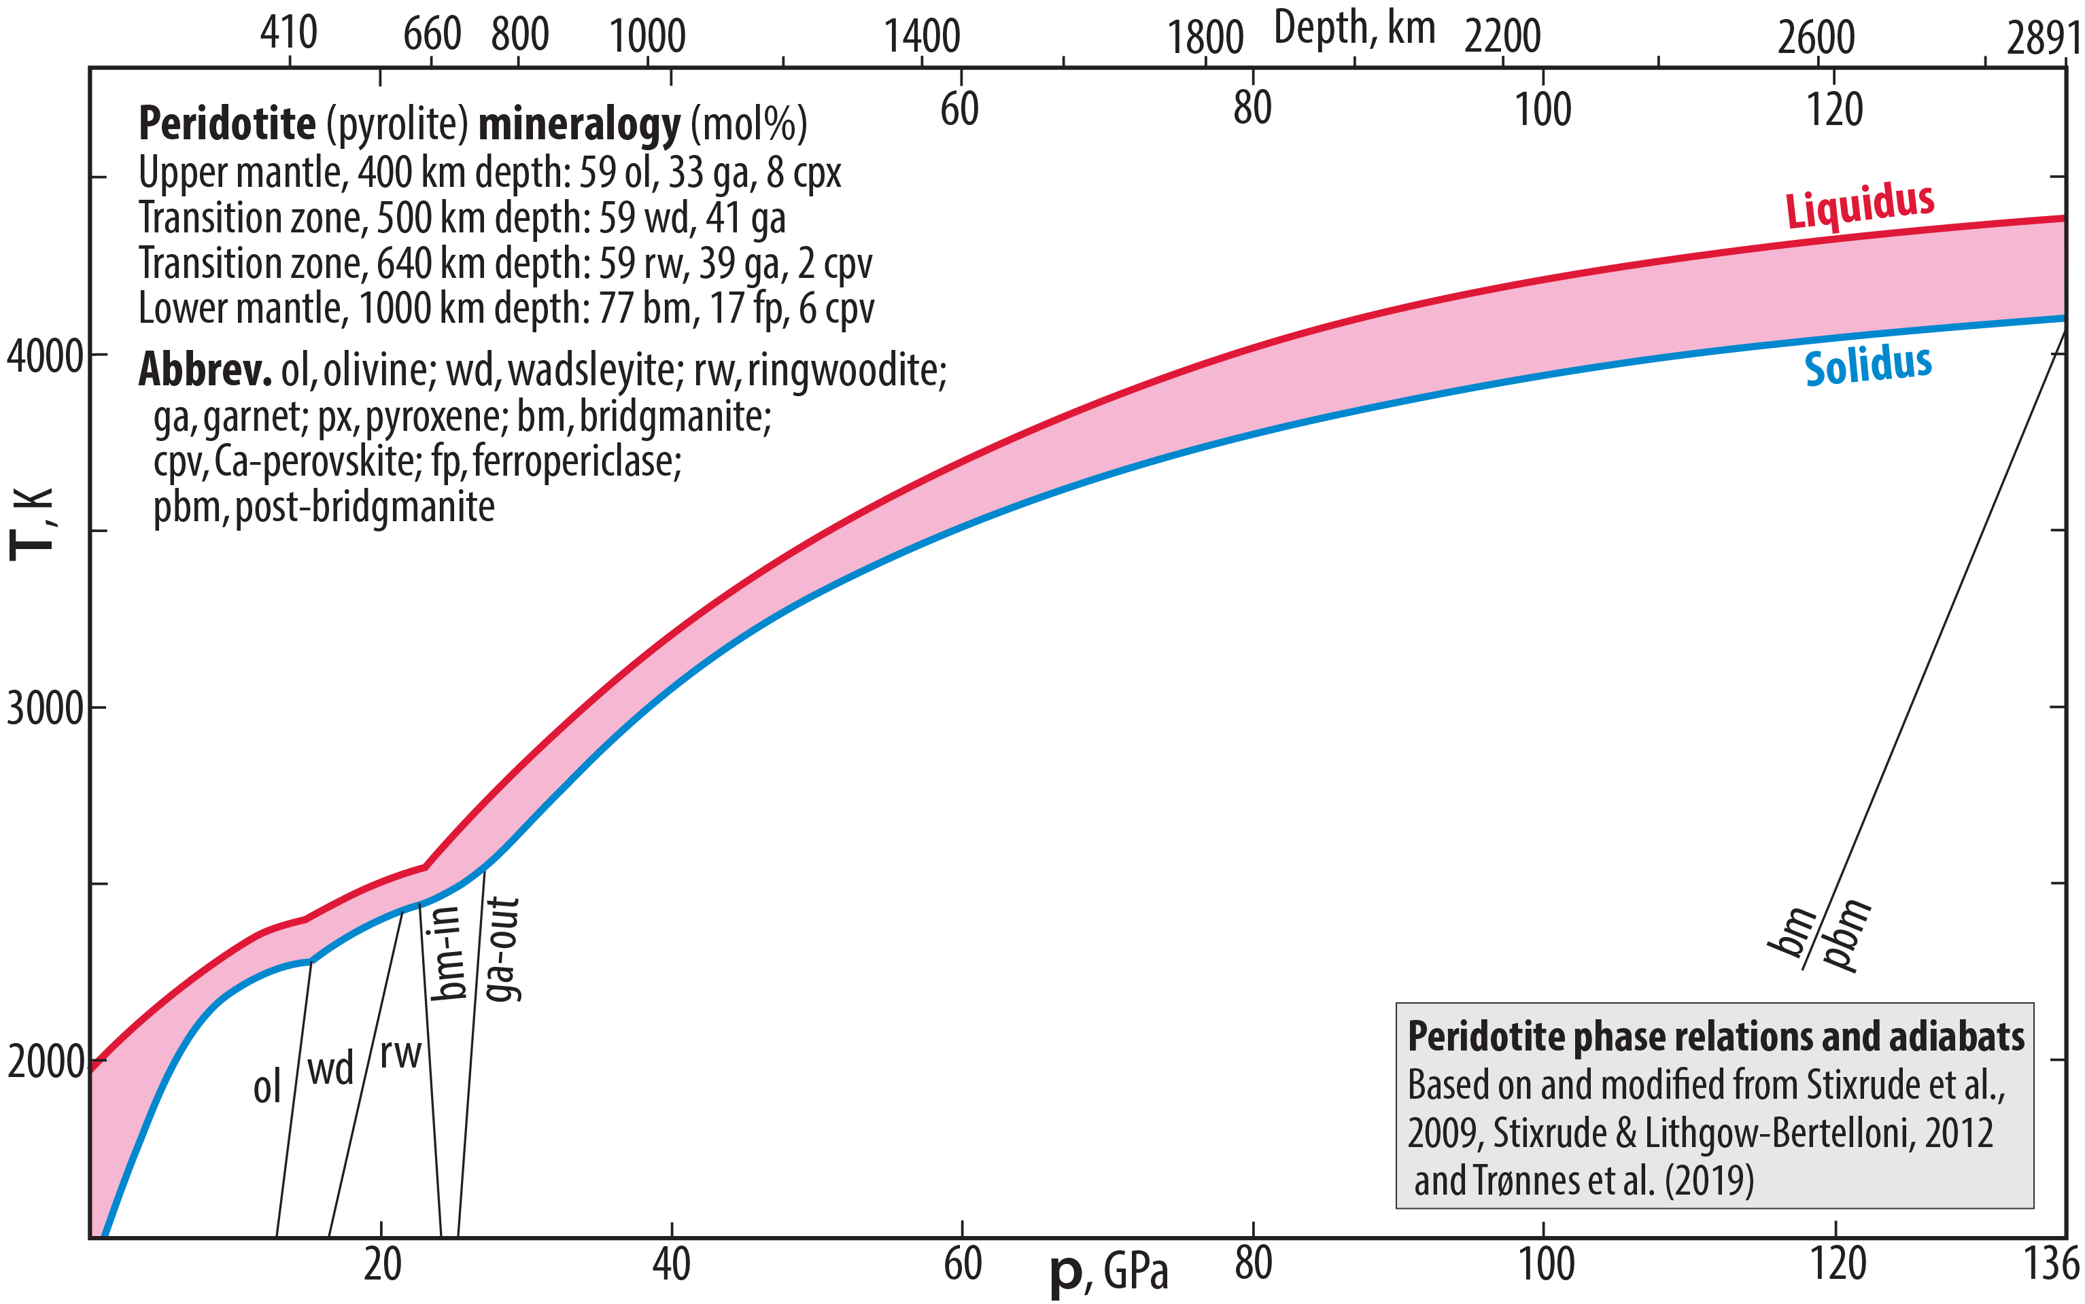
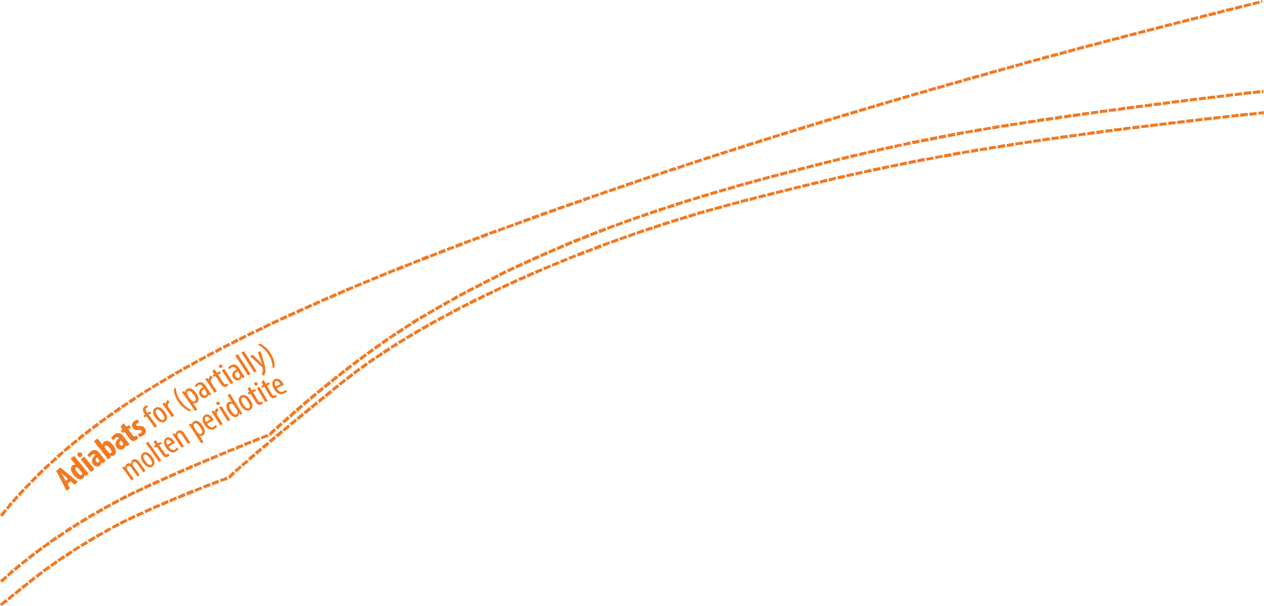

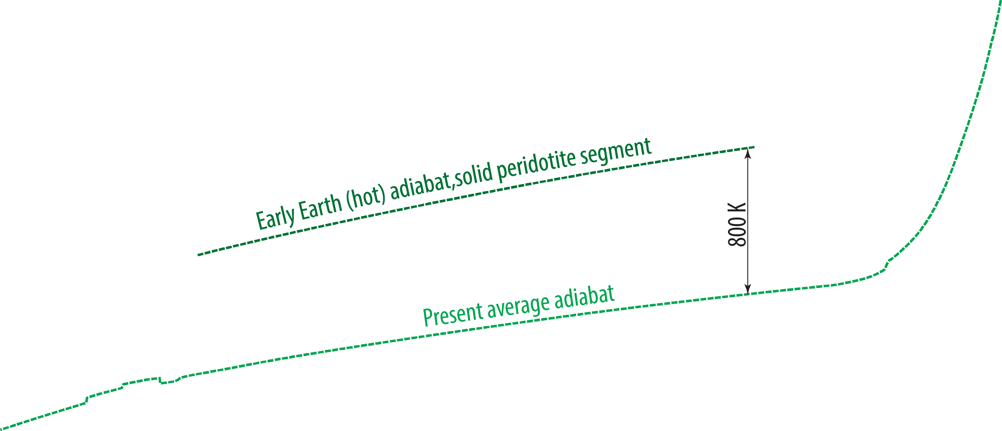
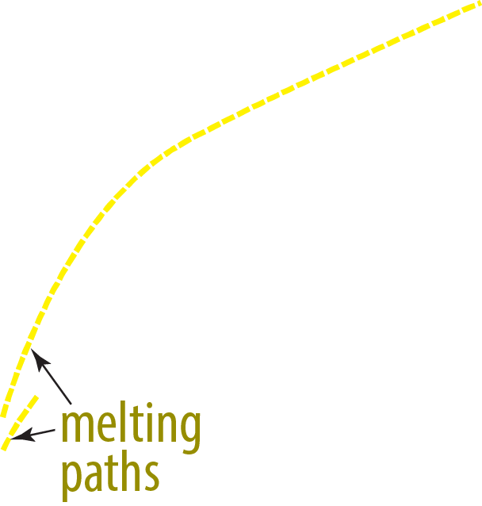

Melting relations, the entire mantle

Slide 4
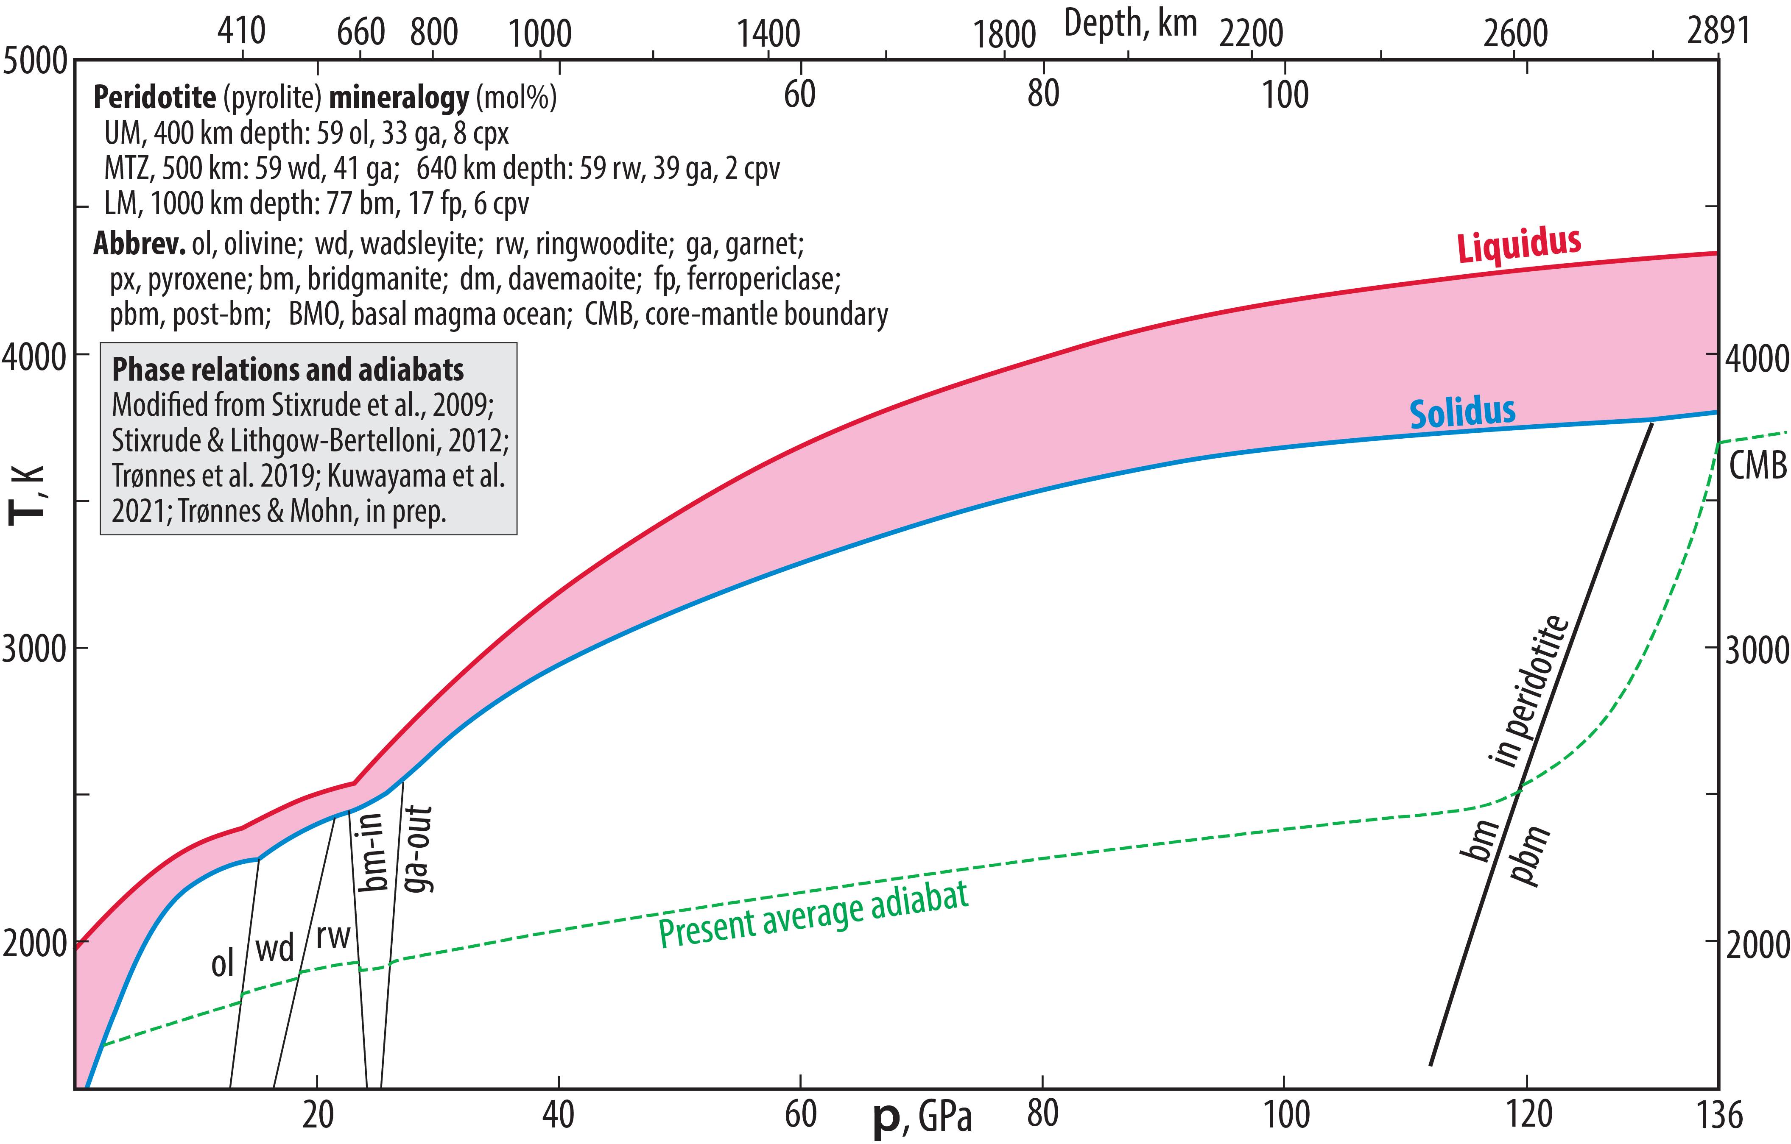
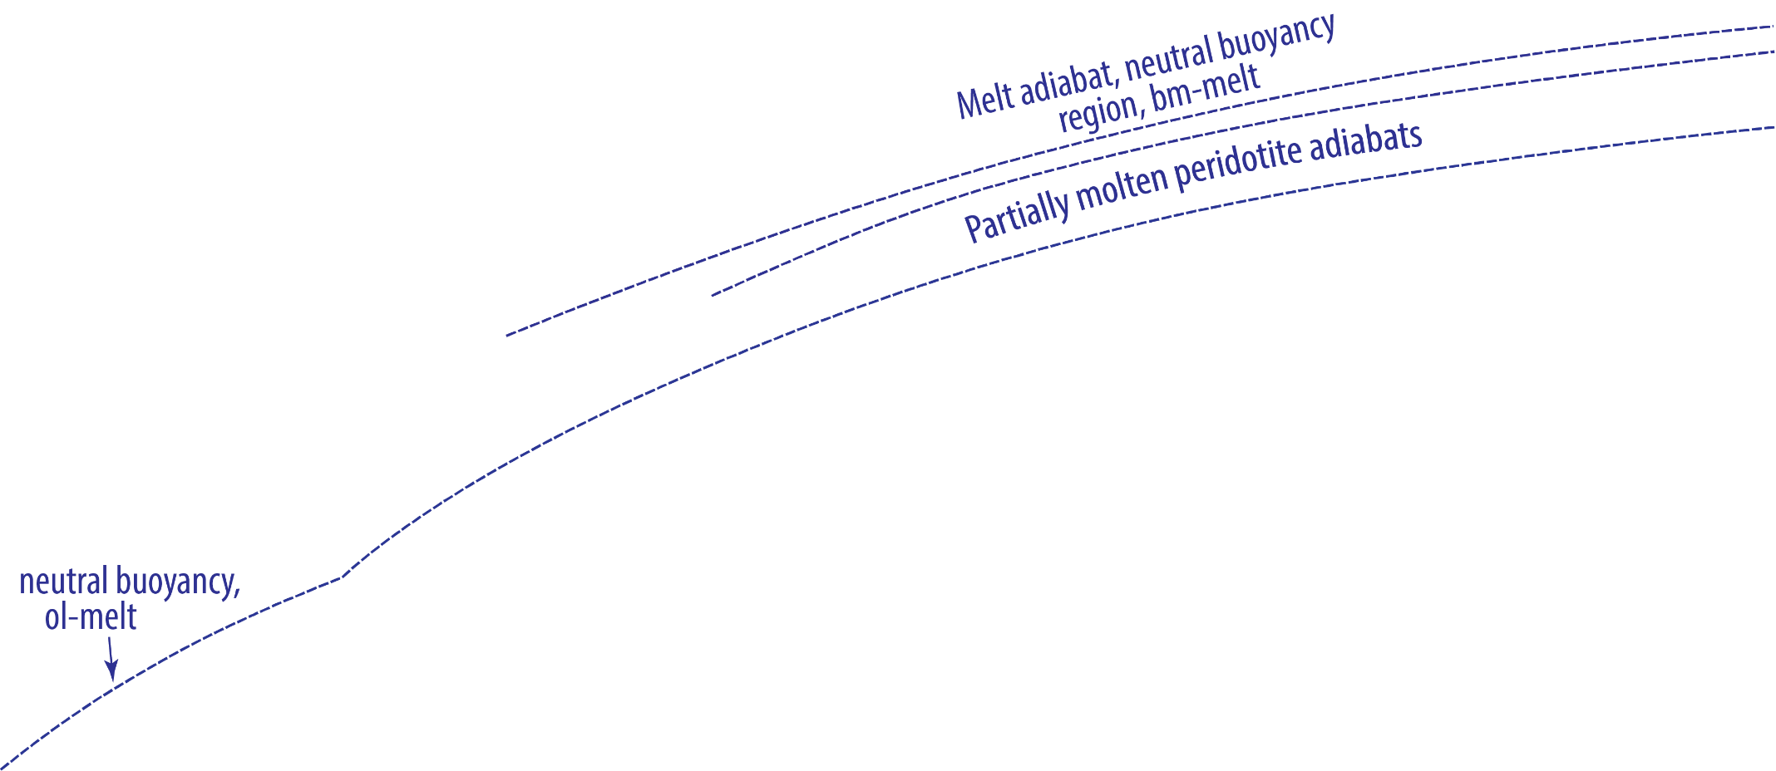
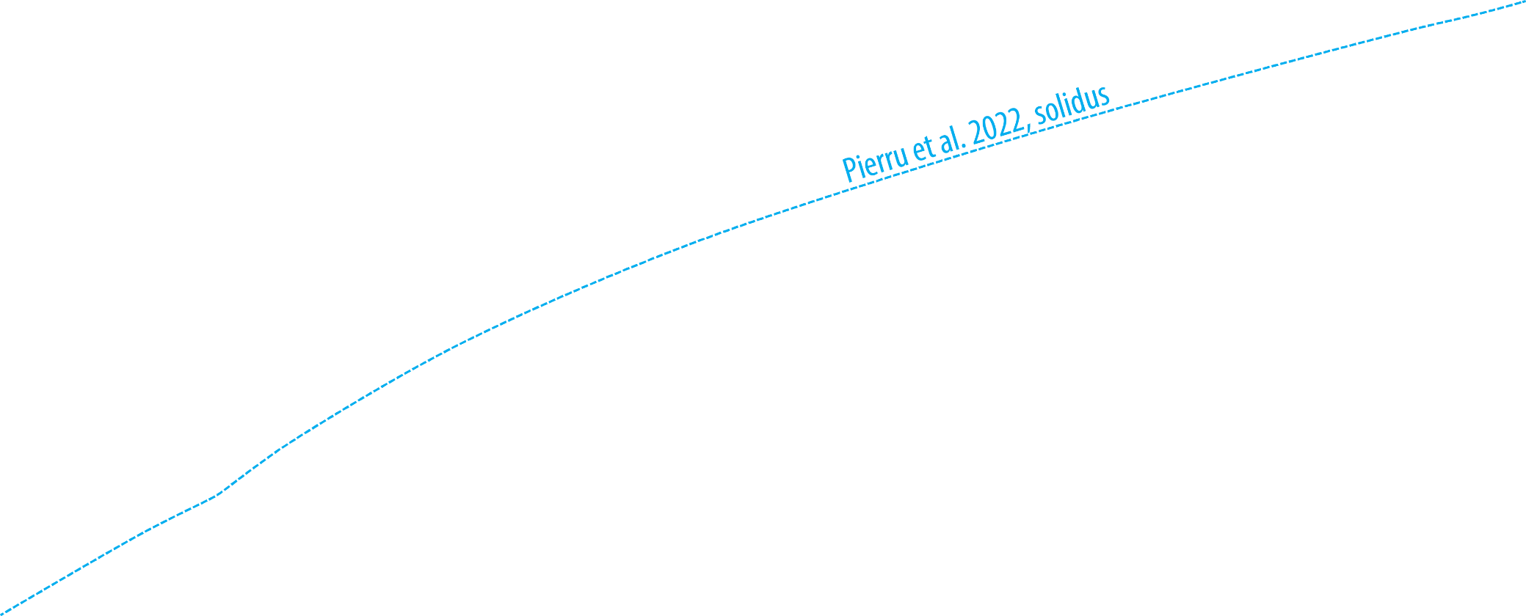
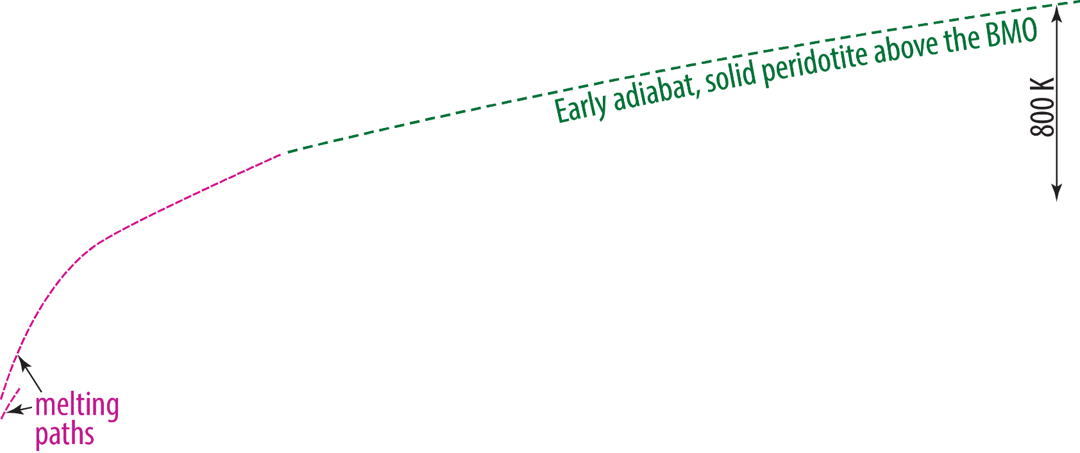

Slide 5
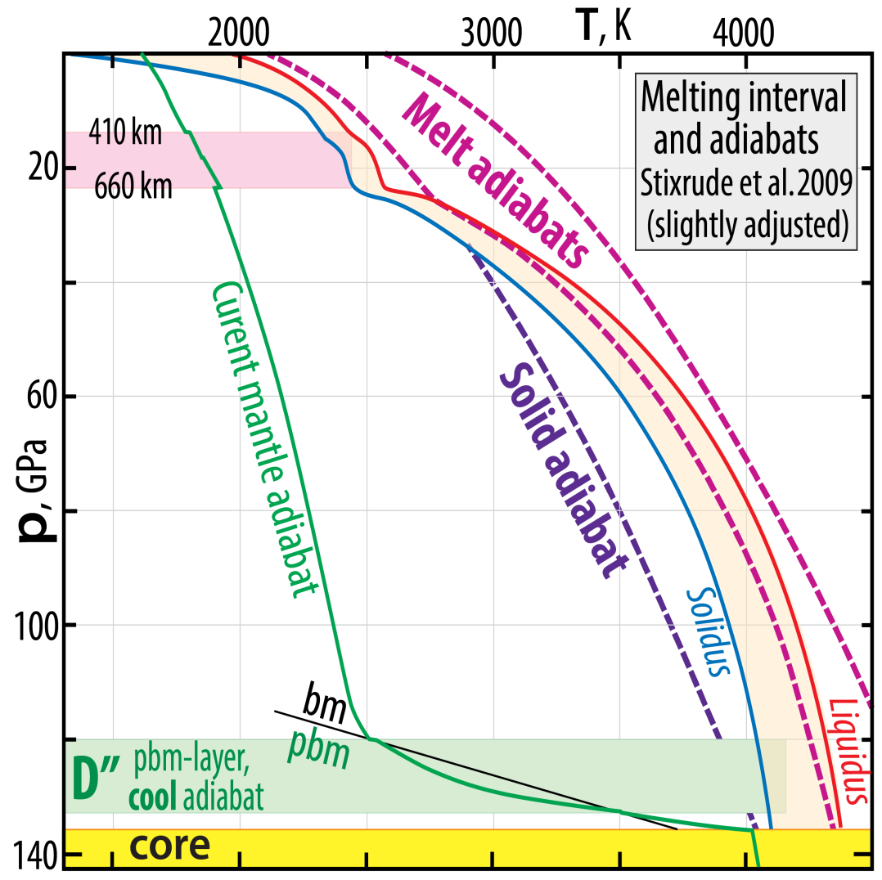
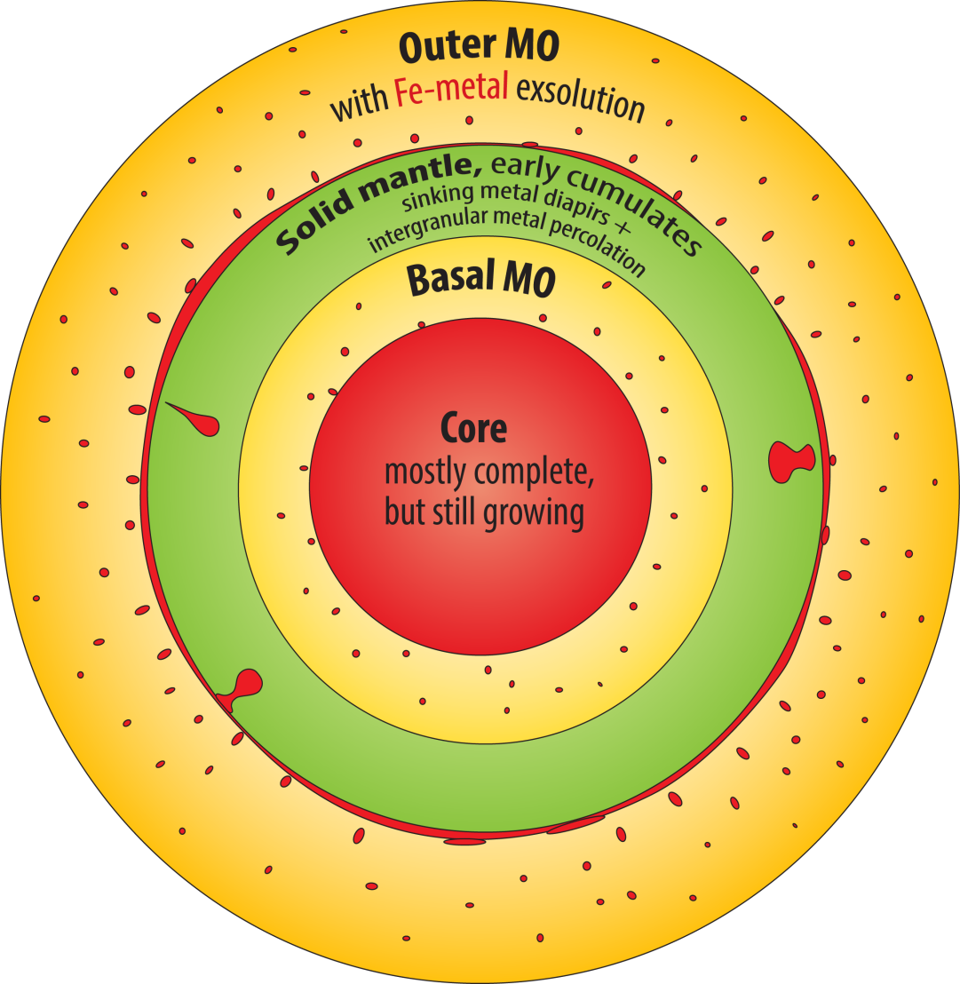
Adiabat-liquidus crossing

Slide 6
First principles simulation of a peridotitic melt
153-atom cell: NaCa₂Fe₄Mg₃₀Al₃Si₂₄O₈₉
wt%: 44.5 SiO₂ 4.72 Al₂O₃ 9.00 FeO 37.3 MgO 3.46 CaO 0.96 Na₂O
Solomatova and
Caracas (2019, JGR)
Pyrolite model composition (primitive" mantle):
25% basalt + 75% depleted harzburgite
The O-atoms are at the corners of grey and blue polyhedra.
Which cations are inside: grey: blue: ?
What is the CN (coord. number) of polyhedra at 0 GPa: 150 GPa: ?
0 to150 GPa: Does the degree of polymerization increase or decrease?
d/d₀ = 0.72 (72%)
V/V₀ = ?
V₀: 1000
V: 369
V/V₀ = 0.37 (37%)
d₀:10
d: 7.17
d₀: 10
d: 7.17
0 GPa, 4000 K
150 GPa, 4000 K

Slide 7
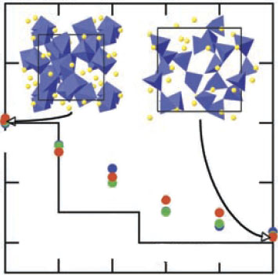
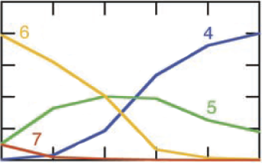
Si-coordination number (CN),
MgSiO₃ melt and solids
Stixrude and Karki
(2005, Science)
p, GPa
125
55
25
13
5
2
7
Si-CN
6
perovskite
3000 K
5
6000 K
majorite:
25% 6-coord.
4000 K
4
pyroxene: 100% 4-coord.
1.0
4-coord.
0.6
6-coord.
Fraction, Si-CN
0.2
0.5
0.6
0.7
0.8
0.9
1.0
V/V_{2 GPa}

Slide 8
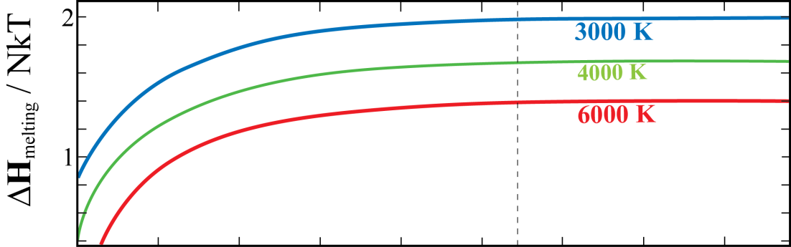
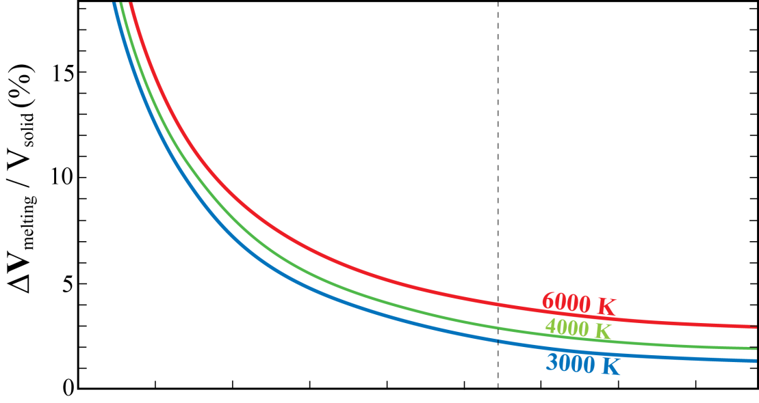
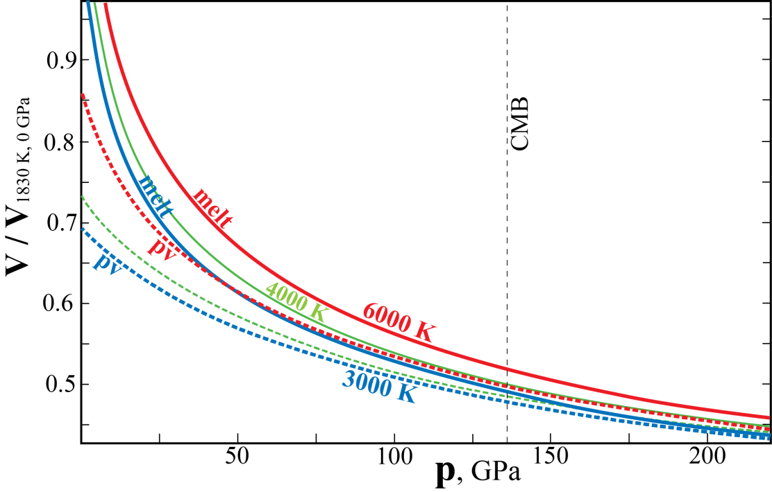
Lower mantle:
wide p-range with bm as the first liquidus phase
Possibility of melt-residue density inversion
ΔH increases slightly through the LM
ΔV stays positive but decreases from 15 to 4% through the LM
Volume and enthalpy change of melting
Melting reaction: MgSiO₃ = MgSiO₃
bridgmanite melt
Clapeyron slope of the melting curve
dT/dp = ΔV/ΔS
ΔG = ΔH − TΔS = 0 along melting curve
i.e. ΔH = TΔS
ΔS = ΔH / T
dT/dp = TΔV / ΔH
Stixrude and Karki
(2005, Science)

Slide 9
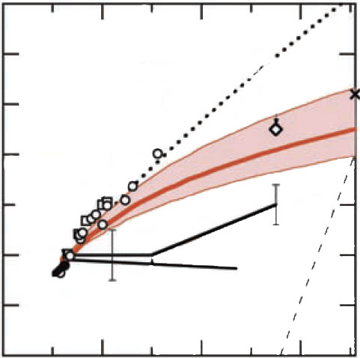
Resulting melting curve, MgSiO₃
- positive dT/dp-slope throughout LM
BUT:
- melt-solid Fe/Mg-partitioning may
cause density crossover for late-stage
melts during magma ocean crystallization
(see below)
Lindemann law
pv-ppv-melt
triple junction,
FPMD
6000
Akins et al, 04
Melt
FPMD
T, K
Zerr, Boehler, 96
4000
Shen, Lazor, 95
Knittle, Jeanloz, 89
Fixed
point
Heinz,
Jeanloz, 87
Sweeney, Heinz, 93
Tsuchiya et al, 04
Ito,
Katsura, 92
2000
Bridgmanite
bm
pbm
40
80
p, GPa
120
Stixrude and Karki (20005, Science)

Slide 10

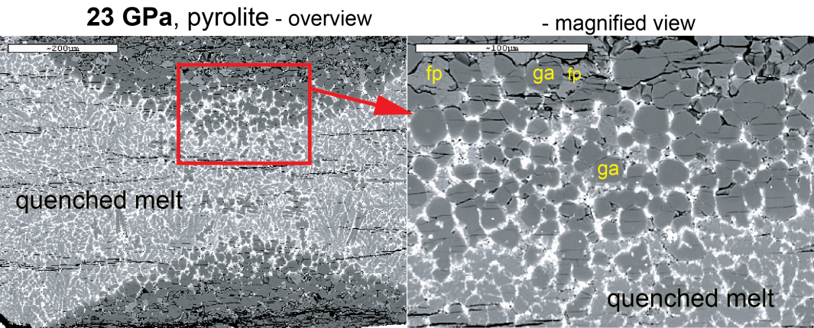
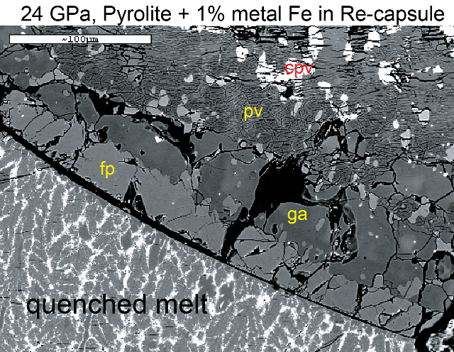
Peridotite melting
relations, 2−36 GPa
ol: olivine, opx: orthopyroxene,
cpx: clinoyroxene, ga: garnet
wd: wadsleyite, rw: ringwoodite
bm: bridgmanite, fp: ferropericlase,
cpv: Ca-perovskite
Tønnes & Frost
(2002, EPSL)

Slide 11

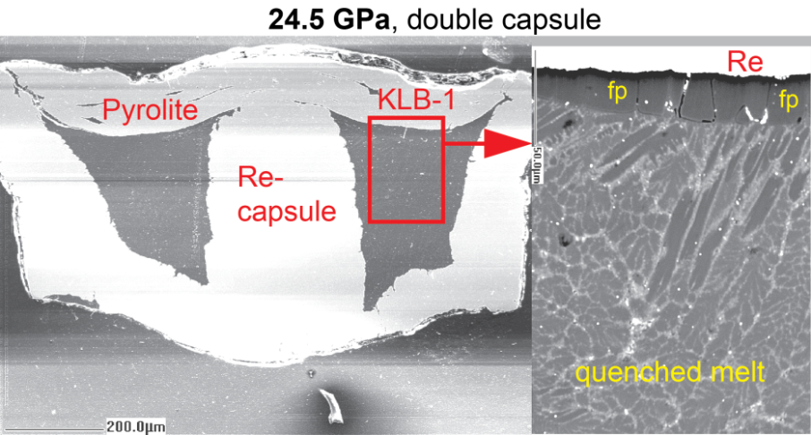
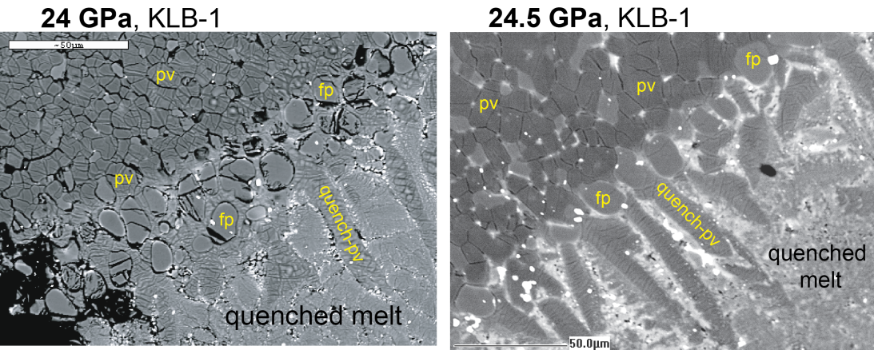
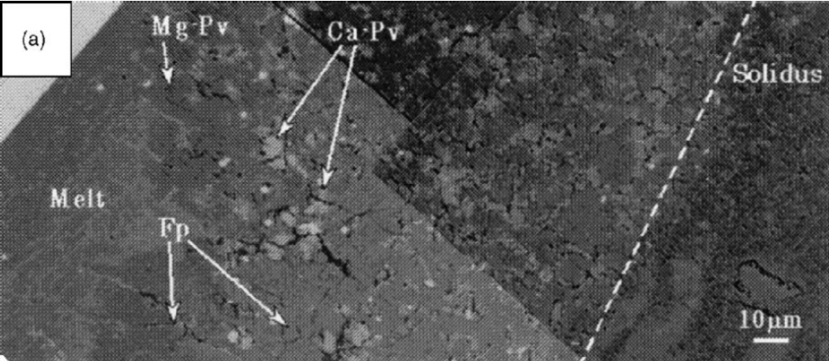
Peridotite melting
relations, 2−36 GPa
Tønnes & Frost
(2002, EPSL)
33 GPa, Ito et al. (2004, PEPI)

Slide 12
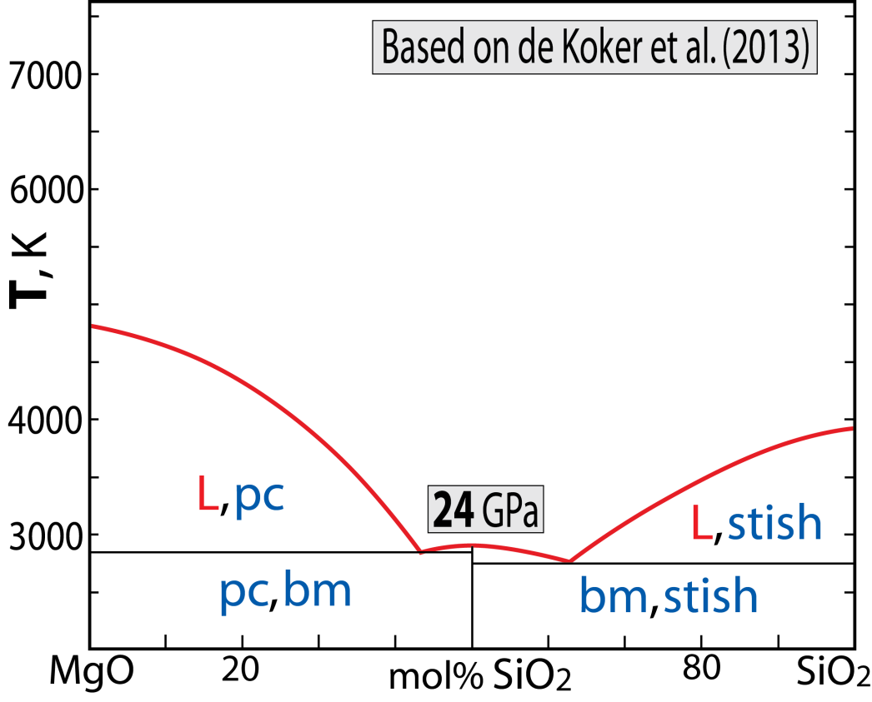
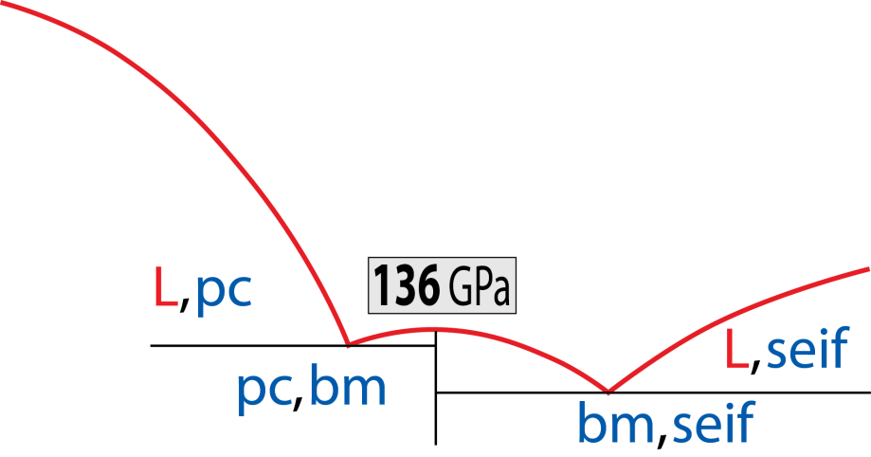
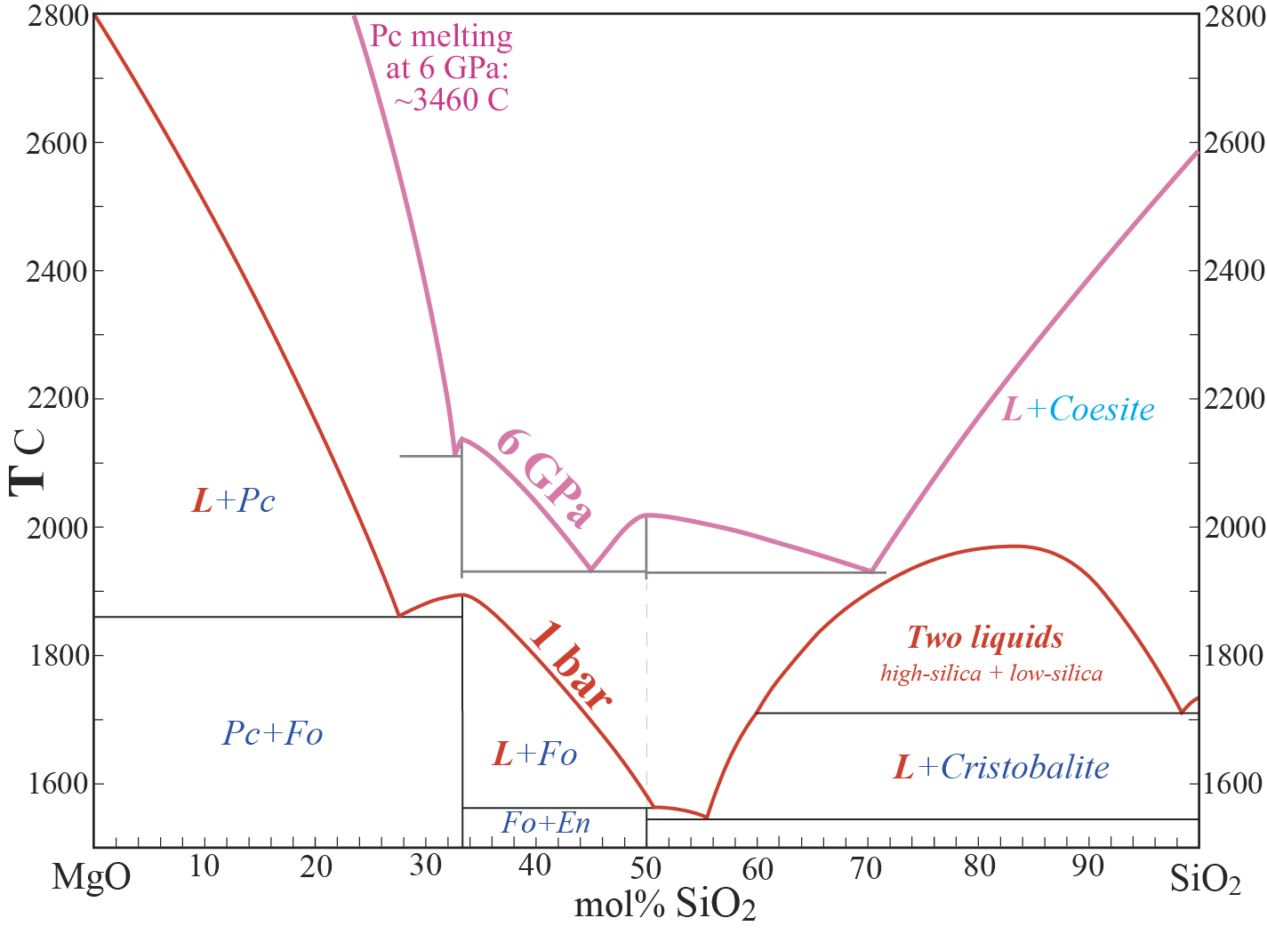
Lower mantle melting relations
Binary joins within the system
CaO-MgO-SiO₂ (CMS)
1. MS-join, 1 bar to 136 GPa
Melting of a peridotite model
Note the important shift of
the invariant composition
from 1 bar to 136 GPa
peridotite

Slide 13
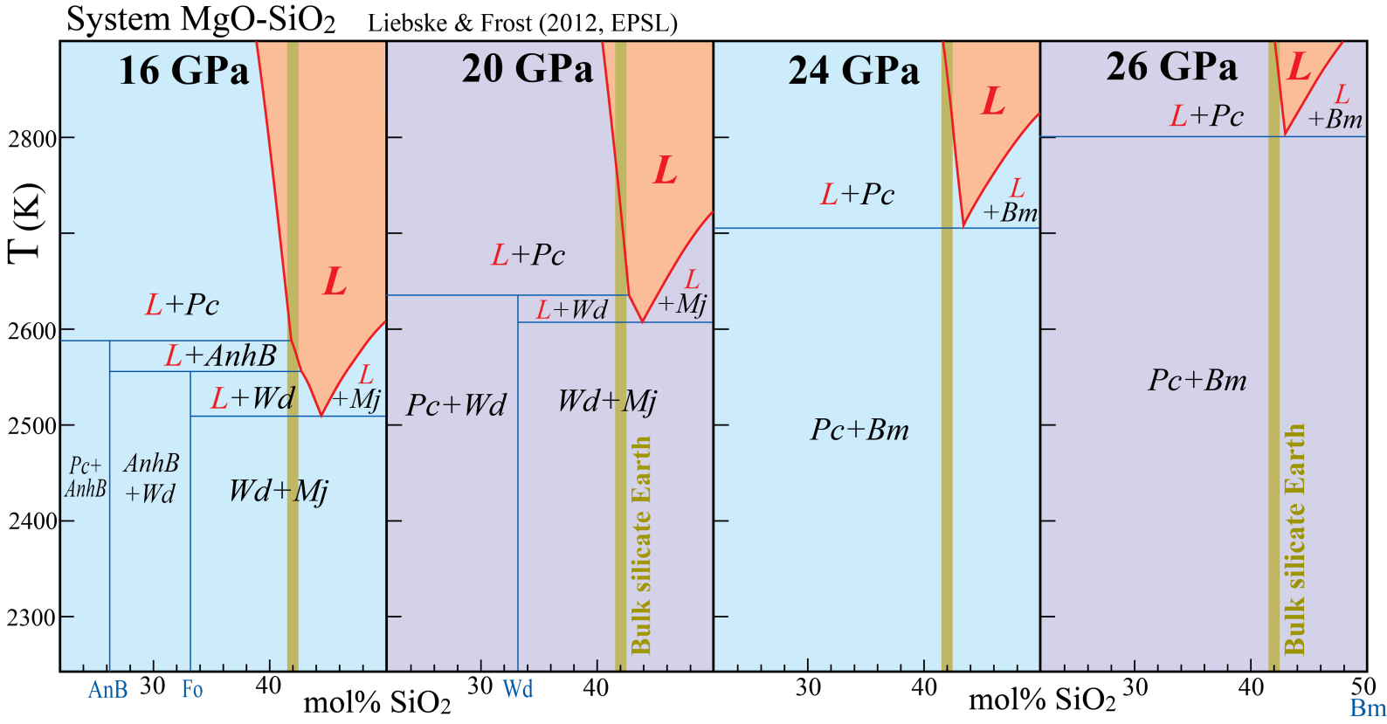
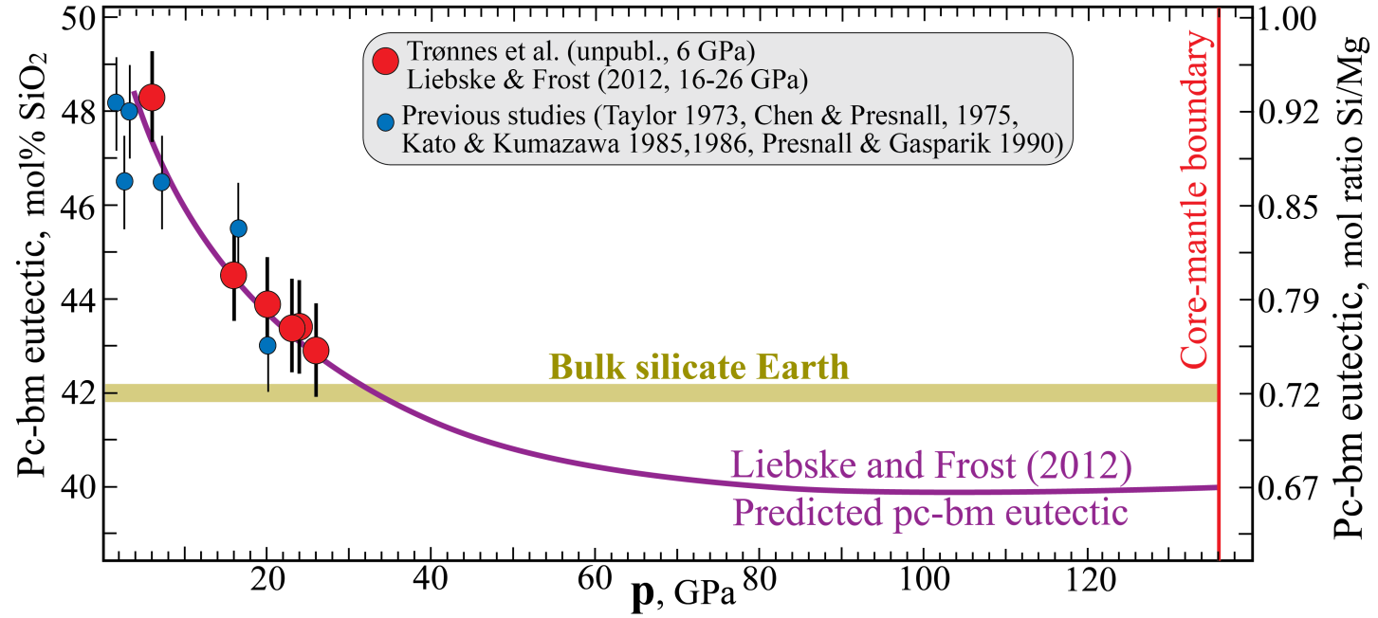
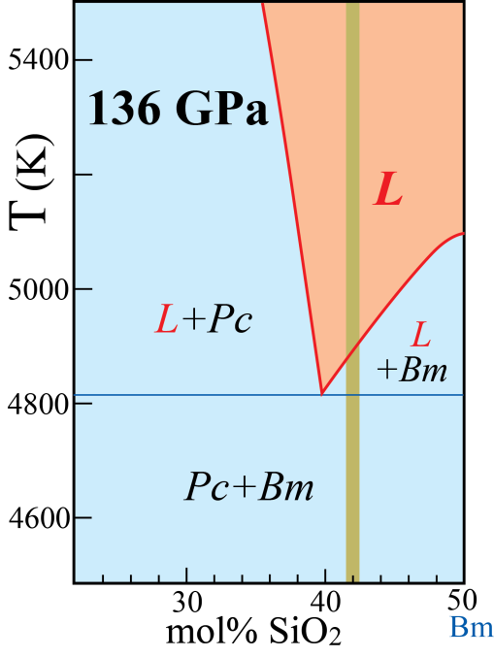
System MgO-SiO₂
at 16-26 GPa
Multianvil experiments
(eutectic moves towards BSE
from 16 to 26 GPa)
Thermodynamic model (eutectic comp. more magnesian than BSE above 35 GPa)

Slide 14
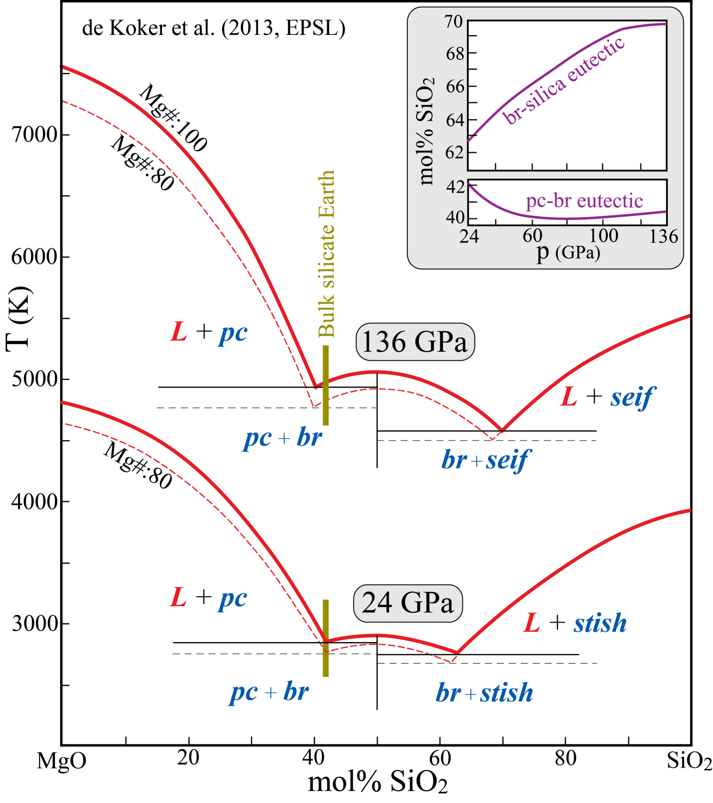
DFT-study
de Koker et al. (2013, EPSL)
The periclase-bridgmanite eutectic
is very similar to results from
16-26 GPa experiments and
associated thermodynamic model
Liebske and Frost (2012, EPSL)

Slide 15
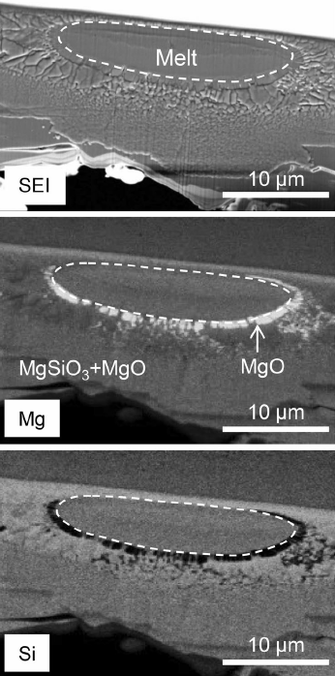
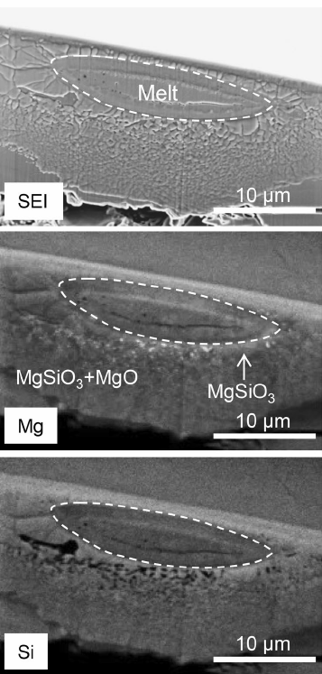
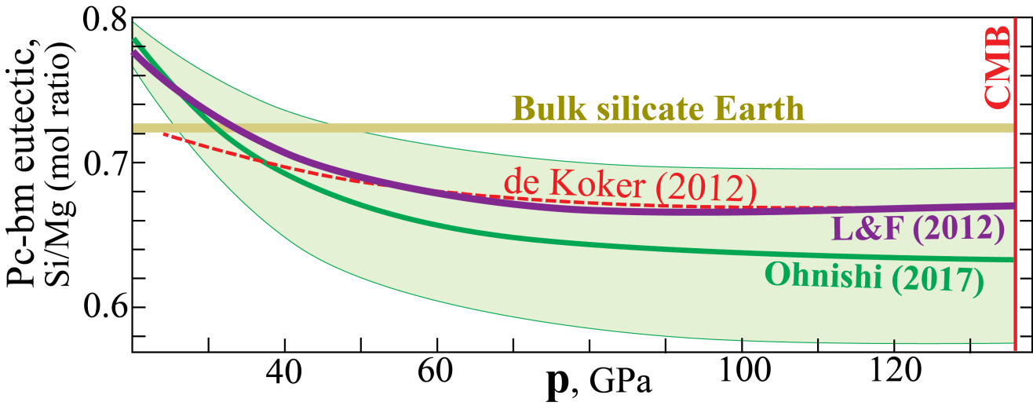
Laser-heated DAC
experiments, 30-70 GPa
Ohnishi et al. (2017, PCM)
Confirming that the pc-bm eutectic composition becomes more magnesian than a model BSE peridotitic composition
In accordance with:
Liebske & Frost (2012) and de Koker et al. (2013)
35 GPa: Mg-rich: pc-side of the eutectic
35 GPa: Mg-poor: bm-side of the eutectic

Slide 16
Laser-heated DAC
experiments, 40-140 GPa
Ozawa et al. (2018, GRL)

Slide 17
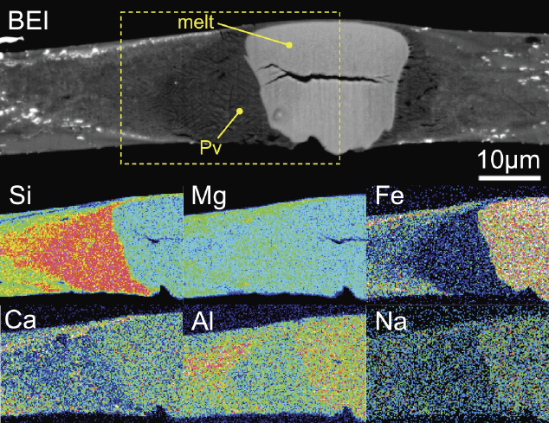
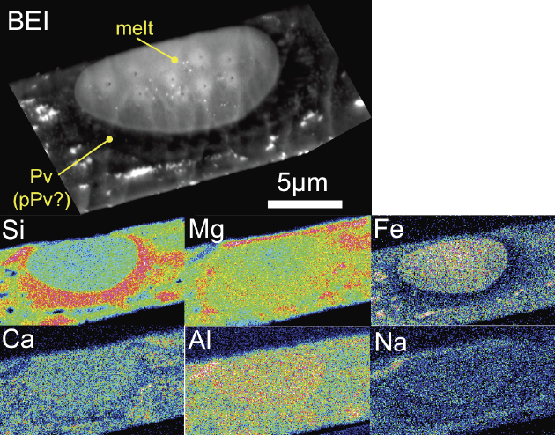
74 GPa
Melting experiments,
fertile peridotite (pyrolite)
50-140 GPa Nomura et al. (2014, Science)
Very clear results
Liquidus phase the in at 40-140 GPa:
Mg-perovskite
Relative to bulk pyrolite:
Melt: Fe-Al-Na-enrichment, Si-depletion
MgPv: Si-enrichment, Ca-Fe-Al-depletion
132 GPa

Slide 18
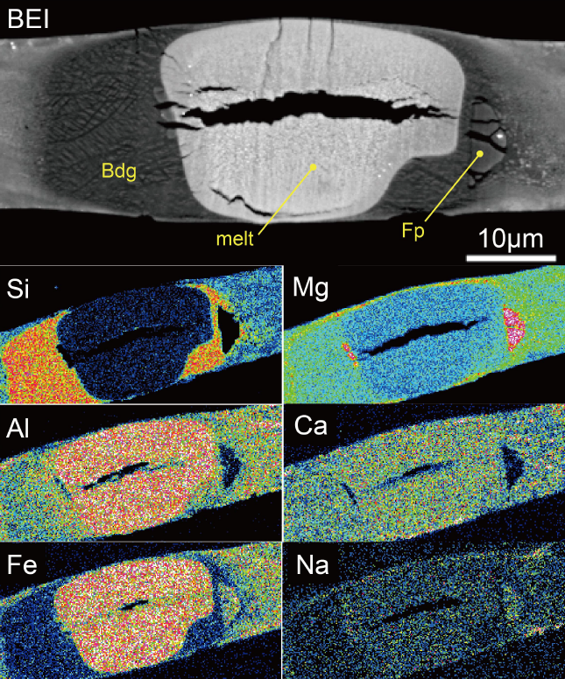
Phase relations at 59 GPa for an
evolved magma ocean comp.
after 50% bm-fract.
Caracas et al. (2019, EPSL)
Wt % Mol ratio
SiO₂ AlO_{1.5} FeO MgO CaO Si/(Fe+Mg)
peridotite 45.0 4.78 8.96 37.7 3.50 0.71
evolved 34.7 4.91 16.2 38.8 5.40 0.49

Slide 19
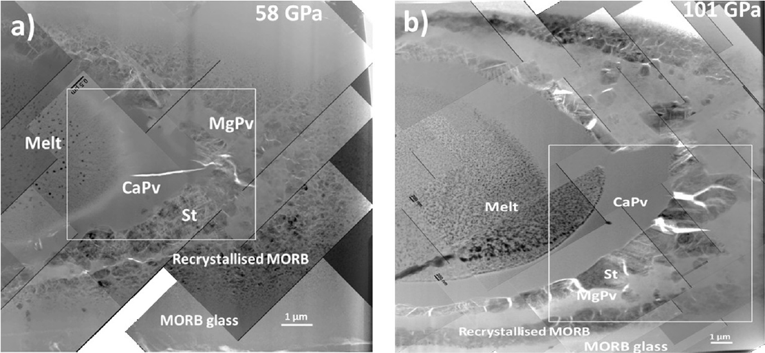
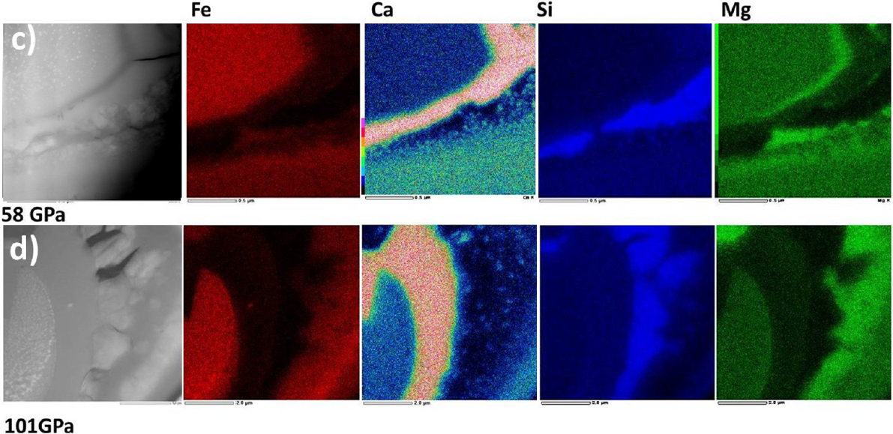
Phase relations, basalt
Pradhan et al. (2015, EPSL)

Slide 20
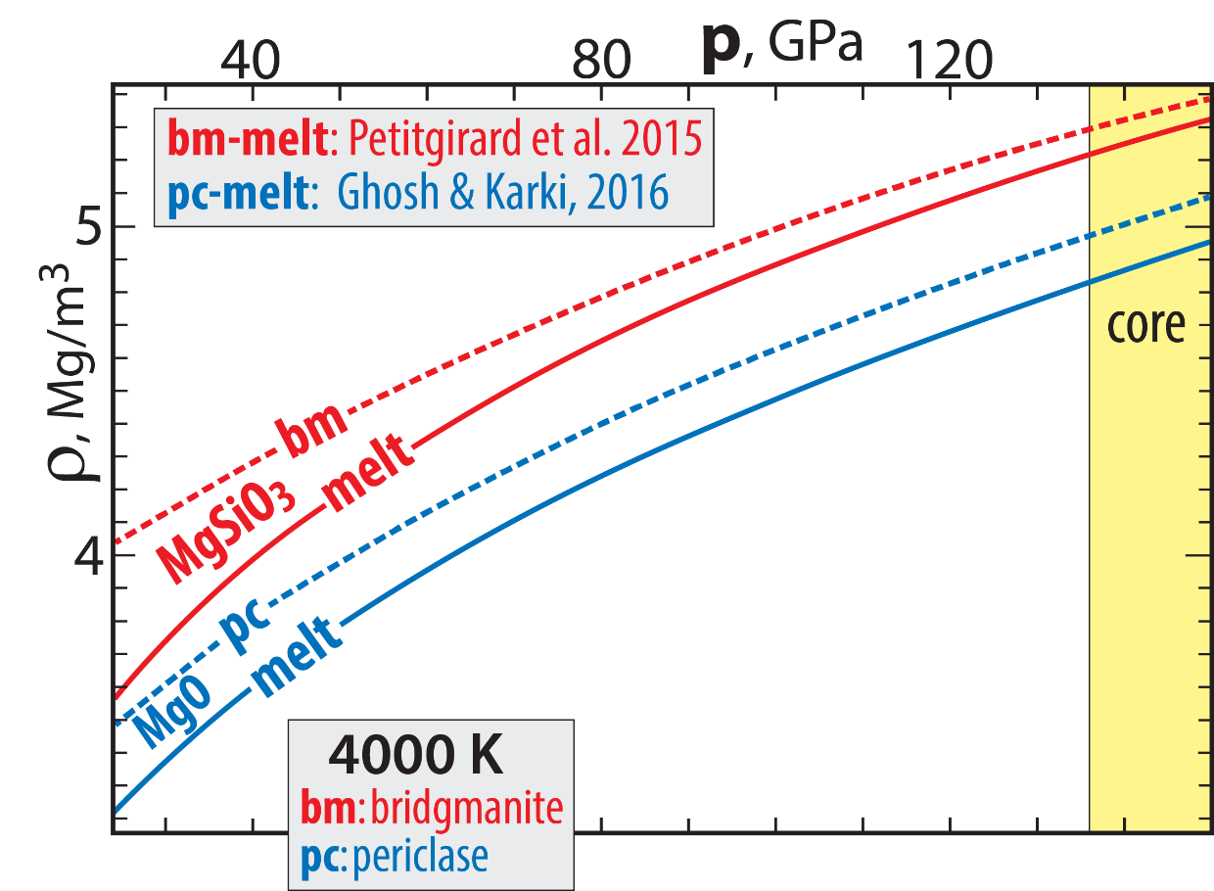
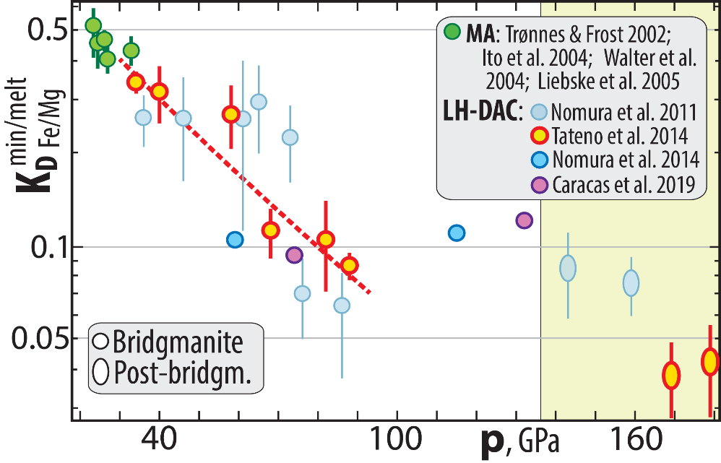
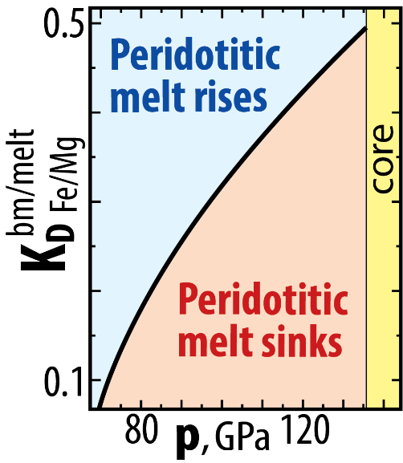
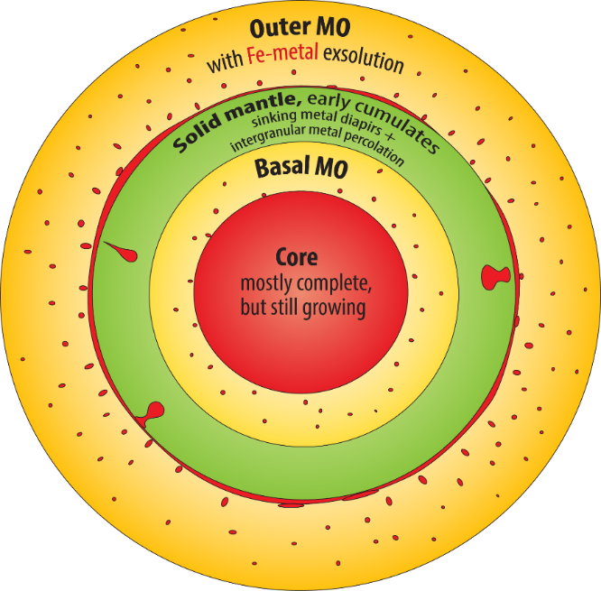
Did Earth have a BMO?
Based on Fe-free system relations: No
But with the strong Fe/Mg partitioning: Yes
bm/melt
Fe/Mg
K_{D} = (Fe/Mg)^{bm} / (Fe/Mg)^{melt}
0.1↔80 GPa
Neutral buoyancy for
K_{D}= 0.1 →73 GPa
73-80 GPa,
~1800 km depth
(PREM)

Slide 21
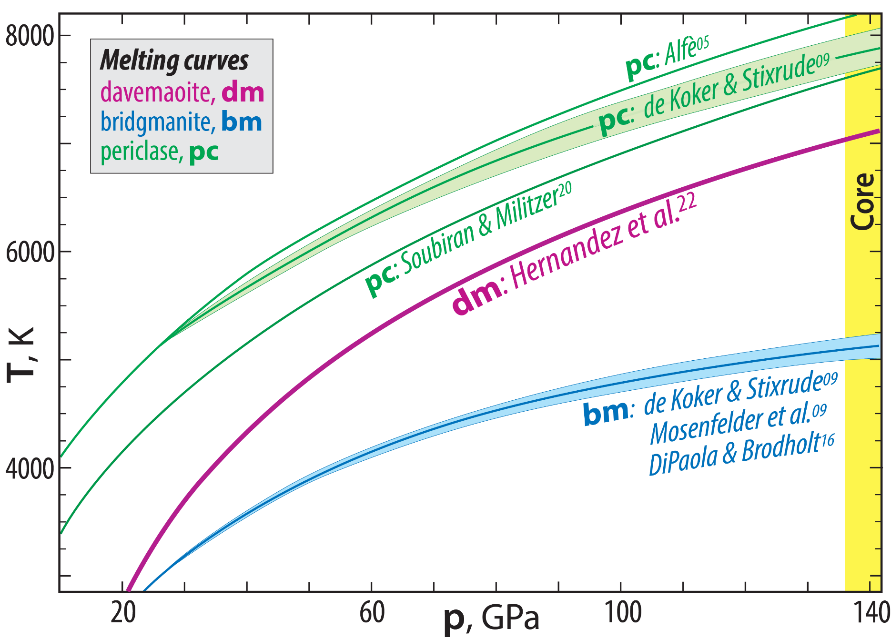
High thermal stability and residual character of Ca-pv: the melting curve
Trønnes et al. in prep.
Simplified from:
Hernandez et al. 2022, GRL

Slide 22
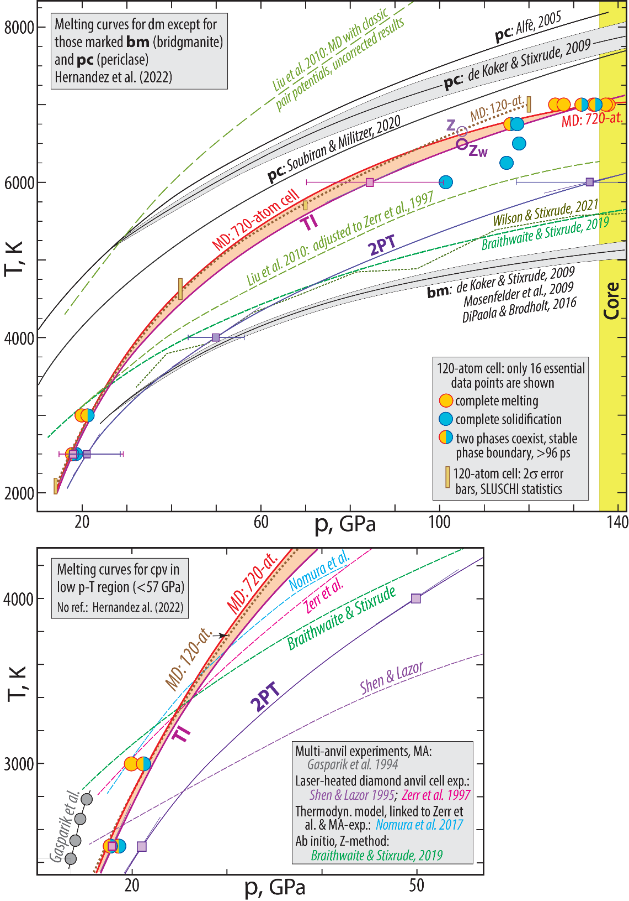
Hernandez et al. 2022, GRL
(slightly modified)

Slide 23
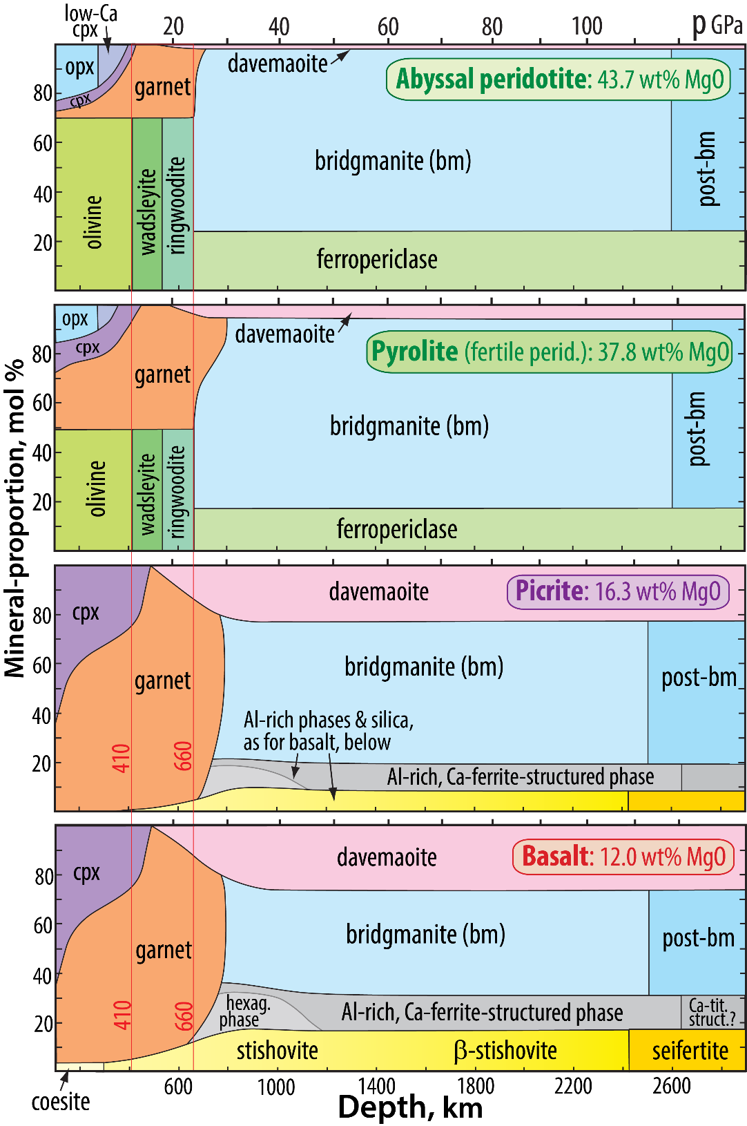
Mineralogical changes from depleted peridotite to basalt
Based on: Stixrude & Lithgow-Bertelloni 2012, AREPS; Irifune & Tsuchiya, 2015, Treat. Geophys.; Trønnes & Mohn, in prep.

Slide 24
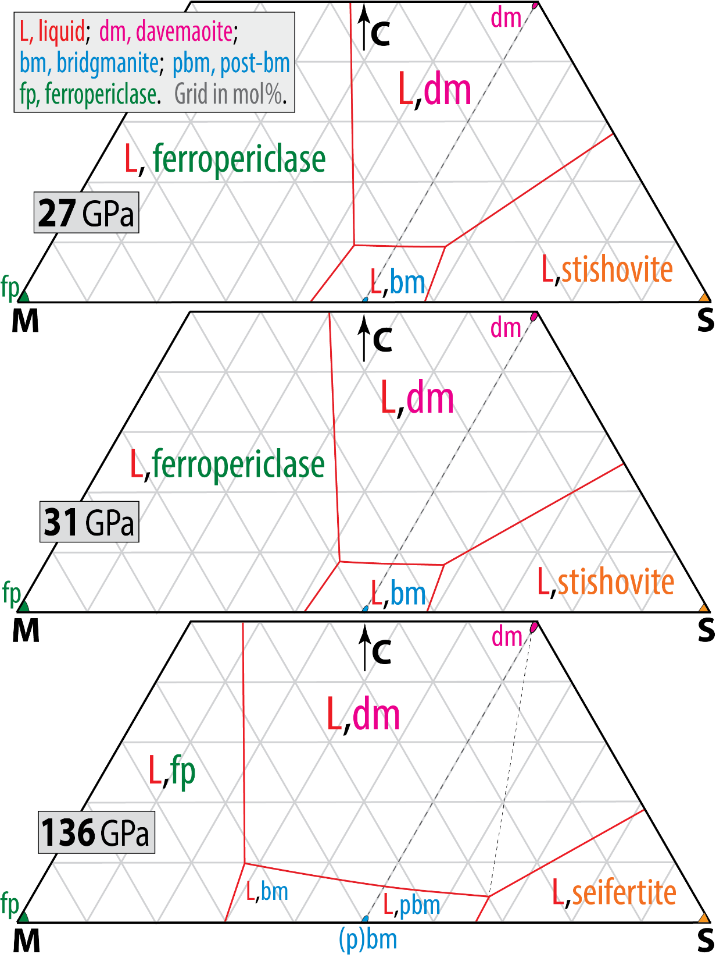
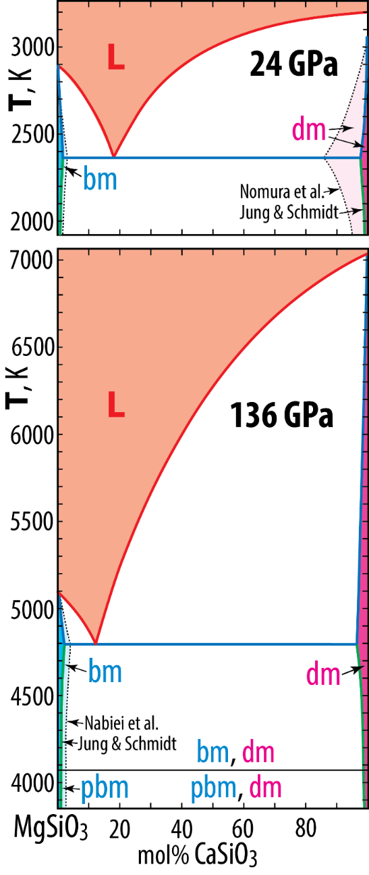
High thermal stability and residual nature of Ca-pv: CMS-projection
Trønnes et al., in prep.
C: Ca+Na
S: Si+0.9Al
M: 100−C−S

Slide 25
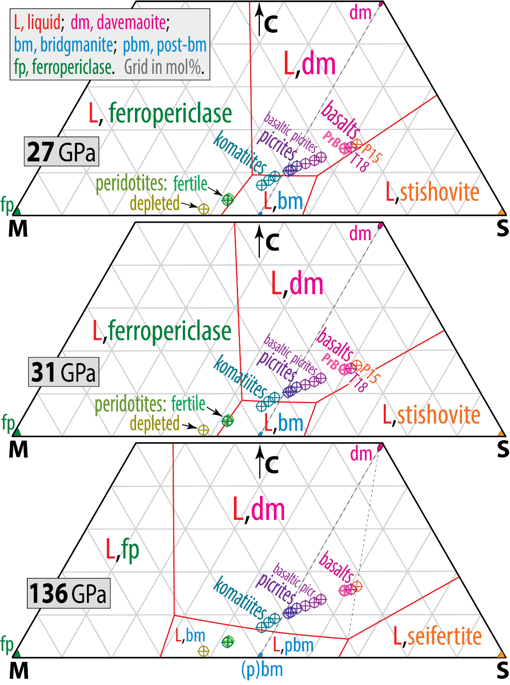
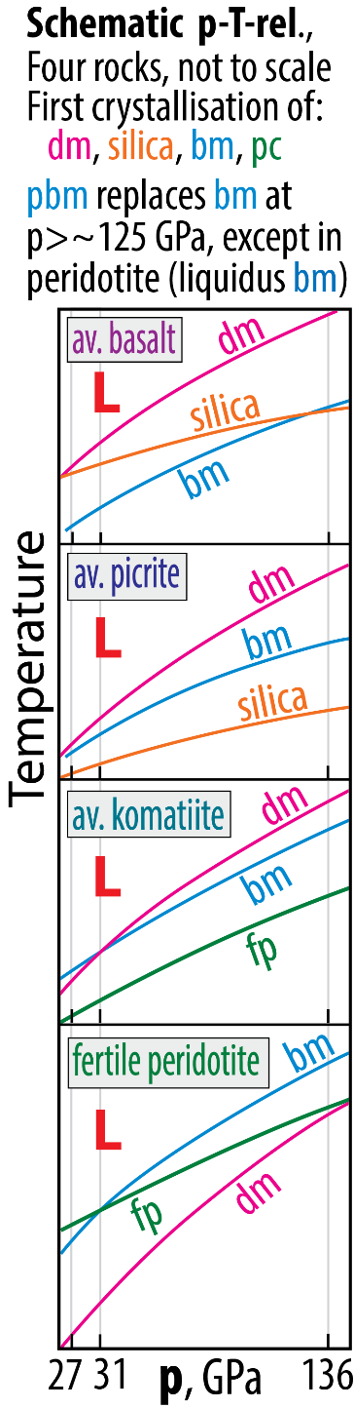
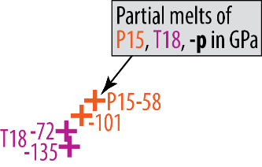
High thermal stability and residual nature of Ca-pv: CMS-projection
Trønnes et al., in prep.
C = Ca + Na
S = Si + 0.9Al
M = 100-(C+S)

Slide 26


Density relations
Trønnes et al., in prep.

Slide 27






Ultra-low velocity zones (ULVZs): density excess and velocity deficit

Slide 28
Ultra-low velocity zones (ULVZs): density excess and velocity deficit
From: Chen, 2021, Natl. Sci. Rev.
3000 K
300 K

Slide 29


Ultra-low velocity zones (ULVZs): velocity deficit and density excess

Slide 30
Density relations
Trønnes et al., in prep.

Slide 31
ULVZ density modelling Trønnes et al., in prep.
Ambient mantle:

Slide 32



ULVZ dynamics
ULVZ: Ultra-low velocity zone
LLSVP: Large low S-wave velocity province

Slide 33


Earth's initial magma ocean crystallisation - two possibilities
Alternative 1: Magma ocean crystallization starts at the bottom
Magma ocean adiabat

Slide 34


Alternative 2: Magma ocean crystallization starts at mid-mantle depths
Computational study by Stixrude et al. (2009, EPSL)
- steeper adiabat (interms of dT
- consistent with Mosenfelder et al. (2007, JGR)
Magma ocean adiabat

Slide 35
Scenario with two magma ocean
Labrosse et al (2007, Nature)
Stixrude et al. (2009, Earth Planet. Sci. Lett.)
Stage 1
Core
Stage 2
Cumulates with lower Fe/Mg
Cumulates with higher Fe/Mg
Core
Stage 3
Inner magma ocean:
melt density > crystal density (pv, fp)
(Fe/Mg)_{melt} > (Fe/Mg)_{crystals}
Fe-rich cumulates
starting point for
thermochemical piles
Core

Slide 36

Deep melting in hot Hadean plumes at >300 km depth (Lee et al. 2010, Nature)
- Melt migration to sill complexes (density trap) at 410 km depth
(somewhat deeper in a hotter Hadean mantle)
- Solidification and cooling of sills to abient T (thermal equilibration)
- Sinking of sill material (high Fe/Mg-ratio) to the CMB
Hot Hadean plumes:
Solidus crossing at 500-700 km depth is likely
Locally depressed solidus T in this range
Based on: Zhang & Herzberg (1994, JGR)
Tønnes & Frost (2002, EPSL)
Ito et al. (2004, PEPI)

Slide 37

Lee et al. (2010, Nature)
Melt accumulation zone
Solidified, thermally
equilibrated melt
sink to the CMB

Slide 38


Earth, Venus and Mars
- Melt-olivine density crossover at ~10 GPa
- Melt accumulation zone centred at ~14 GPa
ρ_{melt} > ρ_{olivine} in the depth ranges:
300 - 410 km: Earth
320 - 440 km: Venus
800 - 1150 km: Mars

Slide 39

Primary planetary crust
- formed in magma oceans by cumulate floatation
Farside highland
anorthosites:
up tp 110 km
Nearside highland
anorthosites:
up to 80 km
S-pole/Aitken
basin
Nearside
Farside

Slide 40

Primary "crusts", formed in the MO
Earth, Venus, Mars
Moon
Thin "secondary" komatiitic(?) crust:
constantly re-formed and
destroyed during the MO-stage
Highland crust
(anorthosites):
Still largely preserved
Subterranean peridotitic-dunitic
"cumulate crust":
Completely destroyed by later mantle
convection, especially in the Earth

Slide 41


Magma ocean crystallisation
Evolution of viscous BEAMS
Refractory & viscous ERD convectively aggregated to BEAMS
(e.g. Manga, 1996, GRL)
Modified, mainly from:
Torsvik et al. (2016, Can. J. Earth Sci.)
Ballmer et al. (2017, Nature Geosci.)
Trønnes et al. (2014, Tectonophys.)

Slide 43

Fe/Mg partitioning, 20−180 GPa

Slide 44



Why did Earth have a BMO?
Answer: peridotite-melt neutral buoyancy at high p
73-80 GPa:
~1800 km depth
Mg# = 100 Mg / (Fe + Mg)
bm/melt
Fe/Mg
K_{D} = (Fe/Mg)^{bm} / (Fe/Mg)^{melt}

