Slide 1
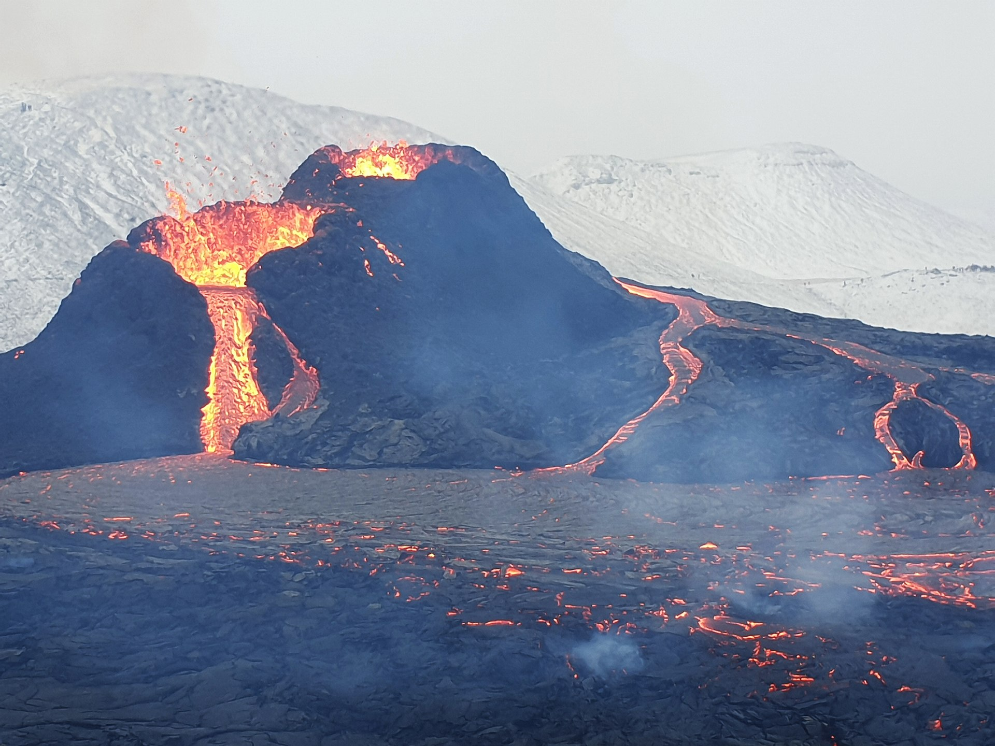
Regional T_{P}-variation, thermal evolution of the Earth, continental crustal growth
Wikipedia, CC BY-SA 4.0
Fagradalsfjall 2021-eruption, Reykjanes peninsula,
SW Iceland (Geldingagalur)

Slide 2
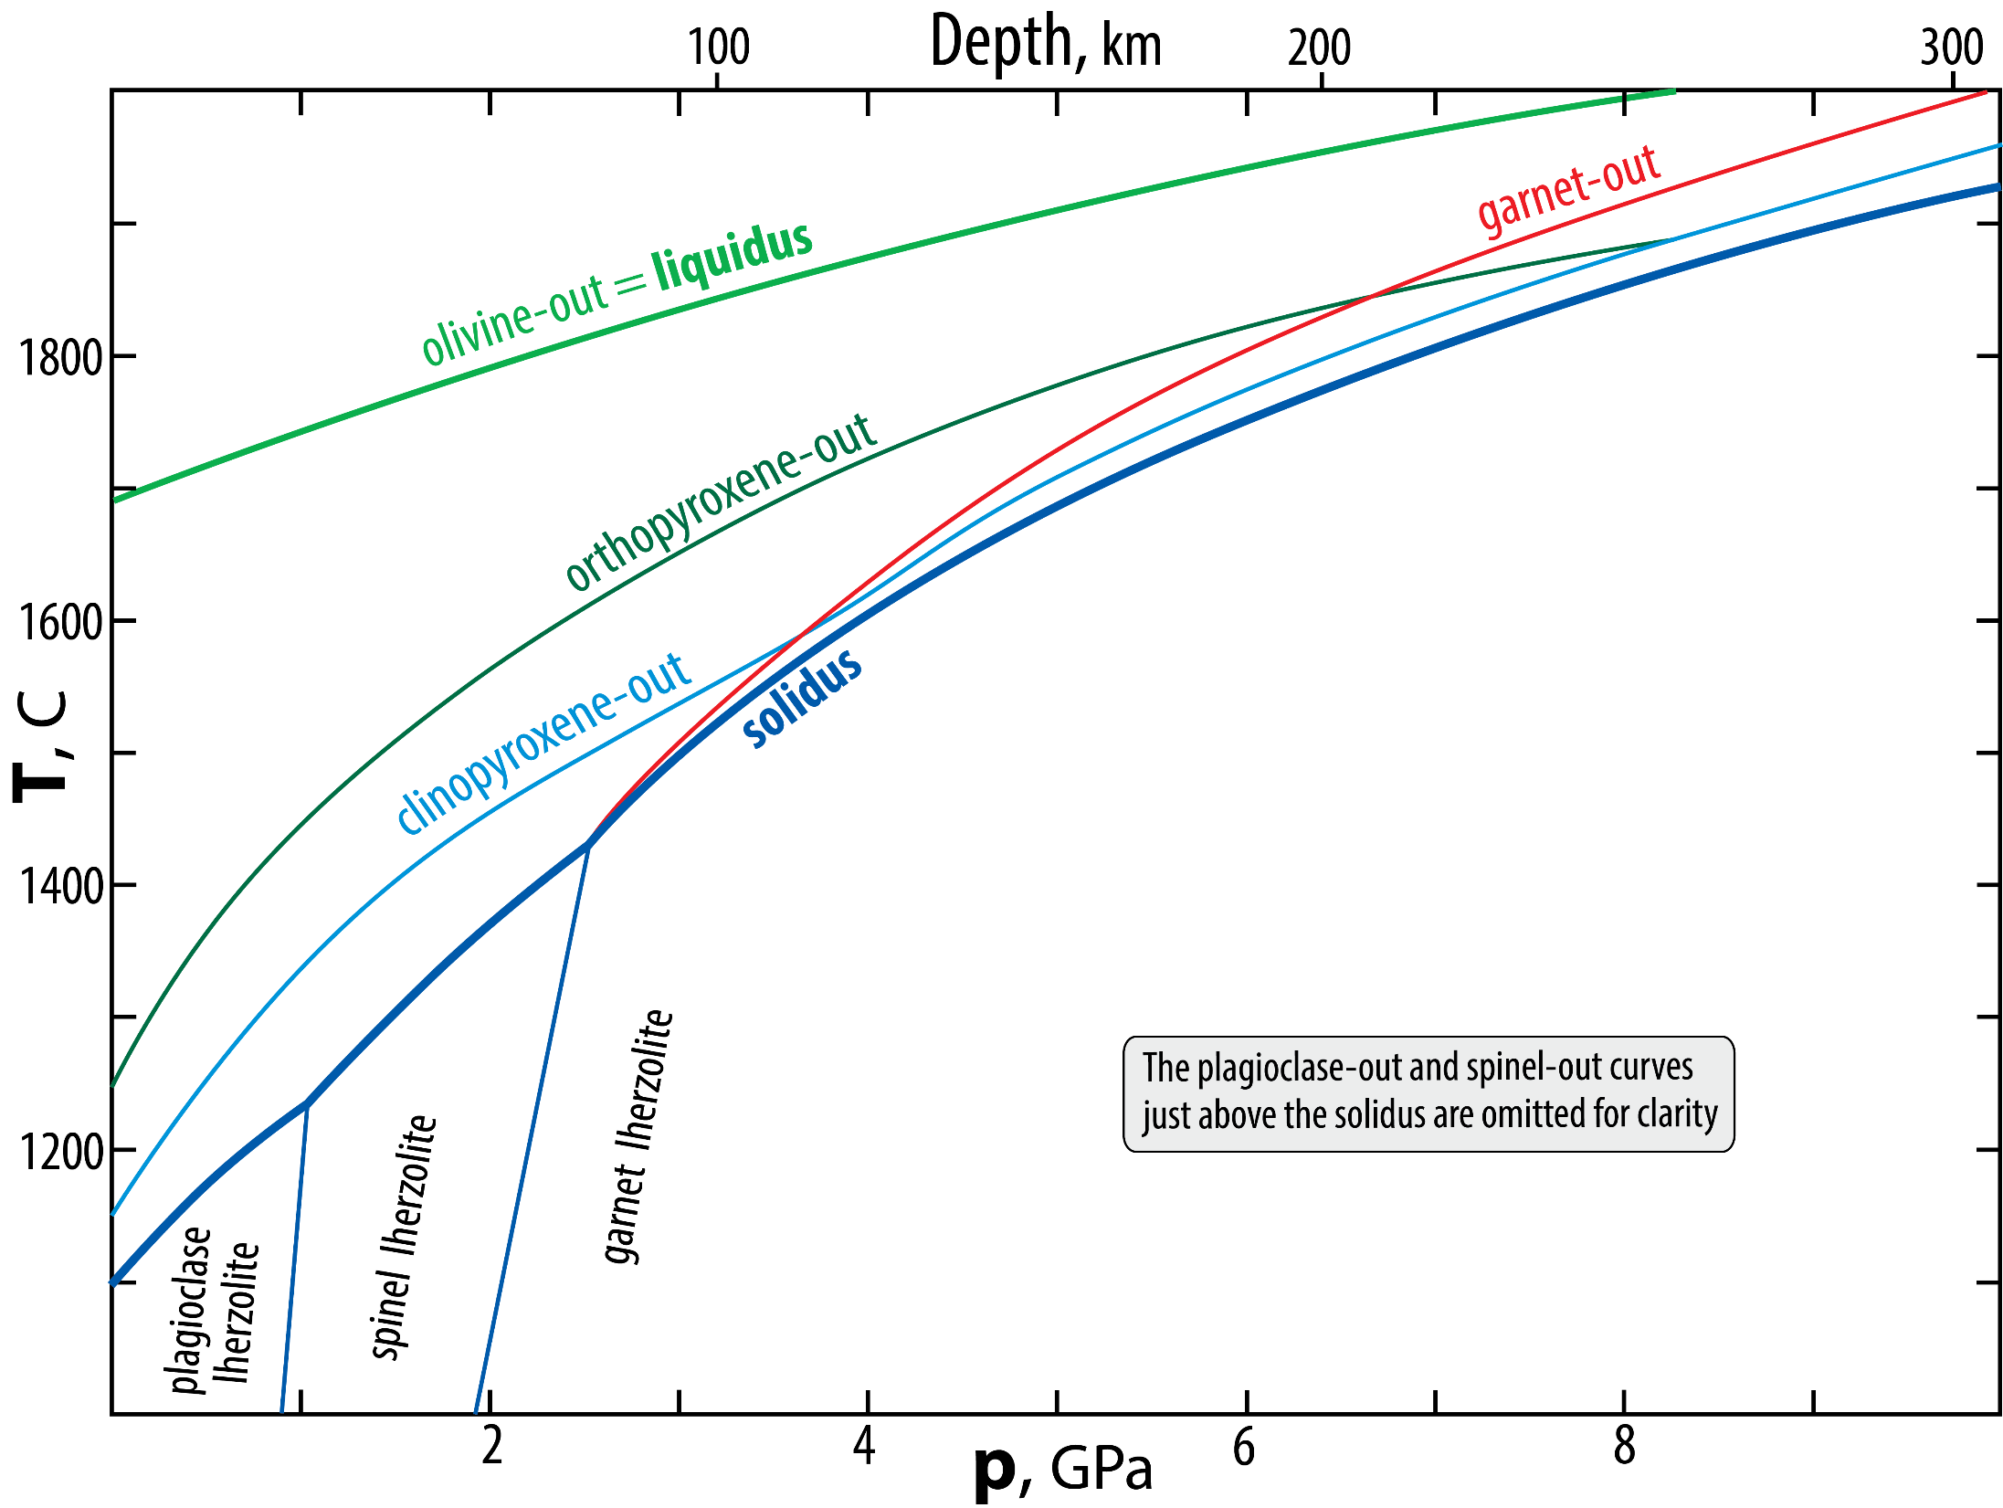
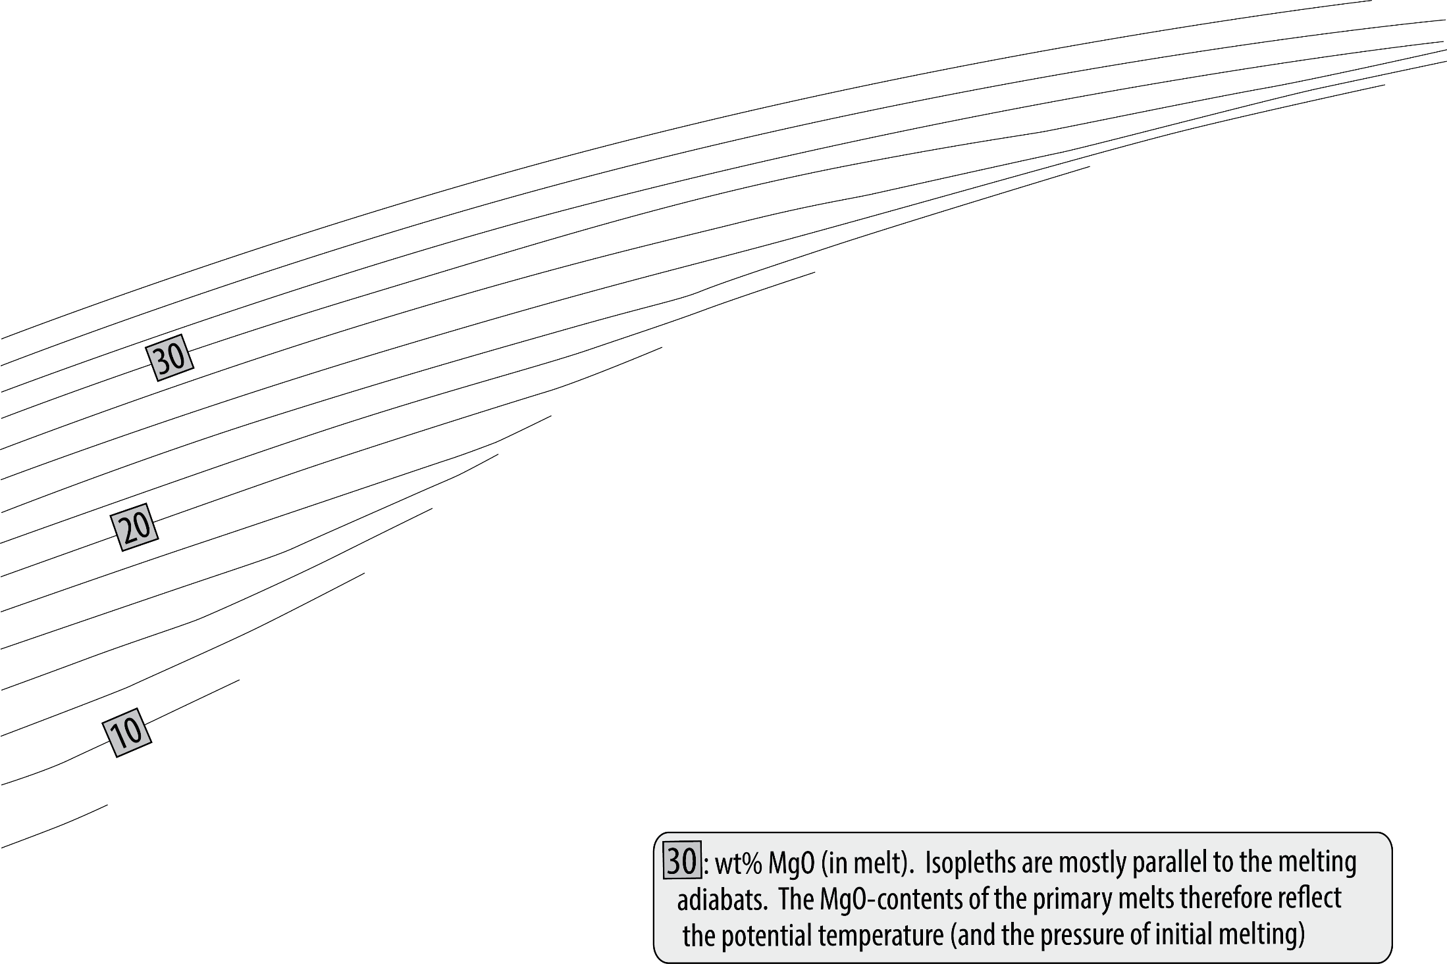
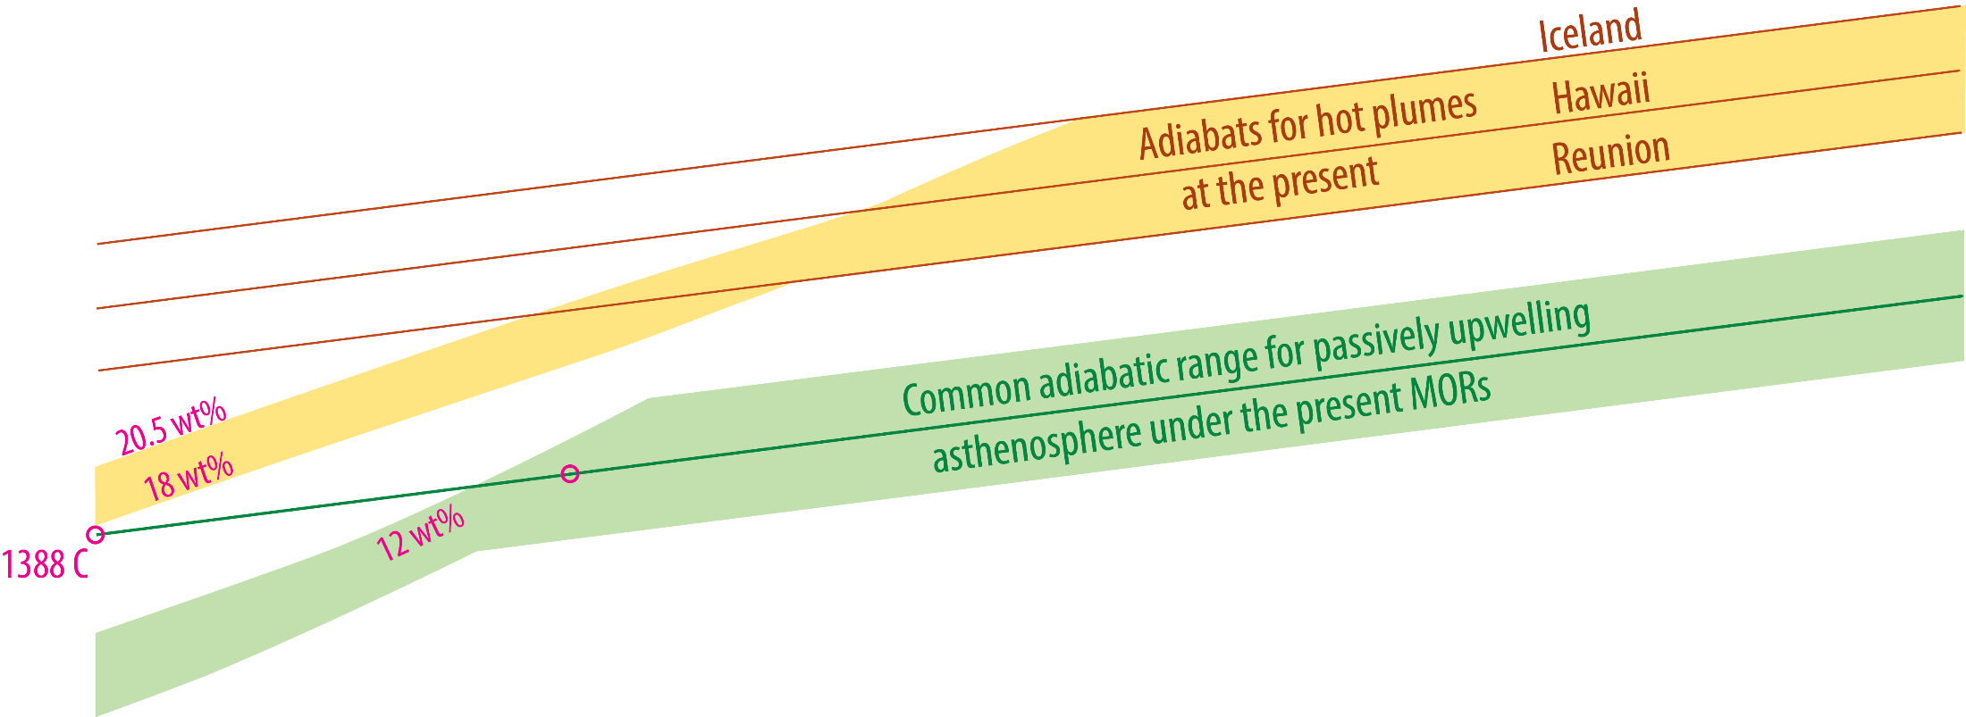
Secular cooling: Peridotite melting, melt-MgO and mantle T_{P}
Herzberg et al. 2002, J.Pet,
Bao et al. 2022, Sci.

Slide 3
Lateral T_{P}-variation in the MTZ
Based on depths to 410, ‘520’ and 660 km discont.
(Waszek et al. 2021, Nat. Geosci.)
The Pacific hemisphere is hotter than the Indo-Atlantic hemisphere
1661 K (1388 C)
1177 C
1527 C
Distribution of hot and cool plumes
ΔT_{P}: 350
Based on seismic tomography (Bao et al. 2021, Sci.)
Mostly subducted
slab signals

Slide 4
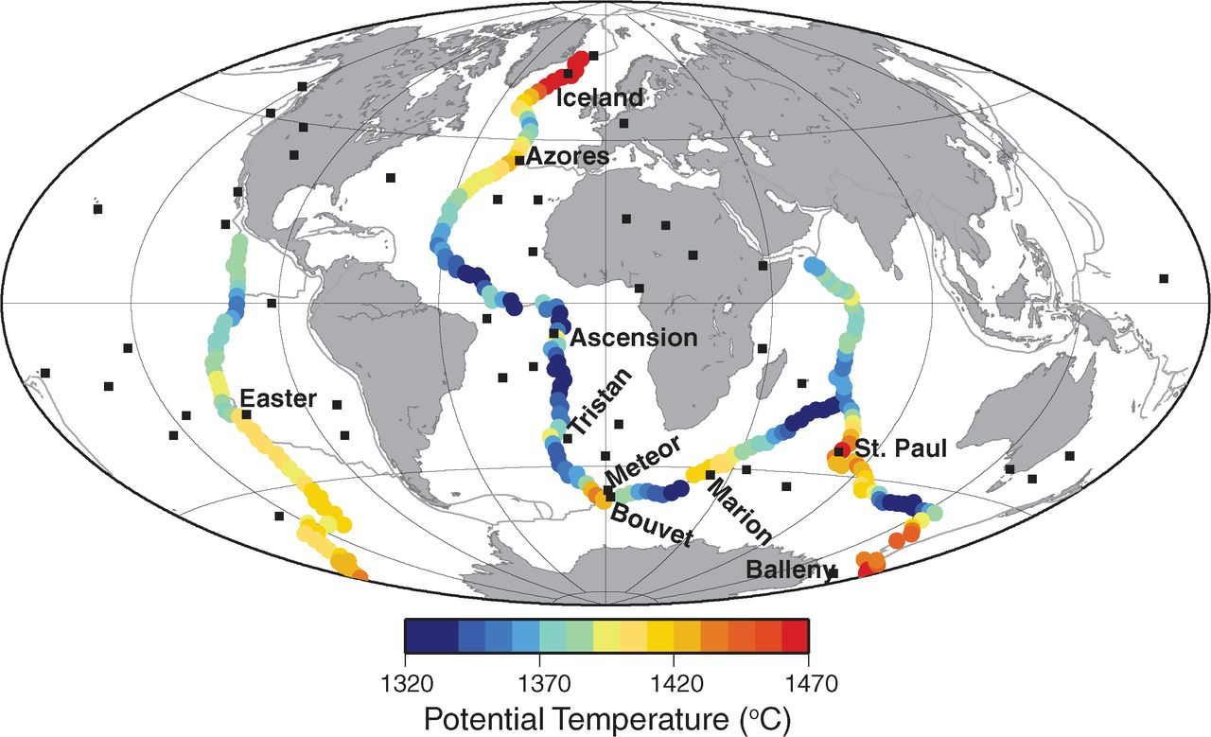
Lateral T_{P}-variation along the main MORs
327 data points
Average T_{P}: 1386 C
Based on depths ridge depth, crustal thickness, geochemistry and V_{S} at 300 km depth (Dalton et al. 2014, Sci.)
It is difficult to separate a
plume effect from ‘ambient’
asthenospheric upwelling
The Iceland plume T_{P} is actually
much higher: 1609 C
ΔT_{P}: 150

Slide 5
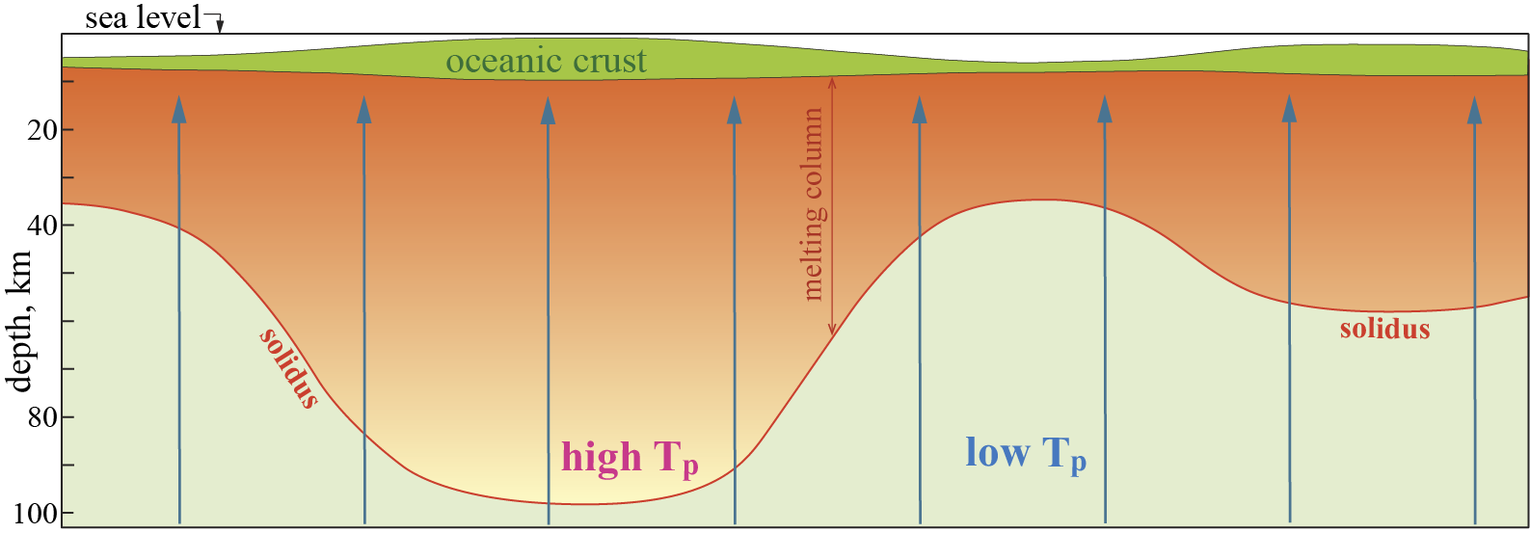
Along-axis profile: Ridge depth, crustal thickness and melting column
shallow water
thick crust
high p₀ & ͞p
deep water
thin crust
low p₀ & ͞p

Slide 6
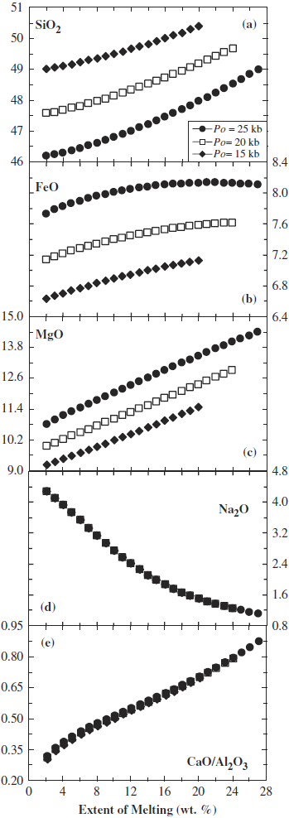
Global MORB systematics
Correlations between:
- potential temperature, T_{p}
- axial depth
- crustal thickness
- basalt coposition
Modeling of decompressional
melt compositions
p₀: 15, 20 and 25 kbar, p_{final}: 8 kbar
10
F, wt%
20
15
20
Parameterization based
on experimental results:
Jaques and Green 1980
Falloon and Green 1987, 1988
Falloon et al. 1988
Hirose and Kushiro 1993
Baker and Stolper 1994
25
25
Pioneering studies by:
Klein and Langmuir (1987, 1989, JGR)
Langmuir et al (1992, AGU Monograph 71)
Revisited by e.g.:
Niu and O'Hara (2008, J. Petrol.)
Dalton et al. (2014, Science)
FeO is especially
diagnostic: largest
%-variation.
20
Fig. from
Niu & O'Hara, 2008, J.Pet.
15
25
20
15
Incompatible Na is enriched
in early melt fractions (low F)
and decreases with p₀ and ͞p
Na- & Ca/Al-curves
for p₀ of 15-25 GPa
coincide (almost)
F% FeO/MgO
2 0.72
10 0.67
18 0.62
36 0.57
Decreasing FeO/MgO
with increasing F
Ca/Al decreases with incr. F, p₀ and ͞p.
High-p melting with more residual ga
ga should give higher, not lower, Ca/Al-
ratio at high F in fractionation-corrected
basaltic rocks.
Also, these curves, based on p₀ ≤ 2.5
GPa (≤ 25 kbar), represent too low p to
account properly for the ga-effect.

Slide 7
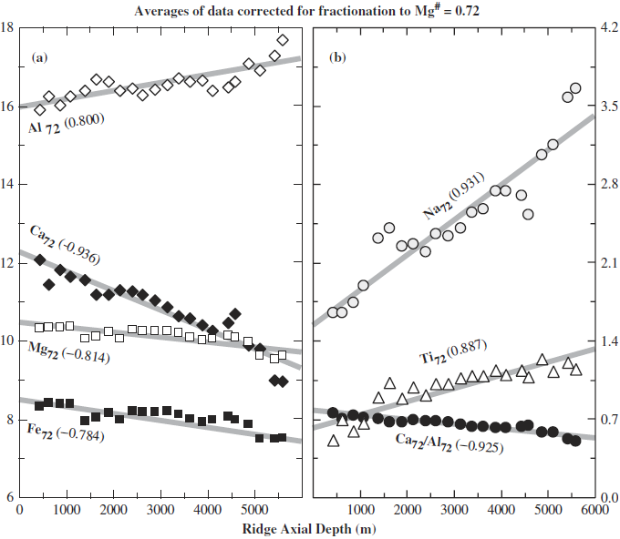
Fractionation correction: to "see through" the effects of magmatic fractionation (differentiation)
Fractionation-correction to a constant basalt Mg# of 72, corresponding to
primitive mantle olivine with Fo₉₀. Mg# = 100 * Mg/(Mg+Fe_{tot})
Please note the Al₇₂ & (Ca/Al)₇₂, consistent with high-p residual ga, as well as
the high-p indicator(s) Fe₇₂ (and Mg₇₂), which increase with increasing F, p₀ and ͞p.
The incompatible minor elements Na₇₂ and Ti₇₂ decreases with increasing F.
Fractionation-correction to a constant MgO
of 8 wt%, which also corresponds approx. to
basalt with Mg# of 72 and mantle olivine with Fo₉₀ (Klein & Langmuir, 1987)
increasing F, z_{crust}, p₀, ͞p
increasing F, z_{crust}, p₀, ͞p

Slide 8
Along-axis profile: Ridge depth, crustal thickness and melting column
shallow water
thick crust
high p₀ & ͞p
high Fe₇₂, (Ca/Al)
low Na₇₂, Ti₇₂
deep water
thin crust
low p₀ & ͞p
low Fe₇₂, (Ca/Al)
high Na₇₂, Ti₇₂
Deep ridges, thin crust may also result from:
- slow spreading, slow upwelling
- fertile, dense source → slow upwelling, low F
- refractory mantle source → low F

Slide 9
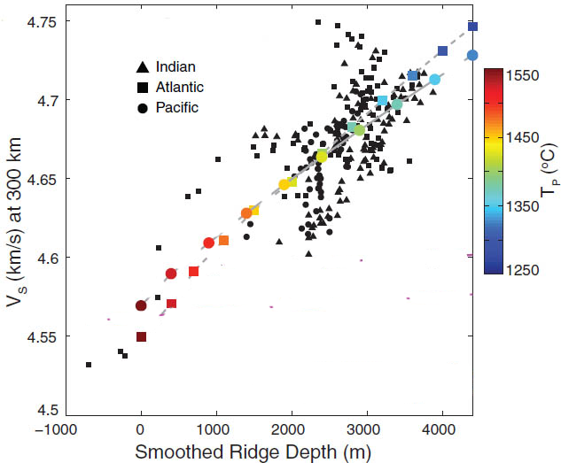
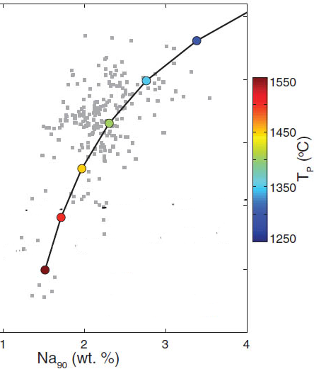
Dalton et al. (2014, Sci):
T_{p} versus compositional variation of V_{S} (at 300 km depth), D_{R} and Na₉₀, Fe₉₀, (Ca/Al)₉₀
(Na₉₀: Na corrected to equilibrium with Fo₉₀ mantle olivine)
CD: 400 km, T_{p}:1350°C
CD: 400 km, T_{p}:1350°C
CD: 400 km
Comp.
variation:
CD: 300 km
Comp.
variation:
CD: 400 km, T_{p}:1450°C
CD: 400 km, T_{p}:1450°C
T-var.
increasing F
increasing F
Isostatic compensation depths (CD):
depth of isostatic columns, including water, crust, residual mantle and fertile mantle

Slide 10
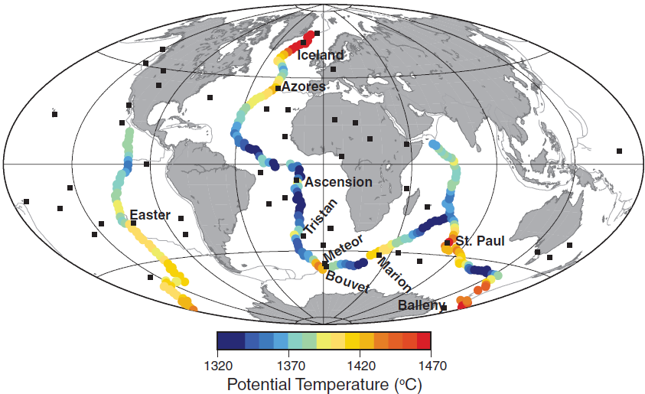
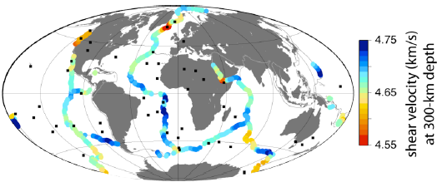
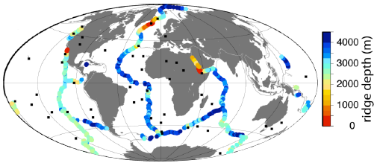
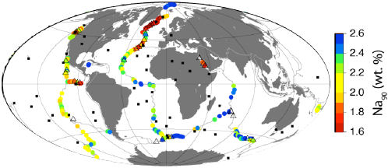
Global along-axis variation

Slide 11
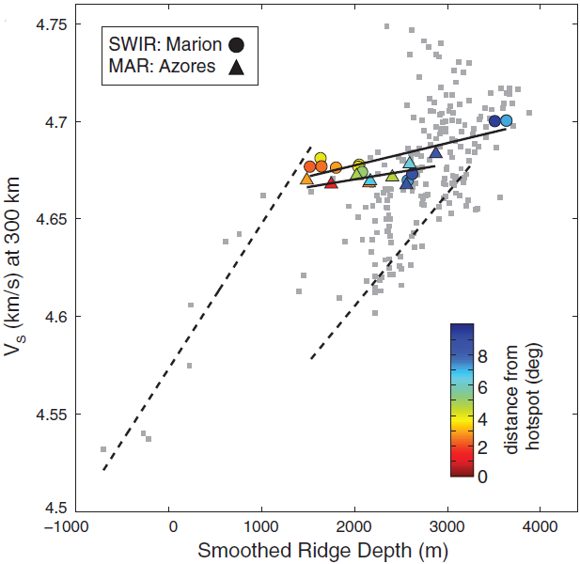
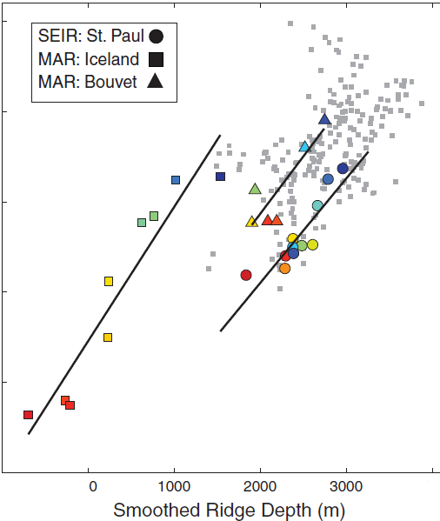
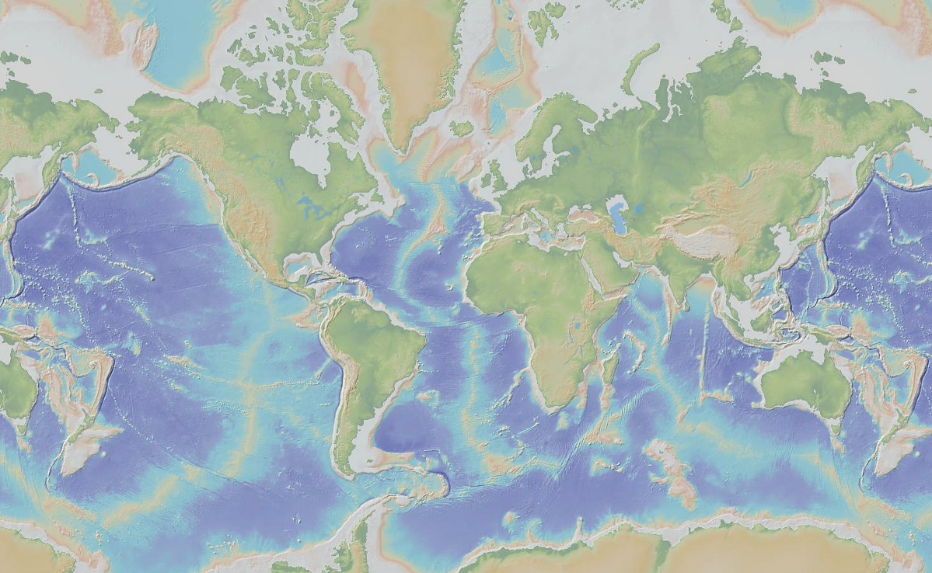
MAR: Bouvet
MAR: Bouvet
MAR, Iceland
MAR, Iceland
SEIR, St. Paul

Slide 12
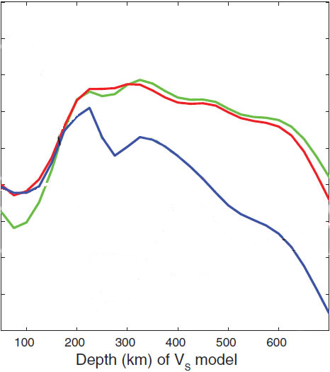
Best correlation between:
- V_{S} and D_{R} (ridge depth)
- V_{S} and Na₉₀
for Vs at 300 km depth
0.8
Best correlation:
200 - 400 km
smoothed D_{R}
0.6
raw D_{R}
Correlation coefficient
0.4
Na₉₀
0.2

Slide 13
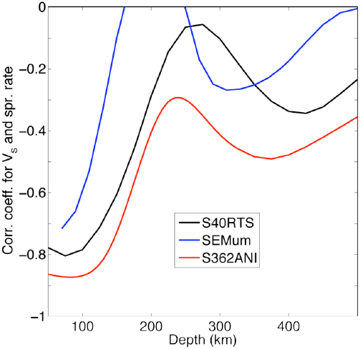
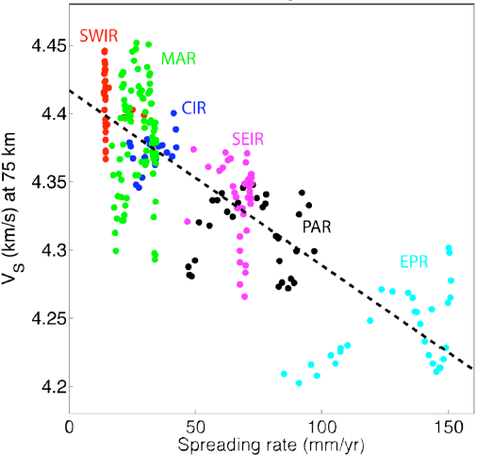
V_{S} at SHALLOW level versus spreading rate
about 75 km:
strong negative
correlation
200-400 km:
weak correlation
"Spurious" negative correlation
Fast-spreading ridges:
wider belt of young and hot lithosphere
and shallow asthenosphere
→ low V_{S} at shallow level (75 km)
fast upwelling of hot asthenosphere

Slide 14
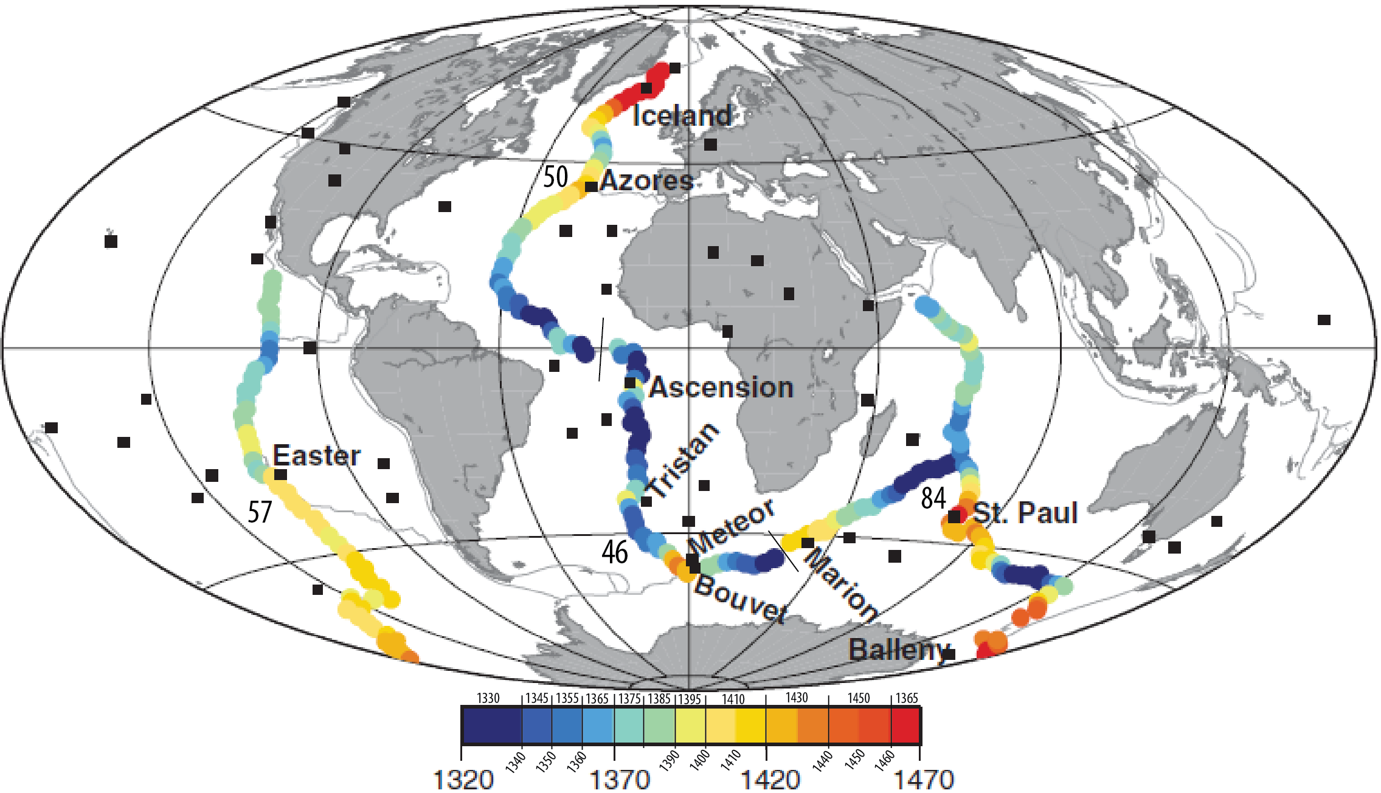
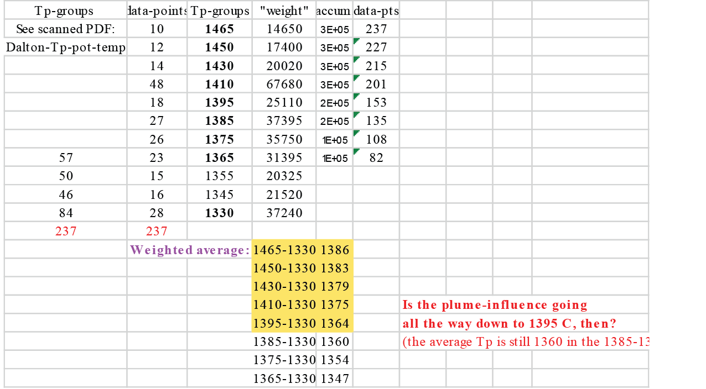
Calculations to show
that T_{P} >> 1350 C

Slide 15
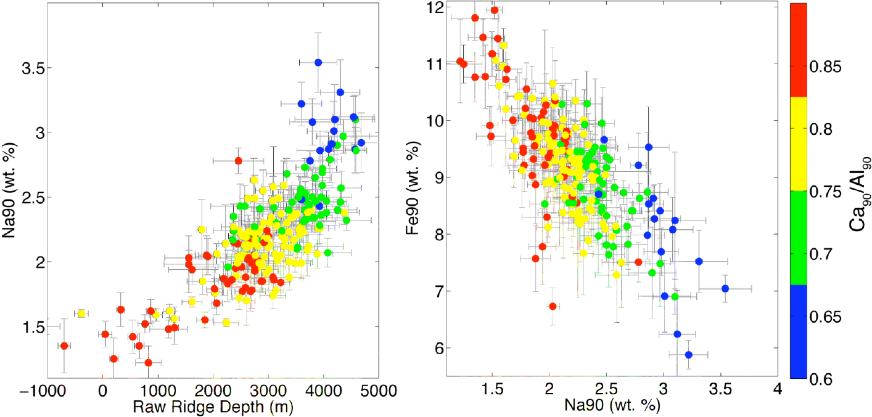
Iceland-
Kolbeinsey
Cayman
Trough
Cayman
Trough
Iceland-
Kolbeinsey
increasing p₀, ͞p, F
increasing p₀, ͞p, F
Postive correlation
p₀ , ͞p and F with T_{P} , z_{crust} , Fe₉₀ , (Ca/Al)₉₀
Negative correlation
p₀ , ͞p and F with D_{R}, Na₉₀

Slide 16
1388℃ adopted as mantle Tp for passively spreading ridges
(Bao et al. 2022, Sci., supported by Putirka 2008, Geol. and Dalton et al. 2014, Sci.)

Slide 17

27 deep-rooted plumes, mostly OIBs
(French & Romanowicz, 2015, Nature)
Iceland
Azores
Canary
Hawaii
Cape Verde
Hoggar
Canary
Afar
Marshall
Micronesia
(Caroline)
Samoa
Galapagos
Ascension
Cameroon
Comoros
Marquesas
Tahiti-Soc
St Helena
Reunion
Macdonald
Seamount
Pitcairn
Easter
San Felix
Walwis R.
Juan Fernandez
Tristan
Gough
Crozet
Kerguelen
Loisville
Herd
Bouvet

Slide 18
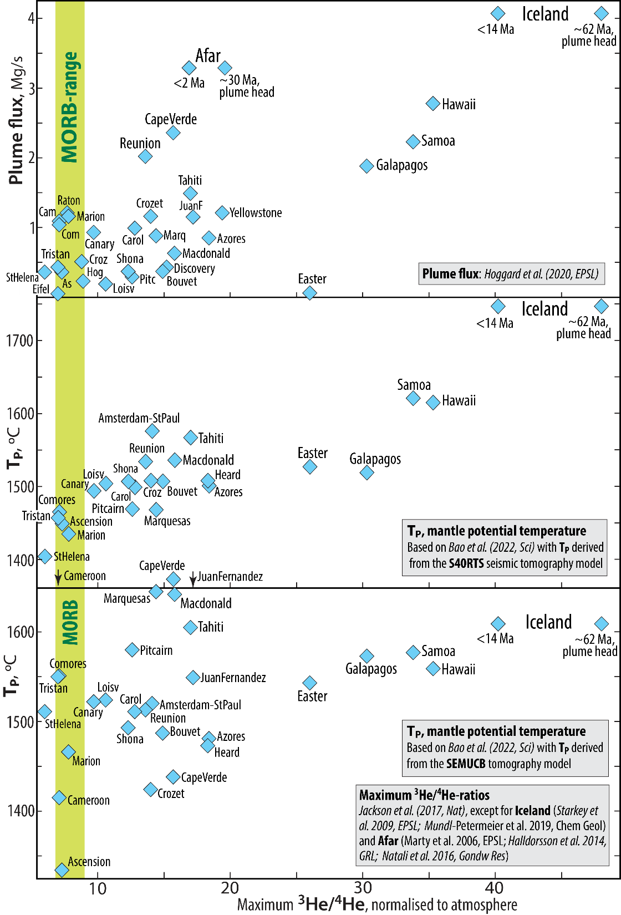
Maximum ³He/⁴He-ratio in plume-derived
volcanic centres versus plume flux and
mantle potential temperature, T_{P}

Slide 19
Secular cooling: Peridotite melting, melt-MgO and mantle T_{P}
Herzberg et al. 2002, J.Pet,
Bao et al. 2022, Sci.

Slide 20
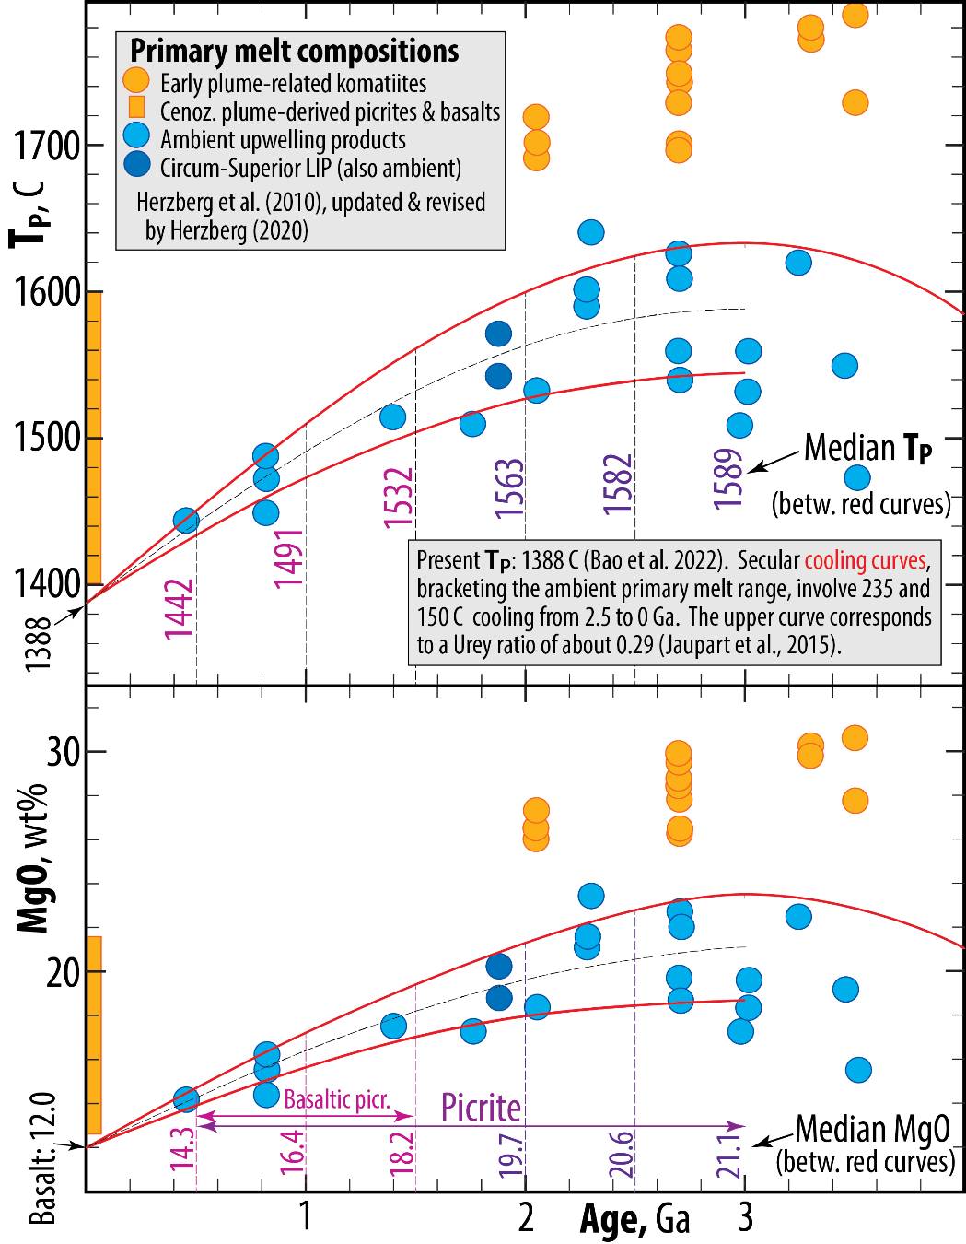
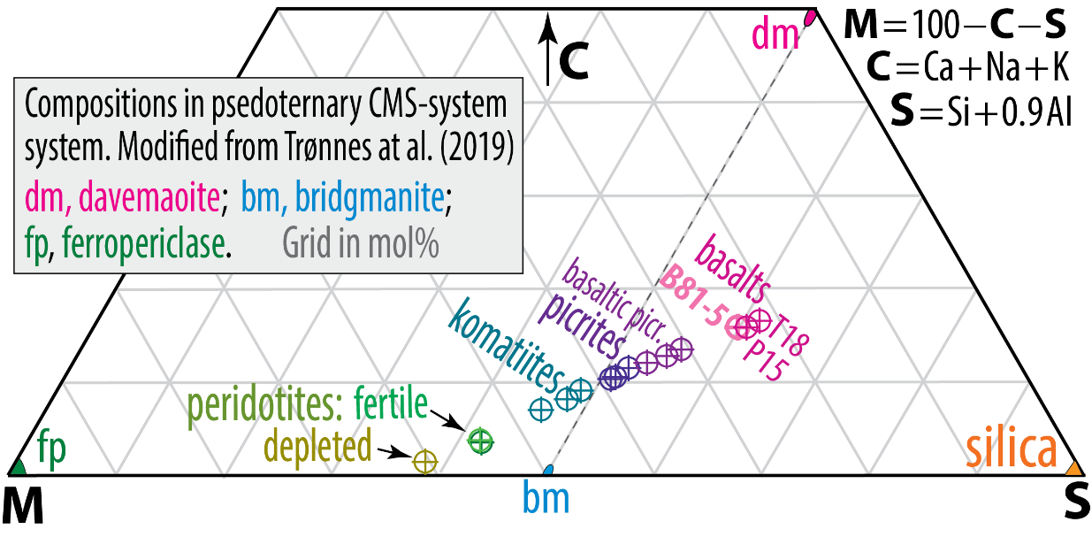
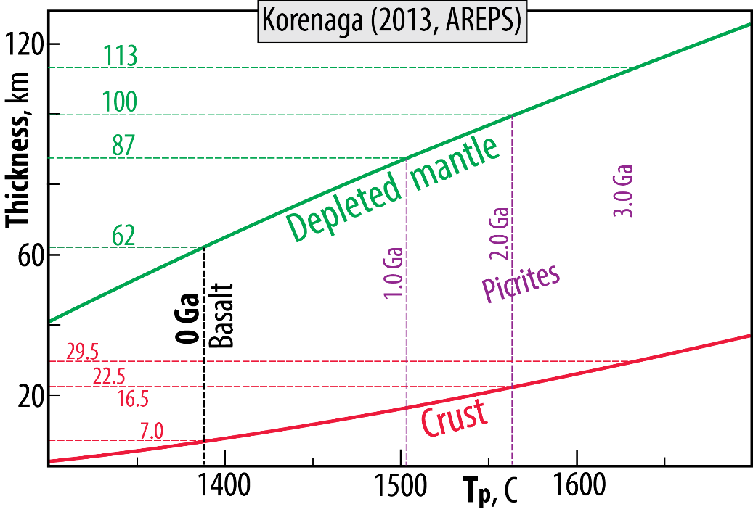
Primary melt and peridotite comp. in psedoternary CMS-system
C = Ca+Na+K, S = Si+0.9Al, M: all the rest

Slide 21
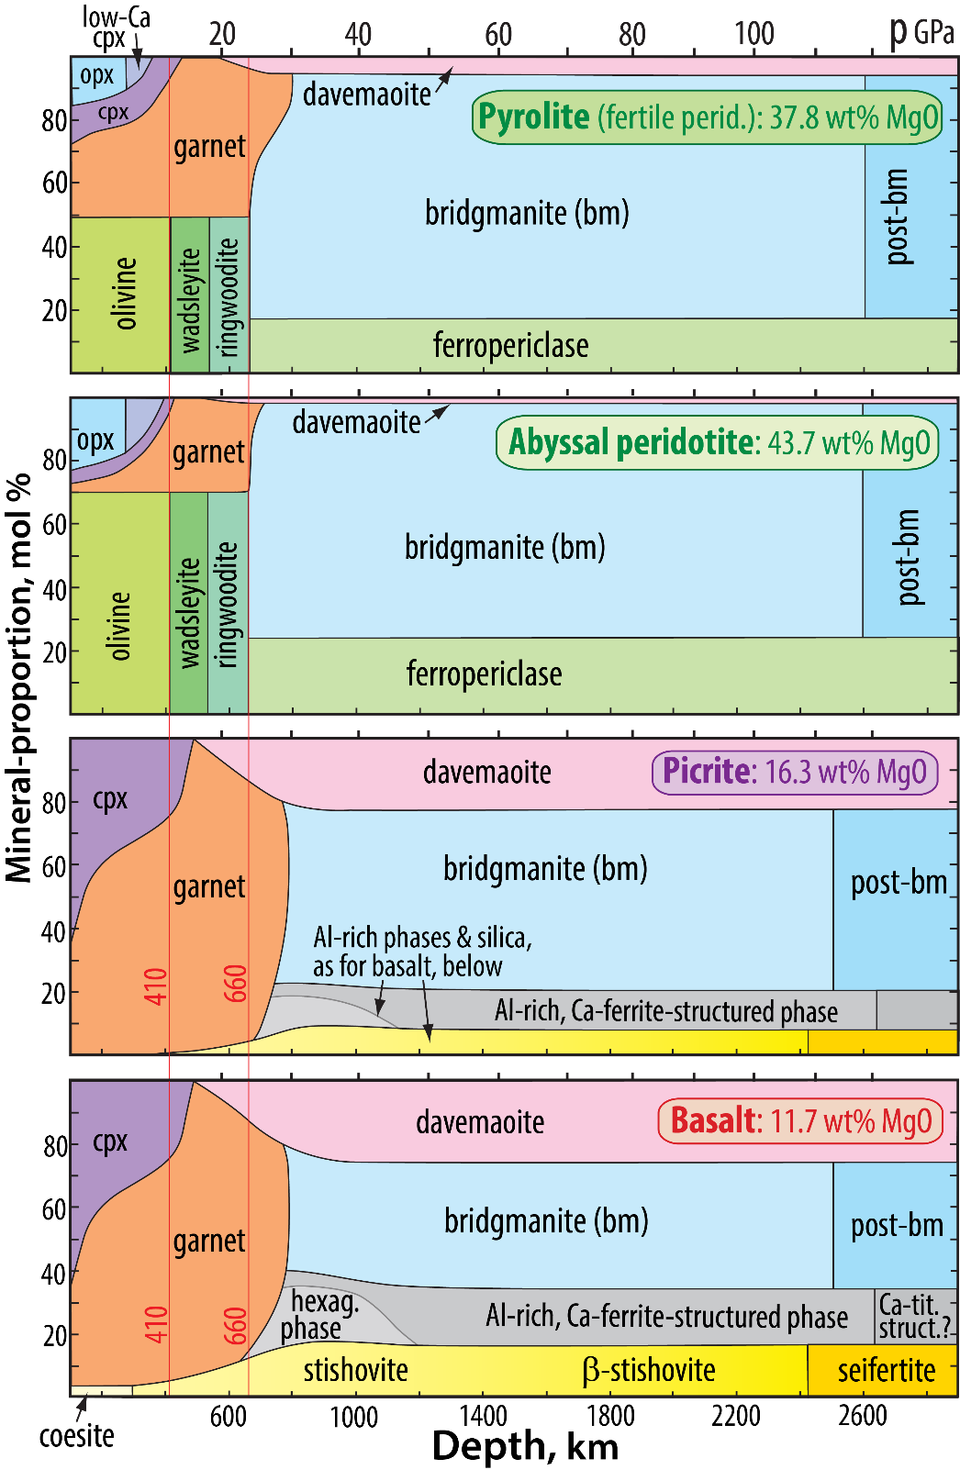
LM-mineralogy of pyrolite, depleted peridotite, picrite and basalts
Mineral
proportions
Bridgmanite
components

Slide 22
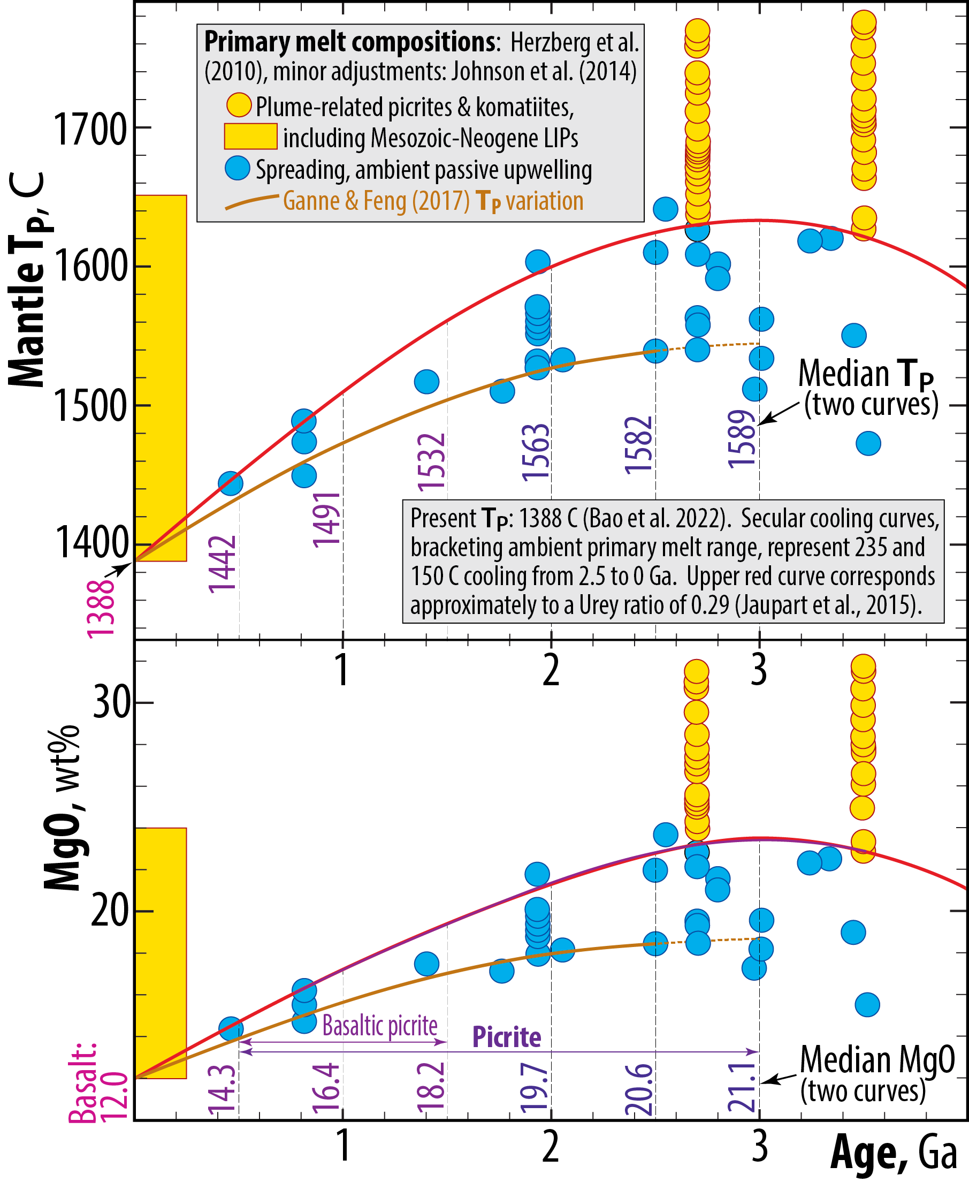
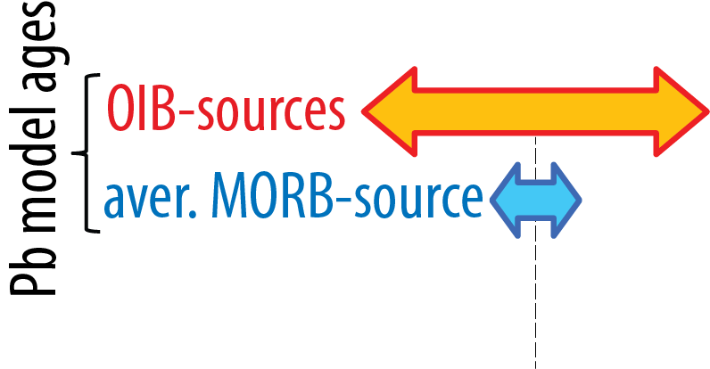
Secular cooling, mantle Tp and
primary melt compositions
(Trønnes & Mohn, in prep.)
Pb model ages:
The slope of the NHRL in the Pb-Pb-diagram,
²⁰⁷Pb/²⁰⁴Pb - ²⁰⁶Pb/²⁰⁴Pb, defines the MORB-source model age of about 2 Ga

Slide 23
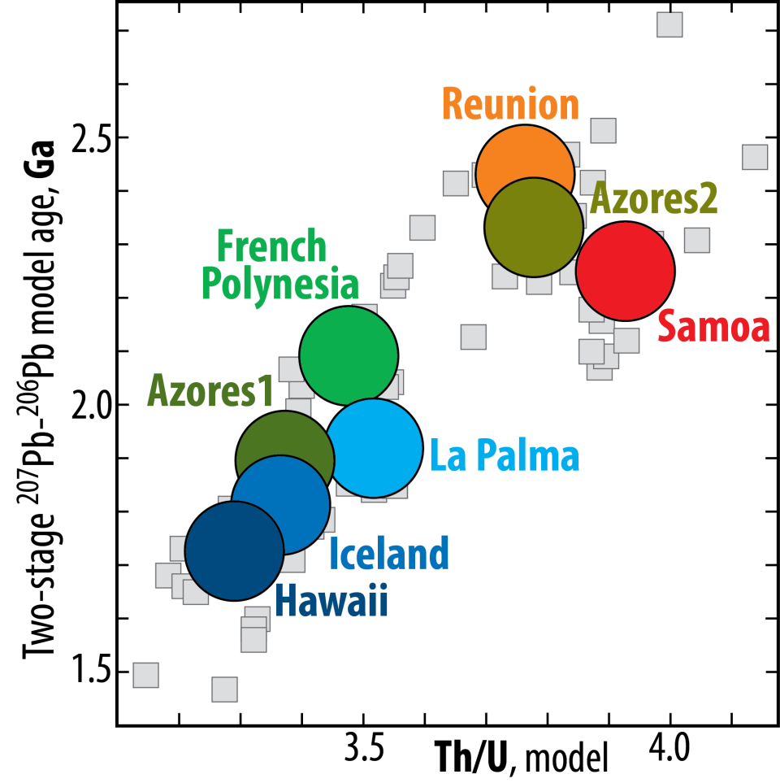
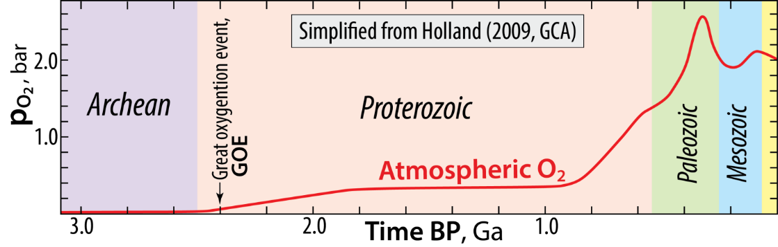
OIBs: Correlated model ages and Th/U ratios
Andersen et al.
(2015, Nature)
Plume source model ages: 1.5 - 2.5 Ga
Great oxidation event: 2.4 Ga
Also: Cabral et al. (2013, Nature)
Olivine-hosted sulphide inclusions in lavas from Cook Islands, Polynesia have S-isotopes indicating Archean ROC
Oxidation of the atmosphere and oceans
recycling of U into the deep mantle
decreasing Th/U ratio of plume
sources with time

Slide 24
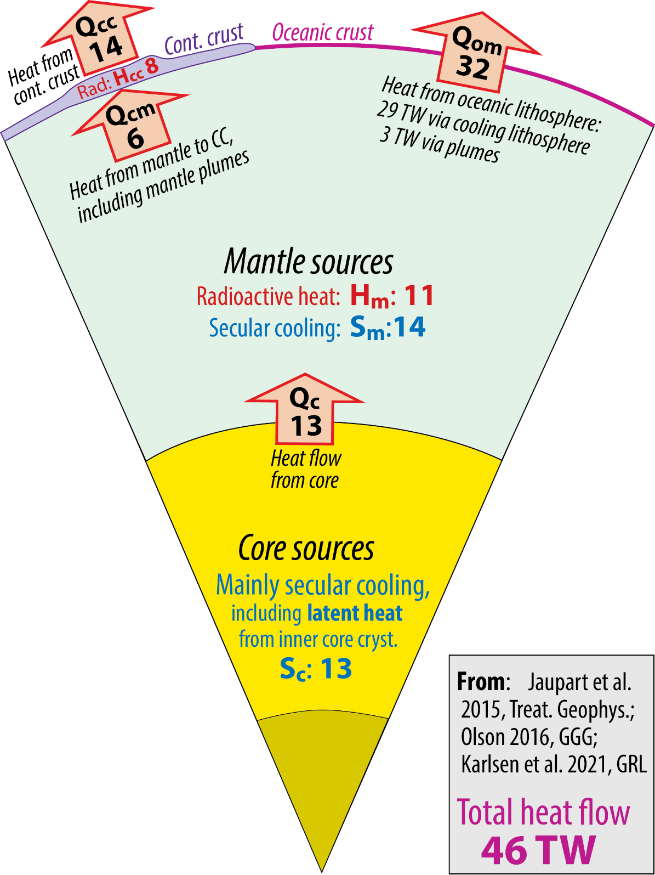
Heat budget
Convective Urey ratio
Ur = H_{m} / (Q_{om}+Q_{cm})
= H_{m} / (S_{c}+S_{m}+H_{m})
= 11 / (13+14+11) = 11/38 = 0.29
Bulk Earth Urey ratio
Ur = (H_{m} + H_{cc}) / (Q_{om}+Q_{cm})
= 19/38 = 0.50

Slide 25
Brandl et al.
(2013, Nat. Geosci.)

Slide 26
Brandl et al. (2013,
Nat. Geosci)
Deep water, low T_{P}
thin crust. low F,
shallow melting
Shallow water, high T_{P}
thick crust, large F,
deep to shallow melting
Oceanic water depth trend
(see above)
5150 m
730 m
Crossing trend:
high-Fe,
high p
low Ca/Al
residual ga,
high-p
Crossing trend:
high-Na-Ti,
enriched,
low F
5150 m
730 m

Slide 27
Brandl et al. (2013,
Nat. Geosci)
Pacific: blue
Atl.-Ind.: red

Slide 28
Brandl et al. (2013,
Nat. Geosci)
This is not high T, but rather:
high p, low F. Possibly the
combination enriched + rel. low T
Na₈
Cooling, decreaing. T_{P}
+ asth. enrichment
roughly constant T_{P}
T_{P}
T_{P}
Current (0-age) MORB
Atlantic, two peaks:
- main enriched (C-S Atlantic) and
- minor depleted (N Atlantic) peaks
Pacific, one intermediate peak:
- slightly more depleted than the
main Atlantic peak
This is not high T, but rather:
high p, low F. Possibly the
combination enriched + rel. low T
S-C Atl:
low T
N Atl:
high T
Cooling,
+ asth. enrichment

Slide 29
Brandl et al. (2013,
Nat. Geosci)
ΔT: 30 C
ΔT: 25 C

Slide 30
OIB compositions
Doucet et al. (2020, Nat. Geosci.)
African domain
Pacific domain
Doucet et al.
(2020, Nat. Geosci.)
⁸⁷Sr/⁸⁶Sr
¹⁴³Nd/¹⁴⁴Nd
¹⁴³Nd/¹⁴⁴Nd
²⁰⁷Pb/²⁰⁴Pb
²⁰⁸Pb/²⁰⁴Pb
²⁰⁶Pb/²⁰⁴Pb
²⁰⁶Pb/²⁰⁴Pb

Slide 31
Van Avendonk et al.
(2017, Nat. Geosci.)

Slide 32
Global
Pacific
Atlantic
+ Indian

Slide 33
Karlsen et al. (2021, GRL)

Slide 34
Karlsen et al. (2021, GRL)

Slide 35
Karlsen et al. (2021, GRL)

Slide 36
Karlsen et al. (2021, GRL)

Slide 37
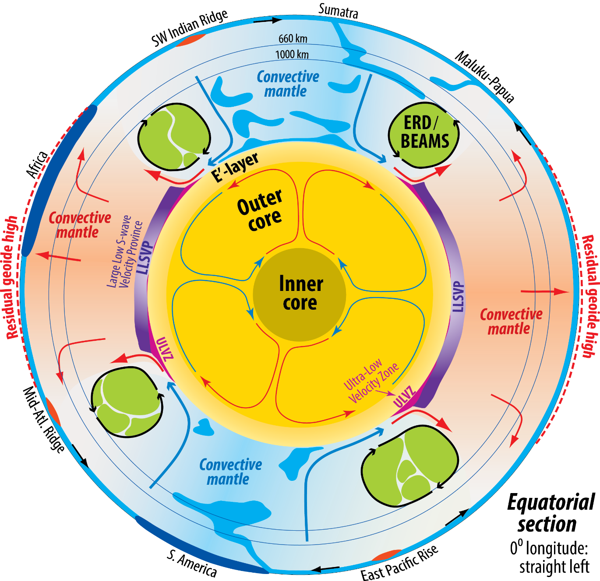
CMB heat flux
Olson 2016, GGG
Radial flow velocity, core
Equatorial plane, 0⁰ longitude: left
Olson 2016, GGG

Slide 38
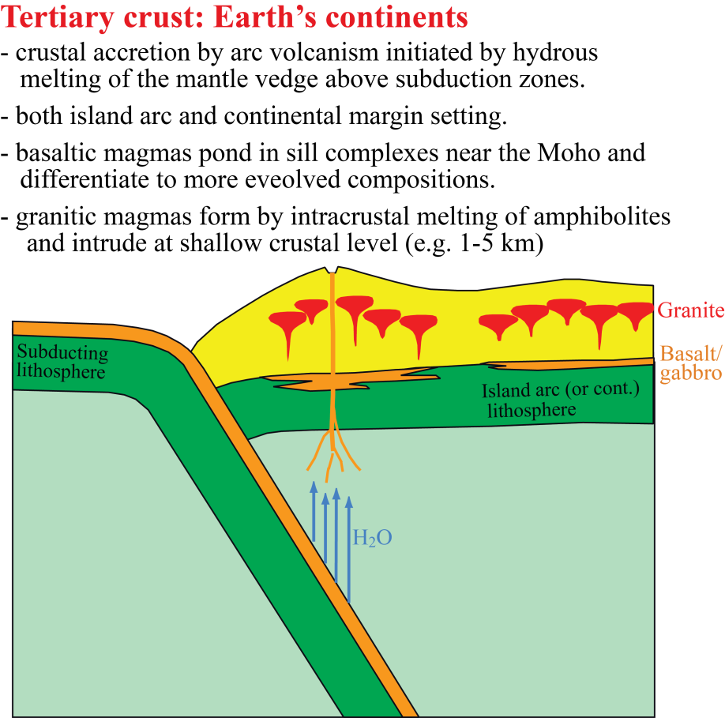
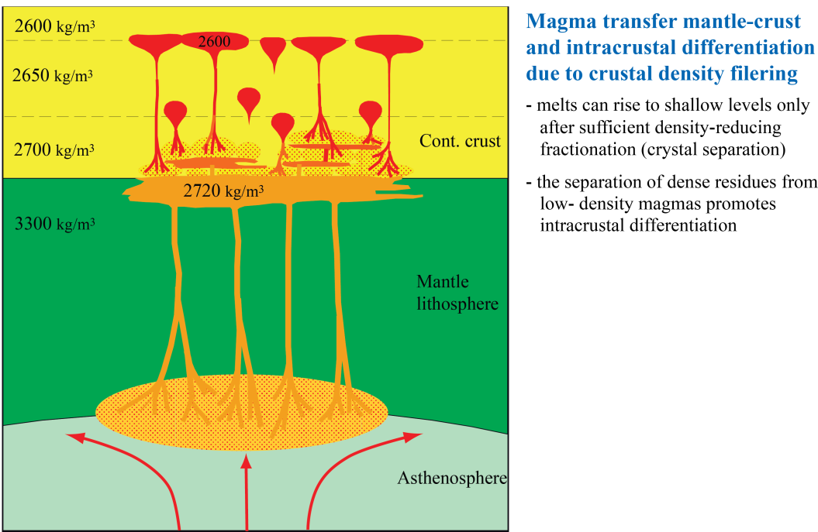
Crustal growth - present

Slide 39
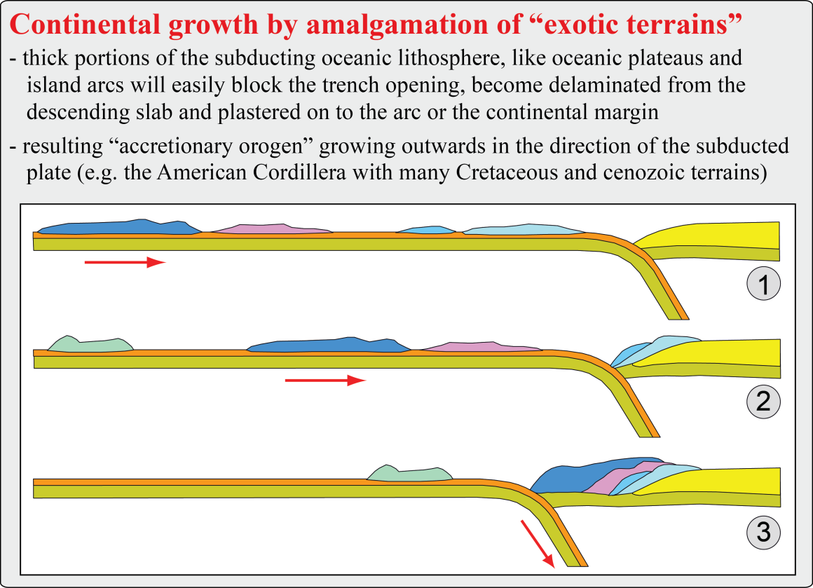
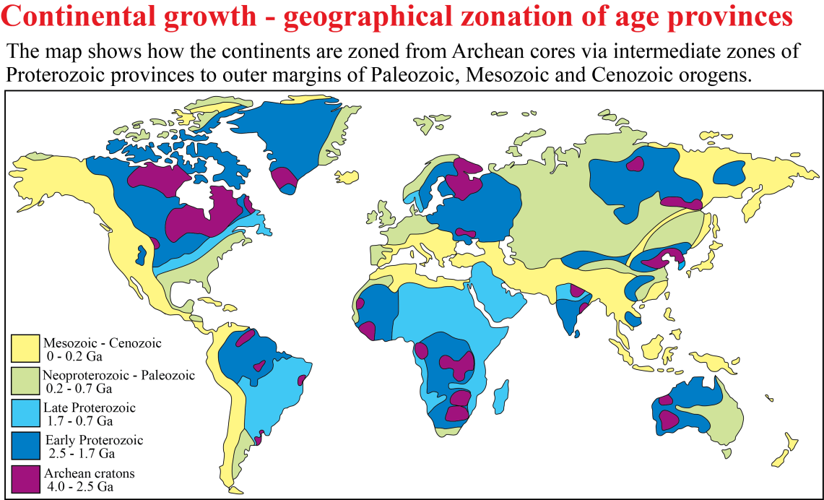
Crustal growth -
ongoing and the record

Slide 40
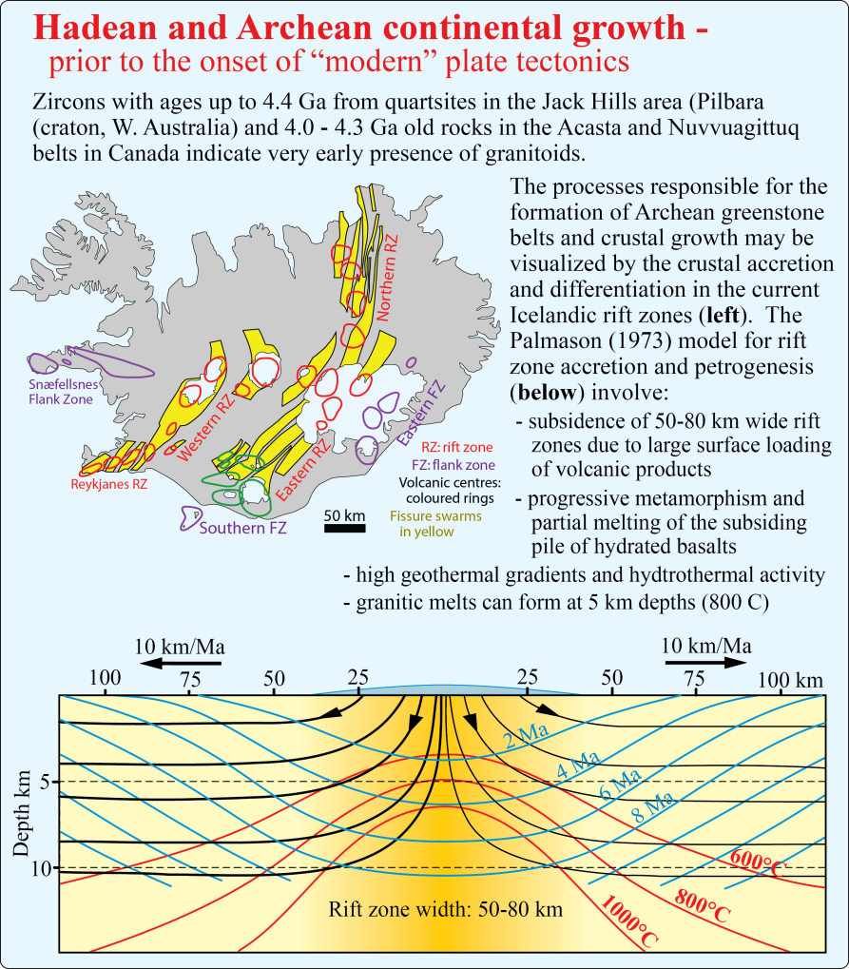
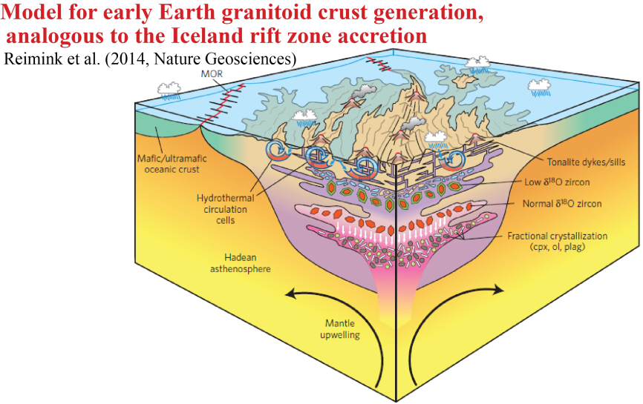
Crustal growth - Hadean, early Archean

Slide 41
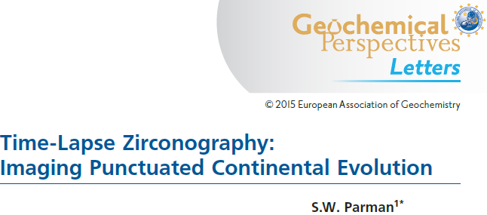
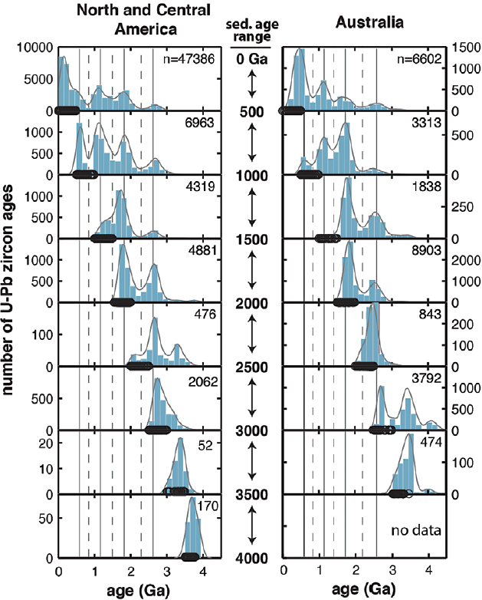
These are crust formation (rather than
destruction) peaks and troughs

Slide 42
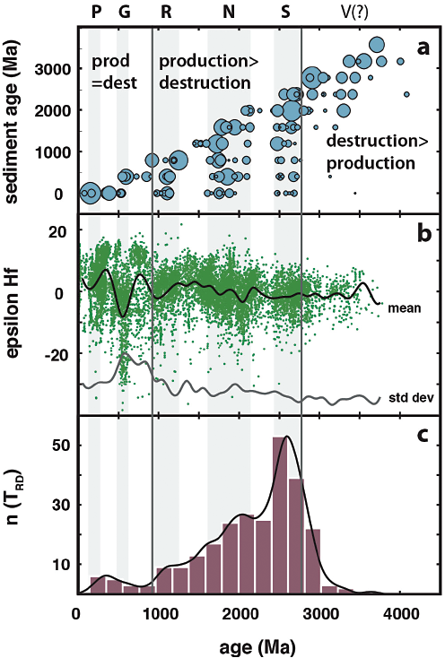
Parmann (2015, Geochem. Persp)

Slide 43
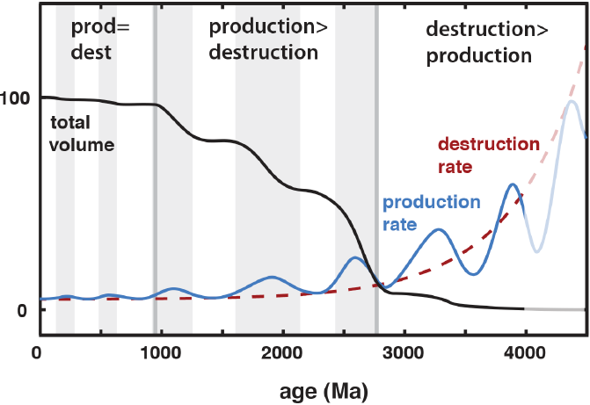
Parmann (2015, Geochem. Persp)

Slide 44
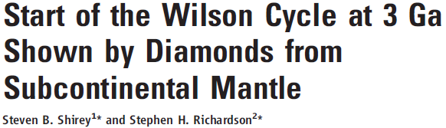
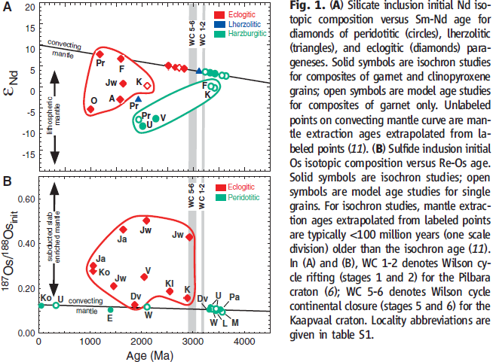
(2011, Science)
Eclogitic diamond inclusions appear only after about 3 Ma:
start of plate tectonics ?

Slide 45
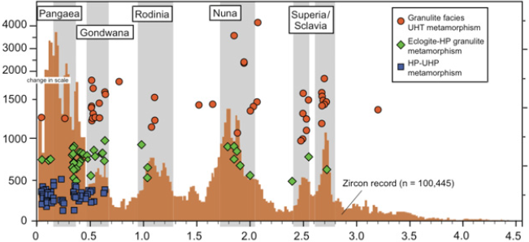
CC-formation and metamorphic
style through time
Valley (2015, Elements, editorial)
1500
Number of analyses
Metamorhic gradient, K/GPa
1000
500

Slide 46
Extra slides

Slide 47
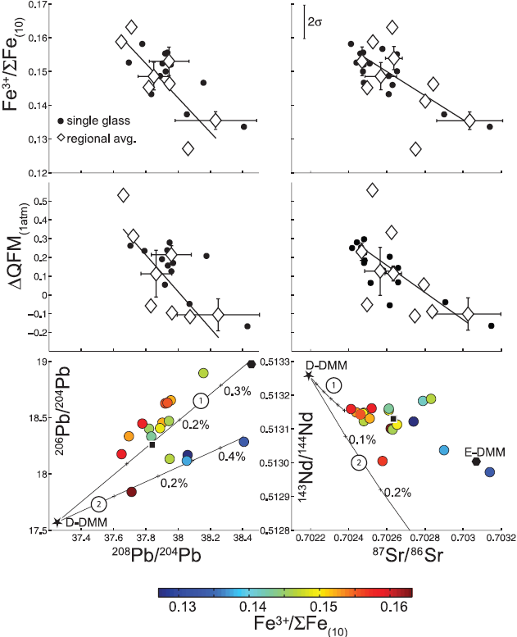
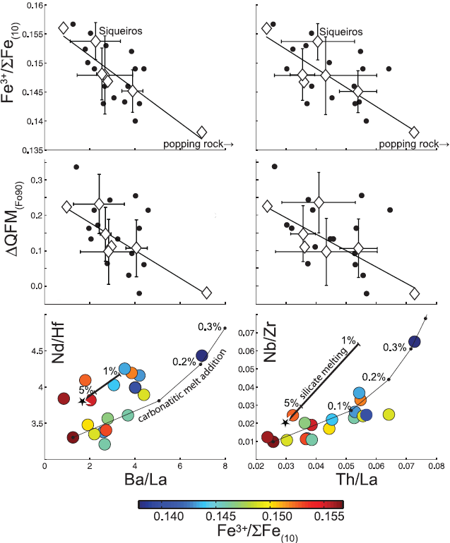
MORB: O-fugacity as a function of isotopic and TE variation
Cottrell et al.
(2013, Nat. Geosci.)
Small carbonatitic melt
fractions with low f_{O2}
1 Addition (0.1% increments) of zero-age carbonatitic melt
from 2 Ga old subducted crust
2 Addition of zero-age carbonatitic melt from subducted
crust infilrated in (metasomatizing) peridotite 2.8 Ga ago

Slide 48
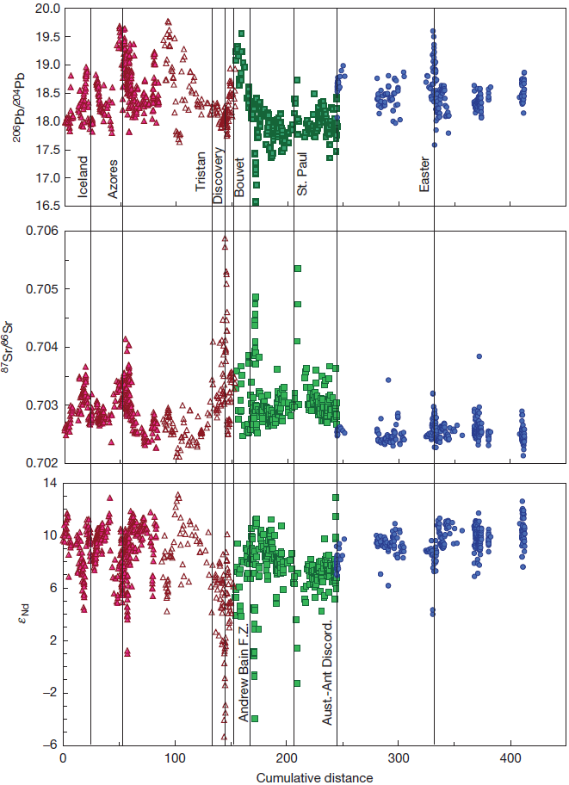
Global MORB,
Sr-Nd-Pb-isot.
Most enriched Indian MORB samples (high-Sr, low-Nd ratios):
Diverging Pb-isotope ratios
1. Near the Andrew Bain FZ:
low ²⁰⁶Pb/²⁰⁴Pb-ratios: EM2-LCC(?)
2. Near the St.Paul-Amsterdam plume(s):
high ²⁰⁶Pb/²⁰⁴Pb-ratios: EM2-like
Atlantic
Indian
Pacific
Discovery
Tristan
Bouvet
Austr-Ant Dicordance
Easter Is.
Bain FZ
St. Paul
White & Klein (2015, Treatise Geochem.)
based on:
Meyzen et al. (2007, Nature)
Zero-point:
Eastern Gakkel R.
(85.6 N, 85.1 E)

Slide 49

Moreira (2013, Geochem. Perspectives)

Slide 50



Kolbeinsey-Mohns ridges:
Elevated Hf-ratios
relative to Nd-ratios
Meyzen et al. (2007, Nature)
Relative deviation (%) from the mean
R_{C} reflects the time-integrated Th/U-ratio
- consistently elevated north of Iceland
- consistently elevated in the S. Atlantic and
Indian Ocean, except the Bouvet area
- negative values elsewhere, including the Pacific
Zero-point:
North Knipovich R.
(85.6 N, 85.1 E)

Slide 51



Global isotope systematics, MORB
Meyzen et al. (2007, Nature)
NOTE: ratios with ²⁰⁶Pb
as denominator
These samples have very unradiogenic
Pb and elevated ²⁰⁸Pb/²⁰⁴Pb for a given
²⁰⁶Pb/²⁰⁴Pb (i.e. high Δ8/4 values)
Meyzen et al. (2007, Nature)

Slide 52




Identifying mantle components, OIBs
Stracke (2012,
Chem. Geol.)
DM
HIMU
Samoa
EM2
Pitcairn-
Walvis R.
EM1
EM2
DM
Samoa
EM1
HIMU
Pitcairn-
Walvis R.
EM2
DM
HIMU
EM1

Slide 53

Earth’s geochemical reservoirs and
thermal evolution: schematically
Korenaga
(2008, Rev. Geophys.)
Layered mantle convection
with left-over primitive mantle
Layered mantle convection
with isolated (enriched) reservoirs
Whole-mantle convection
(continental crust)
(depleted mantle)
(primitive mantle)
Core

Slide 54


Supercontinent cycles
A juvenile Hf-isotope signal
Gardiner et al. (2016, Sci.Rep.)

Slide 55



Slide 56
Gale et al. (2013, J. Petrol)

Slide 57
Gale et al. (2013, J. Petrol)

