Slide 1
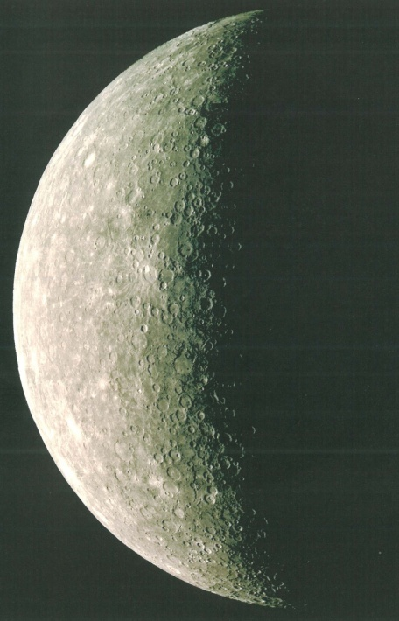
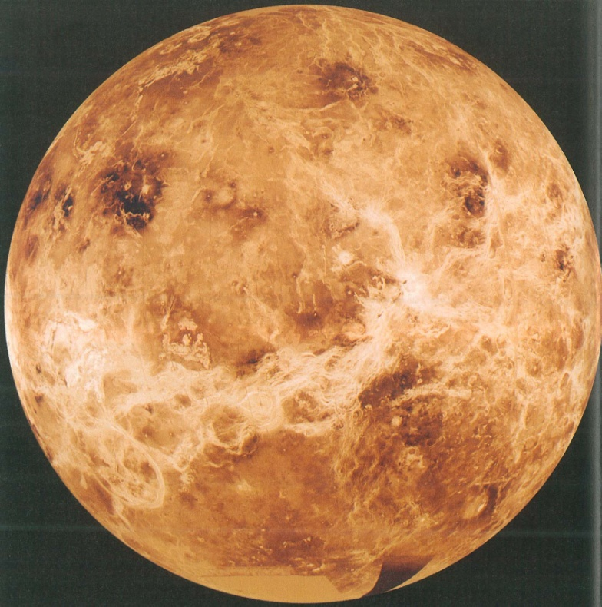
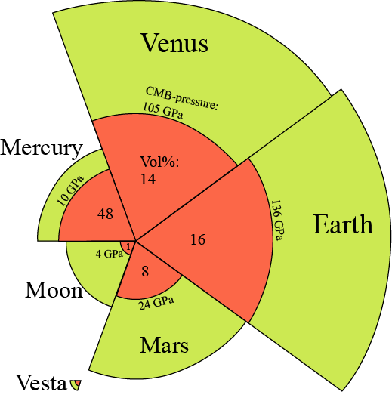
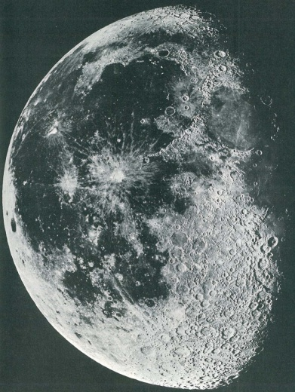
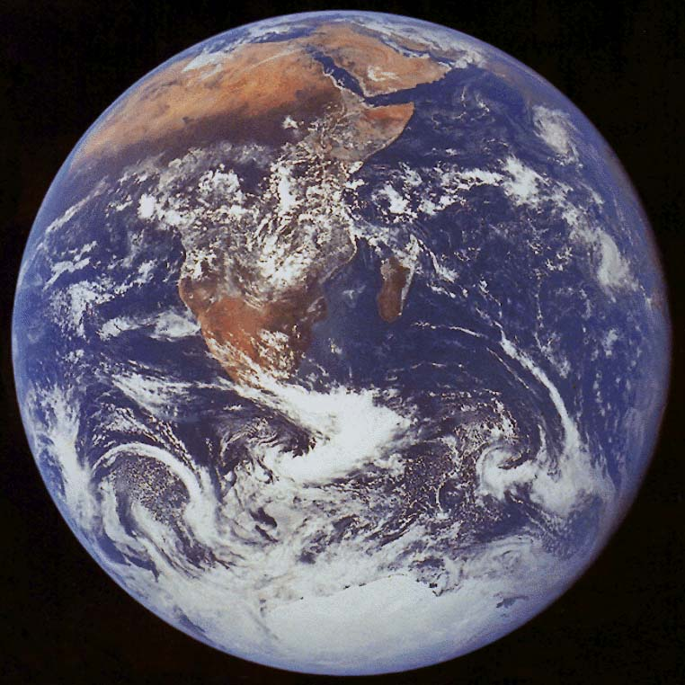
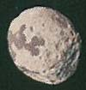
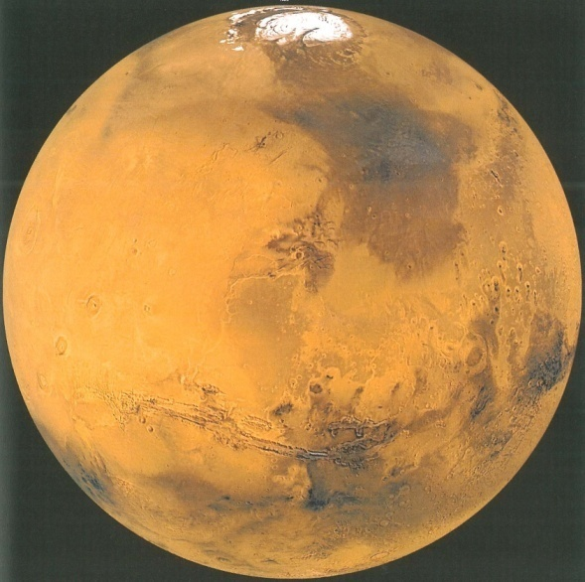
Terrestrial planets,
the core situation

Slide 2

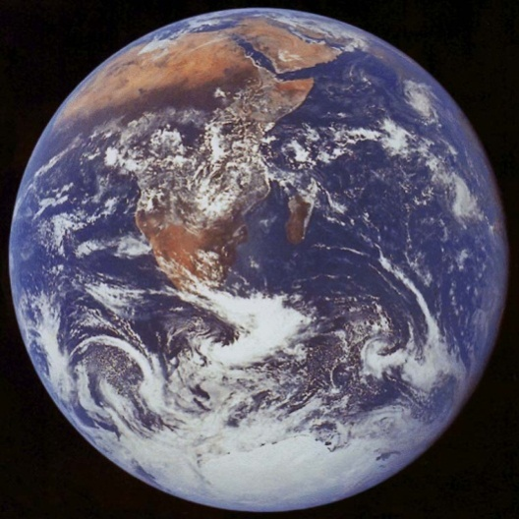
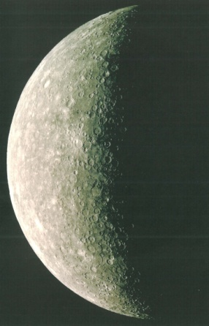
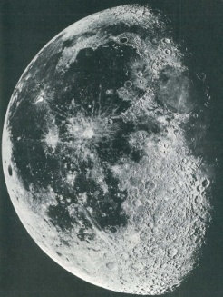


Current geodynamos
Core fractions
Rotation periods and magnetic fields:
58 days
very weak
243 days
extremely weak
24 hr
strong
30 days
very weak
5.3 hr
25 hr
extr. weak

Slide 3
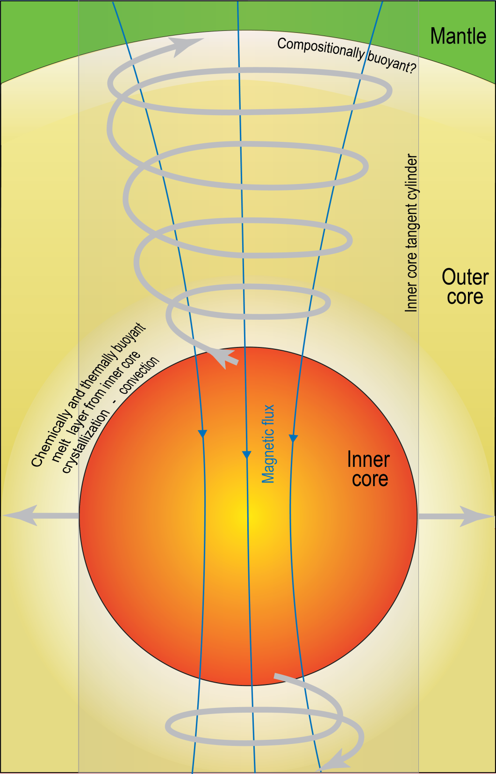
Core-mantle interaction
early Hadean to present
Outstanding questions
Outer core electrical and thermal conductivity
Indications of very high conductivity
→ "problems" with:
- the geodynamo (difficult to sustain)
- age and size of the inner core
Stagnant layer of light buoyant melt near the CMB
Additional outer core heat sources?
Radioactivity: K, but possibly also U
U partitions to sulphide melt under very reducing conditions
(corresponding to enstatite chondrites and to Mercury)
Sulphide can merge into the core metal
Exsolution of MgO from the core metal at CMB:
exothermic process (MgO incorporation in bm and fp)
- requires MgO incorporation in the core at very high T during MO-stage
- counteracted by dissolution of FeO from bm and fp
Selected references
Pozzo et al. (2012, Nature)
Helffrich & Kaneshima (2010, Nature)
Wohlers & Wood (2015, Nature)
Wahl & Militzer (2015, EPSL)

Slide 4
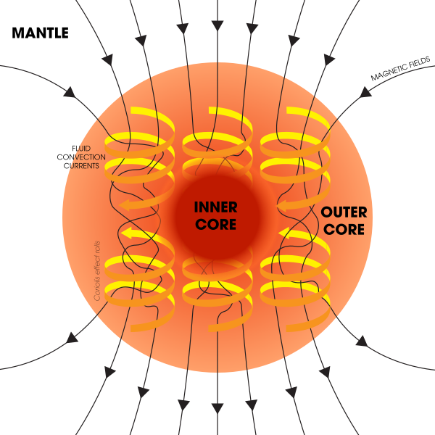

Slide 5
Bono et al. 2019, Nat. Geosci.
Ediacaran Period

Slide 6
The rheology of the solid mantle imposes the
convective and thermal regime of the core
”Mantle is the master - core is the slave”
(Dave Stevenson, Caltech)

Slide 7
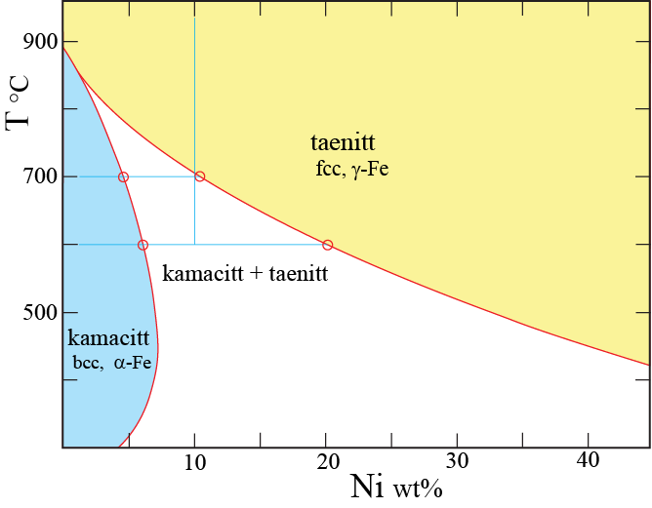
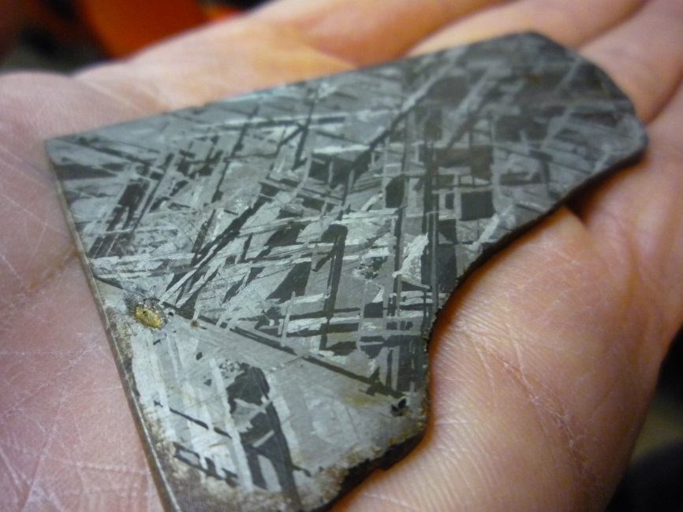

Slide 8
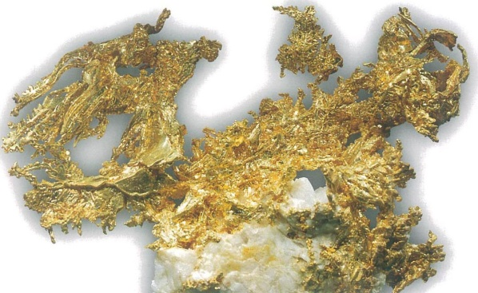
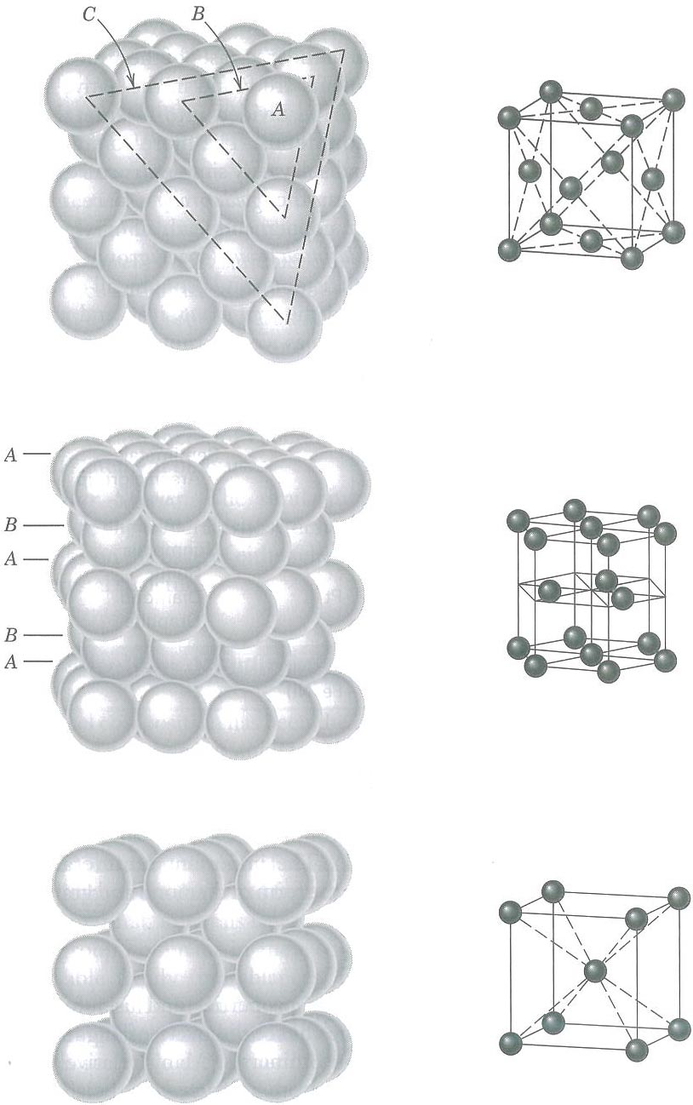
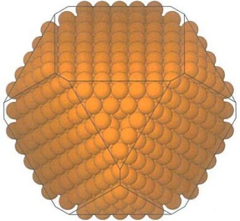
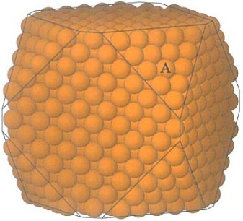
Metals: Fe, Pt, Au, Ag, Cu
Cubic close-packed
CCP
Face-centred cubic
FCC
Closest packing
Coord. number: 12
CN: 12
γ-Fe, taennite
Pt, Au, Ag, Cu,
Hexagonal close-packed
HCP
CN: 12
Mg, Zn, Cd
Body-centred cubic
BCC
CN: 8
α-Fe,
kamacite, ferrite

Slide 9
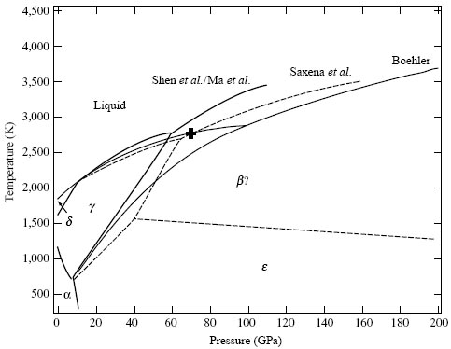
Fe: melting curves and
solid phase relations
- challenging experiments
- still large uncertainties
Outermost
core
Outermost
core
Li & Fei (2003,
Treat. Geochem)

Slide 10
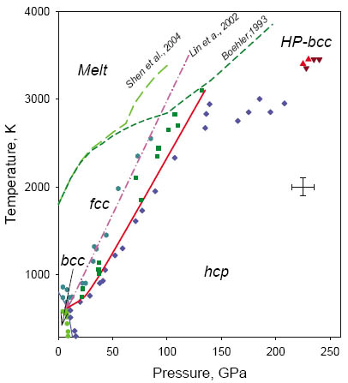
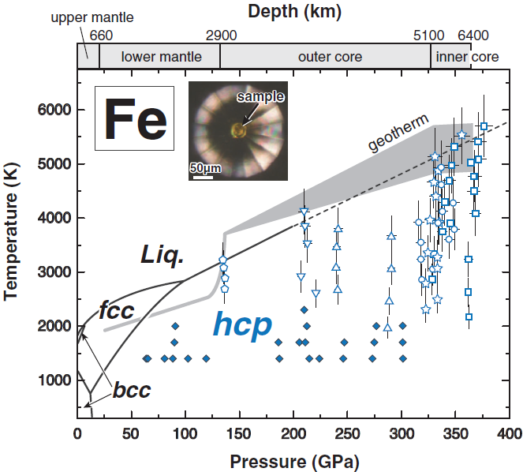
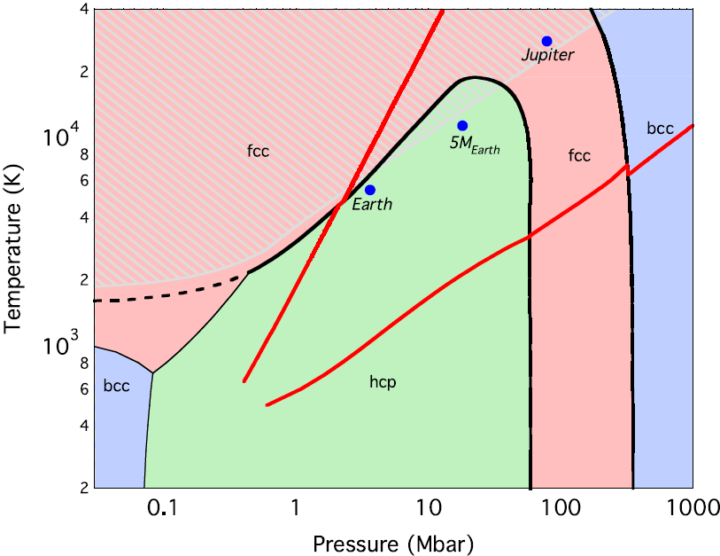
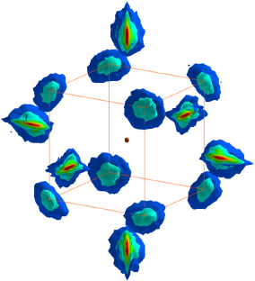
Fe: melting curves and
solid phase relations
- challenging experiments
- still large uncertainties
Is the inner core HP-bcc?? Probably not
γ
α
ε
Li & Fei (2003,
Treat. Geoch.)
Dubrovinski et al.
(2007, Science)
Tateno et al. (2010, Sci.)
- hcp-Fe in the inner core
- only 5100 K at 329 GPa (OC-IC-boundary)
- must assume a low-T geotherm
BUT: This is not specifically a melting study
Two electronic structure computational studies (Stixrude 2012, Belonoshko et al. 2017)
Stixrude (2012, PRL)
Melt
Belonoshko et al. 2017, Nat Geosci
bcc-Fe in the inner core
Probability density of atoms.
Central atom shown as a
small red sphere.
OC: >4000 K
γ
ε
α
CMB:
136 GPa

Slide 11
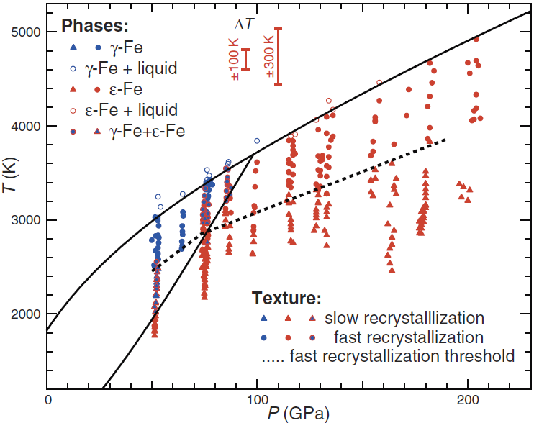
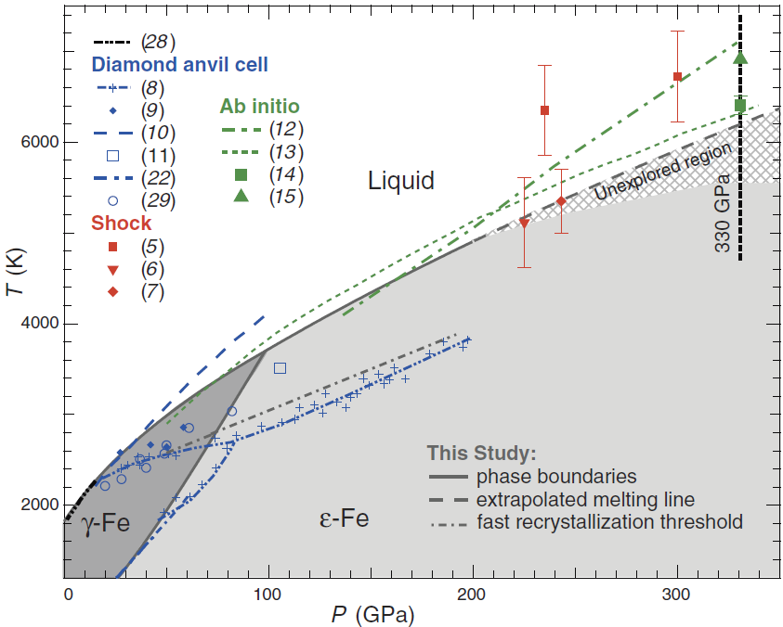
Experimental melting of Fe
at core conditions
Anzellini et al. 2013, Science
Anzellini et al.
2013, Sci.
Melting detected by:
1. Diffuse scattering and loss of XRD-peaks
(in-situ, synchrotron-based XRD)
2. Temperature plateau
3. Volume plateau
ε-Fe
γ-Fe
Anzellini et al.
2013, Sci.
Bohler (1993, Nature)

Slide 12
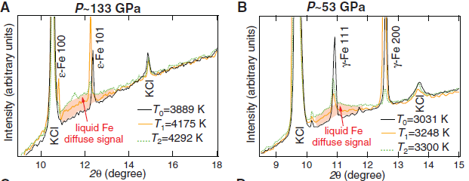
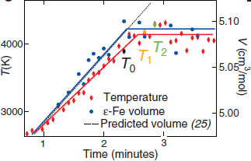
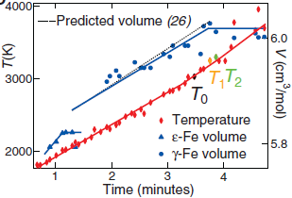
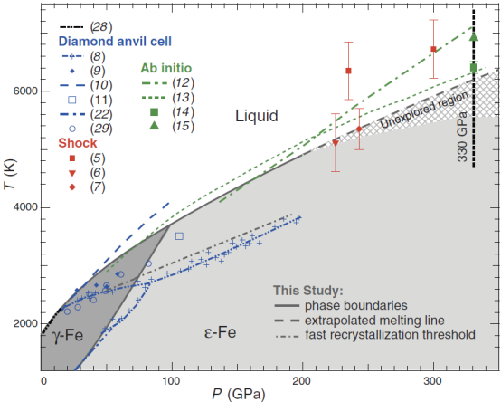
Melting of Fe
Anzellini et al.
2013, Science
- Change/loss of XRD-peaks
- Diffuse scattering
T- and V plateaus

Slide 13
Melting of Fe: resistance heating
Sinmyo et al. 2019, EPSL
Williams et al. 1987
Anzellini et al. 2013
Bohler et
al. 1993

Slide 14
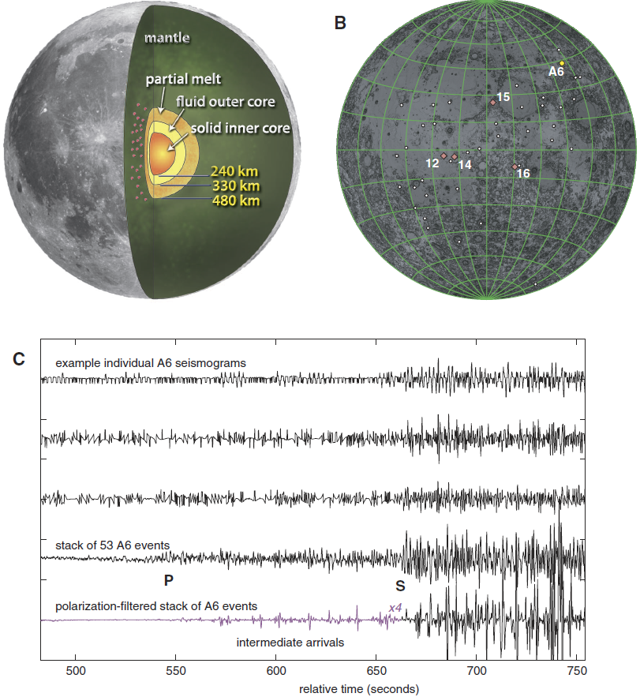
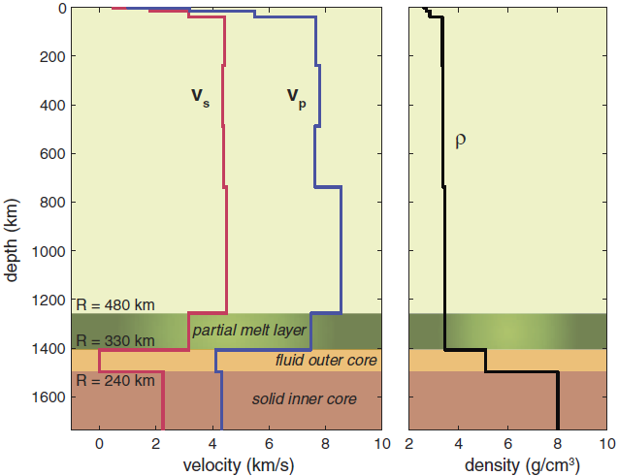
Lunar core structure
Weber et al. (2011, Science)

Slide 15
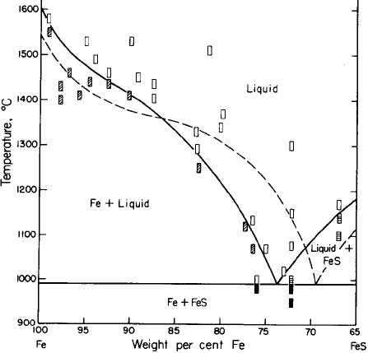
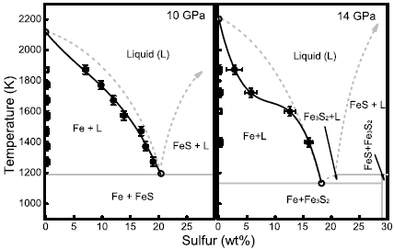
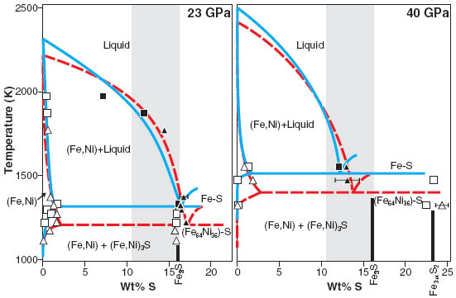
System Fe-S
Brett & Bell
(1969, EPSL)
Chen et al.
(2008, GRL)
1 bar
3 GPa
Fe wt%
90
80
90
80
Stewart et al.
(2007, Science)
Eutectic
composition
GPa wt%
p Fe S
0 69 31
3 74 26
10 80 20
14 82 18
23 84 16
40 88 12

Slide 16
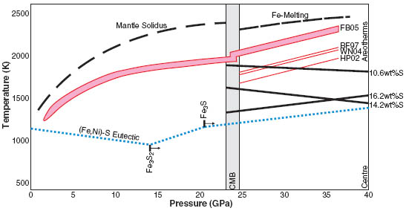
Mars: a "snowing" core?
Stewart et al. (2007, Science)
Eutectic composition
1 bar: 29 wt% S
3 GPa: 24
10 GPa: 20
14 GPa: 18
23 GPa: 17
40 GPa: 13 wt% S
Mars’ core
100% liquid or
constantly ”snowing”

Slide 17
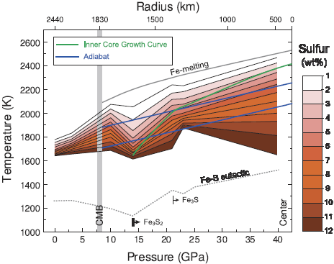
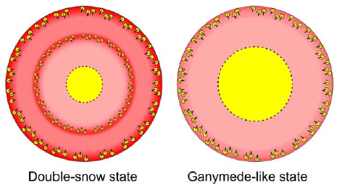
Mercury: also snowing core (?)
Liquidi, Fe-S alloys with 1-12 wt% S
Chen et al. (2008, GRL)
M a r s

Slide 18
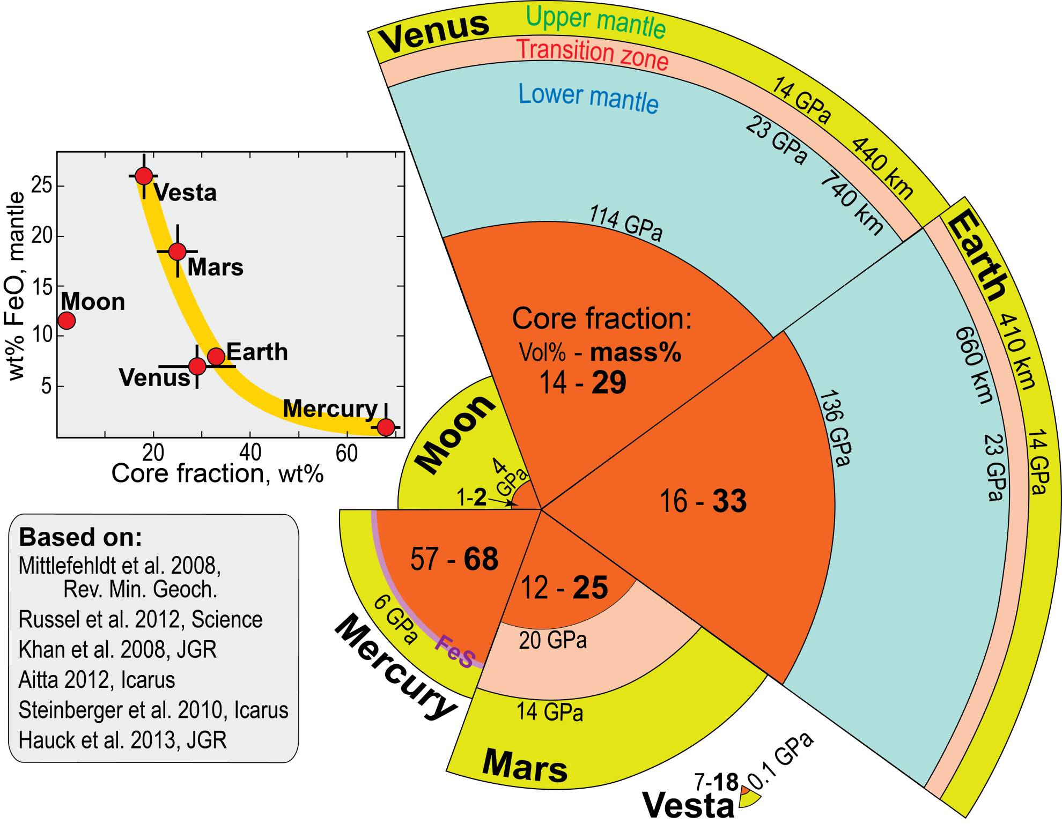
FeO_{mantle} - core fraction
Trønnes et al. 2019,
Tectonophysics

Slide 19
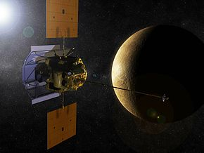
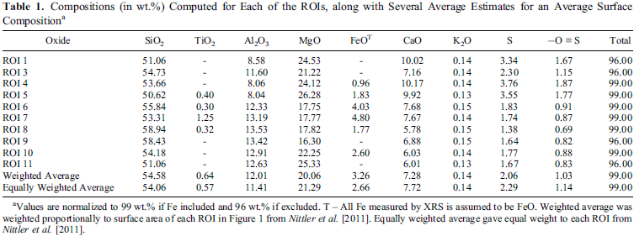
MESSENGER mission:
New and partly surprising results from Mercury
MESSENGER: MErcury Surface, Space
ENvironment, GEochemistry and Ranging
High S, in addition to low FeO
→ very reduced condition during accretion
(conditions similar to enstatite chondrite formation)
McCubbin et al.
(2012, GRL)
Enstatite chondrite minerals like oldhamite (CaS), niningerite (MgS) and djerfisherite (alkali sulphide) are likely

Slide 20
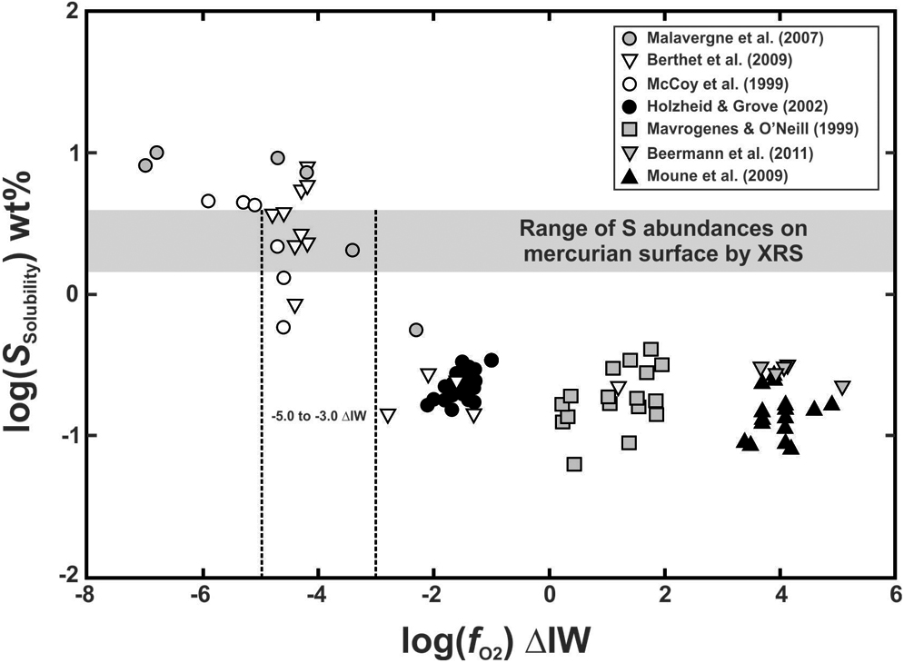
Experimentally determined S-solubility in silicate melt
100
10
Inferred S-solubility in early
Mercurian basalts: 1.5 – 4.0 wt%
log 1.5 = 0.16
log 4.0 = 0.60
0.60
0.16
1
McCubbin et al.
(2012, GRL)
S-solubility wt%
0.1
-5 to -3
Very low f_{O2} (O-content)
High Fe⁰-content, Si partitions to the metal
S-anions replace O in the silicate fraction
Moderate to high f_{O2} (O-content)
Stabilises FeS-rich sulphides
Chalcophile elements (incl. S) partition to metal

Slide 21
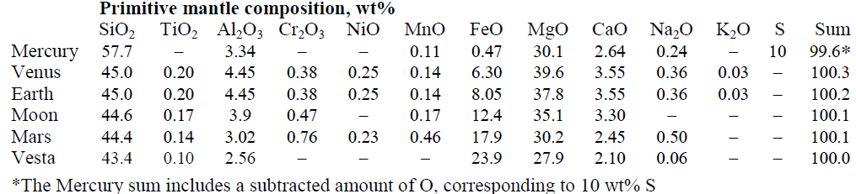
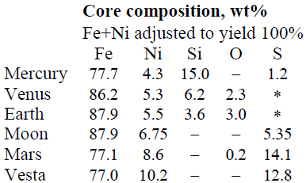
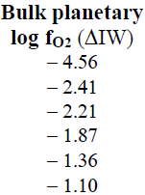

Terrestrial planets: core and mantle compositions
Trønnes et al. 2019,
Tectonophysics
log f_{O2} (ΔIW) =
2 * log (a_{FeO}/a_{Fe})
Observations, explanations
Solar nebula zoning with increasing f_{O2} outwards:
Me →Ve → Ea → Ma → Vesta
Moon’s tiny core and higher FeO_{mantle} (12%) than Venus-Earth (6-8%)
- Moon accreted mainly from Theia (+Earth) mantle debris
- minor core core segregation at oxidising conditions at the post-GI stage

Slide 22
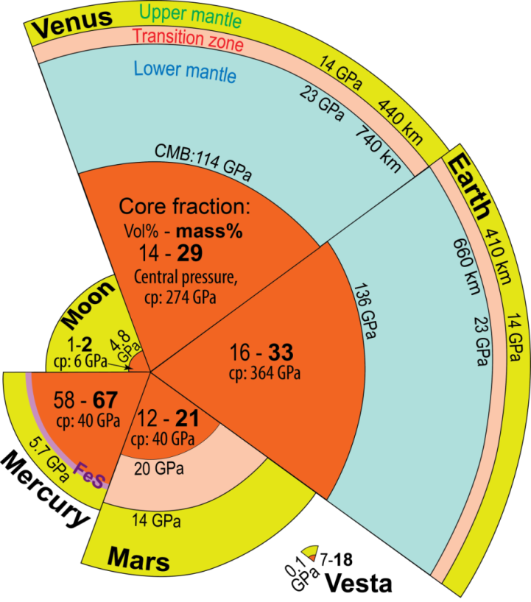
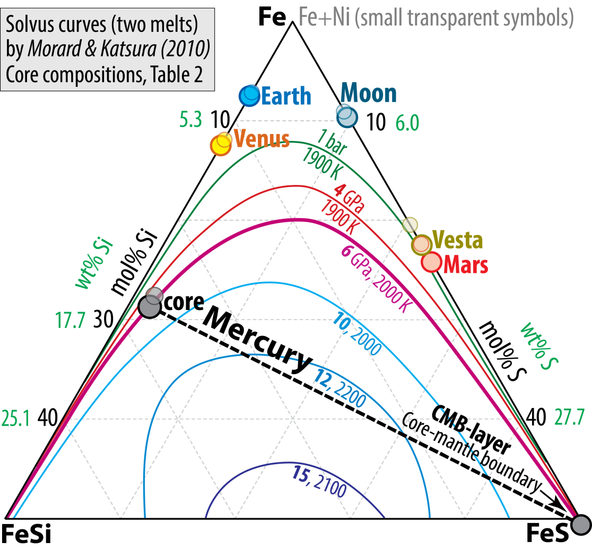
Core compositions
Trønnes et al. 2019,
Tectonophysics
Inner planets: Me-Ve-Ea
Reduced: ΔIW < −2: Si-rich cores.
Ve and esp. Ea: also O
Outer bodies: Mo-Ma-Vesta and the Fe-meteorites
Oxidised: ΔIW > −2: S-dominated cores

Slide 23
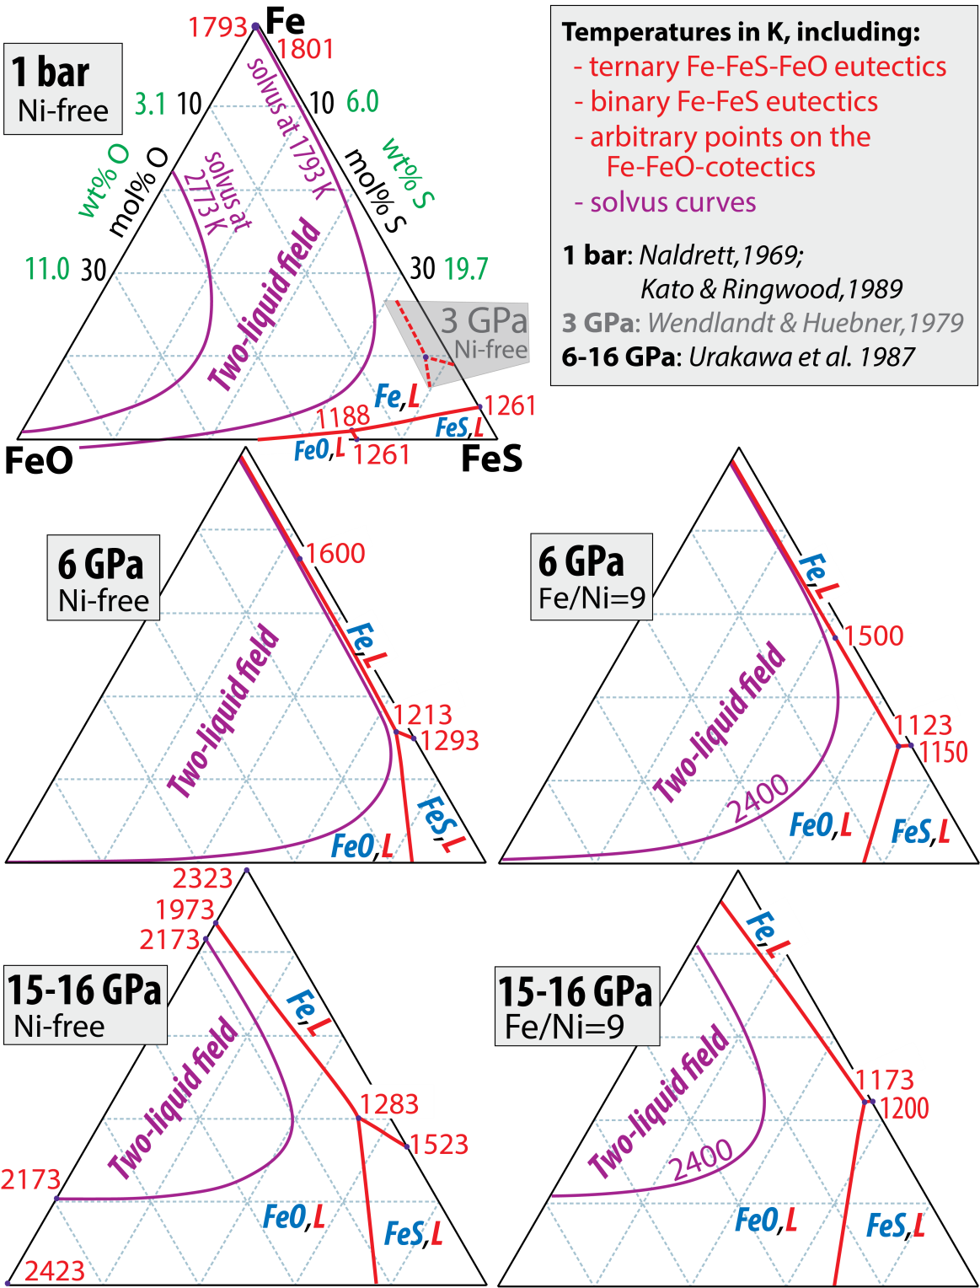
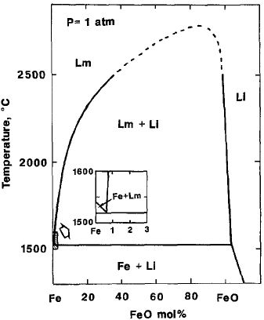
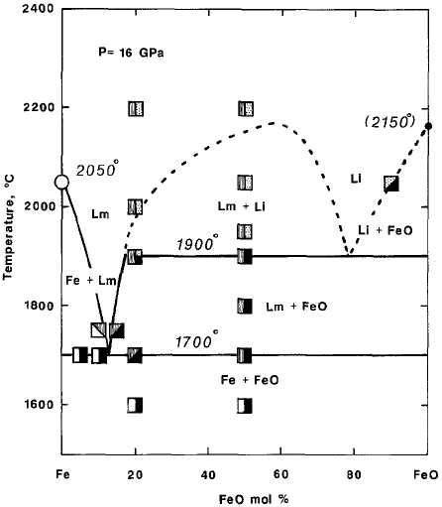
System Fe-FeO, 1 bar, 16 GPa
Kato & Ringwood, 1989, PCM
System Fe-FeO-FeS, 1 bar -16 GPa
with Fe/Ni=9 (right panels)
Trønnes et al. 2019,
Tectonophysics
3073 K
metallic
liquid
ionic
liquid
2773 K
2273 K
1773 K
metallic
liquid
2473 K
ionic
liquid
2273 K
2073 K
1873 K

Slide 24
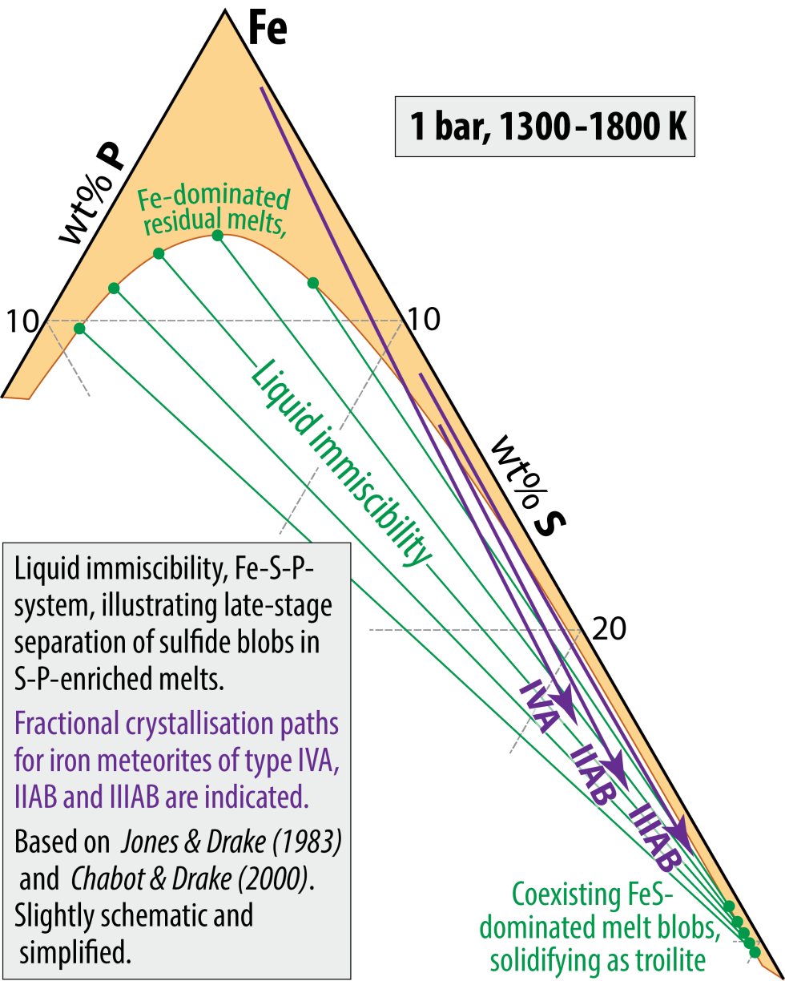


Why do FeS-blobs exsolve
from the Fe-rich melt?
Trønnes et al. 2019,
Tectonophysics
Immiscible
FeS-drop.
(troilite)
Cape York (Agpalilik)
iron meteorite
(Slice at NHM, Univ. Oslo)

Slide 25



Mercury
- Extremely reduced - very large core fraction
- FeS exsolution near the CMB (5.7 GPa) is likely
- approach to 3-phase equilibrium (metal, sulphide and
silicate melts) at the magma ocean stage
Trønnes et al. 2019,
Tectonophysics
The very high Si^{core} and separate exsolved FeS(?) in Mercury reflect a very low O-content and O/S-ratio of the mantle and crust with minerals like niningerite, (Mg,Fe,Mn)S, and oldhamite, CaS, which are also present in enstatite chondrites.

Slide 26

Element partitioning between immiscible sulfide and silicate melts
Kiseeva & Wood (2013, 2015, EPSL)
Wohlers & Wood (2015, Nat; 2017, GCA)
Wood & Kiseeva (2015, Am. Mineral.)
Partitioning dependant on f_{S2} and f_{O2}:
ZnO + 0.5 S₂ = ZnS + 0.5 O₂
silicate sulfide
K₁ = (a_{ZnS}^{sulf} * f_{O2}^{0.5}) / (a_{ZnO}^{sil} * f_{S2}^{0.5})
a_{ZnS}^{sulf} / a_{ZnO}^{sil} ≈ [Zn]^{sulf} / [Zn]^{sil} = D_{Zn}^{sulf/sil}
D_{Zn}^{sulf/sil} = K'₁ * (f_{S2}/f_{O2})^{0.5}
Experiments
- 1.5 GPa, 1400 C,
- variable f_{O2} / compositions
Fugacities of S and O are difficult to
quantify - therefore the equation:
ZnO + FeS = FeO + ZnS
silicate sulfide silicate sulfide
K₂ = (a_{ZnS}^{sulf}/a_{ZnO}^{sil}) * (a_{FeO}^{sil}/a_{FeS}^{sulf})
D_{Zn}^{sulf/sil} = K'₂ * a_{FeS}^{sulf}/a_{FeO}^{sil}
Zn and other chalcophiles are trace elements in the
FeS-dominated sulfide melt → a_{FeS}^{sulf} ≈ 1 and:
log D_{Zn}^{sulf/sil} = K'₂ - log a_{FeO}^{sil}
Generally, for a trace element M with valency n:
log D_{M}^{sulf/sil} ≈ constant - (n/2) * log[FeO]^{sil}
BSE-image
Because divalent Ni and Cu are abundant in sulfide melts and mix nearly ideally with Fe²⁺, we can apply a correction to [FeO]^{sil} to modify the approximation of a_{FeS}^{sulf} ≈ 1 (above):
[FeO]^{sil} (corrected) = [FeO]^{sil} / [Fe/(Fe+Ni+Cu)]^{sil}

Slide 27

Kiseeva & Wood (2013, 2015, EPSL)
Wohlers & Wood (2015, Nature)
Wood & Kiseeva (2015, Am. Mineral.)
Experiments
- 1.5 GPa, 1400 C,
- variable f_{O2} / compositions

Slide 28

Strongly reducing conditions
(corresp. to enstatite chond. and Mercury)
- D_{U} and D_{LREE} approach unity
- D_{Nd} > D_{Sm}
Implications for:
- radioactive core heating
- superchondritic Sm/Nd-ratios
in the mantle
if Earth accreted significant
Mercury-like material
(Wohlers & Wood, 2015, Nature)

Slide 29

Comparative geodynamics
The effect of volatiles on rheology
– the Earth-Venus dichotomy

Slide 30


Venus topography: from Magellan
(radar mapping – topography better known
than for Earth’s oceans)
Ishtar Terra
Uniform cratering density:
global resurfacing at 0.5-1 Ga
Relatively flat
(mostly within 0.5 km from mean radius,
max range: +/- 6 km, Earth: +9 to -11 km)
Broad semi-circular elevated areas:
indicating plume tectonics in a high-
viscosity mantle
Aphrodite
Terra

Slide 31

Earth:
Bimodal topography
Stable plate tectonics
Venus:
Unimodal topography
Volcanic mega-events
and global resurfacing
0.5-1 Ga cycles (?)

Slide 32



Large dome structure
- corona (d = 300 km)
Small dome structures
(d = 25 km)

Slide 33






Plume-peripheral subduction (sagduction) on Venus
Topography comparisons: Earth-Venus
Sandwell and Schubert (1992, Science)
Earth: South Sandwitch trench
Venus: Latona Corona
700 km
Earth: Aleutian trench
Venus: Artemis Corona
1800 km

Slide 34


Sandwell and Schubert (1992, Science)
Beta Regio
N
Alta
Regio
N
Latona
Corona

Slide 35


Davaille et al. (2017, Nature Geosci.)
Artemis Corona, 2000-2400 km diameter
Quetzalpetlatl Corona, 1500-2000 km diameter
Complex interior geology: intensely deformed linear, arcuate fracture zones,
numerous volcanic flows, and "corona-like" features, c.
Three rift segments, r, radiate outwards from the peripheral trench.
A roughly fractured arc, QC, appear radar bright (grey scale inset).
Exterior rift branches, r, radiate outwards. BC: Boala Corona
trench
trench

Slide 36






Fluid tank experiments
Davaille et al. (2017, Nature Geosci.)
View from the top at 260 s, initial rifting in red colour
- aqueous colloidal dispersions of silica nanoparticles,
- dried from above (lithospheric stiffness)
- uniformely heated from below, creating plumes
- domal uplift with triple-juction rifts
- followed by plume extrusion (460°C surface T),
lithospheric sagging and subuction
Oblique overview
Laser-imaged side view
Sagging
lithosphere
Cross sectional views
Laser-imaged side view
1. Domal uplift
2. Initial plume extusion
and sagging
3. Further extrusion and
asymmetric extrusion
Time lapse view:
40, 80, ---, 480 s

Slide 37

Magnified top view:
Boundary between subducting lithosphere and plume (corona)
Three types of deformation features
c: trench-parallel tension fractures near the surface
s: trench-normal striations
cp (yellow regions): compressive folds in lower part of the
plate in areas of high-curvature trench
Hexagonal plume structures (within the corona)
Small-scale downwelling develping under the
thickening new skin
surface
bubbles

Slide 38
What makes Earth special ? (esp. in relation to Venus)
Size
Venus is slightly smaller, insufficient pressure for post-perovskite
Heliocentric distance
sufficient for surface H₂O condensation – contrary to Venus
H₂O greatly reduces mineral strength and mantle viscocity
facilitating plate tectonics and H-recycling to the deep mantle

Slide 39

Earth
Convective Urey ratio
Ur = H_{m} / (Q_{om}+Q_{cm})
= H_{m} / (S_{c}+S_{m}+H_{m})
= 11 / (11+16+11) = 11/38 = 0.29
Bulk Earth Urey ratio
Ur = (H_{m} + H_{cc}) / (Q_{om}+Q_{cm})
= 19/38 = 0.50

Slide 40
Sister planets Earth and Venus
Similarities: Radioactive
Radius Mass Density heat prod.
km 10²⁴ kg kg/m³ TW
Earth 6370 5,97 4030 11
Venus 6050 4,87 3950, lower p ?
Contrasts:
Viscocity Surf. heat flow
10¹⁹ Pa s TW
Earth rel. high 46
Venus higher? lower at
steady state?

Slide 41
Venus
Rotation period: 243 days (retrograde)
Geodynamo: very weak
Surface condition: 480 C, 92 bar
Atmosphere: 97% CO₂ 3% N₂
Earth
Rotation period: 1 day (prograde)
Geodynamo: strong
Surface condition : 15 C, 1 bar
Atmosphere: 78% N₂ 21% O₂ 1% Ar

Slide 42
Venus
- Long periods with heating
shorter resurfacing episodes
- Plume(-sagduction) tectonics
Earth
- Stable mantle convection and
internal heat flow
- Oceans and stable plate tectonics

Slide 43
Venus might have been Earth-like and habitable in the
Archean during the faint young Sun (70% at 4.5 Ga) period

Slide 44

Why so different atmospheres when the inventories of
C, N, O and H was similar in the beginning ?
Where is Earth’s carbon corresponding to Venus’ 92 bar
CO₂-dominated atmosphere ?
753 K
Venus:
- No condensation of volanically degassed H₂O
Upper atmosphere photo-dissociation of H₂O
H₂-escape
Dry planet, no hydro- or cryosphere
Earth:
- Oceans, precipitation of CaCO₃
Photosynthesis → O₂, biomass and black shales
- Hydration of ocean floor
Recycling of wet lithosphere with carbonaceous
material and limestone by subduction

Slide 45


Earth
1 bar: 78% N₂ 21% O₂ 1% Ar
Venus
92 bar !! 97% CO₂ 3% N₂

Slide 46









Venus
A volatile-free peridotite solidus applies
Earth
Melting, viscosity and a pronounced
lithosphere-asthenosphere division is
promoted by deep recycling of CO₂
and H₂O
LAB:
lithosphere-
asthenosphere
boundary
LAB
0.03 wt%
0.1 wt%
LAB

Slide 47
The Earth-Venus dichotomy shows:
- importance of H (H₂O) og other volatiles (e.g. CO₂)
in planetary dynamics
- how a rel. small difference in heliocentric difference can
cause a large difference in planetary evolution
how atmosphere and hydrosphere can be tied to internal
mantle dynamics (on Earth, not on Venus)

Slide 48
In addition: Earth is larger than Venus
Pbm stabilization in Earth’s D"-zone, not in Venus
Very low η in the D"-zone of Earth with fast
and efficient CMB flow and heat transfer

