Slide 1
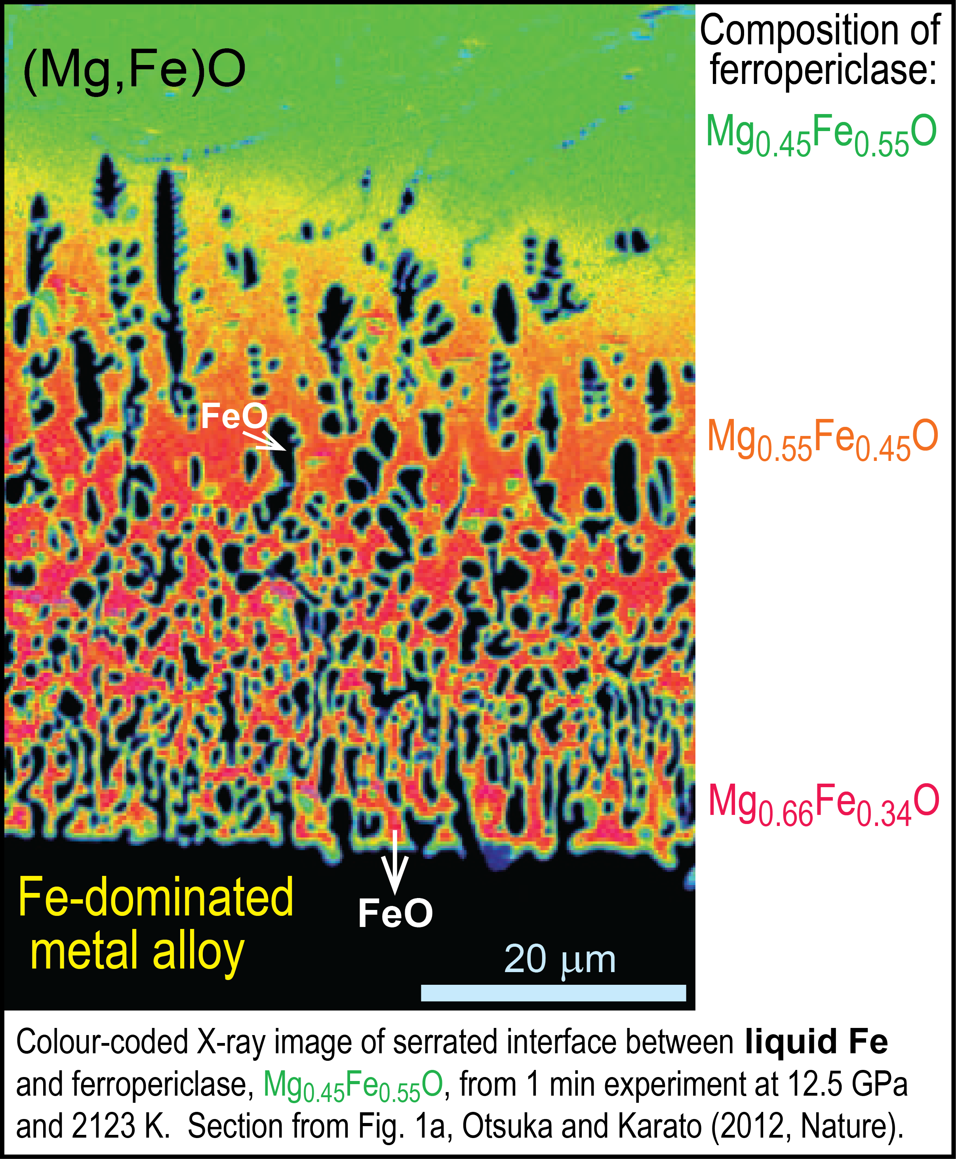
Core-BMO (basal magma ocean) exchange and BMO crystallisation

Slide 2
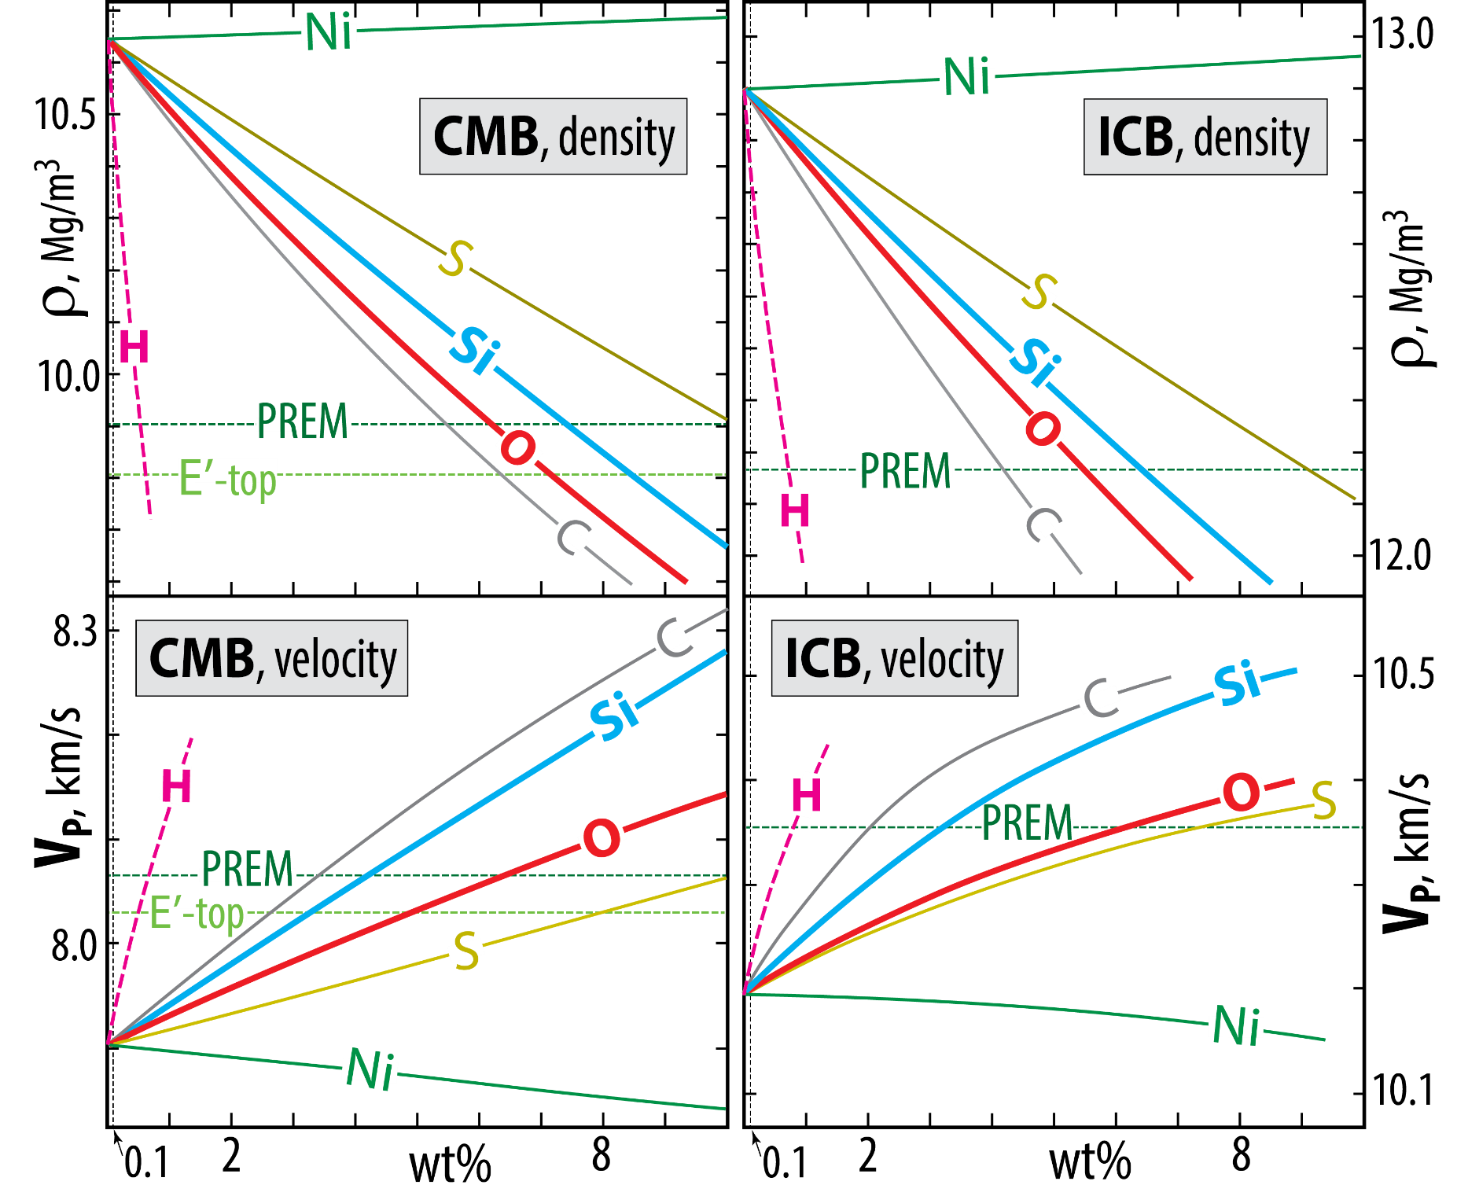

Outer core binary alloys: effects of light elements on ρ
and V_{P} at CMB and ICB conditions (136 and 329 GPa)
Badro et al. (2014; PNAS) and Brodholt & Badro (2017, GRL)
Fe-H curves from Umemoto and Hirose (2020, EPSL) are adjusted
vertically to ρ and V_{P} of pure Fe from Badro et al. (2014; PNAS)
Outer convecting core compositional estimates, wt%
- 5.5 Ni, 3.6 Si, 3.0 O
Trønnes et al. 2019, Tect.
- 0.1 (max. 0.12) H
Li et al. 2022, PEPI
In rough agreement
with PREM-values
for ρ and V_{P}
A maximum core value of 0.12 wt% H, is based on the current IC-OC density jump (Wang et al. 2021, EPSL; Li et al. 2022, PEPI).
This makes the core the largest H and H₂O reservoir in the Earth.

Slide 3

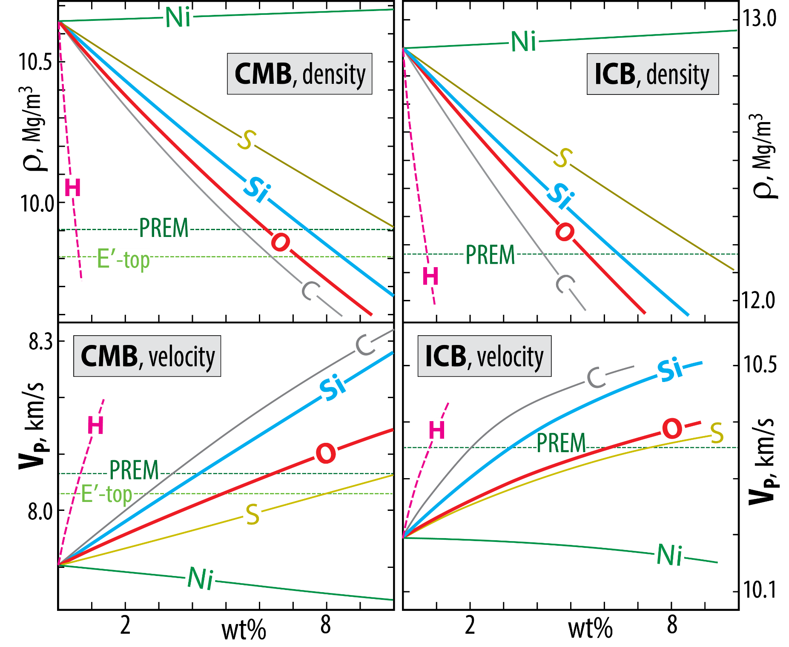
Outer core binary alloys: effects of light elements on ρ
and V_{P} at CMB and ICB conditions (136 and 329 GPa)
Badro et al. (2014; PNAS) and Brodholt & Badro (2017, GRL)
Fe-H curves from Umemoto and Hirose (2020, EPSL) are adjusted
vertically to ρ and V_{P} of pure Fe from Badro et al. (2014; PNAS)
Outer convecting core compositional estimates, wt%
- 3.8 Si, 0.8 O, 0.5 H
Thermodynamic model of
Young et al. 2023, Nat.
0.5% H is too much, combined with 3.8% Si.
Then ρ and V_{P} become consistently too low and too high, resp.
In theory, H-contents of 0.5-0.8% could generally explain the
outer core ρ deficit and
V_{P} excess without any other light elements,
which is unrealistic.

Slide 4
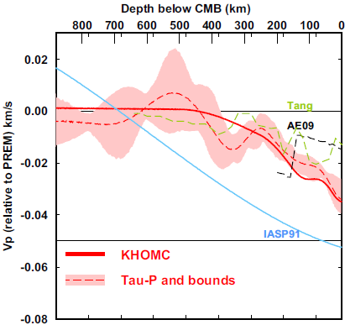
Outermost stagnant E'-layer?
gradationally stratified, low V_{P} - low ρ
0-445 km
below CMB
Feasible because:
- high thermal conductivity supresses convection
- low viscosity reduces viscous entrainment
- an E'-layer may stabilise the geodynamo
(Hernlund & McNamara, 2015, Treat. Geophys.)
0.4 %
Kaneshima (2018, PEPI)
Seismology
Lay & Young, 1990
Garnero et al., 1993
Helffrich & Kaneshima, 2010
Kaneshima & Helffrich, 2013
Kaneshima & Matsuzawa, 2015
Kaneshima, 2018
Irving et al., 2018: Adiabatic outermost core
Models
Buffet, 2010
Buffet & Seagle, 2010
Gubbins & Davies, 2013
Hernlund & McNamara, 2015
Brodholt & Badro, 2017

Slide 5
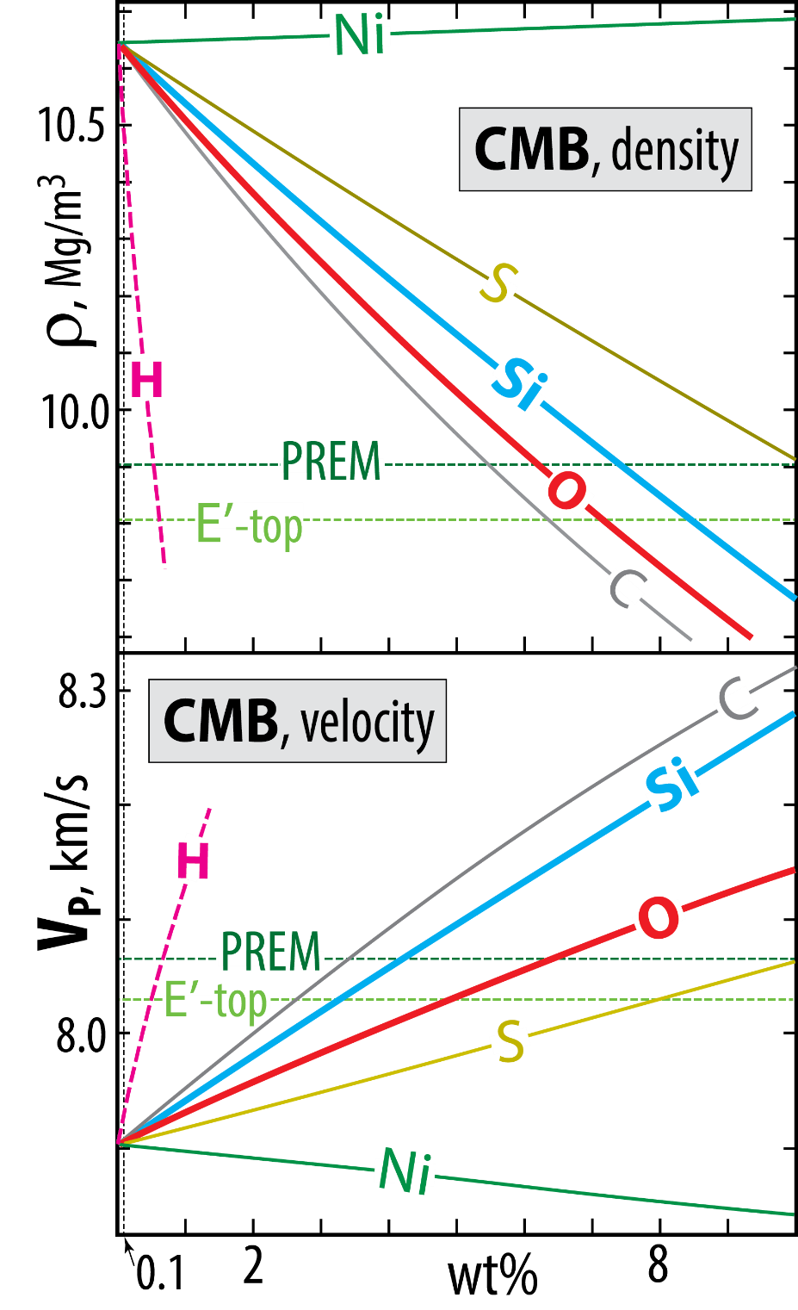
Outermost stagnant E'-layer?
gradationally stratified, low V_{P} - low ρ
Molten binary Fe-alloys: ρ and V_{P}
E'-layer chemical characteristics, material properties
poses a long-standing conundrum (Brodholt & Badro, 2017, GRL)
Each of the light element candidates (Si, O, S, C)
reduces ρ but increases V_{P}
However:
O reduces ρ more and increases V_{P} less than Si.
Therefore:
E'-layer with elevated O and reduced Si relative to
the convecting core may solve the conundrum
Badro et al. (2014, PNAS)
Brodholt & Bardo (2017; GRL)
Umemoto & Hirose (2020, EPSL)

Slide 6
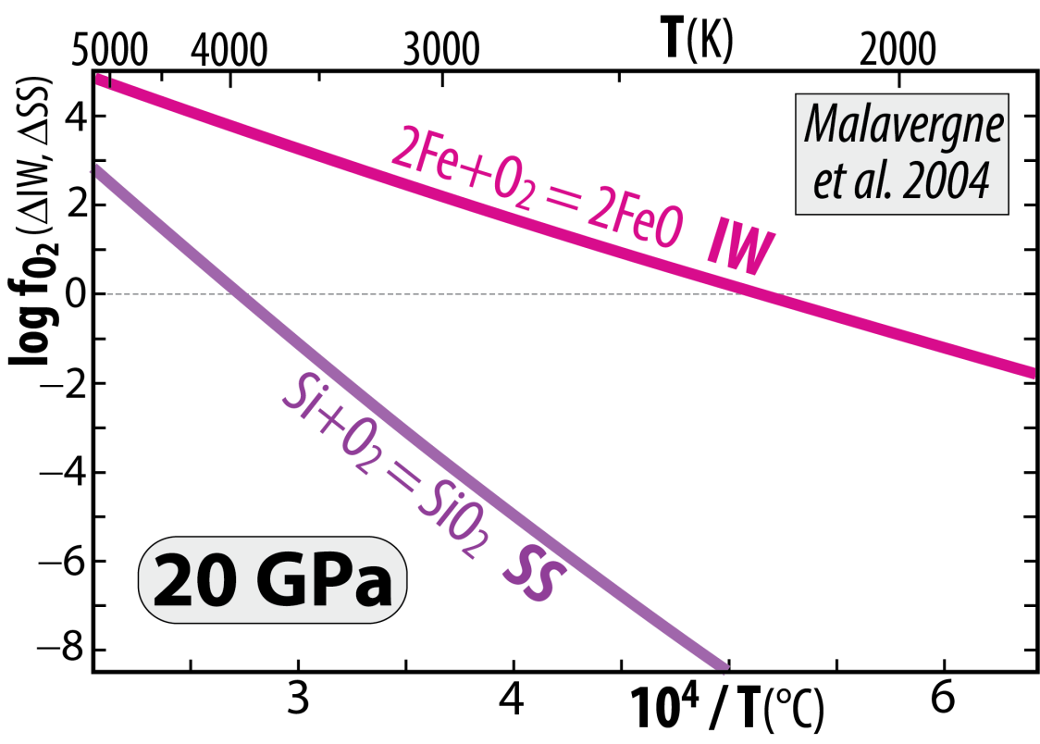
Venus and Earth
- segregated cores at very high T, allowing
high Si^{core} and high FeO^{MO} (high f_{O2})
Because the chemical equilibrium:
2 Fe^{met} + SiO₂^{sil} = Si^{met} + 2 FeO^{sil}
is displaced towards the product side (right) with
increasing T and reversed with decreasing T
2 Fe + O₂ = 2 FeO (IW)
minus: Si + O₂ = SiO₂ (SS)
gives: 2 Fe − Si = 2 FeO − SiO₂
or: 2 Fe + SiO₂ = Si + 2 FeO
Cooling of core and magma ocean (MO)
core-MO chemical exchange
- FeO and FeO_{1.5} to the core
- SiO₂ to the MO (and BMO)
Additional pressure-effect – above 25 GPa
Armstrong and Frost (2019, Nature)
Disproportionation of FeO^{MO} at p > 25 GPa promotes
high f_{O2} in the MO, combined with core segregation:
3 FeO = 2 FeO_{1.5} + Fe
components in the MO liquid metal segregating
and sinking to the core

Slide 7
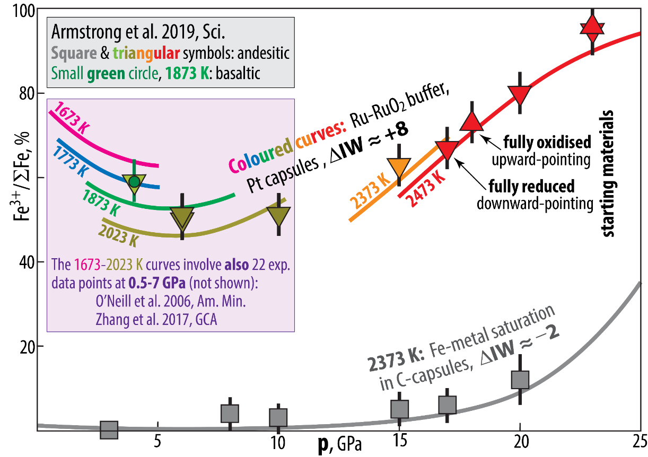
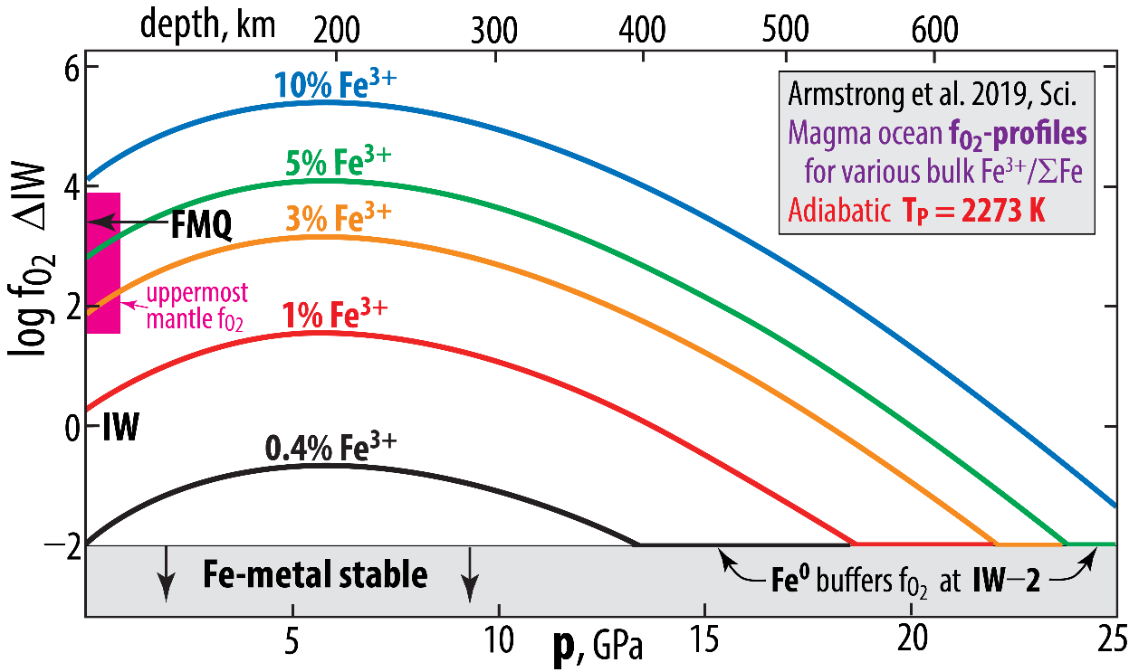
f_{O2}-buffered experiments
Armstrong et al. (2019, Sci.)

Slide 8
Follow-up study
- Ab initio simulations
- Al-free simulation cells, close to
12.5 mol% FeSiO₃
87.5 mol% MgSiO₃
Deng et al. 2020,
Nat. Comm,

Slide 9
Deng et al. 2020,
Nat. Comm,

Slide 10
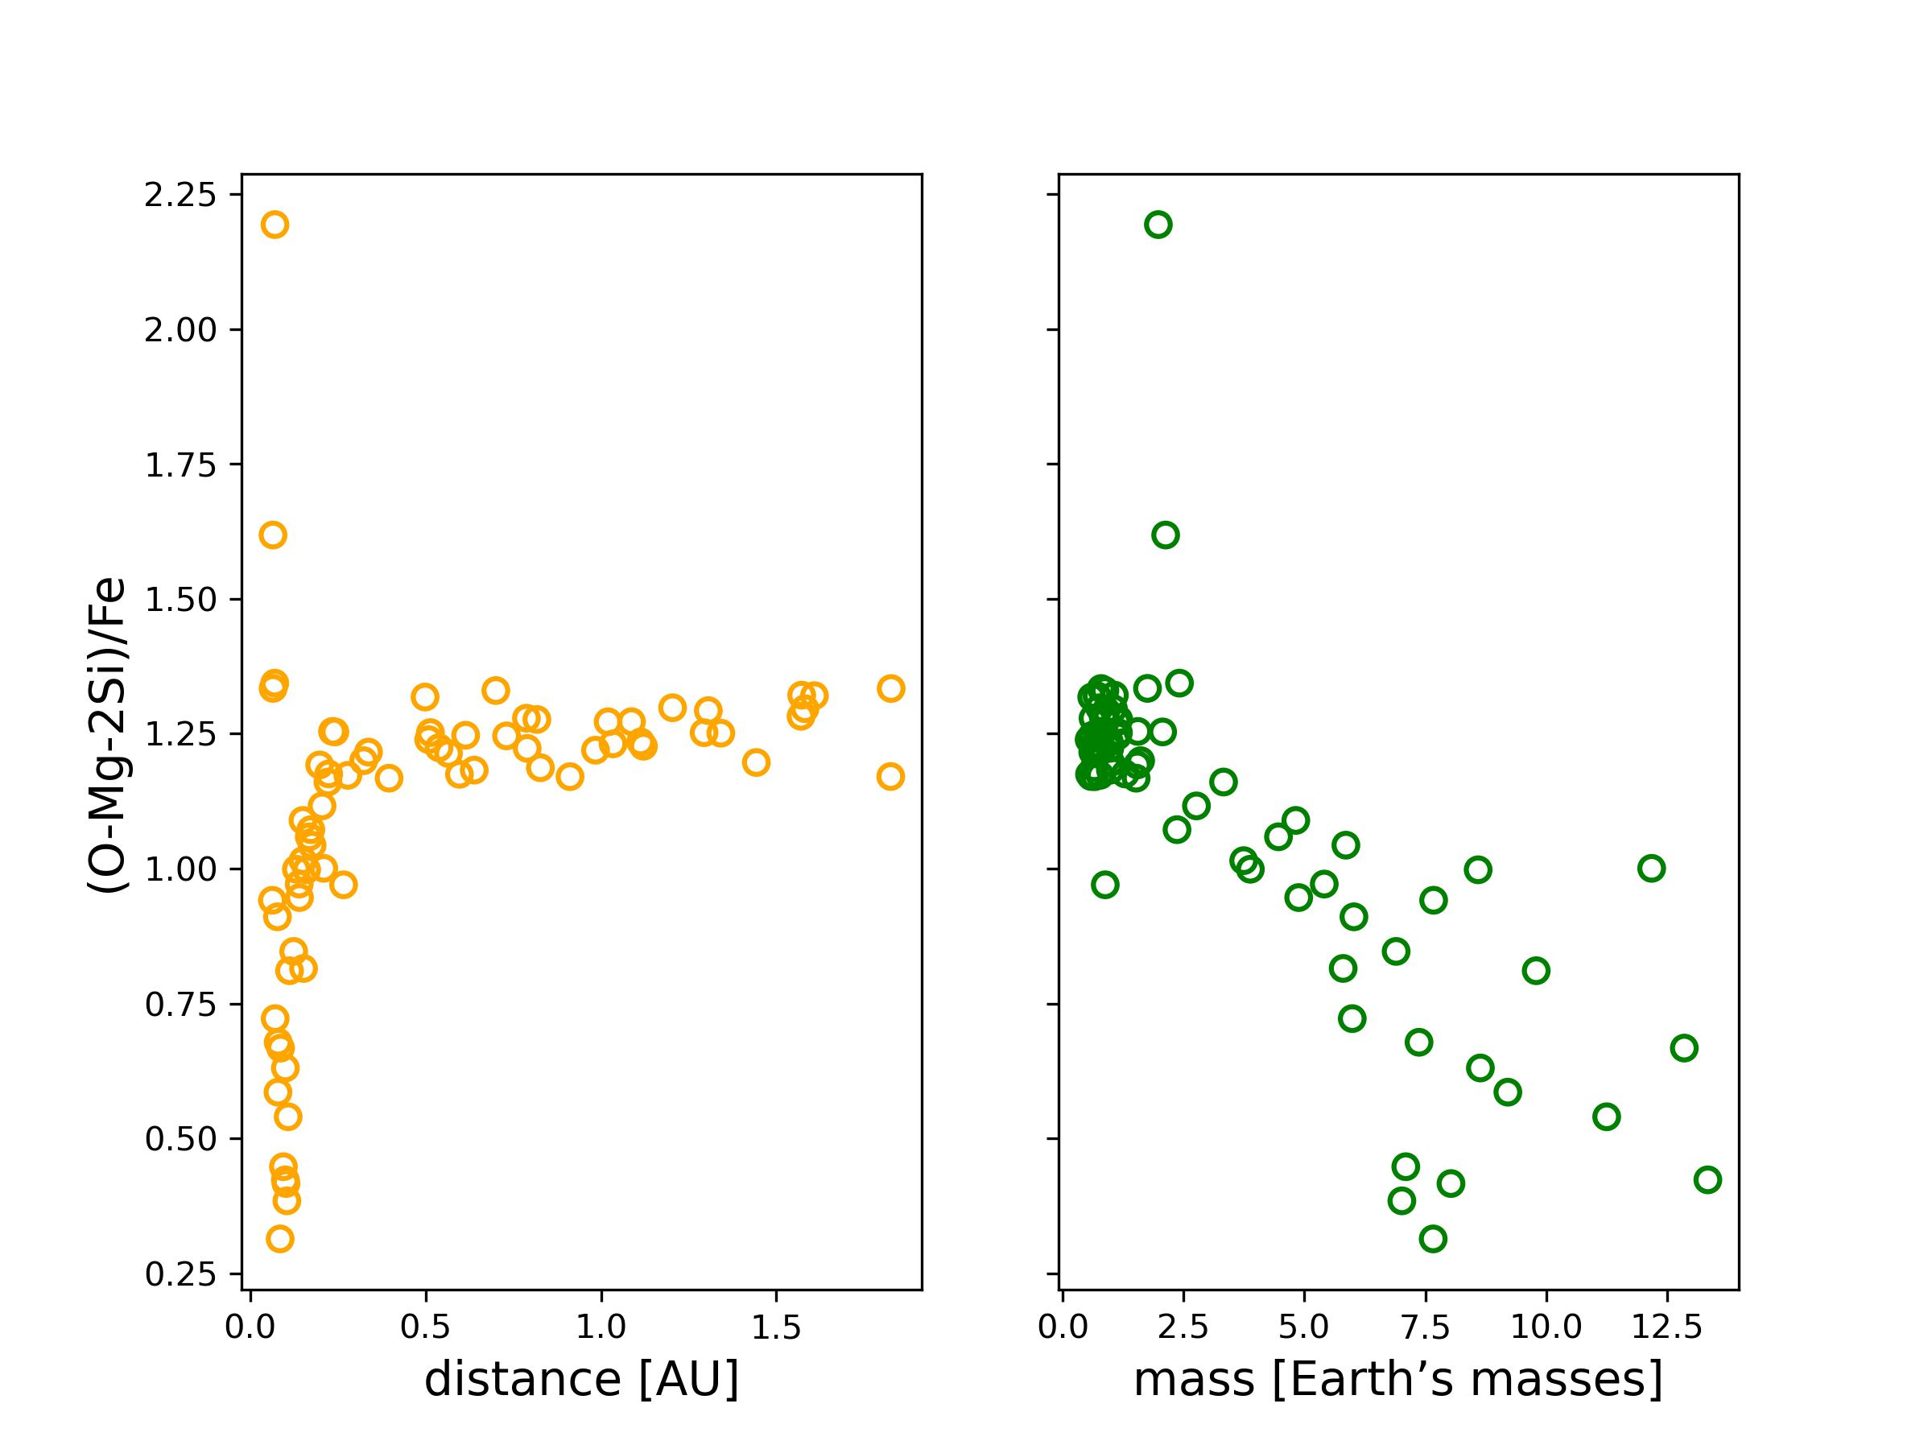
Moon
Mars
Vesta
Venus
Earth
Mass range of the terrestrial
"planets": Mercury to Vesta
Mercury

Slide 13
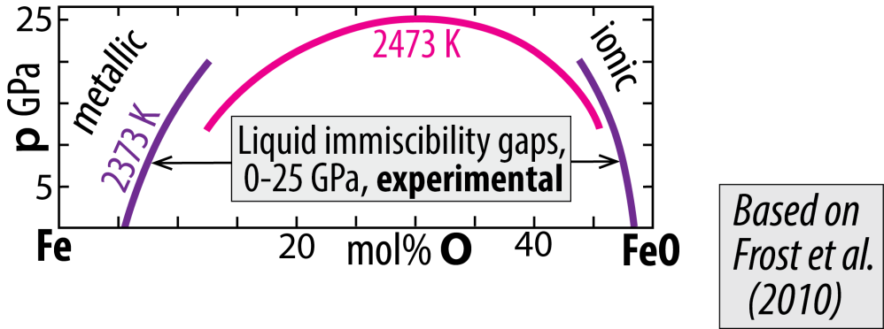
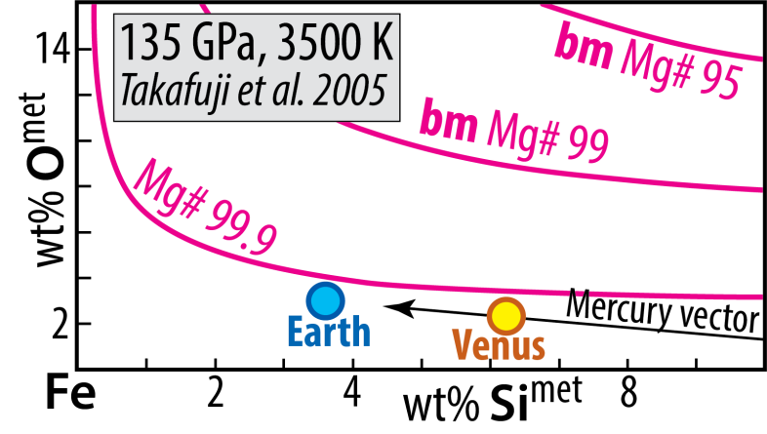
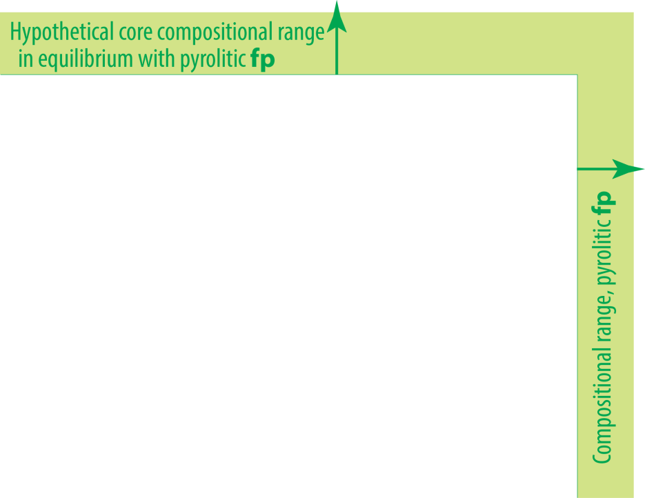
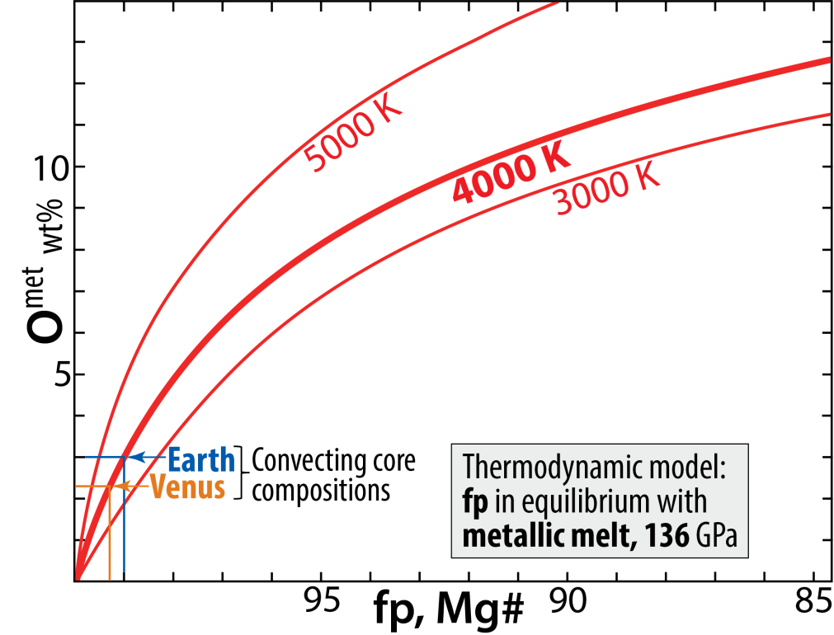
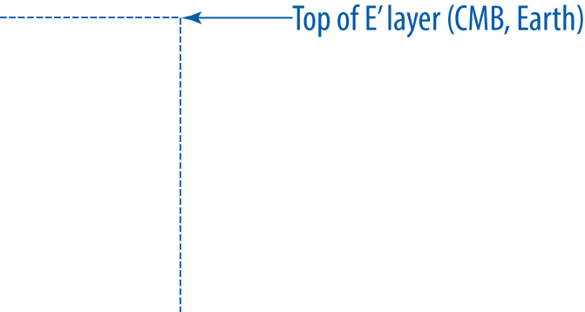
Cooling of core and BMO (basal magma ocean)
core-mantle chemical exchange
Trønnes et al. 2020,
Tectonophyics
System: Fe-Mg-O
metal-ferropericlase equilibrium
System: Fe-Mg-Si-O
metal-bridgmanite equilibrium
Solvus closure with
increasing p and T

Slide 14
FeO-extraction from a ferropericlase single crystal to Fe-melt at 12.5 GPa - 2123 K - 1 min
Initial crystal composition: Mg_{0.45}Fe_{0.55}O
Otsuka & Karato
(2012, Nature)
40 μm

Slide 15
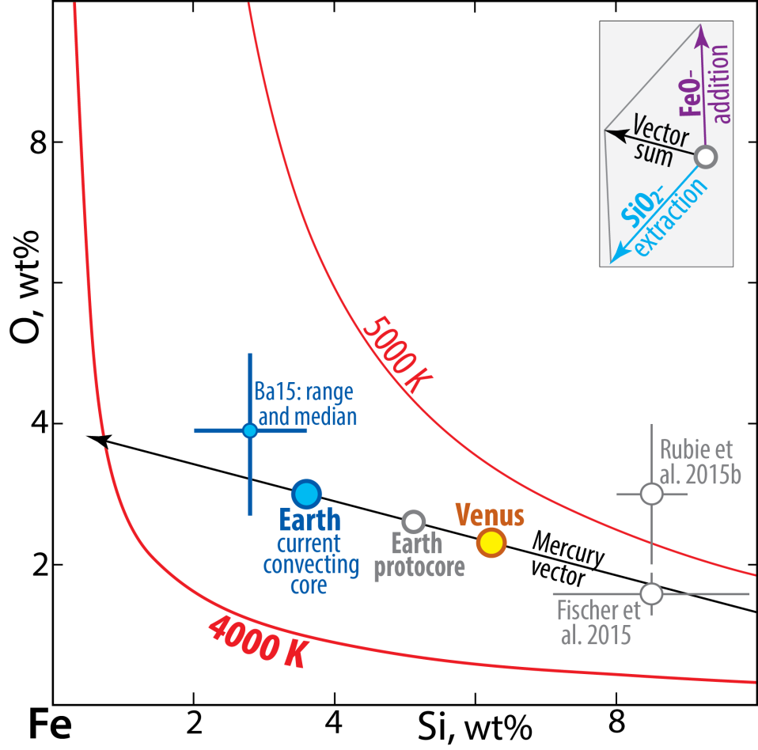
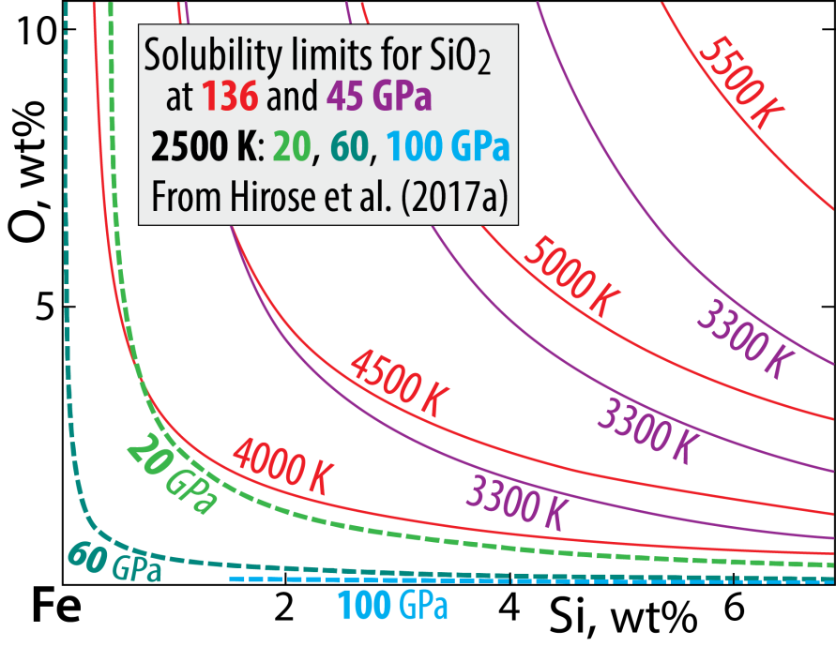
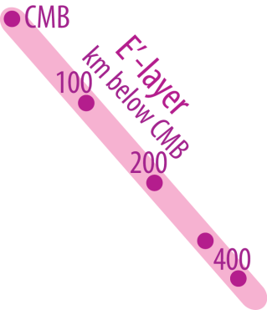
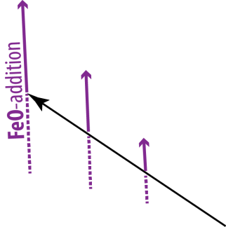
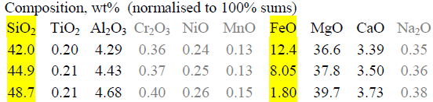
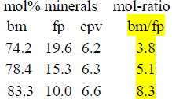

System: Fe-Si-O
Solubility of O and Si in Fe-alloy
Trønnes et al. 2020,
Tectonophyics
Estimated core compositions
Mercury:
15 wt% Si, no O
- O and Si: mutually exclusive
- Solubility increases with T and decreases with p
- Related to the silica liquidus surface in systam Fe-Si-O
Mass balance modelling
Step 1: protoC + earlyMO = convC + pyrolite-MO (total volumes)
Step 2: upper convC + BMO = E'-layer + mod. lowermost M
34 vol%, 28 vol%,
31 wt% of C 34 wt% of M

Slide 16
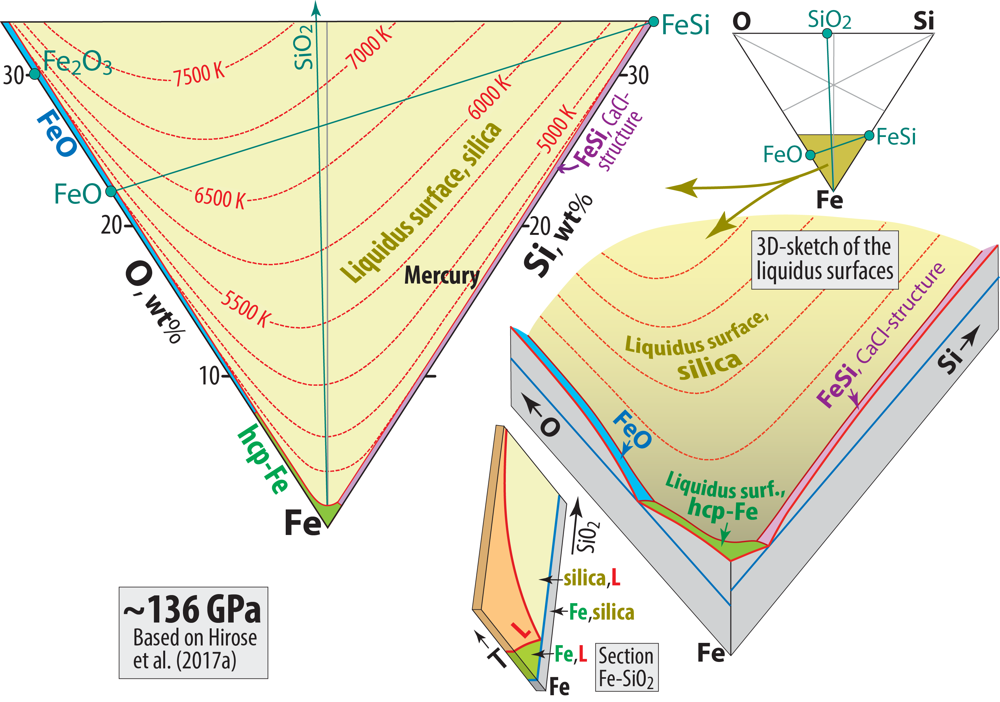
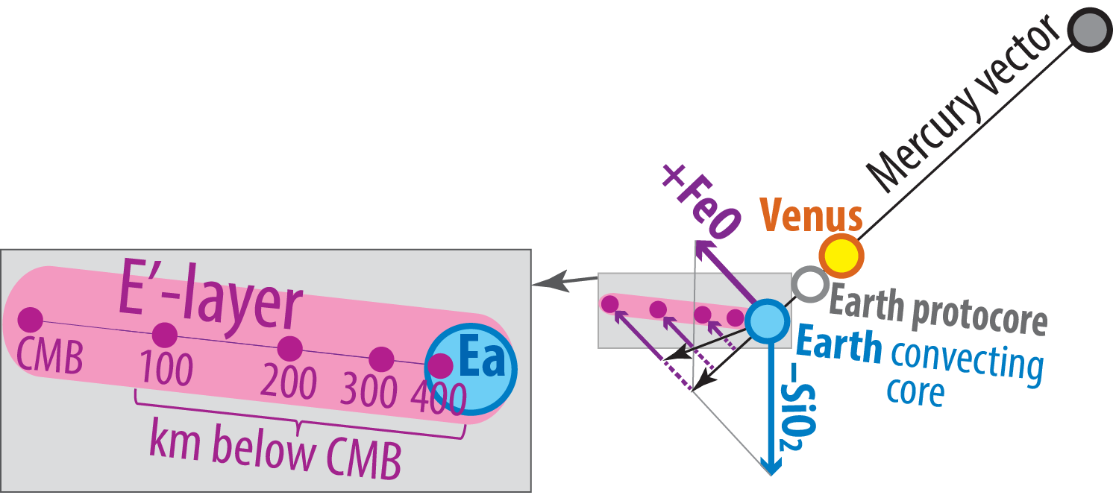
System Fe-Si-O: liquidus relations at 136 GPa
Trønnes et al. 2020,
Tectonophyics
4660 K
4600 K

Slide 17
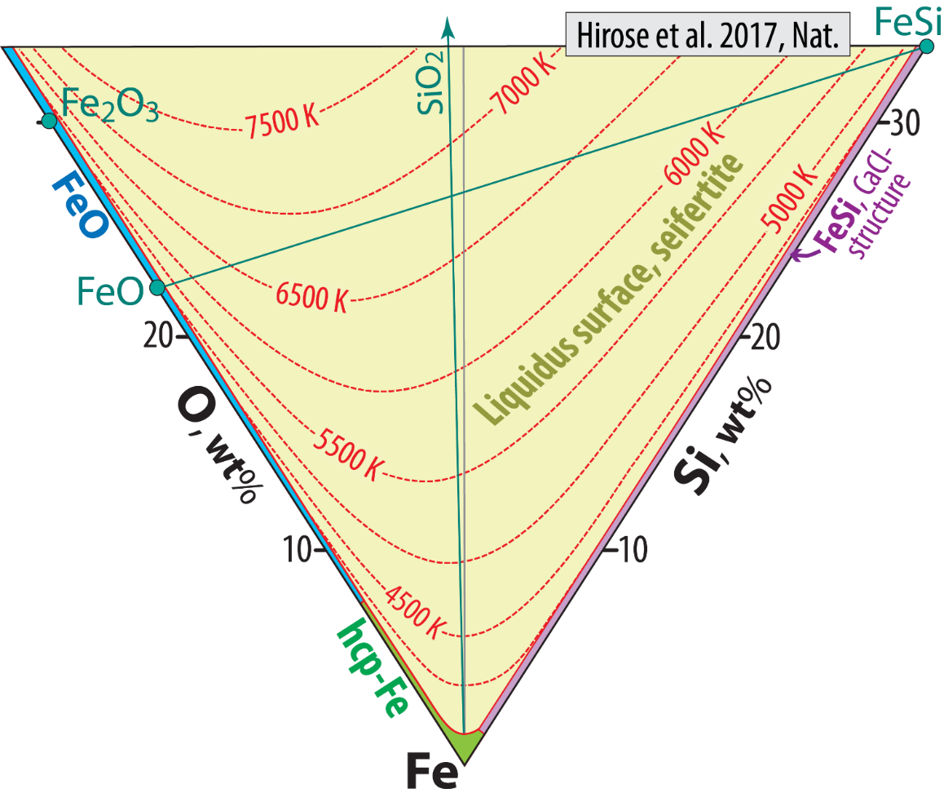
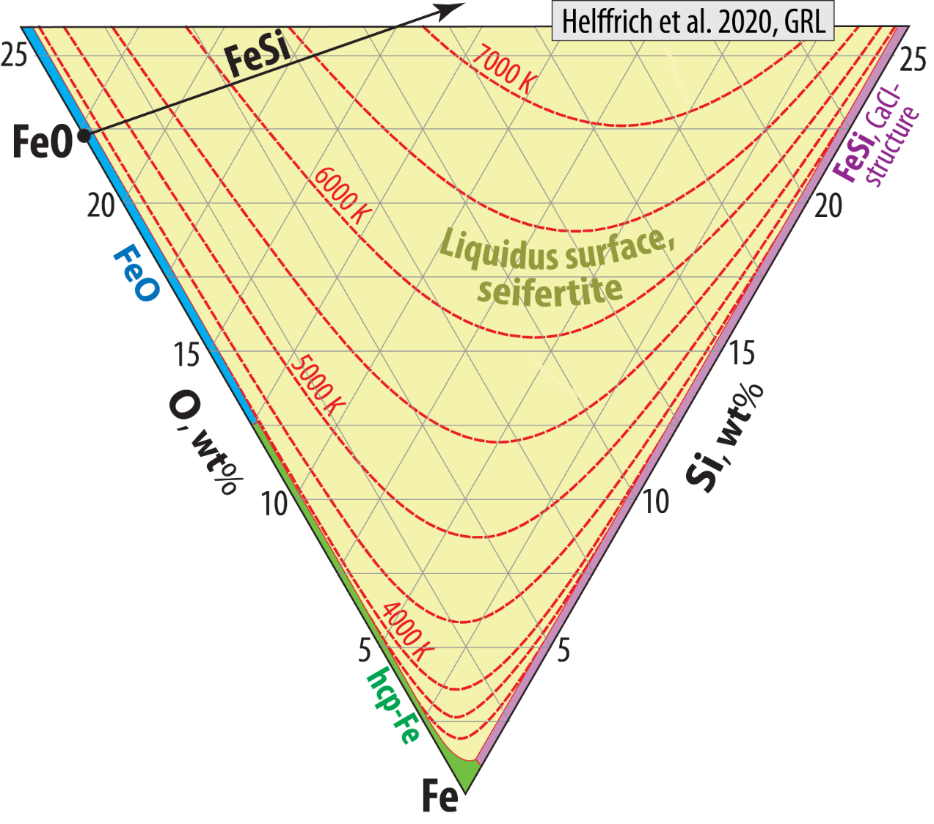
Minor revision of seifertite liquidus surface
The 4000 K isotherm is possibly slightly further from the
Fe-O-join compared to Hirose et al. (2017). Note the very
steep T-gradient in the 2-5 wt% O region.

Slide 18
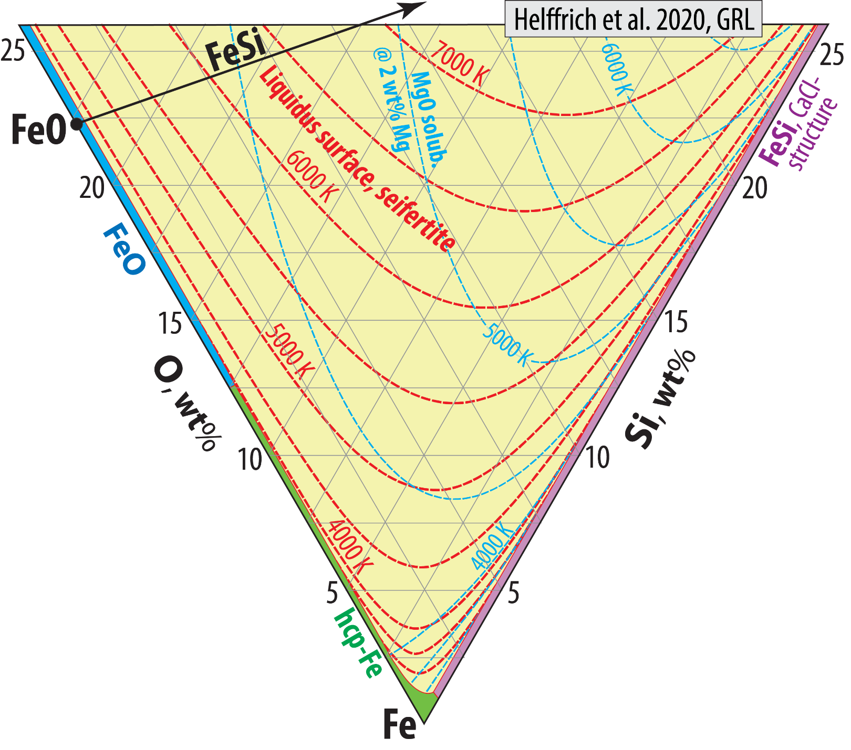
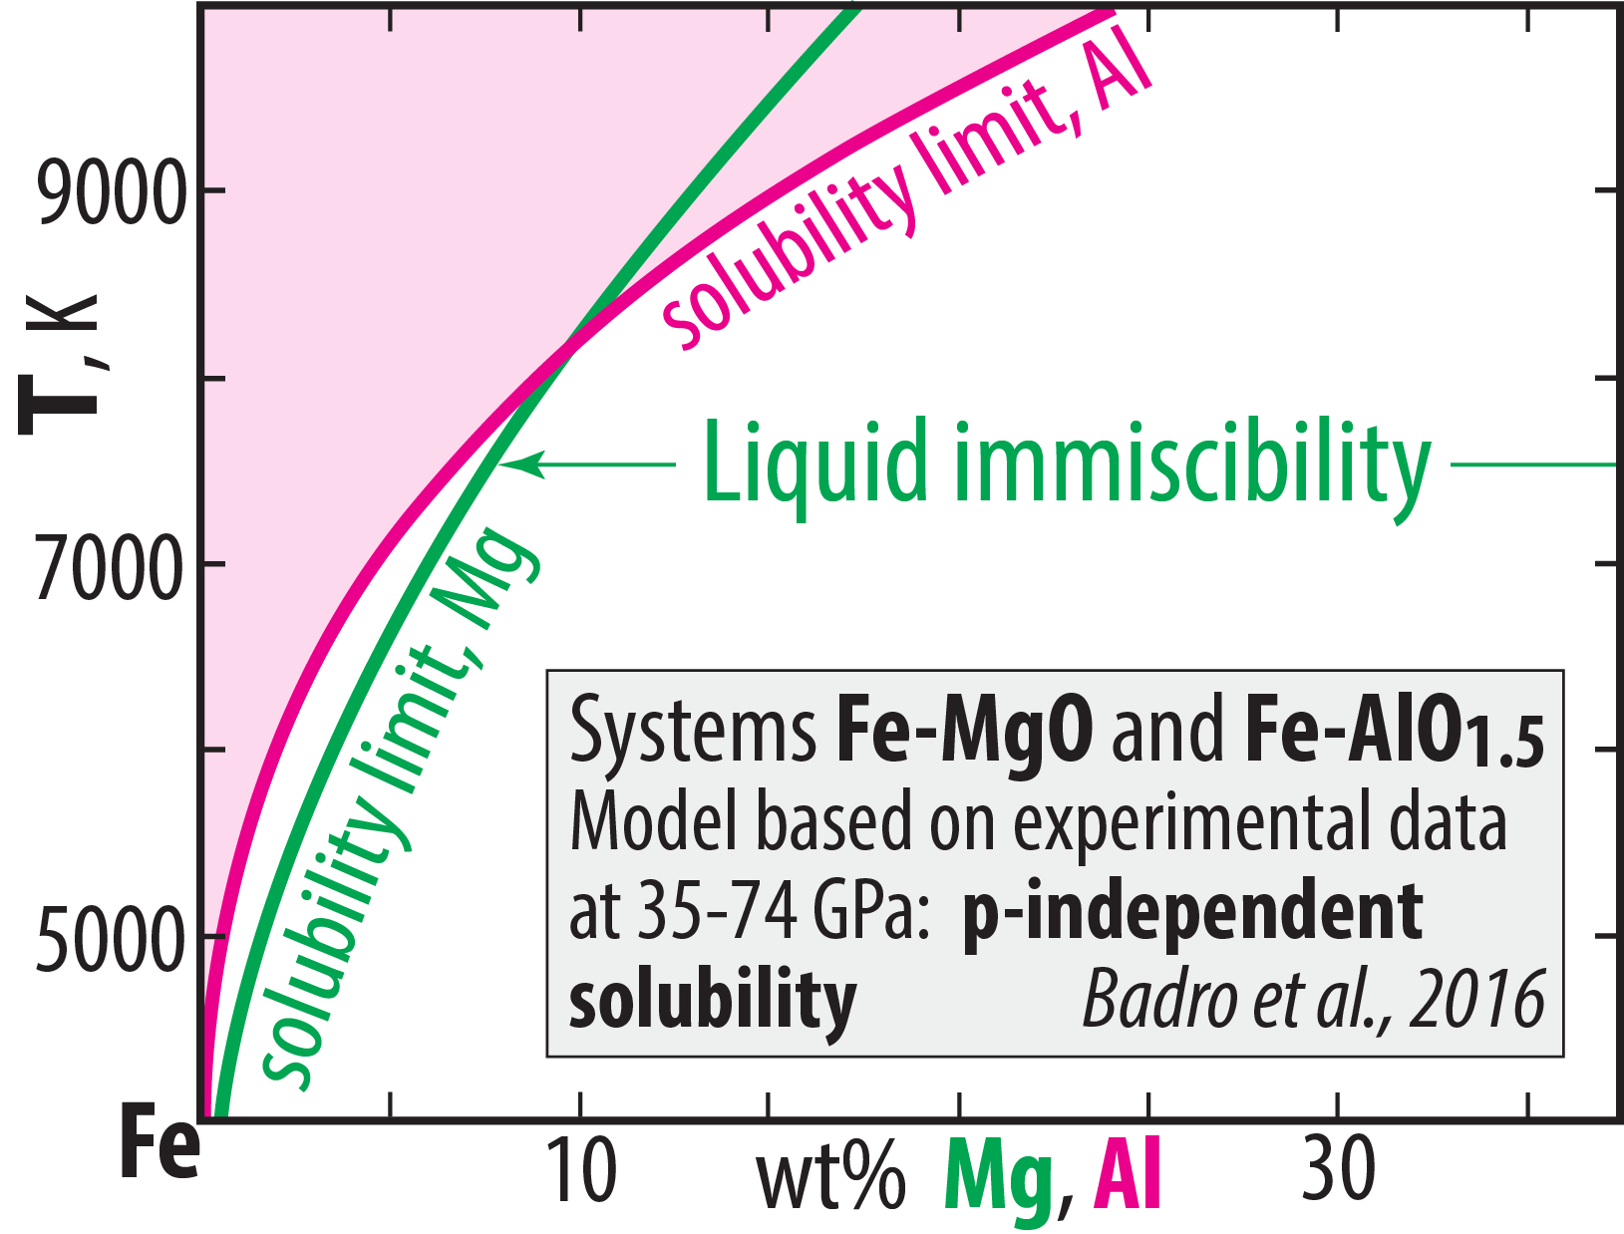

MgO-solubility
3700 K: present CMB-T
5600 K: early Hadean CMB-T model of Laneuville et al. (2018, PEPI)

Slide 19
Major consequence of the core-BMO chemical exchange
for the BMO melt evolution and BMO crystallisation
Exchange reaction: 2 Fe^{core} + SiO₂^{BMO} = Si^{core} + 2 FeO^{BMO}
Reversed during
planetary cooling
Resulting chemical transfer
- SiO₂ from core to BMO
Hypothetical transfer of Si from core to BMO:
Si would immediately be oxidised to SiO₂ with reduction of
FeO and Fe₂O₃ to Fe-metal, which would sink ito the core
- FeO (and Fe₂O₃) from BMO to core
Effect on BMO evolution and crystallisation
- "Buffering" BMO-melt at relatively high Si/(Fe+Mg) and Mg/Fe ratios
- Promotion and extension of the crystallisation of MgSiO₃-dominated bm
- Suppression and delay of fp crystallisation

Slide 20
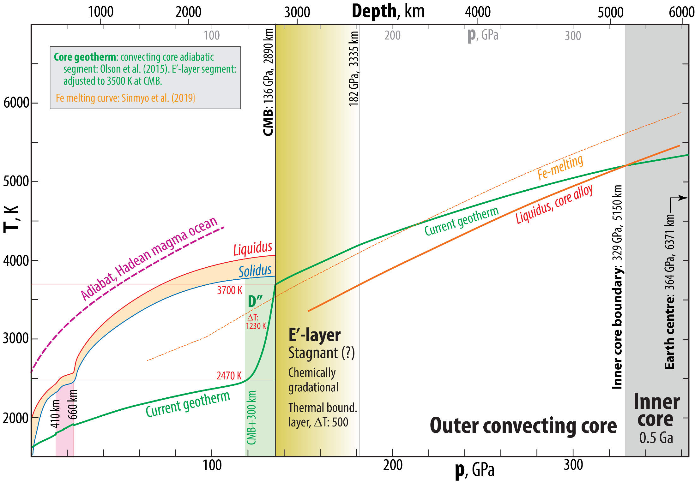
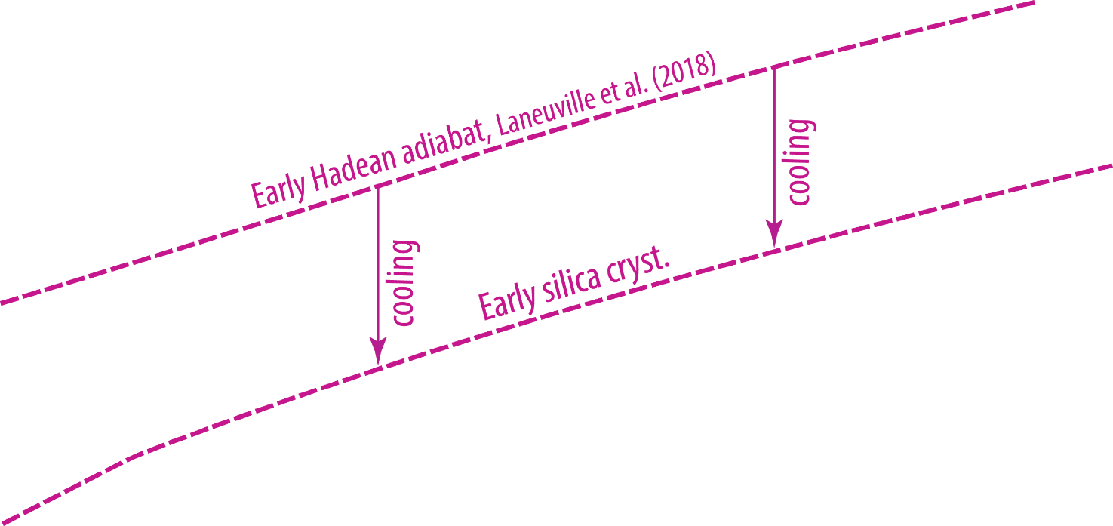
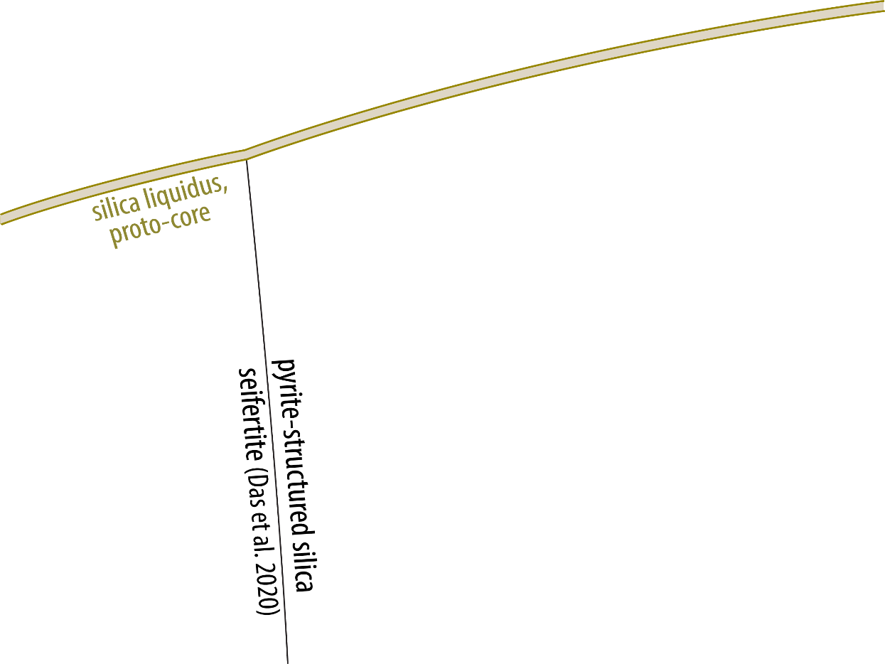
Core structure, geotherm and silica liquidus surface

Slide 21
Fe-oxide transport to the core
Will the BMO be oxidised or reduced during solidification?
If Fe-metal alloy is
extracted and sinks
into the core
If Fe-oxide with a
FeO_{1.5}/FeO ratio higher
than that of the BMO
dissolves into the core

Slide 22
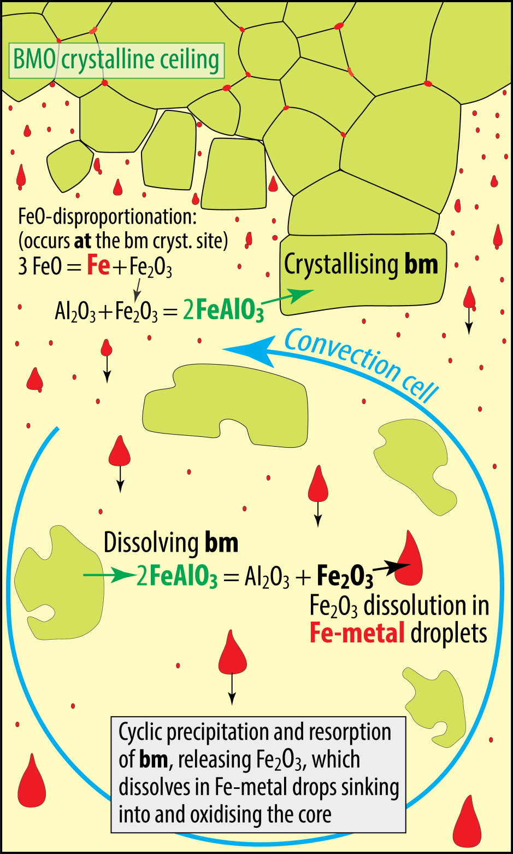
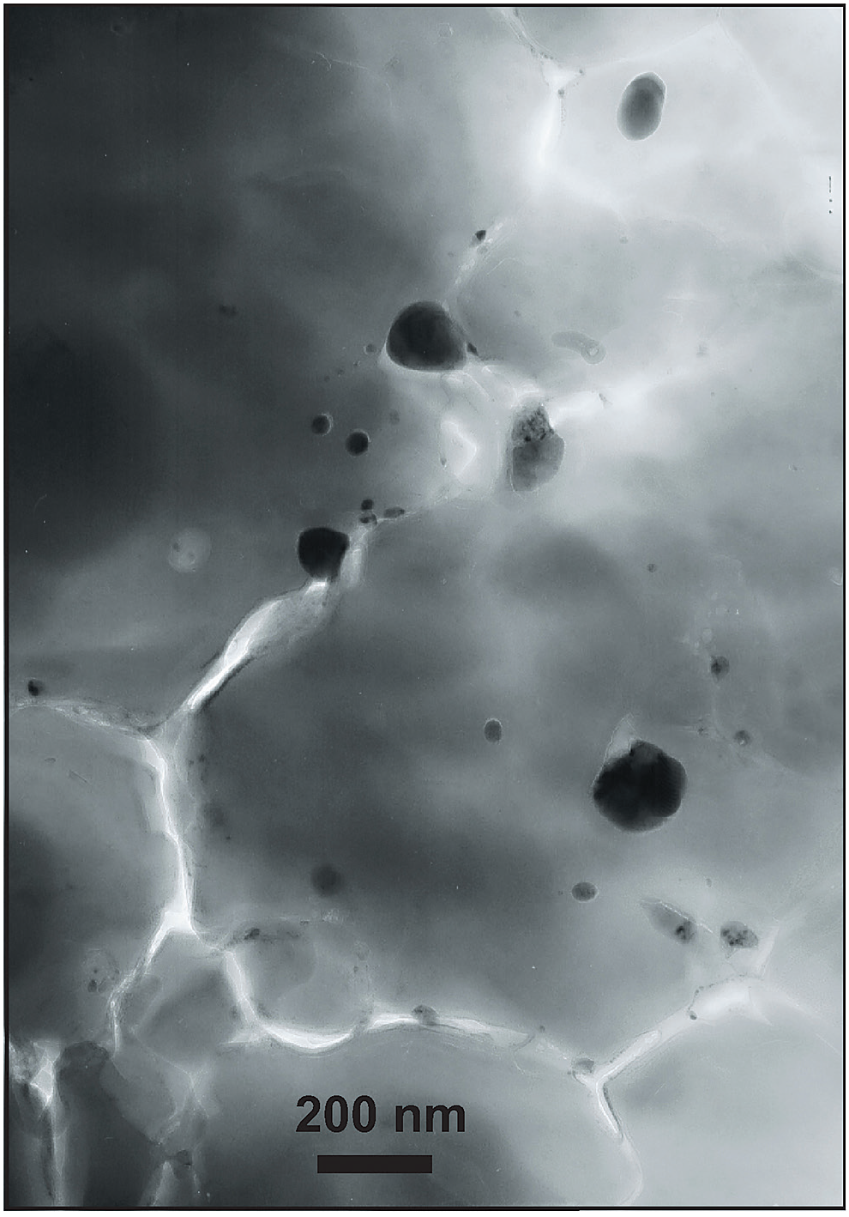
Crystallisation of bm in BMO
Cyclic crystallisation and dissolution of bm
- incorporation of the FeAlO₃-component in bm
- associated by FeO disproportionation and
Fe-metal precipitation (Frost et al. 2004, Nature)
30 nm
160 nm
Might be important for O-loading of the core.
BUT: O-saturation level in metal is < 20 wt%, while FeO and
and Fe₂O₃ contains 22 and 30 wt% O, respectively.
Sinking metal drops will therefore always oxidise the BMO
Andrault et al.
(2018, GPL)

Slide 23
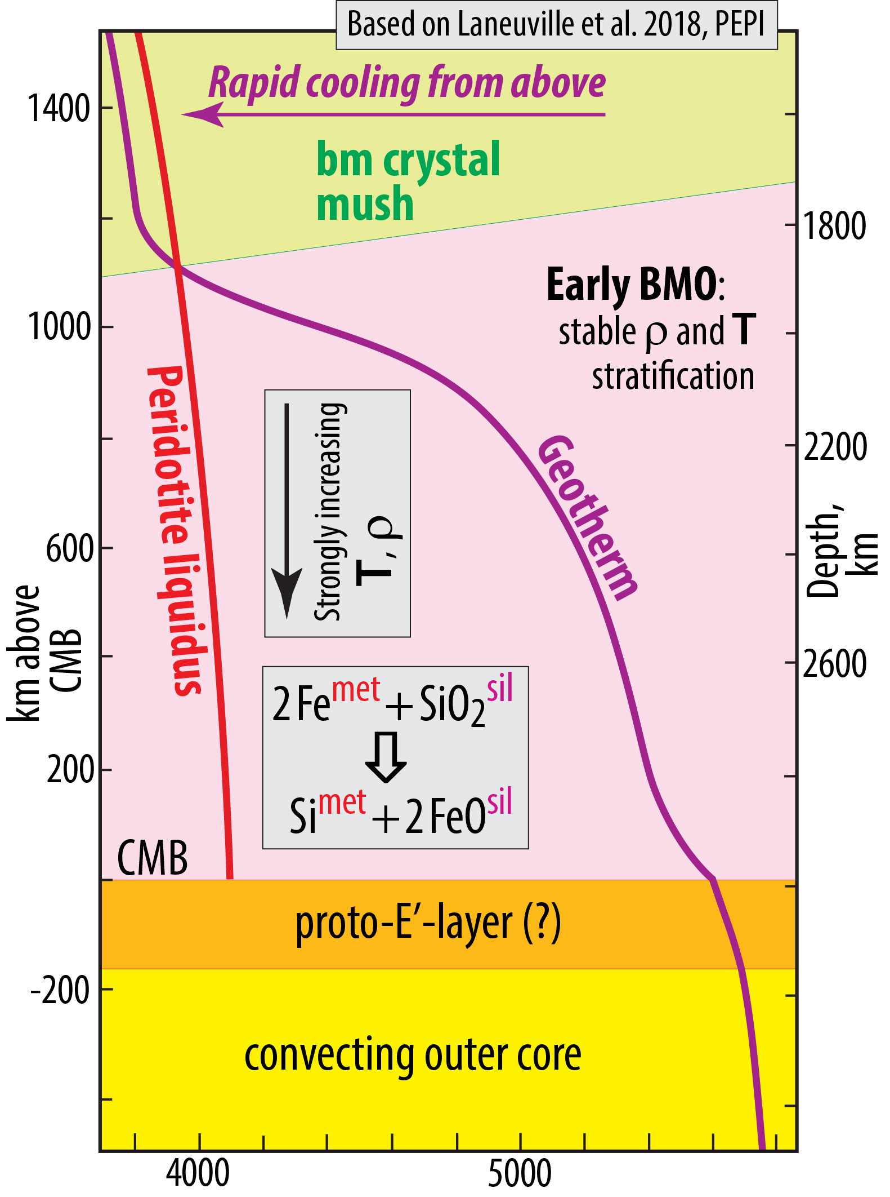
Trønnes et al. 2020,
Tectonophyics

Slide 24
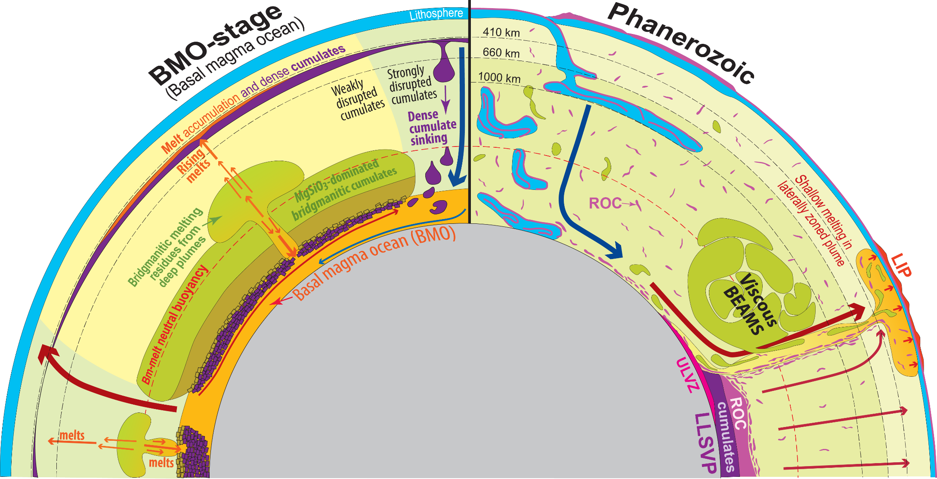
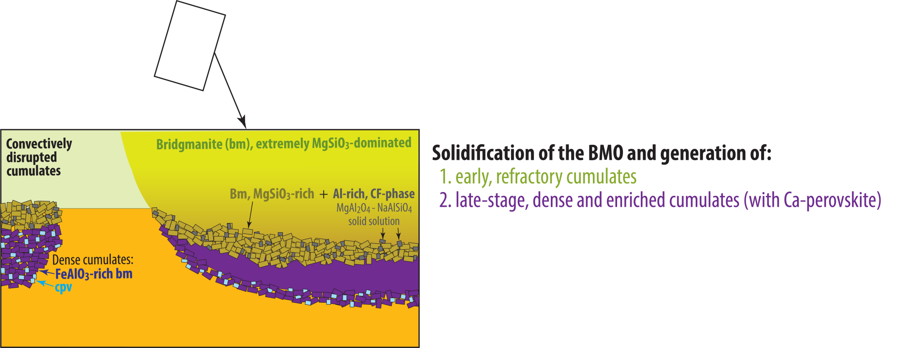
Magma ocean crystallisation
Evolution of viscous BEAMS
Refractory & viscous ERD convectively aggregated to BEAMS
(e.g. Manga, 1996, GRL)
Modified, mainly from:
Torsvik et al. (2016, Can. J. Earth Sci.)
Ballmer et al. (2017, Nature Geosci.)
Trønnes et al. (2014, Tectonophys.)

Slide 25
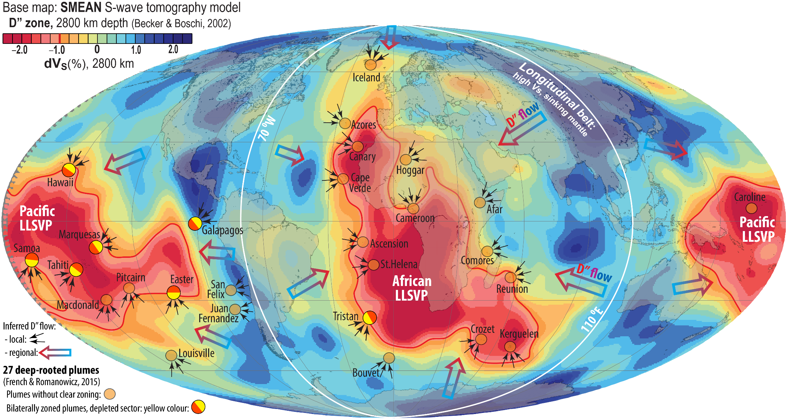
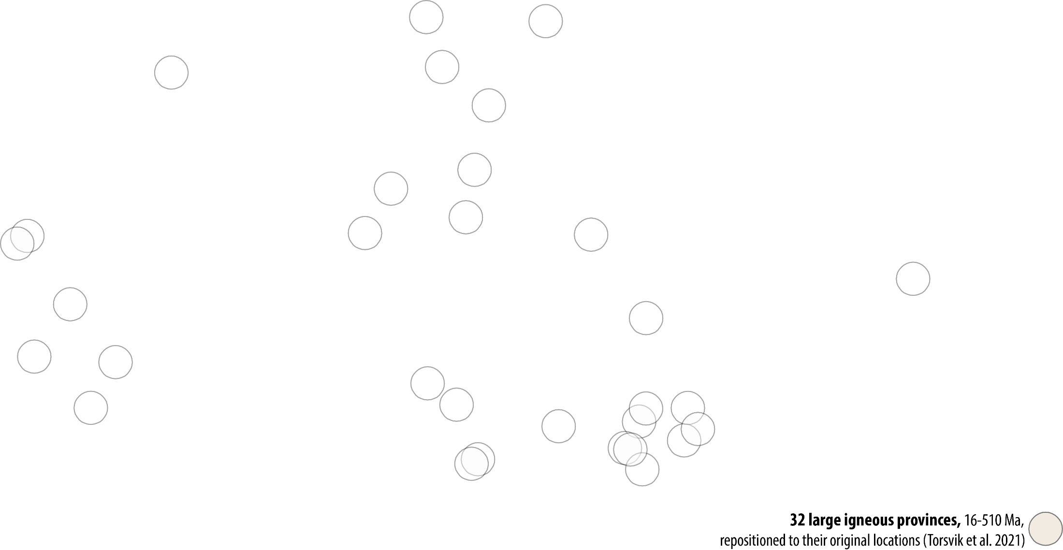
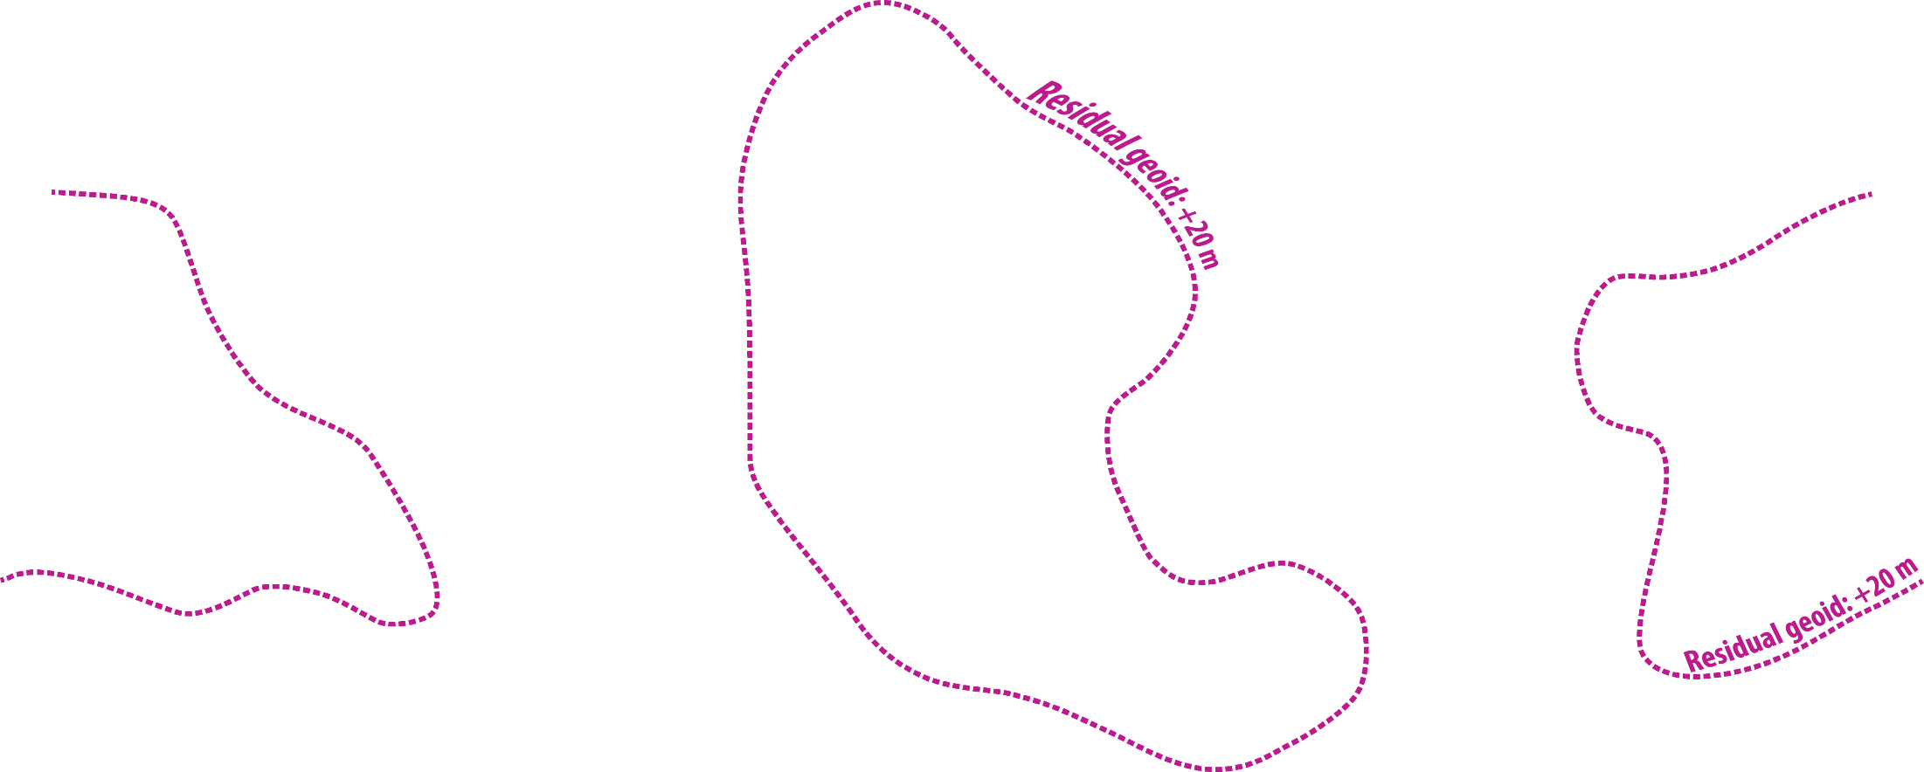
Degree-2 mantle flow pattern and lower mantle structure

Slide 26
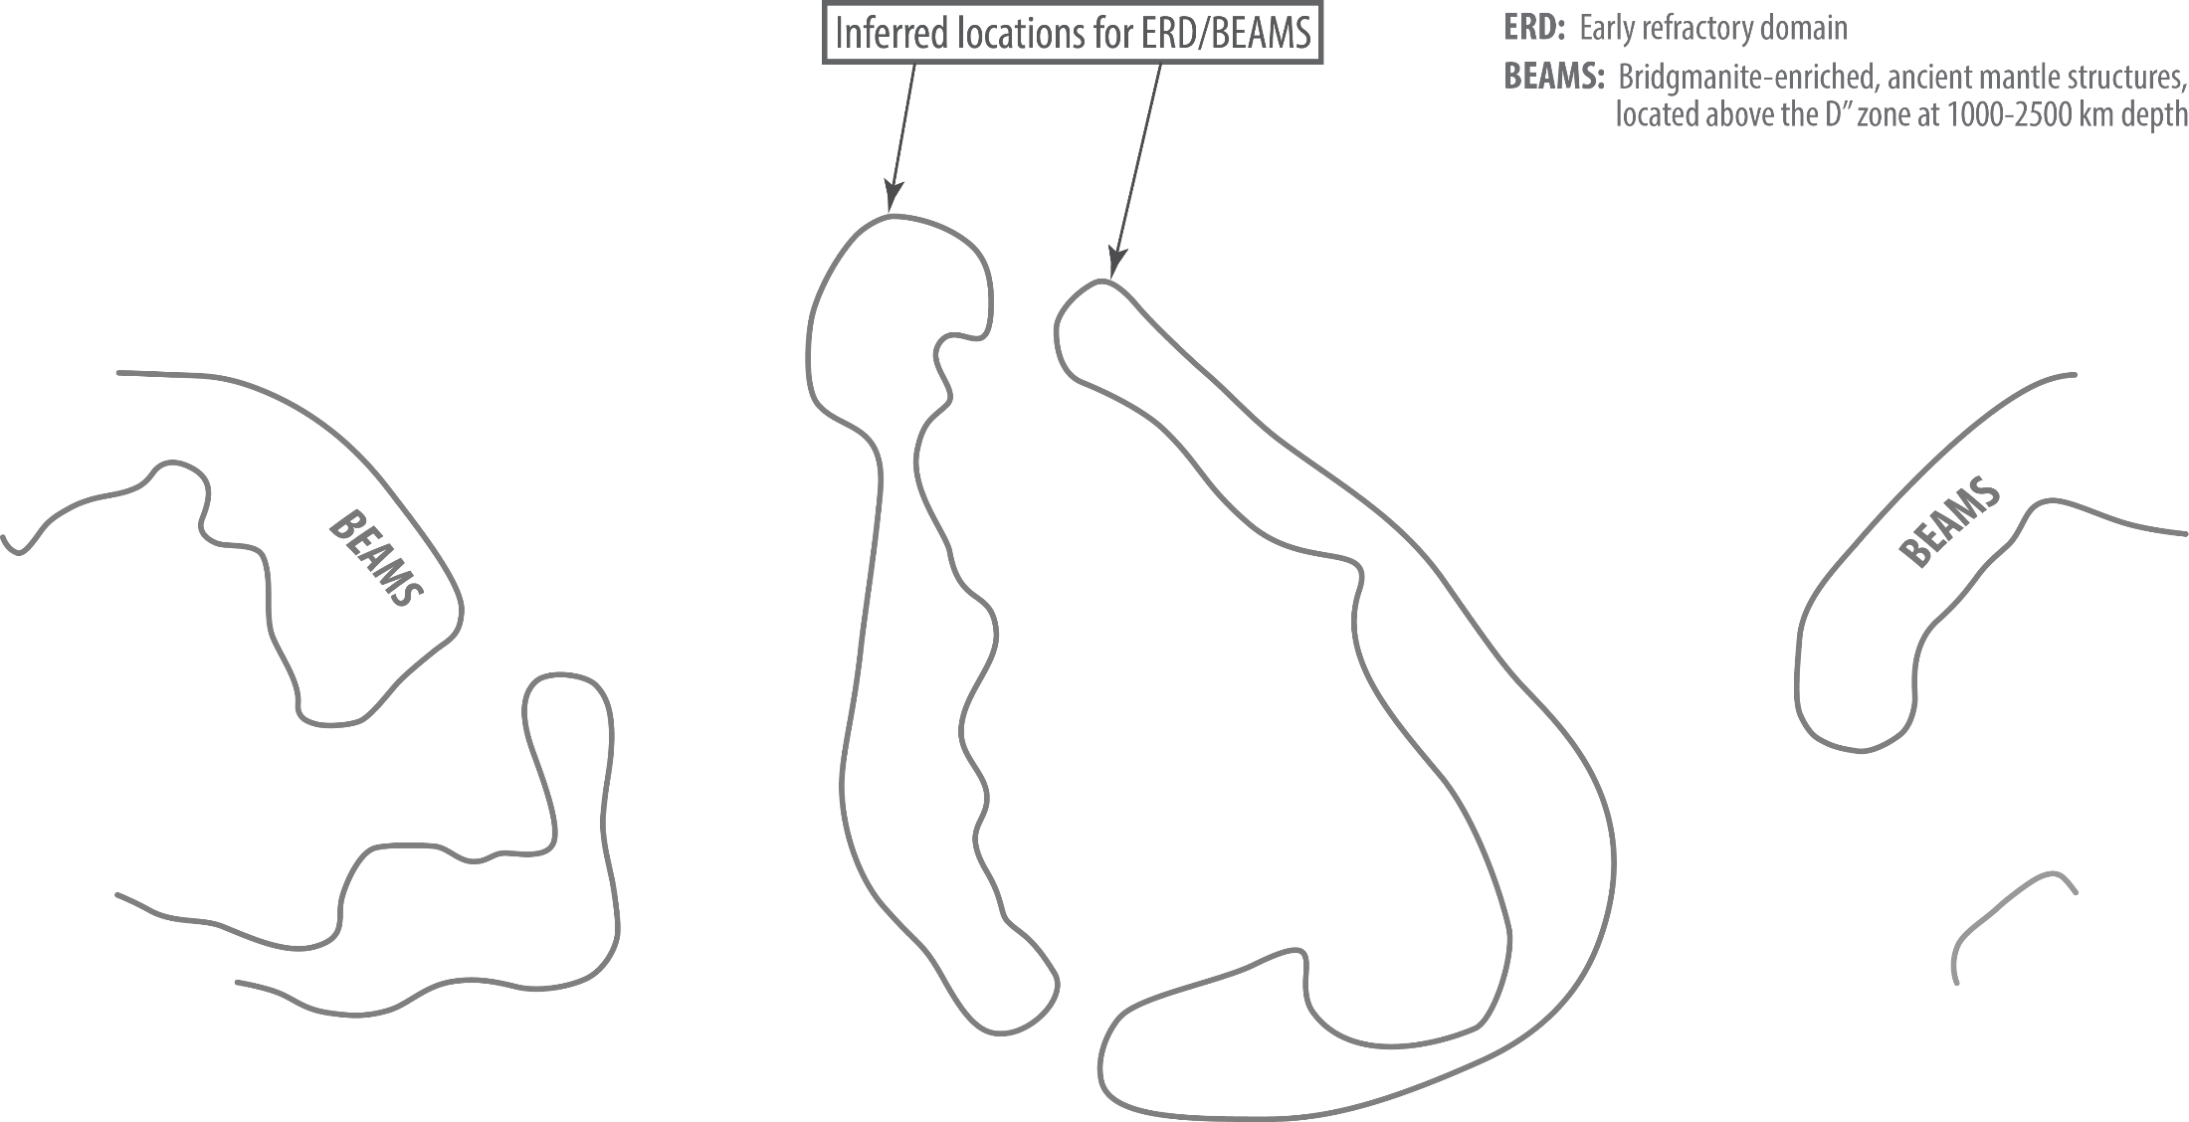

Slide 27
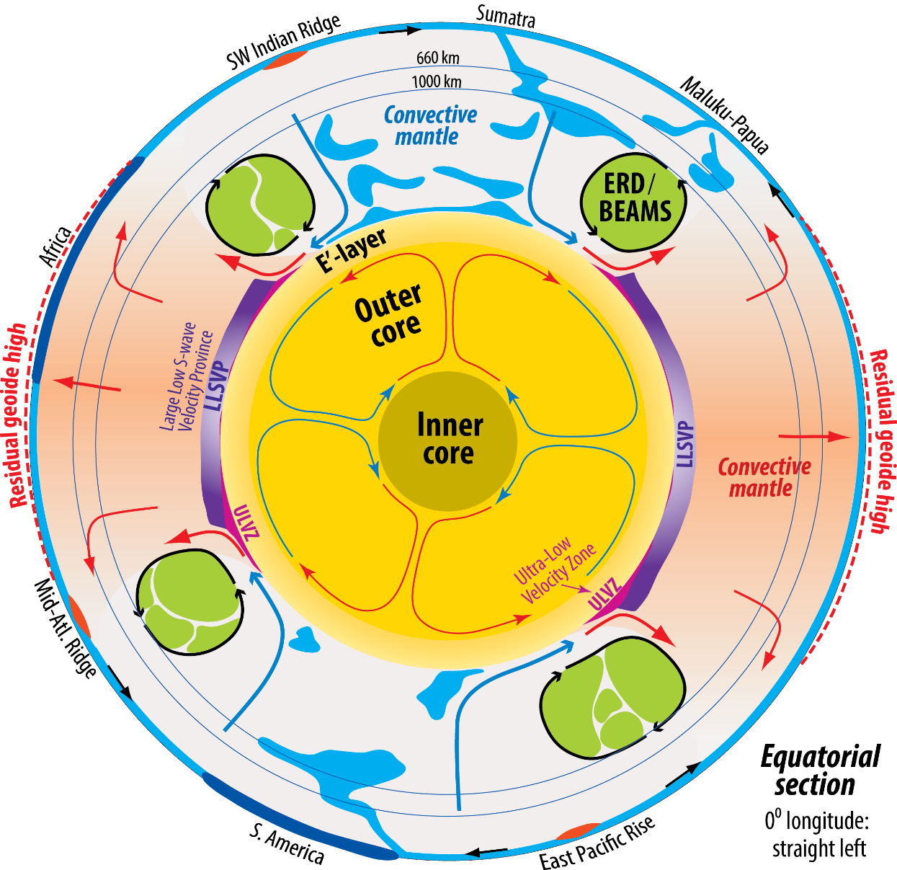
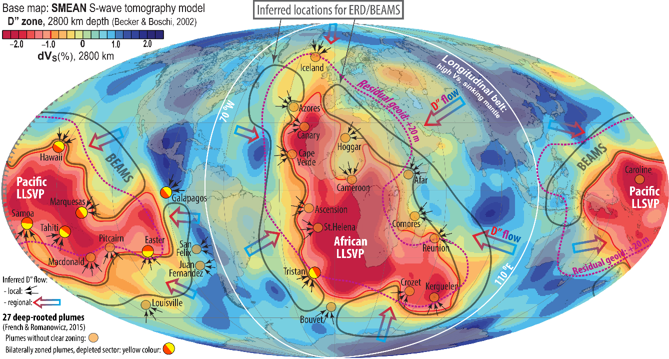
- BEAMS are positioned to avoid ’’interference’’ with
the slabs mapped by van der Meer et al. (2010, 2019)
- Viscous and refractory bridgmanitic material is strongly
indicated from a petrological point of view:
early MO-crystallisation during core-MO and core-BMO
chemical exchange.
- Early refractory domains are likely to be
convectively aggregated into BEAMS
(Manga 1996a,b; Becker et al. 1999; Ballmer et al. 2017)

Slide 28
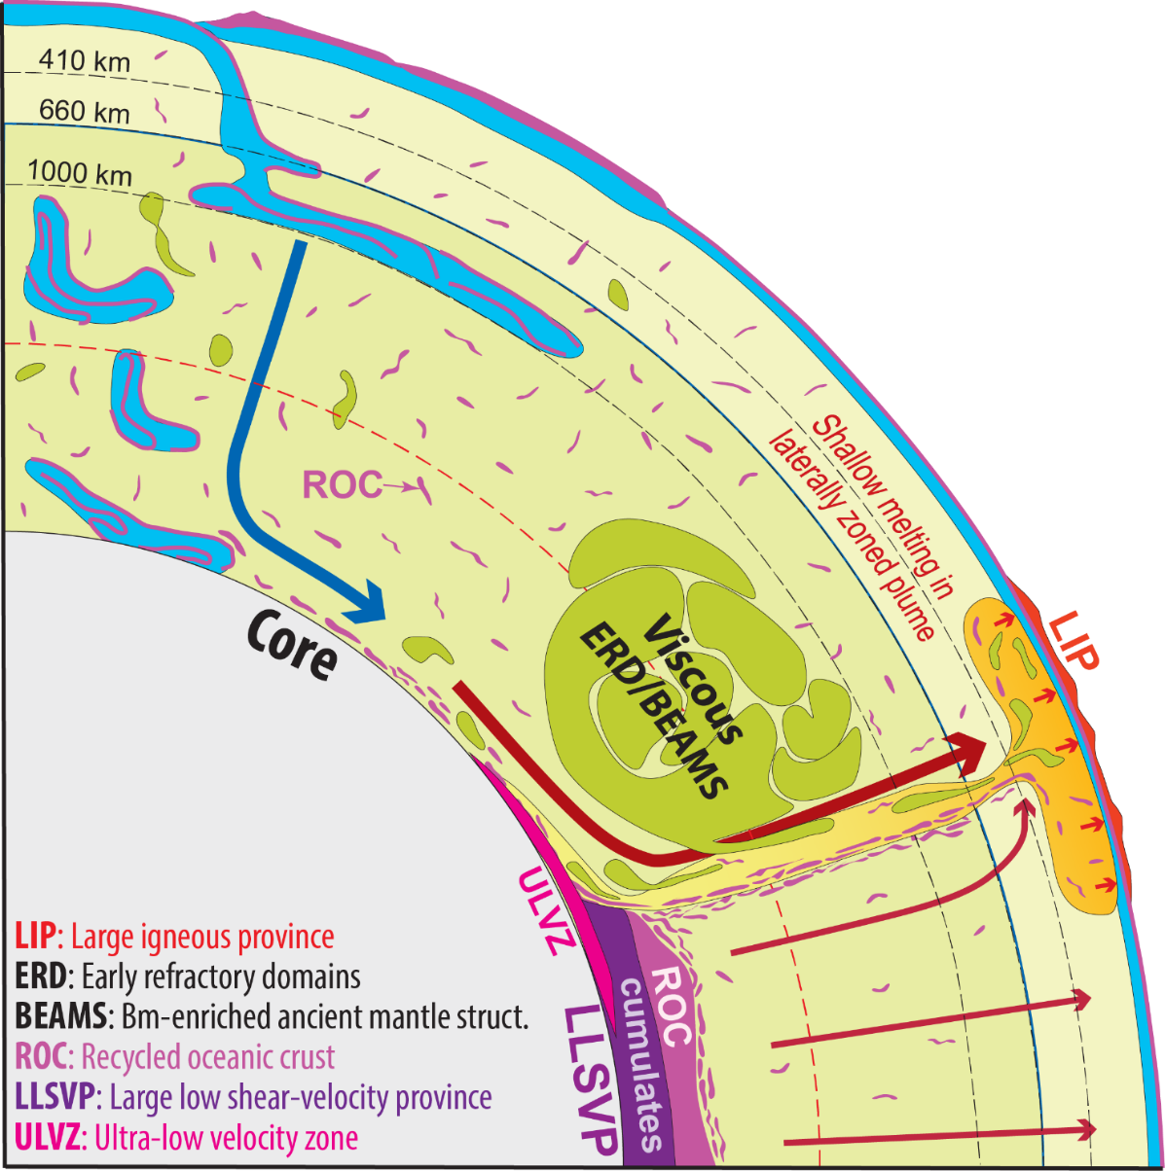
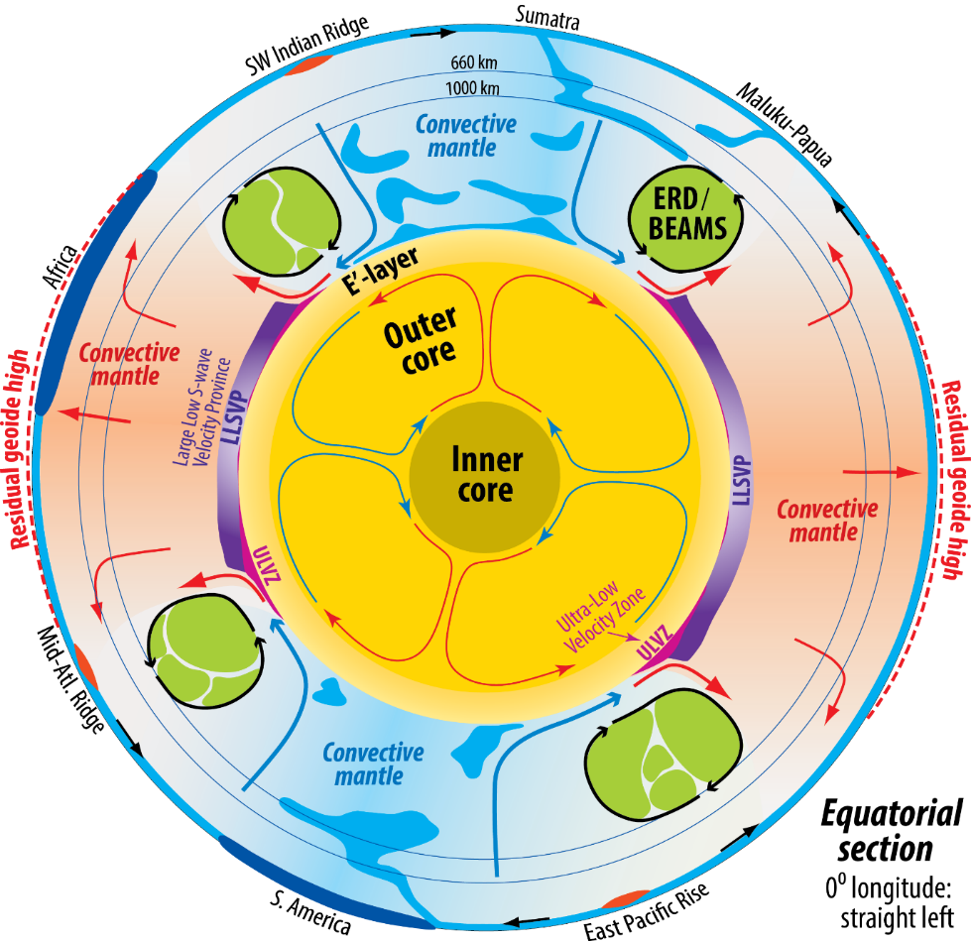
Two important consequences from the presence of BEAMS
- LM is more bridgmanitic ("chondritic") than the bulk mantle − elevated Si/(Fe+Mg) and bm/fp ratios
- The entrainment and UM-melting of ERD-material may be seen as the positive μ¹⁴²Nd-anomalies in some OIBs and kimberlites.
The ERD-material is very refractory (bridgmanitic) in the LM, but turns pyroxenitic and less refractory in the UM melting zone
Modified, mainly from:
Torsvik et al. (2016, Can. J. Earth Sci.)
Ballmer et al. (2017, Nature Geosci.)
Trønnes et al. (2019, Tectonophys.)

