Slide 1
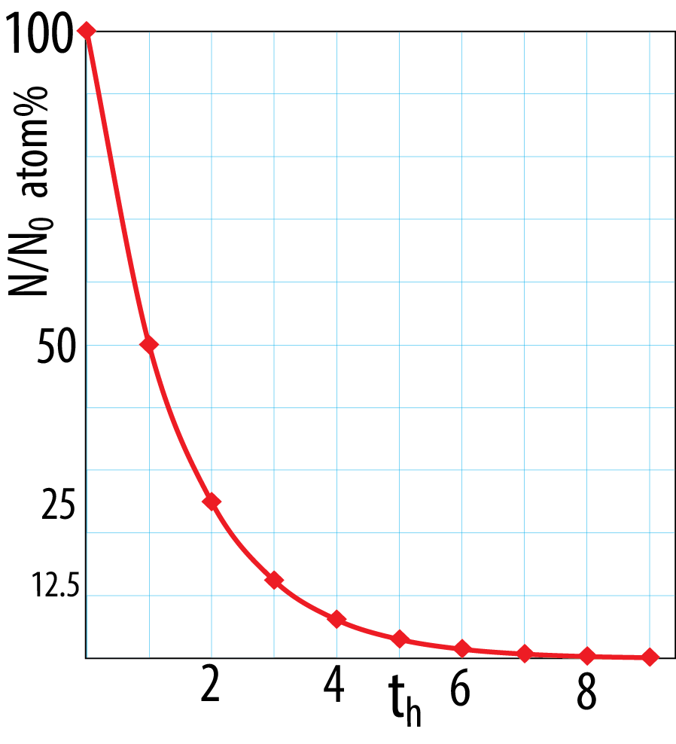
Main heat sources
Radioactive decay:
N = N₀ e^{−λ t}
Planetesimal to runaway
growth stages
- Shortlived radioactive decay
important during the first 2-4 Ma)
mainly ²⁶Al → ²⁶Mg T_{h}: 0.7 My,
i.e. practical life-time: 3 - 3.5 My
- Core segregation
potential energy → heat
- Magma ocean crystallisation
latent heat of cryst., pot. energy → heat
Half-life: t_{h}
N₀/2 = N₀ e^{−λ th}
1/2 = e^{−λ th}
ln1−ln2 = −λt_{h}
t_{h} = ln2 / λ
Giant impact stage
- Impact energy
- Core segregation
- Magma ocean crystallisation
(partly overlapping with, partly subsequent
to core segregation)
Practical lifetime:
4-6 t_{h}

Slide 2
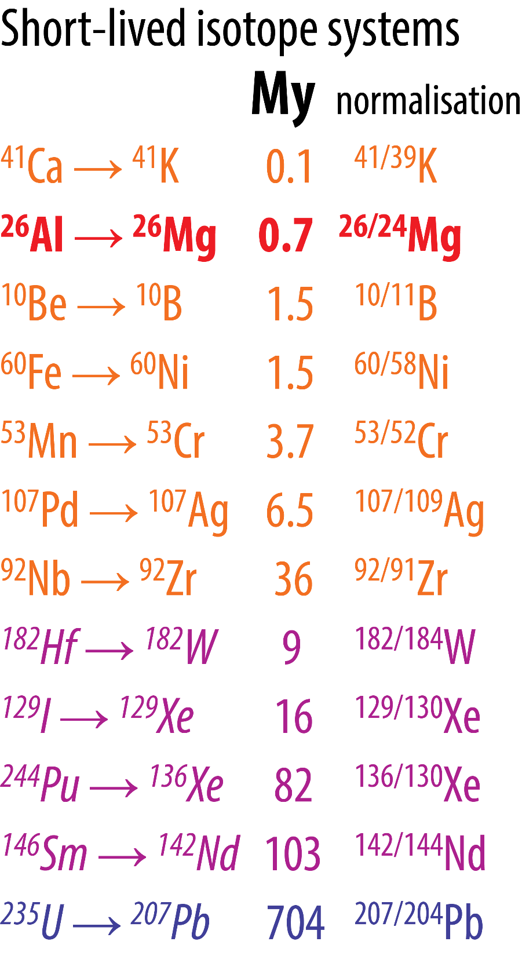
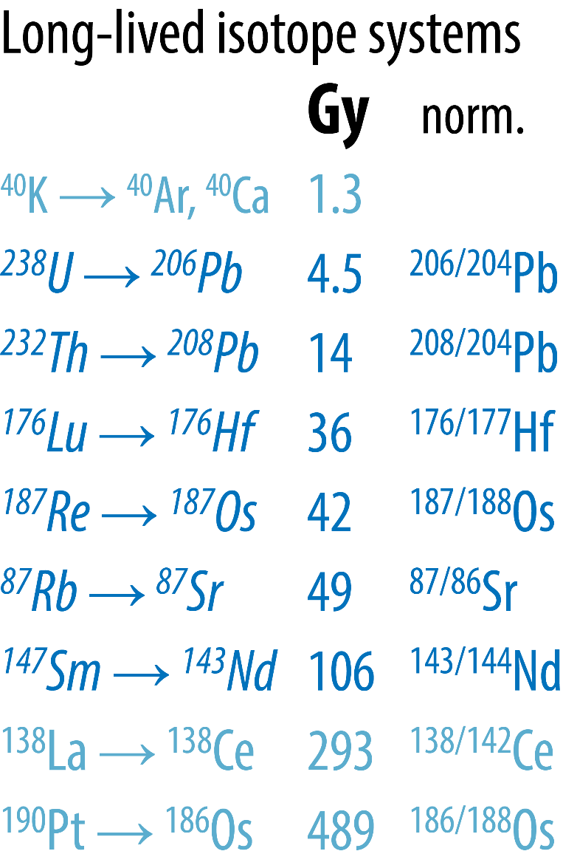
Geochronology: Radioactive decay systems with half-lives in My and Gy
Important heat
source for the
first 2-3 Ma
interm. t_{h}
long t_{h}
Common constraints
on early planetary
differentiation and
core-mantle geo-
chemical reservoirs
Very long
t_{h}

Slide 3

Short-lived isotope decay
Important early heat producers:
²⁶Al → ²⁶Mg, T_{h}: 0.7 Ma
⁶⁰Fe → ⁶⁰Ni, T_{h}: 1.5 Ma
Hf
W
δ²⁶Mg = [(²⁶Mg/²⁴Mg)_{sample} / (²⁶Mg/²⁴Mg)_{stand} -1] * 1000 (‰)
Lazy, short: δ²⁶Mg = [(^{26/24}Mg)_{sample/stand} -1] * 1000
δ²⁶Mg-excess in Al-rich minerals
(plagioclase) formed early
Ηf: lithophile (”silicate-loving”)
W: siderophile (”iron-loving”)
Others with low concentration or
low initial ratios:
⁴¹Ca → ⁴¹K, T_{h}: 0.1 Ma
¹⁰Be → ¹⁰B, T_{h}: 1.5 Ma
¹⁸²Hf → ¹⁸²W, T_{h}: 8.9 Ma
¹⁴⁶Sm → ¹⁴²Nd, T_{h}: 103 Ma
Mantle: high Hf/W ⇒ high ε_{W}^{mantle}
Core: low Hf/W ⇒ low ε_{W}^{core}
ε_{W}-deviation from zero:
inversely proportional to the age of
core-segregation
ε¹⁸²W = [(¹⁸²W/¹⁸⁴W)_{sample} / (¹⁸²W/¹⁸⁴W)_{stand} -1] * 10⁴

Slide 4
Developing the isochron equation, exemplified by the Rb-Sr-decay system
⁸⁷Rb → ⁸⁷Sr
half life: 49 Ga
Isotope ratios measured and used: ⁸⁷Sr/ ⁸⁶Sr and ⁸⁷Rb/ ⁸⁶Sr
Starting point: N = N₀ e^{−λt} (the decay equation)
⁸⁷Rb = ⁸⁷Rb₀ e^{−λt}
Another relation: ⁸⁷Rb = ⁸⁷Rb₀ − ⁸⁷Sr* = ⁸⁷Rb₀ − (⁸⁷Sr − ⁸⁷Sr₀)
Radiogenic Sr
⁸⁷Rb₀ = ⁸⁷Rb + ⁸⁷Sr − ⁸⁷Sr₀
Inserting into the decay equation:
⁸⁷Rb = ( ⁸⁷Rb + ⁸⁷Sr − ⁸⁷Sr₀) e^{−λt} = ⁸⁷Rb e^{−λt} + (⁸⁷Sr − ⁸⁷Sr₀) e^{−λt}
⁸⁷Rb (1 − e^{−λt}) = (⁸⁷Sr − ⁸⁷Sr₀) e^{−λt}
Dividing by e^{−λt} on both sides: ⁸⁷Rb (e^{λt} − 1) = ⁸⁷Sr − ⁸⁷Sr₀
⁸⁷Sr = ⁸⁷Sr₀ + ⁸⁷Rb (e^{λt} − 1)
Dividing by ⁸⁶Sr on both sides: ⁸⁷Sr/⁸⁶Sr = (⁸⁷Sr/⁸⁶Sr)₀ + ⁸⁷Rb/⁸⁶Sr (e^{λt} − 1)

Slide 5
Isochron equation: ⁸⁷Sr/⁸⁶Sr = (⁸⁷Sr/⁸⁶Sr)₀ + ⁸⁷Rb/⁸⁶Sr (e^{λt} − 1)
a, b, c: three different minerals crystallized at time t₀ from the same magma
or three different rocks formed at time t₀ from the same magma, by fractional crystallization
In that case: a, b, c must have identical (⁸⁷Sr/⁸⁶Sr)₀-ratio, but different Rb/Sr-ratio.
How does a, b, and c move in the diagram with progressing time ?
If t₂ is today, the age of the rock or rock suite is t₂-t₀
The slope of the isochron (t₂-line) is e^{λt}−1.
t₂
⁸⁷Sr/⁸⁶Sr
c₂
b₂
c₁
t₁
a₂
b₁
a₁
(⁸⁷Sr/⁸⁶Sr)₀
a
b
c
t_{o}
⁸⁷Rb/⁸⁶Sr

Slide 6
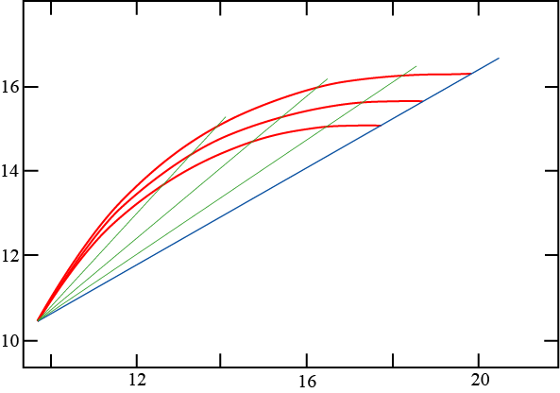
Chronology – radiometric
U-Pb isotope systematics
²³⁵U → ²⁰⁷Pb, T_{h}: 0.7 Ga
²³⁸U → ²⁰⁶Pb, T_{h}: 4.5 Ga
3 Ga
μ=10
2 Ga
μ=9
μ = U/Pb
1 Ga
μ=8
²⁰⁷Pb / ²⁰⁴Pb
Geochron (0 Ga)
Earth’s initial composition
²⁰⁶Pb / ²⁰⁴Pb

Slide 7
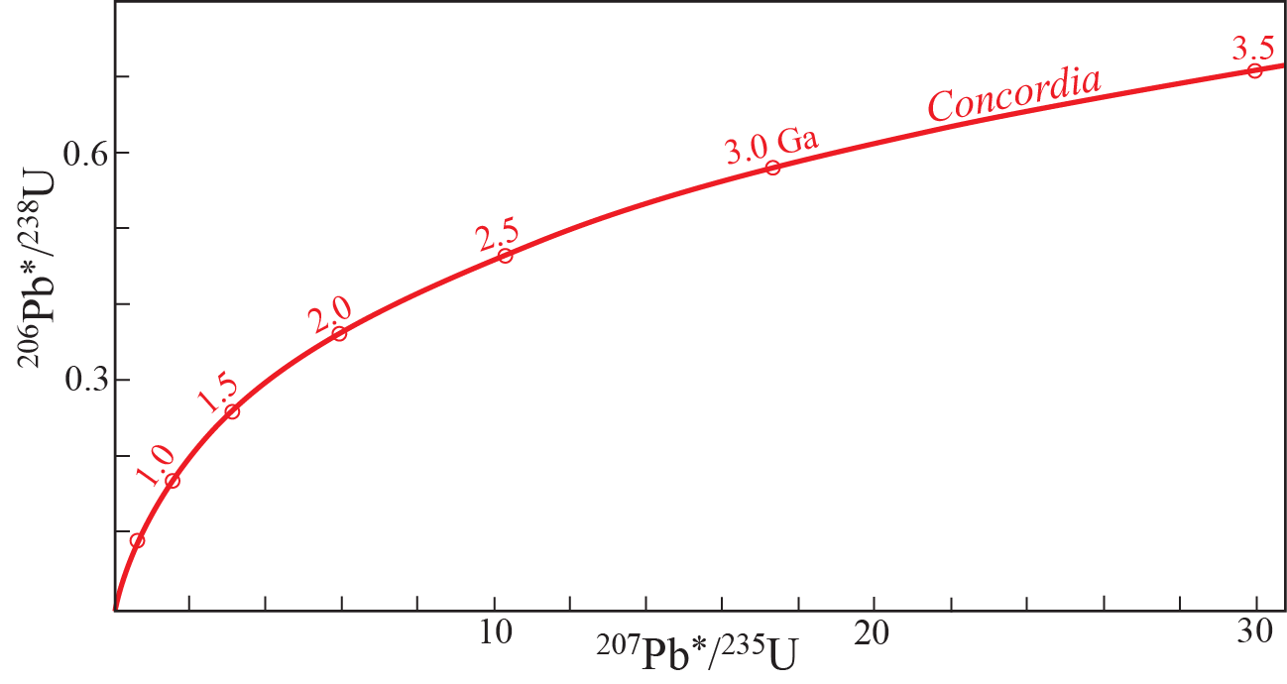
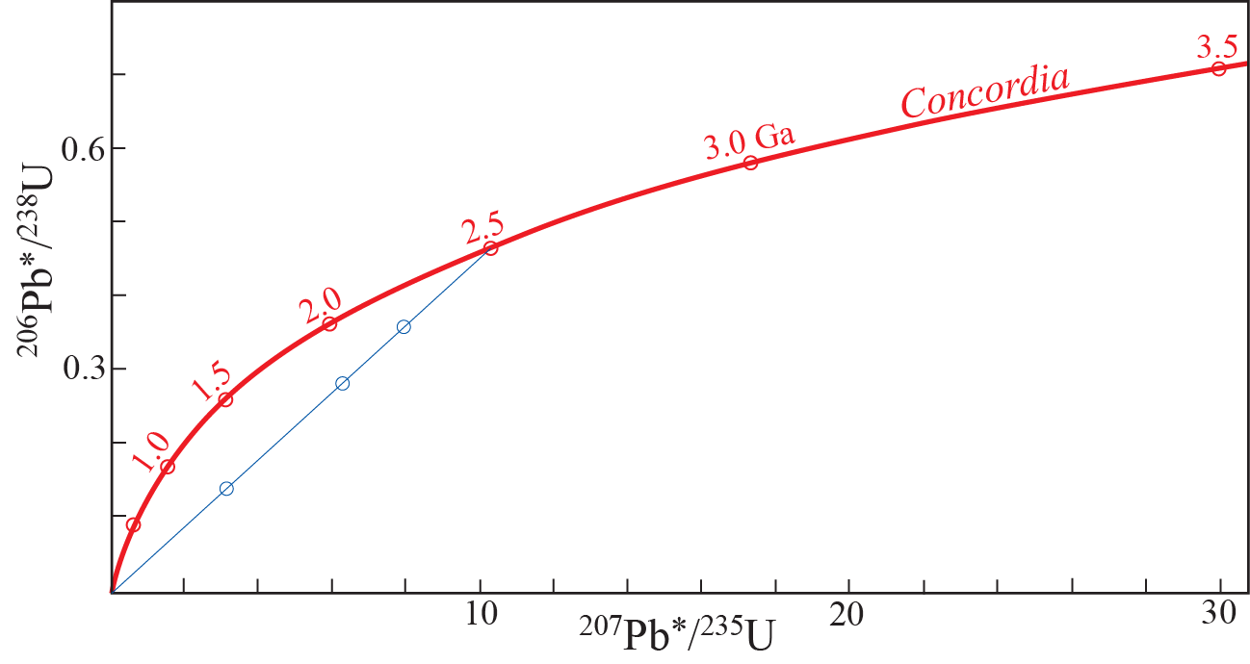
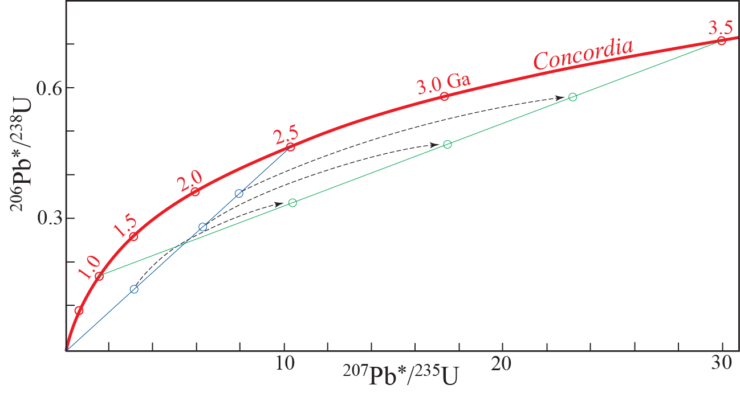
The concordia diagram (Pb*: radiogenic lead)
- dating minerals formed with very low Pb, but high U (e.g. zircon)
All minerals with perfect closed-system
behaviour lie on Concordia today
Partial Pb-loss (from zircons) in
three crustal rocks at 2.5 Ga
Further Pb-growth in the
zircons until 3.5 Ga

Slide 8
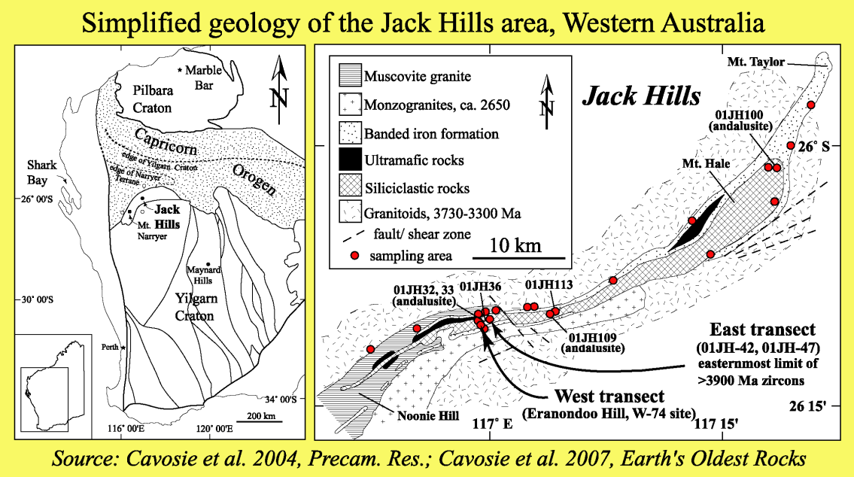
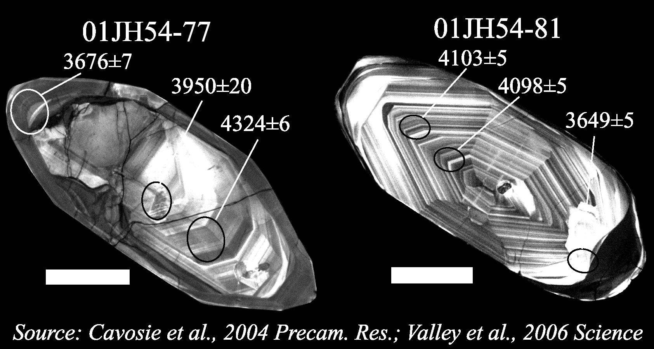
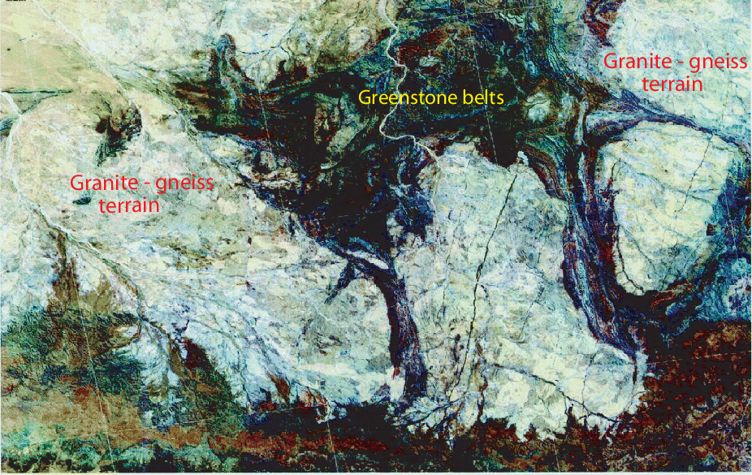
Oldest zircon crystals on Earth, dated by U/Pb-geochronology: up to 4.4 Ga
SEM-image of zircon crystals from a quartsite at Jack Hills,
Pilbara craton, Western Australia.
These are the oldest zircons found on Earth (ages in Ma)
Satellite-image (175 km width) covering parts of the Pilbara craton, NW Australia.
Such cratons typically contain granitic domes (here: 3.0-3.2 Ga) emplaced between dark greenstone belts comprising altered basaltic og komatiitic lavas (here: 3.2-3.5 Ga)

Slide 9
Valley et al. (2014, Nat. Geosci.)
SIMS-analysis and atom-probe tomography

Slide 10
Chronology of the early Solar System
Georg Wilhelm Gabriel Zachén, Lund Univ., Sweeden

Slide 11
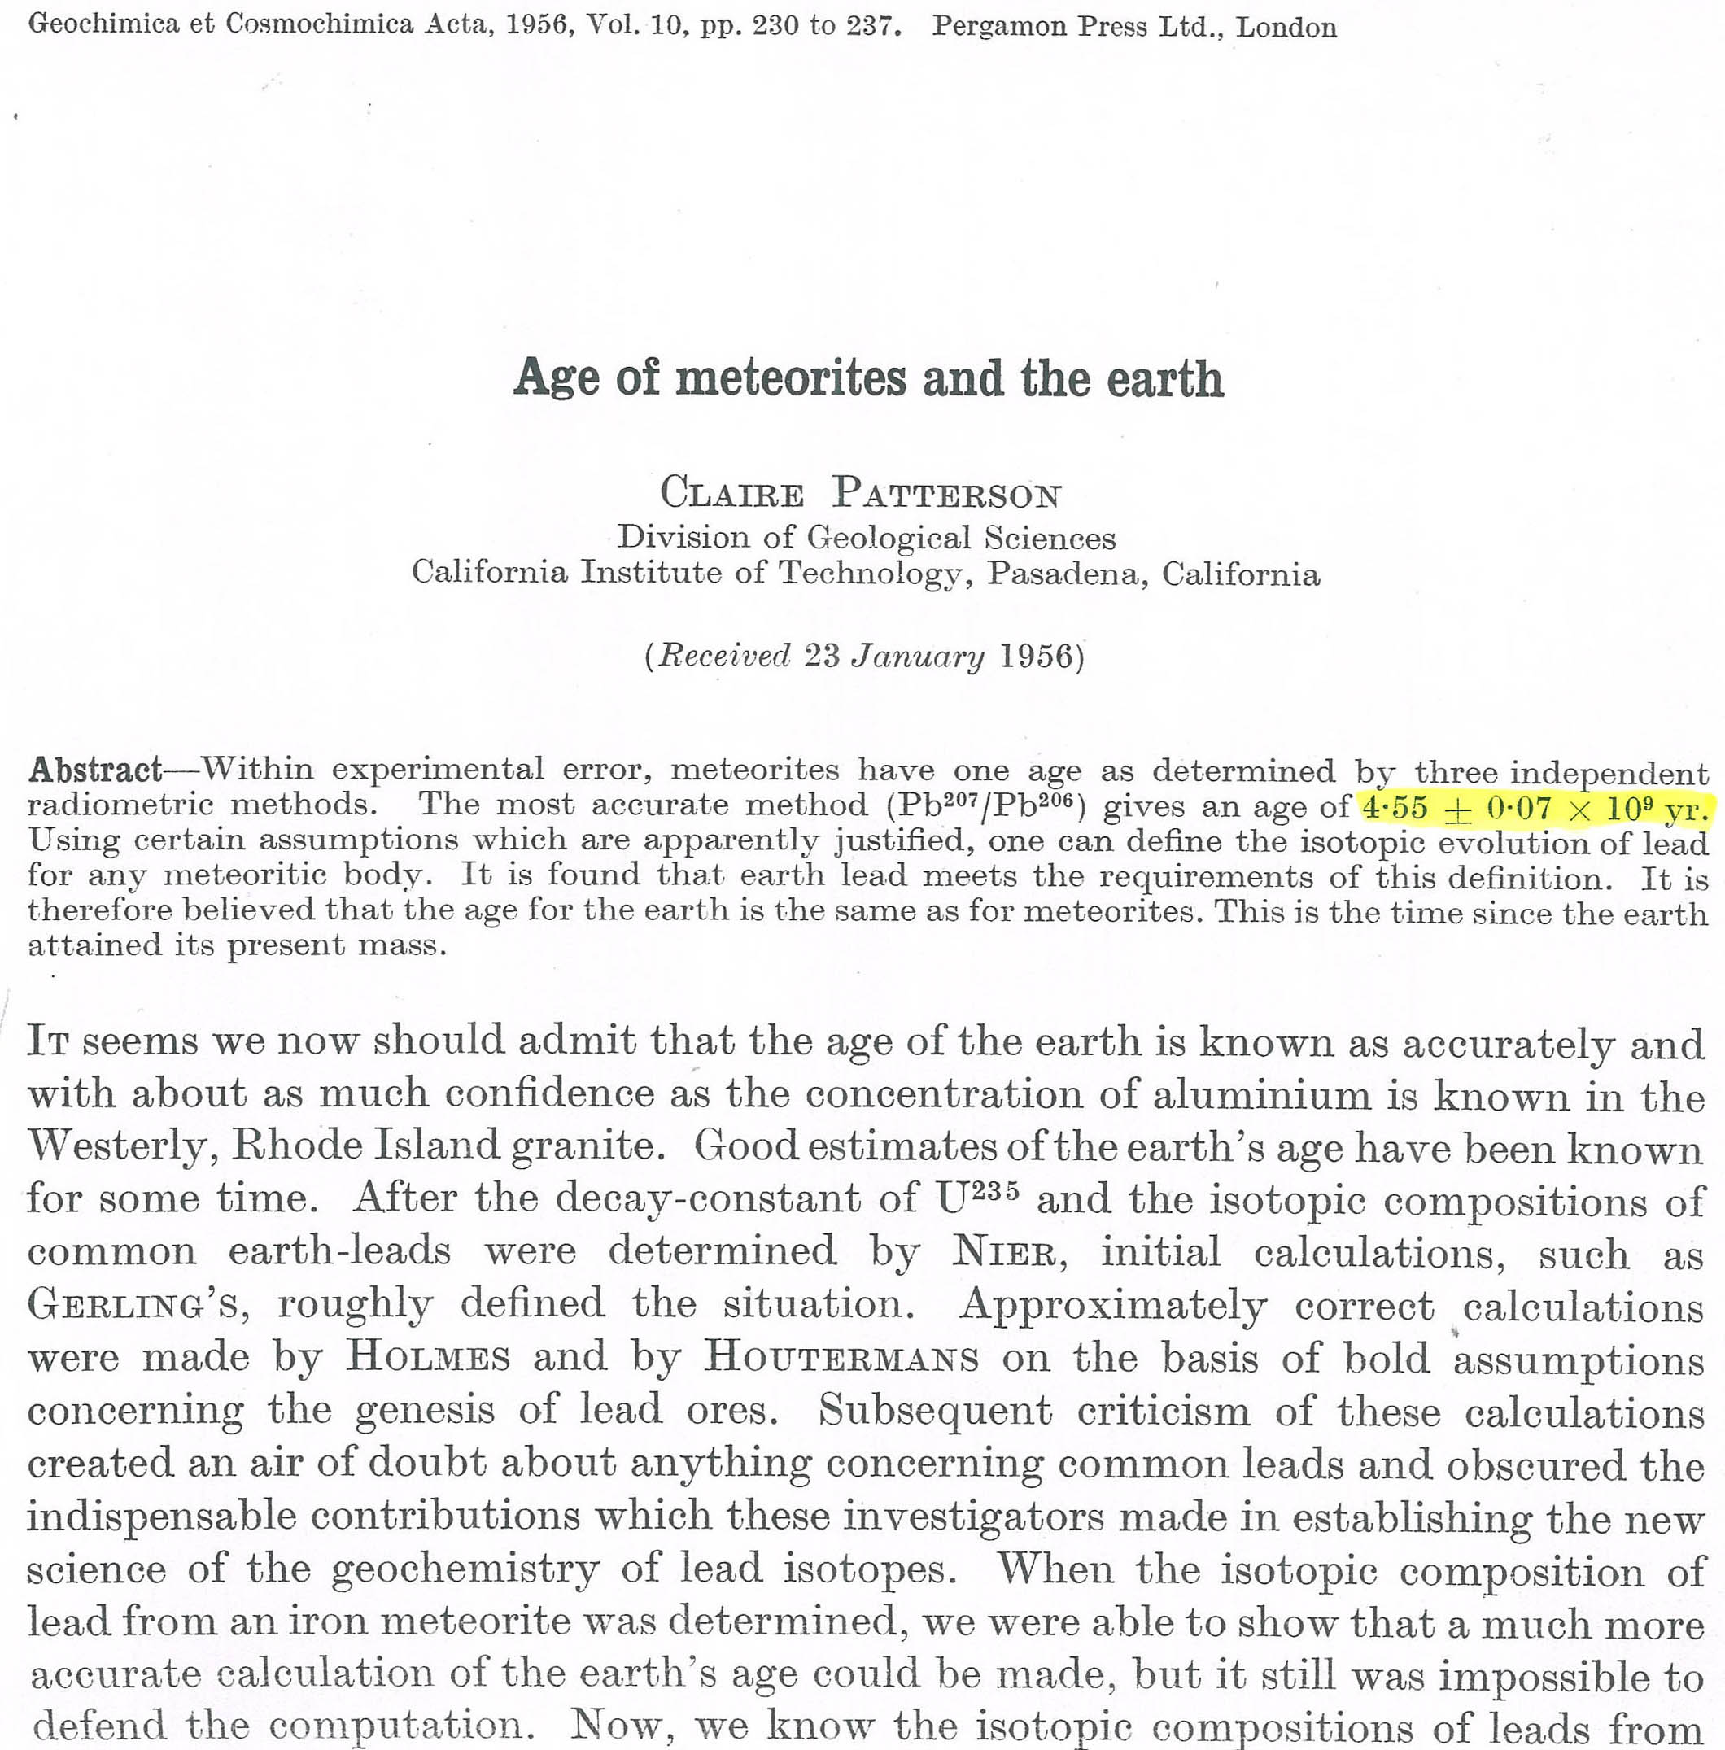
Age of meteorites and the Earth
Mostly established already in 1956 !!
Correct age, within the stated uncertainty

Slide 12
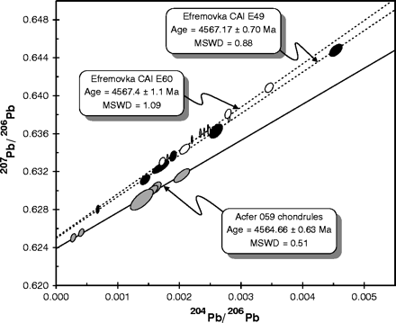
Dating refractory inclusions and chondrules
CV chondrite
t₀ = 4567 Ma
CR chondrite
Chondrules: t = t₀ - 2 Ma
Amelin et al. 2002, Science

Slide 13
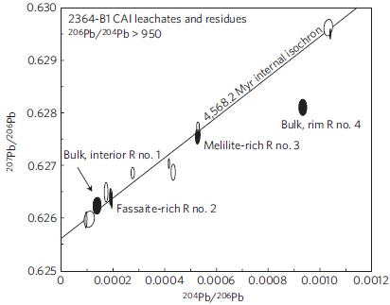
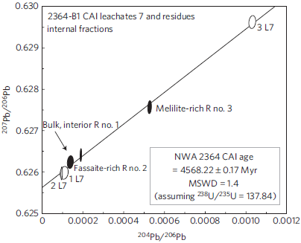
Northwest Africa 2364 CV3 chondrite
Bouvier et al. (2010, Nature Geoscience)
Assumed constant (solar) ²³⁸U/²³⁵U-ratio

Slide 14
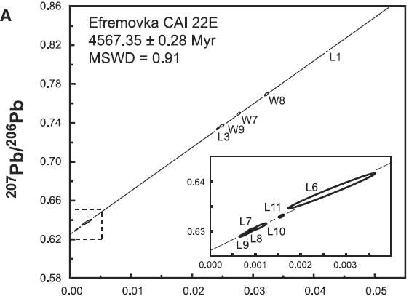
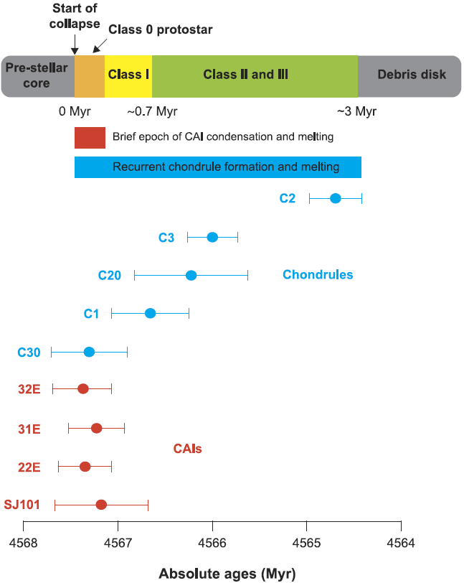
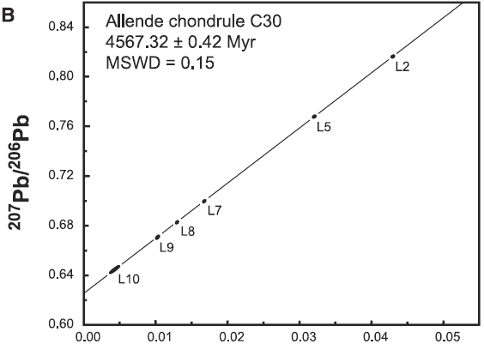
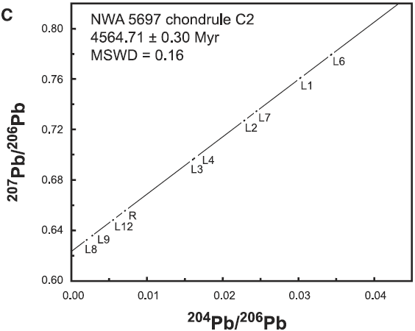
Connelly et al. (2012, Science):
Using measured (variable)
²³⁸U/²³⁵U-ratio
Amelin and Ireland (2013, Elements)
CAIs: 4567.3 ± 0.16 Ma
Chondrules: 4567 − 4564 Ma

Slide 15
Earth-Theia-Moon composition - devolatilisation
Anders Plan, Lund Univ., Sweeden

Slide 16
Common and useful diagram for identifying:
- refractory lithophile elements, RLE
- moderately volatile elements, MVE
- moderately siderophile elements, MSE
- highly siderophile elements, HSE
Two alternative T-scales
50%-T_{condensation} (most common)
1%-T_{evaporation}
Tartese et al. (2021, PNAS)
Earth and Moon overlap in RLE
Tartese et al. (2021, PNAS)
RLE
MVE
Bulk
silicate
Earth
Bulk
lunar
mantle

Slide 17
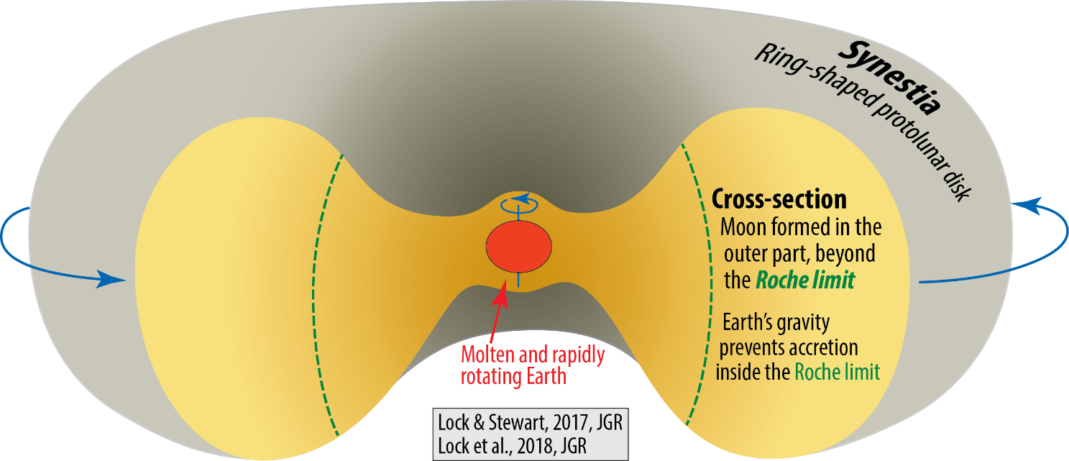
Moon has strong depletion in volatile elements, e.g. Zn, Cu, Na, K, Rb, Cs, Ga, Cr
RLE
Tartese et al. (2021, PNAS)
MVE
Did the volatile depletion happen
in the proto-lunar disc?
No!

Slide 18
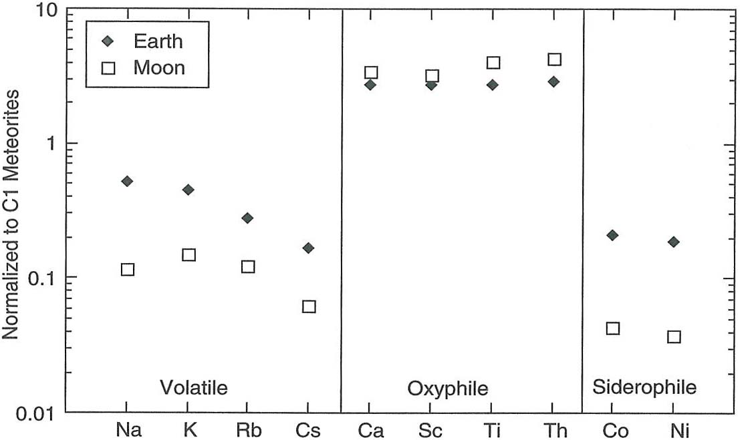
Earth-Moon bulk silicate compositional relations
Condie (2005, Earth as an Evolving Planetary System. Elsevier)
Theia was much
more devolatilized
than the Earth
New/late core segre
at low pressure

Slide 19
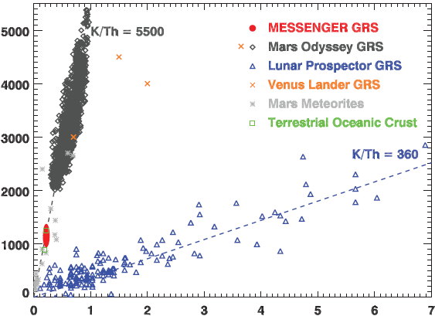
The Moon is distinctly more devolatilized than all of the
other terrestrial planets
K ppm
Th ppm
Peplowski et al. (2011, Science)

Slide 20
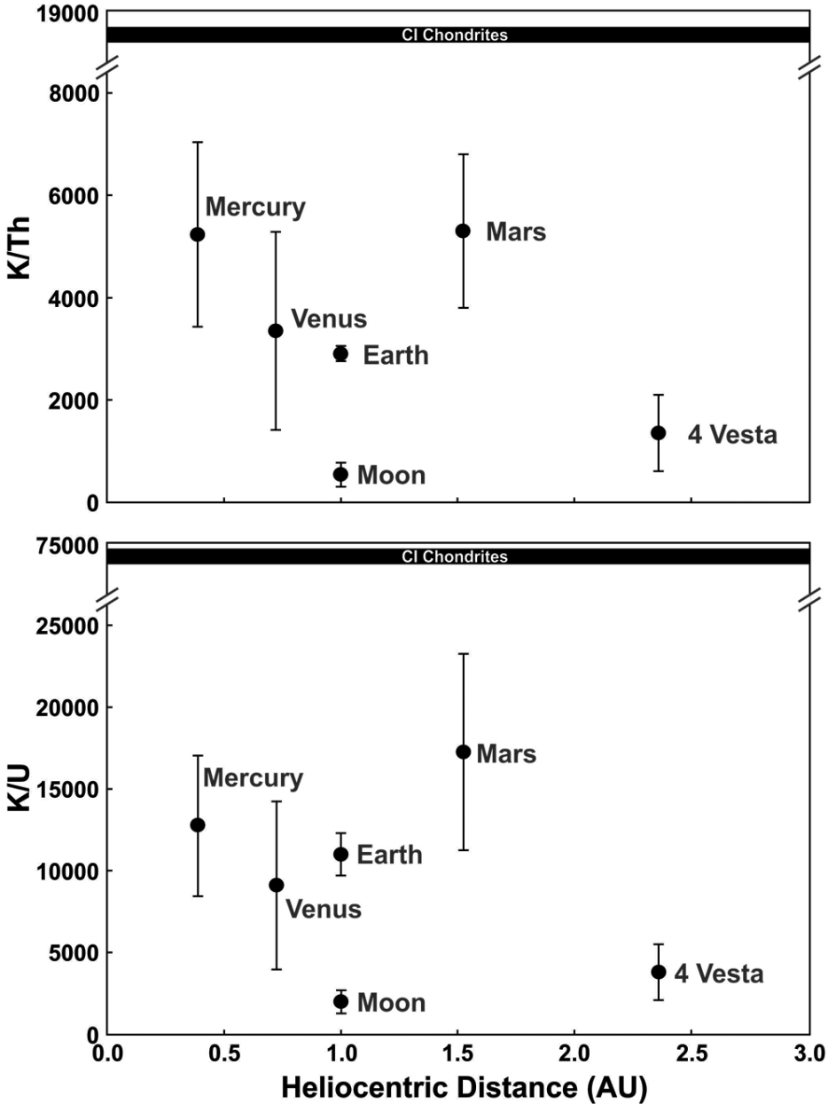
Mercury was thought to be strongly devolatilized during it accretion close to the Sun
γ-ray spectroscopy data from MESSENGER disproved this
McCubbin et al. (2012, GRL)

Slide 21
Cano et al. (2020, Nat. Geosci.)
High resolution O-isotope study of lunar basalts:
- very small but systematic variations
- the deepest magma ocean cumulates are most devolatilised
- O is not a very volatile element

Slide 22
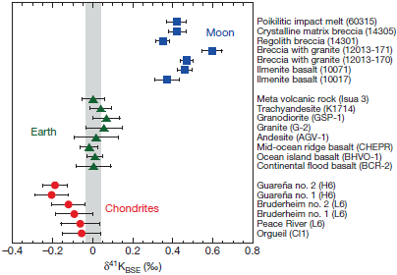
Wang & Jacobsen (2016, Nature):
Fractionated K-isotopes: enriched in the heavy ⁴¹K
δ⁴¹K_{BSE} = [(⁴¹K/³⁹K)_{sample/BSE} −1] *1000‰

Slide 23
Xia et al. (2019, GPL):
Similar isotope fractionation in Zn, Rb, Ga, K, Cu and even Fe
Paquet et al.
2023, EPSL

Slide 24
Earth and Moon overlap in RLE
RLE
MVE
Bulk
silicate
Earth
Bulk
lunar
mantle
Tartese et al.
2021, PNAS
Angrite parent body (APB): extremely devolatilised
Open symbols: siderophile
Filled symbols: lithophile
K/U_{CI-norm.}
Angrites:
Hu et al. 2022,
N. Comm.
(Angra dos Reis)
Rb/Sr_{CI-norm.}

Slide 25
Hu et al. (2022, N. Comm.):
Angrite parent body (APB):
extremely devolatilised and reduced
No corresponding δ⁴¹K enrichment for the APB:
- partial re-condensation of vapourised K with low δ⁴¹K
K/U_{CI-norm.}
263
(Angra dos Reis)
1737
3396
Rb/Sr_{CI-norm.}
6371
1353
APB size adjusted to
Tissot et al (2022, GCA)

Slide 26
Paquet et al.
2023, EPSL
volatile
CM
CV
CI
EH
CO
OC

Slide 27
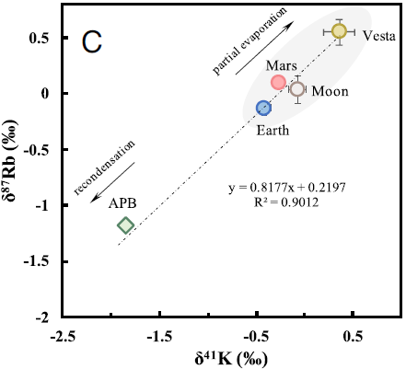
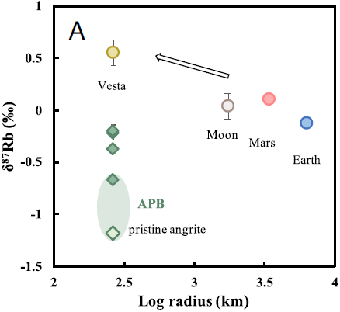
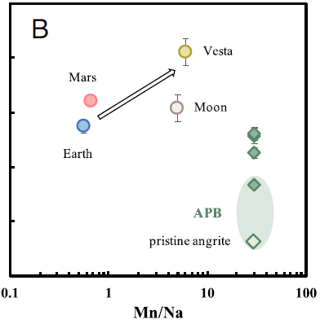

Slide 29
Tartese et al. (2021, PNAS)
Did the Procellarum impact cause
the lunar devolatilisation?
Impossible: Procellarum impact is far too late

Slide 30
Volatile content: intimately linked to the Rb/Sr-ratio
Rb: volatile, Sr: refractory
T_{C-50%}: 800 K, T_{C-50%}: 1455 K
Borg et al.
2022, PNAS
Unprocessed, primitive
meteorites
CI-chondrites and the Sun evolve very fast with much higher Rb/Sr-
ratios than the terrestrial planets
Rb-Sr systematics (< 9% of 87Rb has decayed in timing of volatile depletion
(establishment of SS-domains with different volatile contents)
Earth
Mars
Moon
0.70 10
Moon and Earth: extremely early volatile depletion
4566 and 4561 Ma model ages (Δt: 1 and 7 My), based on:
- the 4.35 Ga lunar anorthosite 60025
- a 3.45 Ga pyroxene from a Barberton komatiite
(⁸⁷Rb/⁸⁶Sr = 0.087 from McDonough & Sun, 1995)
Borg & Carlson,
2023, AREPS
0.7040
0.7020
0.7000
APB: ⁸⁷Rb/⁸⁶Sr = 0.005
(Angrite parent body)
0.6985
0.6980

Slide 31
Meteroritic and planetary O-isotope relations: δ¹⁷O versus δ¹⁸O
Terrestrial Fractionation Line, slope: ~ (−1/2)
CCAM: Carbonaceous Chondrite Anhydrous Mineral Line, slope: ~ (−1/1)

Slide 32
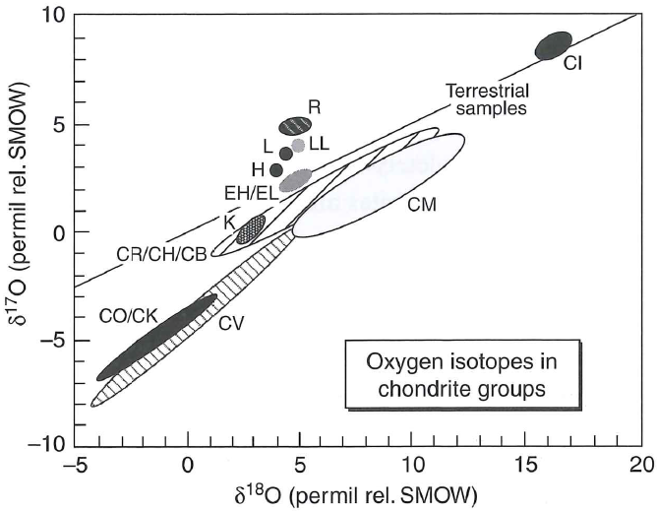
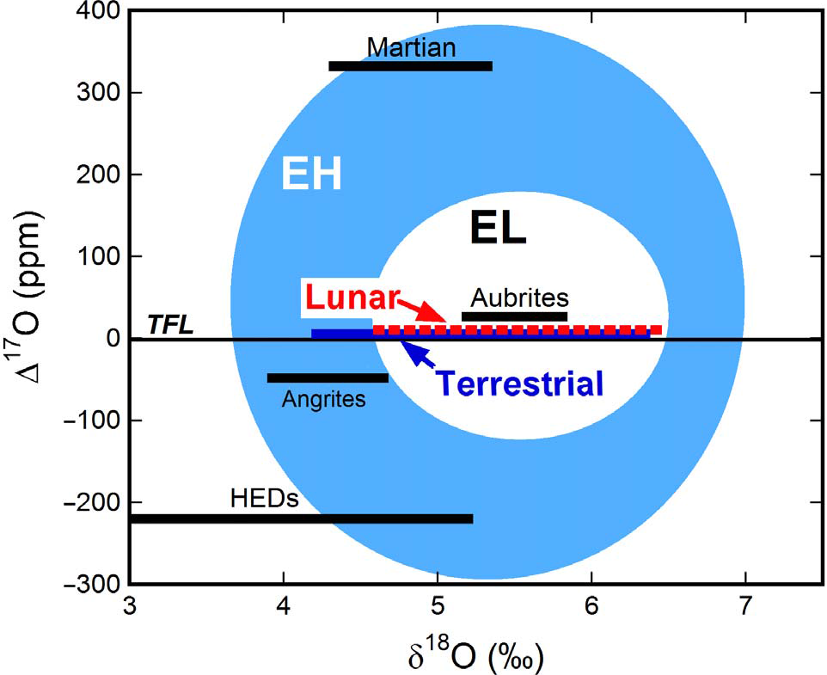
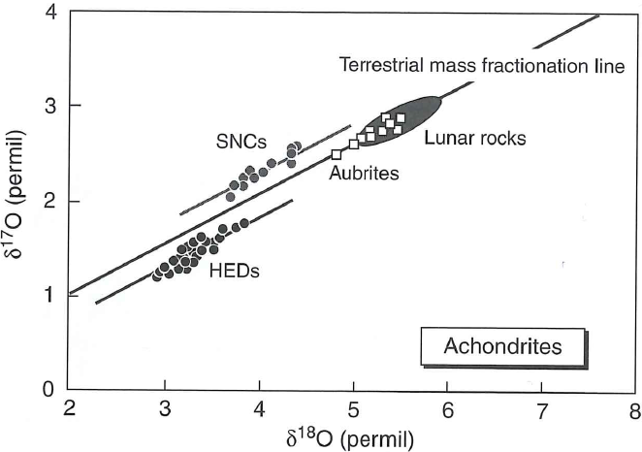
Common heritage: EC-aubrite-Earth-Moon common heritage
McSween & Huss, 2010:
Cosmochemistry.
Cambridge Univ. Press
Δ¹⁷O: vertical distance below or above TFL
Δ¹⁷O = δ¹⁷O − 0.5 δ¹⁸O
Δ'¹⁷O = δ'¹⁷O − 0.5247 δ'¹⁸O
Greenwood et al. (2018,
Sci. Adv. 4, eaao5928)
McSween & Huss, 2010:
Cosmochemistry.
Cambridge Univ. Press
basaltic achondrites

Slide 33
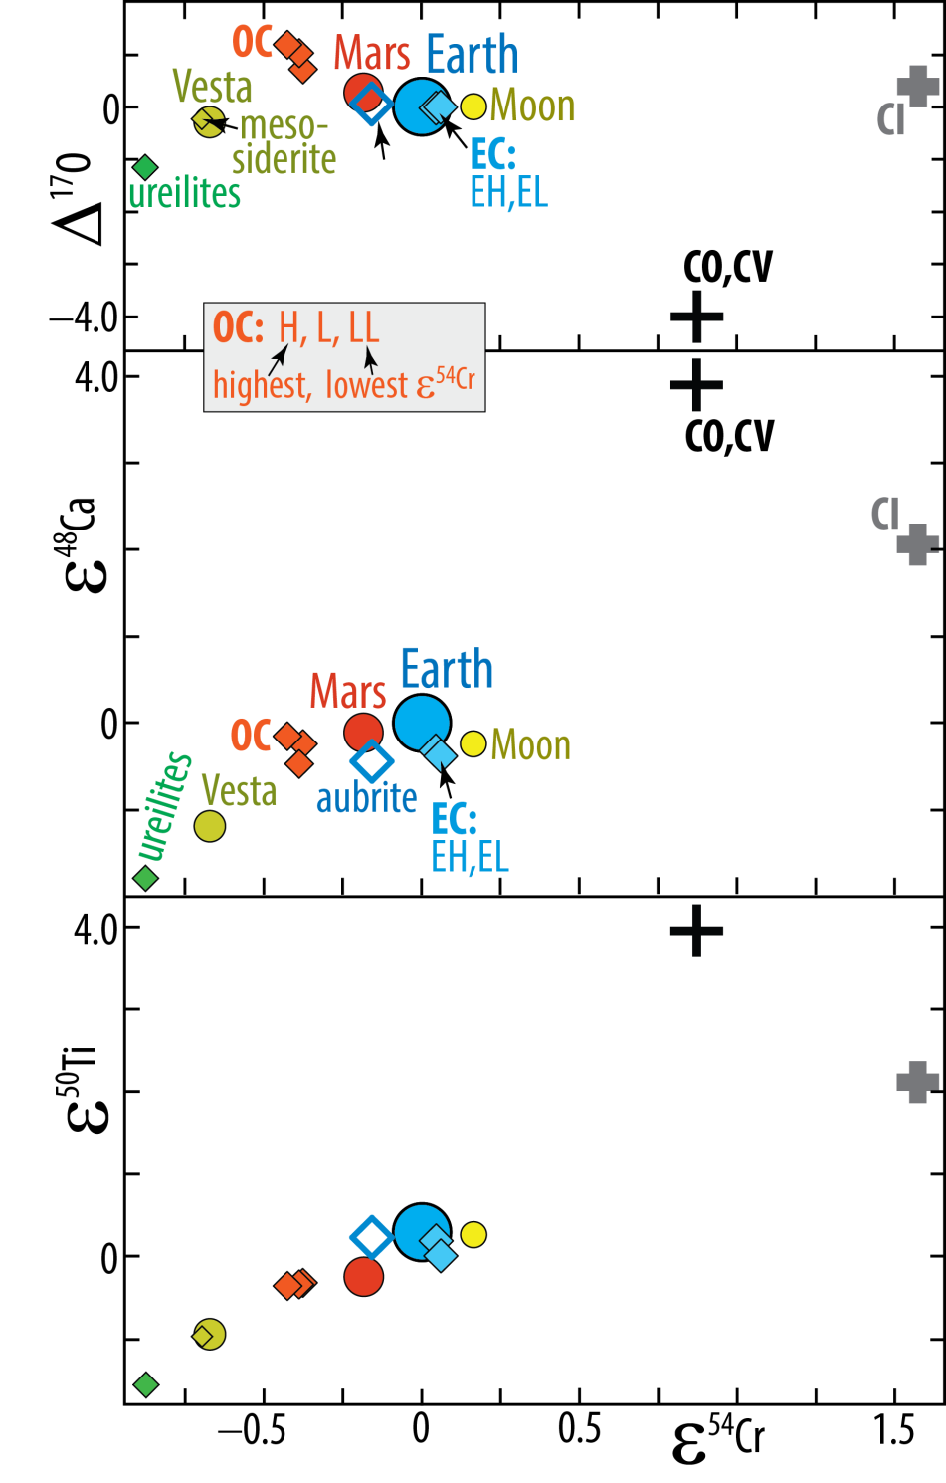
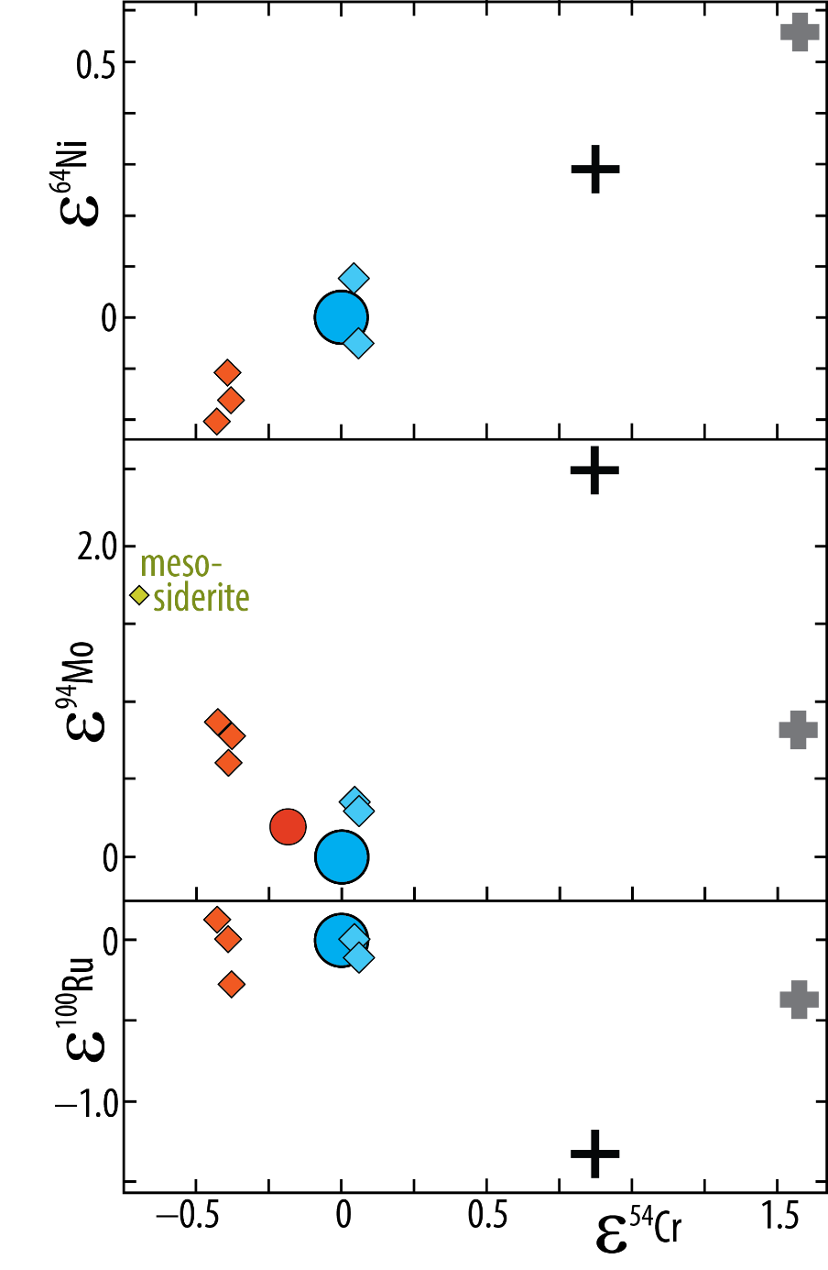
Geochemical provenance, planets-meteorites
Warren (2011, EPSL)
Dauphas (2017, Nat.)
aubrite
⁶⁴Ni/⁵⁸Ni
NC CC
Non-cabonaceous Carb.
chondrites chond.
⁴⁸Ca/⁴⁴Ca
NC CC
Enrichm. of
r-process nucl.
Supernova
nucleosynthesis
⁹⁴Mo/⁹⁶Mo
Low ε⁹²Mo:
s-process dominance
⁵⁰Ti/⁴⁷Ti
¹⁰⁰Ru/¹⁰¹Ru
⁵⁴Cr/⁵²Cr

Slide 34
Burkhardt, 2021, Elements

Slide 35
Burkhardt, 2021,
Elements

Slide 36
Late accretion, Mo-isotopic signal
Mo is siderophile
- Mo in BSE and BSM is mostly from late accretion, involving a significant CC-fraction.
- But the late accretion material arrived too late to be segregated via the magma ocean to the core
- Therefore the apparent CC-fraction viewed from Mo-isotopes is exaggerated
Burkhardt et al.,
2021, Sci. Adv.
Budde et al. (2019,
Nature Astronomy)
⁹⁵Mo/⁹⁶Mo
⁹⁴Mo/⁹⁶Mo

Slide 37
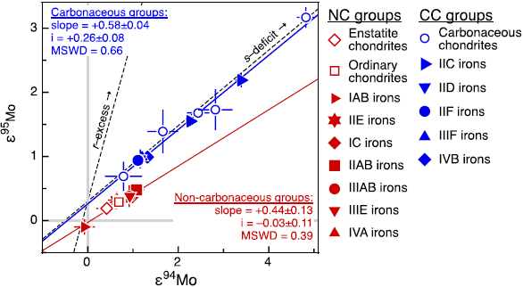
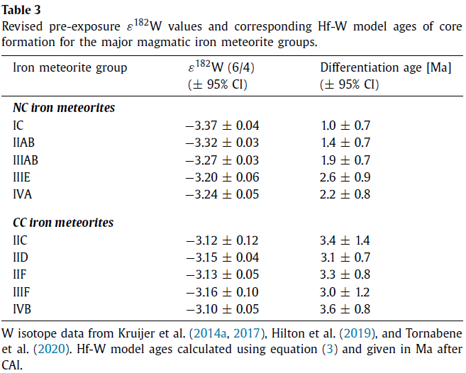
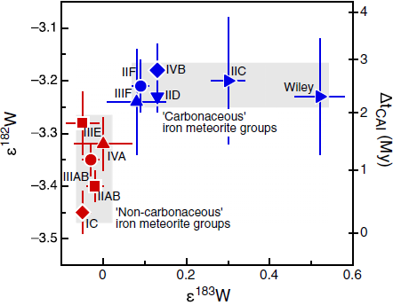
Provenance and time scales, Fe-meteorites
s-excess
Spitzer et al.
(2020, AstrJL)
Kruijer et al.
(2017, PNAS)
higher ε¹⁸²W, ε¹⁸³W > 0
Young and r-process excess
¹⁸²Hf → ¹⁸²W t_{h}: 9 My
low ε¹⁸²W: old, ε¹⁸³W ≈ 0:
no nucleosynth. anomaly
lithophile
siderophile

Slide 38
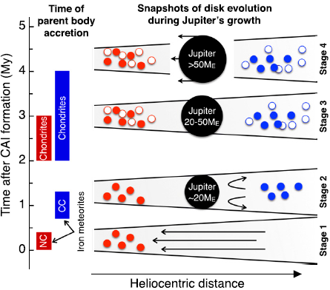
Provenance and time scales
Kruijer et al. (2017, PNAS)
Current Jupiter size: 138 M_{E}
Jupiter has opened a gap in the disc, moves
inwards and disrupts the disc, 3.6 - 5 My:
- mixing of NC and CC material
- Mars: ≤ 5 % CC (had already accreted, pre-3.6 My)
- Earth: ≤ 25 % CC (accretion time: 60-100 My)
OC
CC
IPB
Jupiter barrier maintained, 2 - 3.6 My:
- separate NC and CC planetesimals (IPB, OC, CC)
- planetary embryo Mars is 90 % accreted
IPB
Jupiter barrier established, 0.8 - 2 My:
- separate NC and CC planetesimals (IPB)
No Jupiter barrier, Δt: 0 - 0.8 My:
- unimpeded inflow of gas and dust
- earliest planetesimals (iron met. parent bodies, IPB)

Slide 39
Dauphas & Schauble,
2016, AREPS
Correction for cosmogenic
exposure, lowering the ε⁵⁰Ti

Slide 40
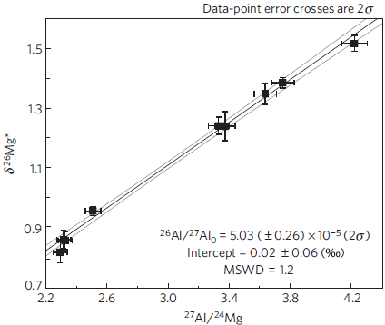
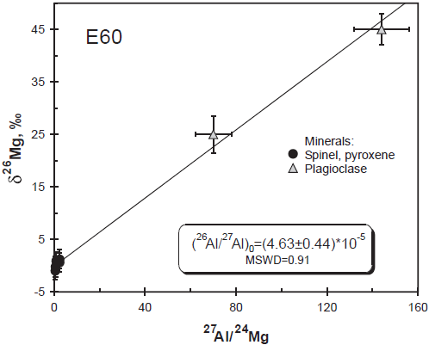
Measuring initial ²⁶Al / ²⁴Al at t₀
δ²⁶Mg = [(²⁶Mg/²⁴Mg)_{sample/stand} -1] * 1000%
CAI, Efremovka
CAI, Northwest Africa 2364
CV3 chondrite
Amelin et al. 2002, Science
Bouvier & Wadhwa 2010, Nature Geoscience

Slide 41
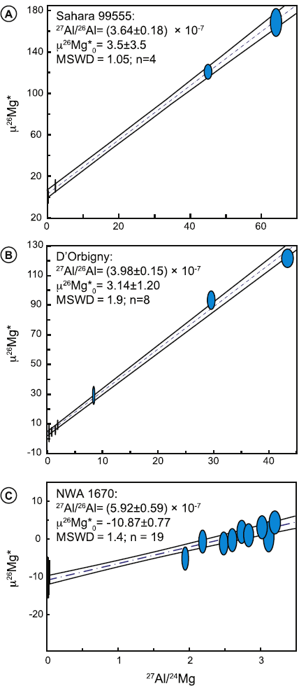
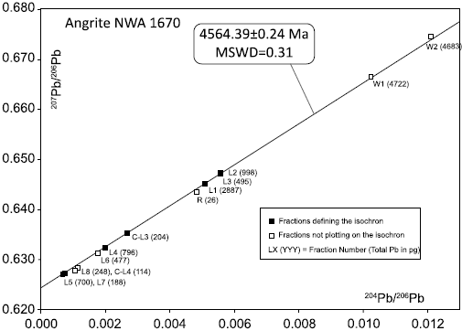
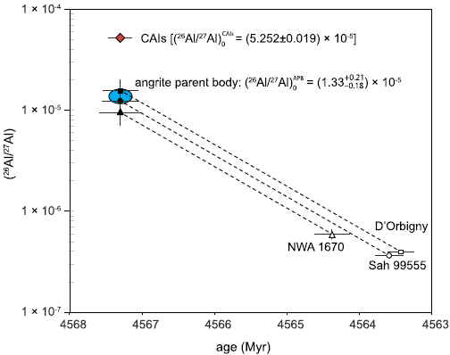
Investigation of the ²⁶Al/²⁷Al ratio in the angrite parent body Schiller et al. (2015, EPSL)
Angrite
basaltic achondrite
mostly augite, minor
oliv, plag, troilite
2 fsp
Age: 4563.58 Ma
1 ol, 1 WR
(²⁷Al/²⁶Al)₀ = 1.33*10⁵
3-4 times lower than
the canonical value!
3 fsp
Age: 4563.42 Ma
5 ol-px-WR
9 fsp/px
10 ol
Age: 4564.39 Ma

Slide 42
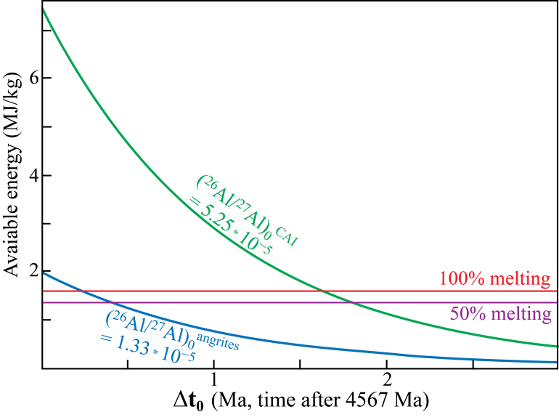
A lower, angrite-like ²⁶Al/²⁷Al-ratio requires early planetesimal formation and heating
Schiller et al (2015, EPSL)

Slide 43
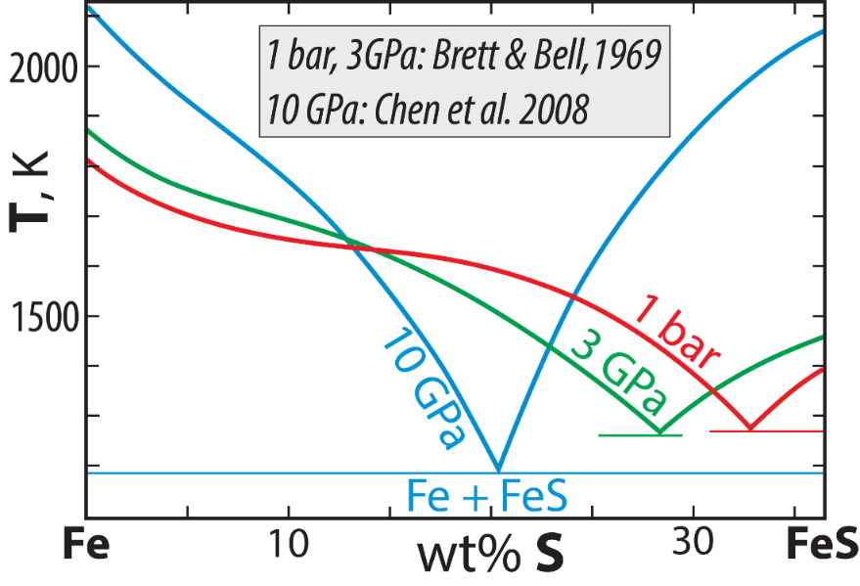
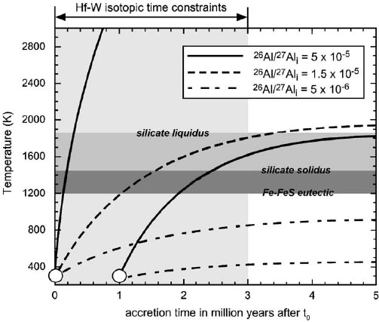
S-rich cores of Mars, Vesta
and Fe-meteorites. Why?
Fe-FeS eutectic (right figure) and relatively high f_{O2} favour initial Fe-sulfide melt segregation to the incipient core
Model for ²⁶Al-heating of chondritic
object, 60 km in diameter
Trønnes et al. (2019,
Tectonophys.)
Canonical CAI-based
²⁶Al/²⁷Al initial ratio
Walter & Trønnes
(2004, EPSL)
The canonical, CAI-based ²⁶Al/²⁷Al-ratio results in a very extensive
and long heating period for planetesimals
The presence of undifferentiated planetesimals then requires either:
- a long period of planetesimal accretion or
- a delay for the initial accretion relative to t₀
in contradiction to most dynamic models

Slide 44
The young Moon
Lan Zhang, Norwegian Univ. Science and Technology

Slide 45
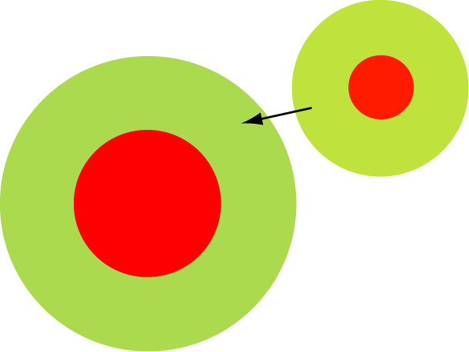

Giant collisions:
largely molten planetary embryos and planetesimals with segregated cores
Extent of core-mante re-equilibration
Two extremes
Minimal re-equilibration
Impactor core merges directly into big core
Extensive re-equilibration
Impactor core emulsifies in silicate magma ocean
Problem with many early, low-energy models
- Moon formed mostly from the impactor (Theia) mantle
- Insufficient equilibration with the Earth
Pahlevan and Stevenson (2007, EPSL)
Lock & Stewart (2017, JGR)
Lock et al. (2018, JGR)
Vapour disc equilibration

Slide 46
Old APB (angrite parent body), young Moon mantle sources
APB:
ΔT: (<)10 My
¹⁸²Hf → ¹⁸²W,
t_{h}: 8.9 My
life-time: ~ 40-60 My
Moon: ΔT >5-8 t_{h}, ΔT >45-71 My, t <
The lunar samples do not record any ¹⁸²W-ingrowth

Slide 47
Old Mars,
young Moon
mantle sources
and FAS
¹⁴⁶Sm → ¹⁴²Nd,
t_{h}: 103 My
life-time: ~Hadean,
~500 My
White symbol
cores: ε¹⁴⁹Sm < 5
(little correction for
neutron capture)

Slide 48
Long-lived Sm-Nd and Lu-Hf systematics
¹⁴⁷Sm → ¹⁴³Nd,
t_{h}: 106 Gy
¹⁷⁶Lu → ¹⁷⁶Hf,
t_{h}: 36 Gy

Slide 49
Oldest Jack Hills zircons,
Valley et al. (2014, Nat. Geosci.)
Harrison (2020, Hadean Earth, Springer)

Slide 50
Summary of lunar chronology

Slide 52
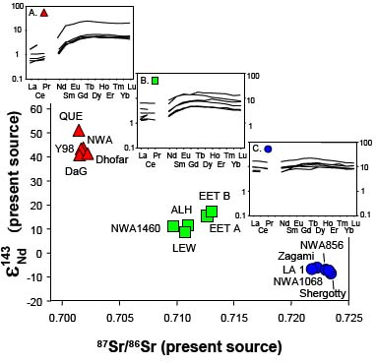
Comparative mantle heterogeneity of Earth, Mars, Moon
Mars: 5 times wider mantle array that for Earth
Reflects heterogeneities produced by magma ocean crystallization the primordial magma
Group A pattern
Mars mantle
Earth
Borg, LPI Contrib. 1335, 2006
Borg et al. 2003, GCA

Slide 53
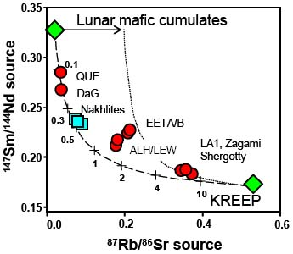
Moon: even larger compositional range than Mars
In spite of probable mantle cumulate turn-over and intense mare basalt volcanism at 3.8 − 3.6 Ga:
Inefficient homogenization of magma ocean heterogeneities in both Mars and the Moon.
Borg, LPI Contrib.1335, 2006
Borg et al.
2003, GCA

Slide 54
Chronological summary
CAI: t₀: 4567.3 ± 0.2 Ma
Chondrules: Δt ≈ ± 0-3 My
Small planetesimals, including Fe-meteorite PB:
Δt < 0.5 My, using the low (²⁶Al/²⁷Al)₀ ratio from the angrites
Δt < about 1 My, using Hf-W-systematics
Chondrites: Δt > 1-2 My (after most of the ²⁶Al-decay)
Hf-W systematics of core segregation:
Fe-meteorite parent bodies: < 1 My
Vesta: Δt = 1-2 My
Mars: Δt ≈ 3 My
Important implication:
Chondrite parent bodies accreted rel. LATE: Δt > 1-2 My
after most of the ²⁶Al (primary heat source) had decayed

Slide 55
Late accretion, the "late veneer"
Alexandra Ostroverkhova, Rutgers Univ., USA
Early mantle differentiation and the question
about geochemically isolated reservoirs
Nidha Eriyattukuzhiyil, Michigan State Univ., USA and Univ. of Bristol, UK

Slide 56
Extra slides

Slide 57
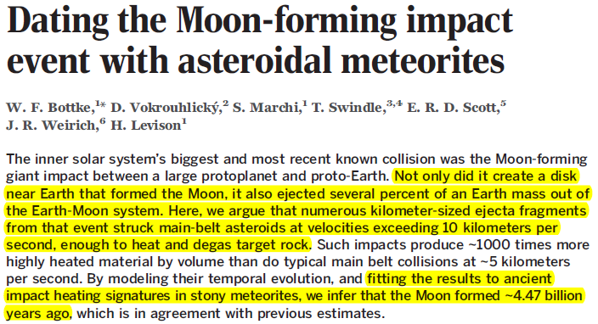
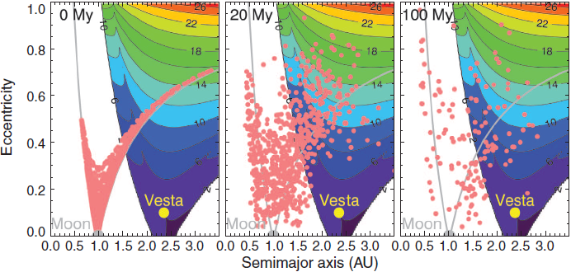
Science,
April 17, 2015
Model based on Ar-Ar and U-Pb impact ages
High frequency of meteoritic impact ages at
about 4.47 Ga ~ Moon-forming impact (GI).
Dynamical evolution of GI ejecta:
colour contours are collision velocities at about 2.5 AU (Vesta-position)

Slide 58
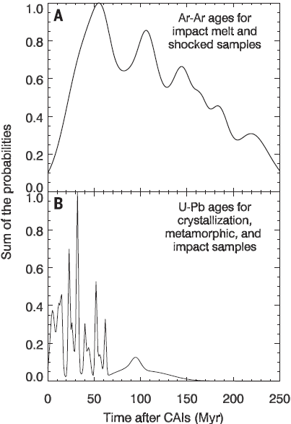
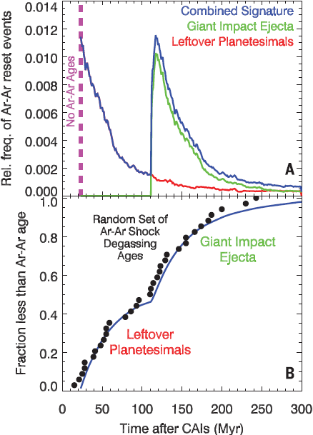
4.57
4.47
4.37
4.57
4.47
4.37
Few ages of
4.3-4.1 Ga,
but many at
4.1-3.5 Ga: LHB
Mixed cryst,
metam, and
impact ages
Only impact
heating ages
Only impact
heating ages
110
Model supports giant Moon-forming impact at 80-120 Ma

Slide 59



The homogenization process (Earth's mantle)
can be dated by the short-lived Sm-Nd-system
Short-lived system ¹⁴⁶Sm → ¹⁴²Nd (t_{h}: 103 Ma – alive for about 500 Ma)
ε₁₄₂ = [(^{142/144}Nd_{sample}/^{142/144}Nd_{stand}) - 1] * 10⁴

Slide 60

Earth is very homogeneous
with respect to ε¹⁴²Nd
Boyet and Carlson,
Nature, EPSL 2005, 2006)
If Earth is
chondritic, then
Hidden
enriched layer?
Alternatively: Earth may have a super-chondritic Sm/Nd ratio

Slide 61

Possible explanations
Alternative 1
Nebular disc fractionation
(e.g. Hewins & Herzberg 1995, EPSL; Caro et al. 2008, Nat,; Dauphas et al. 2015, EPSL; Johnston et al. 2022, Nat.)
- generally high Sm/Nd-ratios in CAI and chondrules in the solar nebula
- fractionation of refractory solids (e.g. olivine, also high Mg/Si, and oldhamite) towards the disc mid-plane is likely
- planets forming preferentially from mid- plane material would have high Sm/Nd
Caro et al.
2008, Nature
Johnston et al.
2008, Nature
Alternative 2
(e.g. Frossard et al. 2022, Sci.)
Collisional erosion of early planetary crusts would preferentially remove enriched material with low Sm/Nd

Slide 62
Super-chondritic Mg/Si (and Sm/Nd) ratios in
the Earth's convecting mantle
Fractional condensation of forsterite
Dauphas et al. (2015, EPSL)
core-incorp.
of Si

Slide 63
The super-chondritic Mg/Si ratio of the Earth's convecting mantle
Fractional condensation of forsterite
(Dauphas et al. 2015, EPSL)
3.5 wt% Si
in the core
Core-incorp.
of Si

Slide 64

Older, less relevant?
Perhaps bulk Earth does NOT have chondritic Sm/Nd
--- but rather superchondritic Sm/Nd
Earth: almost no ε¹⁴²Nd-variation (except a few Archean rocks)
→ mantle convection has erased pre-4Ga heterogeneities
Mars, Moon, Vesta: large ε¹⁴²Nd-heterogeneities (pre-4Ga) still exist
Magma ocean heterogeneities - more limited heat loss from mantle and core
Caro et al.
2008, Nature
Mars

Slide 65




However, there are a few Hadean or Archean heterogeneities
Enriched ε¹⁴²Nd in Haden rocks
the Nuvvuagittuq greenstone belt
O’Neil et al, Science 2008, 321, 1822
ε¹⁴²Nd correlated with Sm/Nd-ratio
Traditional ¹⁴⁷Sm-¹⁴³Nd-isochron dating:
Ultramafic to gabbroic sill
Gabbro sills with gneissic texture

Slide 66


Upadhyay et al. (2009, Nature):
Enriched Hadean reservoir in cratonic roots ?
DC: Dharwar craton
BC: Bastar craton

Slide 67


Could the primordial-like He and Ne isotope ratios result from core contamination?
Unlikely: - Although tiny additions of core metal to plume roots explain clear W- and weak Xe-isotopic signals, they are
probably insufficient to generate the primordial-like He-Ne isotopic signals
- High ³He/⁴He is generally associated with refractory mantle sources (PREMA-FOZO)
- Parts of the refractory sources seem to have formed in the Hadean: Baffin Island, Reunion, Samoa, Hawaii
Short-lived Sm-Nd-system
¹⁴⁶Sm→¹⁴²Nd t_{h}: 103 My, "live" for about 500 My.
The Nd-daughter partitions to melt more than Sm.
Bm-residues/cumulates: high Sm/Nd ratio, high μ¹⁴²Nd
μ¹⁴²Nd = (^{142/144}Nd_{sample} / ^{142/144}Nd_{standard} − 1) *10⁶ (ppm)
ε¹⁴³Nd = (^{143/144}Nd_{sample} / ^{143/144}Nd_{standard} − 1) *10⁴ (pp 10⁴)
Peters et al. (2018, Nature)
Reunion basalts
Positive correlation
³He/⁴He (plume flux)
versus μ¹⁴²Nd

Slide 68
Horan et al.
(2018, EPSL)
5
μ¹⁴²Nd, ppm
0
−5
Samoa
Ofu
04-14
10
20
30
−15
−5
0
5
³He/⁴He, R/R_{atm}
μ¹⁸²W
Residues after melt extraction
at: 4.57 (SS age), 4.50 and 4.42 Ga
20
Original mantle reservoir:
μ¹⁴²Nd = ε¹⁴³Nd = 0
¹⁴⁷Sm/¹⁴⁴Nd: 0.196
Small black symbols on
residue trends corresponds
to ¹⁴⁷Sm/¹⁴⁴Nd:
0.200, 0.204 and 0.208
4.57 Ga
10
4.50 Ga
Loihi
02-02
5
4.42 Ga
Hawaii
μ¹⁴²Nd, ppm
0
Enriched mantle
−5
−5
0
5
−10
μ¹⁴³Nd
μ¹⁴²Nd, ppm
−400
0
400
−4
0
4
ε¹⁴³Nd

Slide 69

Primary kimberlites
Negative correlation: μ¹⁴²Nd- μ¹⁸²W ? No clear correlation with W-concentration
OIBs
Are W-conc. and μ¹⁸²W correlated ??
(Fig. S2, Yoshino et al., 2020, EPSL)

Slide 70



Early Moon age: 4.51 Ga (ΔT: 60 Ma),
from Hf-isotope composition of early crustal zircons
Barboni et al. (2017, Sci. Adv.)

Slide 71
Additional time constraints on the Moon
Halliday (2008, Phil.Trans.R.Soc.):
Agreement between Rb-Sr- and U-Pb-model ages for the Moon:
4.47 ± 0.02 Ga (i.e. Δt: 100 Ma)
based on Rb- and Pb-loss from Moon by volatilization
and
the oldest date of lunar anorthositic crust: 4.46 ± 0.04 Ga
(Norman et al. 2003)
⇓
Earth-Theia collision and Moon formation: Δt ≈ 100 Ma

Slide 72
Spitzer et al.,
2020, Astr J L

Slide 73
Dauphas & Schauble,
2016, AREPS

