Slide 1
Discovery of CaIrO₃-structured "post-perovskite": 2004
This discovery was long overdue and spurred a minor revolution in deep-Earth
mineral physics and geodynamics.
Science, 2004
Nature, 2004
Discovery of Mg-silicate perovskite (MgSiO₃-dominated) = bridgmanite in the Tenham meteorite: 2014
Some of us have since referred to the CaIrO₃-structured phase as post-bridgmanite
Science, 2004

Slide 2
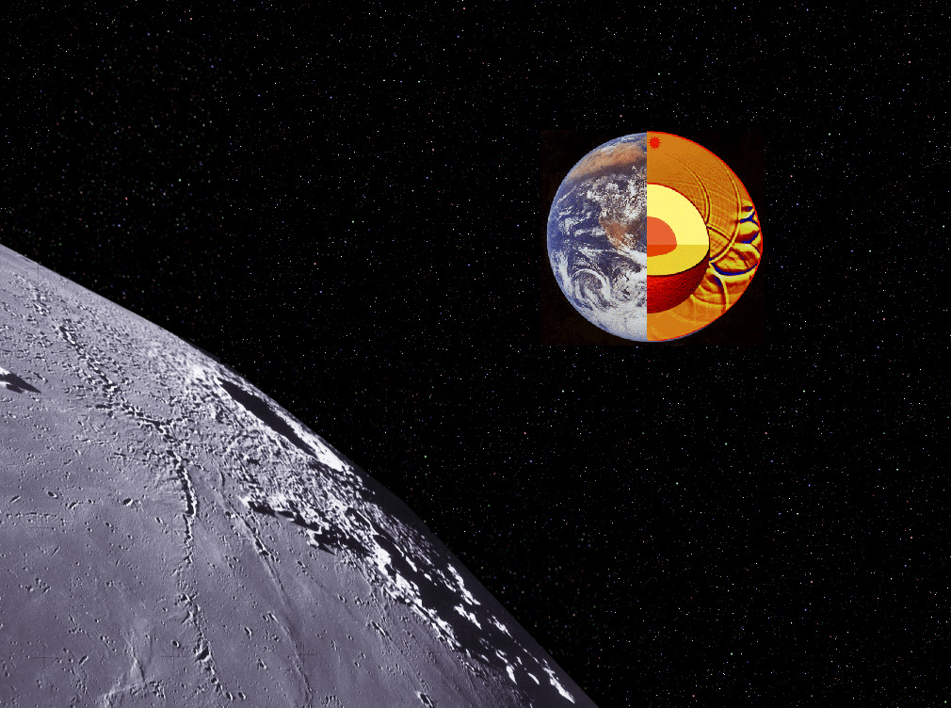
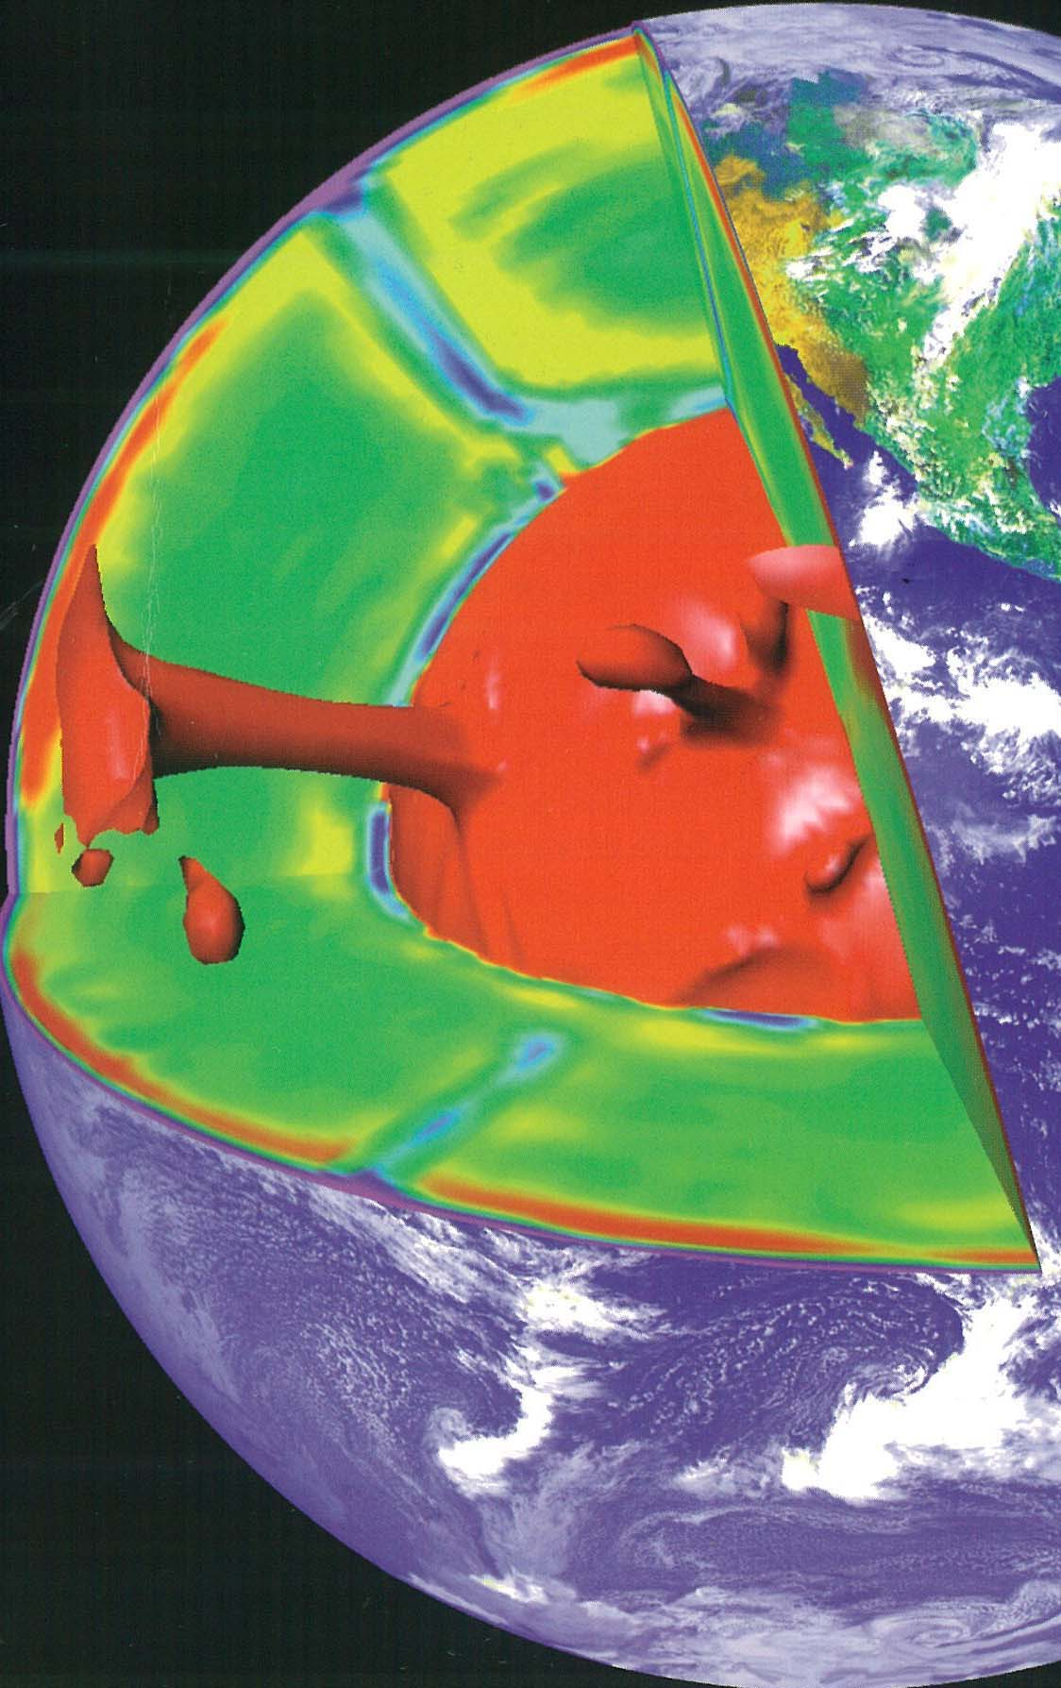
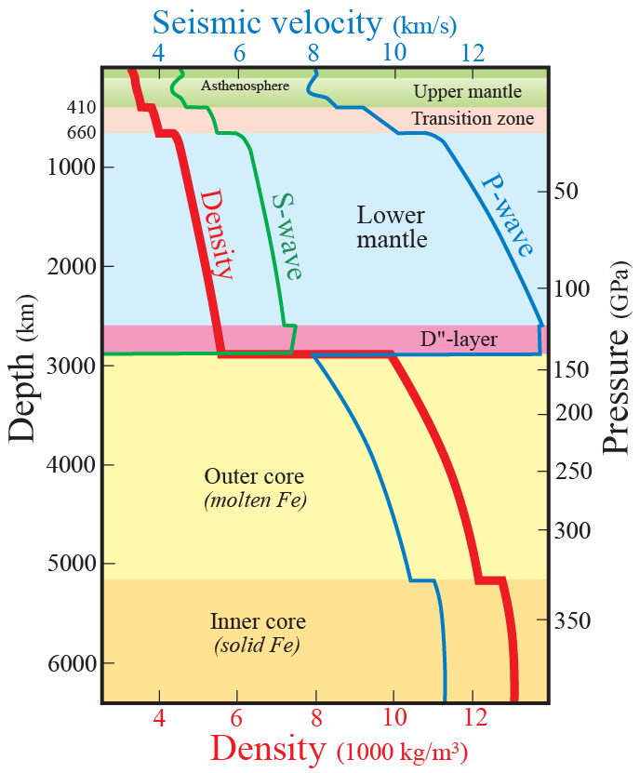
Mineral physics and seismic constraints on Earth’s structure and dynamics
Earth stucture, seismology, mineralogy, elasticity

Slide 3
Primary source of information about the deep interior structure:
seismological data
Other sources of information, Earth structure and dynamics
Gravitational field
Magnetic field
Heat flow, dynamic topography and geoid
Plate movements
Cosmochemistry and geochemistry
High pressure mineralogy and mineral physics: experimental – computational

Slide 4
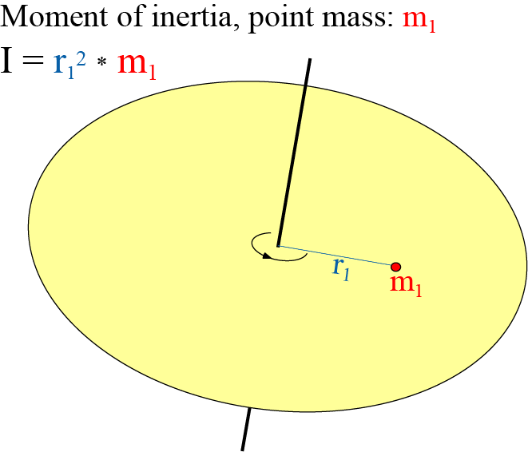
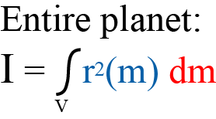
Other planets: no seismology
except rudimentary Mars and Moon seismology (Insight- and Apollo-missions)
Planetary mass distribution: determined via simple flyby
Moment of inertia factor, MIF
MIF = I / R² M
Homogeneous massive sphere: MIF = 0.4
Planet with high-density core: MIF < 0.4
Planetary rotation axis = axis of maximum moment of inertia
The axis of minimum moment of inertia is in the equatorial plane

Slide 5
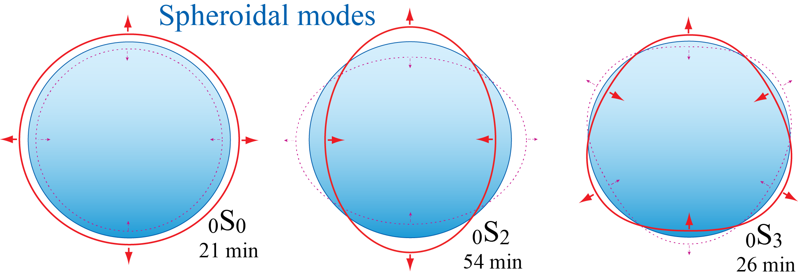
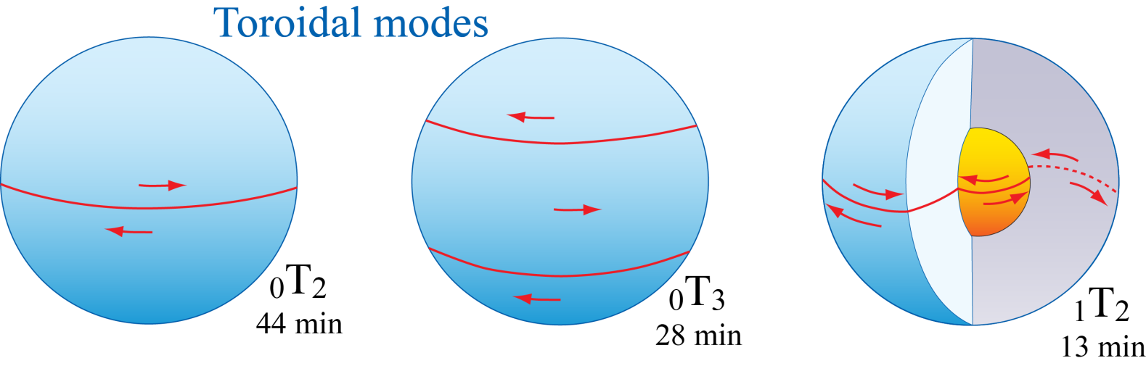
Normal modes
Global, very low frequency vibrations of the entire Earth

Slide 6
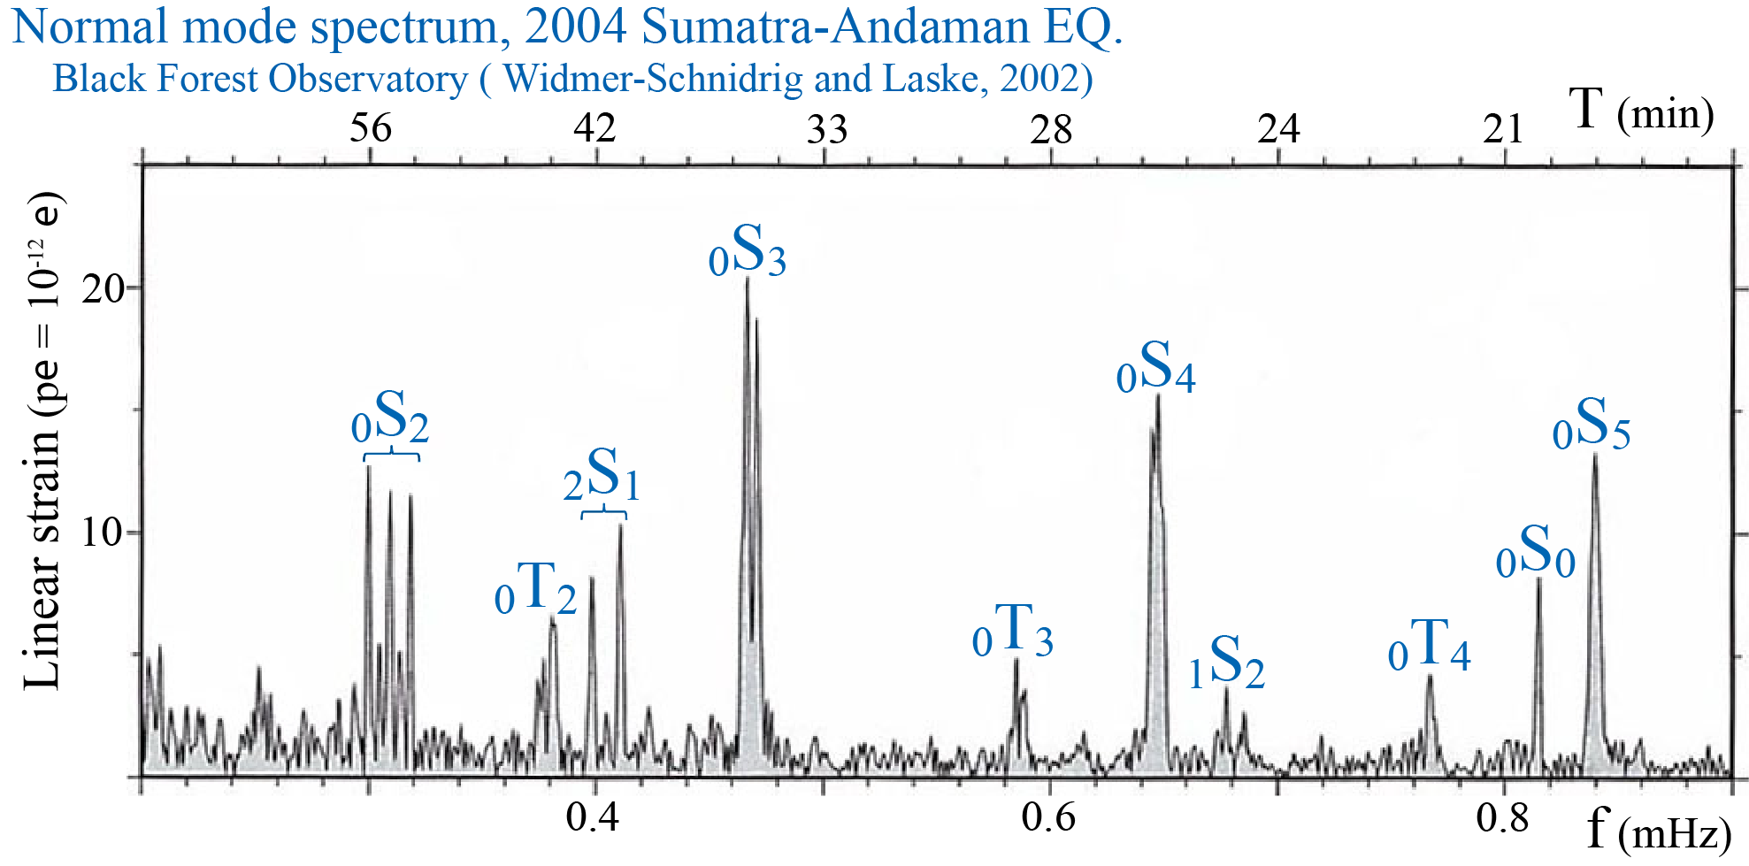
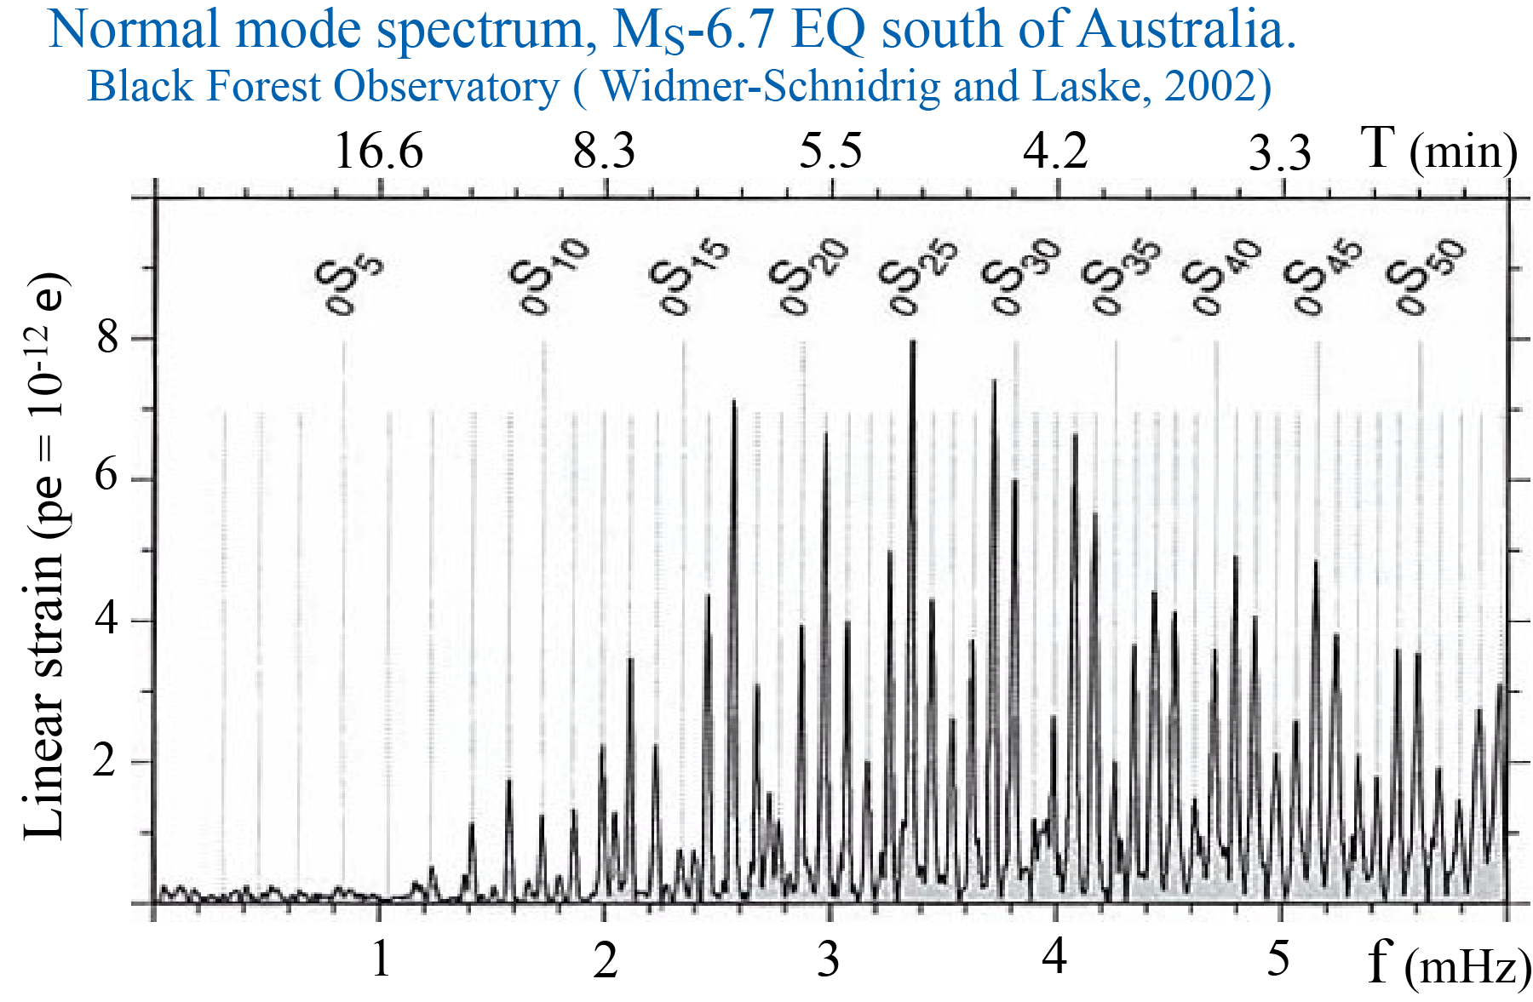
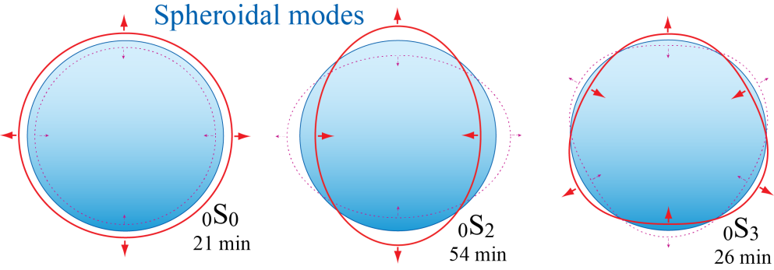
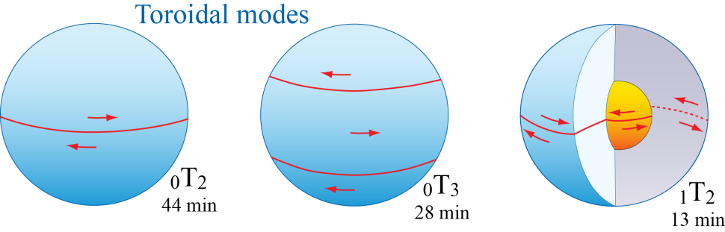
1 mHz =
1cycle / 17min

Slide 7
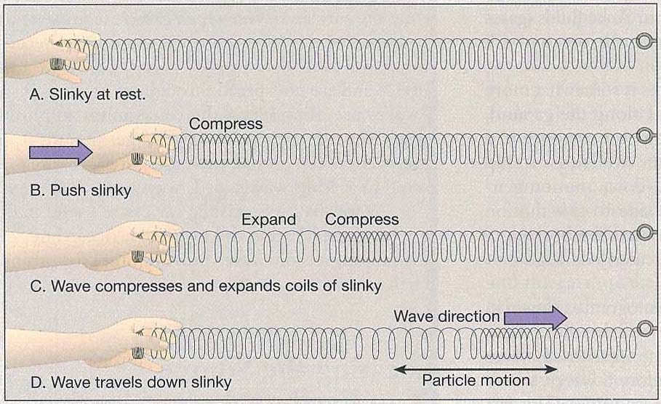
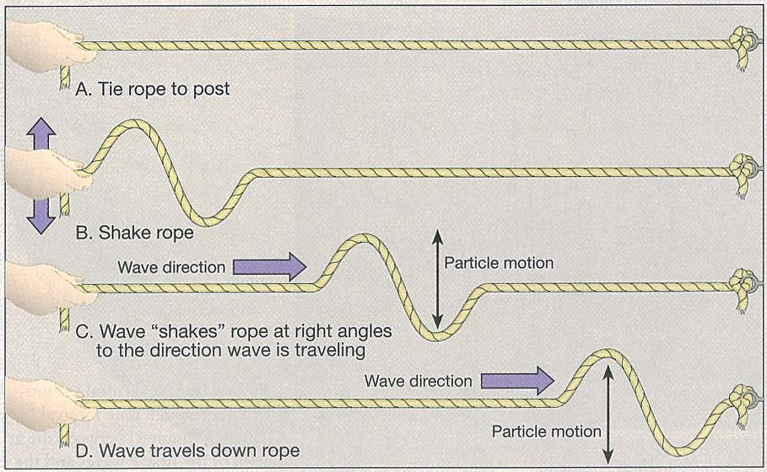
P-waves
Just like sound waves through
air (pressure waves)
S-waves

Slide 8
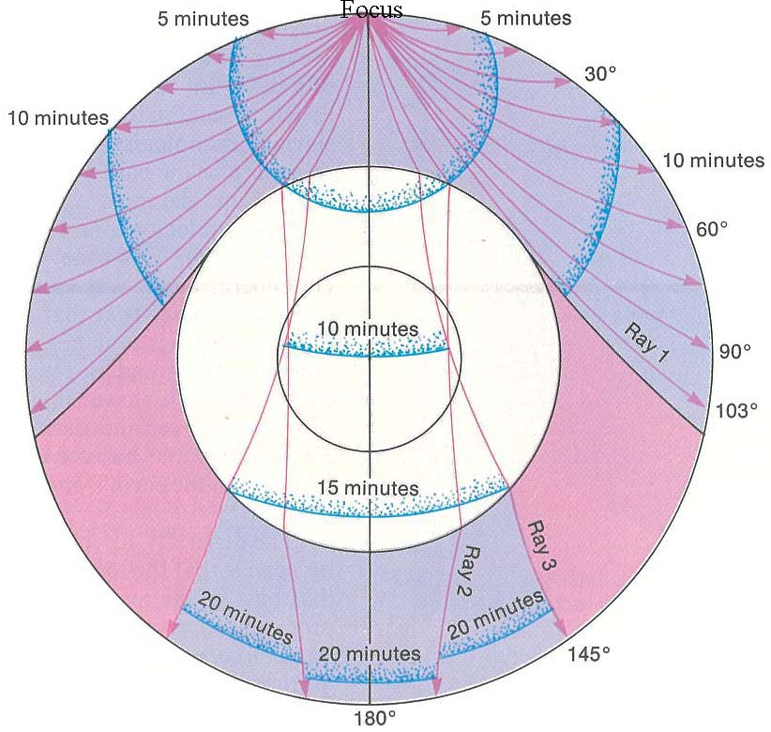
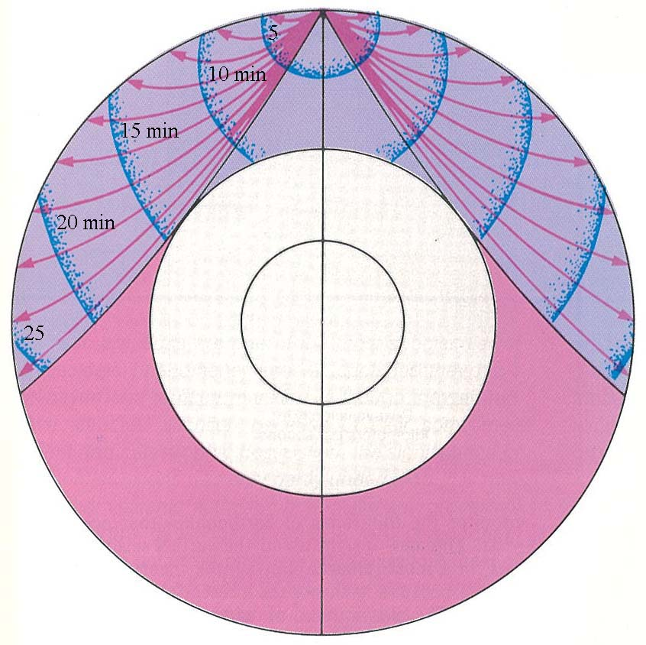
P-wave
S-wave

Slide 9
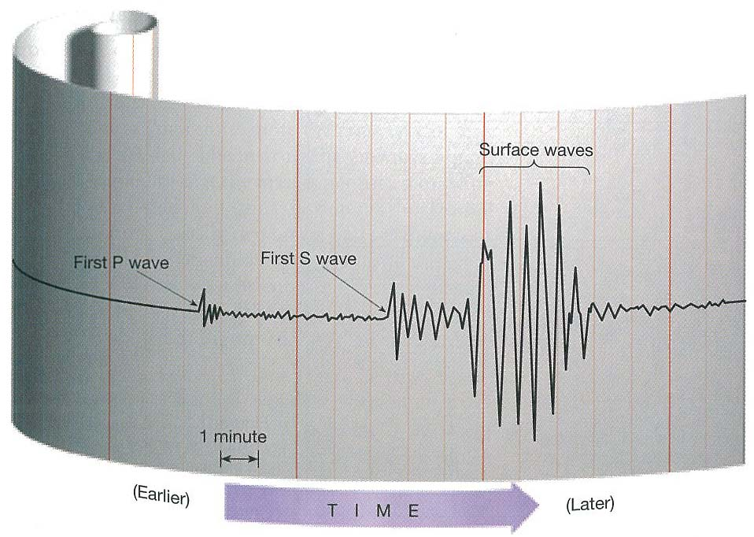

Slide 10
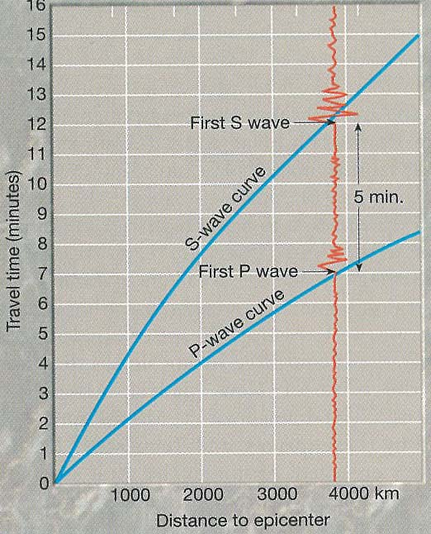
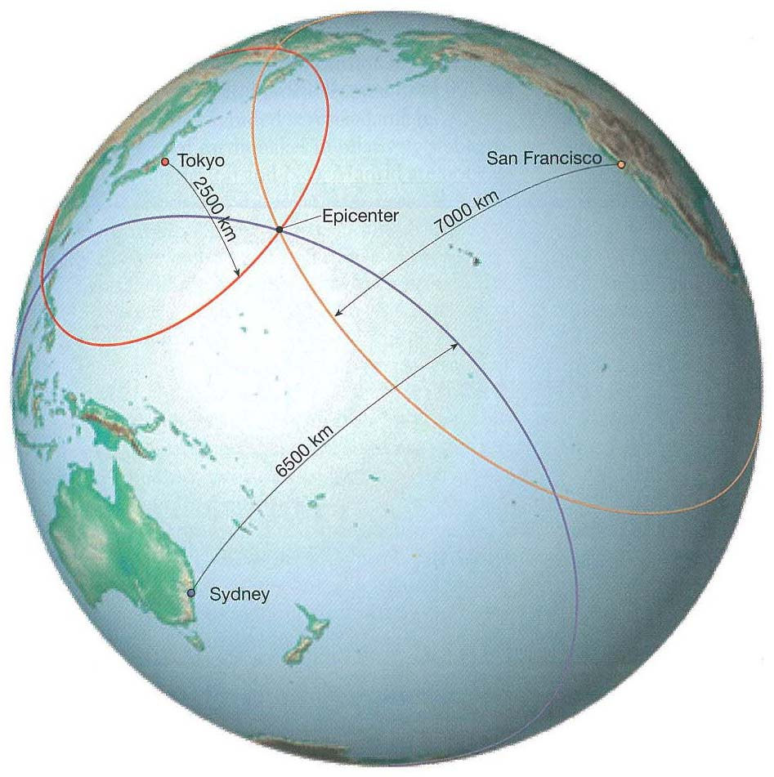

Slide 11
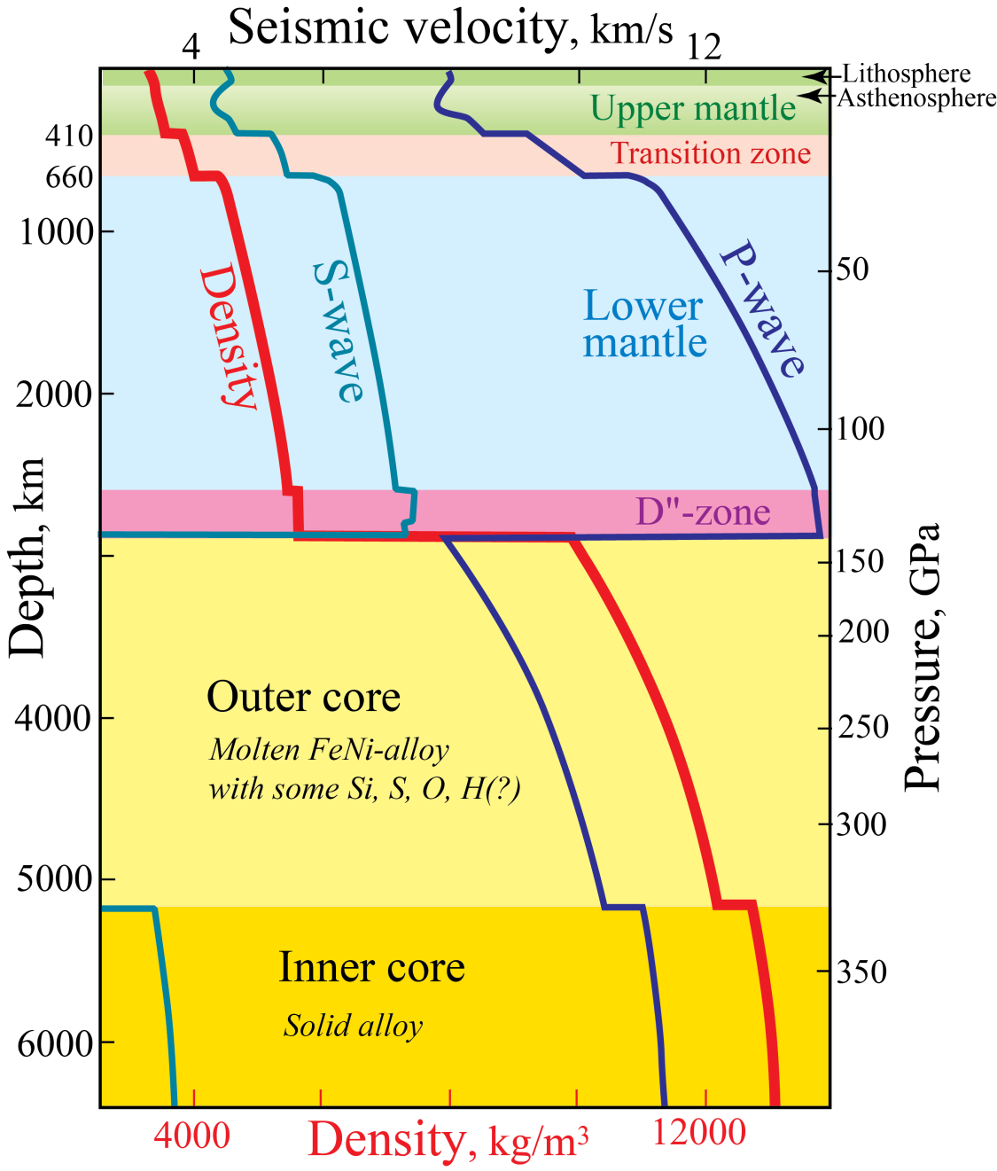
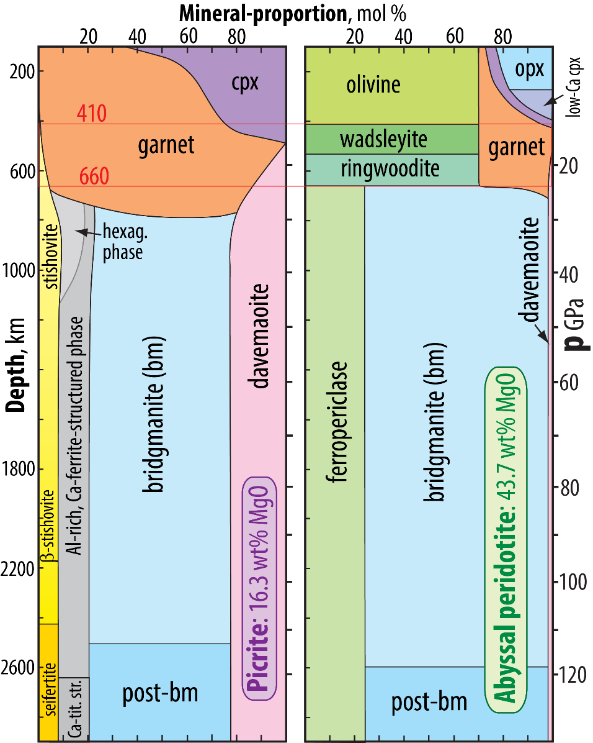
First-order Earth structure
PREM: Preliminary Earth Reference Model
- from seismology (normal modes) and gravity
- includes ρ and p
Dziewonski & Anderson (1981, PEPI)
11 444 citations, March 22, 2022

Slide 12
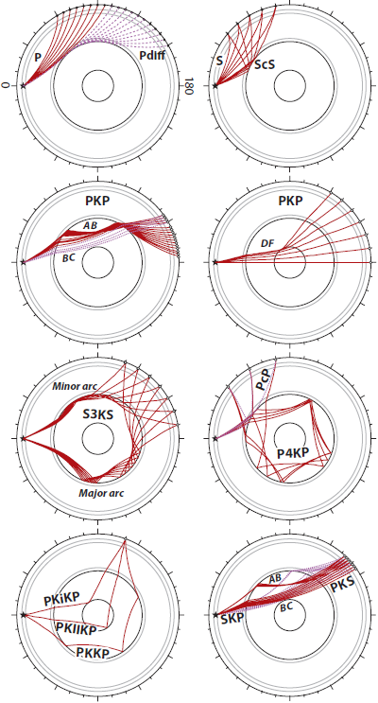
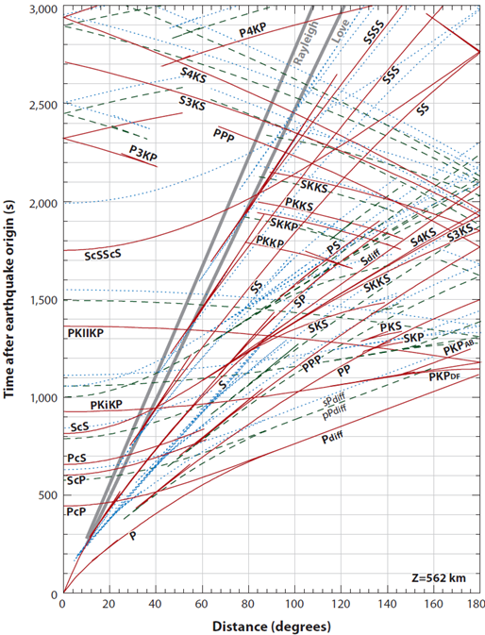
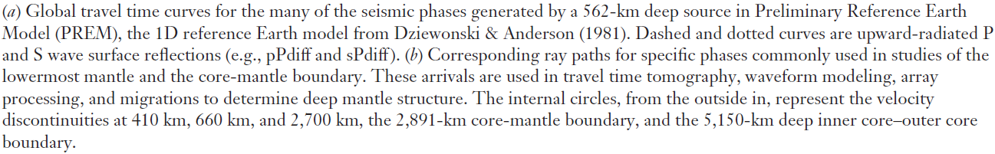
Seismic phases generated by a 562 km deep source in PREM
1-D Reference Earth Model, Dziewonski and Anderson (1981)
Travel time curves. Dashed and dotted curves are upward-radiated P- and S-
wave surface reflections (e.g. pPdiff and sPdiff)
50 min
33.3 min
16.7 min
8.33 min
Lay & Garnero (2011, Ann Rev EPS)

Slide 13
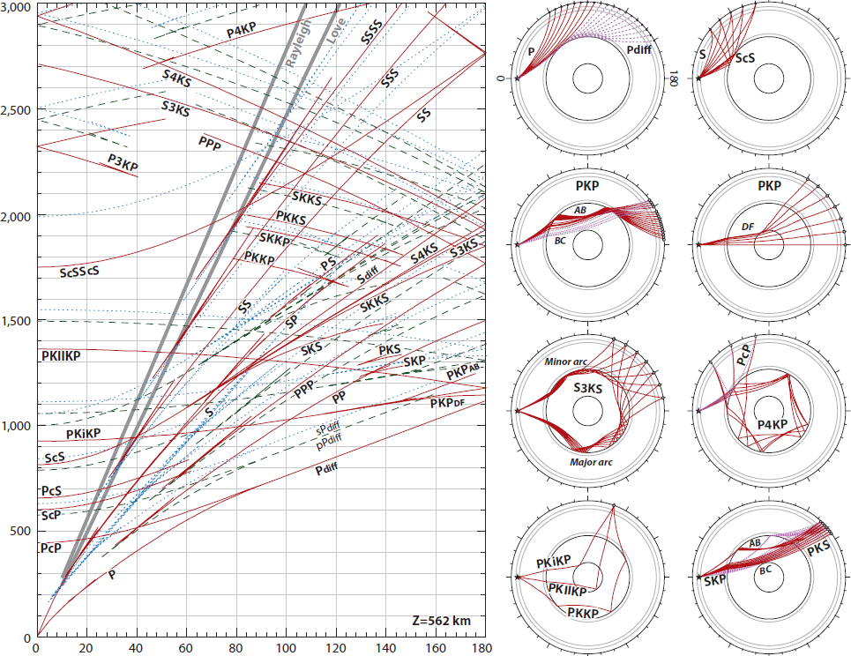

Slide 14
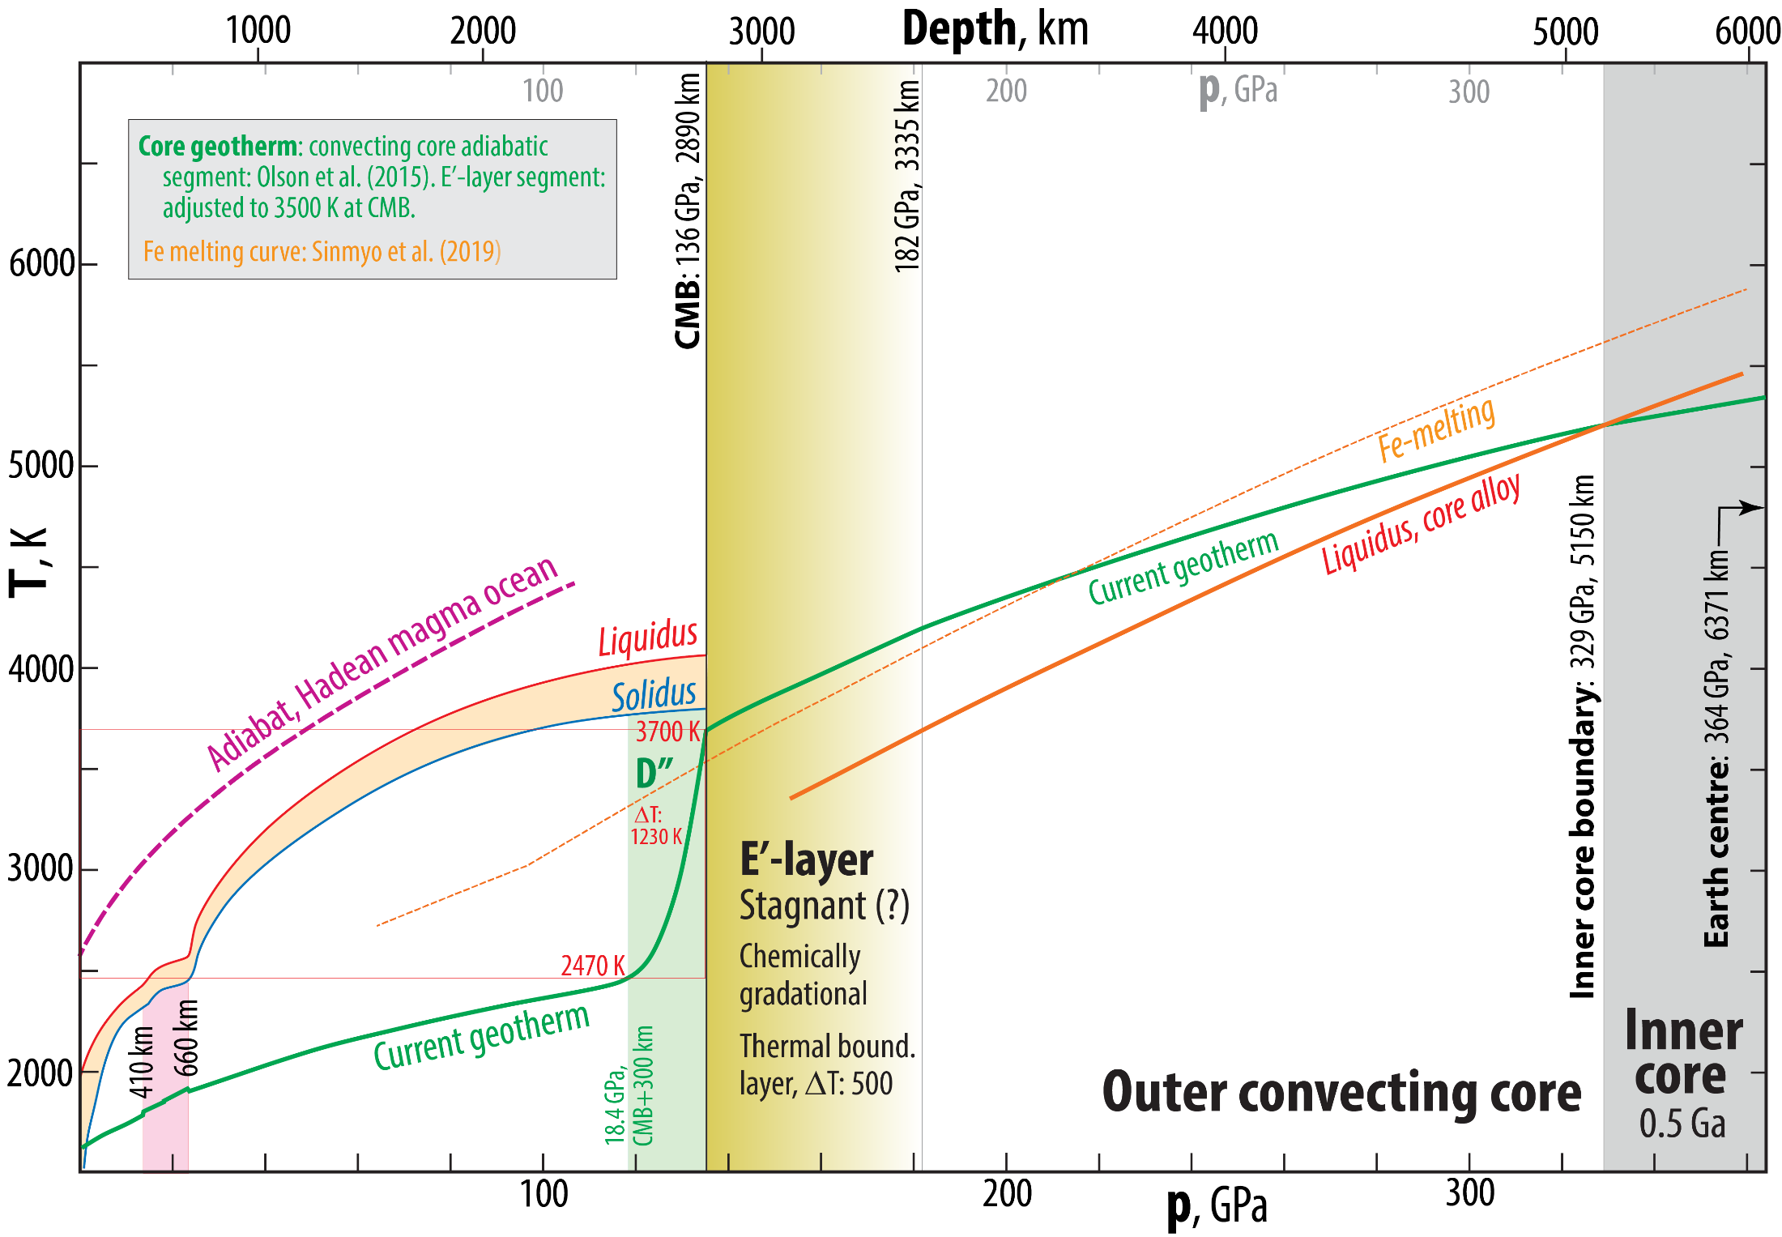

Slide 15
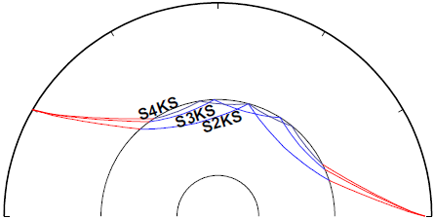
Investigation of the outermost core E'-layer

Slide 16
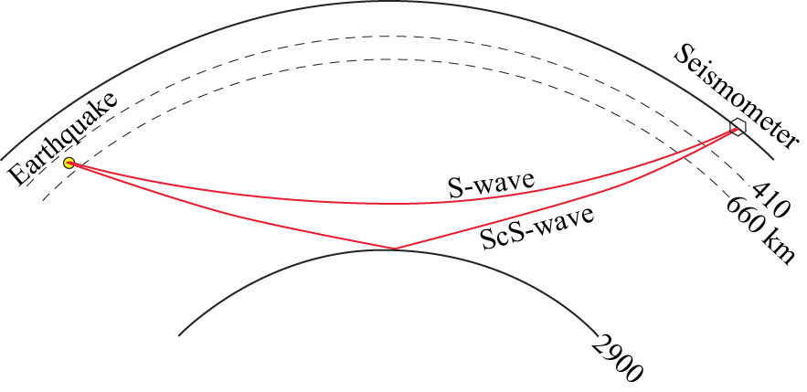
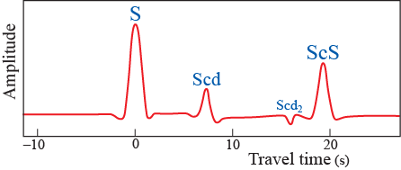
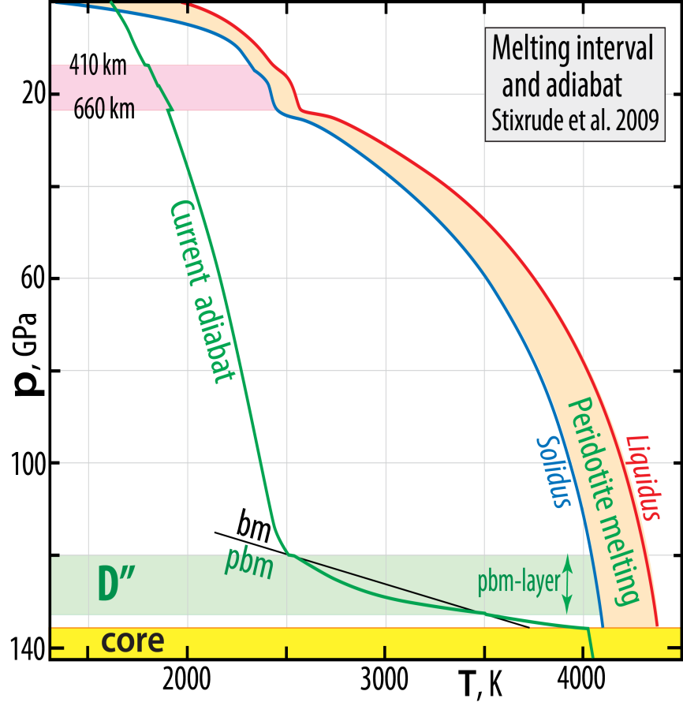
D”-discontinuities
Lay and Helmberger (1983, GJRAS): S-wave triplication: S, Scd and ScS (in certain areas, at least)
The Scd and Scd₂ may be ascribed to
double-crossing of the phase boundary
to post-bridgmanite
Double-crossing scenario:
Hernlund et al. (2005, Nature)
Caused by:
- large thermal gradient across D”
- large dp/dT-slope of phase boundary

Slide 17
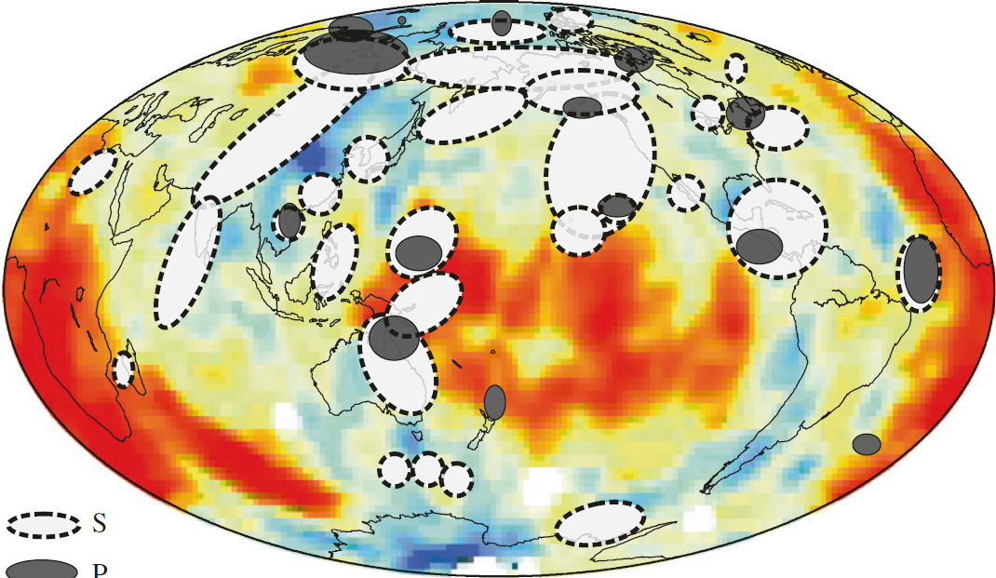

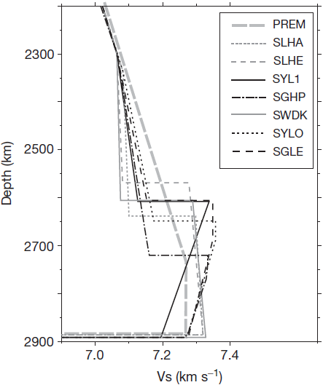
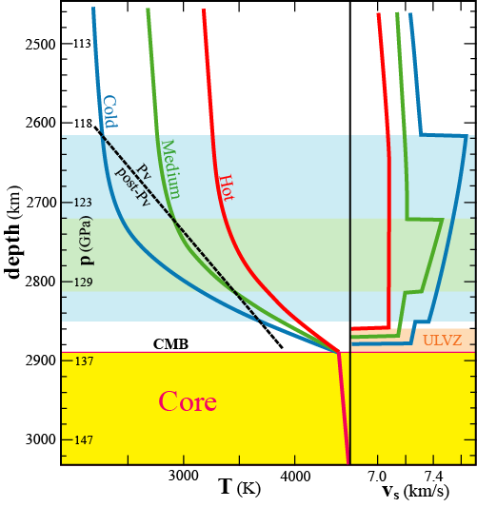
D" reflections
Post-bridgmanite transition
Cobden et al. (2015), in: Khan & Deschamps
(eds.): "The Earth's Heterogeneous Mantle")
African
LLSVP
Pacific
LLSVP
Circumpolar
high-V_{S} belt
African
LLSVP
330 km
290 km
260 km
Lay (2015,
Treat. Geophys.)

Slide 18
Seismic velocities ↔ physical properties
Bulk modulus: K (= incompressibility / stiffness)
Shear modulus: G
G/ρ = v_{s}²
K/ρ = v_{p}² − 4/3v_{s}² = v_{φ}² = Φ
v_{φ}: bulk sound velocity,
Φ : seismic parameter
v_{s}² = G/ρ
v_{p}² = (K + 4/3∗G)/ρ

Slide 19
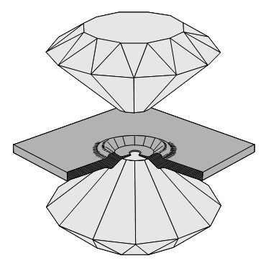
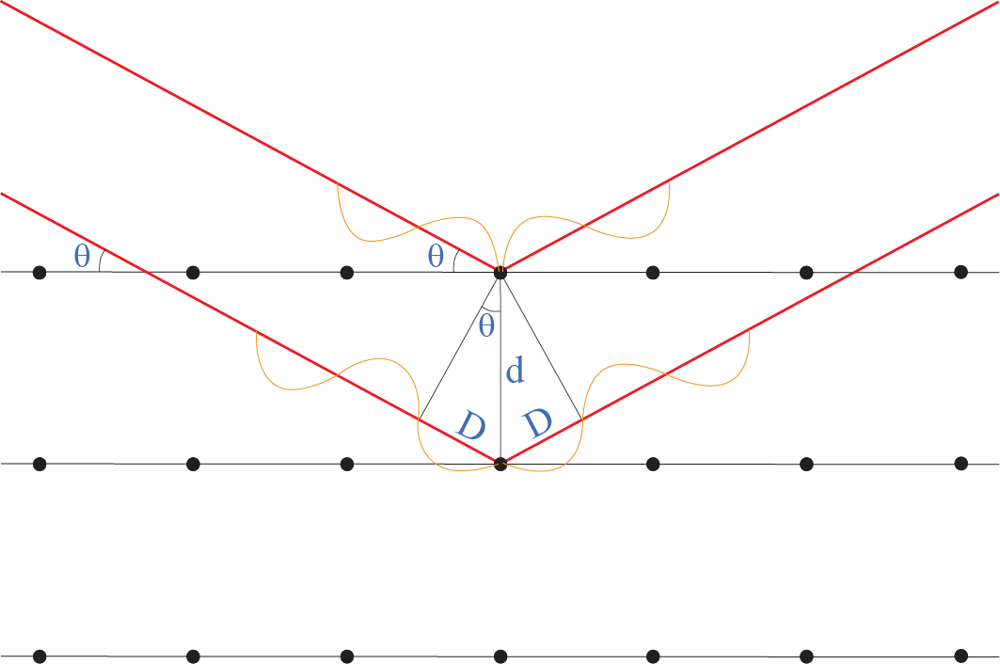
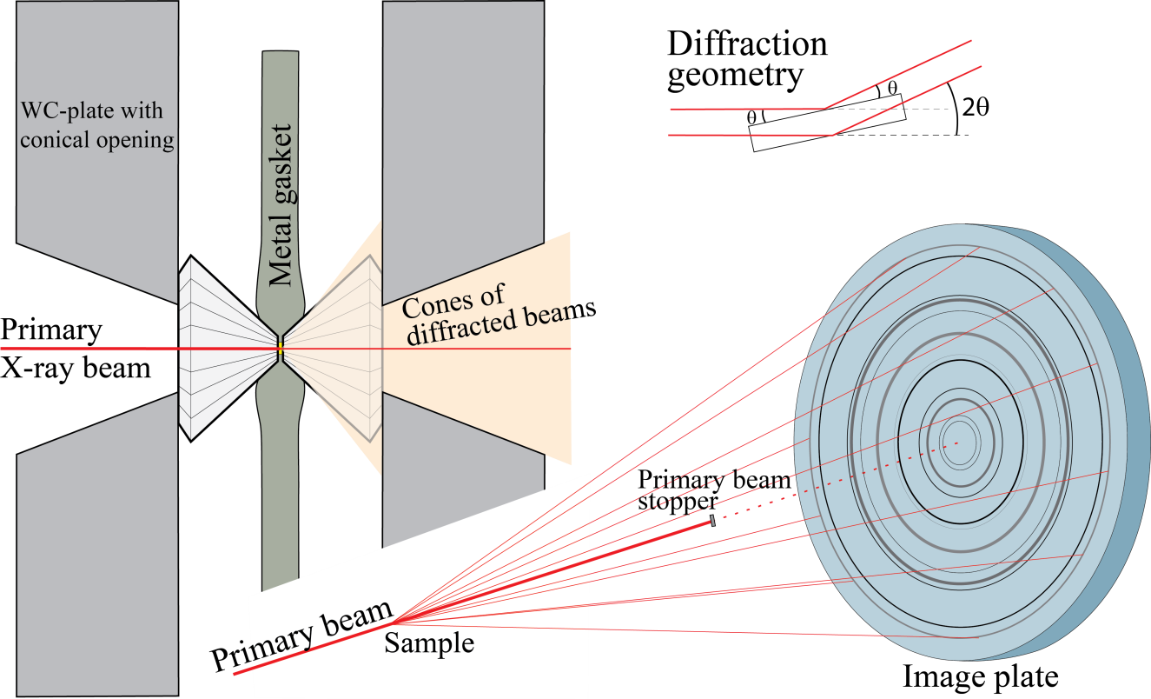
Unit cell V and ρ as a function of p
In-situ high-pT XRD, using high-
intensity synchrotron radiation
Bragg's law
positive interference
when nλ = 2d sinθ
gasket
Angle-dispersive XRD
Monochromatic beam, fixed λ, variable θ
Energy-dispersive XRD
Polychromatic (”white”) beam, fixed θ
d-spacings from the energy peaks
E = hf = hc/λ
λ = hc/E 2d sinθ = nλ = nhc/E

Slide 20
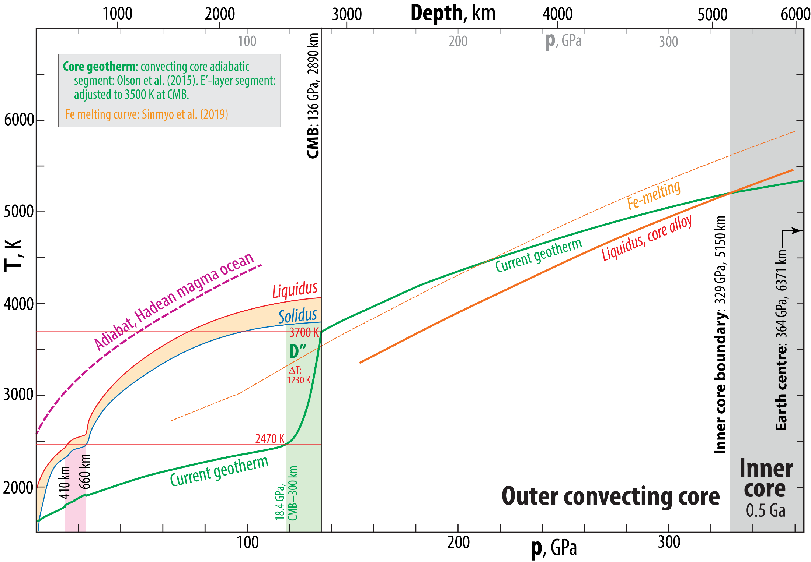

Slide 21
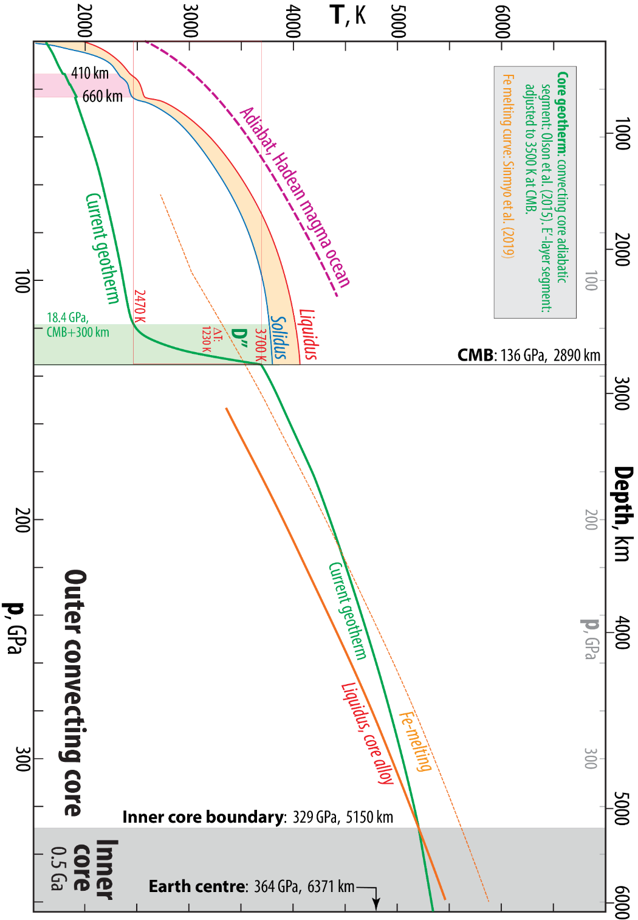
First-order constraints on temperature
660 km discontinuity:
Reaction rwd = bm+fp at 24 GPa
(endothermic transition - small drop in adiabat)
Location of mantle adiabat (geotherm):
below solidi of peridotite and basalt
CMB: extreme thermal boundary layer
2470 - 3700 K ! (ΔT: 1230 K)
Location of outer core adiabat:
above solidus of FeNi (+ Si, O, S)
Inner-outer core boundary at 330 GPa / 5150 km:
melting temperature of FeNi

Slide 22

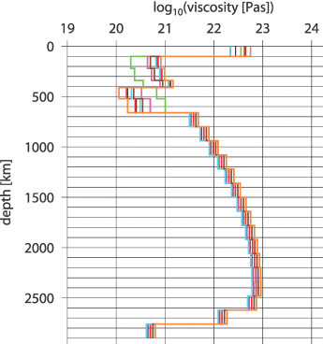
Why such a large thermal boundary layer at CMB ?
Density contrast 5500 - 9900 kg/m³
precludes mantle - core mixing,
but not some chemical exchange
peridotite
liquid FeNi
Viscocity of solid rock is quite high,
even at very high T near the CMB
T-dependent viscosity models
Steinberger and Calderwood
(2006, GJI)
CMB

Slide 23
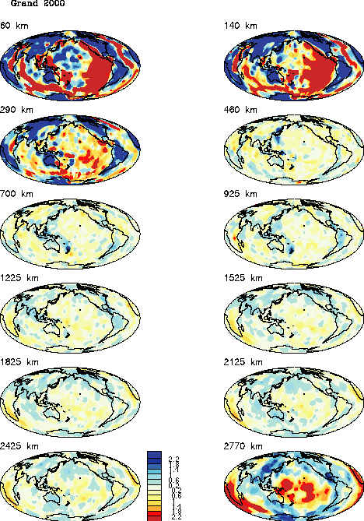
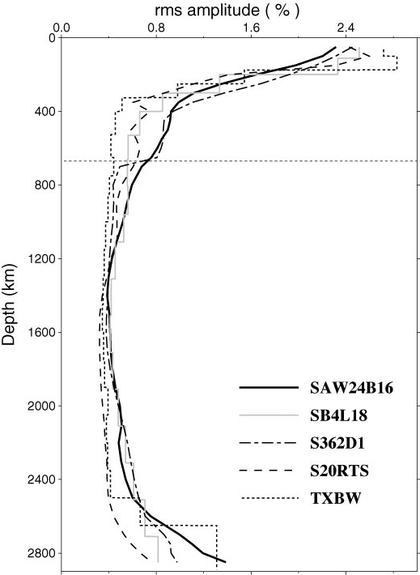
Seismic tomography models
Large v_{S}-amplitudes at the top
and bottom of the mantle
300 km
465 km above CMB
120 km above CMB
Romanowicz (2003,
Ann.Rev. EPS)

Slide 24
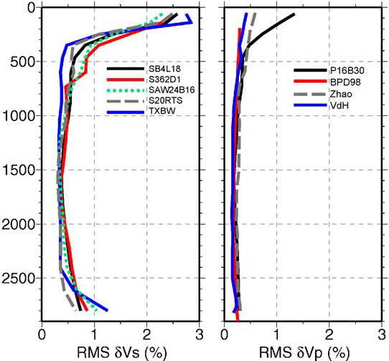
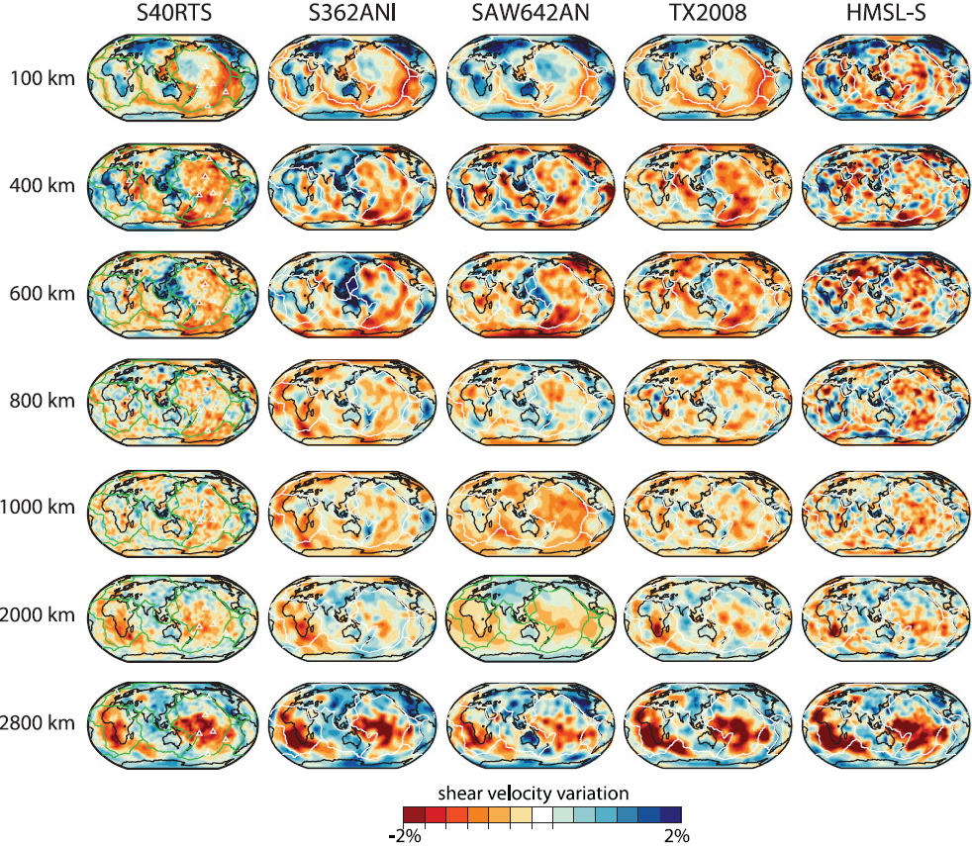
300
km
Lay (2015, Treat. Geophys)

Slide 25
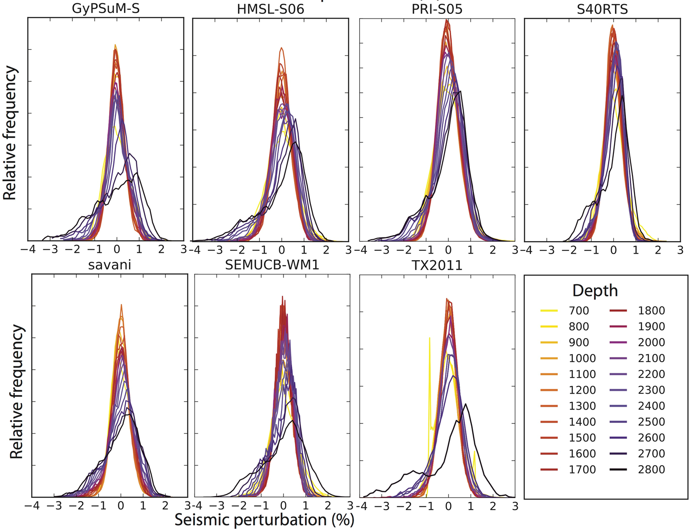
V_{S} models
Shephard et al.
2017, Sci.Rep.
Amplitudes
Fast to slow peak
range: 2-3 %

Slide 26
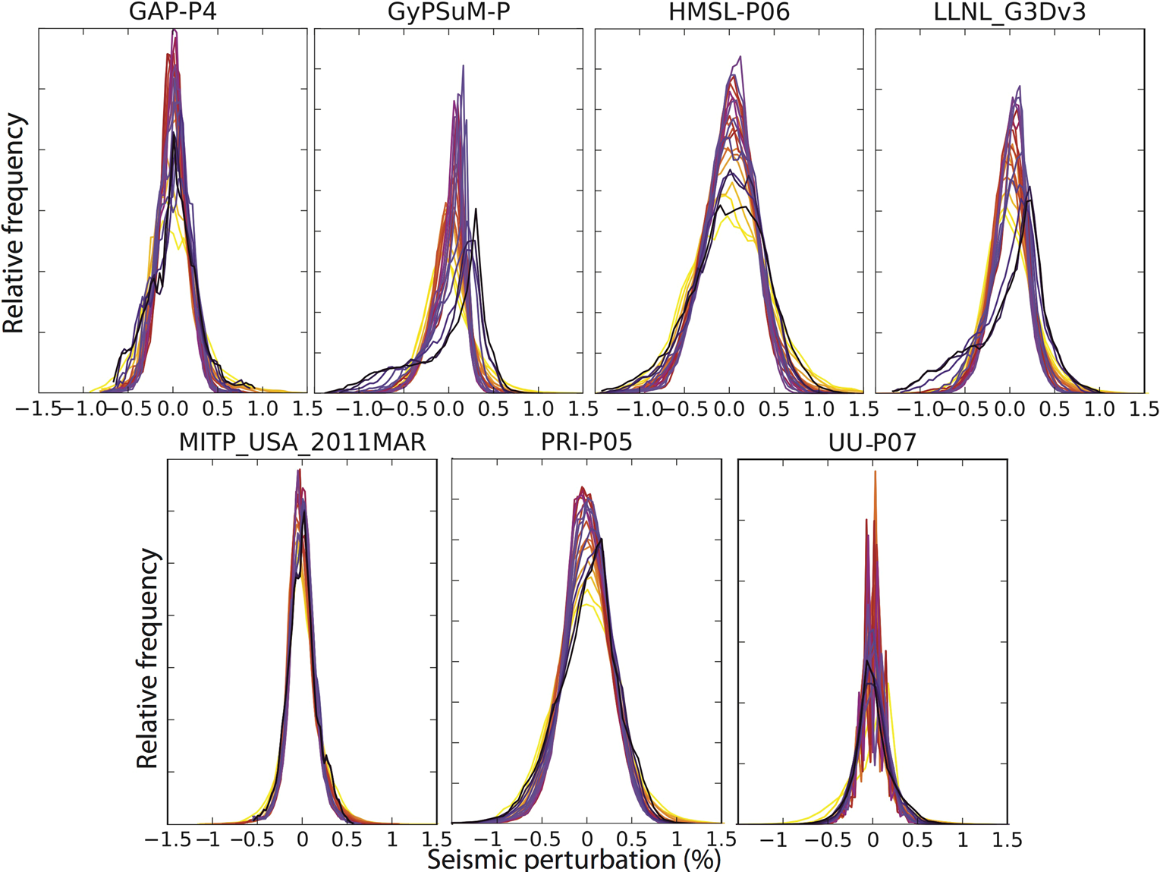
V_{P} models
Shephard et al.
2017, Sci.Rep.
Amplitudes
Fast to slow peak
range: < 1 %
(expanded V_{P}-scale)

Slide 27
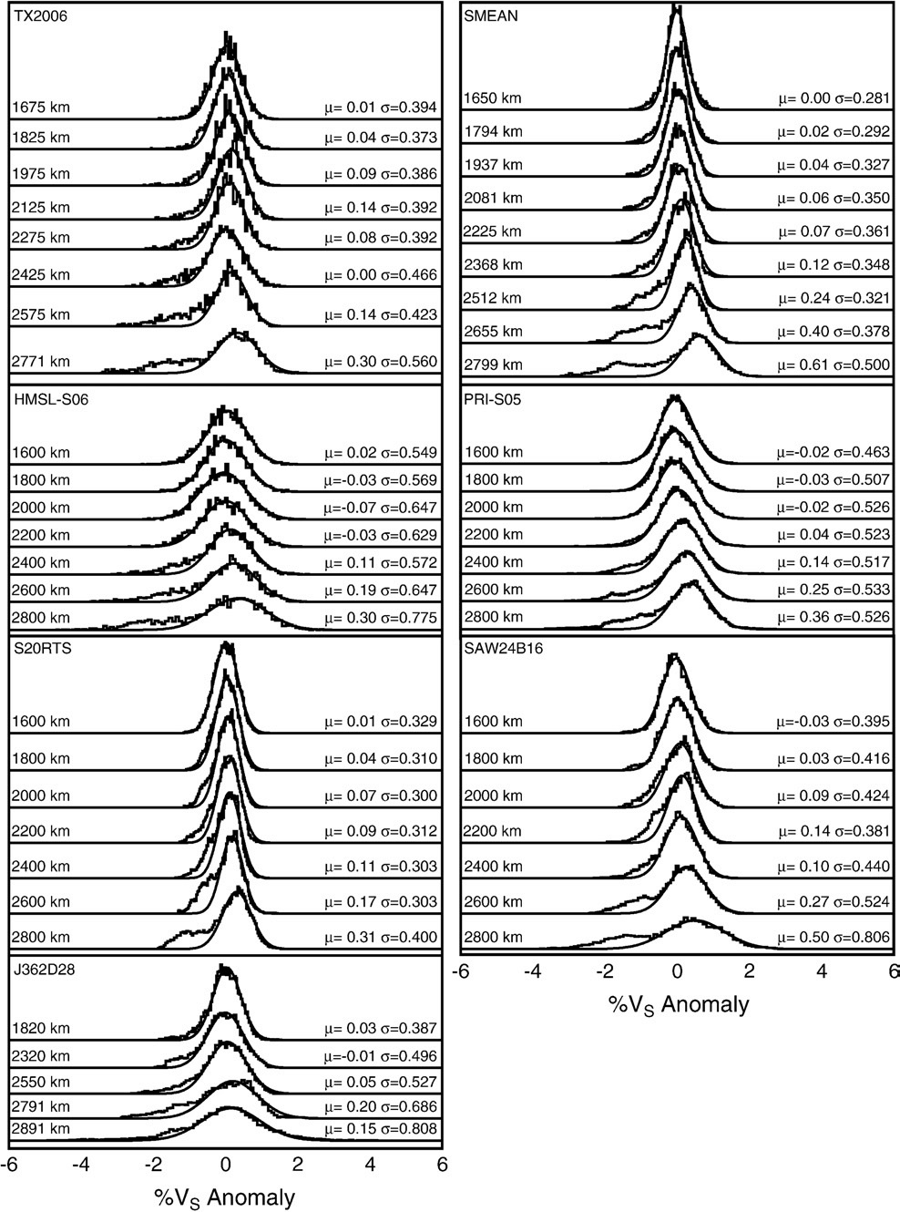
V_{S} models
Hernlund & Houser
2008, EPSL

Slide 28
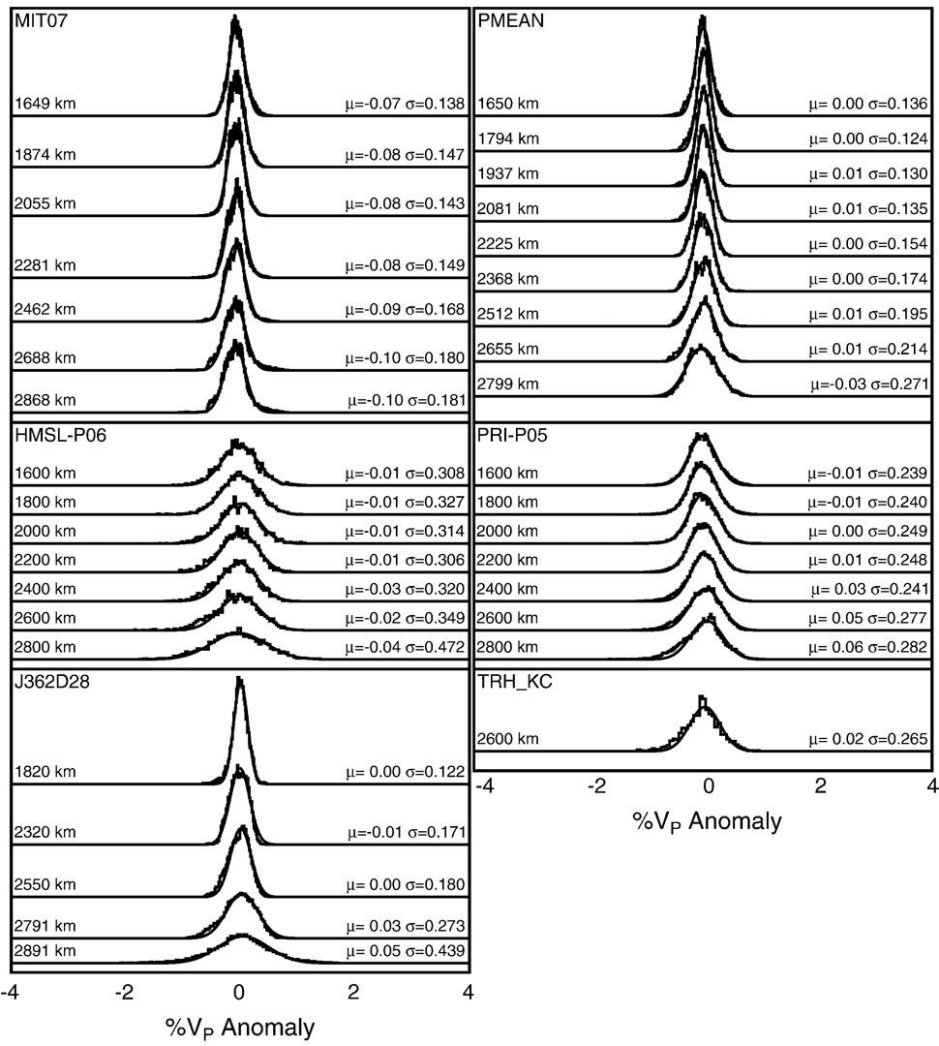
V_{P} models
Hernlund & Houser
2008, EPSL

Slide 29
S-wave models
Ritsema et al.
(2011, GJI)

Slide 30
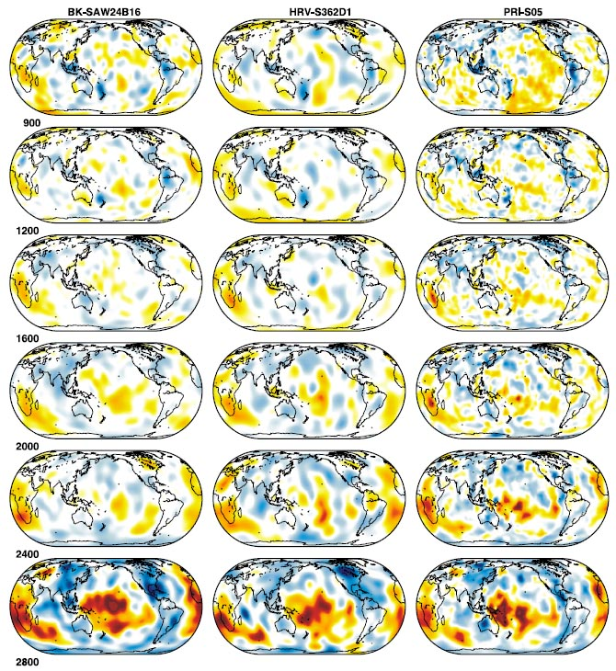
S-wave models
6 depth sections: 900-2800 km
Montelli et al. (2006, GGG)
(finite frequency tomography)

Slide 31
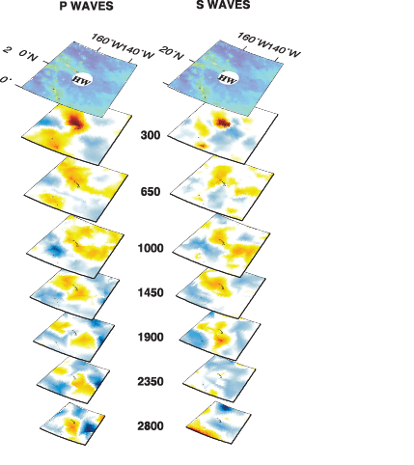
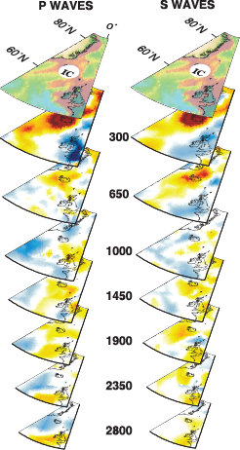
Finite frequency seismic tomography
Montelli et al. (2006, GGG):
Hawaii
Iceland

Slide 32
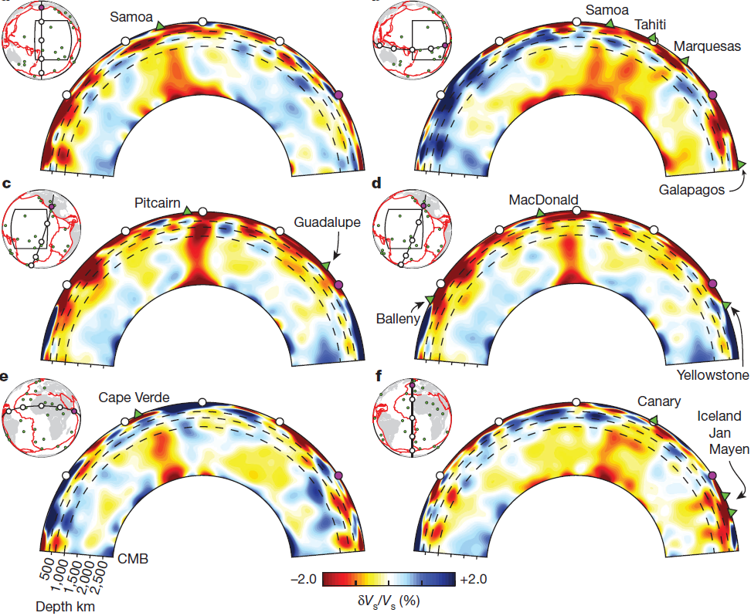

Plume conduit imaging
French and Romanowicz (2015, Nature)

Slide 33

Plume conduit imaging
French & Romanowicz (2015, Nature)
Comparison of model SEMUCB-WM1
(F&R 2015) with four other models

Slide 34



S-wave models, lowermost mantle (D”-zone)
Two large anti-podal, slow provinces - LLSVP
Africa – Pacific (near equator - 180º apart)
Dziewonski et al.
(2010, EPSL)
The degree-2 velocity anomalies, recognized
>30 years ago, coincide with the residual geoid
e.g. Dziewonski et al. (1977, JGR),
Dziewonski & Anderson (1984, Am Sci)

Slide 35
P-wave model, 2500 km depth
Dziewonski & Anderson (1984, Am. Scientist)
S-wave model, 500 km depth sections
3 times larger amplitudes than P-wave model at 2400-2850 km
Forte et al. (1993, AGU Geophys. Monogr.)
Asia
NAm
Afr
SAm
Aust
Aust

Slide 36

Seismic tomography, D"
Dziewonski et al.
(2010, EPSL)
Cluster analysis of 5 tomographic models
Lekic et al. (2012, EPSL)
Note the plume locations:
many/most along the LLSVP-margins
L₂-norm
L₁-norm

Slide 37
Cluster analysis (vote map) models
Cottaar & Lekic (2016, GJI)
Depth,
km
Five V_{S}-models
Five V_{P}-models
1100
1500
These models do NOT reflect the
seismic amplitude variation as a
function of depth (slides 9 and 10).
In my view they give a false impression
that the LLSVPs are extended upwards
beyond the D" zone.
1900
2300
2700

Slide 38




SCLIP
Clustering of reconstructed LIPs along
the LLSVP-margins − implications
- The plume generation zones and the LLSVPs have
long-term stability (> 300-500 Ma)
- The LLSVPs are likely to have (hot) base layers with
a density excess sufficient to counteract destruction
by thermal buoyancy.
Large igneous
provinces (LIPs)
- age span: 16-297 Ma

Slide 39

Large igneous provinces (LIPs)
- age span: 16-297 Ma
SC
Paleogeographic relocation
Clustering near periphery
of LLSVPs
- long-term stability
- dense and hot
(thermo-chemical piles)
+2.5% fast
SC
–1% slow
Pacific
Africa
–3%
slow
Burke & Torsvik, 2004, EPSL
Torsvik et al., 2006, GIJ
Burke et al. 2007, EPSL
Torsvik et al. 2008, EPSL

Slide 40




Comparison of seismic tomography (LLSVPs)
and slab-sinking model at 2800 km depth
Dziewonski et al. (2010, EPSL)
Spherical harmonics modeling
Power spectra
Cumulative power spectra
Tomographic
models
Tomogr.
models
Slab model
Slab model
Degree 2
Degree 2
Tentative conclusions
1. The observed degree-2 pattern is only partly reproduced
by calculated slab-accumulation
2. The LM-structure may thus be old ( > 300-500 Ma)
Lithgow-Bertelloni & Richards
(1998, Rev. Geophys.)

Slide 41



ULVZ distribution
Thorne & Garnero
(2004, JGR)

Slide 42

CMB heat flow
approx. scale: 150-10 mW/m²
Olson & Christensen, 2002, GJI
Dehant et al. (2021,
Surv. Geophys.)

Slide 43

CMB heat flow
approx. scale: 150-10 mW/m²
Olson & Christensen, 2002, GJI
90°W
180°
90°W
0°
180°
90°E
180°
90°E
CMB heat flux
Olson 2016, GGG
Radial flow velocity, core
Equatorial plane, 0⁰ longitude: left
Olson 2016, GGG

Slide 44


CMB heat flow
approx. scale: 150-10 mW/m²
Olson & Christensen, 2002, GJI

Slide 45
IC-velocity anomalies for PKP-waves turning in the following depth ranges:
5150(ICB) - 5600, 5600 - 6000 and 6000-6371 km
Frost et al., 2021
Nat. Geosci.
Zeta (ζ) angle:
deviation from
rotation axis
Turning points from:
Turning points from:
Source
Western hemisphere:
high IC-velocities
(and seismic anisotropy)
Eastern hemisphere:
low IC-velocities
Turning points from:
Receiver
Effective IC-velocity anomaly

Slide 46
IC-velocity anomalies as a function of zeta
Gray shading: ζ < 15°, where dlnV_{WH} > dlnV_{EH}
Frost et al., 2021
Nat. Geosci.
dlnV% versus epicentral distance (~ turning
point depth) for data where ζ ≤ 15°
dlnV ~ epicentral distance and dlnV_{WH} > dlnV_{EH}
zeta < 15°

Slide 47
IC seismic anisotropy
Here: E to the left, W to the right
90°
Frost et al., 2021
Nat. Geosci.
E
W
180°
0°
90°
IC: inferred shape (exaggerated),
westward flow and deformation
E
W
E
W

Slide 48


CMB heat flux
approx. scale: 150-10 mW/m²
Olson & Christensen, 2002, GJI
CMB heat flux
Olson 2016, GGG
60°E
180°
90°W
90°E
180°
120°E

Slide 49
CMB heat flow,
OC-convective flow
Aubert et al. 2008, Nat.
Eastern hemispheric equatorial
view, Indonesia-centred, 110°E
inflow
outflow
North polar view

Slide 50
Radial magnetic field at CMB
Aubert et al. 2008, Nat.
Time-averaged CMB paleomagnetic field
during normal polarity periods 0-5 Ma
Time-averaged CMB magnetic field in flow model
Flow below the CMB
Streamlines of the time-averaged flow below CMB
from geomagnetic secular variations, 1840-1990
Streamlines of the time-averaged flow
in the uppermost OC in flow model

Slide 51
- IC growth rate variations from relative mass anomaly flux across,
the IC-boundary (colour scale)
- Upper IC seismic velocity perturbations (black contours)
Aubert et al. 2008, Nat.
Model used in this and
the previous figures:
S_{T} + S_{Χ} = 0
Ra = 2 .10⁻⁵
~ eastern
hemisphere
S_{T}: volumetric thermal buoyancy source
S_{X}: chemical buoyancy sink
Ra = f₀g₀ / ρΩ³(r₀-r_{i})²
Rayleigh number, based on the
IC-boundary mass anomaly flux, f₀:
Maximum IC equatorial
growth rate under Indonesia

Slide 52



Slide 53


3d
4s
Electronic spin state
transition metals, esp. Fe
Fe: 3d⁶ 4s²
3d-transition metals:
― [Ar] 3d^{X} 4s²
Fe-ions:
Fe²⁺: 3d⁶
Fe³⁺: 3d⁵
Sc: 3d¹ 4s²
Ti: 3d² 4s²
V: 3d³ 4s²
Cr: 3d⁵ 4s¹
Mn: 3d⁵ 4s²
Fe: 3d⁶ 4s²
Co: 3d⁷ 4s²
Ni: 3d⁸ 4s²
Cu: 3d¹⁰ 4s¹
Zn: 3d¹⁰ 4s²
Maximum magnetic
moment
Very high pressures will ultimately favour pairing
of electrons into the lowest energy orbitals, because
that reduces the ionic size.
BUT there is an energy cost (repulsion) involved.
Domains of high
electron probability
2 el.
2 el.
Max, 2 s-electrons
2 el.
Max. 6 p-elctrons
Note:
4s is lower than 3d,
5s is lower than 4d,
etc.
2 el.
Max. 10 d-electrons
2 el.
2 el.
2 el.
2 el.

Slide 54

Periclase and ferropericlase structure
MgO (Mg,Fe)O
Mg,Fe
O
Creative Commons Attribution –
Share Alike 4.0 International

Slide 55




Slide 56
Fe²⁺ spin state in ferropericlase
Effects on elastic moduli and wave-speeds
Valencia-Cardona et al. 2017, GRL

Slide 57
Fe²⁺ spin state in ferropericlase
Effects on elastic moduli
Kennett 2021, EPSL
fp: Mg_{87.5}Fe_{12.5}O₁₀₀
Ab initio, along BS-81 adiabat,
Wu et al. 2013, PRL
G: Shear modulus
K: bulk modulus
p: pressure
Almost linear G/K vs. p/K relation
Low K through
mixed-spin state
Green data curve: slightly concave upwards
Calculated without
spin crossover effect
Elevated K in
low-spin state

Slide 58
Fe²⁺ spin state in ferropericlase
Effects on elastic moduli and wave-speeds
Kennett 2021, EPSL
Mg_{81.25}Fe_{18.75}O
Ab initio, 2000 K,
Wu et al. 2013, PRL
Convex upwards:
Marquardt et al. 2009, EPSL
0.40

Slide 59
Fe²⁺ spin state in ferropericlase
Effects on elastic moduli and wave-speeds
Kennett 2021, EPSL
normal modes
high G, low K sensitivity
Concave upwards:
Convex upwards:
body waves

Slide 60


Spatial resolution by seismic tomography vote map method (Shephard et al. 2021, Nat. Comm)
One particular tomography
model at one specific depth:
Extracting fast (e.g. >+1σ)
and slow (e.g. <−1σ) areas
Combining 4 models
at the same depth
Combining models at numerous depths through the lower mantle

Slide 61

Loss of strong
Vp anomalies
……………………...
D’’
TBL
, full score
No indication of a spin signal in the ambient (average velocity) mantle
- but would we be able to detect it or confirm a lack of signal ?
- would an absent signal, is confirmed, indicate fp-free, refractory
and highly viscous bm-dominated material (BEAMS) ?
- where is the ambient (average velocity) in the lower mantle ?
Possibly not - a very challenging task
Yes, very likely
Let’s look at a map and a cross-section

Slide 62



Degree-2 mantle flow pattern and lower mantle structure

Slide 63


Slide 64


- BEAMS are positioned to avoid ’’interference’’ with
the slabs mapped by van der Meer et al. (2010, NG, 2019, Tectonoph)
- Viscous and refractory bridgmanitic material is strongly
indicated from a petrological point of view
early MO-crystallisation during core-MO and core-BMO
chemical exchange (CEED Ann. Report 2020, SAB-seminar,
2021). (B)MO: (basal) magma ocean
- Early refractory domains are likely to be
convectively aggregated into BEAMS
(Manga 1996a,b, GRL; Becker et al. 1999, EPSL;
Ballmer et al. 2017, NG)

Slide 65

- MgSiO₃-dominated bm is neutrally
buoyant in the mid-LM
- Very refractory in the LM, but less so as an
opx-component in the upper mantle

