Slide 1
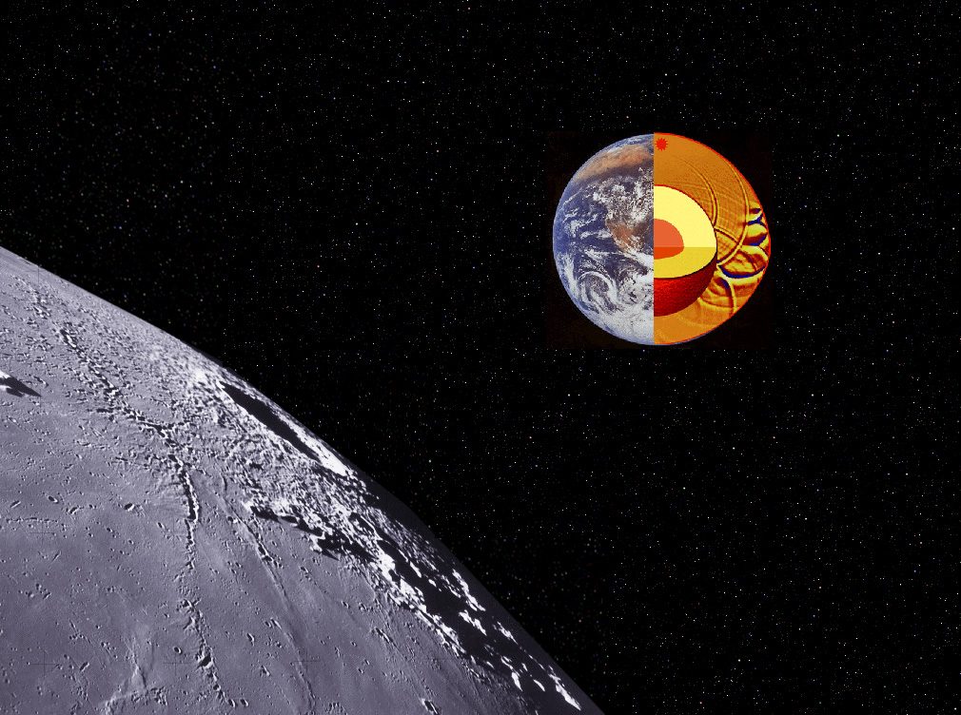
Mineral physics
Experimental methods
p-V-T equations-of-state (EoS)
Partly based on a presentation by
Peter Lazor, Univ. Uppsala

Slide 2
Seismic parameter / bulk sound speed:
K_{S}/ρ = v_{p}² – 4/3v_{s}² = Φ
Shear modulus: G or μ
G/ρ = v_{s}²
v_{s} = (G/ρ)^{1/2}
v_{p} = (K_{s}/ρ + 4/3*G/ρ)^{1/2}
= [(K_{s} + 4/3*G) / ρ]^{1/2}

Slide 3
Objective:
Relate v_{P}-v_{S}-data to mineralogical and chemical composition of Earth’s interior
We need:
Equations of state (EoS): V = f(p,T) or p = f(V,T)
Example: an ideal gas: pV = nRT
Solids are MUCH more complicated
Helmholtz free energy: F(V,T) = F₀(V) + F_{vib}(V,T) + F_{el}(V,T)
0 K compression
component
vibrational
component
electronic thermal
exitation component
Pressure: p = –(dF/dV)_{T}
p(V,T) = p₀(V) + p_{vib}(V,T) + p_{el}(V,T)
p(V,T) = p₀(V) + p_{thermal}(V,T)

Slide 4
Isothermal bulk modulus: K_{T} = –(Vdp/dV)_{T} = 1/β
Compressibility
p-derivative of K_{T}: K_{T}’ = (dK_{T}/dp)_{T}
Units:
bulk modulus: GPa
compressibility: GPa⁻¹
Adiabatic / isentropic bulk modulus: K_{S} = –(Vdp/dV)_{S}
K_{S} = K_{T}(1 + Tαγ)
Thermal
expansivity
~ 2*10⁻⁵ K^{–1}
Grüneisen
parameter
γ = αKs/(ρCp)
~ 1 for silicates

Slide 5
Adiabatic compression law: γ = (dT/dρ)_{S} = αK_{S} / ρC_{P}
Liquid EoS, Mie-Gruneisen form:
p(V,T) = p_{c}(V,T₀) + γ C_{V} (T-T₀)/V
γ = V/C_{V} (dp/dΤ)_{V}
p(V,T) = p_{c}(V,T₀) + (dp/dT)_{V}(T-T₀)

Slide 6
The simplest isothermal EoS
Compressibility:
Isothermal bulk modulus:
Integration of: dV/V = − dP/K_{T} →
where V₀ is zero pressure volume
- does not account for the fact that it is increasingly difficult to
compress a solid at increasing p, i.e. K_{T} increases with p
- here K_{T} is constant and equal to K₀ (the zero pressure value)
Notes:
6

Slide 7
Murnaghan linear EoS
Assumption: K varies linearly with pressure K = K₀ + K’*p
p-derivative of K: K’ = dK/dp
Generally limited to β < 10%, i.e. V/V₀ > 0.9.
Reproduces p-V data and the value of K₀
- Simple EoS, allowing algebraic solutions of V = f(p) and p= f(V)
- Commonly incorporated in thermodynamic databases
Notes:
7

Slide 8
Birch-Murnaghan Equation of State
Finite strain EoSs
- strain energy of a compressed solid expressed as a Taylor series of finite strain, f
- several alternative definitions of f → different p-V-relationships
The Birch-Murnaghan EoS
- based on Eulerian strain, f_{E} = [(V/V₀)^{2/3} – 1]/2
- expansion to 4th order in the strain yields the following EoS:
Notes:
8

Slide 9
Third- and second-order Birch-Murnaghan EoS
Common isothermal EoS-expressions used in high-pressure studies
Fourth-order B-M:
Truncation to 3rd order:
= 0
Implied value of K’’:
Third-order B-M:
Eulerian strain,
f_{E} = [(V/V₀)^{2/3} – 1]/2
K’ = 4: Second-order Birch-Murnaghan EoS
Notes:
9

Slide 10
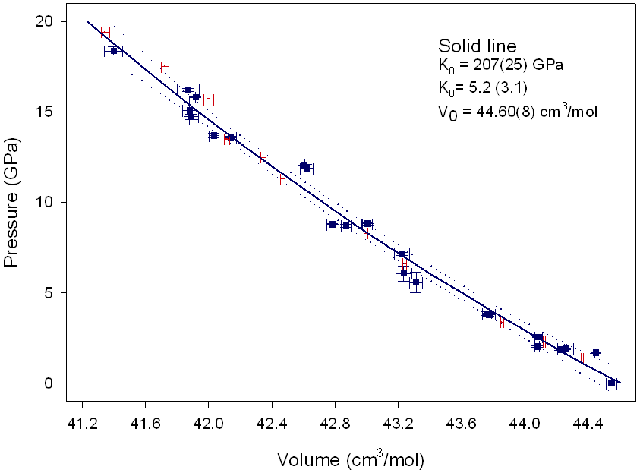
MAGNETITE
The fit of p-V data to the 3rd order Birch-Murnaghan EOS
solid squares – this work
dots with error bars – Haavik et al. (2000)
The dotted lines represent the 90% confidence limits for the fit.
’
Notes:
10

Slide 11
Notes:
11

Slide 12
(Anderson and Ahrens, 1994)
Presence of light
element(s) in the
outer core required.
Pure Fe is too dense.
Liquid Fe
Notes:
12

Slide 13
Thermal Equations of State
Isothermal, third-order BM EoS
Simple method for evaluating p-V-T data
isothermal EoS (e.g. M, BM or Vinet), with V₀ and K₀ as material properties
at p = 0 and high T
High-T V₀ (zero-pressure V):
derived by integration of the
expression for the thermal expansivity:
Common approximations
α(T) = C (constant) or
α(T) = a + bT
Higher-order terms can be used when necessary
Notes:
13

Slide 14
Isothermal, third-order BM EoS
ρ = m/V, V = m/ρ
V/V₀ = m/ρ / m/ρ₀ = ρ₀ / ρ
Neutral buoyancy between:
MgSiO₃-rich bridgmanitic material (0-4 mol% FeSiO₃ + FeAlO₃) and PREM (or pyrolite)
At 120 GPa and ΔT=0:
Δρ = 2.5 for 2 mol% FeSiO₃ and Δρ = 1.5 for 5 mol% FeSiO₃
BM, third-order:
Δp = 1.5 K₀ [(Δρ₀ / Δρ)^{2.33} − (Δρ₀ / Δρ)^{1.67}] [1 − 0.75(4−K'){(Δρ₀ / Δρ)^{0.67} −1}]
BM, second-order
Δp = 1.5 K₀ [(Δρ₀ / Δρ)^{2.33} − (Δρ₀ / Δρ)^{1.67}] [(Δρ₀ / Δρ)^{0.67} −1]
What is Δp for: Δρ₀ = 0.5
2 mol% FeSiO₃: Δp = 1.5 257 [(0.2)^{2.33} − (0.2)^{1.67}] [(0.2)^{0.67} −1] =
5 mol% FeSiO₃: Δp = 1.5 257 [(0.333)^{2.33} − (0.333)^{1.67}] [(0.333)^{0.67} −1]

Slide 15
Within uncertainties of current experimental measurements, the variation of K₀(T) is approximately linear:
Ref. temp. T₀:
mostly 289 K
This formulation, combined with use of a variable K’ in the associated isothermal EoS, includes all second derivatives of the volume with respect to the intensive variables P and T, and is usually sufficient to fit most experimental P-V-T datasets collected from room temperature up to ~1000 K.
Notes:
15

Slide 16
p-V-T equation of state of magnetite
(high temperature BM-EOS after Saxena)
Data sets:
this work
Okudera (1996)
Fei et al. (1999)
Olsen (1994)
Shebanova and Lazor (2003)
dK_{T}/dT = -0.030(5) GPa/K
Notes:
16

Slide 17
Seismic velocities ↔ physical properties
Bulk modulus: K (= incompressibility / stiffness)
Shear modulus: G
G/ρ = v_{s}²
K/ρ = v_{p}² – 4/3v_{s}² = v_{φ}² = Φ
v_{φ}: bulk sound velocity,
Φ : seismic parameter
v_{s}² = G/ρ
v_{p}² = (K + 4/3∗G)/ρ

Slide 18
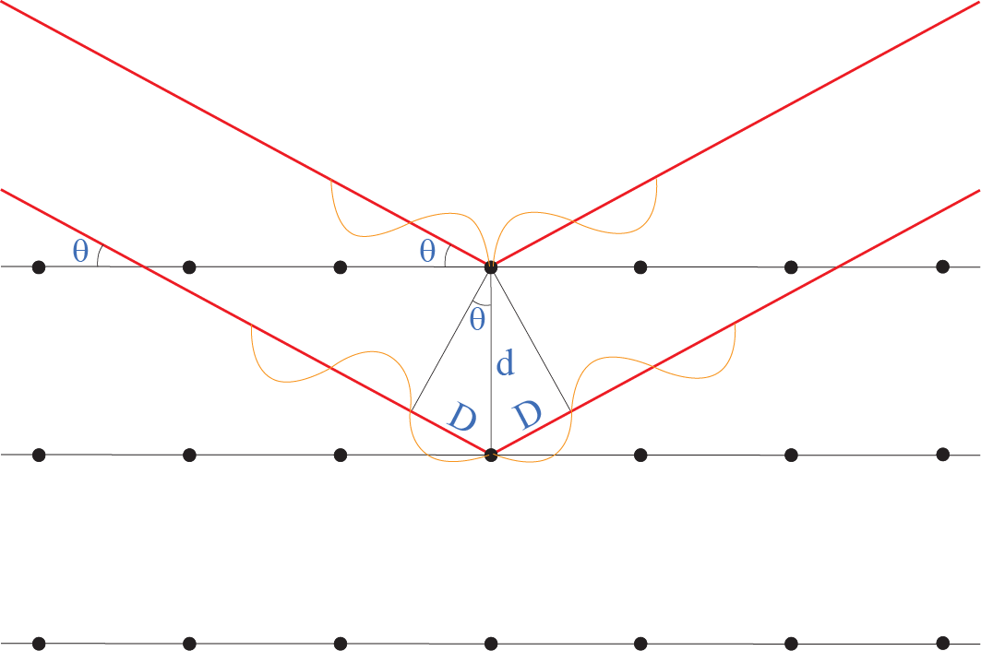
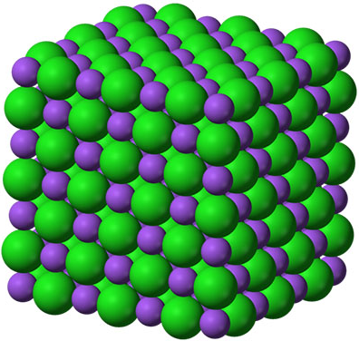
Unit cell V and ρ
as a function of p
Bragg's law
positive interference
when nλ = 2d sinθ
In-situ high-pT XRD, using
high-intensity synchrotron radiation
Angle-dispersive XRD
Monochromatic beam, fixed λ, variable θ
Energy-dispersive XRD
Polychromatic (”white”) beam, fixed θ
d-spacings from dispersed energy peaks
E = hf = hc/λ
λ = hc/E 2d sinθ = nλ = nhc/E

Slide 19
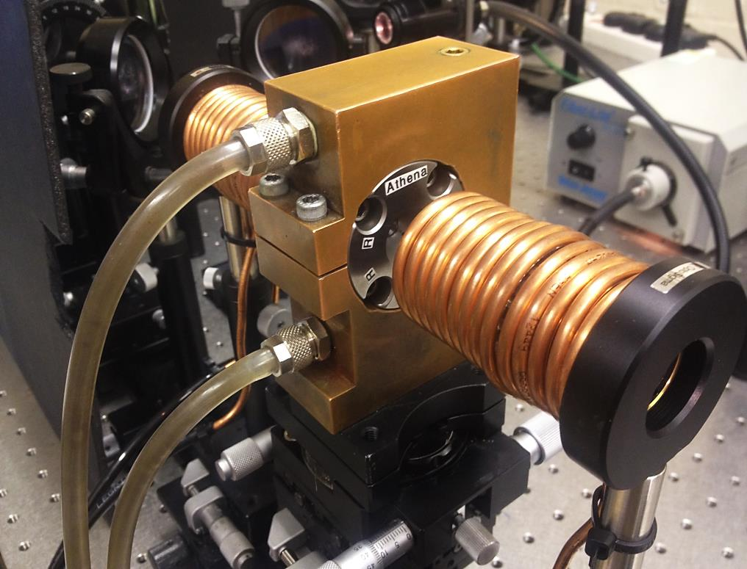
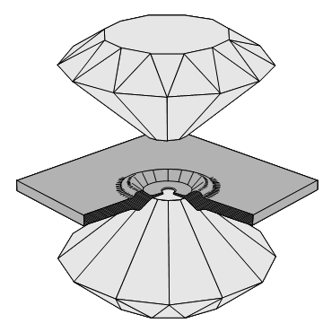
Water-cooled
DAC-holder
cylinder
gasket
piston
c.

Slide 20
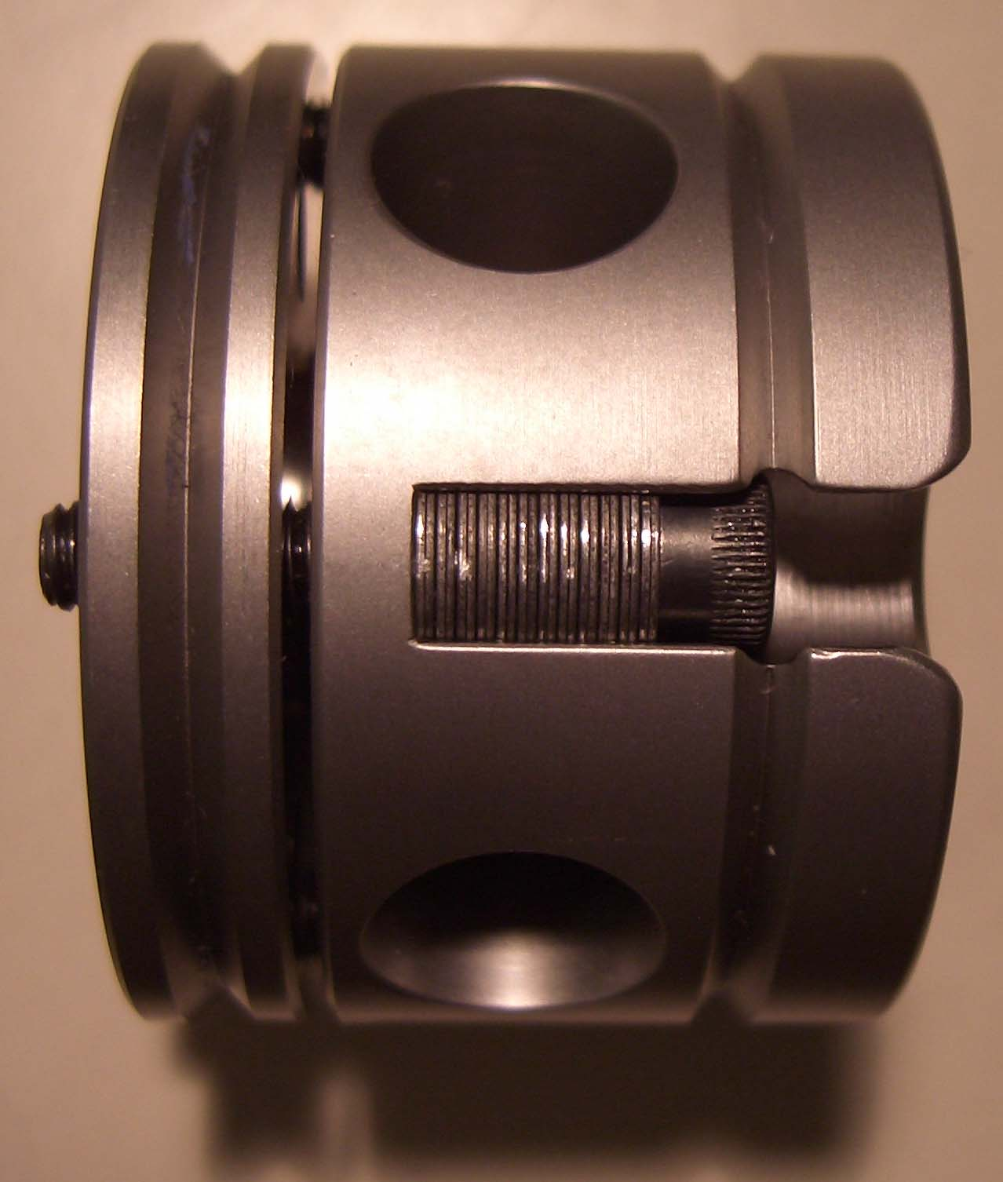
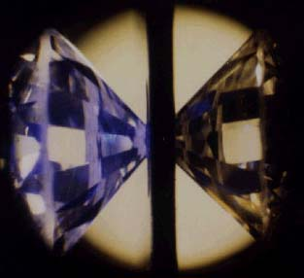
Diamond anvil cell (DAC)
Steel gasket
1 cm

Slide 21
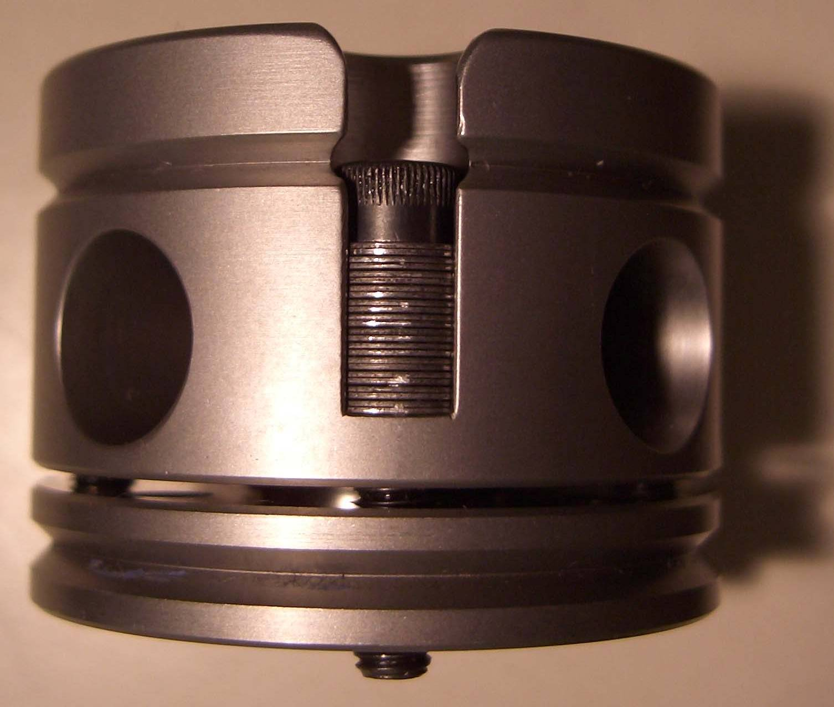
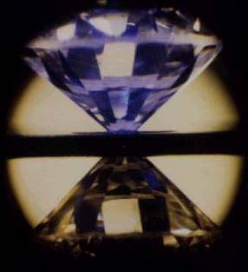
Diamond anvil cell (DAC)
Steel gasket
1 cm

Slide 22
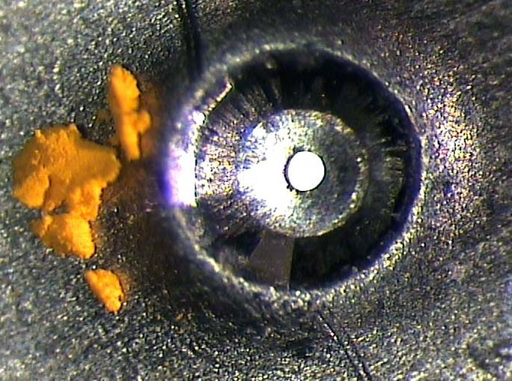
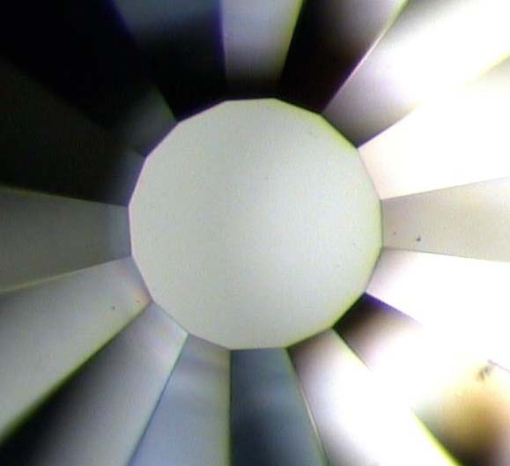
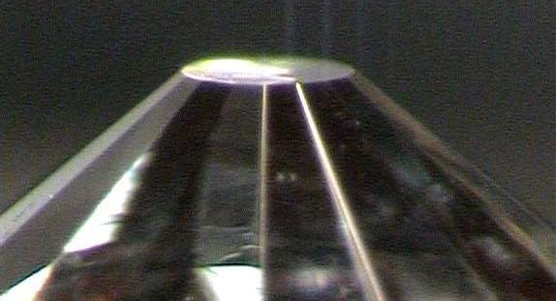
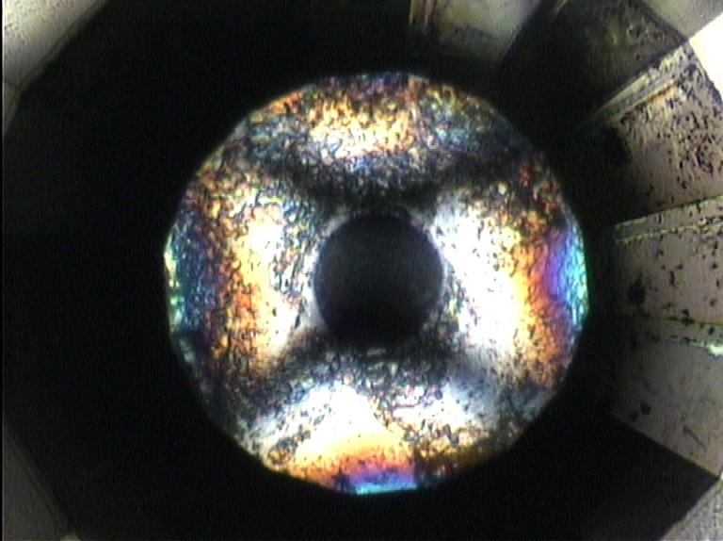
Indented gasket with 100 mm hole og Fe³⁺-bearing sample
Culet diameter: 0.3 mm
From above
Under pressure, from above
From the side

Slide 23
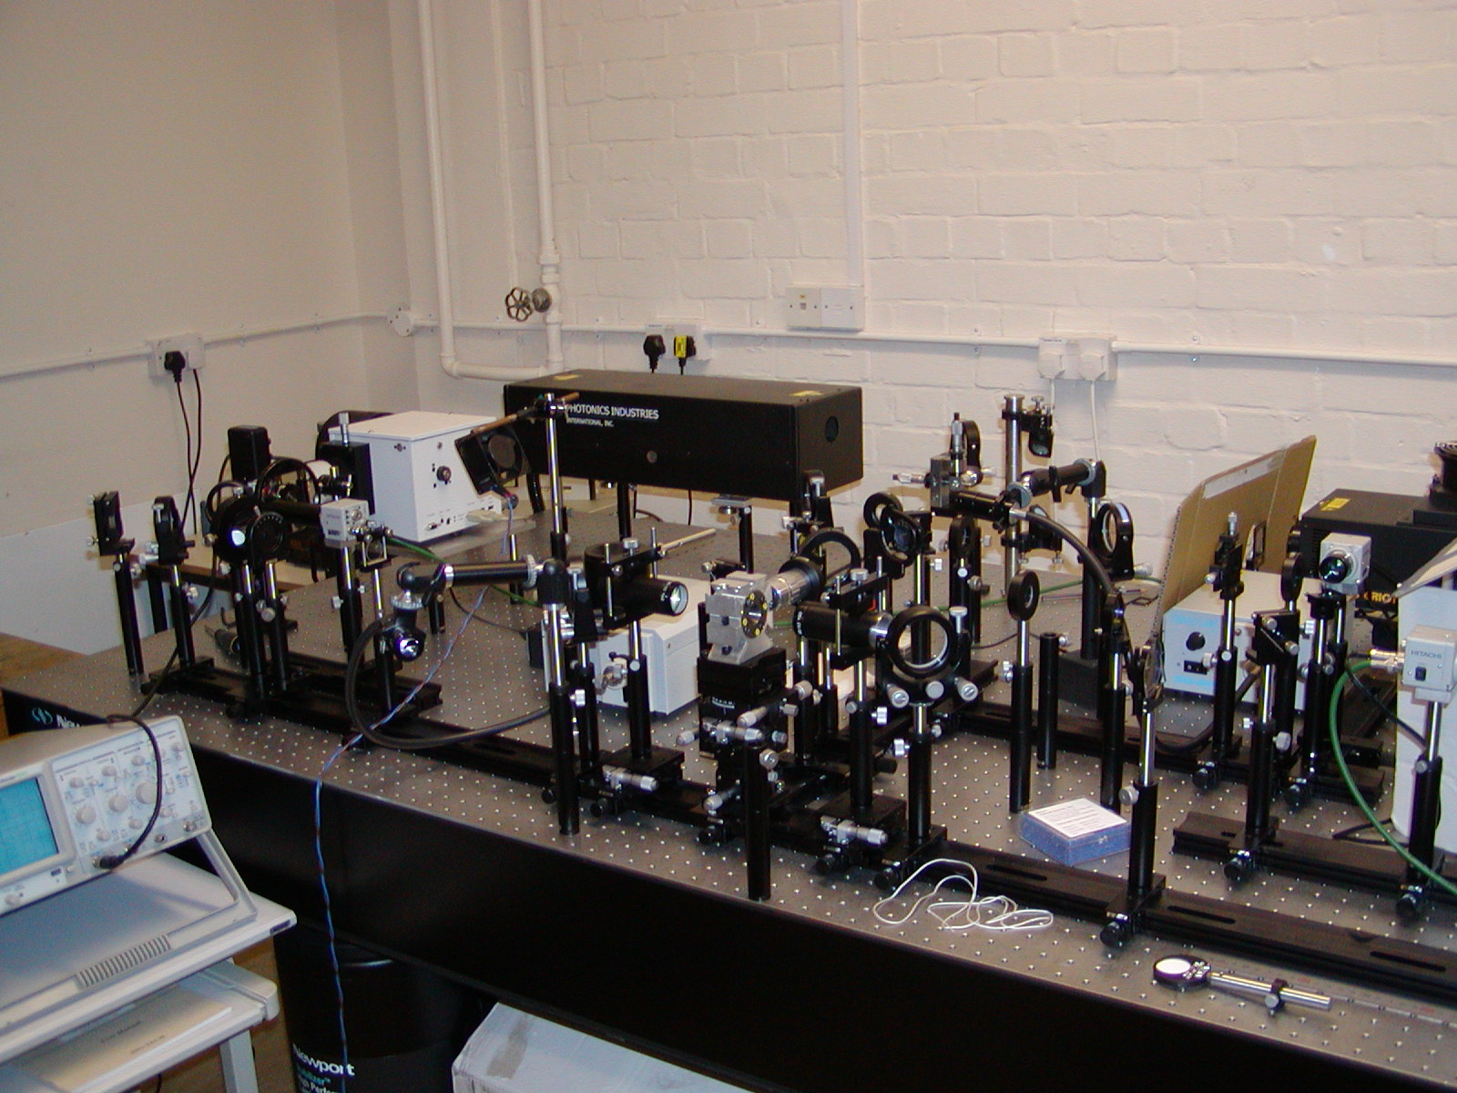
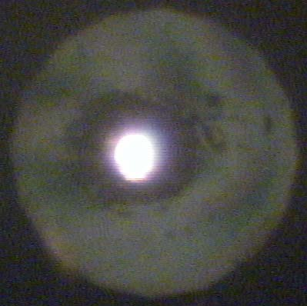
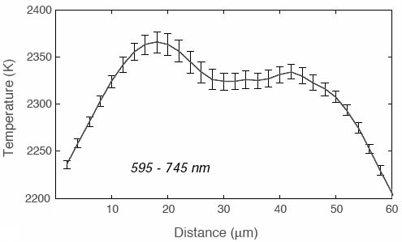
Laser heating facility at Univ. of Bristol
100 μm

Slide 24
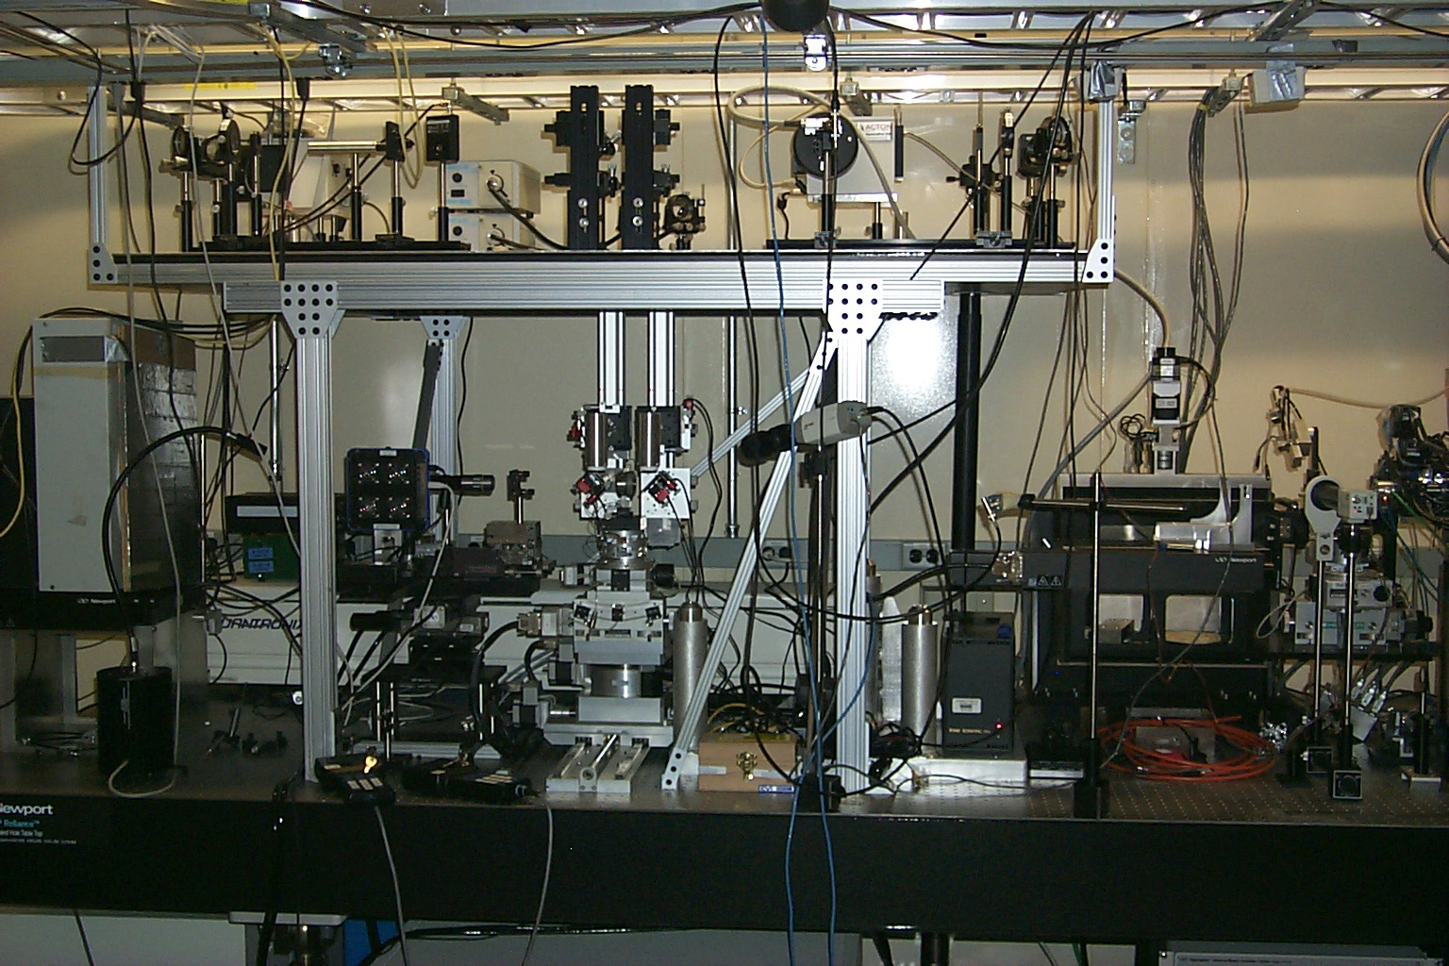
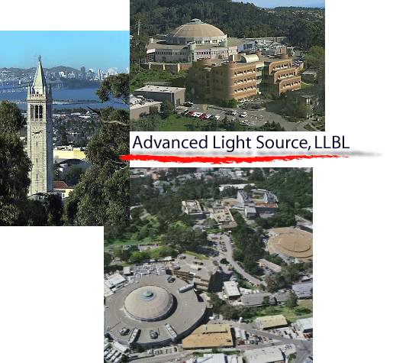
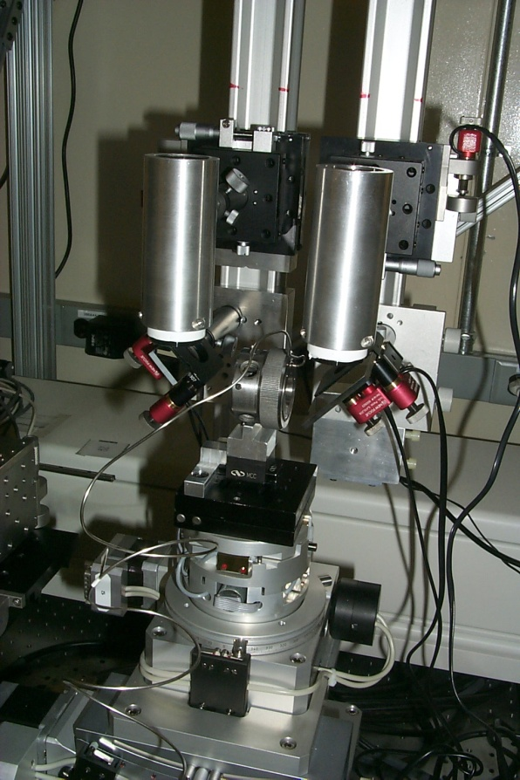
X-ray beam
to detector

Slide 25
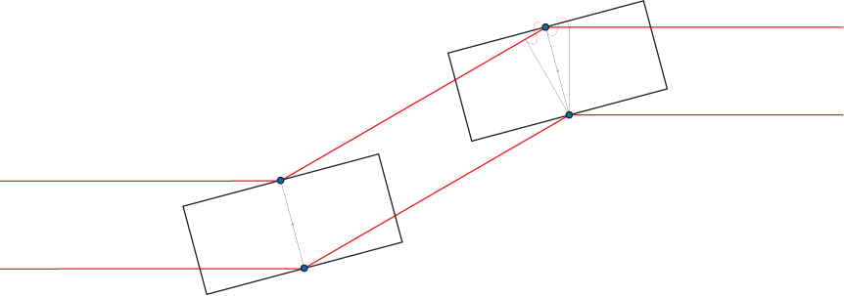
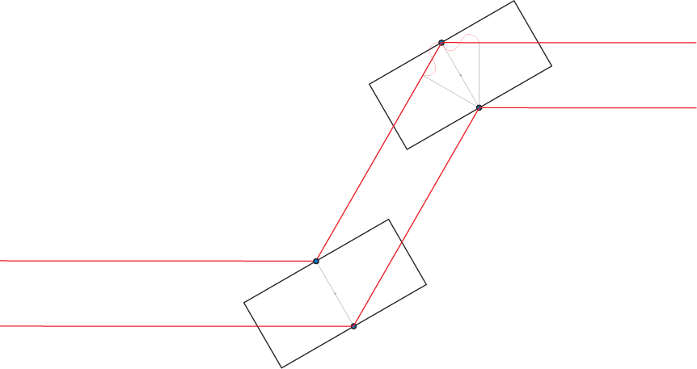
Monochromatizing a ”white” X-ray beam

Slide 26
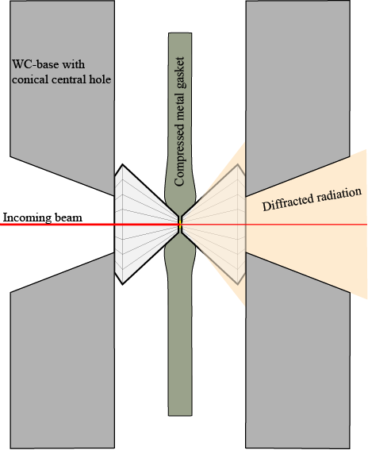
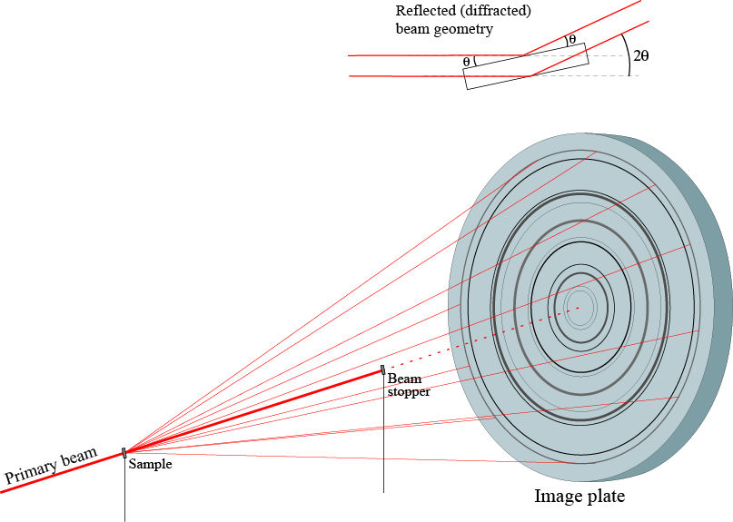

Slide 27
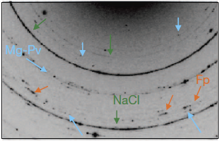
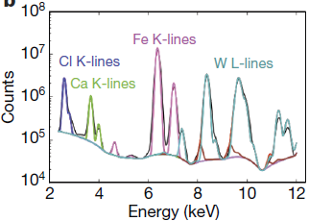
Andrault et al. 2011, Nature

Slide 28
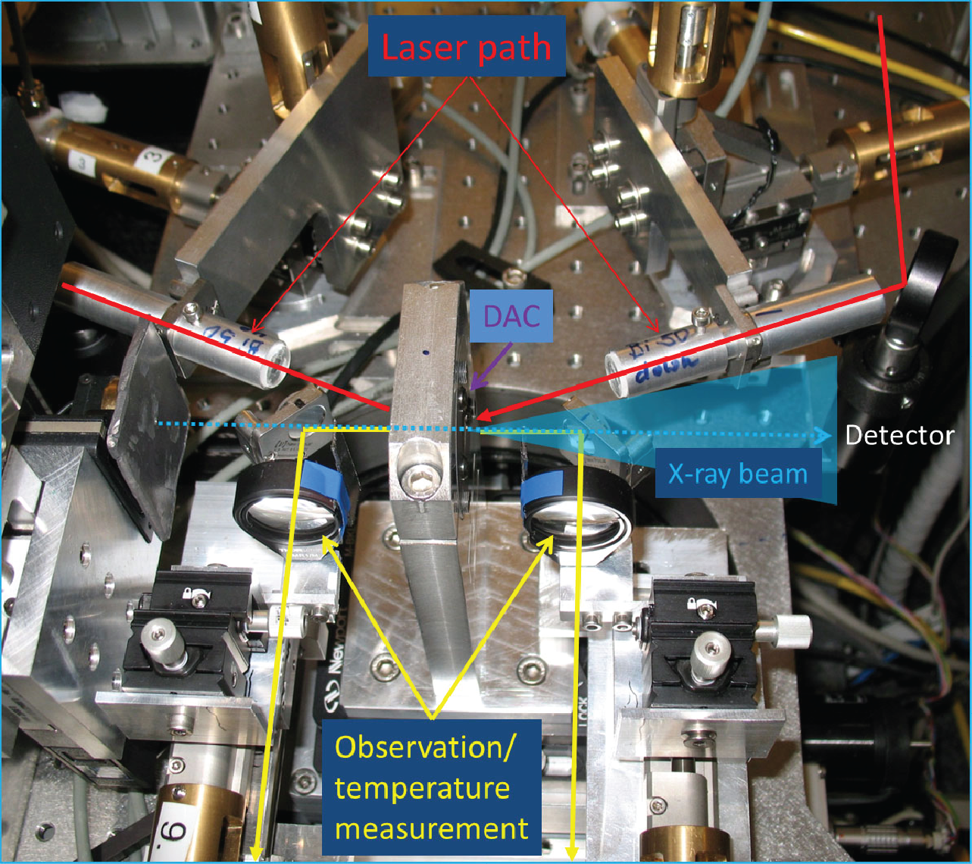
Example of LH-DAC-experimentation with in-situ, synchrotron-based XRD:
Phase relations of aluminous silica to 120 GPa
Extreme Conditions Beamline
(P02.2), PETRA-III,
DESY, Hamburg
Andrault et al.
(2014, Am. Mineral.)

Slide 29
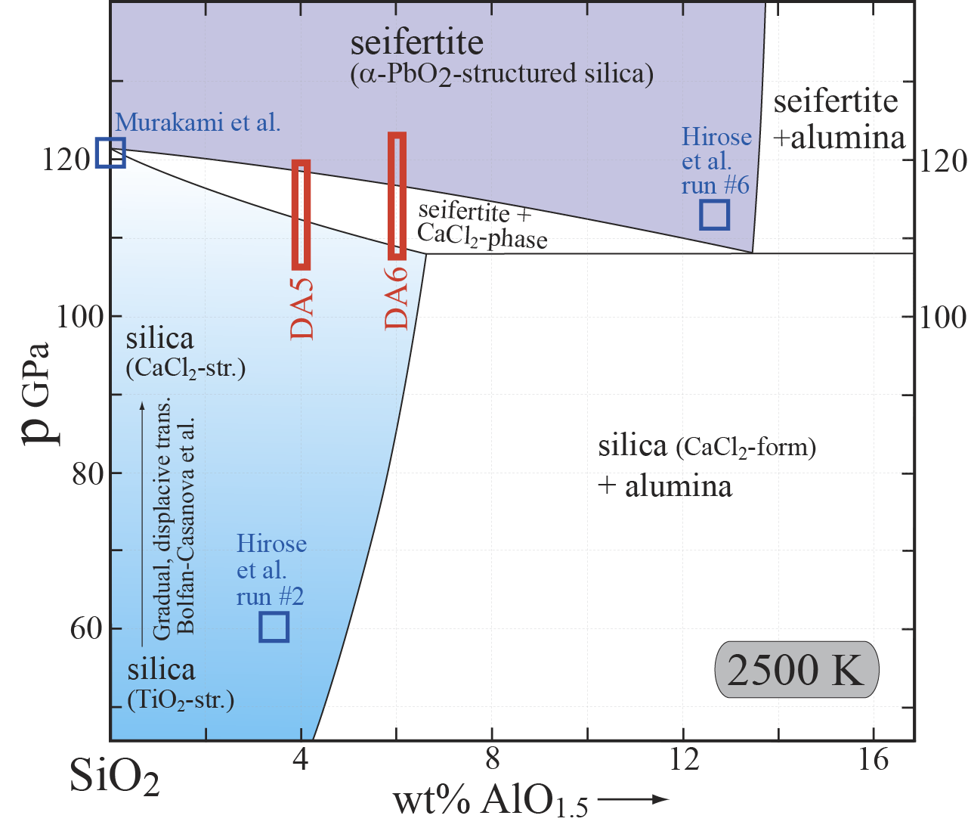
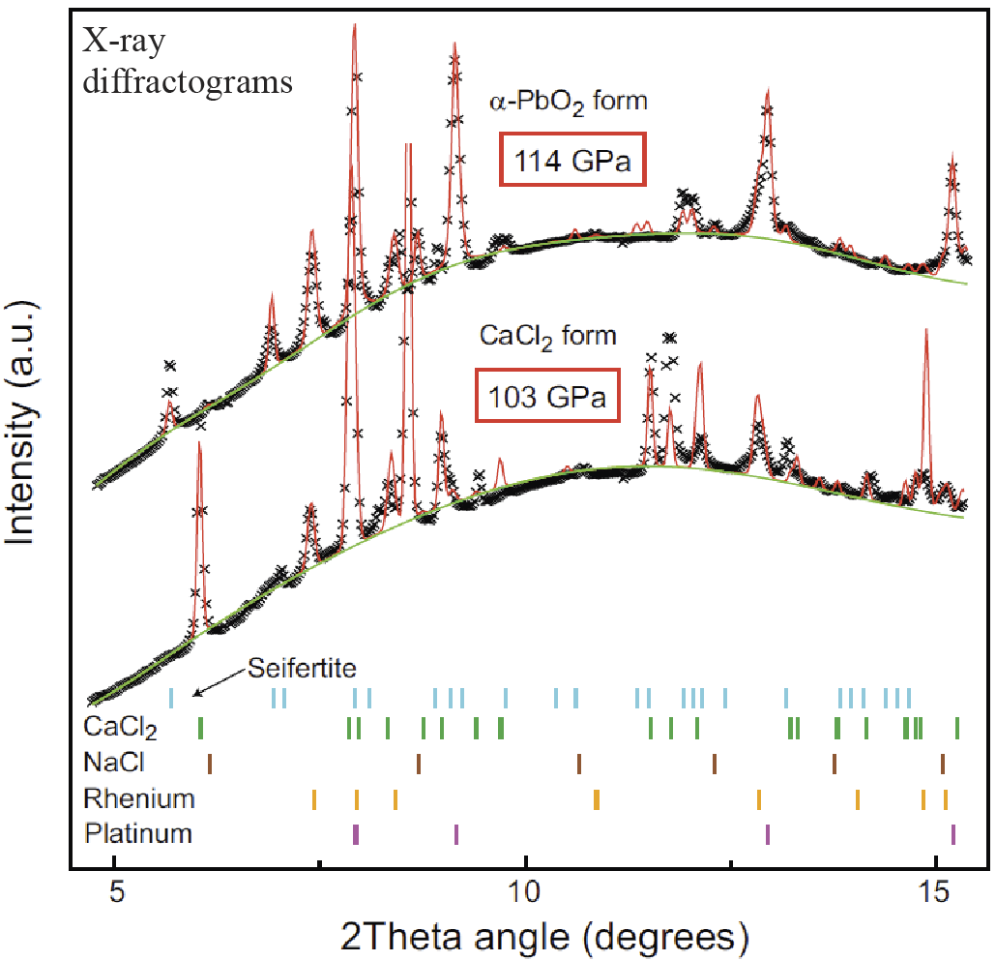
Andrault et al.
(2014, Am. Mineral.)

Slide 30
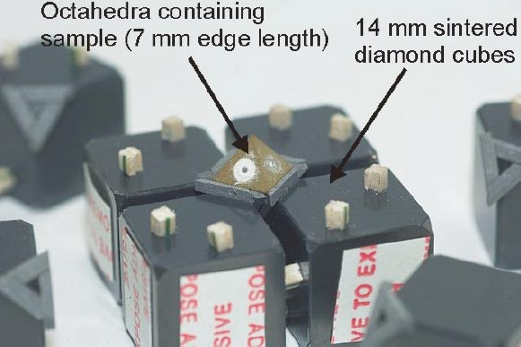
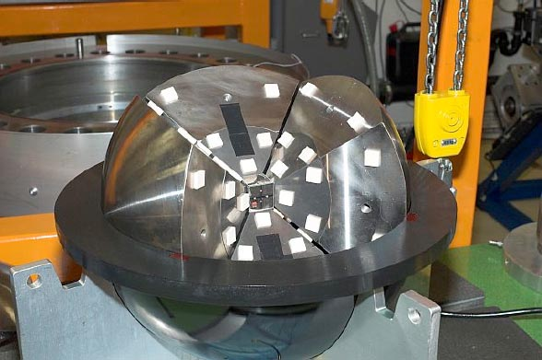
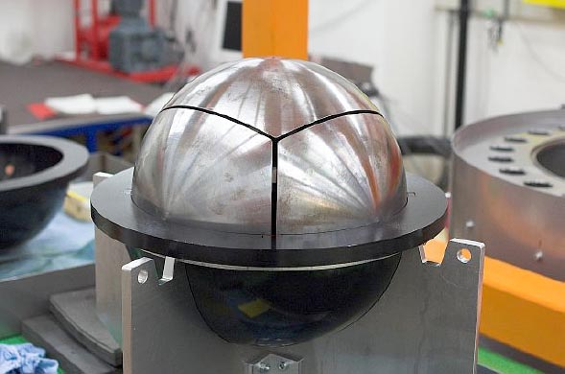
High-pressure experimental methods: Piston cylinder and multianvil technology

Slide 31
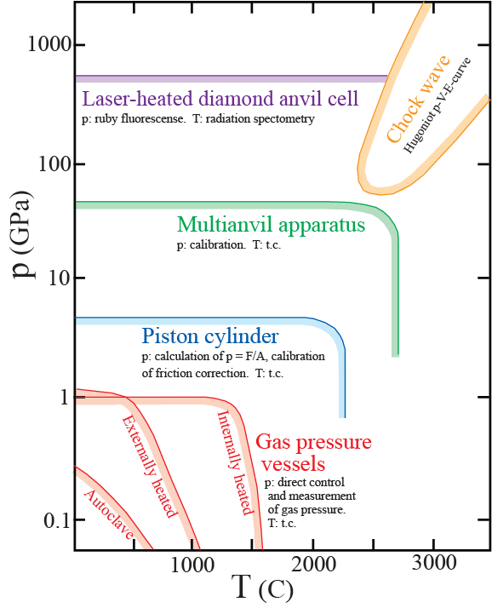
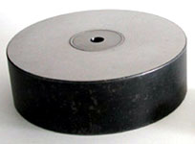
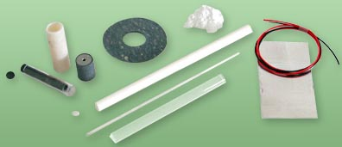

Slide 32
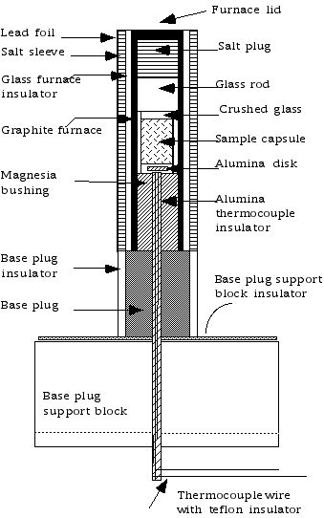
Supporting steel rings
WC-core (of pressure plate)
containing the central
cylindrical pressure chamber
Piston
Supporting steel rings
Base plug support plate
Siff mylar electric insulation

Slide 33
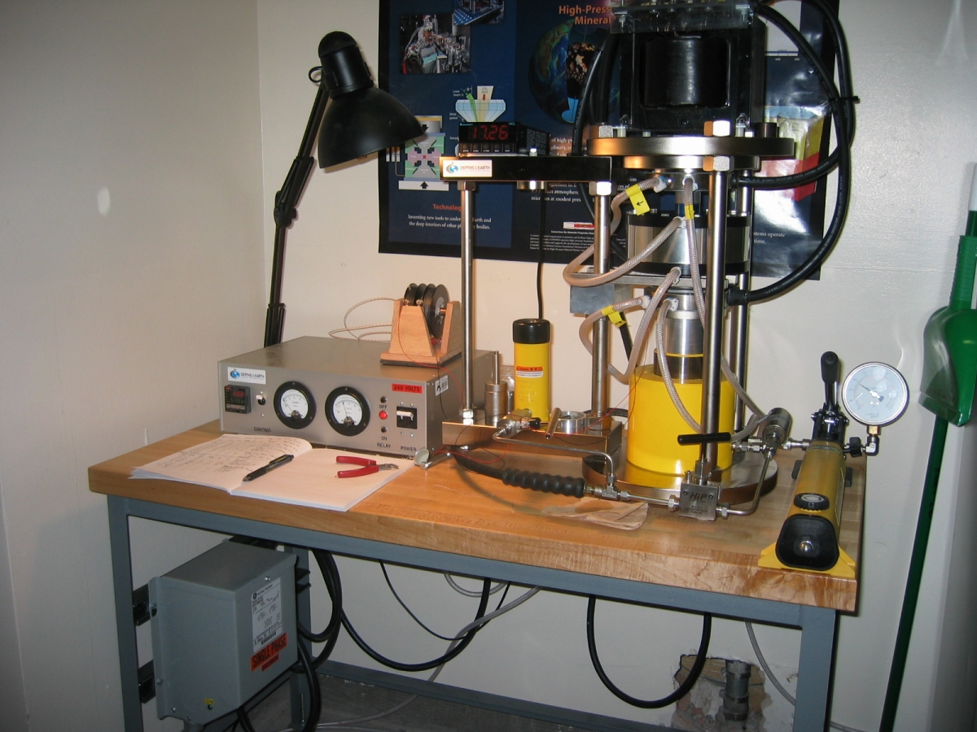

Slide 34
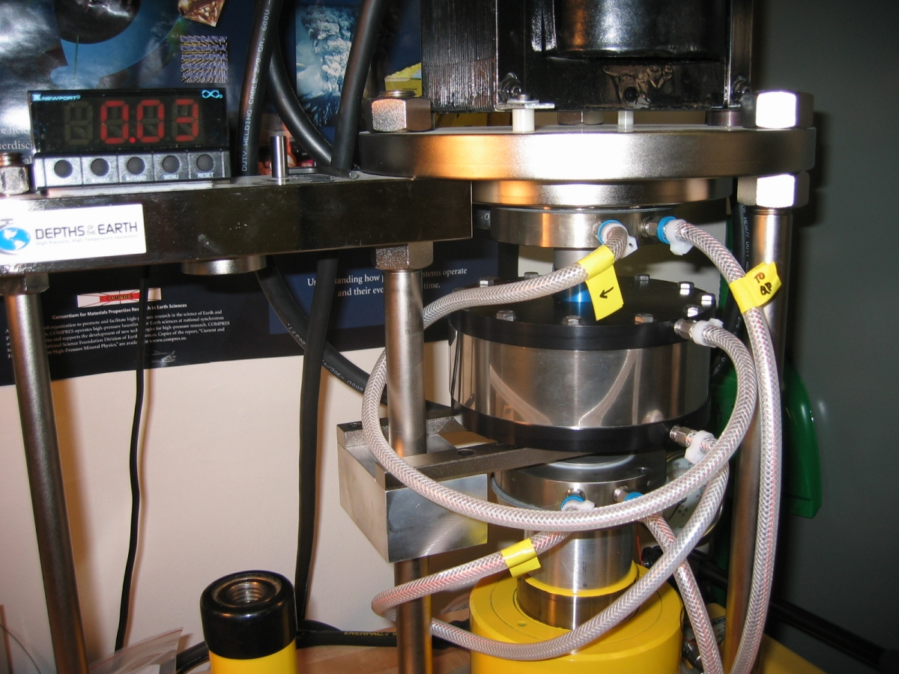

Slide 35
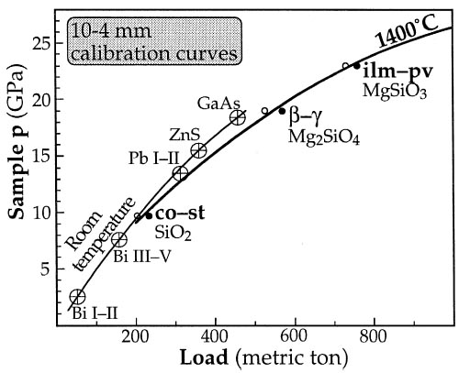

Slide 36
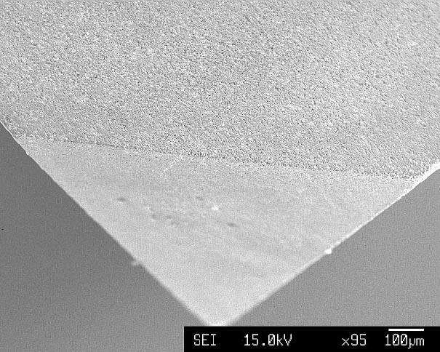
Multi-anvil, sintered diamond technology, ETH, Zurich:
True split-cylinder, 6-8-configuration (design of Kawai & Endo, 1970)
Corner truncation on
sintered diamond cube
1 mm
1 mm
1 mm

Slide 37
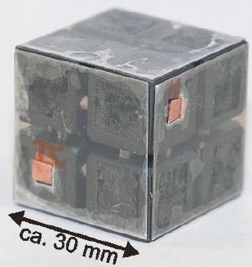

Slide 39
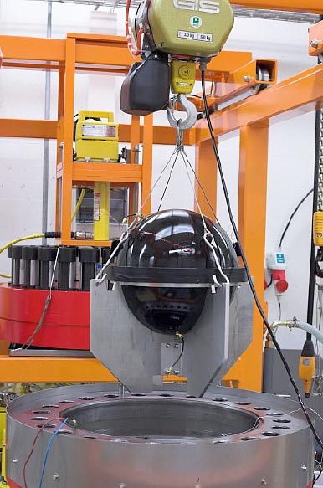
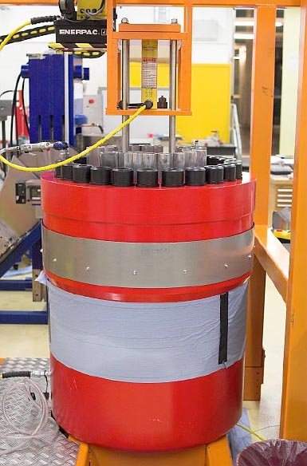

Slide 40
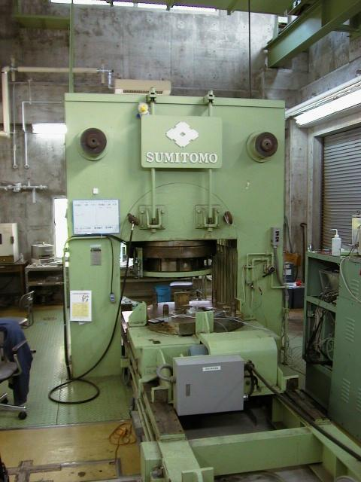
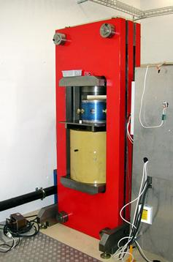
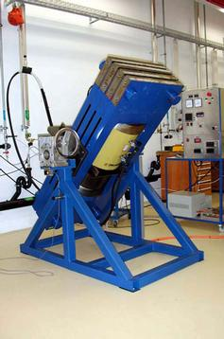
ETH, Zurich
ISEI, Okayama Univ., Misasa
ETH, Zurich

Slide 41
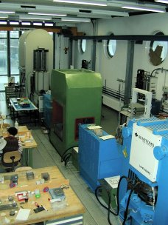
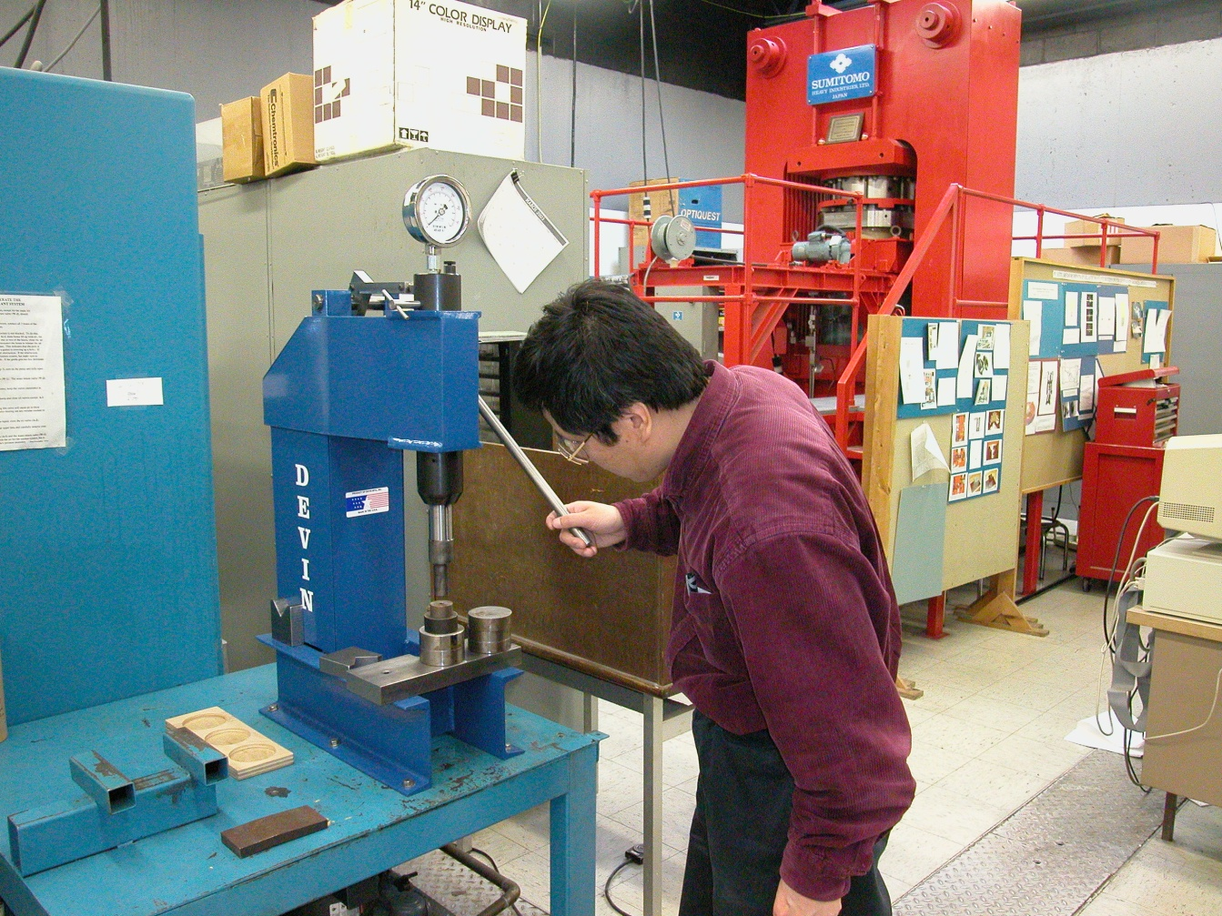
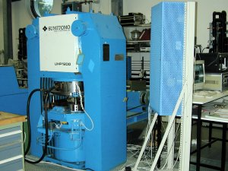
BGI, Bayreuth
SUNY, Stony Brook

Slide 42
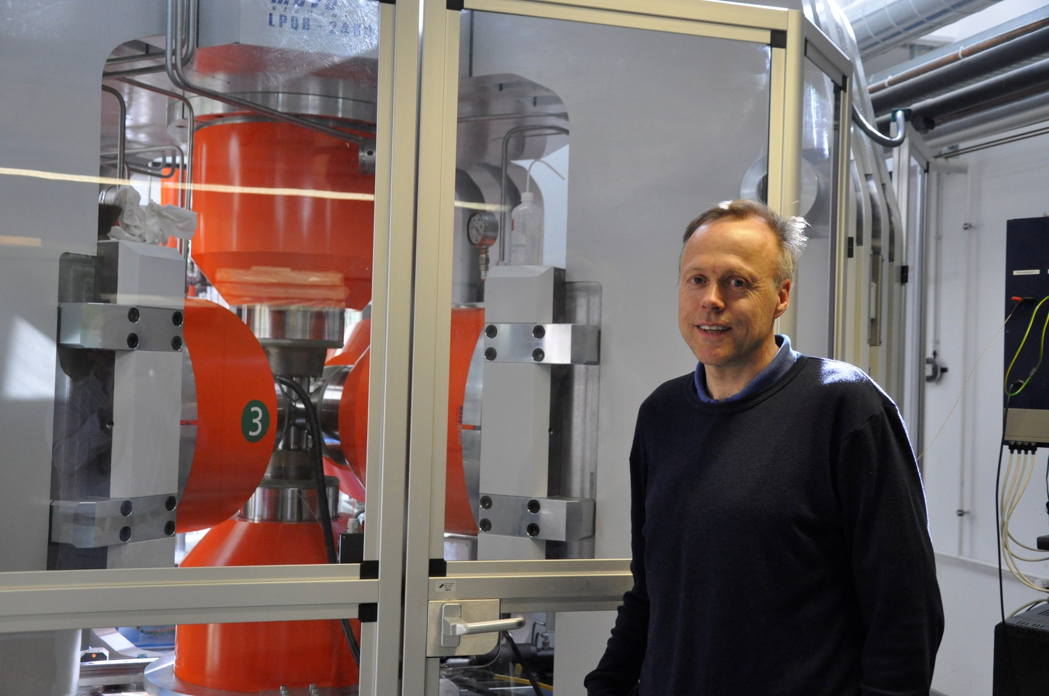

Slide 43
Walker (1989)-type 6-8-configuration design,
Inst. of Meteoritic, Univ New Mexico (C. Agee, D. Draper)

Slide 48
Spring-8, JSRI, Japan

Slide 49
Deformation-DIA-apparatus
Cubic-anvil apparatus

