Slide 1
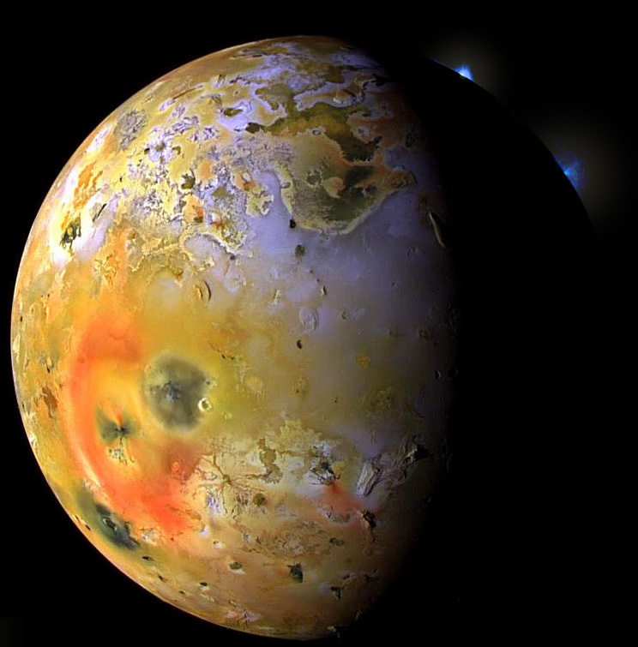
Partial melting and the formation of planetary crusts
Jupiter’s moon, Io, is the most volcanically
active object in our Solar System.
Manipulated photo mosaic, NASA-Galieo, 1997

Slide 2
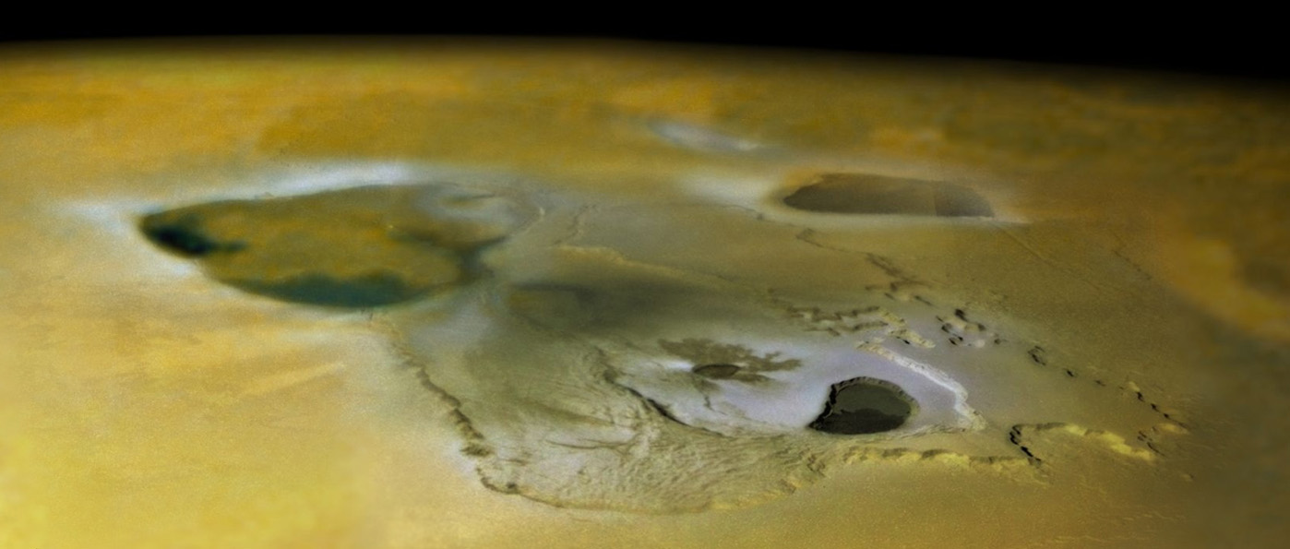
Magmatic processes – responsible for:
- Early segregation (differentiation) of terrestrial planets:
core, mantle, primary crusts
- Formation of secondary and possibly tertiary crusts
basaltic crusts on all terrestrial planetes:
Mercury, Venus, Earth, Moon, Mars, Vesta, Io
continents on Earth (only?)
Tvashtar Catena kaldera-kompleks, Io
Galileo-NASA, 2000

Slide 3
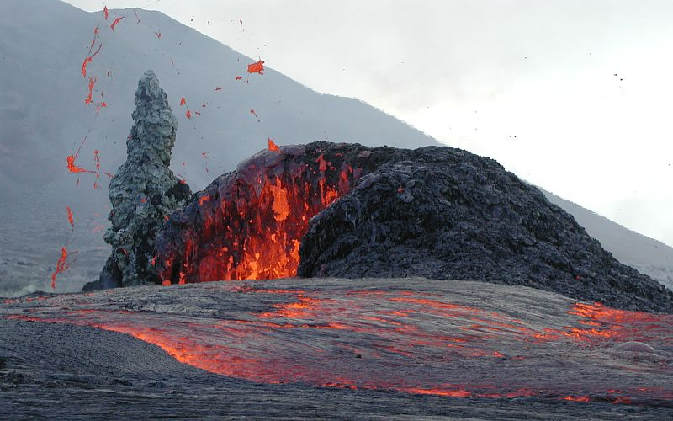
- Melting
- Crystallization
⇒ Change in composition
Partial melting
Fractional crystallization
Kilauea, Hawaii

Slide 4
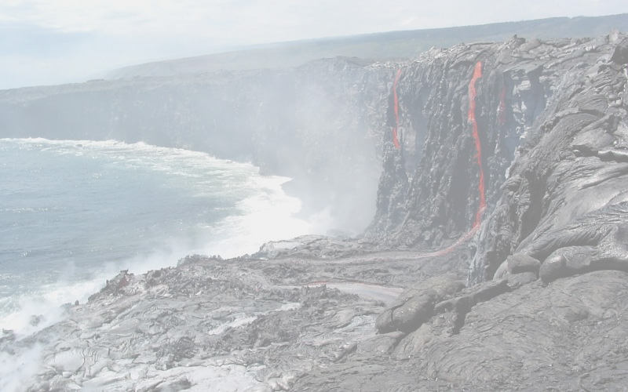
Magmatic differentiation
Major and trace element behaviour during melting and crystallization
Key point:
Melt compositions are mostly very different from the composition of the melting solid, both in terms of major, minor and trace elements.
examples: peridotite in equilibrium with basaltic melt
amphibolite in equilibrium with granitic melt
Kilauea, Hawaii

Slide 5
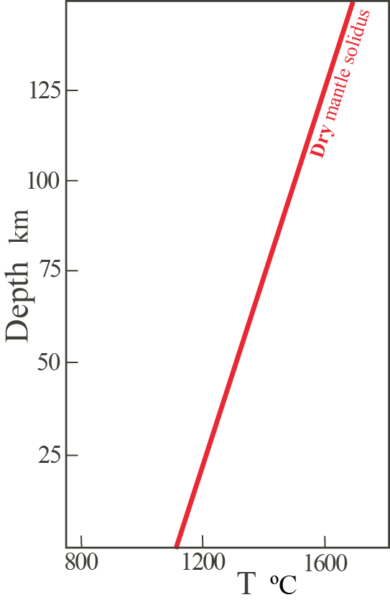
Two main types of mantle melting:
1. Decompression melting
Adiabatically rising
asthenosphere
Explain the change
of direction for the
trajectory here

Slide 6
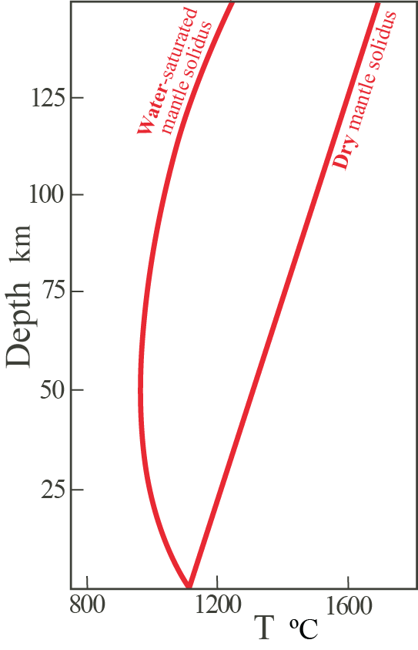
2. Flux melting aided by volatiles (esp. H)
Hydrous fluid
infiltration
from below
Ambient
mantle

Slide 7
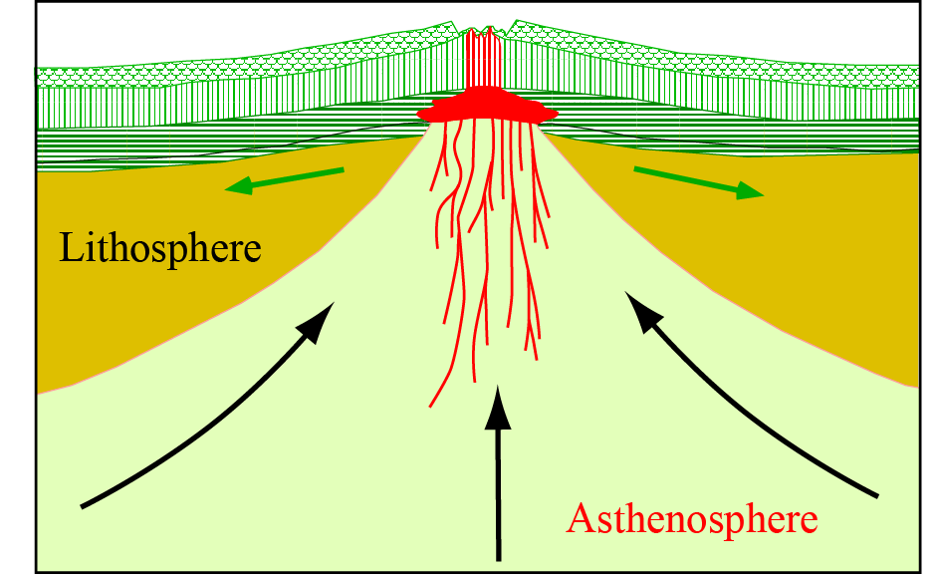
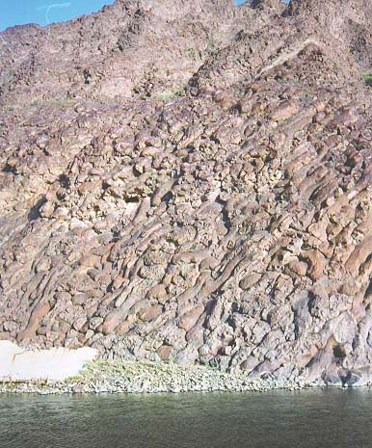
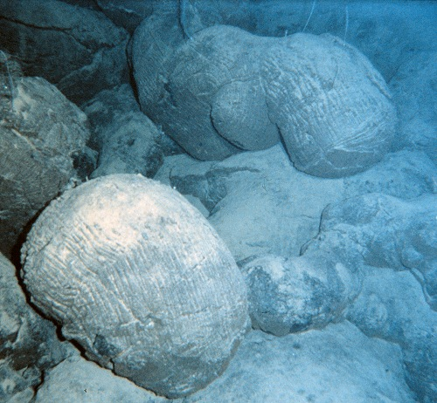
Decompression melting under mid-ocean ridges (MOR)
Pillow lava
Dike complex
Layered gabbroes (cumulates)

Slide 8
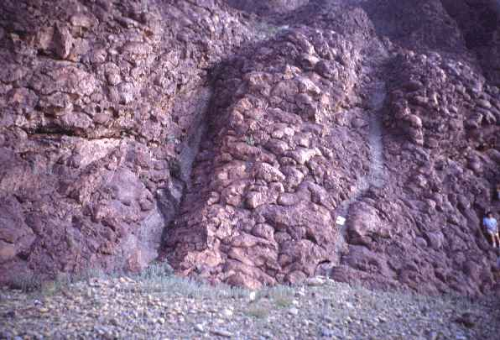
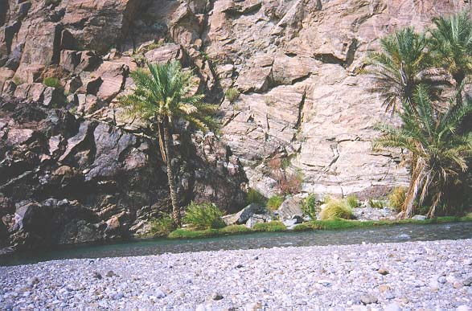
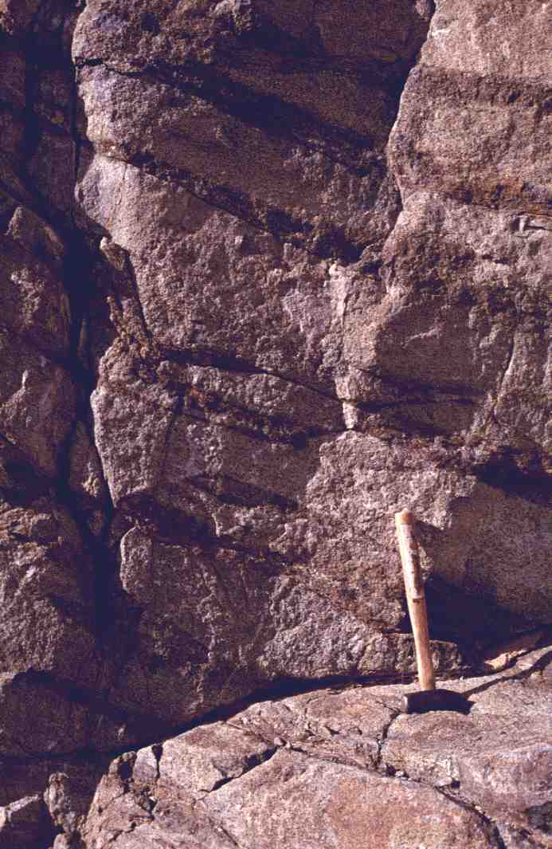
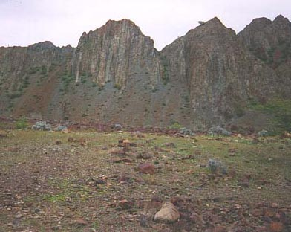
Putelava
Gang-kompleks
Lagdelte gabbroer (kumulater)

Slide 9
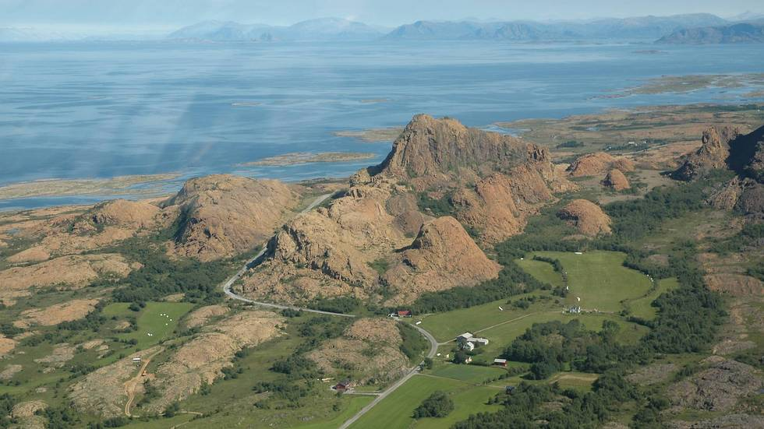
Leka ophiolite, off the coast of northern Trøndelag (mid-Norway)
left: depleted mantle, right: lower crustal cumulates

Slide 10
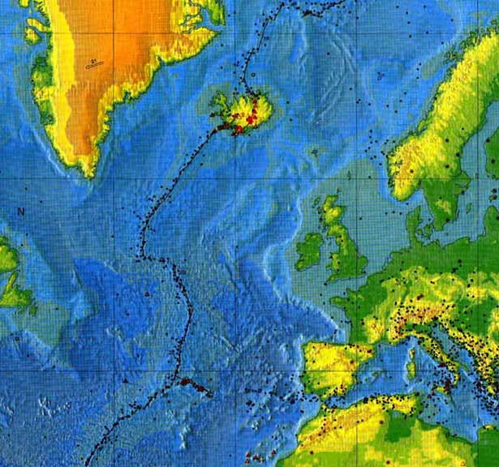
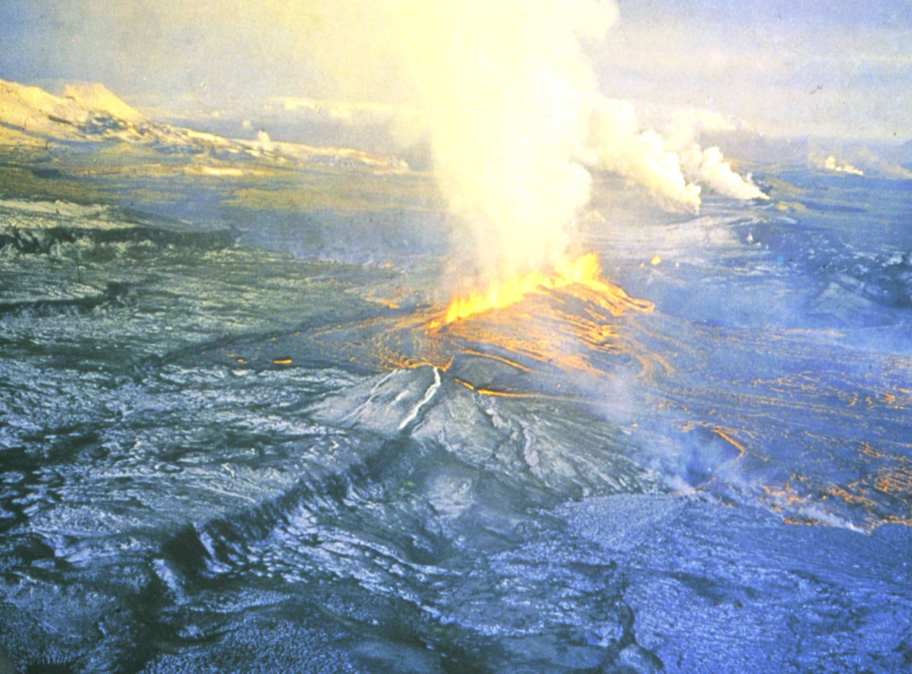
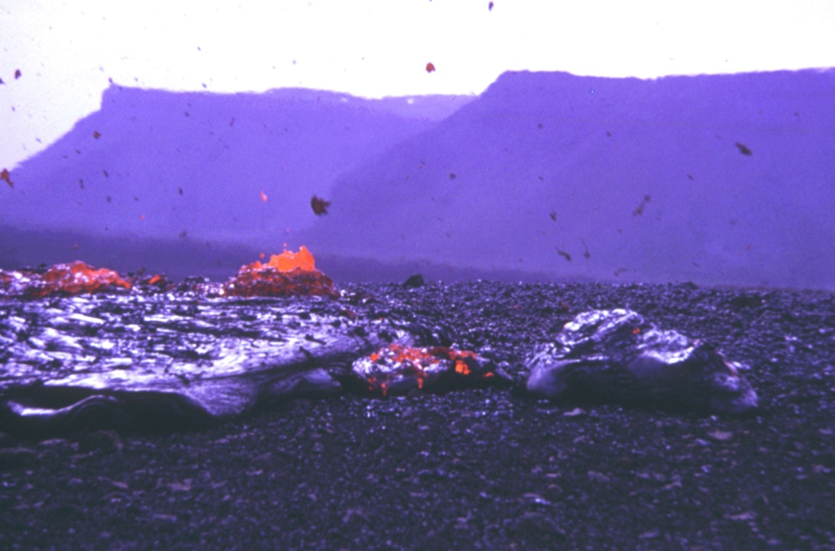
Fissure eruption, Krafla, NE Iceland, 1973
Pahoehoe flow, Krafla

Slide 11
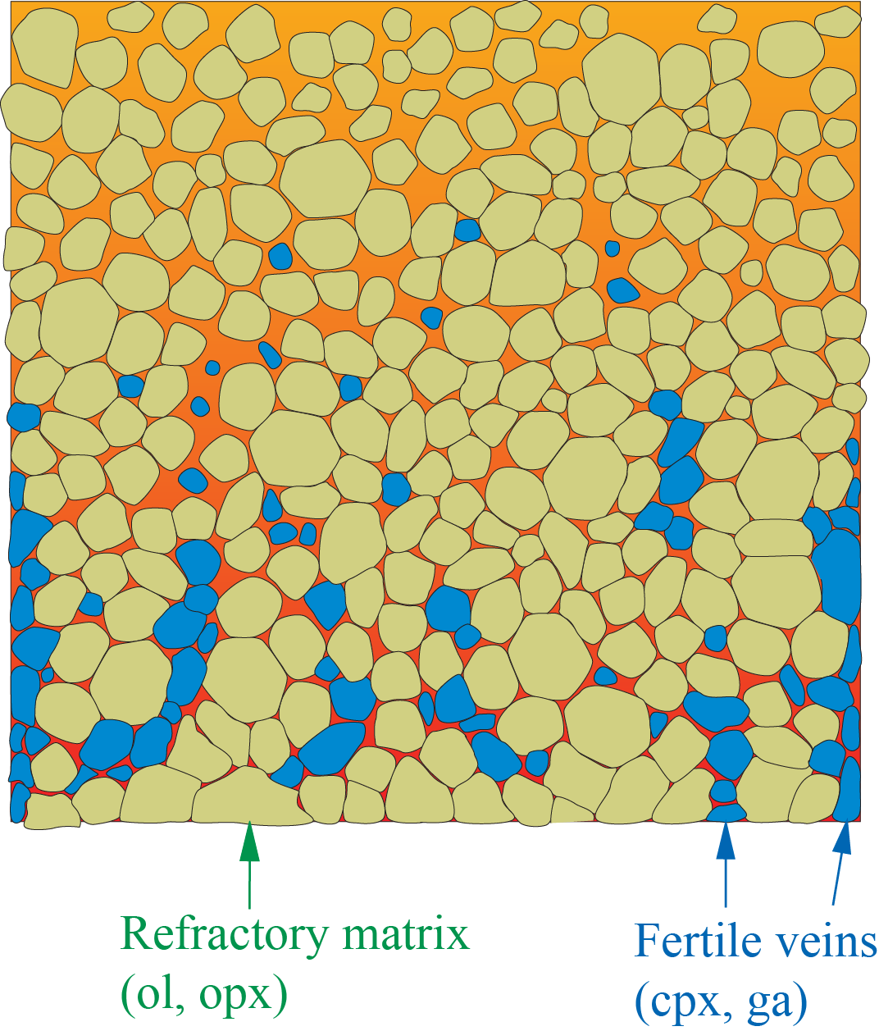
Progressive partial melting of heterogeneous mantel
Dynamic (progressive) melting
of ascending mantle
⇓
- decompression melting
- gradually more depleted source
the fertile veins gradually disappear
extraction of gradually more
depleted melt

Slide 12
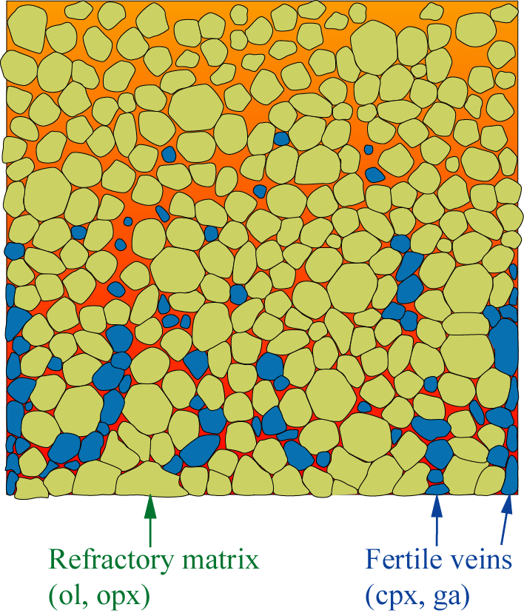
Decompression melting of mantle peridotite basaltic melt
Pillow lava
Dike complex
Layered gabbros
Central questions
Which elements stay behind in the residue ?
Which elements are extracted into the melt ?

Slide 13
The fertile veins melt preferentially.
Which elements are enriched in clinopyroxene and
garnet relative to olivine and orthopyroxene ?
cpx: Ca, Si, Na, Al, Ti, Fe
ga: Al, Ca, Si, Fe
+ most trace elements (LILE, LREE)
ol, opx: Mg
+ Ni, Cr, V

Slide 14
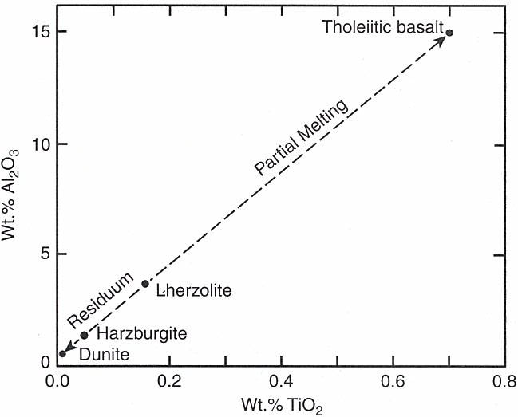
Lherzolite
(fertile mantle)
Olivine
Dunite
90
Peridotites
Wehrlite
Harzburgite
Lherzolite
40
Orthopyroxenite
Olivine Websterite
Pyroxenites
10
10
Websterite
Orthopyroxene
Clinopyroxenite
Clinopyroxene

Slide 15
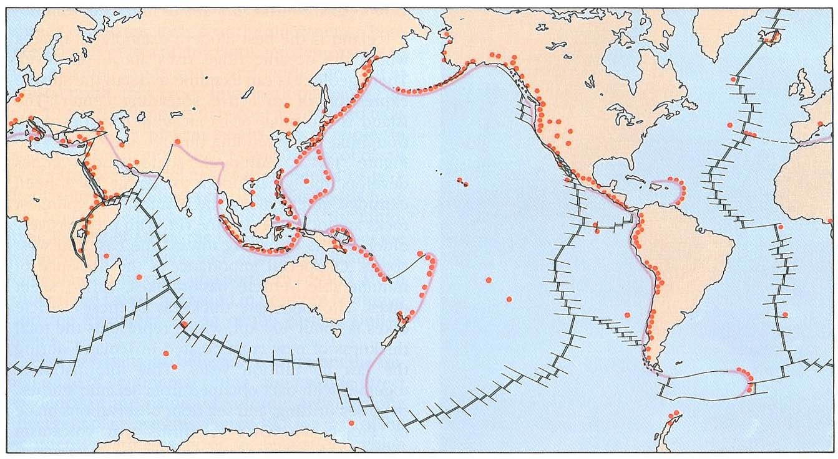
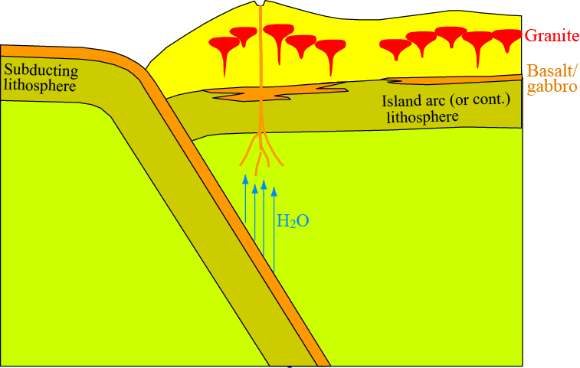
Flux melting of wet mantle above subduction zones

Slide 16
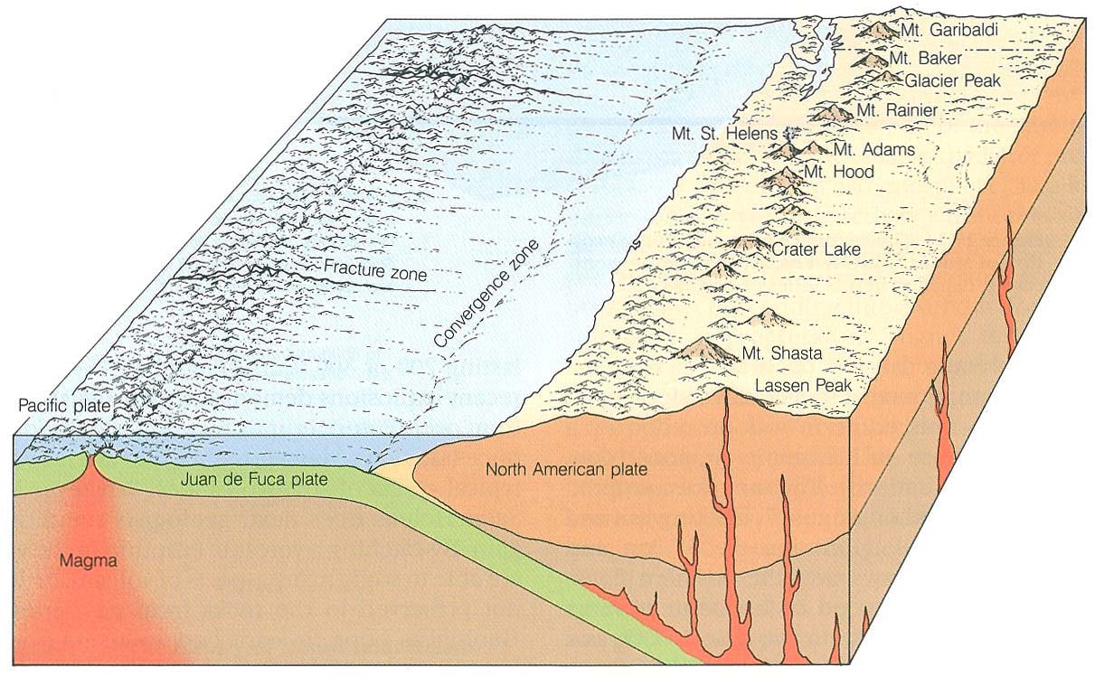
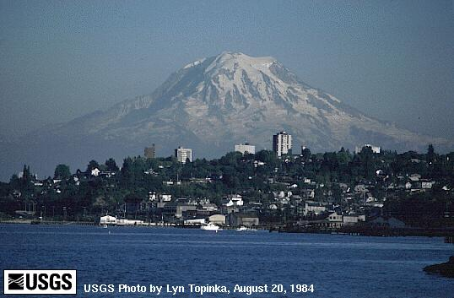
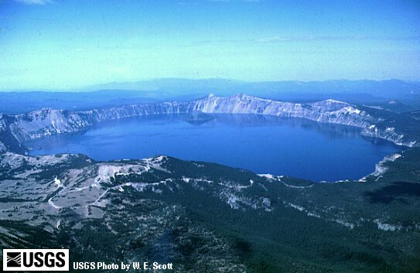
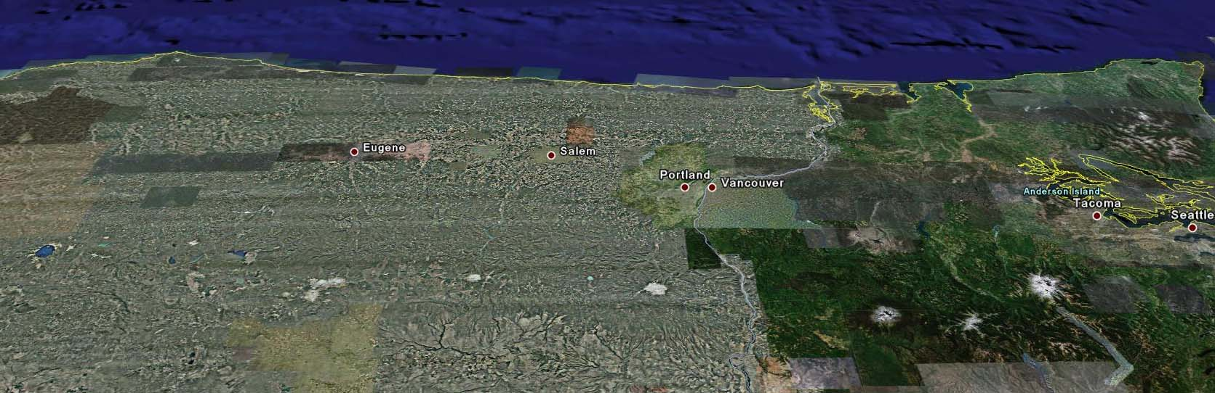
Crater Lake
St. Helens
Three sisters
Jefferson
Hood
Rainier
Adams

Slide 17
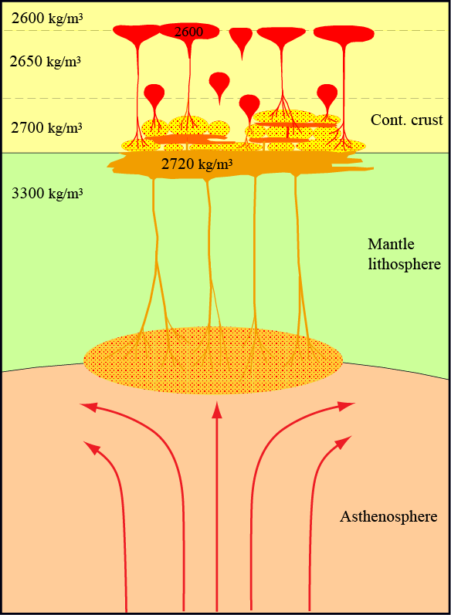
Accretion and differentiation of existing
continental crust by underplating
granite
Intracrustal differentiation
results in and is promoted by
density gradients (density steps)
basaltic sill intrusion/
”underplating”

Slide 18
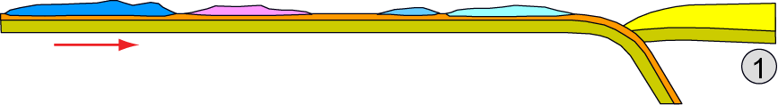
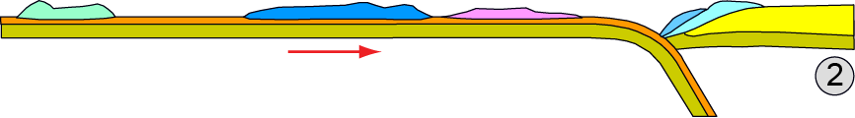
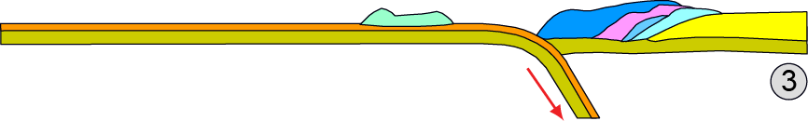
Crustal accretion by addition of exotic terrains
(continental fragments and thick oceanic plateaus)

Slide 19
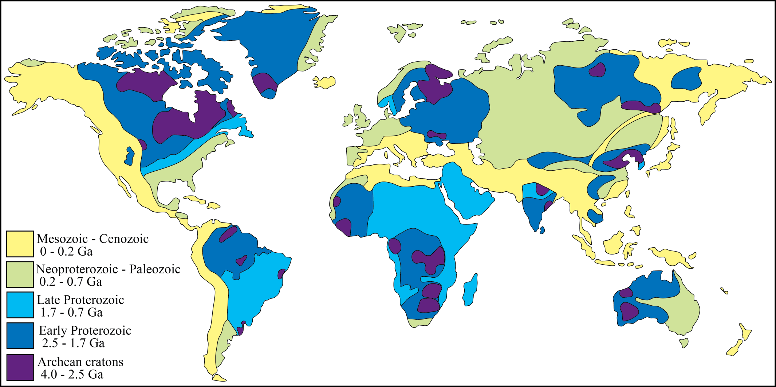
Result: continental age zonation

Slide 20
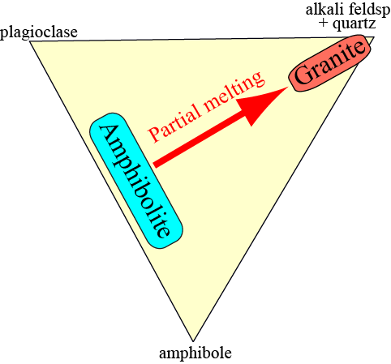
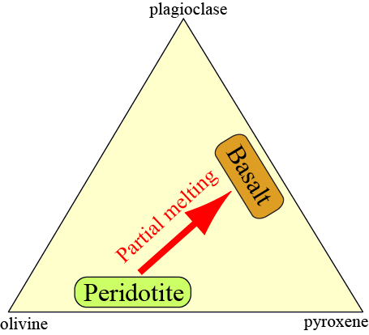
3. order (tertiary) crust: Earth's continents − granite
Stepwise evolution: peridotite → basalt → granite
Melting of
hydrated basalt
⇒ granite
(tertiary crust)
Hydration,
metamorphism
Mantle melting
⇒ basalt
(secondary crust)
via greenstone/
greenschist

Slide 21
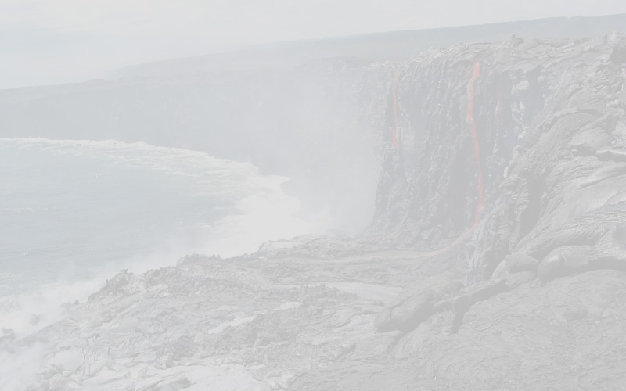
Melting and planetary crust formation
The melting temperature for a eutetic composition is lower than for each component
A eutektic melt is often compositionally very different from the melting material
Important geological examples: peridotite – basalt, amphibolite – granite
Melting in the mantle:
1. Decompression melting
- the adiabatic path crosses the solidus before reaching the surface
2. Flux-melting by release of water from subducted lithosphere
- liquidus- and solidus-T is lowered dramatically
Primary crust: formed by crystallization from early planetary magma oceans
Secondary crust: basalts and cumulates formed by local/regional mantle melting
Tertiary crust: Earth's continental crust (largely granitic, sensu lato) − hydrous melting

Slide 22
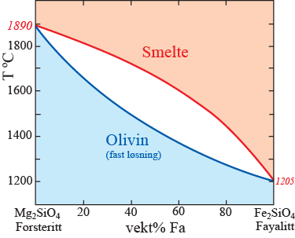
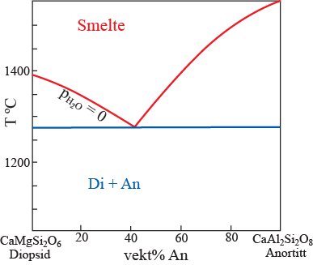
Melting phase relations: from simple systems to natural rocks
Simple 2 or 3-component phase relatios give important clues
basalt
basalt
peridotitt

Slide 23
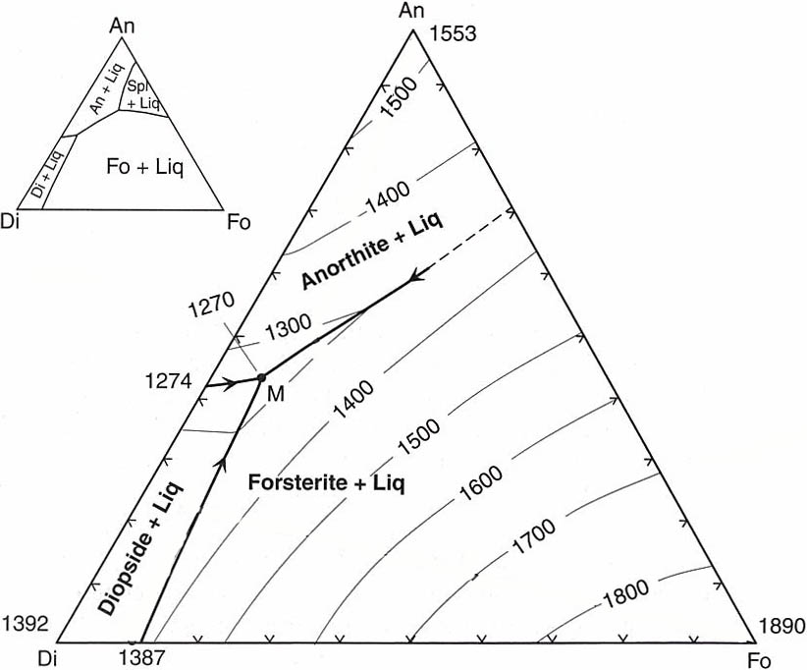
Note that the previous simplified diagram ignores the spinel field, prodruding into the Fo-An-Di triangle
Spinel,
MgAl₂O₄
Fig. 7.2 (Winter)

Slide 24
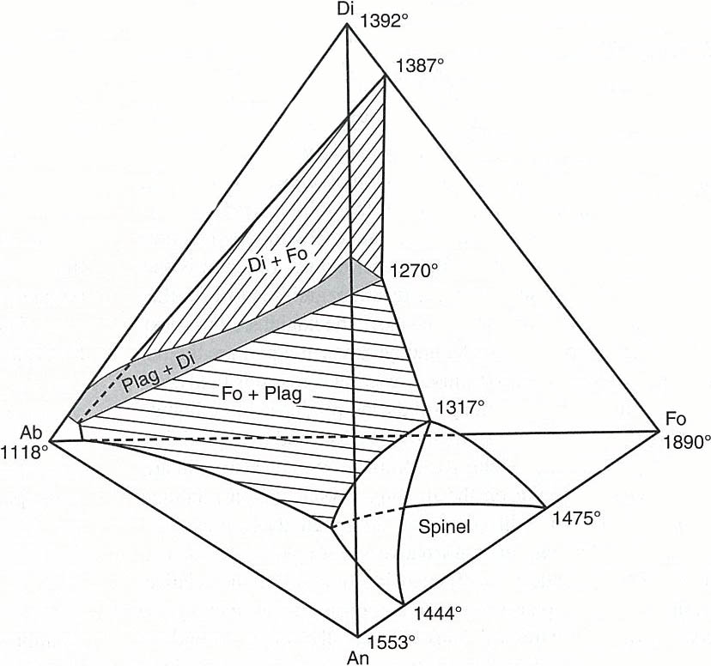
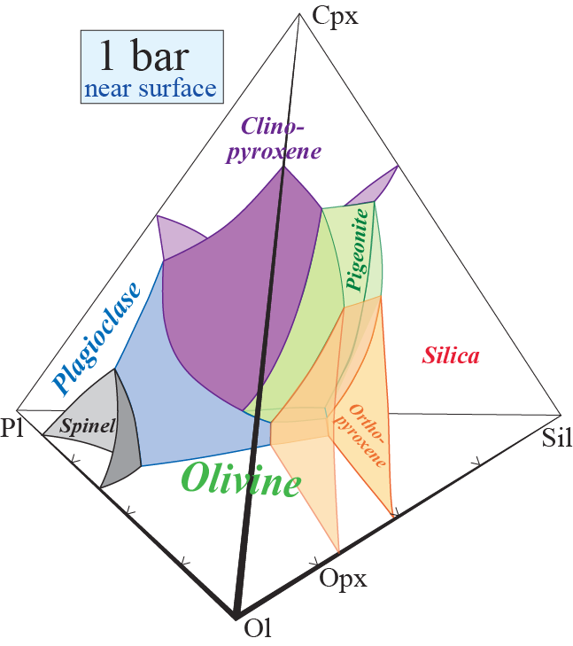
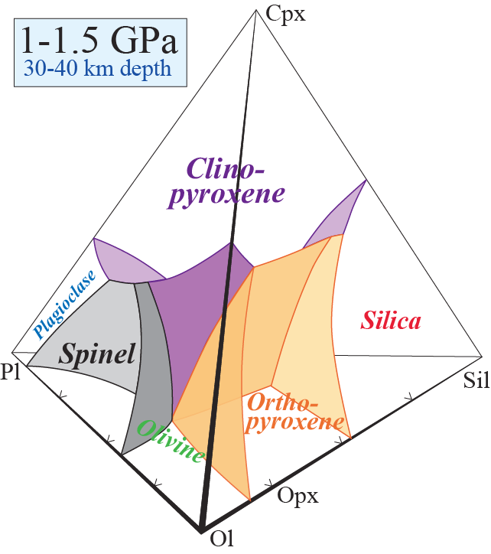
Spinel field
protrusion
Fig. 7.12
(Winter)
Liquidus relations of spinel peridotite
in an approximate 4-component
(pseudoquaternary) system
The effect of p-increase

Slide 25
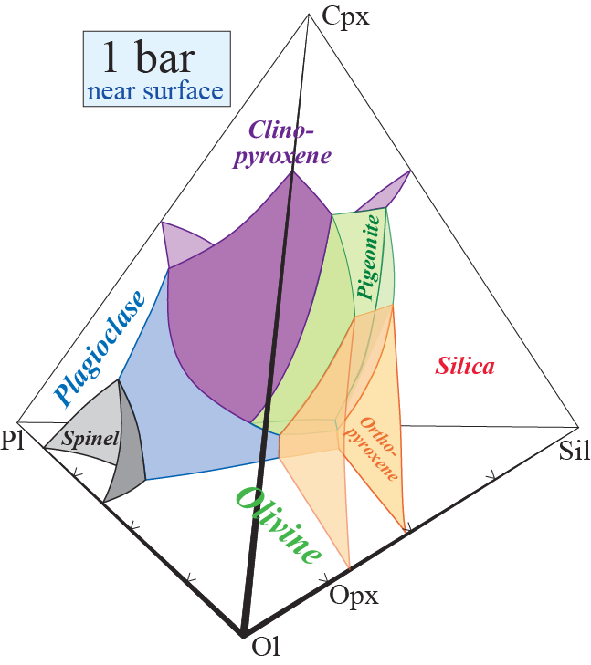

Upper mantle melting and crystallization on Earth: typical pressure of 1-1.5 GPa for melting of spinel peridotite at 30-40 km depth (pseudo-quaternary system Ol-Sil-Pl-Cpx)
pl-ol
cp-pl-ol
ol
Magma ascent to near-
surface chamber
Pseudoinvariant point,
eutectic-like basalt
composition
Peridotite
Terrestrial magma chambers
- early cumulates are olivine-dominated
- opx is almost never in the liquidus assemblage
What about small asteroids and
protoplanets, like Vesta?

Slide 26
Maciej Fitt, Institute of Geological Sciences, Polish Academy of Science
Vesta structure, composition and relation to the HED meteorites

Slide 27
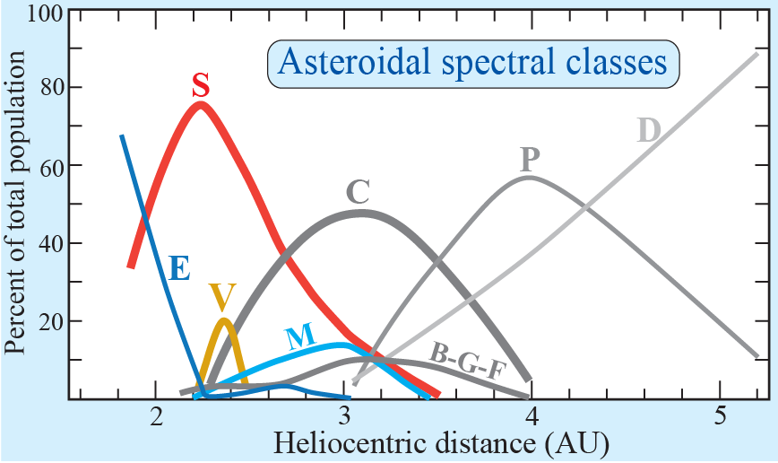
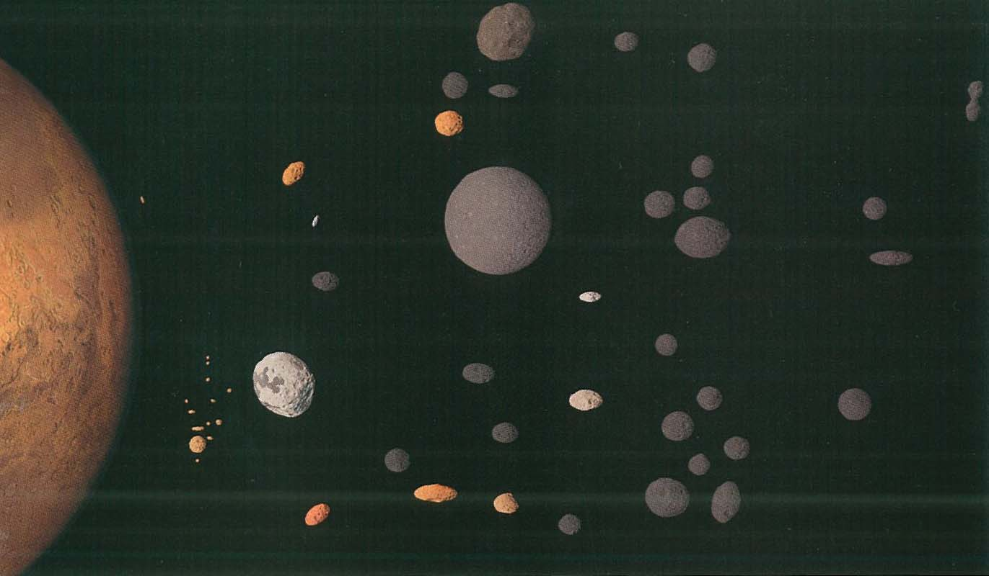
Asteroid spectral groups: link to meteorite types
Carbonaceous chond.: C + BFGD - outer belt
Ordinary chond.: S - inner belt
Metal, Enstatite: M +E
2 Pallas (B)
HED: Vesta, Vestoids: V +R
3 Juno
1 Ceres
250 Bettina
7 Iris
433 Eros
44 Nysa (E)
Mars
10 Hygiea
349
Dembowska (R)
4 Vesta
16 Psyche
8 Flora
15 Eunomia
532
Herculina
6 Hebe

Slide 28
Asteroid spectral groups: link to meteorite types
Carbonaceous chond.: C-type (+ B F G D) - outer belt
Ordinary chond.: S-type - inner belt
Metal, Enstatite: M-type (+ E)
Pallas (B)
HED: Vesta, Vestoids: V-type (+ R)
Hungaria family
(3103 Eger):
aubrites
Juno
Bettina
Ceres
Eros
7 Iris
Nysa
Mars
Hygiea
Baptistina family:
CM, 160 Ma
Dembowska (R)
Psyche
Vesta family:
HED
Flora family:
L, 480 Ma
Eunomia
Herculina
Hebe:
H, IIE

Slide 29
Orbitally, Vesta and the Vestoids are likely to provide a
sizeable fraction on the meteorite population on Earth.
If so: which meteorite group other than the HED
are likely candidates ?
NONE of the other meteorite groups are good candidates
Jan. 27, 2015 we had 1553 HED-meteorites,
constituting about 59% of all achondrites
Inventory of registered
meteorites,
January 27, 2015
Total: 64 024
Chondrites: 60 014, 93.8 %
C-rich: 2.8 %
Ordinary: 90.1 %
Enstatite: 0.8 %
Ungrouped: 0.09 %
Achondrites: 2640, 4.1 %
HED: 1553, 58.8 %
Mars: 144, 5.5 %
Moon: 201, 7.6 %
Others: 742, 28.1 %
Fe-rich meteorites: 1370, 2.1 %
Fe-meteorites: 1061, 77.4 %
Pallasites: 99, 7.2 %
Mesosiderites: 210, 15.3 %
Antarctica: 35 314
Chondrites: 34 089, 97.0 %
C-rich: 3.1 %
Ordinary: 92.7 %
Enstatite: 1.2 %
Ungrouped: 0.04 %
Achondrites: 993, 2.8 %
HED: 685, 69.0 %
Mars: 28, 2.8 %
Moon: 34, 3.4 %
Others: 246, 24.8 %
Fe-rich meteorites: 232, 0.7 %
Fe-meteorites: 144, 62.1 %
Pallasites: 32, 13.7 %
Mesosiderites: 56, 24.1 %
Rate of addition of registrered meteorites, 2008-2012:
Total (entire world): 2028/year
Antarctica: 1435/year (71%)
Rate of addition of registrered meteorites, 2012-2015:
Total (entire world): 7825/year
Antarctica: 2136/year (71%)

Slide 30
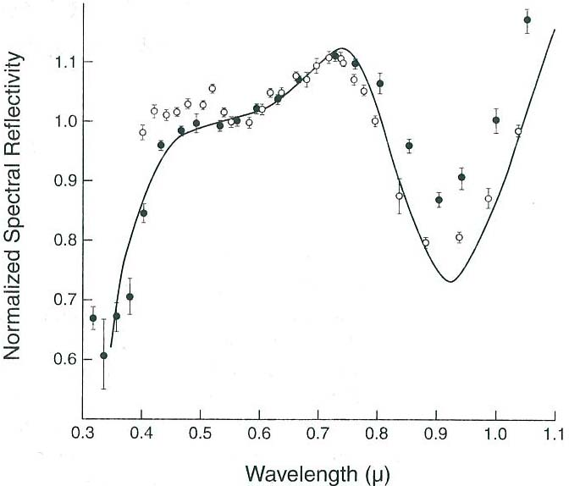
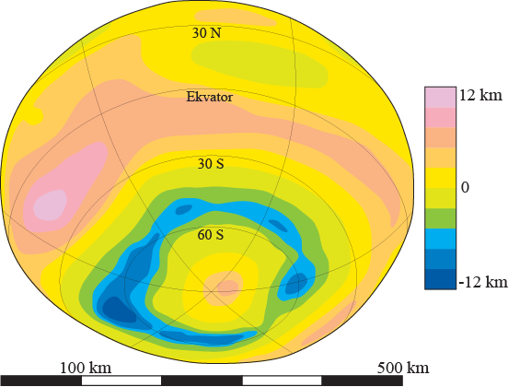
Situation before Dawn:
Why are the HED-meteorites likely fromVesta and the Vestoids ?
Reflection spectroscopy
1. HED-group is chemically coherent
2. Similar reflection spectra: Vesta-Vestoids-HED
3. Vestoids are dynamically/orbitally linked toVesta
Eucrites
Vesta
recordings
4. Vesta has big crater(s) covering most of the southern hemisphere
5. HED-meteorites are from a protoplanet/asteroid with a core
6. HED-meteorittes are chemically not related to any of the Fe-meteorites
(therefore, most likely from a largely intact protoplanet)
Based on Hubble telescope imagery

Slide 31
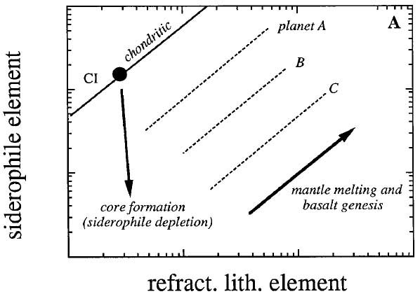
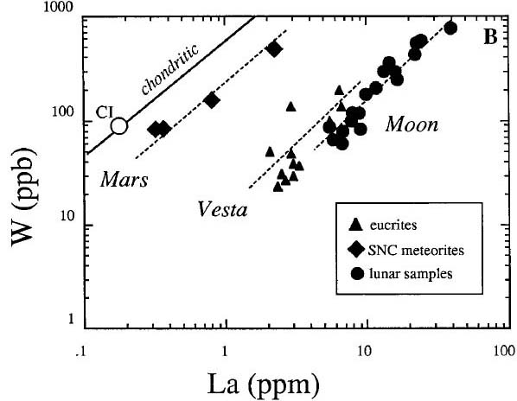
Vesta has segregated a core
Comparing two elemtents partitioning preferentially into silicate melt:
W (siderophile) and La (lithophile)
W
La
Righter & Drake (1996, Icarus)

Slide 32
Situation before Dawn:
Why are the HED-meteorites likely fromVesta and the Vestoids ?
Reflection spectroscopy
1. HED-group is chemically coherent
2. Similar reflection spectra: Vesta-Vestoids-HED
3. Vestoids are dynamically/orbitally linked toVesta
Eucrites
Vesta
recordings
4. Vesta has big crater(s) covering most of the southern hemisphere
5. HED-meteorites are from a protoplanet/asteroid with a core
6. HED-meteorittes are chemically not related to any of the Fe-meteorites
(therefore, most likely from a largely intact protoplanet)
Visible light
The ”Hubble” view of Vesta’s topography
and the inferences above are now largely
confirmed and refined by Dawn
Based on Hubble telescope imagery

Slide 33
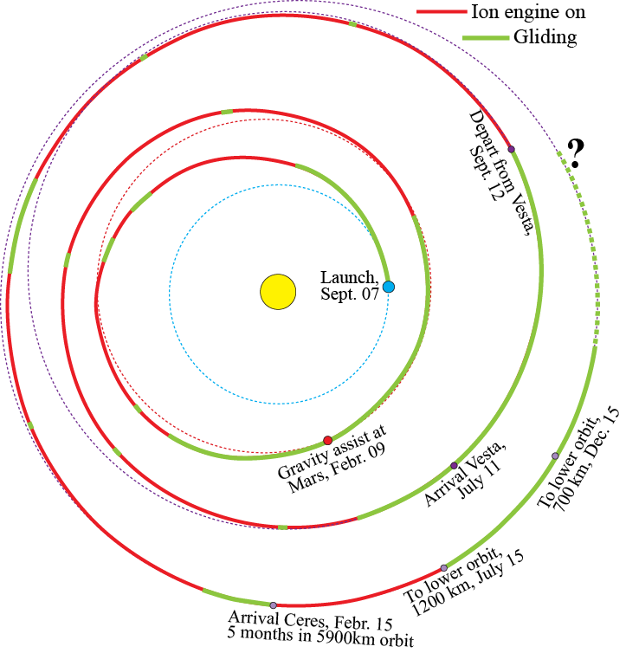
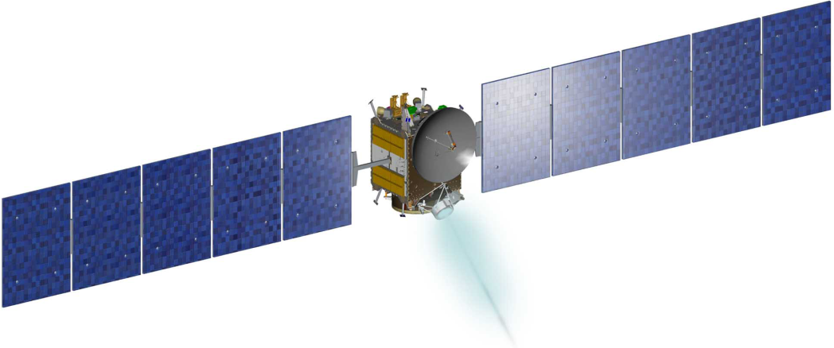
Dawn mapping of Vesta
July 16, 2011: orbit entry
Aug. 2: 69-hour survey orbit (2750 km)
Sept. 27: 12-hour HAMO (680 km)
(high altitude mapping orbit)
Dec. 8: 4.3-hour LAMO (210 km)
From May, 2012: Outwards spiralling
towards HAMO-2 and SO-2
Sept. 5: orbit exit and start of interplanetary
travel towards Ceres

Slide 34
Data from Dawn
Full coverage with colour images: 7 channels for Vesta, 3 for Ceres
→ surface features, geology
Full coverage with infrared spectroscopy: 3 windows: 350-900 nm,
800-250nm, 2400-5000 nm
→ mineralogical composition
Full coverage with neutron- and γ-spectroscopy:
→ abundances of O, Mg, Al, Si, U, Th, H, C and N
Refinement of Dawn’s orbit
→ gravitational field and mass distribution: crust-mantle-core

Slide 35
Shape and size of Vesta
Mean diameter: 525
(triaxial ellipsoid: 573 * 557 * 446 km)
Biaxial reference ellipsoid: R: 285 * 229 km D: 570 * 458 km
Relief range: −22.3 to 19.1 km (associated with the Rheasilvia crater)
Rotation rate
360° / 5.3 hr (= 1 Vesta day)
Core
Radius: 107-113 km
Mass fraction: 18%

Slide 36
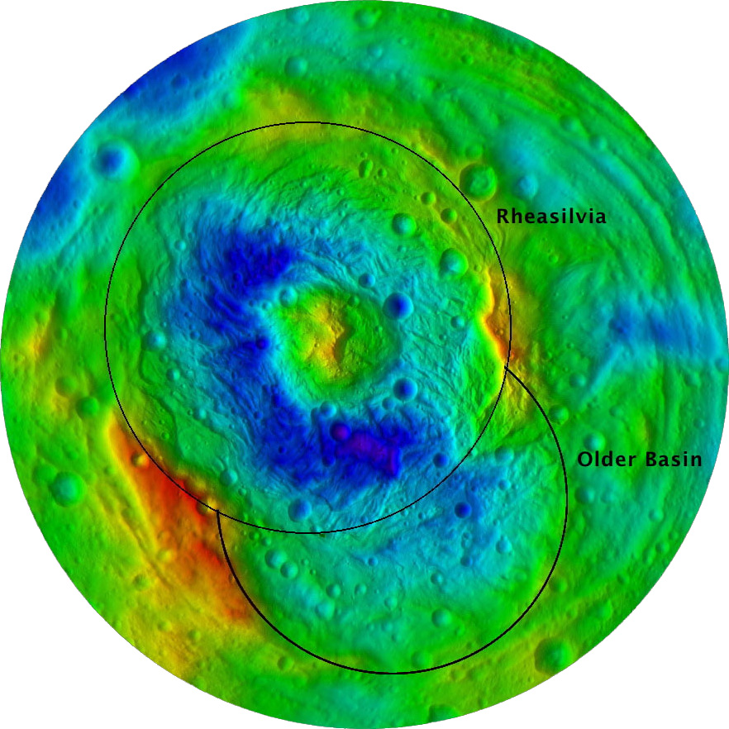
Structural features
Two young (1-2 Ga) giant craters
in the southern hemisphere
Rheasilvia, about 1 Ga
Veneneia, about 2 Ga
Rheasilvia
(500 km diameter)
- central mountain
about 30 km elevation above crater
floor (more than Olympus Mons !!)
- crater rim with large
avalanches
Next:
oblique view
Veneneia
http://dawn.jpl.nasa.gov/

Slide 37

Rheasilvia crater
central mountain and crater rim with large paleo-avalanches
http://dawn.jpl.nasa.gov/

Slide 38

Circumplanetary troughs
Pressure waves from southern hemisphere impact
Older circumplanetary troughs
Yougest near-equatorial troughs
http://dawn.jpl.nasa.gov/

Slide 39




Jaumann et al.
(2012, Science336,687)
Southern hemisphere pole positions
Total vertical
relief: 41,4 km

Slide 40

Spectroscopy
Reflectance
South pole
B I
B II
Pyroxene absorption bands
Southern hemisphere:
larger proportion of diogenite (orthopyroxenite)

Slide 41


B I and B II absorption band
peaks for diogenite and eucrite:
overlaps with howardite
Average /overall surface
composition: howarditic

Slide 42

HED-petrogenesis:

Slide 43

Melting pressure is low
≈ 1 bar
The first invariant melt
of peridotite P₁ ?
Will there be a progressive melting
trend along the liquidus curve in
this case? Explain.
No, because this is a simplified
ternary system without solid
solution
----------
Binary invariant melt
of peridotite P₂
(without plag)
P₁
P₂

Slide 44

Magma mixing is important, either with progressive
melting of complex compositions with SS or with
simple compositions without SS.

Slide 45
Vesta
progressive melting and
magma mixing at ~1 bar,
followed by fract. cryst.
Orthopyroxene cumulates
(diogenites) dominate the
lower crust of Vesta

Slide 46


