Slide 1
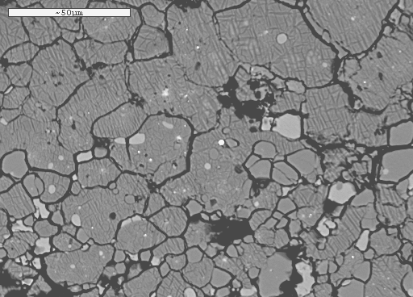
Phase relations of peridotitic and basaltic compositions

Slide 2
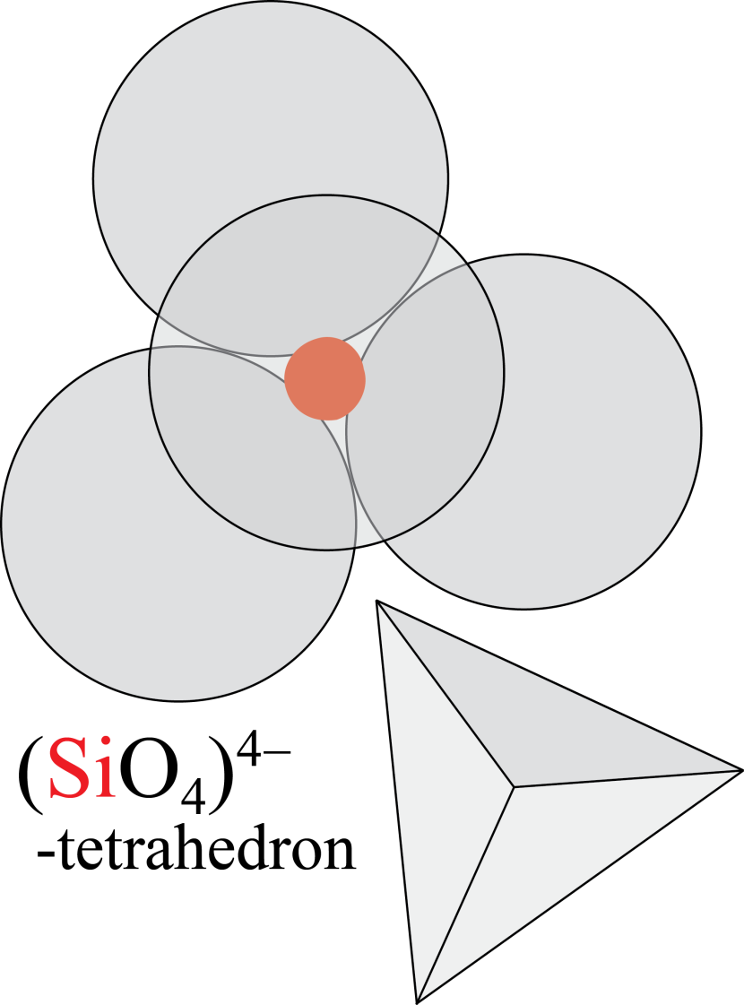
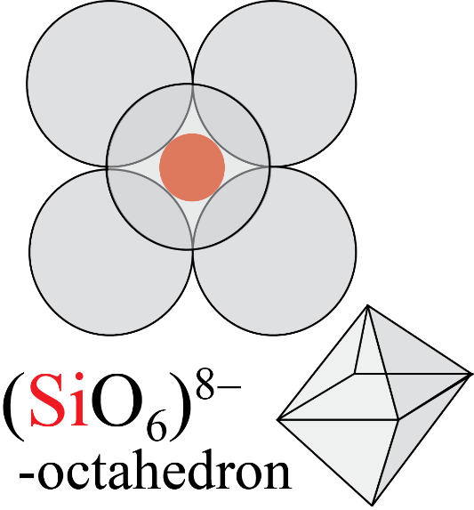
High-pressure adjustments of crystal structures
- anions compressed more than cations – decreasing size difference
may lead to increasing coordination number
Crust and upper mantle
Si in 4-coord. (tetrahedral coord.)
Lower mantle
Si in 6-coord.
(octahedral coord.)
Increasing p, depth

Slide 3
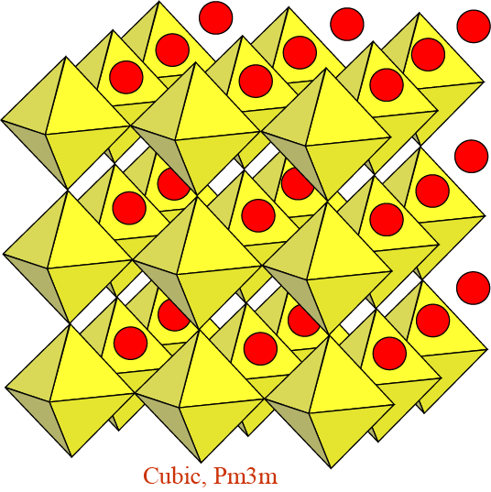
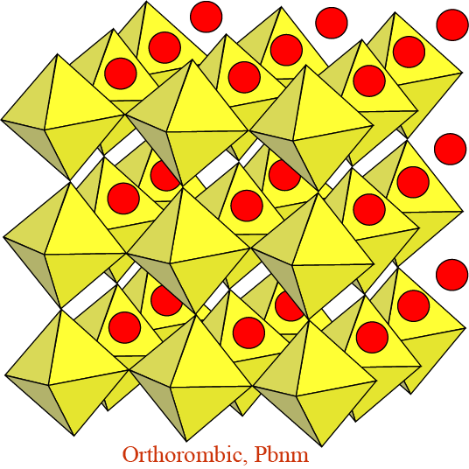
Perovskite-structured minerals:
high coordination numbers - high entropy
The perovskite structure: A^{[12-8]} B^{[6]} O₃
“Ideal”, undistorted structure with larger
divalent cation (Ca) in 12-coordination
Ca^{[12]} Si^{[6]} O₃
Distorted structure with smaller divalent
cations (Mg, Fe) i 8-coordination
Mg^{[8]} Si^{[6]} O₃

Slide 4
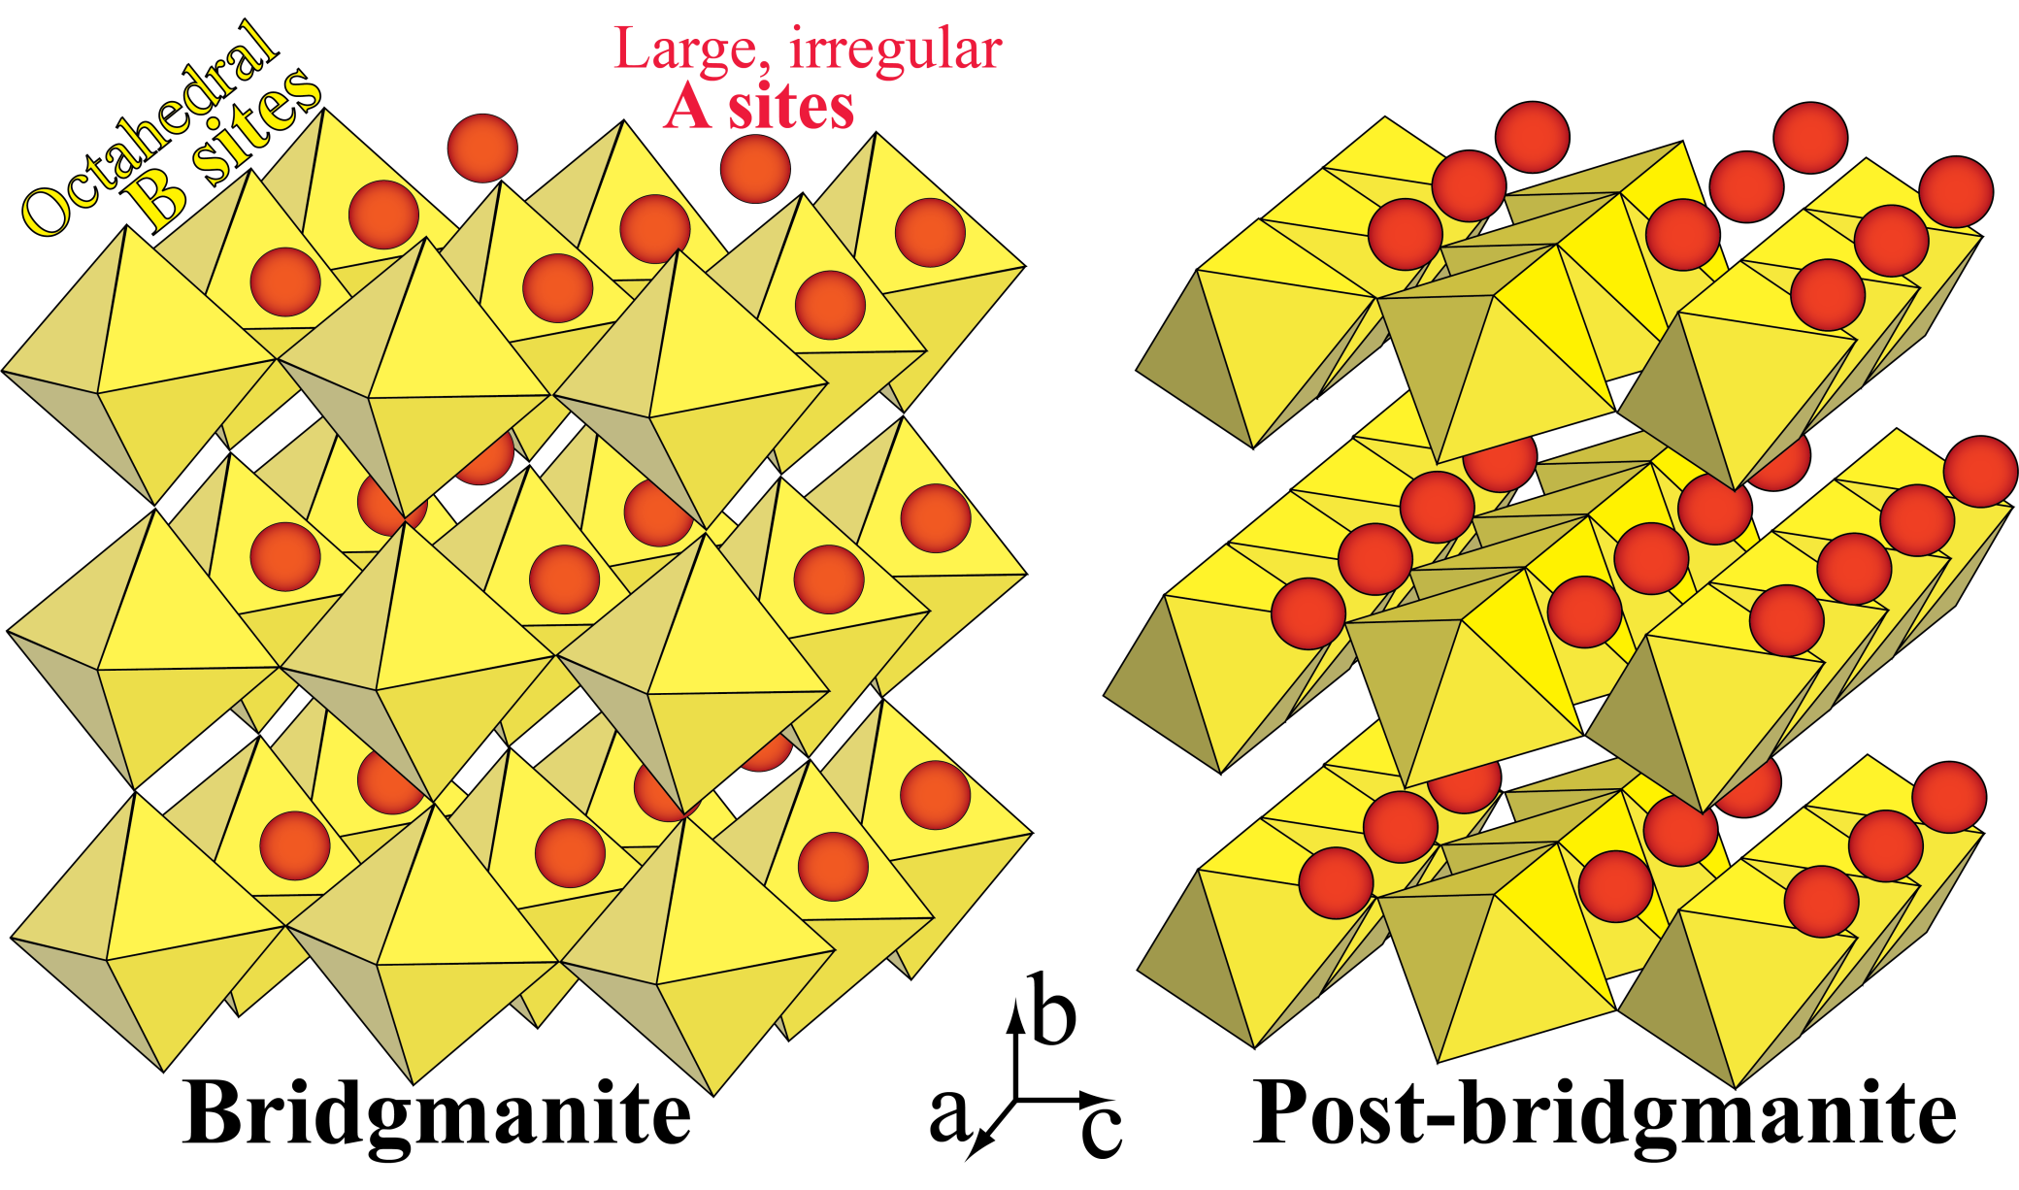
Orthorombic, Pbnm
Orthorombic, Cmcm
High entropy
Slightly lower density than post-bm

Slide 5
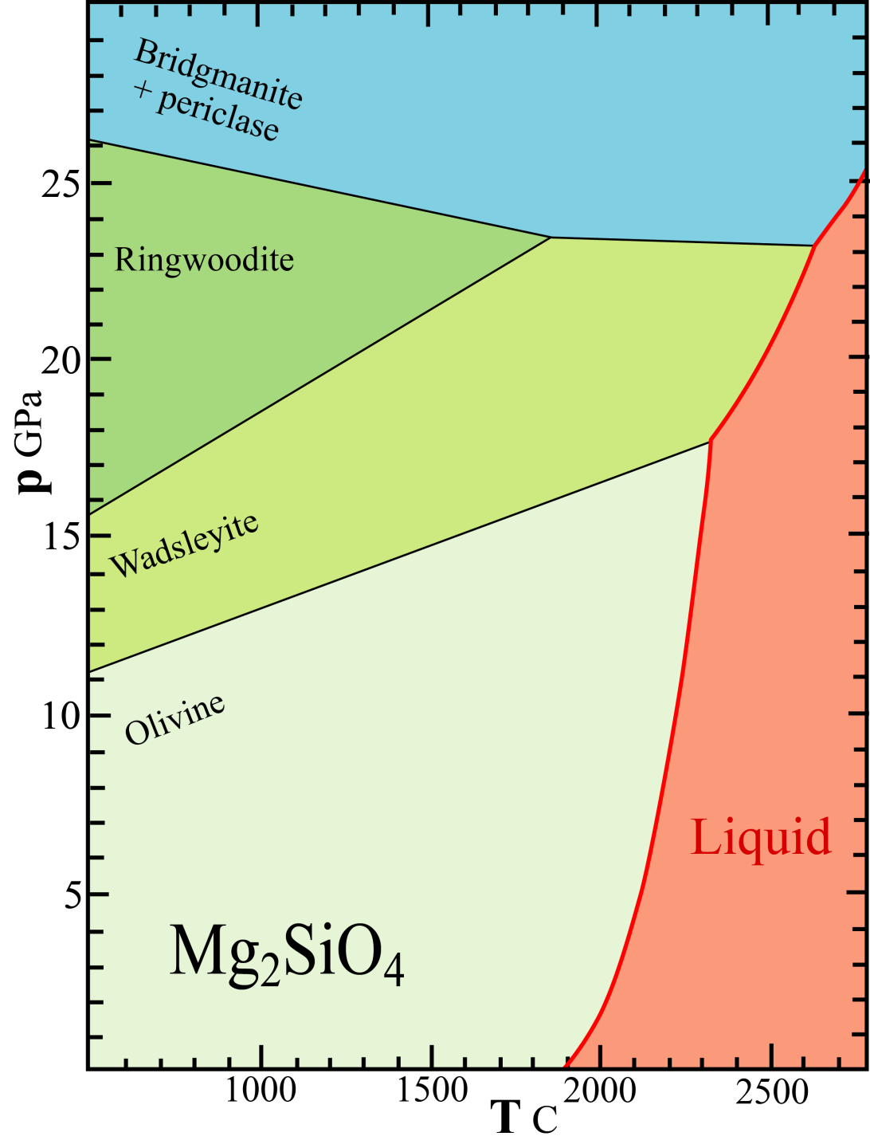
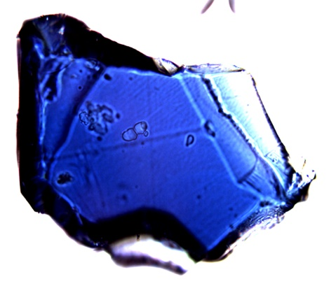
Phase relations UM, TZ, LM:
Simple system Mg₂SiO₄
One-component peridotite analogue
150 μm ringwoodite crystal
synthesised at BGI, Bayreuth
Modified from Fei & Bertka (1999,
Geochem. Soc. Spec. Publ. 6)

Slide 6
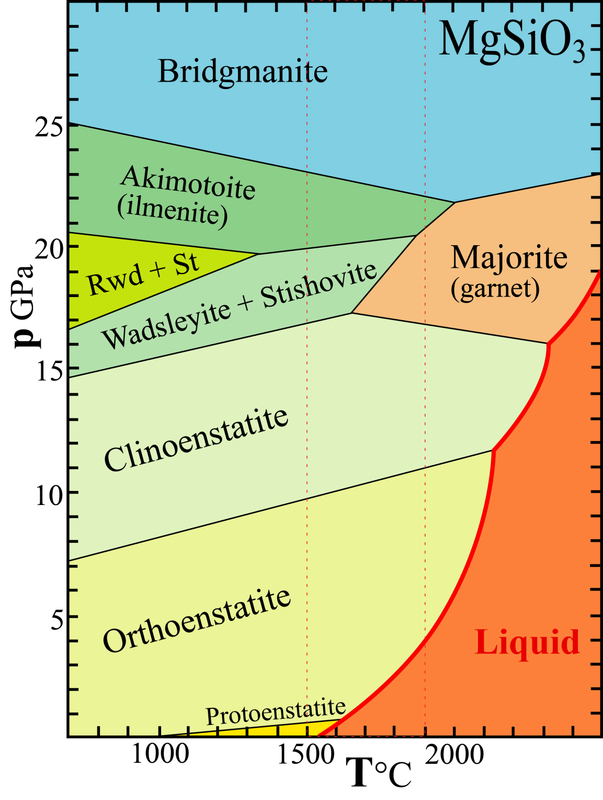
System MgSiO₃
Pyroxene: Mg^{[6]} Si^{[4]} O₃
Garnet: Mg₃^{[8]} MgSi^{[6]} Si₃^{[4]} O₁₂
Akimotoite: Mg^{[6]} Si^{[6]} O₃
Bridgmanite: Mg^{[8]} Si^{[6]} O₃
Modified from Fei & Bertka (1999, Geochem. Soc. Spec. Publ. 6)

Slide 7
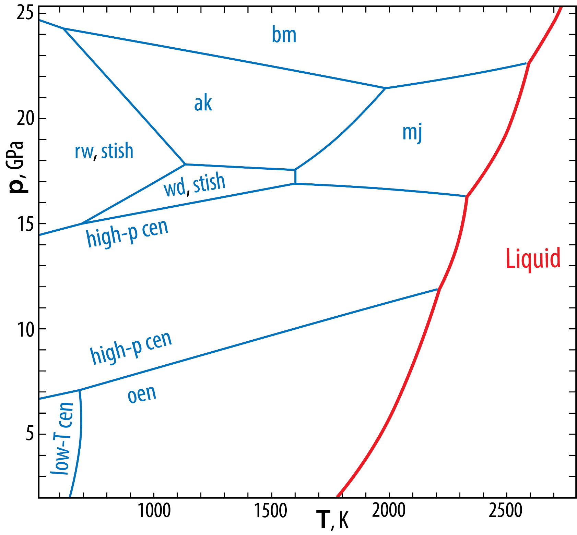
Phase relations,
MgSiO₃
Gasparik, 2003, Phase Diagrams
for Geoscientists, Springer.

Slide 8
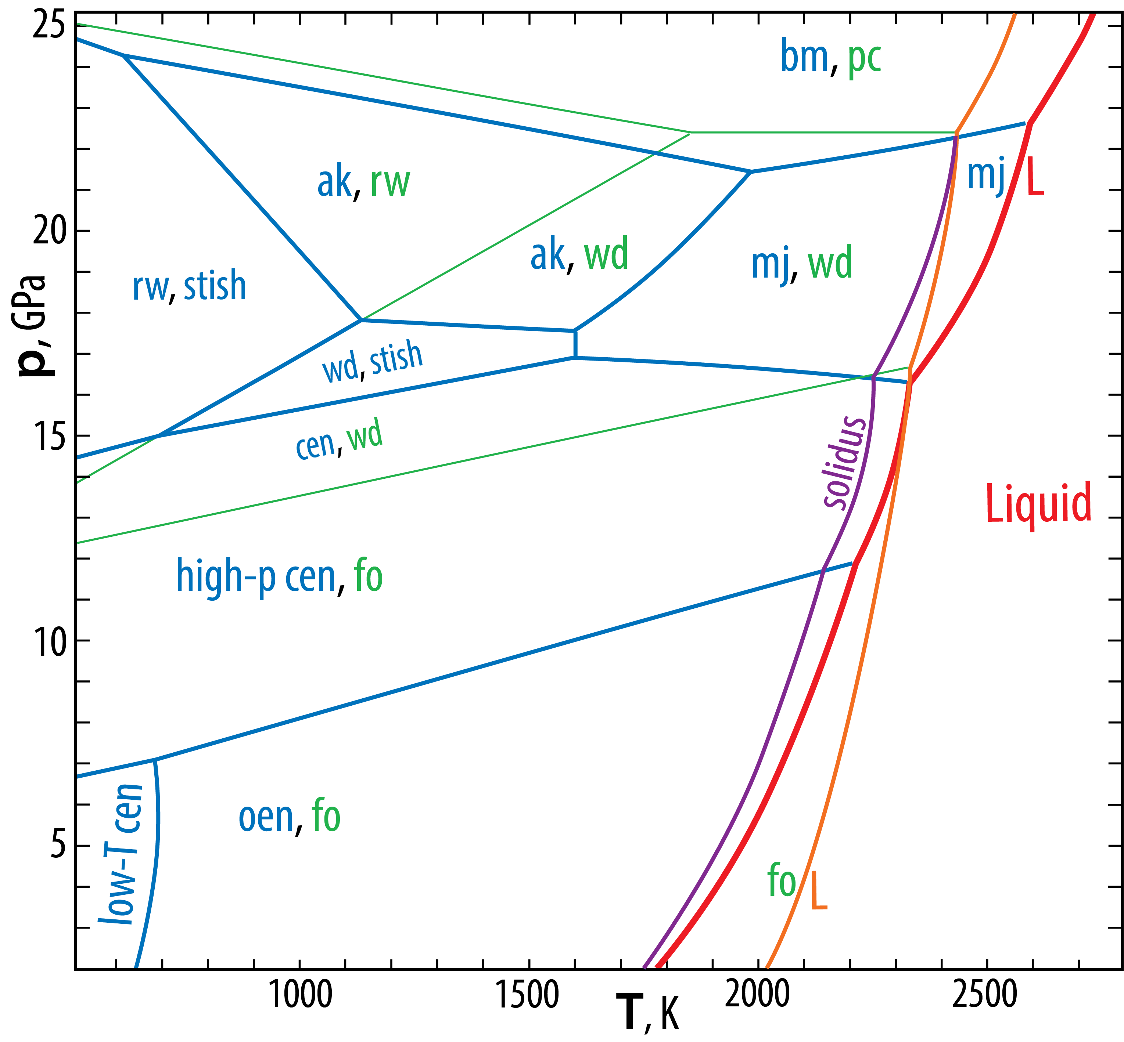
Phase relations,
MgSiO₃-Mg₂SiO₄
Gasparik, 2003, Phase Diagrams
for Geoscientists, Springer.

Slide 9
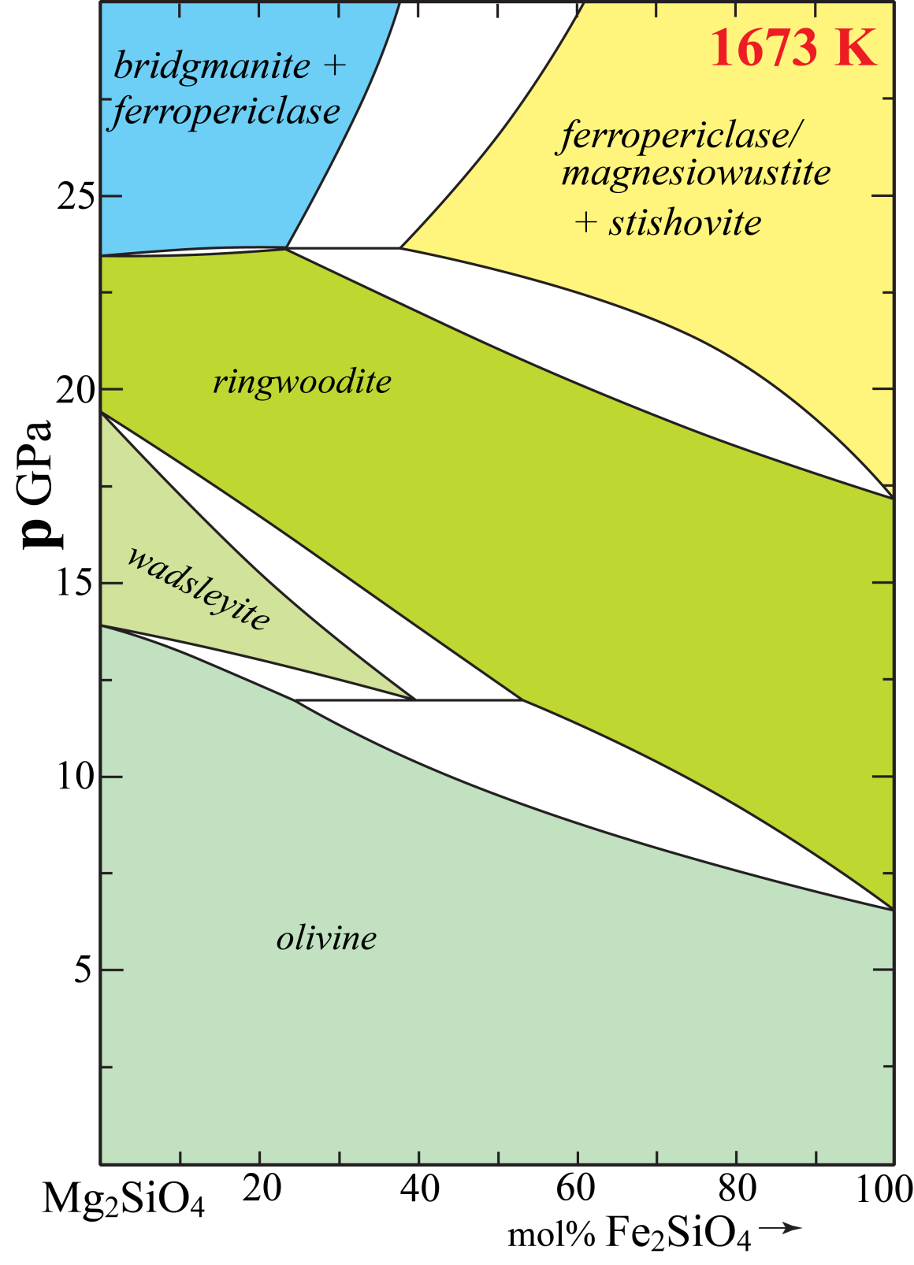
Stixrude & Lithgow-Bertelloni
(2011, GJI)
Average mantle Mg# 90
bm: bridgmanite
fp: ferropericlase
mw: magnesiowustite
ol: olivine
wd: wadsleyite
rwd: ringwoodite
st: stishovite

Slide 10
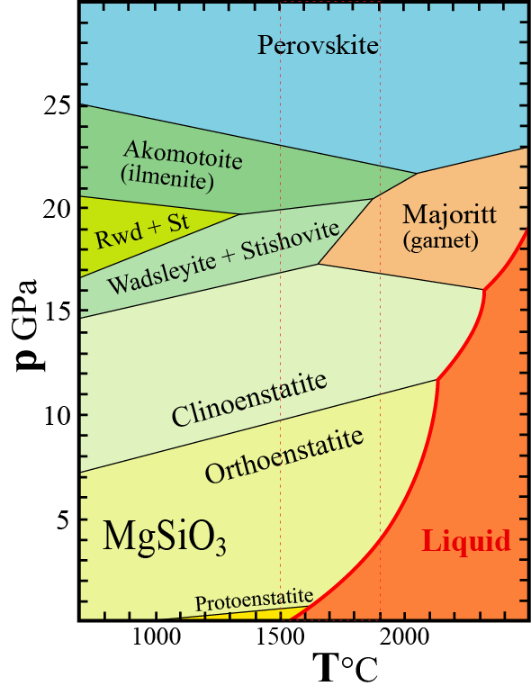
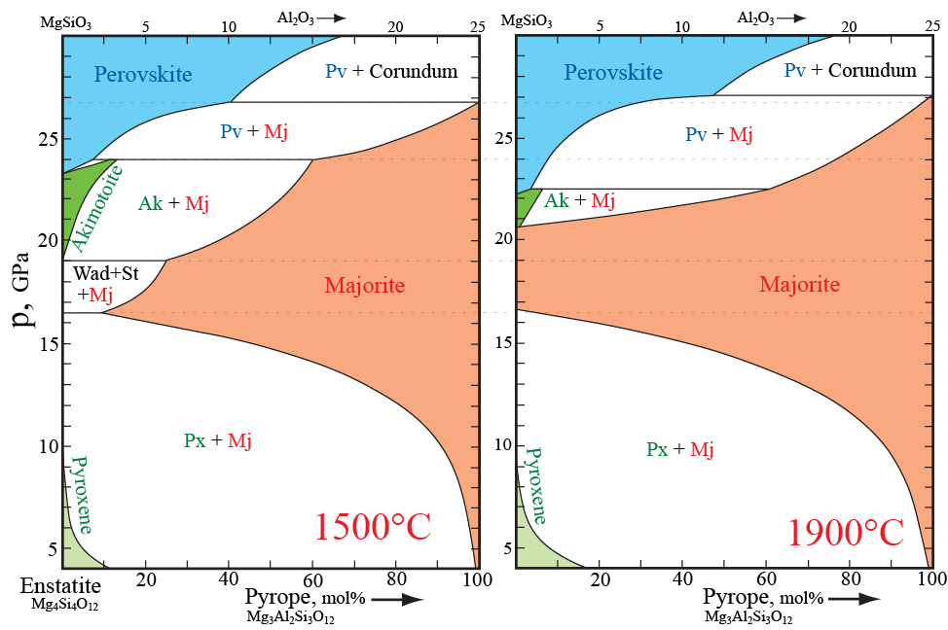
Al-substitutional effects: the system Enstatite-Pyrope
Modified from Fei & Bertka (1999,
Geochem. Soc. Spec. Publ. 6)

Slide 11
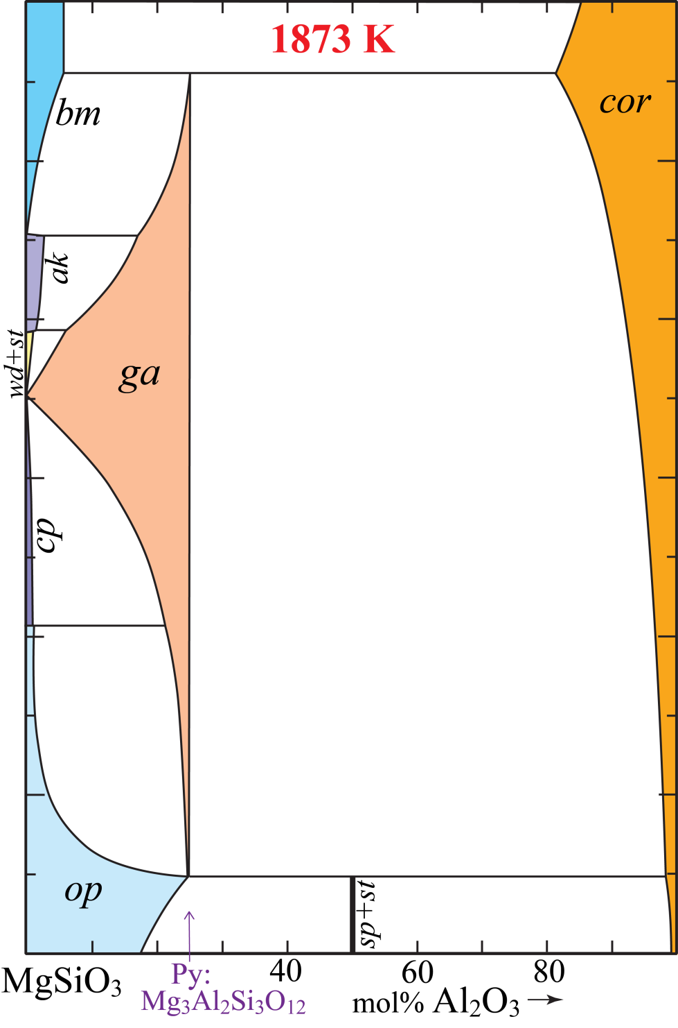
Stixrude & Lithgow-Bertelloni (2011, GJI)
op: orthopyroxene
cp: clinopyroxene
ak: akimotoite
ga: garnet
cor: corundum

Slide 12
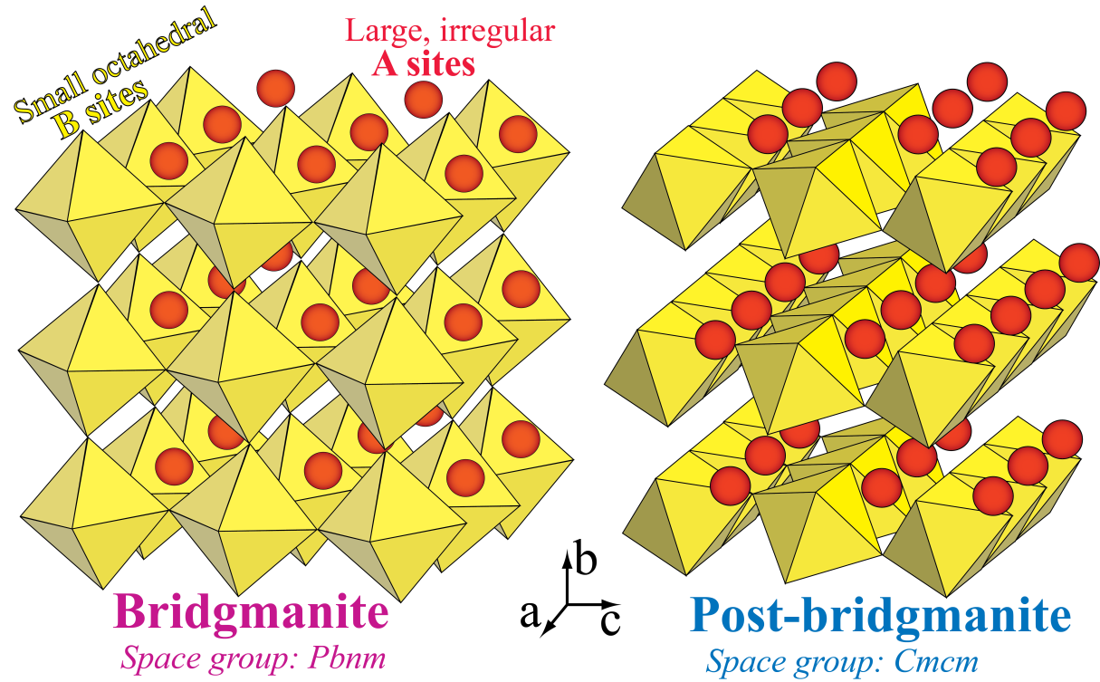
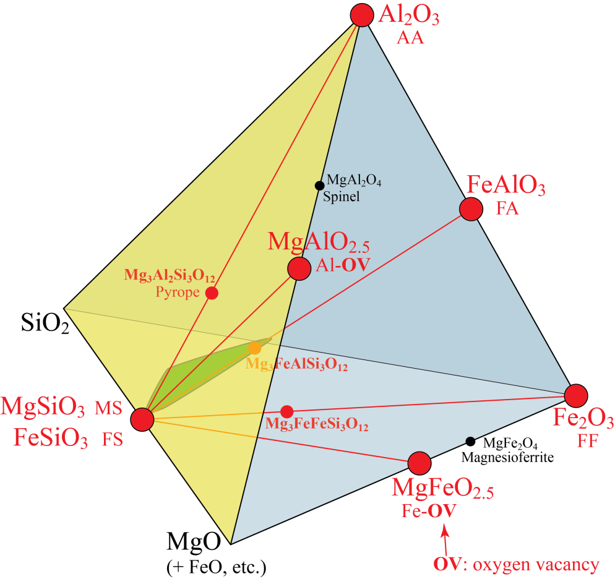
Major element partitioning between bridgmanite and post-bridgmanite
System MSA-Fe³⁺
Trivalent substitution
vectors
A B
Site occupancy, mostly: Mg²⁺ Fe²⁺ Si⁴⁺
Main trivalent cations: Fe³⁺ Al
FeAlO₃
FA
Cation "sizes" (bond lengths):
Fe²⁺ > Mg²⁺ > Fe³⁺ > Al³⁺ > Si⁴⁺
FeSiO₃ FS
ideal
A-site
ideal
B-site

Slide 13
Bridgmanite redox state and composition Experimentally based thermodynamic model,
Huang et al. 2021, GCA
For 200 cations, 300 O and metal
saturation at 50 GPa:
A-site: 3.0 Al, 4.3 Fe³⁺, 2.2 Fe²⁺,
Fe³⁺/Fe^{tot} = 66.2%
Fe^{tot} = 4.3/0.662 = 6.5
B-site: 7.2 Al, 0.2% Fe³⁺, 0.0 OV
Components, %:
AA: 3.0
FA: 4.2
FS: 2.2
MS: 90.6

Slide 14
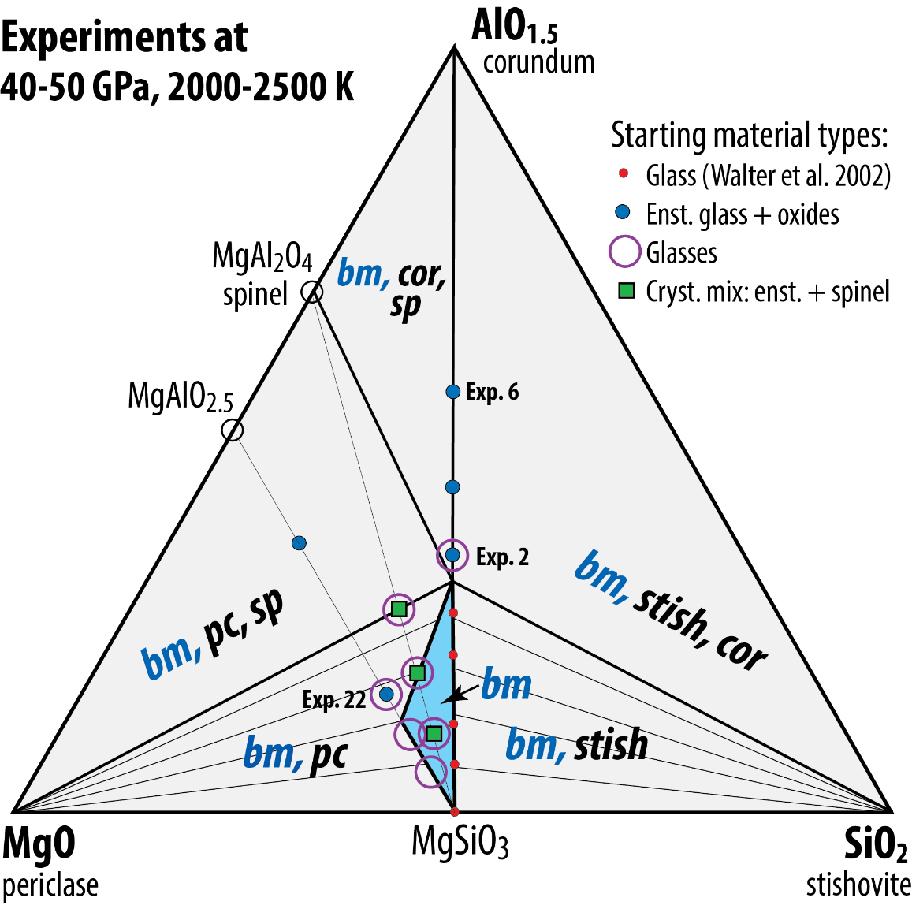
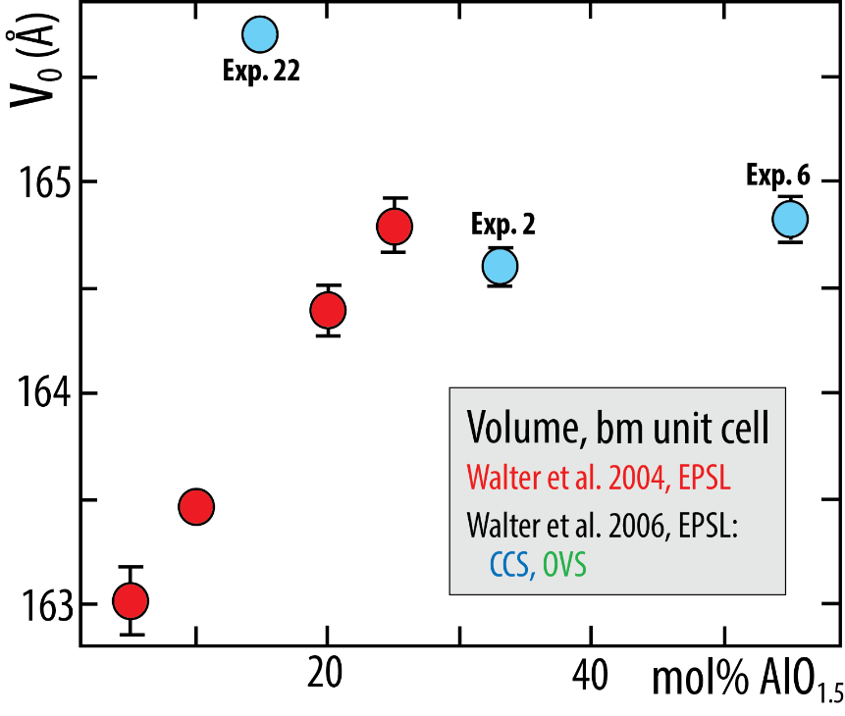
The O-vacant MgAlO_{2.5} component
- Stable in the 24-40 GPa range
- Can easily incorporate considerable H₂O
2 MgAlO_{2.5} + H₂O = Mg₂Al₂O₄(OH)₂
Liu et al. (2017, GPL); Walter et al. (2006, EPSL)

Slide 15
The O-vacant MgAlO_{2.5} component
- Stable in the 24-40 GPa range
- Can easily incorporate considerable H₂O
2 MgAlO_{2.5} + H₂O = Mg₂Al₂O₄(OH)₂
(H₂O, H in mantle and core: Geochem.cycles-1 on Thursday)
Liu et al. (2017, GPL); Walter et al. (2006, EPSL)
charge-coupled
mechanism
O-vacancy
mechanism
O-vacancy
mechanism
charge-coupled
mechanism
Two synthesised compositions (Liu et al. (2017, GPL)
- En₉₀Brm₁₀ (Brm: brownmillerite, MgAlO_{2.5})
ideal comp: Mg₁₀₀₀ Al₁₀₀Si₉₀₀ O₂₉₅₀ (Mg/Si:1.11, Al_{B}/Al_{A}: ∞
synthesised comp: Mg₉₈₂Al₁₈ Al₈₃Si₉₁₈O₂₉₆₉ (Mg/Si:1.07, Al_{B}/Al_{A}: 4.6)
- En₉₅Cor₅ (Cor: corundum, Al₂O₃)
ideal comp: Mg₉₅₀Al₅₀ Al₅₀Si₉₅₀ O₃₀₀₀
synthesised comp: Mg₉₄₈Al₅₀ Al₅₀Si₉₅₁ O₃₀₀₂
Net high-p breakdown reaction of the MgAlO_{2.5} component
2 MgAlO_{2.5} = Al₂O₃ + 2 MgO ΔV: positive or negative ?
in bm in bm in fp
charge-coupled
mechanism

Slide 16
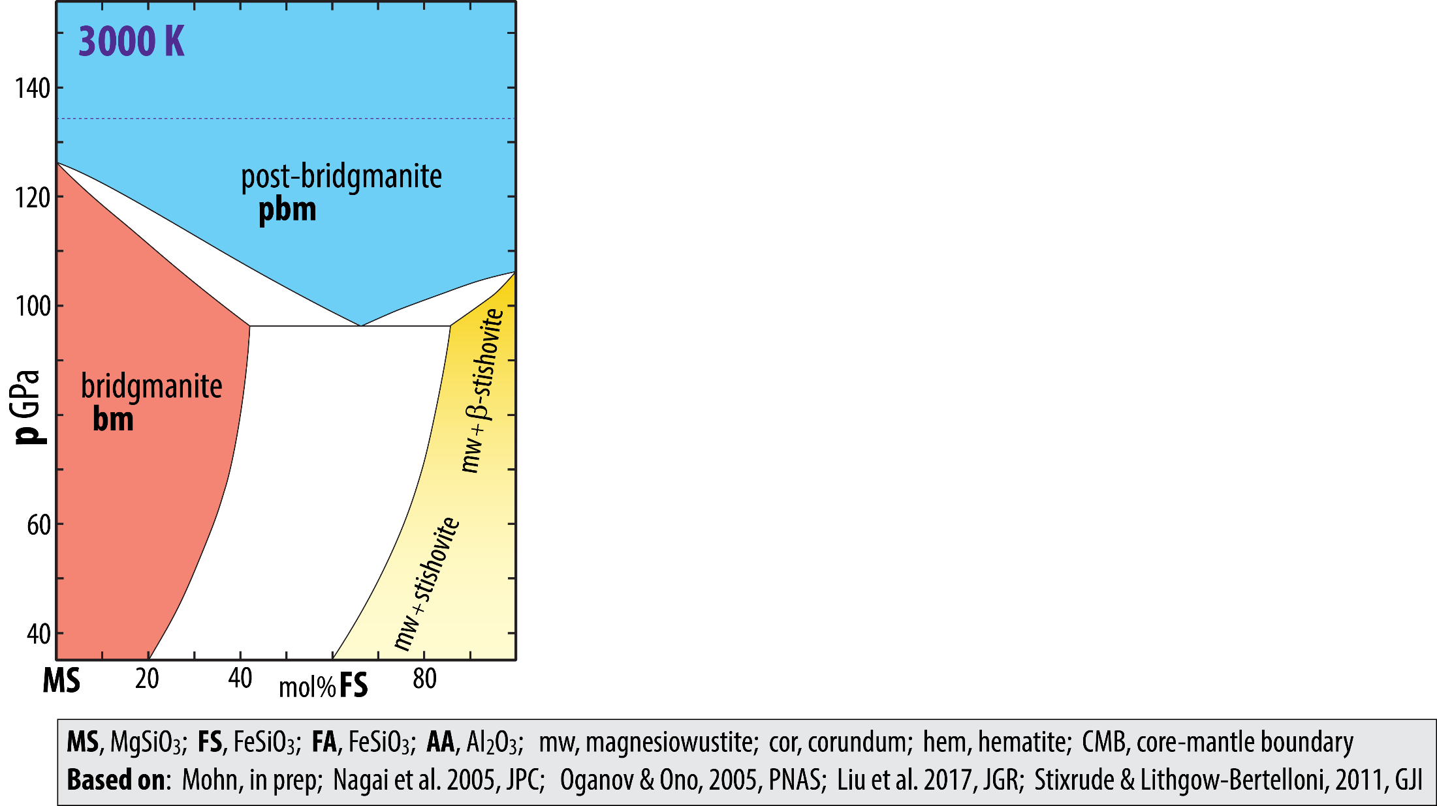
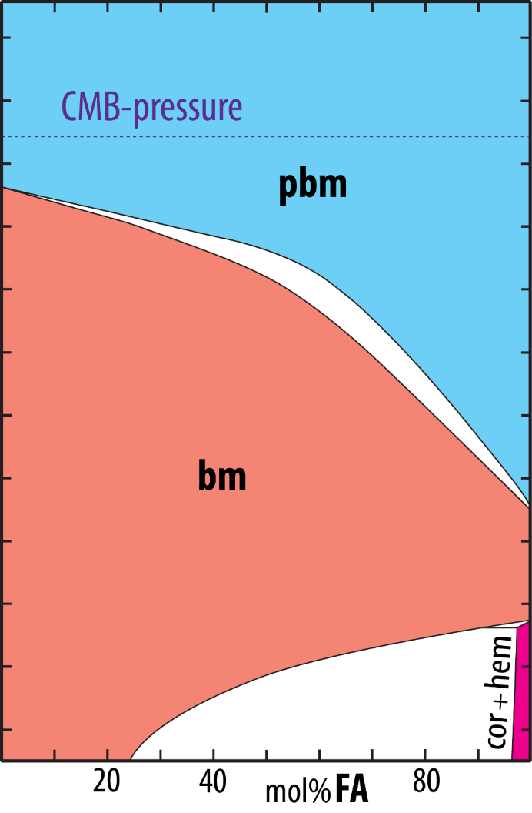
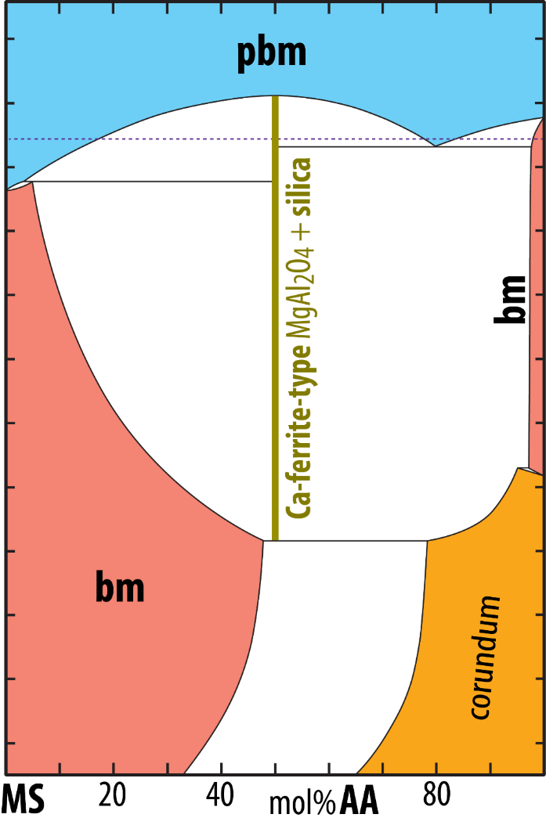
Binary p-X-diagrams for MS-FS, MS-FA and MS-AA joins at 3000 K, 35-155 GPa
FS and FA components partition into pbm.
MS-FS phase loop is at lower p than MS-FA loop.
AA partitions into bm.
Very low Al-solubility in bm at 125 GPa.

Slide 17
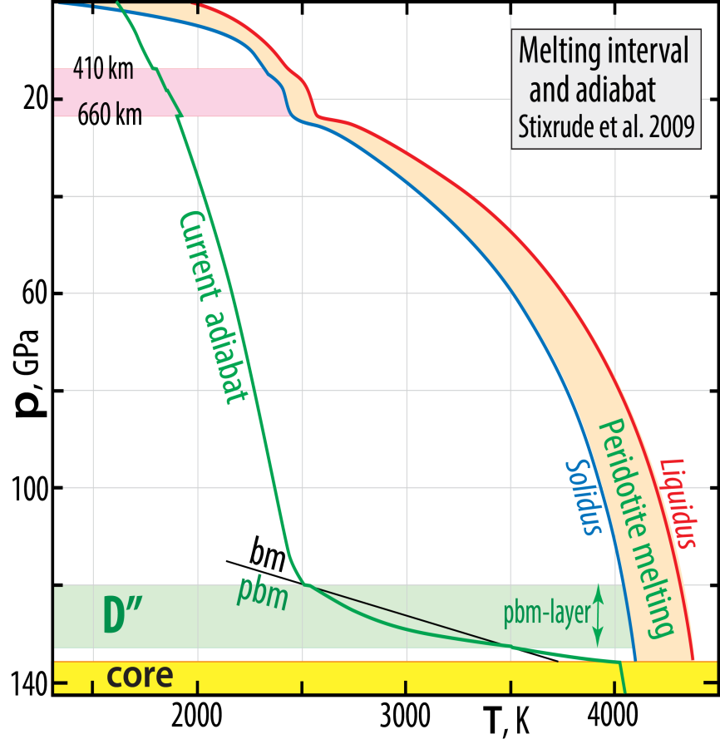
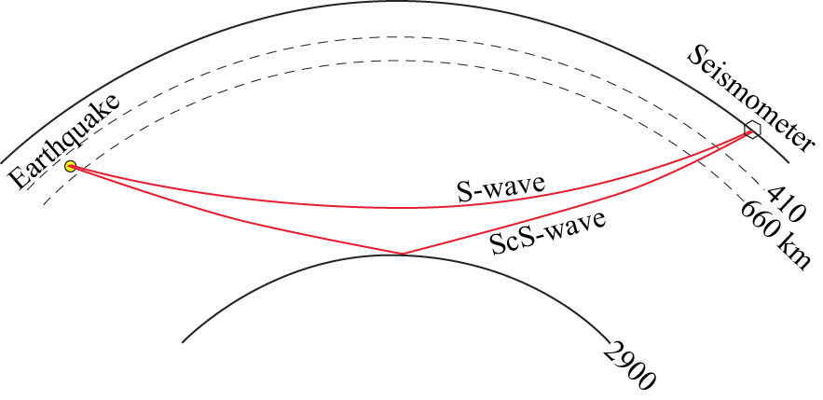
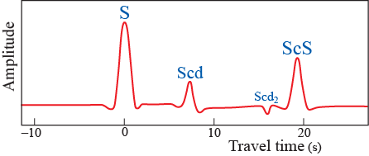
The bm-pbm transition: Is the double-crossing scenario (Hernlund et al. 2005, Nat.)
fact or fiction ?
fiction
D”-discontinuities
Lay and Helmberger (1983, GJRAS): S-wave triplication:
S, Scd and ScS (in certain areas, at least)
The Scd and Scd₂(??) might be ascribed to
double(??)-crossing of the bm-pbm boundary
- large thermal gradient in the D”
- large dp/dT-slope of phase boundary

Slide 18
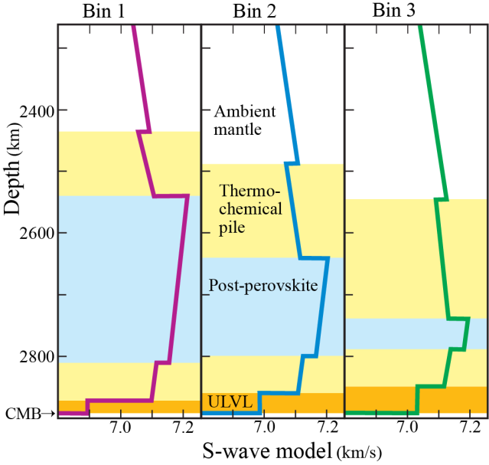
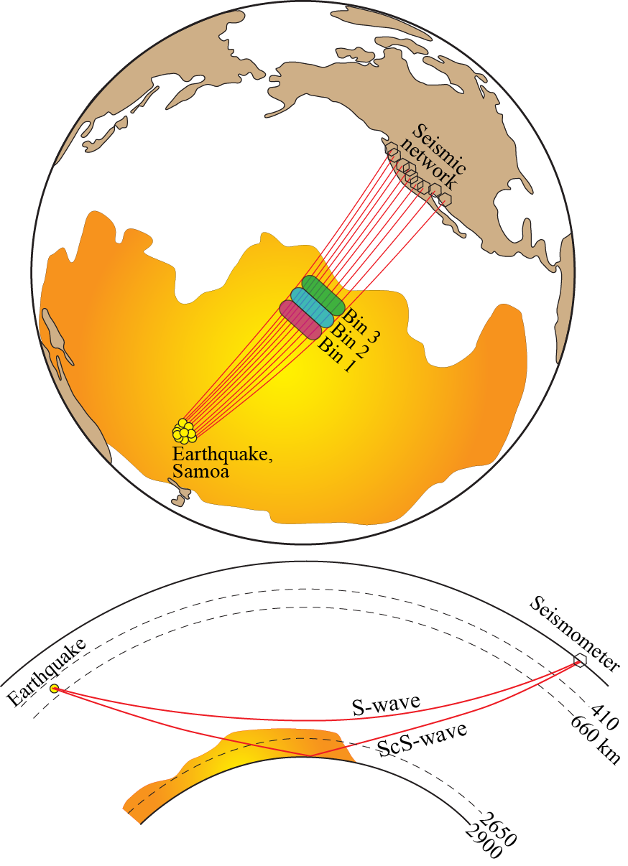
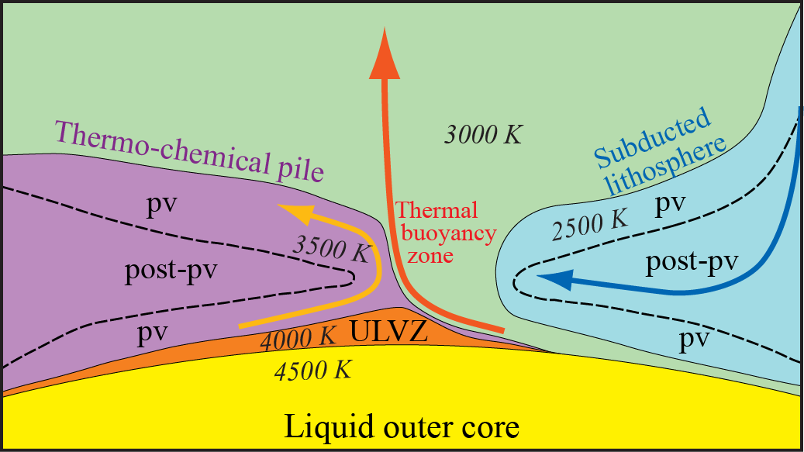
Seismological image of
Plume Generation Zones (PGZ)
S-wave model
S-wave model
NE part of Pacific LLSVP
Samoa quakes, recorded in N-America
Lay et al.
(2006, Science)
Double crossing of the
pv-ppv-transition
Large lateral variation
⇒ horizontal flow (and PGZ)
Mantle flow model
Bin 1-3

Slide 19
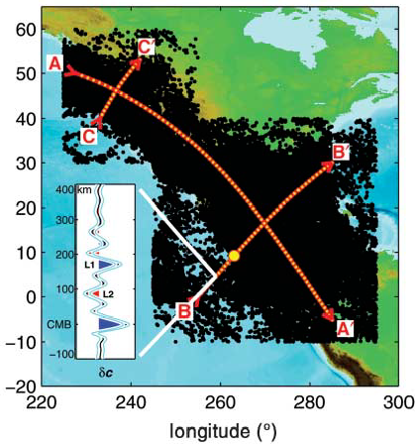
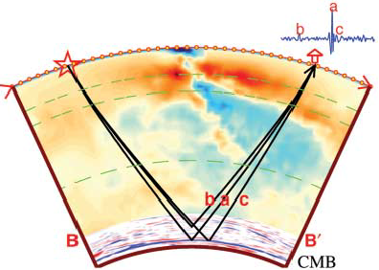
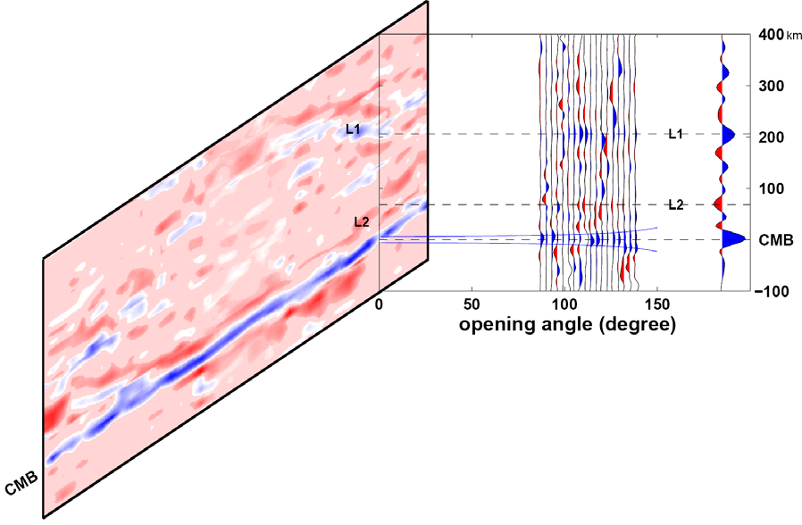
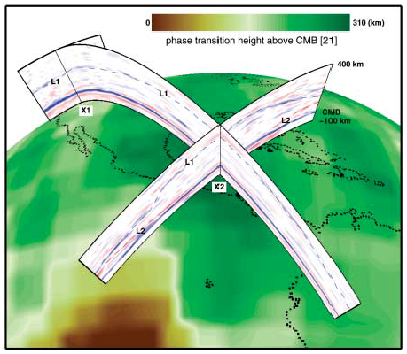
Example of cold region LLSVP-reflections
Western margin of N-, central- and S-America
van der Hilst et al. (2007, Science)
latidtude
Reflectors L1 (Scd) and L2 (Scd₂)
were thought to represent the in-
and out-reaction of ppv

Slide 20
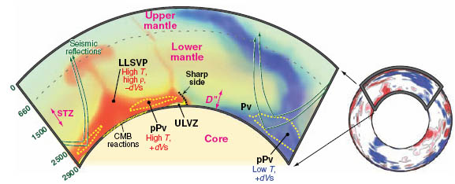
Locally steep thermochemical pile margins
Requirements:
- moderate density contrast (2-5 %)
- pile material: higher bulk modulus than ambient mantle
Garnero & McNamara
(2008, Science)
High thermal conductivity and low thermal expansivity in the
lowermost mantle may help to stabilize the thermochemical piles

Slide 21
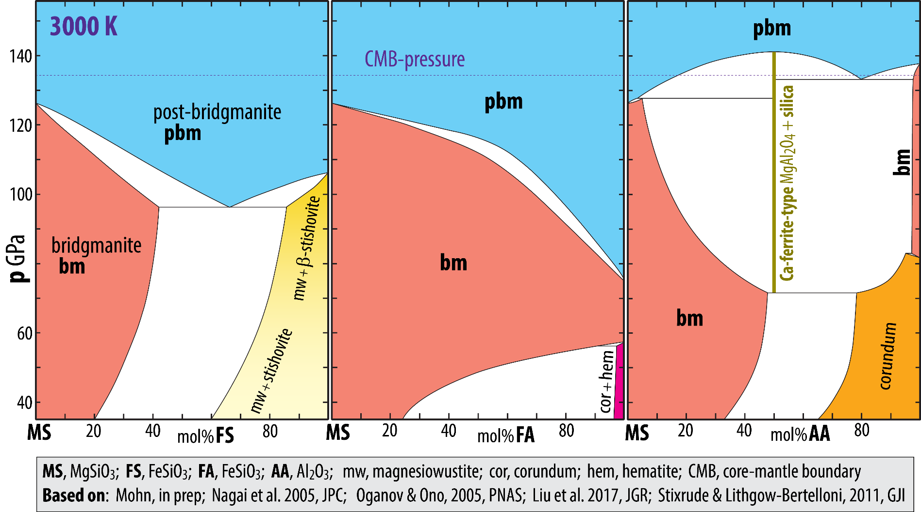
New developments requiring a lower CMB temperature
and pbm-omnipresence in D’’
- reduced melting-T of Fe
- lower solidus-T for peridotite
- lower dp/dT slope for the bm-pbm transition
- moderate increase in pbm stability in Fe-bearing lithologies

Slide 22
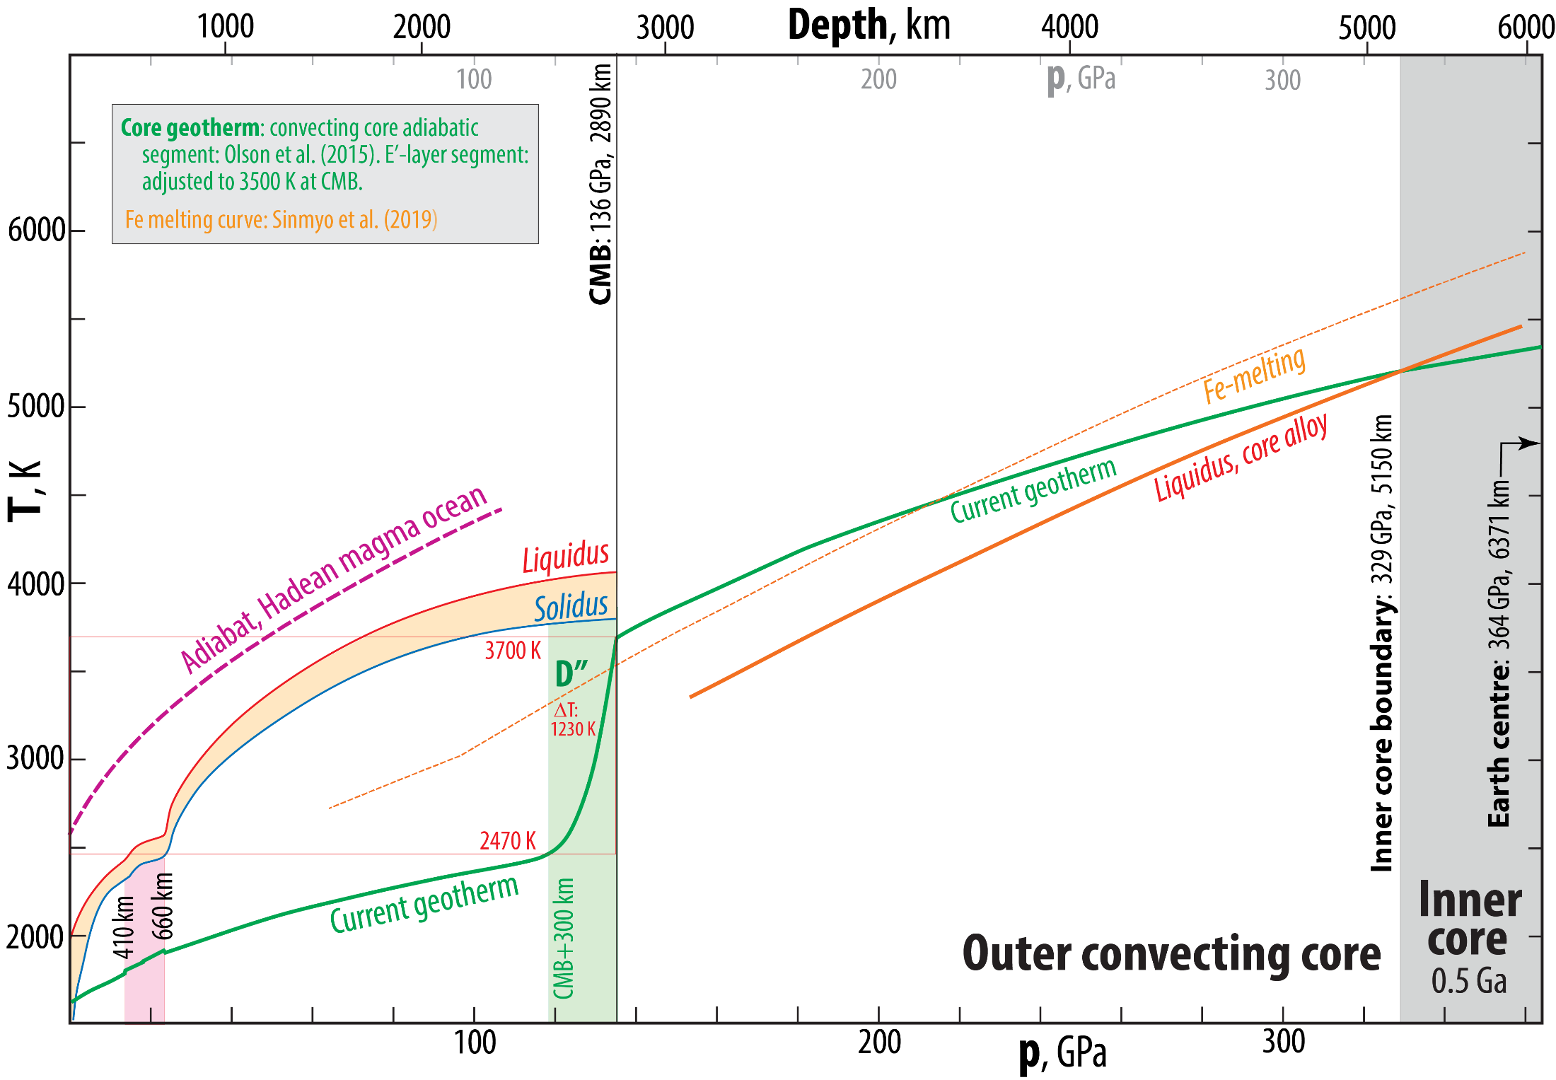
New results on a lower Fe melting curve (Sinmyo et al., 2019, EPSL)

Slide 23
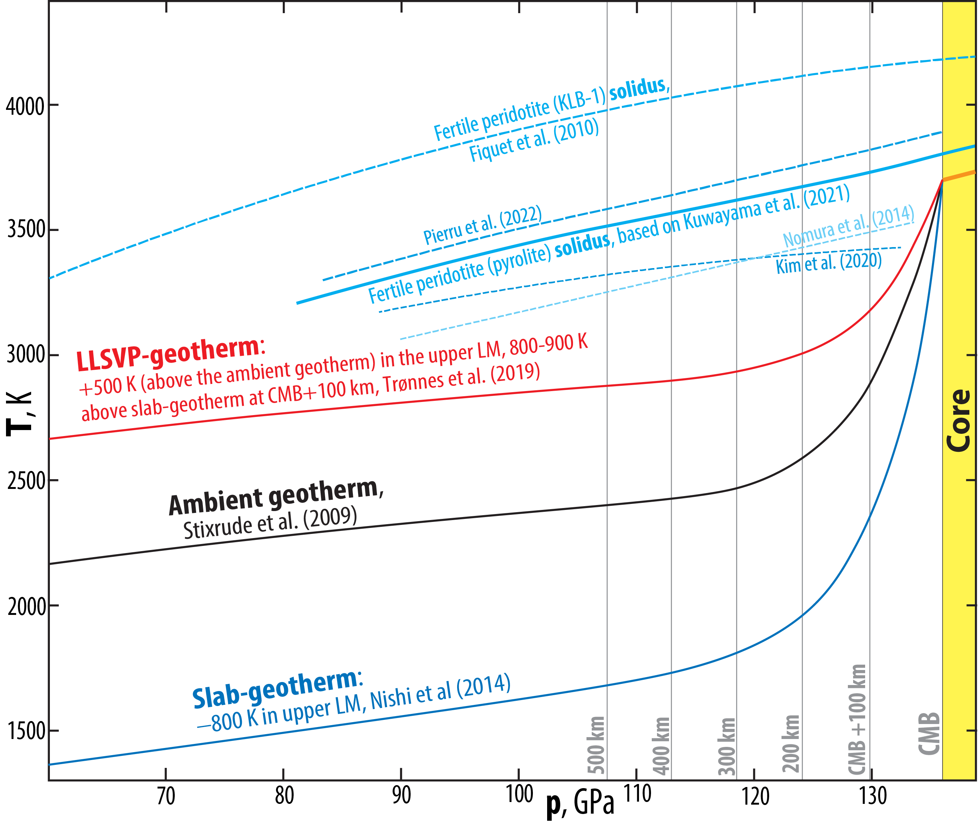

Slide 24
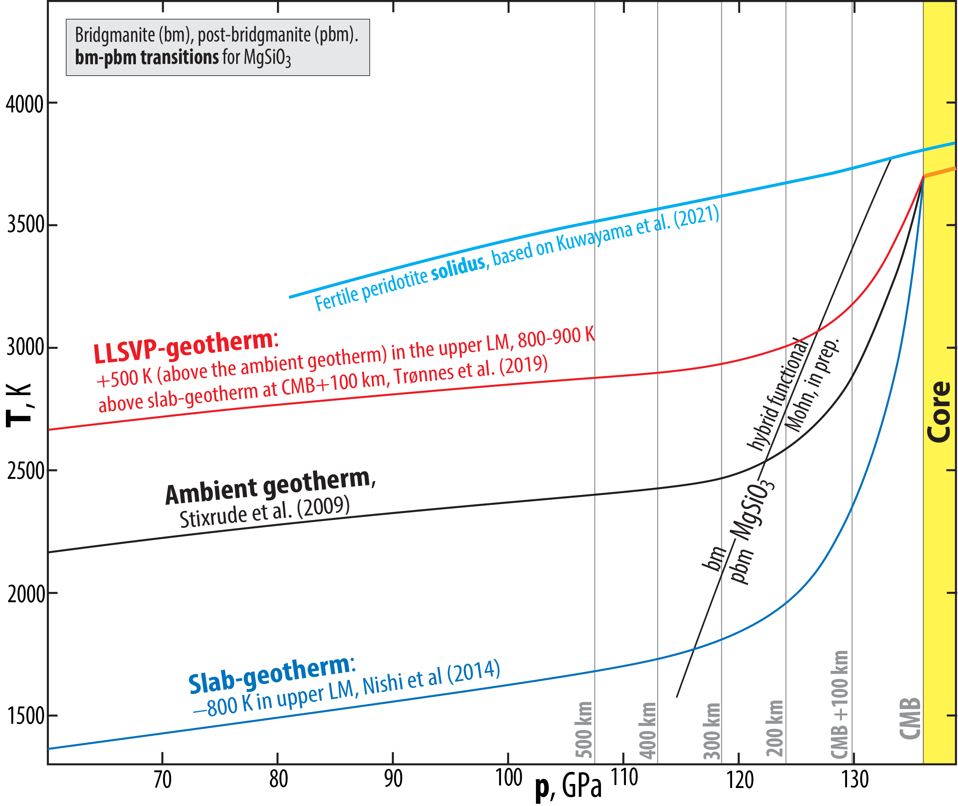

Slide 25
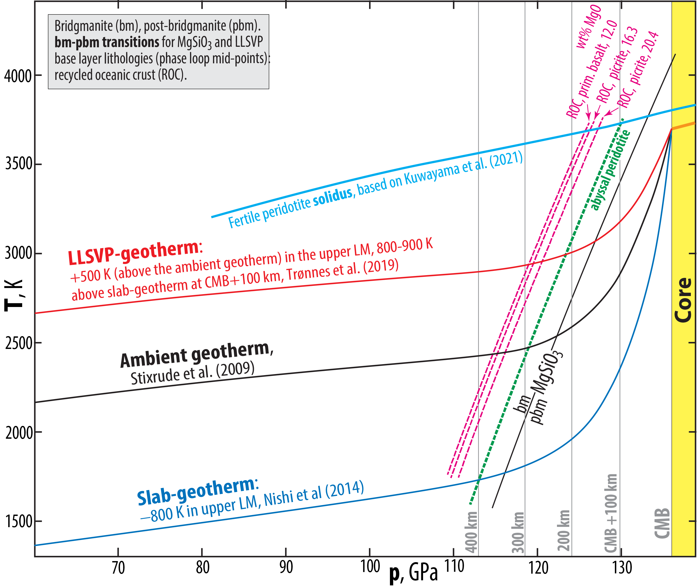

Slide 26
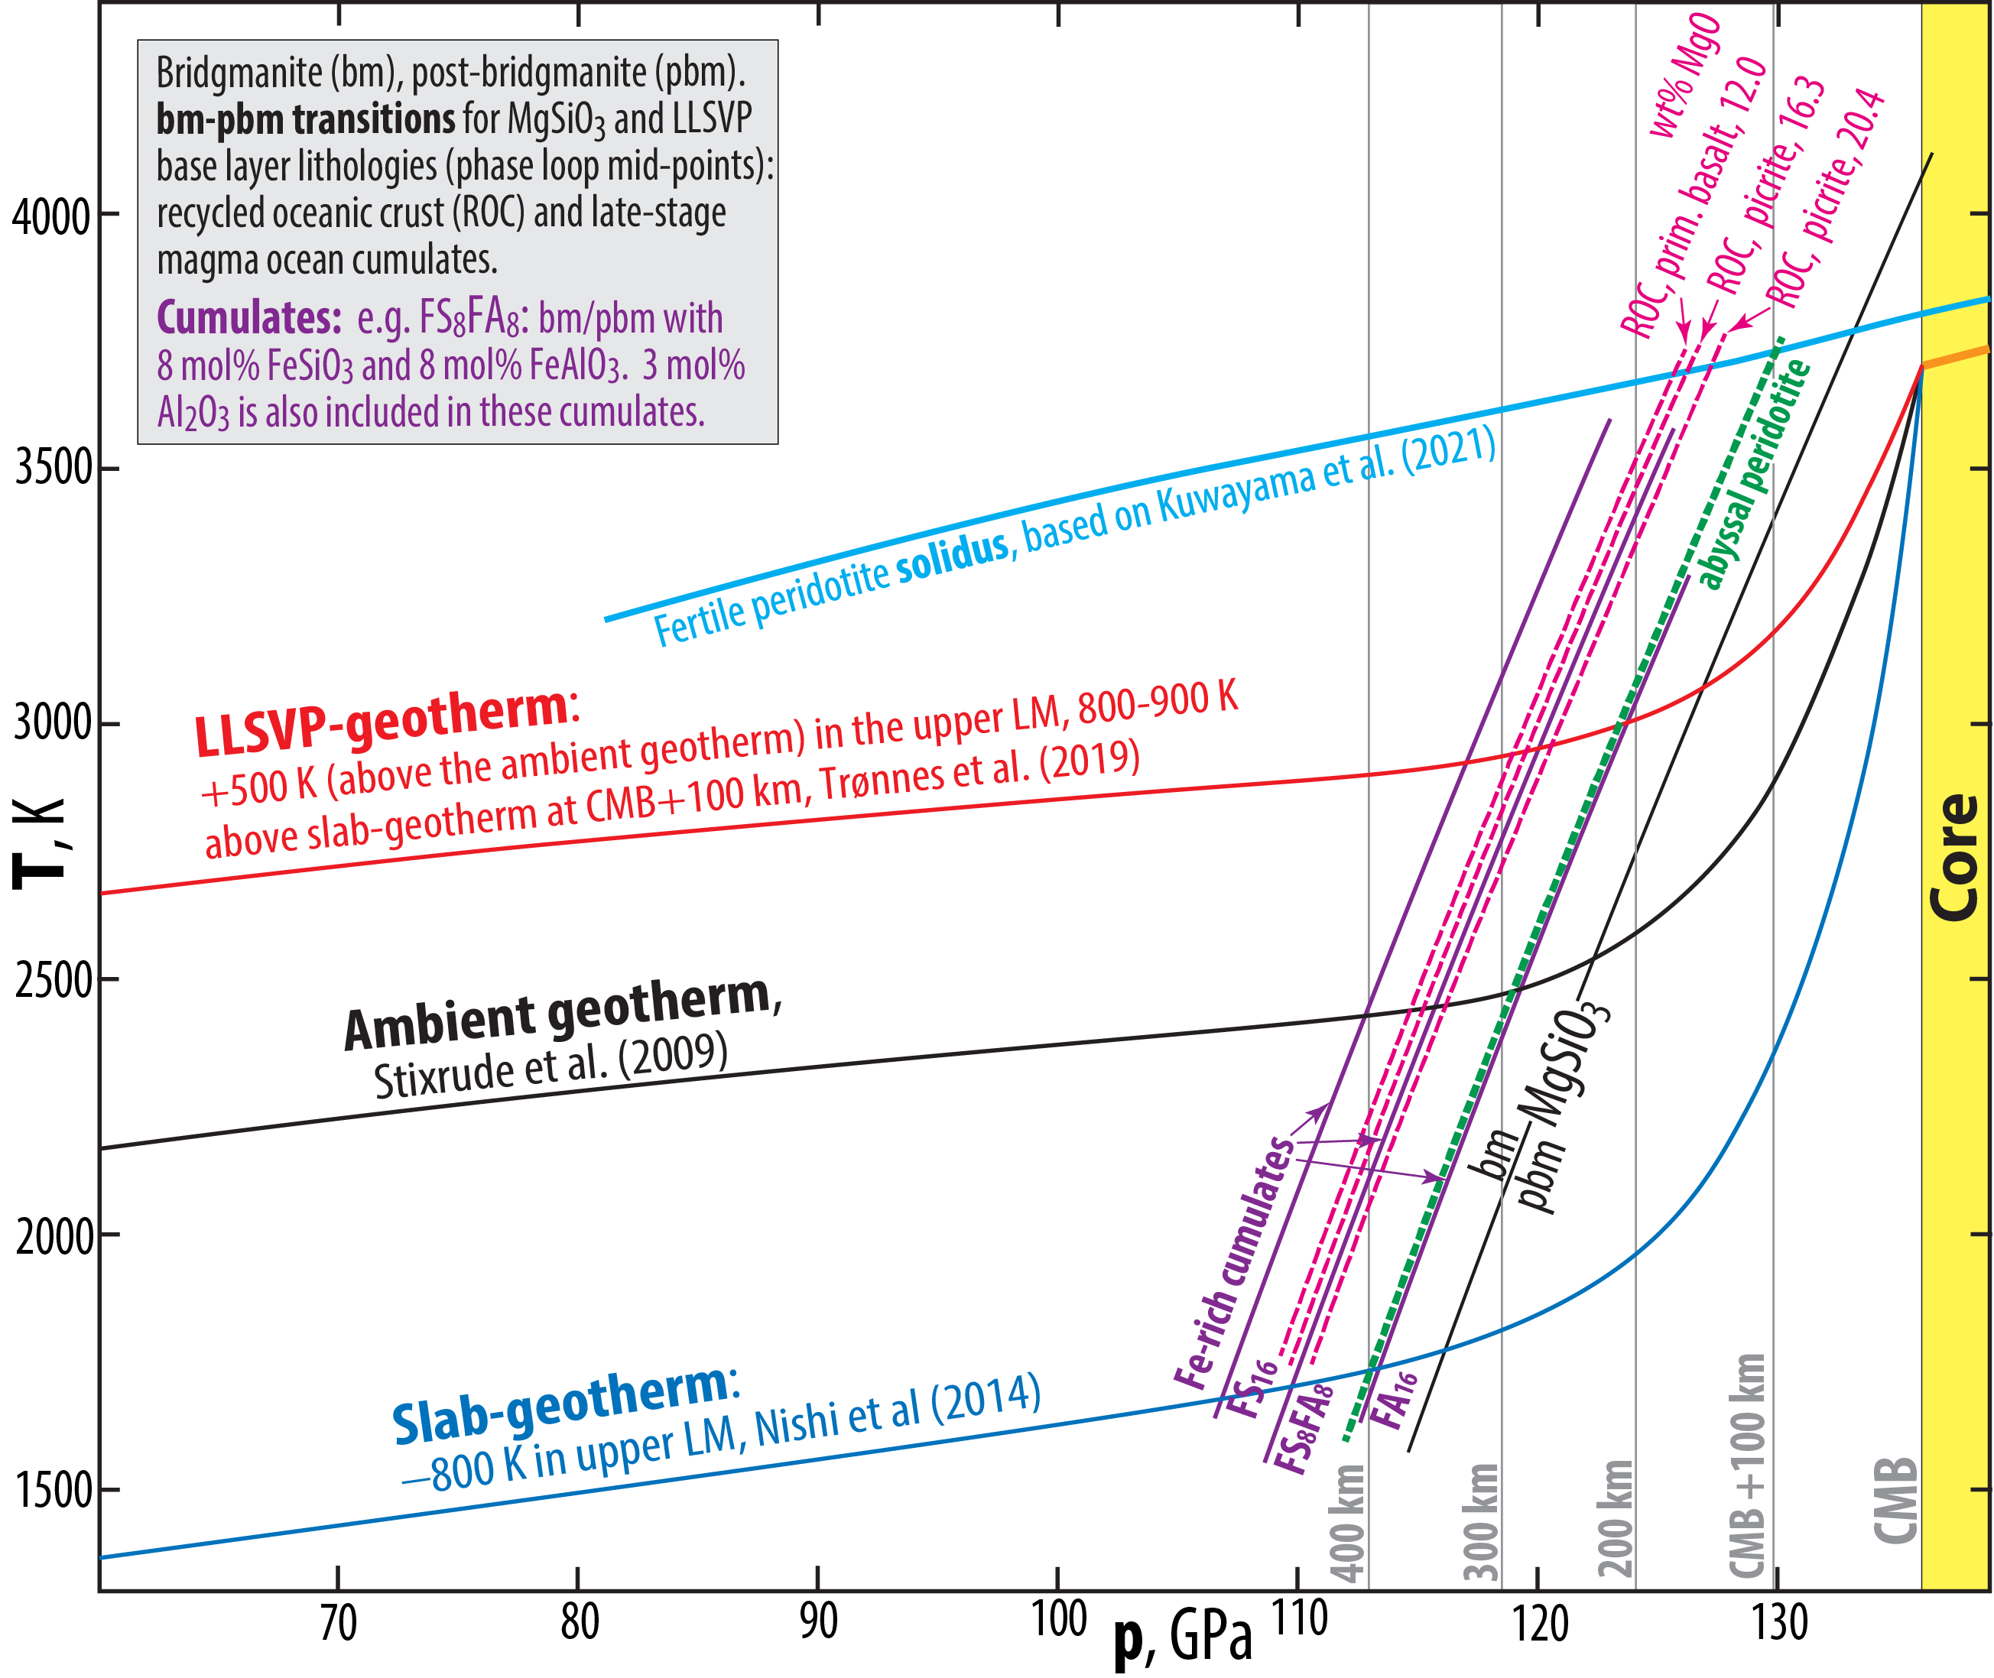

Slide 27
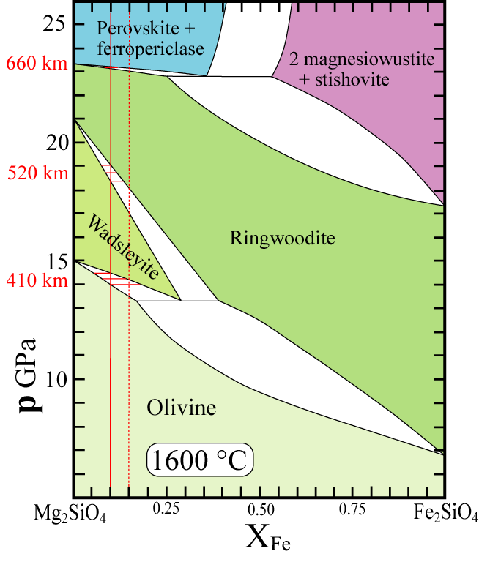
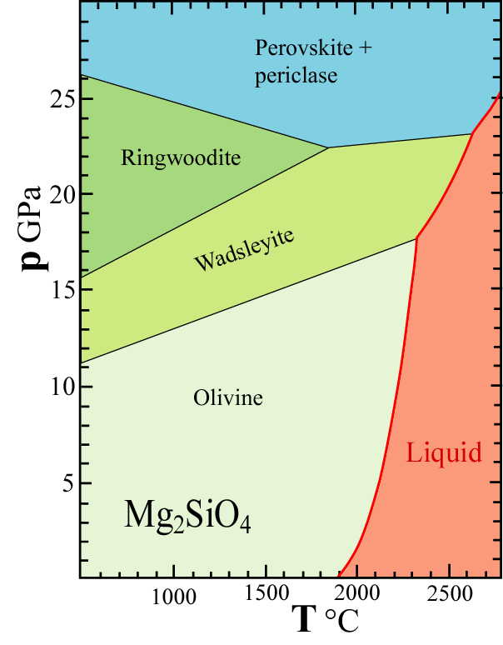
Sharpness of phase transitions
One-component system, p-T-diagram
Modified from Fei & Bertka (1999,
Geochem. Soc. Spec. Publ. 6)

Slide 28
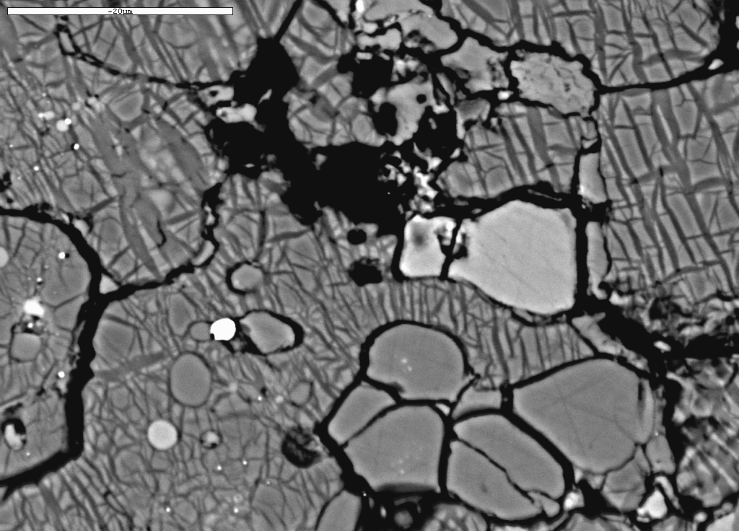
BSE-image of subsolidus phase relations, 24 GPa
Mg-pv
Ferro-
periclase
Ca-pv
ga
FeNiS-metal
garnet
fp
garnet
Mg-perovskite

Slide 29
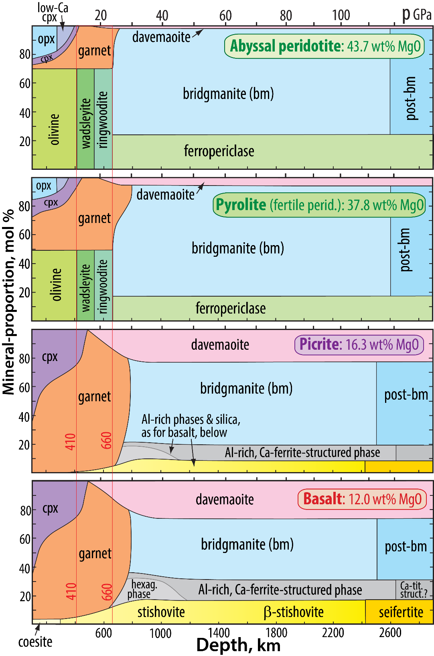
Mineralogical changes from depleted peridotite to basalt
Olivine, wadsleyite and ringwoodite:
decreases 70% → 0%
Clinopx and garnet: increases
Ca-perovskite: increases 0% → 30%
Bridgmanite: decreases 75% → 40%
Al- and Si-rich phases in basalt in the lower mantle
1. Phases near the MgAl₂O₄-NaAlSiO₄-join
Hexagonal phase = NAL, New Aluminous Phase
Ca-ferrite- and Ca-titanite-structured phases
2. SiO₂-dominated phases with a minor AlO_{1.5}-component
Stishovite (TiO₂-structure, tetragonal)
Distorted stishovite (CaCl₂-stucture, orthorombic)
Seifertite (αPbO₂-structure, orthorombic)
Based on: Stixrude & Lithgow-Bertelloni 2012, AREPS; Irifune & Tsuchiya, 2015, Treat. Geophys.; Trønnes & Mohn, in prep.

Slide 30
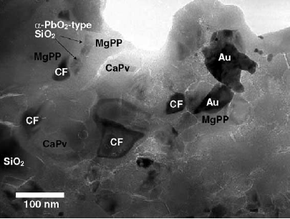
Basaltic mineralogy at 113 GPa, 2240 K (Hirose et al. 2005, EPSL)
Natural MORB
LH-DAC-products
analyzed by ATEM.
Au as p-calibrant
and laser absorber

Slide 31
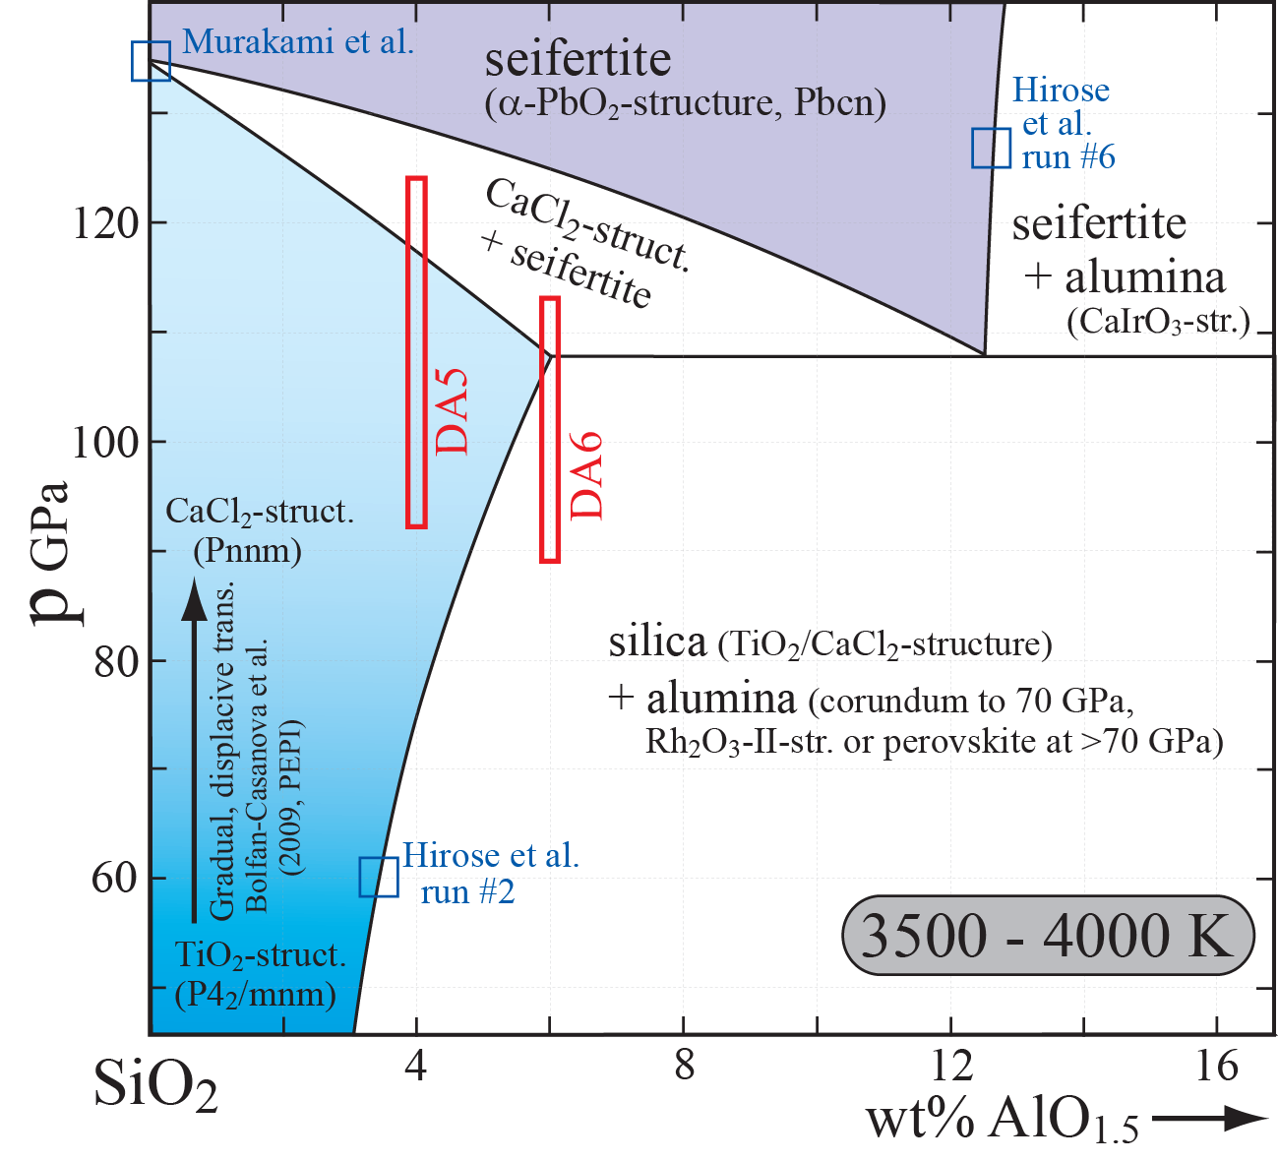
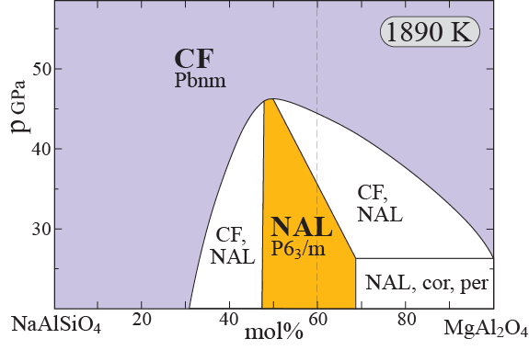
Aluminous silica phases:
CaCl₂ and seifertite (α-PbO₂)
New Aluminous phase (NAL)
Ca-ferrite phase (CF)
Caveat:
Tateno et al. (2018, JGR) did not reproduce
the strong Al-partitioning into seifertite
observed by Hirose et al. (2005
Imada et al. (2011, PCM)
Ono et al. (2008, PCM)
Andrault et al. (2014, Am.Mineral.)

Slide 32
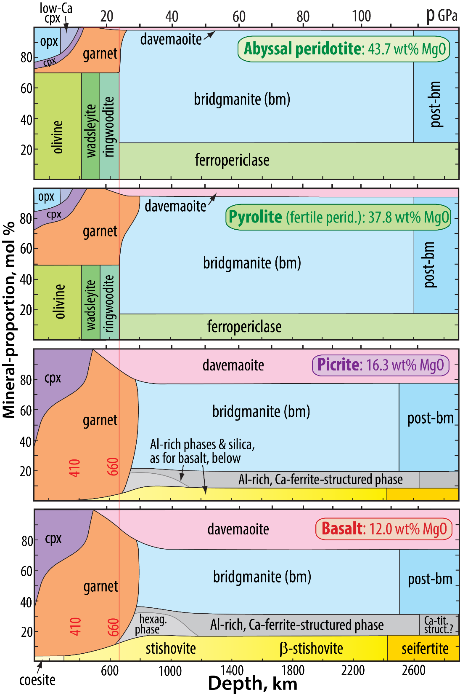
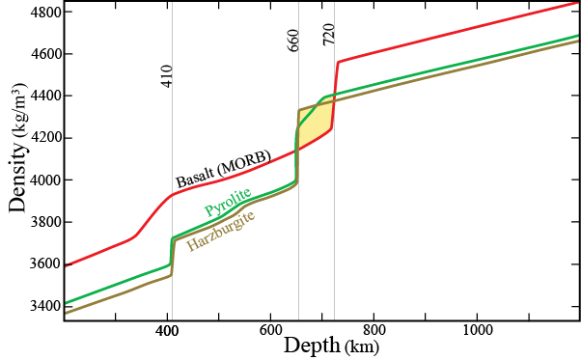
Density relations through the mantle

Slide 33
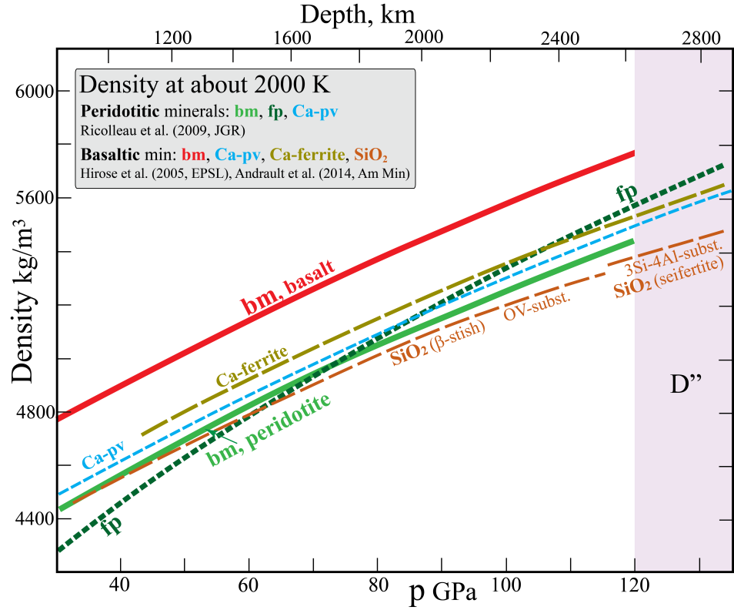
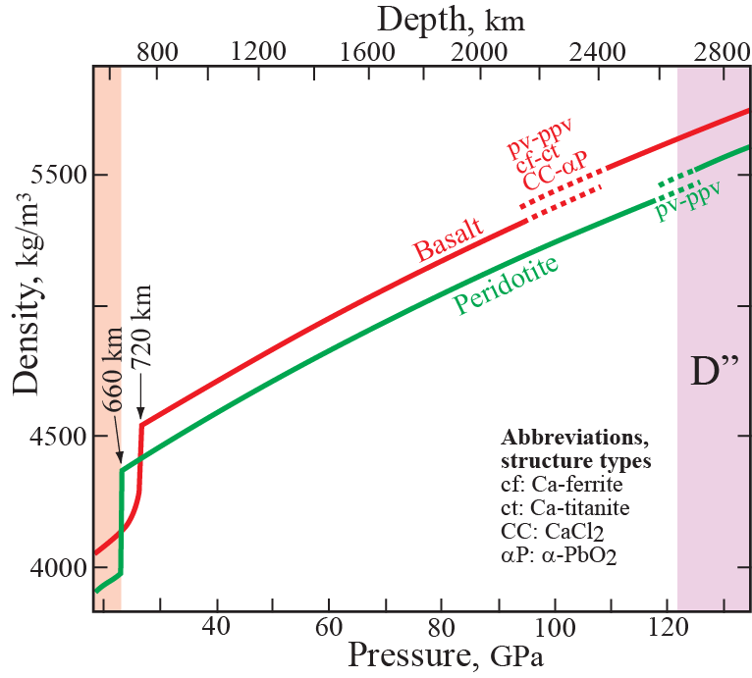



Density: basalt and peridotite
Schematic,
Irifune & Tsuchiya
K₀ (GPa)
bm 257
dm 236
softest: fp 158-152 (FeO-MgO)
stiffest: SiO₂ 314-325 (β-stishovite to seifertite)
Peridotite
bm, fp, dm
low ρ, low K₀
Basalt
bm, dm, SiO₂, NaAl-phase
high ρ, high K₀

Slide 34


Amman et al. (2010, Nature)
DFT-computation of diffusion rates: bm, fp and ppv
Step 1: Testing of agreement between existing experimental data
and computations for pv and fp
Result: very good agreement
MgO
(Mg,Fe)O

Slide 35


Step 2: Computation of diffusion rates for pbm
Result: strongly anisotropic diffusion in pbm
with fast diffusion along a-axis
low viscosity by diffusion creep along a-axis

Slide 36

Most of the lower mantle
- no seismic anisotropy, small grain size and low stress (Solomatov et al. 2002)
- high viscosity
diffusion creep is likely
Lowermost mantle (D")
- areas with strong seismic anisotropy (high V_{SH})
- relatively low viscosity
extensive deformation and LPO is likely
deformation-related dislocation creep is likely
CMB
Steinberger and Calderwood (2006, GJI)
Ammann et al. (2010, Nature), Hunt et al. (2009, Nature Geoscience):
Dislocation creep: pbm may be 4 orders of magnitude weaker than bm
Rheology may change dramatically at a critical phase fraction of 30-50% pbm

Slide 37


With this model:
- D”-discontinuities: rheological boundaries,
steadily increasing pbm-fraction downwards
- High T and pbm-prop. may facilitate diffusion
creep below the lower discontinuity

Slide 38
Extra

Slide 39
Al-incorporation in β-stishovite and seifertite
Substitution mechanisms
Δm/Al: atomic mass change per Al-atom
1. O-vacancy mechanism
SiO₂ ↔ AlO_{1.5} Δm/Al = − 9.10
2. Extra interstitial cations
a) 3Si ↔ 3Al + Al^{interstitial} Δm/Al = + 5.92 Δm/(Al and SiO₂) = 0.09848 = 9.85 %
b) 4Si ↔ 4Al + Si^{interstitial} Δm/Al = + 5.92 Δm/(Al and SiO₂) = 0.09848 = 9.85 %

Slide 40

330 km
290 km
260 km
Lay (2015, Treat. Geophys.)

Slide 41

Earth structure and dynamics
equatorial cross section
Trønnes (2010,
Mineral.Petrol.)

Slide 42

Seismic tomography
N.Africa-Russia
Japan, N
Japan, S
Red:
Low velocity
Warm or low-density
Blue:
High velocity
Cold or high-density
Indonesia
Tonga
Central Amerika

Slide 43














Kurile
Aleutian
Japan
Central America
Izu-Bonin
Mariana
South America
Java
Tonga
Composed from Fukao (2001)

Slide 44




Fukao & Obayashi
(2015, JGR)
Deepest earthquake
recordings

Slide 45

Slab rollback and hinge retreat versus stationary hinge

Slide 46
Slab dip, global
Hu & Gurnis (2020, GGG)

Slide 47

Slab dip, Peru-Chile trenches

Slide 48


Average slab sinking rate
2900 km / 250 Ma =
12 km/Ma = 1.2 cm/a

Slide 49
139 pages

Slide 50




AVERAGE slab sinking rates
van der Meer et al. (2009, Nature Geosci.)
Cizkova et al. (2012 PEPI)
Tomographically observed slabs
traverse the mantle (2900 km) in 240-190 My
→ sinking rates of 12-15 km/My
Realistic sinking rates
Suggested example:
surface - 600 km: 50 km/My: 12 My
600 - 2600 km: 8-12 km/My: 225-175 My
(8.3 - 11.6 km/Ma)
2500 - 2900 km: 80 km/My: 5 My
Total: 240-190 My
240 Ma
240 Ma
S 5 MEAN
S 10 MEAN
Domeier et al.
(2016, GRL)
190 Ma

Slide 51

May explain seismic anisotropy of
postulated akimotoite in the Tonga slab

Slide 52


Mg_{0.8}Fe_{0.2}O
cBN-gaskets
Mg_{0.9}Fe_{0.1}SiO₃ bridgmanite
Merkel et al. (2003, EPSL)
Mg_{0.83}Fe_{0.17}O, Miyagi et al. (2013, RSI)
Mg_{0.83}Fe_{0.17}O, Lin et al. (2009, PCM)

Slide 53


Rudolph et al. (2016, Science)

Slide 54


Girard et al.
(2016, Science)
Starting material:
San Carlos olivine, stoichiometry (ignoring Fe): Mg₂SiO₄,
i.e. MgSiO₃ + MgO, i.e. 67 and 33 mol% bm and fp, respectively
Lower mantle pyrolite has 77, 17 and 6 mol% bm, fp and Ca-pv, resp. and a
depleted peridotite has 74, 24 and 2 mol% bm, Ca-pv and fp, resp.

Slide 55
Do you see the mineralogical difference
between the two bulk compositions?
San Carlos olivine
bulk composition
Weakly depleted peridotite

Slide 56
Girard et al. 2016, Science: Shear deformation of bridgmanite-
ferropericlase aggregates at lower mantle conditions
Two problems
- used SC olivine (33% fp), rather than peridotite
(about 20 % fp) as starting material
- very high strain rate in their rotational Drickamer
apparatus
They called it magnesiowüstite
Deformed
Undeformed
bm
San Carlos olivine
starting material
(Girard et al. 2016)
fp
peridotite starting material
(BGI-experiment, RG Trønnes)
bm
fp
bm
fp

Slide 57
Chen, 2016, Science
Perspectives article, associated
with Girard et al. 2016, Sci.

