Slide 1
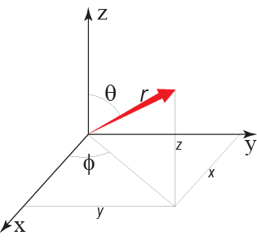
Quantum chemistry determines chemical bonds and therefore:
- relative phase stabilities
- mineral physics (e.g. thermo-elasticity, electric and thermal conductivity, thermal radiativity)
The term quantum: quantities, i.e.
discrete amounts, corresponding to
electron orbitals
h ≈ Δx Δm
h, Planck const.; x, position
m, momentum
Schrödinger equation, equivalent to Newton's 2. law of classical mechanics: F = m* a
State of electrons: - distribution and electron density − Heisenberg's uncertainty principle
- used in first principles atomistic simulation by density functional theory, DFT
General, time-independant expression of the Schrödinger equation:
Εψ = Hψ
E: energy of the state ψ
H: Hamiltonian operator acting on
the wave function, ψ
4 partial functions
Wave function: ψ(r, θ, φ) = R(r) Θ(θ) Φ(φ) ψ_{s}
radius
(distance)
rotation-1
rotation-2
spin
(direction)
Spherical coordinates: r, θ, φ
Cartesian coordinates: x, y, z
The quantum numbers (QN)
correspond to the partial functions
Principal QN, n ~ R
Angular momentum QN, l ~ θ
Magnetic QN, m_{L} ~ Φ
Spin QN, m_{S} ~ ψ_{s}

Slide 2
Quantum numbers
Principal QN: n = 1, 2, - - -, 7 (corresponding to the K, L, M, N, O, P and Q shells, energy levels)
Angular momentum QN: l
For a given n, l can be: 0, - - -, n−1 i.e. for n=3, l is 0, 1, 2
Magnetic QN: m_{L}
For a given l, m_{L} can be: −l, −(l−1), - - -, 0, - - -, l−1, l i.e. for l=2, m_{L} is −2, −1, 0, 1, 2
Spin QN: m_{S}
For a every m_{L}, m_{s} can be: −1/2, +1/2 (each individual orbital can have
two electrons with opposite spin)

Slide 3
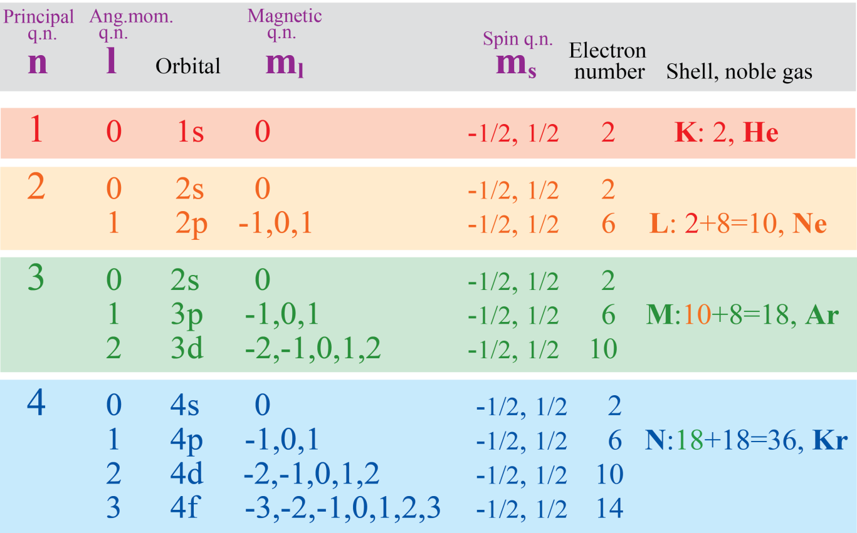
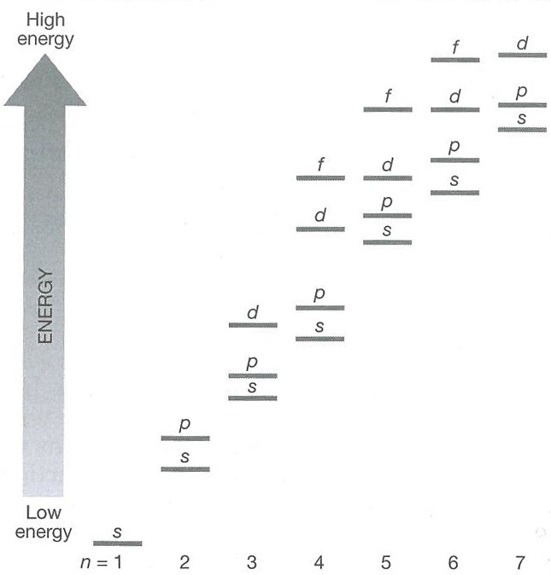
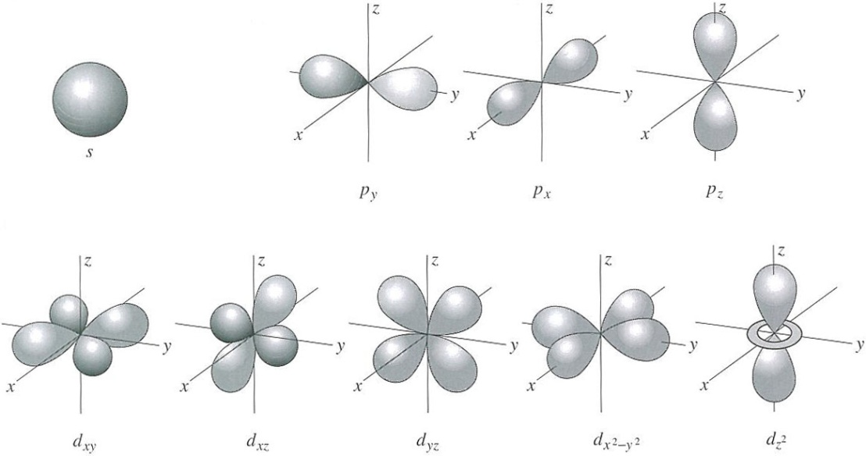
Quantum numbers
and
electron orbitals
one
s-orbital
three
p-orbitals
five
d-orbitals
seven
f-orb
6 p-electrons
2 s-electrons
2 el.
2 el.
2 el.
Domains of high
electron probability
10 d-electrons
2 el.
Note:
4s is lower than 3d,
5s is lower than 4d,
etc.
2 el.
2 el.
2 el.
2 el.

Slide 4
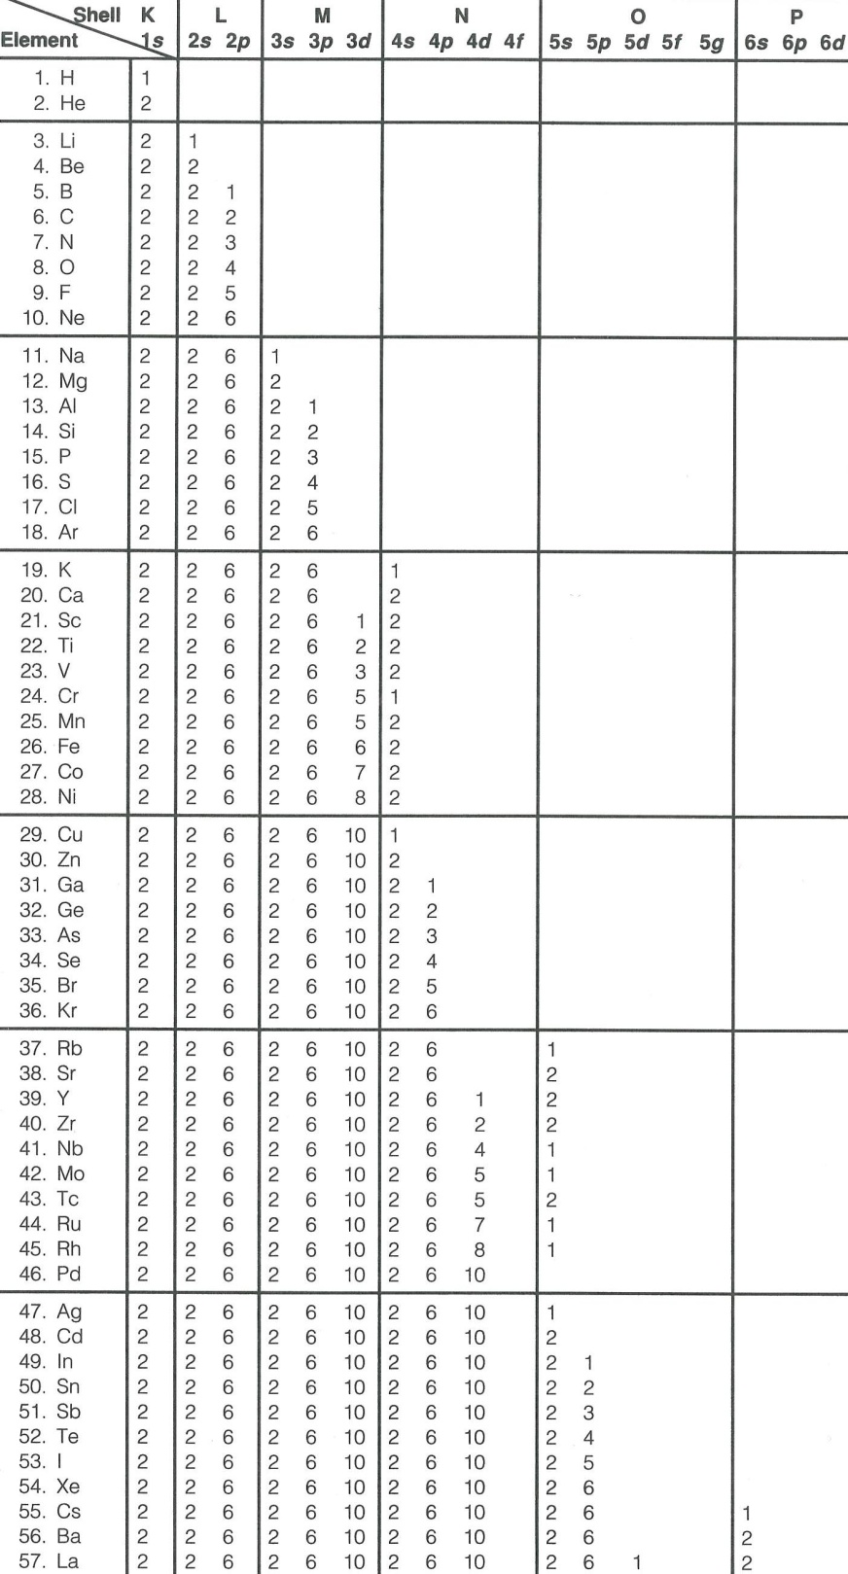
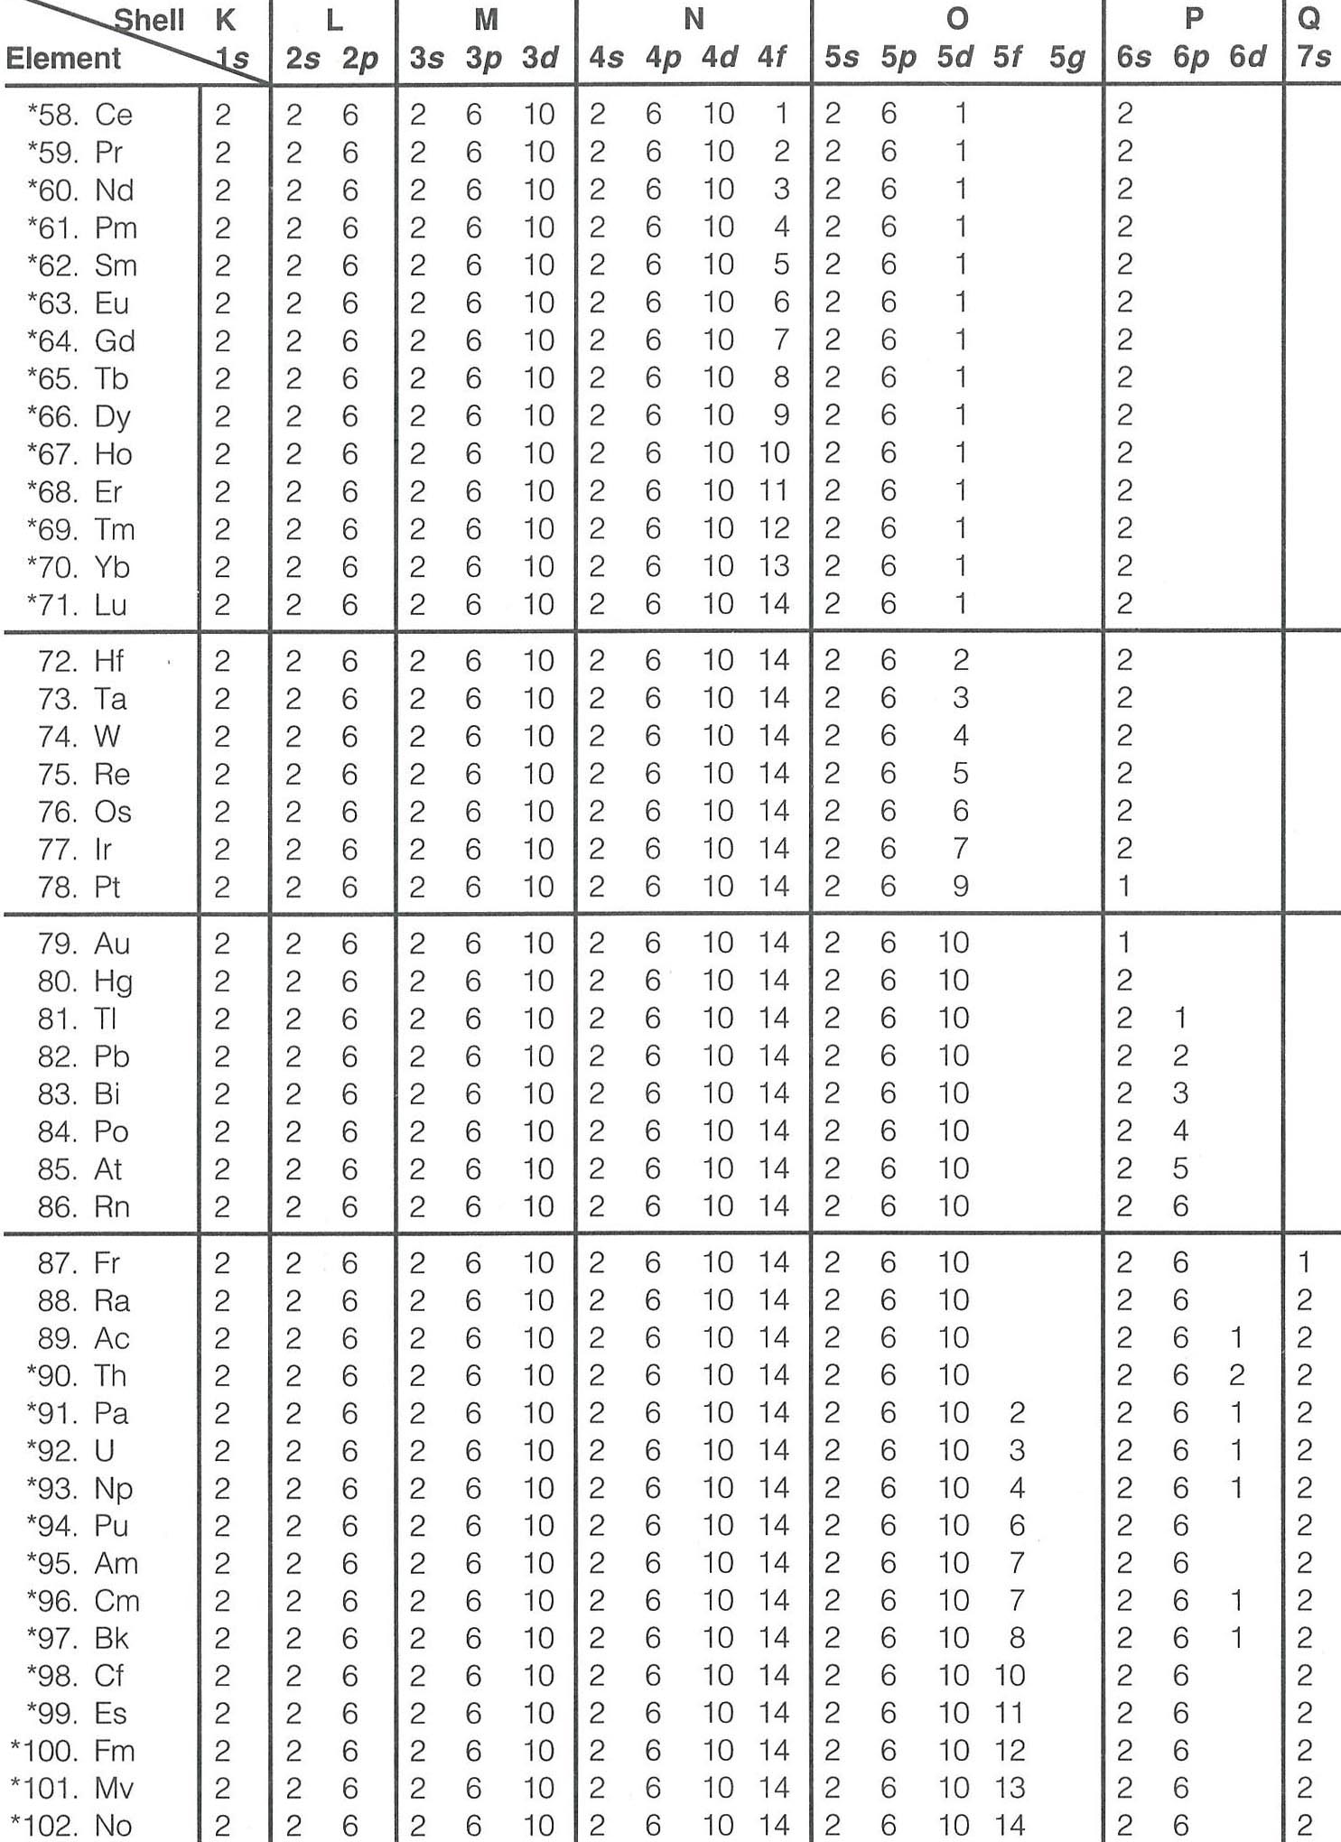
3d and 4d anomalies:
Scerri (2019, Nature)
Lanthanide contraction
Decreasing ionic radii (trivalent) from La to Lu.
Why?
Poor nuclear shielding by 4f-orbital and the poorly
filled O-shell → 6s-electons are pulled inwards.

Slide 5
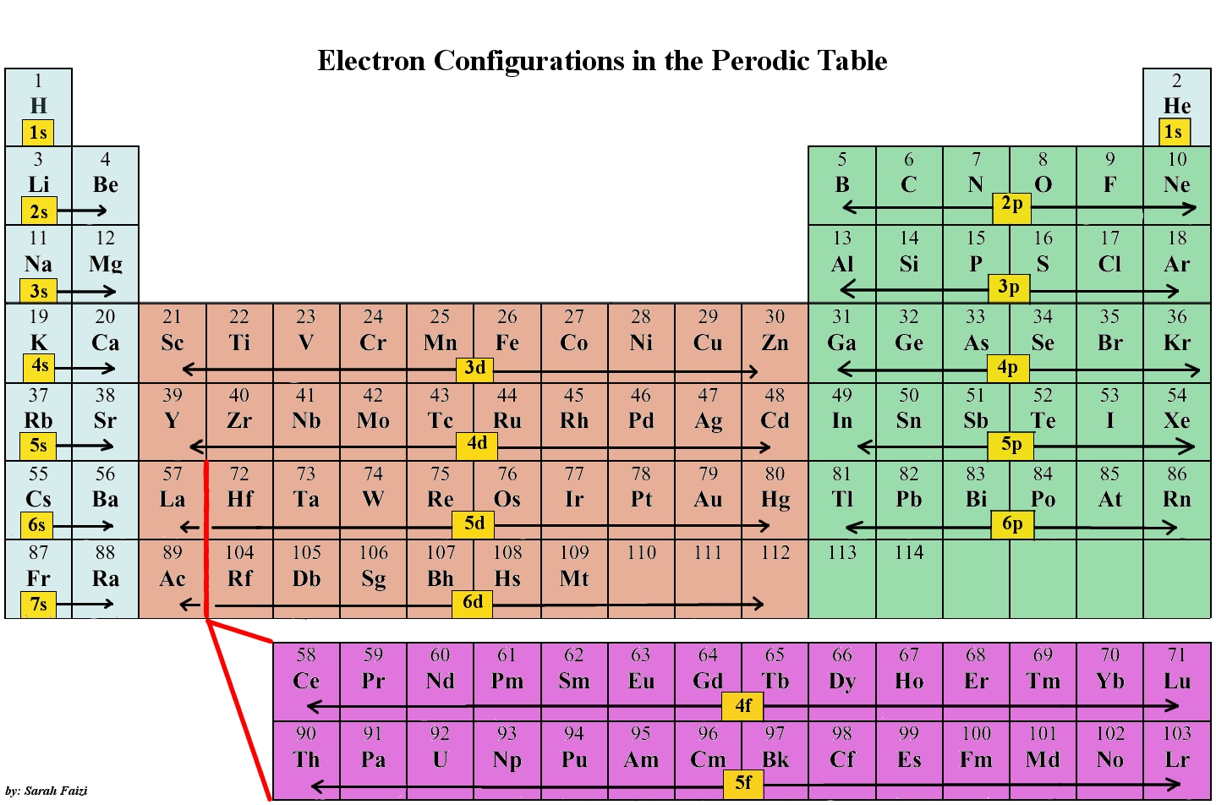
95 Am: Americum
96 Cm: Curium
97 Bk: Berkelium
98 Cf: Californium
99 Es: Einsteinuim
100 Fm: Fermium
101 Md: Mendelevium
102 No: Nobelium
103 Lr: Lawrencium
104 Rf: Rutherfordium
105 Db: Dubnium
106 Sg: Seaborgium
107 Bh: Bohrium
108 Hs: Hassium
109 Mt: Meitnerium
110 Ds: Darmstadtium
111 Rg: Roentgenium
112 Cn: Copernicum
113 Nh: Nihonium
114 Fl: Flerovium
115 Mc: Moscovium
116 Lv: Livermorium
117 Ts: Tennessine
118 Og: Oganesson
Superheavy elements: e.g. Ball (2019, Nature)
Noble gases,
He to Rn:
Full s+p orbitals
of K-P shells
K
L
M
N
O
P
Nh
115
116
117
118
Q
Ds
Rg
Cn
Fl
Mc
Lv
Ts
Og
7p
111
111

Slide 6
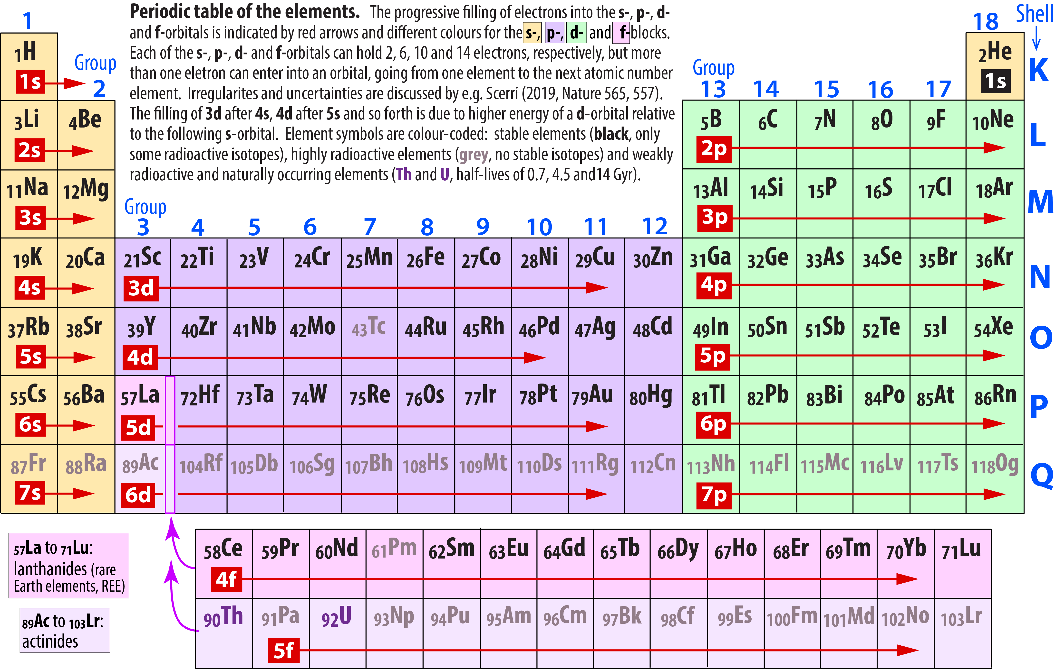

Slide 7
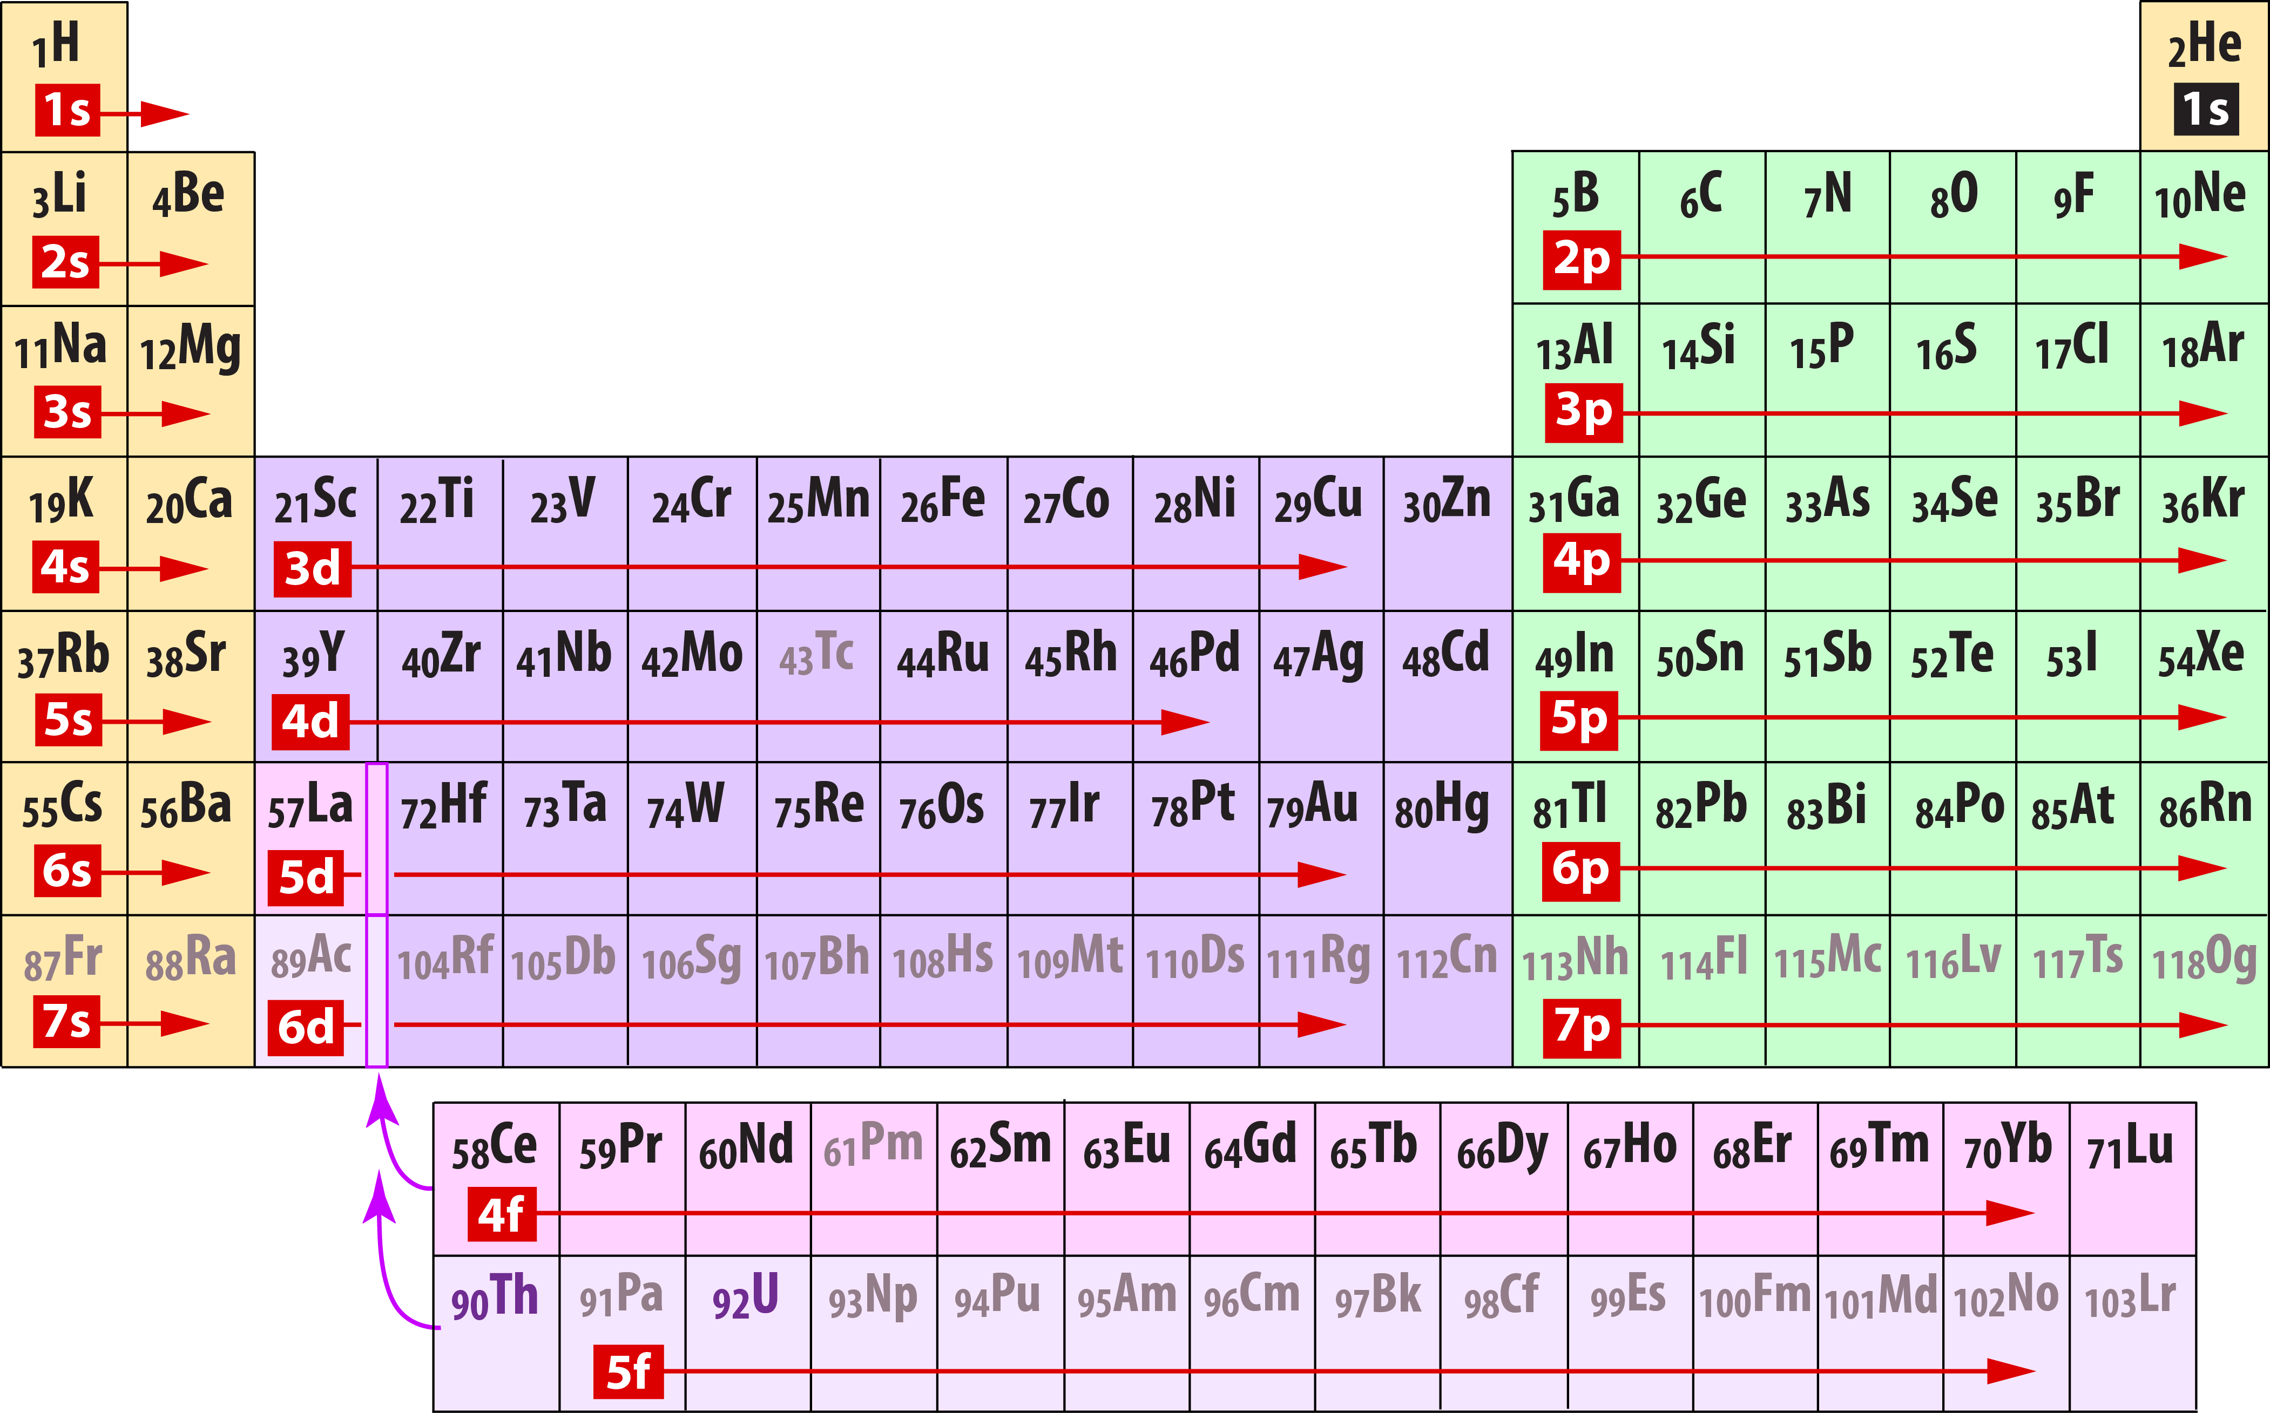

Slide 8
Electronic spin state
transition metal ions, esp. Fe
3d
4s
3d-transition metals:
― [Ar] 3d^{X} 4s²
Fe: 3d⁶ 4s²
Sc: 3d¹ 4s²
Ti: 3d² 4s²
V: 3d³ 4s²
Cr: 3d⁵ 4s¹
Mn: 3d⁵ 4s²
Fe: 3d⁶ 4s²
Co: 3d⁷ 4s²
Ni: 3d⁸ 4s²
Cu: 3d¹⁰ 4s¹
Zn: 3d¹⁰ 4s²
Fe-ions:
Fe²⁺: 3d⁶
Fe³⁺: 3d⁵
Maximum magnetic moment
Very high pressures will ultimately favour pairing
of electrons into the lowest energy orbitals
Energy cost (repulsion) of pairing electrons
⇒ ”degenerate” orbitals in isolated elements
i.e. maximum number of unpaired electrons
(all orbitals have equal probability of being filled)

Slide 9
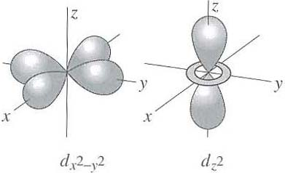
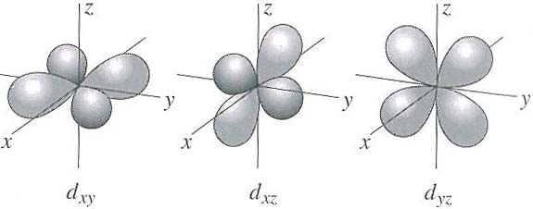
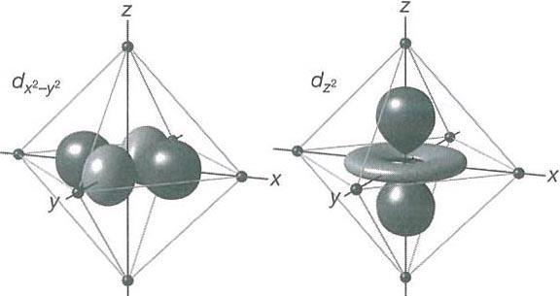
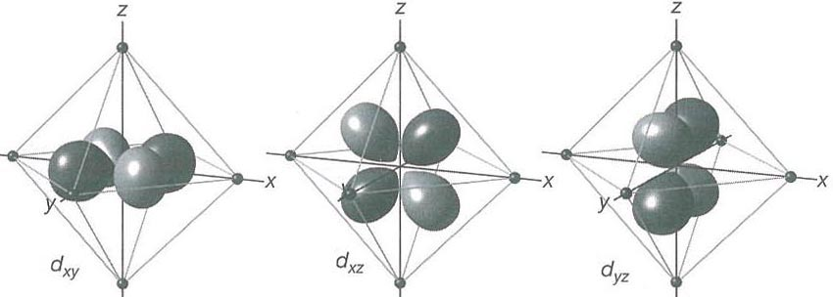
Crystal field theory
- describes electrostatic forces on cations from surrounding anions (ligands)
- ligands are regarded as point charges ⇒ electromagnetic crystal field
- electro-density distribution of the cation influences the stability of cation-anion configuration
e_{g}-orbitals
along axes
t_{2g}-orbitals
between axes
Octahedral coordination polyhedron
e_{g}-orbitals (along axes):
stronger electrostatic repulsion
⇒ higher energy
Energy
t_{2g}-orbitals (between axes):
less electrostatic repulsion
⇒ lower energy
CF splitting

Slide 10
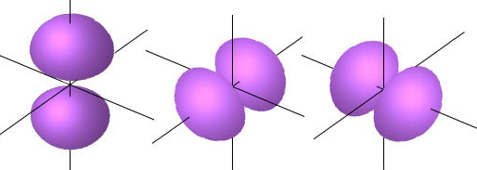
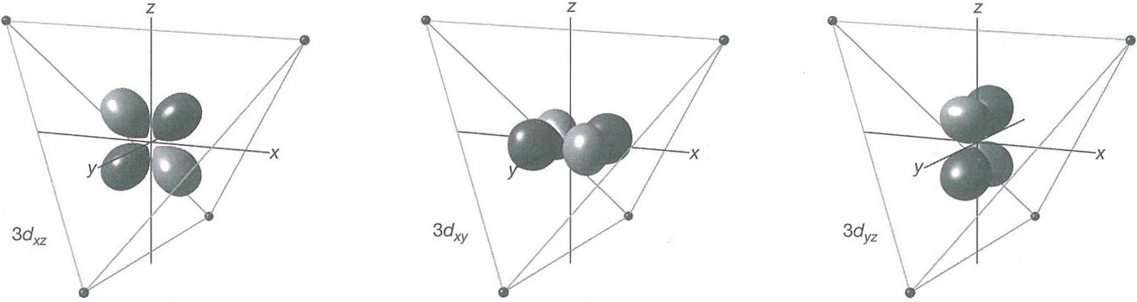
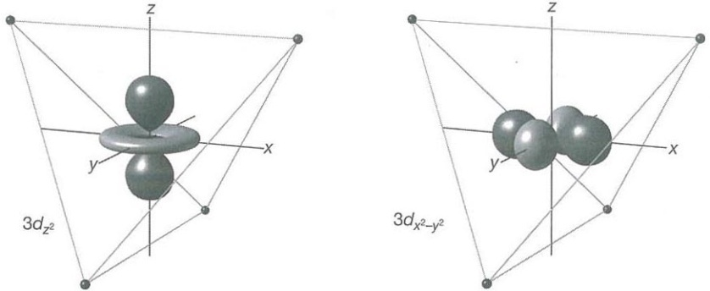
Oxygen electronic configuration: even, spherical electron density
1s
2s
2p
2p_{z}
2p_{y}
2p_{x}
O: 1s² 2s² 2p⁴
O²⁻: 1s² 2s² 2p⁶
Tetrahedral coordination polyhedron
t_{2g}-orbitals:
strong electrostatic repulsion
⇒ high energy
Energy
CF splitting
e_{g}-orbitals:
less electrostatic repulsion
⇒ low energy

Slide 11
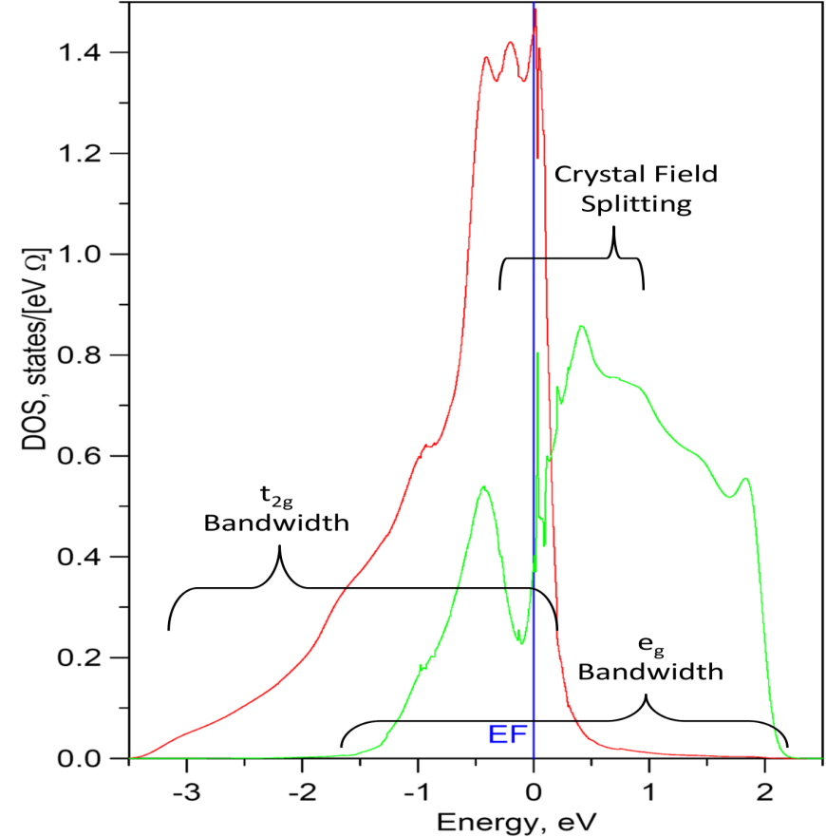
Isolated cation
(e.g in outer space)
Octahedral crystal
field splitting
Cation in octahedral
crystal field
e_{g}
e_{g} bandwidth
Energy
CFS
t_{2g}
t_{2g} bandwidth
CFSE
Cation in ”ideal”/
”isotropic” anion
polyhedron
Shulenburger et al.
(2010, J.Phys.)
EF: Fermi energy level
DOS: Density of states
1/(eV*spin)

Slide 12
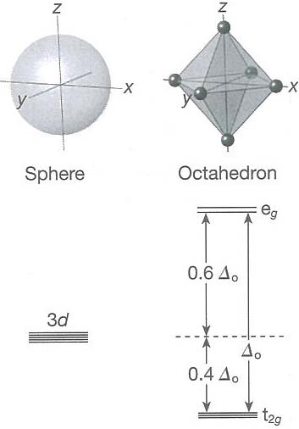
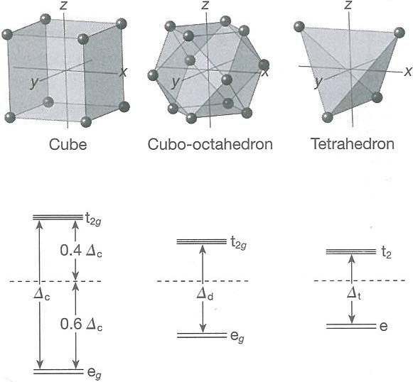
e_{g}-orbitals
along axes
t_{2g}-orbitals
between axes
t_{2g}: between axes,
low repusion,
low energy
e_{g}: along axes, low repusion, low energy
crystal field
splitting
Energy
Octahedral
CFSE

Slide 13
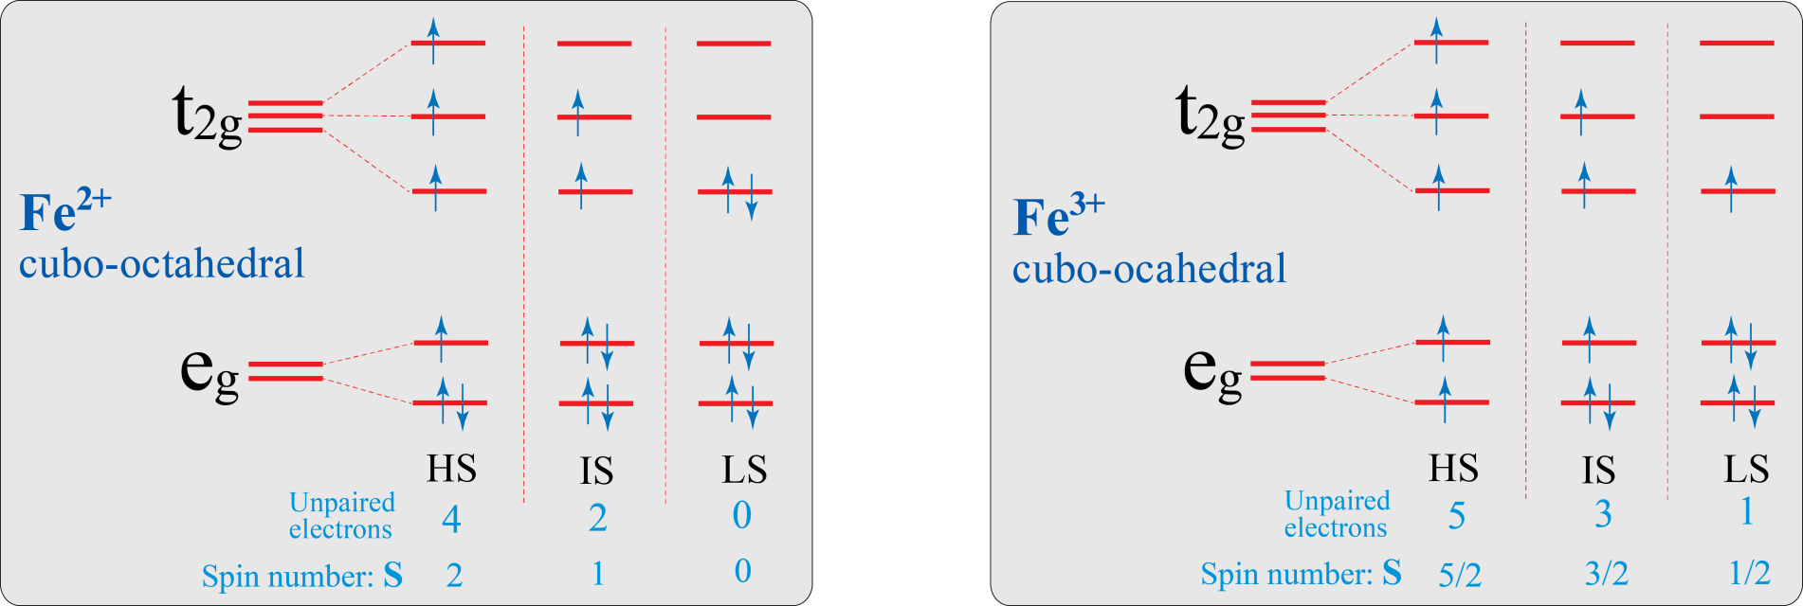
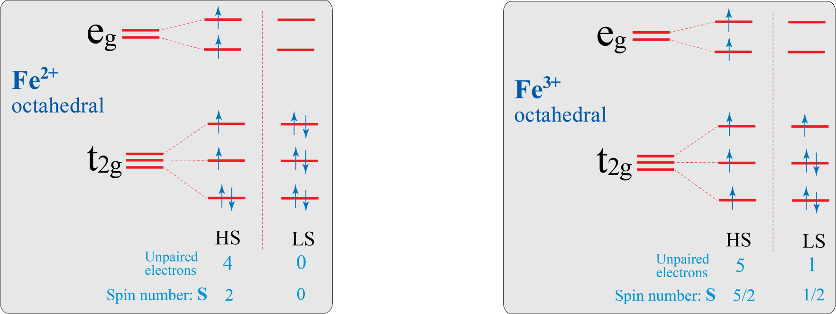

Slide 14
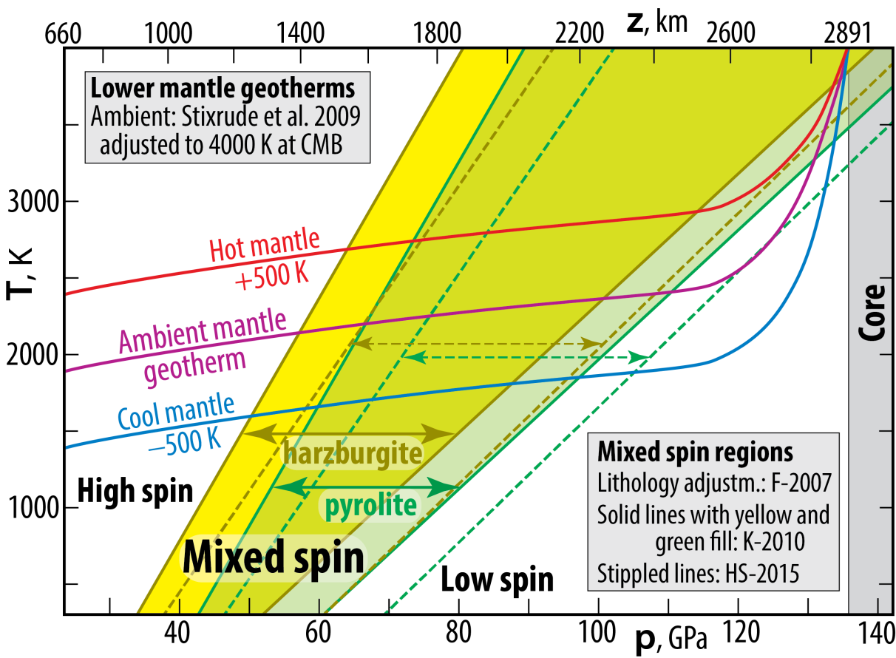
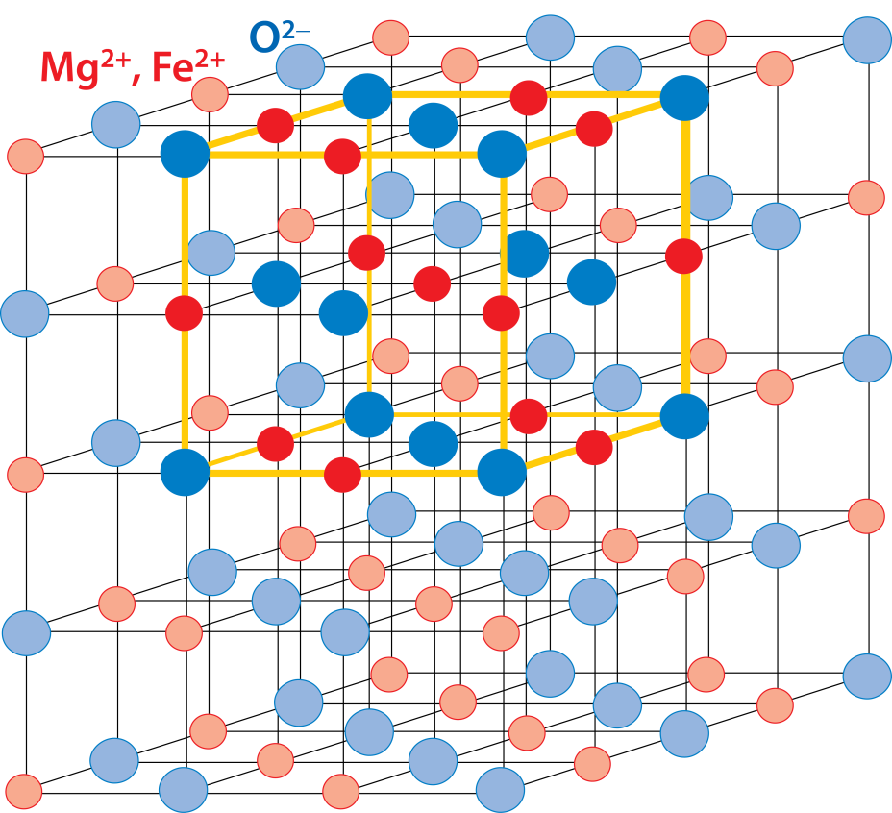
Fe²⁺ spin state in ferropericlase
Wide stability field of mixed spin state (equal
proportions of Fe_{HS} and Fe_{LS}) minimises crystal
lattice strain)
Ionic radii, octahedral coordination
(Shannon & Prewitt 1969, 1970, Acta. Cryst. B)
Mg²⁺: 0.72 Å
Fe²⁺_{HS}: 0.78 Å
Fe²⁺_{LS}: 0.61 Å
O²⁻: 1.40 Å
F-2007: Fei et al., 2007, GRL
K-2010: Komabayashi et al., 2010, EPSL
HS-2015: Holmström & Stixrude, 2015, PRL

Slide 15
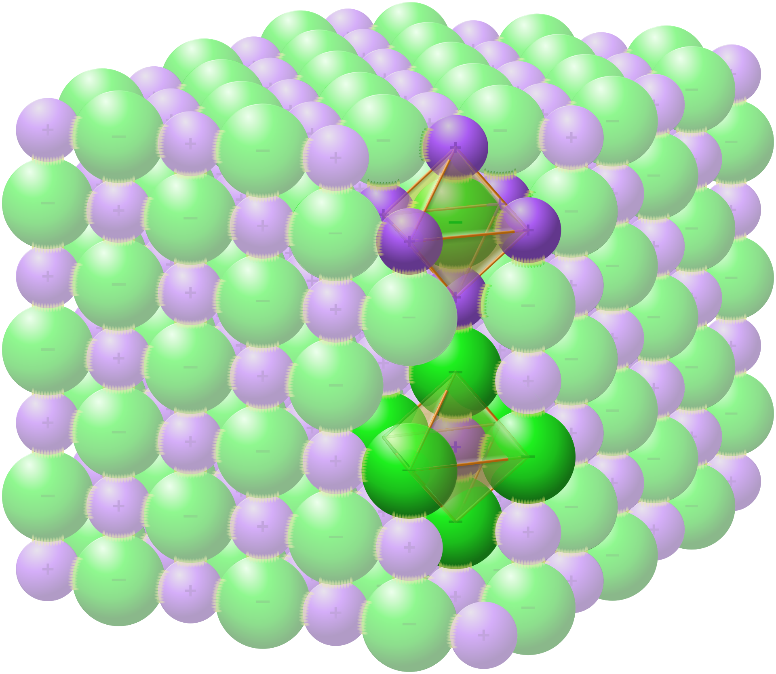
3D-ferropericlase structure
(Mg,Fe)O
Mg,Fe
O
Creative Commons Attribution –
Share Alike 4.0 International

Slide 16
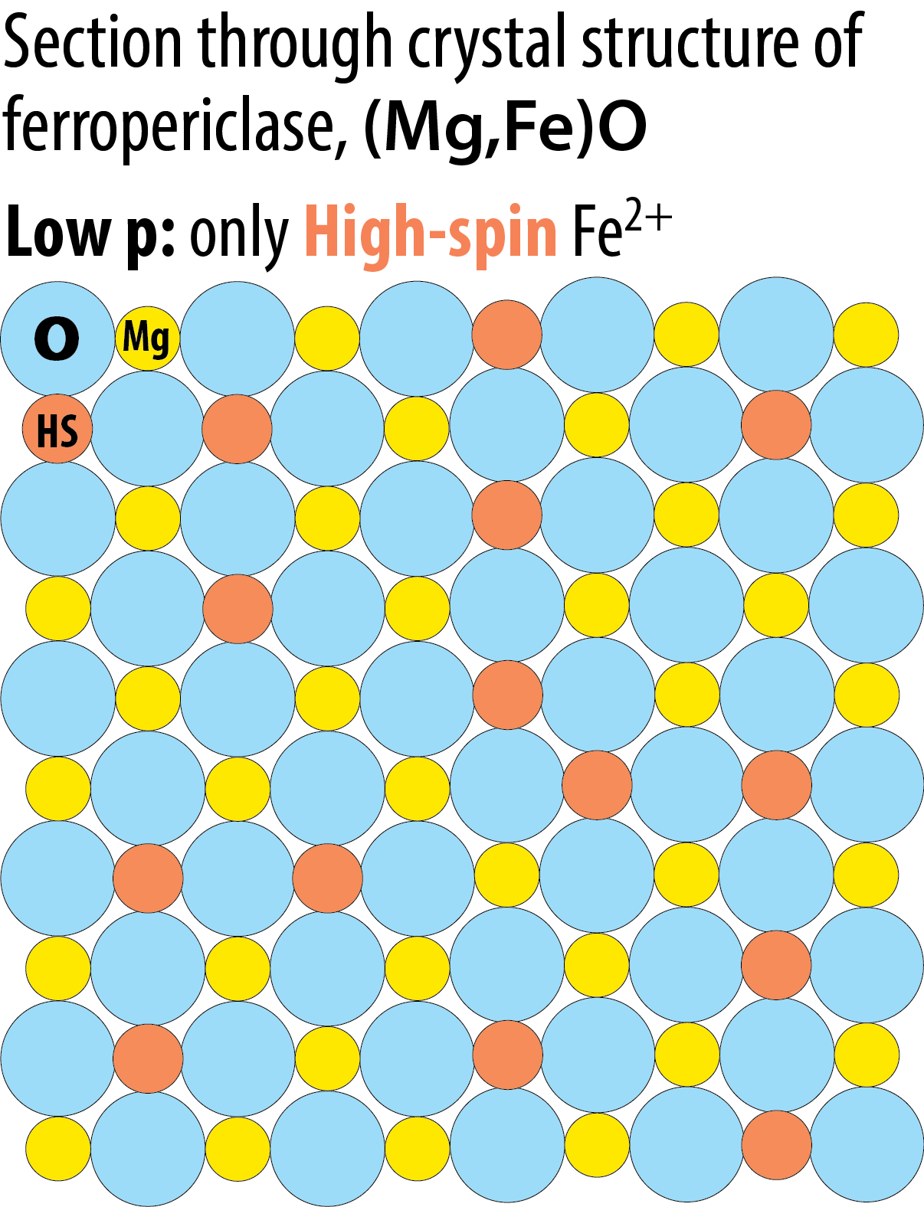
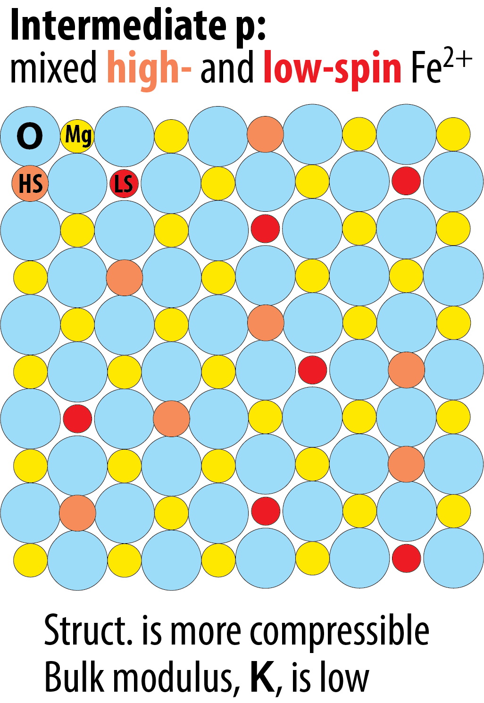
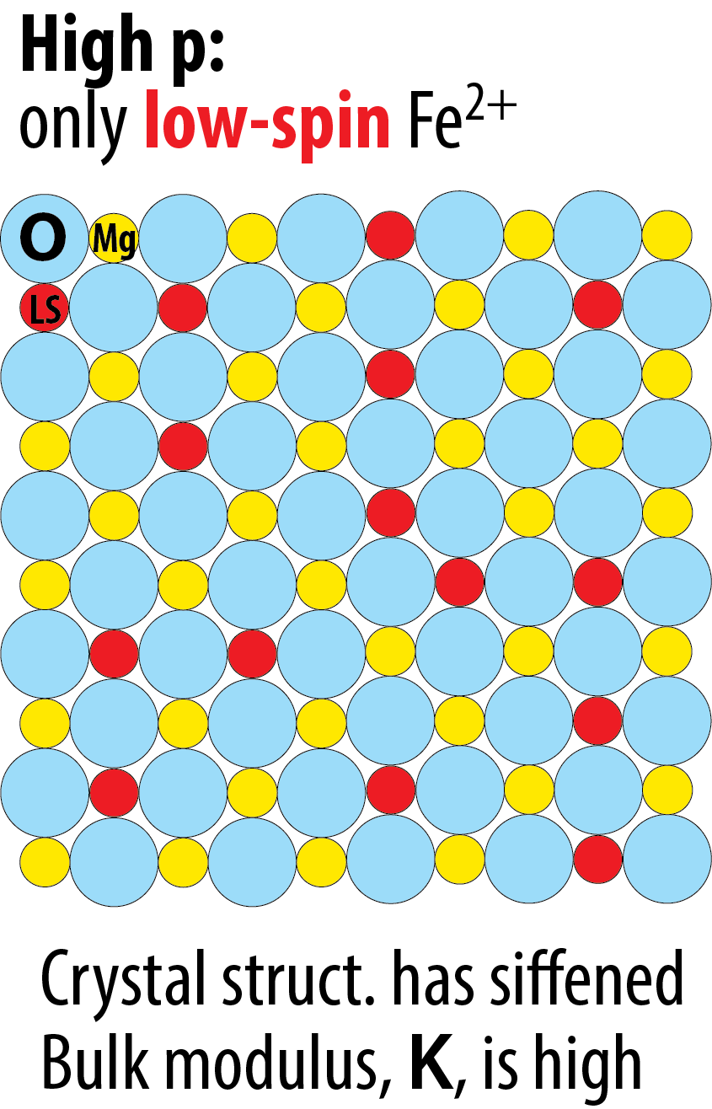

Slide 17
Fe²⁺ spin state in ferropericlase
Effects on elastic moduli and wave-speeds
Valencia-Cardona et al. 2017, GRL

Slide 18
Fe²⁺ spin state in ferropericlase
Effects on elastic moduli
Kennett 2021, EPSL
fp: Mg_{87.5}Fe_{12.5}O₁₀₀
Ab initio, along BS-81 adiabat,
Wu et al. 2013, PRL
G: Shear modulus
K: bulk modulus
p: pressure
Almost linear G/K vs. p/K relation
Low K through
mixed-spin state
Green data curve: slightly concave upwards
Calculated without
spin crossover effect
Elevated K in
low-spin state

Slide 19
Fe²⁺ spin state in ferropericlase
Effects on elastic moduli and wave-speeds
Kennett 2021, EPSL
Mg_{81.25}Fe_{18.75}O
Ab initio, 2000 K,
Wu et al. 2013, PRL
Convex upwards:
Marquardt et al. 2009, EPSL
0.40

Slide 20
Fe²⁺ spin state in ferropericlase
Effects on elastic moduli and wave-speeds
Kennett 2021, EPSL
normal modes
high G, low K sensitivity
Concave upwards:
Convex upwards:
body waves

Slide 21
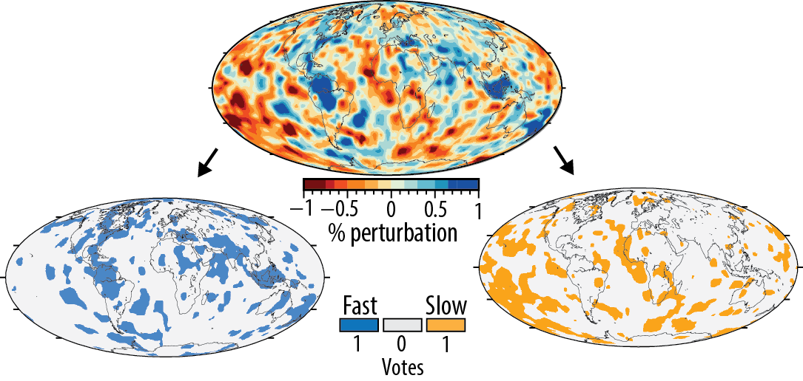
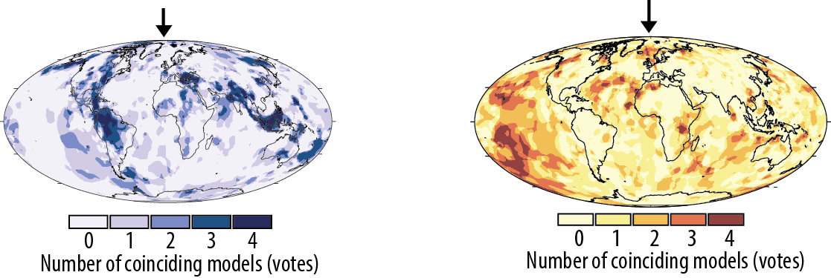
Spatial resolution by seismic tomography vote map method (Shephard et al. 2021, Nat. Comm)
One particular tomography
model at one specific depth:
Extracting fast (e.g. >+1σ)
and slow (e.g. <−1σ) areas
Combining 4 models
at the same depth
Combining models at numerous depths through the lower mantle

Slide 22
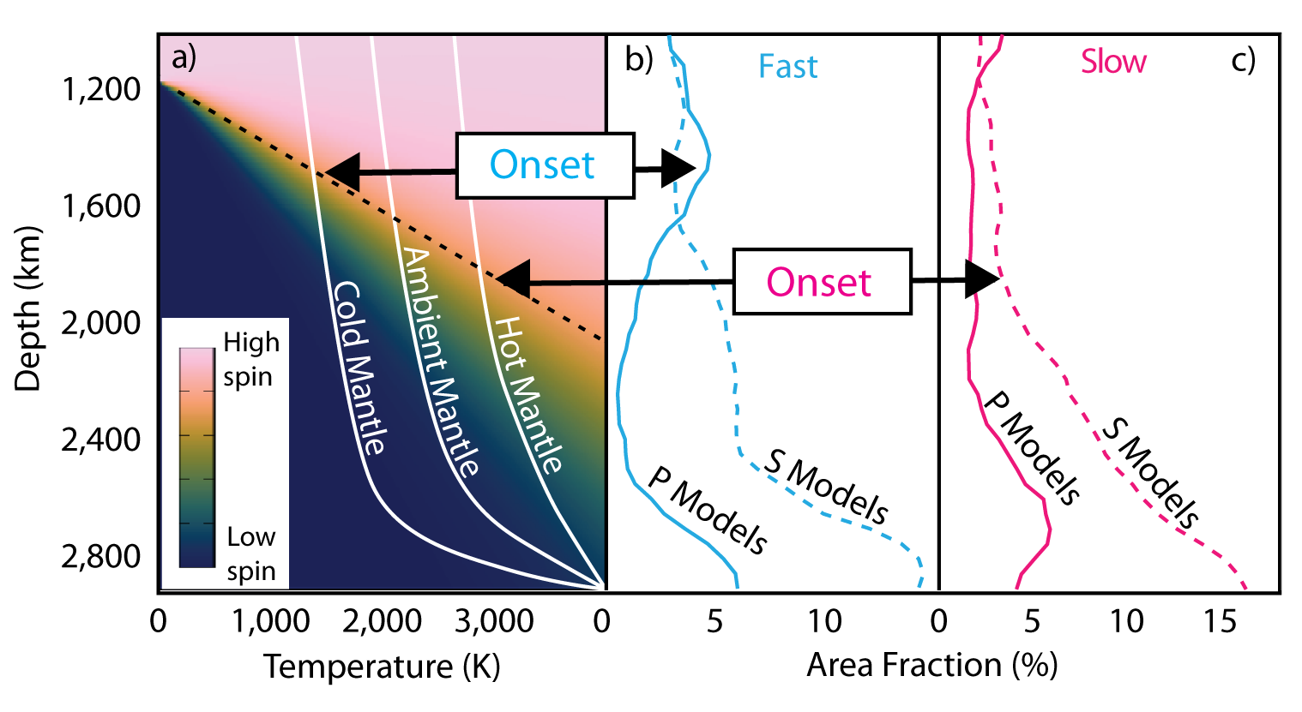
Loss of strong
Vp anomalies
……………………...
D’’
TBL
, full score
No indication of a spin signal in the ambient (average velocity) mantle
- but would we be able to detect it or confirm a lack of signal ?
- would an absent signal, is confirmed, indicate fp-free, refractory
and highly viscous bm-dominated material (BEAMS) ?
- where is the ambient (average velocity) in the lower mantle ?
Possibly not - a very challenging task
Yes, very likely
Let’s look at a map and a cross-section

Slide 23
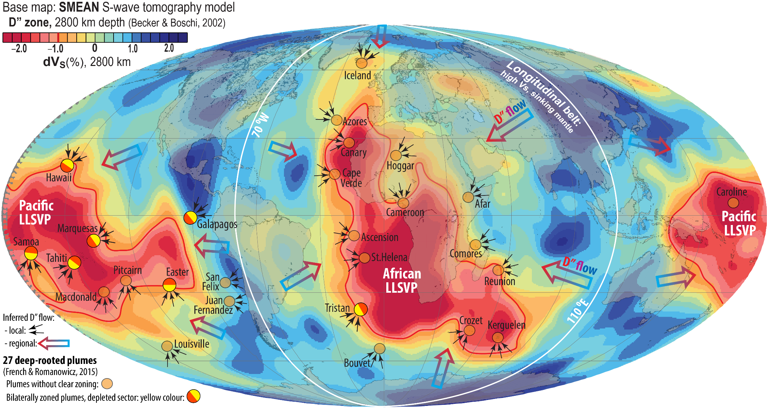
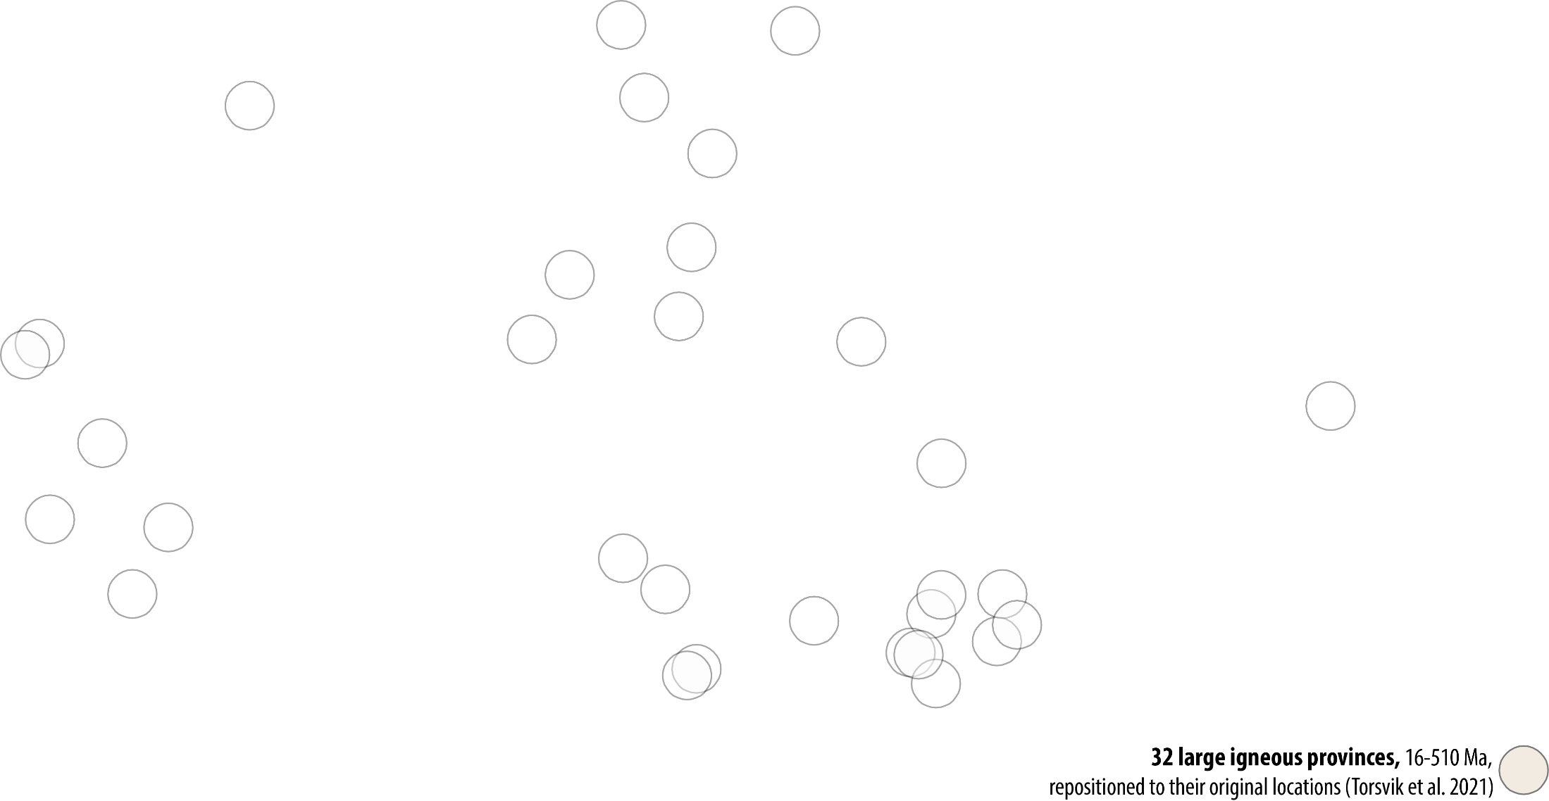
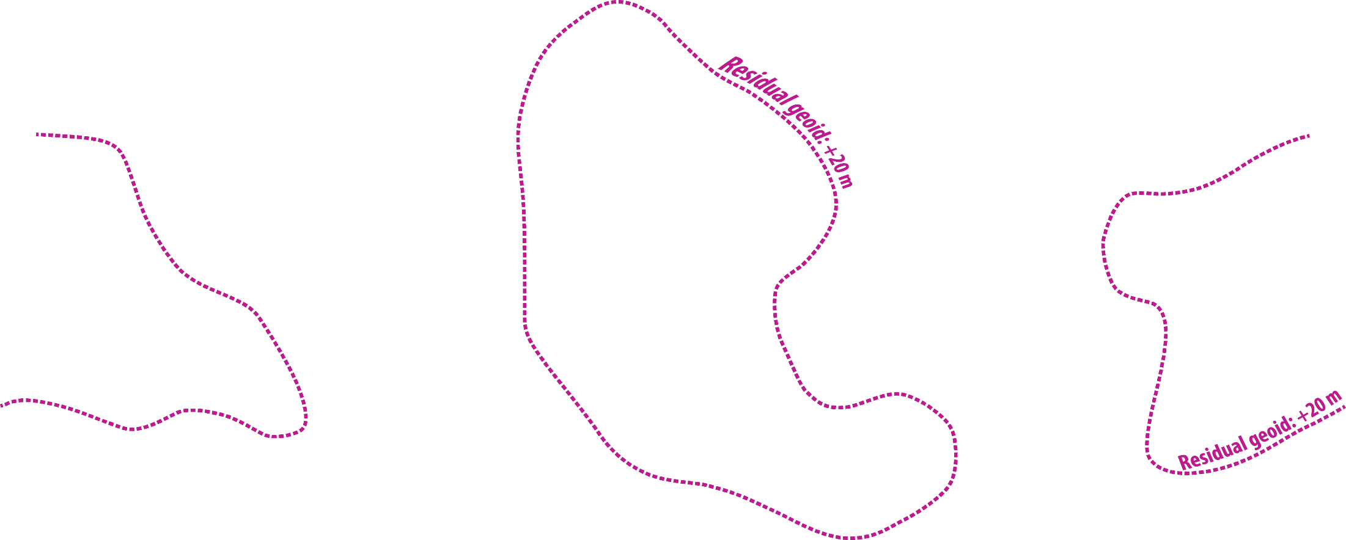
Degree-2 mantle flow pattern and lower mantle structure

Slide 24
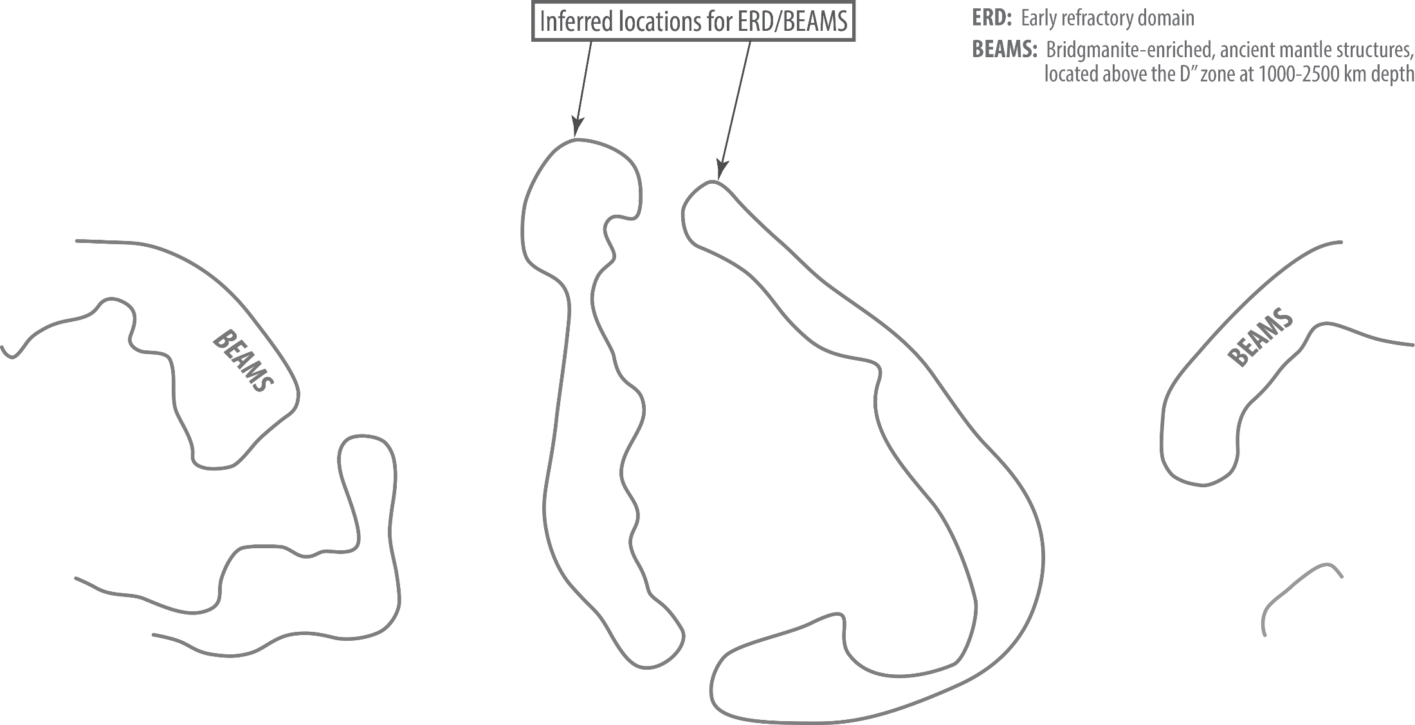

Slide 25
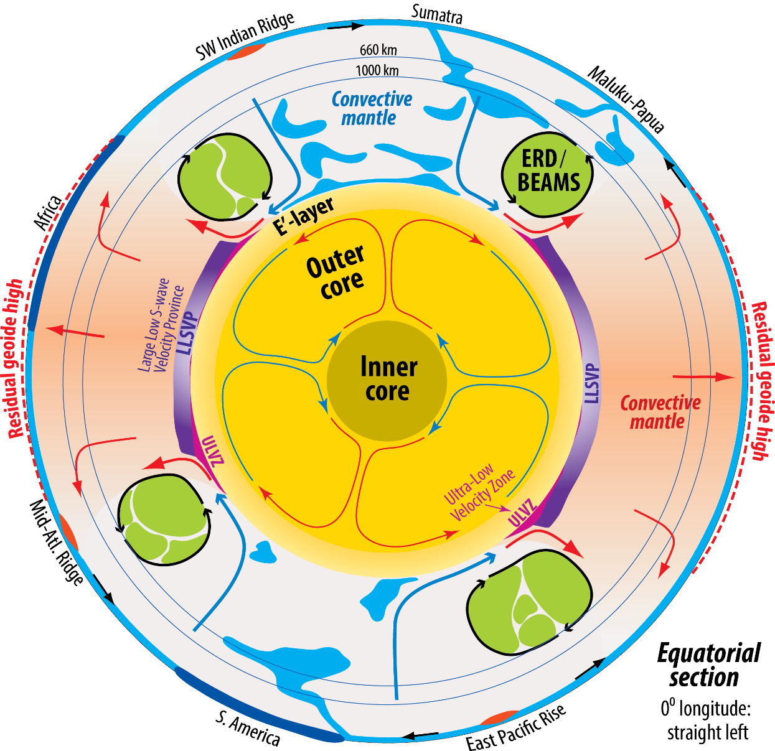
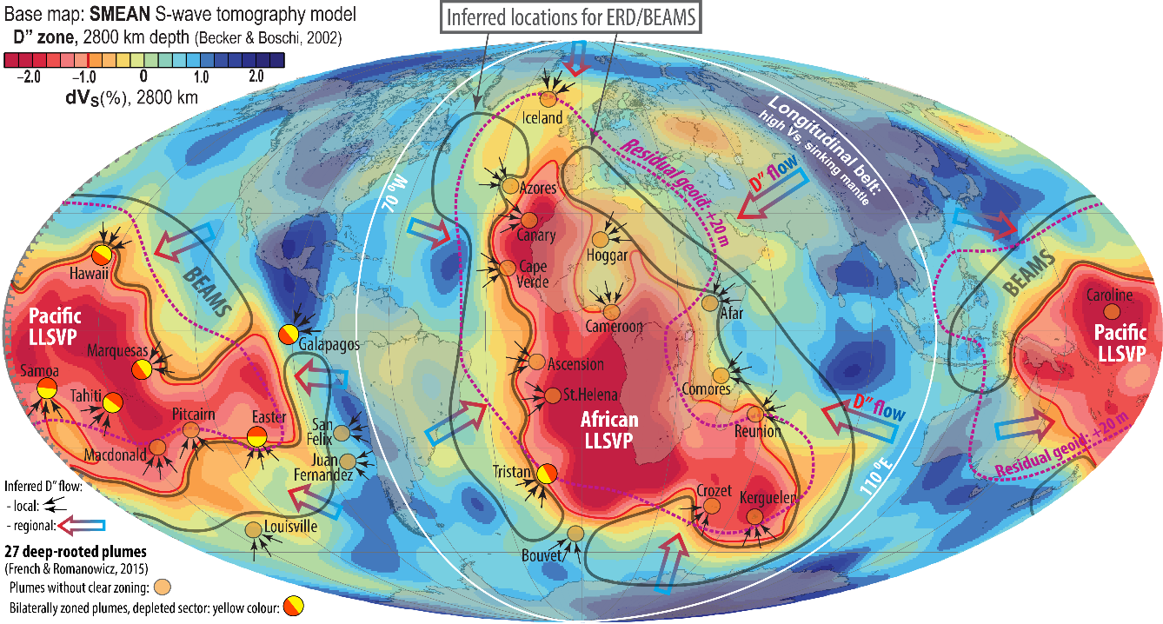
- BEAMS are positioned to avoid ’’interference’’ with
the slabs mapped by van der Meer et al. (2010, NG, 2019, Tectonoph)
- Viscous and refractory bridgmanitic material is strongly
indicated from a petrological point of view
early MO-crystallisation during core-MO and core-BMO
chemical exchange (CEED Ann. Report 2020, SAB-seminar,
2021). (B)MO: (basal) magma ocean
- Early refractory domains are likely to be
convectively aggregated into BEAMS
(Manga 1996a,b, GRL; Becker et al. 1999, EPSL;
Ballmer et al. 2017, NG)

Slide 26
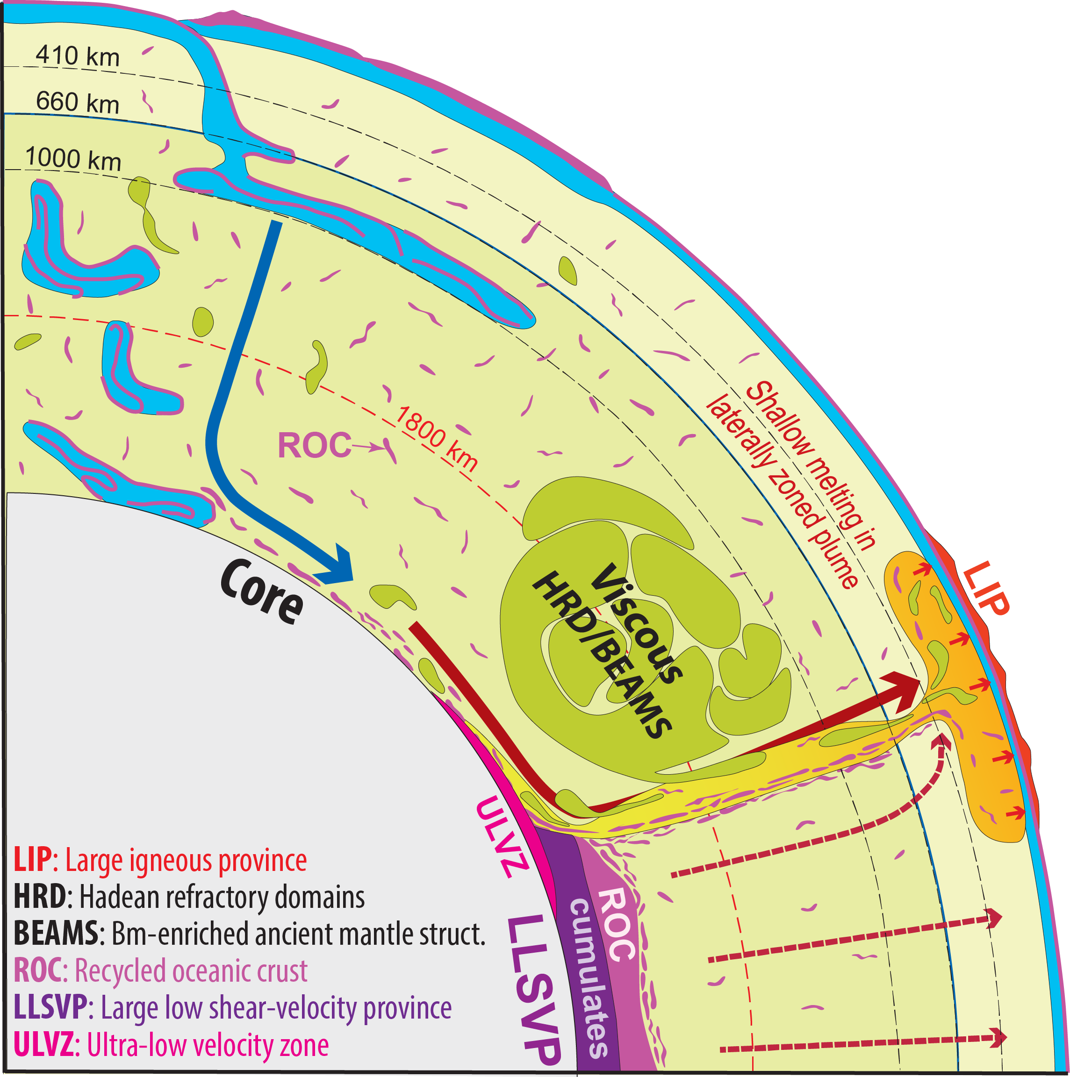
- MgSiO₃-dominated bm is neutrally
buoyant in the mid-LM
- Very refractory in the LM, but less so as an
opx-component in the upper mantle

Slide 27
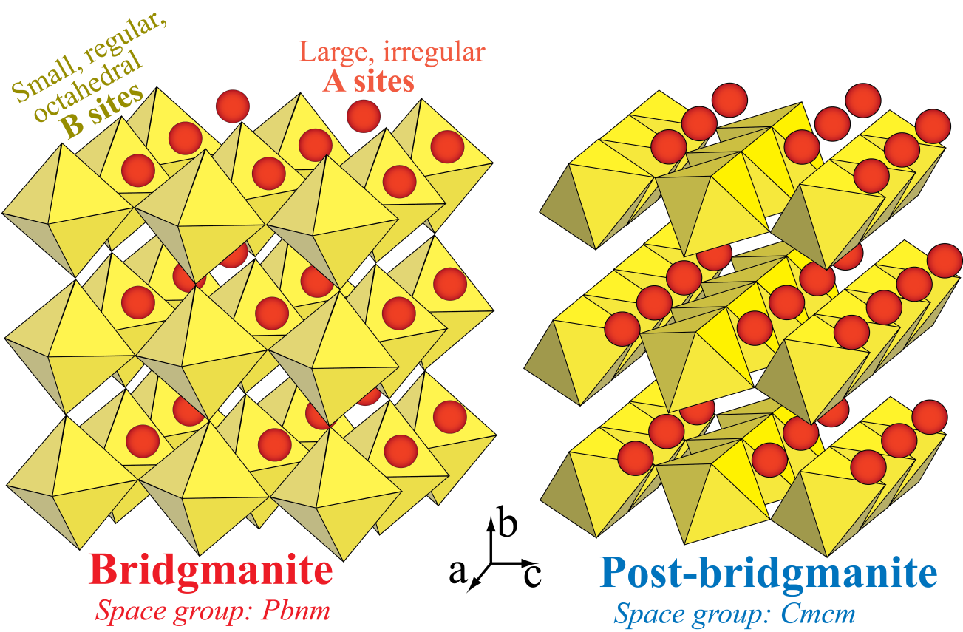
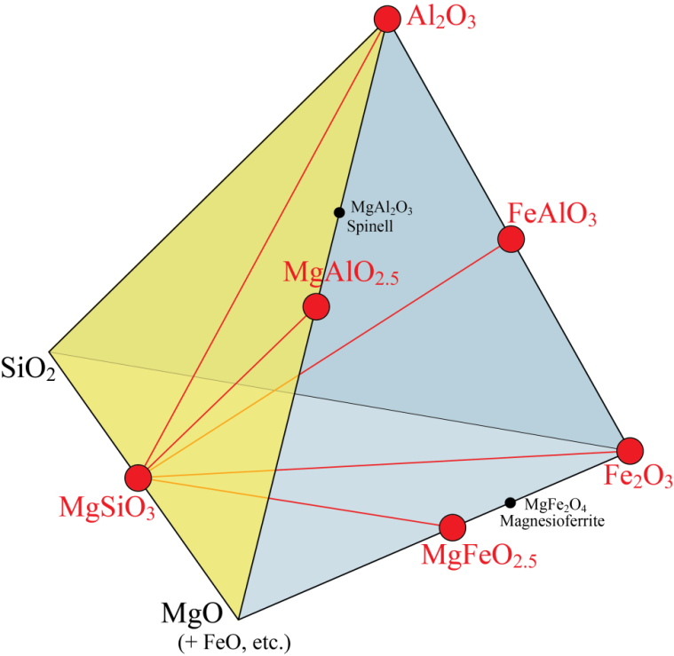
Bridgmanite (bm) and post-bridgmanite (pbm): ABO₃-compounds
Site occupacy
A: Mg²⁺ Fe²⁺ B: Si⁴⁺
Additional trivalent cations,
mostly: Fe³⁺_{A} Al_{B}
System MSA-Fe³⁺
Trivalent substitution
vectors
FeAlO₃
FeSiO₃

Slide 28
Bridgmanite (bm) crystallographic site occupancy and spin-state of Fe
Mohn & Trønnes
(2016, EPSL)
Phase relations of bm in peridotitic (including strongly depleted peridotites) and basaltic lithologies
Only four components are relevant (present) in the deeper parts of the lower mantle (>40 GPa):
MS, FS, FA, AA, i.e. MgSiO₃, FeSiO₃, FeAlO₃, Al₂O₃
Uppermost part (<40 GPa) of the lower mantle:
The O-vacant component MA, MgAlO_{2.5} may also be present.
The bm component FF, Fe₂O₃, which is not present in the common lithologies of the Earth's mantle, but possibly in subducted BIFs
(banded iron formations), if they exist, has equal amounts of Fe³⁺_{A-HS} and Fe³⁺_{B-LS} at pressures exceeding 40-50 GPa.
Fe site occupancy and spin state
FS-component
Fe²⁺_{A-HS} is the stable configuration.
Nearly ideal MS-FS mixing and no metastability
or kinetcs problems
Ab initio study of A- and B-site occupancy and Fe spin state in bm
(Mohn & Trønnes, 2016, EPSL)
Methods - summary
- DFT and Boltzmann statistics of numerous configurations, VASP software
- Thermodynamic properties from configurational Boltzmann averaging at 3000 K
FA-component
Fe³⁺_{A-HS} is the stable configuration based on ab initio
theory and experiments, starting from pre-synthesised
polycrystalline or single crystal bm at about 24 GPa.
Experiments (LH-DAC) synthesising bm directly from
amorphous starting materials (glass or gel) at > 40 GPa
may trap, metastably, some Fe³⁺_{B-LS}, compensated by a
corresponding amount of Al_{A}.
Σ Y_{i} exp(−G_{i} / k_{B}T)
Property Y =
_{i}
Σ exp(−G_{i} / k_{B}T)
_{i}
Gibbs free energy: G_{i} = H_{i} + E_{i} -TS_{i} for configuration i.
H_{i}: static enthalpy, S_{i}: vibr. entropy (quasiharmonic lattice dyn.), E_{i}: zero point motion
- G_{i} and spin-polarisations of Fe were calculated by alternative functionals,
especially GGA and GGA +U (U: 5eV for FA, 3eV for FS)
- Elastic constants are calculated directly from the force constants.
- Simulation box: 80 atoms = 16 fmu, energy cut-off: 700 eV, k-mesh grid:2*2*2

Slide 29
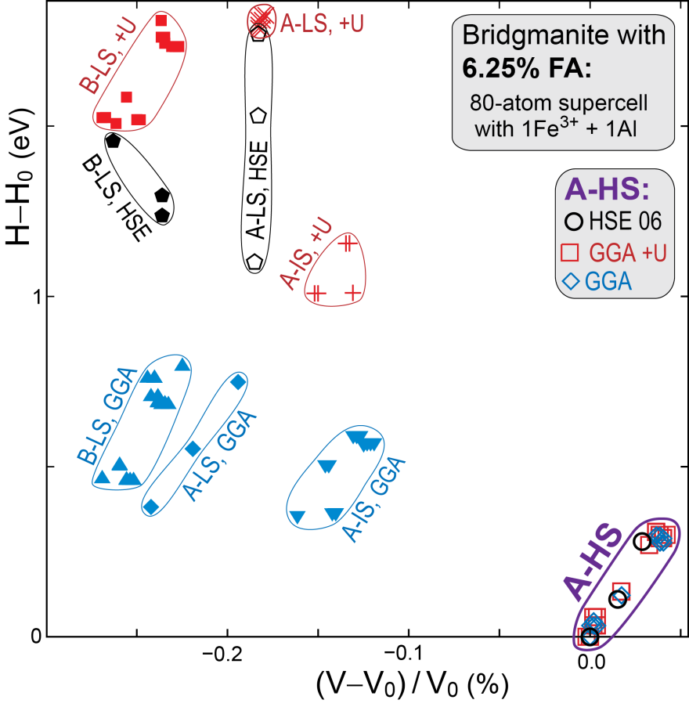
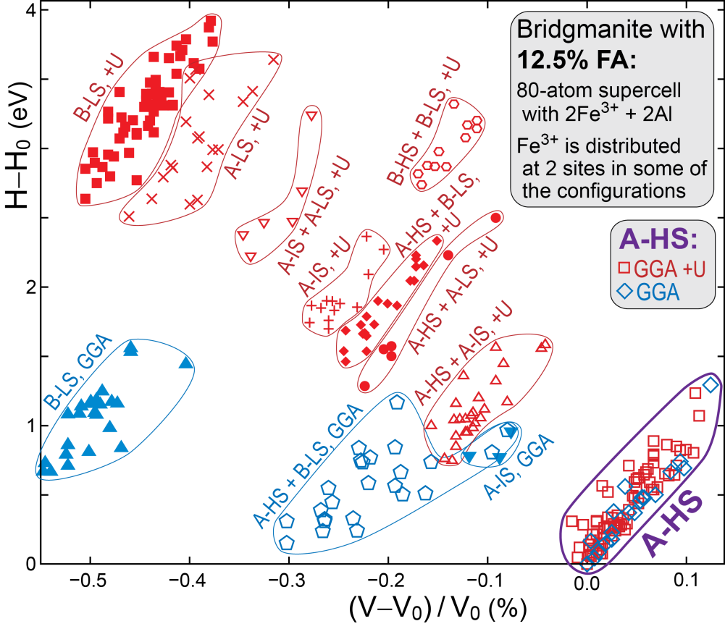
Site occupancy and spin state, FA-component in bm and pbm at lowermost mantle condition
- Contentious issues, but agreement that Fe³⁺_{A} is HS and Fe³⁺_{B} is LS (e.g. on the MS-Fe₂O₃ join)
- Some exp. on the MS-FA join indicate metastable trapping of the Al_{A}-Fe³⁺_{B-LS} config. (e.g Hsu et al. 2012, EPSL)
Enthalpy-volume relations for configurations in bridgmanite (Mohn & Trønnes, 2016, EPSL)
HS-Fe³⁺_{A} is energetically favourable compared to LS-Fe³⁺_{B}, especially with the GGA+U and HSE06 functionals (conventional GGA: hampered by self-interaction errors). BUT the volume of HS-Fe³⁺_{A} is rather high.

Slide 30
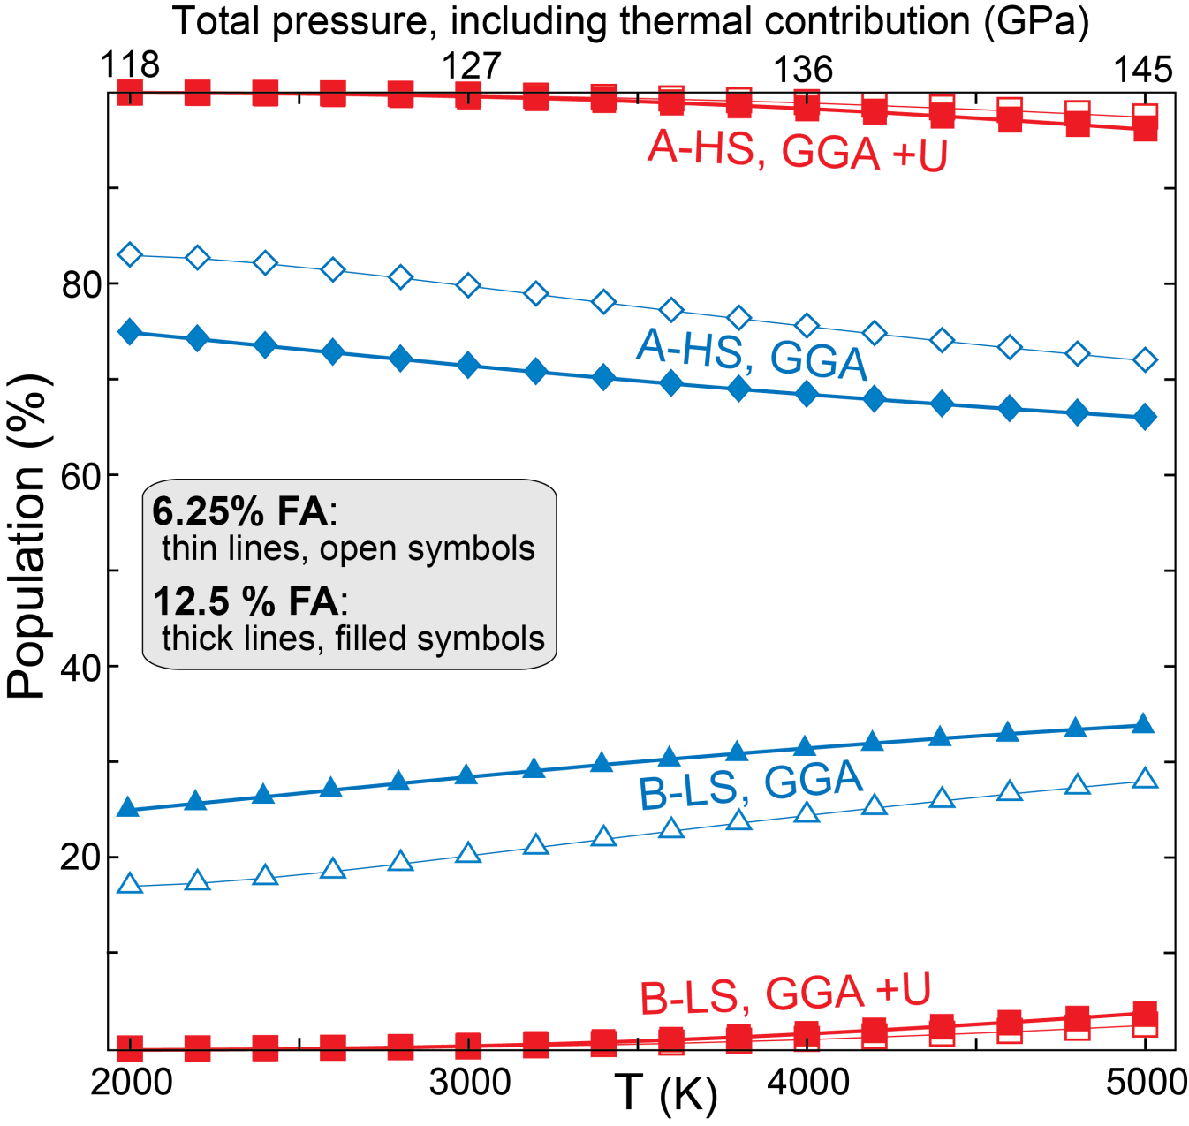
Site population and spin state, Fe³⁺ in MS-FA bridgmanite
2000-5000 K
118-145 GPa total pressure
6.25 and 12.5 mol% FA
GGA+U:
100-96% Fe³⁺_{A-HS}
0-4% Fe³⁺_{B-LS}
GGA:
80-70% Fe³⁺_{A-HS}
20-30% Fe³⁺_{B-LS}
Summary, Fe spin state and site occupancy
MS-FA join: the configuration Fe³⁺_{A-HS} Al_{B} is energetically favourable in both bm and pbm
MS-FS join: Fe²⁺_{A-HS} is also energetically favourable in both bm and pbm

Slide 31
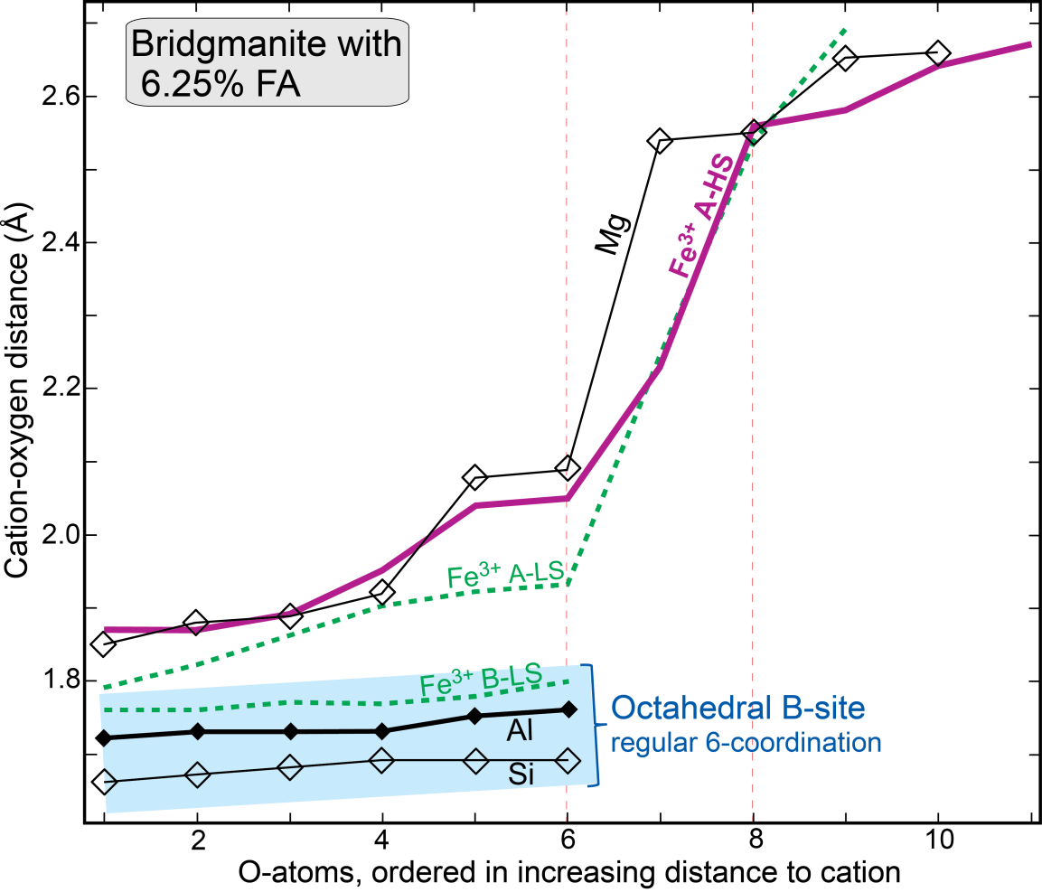
But is the volume an obstacle?
Cation-oxygen bond lengths, MS-FA-join
regular octahedral B site − irregular A site
Irregular A site
No specific coord. numb.
Mg-O bond lengths are
"grouped" with a 4-2-2-2
division: 4 at 1.85-1.92, 2 at 2.08-2.09, 2 at 2.54-2.55 and 2 at 2.65-2.66 Å, resp.
- Considerable charge transfer and
covalency of flexible Fe-O bonds
- Large HS-Fe fits well in the
irregular A site
Deviations (%) from fully
ionic character (GGA +U)
Mg²⁺_{A}: 14 Si⁴⁺_{B}: 19
Fe³⁺_{A-HS}: 38 Al³⁺_{B}: 18 O_{FeA-HS}: 18
Al³⁺_{A}: 17 Fe³⁺_{B-LS}: 49 O_{FeB-LS}: 18
Bader radius (Å)
Mg²⁺_{A}: 0.77 Si⁴⁺_{B}: 0.65 V_{80-atom cell} (FA_{6.25%})
Fe³⁺_{A-HS}: 0.92 Al³⁺_{B}: 0.68 O_{FeA-HS}: 1.03 521 Å³
Al³⁺_{A}: 0.72 Fe³⁺_{B-LS}: 0.90 O_{FeB-LS}: 1.03 519 Å³

