Slide 1
Deep geochemical cycles
Part 1: Redox relations and transfer of O, C and H
Main objective and outline
Review of:
- liquid silicate-metal equilibria, setting the redox state of the terrestrial planetary mantles
- mantle as a key reservoir and link between the surface and the core
- mineral-metal equilibria, setting the redox state of the mantle
- transfer and cycling of O, C and H between core and the surface (crust, hydrosphere and atmosphere)

Slide 2
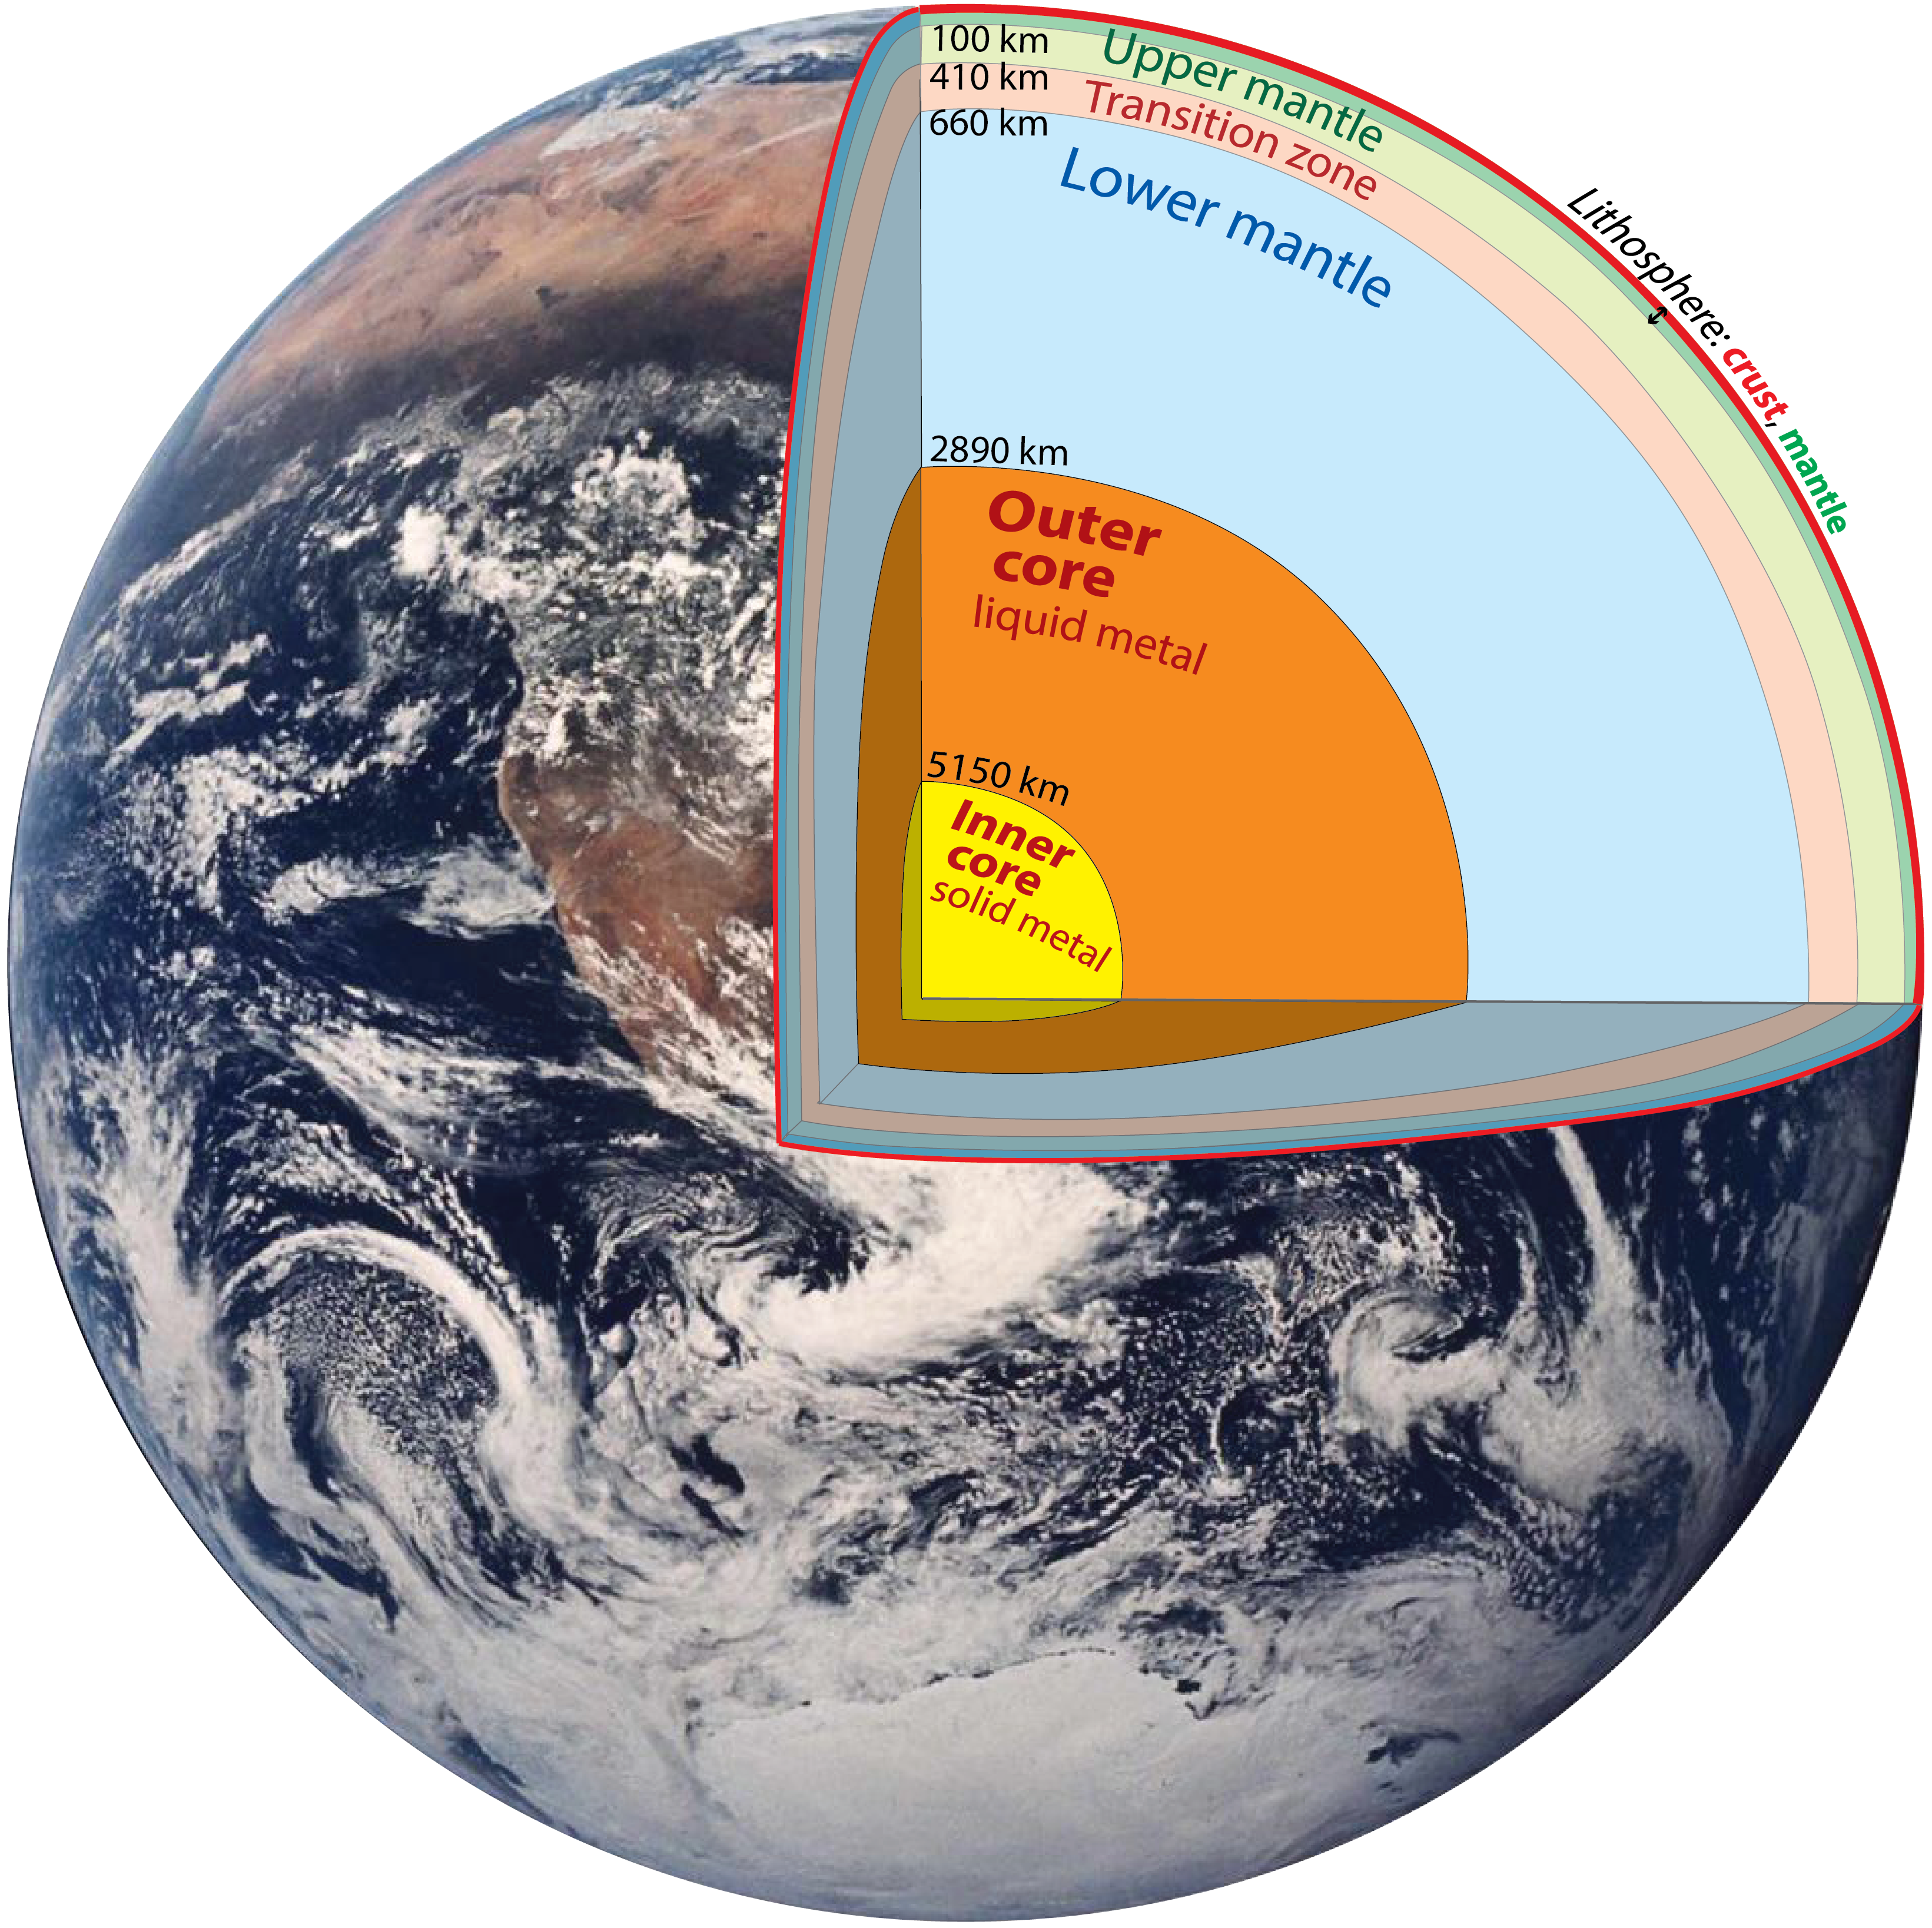
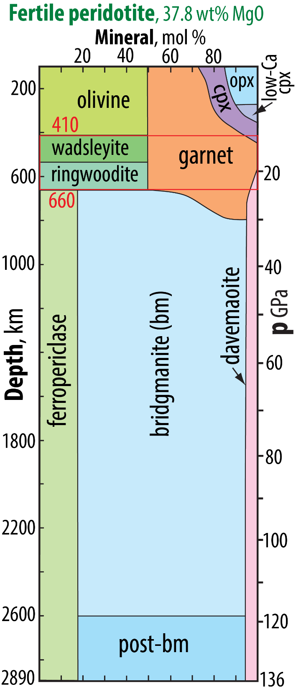
Earth structure and
mineralogy
- garnet and bridgmanite are important redox agents
- wadsleyite and ringwoodite (transition zone) have high
high H₂O storage capacity (~3 wt%)

Slide 3
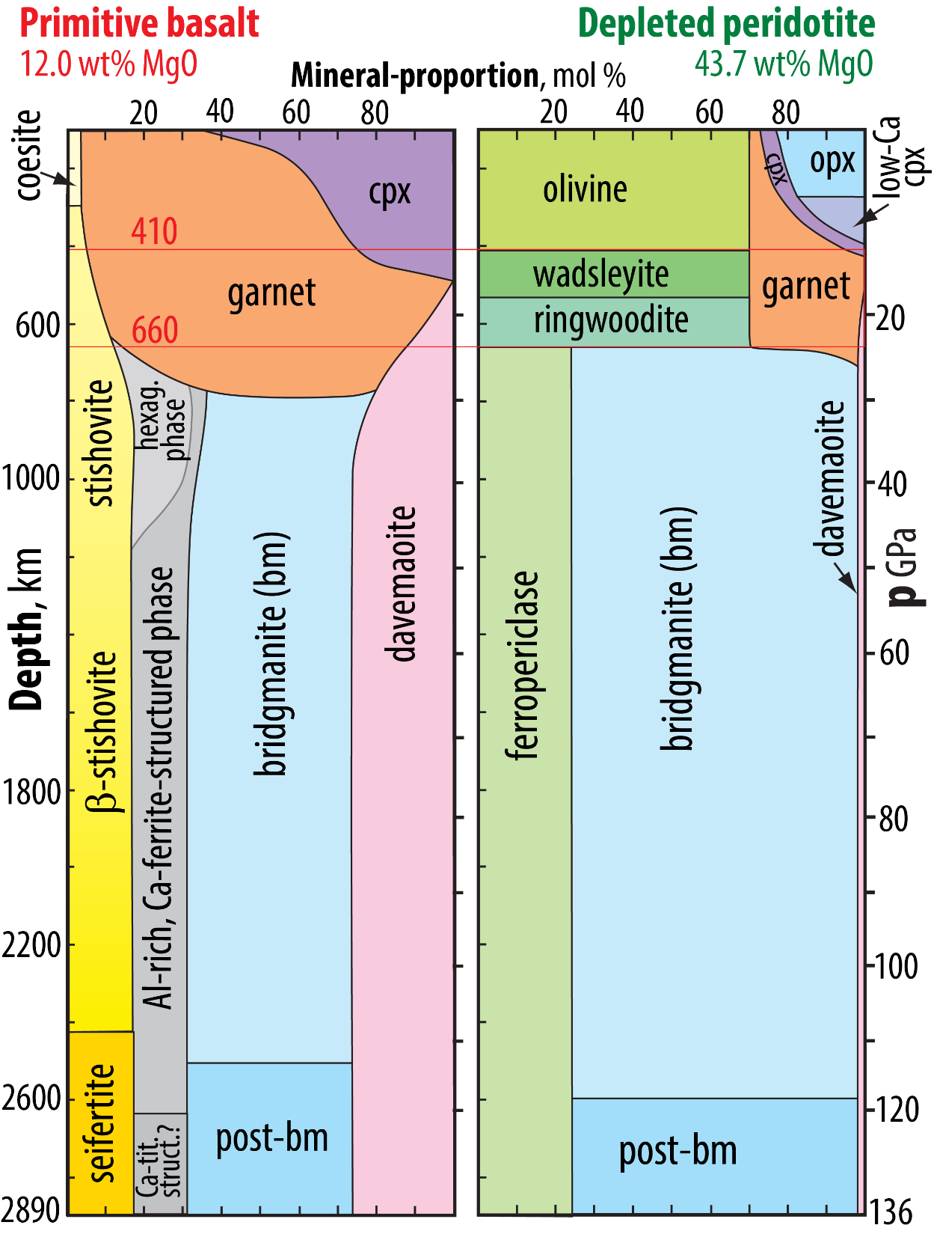
Approximate mineral compositions
ferropericlase: (Mg,Fe) O
olivine, wadsleyite, ringwoodite: (Mg,Fe)₂ Si O₄
garnet: (Mg,Fe,Ca)₃ (Al,Si)₂ Si₃ O₁₂
opx (orthopyroxene), bm (bridgmanite), post-bm:
(Mg,Fe,Al) (Si,Al) O₃
cpx (clinopyroxene): (Ca,Mg,Fe,Al) (Si,Al) O₃
davemaoite (Ca-silicate perovskite): Ca Si O₃
Al-rich, Ca-ferrite-structured phase, two main
components: (Na,K) AlSi O₄ - (Mg,Fe) Al₂ O₄
coesite, stishovite, β-stishovite, seifertite: Si O₂
Modified from Stixrude &
Lithgow-Bertelloni (2012,
AREPS) and Trønnes & Mohn, in prep.

Slide 4
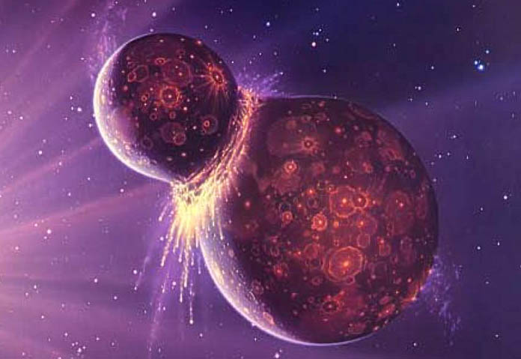
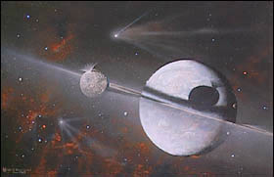
Solar system's starting point, t₀: approximately 4570 Ma
Minerals in the early condensates of the Solar nebula, the Ca-Al-inclusions are very accurately dated to 4567.3 ± 0.9 Ma (Amelin et a. 2002, Sci.) and 4567.35 ± 0.28 Ma (Connelly et al. 2012, Sci.)
Starting point for the condensed and liquid Earth, following the protoEarth-Theia collision
Cannot be determined accurately: 100-200 Ma after

Slide 5
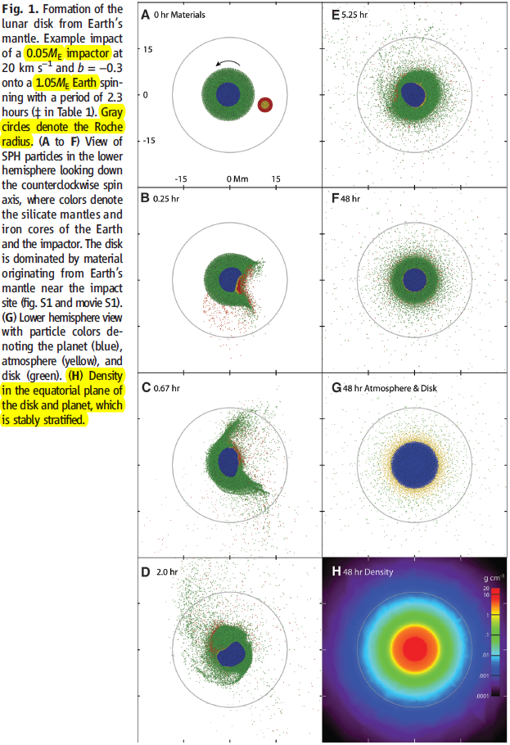
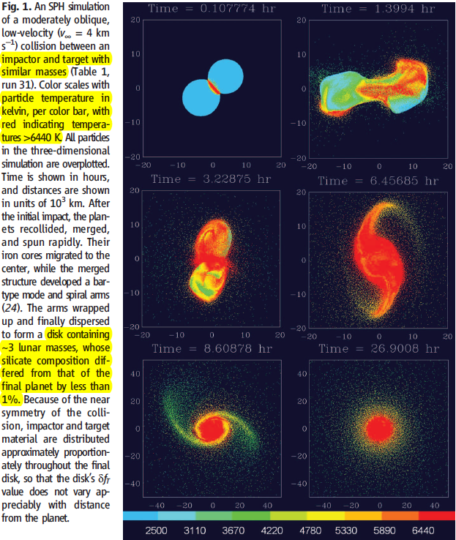
Modelling of Earth-Theia collision, two articles in Science, Nov. 22, 2012: Resulting in silicate vapour and melt discs
Cuk & Stewart:
Small Theia in head-on collision with fast-spinning Earth
Canup:
Almost equal-sized Theia and Earth

Slide 6
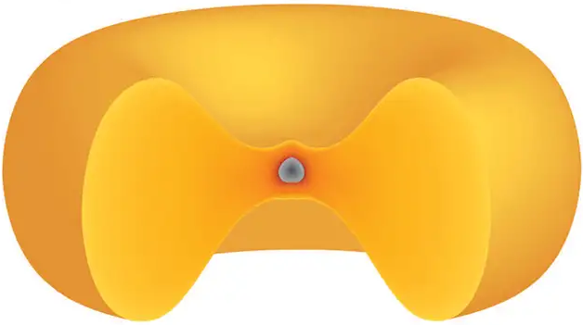
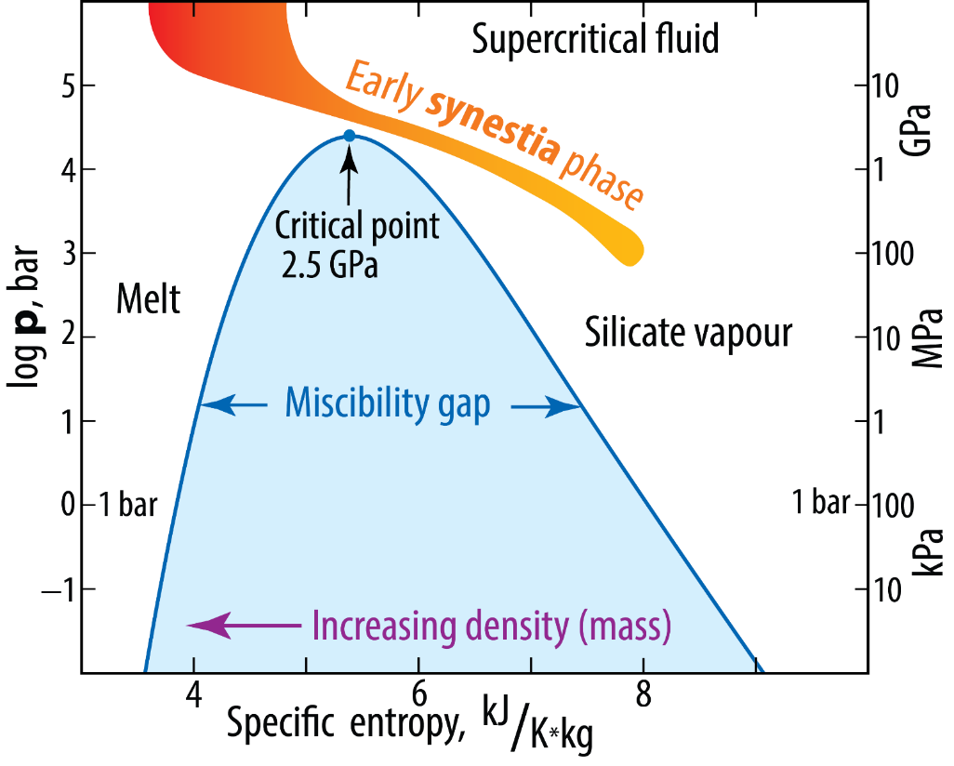
The proto-Lunar disk of silicate
vapour and melt: the "synestia"
Lock & Stewart, 2017, JGR
Lock et al., 2019, JGR
Etymology
syn-Hestia
Greek goddess of
the heart and home
synchrouous
= "connected"
Moon formed outside
the Roche limit
Phase diagram for peridotite
at low p and extreme T
2.8 GPa

Slide 7
Condensed (liquid) Earth's starting point
Very hot protocore
- mainly Fe-Ni, Si, O
- minor amounts of S, C, H, Mg, Al (?)
Magma ocean (MO)
- peridotitic (approximately pyrolitic, bulk silicate Earth composition)
- very high H₂O-solubility, would be able to hold more than all available H
and quickly developing: proto-atmosphere and ocean
Proto-atm.: was commonly thought to be reduced and dominated by
CH₄ and N₂ (because Earth accreted mainly from enstatite chondritic material)

Slide 8
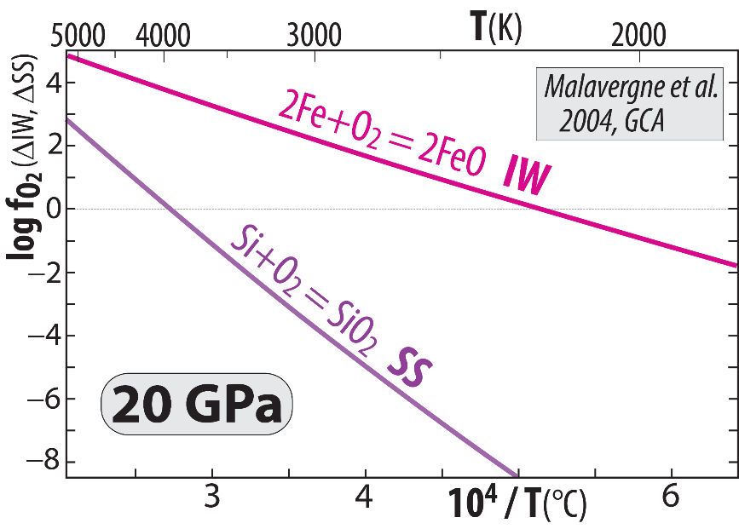
Venus and Earth
Segregated cores at very high T, allowing
high Si^{core} and high FeO^{MO} (high f_{O2})
because the net chemical exchange equilibrium:
2Fe^{core} + SiO₂^{sil-MO} = Si^{core} + 2FeO^{sil-MO}
is displaced towards the product side (right) with inceasing T
and reversed with decreasing T
Summing the two buffer reactions:
2 Fe + O₂ = 2 FeO (IW)
Re-arranged: SiO₂ = Si + O₂ (SS)
gives: 2 Fe + SiO₂ = Si + 2 FeO
Cooling of core and magma ocean (MO)
core-MO chemical exchange
- O (as FeO and FeO_{1.5}) to the core
- Si (as SiO₂) to the MO (or BMO)
2FeO = O₂ + 2Fe
MO/
BMO
Si+O₂ = SiO₂
FeO
Si
core
Fe+O
Additional pressure-effect – above 25 GPa
Armstrong et al. (2019, Sci) and Deng et al. (2020, Nat Comm)
Disproportionation of FeO^{MO} at p > 25 GPa promotes
high f_{O2} in the MO, combined with core segregation:
3 FeO = 2 FeO_{1.5} + Fe
components in the MO exsolved liquid metal
sinks to the core

Slide 9
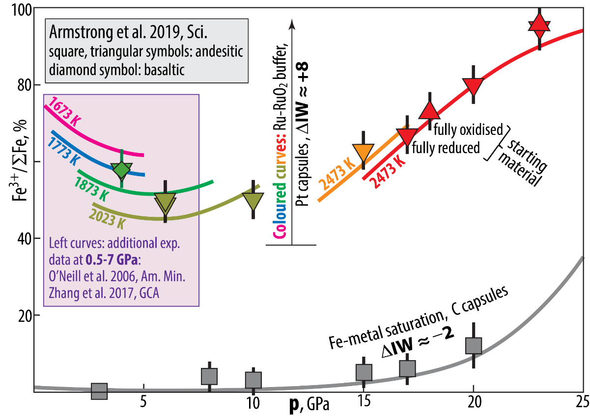
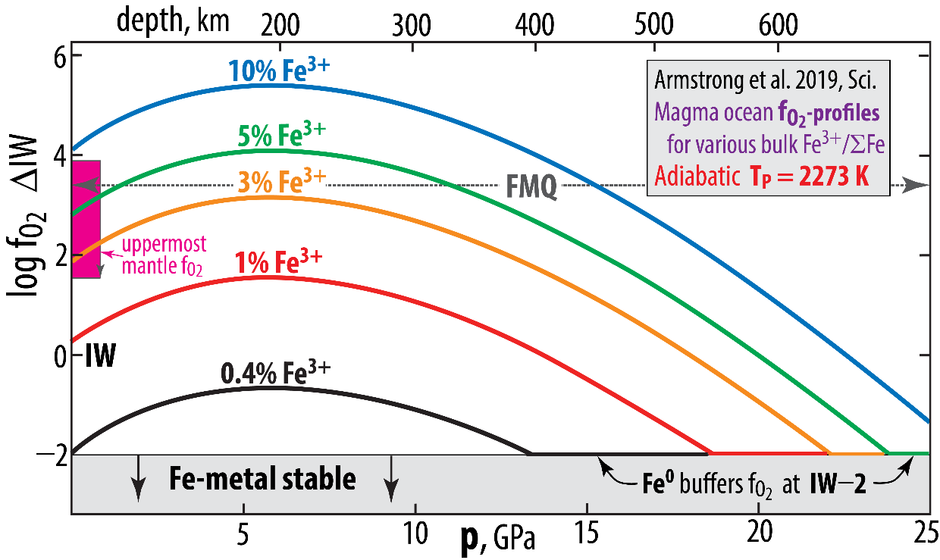
f_{O2}-buffered experiments, andesitic melts
Armstrong et al. (2019, Sci.)

Slide 10
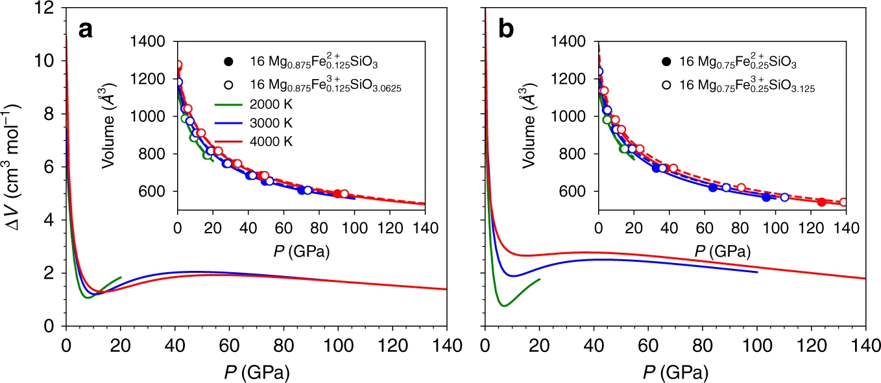
First principles atomistic simulations Deng et al. (2020, Nat. Comm.)
Confirming the Armstrong et al. (2019, Sci.) experimental results
ΔV = (V_{FeO} – V_{FeO1.5}) > 0
12.5% Fe
FeO: filled, solid; FeO_{1.5}: open, stippled
25.0% Fe
FeO: filled, solid; FeO_{1.5}: open, stippled
80
80
81
82
atoms
in cell
atoms
in cell

Slide 11
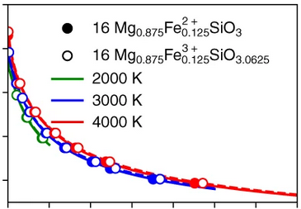
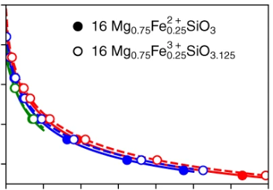
First principles atomistic simulations Deng et al. 2020, Nat. Comm.
FeO: filled, solid
FeO_{1.5}: open, stippled
140
12.5% Fe
25.0% Fe
100
p, GPa
60
20
V/p
FeO 25.5
FeO_{1.5} 22.0
V/p
6.5
6.2
V/p
FeO 5.7
FeO_{1.5} 5.2
V/p
14.2
12.7
1200
1000
800
600
V, Å³
1200
1000
800
600

Slide 12
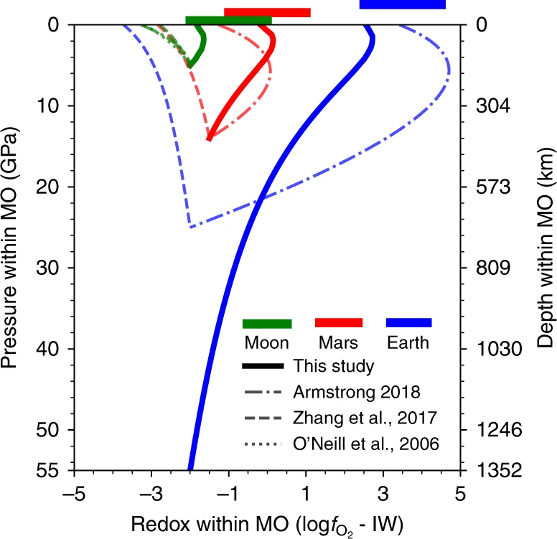
First principles atomistic simulations
Deng et al. 2020, Nat. Comm.
metal precipitation

Slide 13
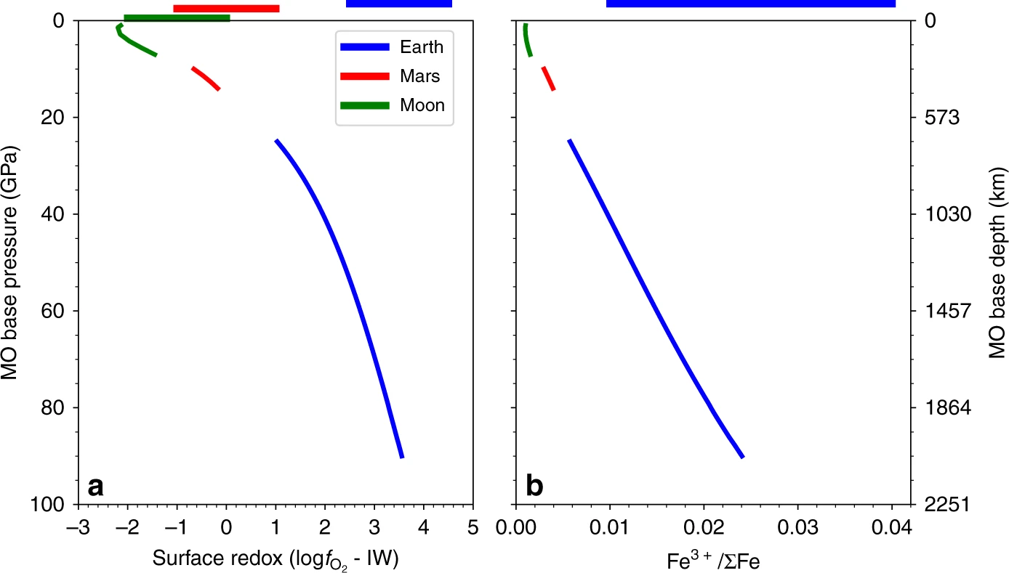
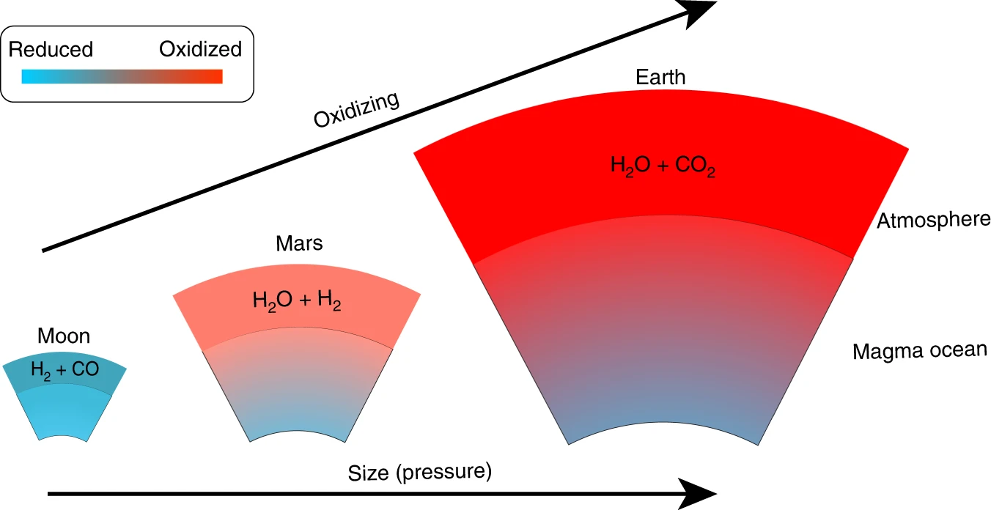
First principles atomistic simulations
Deng et al. 2020, Nat. Comm.
metal precipitation
1%
4%

Slide 14
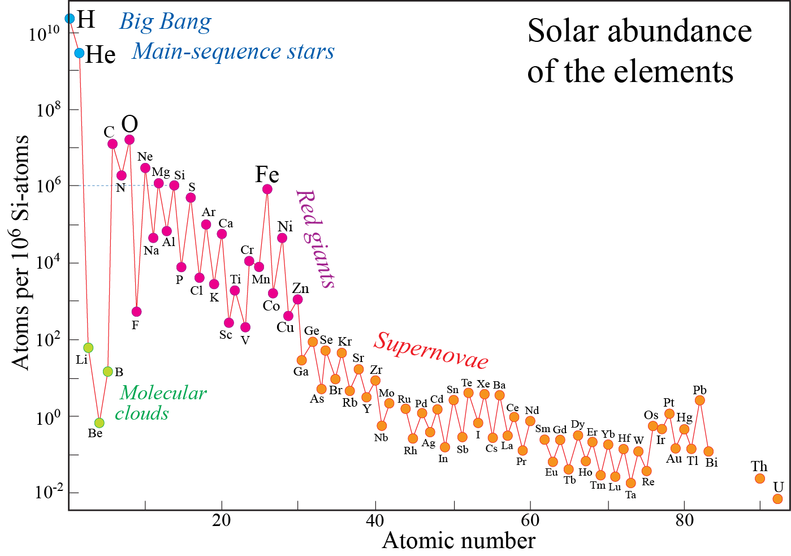
Solar photosphere = bulk solar system composition
Terrestrial planets:
mainly rock and Fe-dominated metal
Rock
Odd-even atomic numbers
zig-zag pattern
Fe-metal
Rock
Key points
- The O/Fe ratio is too low
to oxidise all Fe cores
- At high T (or low O-fugacity):
Si entered the cores of
Mercury, Venus and Earth
- Cooling resulted in
strongly O-starved cores
in Earth and Venus

Slide 15
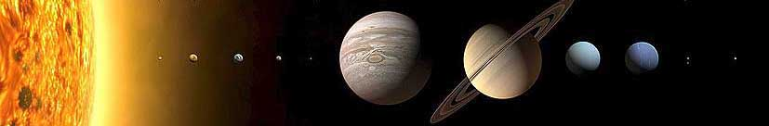
Solar system: general zoning from metal and silicates to gas and ice
Terrestrial planets:
metal and rock
Gas giants:
H, He
Ice giants:
ice + gas
Kuiper belt:
ice

Slide 16
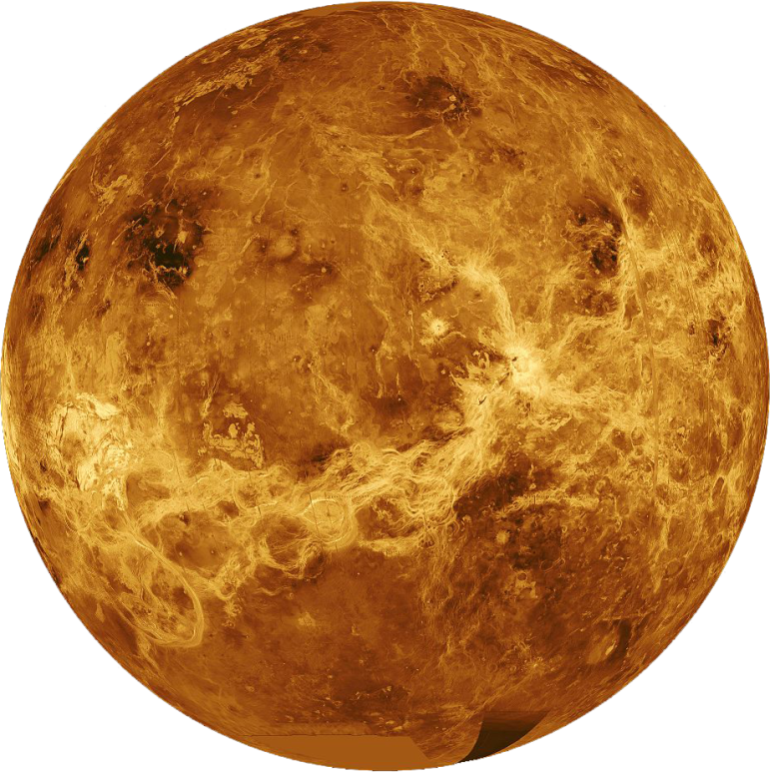
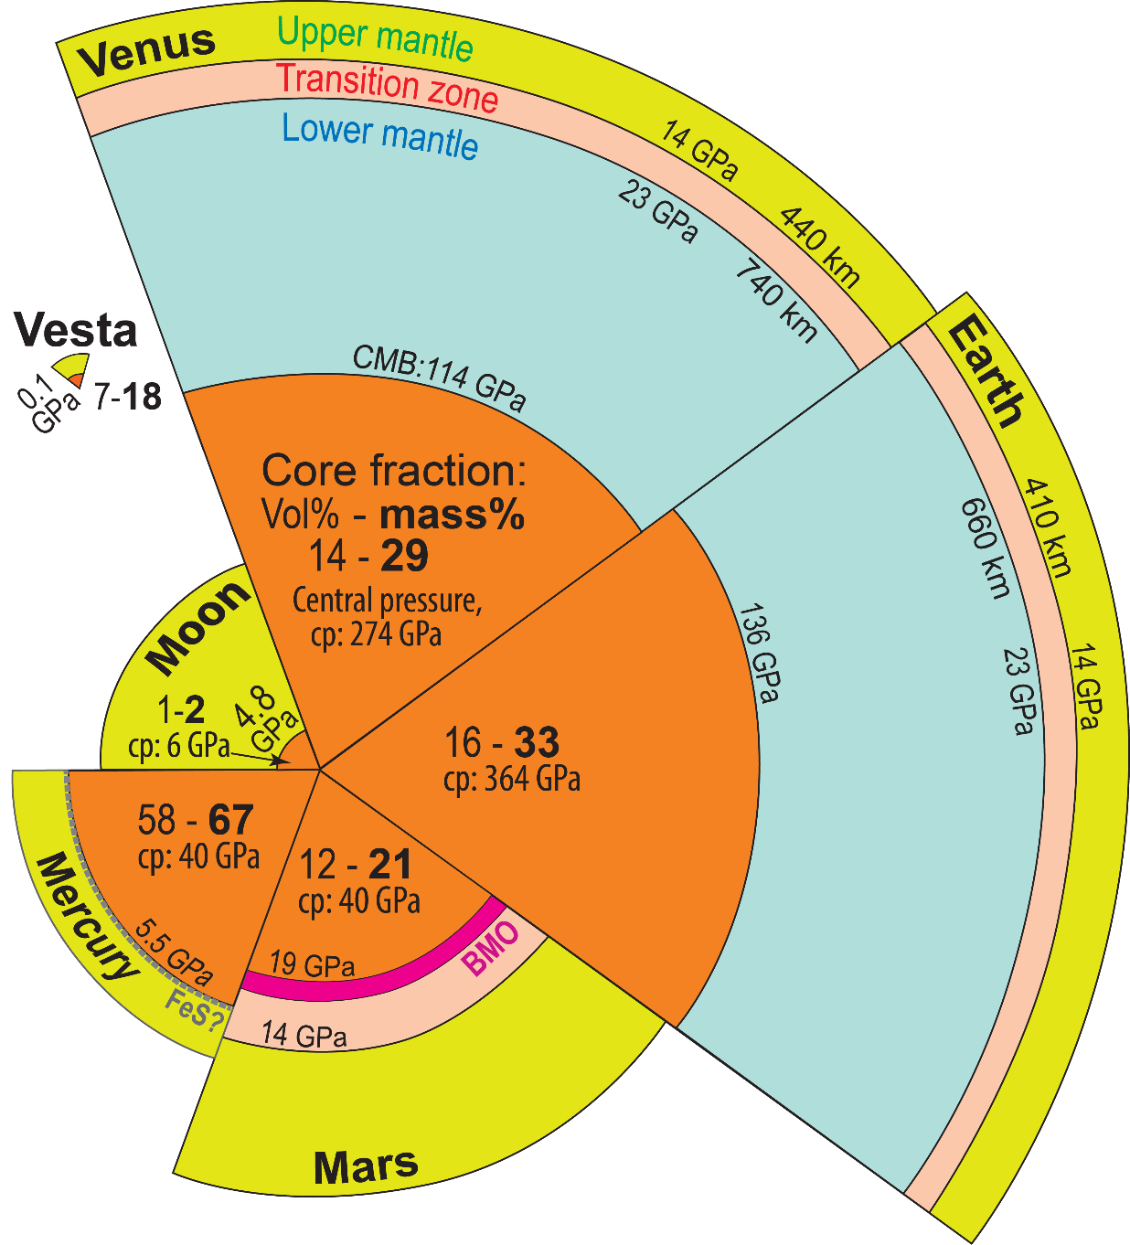
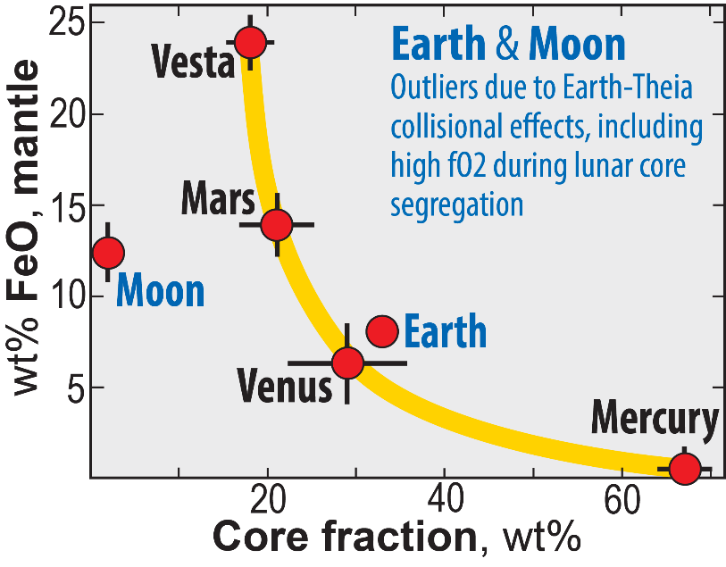

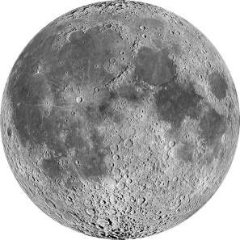
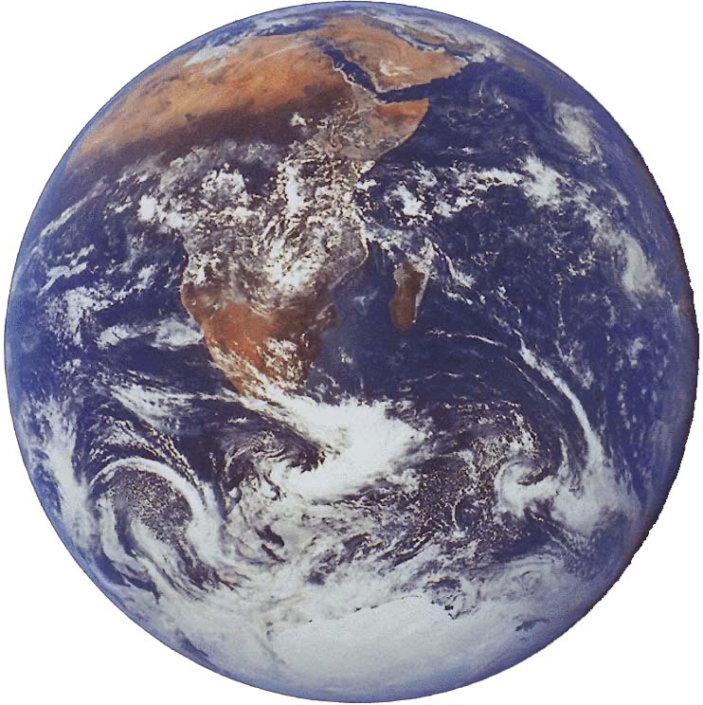
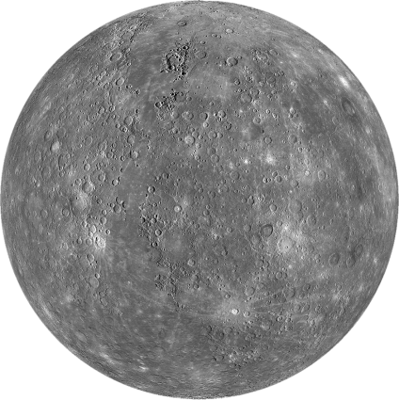
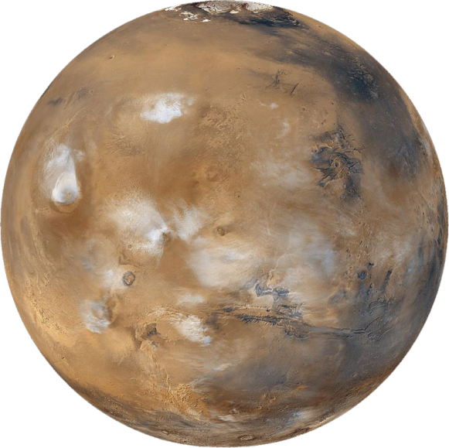
Terrestrial planets: sizes, core fractions, FeO-contents
Trønnes et al. (2019, Tectonophys.),
with Mars revision
BMO: basal
magma ocean

Slide 17
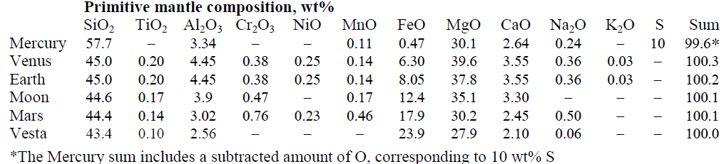
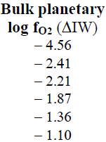

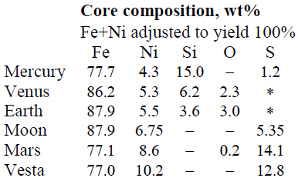
Core-mantle ”bulk equilibrium” records the "bulk planetary" oxidation state
Iron-Wustite buffer reaction
O₂ + 2 Fe = 2 FeO
in metal in silicate
i.e. core i.e. mantle
At the IW-buffer: f_{O2} = a_{Fe-met} = a_{FeO-sil} = 1
Equilibrium const.: K = a_{FeO-sil}² / (f_{O2} * a_{Fe-met}²) = 1
f_{O2} = a_{FeO-sil}² / a_{Fe-met}² = (a_{FeO-sil} / a_{Fe-met})²
Relative to the IW-buffer:
log f_{O2} (ΔIW) = 2 * log (a_{FeO-sil /} a_{Fe-met})
Earth: log f_{O2} = 2*log (1.1 * 5.7 / 79.4) = −2.2
activity coeff.
Trønnes et al. (2019, Tectonophys.)

Slide 18
O-fugacity of upper mantle peridotite
equilibra involving mineral components with
variable oxidation states
oxygen barometers: reactions involving spinel and garnet
with relatively high Fe³⁺contents

Slide 19
Spinel peridotite equilibrium:
6 Fe₂SiO₄ + O₂ = 6 FeSiO₃ + 2 Fe₃O₄
fayalite in olivine ferrosilite in opx magnetite in spinel
Garnet peridotite equilibrium:
4 Fe₂SiO₄ + 2 FeSiO₃ + O₂ = 2 Fe₃Fe₂Si₃O₁₂
fa in olivine fs in opx skiagite in garnet
Equilibrium constant: K = a_{sk}² / [f_{O2} * a_{fa}⁴ * a_{fs}²]
ln K = – ΔG / (RT)
log K = – 0.434 ΔG / (RT) = 2 log a_{sk} – log f_{O2} – 4 log a_{fa} – 2 log a_{fs}
log f_{O2} = 2 log a_{sk} – 4 log a_{fa} – 2 log a_{fs} + 0.434 ΔG / (RT)
ΔV < 0: reactions favoured by increasing p – not only by high f_{O2}

Slide 20
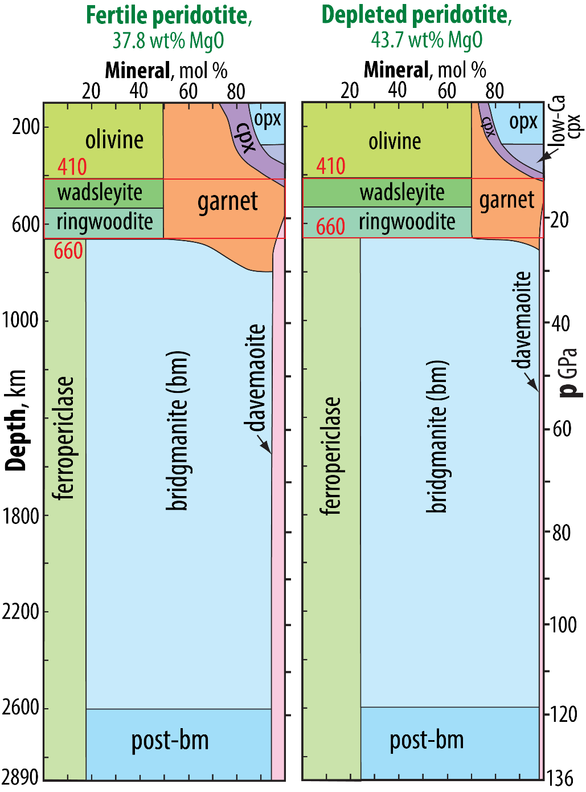
Lower part of the upper mantle
- increasing proportion of garnet
- pyroxenes dissolve into majoritic garnet
⇒ dilution of the Fe³⁺-component (skiagite)
⇒ decreasing f_{O2}
The UM and TZ are Fe-metal saturated
below about 260 km depth
Ballhaus (1995, EPSL)
Rohrbach (2007, Nature, 27 Sept)
Modified from Stixrude & Lithgow-Bertelloni (2012, AREPS) and Trønnes & Mohn, in prep.

Slide 21
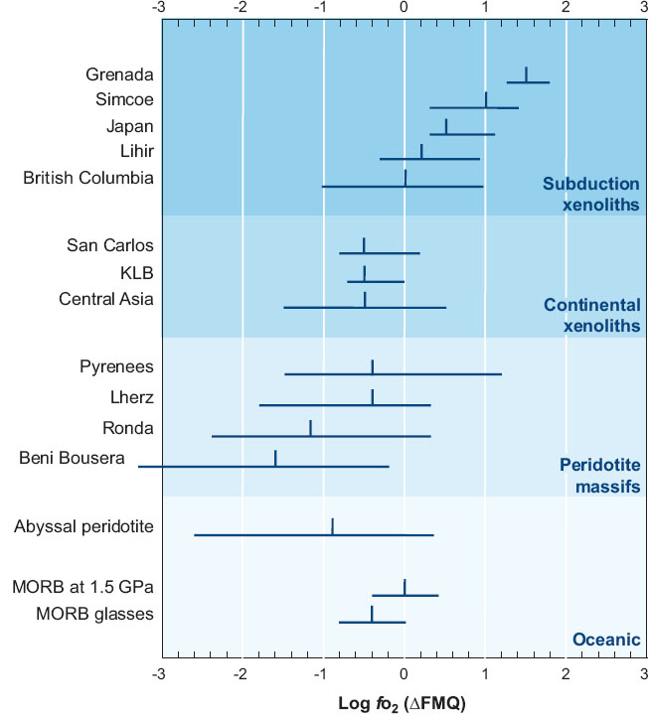
Fayalite-magnetite quartz buffer
FMQ: 3 Fe₂SiO₄ + O₂ = 2 Fe₃O₄ + 3 SiO₂
Equilibrium constant: K = a_{mt}² * a_{qz}³ / [f_{O2} * a_{fa}³]
log K = 2 log a_{mt} + 3 log a_{qz} – log f_{O2} – 3 log a_{fa} = – 0.434 ΔG / RT
log f_{O2} = 2 log a_{mt} + 3 log a_{qz} – 3 log a_{fa} + 0.434 ΔG / RT
Frost & McCammon, 2008,
Ann. Rev. Earth Planet. Sci.

Slide 22
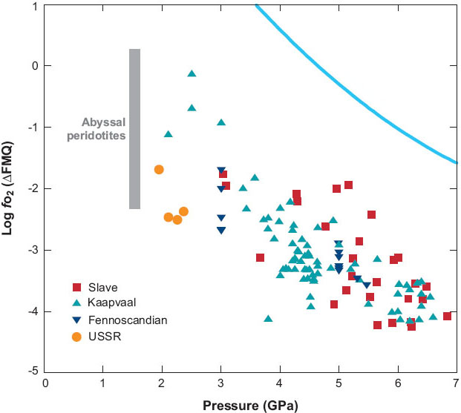
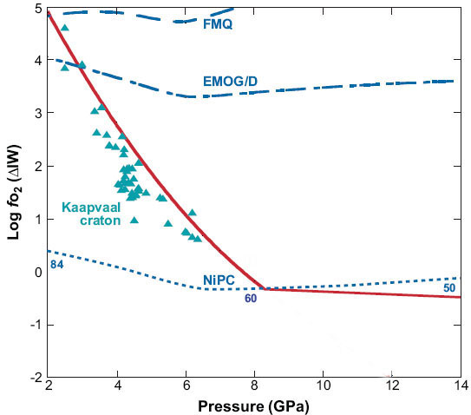
FMQ
2Fe₃Fe₂Si₃O₁₂ = 4Fe₂SiO₄+2FeSiO₃+O₂
Frost & McCammon, 2008, Ann.Rev. EPS
Archean cratonic
mantle roots
IW
MgSiO₃+MgCO₃ = Mg₂SiO₄+C+O₂
IW-buffer:
2FeO = 2Fe + O₂
Ga-perid equil. by equation:
2Fe₃Fe₂Si₃O₁₂ = 4Fe₂SiO₄+2FeSiO₃+O₂
FeNi-precipitation curve:
X_{Ni}^{met} =
(Fe,Ni)₂SiO₄ = 2(Fe,Ni) + SiO₂ + O₂
in olivine in metal coes./stishov
IW
X_{Ni}^{met} =
Ga-perid equil. with met.sat.

Slide 23
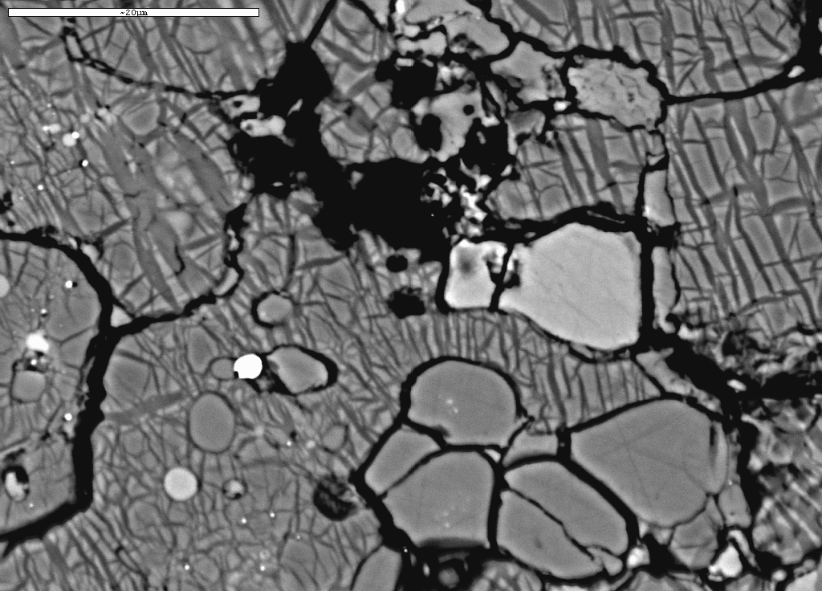
Lower mantle redox conditions
and the bridgmanite "redox pump"
BSE image of experimental run product:
peridotite comp. at 24 GPa and 2100 °C
Frost et al. (2004, Nature), unpubl. background image
Ca-pv
Fe-metal
bridgmanite
ferro-
periclase
Ca-pv
ga
Fe-metal
2 μm
garnet
fp
garnet
bridgmanite

Slide 24
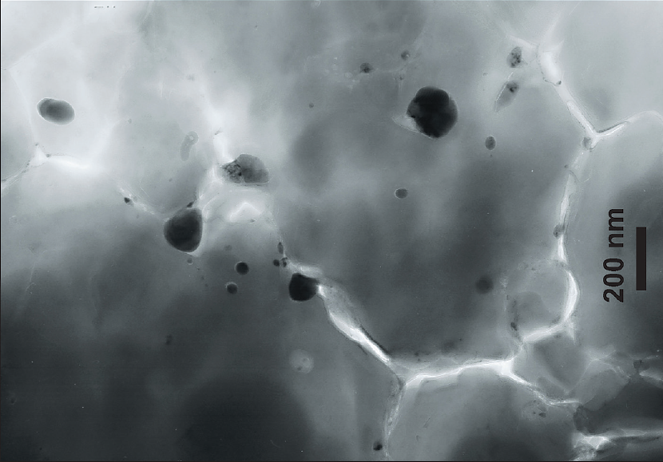
Bridgmanite,
40 GPa, 2500 K
Andrault et al. (2018, GPL)
TEM image, submicron-sized Fe-metal
particles (30-150 nm) in bridgmanite
Starting material:
pyroxene + alumina
(Mg,Fe)SiO₃ + Al₂O₃
No ferric nor metallic Fe
150
nm
30
nm
85
nm
Fe-metal precipitation and peridotite reduction
Bridgmanite extracts Fe³⁺ by converting 3 FeO to 2 FeO_{1.5} + Fe (metal)
Garnet has a similar, but not so strong, effect in the lower part of the UM and the TZ

Slide 25
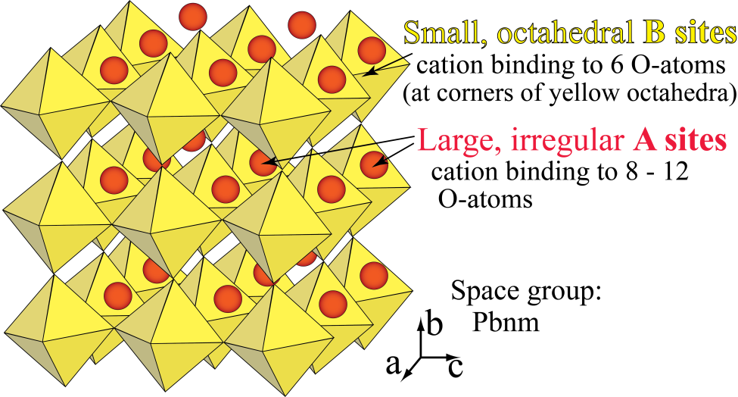
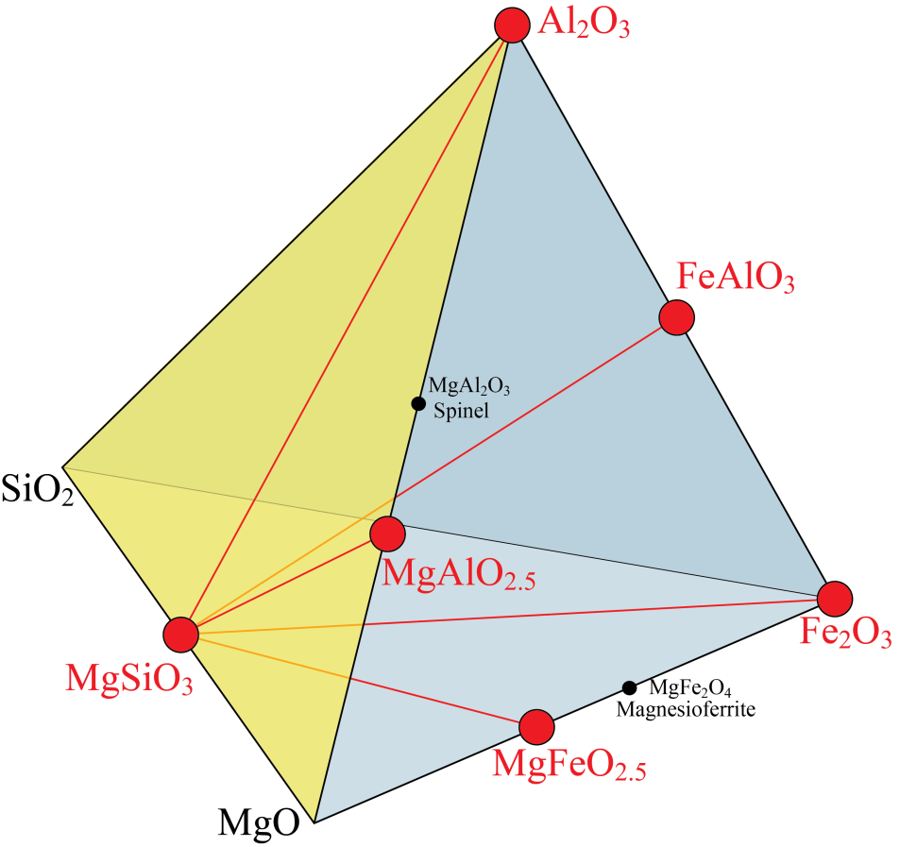
Crystal chemistry of MgSiO₃-dominated bridgmanite
ABO₃-compound
A²⁺: Mg, Fe²⁺
B⁴⁺: Si
Cation "sizes" (bond lengths):
Fe²⁺ > Fe³⁺ > Mg²⁺ > Al³⁺ > Si⁴⁺
In peridotites, bm must hold
almost all Al, which fits best
in the small B-position. The
ideal charge compensation
is by Fe³⁺ in the A-position.
ideal
A-site
ideal
B-site
FeAlO₃
Trivalent cation substitition
- Stoichiometric: A²⁺B⁴⁺O₃ ↔ A³⁺B³⁺O₃
e.g. FeAlO₃
Oxygen vacancy: A²⁺B⁴⁺O₃ ↔ A²⁺B³⁺O_{2.5}
e.g. MgAlO_{2.5}
+FeO

Slide 26
Below about 250 km depth
Redox reactions: reduced conditions and Fe-metal
- Bulk mantle peridotite: Fe³⁺ / Fe^{total} ≈ 2%
- The dominant minerals garnet and bridgmanite,
however, have Fe³⁺ / Fe^{total} of 30 − 70%
- This leads to the precipitation of Fe-metal
Reaction at the 660 km discontinuity
2 Fe₂SiO₄ + 2 Mg₂SiO₄ + Al₂O₃ = 2 FeAlO₃ + 4 MgSiO₃ + FeO + Fe
rwd
from ga
bm
fp
FeNiS-
alloy
Metallic Fe will reduce carbonate to diamond:
e.g.: 2 Fe + MgCO₃ = C + MgFe₂O₃
fp, (Mg,Fe)O

Slide 27
Lower mantle iron disproportionation
Reaction at the 660 km boundary:
ringwoodite (rwd) + garnet = bridgmanite (bm) + ferropericlase (fp) + metal
2 Fe₂SiO₄ + 2 Mg₂SiO₄ + Al₂O₃ = 2 FeAlO₃ + 4 MgSiO₃ + FeO + Fe
ga-comp.
bm
fp
Fe-dominated
metal
rwd
Or:
2 Fe₂SiO₄ + 2 Mg₂SiO₄ + Mg₃Al₂Si₃O₁₂ = 2 FeAlO₃ + 7 MgSiO₃ + FeO + Fe
ga-comp.
bm
fp
Fe-dominated
metal
rwd
Corresponding "O-buffer" reaction:
Fe₂SiO₄ + Mg₂SiO₄ + Mg₃Al₂Si₃O₁₂ + 0.5 O₂ = 2 FeAlO₃ + 5 MgSiO₃
rwd
ga-comp.
bm
Equilibrium constant: K = a_{FA}² * a_{MS}⁵ / [f_{O2}^{0.5} * a_{fa *} a_{fo *} a_{py}]
log K = 2 log a_{FA} + 5 log a_{MS} – 0.5 log f_{O2} – log a_{fa} – log a_{fo} – log a_{py} = – 0.434 ΔG / RT
log f_{O2} = 2*(2 log a_{FA} + 5 log a_{MS} – log a_{fa} – log a_{fo} – log a_{py} + 0.434 ΔG / RT)

Slide 28
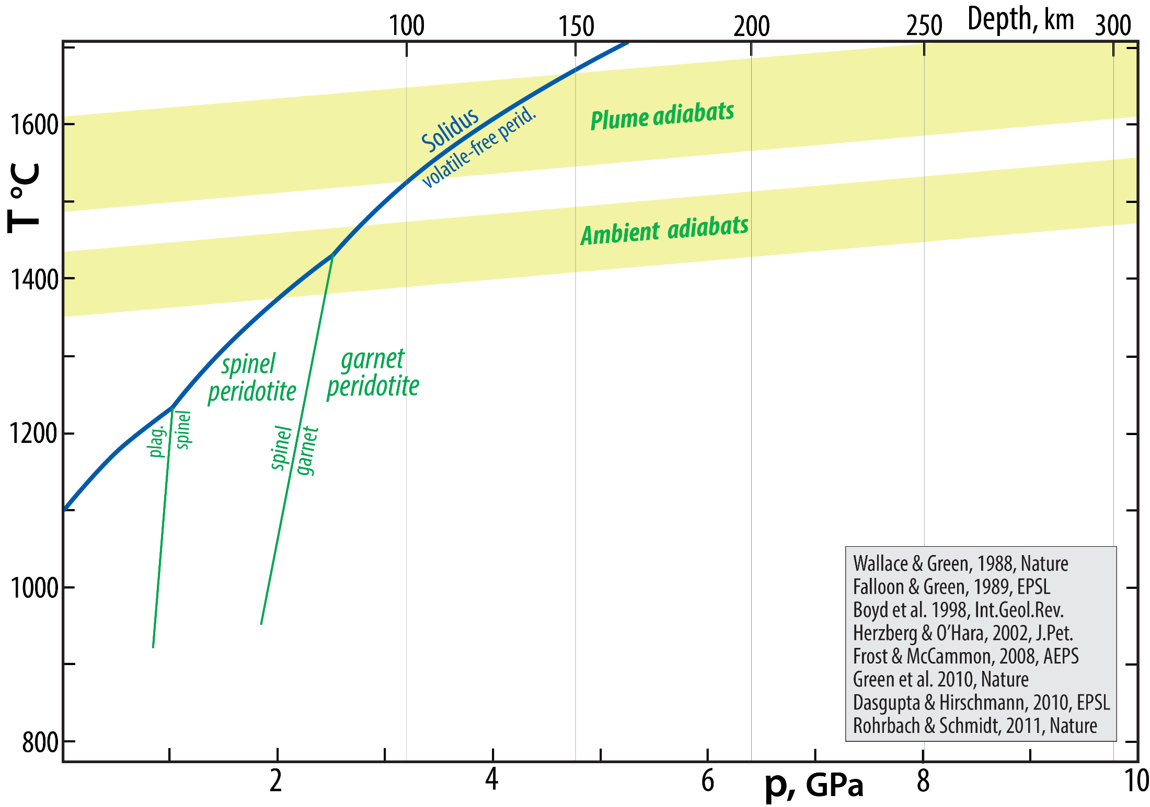
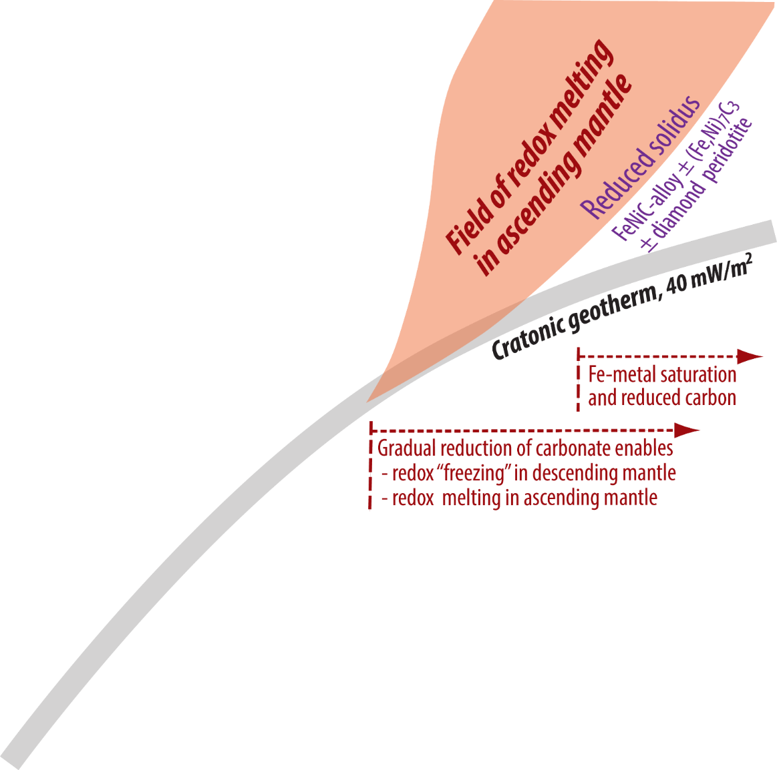
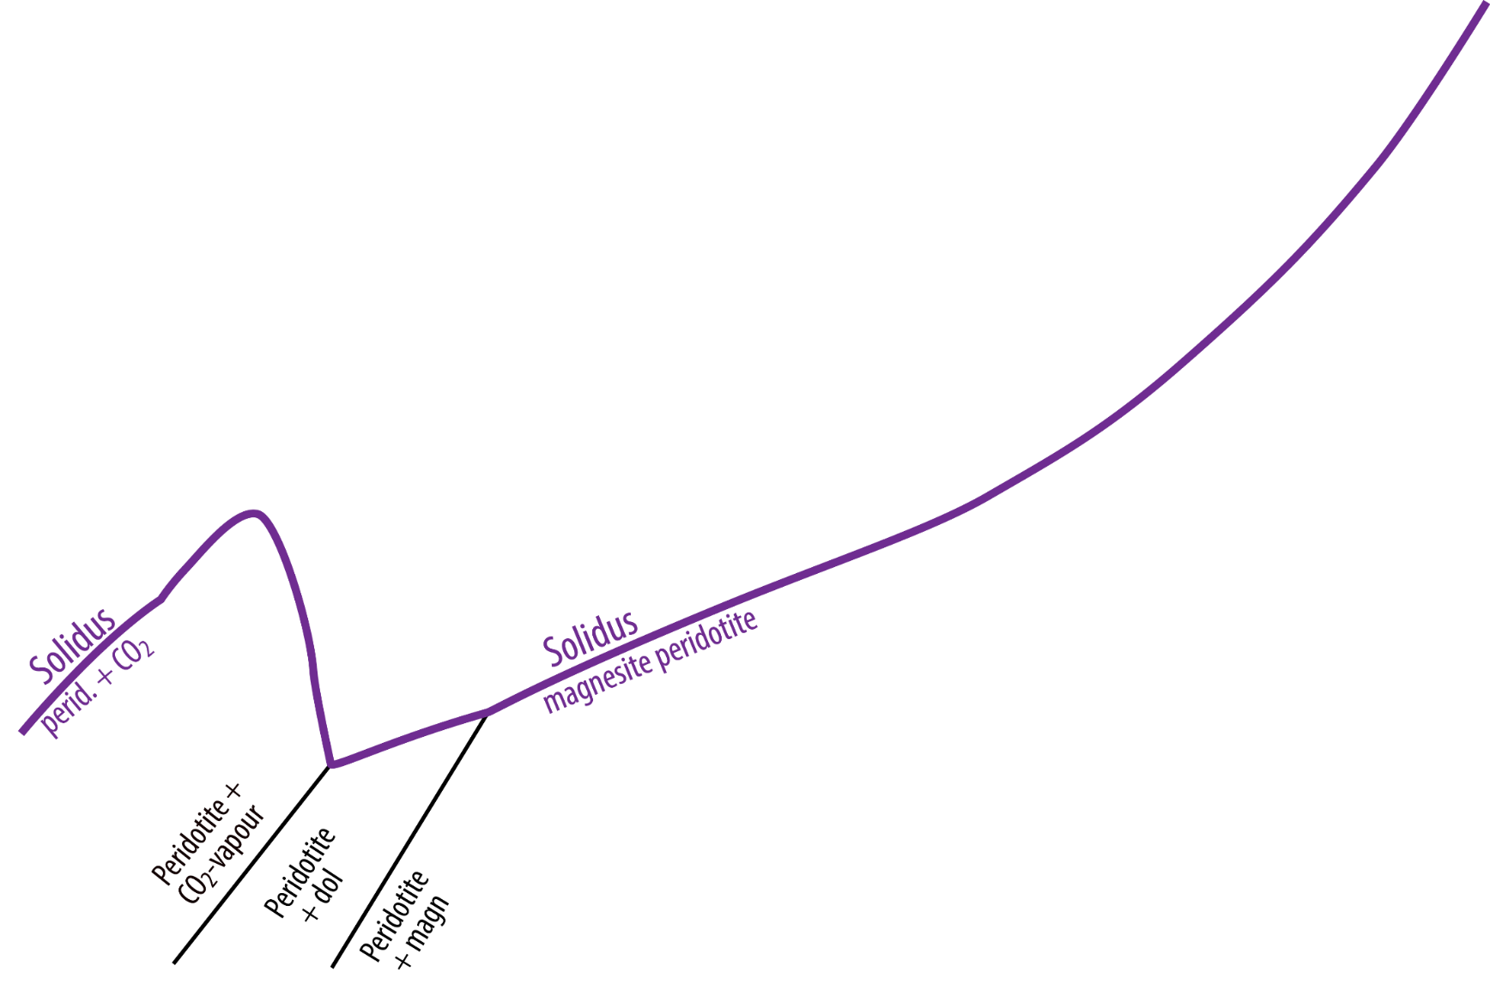
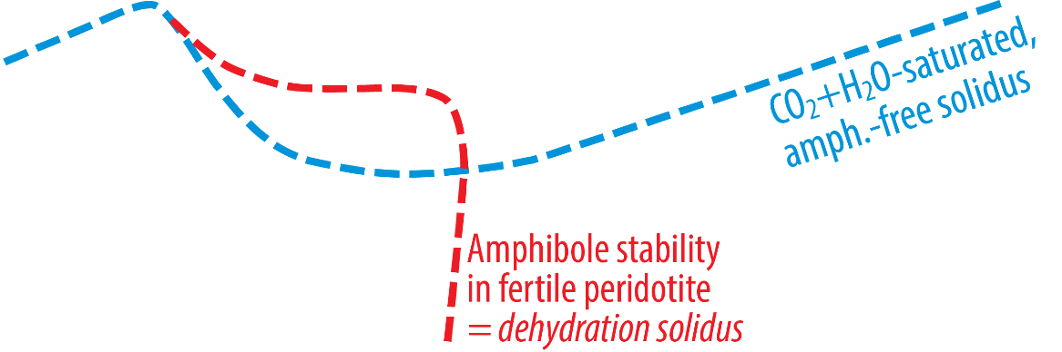
Upper mantle carbonate reduction by Fe-metal at about 260 km depth
MgCO₃ + 2 Fe + 3 MgSiO₃ = C + [2 Mg₂SiO₄ + Fe₂SiO₄]
in pyroxene
diamond
in olivine
Melting relations

Slide 29
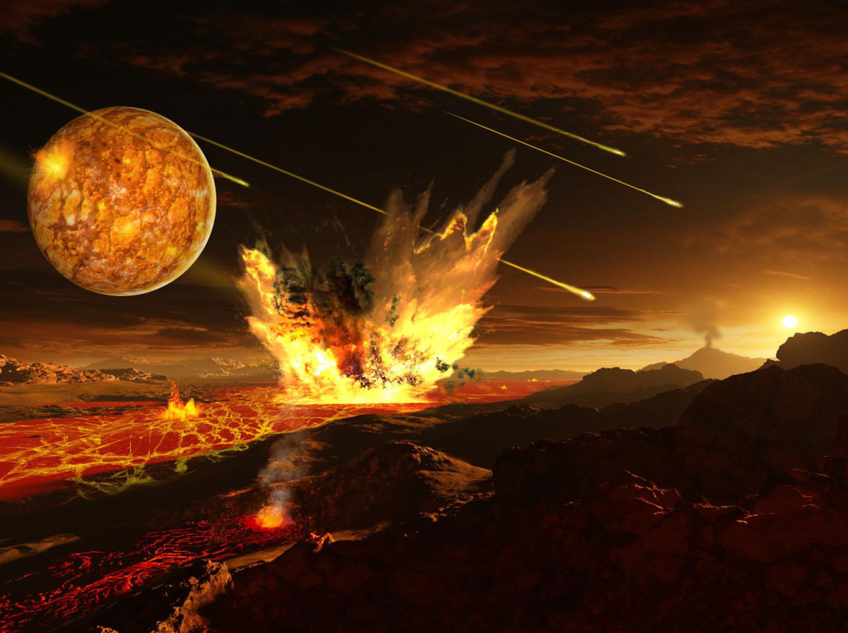
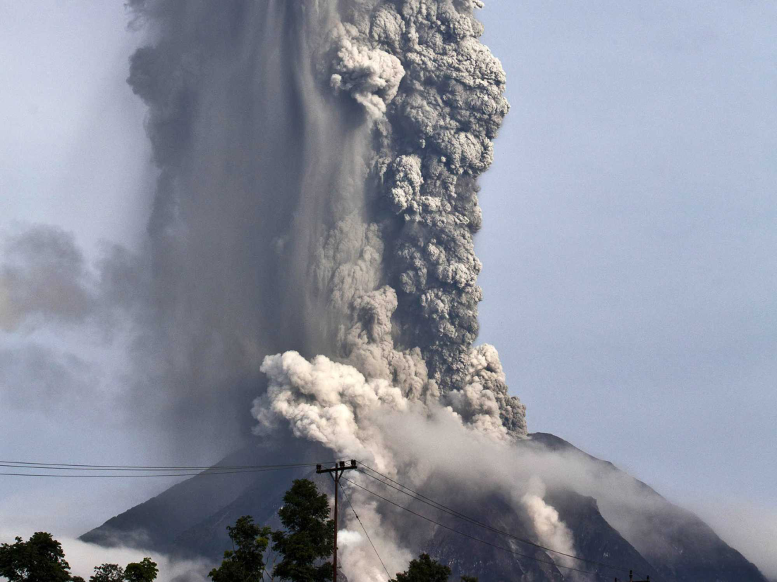
Global O, H, C fluxes
Volcanoes release H₂O and CO₂
Silicate melt can hold lots of dissolved H₂O and CO₂ (at moderate and high p),
- will be exsolved during decompression and crystallisation
Starting at the surface
In the Hadean:
degassing magma oceans
(via chaotic volcanism)
Today:
volcanic degassing

Slide 30
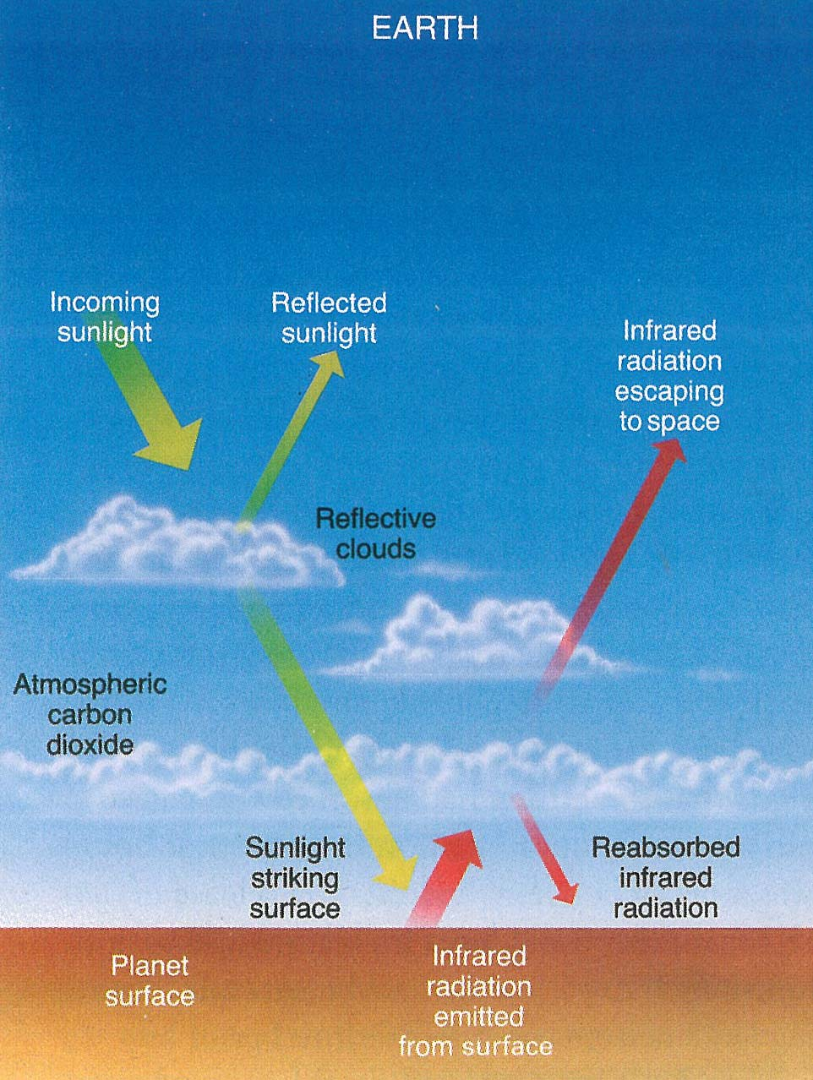
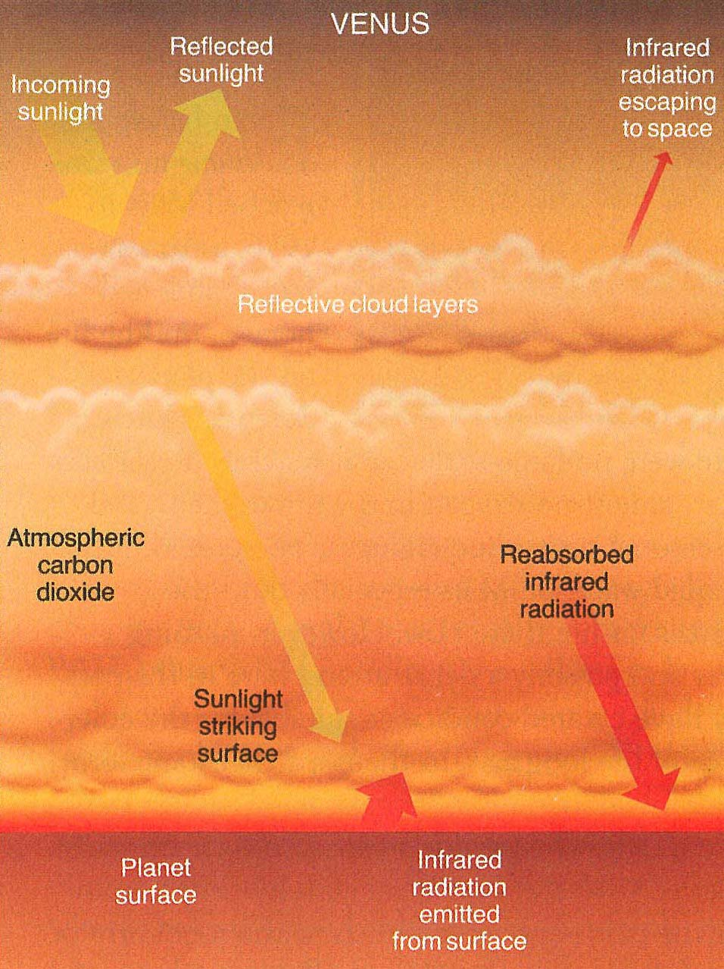
H₂O molecules: photo-dissociated in the upper atmospheres
H₂-escape to space atmospheric oxidation
The Earth-Venus dichotomy with a mostly dessicated Venus
Earth
1 bar: 78% N₂ 21% O₂ 1% Ar
+ very variable H₂O (greenhouse)
Venus
92 bar !! 97% CO₂ 3% N₂

Slide 31
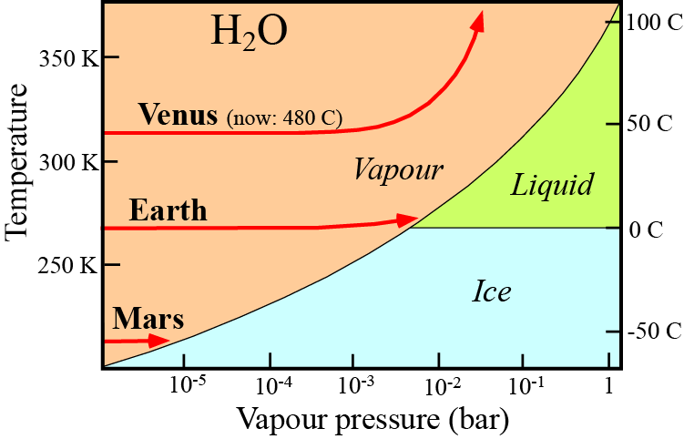
Why are the atmospheres so different if inventories of
C, N, O and H were similar in the beginning ?
Where is Earth’s carbon corresponding to the 92 bar
CO₂-dominated atmosphere of Venus ?
Present Venus: 753 K
480 C
200 C
Earth
- Oceans, precipitation of CaCO₃
Photosynthesis → O₂, biomass and black shales
- Hydration of ocean floor
Recycling of wet lithosphere with organic
material and carbonates by subduction
Venus
- No condensation of volanically degassed H₂O
The atmospheric residence time of H₂O is short
Photo-dissociation and H₂-escape
Dry planet without hydro- or cryosphere
Heliocentric distances
Venus: 0.7 AU
Earth: 1.0 AU
Mars: 1.5 AU
or partial water pressure: p_{H2O}
≈ water fugacity: f_{H2O}

Slide 32
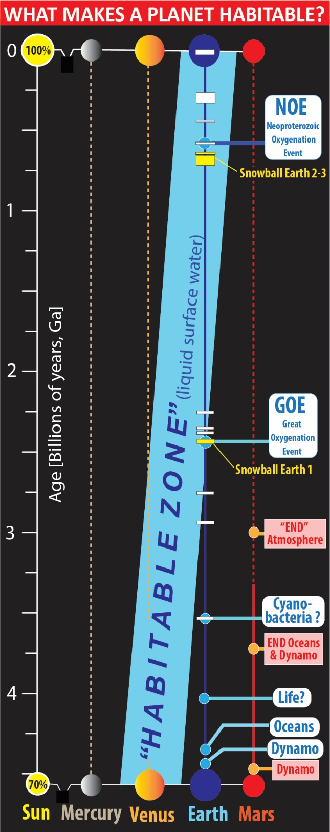
The young faint Sun (~70% of present)
and the habitable zone
Venus
might have started in the habitable zone and moved out of it,
to the hot side, e.g in late Archean to early Proterozoic
Earth
might have started on the cold side and moved into the
habitable zone, e.g. in late Archean to early Proterozoic
Early Earth: analogue to the present Europa?
Torsvik et al. 2021
PHAB-proposal to
RCN

Slide 33
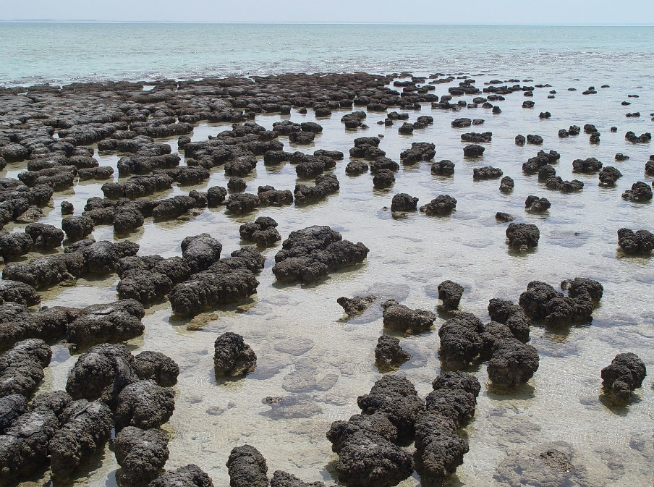
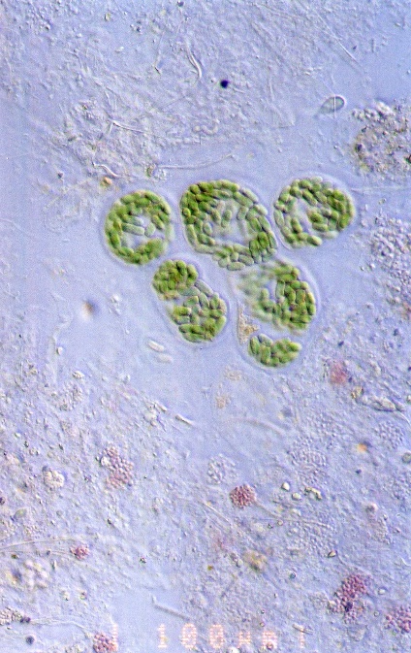

Earth
Development of photosynthetic biota
and resulting surface oxidation:
H₂O + CO₂ = CH₂O + O₂
sugar, starch,
organic matter
Stromatolites, Shark Bay, Australia (P. Harrison, Wikipeia)
Cyanobacteria, microbial mat,
Baja California (NASA,Wikipeia)
Surface oxidation and hydration (weathering) of
ferrous iron (Fe²⁺) in ferromagnesian minerals
(olivine, pyroxene, amphibole, mica, etc.)
2 FeO + H₂O + 0.5 O₂ = 2 FeO OH
goethite, rust
Weathered peridotite,
Mayaguez, Puerto Rico

Slide 34



Banded iron formations (BIF)
Archean Algoma-type BIF, Pilbara craton, Western Australia
Dales Gorge, Karijini National Park, G. Churchard, Wikip
Paleo-Proterozoic, 2.1 Ga, Superior-type BIF, N-America
National Museum of Mineralogy and Geology, Dresden, A. Karwath, Wikip
GOE: time of O₂-saturation of the shallow oceans

Slide 35
When did the deep recycling start?
(more about this in lecture 2)
Eclogitic diamond inclusions appear at
about 3 Ma: start of plate tectonics?
Shirey & Richardson
(2011, Science)

Slide 36


Deep recycling of oxidised materials into the mantle and core
by sinking slabs transporting carbonates as well as hydrous and oxidised minerals
We need further insights into the structure and dynamics of the lowermost mantle and the core
Equatorial Earth sections
ERD: Early refractory
domains
Modified from e.g. Trønnes (2010, Mineral. Petrol.), Torsvik et al.
(2016, Can. J. Earth Sci.), Ballmer et al. (2017, Nature Geosci.)

Slide 37

Cyclic crystallisation and dissolution of bridgmanite in the BMO additional core growth
This process will contribute to O-loading of the core
BUT:
O-saturation level in metal is < 15-20 wt%, whereas FeO and Fe₂O₃ contains 22 and 30 wt% O, respectively.
Metal drops sinking into the core will therefore always oxidise the BMO
Additional oxidation effect without bm crystallisation
at p >15-20 GPa Armstrong et al. (2019), Deng et al. (2020)
High-p disproportionation of FeO^{MO} promotes high f_{O2} in the
MO, combined with core segregation:
3 FeO = 2 FeO_{1.5} + Fe
components in the MO liquid metal segregating
and sinking to the core

Slide 38
O-undersaturation of the core
Partly relieved by FeO and Fe₂O₃ extraction from a long-lived BMO and from crystalline
bm and fp after BMO solidification (BUT the solid-state diffusion rate is very limited)
Si-saturation of the core
Relieved by diffusion of SiO₂ out of the core, esp. at the BMO-stage
The processes above are interdependent because 1 mole SiO₂ extracted from the core requires the supply of >2 moles of FeO to the core, in order to relieve any of the O-undersaturation.
Mineral reactions:
2 FeAlO₃^{bm} + SiO₂^{from core} + MgO^{fp} = Fe₂O₃^{to core} + (MgSiO₃+Al₂O₃)^{bm}
(FeO+MgO)^{fp} + SiO₂^{from core} = FeO^{to core} + MgSiO₃^{bm}
Additional O to the core:
FeO^{fp} = FeO^{to core}
FeSiO₃^{bm} + MgO^{fp} = FeO^{to core} + MgSiO₃^{bm}

Slide 39
Solid Earth transfer of O, H and C
O - the core is an O-sink
- the transport of subducted slabs with surface-induced oxidation and hydration to
the lowermost mantle can cause some inward O- (and H-)transport to the core
H, C - considerably lower core solubilities
- recycled by subduction to the mantle-core boundary and back to the surface
by hot convective upwelling
- redox relations affect the host mineralogy, especially for C, and can promote
partial melting in upwelling upper mantle
- H₂O and CO₂ are the two main volcanic degassing species

Slide 40


Also:
The transition zone represents an "infinite"
H₂O-reservoir
Seismologic evidence for low-velocity layers above
the 410 km and below the 660 km dicontinuities
H₂O-induced melting
Lithosphere
Fe-metal and reduced
conditions - diamond
410 km
660 km

Slide 41
Based on e.g. Sakamaki et al. (2003, Nature), it was commonly assumed that the hydrous melts
formed by dehydration melting in ascending mantle by the conversion of wadsleyite to olivine
would be negatively buoyant and accumulate above the 410 km discontinuity.
Drewitt et al.
2022, EPSL
But now:

Slide 42
Seismic and experiments evidence for hydrous melting above the 410 km discontinuity
89 stations with low-vel. zones above the 410 km discontinuity
152 stations investigated
Tauzin et al. (2010, Nat. Geosci.)
63 stations without clear low-vel. zones
H₂O-bearing peridotite synthesised at
14 GPa (>410 km depth) and run at 12 GPa
Freitas et al. (2018, Nat. Comm)
Although the indications low-velocity layers above the mantle transition zone may support partial dehydration melting of wadsleyite, it does not necessarily imply melt accumulation at this level (Drewitt et al. 2022, EPSL)

Slide 43
Seismic study, western USA
USArray-data, P- to S-conversions
Schmandt et al. (2015, Science)
SH11-TX tomography model
S40RTS tomography model
Sinking
mantle
Sinking
mantle
Rising
mantle
Rising
mantle
Rising mantle,
Colorado Plateau to Baja California
Sinking mantle
Rising mantle,
Colorado Plateau to Baja California
Sinking mantle
Rising mantle,
Colorado Pl. to Baja Calif.
Sinking mantle
Sinking mantle

Slide 44


Summary
1. The core-mantle "bulk equilibria" of the terrestrial planets show increasing f_{O2} with
increasing heliocentric distance from Mercury to Vesta
2. Core segregation at very high T (Earth and Venus) yields a core with low O and high Si.
Planetary cooling leads to O-undersaturation and Si-oversaturation in the core.
3. Core-mantle exhange involves
- sinking of metal droplets from BMO to core, which will oxidise the mantle
- diffusion of FeO + Fe₂O₃ from BMO to core
- diffusion of SiO₂ from the core to BMO
This would have maintained relatively high Si/(Mg+Fe) and Mg/Fe ratios, promoting
and prolonging bm-crystallisation.
4. The deeper parts of the magma ocean self-disproportionate ferrous Fe to ferric Fe and
exsolved Fe-metal, which sinks to the core. The resulting high f_{O2} would have led to
MO-degassing of mainly H₂O+CO₂ from the very beginning, resulting in a water ocean
and a CO₂-rich proto-atmosphere.
5. Bridgmanite and garnet have strong crystal-chemical affinity for Fe³⁺ which leads to
- FeO-disproportionation and Fe-metal precipitation below 260 km depth
- The reducing conditions may convert carbonate to diamond and Fe-carbide
6. The atmosphere and ocean are further oxidised by cyanobacteria and plant photosynthesis
and some photo-dissociation of H₂O, coupled with H₂-escape.
7. Return flow leads to hydrous melting above the 410 km discontinuity and futher redox
melting where diamond and Fe-carbide oxidise to carbonate. Low density and viscosity
of the hydrous melt above 410 km prevents deep melt accumulation and provides a fairly
uniform mantle H₂O content of only about 300 ppm, corresponding to about one ocean
mass equivalent.
8. Sinking mantle causes hydrous melting below the transition zone under western N-America
9. The core can hold up to 1000 ppm H, corresponding to a maximum of 13 ocean mass
equivalents of H₂O, assuming a sufficient O-content in the core. The O- and Si-contents
of the liquid core (96 vol% of the core) are probably both within the 3-5 wt% range.

Slide 45

Deep geochemical cycles 1:
redox relations and transfer of O, C
and H between Earth reservoirs
Main objective and outline
The redox state governs the global cycling of O, C and H:
- cycling from core to surface (crust, hydrosphere and atmosphere)
- mantle as a key reservoir and link between surface and core
- silicate-metal equilibria setting the redox state of the mantle
Reidar G. Trønnes
NHM & PHAB,
Univ. Oslo
Key observations and results
- the core and mantle "bulk equilibria" imply increasing f_{O2} with increasing heliocentric distance from Mercury to Vesta.
- metallic core segregation oxidises the mantles of the terrestrial planets.
- self-oxidation of deep magma oceans in the two largest terrestrial planets led to our ocean and CO₂-dominated proto-atmosphere.
- the abundant minerals garnet and bridgmanite need Fe³⁺, resulting in metallic Fe-precipitation below about 280 km depth in Earth.
- in spite of high H₂O solubility in wadsleyite and ringwoodite, hydrous melts generated above the transition zone percolate
upwards to the asthenosphere. The mantle H₂O-content is therefore only about 300 ppm, which is 1 ocean mass equivalent.
- the core can hold up to 1000 ppm H, corresponding to a maximum of 13 ocean mass equivalents of H₂O, assuming a sufficient O-
content in the core. The O- and Si-contents of the liquid core (96 vol% of the core) are probably both within the 3-5 wt% range.

