Slide 1
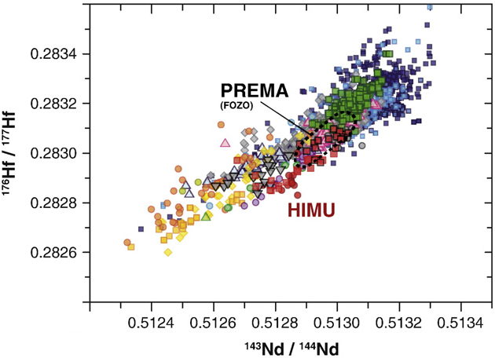
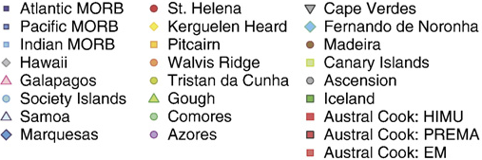
EM1 versus SCLM (subcontinental lithospheric mantle): Nd-Hf isotope systematics
DM
EM2
EM1
Δ-notation:
ΔHf
Mantle
regression line

Slide 2
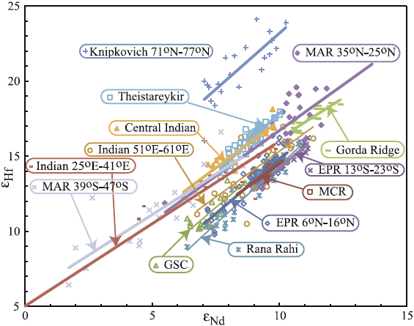
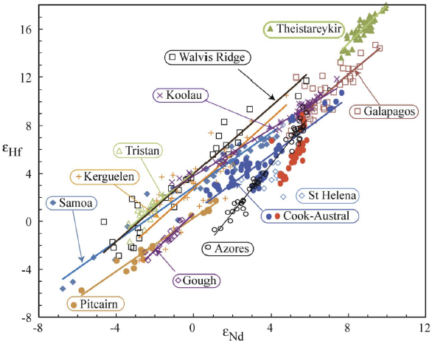
Nd-Hf isotope systematics
- insights into strongly depleted mantle sources
- deviations from the mantle array and mantle regression line
MORB
OIB
Mantle array
Salters et al. (2011, GGG)

Slide 3
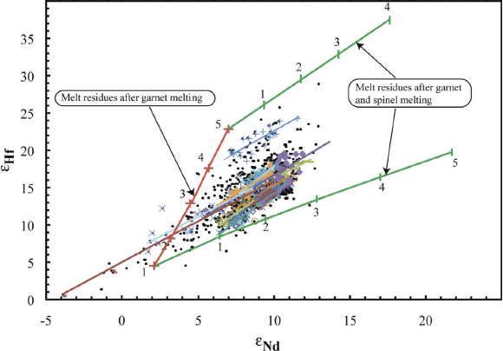
Melting models to produce refractory lithosphere from BSE, 1 Ga ago
Red: residues of ga-peridotites F: 1-5 %
Green: continued melting in spinel perid.
Salters et al. (2011, GGG)

Slide 4
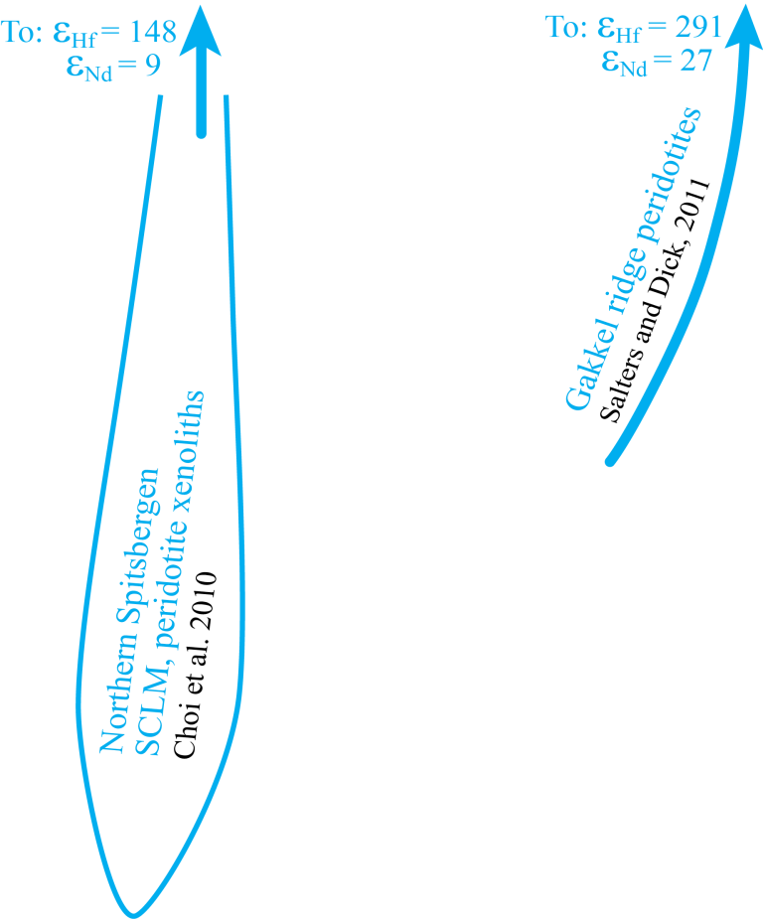
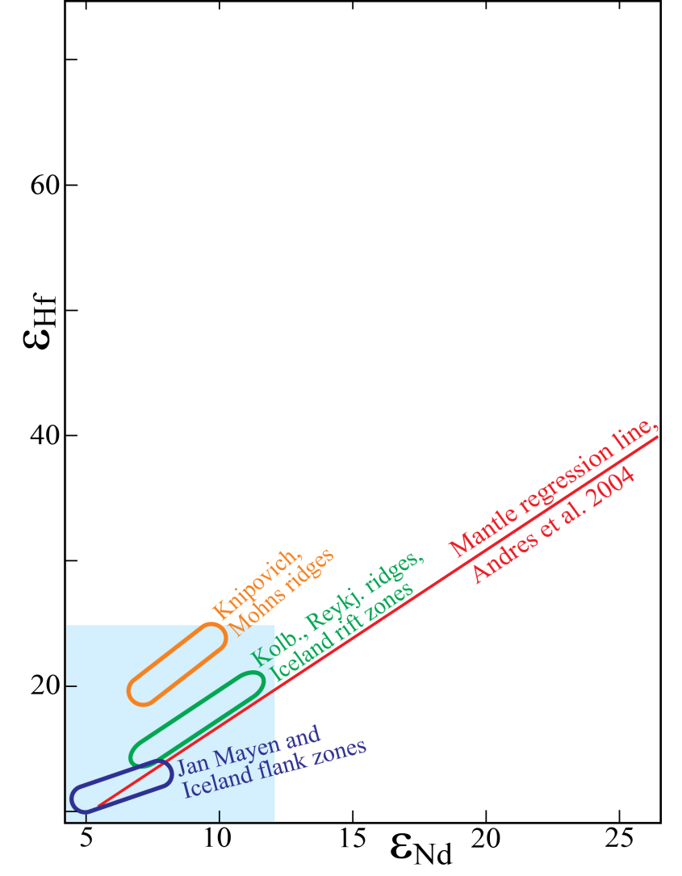
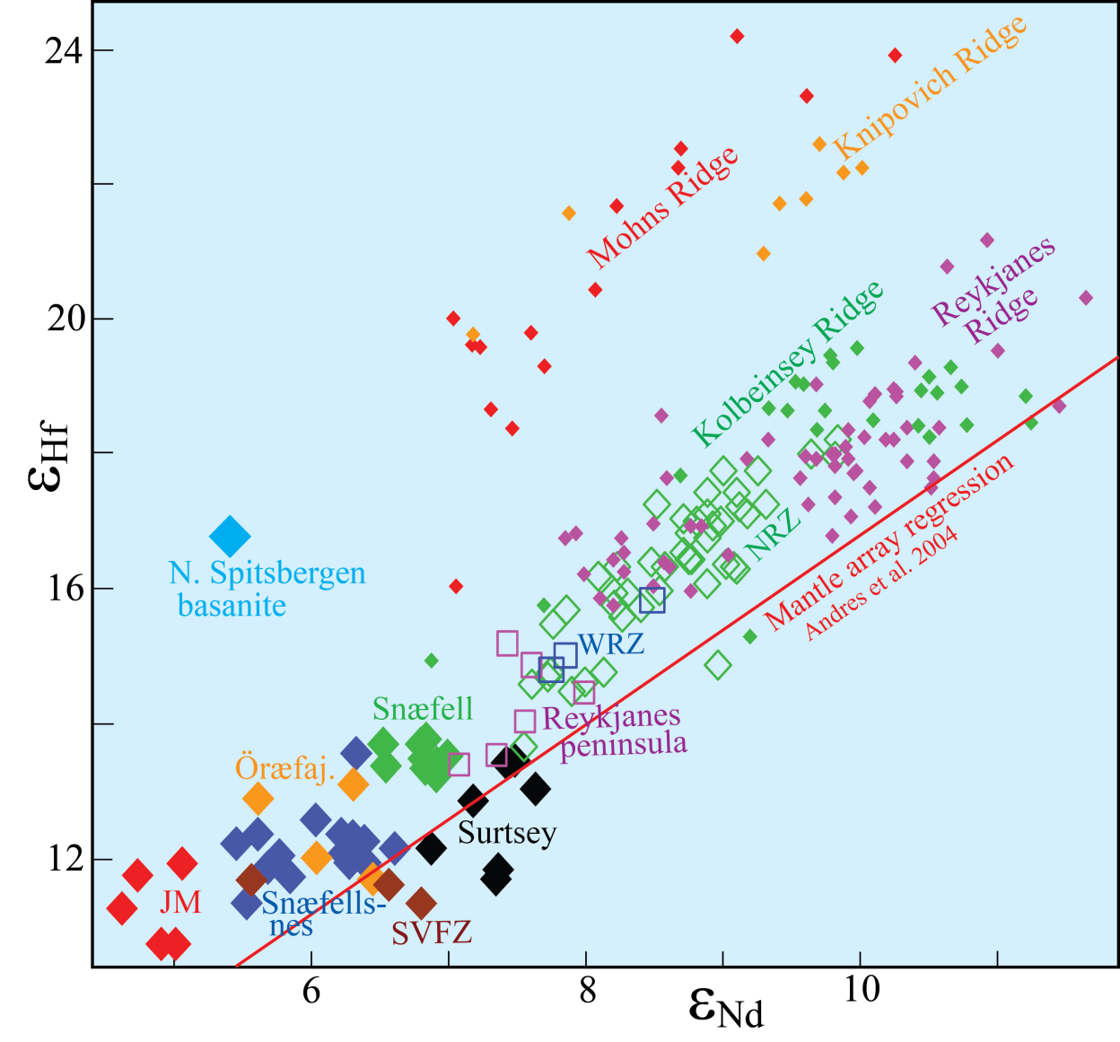
Hf-Nd-isotopes, NE Atlantic and Arctic
- Northernmost Atlantic and Arctic: SCLM-rich mantle
- Origin of SCLM: Strong Archean melt depletion at high
pressure, retaining residual garnet
→ very high Lu/Hf
old → very high ε_{Hf}
Also: low ¹⁸⁷Os/¹⁸⁸Os (low Re/Os after Archean melt extraction)
- later re-enrichment (e.g. Jan Mayen) will not decrease
Lu/Hf and increase Re/Os ratios appreciably
→ only minor time-integrated effects on Hf-Os-isotopes

Slide 5
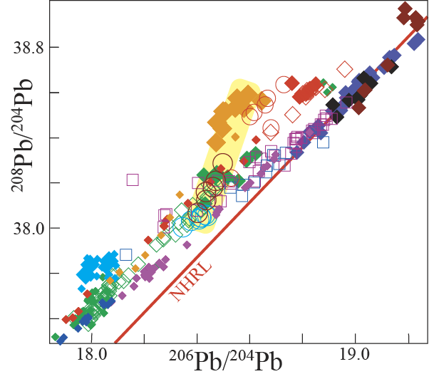
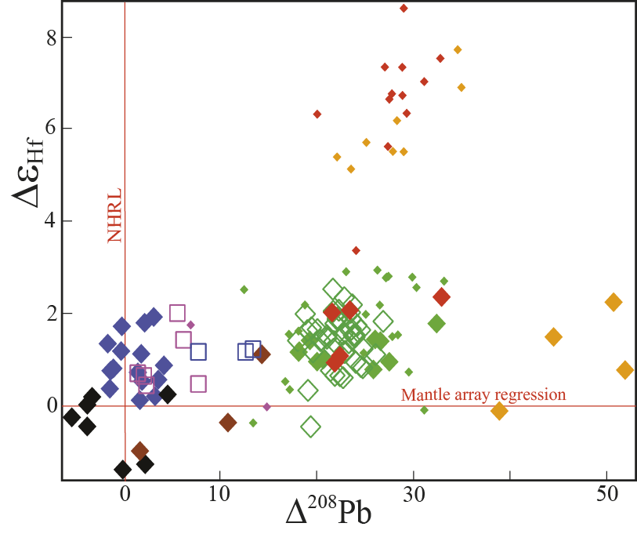
Hf-Pb isotopes, esp. ²⁰⁸Pb/²⁰⁶Pb ratio
The Δ²⁰⁸Pb- Δε_{Hf} correlation
Southern flank zone
+ Snæfellsnes
SCLM
W-Gakkel, E-Gakkel,
Kolbeinsey, Mohns,
Reykjanes
ROC
North of Iceland:
²⁰⁸Pb/²⁰⁶Pb increasingly above NHRL,
i.e. high Δ²⁰⁸Pb (old age, Archean mantle: high Th/U)
esp. western Gakkel Ridge and Spitsbergen
The most depleted ‘tail’ of Reykjanes R.
has also high Δ²⁰⁸Pb

Slide 6
Enriched Indian ocean (and possibly S-Atlantic?) MORB:
EM1 (DUPAL) component: high ¹⁸⁷Os/¹⁸⁸Os

Slide 7
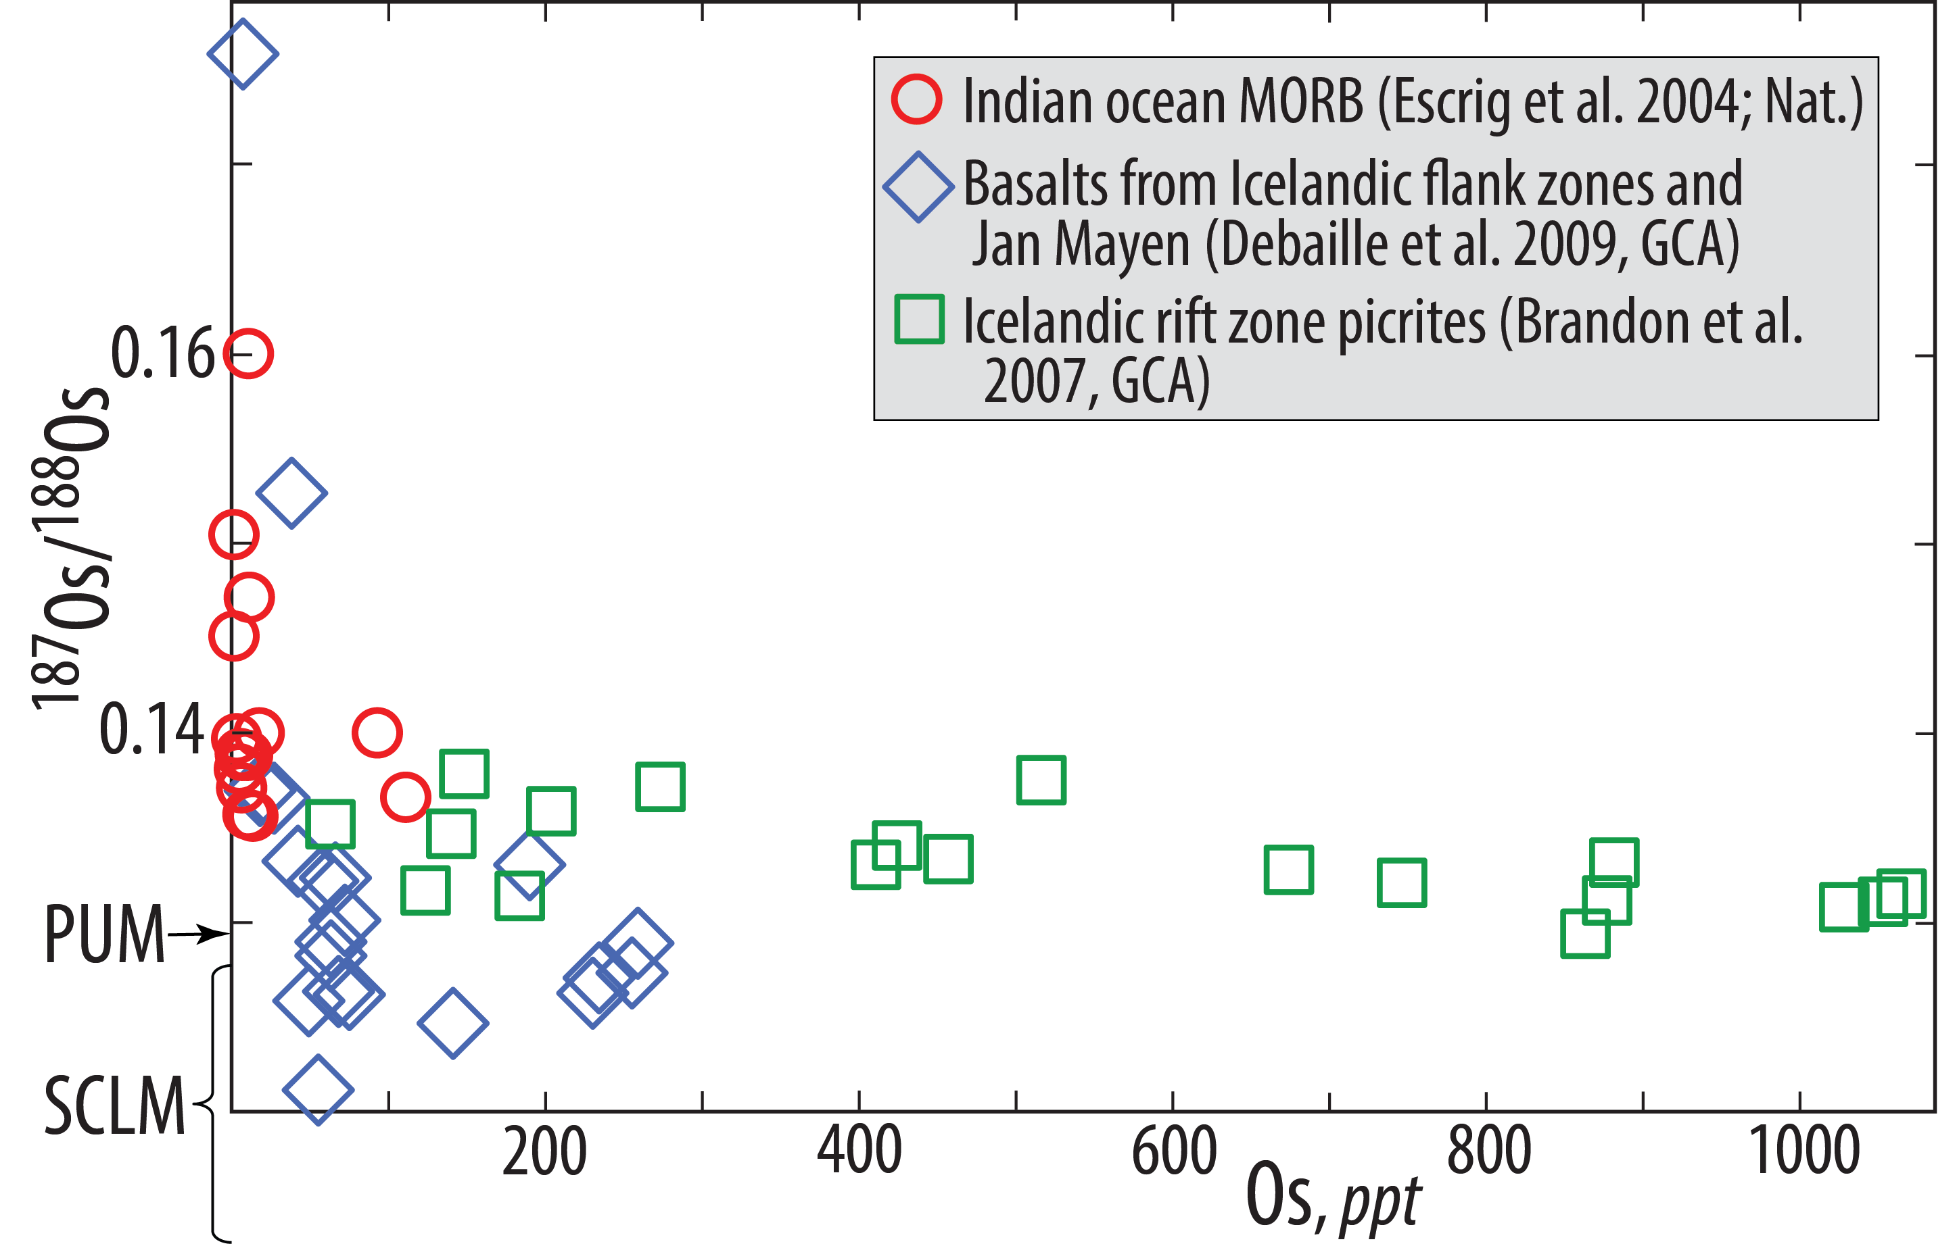
Iceland, Jan Mayen, Spitsbergen, as well as NE Atlantic and Arctic MORB (esp. the
Kolbeinsey, Mohns and Gakkel ridges: SCLM component: low ¹⁸⁷Os/¹⁸⁸Os
Note that enriched Icelandic flank zone and Jan Mayen basalts have lower ¹⁸⁷Os/¹⁸⁸Os
(larger SCLM component) than the Icelandic rift zone tholeiitic basalts and picrites.

Slide 8
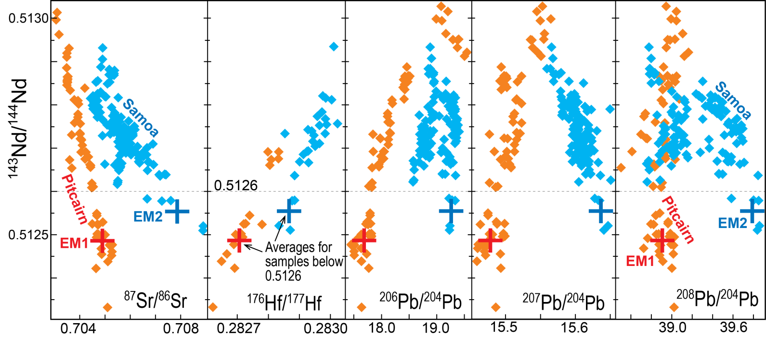
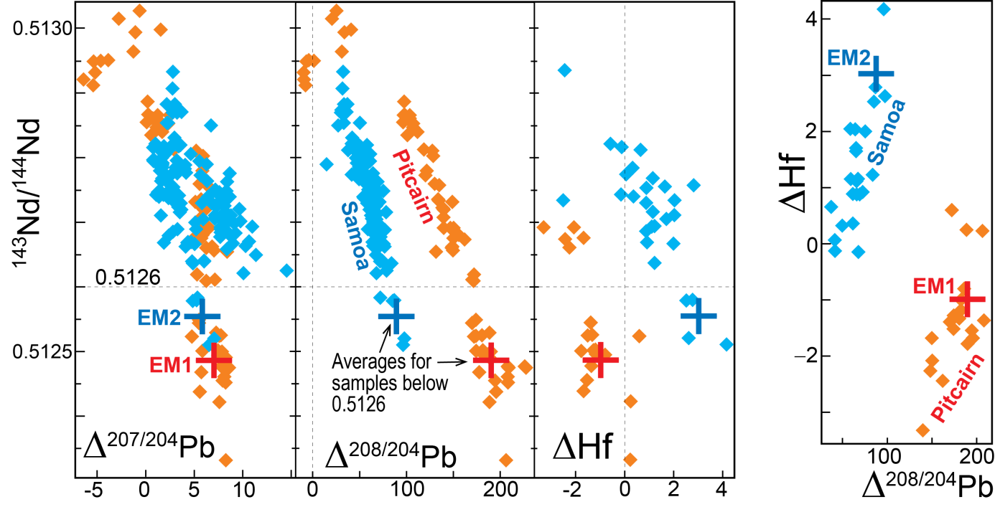
Isotope characteristics of the EM1 (Pitcairn) and EM2 (Samoa) trends
EM1 has:
- high Δ²⁰⁸Pb (+190)
but
- negative ΔHf (−1)
Negative ΔHf:
- EM1 is not SCLM,
- probably LCC, possibly pelagic sed.
- possibly residual arc mantle wedge

Slide 9
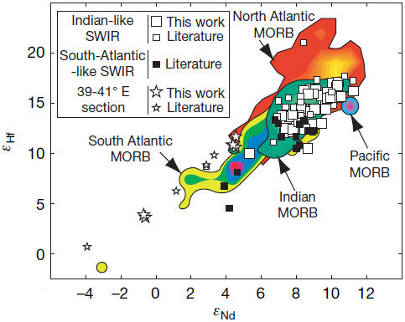
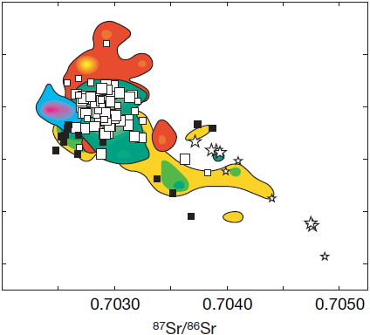
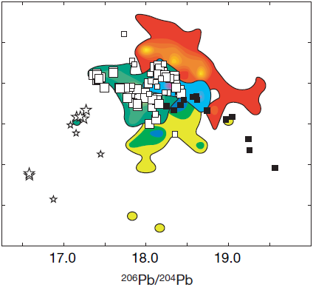
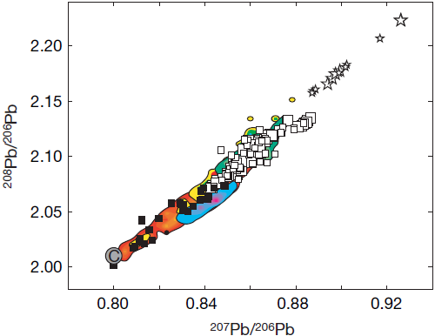
Global isotope systematics, MORB
Meyzen et al. (2007, Nature)
NOTE: ratios with ²⁰⁶Pb
as denominator
Samples with unradiogenic
Pb and high ²⁰⁸Pb/²⁰⁶Pb
(i.e. high Δ8/4 values)

Slide 10
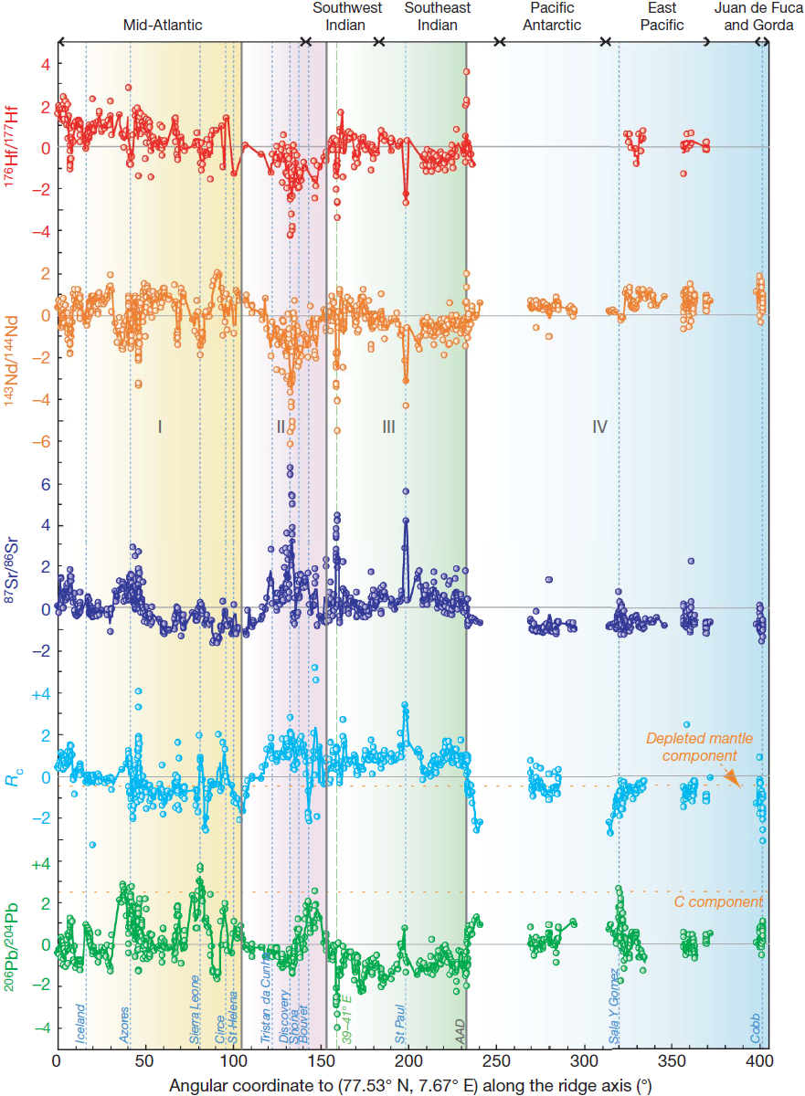

S-Atl.
Meyzen et al. (2007, Nature):
Along-axis variation: N-Knipowich → Mid-Atlanic → S-Atl. → SWIR → SEIR → Pacific-Antarctic → EPR → J. de Fuca
Mohns-Kolbeinsey:
Elevated Hf- rel. to
Nd-ratios. High ΔHf
Indian MORB
"normal" ΔHf
Relative deviation (%) from the mean
old
R_{C} reflects the time-integrated Th/U-ratio
old
old
young
young
C: Common Pb-component,
Hanan & Graham (1996, Sci.)
young
(Th/U)^{mantle} decreases with age, 2.4 → 0 Ga
due to surface oxidation and U-recycling:
CC → ocean → OC → sinking slabs →
lowermost mantle → rising plumes
Zero-point:
North
Knipovich

Slide 11
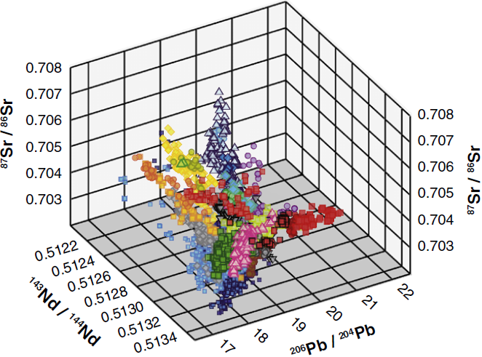
Conclusions, inferencesDistinct recycled material
HIMU: ROC = MORB minus an arc component
EM1: LCC (and residual base of mantle wedge???)
EM2: UCC
SCLM: characterised by very high Δ²⁰⁸Pb and ΔHf
PREMA, FOZO, C: mix of components, the "matrix" is
refractory lower mantle with primordial-like He and Ne
Sr-Nd-Pb isotope space
3D-visualization
EM2
EM1
SCLM
HIMU
PREMA
DM

Slide 12
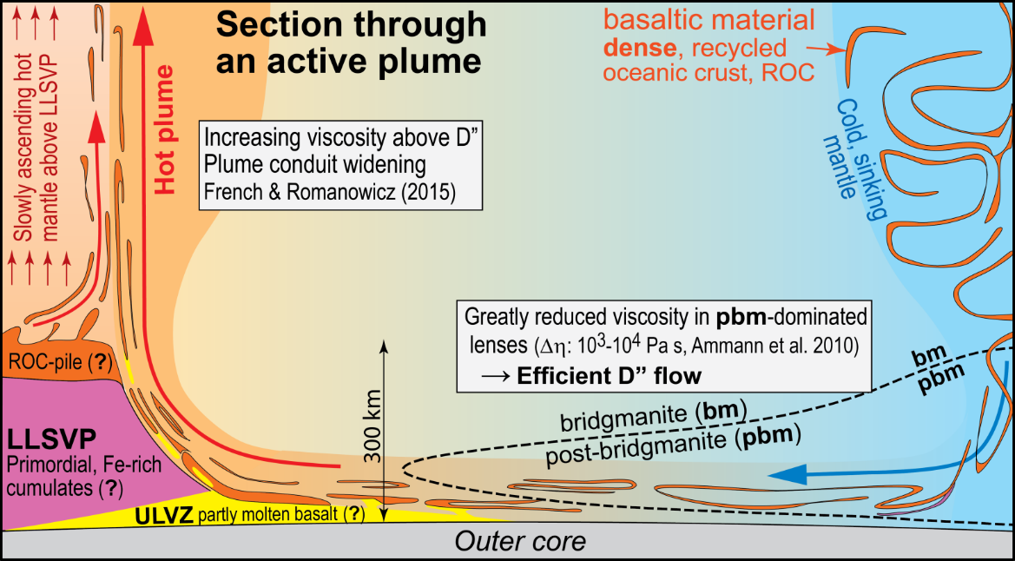
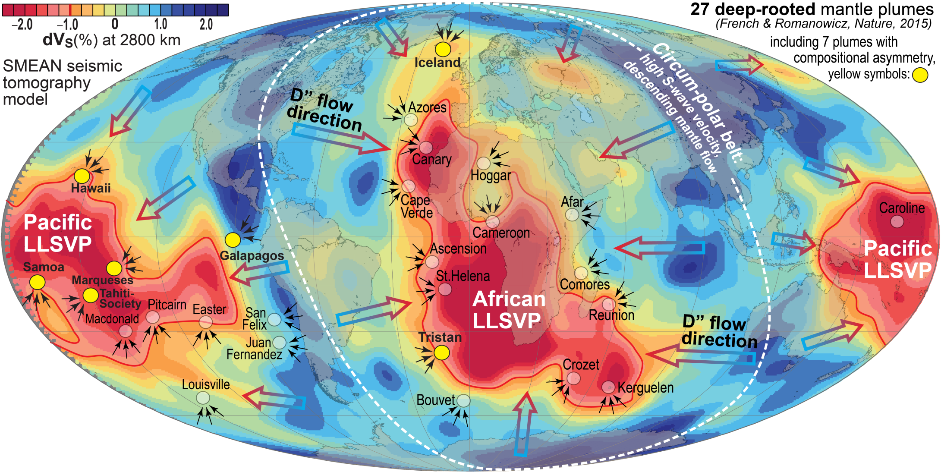
Updated conclusions, inferences
Surface-D"-surface recycling: timescale, likely
storage sites
Asthenosphere-MORB: average model age: 2.0 Gy
OIB (leveraged by HIMU-ROC): 1.5 − 2.5 Gy
Likely storage site for ROC:
upper parts of LLSVP-piles
and bilateral plume zonation
Modified from Torsvik
et al. (2016, CJES)

Slide 13
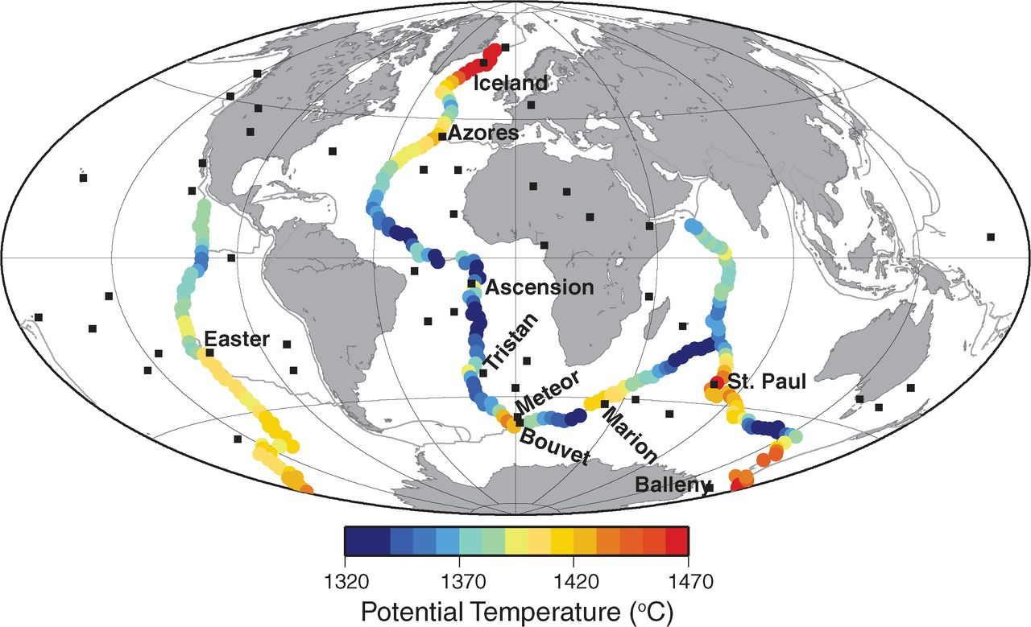
Lateral T_{P}-variation along the main MORs
327 data points
Average T_{P}: 1386 C
Based on depths ridge depth, crustal thickness, geochemistry and V_{S} at 300 km depth
(Dalton et al. 2014, Sci.)
It is difficult to separate a
plume effect from ‘ambient’
asthenospheric upwelling
The Iceland plume T_{P} is much
higher: 1609 C
ΔT_{P}: 150

Slide 14
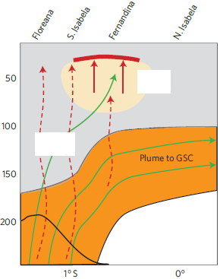
"Displaced primordial
He-signal", Galapagos
Villagomez et al.,
2014, Nature Geosci.
Primordial
^{3/4}He signal
S
N
Melt accumulation
Main
silicate
melting
hydrous,
carbonatitic
fluids
flow trajectories
Fertile plume flow
towards Galapagos
spreading centre
End of main dehydration
and decarbonatization

Slide 15
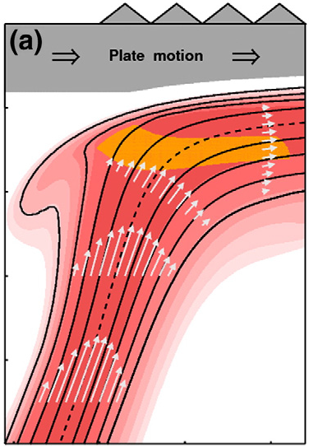
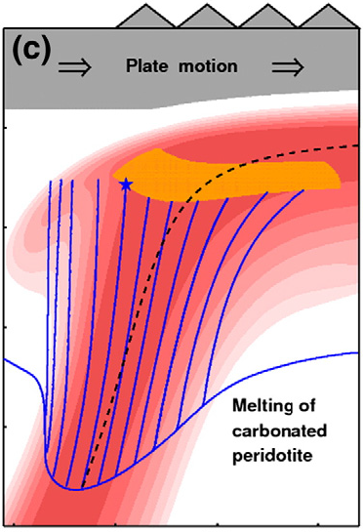

"Displaced primordial He-signal", Hawaii
Hofmann et al. 2011, EPSL
Primordial
^{3/4}He signal,
Loihi seamount
Main melting
zone
200 km
Trajectories, hydrous
and carbonatitic fluids
(star: central trajectory)
Carbonated and
hydrous mantle
solidus
Plume flow
trajectories
(stippled centre line)
&
Schematic flow speed
(white arrows)
400 km
0
100 km
200 km
0
100 km
200 km
Distance from onset of main melting

Slide 16
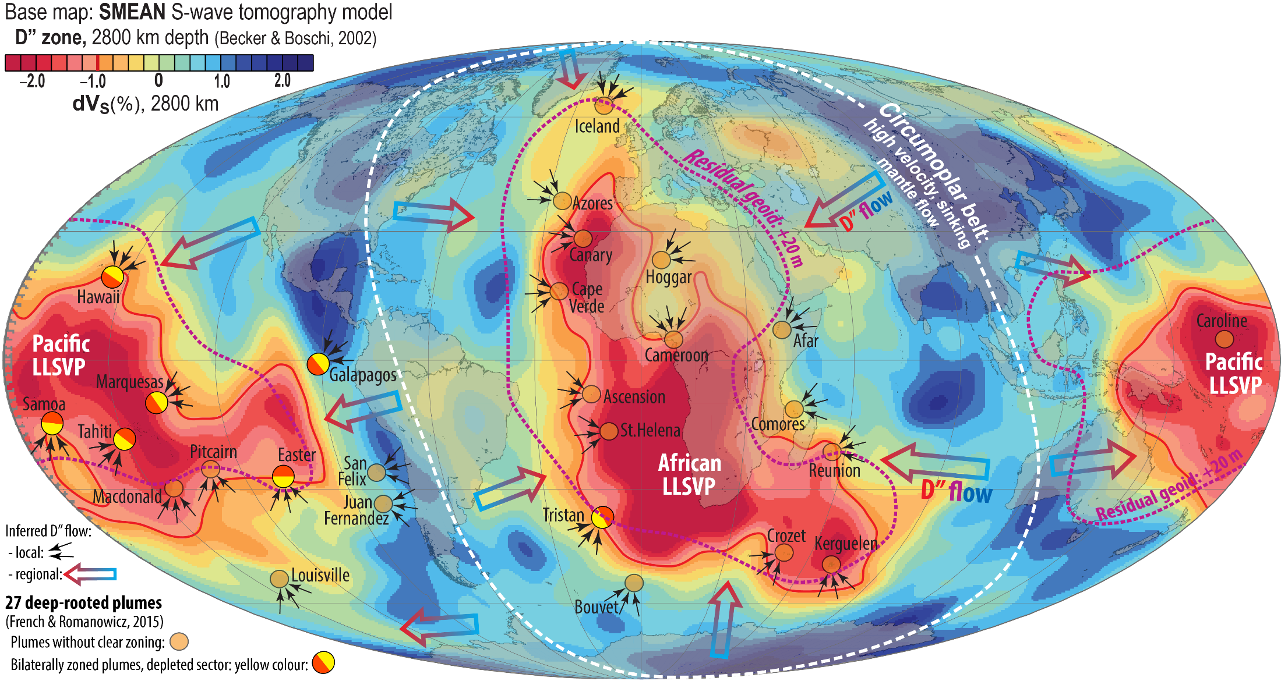
Bilateral plume zonation, the Samoa example

Slide 17
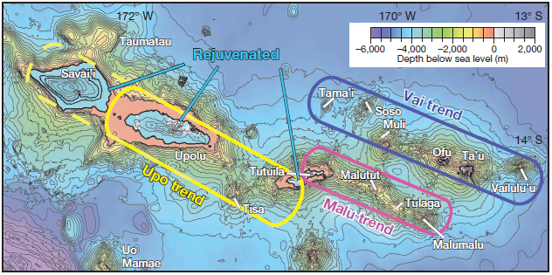
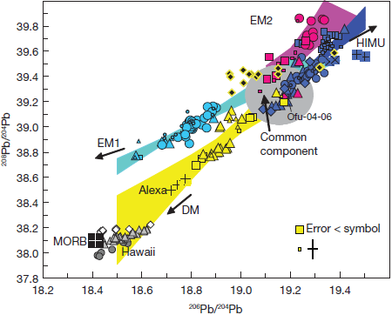
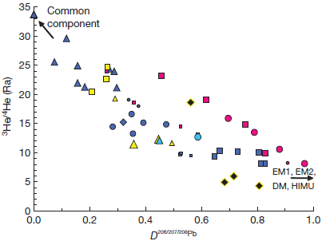
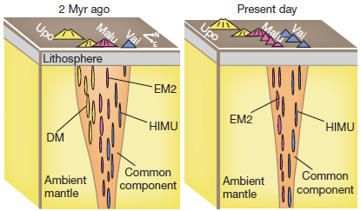
Samoa: Beautiful example of resolved heterogeneities involving DM, EM1, EM2 and HIMU components,
mixed into a mildly depleted lower mantle, characterised by the "Common" component (C,
FOZO, PREMA) with high ³He/⁴He-ratio.
Jackson et al.
(2014, Nature)
Pacific LLSVP
Four independant mixing
arrays, all departing from
a C-component
The C-component is a high ³He/⁴He component
The model:
Distance from the C comp. in Pb-isotope space

Slide 18
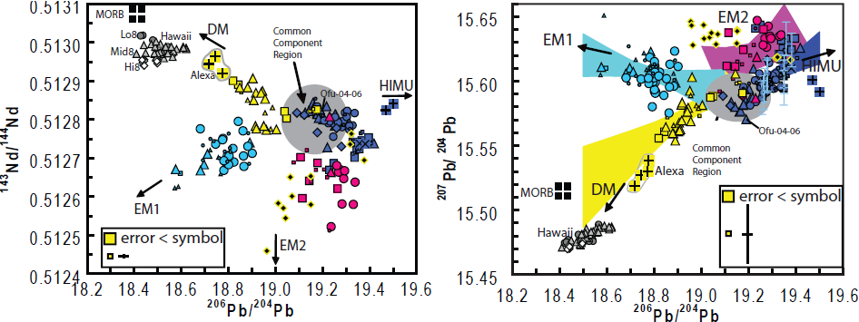
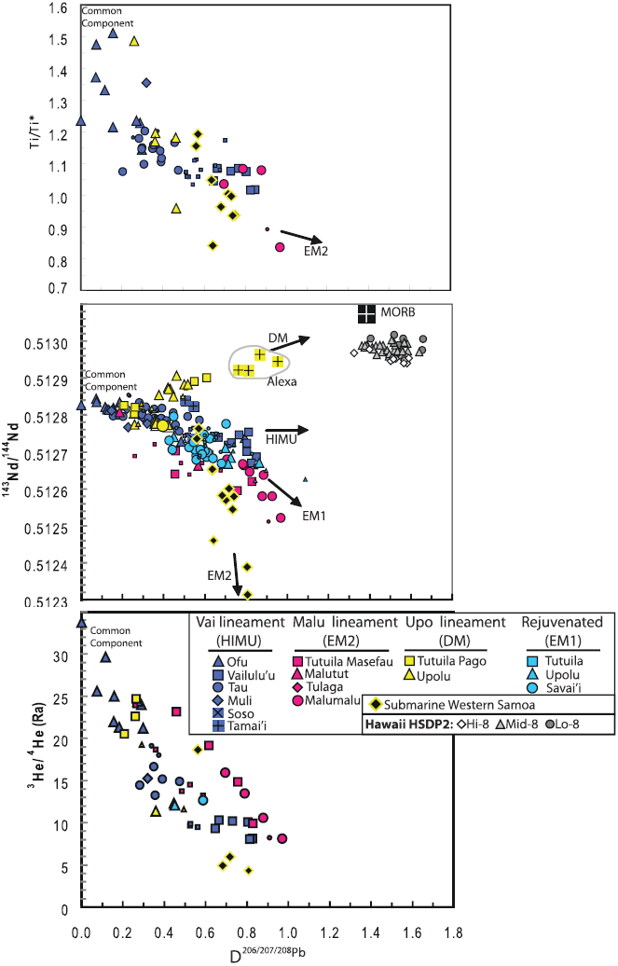
Jackson et al.
(2014, Nature)

Slide 19
Bilateral plume zonation, Societies, Marquesas, Hawaii, Galapagos, Easter

Slide 20
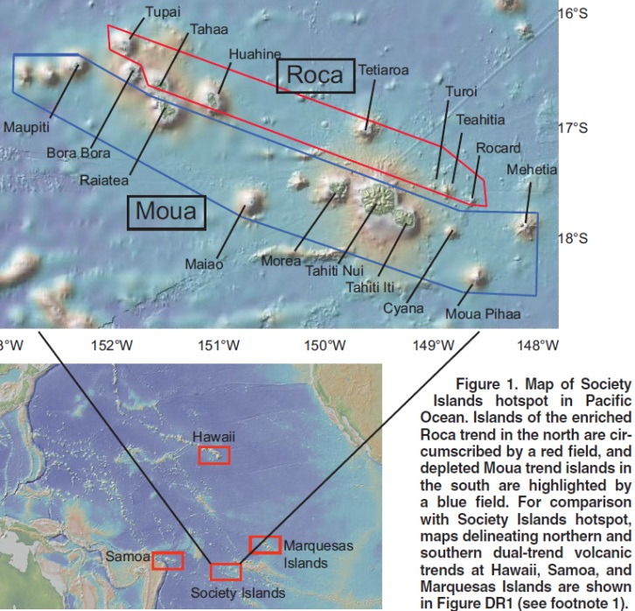
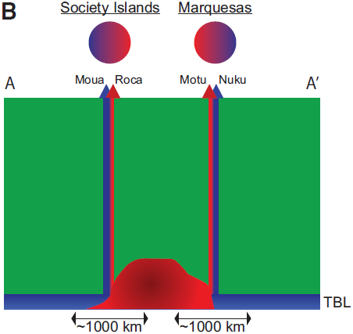
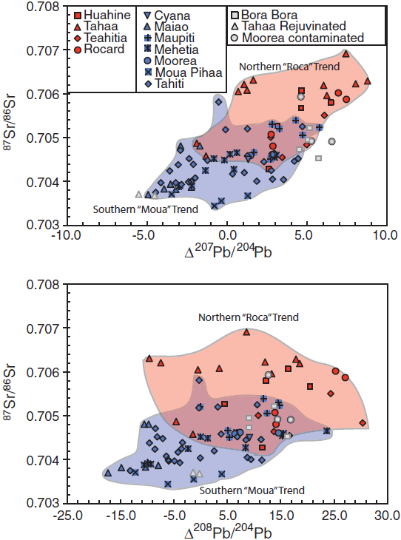
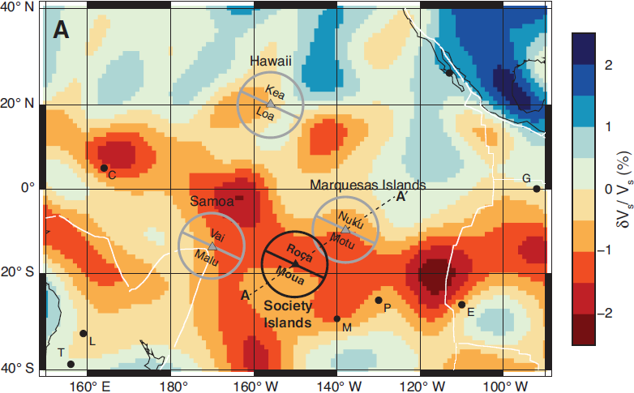
Payne et al.
(2013, Geology)

Slide 21
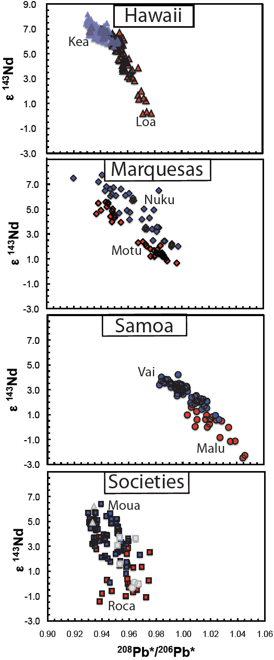
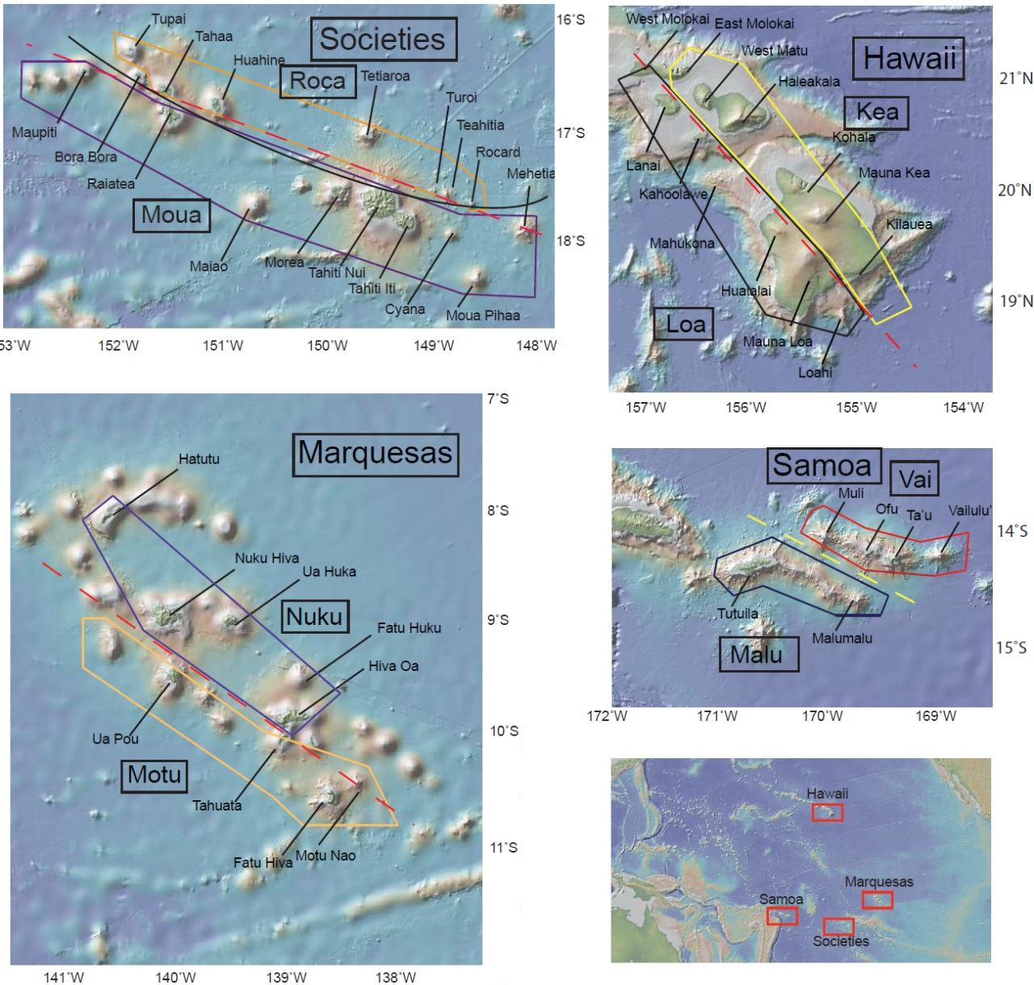

Slide 22
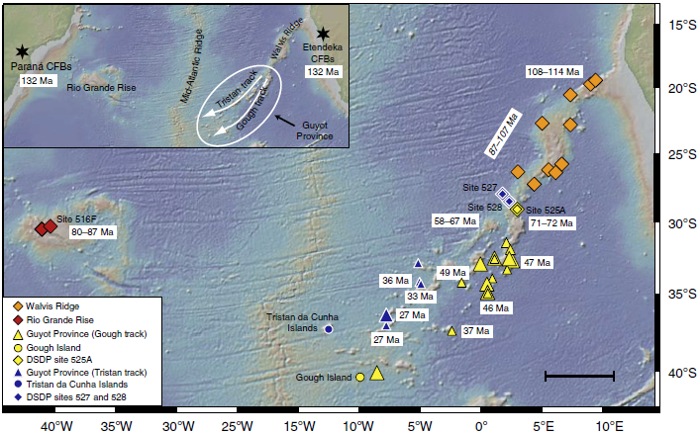
Hoernle et al. (2015, Nat. Comm.)

Slide 23
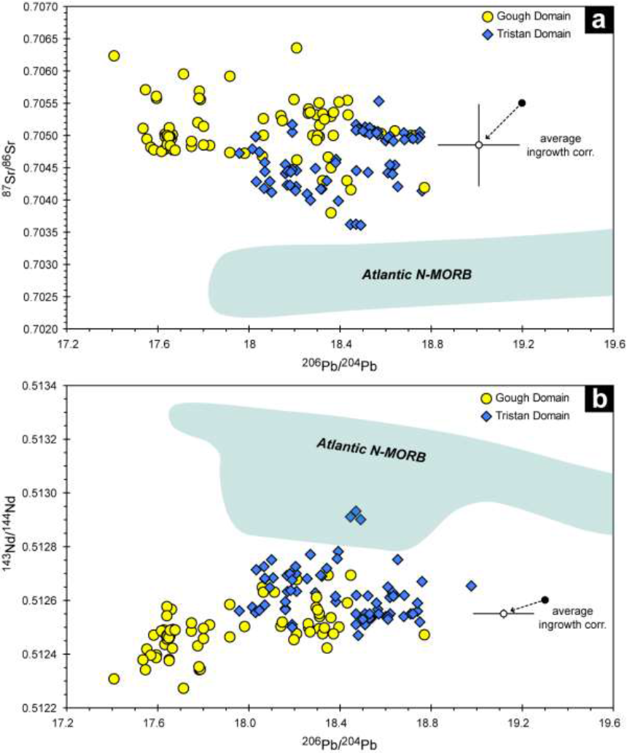
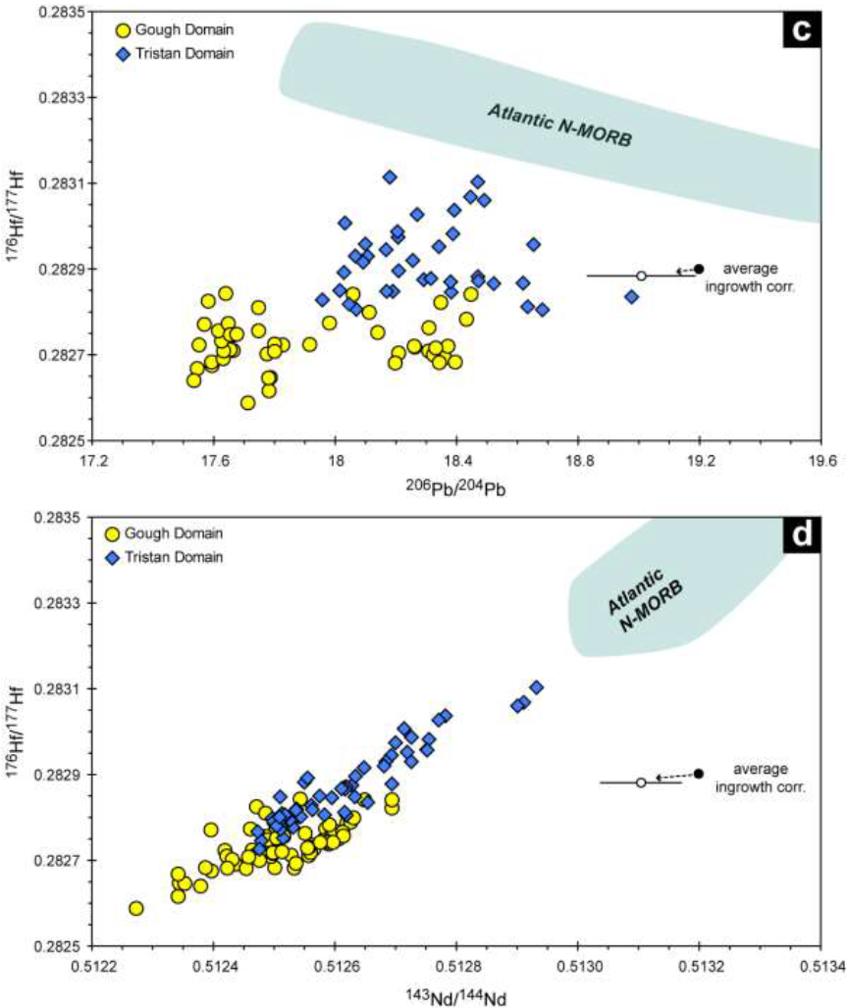
Gough: most enriched
Hoernle et al. (2015, Nat. Comm.)

Slide 24
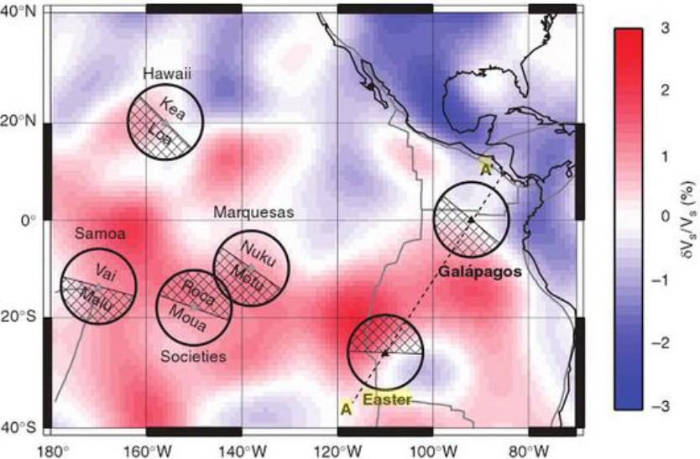
Galapagos and Easter
Harpp et al. (2014, GGG)

Slide 25
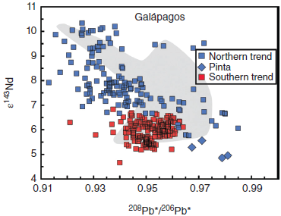
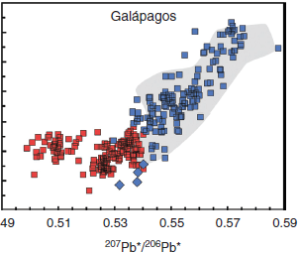
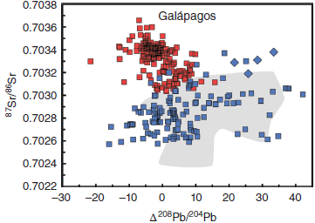
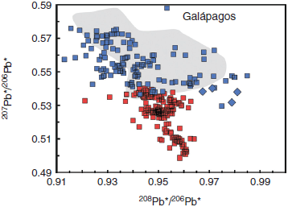

Slide 26
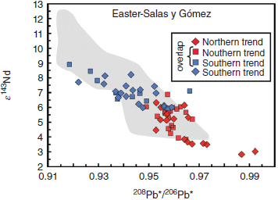
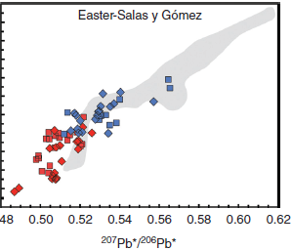
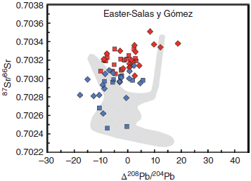
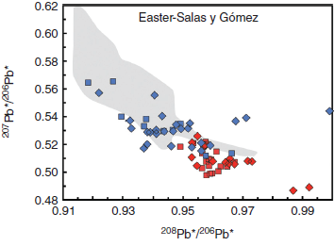

Slide 27


Galapagos
Harpp et al. (2014, GGG)

Slide 28

Galapagos
Vidito et al. (2013, GGG)

Slide 29

Deep-rooted plumes may sample Hadean refractory domains and the core
27 deep-rooted plumes, mostly OIBs
(French & Romanowicz, 2015, Nature)
Iceland
Azores
Canary
Hawaii
Cape Verde
Hoggar
Canary
Afar
Marshall
Micronesia
(Caroline)
Samoa
Galapagos
Ascension
Cameroon
Comoros
Marquesas
Tahiti-Soc
St Helena
Reunion
Macdonald
Seamount
Pitcairn
Easter
San Felix
Walwis R.
Juan Fernandez
Tristan
Gough
Crozet
Kerguelen
Loisville
Herd
Bouvet

Slide 30


Slide 31

Buoyancy flux for
12 major plumes

Slide 32


Slide 33
He (and Ne) isotope systematics
- resist resetting by recycling
- can potentially track the mantle evolution more rigorously than
Sr-Nd-Hf-Pb-isotope systematics:
parent and daughter isotopes follow recycled crust back in the mantle
He (smallest noble gas atom)
³He is primordial, ⁴He radiogenic from U and Th-decay chains
Th and U decay chains produce ⁴He (α-part.)
²³²Th → ²⁰⁸Pb
²³⁵U → ²⁰⁷Pb
²³⁸U → ²⁰⁶Pb
atm MORB Jupiter
⁴He/³He 719000 90000 6000
³He/⁴He, R/R_{atm} 1 8 120
- Continuously lost to space from the atmosphere
Incompatible during mantle melting
High diffusion rate: efficiently (re)moved (by ”degassing”)
He with high ³He/⁴He ratio may be stored in
- the outer core (and might diffuse into He-depleted domains in the lower mantle)
- strongly melt-depleted bridgmanitic mantle domains with low U, Th and high viscosity

Slide 34

³He/⁴He, R/Ra
Moreira (2013, Geochem. Perspectives)

Slide 35




Strong evidence that the primordial-like He (and Ne) source material is refractory
Increasing
³He/⁴He
Increasing
³He/⁴He
>15 R/Ra
9-15
< 7
8 ±1
Similar correlation with incompatible trace element
concentrations and ratios
Class & Goldstein
(2005, Nature)
Increasing
³He/⁴He

Slide 36


³He/⁴He versus ⁸⁷Sr/⁸⁶Sr and ¹⁴³Nd/¹⁴⁴Nd
Maximum He-values of the Samoa, Hawaii
and Heard-Kerguelen trends are stippled
positive ³He/⁴He - ¹⁴³Nd/¹⁴⁴Nd correlation
negative ³He/⁴He - ⁸⁷Sr/⁸⁶Sr correlation
Contamination will invariably change
compositions to lower ³He/⁴He ratios
Iceland plume head with extremely high
³He/⁴He ratios (Baffin Island, West Greenland):
high Os
low Re and ¹⁸⁷Os/¹⁸⁸Os ratios

Slide 37



.703
.51312
17.75
EM2
DM
Samoa
.51312
EM1
HIMU
Pitcairn-
Walvis R.
.7030
EM2
HIMU
EM1
17.75
17.75

Slide 38

Identifying mantle components, OIBs
Stracke (2012,
Chem. Geol.)
DM
HIMU
Samoa
EM2
Pitcairn-
Walvis R.
EM1
EM2
DM
Samoa
EM1
HIMU
Pitcairn-
Walvis R.
EM2
DM
HIMU
EM1

Slide 39


Could the primordial-like He and Ne isotope ratios result from core contamination?
Unlikely: - Although tiny additions of core metal to plume roots explain clear W- and weak Xe-isotopic signals, they are
probably insufficient to generate the primordial-like He-Ne isotopic signals
- High ³He/⁴He is generally associated with refractory mantle sources (PREMA-FOZO)
- Parts of the refractory sources seem to have formed in the Hadean: Baffin Island, Reunion, Samoa, Hawaii
Short-lived Sm-Nd-system
¹⁴⁶Sm→¹⁴²Nd t_{h}: 103 My, "live" for about 500 My.
The Nd-daughter partitions to melt more than Sm.
Bm-residues/cumulates: high Sm/Nd ratio, high μ¹⁴²Nd
μ¹⁴²Nd = (^{142/144}Nd_{sample} / ^{142/144}Nd_{standard} − 1) *10⁶ (ppm)
ε¹⁴³Nd = (^{143/144}Nd_{sample} / ^{143/144}Nd_{standard} − 1) *10⁴ (pp 10⁴)
Peters et al. (2018, Nature)
Reunion basalts
Positive correlation
³He/⁴He (plume flux)
versus μ¹⁴²Nd

Slide 40
Horan et al.
(2018, EPSL)
5
μ¹⁴²Nd, ppm
0
−5
Samoa
Ofu
04-14
10
20
30
−15
−5
0
5
³He/⁴He, R/R_{atm}
μ¹⁸²W
Residues after melt extraction
at: 4.57 (SS age), 4.50 and 4.42 Ga
20
Original mantle reservoir:
μ¹⁴²Nd = ε¹⁴³Nd = 0
¹⁴⁷Sm/¹⁴⁴Nd: 0.196
Small black symbols on
residue trends corresponds
to ¹⁴⁷Sm/¹⁴⁴Nd:
0.200, 0.204 and 0.208
4.57 Ga
10
4.50 Ga
Loihi
02-02
5
4.42 Ga
Hawaii
μ¹⁴²Nd, ppm
0
Enriched mantle
−5
−5
0
5
−10
μ¹⁴³Nd
μ¹⁴²Nd, ppm
−400
0
400
−4
0
4
ε¹⁴³Nd

Slide 41

Primary kimberlites
Negative correlation: μ¹⁴²Nd- μ¹⁸²W ? No clear correlation with W-concentration
OIBs
Are W-conc. and μ¹⁸²W correlated ??
(Fig. S2, Yoshino et al., 2020, EPSL)

Slide 42
W-isotopic evidence for core contaminatination of deep-rooted plumes (via ULVZs?)
¹⁸²Hf → ¹⁸²W, T_{h}: 9 My
- W is siderophile (partitions into the core)
- Hf is lithophile (goes to the MO)
→ extremely low ¹⁸²W/¹⁸⁴W in the core
Mundl et al. (2017, Science)
Rizo et al. (2019, GPL)
Mundl-Petermeier et al. (2019, Chem.G.)
μ(¹⁸²W) = (^{182/184}W_{sample} / ^{182/184}W_{standard} − 1) * 10⁶
Iceland plume head, Paleocene, 62 Ma
W. Greenland - Baffin Island
μ (¹⁸²W)
Iceland, Ísafjörður
Mid Miocene, 12-15 Ma
increased plume flux
All OIBs have
negative anomalies
³He/⁴He, R/R_{atm}
Mundl-Petermeier et al. (2020, GCA)

Slide 43
Ne-isotope composition, atmosphere, Sun, OIB, MORB White, 2015, Chem. Geol.
The Rochambeau rift in N. Lau backarc
basin is very close to the Samoa plume
(e.g. Peto, 2013, EPSL)
Loihi
Iceland
Kerguelen
2πD43
meteorites
MAR-GSC
IRs
Mass fractionation, heavy atmospheric Ne
Rochambeau
Galapagos
Samoa
Reunion
heavy Ne, mass fr.

Slide 44
Weak Xe-isotopic evidence for core contaminatination (via ULVZs?) of deep-rooted plumes
Icelandic basalts, in particular, have elevated ¹²⁹Xe/¹³⁶Xe
Practical T_{h} My lifetime, 5 t_{h}
¹²⁹I → ¹²⁹Xe, 16 80
²⁴⁴Pu → ¹³⁶Xe, 81 405
(fission decay)
¹²⁹I: extinct before Earth-Theia collision and proto-lunar disk
- I: siderophile at high p - partitioning to the core
- Pu: lithophile - to the MO
→ elevated ¹²⁹Xe/¹³⁶Xe in the core
White (2015, Chem. Geol.)
Note the effect of air
contamination for Xe
(mixing line between MORB-
source and atmosphere)
MORB-source
MORB-array
Low (air-like) ¹²⁹Xe/¹³⁶Xe and
¹²⁹Xe/¹³⁶Xe in OIB relative to MORB:
subduction of atmospheric Xe (?)
Iceland and Hawaii (Loihi):
- slightly elevated ¹²⁹Xe/¹³⁶Xe
- core signal (?)
Air

Slide 45

MORB-OIB relations = depleted peridotite - ROC relations
Loss of Xe from the deep mantle (MO, bm) to the proto-atmosphere during
the first 80-405 My of ¹²⁹I and ²⁴⁴Pu-decay (Shcheka & Keppler 2012, Nat.)
→ elevated ¹²⁹Xe/¹³⁰Xe and ¹³⁶Xe/¹³⁰Xe ratios in the depleted mantle,
incl. the MORB-source
Can Xe in the proto-atmospheres of Earth and Theia partly survive the
proto-lunar disk (synestia) stage ??
ROC with atmospheric Xe
→ low ¹²⁹Xe/¹³⁰Xe and ¹³⁶Xe/¹³⁰Xe ratios in OIB
Solubility of noble gases in bridgmanite
Low solubility of Xe in bridgmanite →
Degassing during MO-solidification, followed by
¹²⁹Xe ingrowth and late Xe accretion/implantation
Xe can be recycled into the mantle by subduction
Refractory deep mantle sources might have lost I and Pu by melt-extraction and degassing within the first 80 Ma ?

Slide 46
Samples
Eifel springs and Iceland
plume with core contribution
Lignat spring, Massif Central
MORB-like signature
¹³⁰Xe, ¹³⁴Xe: non-radiogenic
¹²⁹Xe: derived from ¹²⁹I
¹³⁶Xe: derived from ²⁴⁴Pu
Moreira et al.
(2018, GPL)
¹²⁹Xe/¹³⁰Xe
core
Note the effect of air
contamination for Xe
(mixing line between MORB-
source and atmosphere)
Iceland
¹³⁴Xe/¹³⁰Xe
core
¹³⁶Xe/¹³⁰Xe

Slide 47

High thermal stability and residual character of Ca-pv: the melting curve
Trønnes et al. in prep.
Simplified from:
Hernandez et al. 2022, GRL

Slide 48


Density relations through the mantle
Based on: Stixrude & Lithgow-Bertelloni 2012, AREPS; Irifune & Tsuchiya, 2015, Treat. Geophys.; Trønnes & Mohn, in prep.

Slide 49


High thermal stability and residual nature of Ca-pv: CMS-projection
Trønnes et al., in prep.
C: Ca+Na
S: Si+0.9Al
M: 100−C−S

Slide 50



High thermal stability and residual nature of Ca-pv: CMS-projection
Trønnes et al., in prep.
C = Ca + Na
S = Si + 0.9Al
M = 100-(C+S)

Slide 51


Density relations
Trønnes et al., in prep.

Slide 52



ULVZ dynamics
ULVZ: Ultra-low velocity zone
LLSVP: Large low S-wave velocity province

Slide 53
Mineral-melt partitioning: Brice curves for davemaoite (dm) and bridgmanite (bm)
Sc
Zr
Mn
D^{bm/melt}
Note the high D_{Hf} (>1) and low D_{Lu} (<0.8), and D_{W} (<0.2)
Hf
Sn
Fe
Lu
Ni
Mg,
Co
Ga
Er
Cr
Ho,Y
W, hexavalent
Although D_{W} is unknown,
its r_{cation} is plotted on the
quadrovalent curve
Dy
References for dm:
Walter et al. (2004, GCA)
Liebske et al. (2005, Lithos)
Corgne et al. (2005, GCA)
Ca
Tb
Gd
D^{bm/melt}
Li
Na
Sm
Monovalent
U
Divalent
Trivalent
Nd
K
Quadrovalent
Pr
Eu
Sr
Rb
Ce
Pb
Th
La
Cs
Ionic radius

Slide 54
Mineral-melt partitioning: Brice curves for davemaoite (dm) and bridgmanite (bm)
Ionic radius
Gd
Sm
U:14.9
Y
Nd
D^{dm/melt}
Note the very high D_{REE} (8-20), D_{U} (15), and D_{Th} (13)
Th:13.1
U
Th
La
Ca
Eu
Zr
Sr
D^{dm/melt}
Hf
Sc
Pb
References for dm:
Corgne et al. (2005, GCA)
Sn
Mn
Monovalent
Fe
K
Co
Na
Rb
Mg
Divalent
Trivalent
Ga
Quadrovalent
Cr
Ni
Cs
Li
Ba

Slide 55


Magma ocean crystallisation
Evolution of viscous BEAMS
Refractory & viscous ERD convectively aggregated to BEAMS
(e.g. Manga, 1996, GRL)
Modified, mainly from:
Torsvik et al. (2016, Can. J. Earth Sci.)
Ballmer et al. (2017, Nature Geosci.)
Trønnes et al. (2014, Tectonophys.)

Slide 56




Diffusion length scales for He and Ne in bm
Sufficient for recharging over:
- 19 mm length scale at liquidus in 10 hr
- 10 km length scale at liquidus in 300 Ma
- 10 km length scale at solidus in 500 Ma
AND: Insufficient for resetting to convective mantle ³He/⁴He composition over:
- 10 km length scale at 200 K above the present ambient mantle geotherm in 4 Gy

Slide 57


Modified, mainly from:
Torsvik et al. (2016, Can. J. Earth Sci.)
Ballmer et al. (2017, Nature Geosci.)
Trønnes et al. (2014, Tectonophys.)

Slide 58

Favoured model for generating coupled He-W-(Xe)-isotope ratios
- Primordial-like He and Ne sourced from BEAMS
- Low ¹⁸²W/¹⁸⁴W and high ¹²⁹Xe/¹³⁶Xe sourced from the outer core via ULVZs
Additional question: Is Eifel a branch of the Iceland plume?

