Slide 1
Exercises
1. Clapeyron slope - general features. Although the indicated chemical reactions (below) are highly schematic, they must in principle be balanced. Subscripts _{R} and _{P} indicate reactants and products, respectively. A reaction written as e.g. Solids_{R} = Solids_{P}, might have one, or more than one, phase on each side.
a. Relate dT, dp, ΔS and ΔV by the Clapeyron equation (write the equation.
Develop the Clapeyron equation (mathematically) from the expression for
ΔG = ΔE + pΔV + TΔS, based on the andalusite to kyanite transition
example in the figure, below.
b. State or discuss the signs (positive or negative) for ΔS and ΔV of the schematic reactions 1-3 (below). Discuss specifically why ΔV is likely to change more than ΔS with increasing pressure in reactions 2 and 3.
1. Reaction occurring in response to increasing p: Solids_{R} = Solids_{P}
2. Melting reaction: Solids_{R} = Melt_{P}
3. Devolatilisation reactions: Solids_{R} = Solids_{P} + fliud/vapour
e.g. KAl₂ Si₃Al O₁₀ (OH)₂ (muscovite) + SiO₂ (quartz) = KAlSi₃O₈ (K-felspar) + Al₃SiO₅ (kynaite) + H₂O (vapour)
or: CaCO₃ (calcite) + SiO₂ (quartz) = CaSiO₃ (wollastonite) + CO₂ (vapour)
Clayperon-equation
dpΔV = dTΔS
dp/dT = ΔS/ΔV
p
kyanite
ΔG = ΔE + p₁ΔV – T₁ΔS = 0
ΔG = ΔE + (p₁+dp)ΔV – (T₁+dT)ΔS = 0
dp
p₁+dp, T₁+dT
Subtracting the upper from the lower equation
p₁
p₁,T₁
andalusite
dpΔV − dTΔS = 0
dpΔV = dTΔS
dp/dT = ΔS/ΔV
dT
T
T₁
Always: ΔV<0
Commonly ΔS is also negative, but sometimes the high-presure phase(s) has/have higher entropy than the the reacting low-low pressure phases
(e.g. S_{sillimanite} > S_{andalusite} and S_{bridgmanite} > S_{akimotoite}).
Always: ΔS > 0
Normally ΔV is also positive, but melts are more compressible than solids, leading to steadily decreasing ΔV with increasing p within the stability range of a certain subsolidus mineral assemblage. Exceptionally, this may lead to negative ΔV and an associated melt-solid density cross-over.
Always: ΔS > 0
ΔV is positive at low pressure, but fluids are very compressible, leading to steadily decreasing ΔV with increasing p within the stability range of a certain subsolidus mineral assemblage. Exceptionally, this may lead to negative ΔV and an associated fluid-solid density cross-over.

Slide 2
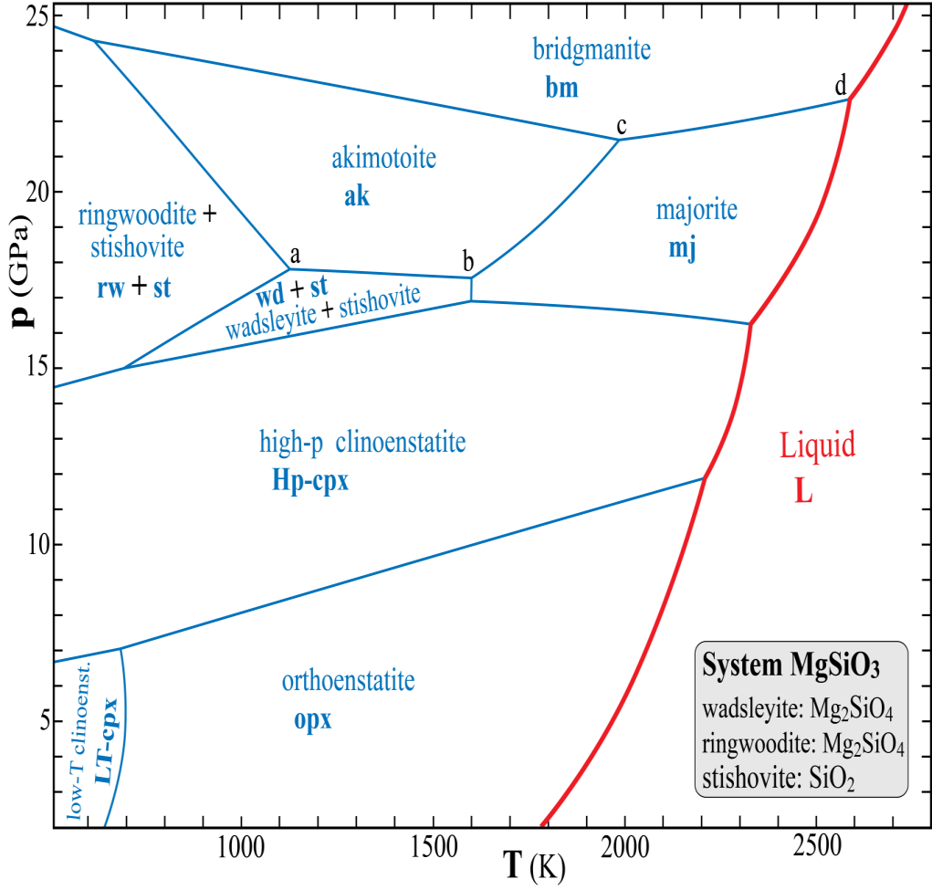
2. Phase relations in the MgSiO₃ system. The phases with compositions other than MgSiO₃ are listed in the grey box. The phase fields are marked with phase names, as well as abbreviations (bold letters).
Why do the melting curves have more curvature (with the convex side towards the melt field) than the majority of the solid-solid phase transitions?
Melts are generally more compressible than coexisting solids. Because ΔS of a melting reaction (solid → melt) is
always positive and changes relatively little with pressure, the Clapeyron slope dp/dT = ΔS/ΔV will increase with
increasing p as ΔV decreases (for the most common situation of ΔV>0). If ΔV reaches 0 and turns negative the melting
curve will "curve around" and attain a negative dp/dT slope.
b. Which of the two phases LT-cpx and opx is most compressible? opx (same explanation as above)
c. Which of the two phases mj and bm has the the largest molar volume? mj (because mj is the low-p phase)
d. Which of the phases ak and bm has the largest molar volume? ak (because ak is the low-p phase)
e. Use the Clapeyron relation to deduce the phase in each of the following two pairs with the largest entropy?
mj or bm: mj ak or bm: bm Explain briefly your reasoning:
If you have wrong answers in c and d, you should get bm and ak, respectively.
The reactions mj→bm and ak→bm have ΔV < 0 (3c-d, because they occur in response to increasing p at constant T).
The phase diagram shows that the first reaction has dp/dT = ΔS/ΔV > 0 and that the second reaction has dp/dT=
ΔS/ΔV < 0. The reactions mj→bm and ak→bm have therefore negative and positive ΔS, respectively.
f. Use the phase rule to find the variance (F) at the points a, b, c and d and along the phase boundaries a-b and c-d.
For each of the six cases you should specify the components (C) and phases (P) - not just their numbers.
Note: For a valid phase rule analysis of variance, the univariant phase boundaries (e.g. a-b) cannot not include
invariant end points, like a and b.
a: C: 2: MgO, SiO₂
P: 4: wd, rw, st, ak
F: 4−4 = 0, invariant
b: C: 2: MgO, SiO₂
P: 4: wd, st, ak, mj
F: 4−4 = 0, invariant
a-b: C: 2: MgO, SiO₂
P: 3: wd, st, ak
F: 4−3 = 1, univariant
c: C: 1: MgSiO₃
P: 3: mj, ak, bm
F: 3−3 = 0, invariant
d: C: 1: MgSiO₃
P: 3: mj, bm, L
F: 3−3 = 0, invariant
c-d: C: 1: MgSiO₃
P: 2: mj, bm
F: 3−2 = 1, univariant

Slide 3
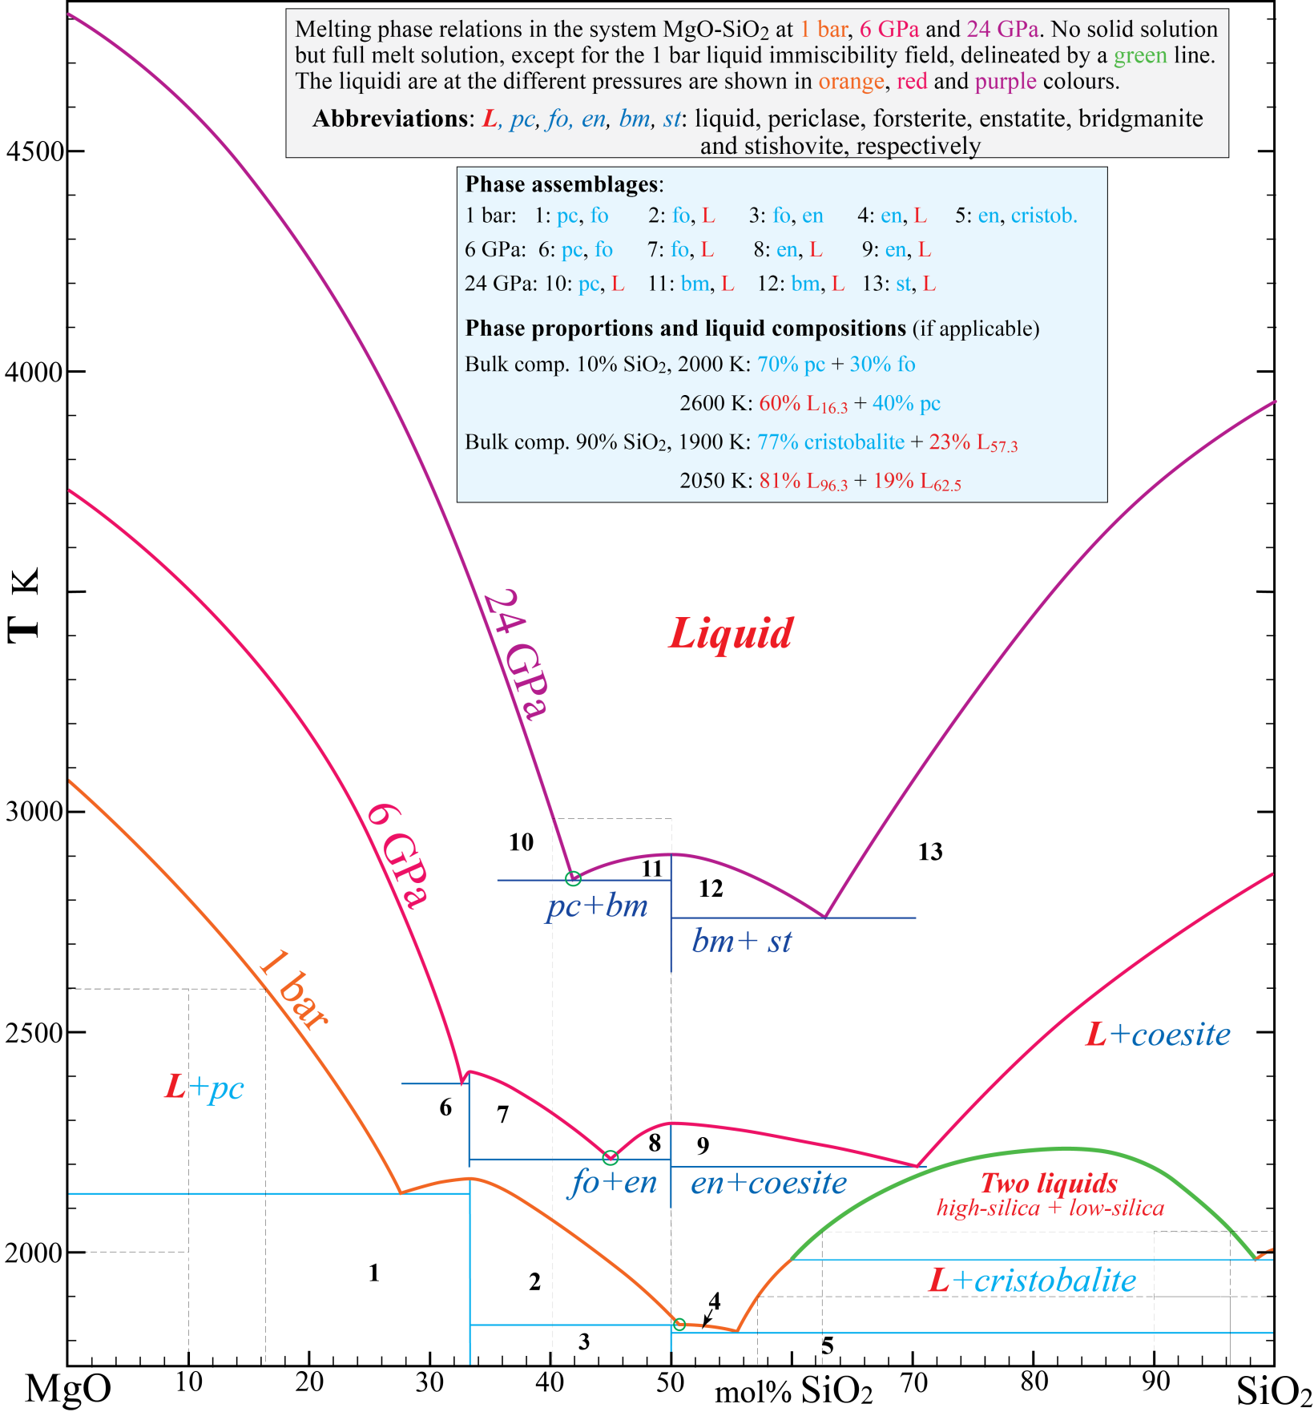
3. Melting phase relations in the system MgO-SiO₂ - se further descriptions in the grey box.
Give the phase assemblages (without phase proportions and compositions, use the abbreviations) for the numbered field
in the light blue box.
b. Give (blue box) the phase proportions and liquid compositions (if applicable) for bulk compositions with 10 and 90%
SiO₂ at the indicated temperatures. You can give the liquid compositions as L_{X}, where X is mol% SiO₂.
c. Assume that a typical peridotite in this simple model system has 60% olivine and 40% orthopyroxene. Give the
approximate model composition in mol% SiO₂ of such a peridotite: 40 mol%
d. Mark the initial (invariant) melt compositions of such a model peridotite at 1 bar, 6 GPa and 24 GPa with small rings.
e. How does the invariant melt compositions of a peridotite in this system change with increasing pressure from 1 bar to 24 GPa? The melt composition becomes more magnesian.

Slide 4
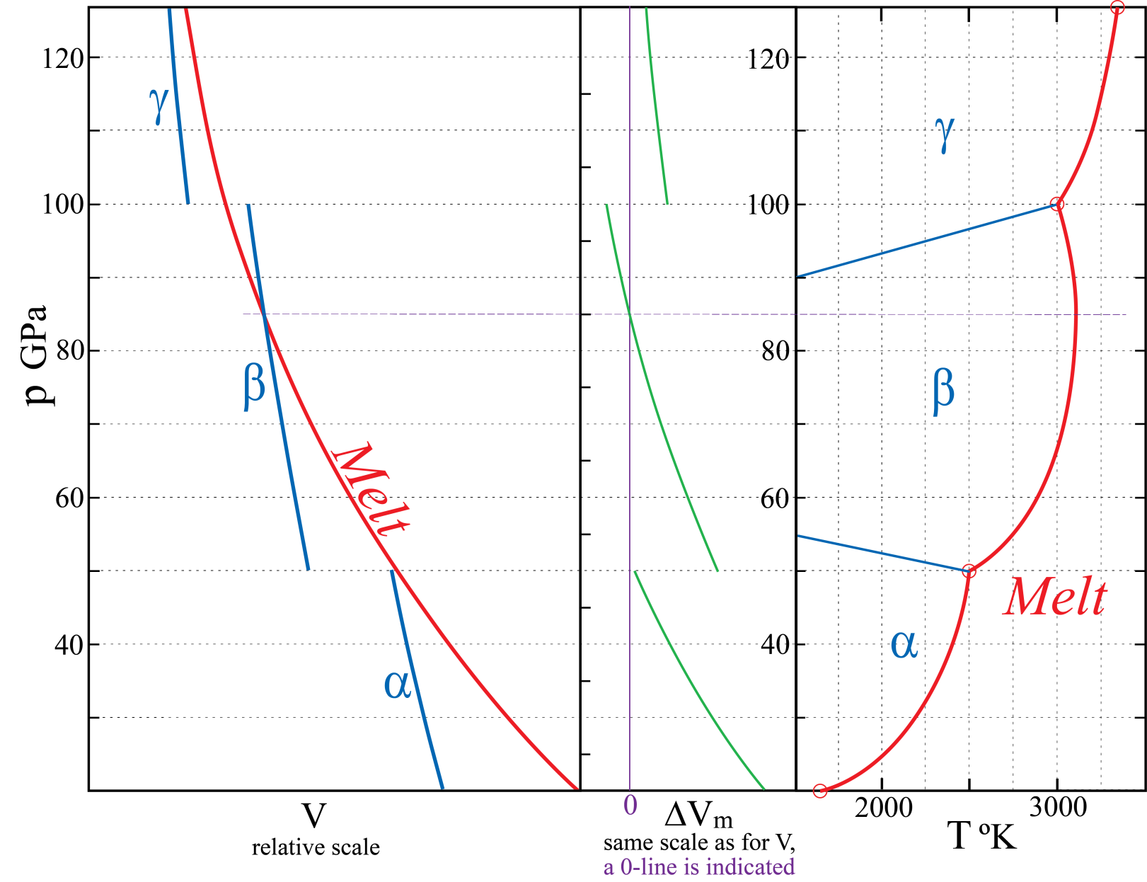
4. General features of melting curves, exemplified by an imaginary one-component system with three solid phases
α, β and γ. The left figure panel shows the molar volume V for melt and solids (along the melting curve) as a
function of pressure.
Melting reactions (solid → liquid) have positive heat of fusion (subscript m for melting), ΔH_{m} = ΔE + pΔV_{m} > 0.
The relation ΔG_{m} = ΔH_{m} ̶̶ TΔS_{m} = 0 at equilibrium (at the melting curve) requires that ΔS_{m} > 0. Make the
simplifying assumption that ΔS_{m} is constant in the problem below.
a. Draw ΔV_{m} as a function of pressure in the middle panel, using the same relative scale for the ΔV_{m}-panel as for the V-panel and your mm-ruler for measurements.
b. Draw the complete p-T phase diagram in the right panel. Put the melting curve-segments through the four fixed points marked by red circles at pressures of 30, 50, 100 and 125 GPa. The α-β and β-γ phase transitions should have Clapeyron slopes (dp/dT) of −5.0 and +6.7 MPa/K, respectively. Label the four phase fields.
c. Explain briefly why pT-melting curves are almost always convex towards the liquid field?
Because the melt is more compressible than the solids, which results in decreasing ΔV_{m} and therefore increasing
dp/dT = ΔS_{m}/ΔV_{m} with increasing p for each melting curve segment, representing one specific subsolidus
assemblage
d. ΔV_{m} for very high pressure partial melting of multi-component peridotite is likely to become negative within certain depth intervals in the Earth’s mantle. The preferential partitioning of Fe into melt will contribute to such a density crossover. During early Earth differentiation, late-stage melts from mantle magma ocean crystallisation and partial melts formed in very hot mantle plumes, rising from the core-mantle boundary, were therefore likely to accumulate at two different depth levels in the the Earth.
Give the two levels: 410 km (or slightly deeper) and the core-mantle boundary. I will also give 50% points for Moho, although that melt accumulation level is relevant for basaltic, rather than peridotitic melts.
and the corresponding depth ranges (very approximate) where peridotitic melt would sink (be negatively buoyant):
300-410 km and approximately lower 500-1000 km of the mantle.

Slide 5
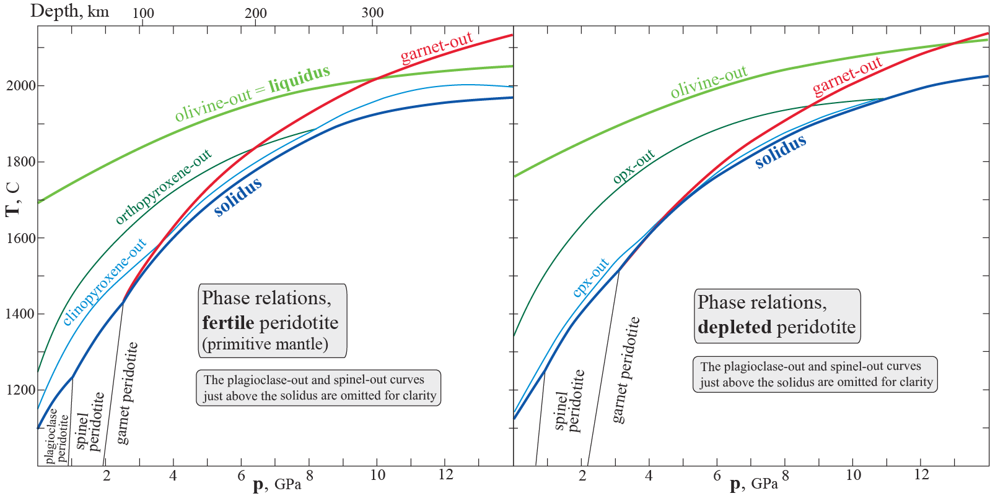
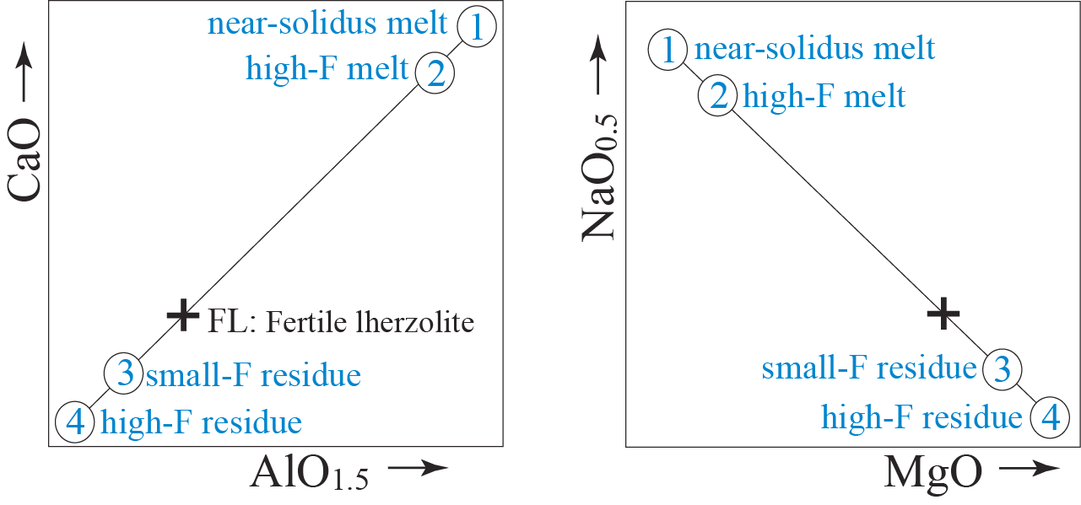
adiabatic melting paths with
solidus crossings at 6-8 GPa
5. Melting phase relations of fertile and depleted peridotite compositions.
a. Write the balanced chemical reactions for the following two subsolidus transitions:
1) plagioclase to spinel lherzolite in the system: CaO-MgO-AlO_{1.5}-SiO₂
CaAl₂Si₂O₈ + 2 Mg₂SiO₄ = MgAl₂O₄ + CaMgSi₂O₆ + 2 MgSiO₃
2) spinel to garnet lherzolite in the system: MgO-AlO_{1.5}-SiO₂
MgAl₂O₄ + 4 MgSiO₃ = Mg₃Al₂Si₃O₁₂ + Mg₂SiO₄
b. Based on the suprasolidus phase relations above, show the following approximate compositions (with correct relative positions) in the CaO-AlO_{1.5}- and NaO_{0.5}-MgO-diagrams below (relative scale, only). Use small rings around the numbers, 1-4. A fertile lherzolite composition is indicated in both of the diagrams with a cross.
1. Low-degree melt formed near the solidus
2. Melt formed by more extensive melting
3. Residue from the low-degree melting
4. Residue from the extensive melting
c. What is the two-phase mineralogy and rock name for extensively melt-depleted residues at p < 6-8 GPa ?
(Note that melting will stop well before p=0)
The two main minerals: ol + opx Rock name: harzburgite.
Because the minor minerals
clinopyroxene and the Al-rich
phases, containing high Ca, Na
(+most incompatible trace elem.)
and Al (from the Al-rich phases)
contribute most to the early melt
fractions

Slide 6
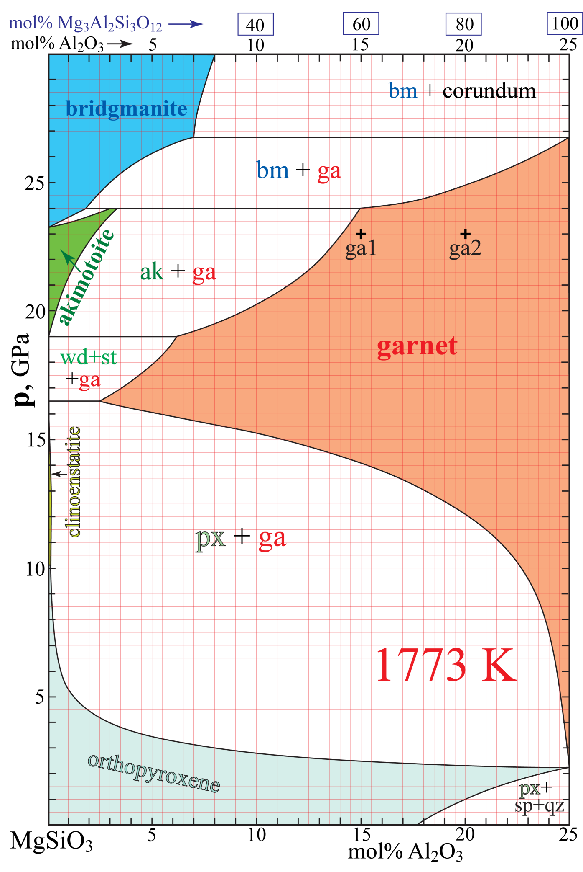
6. The system MgSiO₃-Al₂O₃ at 1773 K and 5-30 GPa. The small figure on the next page shows the entire system.
Abbreviations and compositions: px, sp, qz, st, ga, wd, ak, bm and co: pyroxene, spinel (stoichiometric MgAl₂O₄),
quartz and stishivite (both stoichiometric SiO₂), garnet, wadsleyite (stoichiometric Mg₂SiO₄), akimotoite,
bridgmanite and corundum (at 27 GPa: 80 mol% Al₂O₃, co₈₀), respectively.
3
15
15+55=70
80-25 = 55
4
14.3
55+15= 70
7.5
4.5
Fig. 6
Rock B
Rock A
5
25

Slide 7
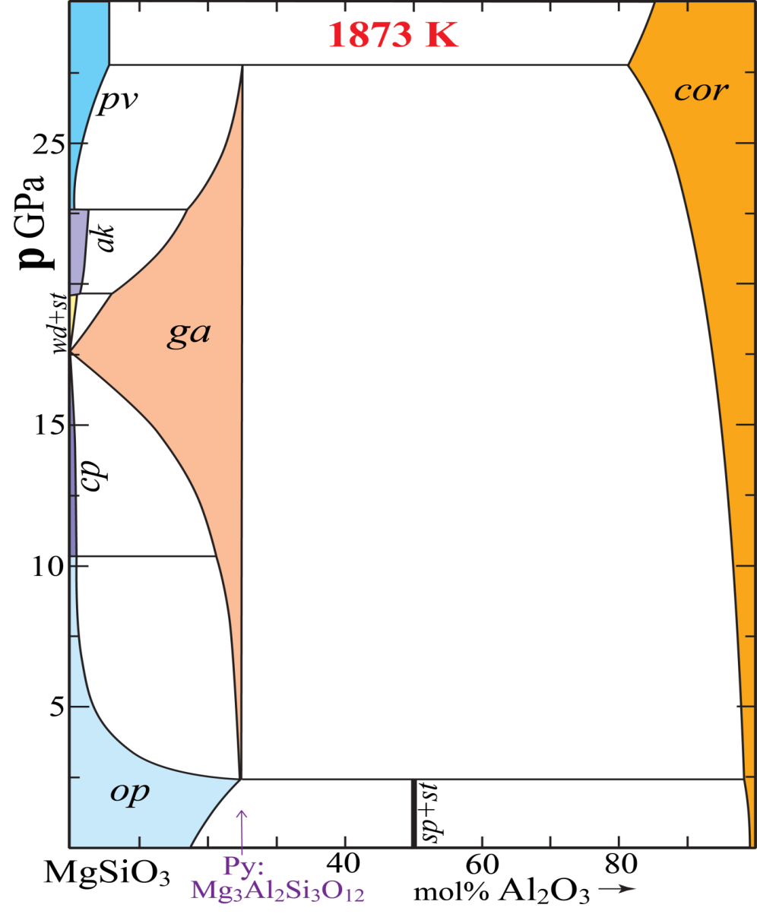
a. The generalized garnet formula is A₃B₂C₃O₁₂, where A, B and C are three distinct cation types. Give the cation
valence and coordination numbers of O around the cation sites corresponding to the A, B and C cation sites.
A-site: valence: 2+ coord.: 8 B-site: valence: 3+ and majorite 2+ & 4+ coord.: 6 C-site: valence: 4+ coord.: 4
b. Explain briefly why garnet has 25 mol% Al₂O₃ as an upper limit, based on a simple crystallographic consideration.
The Al³⁺ ions are only accepted into the octahedral (B) site, corresponding to 25% Al₂O₃ and 75% MgSiO₃
c. Give values for mol% pyrope in the four empty boxes along the top compositional axis.
d. Give the the exact amount of Al, Si and Mg atoms per formula unit in the B-site of the two majoritic garnet
compositions g1 and g2 shown in the phase diagram. The sum of the B-site atoms must be 2.
g1: Al: 1.2 Si: 0.4 Mg: 0.4 g2: Al: 1.6 Si: 0.2 Mg: 0.2
e. Give the compositions and proportions (%) of the equilibrium phases for a bulk composition of 10 % Al₂O₃
(abbreviated: bc₁₀) at 1773 K and the given pressures. Use numbers rounded off to one decimal. You should give
the phase (mineral) compositions as mol% Al₂O₃ as subscripts to the phase abbreviation (e.g. px₂₀).
Assume that the solid solution range for corundum at 27 GPa is co₈₀ at 27 GPa
20.0 GPa: 100% ga₁₀ 23.5 GPa: 62.5% ga_{14.5} + 37.5% ak_{2.8}
26.5 GPa: 78.1% bm_{6.0} + 21.9% ga_{24.3} 27.0 GPa: 95.9% bm_{7.0} + 4.1% co₈₀
f. At 1 GPa, the assemblage spinel+quarts (i.e. MgAl₂O₄+SiO₂) lies outside /to the right of) the phase diagram.
Give mol% Al₂O₃ for this pure assemblage on the MgSiO₃-Al₂O₃ join: 50 and the mol ratio of sp/qz: 1.
We are on the MgSiO₃-Al₂O₃ join, where the spinel-quartz asseblage MgAl₂O₄+SiO₂ corresponds to
1 mol MgSiO₃ + 1 mol Al₂O₃ , i.e. to 50 mol% MgSiO₃ + 50 mol% Al₂O₃
Give the compositions and proportions (%) of pyroxene and the combined sp+qz assemblage for for a bulk
composition of 25% Al₂O₃ (bc₁₀): 83.3% px₂₀ + 16.7% (sp-qz)₅₀

Slide 8
g. Specify the actual components, C and phases, P, (not only the numbers of components and phases), and use
the phase rule to investigate the variance (F) for the following bulk compositions (bc, with mol% Al₂O₃
as subscript) and pressures:
In the range bc₄₋₁₀ and 4-15 GPa
C: MgSiO₃ + Al₂O₃ or MgSiO₃ + Mg₃Al₂Si₃O₁₂
P: px + ga
F= 3 − 2 = 1, univariant
In the range bc₁₀₋₂₅ and 16-20 GPa
C: MgSiO₃ + Al₂O₃ or MgSiO₃ + Mg₃Al₂Si₃O₁₂
P: ga
F= 3 − 1 = 2, divariant
At bc₀ and 16.5 GPa
C: MgO + SiO₂
P: px + wd + st
F= 3 − 3 = 0, invariant
At bc₀ and 19.0 GPa
C: MgO + SiO₂
P: ak + wd + st
F= 3 − 3 = 0, invariant
h. What is the direct (and easy) indication of the presence of a majorite component in a complex garnet formula ?
Si > 3.00 in a formula normalized to a sum of 12 oxygen atoms or 8 cations
i. Calculate the proportions of the garnet end member components andradite, grossular, spessartine, almandine, pyrope
and majorite (Mg₄Si₄O₁₂) in the garnet compositions below. Not all of the composition contain all of the components.
For the allocation of cations to the components, follow the order: andr, gros, spes, alm, pyr, maj (as the sequence above).
If there is too little Ca for andradite, try to allocate the rest of the Fe³⁺ to the skiagite component: Fe²⁺₃ Fe³⁺₂ Si₃O₁₂.
Andradite from Fe³⁺ (if too litte Ca: calculate skiagite from remaining Fe³⁺), grossular from the rest of Ca, spessartin from Mn, almandine from (remaining) Fe²⁺, pyrope from remaining Al and majorite from remaining Mg and Si.
Comment: Alternatively, one could calculate skiagite first from all the Fe³⁺ in the mineral formulas. For the three garnet compositions used here, that would be possible and it would result in no andradite and almandine, more grossular and the same amounts of the pyrope and majorite component as with the component sequence specified above. Naturally, the sum of the ferric iron components must also be the same with the two different allocation sequences: i.e. the sum of andridide + skiagite must be constant (the same) for the two alternative component allocation sequences.
1. Ca_{0.6}Fe²⁺_{0.3}Mn_{0.1}Mg_{2.1}Al_{1.6}Fe³⁺_{0.2}Si_{3.1}O₁₂
2. Ca_{0.15}Fe²⁺_{0.15}Mn_{0.15}Mg_{2.85}Al_{1.3}Fe³⁺_{0.1}Si_{3.3}O₁₂
3. Ca_{0.3}Fe²⁺_{0.6}Mg_{2.4}Al_{1.0}Fe³⁺_{0.4}Si_{3.3}O₁₂
Cation proportions ~ 80, norm. to 100%
Andr: Ca_{0.3}Fe³⁺_{0.2}Si_{0.3} 3+2+3 = 8, 10%
Gros: Ca_{0.3}Al_{0.2}Si_{0.3} 3+2+3 = 8, 10%
Spes: Mn_{0.1}Al_{0.067}Si_{0.1} 1+0.67+1 = 2.67, 3.34%
Alm: Fe²⁺_{0.3}Al_{0.2}Si_{0.3} 3+2+3 = 8 10%
Pyr: Mg_{1.69}Al_{1.13}Si_{1.69} 16.9+11.3+16.9 = 45.1, 56.4%
Maj (rest of Mg and Si): Mg_{0.41}Si_{0.41} 4.1+4.1 = 8.2, 10.3%
Cation proportions ~ 80, norm. to 100%
Andr: Ca_{0.15}Fe³⁺_{0.1}Si_{0.15} 1.5+1+1.5 = 4, 5%
Gros: No more Ca
Spes: Mn_{0.15}Al_{0.1}Si_{0.15} 1.5+1+1.5 = 4, 5%
Alm: Fe²⁺_{0.15}Al_{0.1}Si_{0.15} 1.5+1+1.5 = 4, 5%
Pyr: Mg_{1.65}Al_{1.1}Si_{1.65} 16.5+11+16.5 = 44, 55%
Maj (rest of Mg and Si): Mg_{1.2}Si_{1.2} 12+12 = 24, 30%
Cation proportions ~ 80, norm. to 100%
Andr: Ca_{0.3}Fe³⁺_{0.2}Si_{0.3} 3+2+3 = 8, 10%
Gross: No more Ca
Skiag: Fe³⁺_{0.3}Fe³⁺_{0.2}Si_{0.3} 3+2+3 = 8, 10%
Spess: No Mn
Alm: Fe²⁺_{0.3}Al_{0.2}Si_{0.3} 3+2+3 = 8, 10%
Pyr: Mg_{1.2}Al_{0.8}Si_{1.2} 12+8+12 = 32, 40%
Majorite (rest of Mg and Si): Mg_{1.2}Si_{1.2} 12+12 = 24, 30%

Slide 9
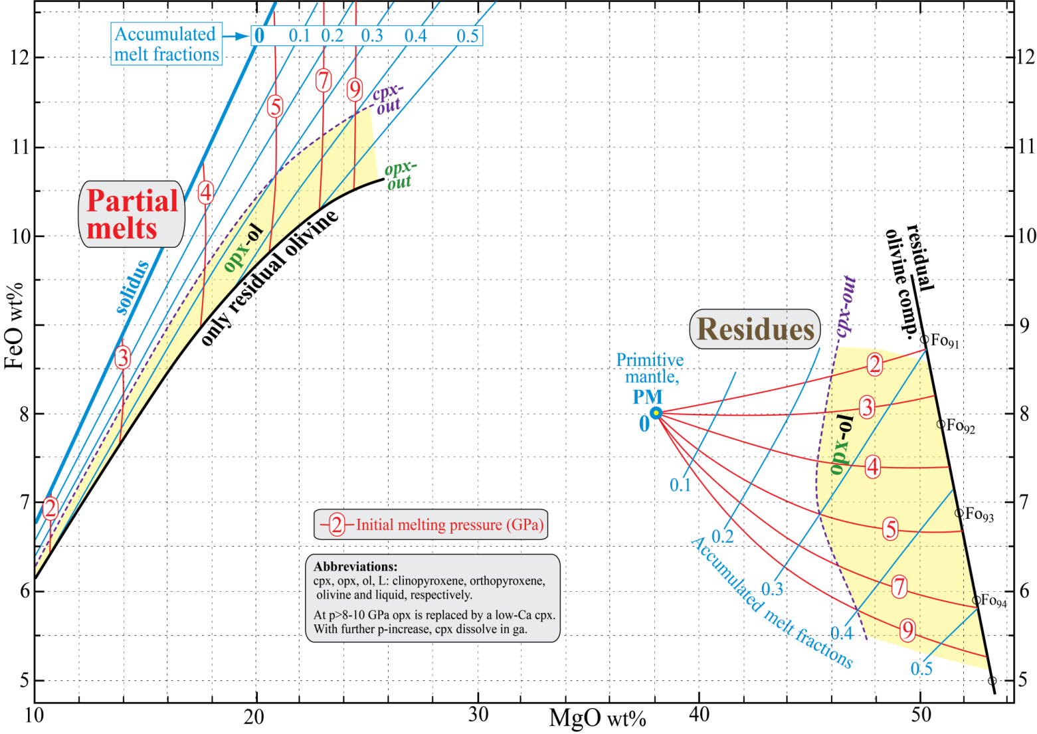
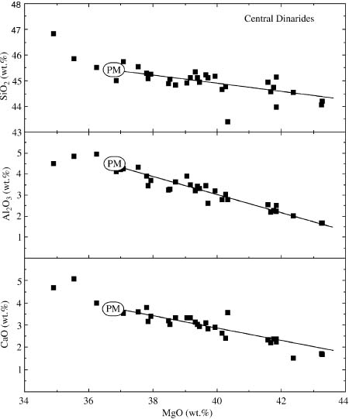
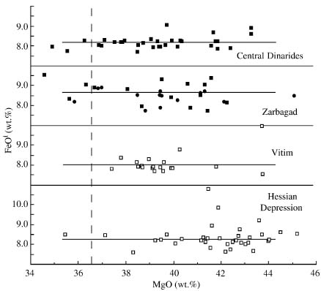
7. Melt residues, oceanic and orogenic peridotites and Archean cratonic lithosphere.
a. The simple FeO-MgO diagram in Fig. 7A shows the relations between melts and residues derived from melting of primitive mantle peridotites for various initial melting pressures and accumulated melt fractions. Fig 7B shows the composition and melt-extraction trends for various suites of oceanic and orogenic peridotites, plotted with MgO along the x-axis. Note that the melt extraction trends for FeO are quite flat for these pperidotites. Based on Fig 7A, give the expected
approximate initial melting pressure (or pressure range): 3 GPa (or may be a range of 2.5-3.5 GPa)
and the approximate range of melt fractions (up to 45% MgO): up to about 0.22 (i.e. 22%)
Fig. 7A
PM: assumed primitive mantle composition, samples to
the left of PM may be metasomatically enriched
Fig. 7B
Melt extraction trend
PM
Melt extraction trend

