Slide 1
Exercises
1. Clapeyron slope - general features. Although the indicated chemical reactions (below) are highly schematic, they must in principle be balanced. Subscripts _{R} and _{P} indicate reactants and products, respectively. A reaction written as e.g. Solids_{R} = Solids_{P}, might have one, or more than one, phase on each side.
a. Relate dT, dp, ΔS and ΔV by the Clapeyron equation (write the equation).
Develop the Clapeyron equation (mathematically) from the expression for
ΔG = ΔE + pΔV + TΔS, based on the andalusite to kyanite transition
example in the figure, below.
b. State or discuss the signs (positive or negative) for ΔS and ΔV of the schematic reactions 1-3 (below). Discuss specifically why ΔV is likely to change more than ΔS with increasing pressure in reactions 2 and 3.
1. Reaction occurring in response to increasing p: Solids_{R} = Solids_{P}
2. Melting reaction: Solids_{R} = Melt_{P}
3. Devolatilisation reactions: Solids_{R} = Solids_{P} + fliud/vapour
e.g. KAl₂ Si₃Al O₁₀ (OH)₂ (muscovite) + SiO₂ (quartz) = KAlSi₃O₈ (K-felspar) + Al₃SiO₅ (kynaite) + H₂O (vapour)
or: CaCO₃ (calcite) + SiO₂ (quartz) = CaSiO₃ (wollastonite) + CO₂ (vapour)
p
kyanite
dp
p₁+dp, T₁+dT
p₁
p₁,T₁
andalusite
dT
T
T₁

Slide 2
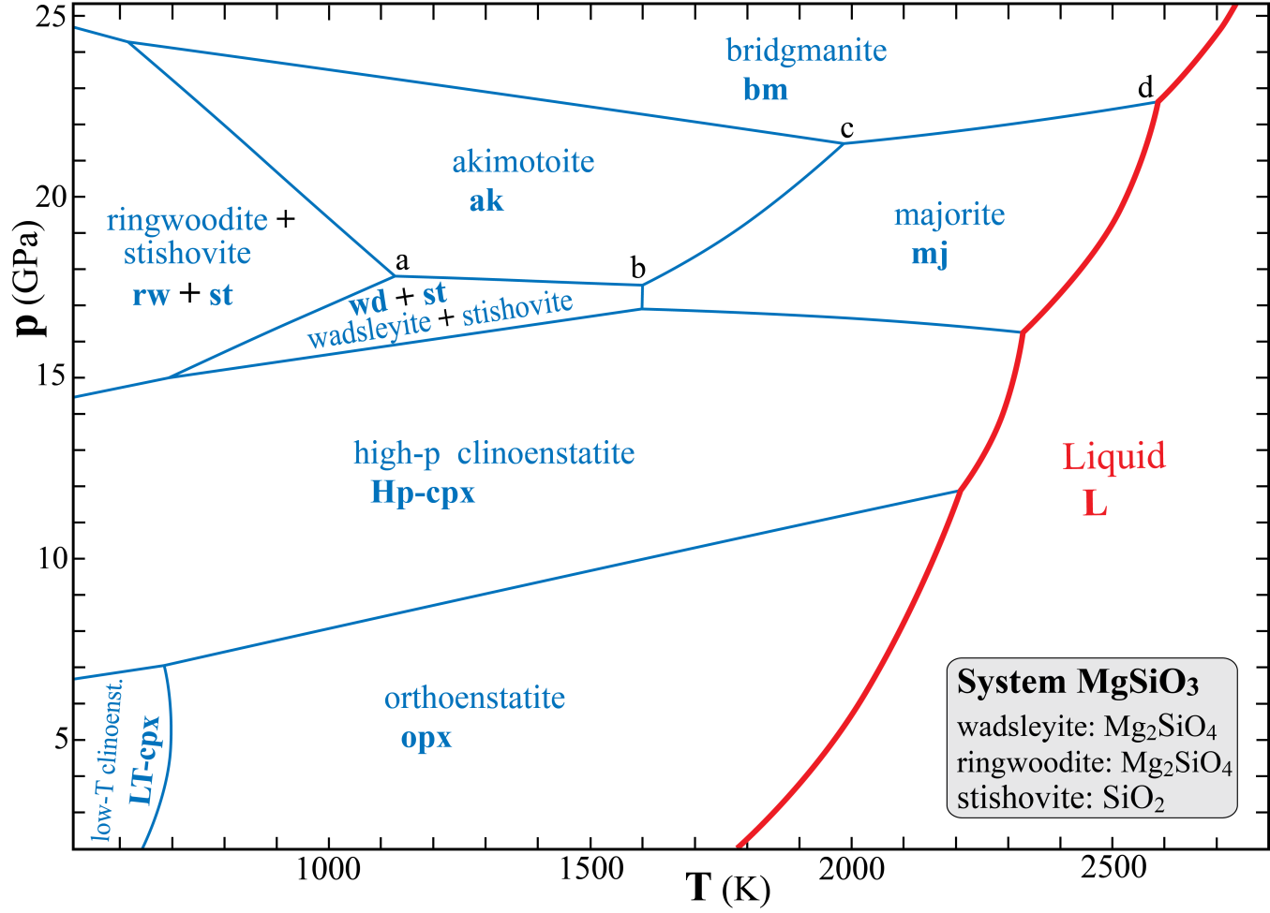
2. Phase relations in the MgSiO₃ system. The phases with compositions other than MgSiO₃ are listed in the grey box. The phase fields are marked with phase names, as well as abbreviations (bold letters).
Why do the melting curves have more curvature (with the convex side towards the melt field) than the majority of the solid-solid phase transitions?
b. Which of the two phases LT-cpx and opx is most compressible? .
c. Which of the two phases mj and bm has the the largest molar volume? .
d. Which of the phases ak and bm has the largest molar volume? .
e. Use the Clapeyron relation to deduce the phase in each of the following two pairs with the largest entropy?
mj or bm: ak or bm: . Explain briefly your reasoning:
f. Use the phase rule to find the variance (F) at the points a, b, c and d and along the phase boundaries a-b and c-d.
For each of the six cases you should specify the components (C) and phases (P) - not just their numbers.
a: C: .
P: .
F: .
b: C: .
P: .
F: .
a-b: C: .
P: .
F: .
c: C: .
P: .
F: .
d: C: .
P: .
F: .
c-d: C: .
P: .
F: .

Slide 3
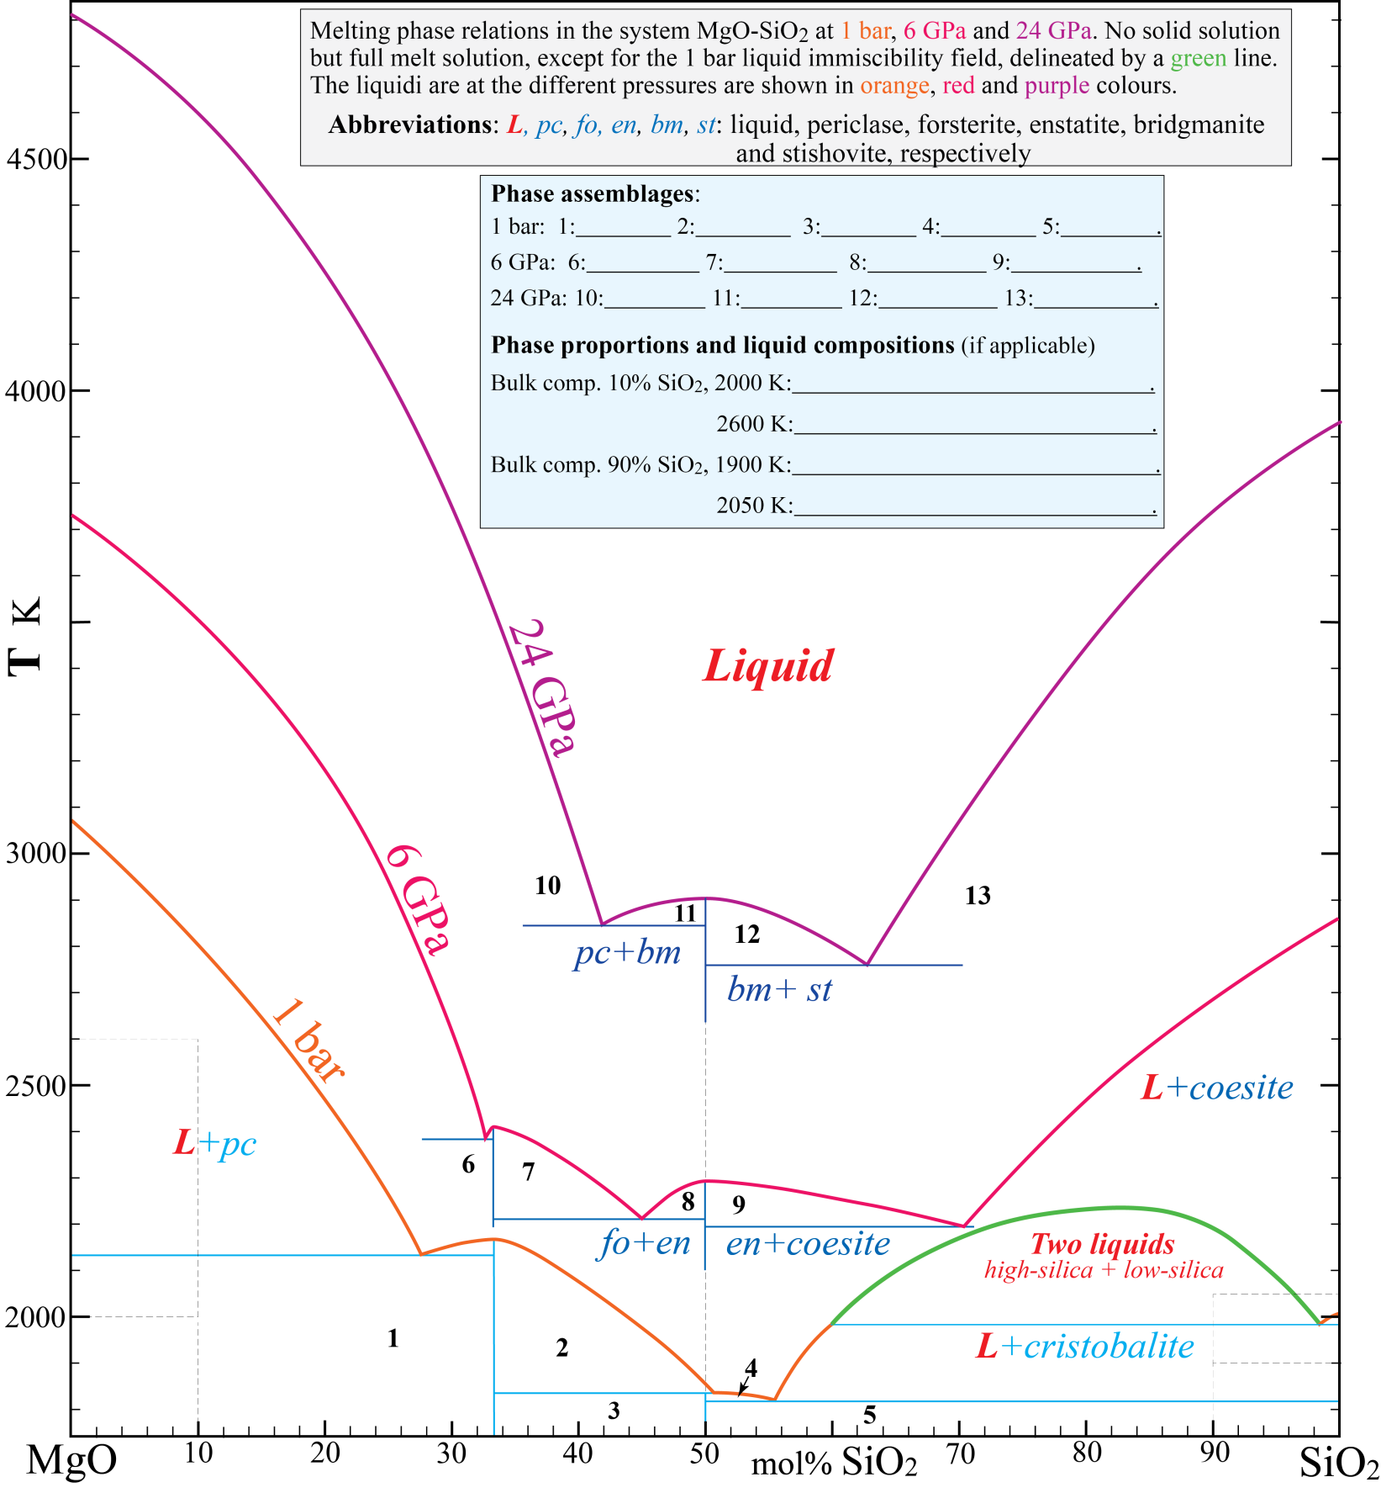
3. Melting phase relations in the system MgO-SiO₂ - se further descriptions in the grey box.
Give the phase assemblages (without phase proportions and compositions, use the abbreviations) for the numbered field
in the light blue box.
b. Give (blue box) the phase proportions and liquid compositions (if applicable) for bulk compositions with 10 and 90%
SiO₂ at the indicated temperatures. You can give the liquid compositions as L_{X}, where X is mol% SiO₂.
c. Assume that a typical peridotite in this simple model system has 60% olivine and 40% orthopyroxene. Give the
approximate model composition in mol% SiO₂ of such a peridotite: .
d. Mark the initial (invariant) melt compositions of such a model peridotite at 1 bar, 6 GPa and 24 GPa with small rings.
e. How does the invariant melt compositions of a peridotite in this system change with increasing pressure from 1 bar to 24 GPa? .

Slide 4
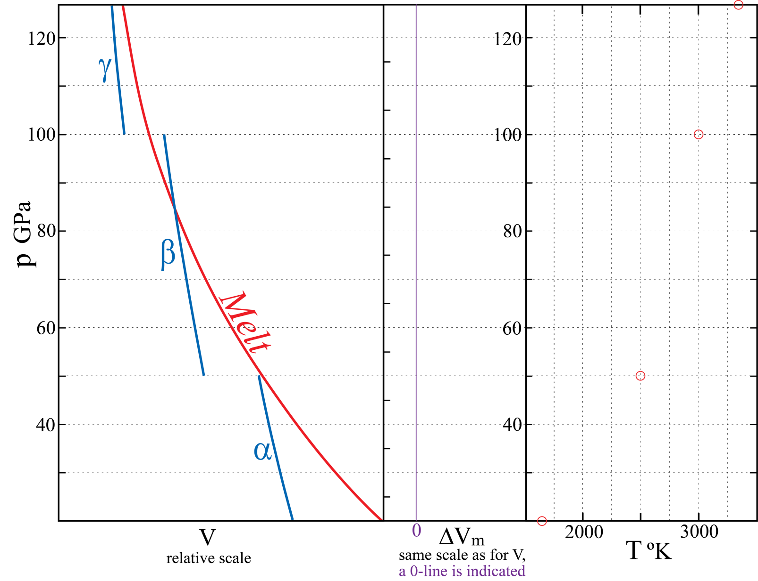
4. General features of melting curves, exemplified by an imaginary one-component system with three solid phases
α, β and γ. The left figure panel shows the molar volume V for melt and solids (along the melting curve) as a
function of pressure.
Melting reactions (solid → liquid) have positive heat of fusion (subscript m for melting), ΔH_{m} = ΔE + pΔV_{m} > 0.
The relation ΔG_{m} = ΔH_{m} ̶̶ TΔS_{m} = 0 at equilibrium (at the melting curve) requires that ΔS_{m} > 0. Make the
simplifying assumption that ΔS_{m} is constant in the problem below.
a. Draw ΔV_{m} as a function of pressure in the middle panel, using the same relative scale for the ΔV_{m}-panel as for the V-panel and your mm-ruler for measurements.
b. Draw the complete p-T phase diagram in the right panel. Put the melting curve-segments through the four fixed points marked by red circles at pressures of 30, 50, 100 and 125 GPa. The α-β and β-γ phase transitions should have Clapeyron slopes (dp/dT) of −5.0 and +6.7 MPa/K, respectively. Label the four phase fields.
c. Explain briefly why pT-melting curves are almost always convex towards the liquid field?
d. ΔV_{m} for very high pressure partial melting of multi-component peridotite is likely to become negative within certain depth intervals in the Earth’s mantle. The preferential partitioning of Fe into melt will contribute to such a density crossover. During early Earth differentiation, late-stage melts from mantle magma ocean crystallisation and partial melts formed in very hot mantle plumes, rising from the core-mantle boundary, were therefore likely to accumulate at two different depth levels in the the Earth.
Give the two levels: and .
and the corresponding depth ranges (very approximate) where peridotitic melt would sink (be negatively buoyant):
and .

Slide 5
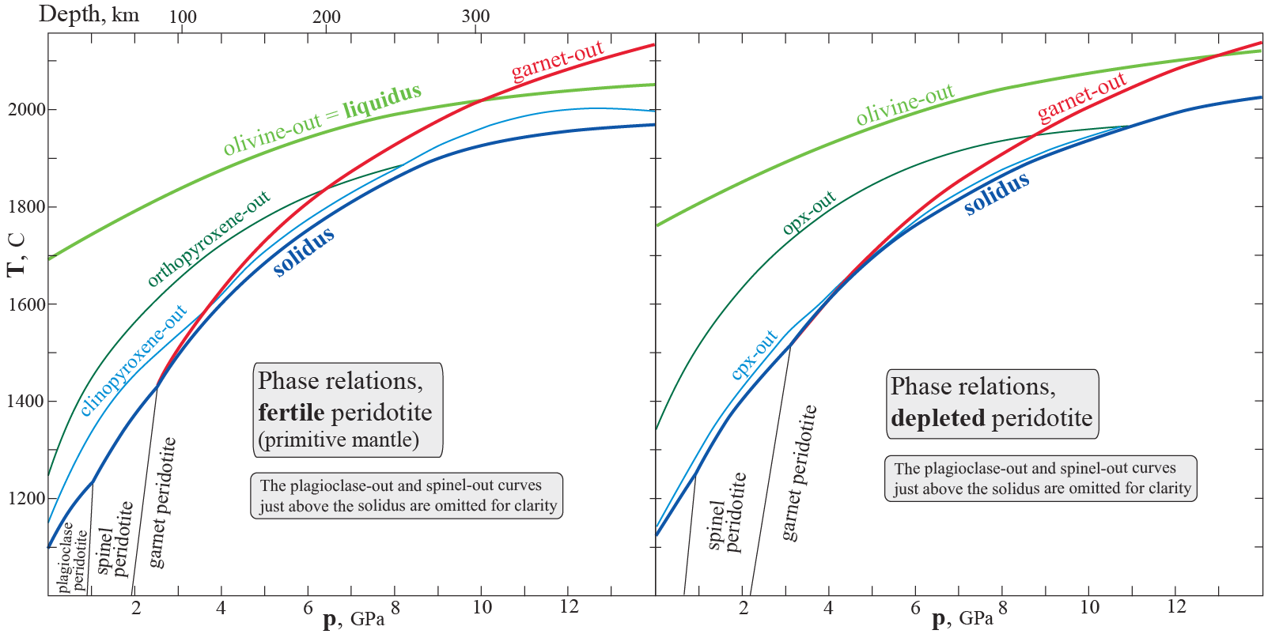
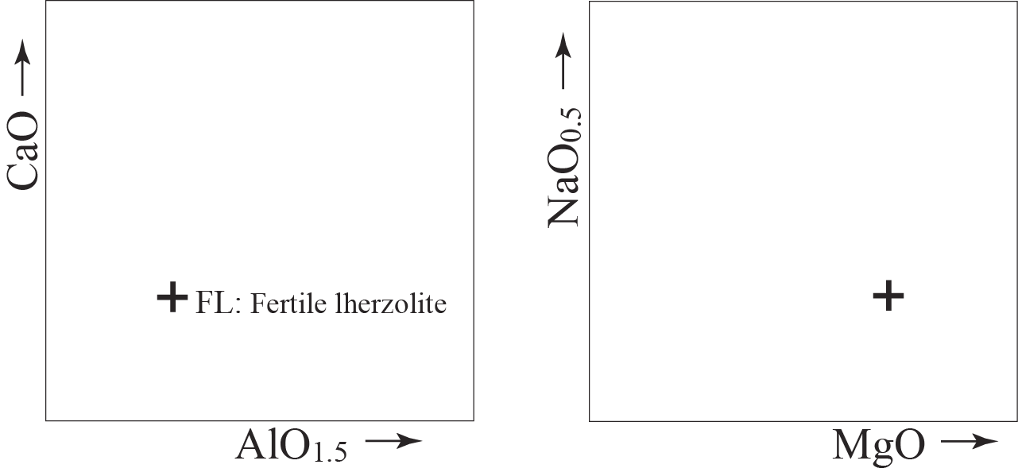
5. Melting phase relations of fertile and depleted peridotite compositions.
a. Write the balanced chemical reactions for the following two subsolidus transitions:
1) plagioclase to spinel lherzolite in the system: CaO-MgO-AlO_{1.5}-SiO₂
2) spinel to garnet lherzolite in the system: MgO-AlO_{1.5}-SiO₂
b. Based on the suprasolidus phase relations above, show the following approximate compositions (with correct relative positions) in the CaO-AlO_{1.5}- and NaO_{0.5}-MgO-diagrams below (relative scale, only). Use small rings around the numbers, 1-4. A fertile lherzolite composition is indicated in both of the diagrams with a cross.
1. Low-degree melt formed near the solidus 3. Residue from the low-degree melting
2. Melt formed by more extensive melting 4. Residue from the extensive melting
c. What is the two-phase mineralogy and rock name for extensively melt-depleted residues at p < 6-8 GPa ?
(Note that melting will stop well before p=0)
The two main minerals: . Rock name: .

Slide 6
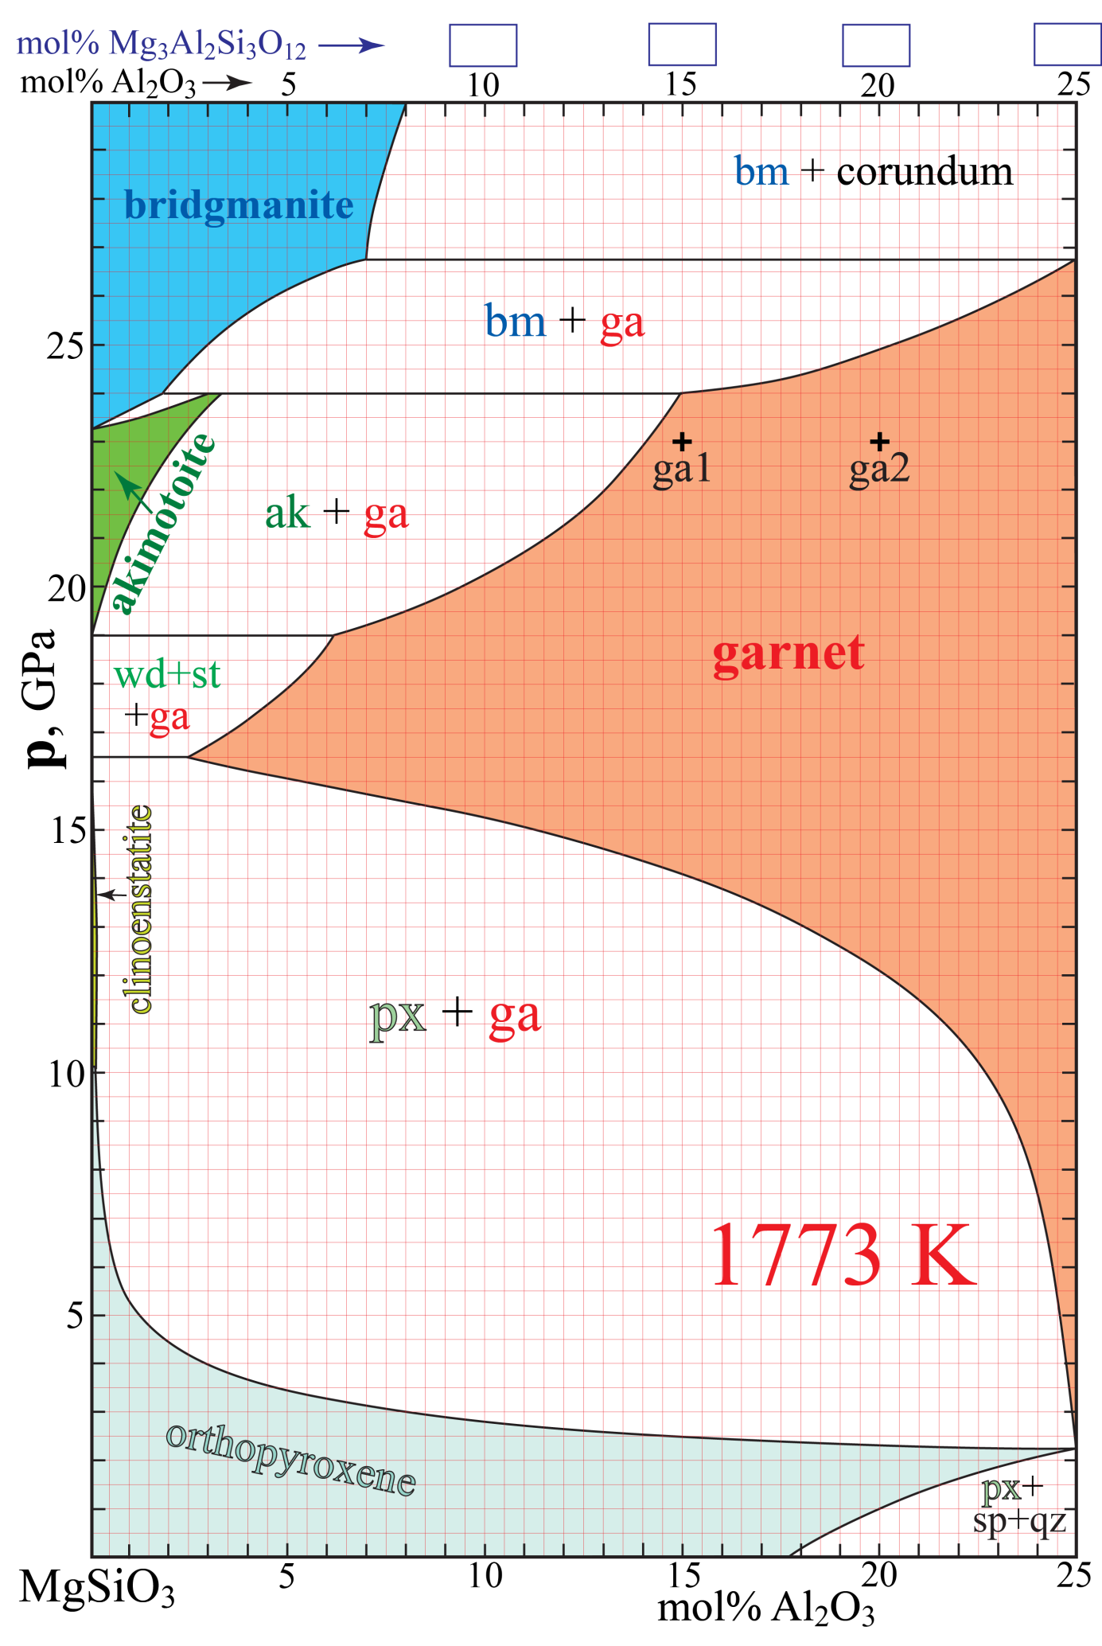
6. The system MgSiO₃-Al₂O₃ at 1773 K and 5-30 GPa. The small figure on the next page shows the entire system.
Abbreviations and compositions: px, sp, qz, st, ga, wd, ak, bm and co: pyroxene, spinel (stoichiometric MgAl₂O₄),
quartz and stishivite (both stoichiometric SiO₂), garnet, wadsleyite (stoichiometric Mg₂SiO₄), akimotoite,
bridgmanite and corundum (at 27 GPa: 80 mol% Al₂O₃, co₈₀), respectively.
Fig. 6A
1500 °C

Slide 7
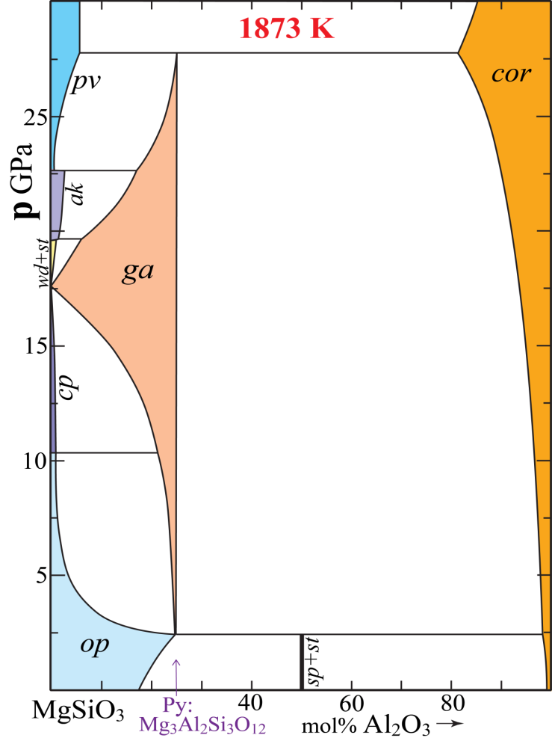
Fig. 6A
a. The generalized garnet formula is A₃B₂C₃O₁₂, where A, B and C are three distinct cation types. Give the cation
valence and coordination numbers of O around the cation sites corresponding to the A, B and C cation sites.
A-site: valence: coord.: B-site: valence: coord.: C-site: valence: coord.: .
b. Explain briefly why garnet has 25 mol% Al₂O₃ as an upper limit, based on a simple crystallographic consideration.
c. Give values for mol% pyrope in the four empty boxes along the top compositional axis.
d. Give the the exact amount of Al, Si and Mg atoms per formula unit in the B-site of the two majoritic garnet
compositions g1 and g2 shown in the phase diagram. The sum of the B-site atoms must be 2.
g1: Al: Si: Mg: g2: Al: Si: Mg: .
e. Give the compositions and proportions (%) of the equilibrium phases for a bulk composition of 10 % Al₂O₃
(abbreviated: bc₁₀) at 1773 K and the given pressures. Use numbers rounded off to one decimal. You should give
the phase (mineral) compositions as mol% Al₂O₃ as subscripts to the phase abbreviation (e.g. px₂₀).
Assume that the solid solution range for corundum at 27 GPa is co₈₀ at 27 GPa
20.0 GPa: 23.5 GPa: .
26.5 GPa: 27.0 GPa: .
f. At 1 GPa, the assemblage spinel+quarts (MgAl₂O₄+SiO₂) lies outside (to the right of) the shown phase diagram.
Give mol% Al₂O₃ for this pure assemblage on the MgSiO₃-Al₂O₃ join: and the mol ratio of sp/qz: .
Give the compositions and proportions (%) of pyroxene and the combined sp+qz assemblage for a bulk composition
of 25% Al₂O₃ (bc₁₀):
px + (sp-qz) .

Slide 8
g. Specify the actual components, C and phases, P, (not only the numbers of components and phases), and use
the phase rule to investigate the variance (F) for the following bulk compositions (bc, with mol% Al₂O₃
as subscript) and pressures:
At bc₀ and 16.5 GPa
C:
P:
F=
At bc₀ and 19.0 GPa
C:
P:
F=
In the range bc₄₋₁₀ and 4-15 GPa
C:
P:
F=
In the range bc₁₀₋₂₅ and 16-20 GPa
C:
P:
F=
h. What is the direct (and easy) indication of the presence of a majorite component (MgSiO₃ or Mg₄Si₄O₁₂) in a complex garnet formula ?
i. Calculate the proportions of the garnet end member components andradite, grossular, spessartine, almandine, pyrope
and majorite (Mg₄Si₄O₁₂) in the garnet compositions below. Not all of the composition contain all of the components.
For the allocation of cations to the components, follow the order: andr, gros, spes, alm, pyr, maj (as the sequence above)
If there is too little Ca for andradite, allocate the rest of the Fe³⁺ to the skiagite component: Fe²⁺₃ Fe³⁺₂ Si₃O₁₂.
1. Ca_{0.6}Fe²⁺_{0.3}Mn_{0.1}Mg_{2.1}Al_{1.6}Fe³⁺_{0.2}Si_{3.1}O₁₂
2. Ca_{0.15}Fe²⁺_{0.15}Mn_{0.15}Mg_{2.85}Al_{1.3}Fe³⁺_{0.1}Si_{3.3}O₁₂
3. Ca_{0.3}Fe²⁺_{0.6}Mg_{2.4}Al_{1.0}Fe³⁺_{0.4}Si_{3.3}O₁₂

Slide 9
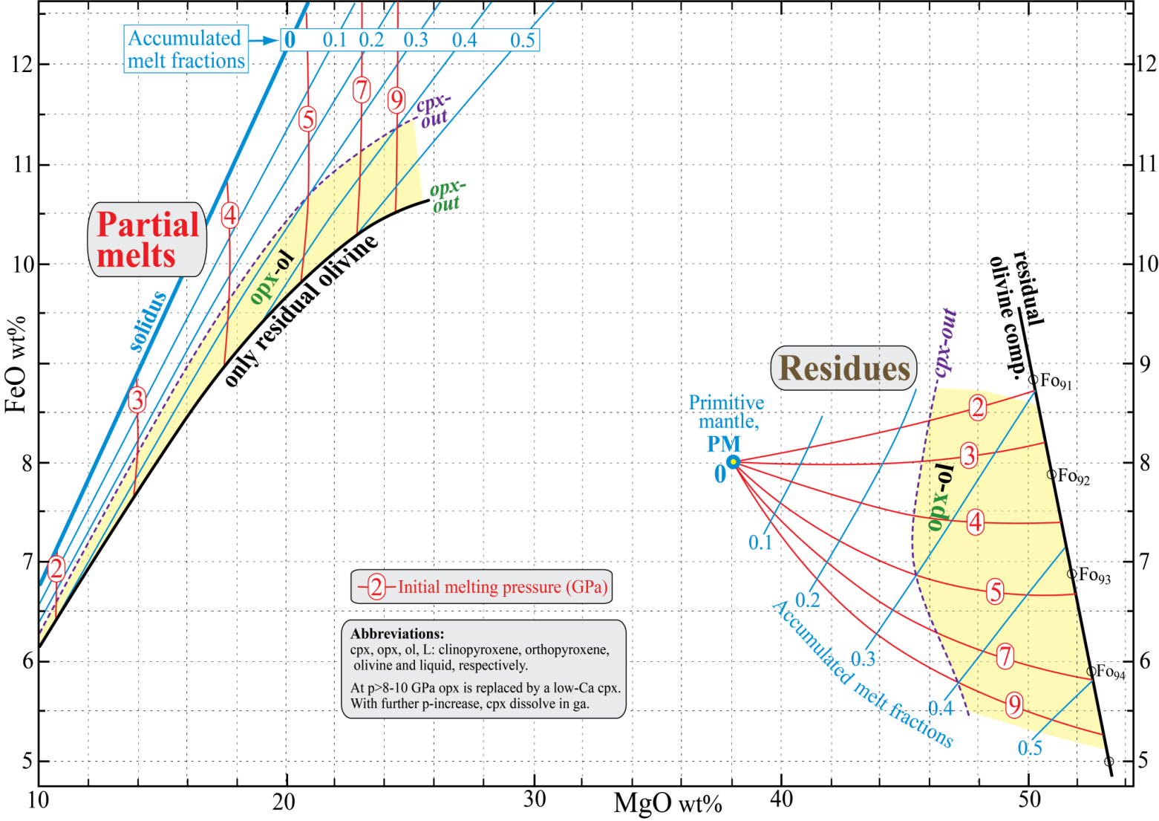
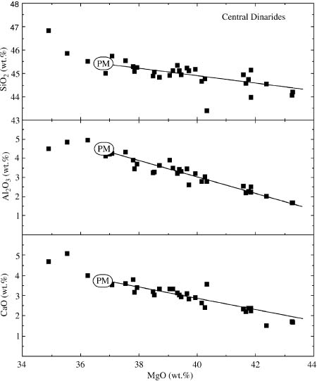
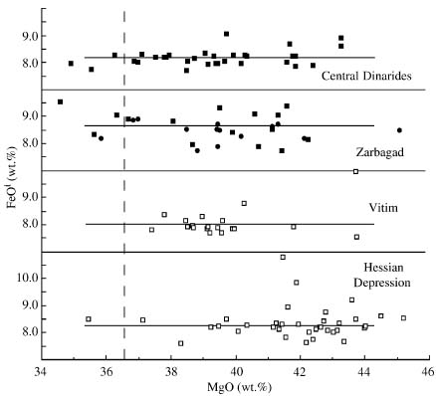
7. Melt residues, oceanic and orogenic peridotites and Archean cratonic lithosphere.
a. The simple FeO-MgO diagram in Fig. 7A shows the relations between melts and residues derived from melting of primitive mantle peridotites for various initial melting pressures and accumulated melt fractions. Fig 7B shows the composition and melt-extraction trends for various suites of oceanic and orogenic peridotites, plotted with MgO along the x-axis. Note that the melt extraction trends for Feo are quite flat for these pperidotites. Based on Fig 7A, give the expected
approximate initial melting pressure (or pressure range): .
and the approximate range of melt fractions (up to 45% MgO): .
Fig. 7A
PM: assumed primitive mantle composition, samples to
the left of PM may be metasomatically enriched
Fig. 7B
Melt extraction trend
PM
Melt extraction trend

Slide 10
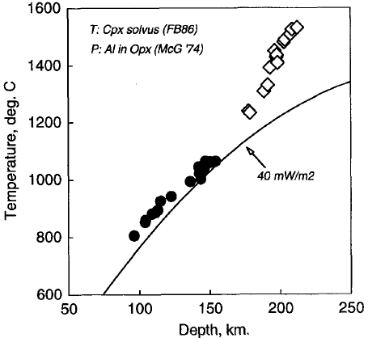
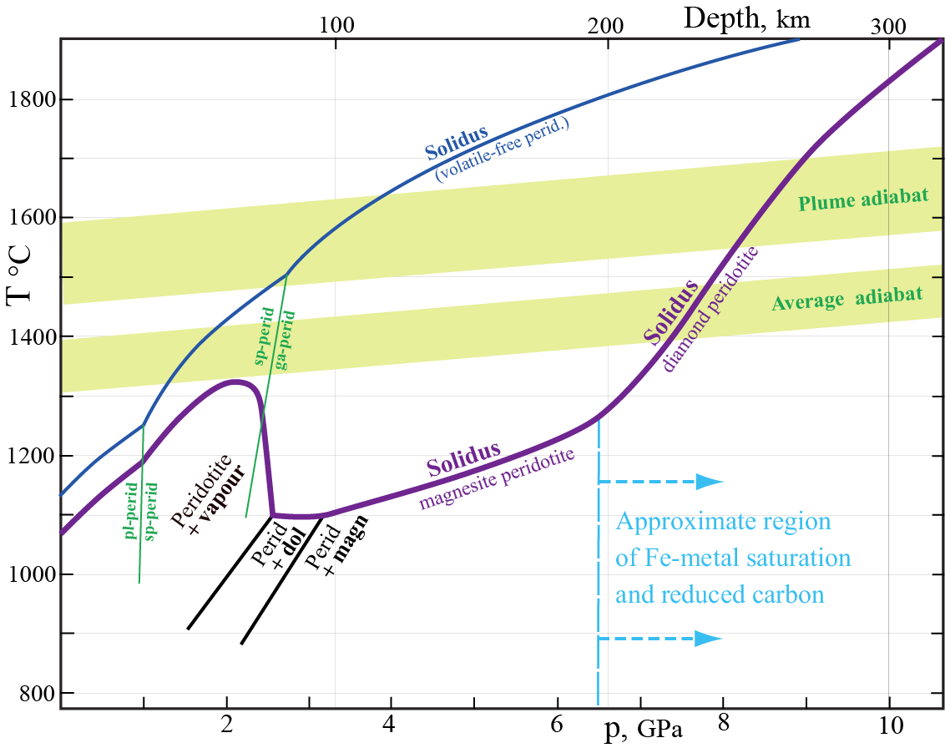
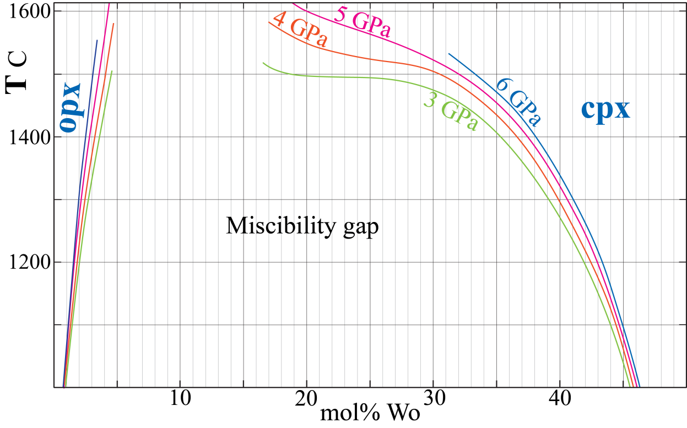
b. Figure 7C shows a xenolith-based geotherm from the Kaapvaal craton determined in the following way:
1. Geobarometry from the Al₂O₃-content of orthopyroxene (opx) in equilibrium with garnet. The opx-solvus in Fig. 6
(problem 6) is fairly insensitive to temperature
2. Geothermometry from the opx-cpx-solvus (Fig. 7D, below, compositions on the enstatite wollastonite join)
You should determine the pressure of two garnet lherzolites with high Mg# = 100Mg/(Mg+Fe) of 92-93 and the following key mineral compositions (we use the phase diagrams, Fig. 5 and Fig. 7D for the Fe-free systems in this problem):
Rock A: Opx with 3.0 mol% Al₂O₃ and cpx with 45.7 % Wo (wollastonite component)
Rock B: Opx with 0.6 mol% Al₂O₃ and cpx with 33.4 % Wo
Use the procedure above to estimate first the pressure of equilibration for rock A: , rock B: and
then the temperature of equilibration, using the correct cpx-solvus for rock A: , rock B: .
Using the following pressure-depth relation for the mantle: depth(km) = p(GPa)/0.03, i.e. 200 km ~ 6 GPa, mark the approximate positions of rocks A and B in Fig. 7C with small rings. Which of the two rocks is most likely to have equilibrated in the asthenosphere: .
c. The gap in sampling of mantle xenoliths brought to the surface by kimberlites (see Fig. 7C) might be related to the occurrence of abundant carbonate minerals at the asthenosphere-lithosphere boundary region where kimberlite mmagmas are likely to form. Based on Fig. 7E, explain briefly why kimberlites are generally unable to bring carbonate-rich samples to the surface.
Geotherm based on mineral compositions
in xenoliths from the Kaapvaal craton
High-T xenoliths,
mostly deformed
Fig. 7E
Gap
Fig. 7C
Low-T xenoliths
mostly granular
Fig. 7D

