Slide 1
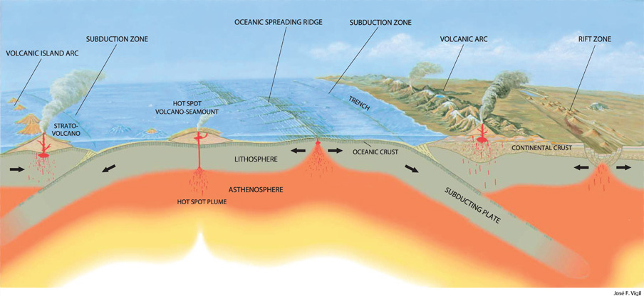
The Initiation of Plate Tectonics on Earth
Bence Horányi
09/05/2023
Institute des Sciences de la Terre d’Orléans - Centre National Recherche Scientifique
Source: www.oregongeology.com

Slide 2
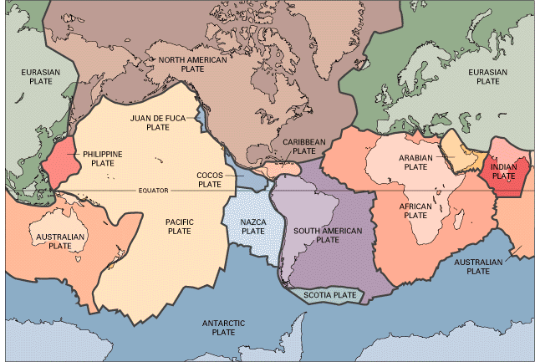
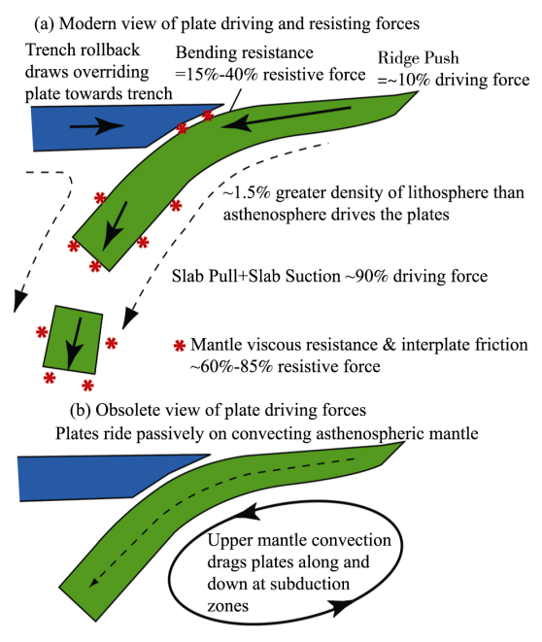
Introduction to Plate Tectonics
Introduction
Earth and Planteray Materials and Dynamics
Tuesday 9 May 2023
Source: USGS
Stern. 2007

Slide 3
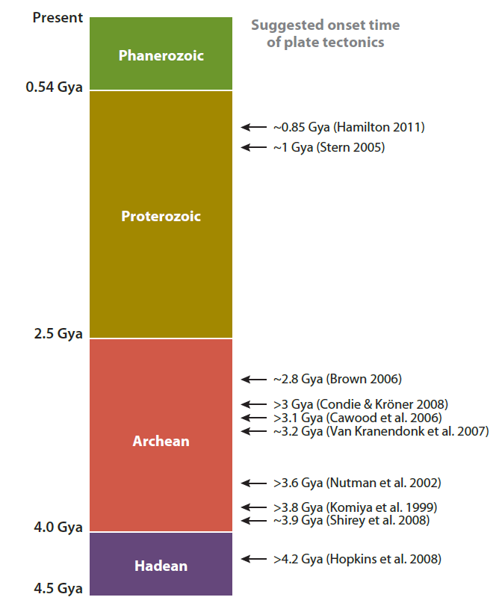
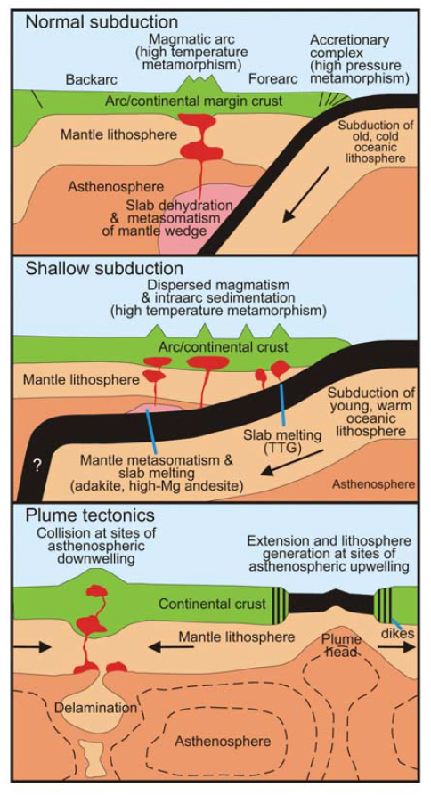
Origin of Plate Tectonics
Evolution of Plate Tectonics
Earth and Planteray Materials and Dynamics
Tuesday 9 May 2023
2.2 Gya
Formation of Columbia
Formation of Supercratons
Korenaga, 2013
Cawood et al., 2006

Slide 4
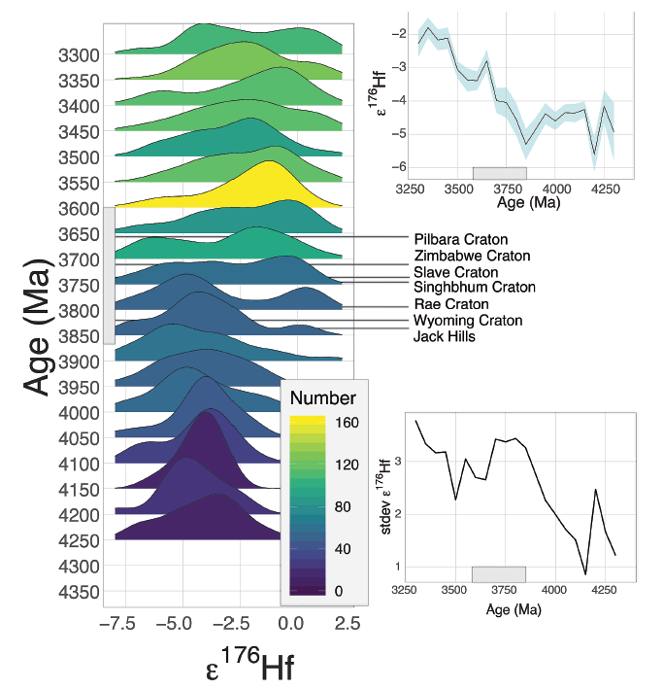
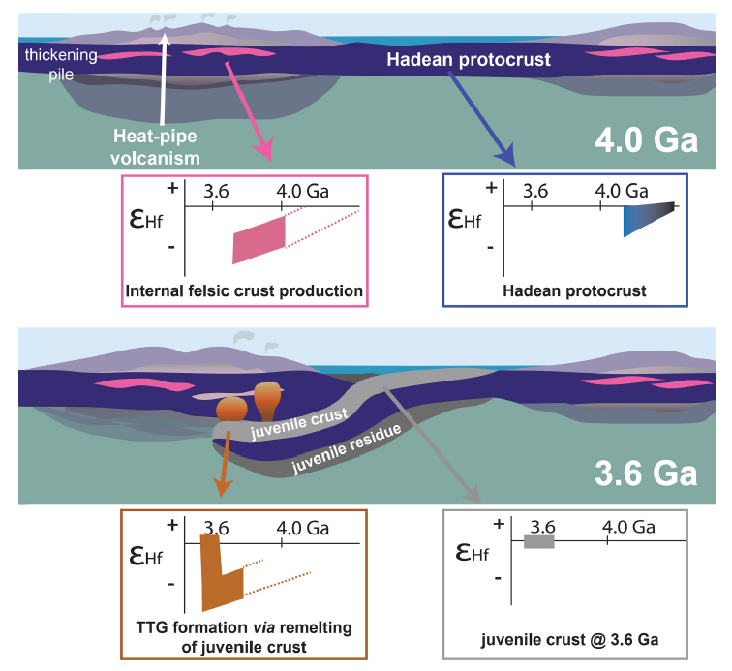
Evidence from Hf Isotopes in Zircons
Evolution of Plate Tectonics
Earth and Planteray Materials and Dynamics
Tuesday 9 May 2023
Bauer et al., 2020

Slide 5
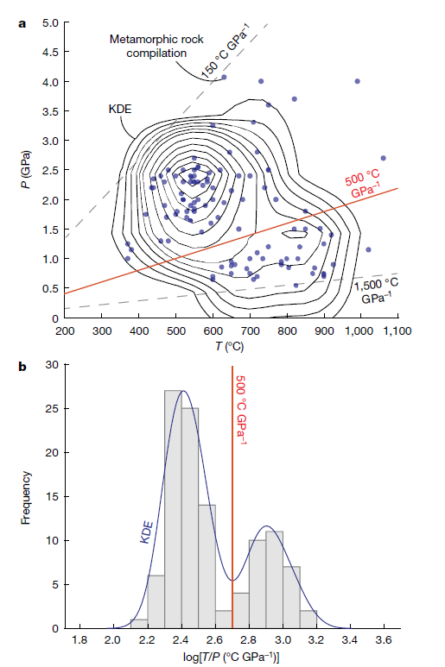
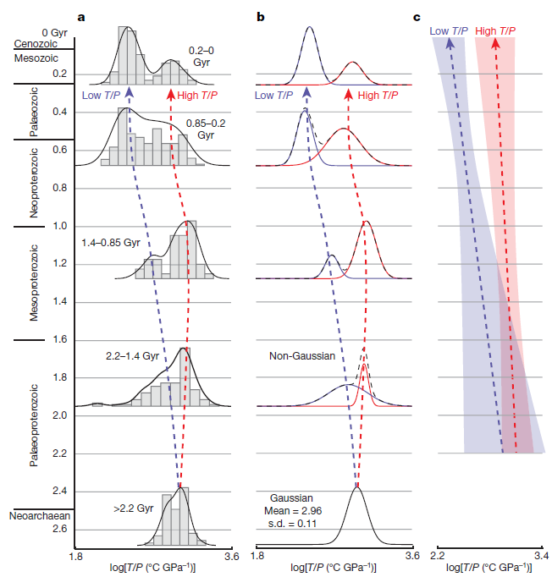
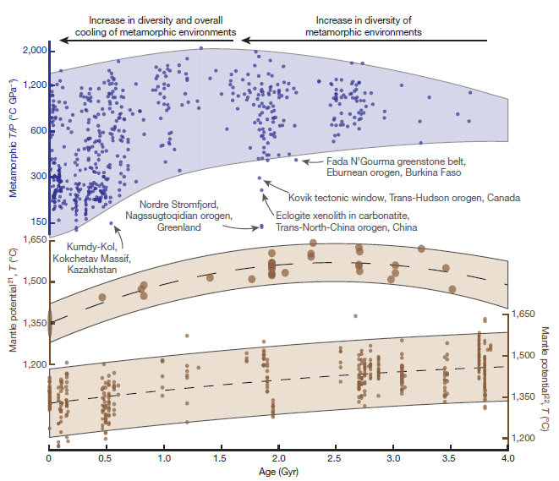
Bimodal Metamorphic Belts
Evolution of Plate Tectonics
Earth and Planteray Materials and Dynamics
Tuesday 9 May 2023
Holder et al., 2019

Slide 6
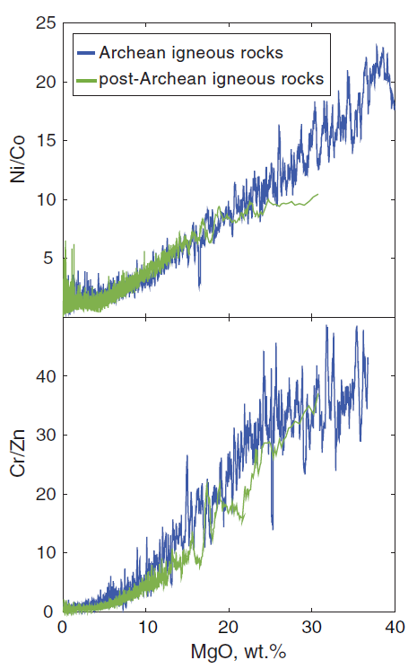
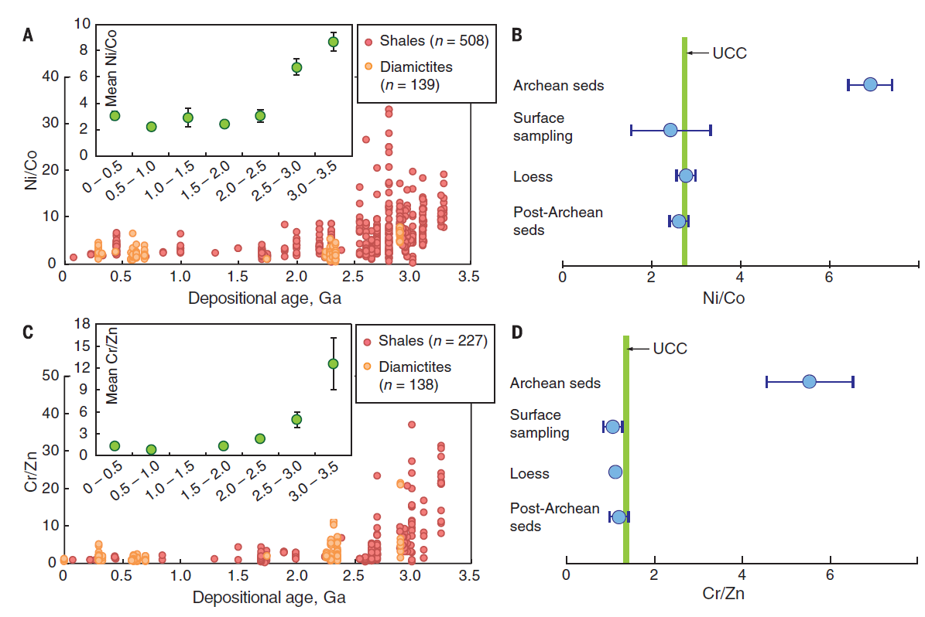
Mafic to Felsic Crustal Transition
When Did Modern-Day Plate Tectonics Begin?
Earth and Planteray Materials and Dynamics
Tuesday 9 May 2023
Tang et al., 2016

Slide 7
Mafic to Felsic Crustal Transition
When Did Modern-Day Plate Tectonics Begin?
Earth and Planteray Materials and Dynamics
Tuesday 9 May 2023
Tang et al., 2016

Slide 8
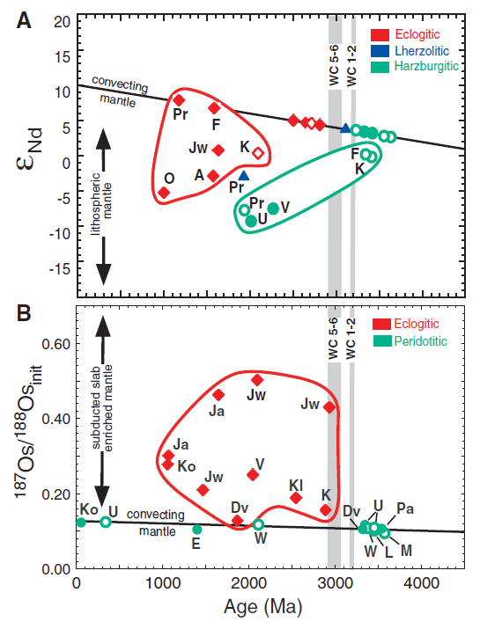
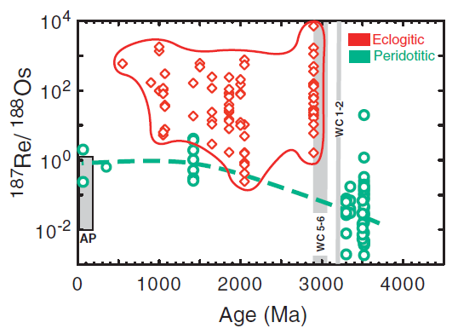
Evidence from Diamond Inclusions
When Did Modern-Day Plate Tectonics Begin?
Earth and Planteray Materials and Dynamics
Tuesday 9 May 2023
Shirey and Richardson, 2011

Slide 9
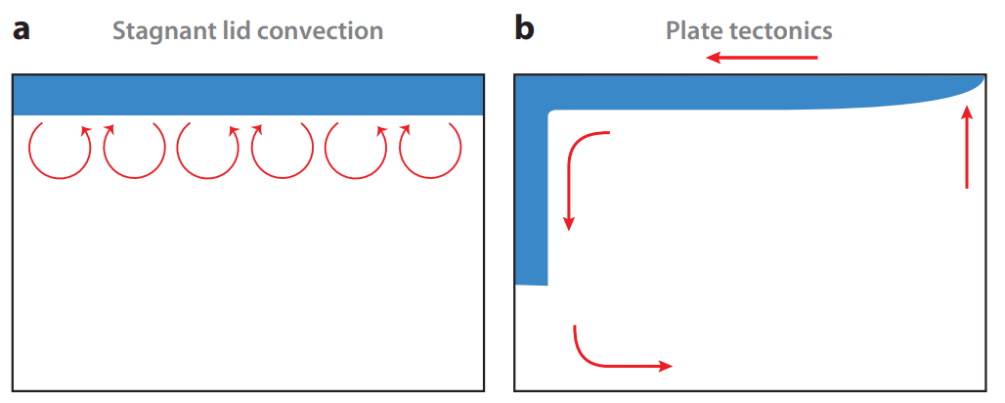
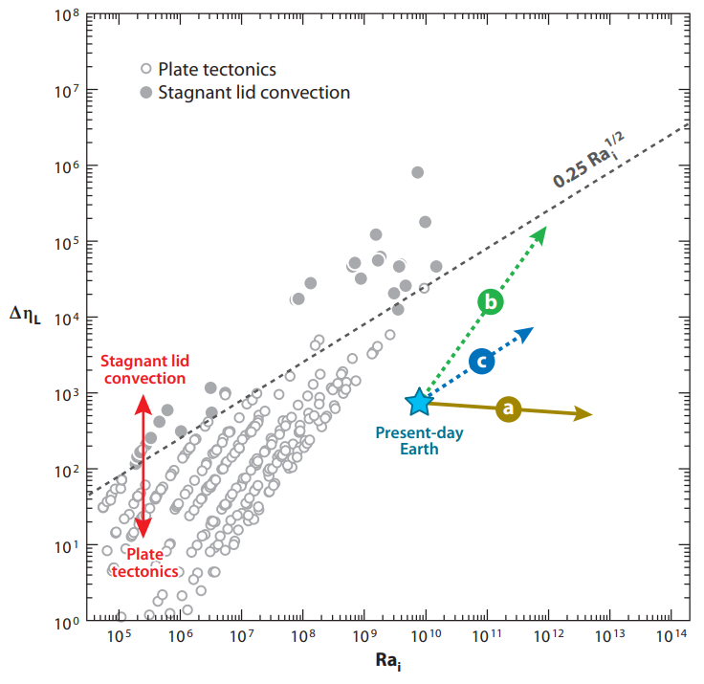
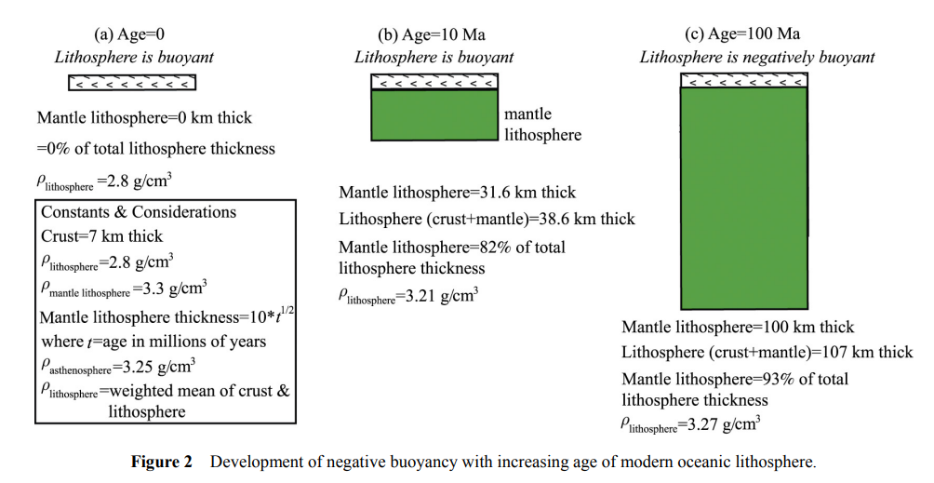
Secular Cooling
How did Plate Tectonics Begin?
Earth and Planteray Materials and Dynamics
Tuesday 9 May 2023
Stern, 2007
Korenaga, 2013

Slide 10
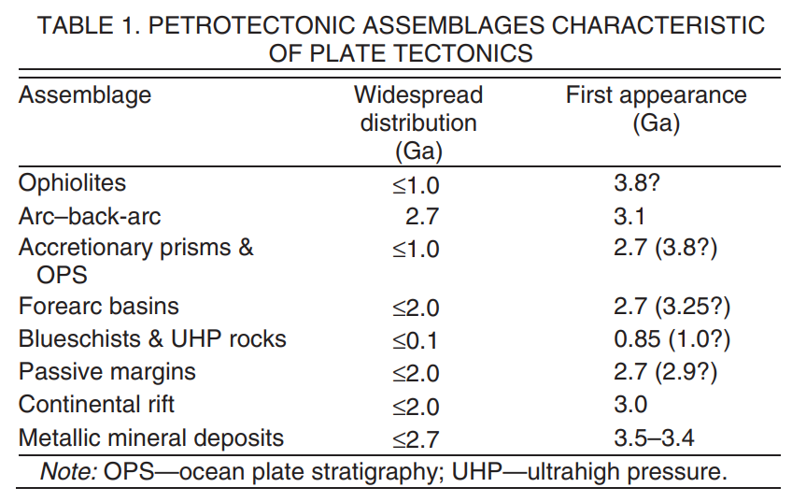
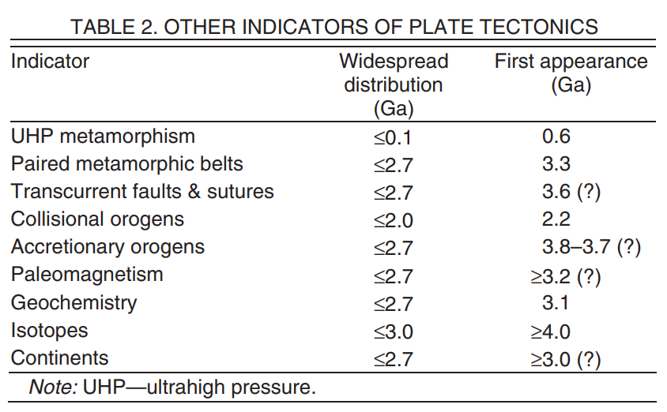
Summary
Conclusions
Earth and Planteray Materials and Dynamics
Tuesday 9 May 2023
Early Earth was too hot for widespread plate tectonics and was dominated by plume magmatism and stagnant plate tectonism.
Modern-day plate tectonics has become widespread in the Mesoarchean-Neoarchean.
Plate tectonics evolved slowly over hundreds of millions of years by secular cooling
Condie and Kröner, 2008

Slide 11
Any Questions?
Thank You for Your Attention.
Earth and Planteray Materials and Dynamics
Tuesday 9 May 2023

