Slide 1
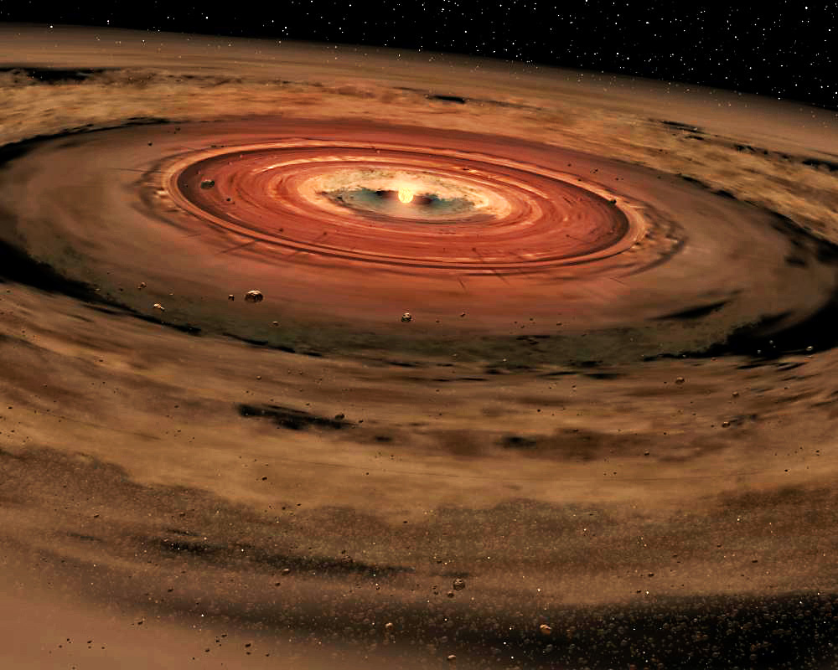
Chronology of the early solar system
NASA/JPL-Caltech/T. Pyle (SSC)

Slide 2
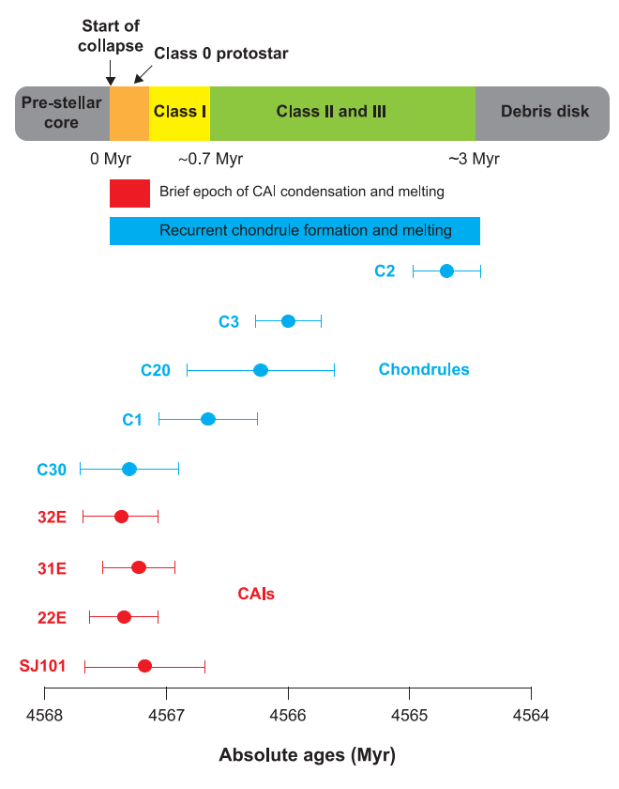
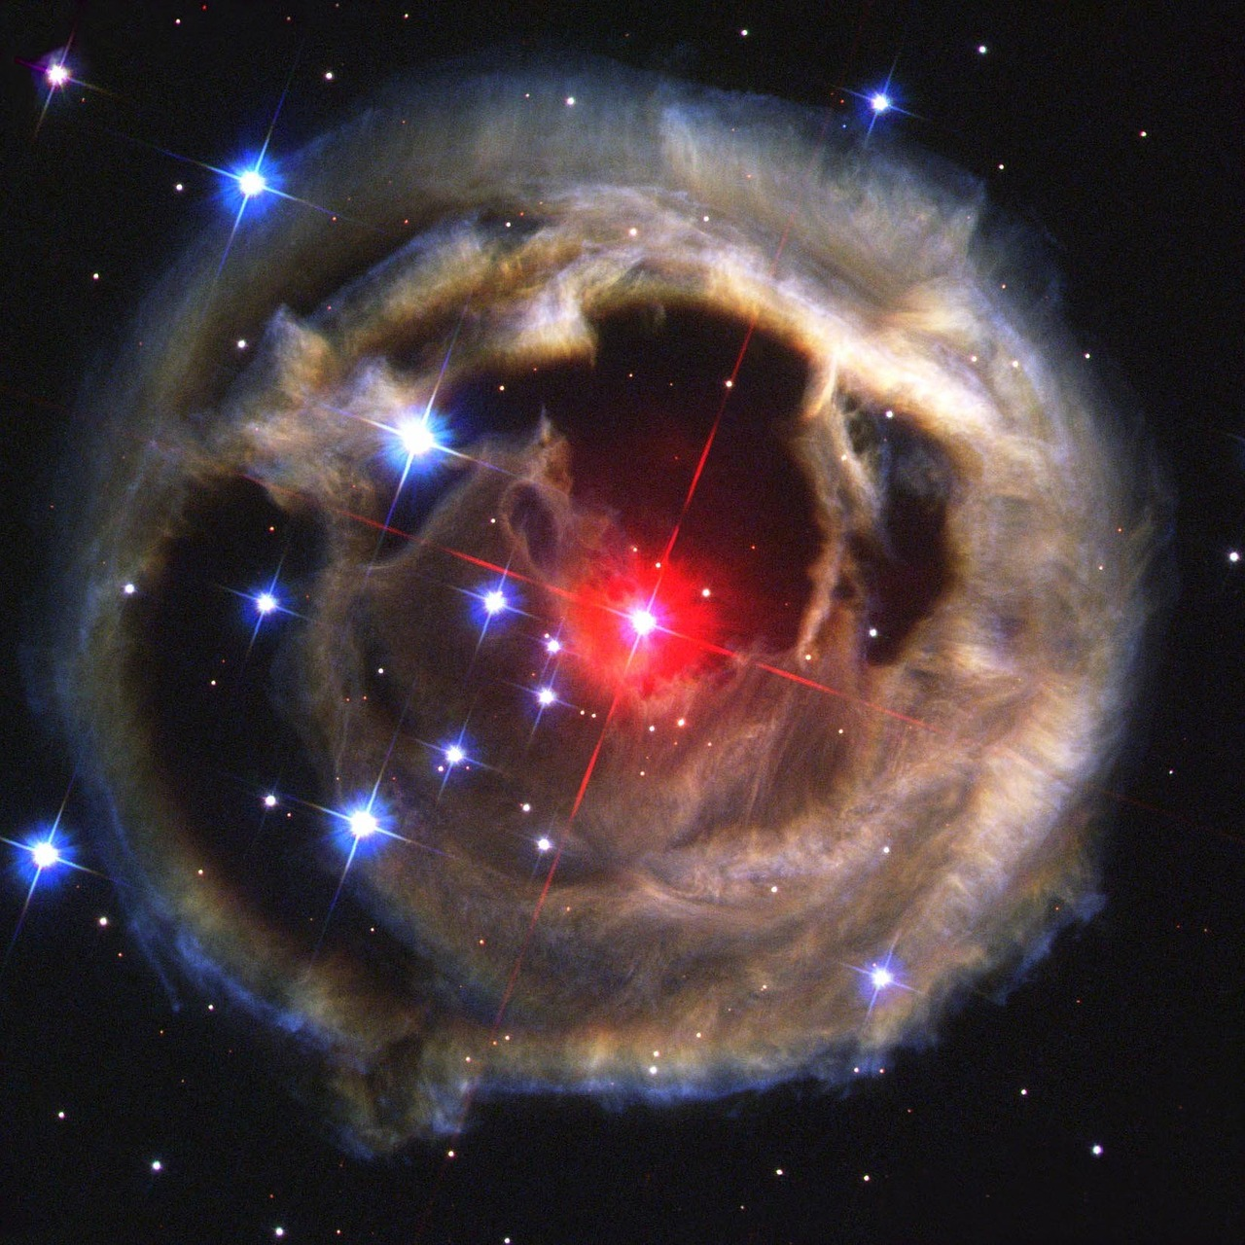
Presolar nebula
<<
Connelly et al. 2012
Nebula formed from materials thrown out from supernovae
Later supernovae compress regions of the nebula, forming dense pockets
NASA/ESA

Slide 3
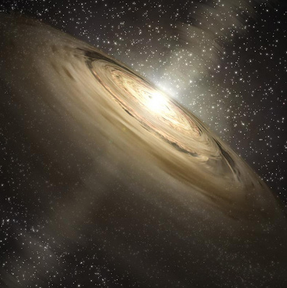
Early sun
Connelly et al. 2012
Our star forms, constantly pulls in more material
Material rotates around the early Sun
Flattens into disk through collisions/friction → average angular axis/velocity
NASA/JPL-Caltech/T. Pyle

Slide 4
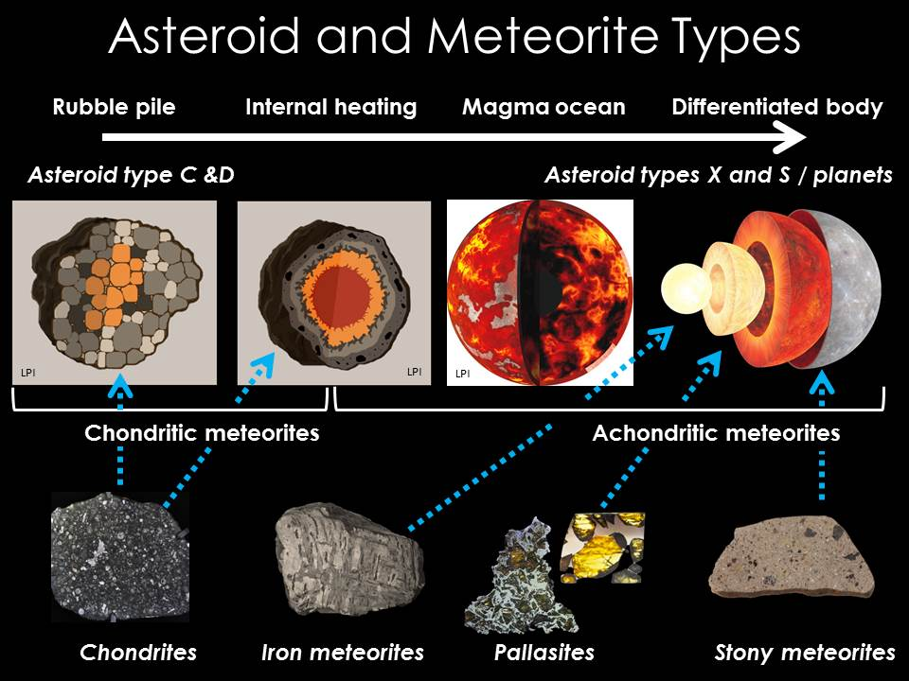
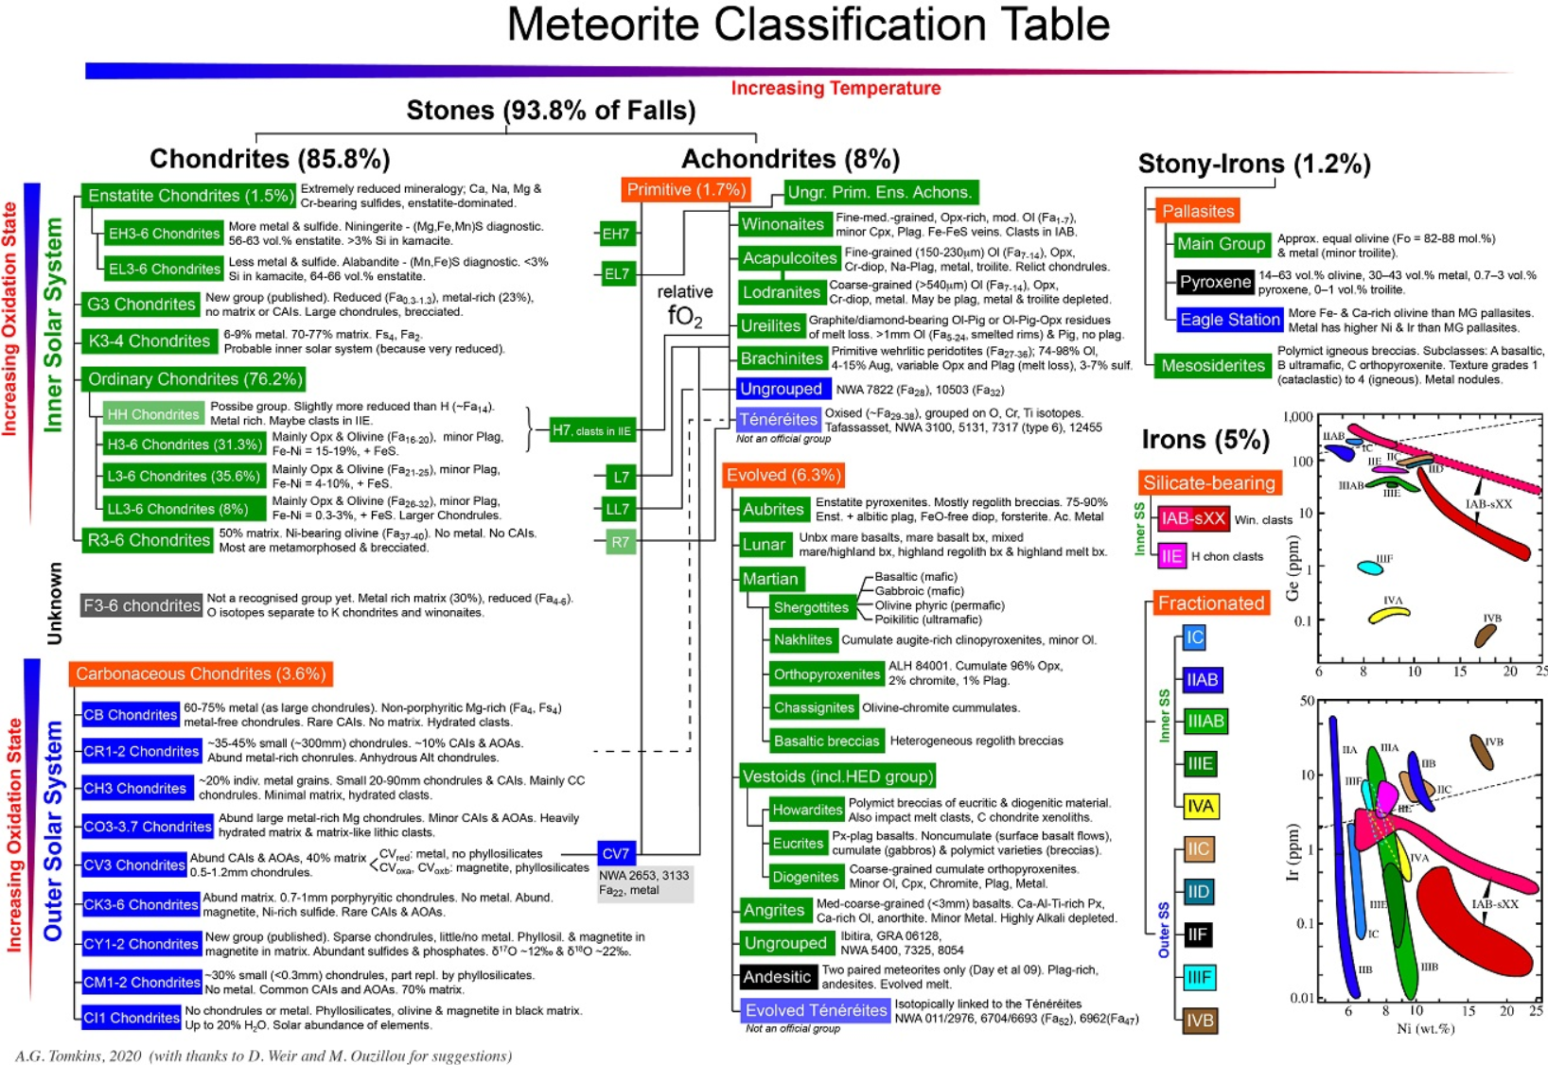
Meteorites as archives
Nothing on Earth has survived from the earliest million years
Oldest zircons are ∼170 Myrs after formation of first solids
Meteorites preserve processes of the early solar system
Many ways to classify meteorites
Stony, iron, stony-iron
Achondrites, chondrites
Carbonaceous, non-carbonaceous
Image by KJoy adapted from LPI/E&SS/NASA/Earth interior graphic adapted from Gary Hincks/Science Photo Library

Slide 5
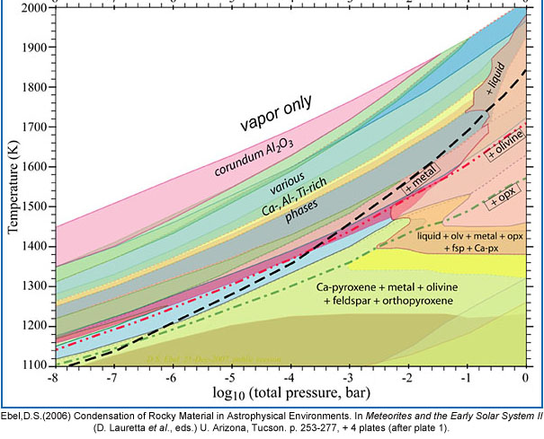
The first solids
Connelly et al. 2012
Disk grows dense enough for the first solids to condense/sublimate: CAIs
McSween & McSween 1999

Slide 6
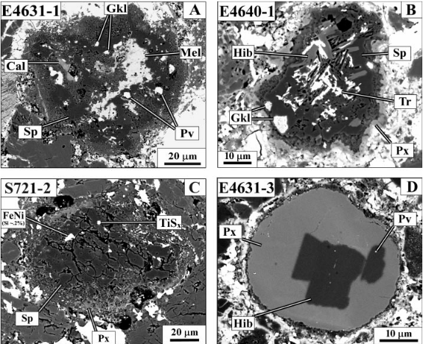
CAIs
Connelly et al. 2012
CAIs: Calcium- aluminium-rich inclusions in chondrites

Slide 7
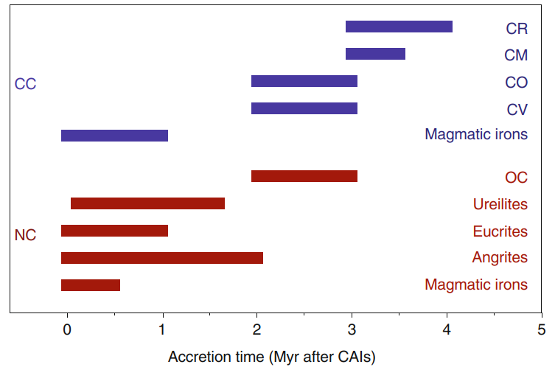
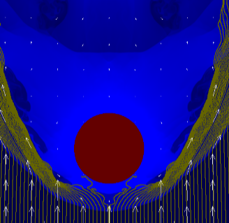
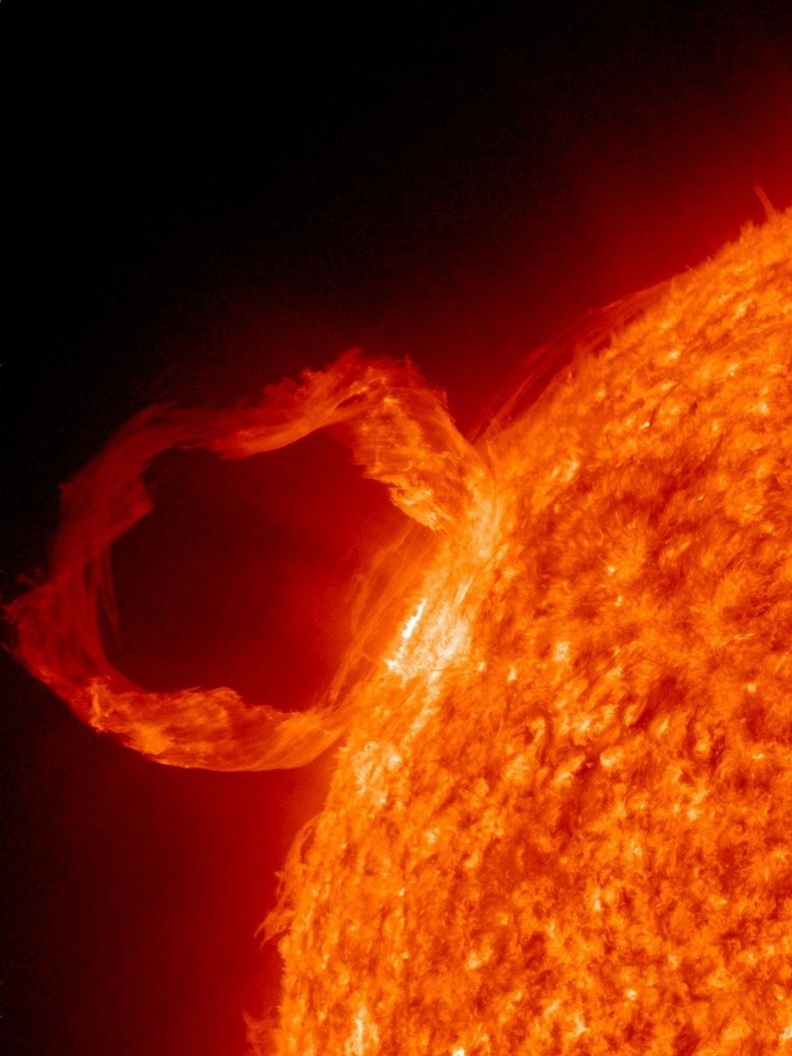
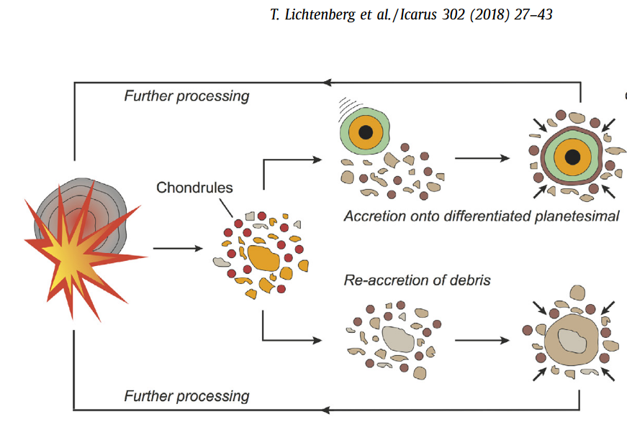
Chondrule formation
Connelly et al. 2012
Start forming together with CAIs
Formation continues for 3 Myrs, majority after CAIs
Various suggested processes, likely a mix
Impacts
Lightning
Solar activity
Planetesimal bow shocks
Rapid accretion (< 0.3Myrs) of planetesimals within CAI formation epoch
Kruijer et al. 2020
Morris et al. 2012

Slide 8
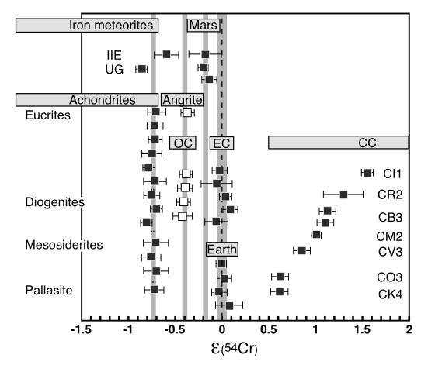
Material transport
Connelly et al. 2012
Isotope heterogeneities between chondrules/CAIs and whole-rock
Indicates transport of building blocks to accretion regions
A. Trinquier, J.-L. Birck, C. G. Allègre, Astrophys. J. 655, 1179 (2007).

Slide 9
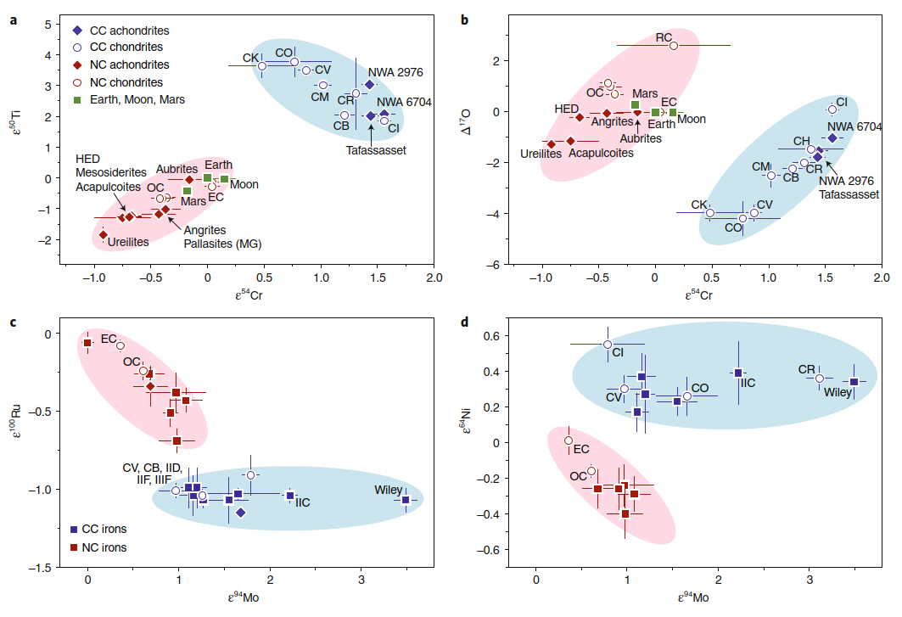
NC-CC dichotomy
Two separate isotopic reservoir groups
Carbonaceous group
Primitive meteorites, both chondrites and achondrites
Non-carbonaceous group
Ordinary chondrites and achondrites
Kruijer et al. 2020
Kruijer et al. 2020

Slide 10
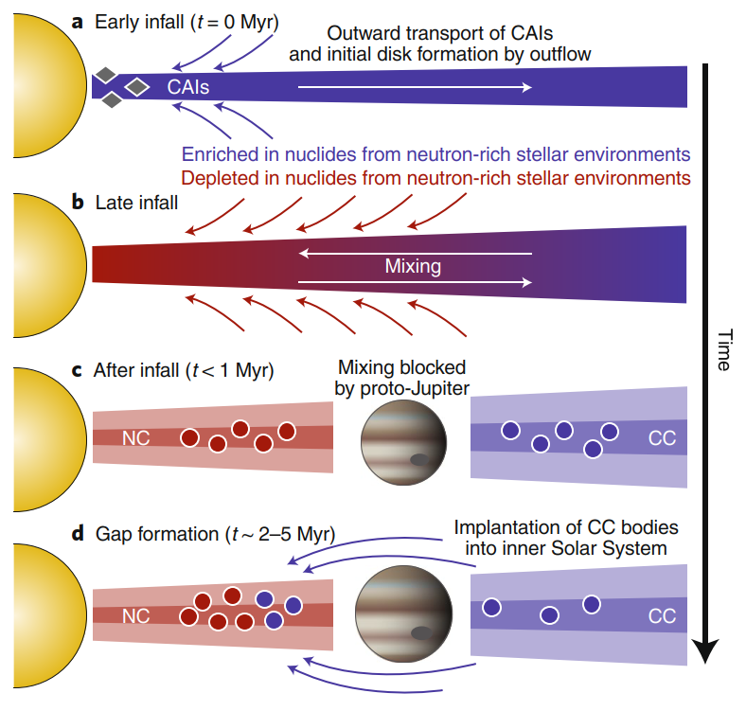
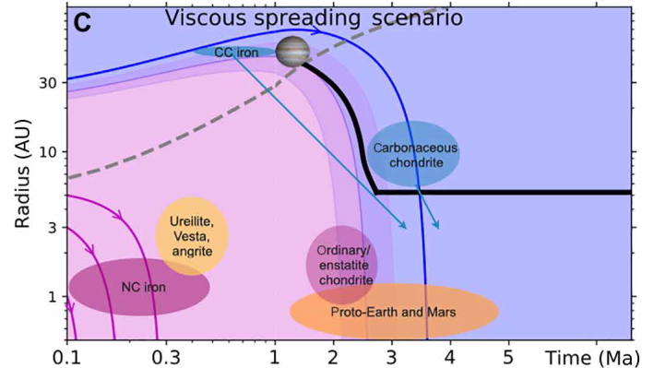
NC-CC dichotomy
Two separate isotopic reservoir groups
Carbonaceous group
Primitive meteorites, both chondrites and achondrites
Non-carbonaceous group
Ordinary chondrites and achondrites
Kruijer et al. 2020
Liu et al. 2022
Possibly early separation by Jupiter
Hindering mixing of late infall materials
Later scattering of CC materials into inner solar system

Slide 11
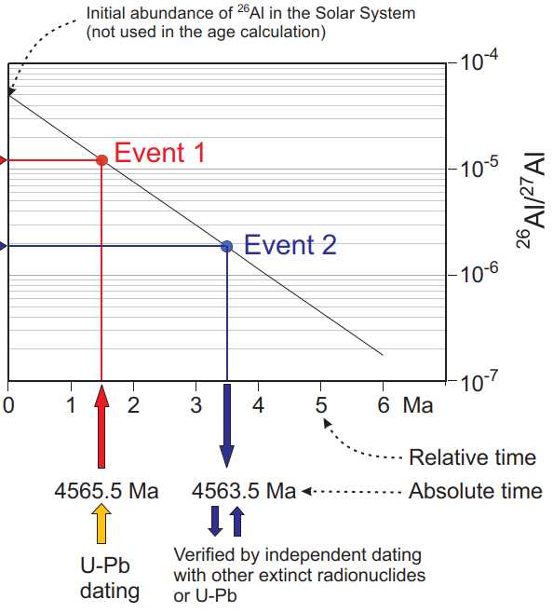
How do we know?
Amelin & Ireland 2013
Accurate and precise dating of CAIs and chondrules using:
Long-lived Pb-Pb system
Short-lived ²⁶Al-²⁶Mg, ⁵³Mn-⁵³Cr, ¹⁸²Hf-¹⁸²W, present in the early solar system, give high-resolution information on early processes
²⁶Al was likely not homogeneously distributed
Short-lived systems give relative times, need to be coupled with long-lived system ages to give absolute ages

