Slide 1
Seismic structure, upper mantle to uppermost lower mantle
Justin Leung

Slide 2
Sampling the earth interior
(Dziewonski and Romanowicz, 2015)

Slide 3
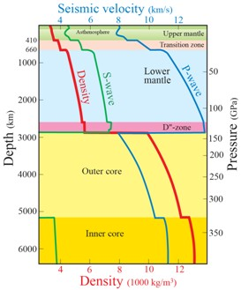
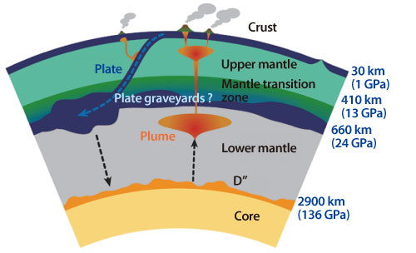
Overall structure
410: Olivine → Wadsleyite
520: Wadsleyite → Ringwoodite
660: Ringwoodite → Bridgmanite + Ferropericlase
(Trønnes, 2010)
(Spring-8 website)

Slide 4
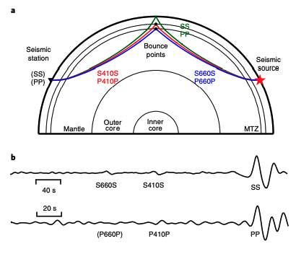
Detecting the mantle transition zone (MTZ)
Use SS and PP pre-cursors → sensitive to discontinuity depths and elastic property changes
P660P is not always observed
(Waszek et al., 2021)

Slide 5
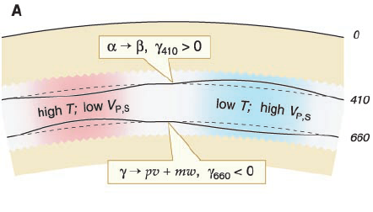
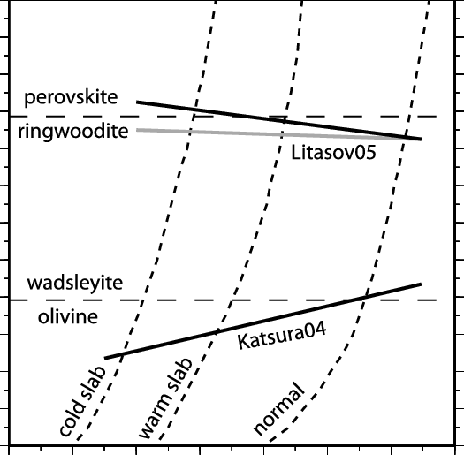
MTZ: a relative thermometer?
410km: positive Clapeyron slope
660km: negative Clapeyron slope
Cannot provide absolute temp estimates
(Lebedev et al., 2002)

Slide 6
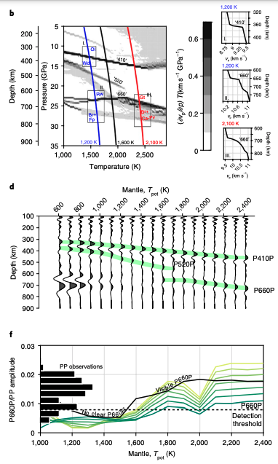
P660P phase: absolute Thermometer?
P660P only observable in “hotter” parts of the MTZ
Associated with second reaction: Majorite Garnet → Bridgmanite + Ca-perovskite
(Waszek et al., 2021)

Slide 7
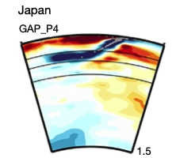
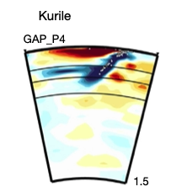
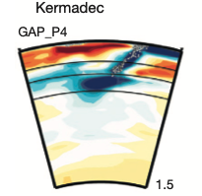
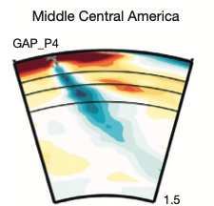
Slab stagnation
Slabs observed to stop at 660km → 30x viscosity jump
Also proposed to stagnate at around 1000km depth
MTZ is a temporary reservoir for slabs

Slide 8
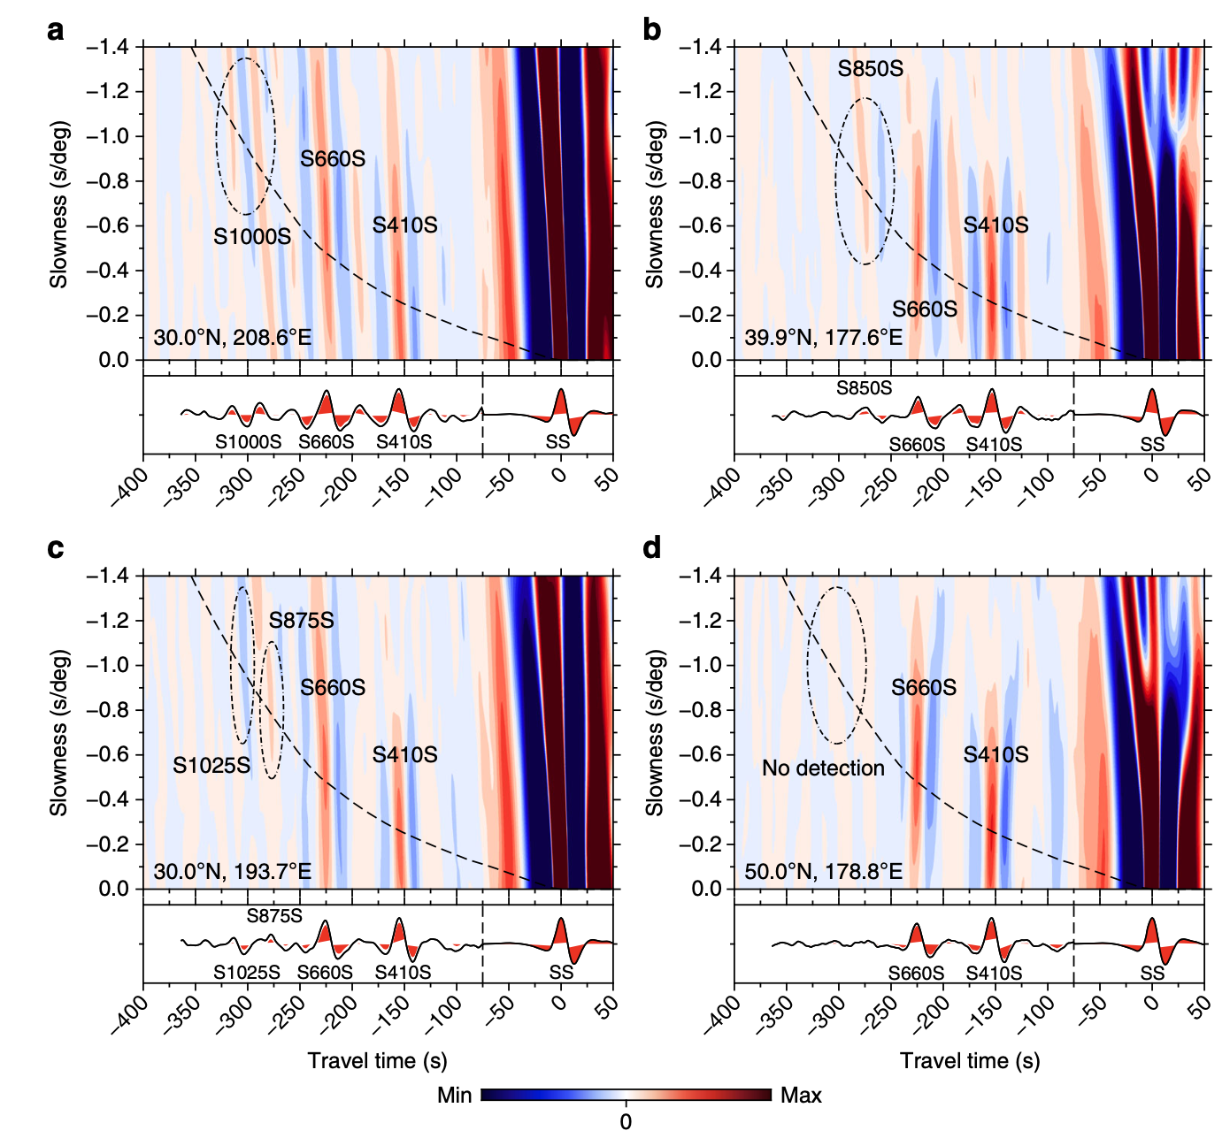
Mid-mantle reflections
Regionally vary in seismic properties and depth
(Waszek et al., 2018)

Slide 9
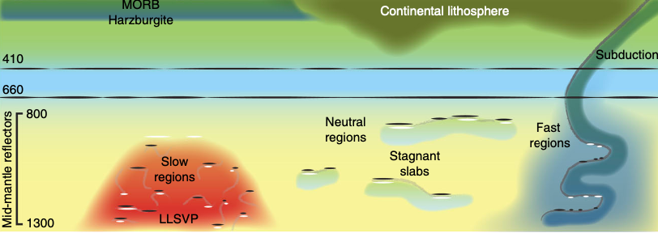
Mid-mantle reflections
Theories:
Viscosity jump
Radial change in mantle composition
Different composition of subducted material
Fe spin crossover
Fe depletion in Mg-perovskite
Still an active area of research → mid-mantle has poor coverage
(Waszek et al., 2018)

