Slide 1
The Evolving Chronology of Moon Formation
Lan Zhang
03-20-2023

Slide 2
Constraints on the age of the Moon
Goal: Define the age of the Moon
Review the most commonly invoked constraints on the age of the Moon based on:
volatile element depletion
core formation
LMO (lunar magma ocean) crystallization
post-LMO crustal magmatism
Notes:
three dateable crystallization products of the magma ocean

Slide 3
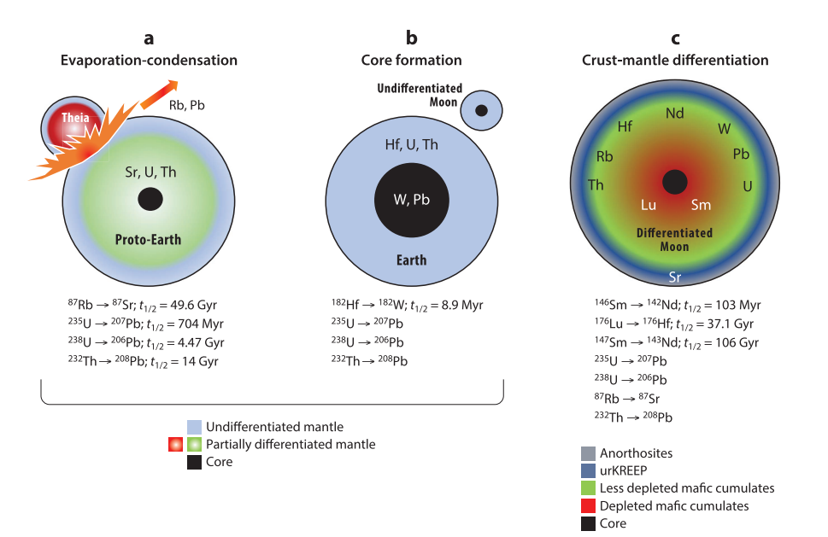
Age constraints from volatile element depletion & core formation
Three major chemical differentiation processes involved in early planet evolution that fractionate parent from daughter elements, and hence can potentially be dated using radioactive chronologic techniques
(a) and (b) can happen before planet formation.
All three can be caused by later high-temperature events
(a) results in volatile-refractory
element fractionation
(b) results in lithophile-siderophile/
chalcophile element fractionation
(c) results in lithophile element fractionation

Slide 4
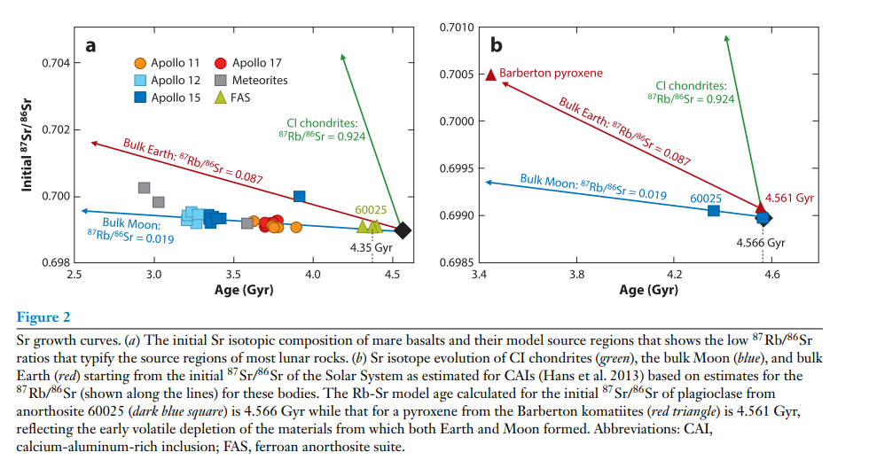
Volatile Element Depletion
The Rb-Sr model age calculated for the initial ⁸⁷Sr/⁸⁶Sr of plagioclase from anorthosite 60025 (dark blue square) is 4.566 Gyr while that for a pyroxene from the Barberton komatiites (red triangle) is 4.561 Gyr.
The ages based on examination of the timing of volatile-refractory element separation most likely date events occurring during the earliest stages of formation of solids in the protoplanetary disk rather than events associated with terrestrial planet and Moon formation.

Slide 5
Core Formation
Given the relatively small size of the core of the Moon, core-mantle separation on the Moon likely did not leave as large a chemical imprint as it did on Earth or on a differentiated planetary embryo (Theia?).
For this reason, much like the case for the Moon’s depletion in volatile elements, addressing whether the chemical and isotopic signatures of core formation recorded in lunar samples reflect core formation on the Moon or on the precursors from which it was derived is critical but elusive.

Slide 6
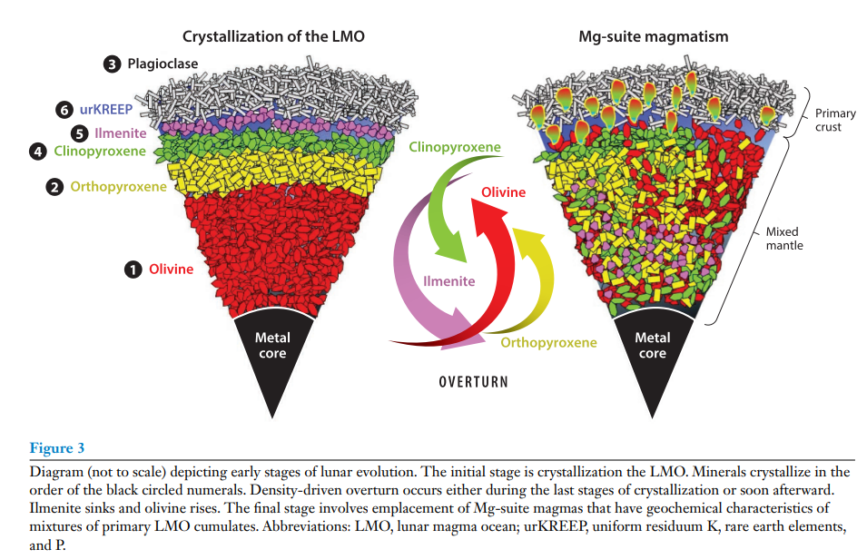
Age constraints from magma ocean crystallization
Petrogenetic Models for the Differentiation of the Moon
The chemical differentiation that occurs through the crystallization of a magma ocean yields a strong signal that can potentially be deciphered using radioactive chronometers.
Based on the sequence of LMO crystallization, the age of solidification of the LMO have focused on defining the formation age of (a) LMO mafic cumulates, (b) ferroan anorthosite crust, and (c) urKREEP (uniform residuum K, rare earth elements, and P which are latestage crystallization products).

Slide 7
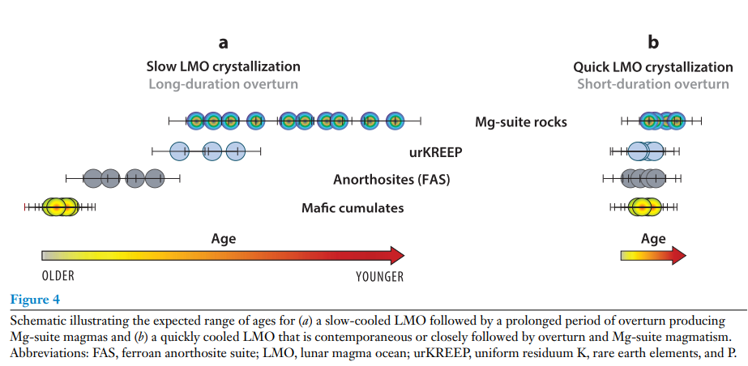
Age constraints from magma ocean crystallization
Two aspects of LMO evolution affect the translation of sample ages to determine the age of the Moon:
whether LMO crystallization causes an overturn of the cumulate pile,
2) the duration required to completely crystallize the LMO (different cooling and dynamic models for the evolution of the LMO )

Slide 8
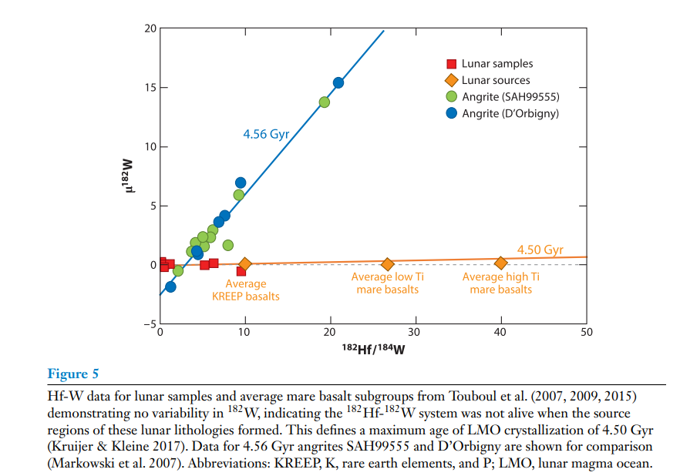
Differentiation age of the moon
(1) The age of mafic lunar magma ocean cumulates
Hf (hafnium)-W (tungsten) system could provide precise age constraints on planetesimal-scale differentiation events if they occurred within a few million years of Solar System formation.
It provides an upper limit to the time of magma ocean differentiation of 4.50 Gyr.

Slide 9
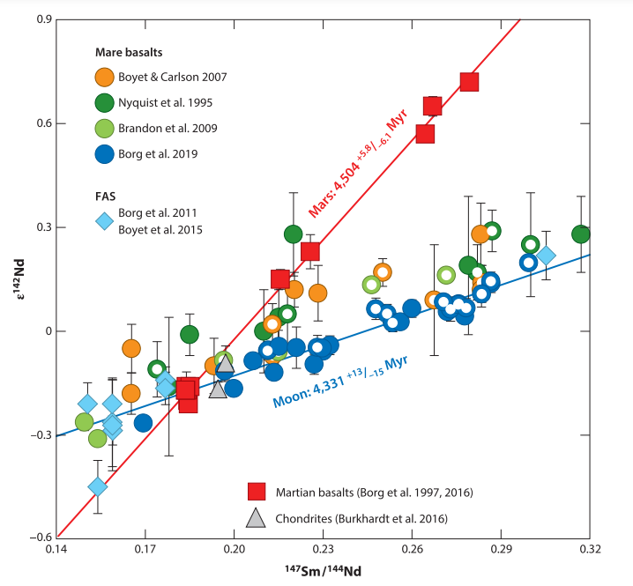
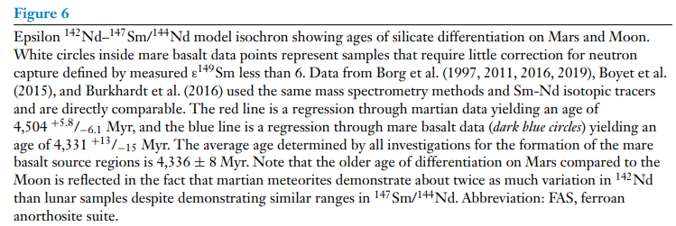
Differentiation age of the moon
(1) The age of mafic lunar magma ocean cumulates
The most widely applied short-lived system for lunar studies is based on the decay of ¹⁴⁶Sm (samarium) to ¹⁴²Nd (neodymium) with a half-life of 103 Myr
The weighted average age reported for the formation of the mare basalt source regions by all lunar investigations is 4,336 ± 8 Myr (uncertainty 2 SD).

Slide 10
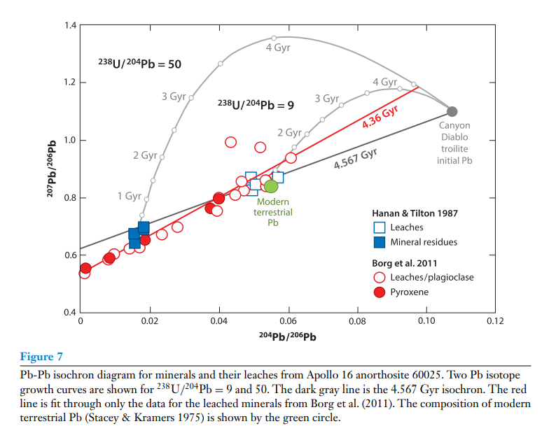
Differentiation age of the moon
(2) The age of the anorthositic crust
The FAS (ferroan anorthosite suite) makes up the majority of the lunar crust. It is thought to be a flotation cumulate produced after 70–80% solidification of the LMO, thus, ferroan anorthosite ages should approximate the age of LMO crystallization at the point of plagioclase saturation.
The average age of 60025 is 4,360 ± 3 Myr and provides the tightest age constraint on formation of a FAS sample. The weighted average age is 4,361 ± 21 Myr (uncertainty is 2 SD) and probably provides the best estimate for the timing and duration of FAS magmatism currently available

Slide 11
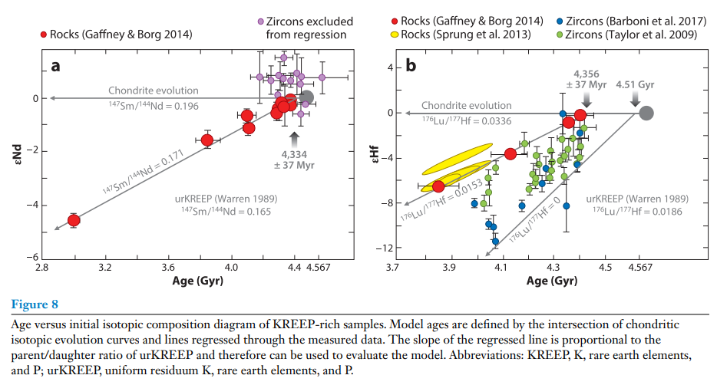
Differentiation age of the moon
(3) KREEP model ages
The most geologically reasonable age determinations for urKREEP are defined by regression through the whole-rock data.
The weighted average urKREEP model age determined by regression of the Sm-Nd and Lu-Hf data is 4,345 ± 26 Myr.

Slide 12
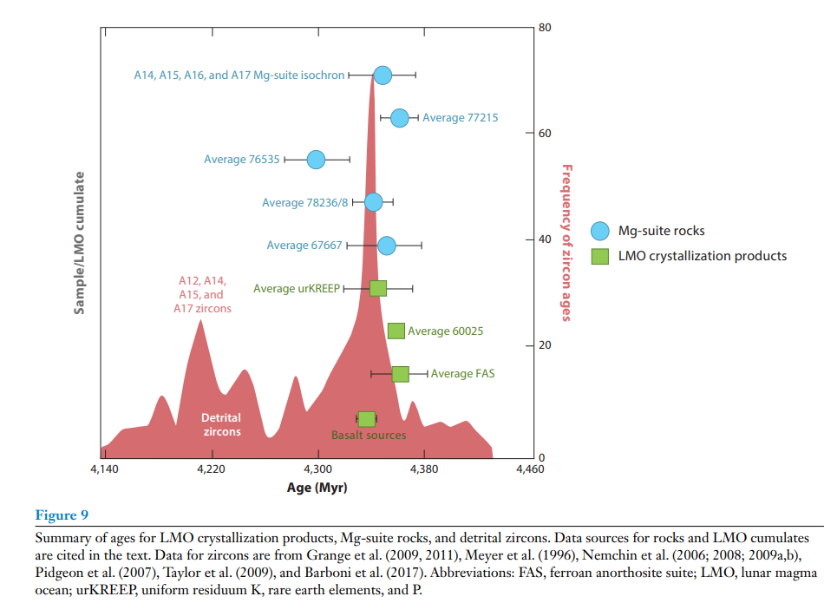
Evaluation of Ages of Lunar Magma Ocean Cumulates
There are essentially no discernable differences in the range of ages determined for crystallization of various LMO cumulates including
mafic cumulates (4,336 ± 8 Myr),
FAS felsic cumulates (average FAS = 4,361 ± 21 Myr; 60025 = 4,360 ± 3 Myr),
and urKREEP (4,345 ± 26 Myr),
providing confidence that they record the fractionation of parent and daughter isotopes associated with the crystallization of the LMO.

Slide 13
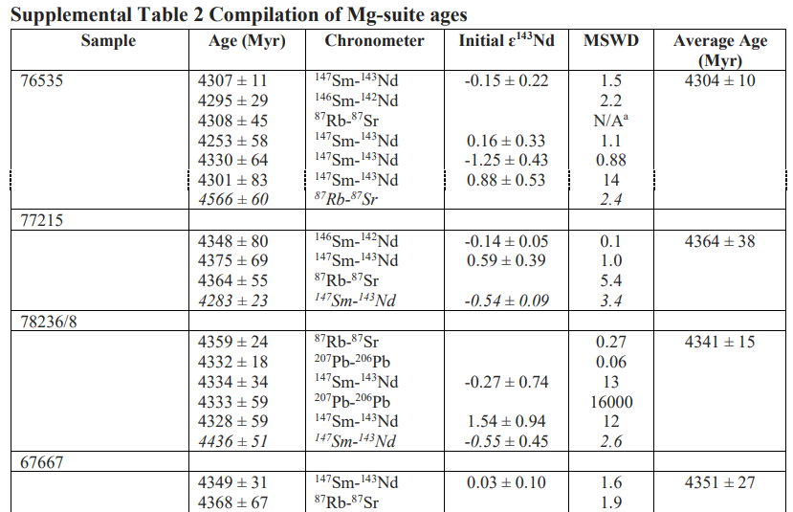
Age constraints from other highland rock suites
The lunar crust is composed of 3 suites of crustal rocks: the FAS, Mg-suite, alkali-suite.
(1) Ages of the Mg (magnesium)-Suite
The Mg-suite contains Ca-rich plagioclase accompanied by high proportions of Mg-rich olivine (troctolites) and Mg-rich orthopyroxenes (norites),
and is derived from three LMO cumulate reservoirs: 1) the olivine- and pyroxene-rich mafic cumulates. 2) plagioclase-rich cumulates. 3) urKREEP.
Most of Mg-suite ages are between 4.30 and 4.36 Gyr

Slide 14
Age constraints from other highland rock suites
(2) Ages of the Alkali-Suite
This suite of rocks is predominantly composed of evolved felsites and granites.
There is clearly a peak of zircon ages at ∼4,340 ± 20 Myr that coincides with the ages of both the LMO cumulates and the Mg-suite samples.

Slide 15
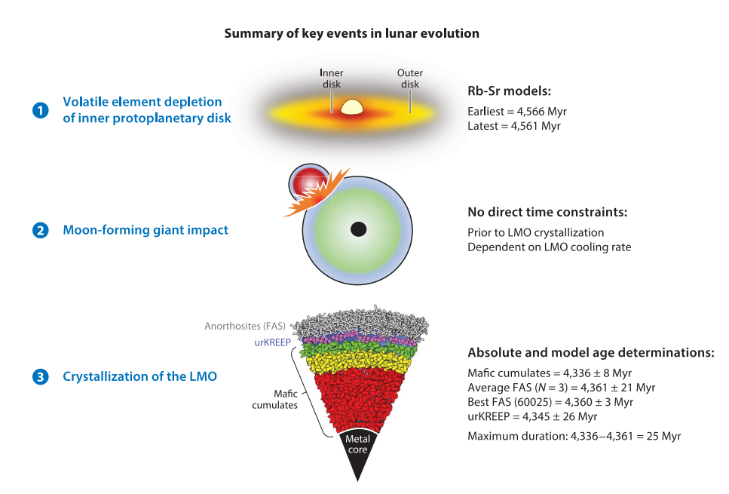
Key events in lunar evolution + the best current constraints
on their timing

Slide 16
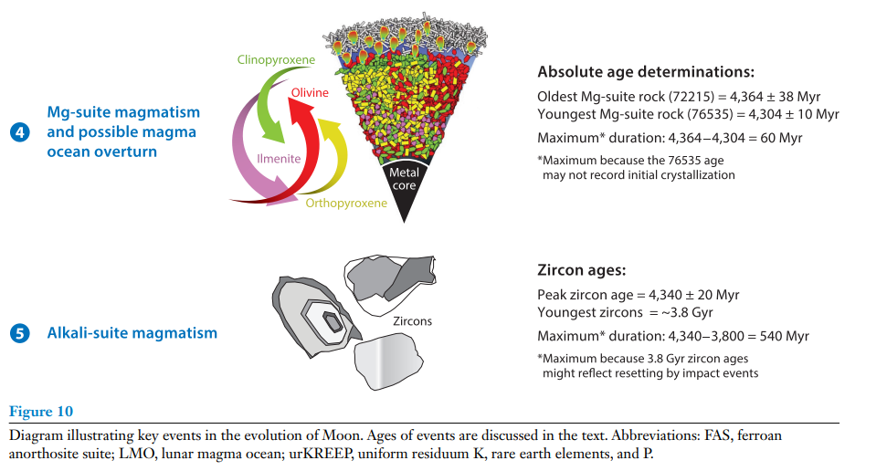
Key events in lunar evolution + the best current constraints
on their timing

Slide 17
Take-home message
We suggest that the ∼4.36 Gyr ages defined by LMO cumulates provide our most precise information on the timing of the giant impact and the formation of the Moon
The duration of planet formation is key information in understanding the mechanisms by which the terrestrial planets formed.
Ages of the oldest lunar rocks range widely, reflecting either the duration of Moon formation or disturbed ages caused by impact metamorphism.
Ages determined for compositionally distinct crust and mantle materials produced by lunar magma ocean differentiation cluster near 4.35 Gyr.
The repeated occurrence of 4.35 Gyr ages implies that Moon formation occurred late in Solar System history, likely by giant impact into Earth.

Slide 18
Thank you
Lan Zhang
03-20-2023

