Slide 1


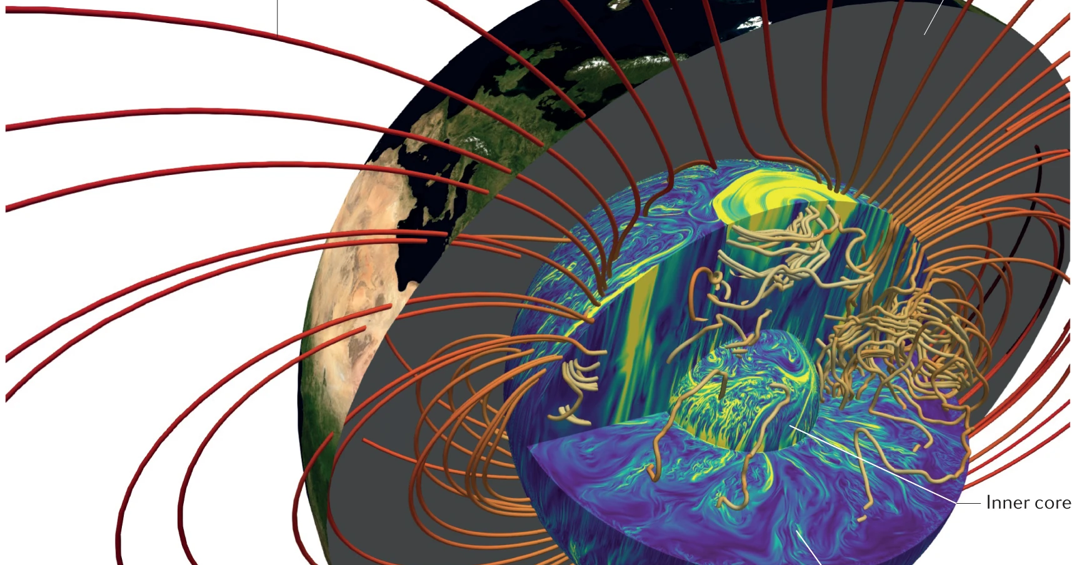

Geodynamo Evolution and Inner Core Growth
Yi Xue

Slide 2


The Earth’s interior
Mantle
Magnetic fields is generated by fluid motion
Solid inner core
Liquid outer core
The flow of liquid mental sustains dynamo action
Landeau et al. (2022)

Slide 3
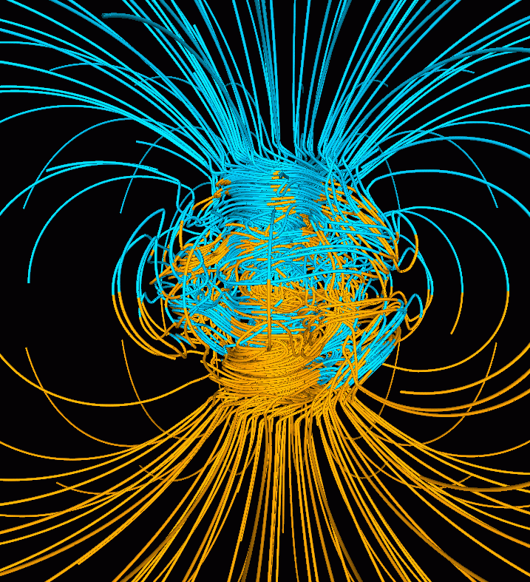
Earth’s magnetic field
An intrinsic field
Energy sources: growth of inner core --latent heat and buoyancy
Dipole field: 5 ±2 e22 A m²
Geomagnetic field <=> inner core
Glatzmaier and Robert (1995)

Slide 4
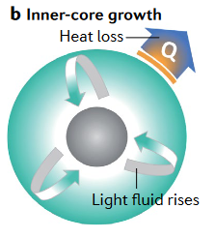
Inner Core Growth
Grows by the freezing of liquid iron at its surface.
Depends on the rate and nature of heat loss to the mantle
The origin of the inner core structure?
Landeau et al. (2022)

Slide 5
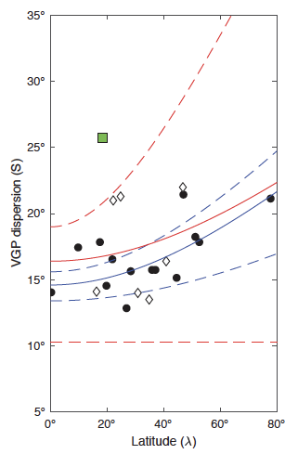
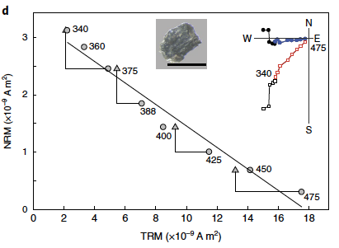
Ediacaran ultra-low field
VGP dispersion
Bono et al., 2019:
paleointensity ~565 Ma Sept-Iles intrusive suite anorthosite
time-averaged moment
ultra-low field: 0.7 e22 Am2
Sept IIes
PDM = 0.7e22 A m²
Bono et al., 2019
Fingerprint of inner core nucleation

Slide 6
Ediacaran ultra-low field
Bono et al., 2019
A gradually decay of magnetic field strength
Greater than the field that would be induced in the absence of a core dynamo
Bono et al., 2019
The geodynamo existed but was in an extraordinary state.

Slide 7
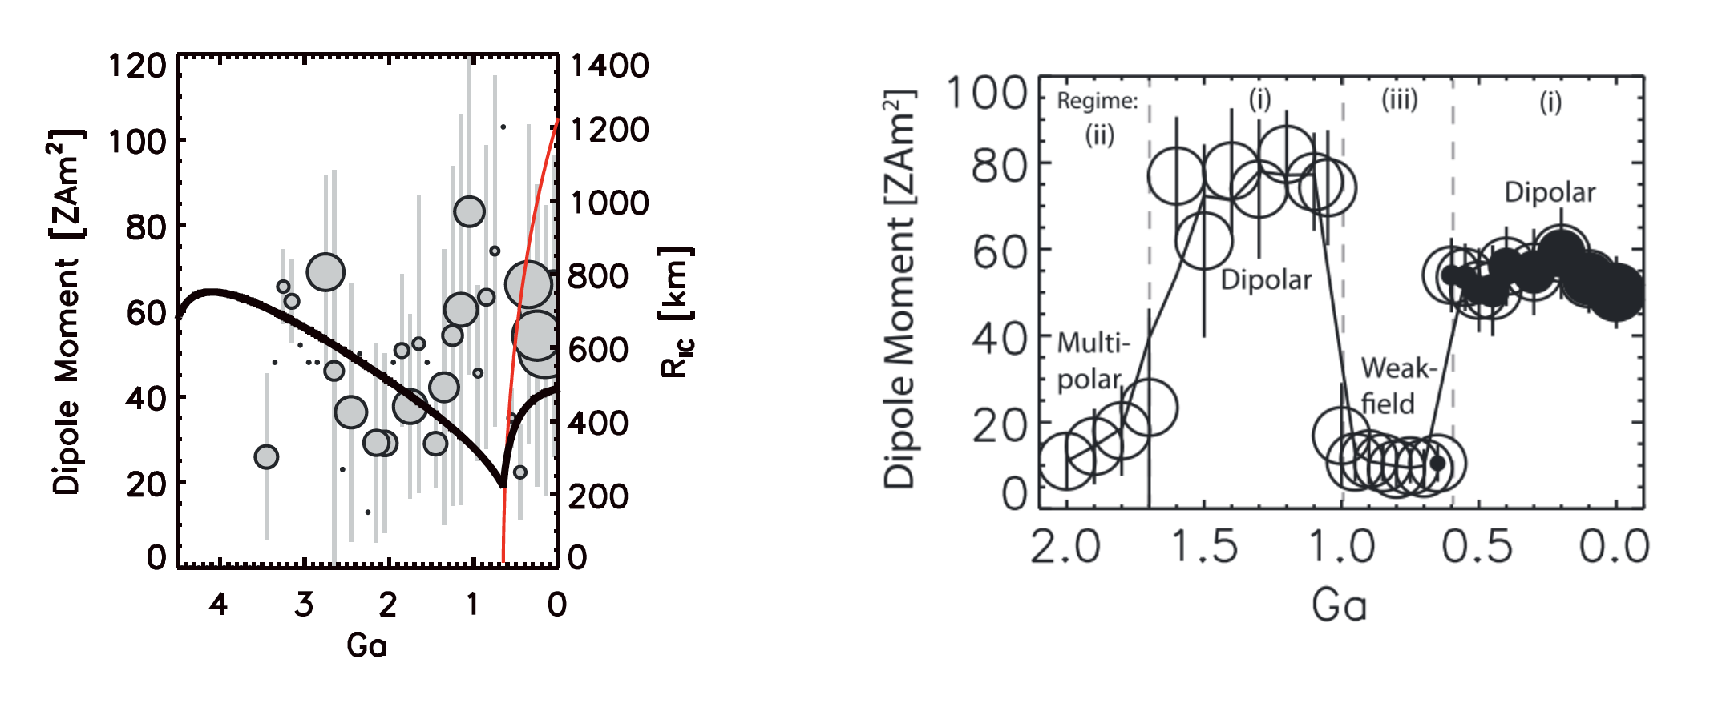
Ediacaran ultra-low field
Modelled inner core formation time: ~ 650 Ma
A weak field state prior to inner core nucleation
Driscoll 2016

Slide 8
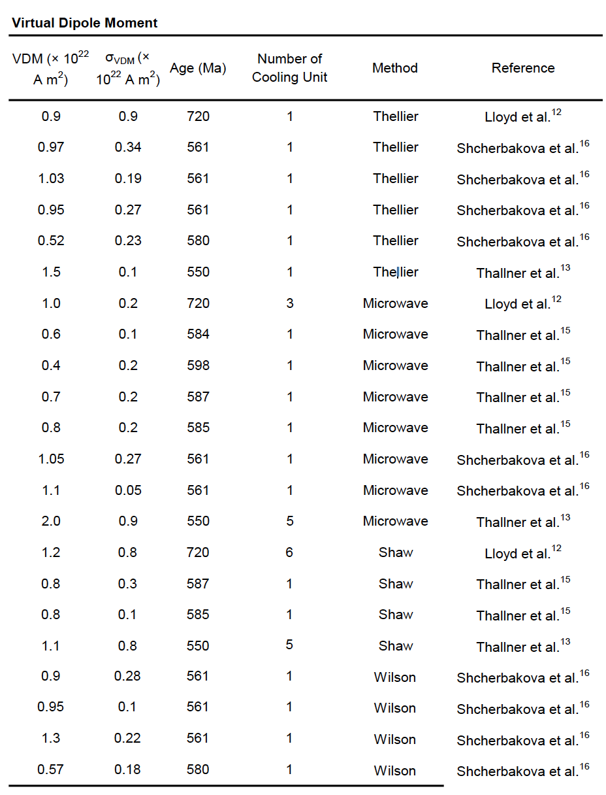
Ediacaran ultra-low field
The inner core nucleated at Ediacaran period
Newfoundland
Canadian Arctic
and Greenland
Ukraine
Quebec
Ontario
n>2
Zhou et al., 2022

Slide 9
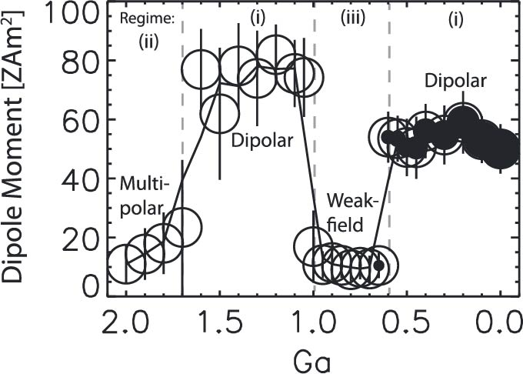
The Inner Core Nucleation
Bono et al., 2019:
ultra-low field from ~565 Ma Sept-Iles intrusive suite
?
Driscoll et al., 2016
modeled inner core formation time: ~ 650 Ma

Slide 10
The Inner Core Nucleation
Zhou et al. 2022
Early Cambrian (~532 Ma) anorthosites
Higher field: 3.5 e22 Am2
5 times greater than the Ediacaran
Zhou et al. (2022)

Slide 11
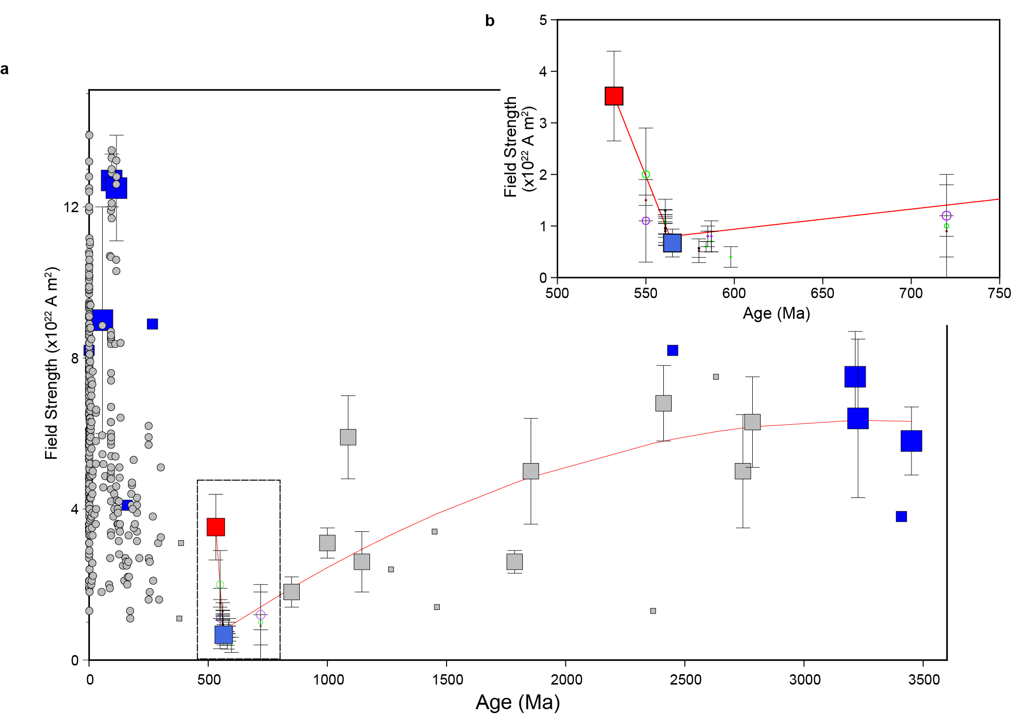
The Inner Core Nucleation
3.5 (532 Ma)
Rapid recovery of geomagnetic field strength in 33 Myr
Match with the prediction of simulations
Ultra-low field + recovered field
Ediacaran inner core
0.7 (565 Ma)
Zhou et al. (2022)

Slide 12
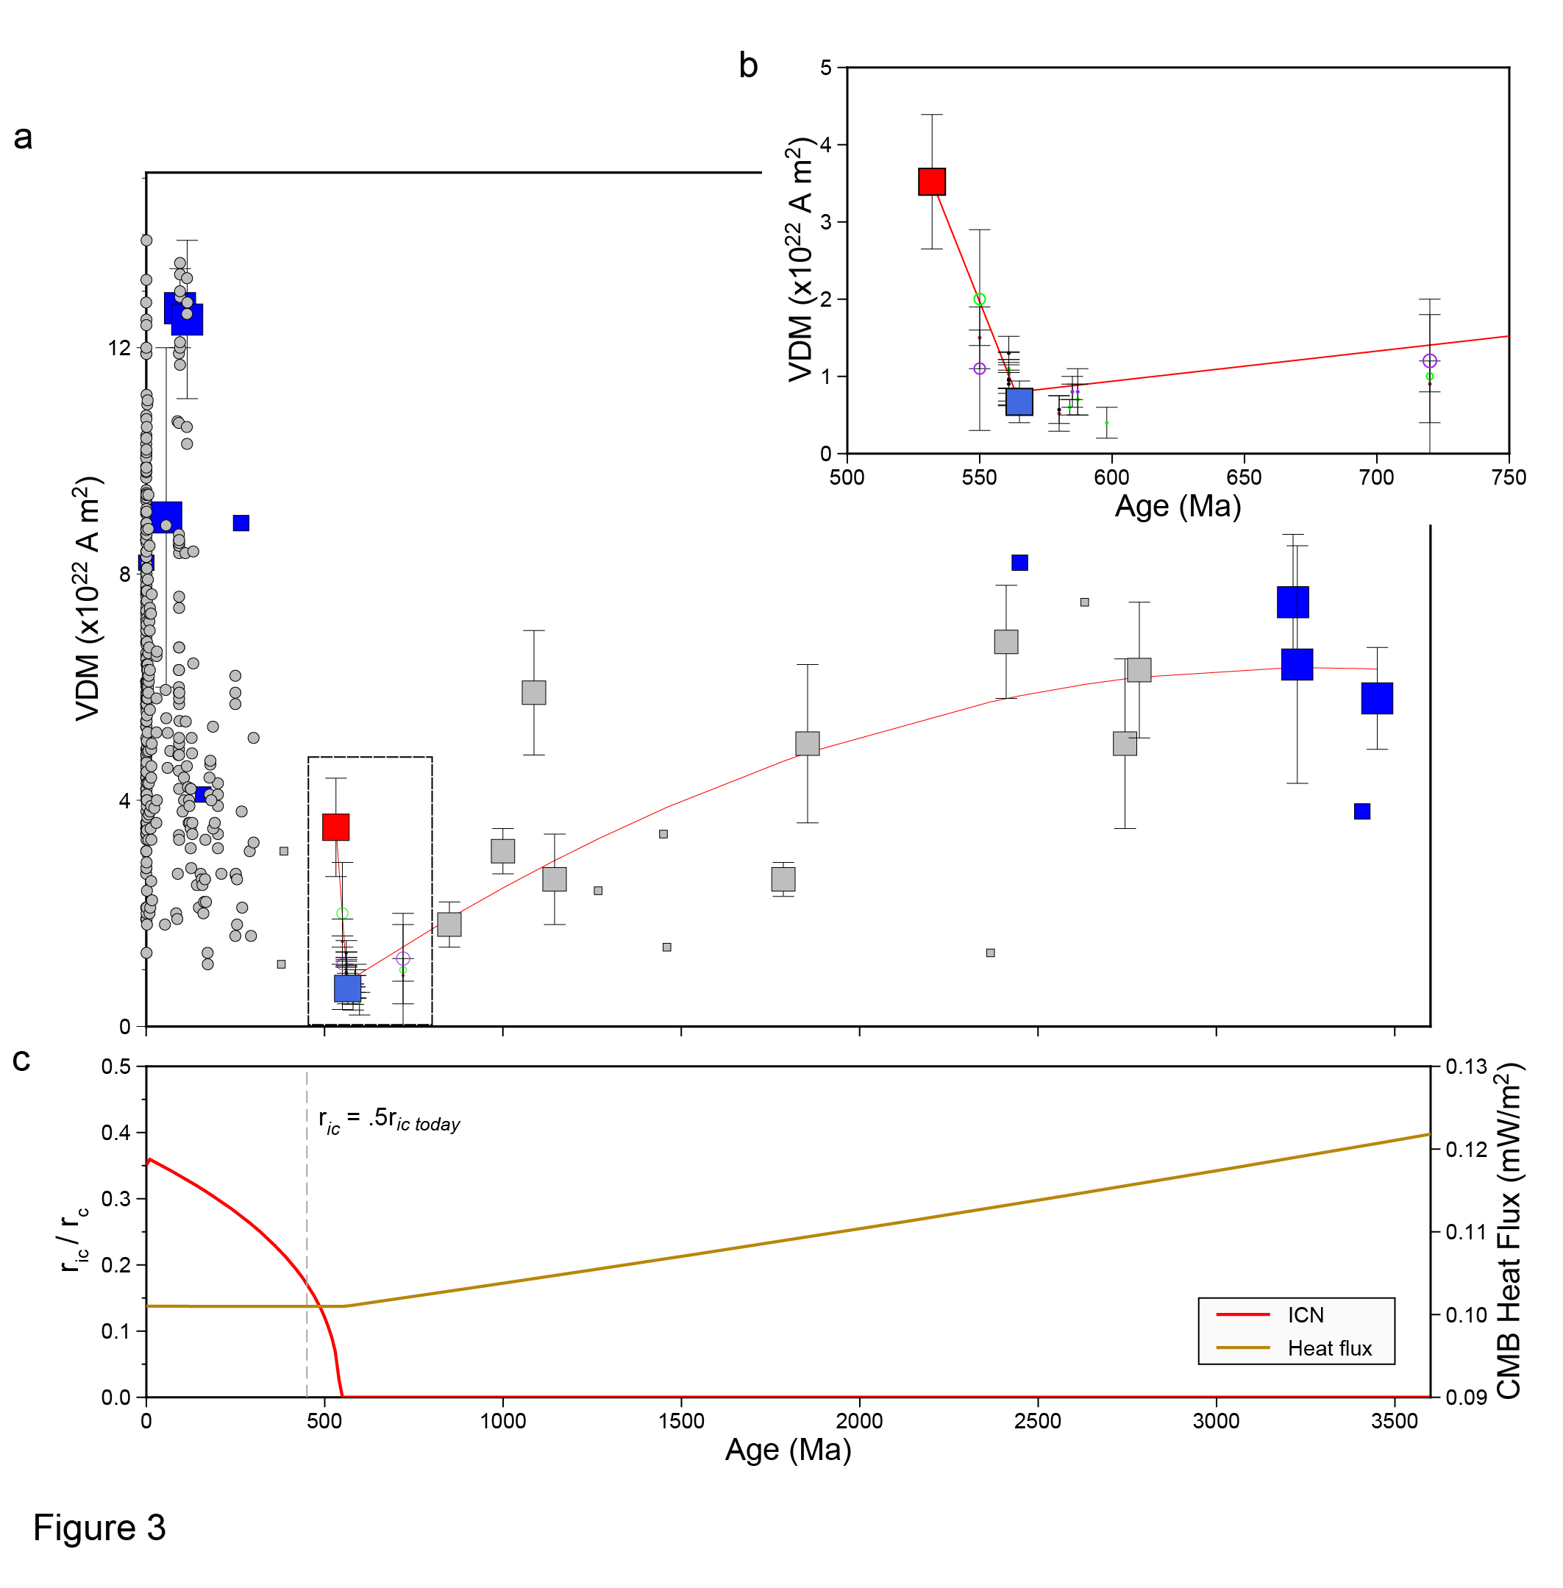
The Inner Core Nucleation
ICN onset age: ~550Ma (530-570Ma)
Thermal evolution model (based on Nimmo, 2015): ~450 Ma (435-460Ma)
IC grows to 0.5 r_{ic} (OIC/IMIC boundary)
The present deep mantle structure started to form at ~450 Ma!
Zhou et al. (2022)

Slide 13
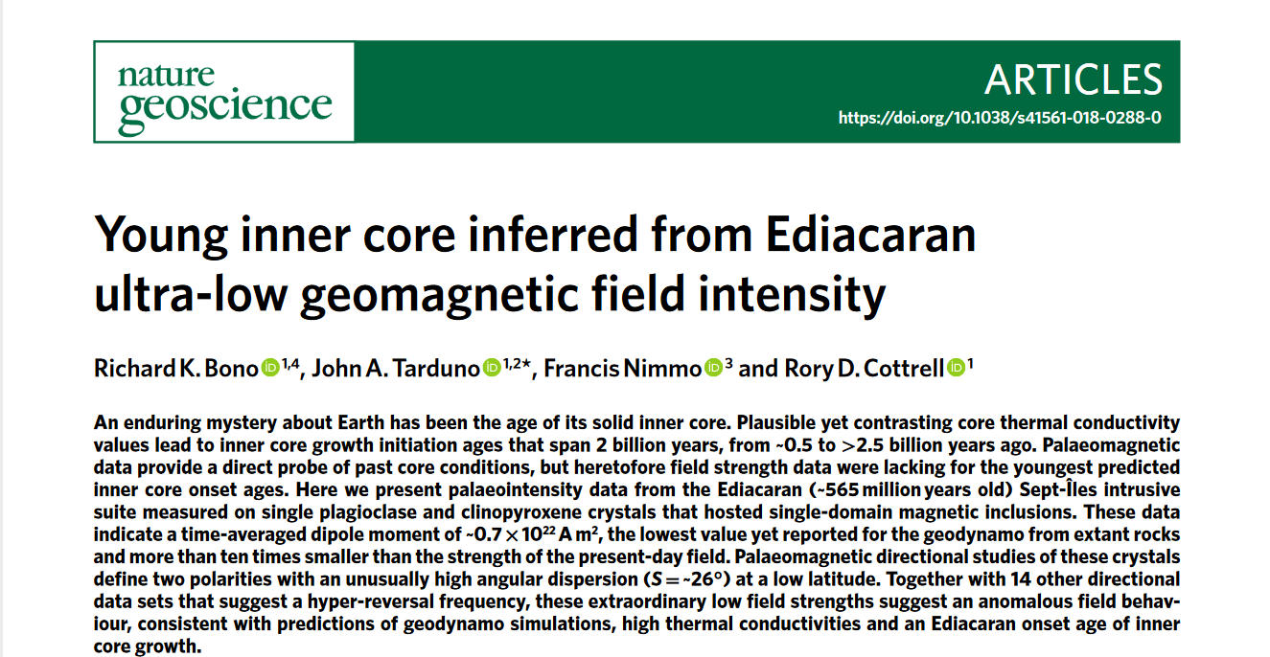
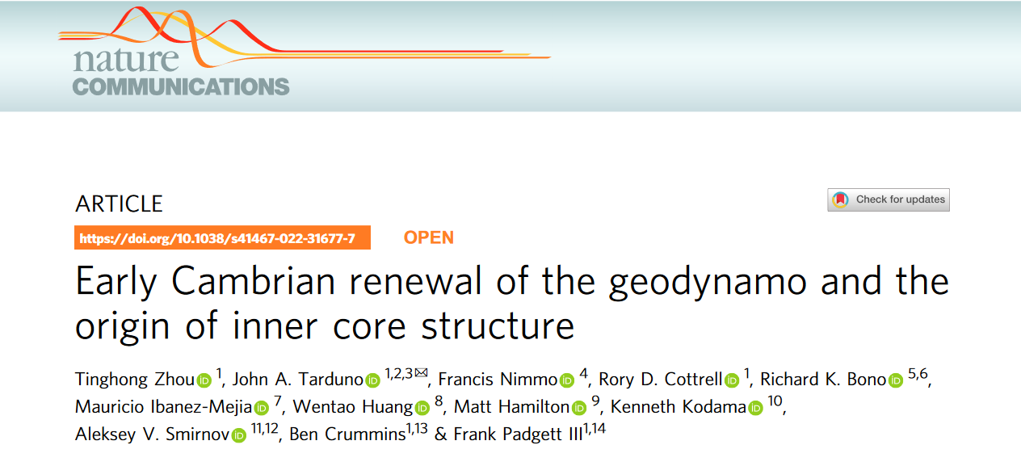
Geodynamo Evolution and Inner Core Growth
Thanks for your attention!

