Slide 1
Home exam, Earth and planetary materials and dynamics, in pptx- and PDF-format
A few extra articles relevant to some of the exam problems will be under "Short presentations" on the website. Otherwise you will find the background figures and information in the lecture presentations. Please submit the report as a PDF-file by June 6. You can put answers directly into this booklet (in pptx) or on a separate Word or PowerPoint document, before conversion to PDF. You do not need to copy the problem text into your answer report if you use separate sheets (numbers 1a, 1b, - - - is sufficient). No restriction on literature or www-based sources. Please ask me or others, if you are "stuck" somewhere. In most places short phrases and key words will be sufficient. Short answers are best.
Problem 1, Planetary accretion
a. List the main heat sources for planetary melting and differentiation, during planetary accretion and core segregation, sorted in two main stages:
- Very early (< 2-3 My after t₀) planetesimal formation (one main heat source):
- giant collisional stage from planetary embryos to planets (2-3 heat sources):
b. How does the "Grand Tack model" of Walsh et al. (2011, Nature) explain the low planetary mass in the in region between 1 and 5 AU?
c. Borg & Carlson (2023, Annu. Rev. Earth Planet Sci., in press) suggest that the Lunar magma ocean solidified as late as 4.35 Ga. Explain how such a young Moon might be problematic in light of some specific geochronological data from Australia.
d. Please try to suggest possible explanations for why the Lunar magma ocean solidification could be delyed relative to the crystallisation of most of Earth's magma ocean (except for the basal magma ocean).

Slide 2
Problem 2, Seismic velocity, mineral physics
a. Express the seismic S-wave and P-wave velocities (V_{S}, V_{P}) in terms of bulk (K) and shear (G) moduli and density (ρ).
b. The temperature is not a parameter in these equations. How will increasing temperature affect (increase or decrease) each of the parameters K, G and ρ, as well as the seismic velocities? Assume constant pressure (depth) and composition.
c. Explain briefly the common experimental procedures for determining the bulk modulus and density of a given mineral (single crystal or polycrystalline aggregate).
Problem 3. H₂O in the mantle and H in the core
a. On what basis did Drewitt et al. (2022, Earth Planet. Sci. Lett. 81, 117408) suggest that the H₂O-content is broadly uniform throughout the entire mantle, at approximately 0.03 wt%?
b. Calculate the total mass of H₂O in the entire mantle and in the entire core, assuming a uniform concentration of H₂O of 0.03 wt% in the mantle and a uniform concentration of H of 0.1 wt% in the core. Calculate also the ocean mass equivalents ("numbers of ocean masses") in the mantle and the core.
Use the following approximate masses:
mantle: 4001 Yg, core: 1971 Yg, ocean: 1.35 Yg (Yotta-gram, Yg = 10²⁴ g = 10²¹ kg). The approximate atomic weights of H and O is 1 and 16, resulting in a molecular weight of 9 for HO_{0.5} (i.e. 0.5 H₂O).
Mass of H₂O in the mantle: Yg. Ocean masses in the mantle: .
Mass of H₂O in the core: Yg. Ocean masses in the core: .
Please note that the estimate of 22 ocean masses estimated for the core, assuming a H-concentration of 0.12 wt%, by Li et al. (2022, Phys. Earth Planet. Int. 329-330, 106907) seems to be largely wrong.

Slide 3
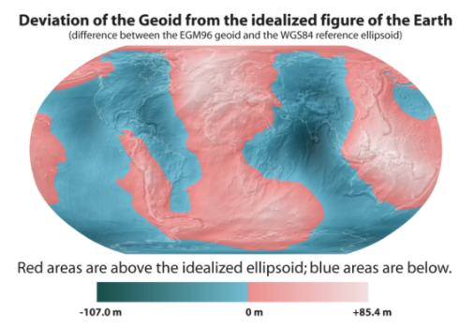
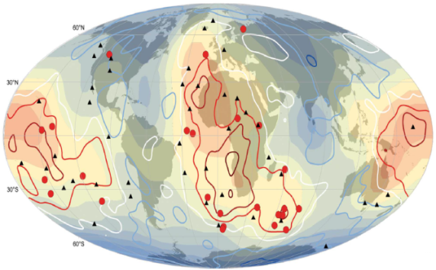
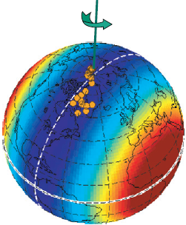
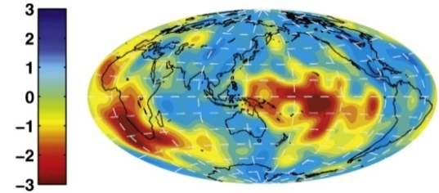
Problem 4. Geoid, dynamic topography, true polar wander, planetary rotation, lowermost mantle S-wave structure
a. How do we obtain the residual geoid from the observed geoid
b. Explain briefly why the residual geoid may correspond to the lowermost mantle seismic structure.
c. Define the term true polar wander (TPW).
d. What is the most efficient and common trigger for TPW?
e. Explain the difference between dynamic topography and the geoid.
f. How would you interpret the observation that the Earth's rotation axis generally moves within the plane of the circumpolar high-V_{S} belt in the lowermost mantle (see the figure below), during TPW events?
Observed geoid (from Wikipedia)
Residual geoid (Burke et al. 2011, GRL)
S-wave velocity model S362ANI at 2800 km depth
(Dziewonski et al, 2010, EPSL)
Green: present
rotation axis
Orange dots:
Paleo-poles,
0-200 Ma
Bold contours:

Slide 4
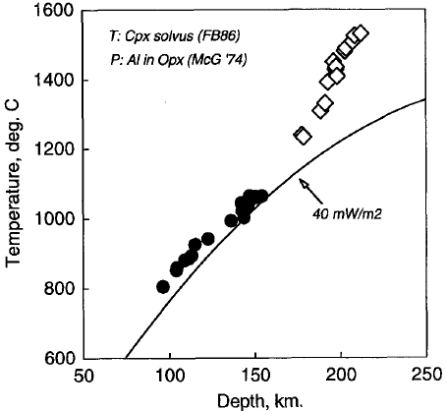
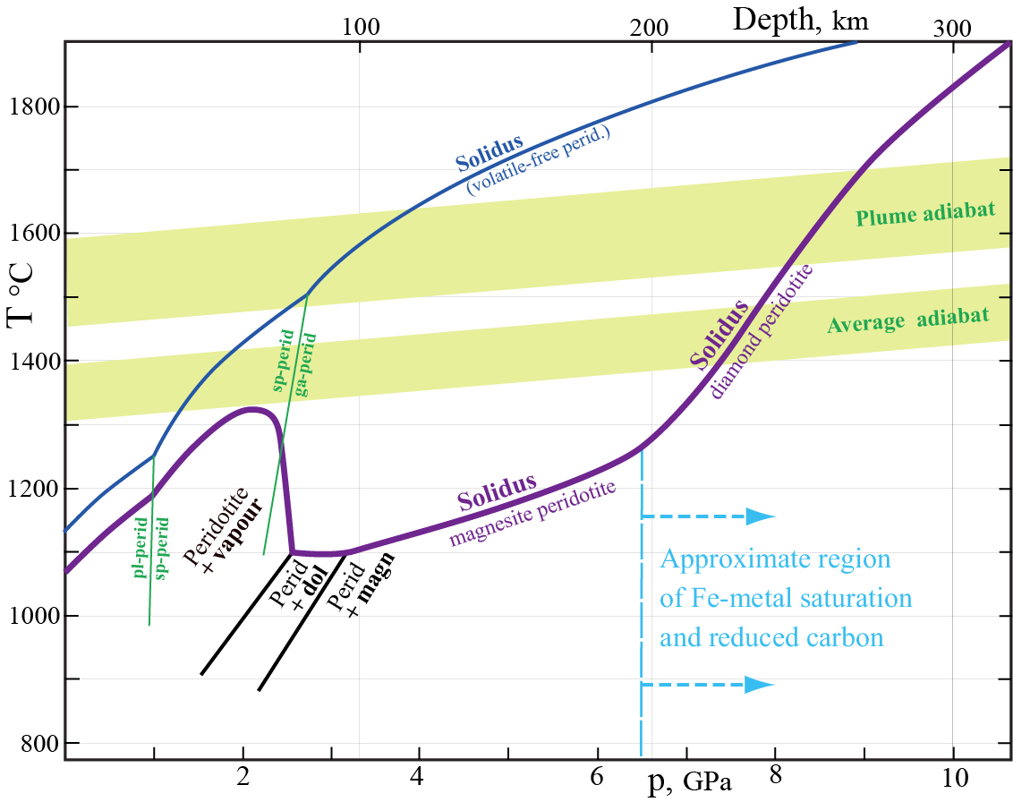
Problem 5. Deep Archean cratonic xenoliths in kimberlites.
a. Figure 5a shows a xenolith-based geotherm from the Kaapvaal craton determined in the following way:
1. Geobarometry from the Al₂O₃-content of orthopyroxene (opx) in equilibrium with garnet. The opx-solvus in Fig. 5c
(next page) is fairly insensitive to temperature
2. Geothermometry from the opx-cpx-solvus (Fig. 5d, next page, compositions on the enstatite-wollastonite join)
You should determine the pressure of two garnet lherzolites with high Mg# = 100Mg/(Mg+Fe) of 92-93 and the following key mineral compositions (we use the phase diagrams, Fig. 5c for the Fe-free systems in this problem):
Rock A: Opx with 3.0 mol% Al₂O₃ and cpx with 45.7 % Wo (wollastonite component)
Rock B: Opx with 0.6 mol% Al₂O₃ and cpx with 33.4 % Wo
Use the procedure above to estimate first the pressure of equilibration for rock A: , rock B: and
then the temperature of equilibration, using the correct cpx-solvus for rock A: , rock B: .
Using the following pressure-depth relation for the mantle: depth(km) = p(GPa)/0.03, i.e. 200 km ~ 6 GPa, mark the approximate positions of rocks A and B in Fig. 5a with small rings. Which of the two rocks is most likely to have equilibrated in the asthenosphere: .
b. The gap in sampling of mantle xenoliths brought to the surface by kimberlites (see Fig. 5a) might be related to the occurrence of abundant carbonate minerals at the asthenosphere-lithosphere boundary region where kimberlite magmas are likely to form. Based on Fig. 5b, explain briefly why kimberlites are generally unable to bring carbonate-rich samples to the surface.
High-T xenoliths,
mostly deformed
Fig. 5a
Geotherm based on
mineral compositions
in xenoliths from the
Kaapvaal craton
Gap
Low-T xenoliths
mostly granular
Fig. 5b

Slide 5
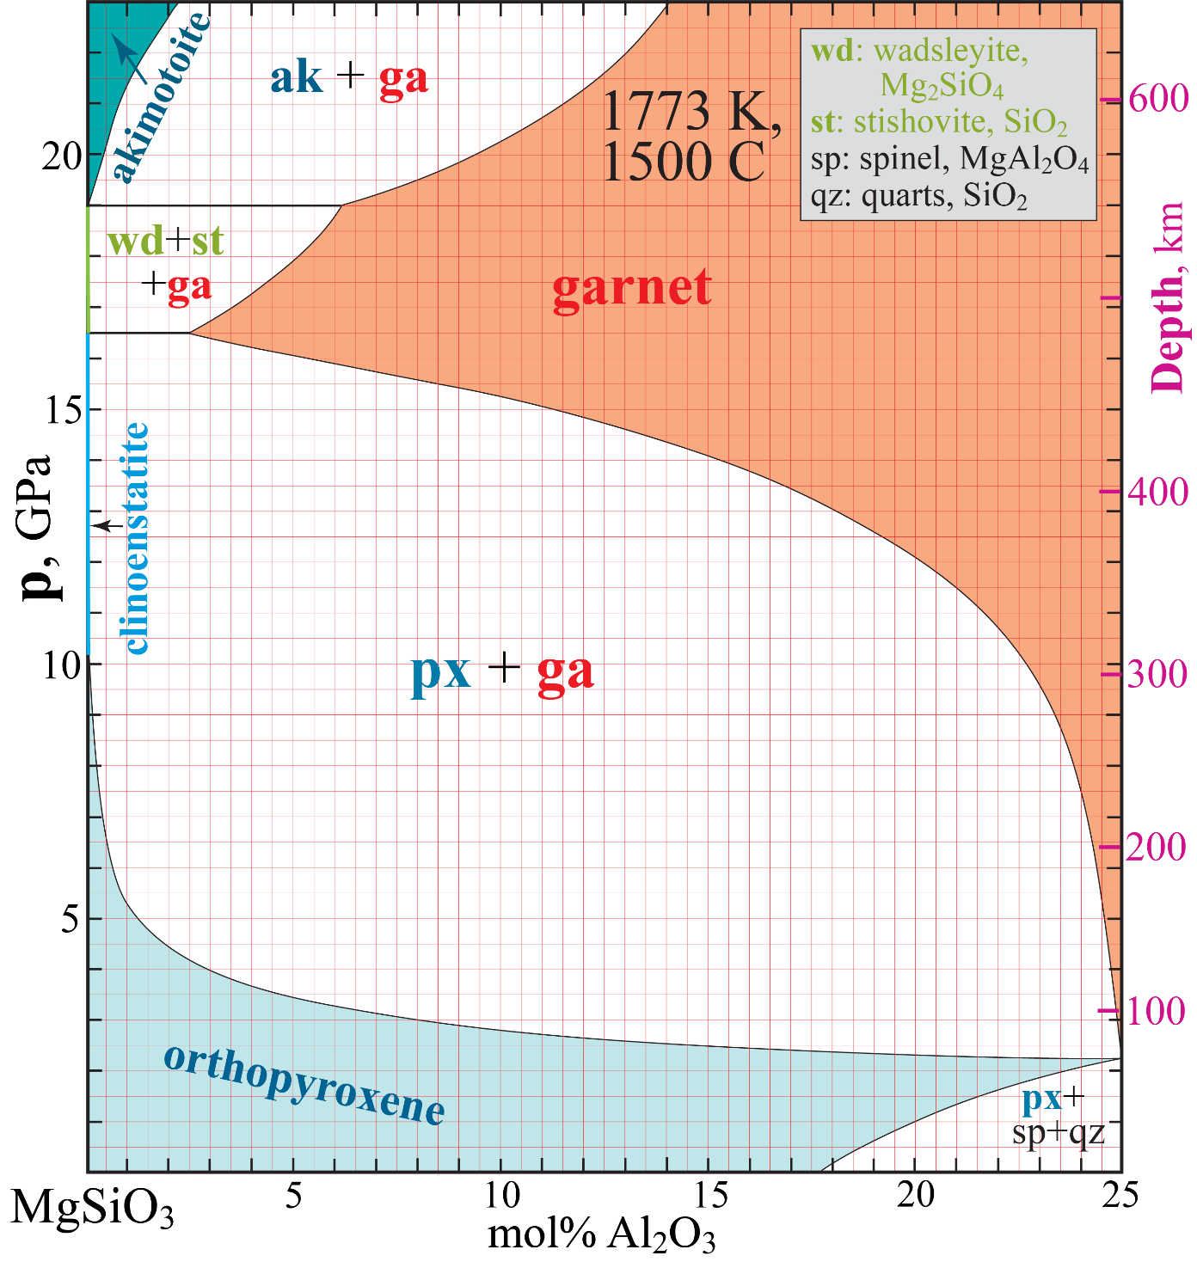
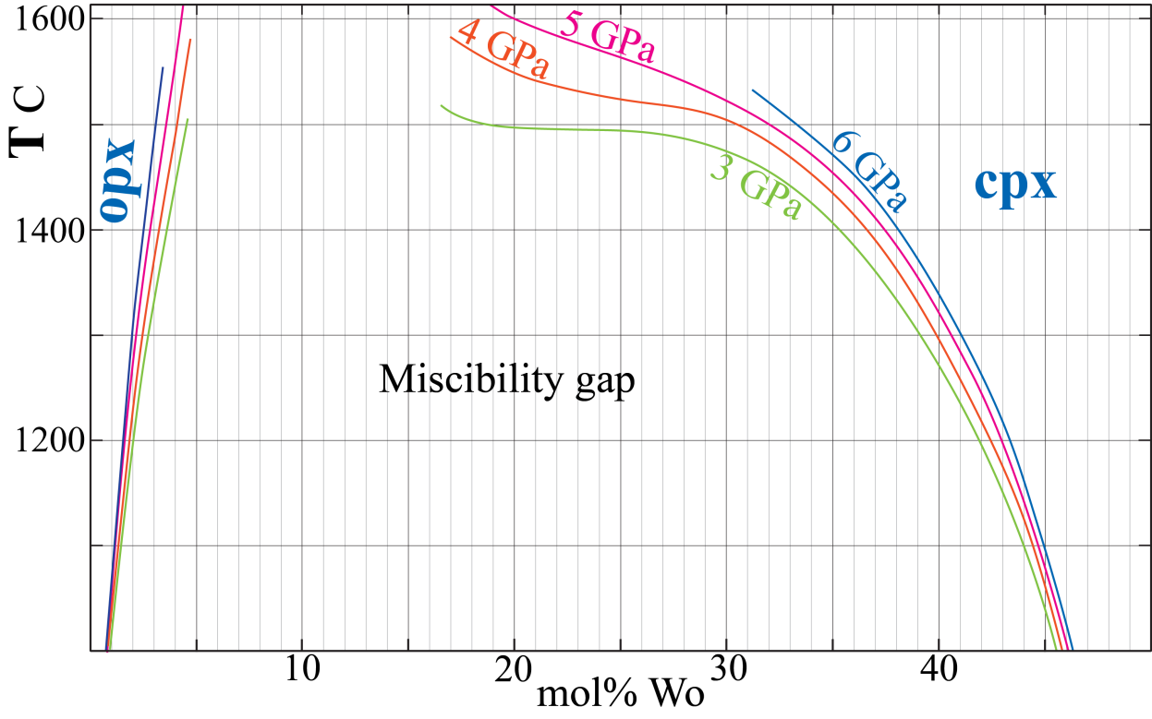
Fig. 5c
Fig. 5d

