Slide 1
Thermodynamics and mineral-melt phase relations:
The foundation of petrology and geochemistry
Textbook:
Chapters 5 (thermodynamics) + 6,7,10 (phase relations)
Metamorphic phase relations also in Part 2
But first:
A short review of the recalculation (manipulation) of mineral and rock compositions

Slide 2
Mineral- and rock compositions
Weight% versus atom% (or mol%)
Very basic features
- Silicate minerals and common rocks are nearly "fully oxidized",
with O as the most important and often the only anion
BUT: Fe occurs as a combination of Fe²⁺ (as FeO) and Fe³⁺ (as Fe₂O₃ / FeO_{1.5})
- Oxide-, carbonate-, phosphate-, sulfate- and tungstate-minerals are also "fully oxidized"
- The contents of halogenides and sulfides are very low in common silicate rocks
Chemical analyses of minerals and rocks are normally presented as oxides
BUT:
useful to recalculate to cation basis, especially for minerals
(i.e. relatively simple stoichiometric compounds)

Slide 3
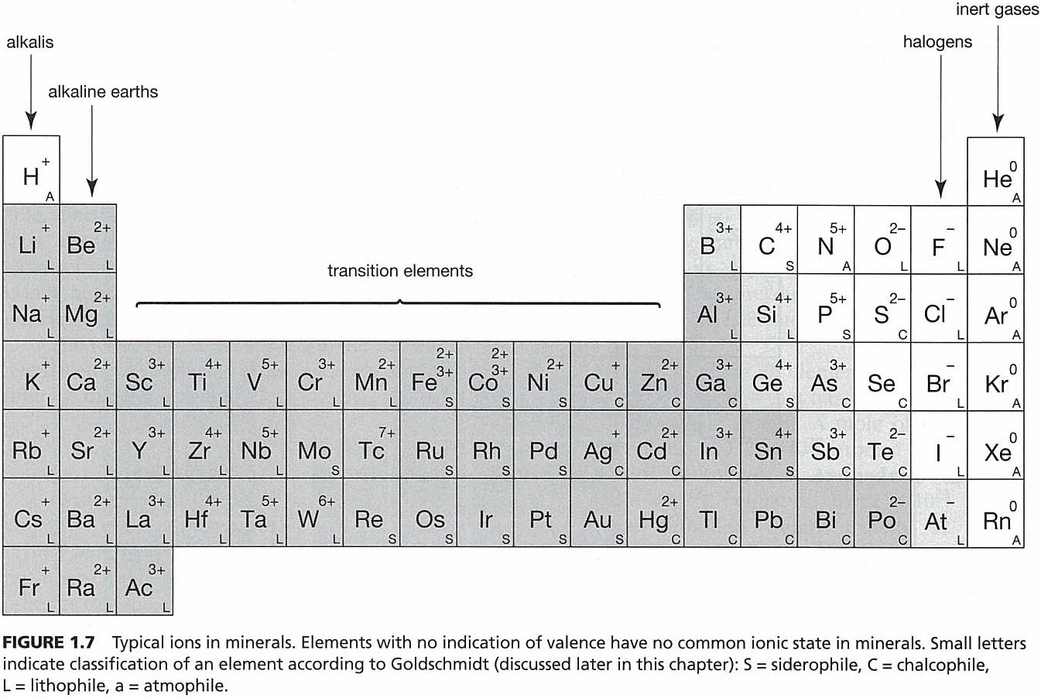
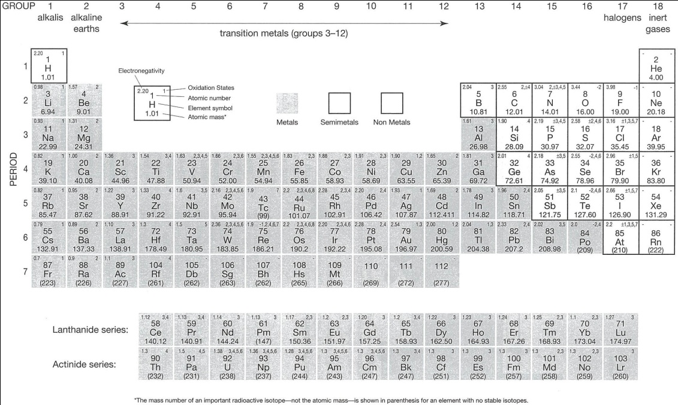
Basic information:
Valency / oxidation state for
major and trace elements
- The great majority of major and trace elements
has one dominating valency in silicate minerals
and rocks in planetary mantles and crusts.
- Important exception: Fe
Which are the common valencies?

Slide 4
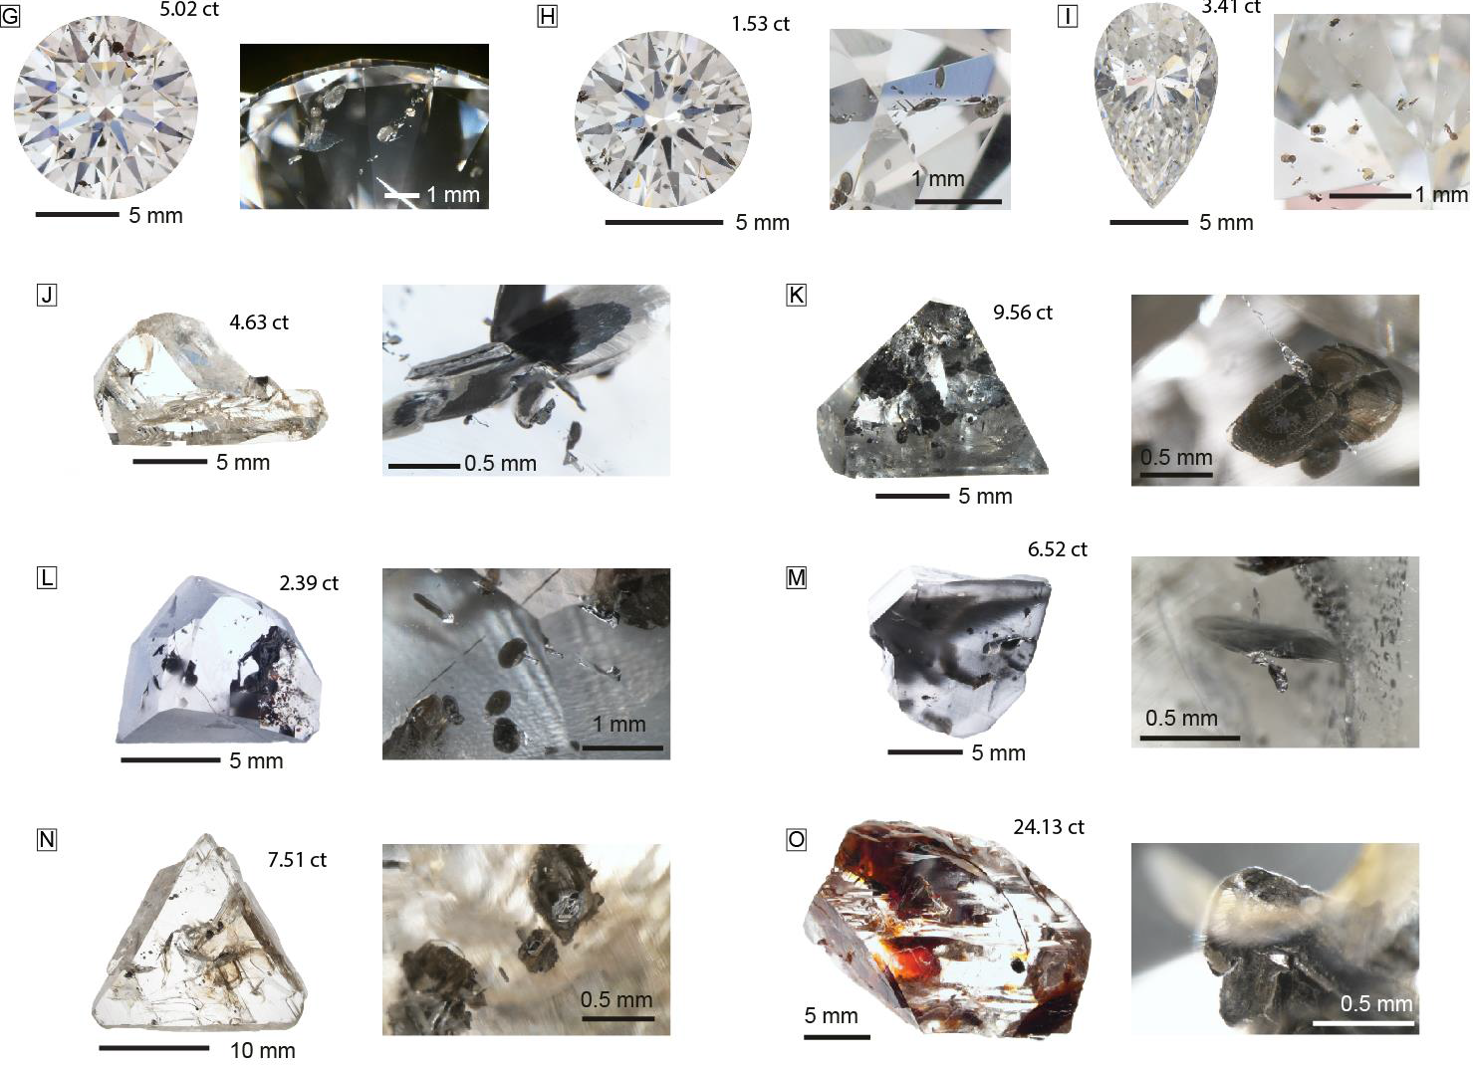
What are most of the dark inclusions in these diamonds?

Slide 5
SiO₂
Al₂O₃ or AlO_{1.5}
FeO
Fe₂O₃ or FeO_{1.5}
CaO
Na₂O or NaO_{0.5}
K₂O or KO_{0.5}
Important question
Choice of stoichiometry /
formula for the oxides
Is 19 wt% Al₂O₃ identical to 19 wt% AlO_{1.5} ?
Yes !
but Al₂O₃ has 2 cations + 3 anions and twice the molecular weight of AlO_{1.5}
Calculation of mineral formulas based on wt%:
I use mostly one-cation-oxides

Slide 6
Calculation of mineral formula (structural formula) for a feldspar analysis
General feldspar formula: (K,Na,Ca)(Al,Si)₄O₈, i.e. 5 cations + 8 O-ions
The advantage of
1-cation oxides
Mineral formula,
normalized to 5 cations
= cp*5 / 18635
Si 2.943
Al 1.024
Fe³⁺ 0.035
Ca 0.029
Na 0.616
K 0.353
Σ_{cations} 5.000
Σ_{charge} 15.974
Mineral formula,
normalized to 8 O-ions
= op*8*1 / (29769)
Si 2.947
Al 1.025
Fe³⁺ 0.035
Ca 0.029
Na 0.618
K 0.354
Σ_{cations} 5.008
Σ_{charge} 16.00
wt%
65.90
19.45
1.03
0.61
7.12
6.20
mol. wt
mw
60.08430
50.98064
79.84410
56.07740
30.98947
47.09800
cation prop.
cp = 10⁴*wt% / mw
10968
3815
129
109
2298
1316
Σ 18635
oxygen-prop.
op = 10⁴*O*wt% / mw
21936
5723
194
109
1149
658
Σ 29769
SiO₂
AlO_{1.5}
FeO_{1.5}
CaO
NaO_{0.5}
KO_{0.5}
4.002
4.007
0.998
1.001
Mineral formula normalized to 5 cations:
K_{0.35}Na_{0.62}Ca_{0.03}(Fe_{0.04}Al_{1.02}Si_{2.94}) O_{7.987}
Mineral formula normalized to 8 O-ions:
K_{0.35}Na_{0.62}Ca_{0.03}(Fe_{0.04}Al_{1.03}Si_{2.95}) O_{8.00}

Slide 7
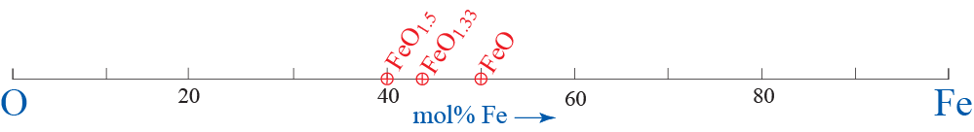
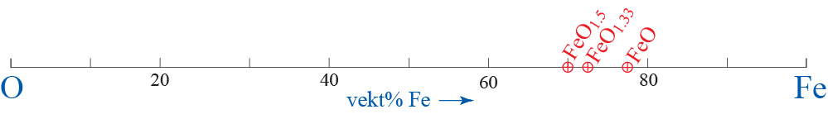
Graphic presentation of mineral compositions
Along a simple axis, system O-Fe:
3 phases (minerals): wüstite: FeO, hematite: Fe₂O₃ and magnetite: Fe₃O₄ (FeO Fe₂O₃)
Mol%
FeO: 1Fe + 1O = 2, 1/2 = 50% Fe
Fe₂O₃: 2Fe + 3O = 5, 2/5 = 40% Fe
Fe₃O₄: 3Fe + 4O = 7, 3/7 = 43% Fe
Weight% Fe O
FeO: 55.845 Fe + 15.9994 O = 71.8444, 77.7 22.3
Fe₂O₃: 2ˑ55.845 Fe + 3ˑ15.9994 O = 159.69, 69.9 30.1
Fe₃O₄: 3ˑ55.845 Fe + 4ˑ15.9994 O = 231.55, 72.4 27.6

Slide 8
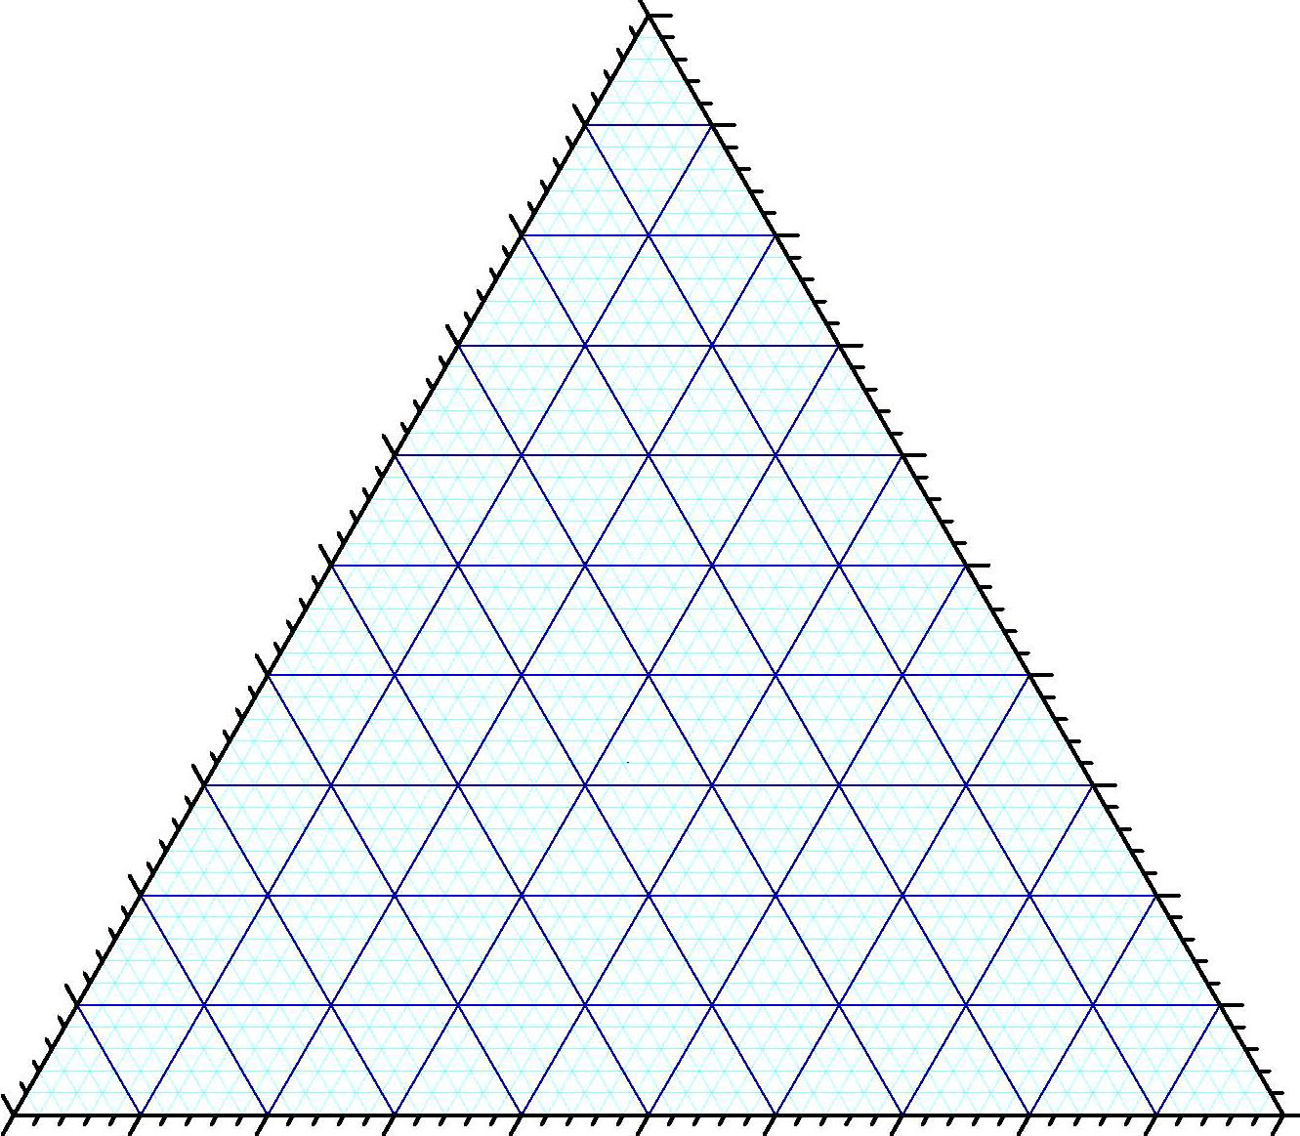
Graphic presentation of mineral compositions
System MgO-SiO₂-Al₂O₃. Display of mineral endmembers (components) forsterite (Mg₂SiO₄),
enstatite (MgSiO₃), silica (SiO₂), spinel (MgAl₂O₄) og pyrope (Mg₃Al₂Si₃O₁₂)
Mol%
Mg₂SiO₄ : 2MgO + 1SiO₂ = 3 1/3 = 33.3% SiO₂
MgSiO₃ : 1MgO + 1SiO₂ = 2, 1/2 = 50.0% SiO₂
SiO₂: 100% SiO₂
MgAl₂O₄ : 1MgO + 1Al₂O₃ = 2, 1/2 = 50.0% Al₂O₃
Mg₃Al₂Si₃O₁₂ : 3MgO + 1Al₂O₃ + 3SiO₂ = 7,
3/7 = 42.9 % MgO
3/7 = 42.9% SiO₂
1/7 = 14.3% Al₂O₃
Weight%
Mg₂SiO₄ : 2ˑ40.3044 + 60.0843 = 140.6931, 42.7% SiO₂
MgSiO₃ : 40.3044 + 60.0843 = 100.3887, 59.9% SiO₂
SiO₂: 100% SiO₂
MgAl₂O₄ : 40.3044 + 101.9612 = 142.2656, 71.7% Al₂O₃
Mg₃Al₂Si₃O₁₂ : 3ˑ40.3044 + 101.9612 + 3ˑ60.0843 = 403.1273,
30.0% MgO
44.7% SiO₂
25.3% Al₂O₃
Al₂O₃
Sp
Sp
Py
Py
MgO
Fo
Fo
En
En
SiO₂

Slide 9
Graphic presentation of mineral compositions
System MgO-SiO₂-AlO_{1.5}. Display of mineral endmembers (components) forsterite (Mg₂SiO₄),
enstatite (MgSiO₃), silica (SiO₂), spinel (MgAl₂O₄) og pyrope (Mg₃Al₂Si₃O₁₂)
Different Mol% (for spinel and pyrope)
Mg₂SiO₄ : 2MgO + 1SiO₂, 1/3 = 33.3% SiO₂
MgSiO₃ : 1MgO + 1SiO₂ = 2, 1/2 = 50.0% SiO₂
SiO₂: 100% SiO₂
MgAl₂O₄ : 1MgO + 2AlO_{1.5} = 3, 2/3 = 66.7% AlO_{1.5}
Mg₃Al₂Si₃O₁₂ : 3MgO + 2AlO_{1.5} + 3SiO₂ = 8,
3/8 = 37.5 % MgO
3/8 = 37.5% SiO₂
2/8 = 25.0% AlO_{1.5}
Same weight%
Mg₂SiO₄ : 2ˑ40.3044 + 60.0843 = 140.6931, 42.7% SiO₂
MgSiO₃ : 40.3044 + 60.0843 = 100.3887, 59.9% SiO₂
SiO₂: 100% SiO₂
MgAl₂O₄ : 40.3044 + 101.9612 = 142.2656, 71.7% Al₂O₃
Mg₃Al₂Si₃O₁₂ : 3ˑ40.3044 + 101.9612 + 3ˑ60.0843 = 403.1273,
30.0% MgO
44.7% SiO₂
25.3% Al₂O₃
AlO_{1.5}
Sp
Sp
Py
Py
MgO
Fo
Fo
En
En
SiO₂

Slide 10
System MgO-SiO₂-CaO. Mark the mineral endmembers (components) enstatite (MgSiO₃), wollastonite (CaSiO₃) and diopside (CaMgSi₂O₆) as mol% and as weight%.
Use the following atomic weights: O: 15.9994, Si: 28.0855, Mg: 24.305, Ca: 40.078
CaO
MgO
SiO₂

Slide 11
Definition of the terms phase, system and components
Phase: chemically homogenous, physically distinct and mechanically separable substance
Examples: water, ice, steam, kyanite, sillimanite, andalusite, quartz, granitic melt

Slide 12
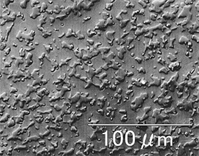
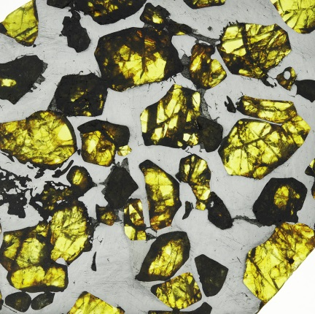
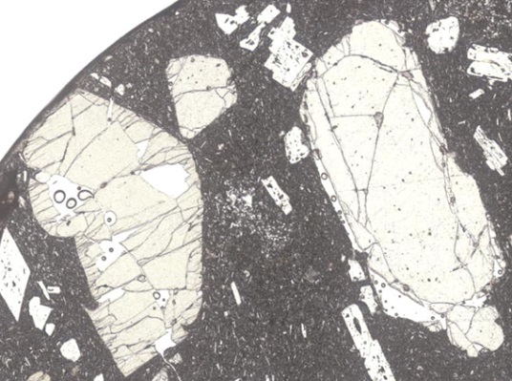
System: a collection of phases under consideration
We often choose a system, as the most convenient part of the universe to consider in order
to understand certain chemical and thermodynamic equilibria.
Examples:
- an experimental run product with
75 mol% Mg₄Si₄O₁₂ + 25 mol% Mg₃Al₂Si₃O₁₂
27 GPa,
1800°C
Phases:
garnet (high-relief crystals)
bridgmanite (matrix)
+ tiny crystals of stishovite because
non-stoichiometry of bridgmanite
- a pallasite with FeNi-alloy and olivine crystals,
representing FeNi-melt in equilibrium(?) with olivine crystals
- a basalt with phenocrysts of olivine and plagioclase

Slide 13
- an outcrop of lenses of pyroxenite in eclogite
- an outcrop of blocks of coronized
pyroxene-bearing granulite in amphibolite
- or only the coronized granulite subsystem

Slide 14
Components (system components): the minimum collection of chemical entities that is
required in order to characterize all of the phases in a system
(components can be elements, oxides or more complex compositions)
Unneccesary term
Phase components: the smallest collection of chemical entities necessary for
characterization of a phase (e.g. elements, oxides or more complex formula units)

Slide 15
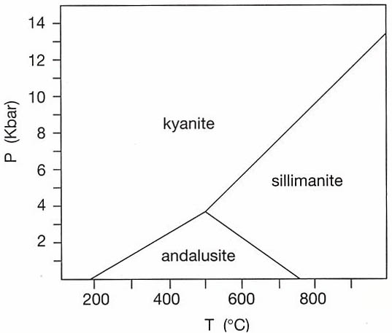
Choice of components
Al-silicate system containing the phases kyanite, sillimanite and andalusite.
Polymorphs with chemical composition: Al₂SiO₅
3 elements: Al, Si, O
2 oxides: Al₂O₃, SiO₂
How many components ?
1: Al₂SiO₅

Slide 16
The ”olivine system” of solid solution between
forsterite (Mg₂SiO₄) and fayalite (Fe₂SiO₄)
4 elements: Mg, Fe, Si, O
3 oxides: MgO, FeO, SiO₂
How many components?
2: Mg₂SiO₄ and Fe₂SiO₄
How many phases?
1: olivine

Slide 17
The phase rule
For a system in equilibrium:
P + F = C + m
P: Number of phases present in equilibrium at any given location in a phase diagram
F: Number of degrees of freedom or variance: number of variables that can change
independently of each other (e.g. p-T-X, pressure-temperature-composition)
C: The smallest number of chemical components required to characterize all of the phases
m: Number of external variables that influence the system, commonly m = 2 (p and T)

Slide 18
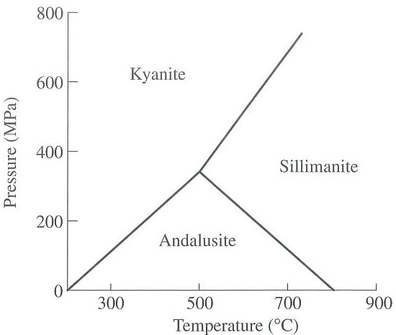
Phase rule:
P + F = C + 2
System: Al₂SiO₅
C = 1 (component Al₂SiO₅ is common to all 3 phases)
P = 3 ⇒ 3 + F = 1 + 2
F = 0 (invariant point)
P = 2 ⇒ 2 + F = 3
F = 1 (univariant lines)
P = 1 ⇒ 1 + F = 3
F = 2 (divariant field)

Slide 19
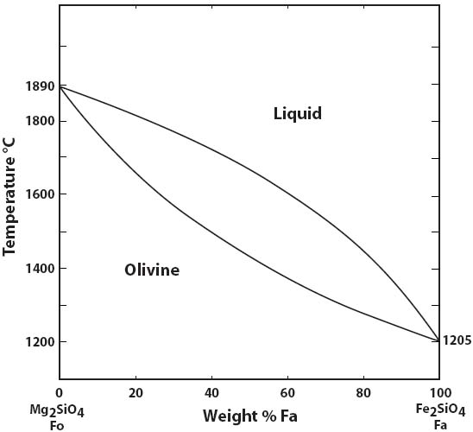
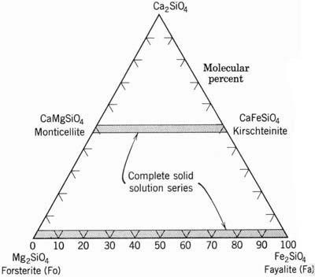
Olivine group
the very first
melt
olivine
Liquidus
Solidus
Forsterite: very high melting point
System forsterite-fayalite: full solid solution
and liquid solution
Bulk composition:
Fo₈₇, Fa₁₃

Slide 20
System: (Mg,Fe)₂SiO₅ or Mg₂SiO₄ – Fe₂SiO₄
C = 2 both of the phases comprise different
proportions of the components
forsterite and fayalite
This is a T-X-diagram at
constant (fixed) pressure (1 bar)
⇓
Phase rule:
P + F = C + 1
P + F = 2 + 1 = 3
F = 3 – P
P = 1 ⇒ F = 2
divariant fields, can vary both T and X
i.e. for a fixed T (e.g. 1200 C) can
olivine vary from Fo₁₀₀ to Fo₀
P = 2 ⇒ F = 1
- univariant curves. If T is fixed, the
compositions of the two phases are also fixed
- changing T ⇒ changing X_{sol} and X_{melt}
Three phases are never present in this diagram.
Therefore, there are no binary invariant points.
BUT the melting points for pure forsterite and pure
fayalite are unary invariant points (i.e. in the two
one-component systems Fo and Fa.)

Slide 21
The lever rule:
Measuring the mass proportion of two phases
Bulk composition Fa₂₀ (Fo₈₀)
Equilibrium at 1660 C
99.99% olivine (Fa₂₀Fo₈₀) +
0.01% melt (Fa₅₂Fo₄₈)

Slide 22
The lever rule:
Measuring the mass proportion of two phases
Bulk composition Fa₂₀ (Fo₈₀)
Equilibrium at 1700 C
olivine (Fo₈₄) + melt (Fo₅₆)
7
41
100*41/48
= 85.4%
100*7/48
= 14.6%

Slide 23
The lever rule:
Measuring the mass proportion of two phases
Bulk composition Fa₂₀ (Fo₈₀)
Equilibrium at 1800 C
olivine (Fo₉₃) + melt (Fo₇₇)
22
5
100*5/27
= 18.5%
100*22/27
= 81.5%

Slide 24
Teaching Phase Equilibria
http://serc.carleton.edu/research_education/equilibria/index.html

Slide 25
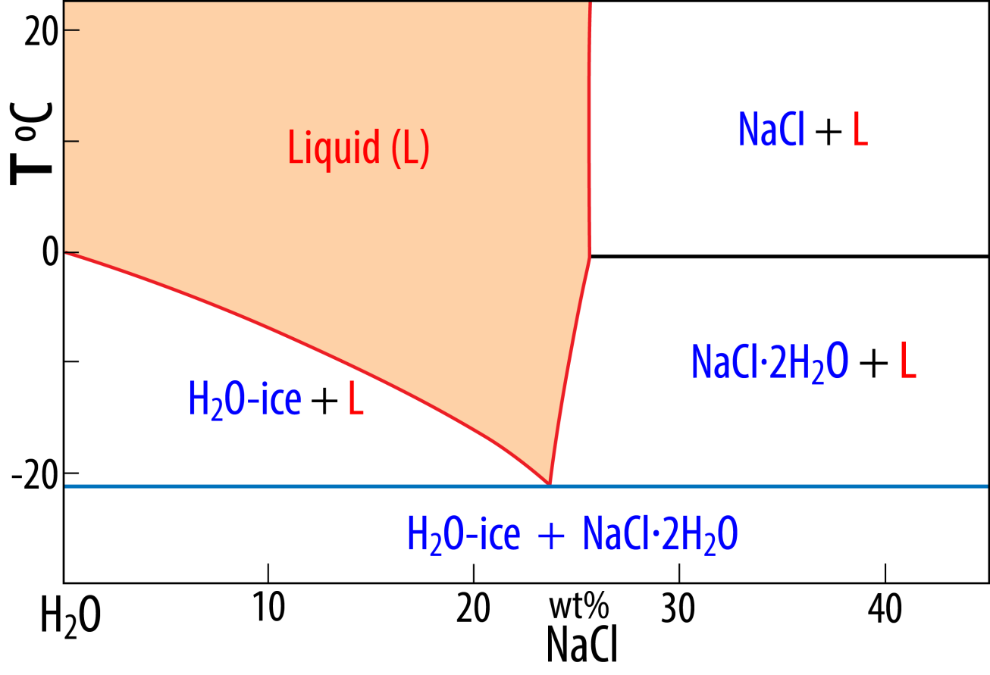
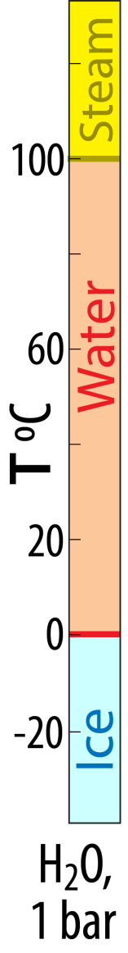
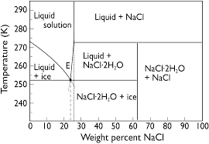
One-component (unary)
system: H₂O
Two-component (binary) system: H₂O-NaCl
Eutectic point,
23-24% NaCl

Slide 26
Experiment
Materials: nice fresh snow, NaCl (rdinary salt), balance, thermometer, container, ladle and spoon.
Procedure: mixing 22 mass units of NaCl and 78 mass units of snow at about 0℃
What will happen within the first few minutes and why? (e.g. the temperature in the mixture)

Slide 27
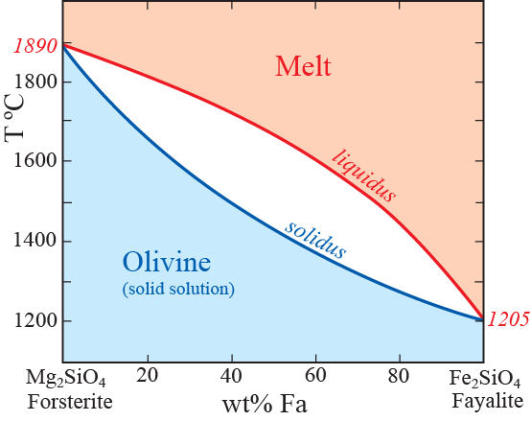
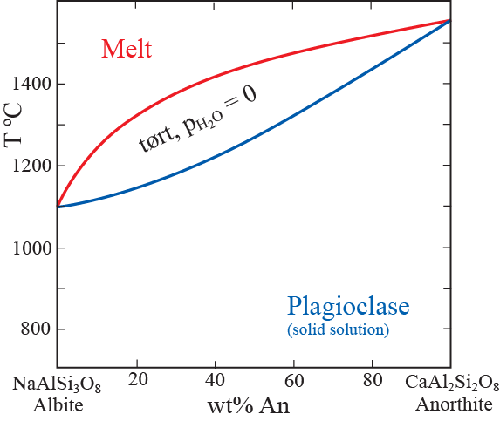
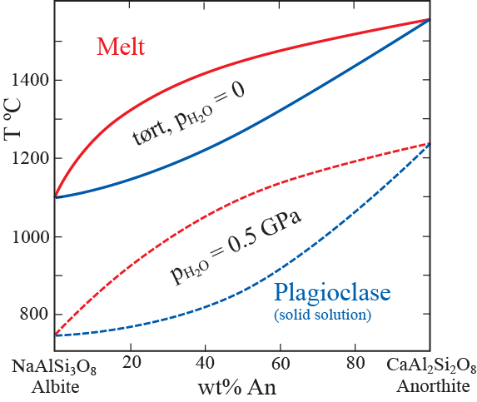
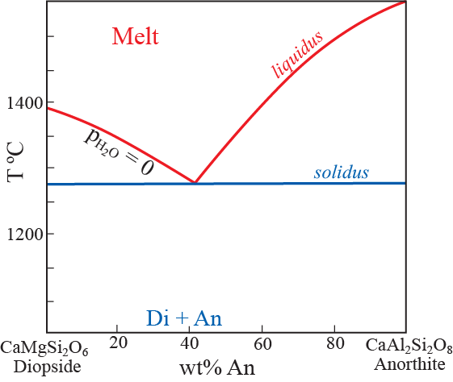
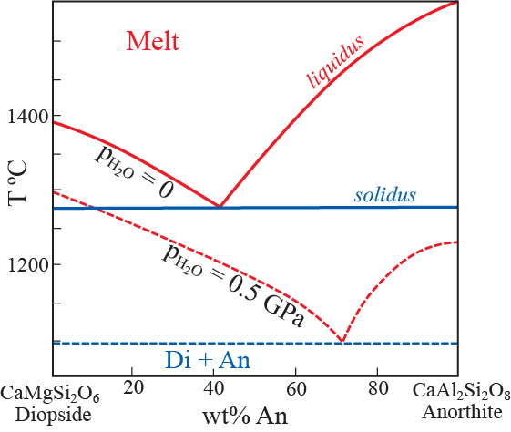
Phase relations: basalt – peridotite, binary systems

Slide 28
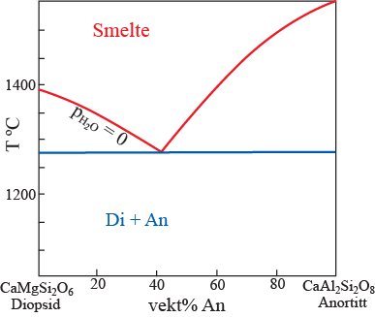
Melting relations for natural rocks – Multicomponent systems
Not a simple binary system:
A ternary system is much better,
but still only a simplified model
Eutektic
point
basalt
peridotite

Slide 29
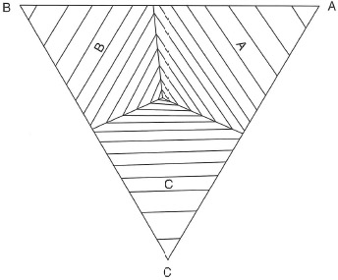
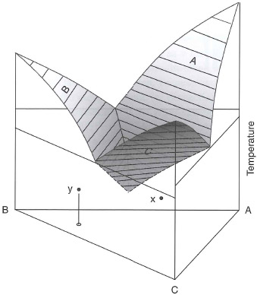
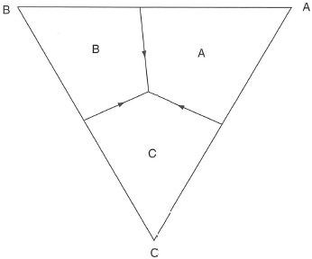
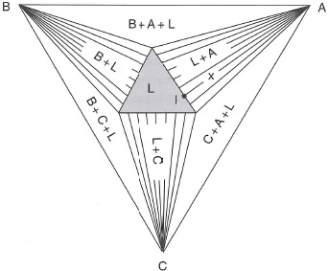
Generalized 3D-perspective drawing of the
liquidus phase relations in the system ABC
with binary and ternary eutectics
2D-projections
Liq. phase boundaries
and T-contours
Liq. phase boundaries
Isothernal section above
the ternary eutectic
Fig. 10.20, Ph & A

Slide 30

Decreasing solid solution
Full SS at high T

Slide 31
Thermodynamics (the study of energy)
Thermodynamic data (volume, entropy, enthalpy) can be derived from:
- experiments at a range p-T-X
- atomistic simulations (first-principles computations)
Why do we care?
Thermodynamic data are used to derive phase relations,
i.e. to construct phase diagrams
A universal and internally consistent thermodynamic data base
allows the construction of all thinkable phase diagrams (p-T-X)

Slide 32
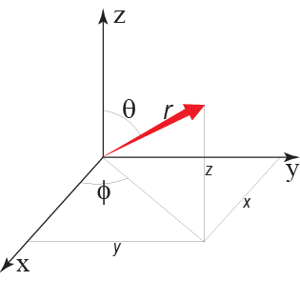
Pages 38-42: Background information - not for test and exam
Quantum chemistry determines chemical bonds and therefore:
- relative phase stabilities
- mineral physics (e.g. thermo-elasticity, electric and thermal conductivity, thermal radiativity)
The term quantum:
quantities, amounts,
i.e. discrete amounts,
corresponding to
electron orbitals
Schrödinger equation, equivalent to Newton's 2. law of classical mechanics: F = m* a
State of electrons: - distribution and electron density − Heisenberg's uncertainty principle
- first principles atomistic simulation by density functional theory, DFT
General, time-independant expression of the Schrödinger equation:
Εψ = Hψ
E: energy of the state ψ
H: Hamiltonian operator acting on
the wave function, ψ
4 partial functions
Wave function: ψ(r, θ, φ) = R(r) Θ(θ) Φ(φ) ψ_{s}
radius
(distance)
rotation-1
rotation-2
spin
(direction)
Spherical coordinates: r, θ, φ
Cartesian coordinates: x, y, z
The quantum numbers (QN)
correspond to the partial functions
Principal QN, n ~ R
Angular momentum QN, l ~ θ
Magnetic QN, m_{L} ~ Φ
Spin QN, m_{S} ~ ψ_{s}

Slide 33
Quantum numbers
Principal QN: n = 1, 2, - - -, 7 (corresponding to the K, L, M, N, O, P and Q shells, energy levels)
Angular momentum QN: l
For a given n, l can be: 0, - - -, n−1 i.e. for n=3, l is 0, 1, 2
Magnetic QN: m_{L}
For a given l, m_{L} can be: −l, −(l−1), - - -, 0, - - -, l−1, l i.e. for l=2, m_{L} is −2, −1, 0, 1, 2
Spin QN: m_{S}
For a every m_{L}, m_{s} can be: −1/2, +1/2

Slide 34
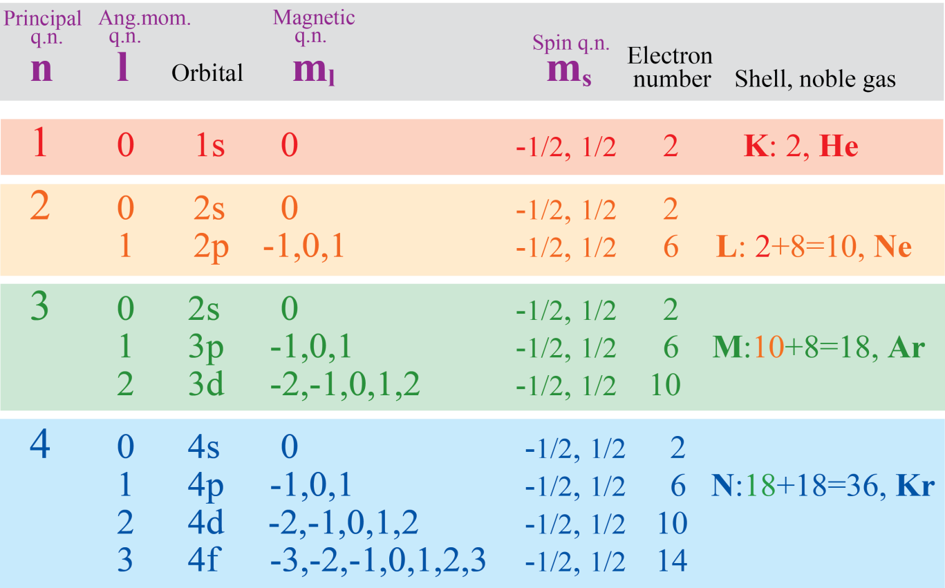
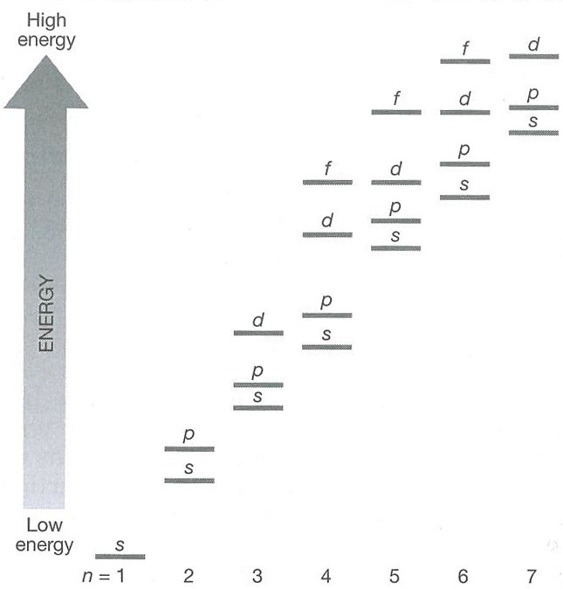
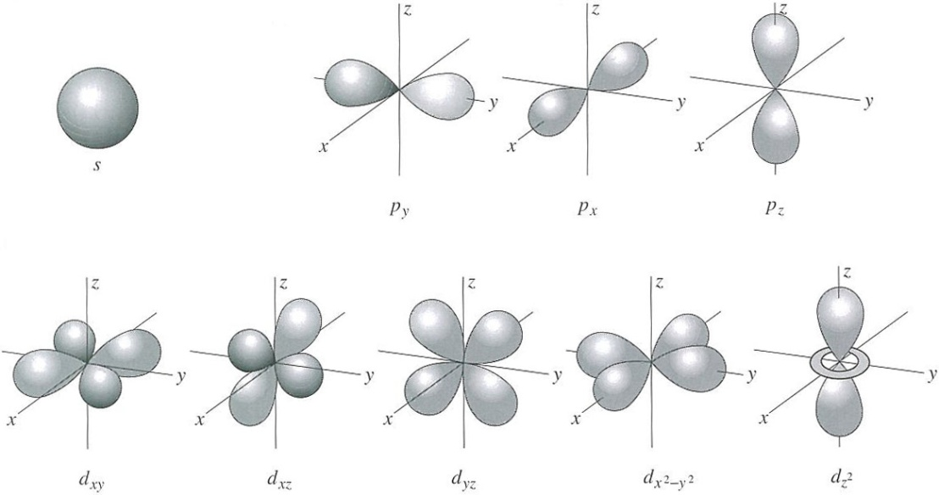
Quantum numbers
and
electron orbitals
one
s-orbital
three
p-orbitals
five
d-orbitals
seven
f-orb
6 p-electrons
2 s-electrons
2 el.
2 el.
2 el.
Domains of high
electron probability
10 d-electrons
2 el.
Note:
4s is lower than 3d,
5s is lower than 4d,
etc.
2 el.
2 el.
2 el.
2 el.

Slide 35
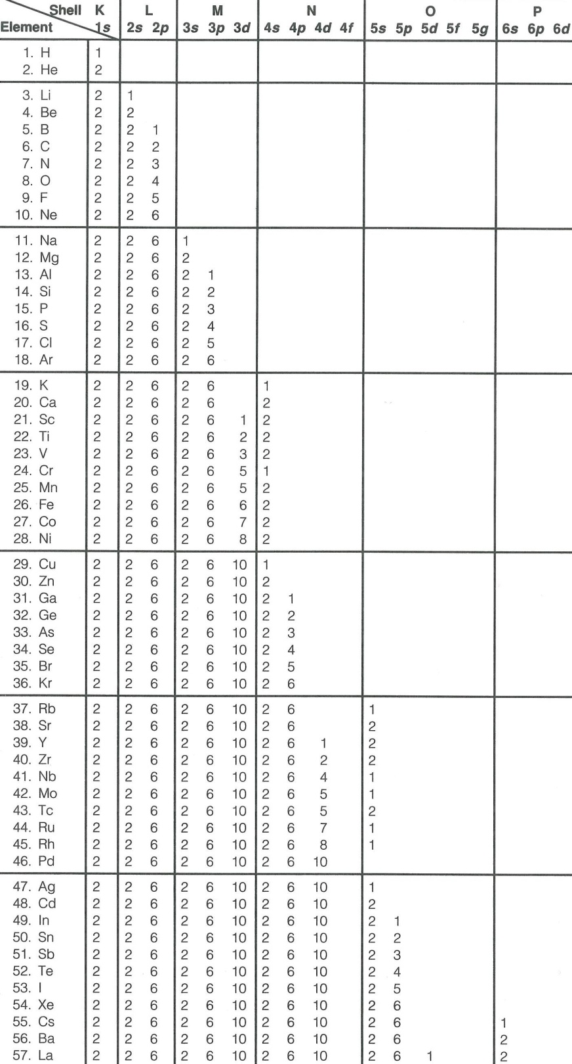
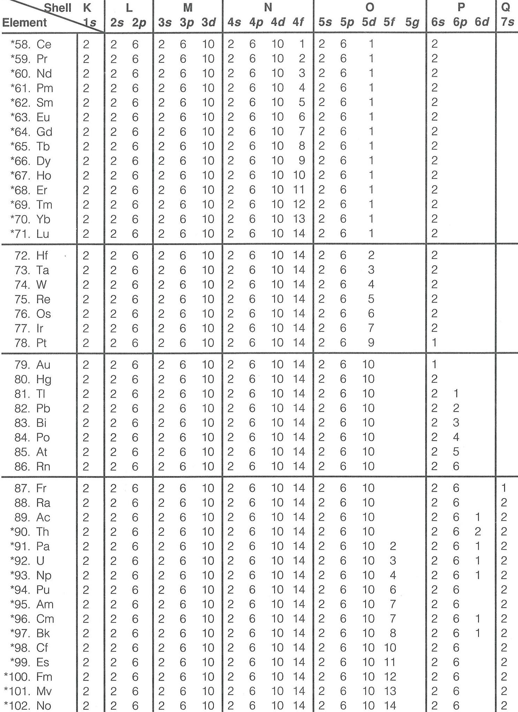
3d and 4d anomalies:
Scerri (2019, Nature)
Lanthanide contraction
Decreasing ionic radii (trivalent) from La to Lu.
Why?
Poor nuclear shielding by the 4f and the poorly
filled O-shell → 6s-electons are pulled inwards.

Slide 36
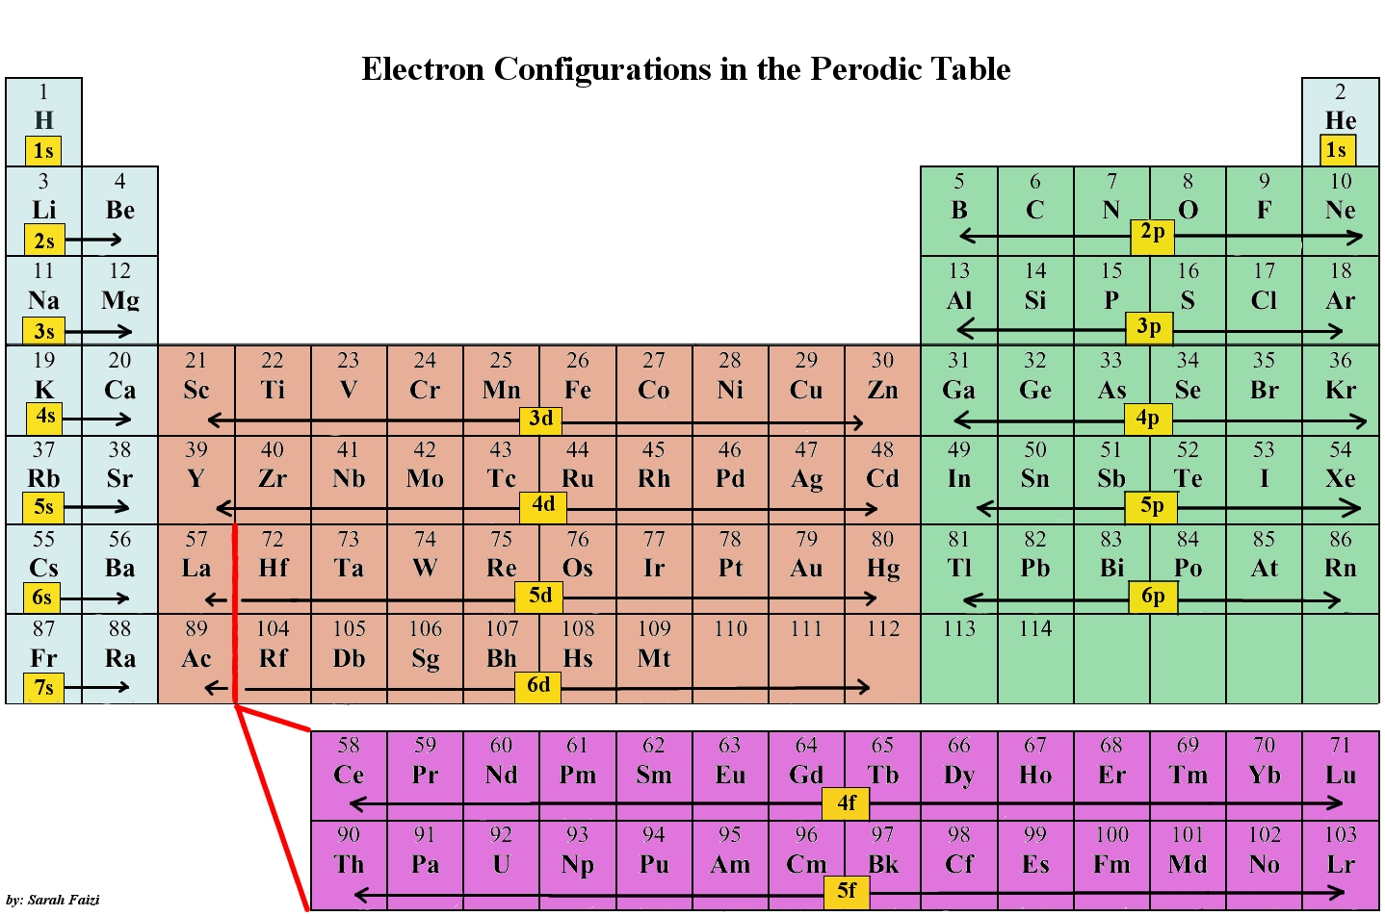
Am: Americum
Cm: Curium
Bk: Berkelium
Cf: Californium
Es: Einsteinuim
Fm: Fermium
Md: Mendelevium
No: Nobelium
Rf: Rutherfordium
Db: Dubnium
Sg: Seaborgium
Bh: Bohrium
Hs: Hassium
Mt: Meitnerium
Ds: Darmstadtium
Rg: Roentgenium
Cn: Copernicum
Nh: Nihonium
Fl: Flerovium
Mc: Moscovium
Lv: Livermorium
Ts: Tennessine
Og: Oganesson
Superheavy elements: e.g. Ball (2019, Nature)
Noble gases:
Full 1s + 2p-6p
orbitals of the
K-Q shells
K
L
M
N
O
P
Nh
115
116
117
118
Q
Ds
Rg
Cn
Fl
Mc
Lv
Ts
Og
7p
111
111

Slide 37
Second law of thermodynamics
Relation between heat content and entropy
Change of heat content: dQ = TdS
for a reversible process
Third law
S_{crystal} = 0 at T = 0 K
perfect crystal,
no solid solution
First law:
internal energy of an isolated system is constant
dE_{int} = dQ – dW = TdS – pdV = 0
Checking the units of work/energy:
Mechanical work of pulling the
yellow box against the frictional force:
W = Fd (Nm = J)
Pressure = force/area
p = F/A = F/d² (N/m² = Pa)
F = pd²
F
F
W = Fd = pd³
= pV (m³N/m² = Nm = J)
distance: d
Example, non-isolated syst.:
Adding energy to a system,
e.g. a crystal:
Contribution 1: added energy (dE₁) increases the heat content (dQ)
dQ goes into the system − therefore positive:
TdS
dE₁ = dQ = TdS
heating
Contribution 2: added energy (dE₂) enables the system to perform
work on the surroundings ( = volume increase against constant pressure)
−pdV
dW goes out of the system − therefore negative:
dE₂ = −dW = −pdV
volume
increase

Slide 38
First law: dE_{int} = dQ – dW = TdS – pdV
Chemical reaction:
prod = reactants
At equilibrium:
ΔG = G_{prod} – G_{react} = 0
Gibbs free energy, G
- energy in addition to the internal energy
Definition: G = E_{tot} – E_{int}
= E_{tot} – (TS – pV)
G = E_{tot} + pV – TS
= H – TS
ΔG = ΔH – TΔS = 0
ΔH = TΔS i.e. change in heat
content of reaction
enthalpy: H
= G + TS
Helmholtz free energy, F
F = E_{tot} – TS = (G – pV + TS) – TS
F = G – pV
Gibbs free energy: G = F + pV
Helmholtz free energy, F
F = E_{tot} – TS
Some text books and articles
seem to mix: E_{tot} and E_{int}
Be aware !

Slide 39
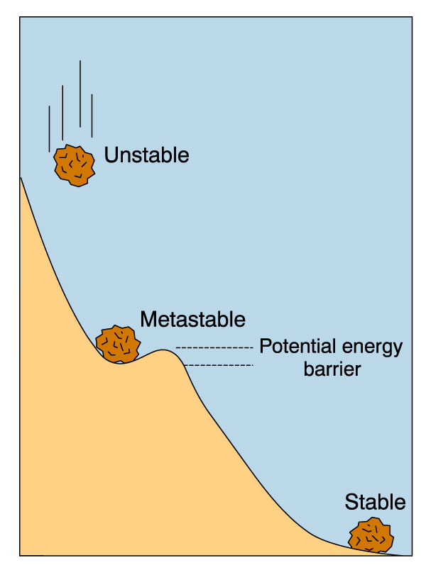
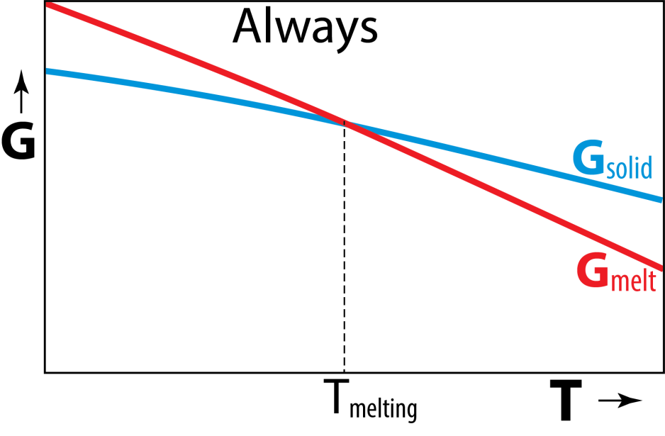
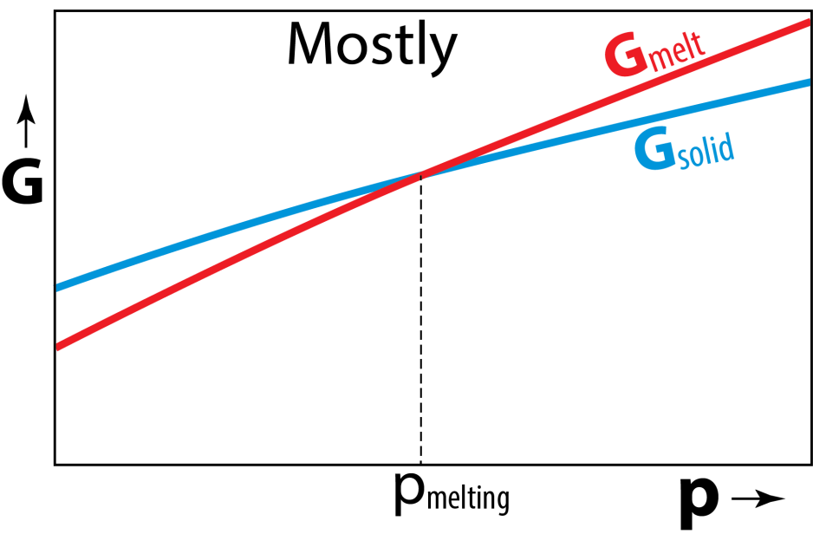
Simple melting reaction:
SiO₂ = SiO₂
solid melt
(e.g. tridymite)
Const. p
For each phase:
G = E_{tot} + pV − TS
dG = E_{tot} + dpV − d TS
Lowest energy level: greatest stability
Const. T
In this case:
Will the melting point (curve) increase or
decrease with increasing pressure?
T
melt
solid
p

Slide 40
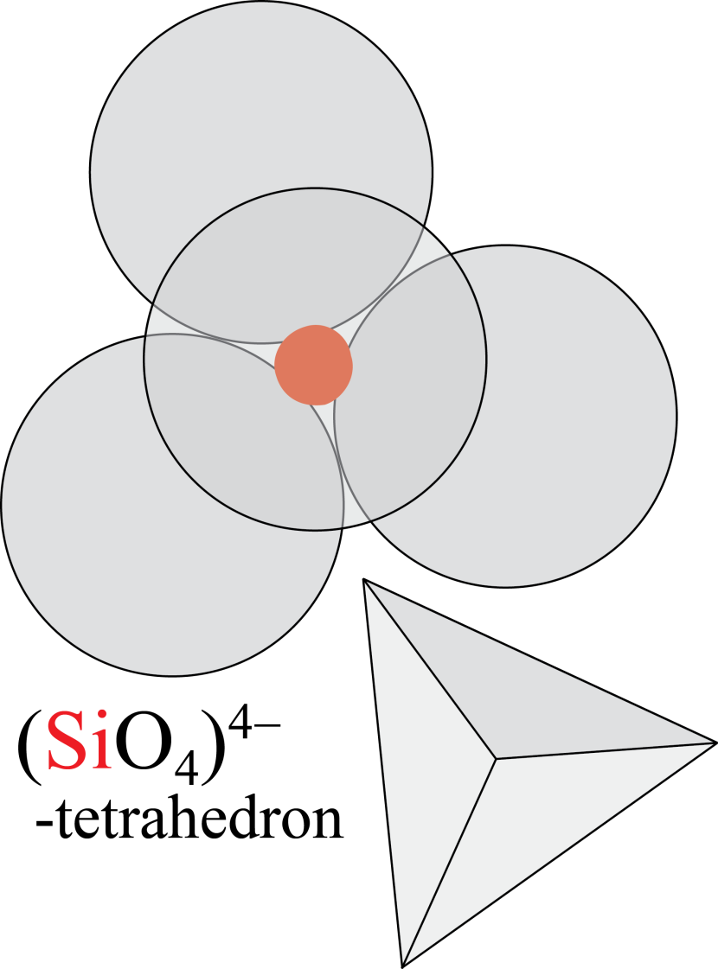
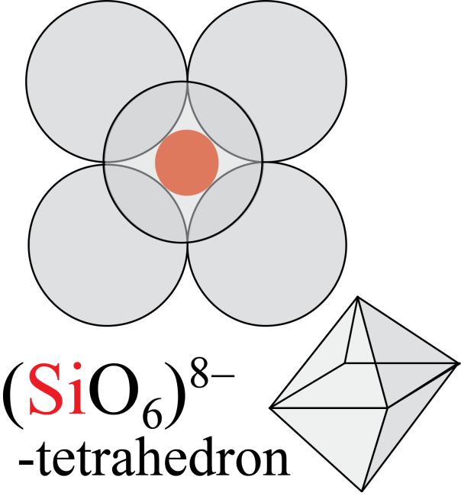
High-pressure adjustments of crystal structures
- anions compressed more than cations – decreasing size difference
may lead to increasing coordination number
Crust and upper mantle
Si in 4-coord. (tetrahedral coord.)
Lower mantle
Si in 6-coord.
(octahedral coord.)
Increasing p, depth

Slide 41
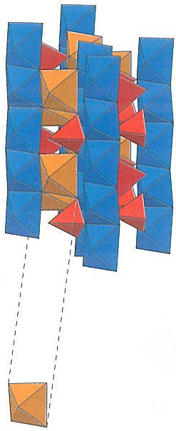
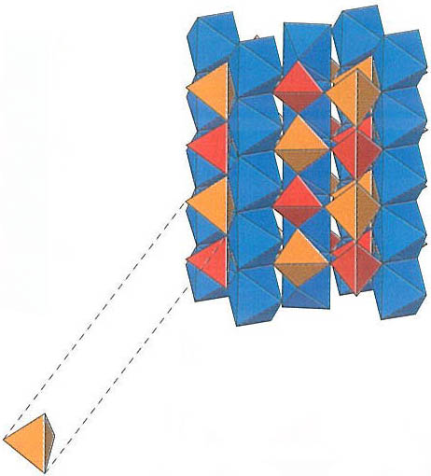
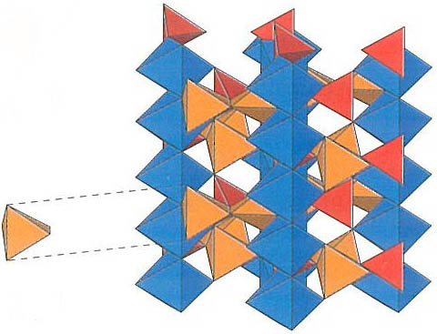
The aluminium silicates: Al₂SiO₅
Kyanite:
Al^{[6]} Al^{[6]} Si O₅
Triclinic
Sillimanite:
Al^{[6]} Al^{[4]} Si O₅
Orthorombic
c
c
p
Al^{[6]}
T
Al^{[4]}
c
Andalusite:
Al^{[6]} Al^{[5]} Si O₅
Orthorombic
Al^{[5]}

Slide 42
The Clapeyron relation and
dp/dT-slopes of phase boundaries
Reaction Al₂SiO₅ = Al₂SiO₅
andalusite kyanite
ΔV = V_{prod} – V_{reactants} = V_{ky} – V_{and}
positive or negative ΔV?
and ΔS ?
< 0
ΔS = S_{ky} – S_{and} < 0
p
kyanite
At the reaction boundary: ΔG = 0
Consider two points on the phase boundary:
p₁,T₁ and
p₁+dp, T₁+dT
p₁
dp
p₁+dp, T₁+dT
p₁,T₁
First law: ΔG = ΔE + p₁ΔV – T₁ΔS = 0
ΔG = ΔE + (p₁+dp)ΔV – (T₁+dT)ΔS = 0
andalusite
Subtract the upper equation from the lower equation
dT
T₁
T
dpΔV − dTΔS = 0
dpΔV = dTΔS
dp/dT = ΔS/ΔV
Clayperon-equation
negative ΔV and ΔS gives positive dp/dT-slope

Slide 43
Aluminium silicates: Al₂SiO₅
p
Kyanite
Al^{[6]} Al^{[6]} Si O₅
Triclinic,
D: 3600 kg/m³
Sillimanite
Al^{[6]} Al^{[4]} Si O₅
Orthorombic,
3250 kg/m³
Andalusite
Al^{[6]} Al^{[5]} Si O₅
Orthorombic,
3180 kg/m³
T
Al₂SiO₅ = Al₂SiO₅
andalusite sillimannite
ΔV = V_{sill} – V_{and}
ΔS = S_{sill} – S_{and}
positive? or negative?
< 0
> 0
dp/dT = ΔS/ΔV
positive? or negative?

Slide 44
General features regarding melting and crystallisation
What is melting ?
Solid/ordered crystal lattice breaks down (”dissolves”)
What is required? (Reaction: crystal → melt)
- heating to T_{m}
- heat of fusion, ΔH_{m} = ΔE_{m} + pΔV_{m} > 0
First law
(Internal energy in isolated system is constant)
dE_{int} = dQ – dW = TdS – pdV
Gibbs free energy: energy in addition to the internal energy
Definition: G = E_{tot} + pV – TS = H – TS
At equilibrium: ΔG = G_{prod} – G_{react} = 0

Slide 45
General features regarding melting and crystallisation
What is melting ?
Solid/ordered crystal lattice breaks down (”dissolves”)
What is required? (Reaction: crystal → melt)
- heating to T_{m}
- heat of fusion, ΔH_{m} = ΔE_{m} + pΔV_{m} > 0
What about ΔV?
Mostly: ΔV > 0
But: ΔV may be negative, esp. at very high p
ΔH_{m} is always positive
Equilibrium: ΔG_{m} = ΔH_{m} ̶̶ TΔS_{m} = 0
ΔS_{m} = ΔH_{m}/T > 0
always positive ΔS_{m}
First law
(Internal energy in isolated system is constant)
dE_{int} = dQ – dW = TdS – pdV
Gibbs free energy: energy in addition to the internal energy
Definition: G = E_{tot} + pV – TS = H – TS
At equilibrium: ΔG = G_{prod} – G_{react} = 0

Slide 46
Basic question (try to reason intuitively):
Assuming that ΔV_{m}>0,
how does T_{m} change with increasing p? and why?
T_{m} increases with increasing p because the volume increase due to melting
(ΔV_{m} > 0) becomes more unfavourable as p increases.
Increasing T_{m} is required to compensate for the unfavourable p-V-effect.

Slide 47
Clapeyron-equation for melting
Reaction Mg₂SiO₄ = Mg₂SiO₄
forsterite melt
ΔV = V_{m} – V_{sol} > 0
ΔS > 0
positive ΔV and ΔS:
positive dp/dT-slope
Melting curves
Convex towards melt phase
Why?
p
T
Forsterite
Melt
Melt
Forsterite
T
p

Slide 48
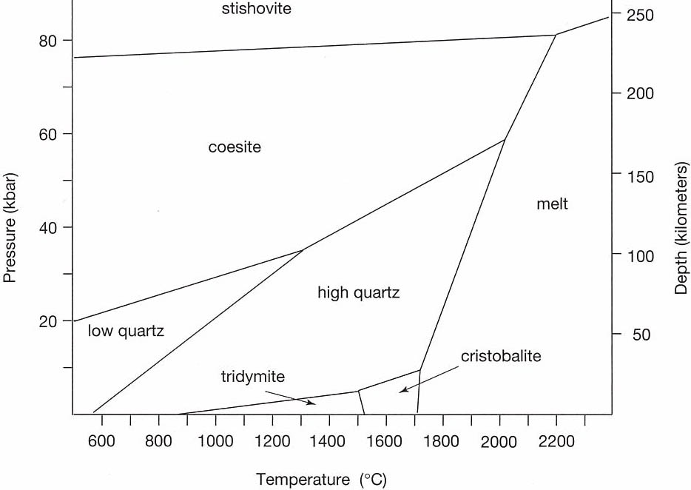
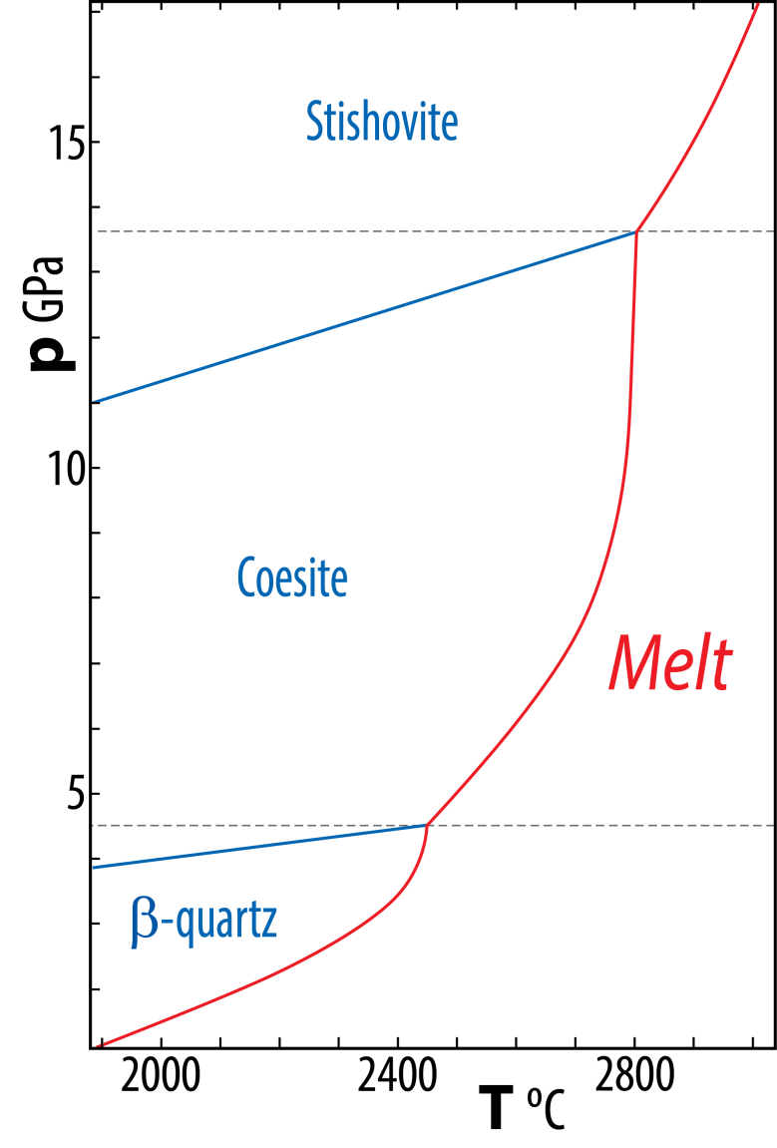
Older and somewhat wrong (oversimplified) phase
diagram for SiO₂ (reproduced in Perkins, 2011, Mineralogy)
Melting curve from rel. recent experiments (Kanzaki 1990-JACS;
Zhang et al. 1993-JGR)
Is this an acceptable
smoothing of the
melting curve?
No
Extremely high T,
difficult experiments
p-T melting curves are not linear, but have
increasing dp/dT with increasing p and T
(convex towards the melt)
Why? How can we answer this question?

Slide 49

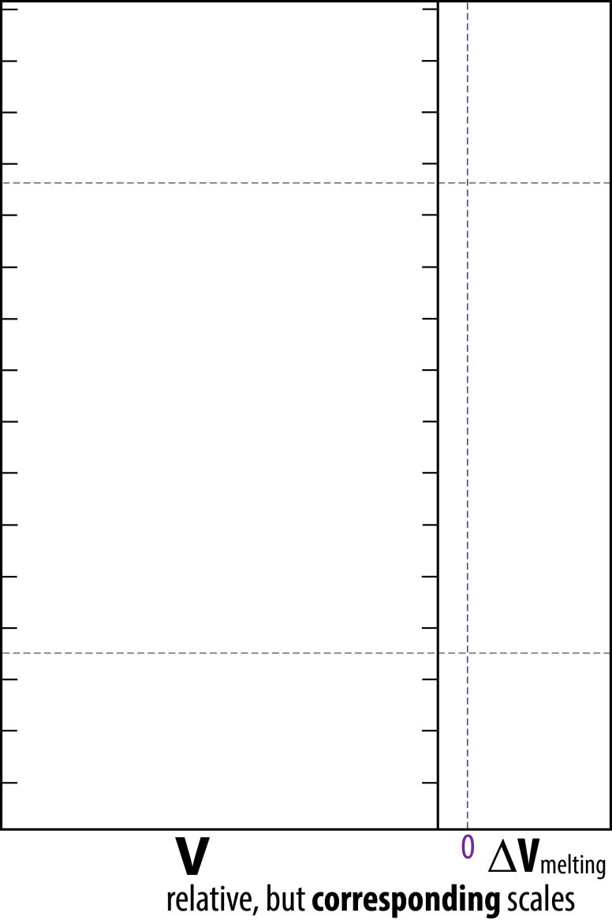
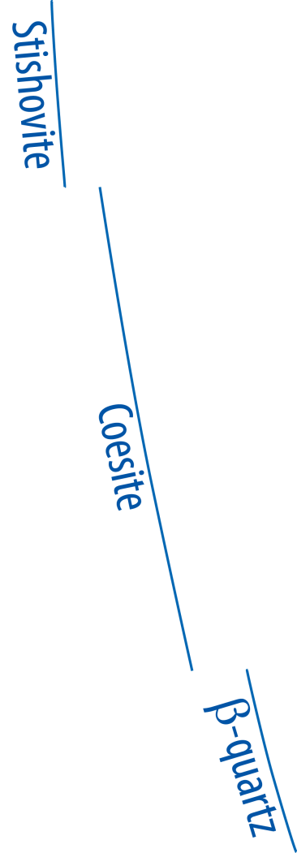
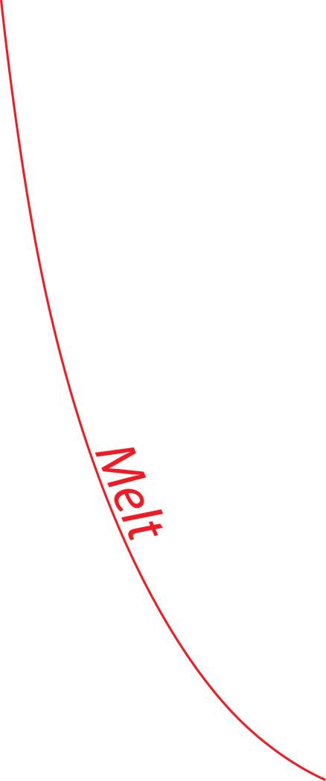
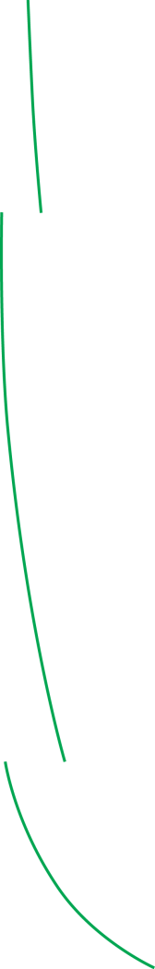
Consider the Clapeyron-slope of the melting curve: dp/dT = ΔS_{m}/ΔV_{m}
Melting reaction: SiO₂ (solid) = SiO₂ (melt)
ΔS_{m} = S_{melt} − S_{solid}
ΔV_{m} = V_{melt} − V_{solid}
Remember: ΔS_{m} is always postitive − for simplicity, let us assume
that it is nearly constant
What about ΔV_{m} ?
What is most compressible:
mineral or melt ?
First ΔV_{m}:
dp/dT = ΔS_{m}/ΔV_{m} → ∞
in the highest p-range of
β-quartz and coesite
ΔV_{m}→ 0

Slide 50
Pages 56-57: Background information, philosophical reflections - not for test and exam
What about the synthesis of
organic matter and life ?
Gibbs free energy: G = E_{tot}+pV–TS
At chemical equilibrium:
G_{prod} = G_{react} , ΔG = 0
Example: photosynthesis
CO₂ + H₂O = CH₂O + O₂
Is this a reduction or oxidation reaction?
Does the reaction release or bind energy ?
Reduction, binds energy
Breakdown of organic matter:
CH₂O + O₂ = CO₂ + H₂O
How would you characterize this reaction?
Exotherm or endotherm reaction ?
Lowest energy level: greatest stability
Oxidation, combustion, breathing,
Exotherm, releases energy

Slide 51
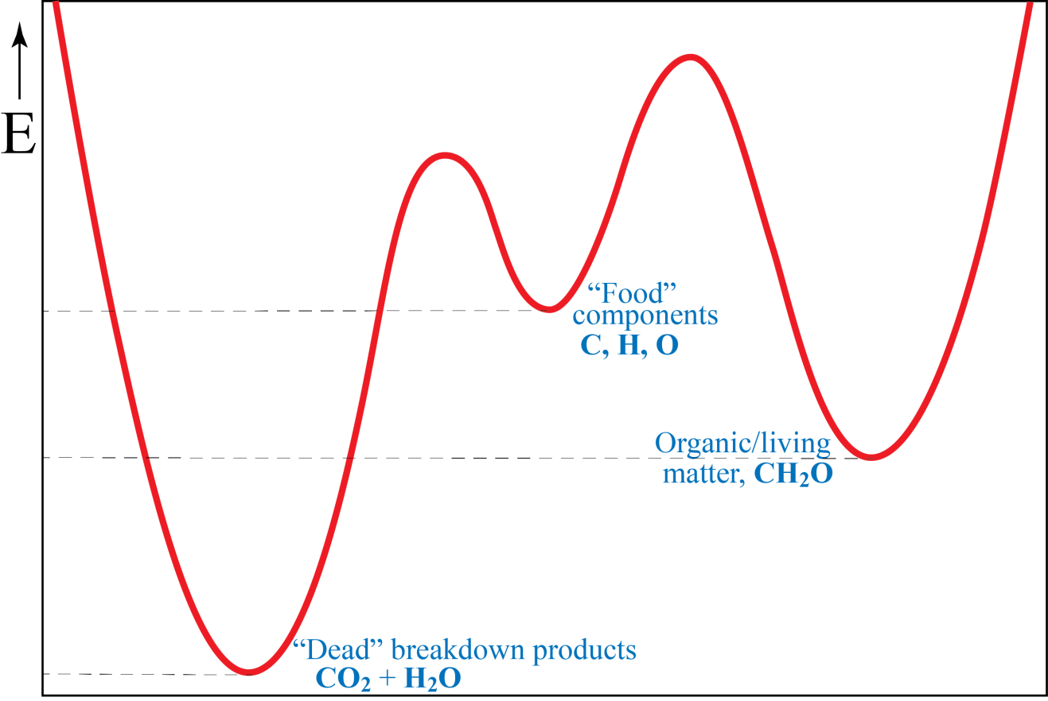
Organic life: Energy levels - energy landscape
Photosynthesis: CO₂ + H₂O = CH₂O + O₂ (endergonic reaction at ΔG > 0 at 293 K and 1 bar)
Breakdown of organic matter: CH₂O + O₂ = CO₂ + H₂O (exergonic reaction)
Characteristics of life
- metabolism
- compartmentalization
- replication
- far from thermodynamic
equilibrium
Le Chaterlier's principle
Le Chaterlier's principle
When a system at equilibrium is subjected to change in concentration, T, p or V, the system will readjust to (partially) counteract the effect of the applied change and establish a new equilibrium.
Can Le Chatelier's principle be applied to either of the equations above?
- possibly to the breakdown reaction ???
- but even this is hardly a reversible equilibrium reaction

