Slide 1
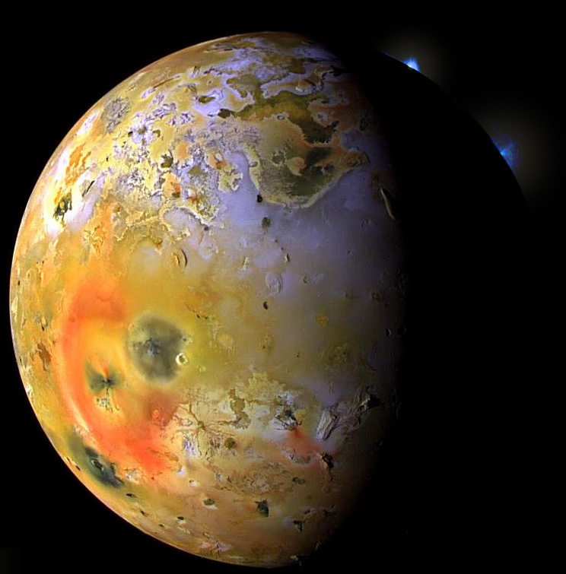
Partial melting and the formation of planetary crusts
Jupiter’s moon, Io, is the most volcanically
active object in our Solar System.
Manipulated photo mosaic, NASA-Galieo, 1997

Slide 2
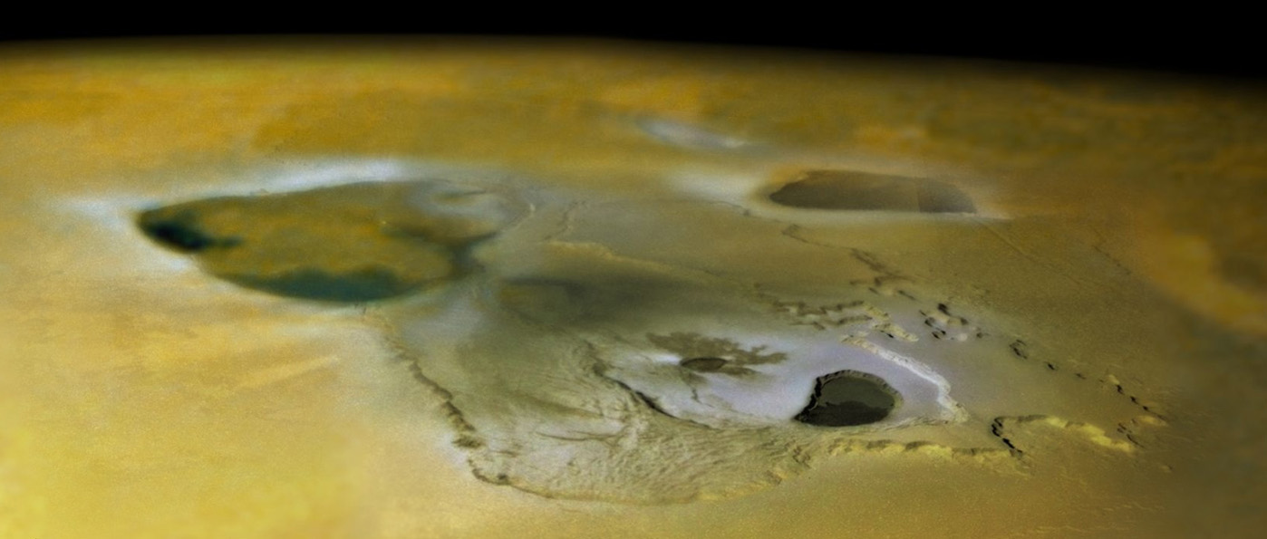
Magmatic processes – responsible for:
- Early segregation (differentiation) of terrestrial planets:
core, mantle, primary crusts
- Formation of secondary and possibly tertiary crusts
basaltic crusts on all terrestrial planetes:
Mercury, Venus, Earth, Moon, Mars, Vesta, Io
continents on Earth (only?)
Tvashtar Catena kaldera-kompleks, Io
Galileo-NASA, 2000

Slide 3
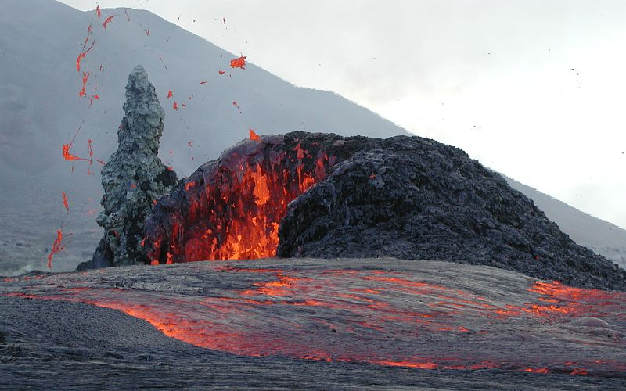
- Melting
- Crystallization
⇒ Change in composition
Partial melting
Fractional crystallization
Kilauea, Hawaii

Slide 4
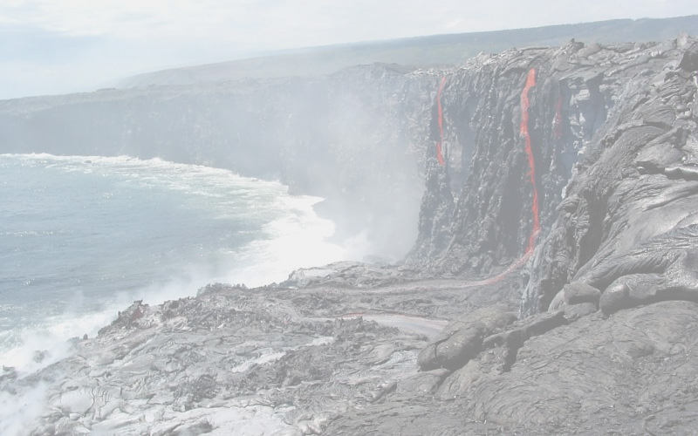
Magmatic differentiation
Major and trace element behaviour during melting and crystallization
Key point:
Melt compositions are mostly very different from the composition of the melting solid, both in terms of major, minor and trace elements.
examples: peridotite in equilibrium with basaltic melt
amphibolite in equilibrium with granitic melt
Kilauea, Hawaii

Slide 5
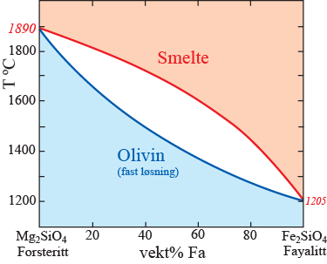
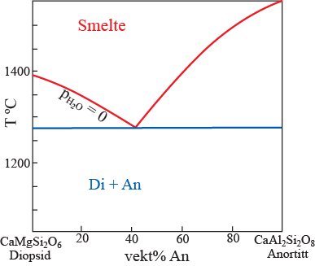
Simple 2 or 3-component phase relatios give important clues
basalt
basalt
peridotitt

Slide 6
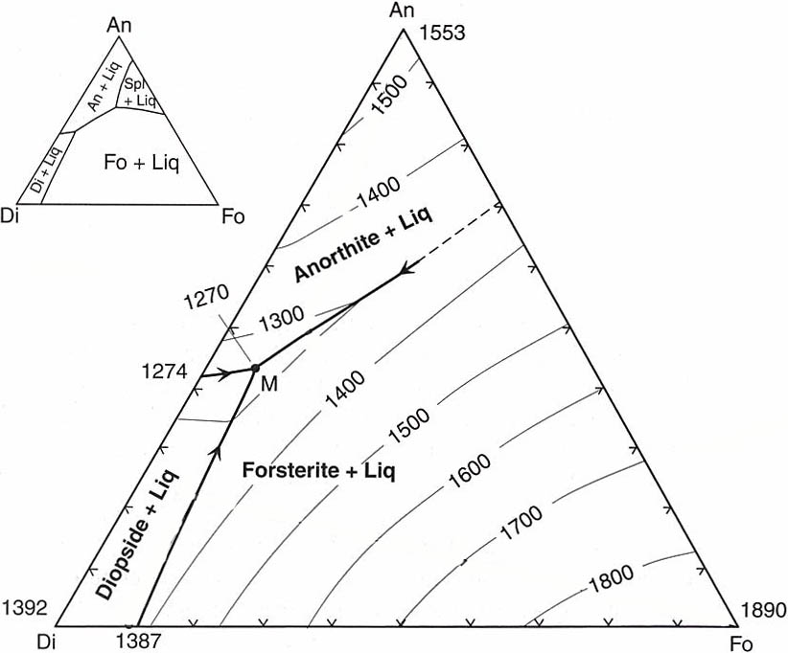
Note that the previous simplified diagram ignores the spinel field, prodruding into the Fo-An-Di triangle
Spinel,
MgAl₂O₄
Fig. 7.2 (Winter)

Slide 7
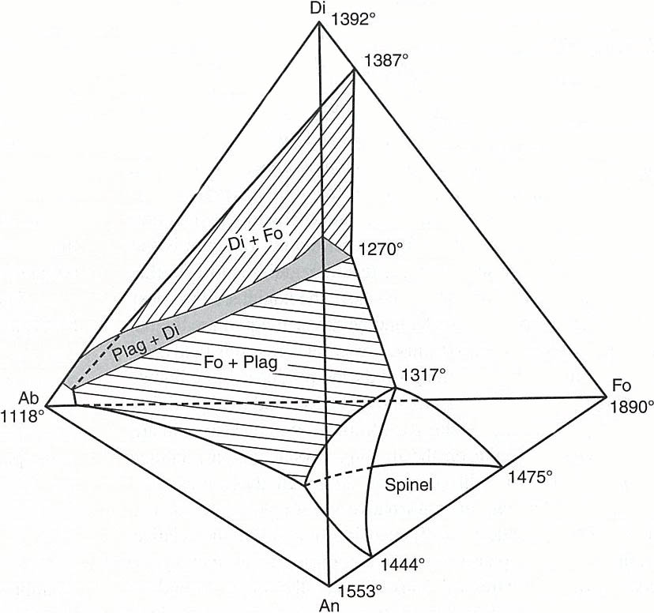
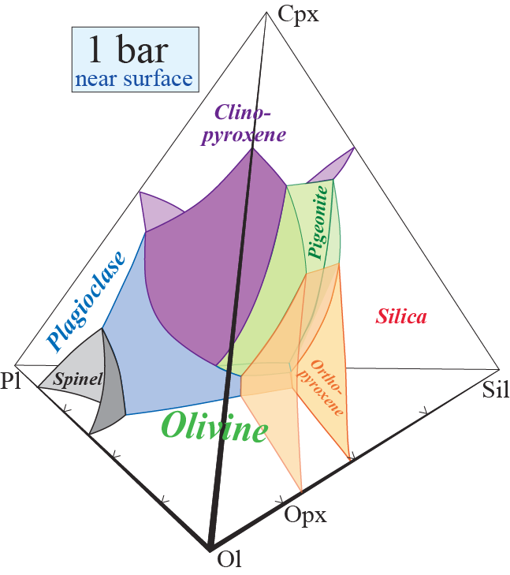
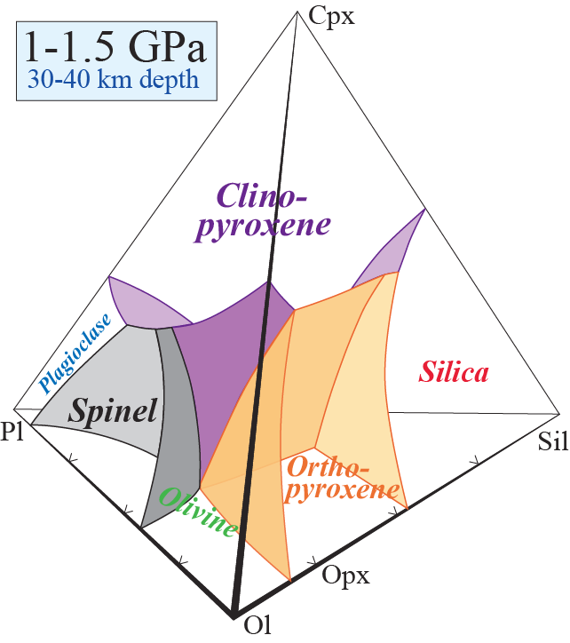
Spinel field
protrusion
Fig. 7.12
(Winter)
cpx
olivine
Liquidus relations of spinel peridotite
in an approximate 4-component
(pseudoquaternary) system
plag
The effect of p-increase

Slide 8
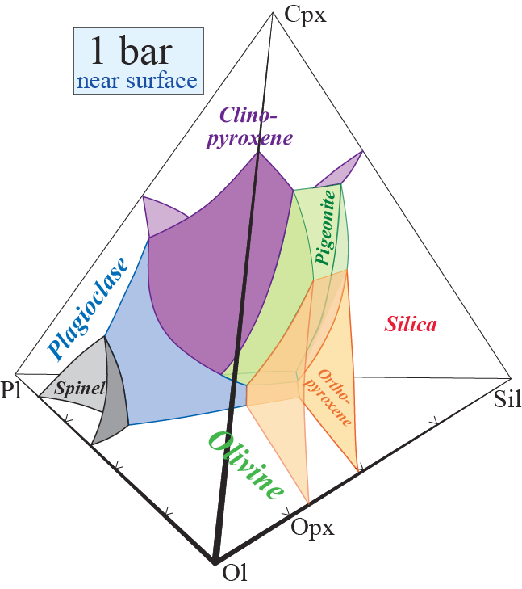

Upper mantle melting and crystallization on Earth: typical pressure of 1-1.5 GPa for melting of spinel peridotite at 30-40 km depth (pseudoquaternary system Ol-Sil-Pl-Cpx)
pl-ol
cp-pl-ol
ol
Magma ascent to near-
surface chamber
Pseudoinvariant point,
eutectic-like basalt
composition
Progressive melting trend
Peridotite
Terrestrial magma chambers
- early cumulates are olivine-dominated
- opx is almost never in the liquidus assemblage

Slide 9
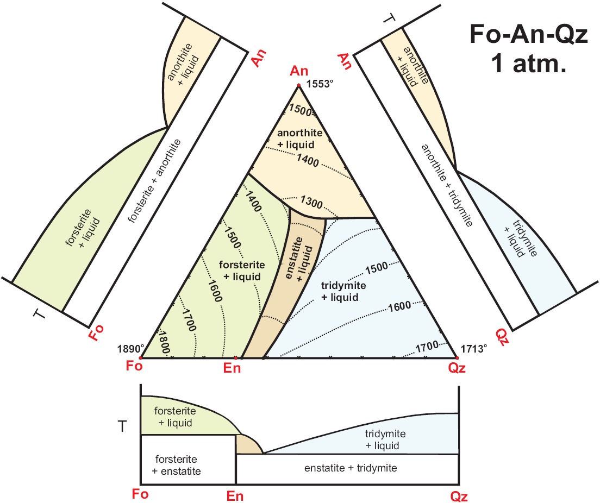
basalt
perid.

Slide 10
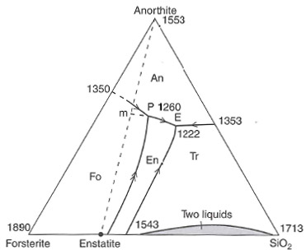
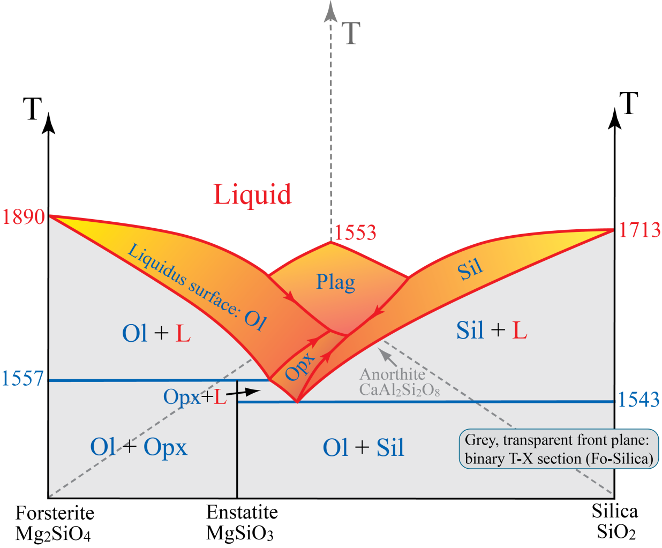
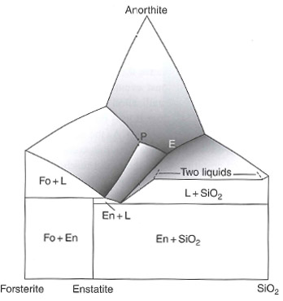
The previous simplified diagrams ignores the liquid immiscibility near the En-Sil-join
Ch. 10
(Ph & A)
Note that P (1260 C) and E (1222 C) are the lowest points in the ternary diagram
− the drawn perspective may be misleading

Slide 11
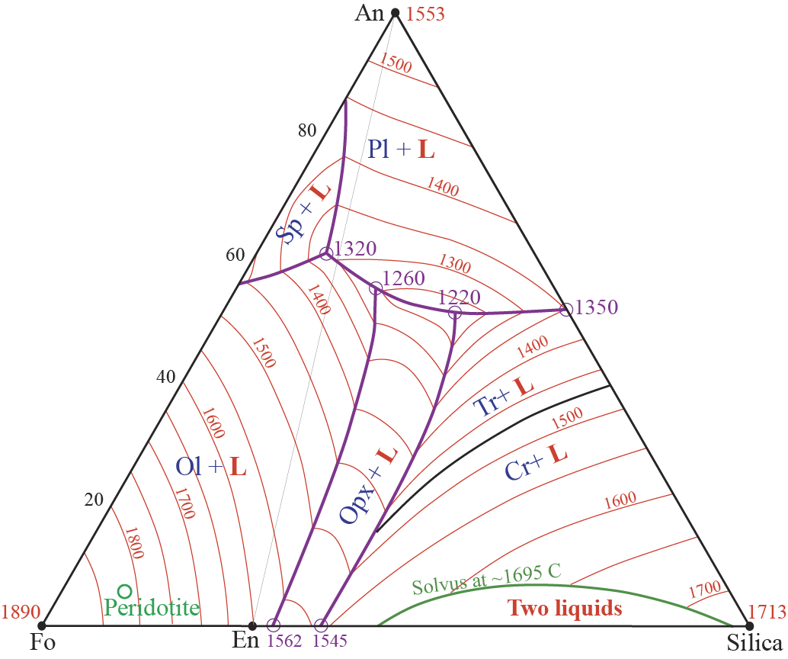
This is a nearly correct liquidus surface
diagram (incl. spinel and liquid immiscibility fields)
What do we call the following points:
1320 ?
1260 ?
1220 ?
1562 ?
1545 ?
1350?
Evaluate the variance
of these points.
P + F = C + 1
F = C + 1 − P

Slide 12
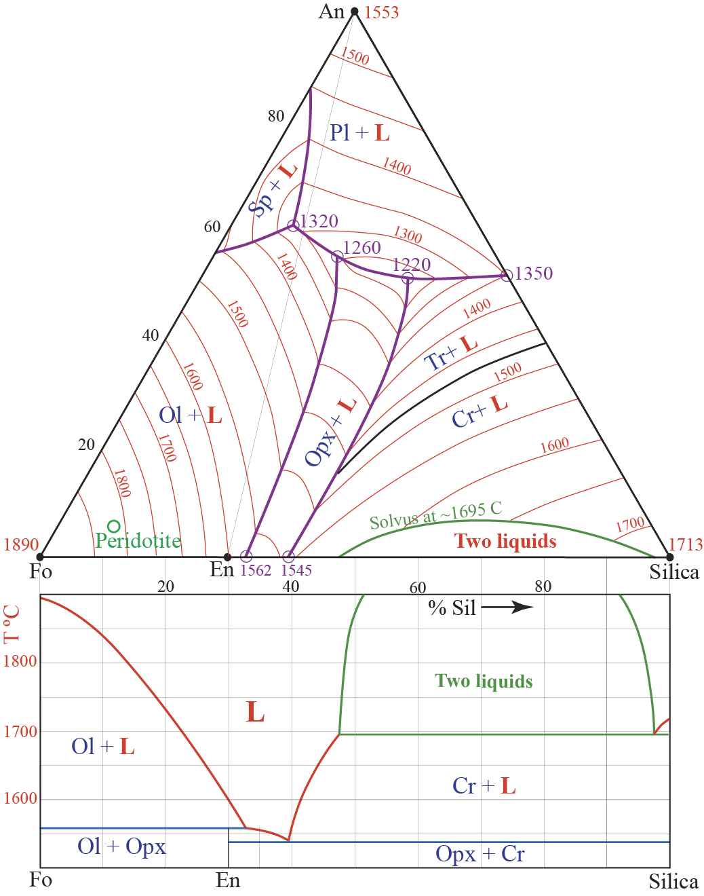
Composition M (60 % SiO₂):
Phases and their proportions present at:
1696 and 1850 C ?
1696 C: 74.7% Liq (47.5% SiO₂) +
25.3% Liq (97.5% SiO₂)
1850 C: 75.9% Liq (49.0% SiO₂) +
24.1% Liq (94.8% SiO₂)
M
33
104
38
112

Slide 13
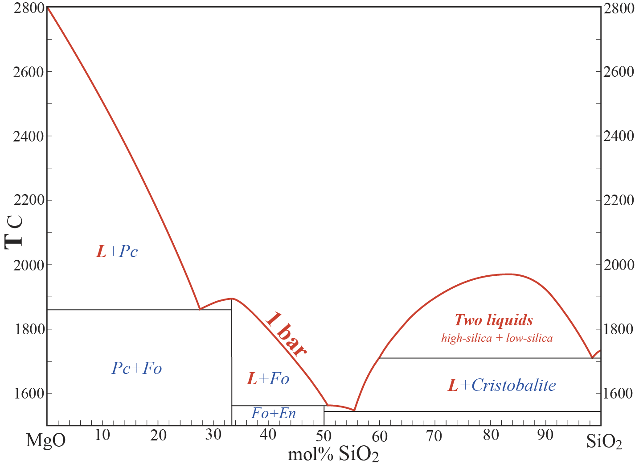
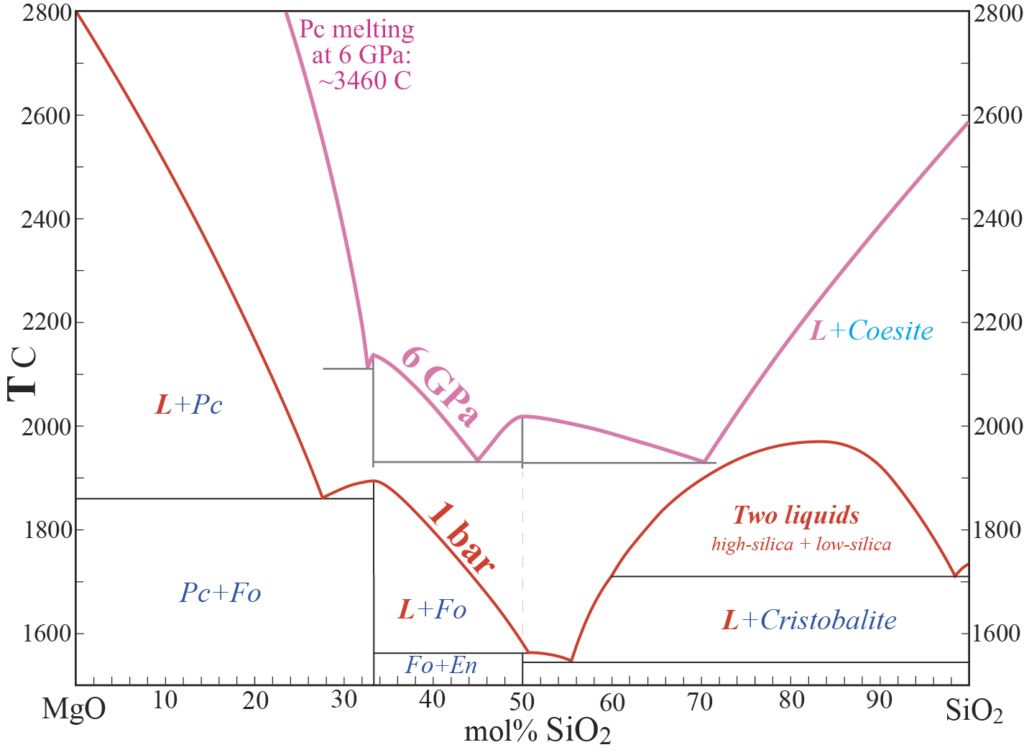

Slide 14
Try to reason intuitively with thermodynamic principles in mind:
Why do we have liquid immiscibility in the silica-rich region at 1 bar, but not at all at 6 GPa?
What does this tell us about the thermodynamic stability of cristobalite and coesite?
What happens to the relative stability of Pc, Fo and En from 1 bar to 6 GPa?

Slide 15
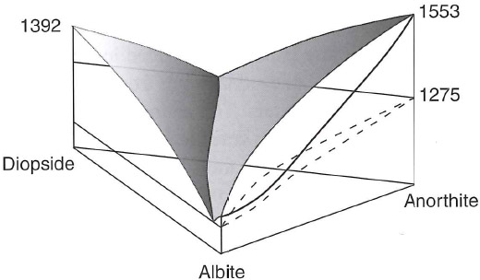
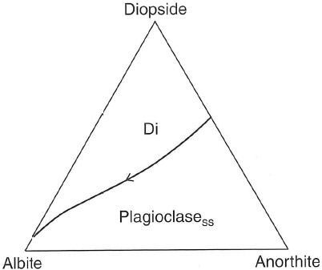
This perspective drawing gives the correct impression
An-Ab-phase
loops at 5 % Di
Fig. 10.23 (Ph & A)

Slide 16
Upper mantle melting and crystallization on Earth: typical pressure of 1-1.5 GPa for melting of spinel peridotite at 30-40 km depth (pseudo-quaternary system Ol-Sil-Pl-Cpx)
pl-ol
cp-pl-ol
ol
Magma ascent to near-
surface chamber
Pseudoinvariant point,
eutectic-like basalt
composition
Peridotite
Terrestrial magma chambers
- early cumulates are olivine-dominated
- opx is almost never in the liquidus assemblage
What about small asteroids and
protoplanets, like Vesta?

Slide 17
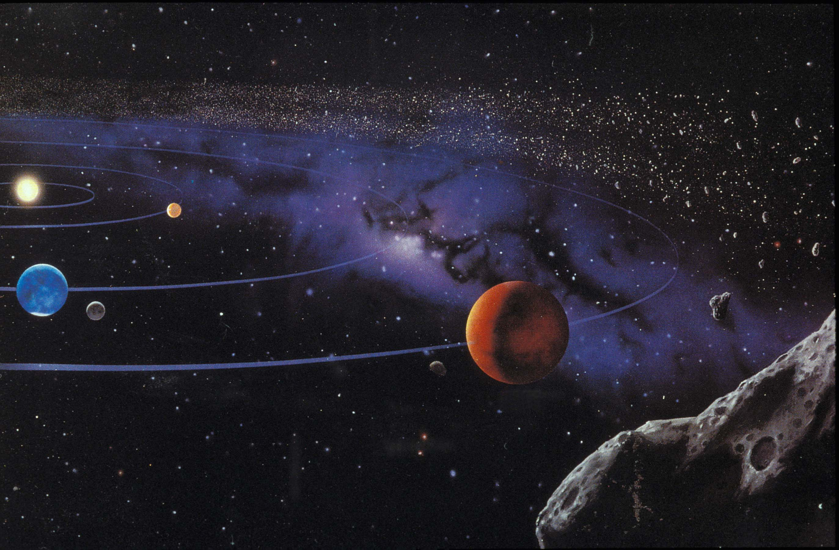
See a separate presentation about meterorites and asteroids, including Vesta
Asteroid belt
Mercury
Venus
Earth-Moon
Mars

Slide 18
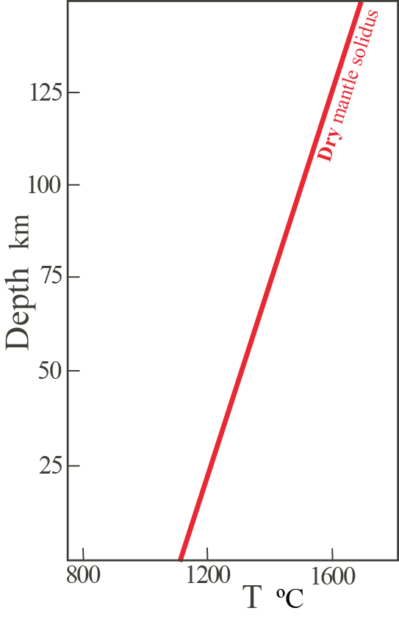
Back to the Earth:
(high pressure and volatiles)
Two main types of mantle melting:
Adiabatically rising
asthenosphere
1. Decompression melting
Explain the change
of direction for the
trajectory here

Slide 19
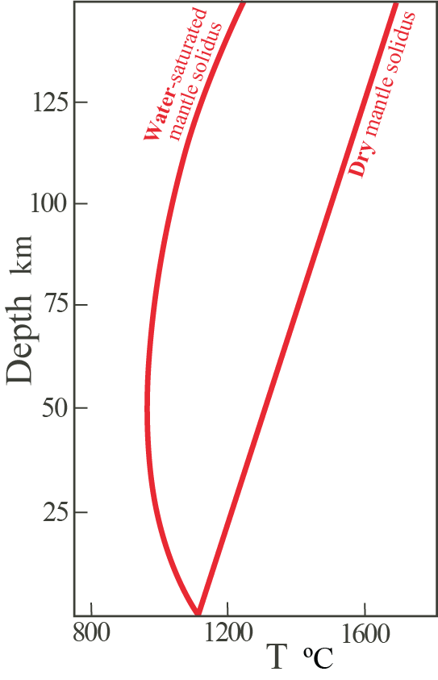
2. Flux melting aided by volatiles (esp. H)
Hydrous fluid
infiltration
from below
Ambient
mantle

Slide 20
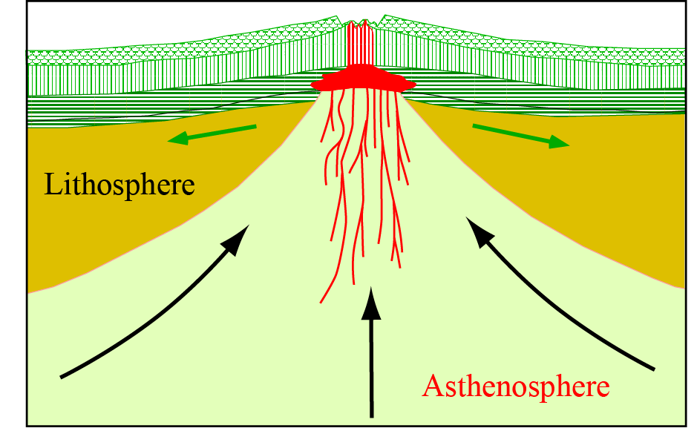
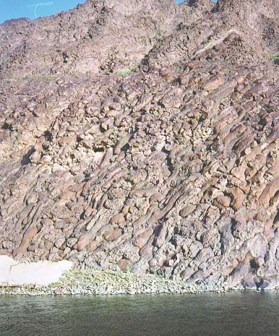
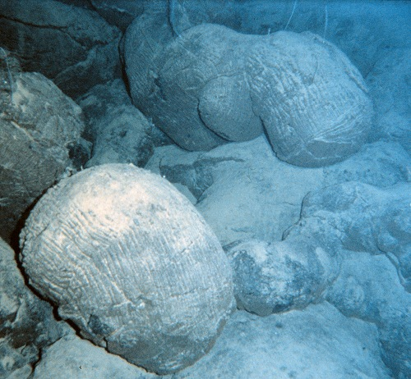
Decompression melting under mid-ocean ridges (MOR)
Pillow lava
Dike complex
Layered gabbroes (cumulates)

Slide 21
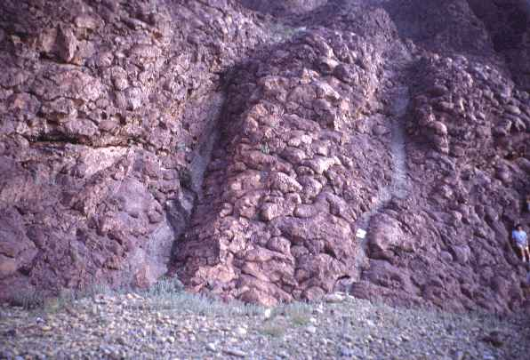
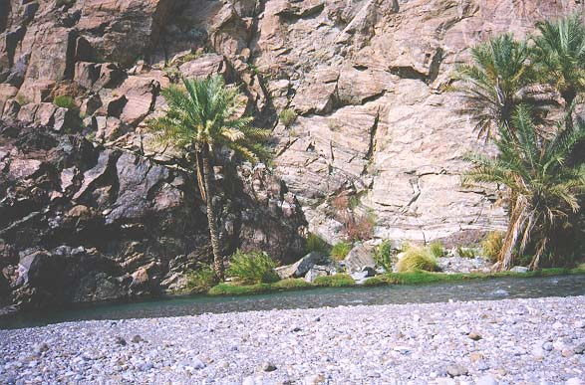
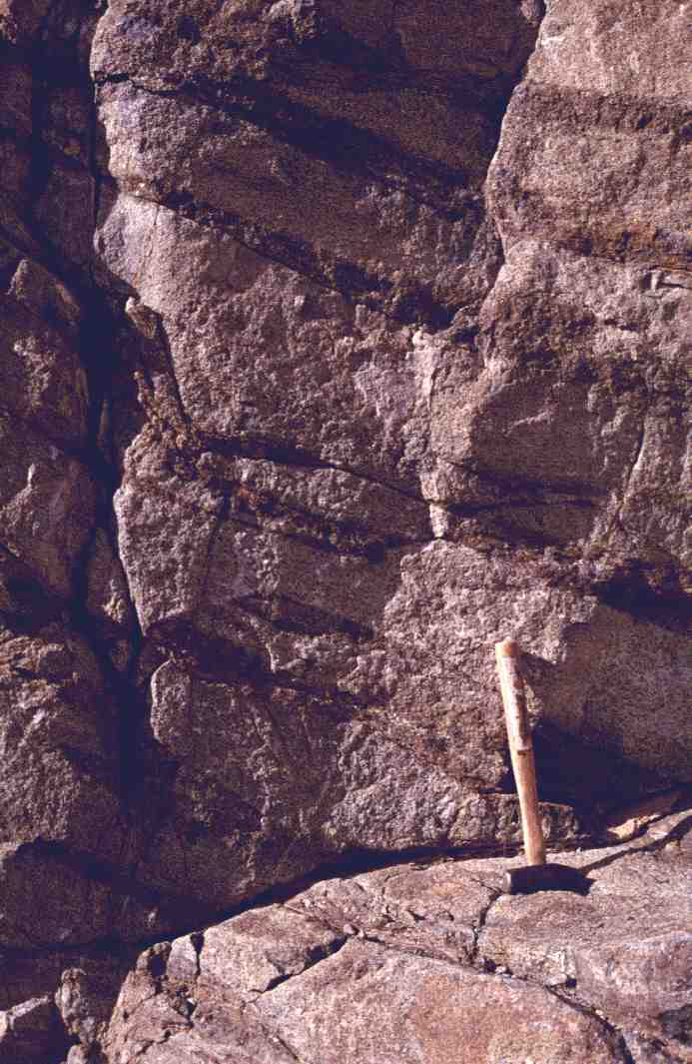
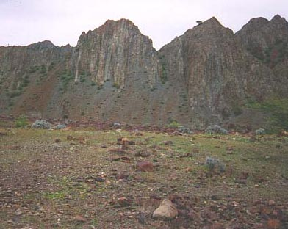
Putelava
Gang-kompleks
Lagdelte gabbroer (kumulater)

Slide 22
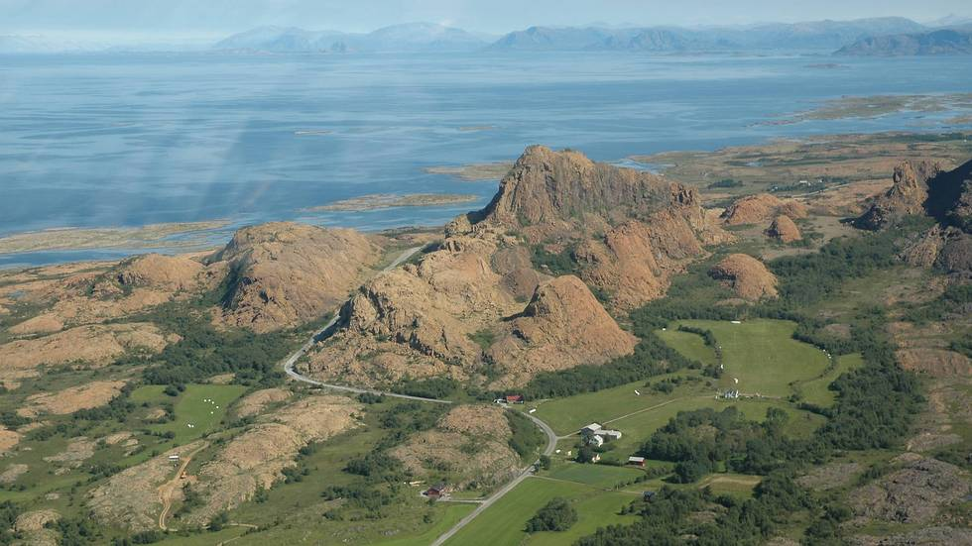

Slide 23
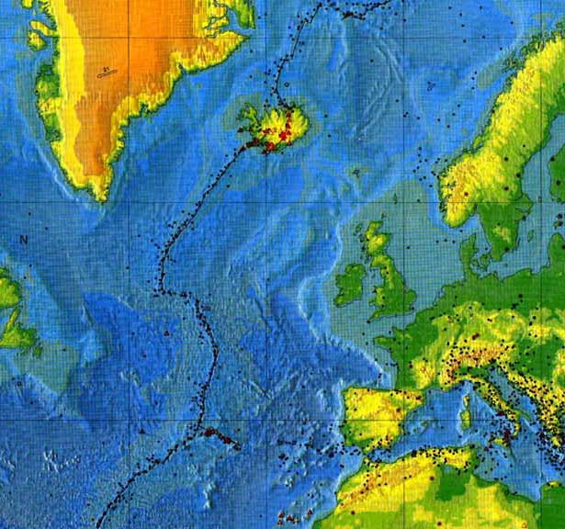
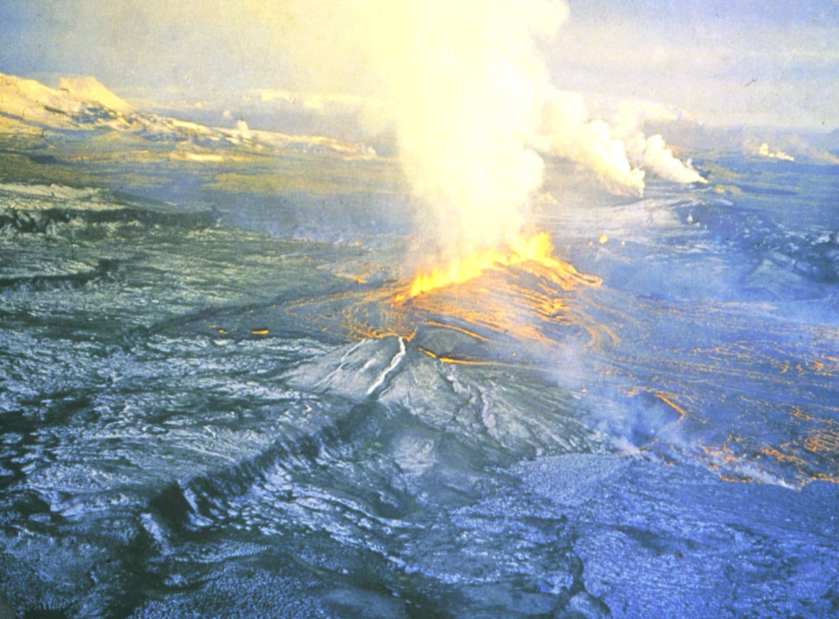
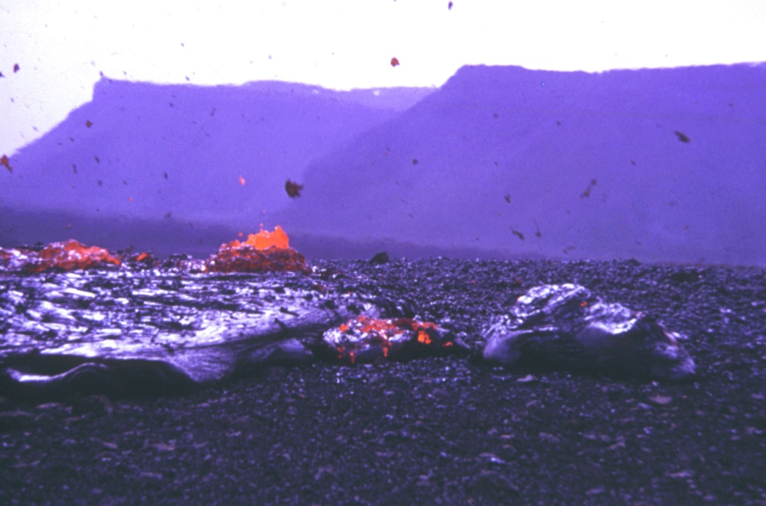
Fissure eruption, Krafla, NE Iceland, 1973
Pahoehoe flow, Krafla

Slide 24
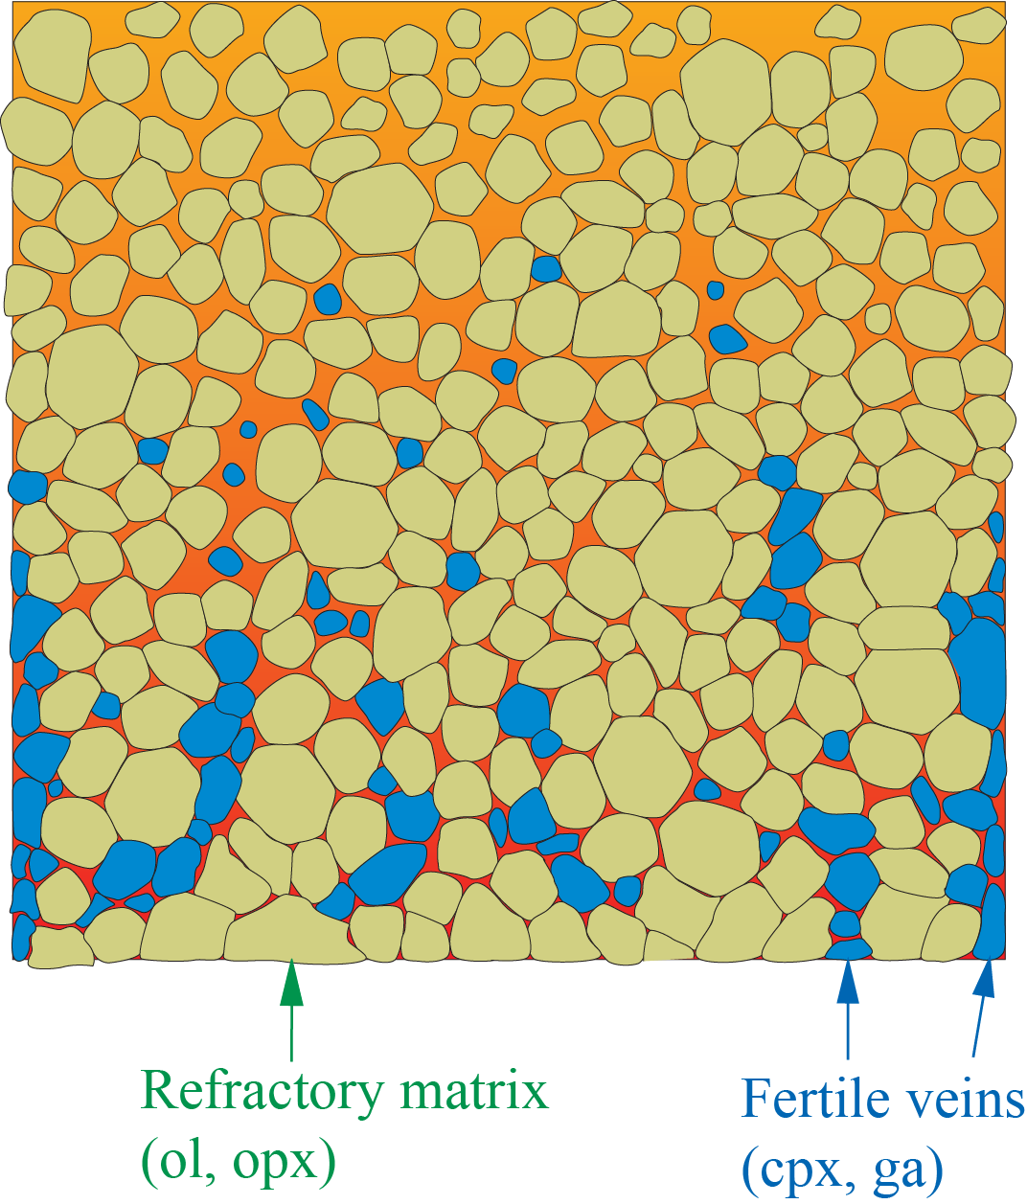
Progressive partial melting of heterogeneous mantel
Dynamic (progressive) melting
of ascending mantle
⇓
- decompression melting
- gradually more depleted source
the fertile veins gradually disappear
extraction of gradually more
depleted melt

Slide 25
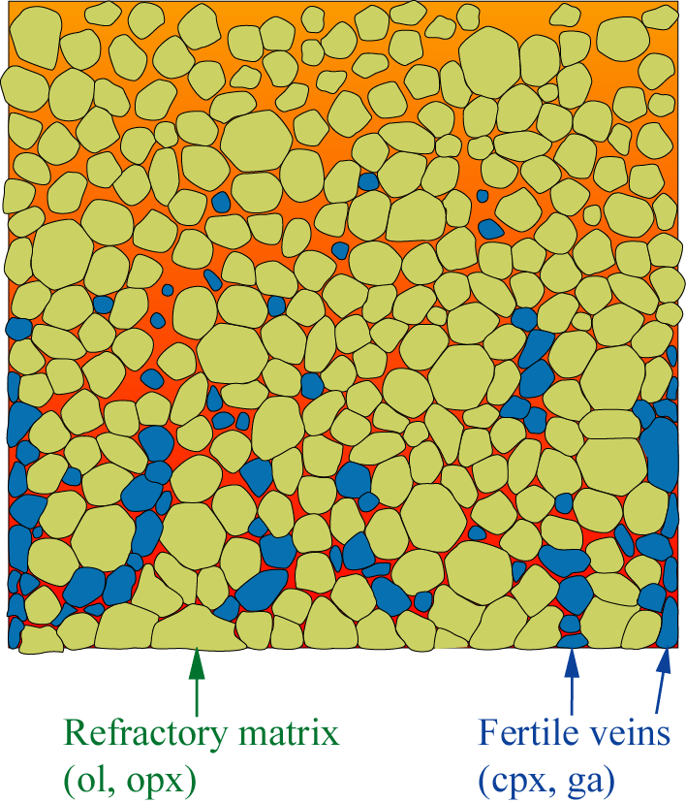
Decompression melting of mantle peridotite basaltic melt
Pillow lava
Dike complex
Layered gabbros
Central questions
Which elements stay behind in the residue ?
Which elements are extracted into the melt ?

Slide 26
The fertile veins melt preferentially.
Which elements are enriched in clinopyroxene and
garnet relative to olivine and orthopyroxene ?
cpx: Ca, Si, Na, Al, Ti, Fe
ga: Al, Ca, Si, Fe
+ most trace elements (LILE, LREE)
ol, opx: Mg
+ Ni, Cr, V

Slide 27
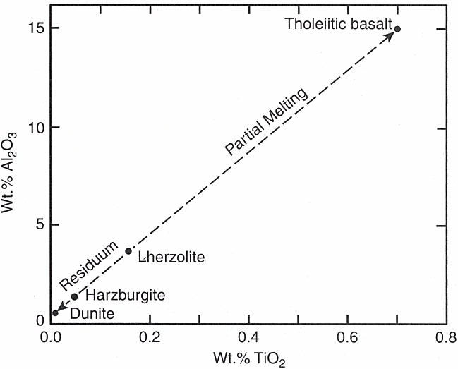
Lherzolite
(fertile mantle)
Olivine
Dunite
90
Peridotites
Wehrlite
Harzburgite
Lherzolite
40
Orthopyroxenite
Olivine Websterite
Pyroxenites
10
10
Websterite
Orthopyroxene
Clinopyroxenite
Clinopyroxene

Slide 28
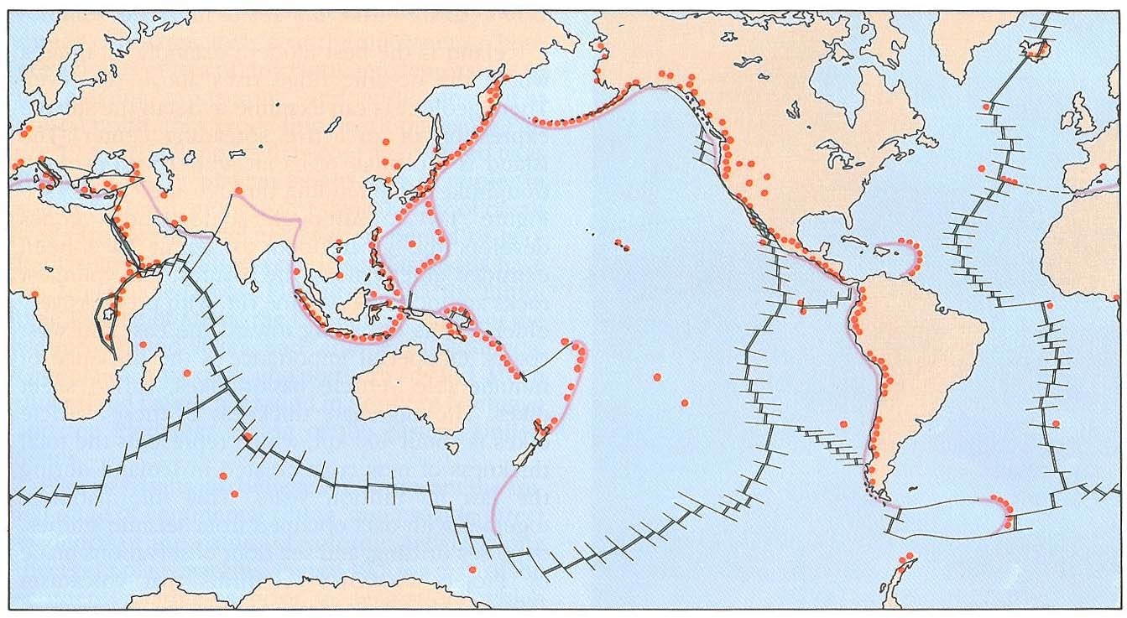
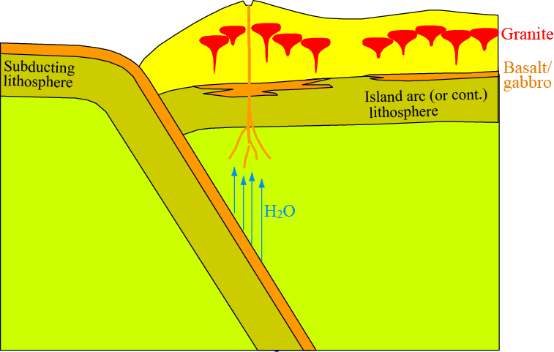
Flux melting of wet mantle above subduction zones

Slide 29
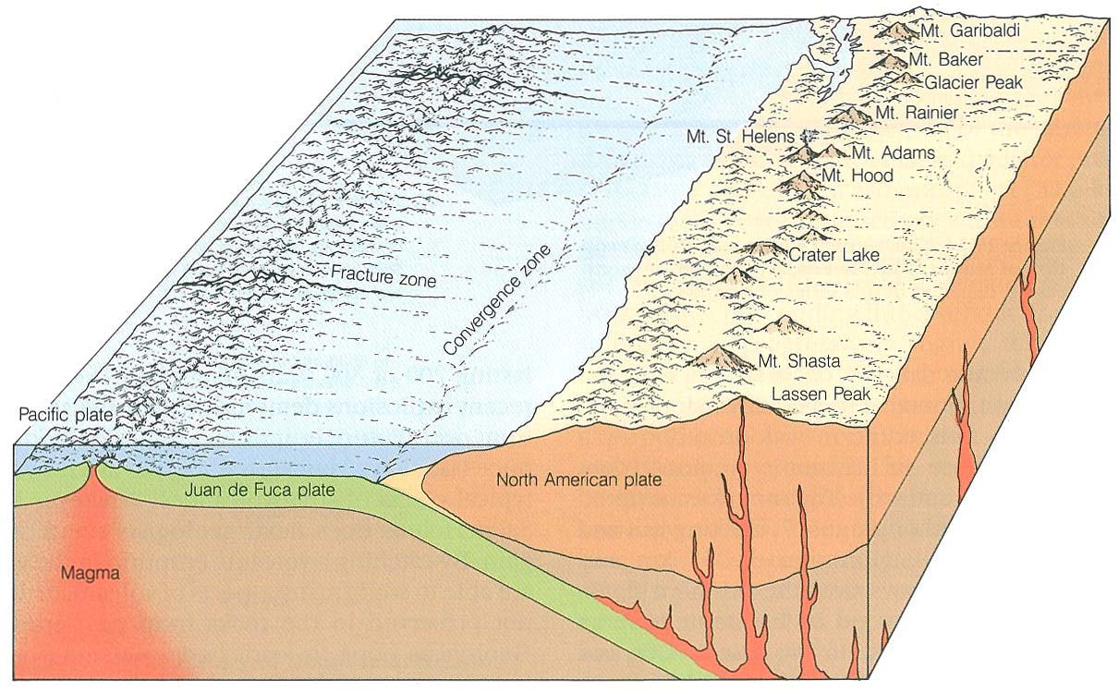
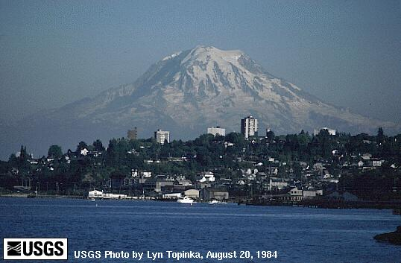
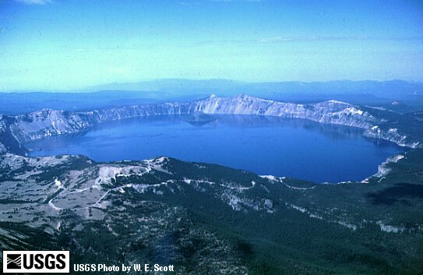
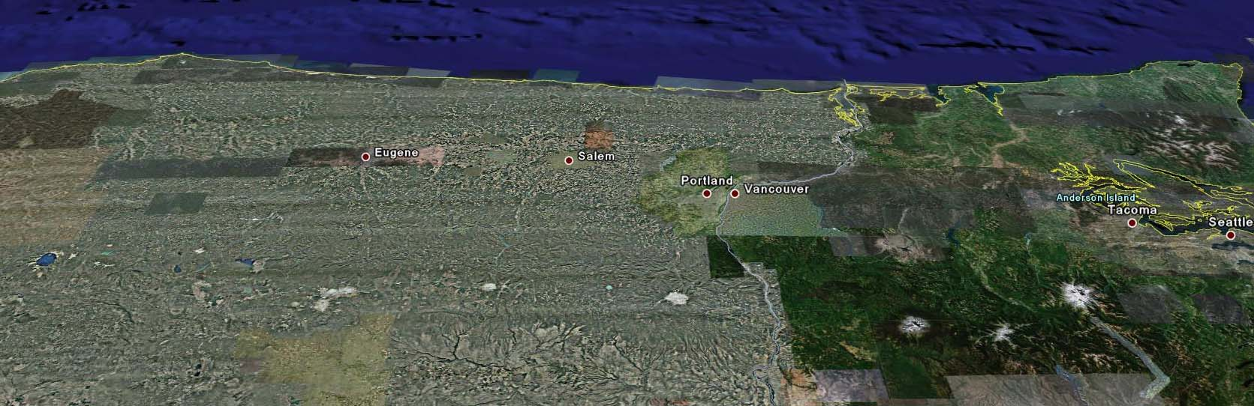
Crater Lake
St. Helens
Three sisters
Jefferson
Hood
Rainier
Adams

Slide 30
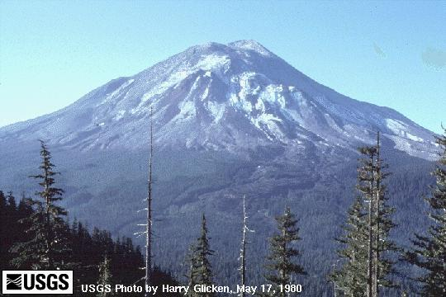
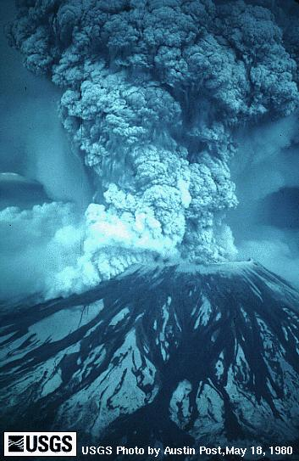
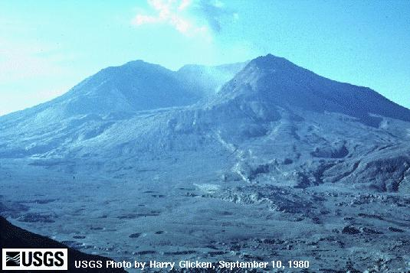
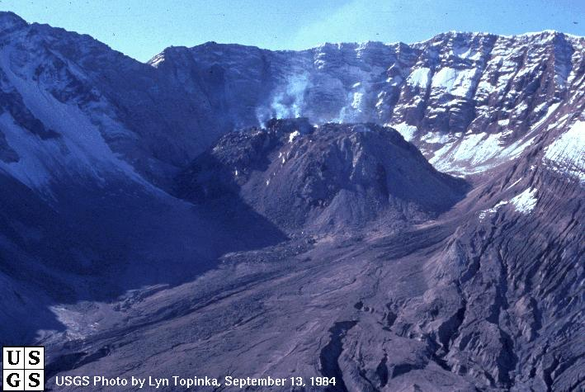
Mount St. Helens, May 17, 1980
May 18 eruption
Mount St. Helens,
after the eruption

Slide 31
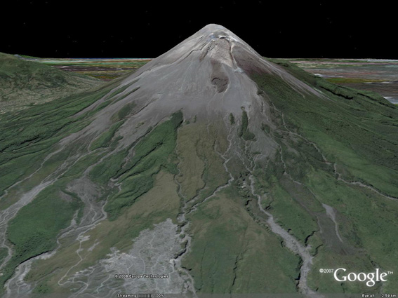
Merapi, Java, Indonesia

Slide 32
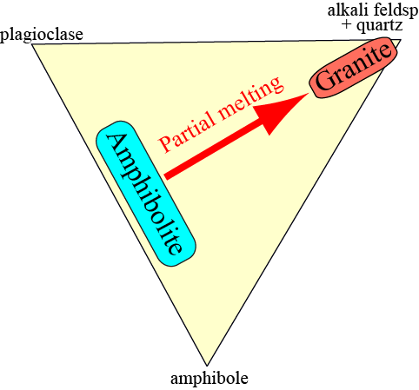

3. order (tertiary) crust: Earth's continents − granite
Stepwise evolution: peridotite → basalt → granite
Melting of
hydrated basalt
⇒ granite
(tertiary crust)
Hydration,
metamorphism
Mantle melting
⇒ basalt
(secondary crust)
via greenstone/
greenschist

Slide 33
Tertiary crust: Earth’s continents
Continental crustal growth:
Island arc and continental arc settings

Slide 34

Accretion and differentiation of existing
continental crust by underplating
granite
Intracrustal differentiation
results in and is promoted by
density gradients (density steps)
basaltic sill intrusion/
”underplating”

Slide 35



Crustal accretion by addition of exotic terrains
(continental fragments and thick oceanic plateaus)

Slide 36

Result: continental age zonation

Slide 37

Melting and planetary crust formation
The melting temperature for a eutetic composition is lower than for each component
A eutektic melt is often compositionally very different from the melting material
Important geological examples: peridotite – basalt, amphibolite – granite
Melting in the mantle:
1. Decompression melting
- the adiabatic path crosses the solidus before reaching the surface
2. Flux-melting by release of water from subducted lithosphere
- liquidus- and solidus-T is lowered dramatically
Primary crust: formed by crystallization from early planetary magma oceans
Secondary crust: basalts and cumulates formed by local/regional mantle melting
Tertiary crust: Earth's continental crust (largely granitic, sensu lato) − hydrous melting

