Slide 1
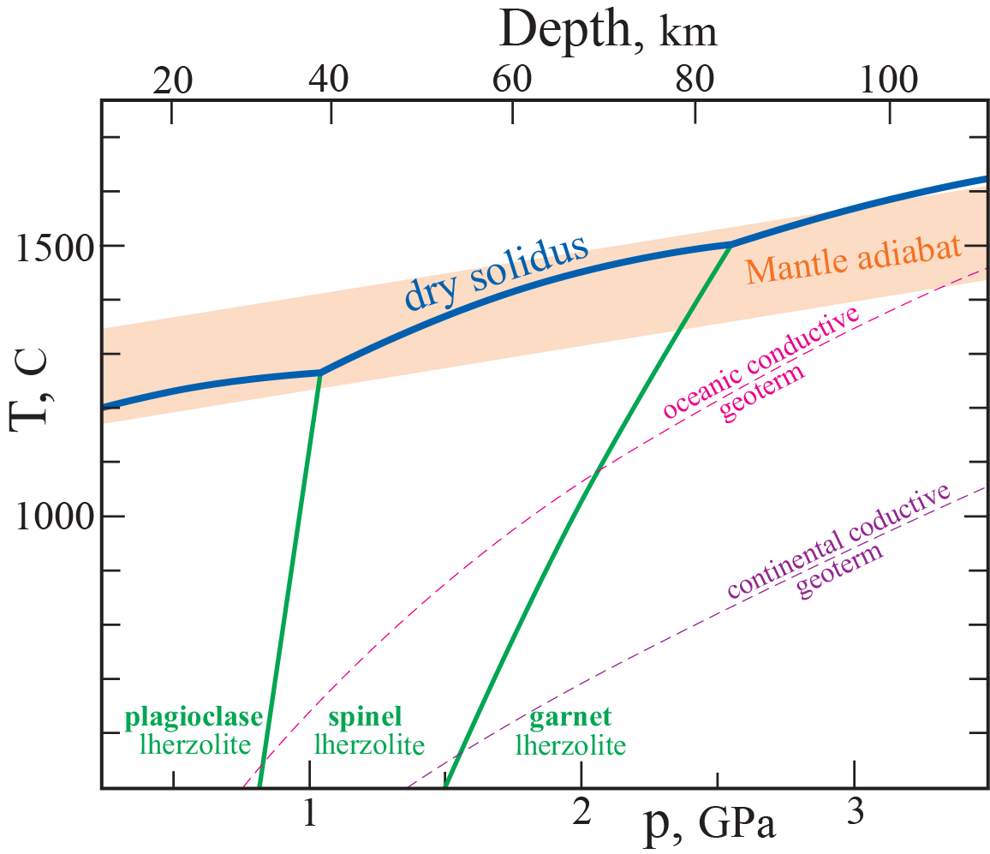
Phase relations of mantle peridotite-basalts
Origin of the lithosphere-asthenosphere division
Winter (2013):
Chapter 8 and 10
Liquidus-subsolidus phase
relations, peridotite
Compiled from:
Dasgupta and Hirshmann (2010)
Winter (2010)
Wyllie (1979)
The mantle potential temperature, T_{p}
The temperature of an adiabat extrapolated to 1 bar, with the artificial assumption of no melting.

Slide 2
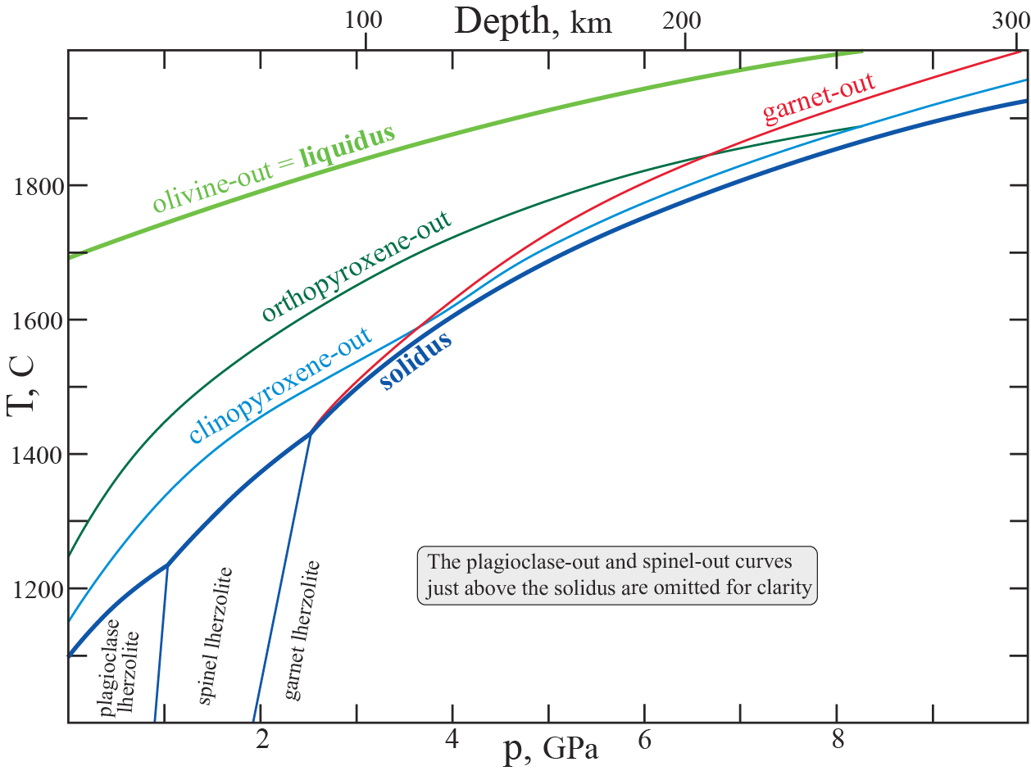
Progressive melting: disappearance of ga, cpx and opx
Based on Herzberg et al. (2002)

Slide 3
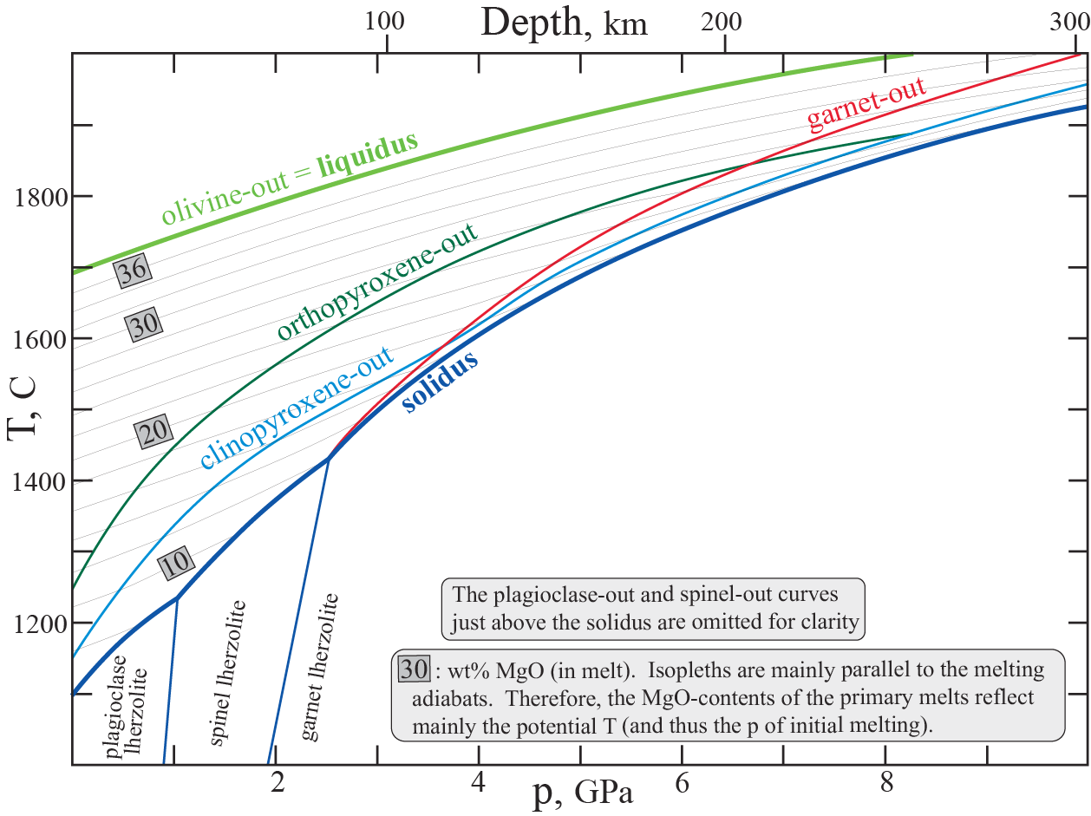
MgO_{melt} content for various T_{p}-values
Based on Herzberg et al. (2002)

Slide 4
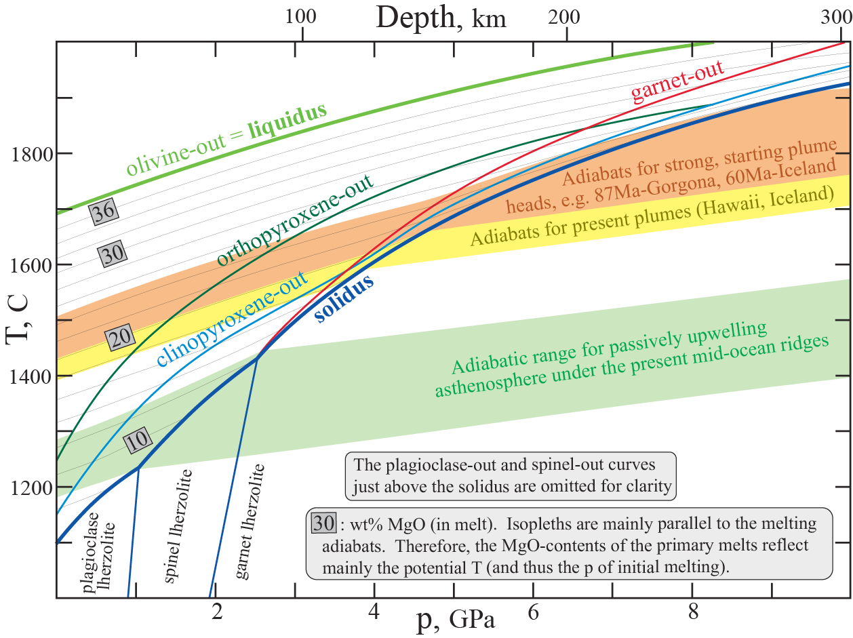
Melting for various ranges of mantle adiabats
Based on Herzberg et al. (2002)

Slide 5
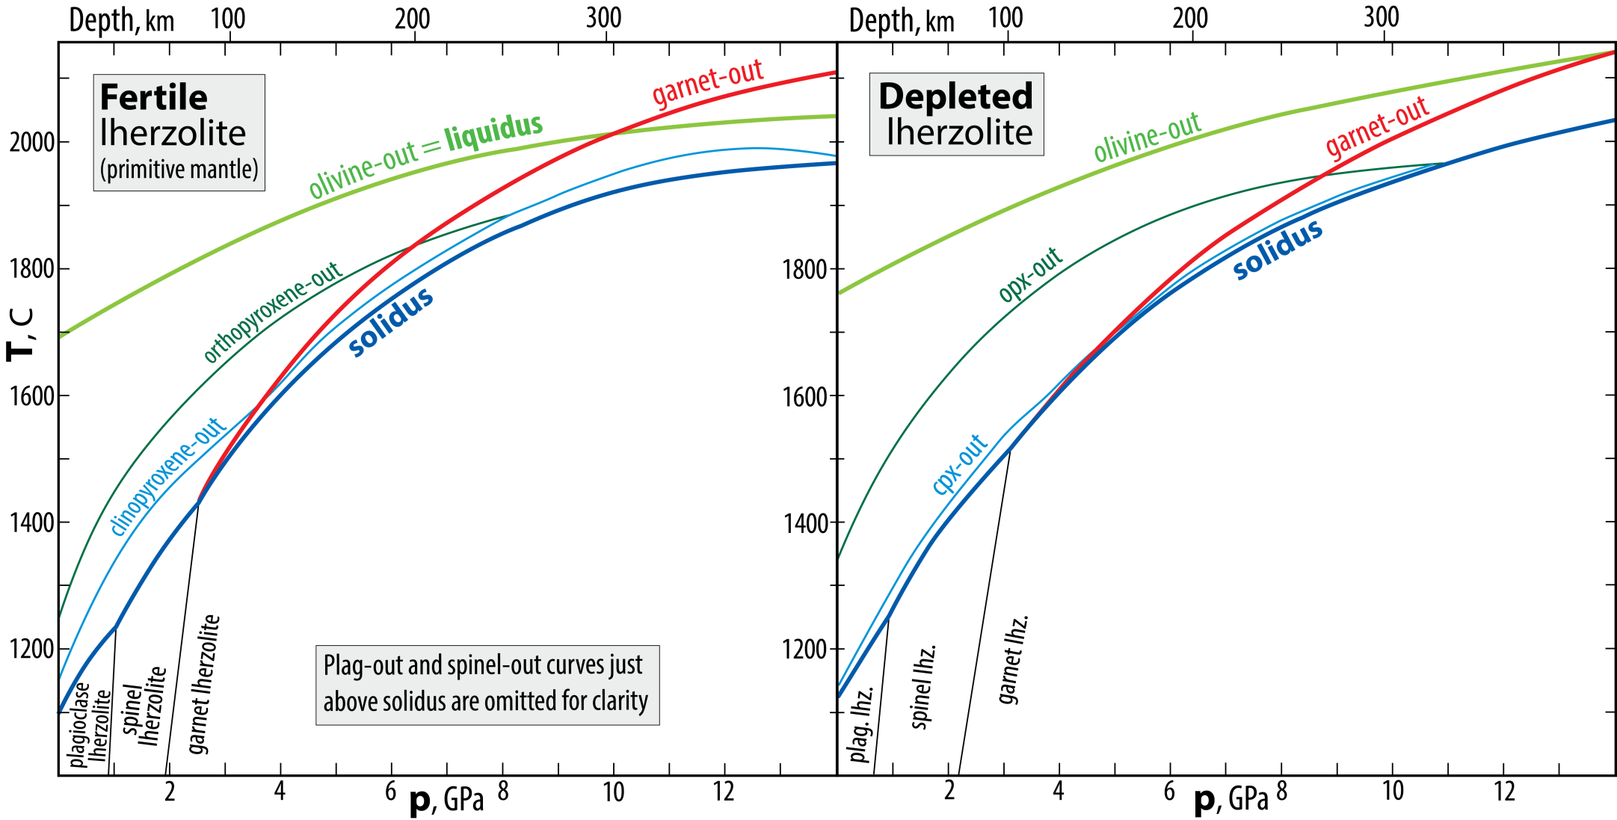
Phase relations: fertile versus enriched peridotite
What are the differences?
Elevated liquidus
Elevated solidus
Inceased ol and opx stability
rel. to cpx and ga stability
ol-ga cotectic displaced
to higher pressure
Expanded spinel
stability field

Slide 6
Progressive melting: disappearance of ga, cpx and opx
Based on Herzberg et al. (2002)

Slide 7
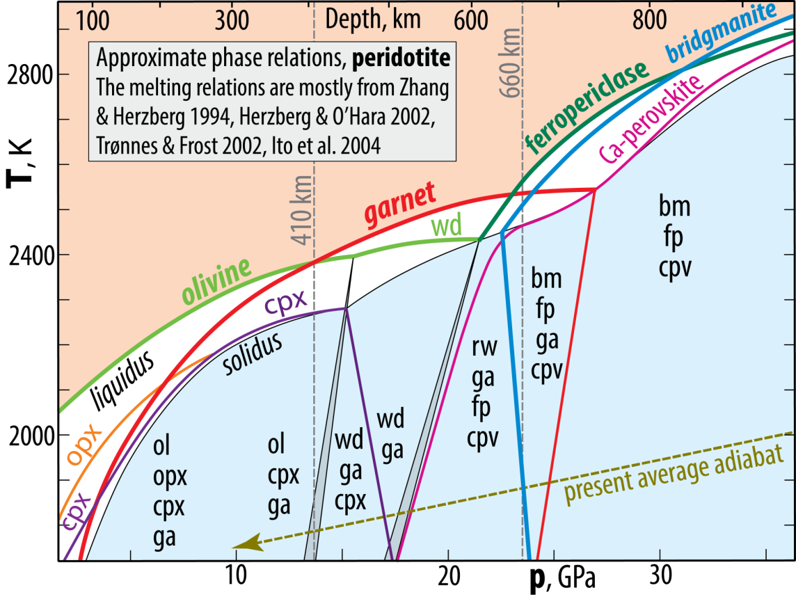
Melting relations, transition zone and uppermost lower mantle

Slide 8
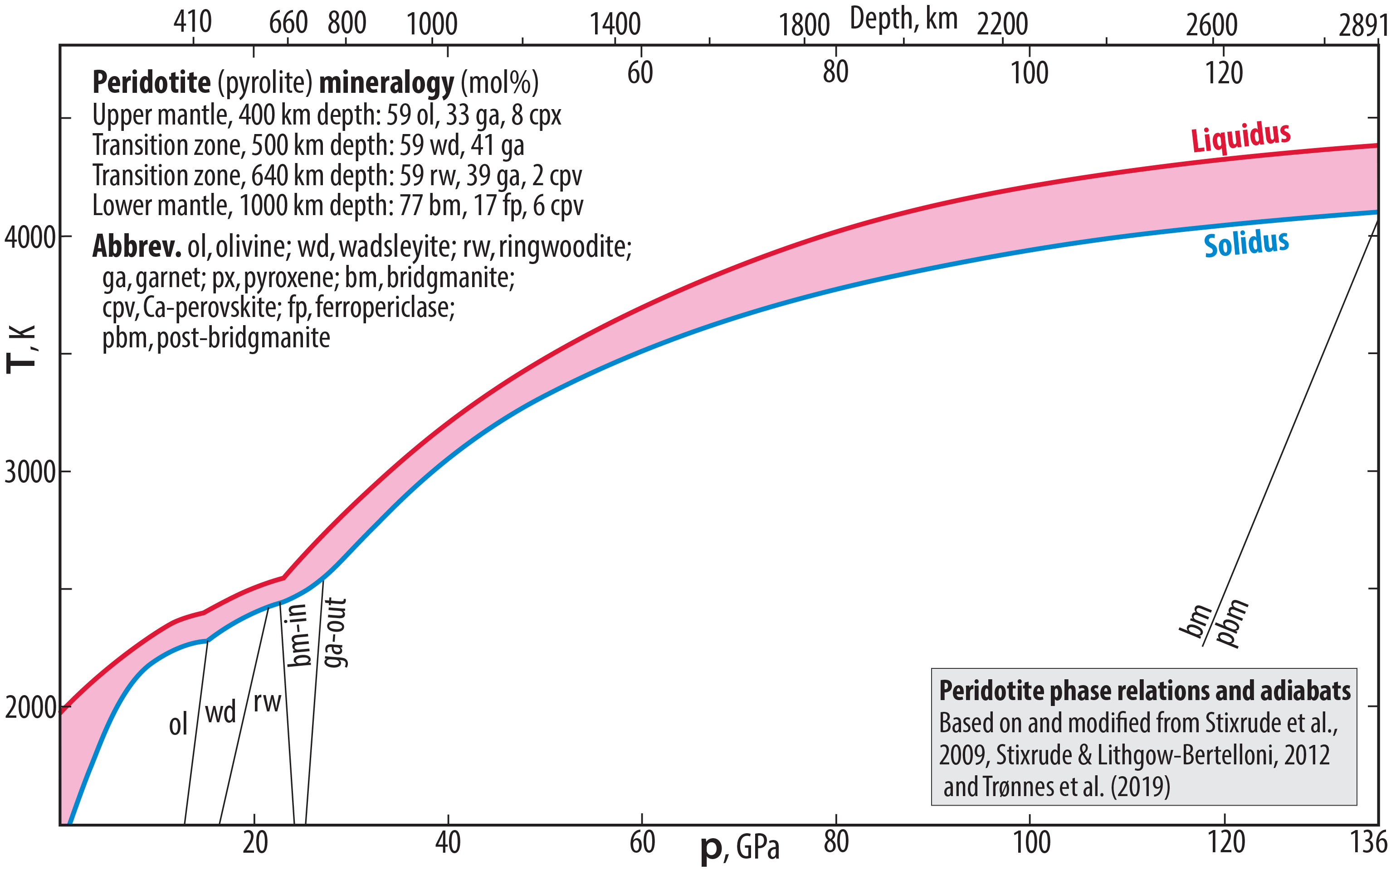
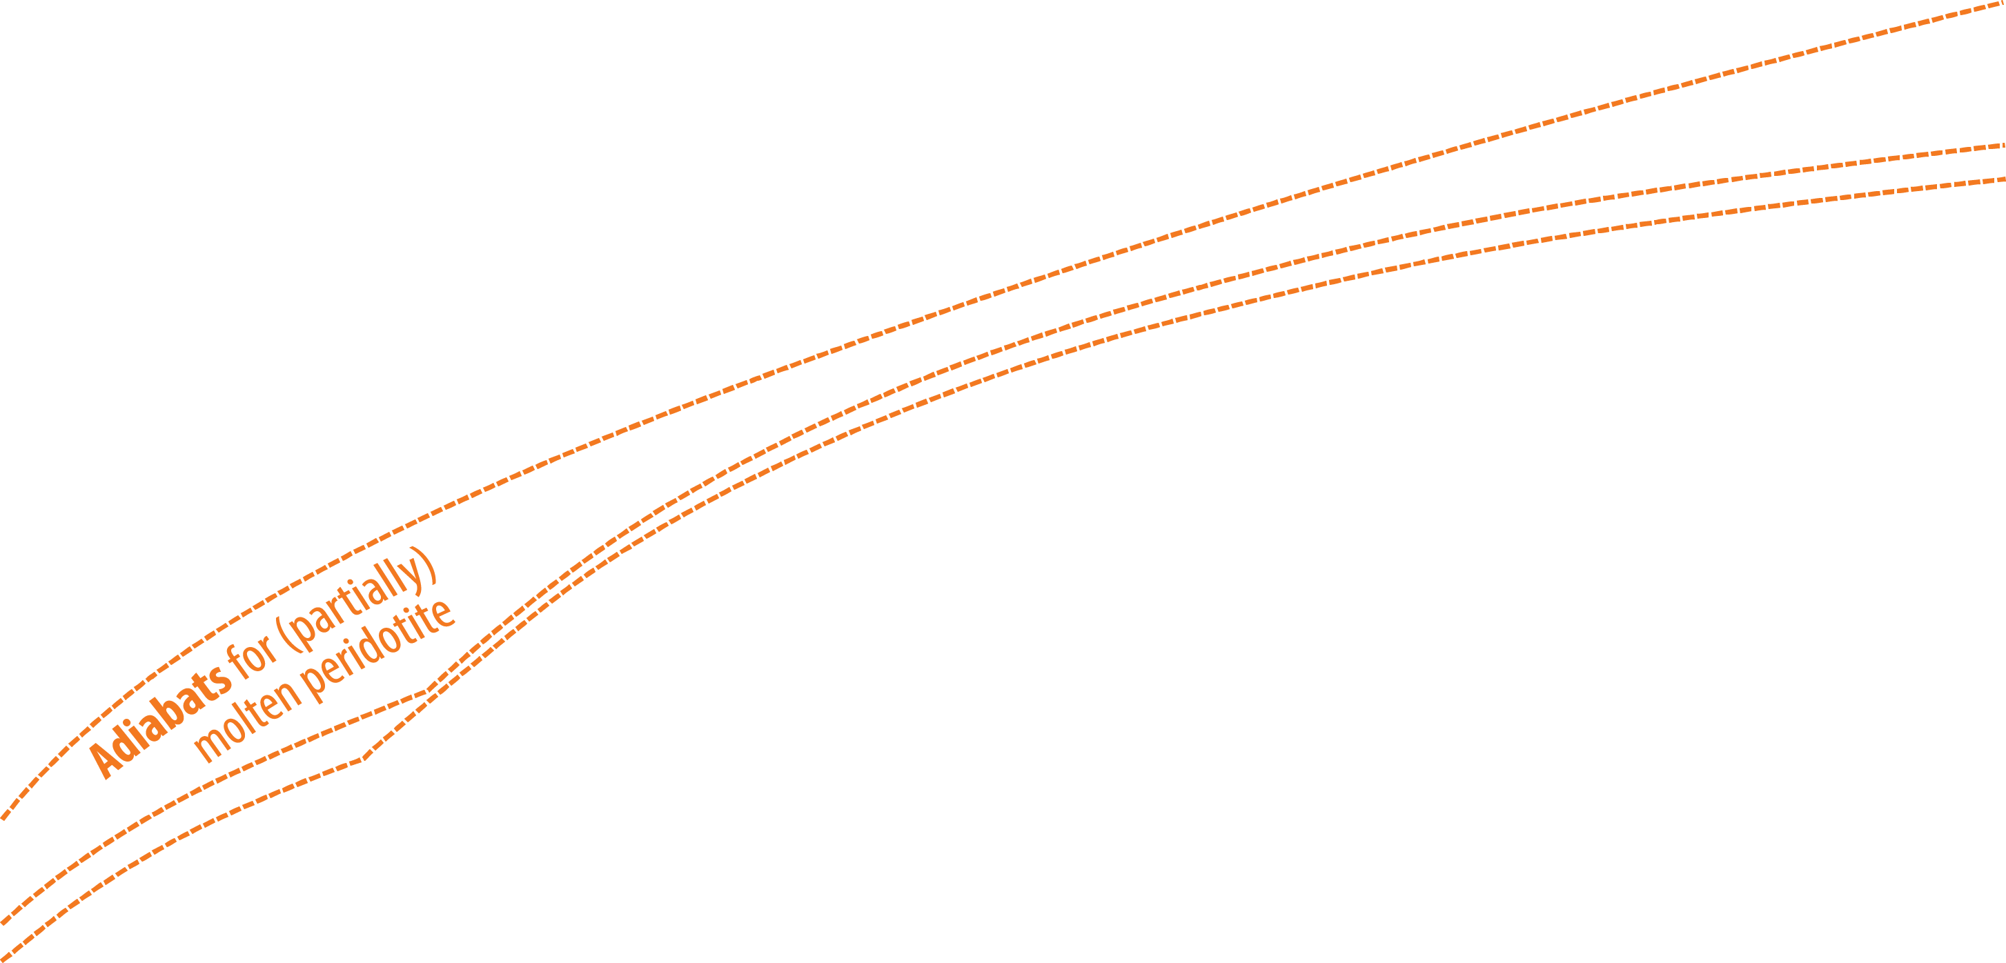
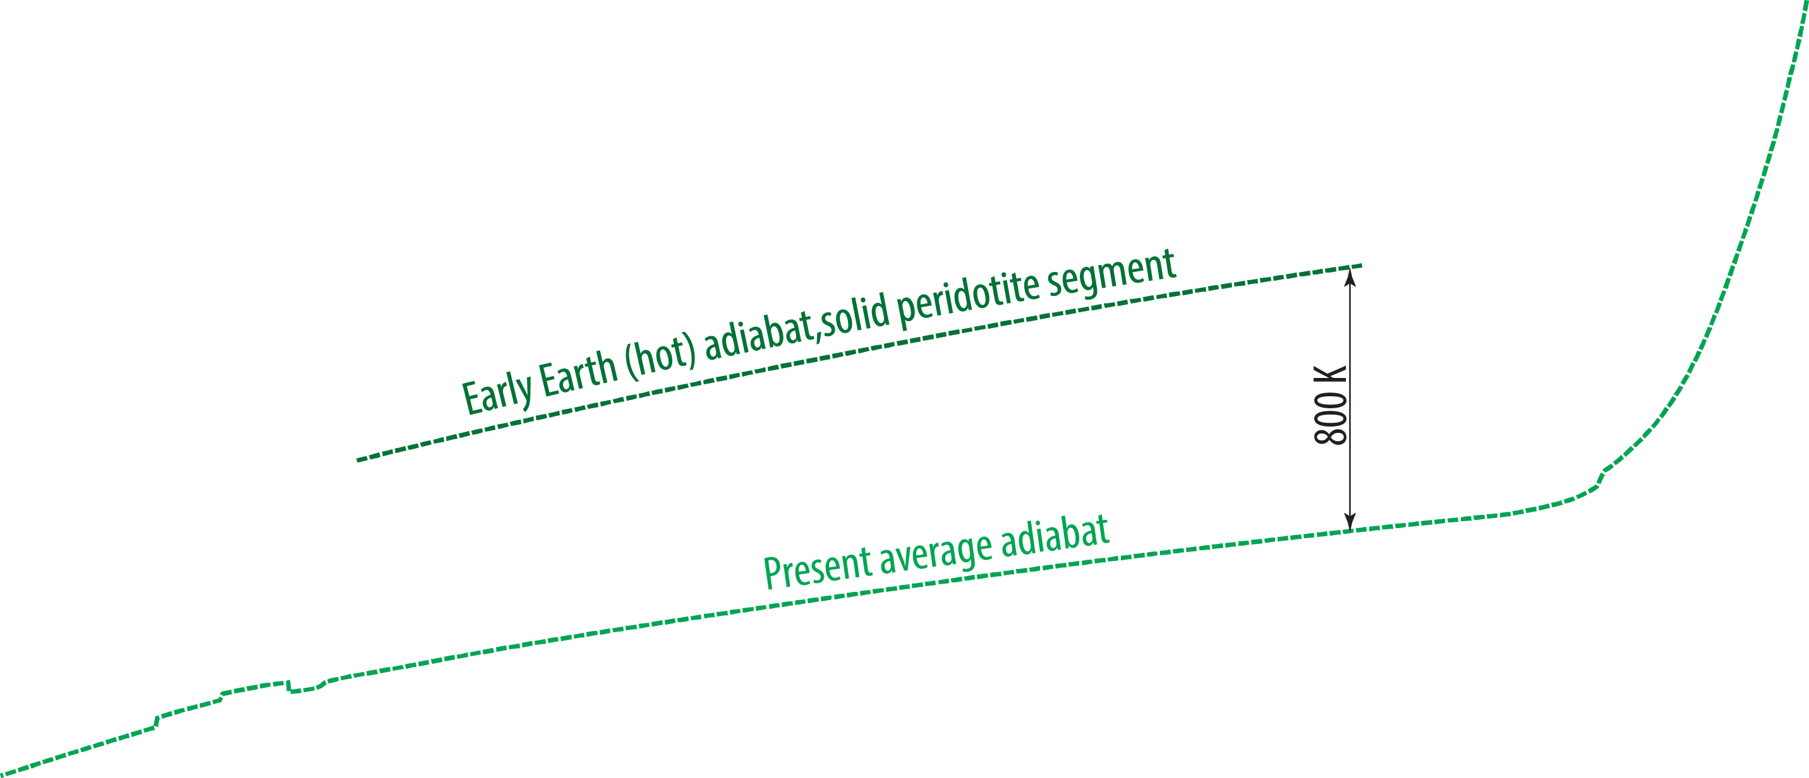
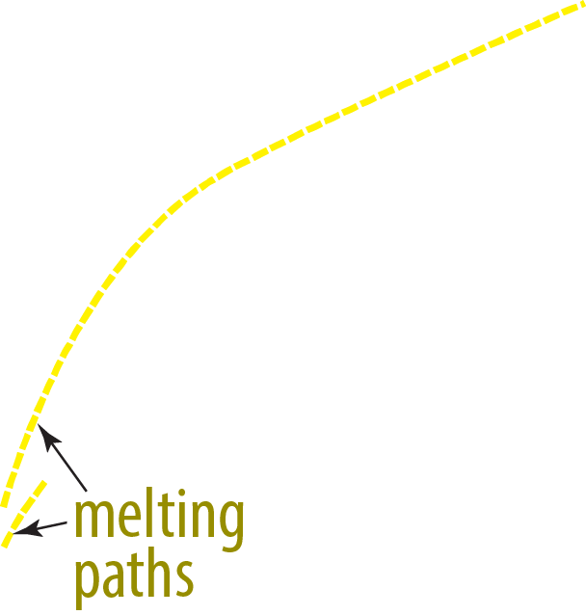
Melting relations, the entire mantle

Slide 9
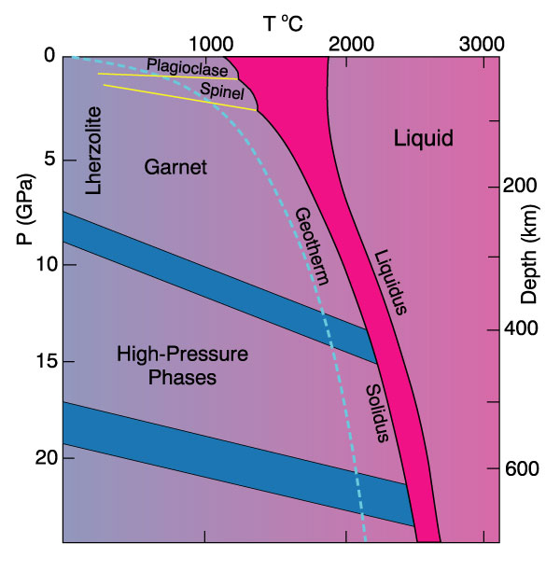
Winter (2010), Fig. 10.2, 10.3, 10.4:
Wrong (concave) curvature of liquidus
− it should be convex
Solidus is correct

Slide 10
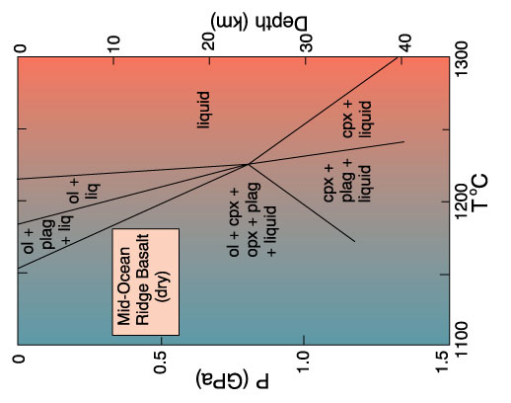
Winter may have been thinking of this phase diagram for MOR-basalt (Fig 10.13, from Fujii and Kushiro, 1977). The ol- and cpx-liquidus segments are simply drawn as straight lines and combined they may appear concave.
Winter (2010), Fig. 10.2, 10.3, 10.4:
Wrong (concave) curvature of liquidus
− it should be convex
Solidus is correct
However, a correct version includes two convex liquidus segments.

Slide 11
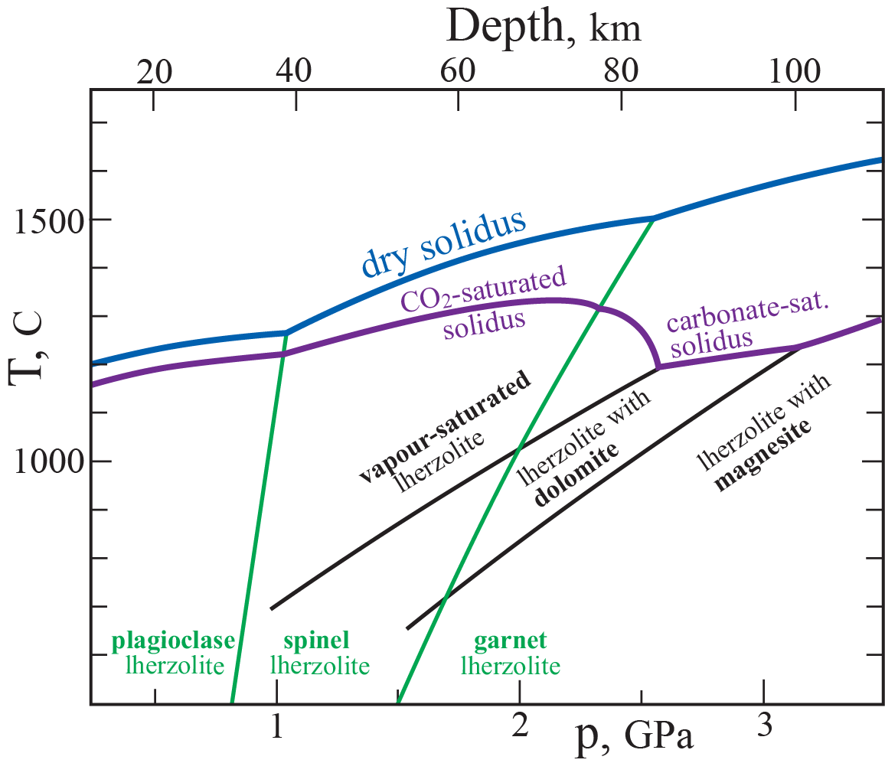
Liquidus-subsolidus phase relations, peridotite
Compiled from:
Dasgupta and Hirshmann (2010)
Winter (2010)
Wyllie (1979)
Peridotite-CO₂-system (CMS-CO₂)
Write net, balanced reactions for:
- transition from lherzolite + CO₂
to dolomite-bearing lherzolite
- transition from dolomite- to
to magnesite-lherzolite
Why is the CO₂-saturated solidus relatively close to the dry solidus,
in contrast to the strongly depressed solidus of carbonate-lherzolites (esp.
dolomite-lhz ?

Slide 12
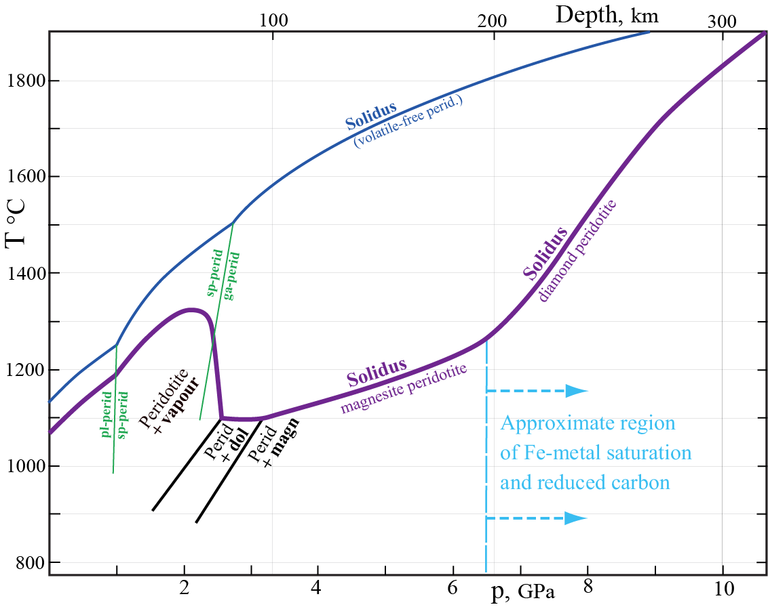
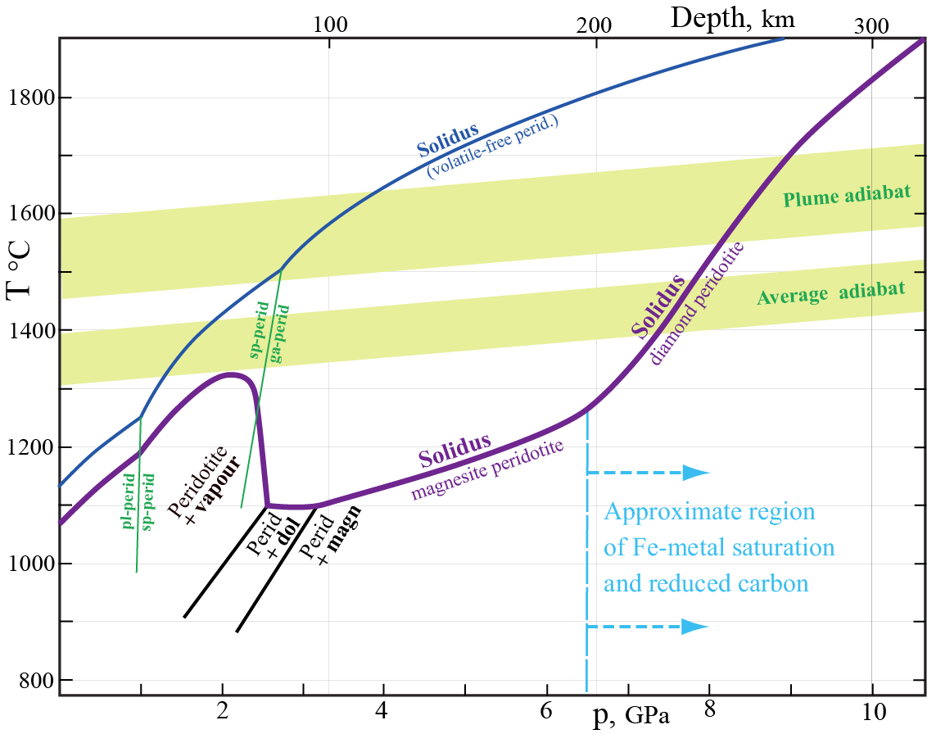
Solidus for CO₂-bearing peridotite at various redox-conditions (metal under- and oversaturation)
Oxidizing conditions
Magnesite is stable in C-bearing
mantle throughout the upper mantle
at depths exceeding 100 km depth possibly even in the transition zone.
However, under strongly reducing conditions with Fe-metal
saturation - - - -
Write simple balanced reactions, involving:
- ol
- ferropericlase [(Mg,Fe)O] for the reduction of carbonate (magnesite) as a result of Fe-metal saturation.(system Fe-Mg-Si-C-O)
cratonic geotherm
Redox processes in the deeper parts of the upper mantle
Rohrbach and Schmidt (2011, Nature): ”Redox freezing and melting”
What is the fate of subducted lithosphere (peridotitic composition)’ with carbonate
(e.g. carbonate veins) in the middle to deeper part of the lower mantle?
Explain the presence of diamond on deep continental lithosphere.

Slide 13
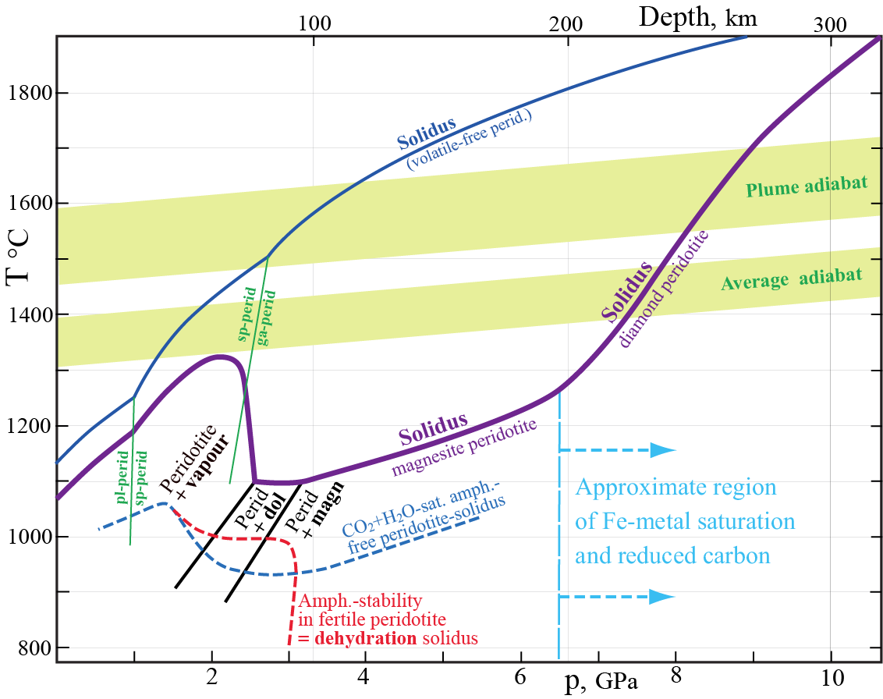
Solidus for CO₂-bearing peridotite at various redox-conditions (metal under- and oversaturation)
Solidus in the presence of CO₂ + H₂O
Pargasitic amphibole
stable in fertile lherzolite above the
CO₂-H₂O-saturated solidus to about
3 GPa / 100 km depth
(Green et al. 2010, Nature)
Related to the lithosphere-
asthenosphere boundary ?
cratonic geotherm
ambient mantle
geotherm

Slide 14
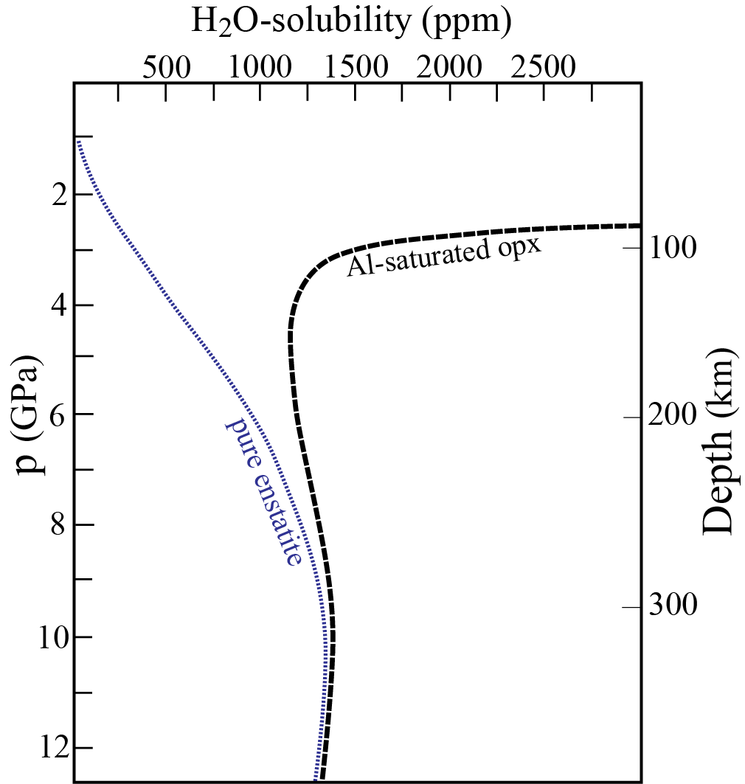
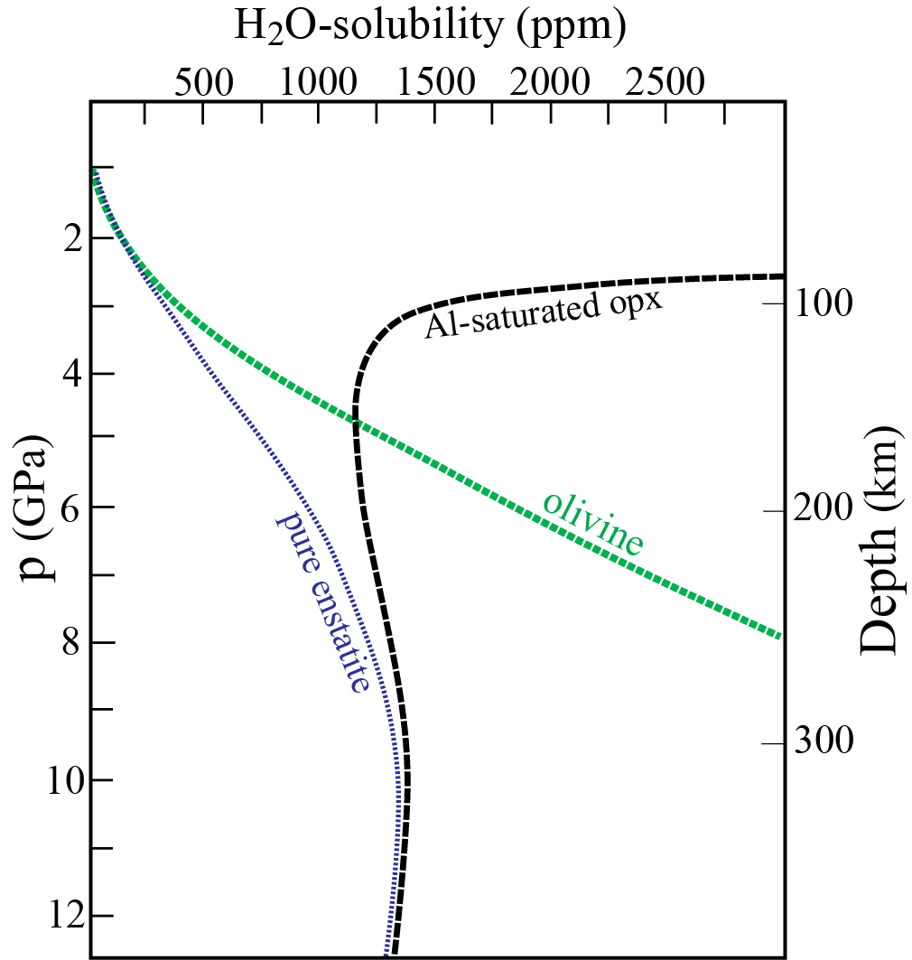
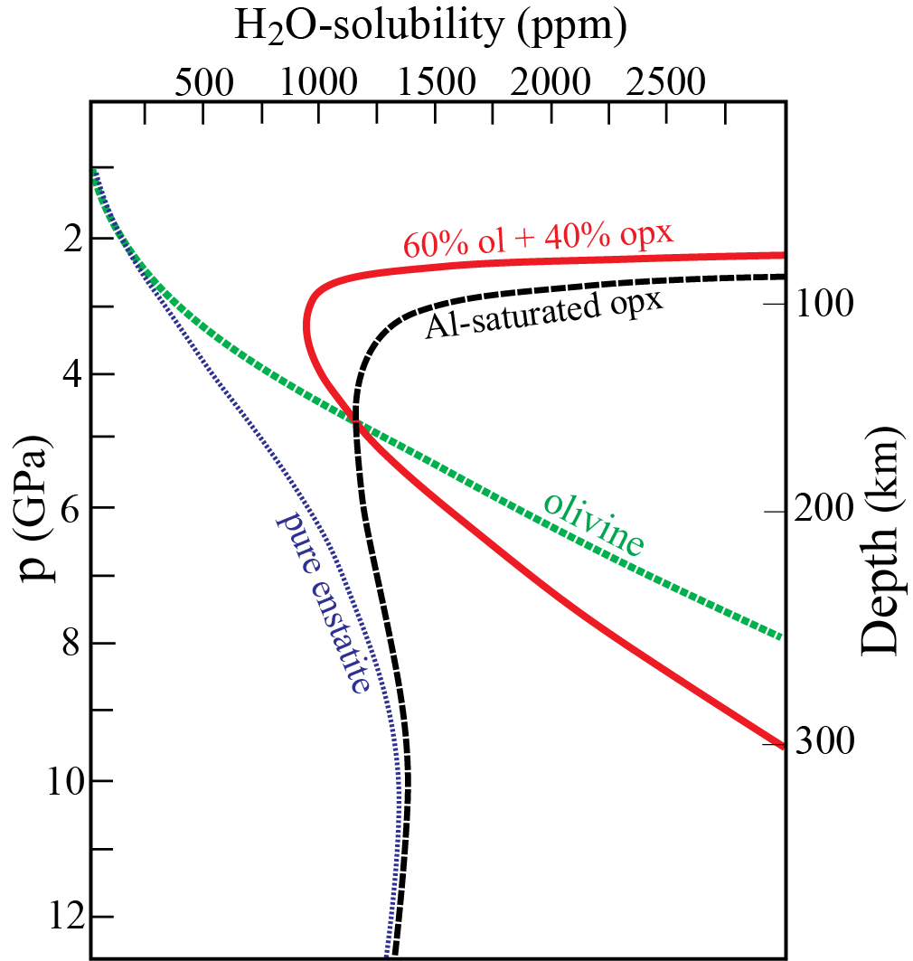
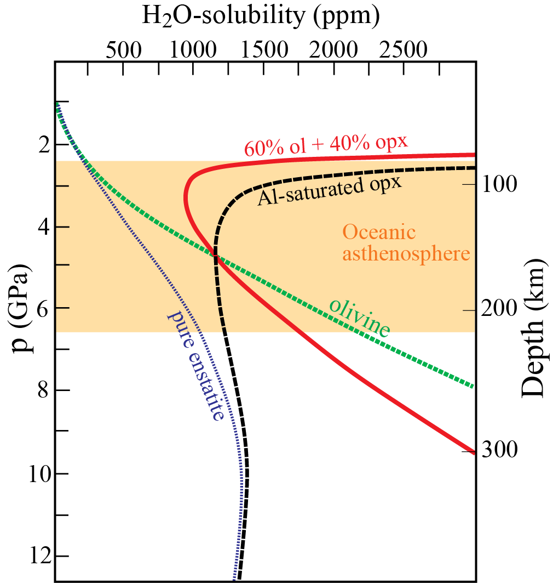
Lithosphere – asthenosphere transition promoted by
H-solubility in orthopyroxene (Mierdel et al., 2007, Science)
Two substitution mechanisms
for aluminous opx at low p
(approximately equal prop.)
0.1 wt%
Mg₂Si₂O₆ ↔ Mg₂AlSiO₆H
Mg₂Si₂O₆ ↔ AlSi₂O₆H
Al-rich opx: only at < 3 GPa
Oceanic asthenosphere,
(uppermost part)
The combined H₂O-solubility in
ol and opx reaches a minimum
at 2.5-3.0 GPa
H₂O-saturation and low-degree,
hydrous melt fractions are likely
Common oceanic mantle:
0.1 wt% (1000 ppm) H₂O

Slide 15
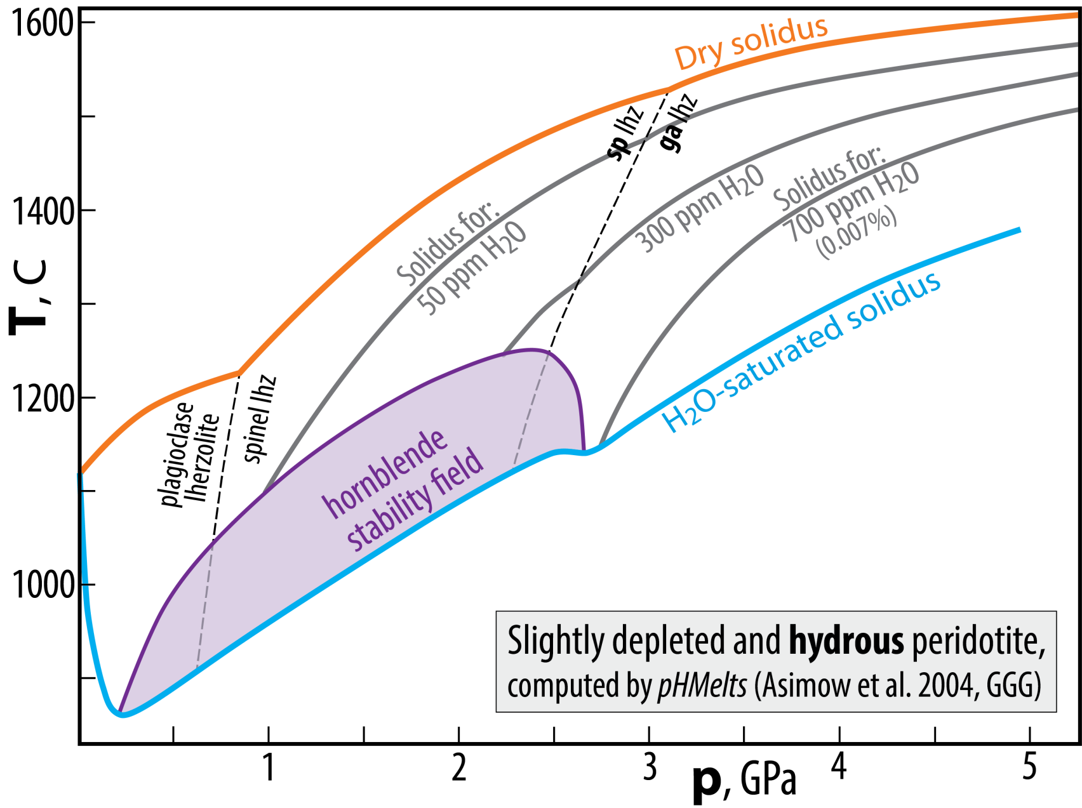
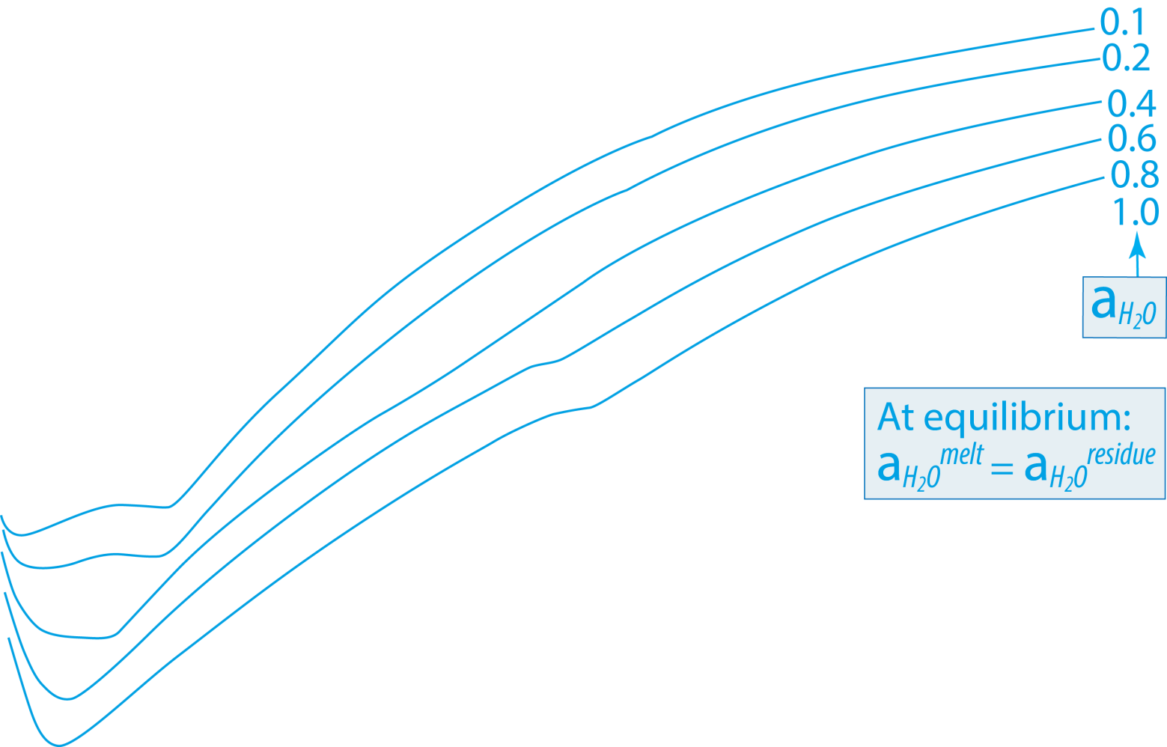
Melting relations, hydrous peridotite
340 C

Slide 16
Solution models − Activity-composition relationships
Activity-composition relation:
a_{i}^{p} = γ_{i}^{p} * X_{i}^{p}
activity of
component i
in phase p
activity
coeff.
mole-
fraction
Example 1: ideal solution, ideal (dilute) gas mixture
a_{i}^{p} = X_{i}^{p}
Air at the Earth's surface (close to an ideal gas):
p_{total} = 1 bar = p_{N2} + p_{O2} + p_{Ar} + p_{H2O} + p_{CO2}
= 0.78 + 0.21 + 0.01
+ 0.00001−0.05
+ 0.00028−0.00040
280 V ppm 400 V ppm
before 1800 AD 2016 AD
For gases: activities are labelled fugacities
In ordinary air at surface condition: f_{O2} =
0.21 bar

Slide 17
However:
For mineral-melt assemblages without a separate gas phase or where such a
possible gas phase would be difficult to handle analytically, we refer the f_{O2} to a
solid state mineral assemblage via an oxygen buffer reaction
Example
Bulk Earth or planetary core-mantle "equilibrium" (not actually in equilibrium)
O₂ + 2 Fe = 2 FeO (Iron-Wustite buffer reaction)
in core in mantle
K = a_{FeO}² / (f_{O2} * a_{Fe}²) = 1 (at IW)
f_{O2} = a_{FeO}² / a_{Fe}²
log f_{O2} (ΔIW) = 2 * log (a_{FeO}/a_{Fe})
≈ 2 * log (X_{FeO}/X_{Fe})
5.7 mol% FeO
in Earth's mantle:
i.e. X_{FeO}= 0.057
79 mol% Fe
in Earth's core:
i.e. X_{Fe}= 0.79
log f_{O2} (ΔIW) = 2 * log (0.057/0.79) = − 2.18

Slide 18
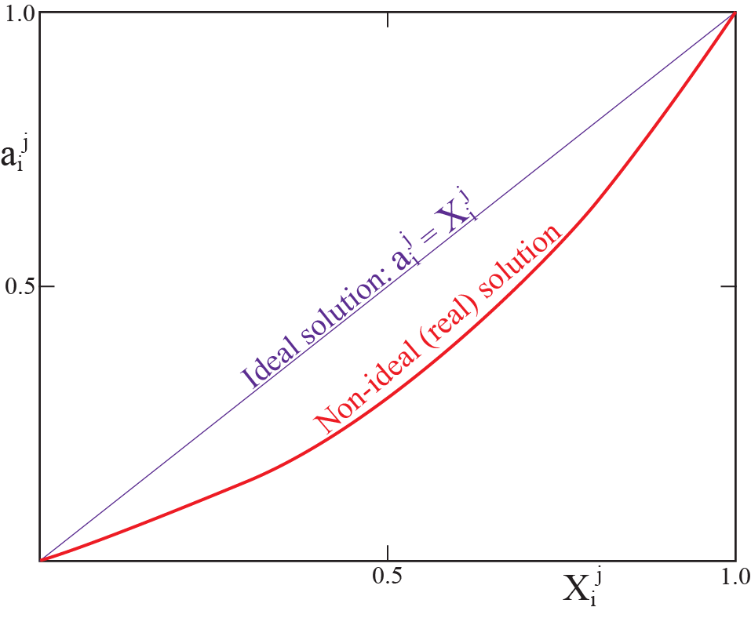
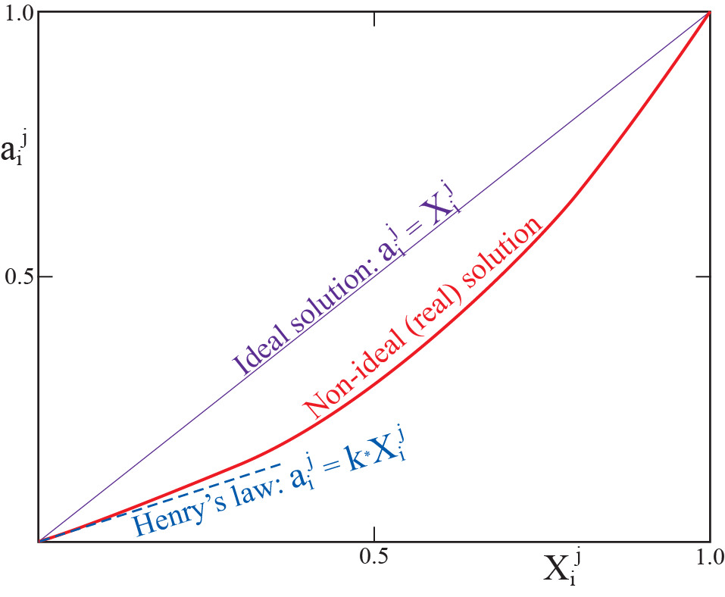
Solution models − Activity-composition relationships
Activity-composition relation:
a_{i}^{p} = γ_{i}^{p} * X_{i}^{p}
Example 2: mineral-melt trace element (TE) partitioning
- Generally: TEs in non-ideal solutions in minerals and melts
- Low concentrations, however, may justify simplified a-X relationships
activity of
component i
in phase p
activity
coeff.
mole-
fraction
Henry’s law:

Slide 19
Simple thermodynamic treatment:
an example of Ni-partitioning between olivine and melt
Reaction: Ni₂SiO₄ ↔ Ni₂SiO₄
melt olivine
At equilibrium: ΔG = μ_{Ni2SiO4}^{ol} – μ_{Ni2SiO4}^{melt} = 0
μ_{0Ni2SiO4}^{ol} + RT lna_{Ni2SiO4}^{ol} = μ_{0Ni2SiO4}^{melt} + RT lna_{Ni2SiO4}^{melt}
μ_{0Ni2SiO4}^{ol} – μ_{0Ni2SiO4}^{melt} = – RT ln (a_{Ni2SiO4}^{ol} / a_{Ni2SiO4}^{melt})
ΔG₀ = – RT lnK
With dilute solutions (a_{i}^{j} = kX_{i}^{j}): K = k^{ol}X_{Ni}^{ol} / k^{melt}X_{Ni}^{melt}
= k (C_{Ni}^{ol} / C_{Ni}^{melt}
Or just for simplicity: K = k (Ni^{ol} / Ni^{melt})
Nernst partitioning (distribution) coefficient: D_{Ni}^{ol/melt} = Ni^{ol} / Ni^{melt}

Slide 20
Bulk partitioning (distribution) coefficient
Example: Incipient melting of a garnet lherzolite with
60% ol, 25% opx, 10% cpx and 5% ga
D^{bulk} = 0.60*D^{ol/m} + 0.25*D^{opx/m} + 0.10*D^{cpx/m} + 0.05*D^{ga/m}
Assuming that melting consumes preferentially cpx and ga, and that about 15 %
melting has changed the residual mineral mode to:
68% ol, 27% opx, 3% cpx and 2% ga,
the bulk distribution coefficient for further melting would be:
D^{bulk} = 0.68*D^{ol/m} + 0.27*D^{opx/m} + 0.03*D^{cpx/m} + 0.02*D^{ga/m}
Although D^{bulk} will actually change continuously during progressive melting, simple trace
element modelling often assumes a D^{bulk} that is either constant or that changes stepwise
(e.g. incremental batch melting)

Slide 21
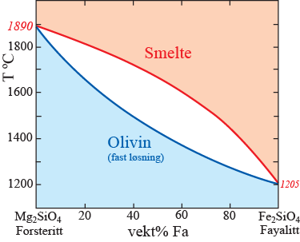
Normalized partitioning coefficient: K_{D}
e.g. Sr/Ca-partitioning between plagioclase and melt
reaction: SrAl₂Si₂O₈ + CaAl₂Si₂O₈ ↔ SrAl₂Si₂O₈ + CaAl₂Si₂O₈
melt plagioclase plagioclase melt
K_{D} = (Sr/Ca)^{pl}/(Sr/Ca)^{m}
= (Sr^{pl}/Sr^{m})/(Ca^{pl}/Ca^{m})
= D_{Sr}^{pl/m}/D_{Ca}^{pl/m}
Advantage: reduces the effects of compositions and T
e.g. Fe/Mg-partitioning between olivine and melt
reaction: Fe₂SiO₄ + Mg₂SiO₄ ↔ Fe₂SiO₄ + Mg₂SiO₄
melt olivine olivine melt
K_{D}^{ol/m} (Fe/Mg) = (Fe/Mg)^{ol}/(Fe/Mg)^{m} ≈ 0.3
i.e. melt has higher Fe/Mg-ratio than olivine
Also: K_{D}^{min/melt} (Fe/Mg) ≈ 0.2 – 0.4 for the other upper mantle minerals,
orthopyroxene, clinopyroxene and garnet

Slide 22
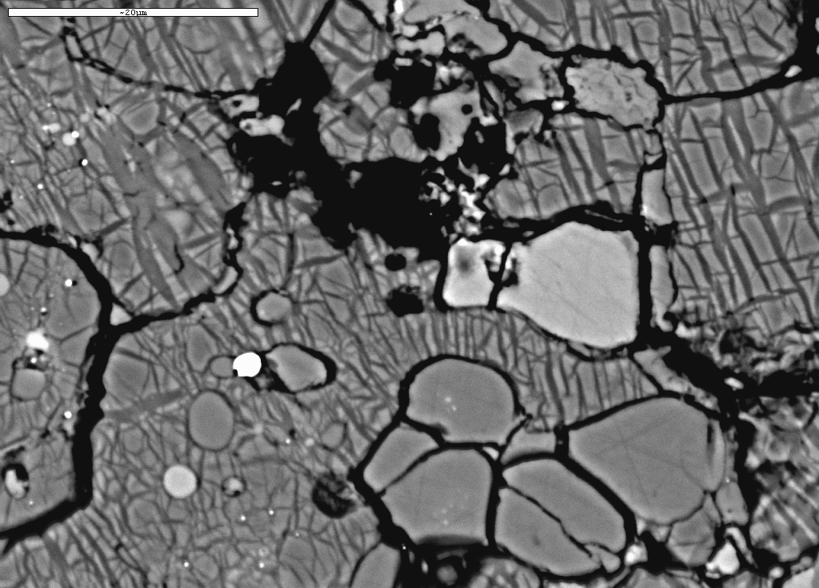
Short introduction to:
- mineralogy and phase relations of the transition zone and lower mantle
BSE-image
(back-scattered electrons)
Subsolidus peridotite, 24 GPa
bm
Bridgmanite
(bm)
Ferro-
periclase
Ca-pv
ga
FeNiS-metal
ga
ga
fp
garnet
bm

Slide 23
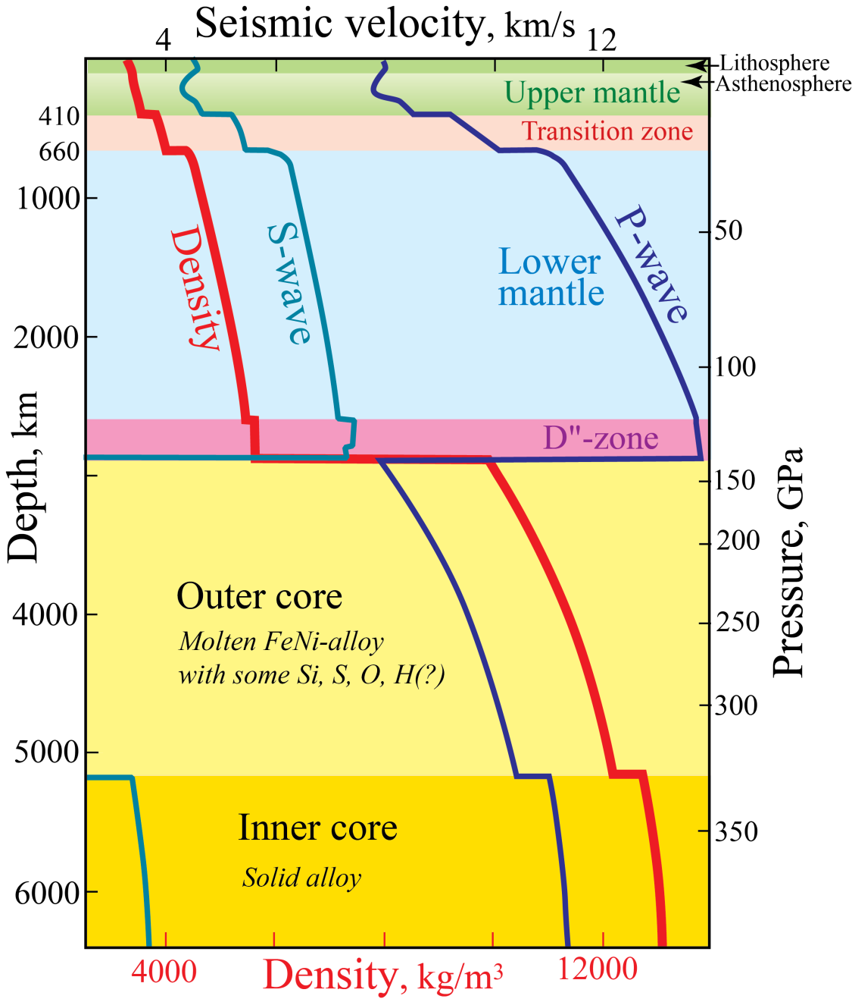
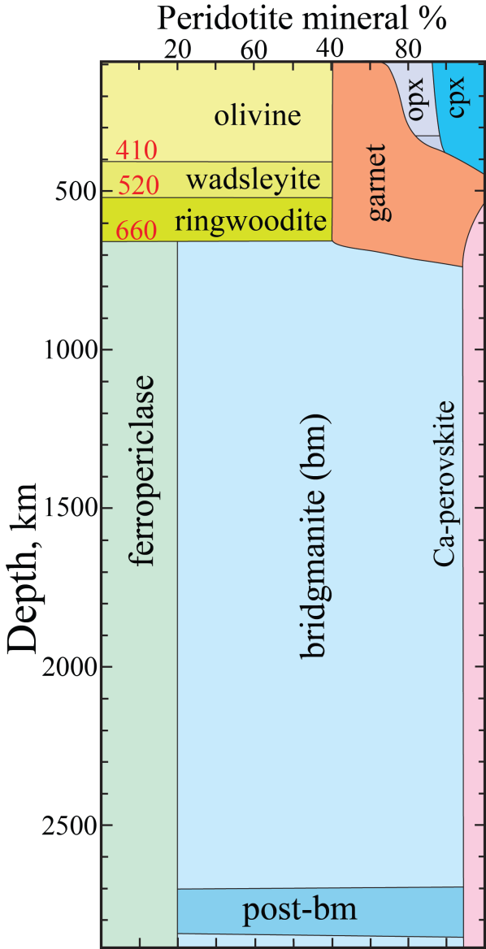
First-order Earth structure
PREM: Preliminary Earth Reference Model
- from seismology (normal modes) and gravity
- includes ρ and p
Dziewonski & Anderson (1981, PEPI)
Google Scholar: 8849 citations, Jan 28, 2019
9340 citations, Jan 29, 2020

Slide 24
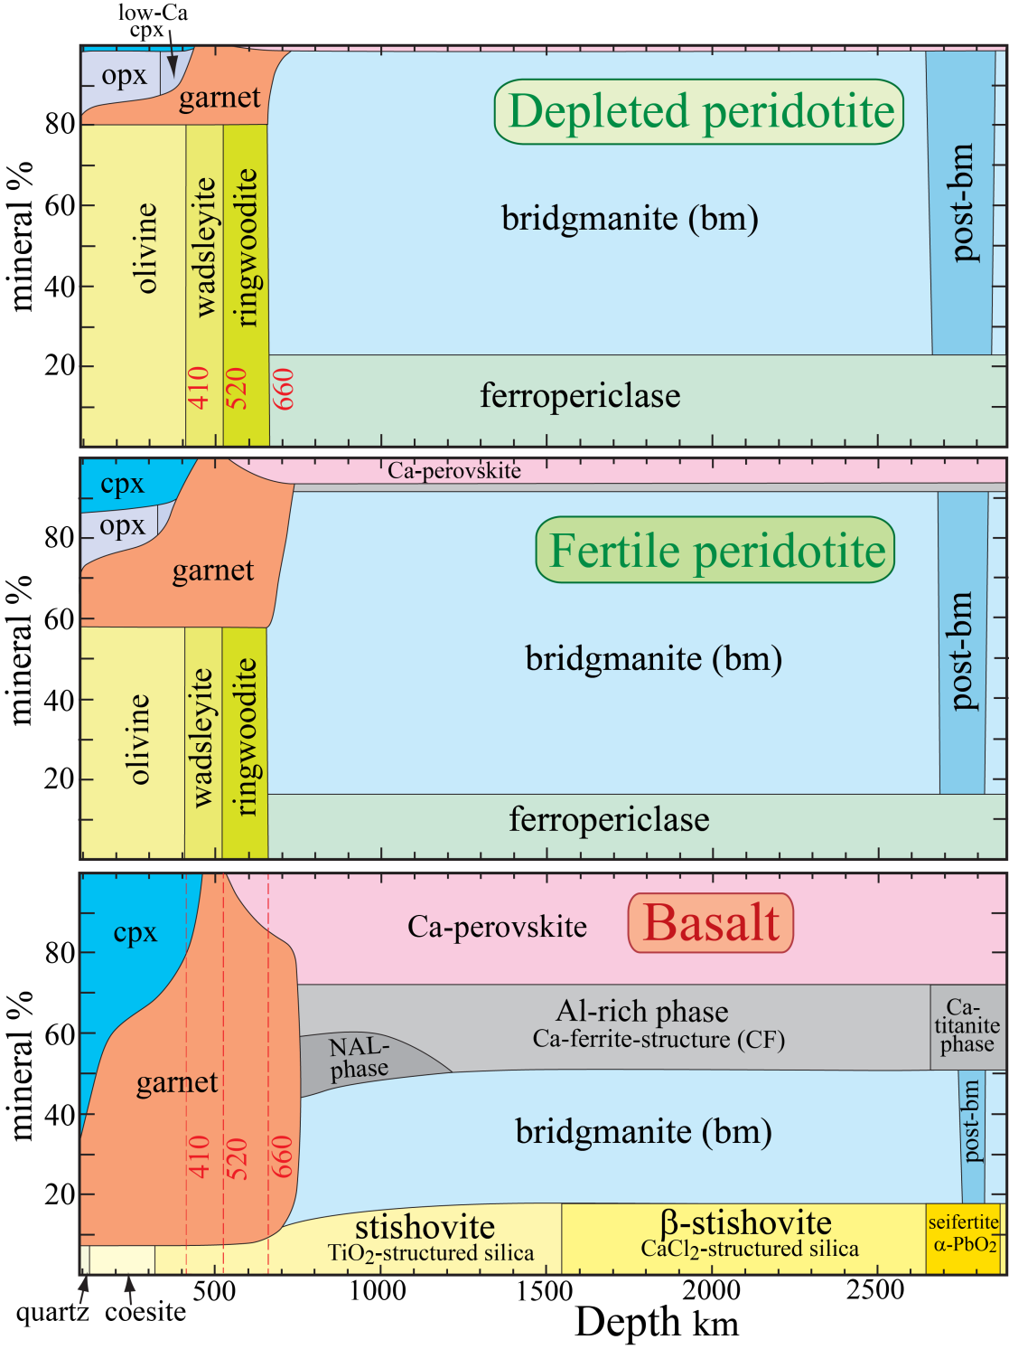
Mineralogical changes from depleted peridotite to basalt
Olivine, wadsleyite and ringwoodite:
decreases 80% → 0%
Clinopx and garnet: increases
Ca-perovskite: increases 0% → 30%
Mg-perovskite: decreases 75% → 40%
Al- and Si-rich phases in basalt in the lower mantle
1. Phases near the MgAl₂O₄-NaAlSiO₄-join
NAL (New Aluminous Phase)
Ca-ferrite- and Ca-titanite-structured phases
2. SiO₂-dominated phases with a minor AlO_{1.5}-component
Stishovite (TiO₂-structure, tetragonal)
Distorted stishovite (CaCl₂-stucture, orthorombic)
Seifertite (αPbO₂-structure, orthorombic)
Modified from Stixrude &
Lithgow-Bertelloni (2012,
Ann Rev Earth Planet Sci)

Slide 25
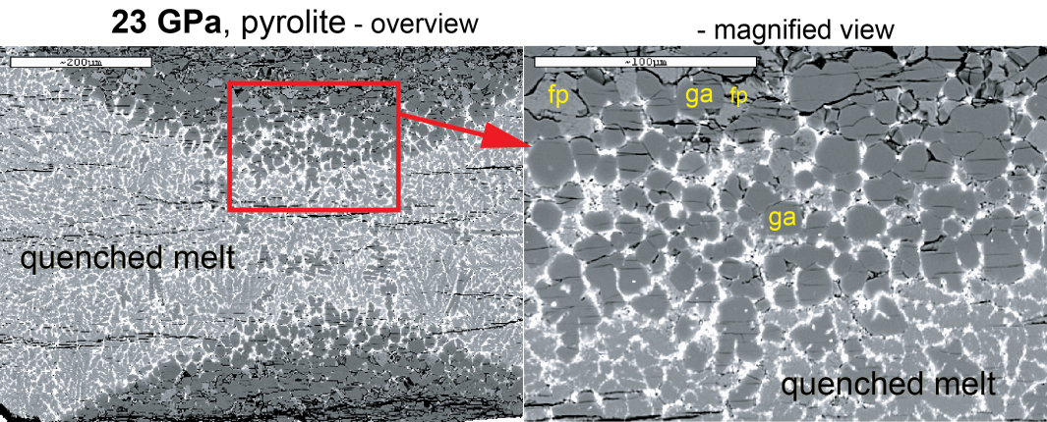
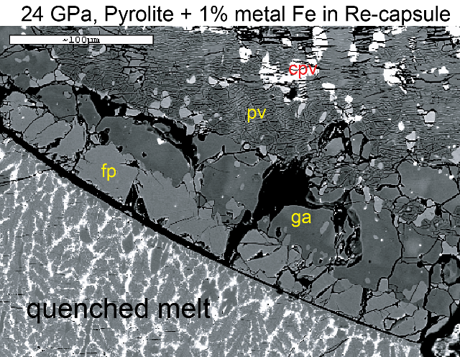
Peridotite melting
relations, 2−36 GPa
ol: olivine, opx: orthopyroxene,
cpx: clinoyroxene, ga: garnet
wd: wadsleyite, rw: ringwoodite
bm: bridgmanite, fp: ferropericlase,
cpv: Ca-perovskite
Tønnes & Frost
(2002, EPSL)

Slide 26
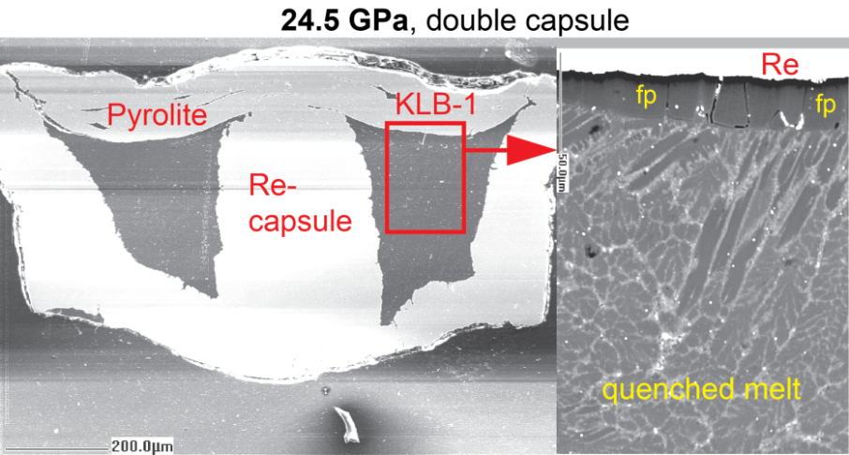
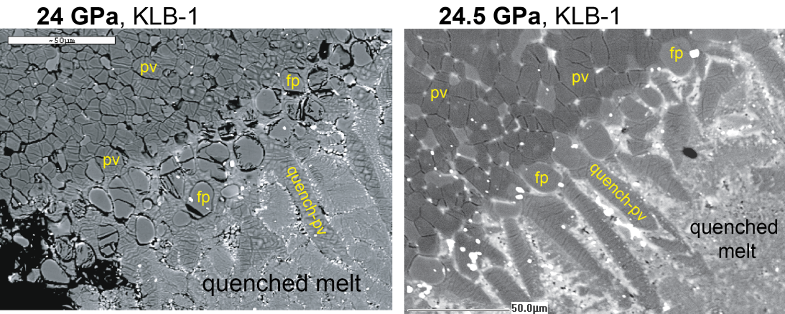
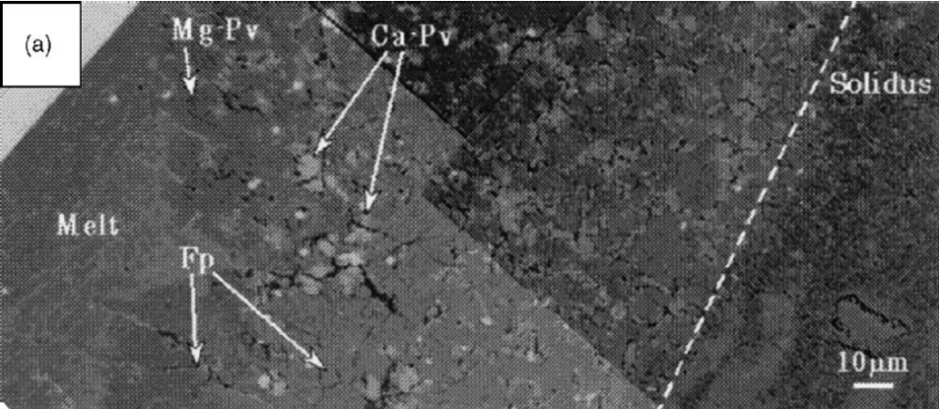
Peridotite melting
relations, 2−36 GPa
Tønnes & Frost
(2002, EPSL)
33 GPa, Ito et al. (2004, PEPI)

Slide 27
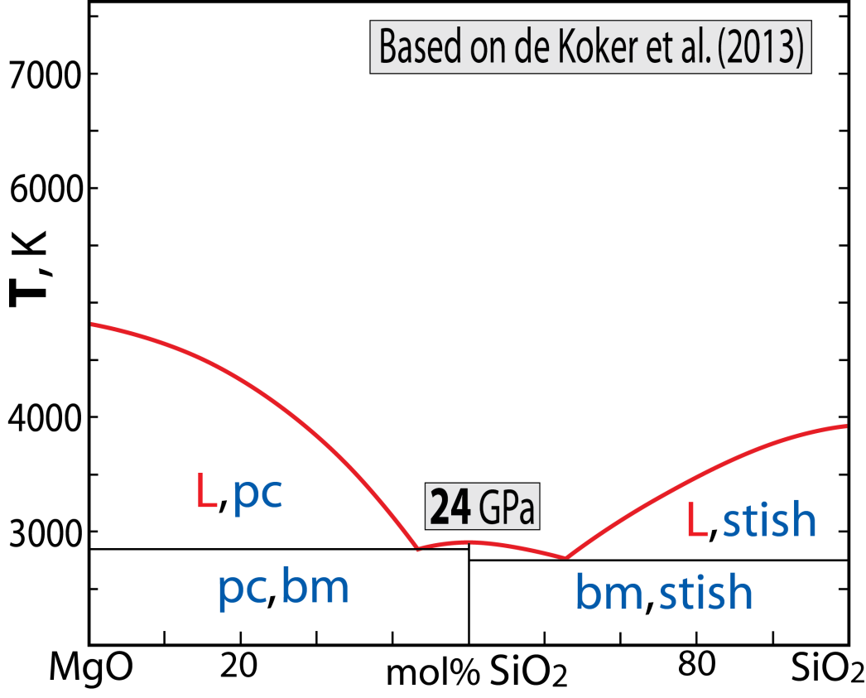
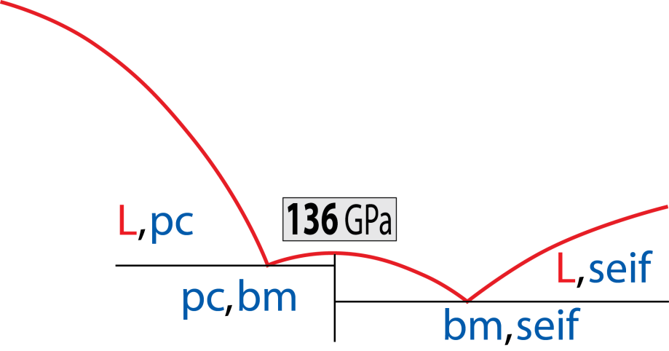
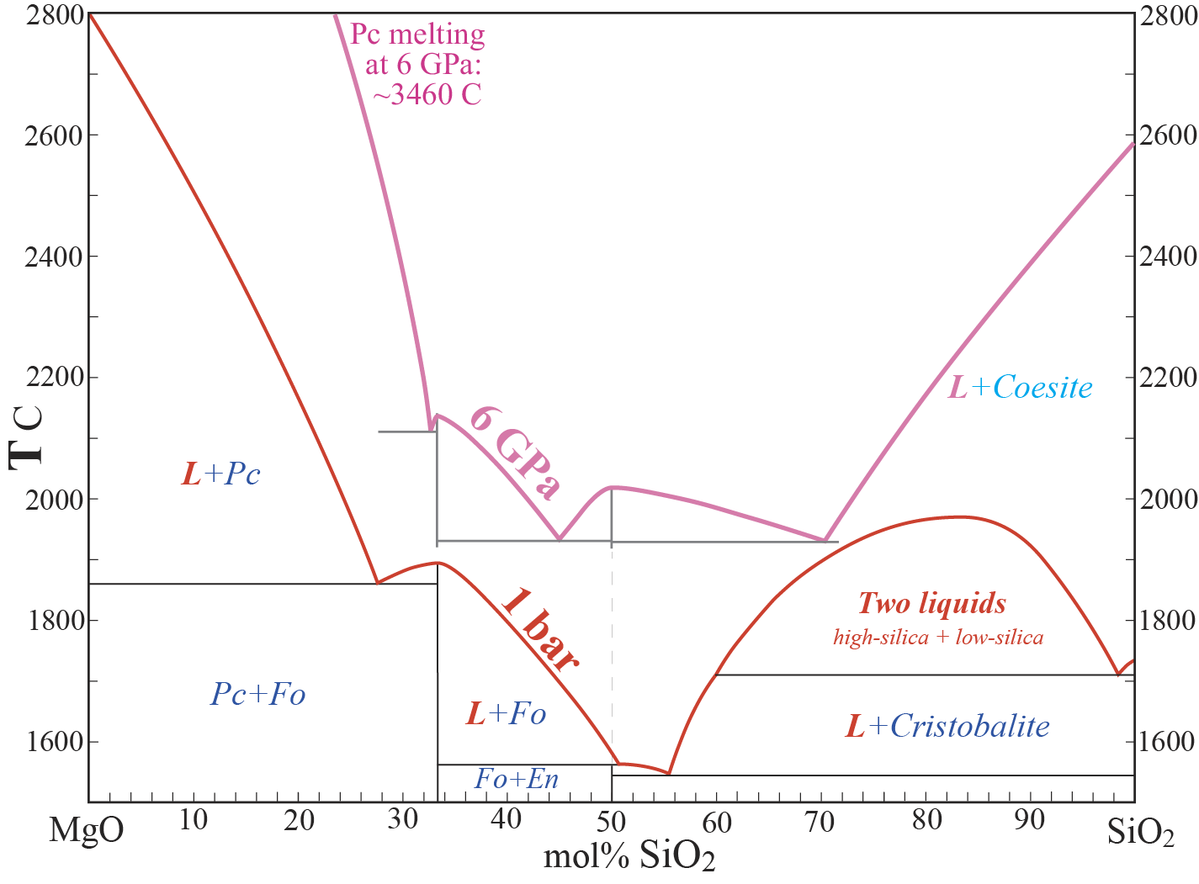
Lower mantle melting relations
Binary joins within the system
CaO-MgO-SiO₂ (CMS)
1. MS-join, 1 bar to 136 GPa
Melting of a peridotite model
Note the important shift of
the invariant composition
from 1 bar to 136 GPa
peridotite

Slide 28
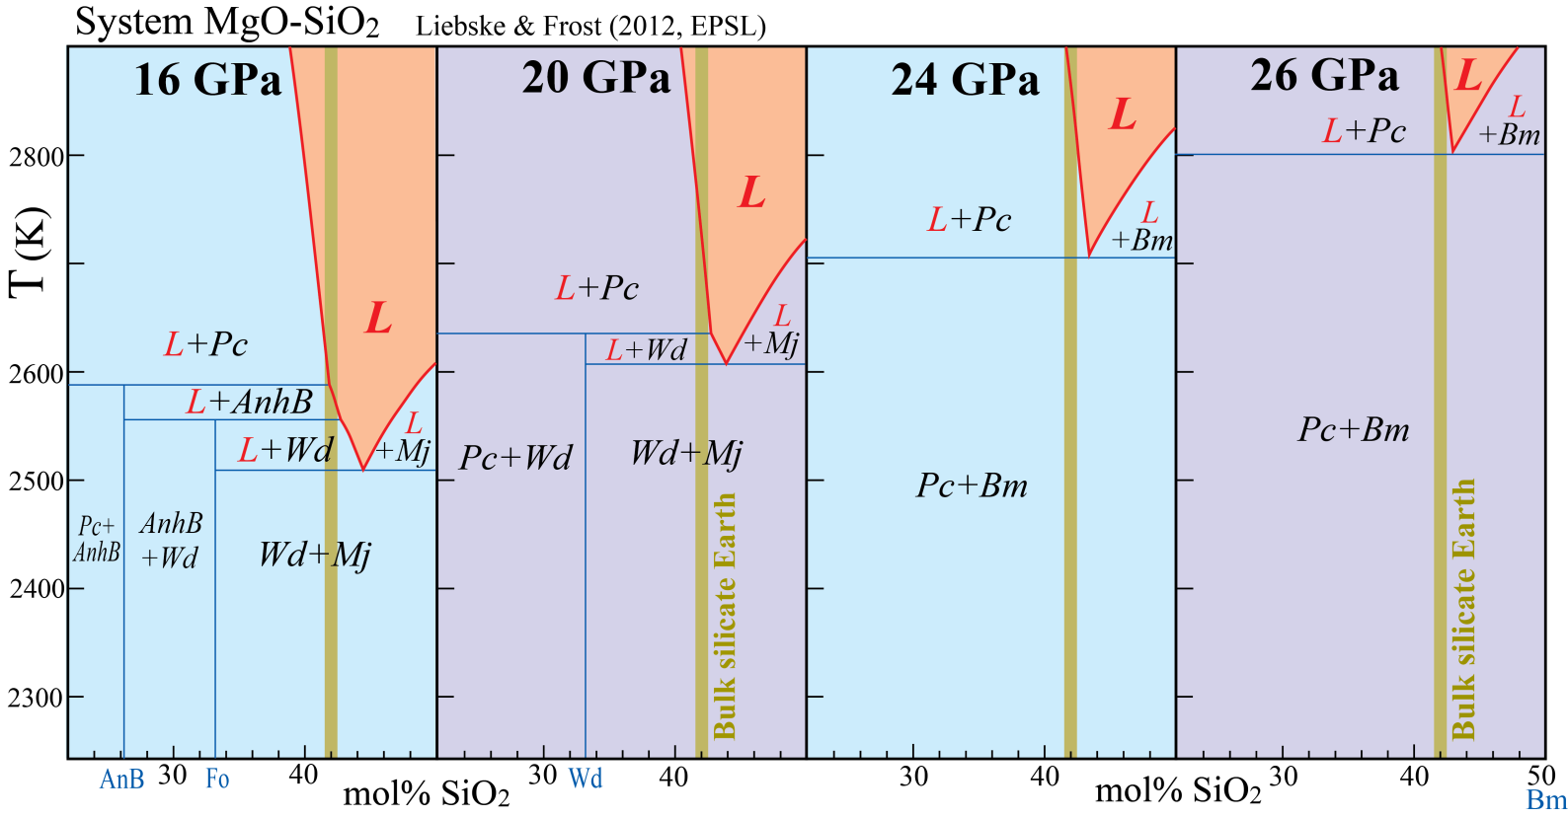
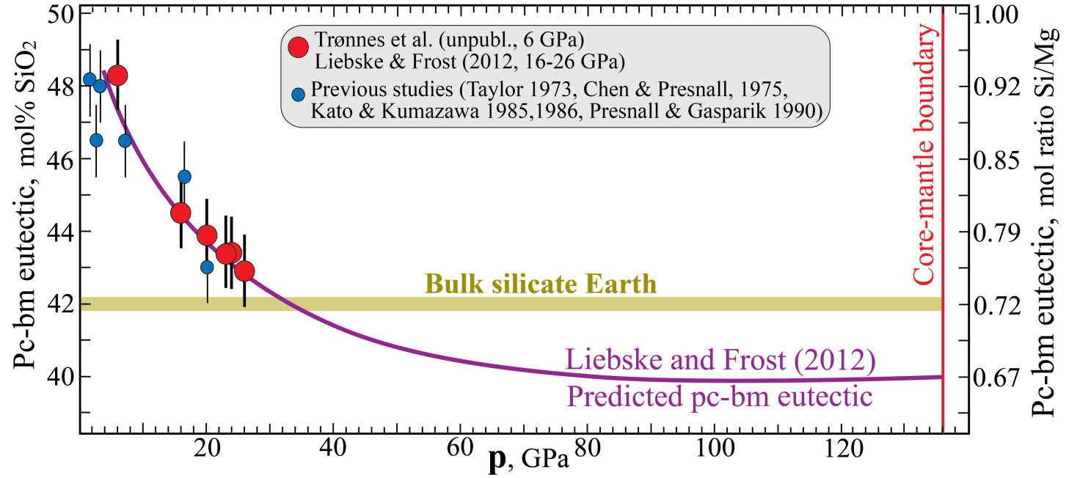
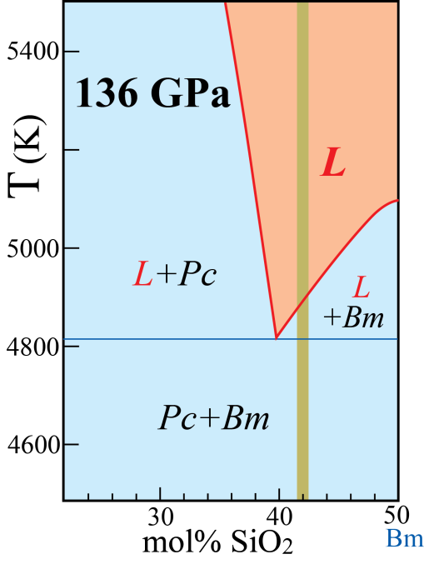
System MgO-SiO₂
at 16-26 GPa
Multianvil experiments
(eutectic moves towards BSE
from 16 to 26 GPa)
Thermodynamic model (eutectic comp. more magnesian than BSE above 35 GPa)

Slide 29
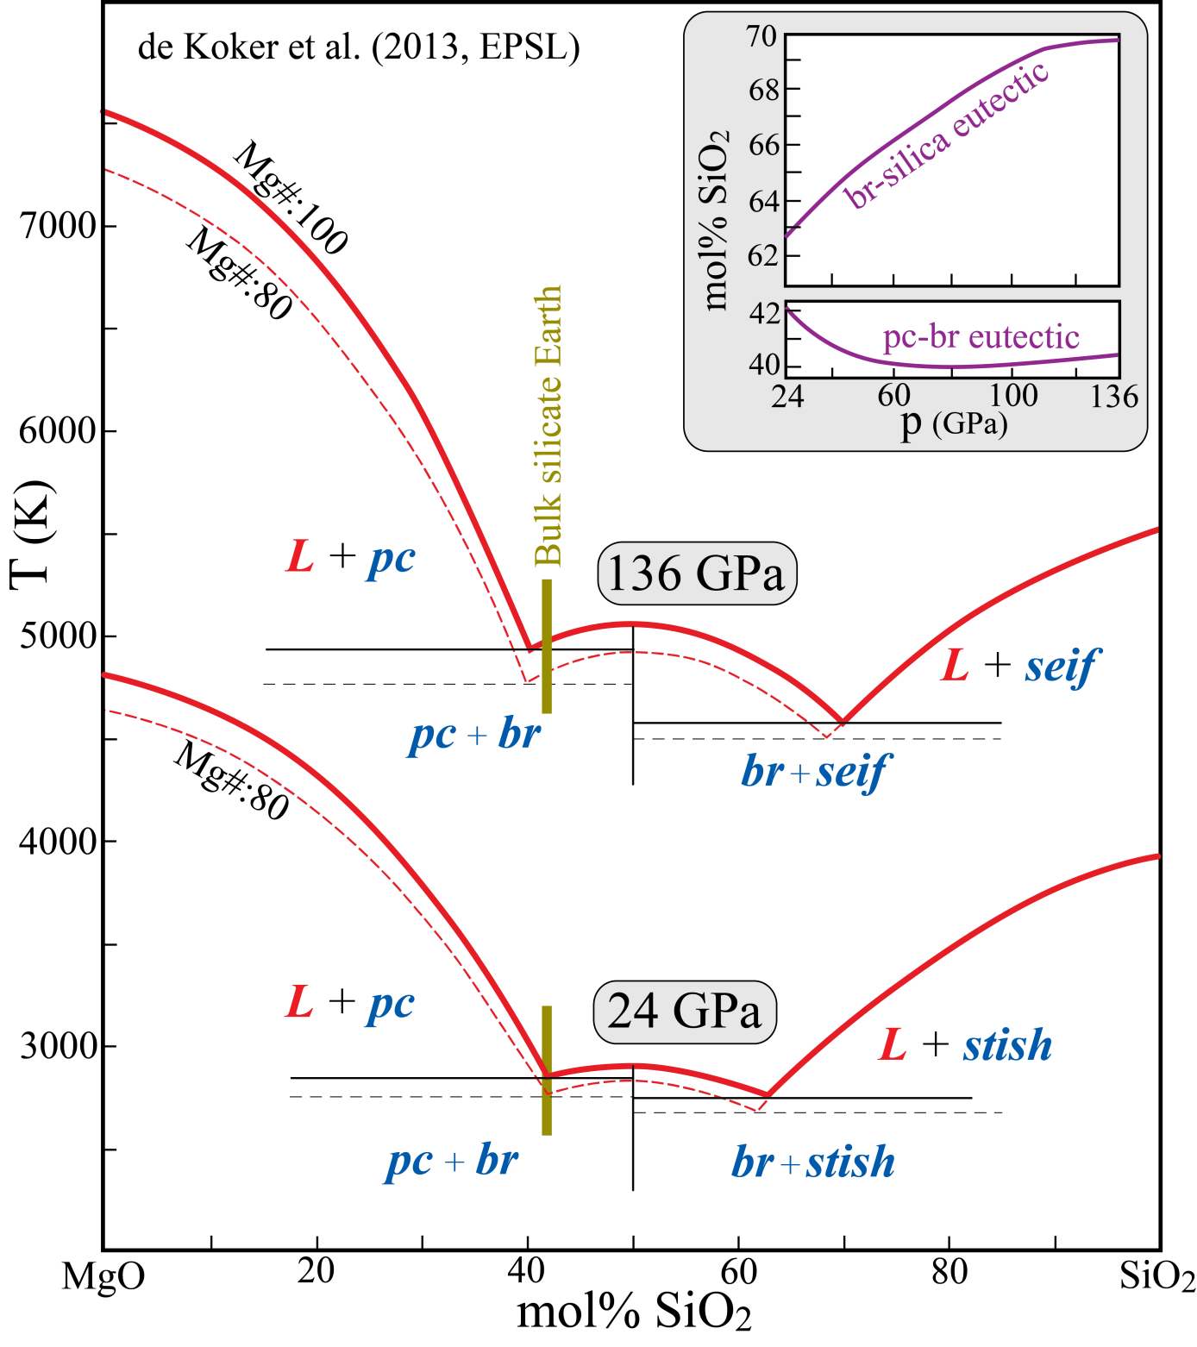
DFT-study
de Koker et al. (2013, EPSL)
The periclase-bridgmanite eutectic
is very similar to results from
16-26 GPa experiments and
associated thermodynamic model
Liebske and Frost (2012, EPSL)

Slide 30
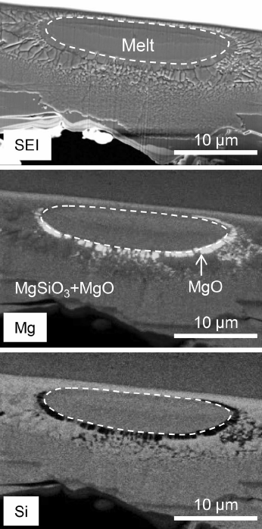
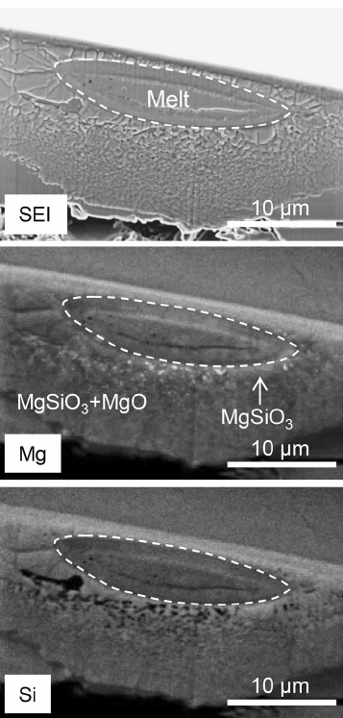
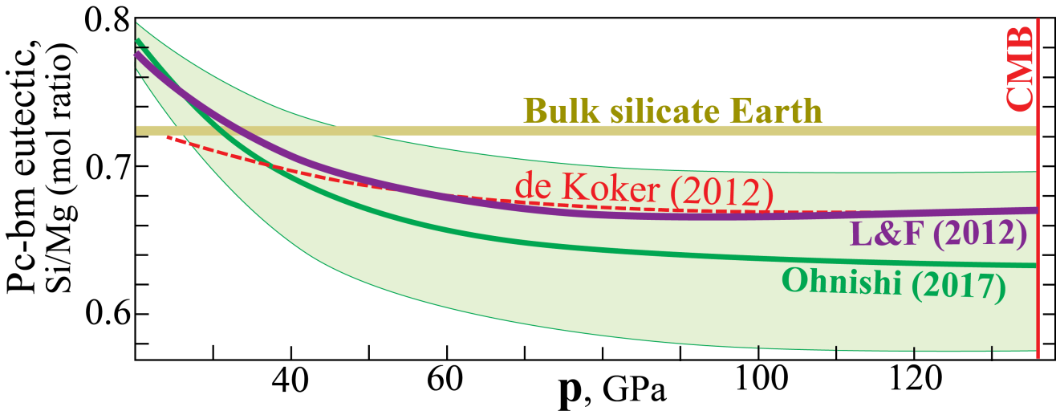
Laser-heated DAC
experiments, 30-70 GPa
Ohnishi et al. (2017, PCM)
Confirming that the pc-bm eutectic composition becomes more magnesian than a model BSE peridotitic composition
In accordance with:
Liebske & Frost (2012) and de Koker et al. (2013)
35 GPa: Mg-rich: pc-side of the eutectic
35 GPa: Mg-poor: bm-side of the eutectic

Slide 31
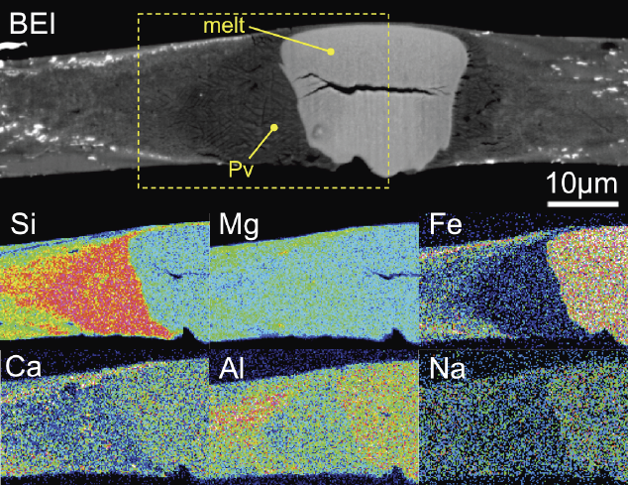
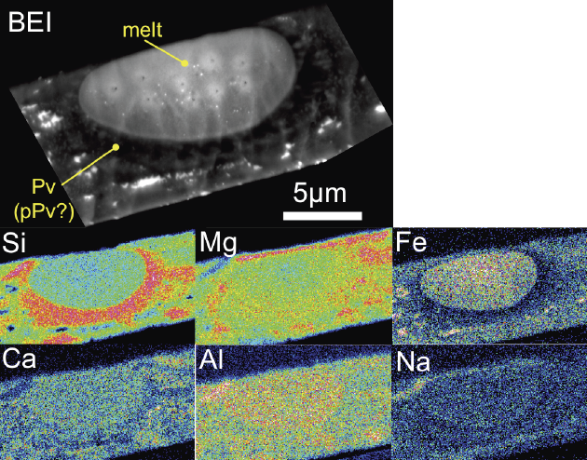
74 GPa
Melting experiments,
fertile peridotite (pyrolite)
50-140 GPa Nomura et al. (2014, Science)
Very clear results
Liquidus phase the in at 40-140 GPa:
Mg-perovskite
Relative to bulk pyrolite:
Melt: Fe-Al-Na-enrichment, Si-depletion
MgPv: Si-enrichment, Ca-Fe-Al-depletion
132 GPa

Slide 32
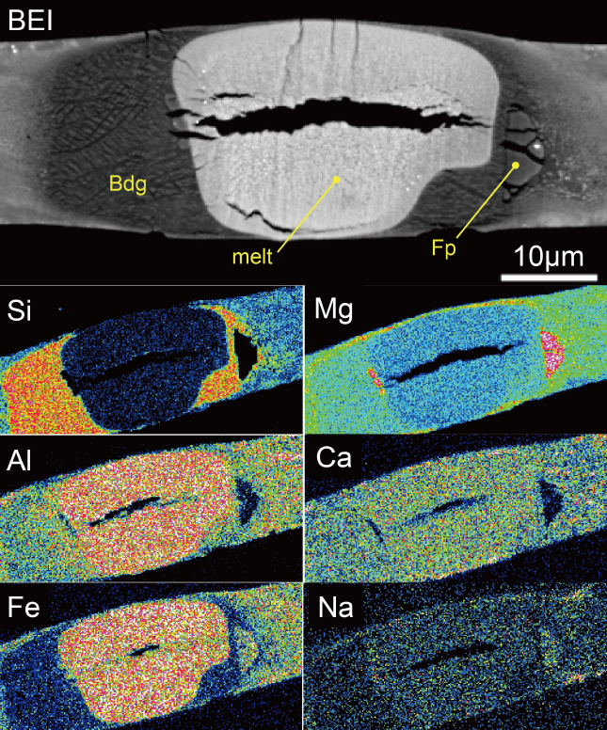
Phase relations at 59 GPa for an
evolved magma ocean comp.
after 50% bm-fract.
Caracas et al. (2019, EPSL)
Wt % Mol ratio
SiO₂ AlO_{1.5} FeO MgO CaO Si/(Fe+Mg)
peridotite 45.0 4.78 8.96 37.7 3.50 0.71
evolved 34.7 4.91 16.2 38.8 5.40 0.49

Slide 33
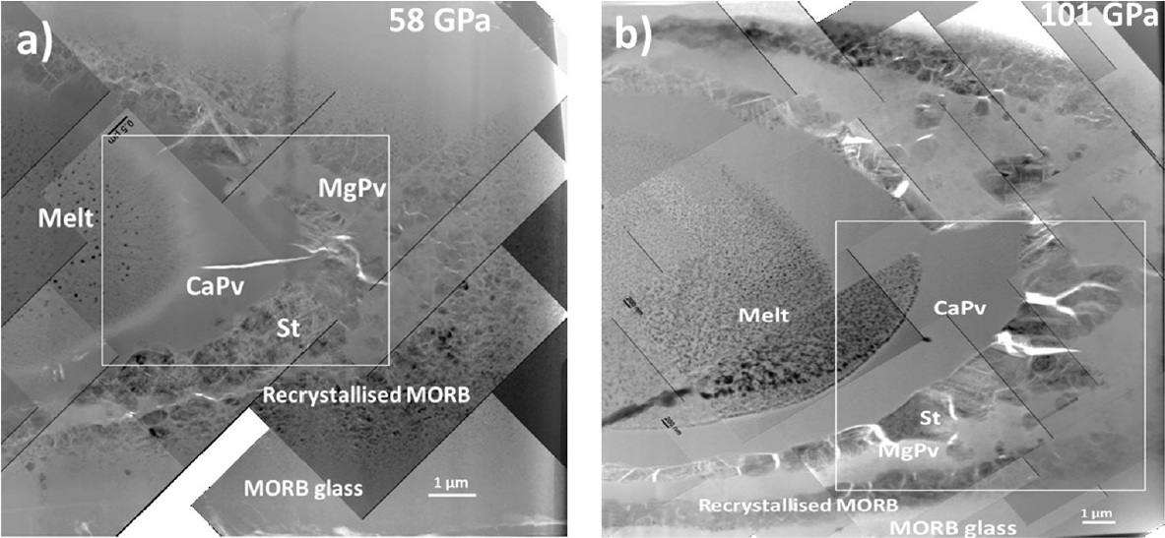
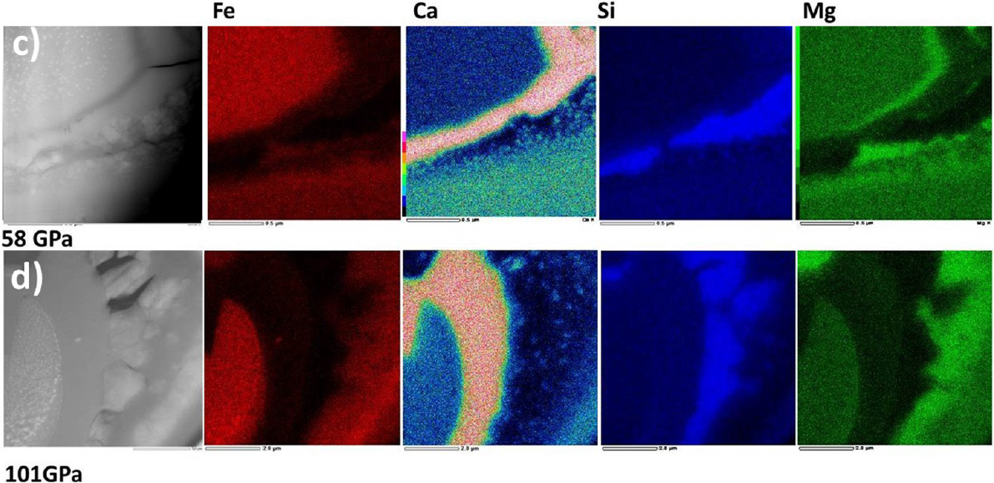
Phase relations, basalt
Pradhan et al. (2015, EPSL)

Slide 34
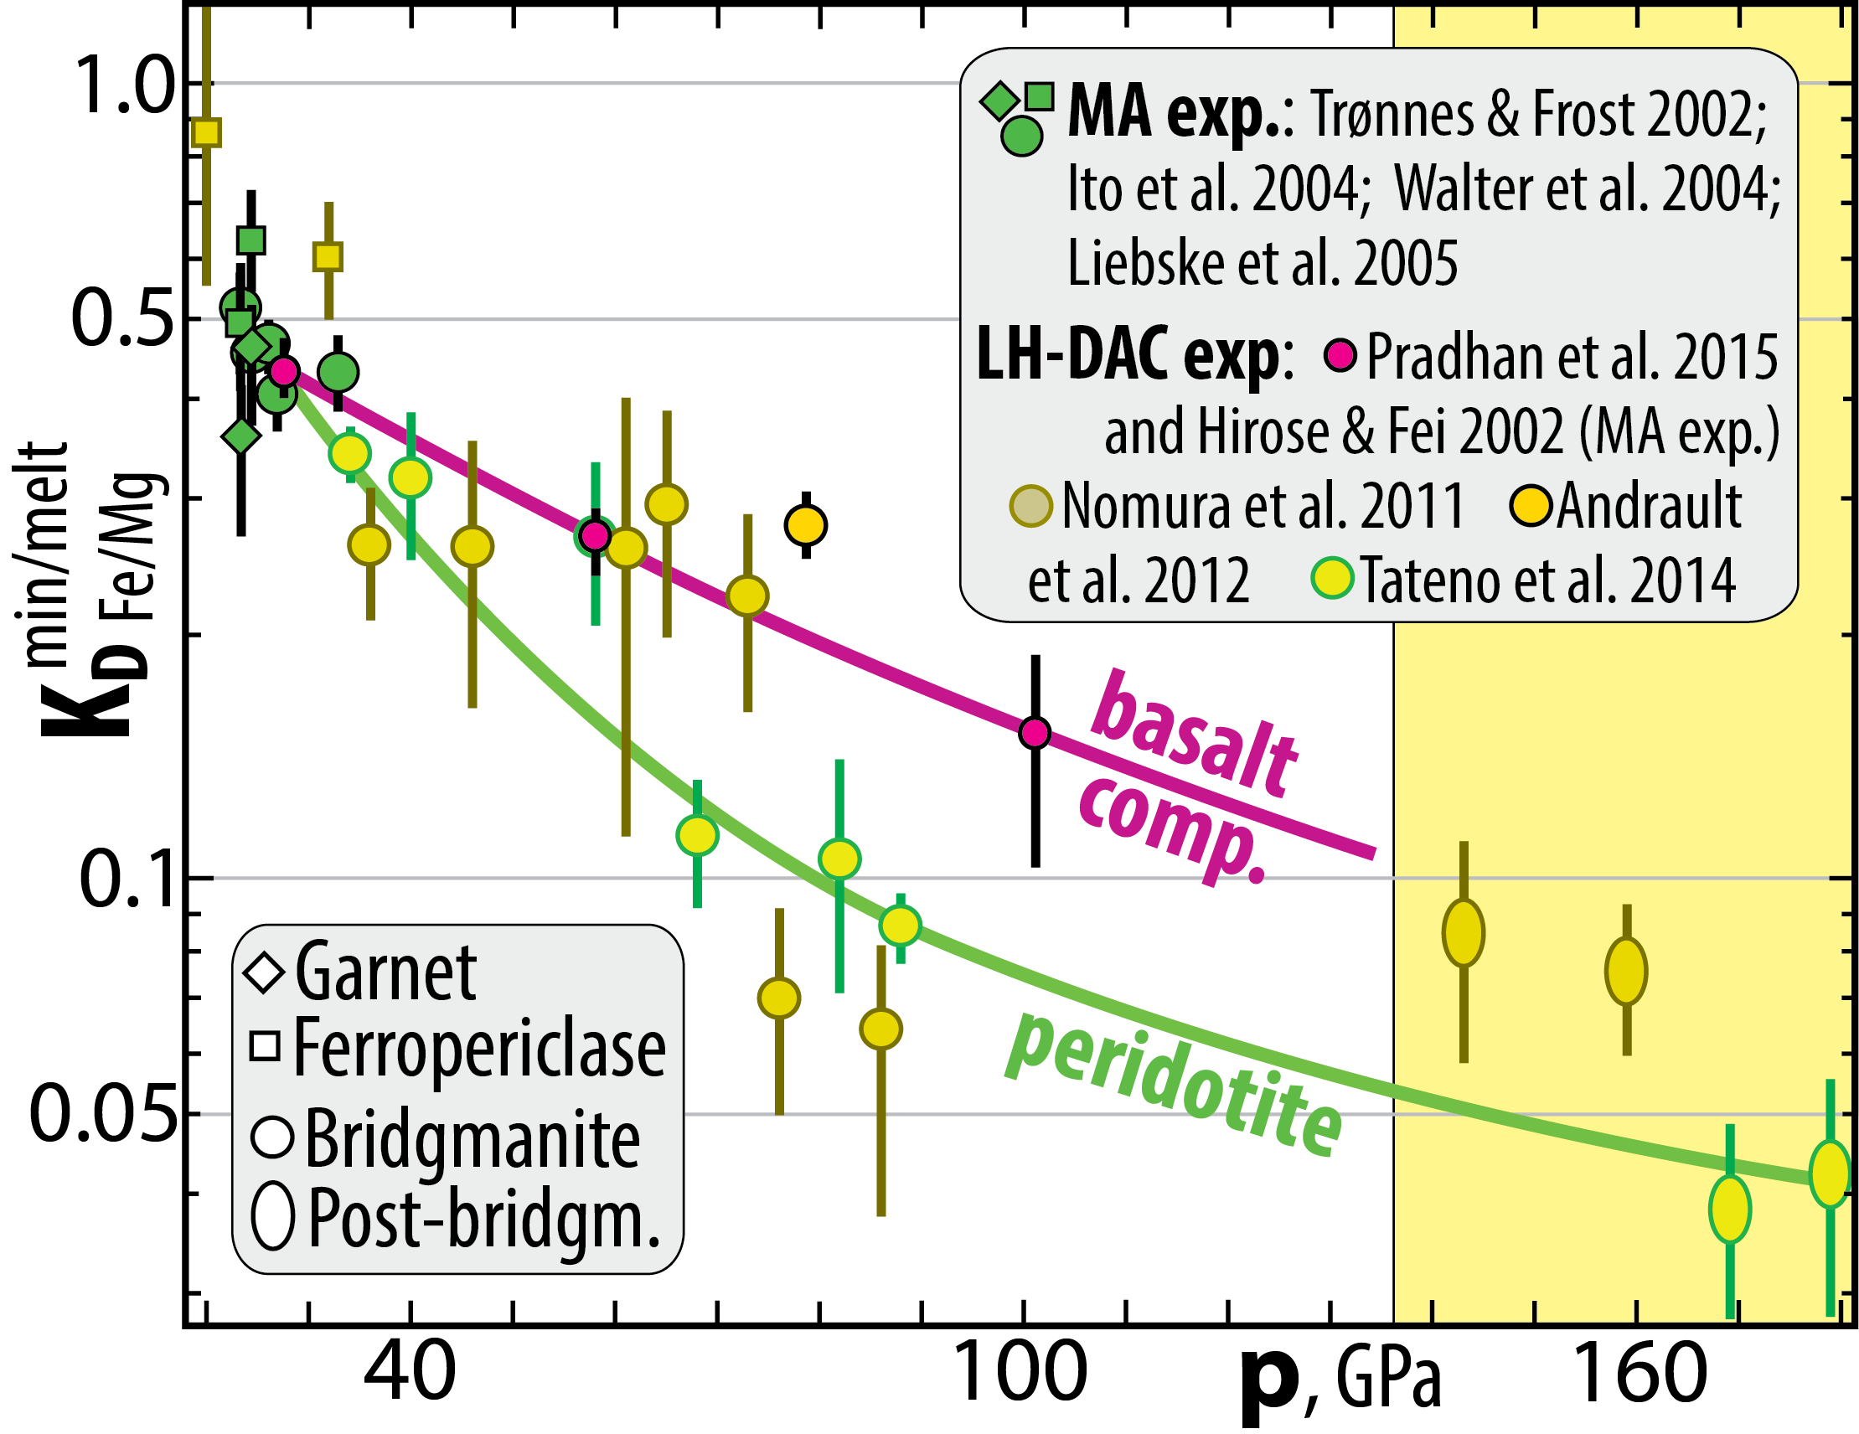
Fe/Mg partitioning, 20−180 GPa

Slide 35
2. MgSiO₃-CaSiO₃ join, 24 GPa
3. MgO-CaSiO₃ join, 24 GPa
Note the widely differing melting
temperatures of bm, cpv and pc.
Task:
Label the six different phase fields
in each of the diagrams.

Slide 36
3360
Coloured fields:
mineral compositions
sol.solution ranges
Red dots:
binary eutectics
3100
2560
5000
2850

