Slide 1
Silicate melt structure
A bit in:
Chapter 3-4, Winter (2013)
Melt structural elements
- same as as for silicate minerals
- degree of polymerization expressed as NBO/T
(Non-Bridging Oxygens per Tetrahedral cation)
- irregular (continuously varying) combinations of structural elements
Melt structural variations govern liquidus phase relations
- weakly polarized melts favour weakly polarized liquidus minerals (e.g. olivine)
more strongly polarized melts favour more strongly polarized liquidus minerals
(e.g. pyroxene, feldspar)
- melt structural variations are strongly affected by volatiles (e.g. H₂O, HF, CO₂)

Slide 2
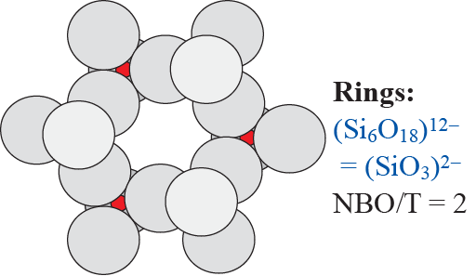
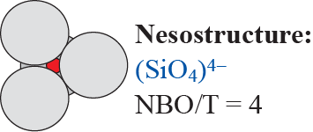
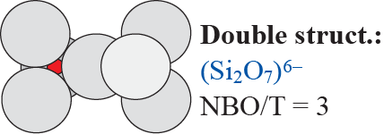
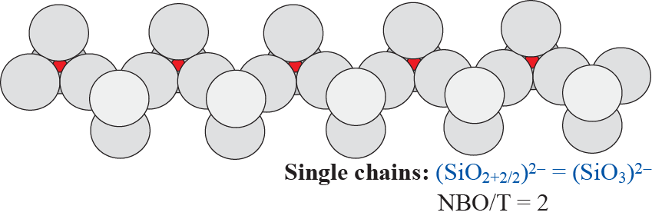
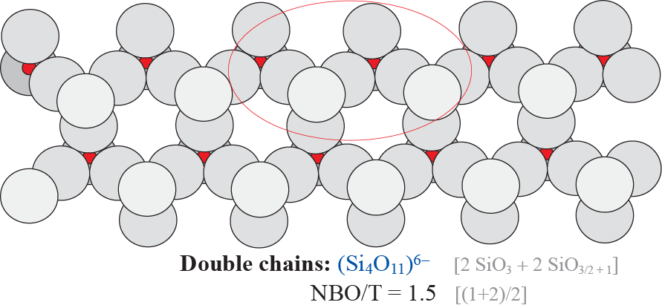
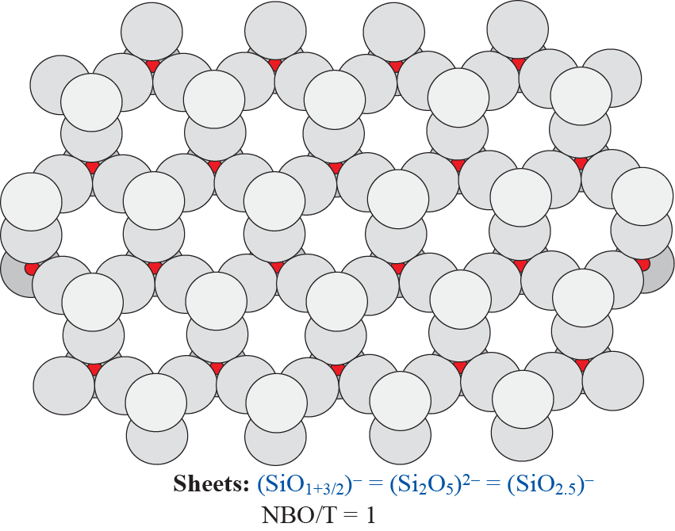

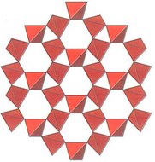
Melt structural
elements
NBO/T =(2*2 + 2*1) / 4
= 6/4 = 3/2 = 1.5

Slide 3
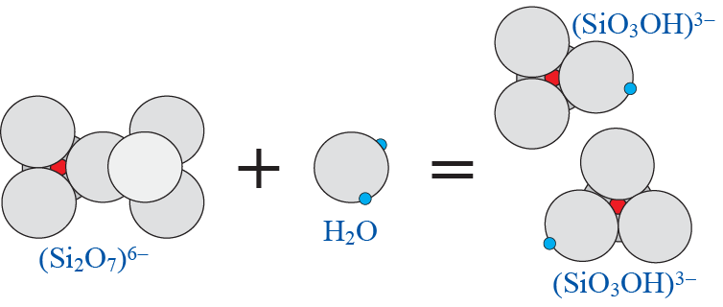
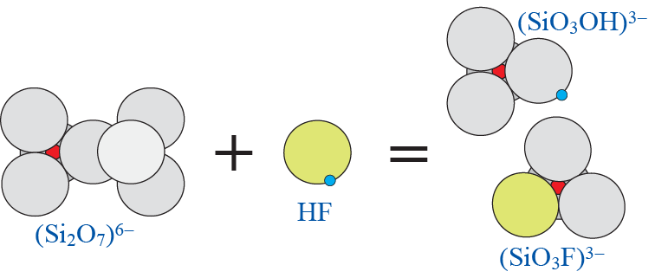
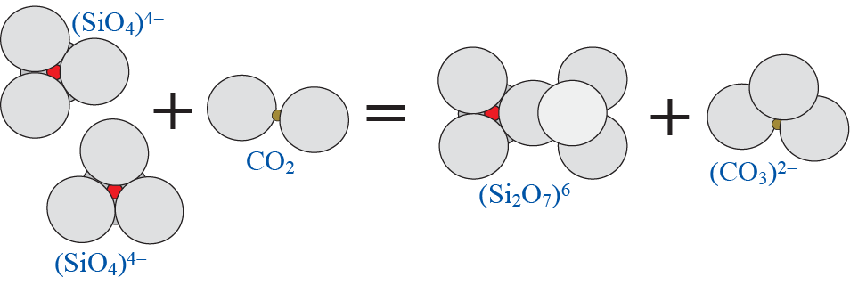
Dissolution of H₂O, HF and CO₂
H₂O:
Depolymerization
HF:
Depolymerization
CO₂:
Polymerization

Slide 4
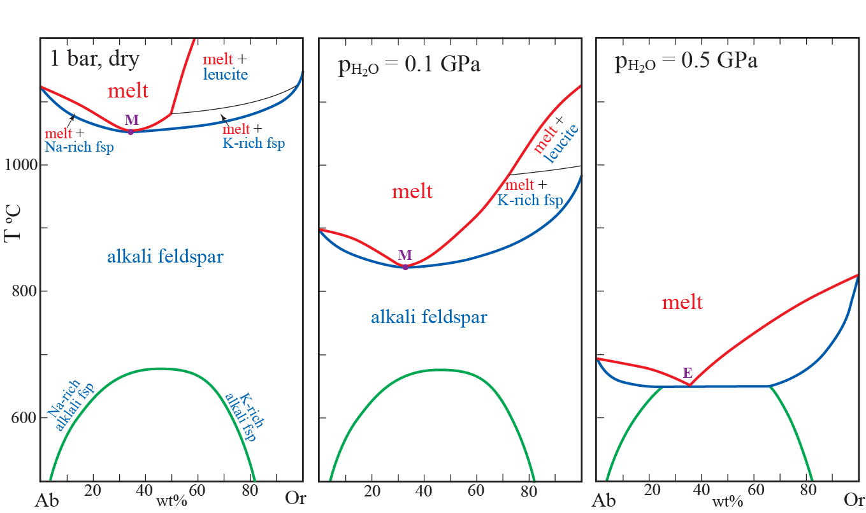
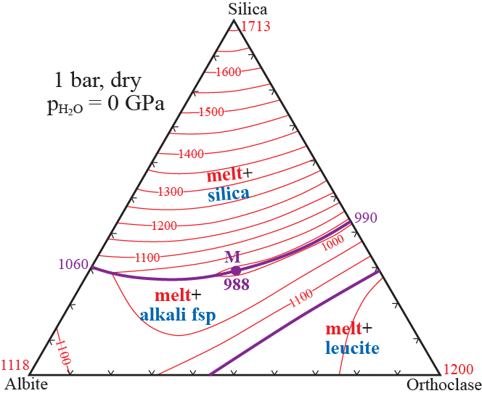
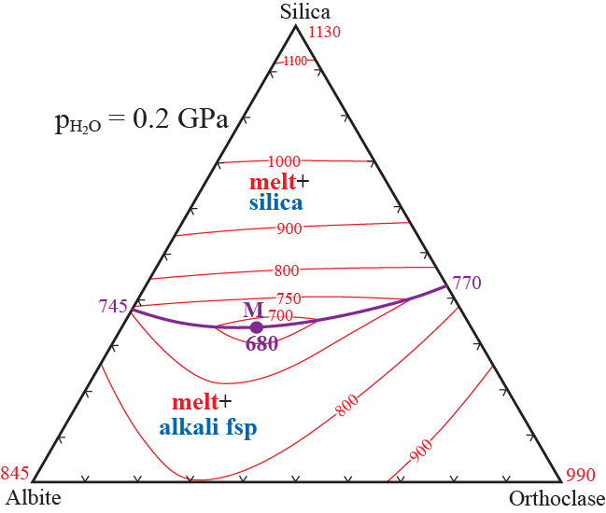
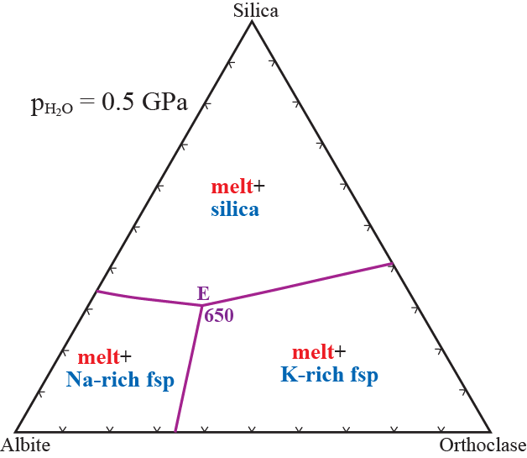
The effects on granitic phase relations from variable H₂O-saturated pressure

Slide 5
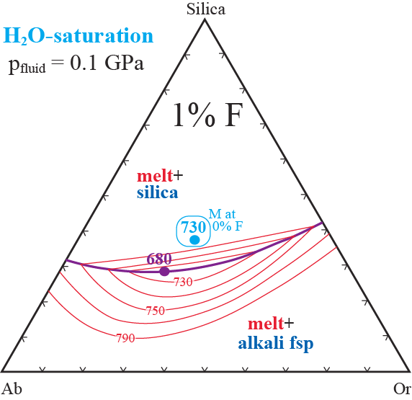
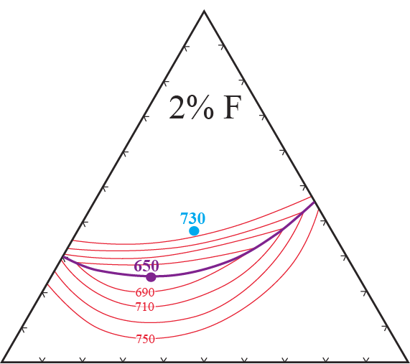
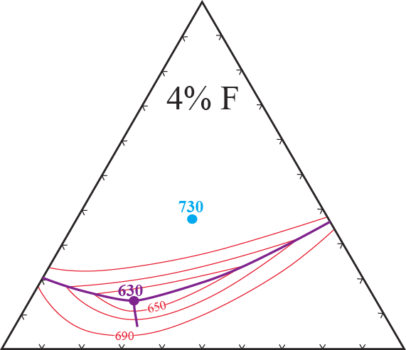
The LARGE effect of F on liquidus
phase relations in granitic systems
System Ab-Or-Qz with a 2-component
H₂O-HF volatile phase
H₂O-saturation + variable wt% F
Manning (1981, CMP)

Slide 6
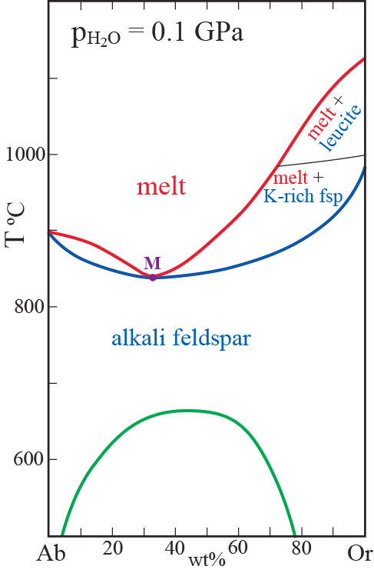
with 2 - 4 % F
Melts coexisting
with 2 feldspars:
2 and 4 % F
4 % F
Exploratory experiments (Manning, 1981)
Exp. duration: 2 months (62-63 days)
Qz, Ab-rich fsp and Or-rich fsp.
coexist with small fractions of liquid
even at 600 and 550 C !! (2-4 % F)

Slide 7
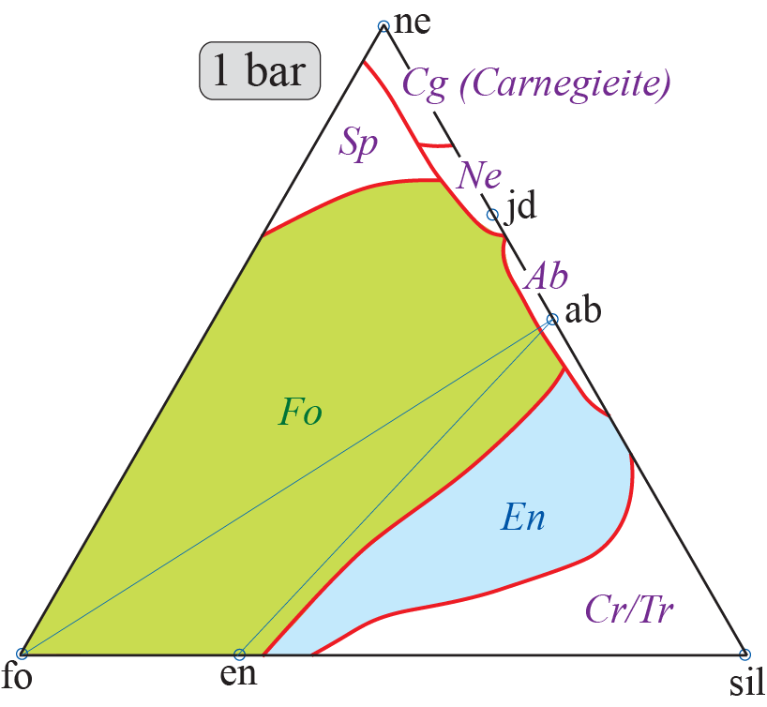
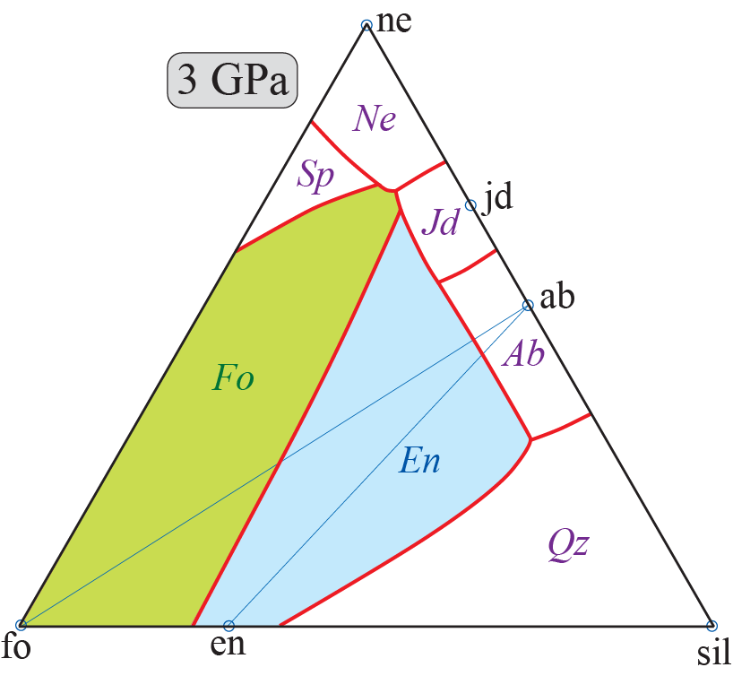
The effect of pressure on melt structure and
liquidus phase relations (volatile-free systems)
Based on several studies
by Kushiro et al.
What does this tell us about change in the relative stability of melt and different liquidus phases with increasing pressure ?
- The liquidus field of the more polymerized phases, En, Jd, Ab and Ne increase at the
expence the liquidus field of the most depolymerized phase, olivine.
- Is the melt more polymerized at higher pressure?

Slide 8
First principles simulation of a peridotitic melt
153-atom cell: NaCa₂Fe₄Mg₃₀Al₃Si₂₄O₈₉
wt%: 44.5 SiO₂ 4.72 Al₂O₃ 9.00 FeO 37.3 MgO 3.46 CaO 0.96 Na₂O
Solomatova and
Caracas (2019, JGR)
Pyrolite model composition (primitive" mantle):
25% basalt + 75% depleted harzburgite
The O-atoms are at the corners of grey and blue polyhedra.
Which cations are inside: grey: blue: ?
What is the CN (coord. number) of polyhedra at 0 GPa: 150 GPa: ?
0 to150 GPa: Does the degree of polymerization increase or decrease?
d/d₀ = 0.72 (72%)
V/V₀ = ?
V₀: 1000
V: 370
V/V₀ = 0.37 (37%)
d₀:10
d: 7.17
d₀: 10
d: 7.17
0 GPa, 4000 K
150 GPa, 4000 K

Slide 9
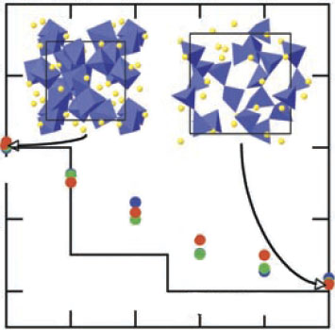
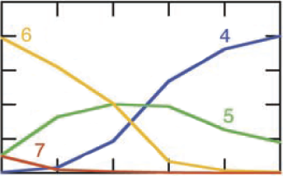
Si-coordination number (CN),
MgSiO₃ melt and solids
Stixrude and Karki
(20005, Science)
p, GPa
125
55
25
13
5
2
7
Si-CN
6
perovskite
3000 K
5
6000 K
majorite:
25% 6-coord.
4000 K
4
pyroxene: 100% 4-coord.
1.0
4-coord.
0.6
6-coord.
Fraction, Si-CN
0.2
0.5
0.6
0.7
0.8
0.9
1.0
V/V_{2 GPa}

Slide 10
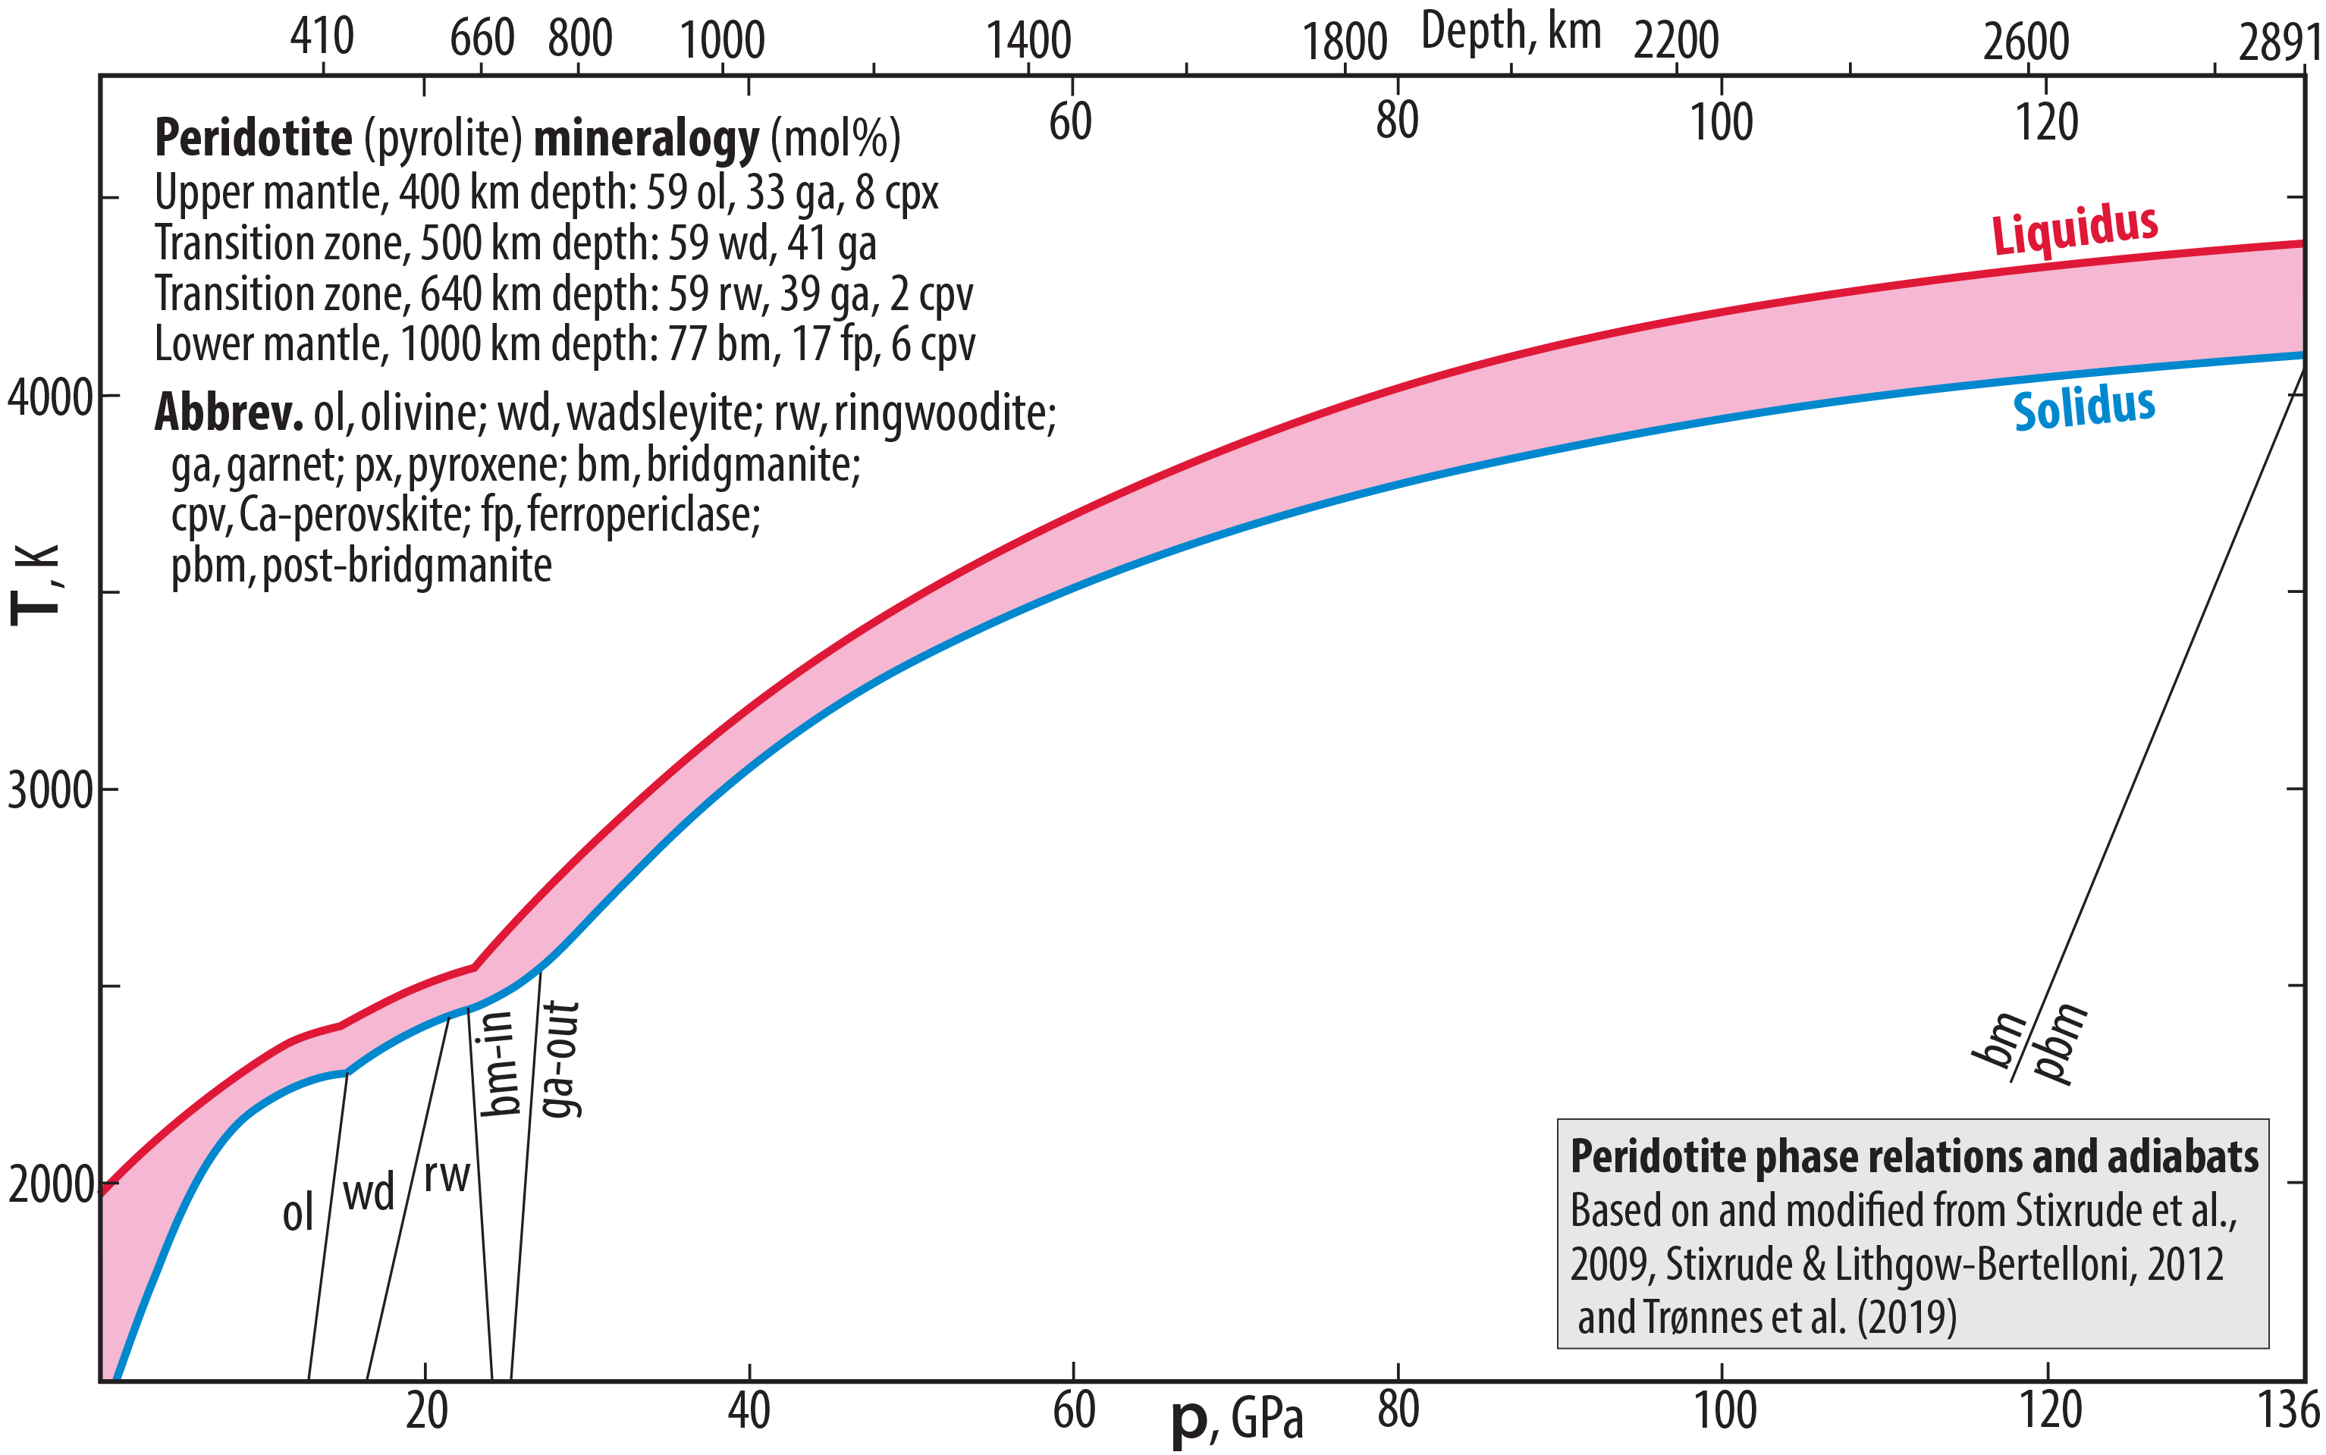
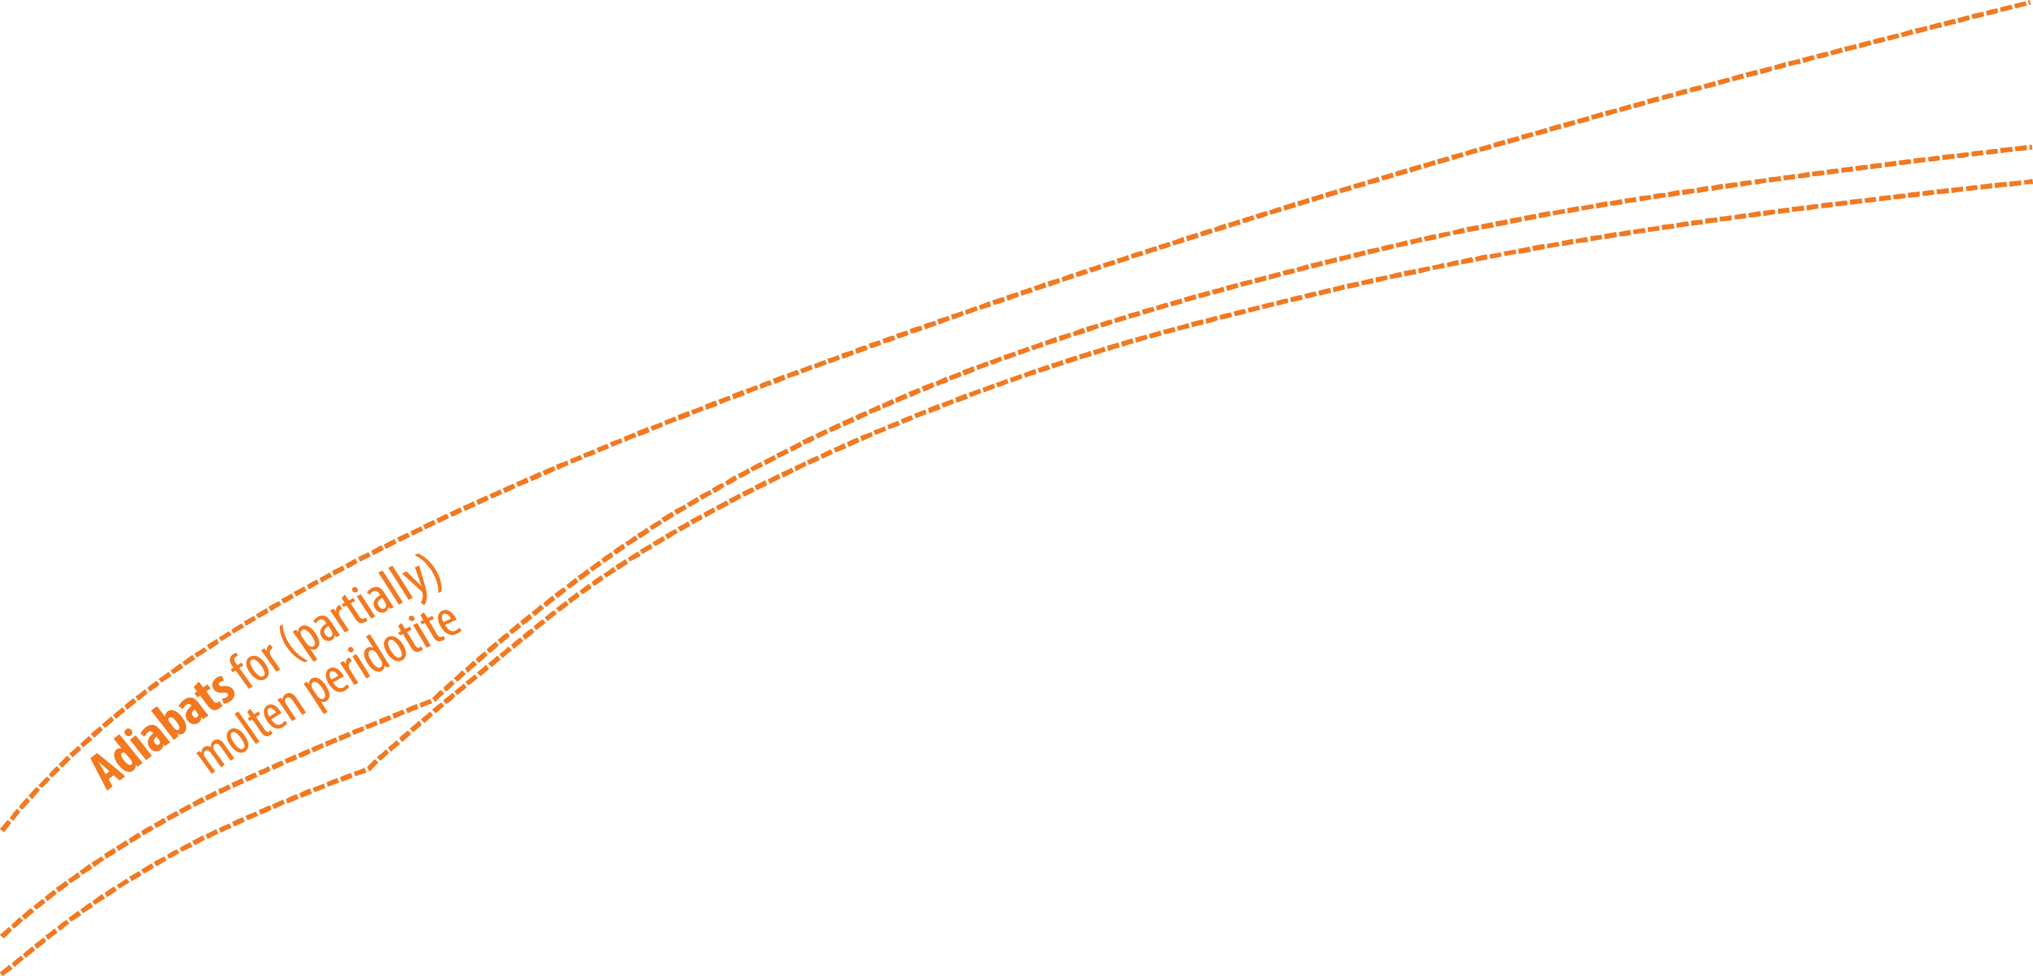
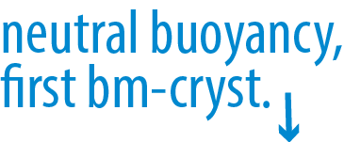
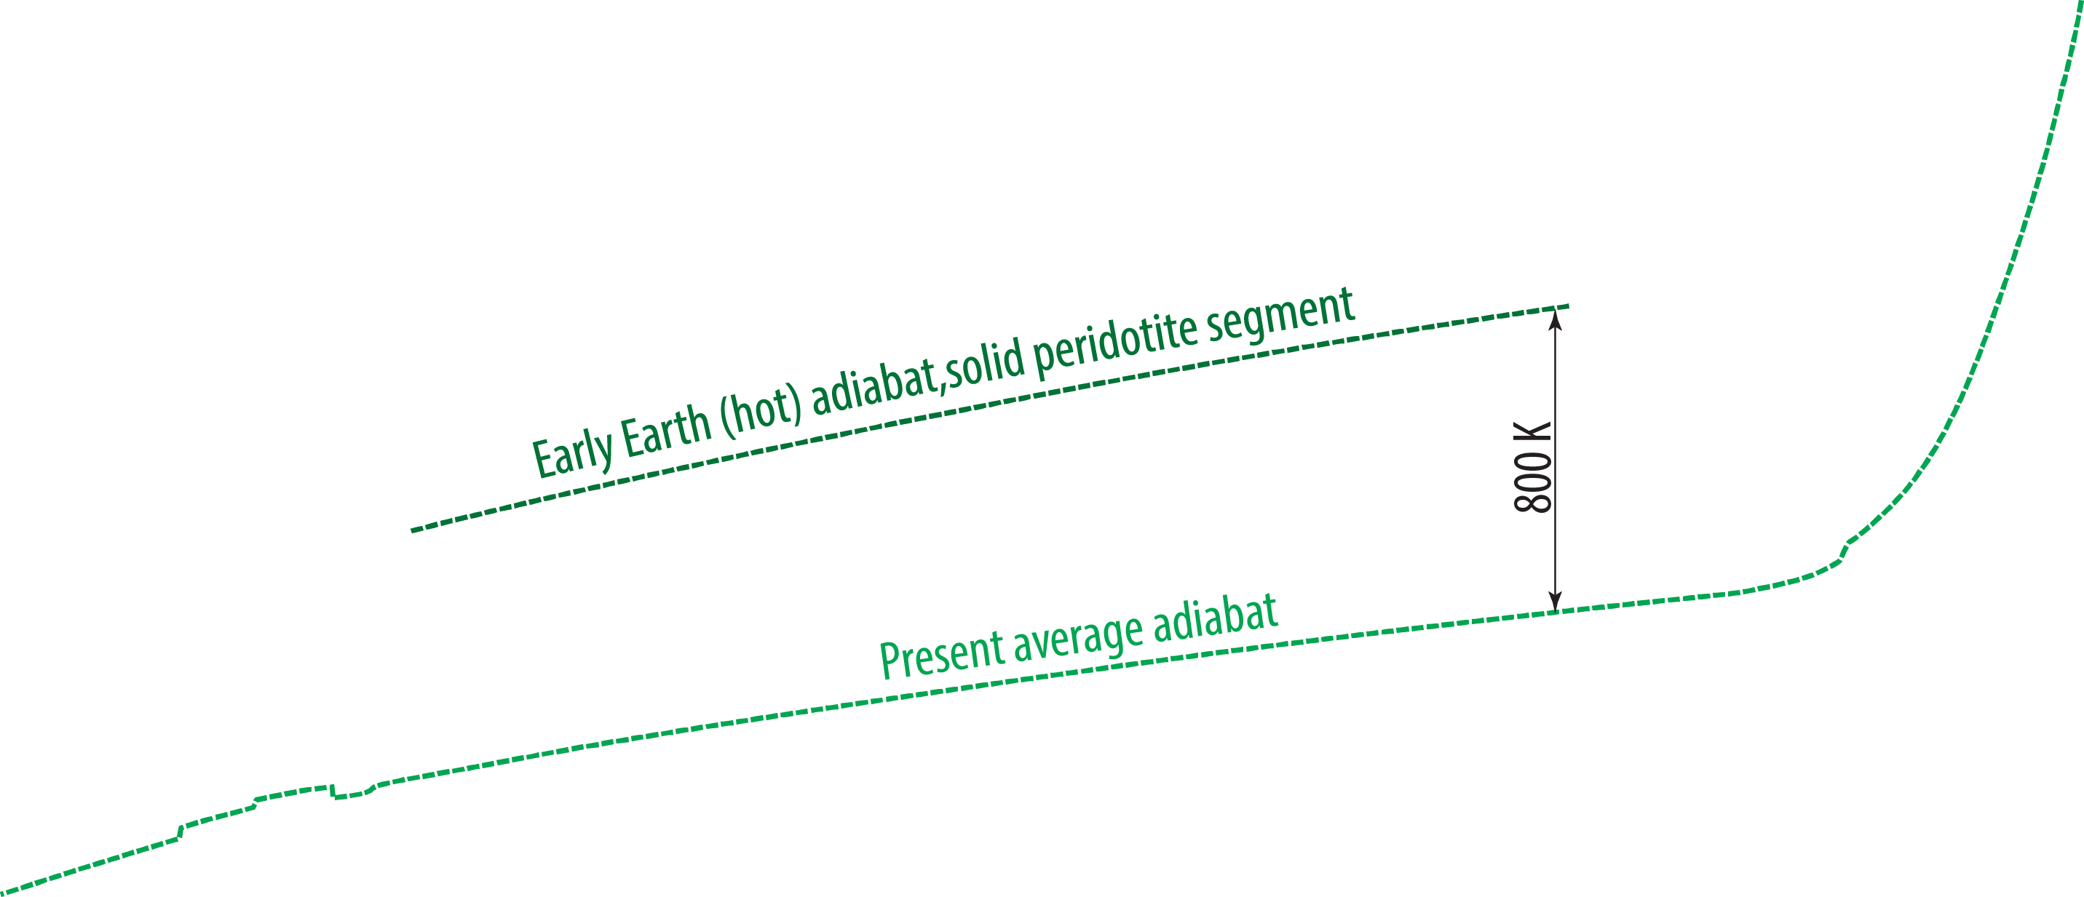
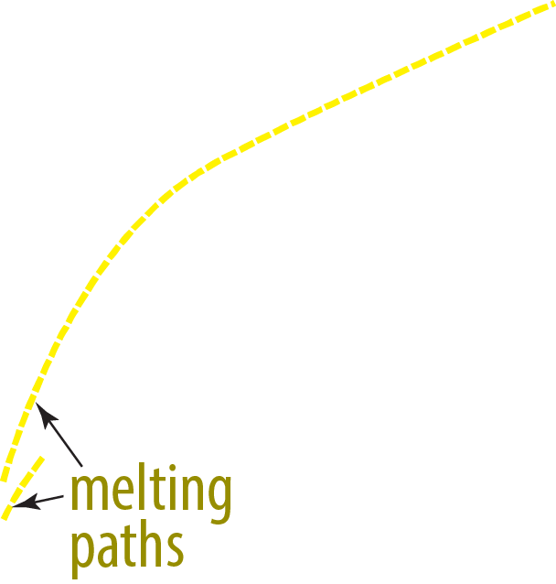

Melting relations, the entire mantle

Slide 11
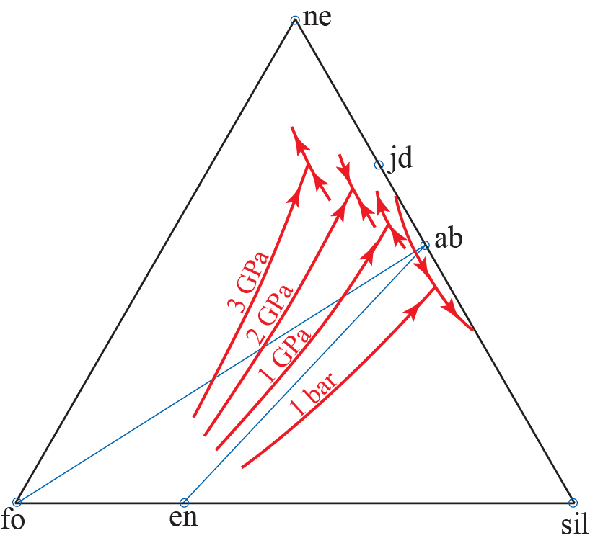
Shifts in the forsterite-enstatite cotectic

Slide 12
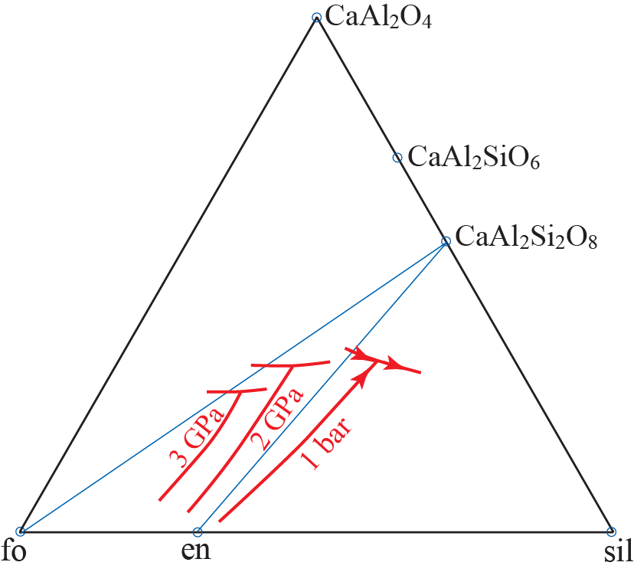
Shifts in the forsterite-enstatite cotectic

Slide 13
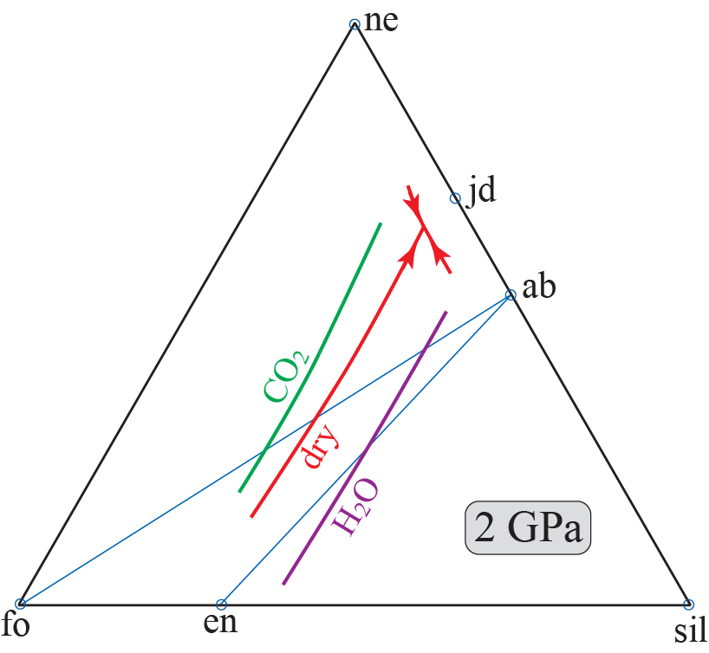
The effect of CO₂ versus H₂O on melt structure
Explain the shift in liquidus phase boundary location
Shifts in the forsterite-enstatite cotectic

Slide 14
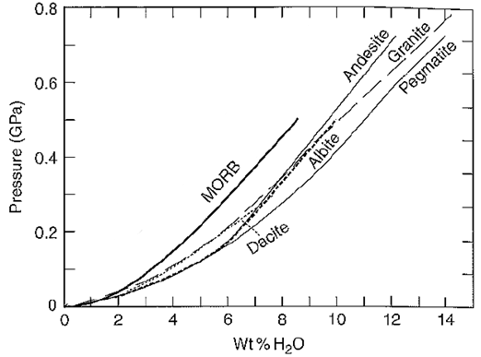
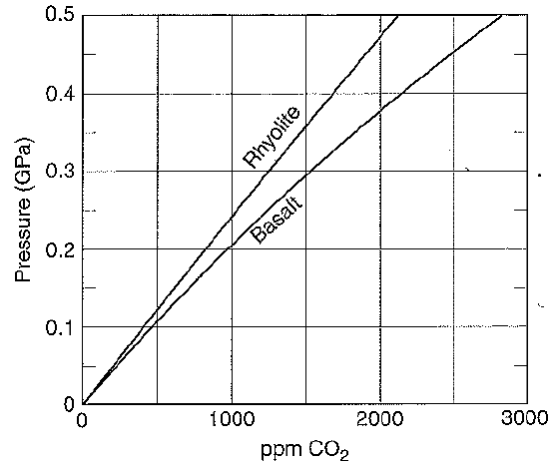
Relative effect of H₂O and CO₂ on melt structure
Insights from measured solubility
0.3%
Why is the solubility of H₂O higher in granite than in basalt ?
Why is the solubility of CO₂ higher in basalt than in granite ?

Slide 15
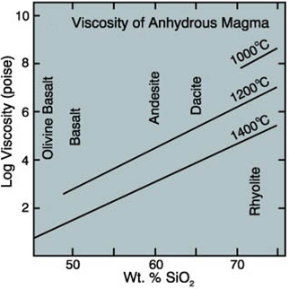
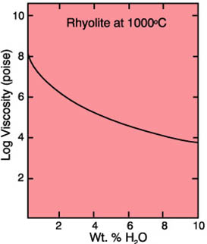
Melt structure determines melt vicosity
Melt composition –
degree of polymerization
The depolymerization effect
of H₂O
1 poise = 0.1 Pa s
- Magma viscosity governs rheology and chemical diffusivity
- Chemical diffusivity influences crystal growth

Slide 16
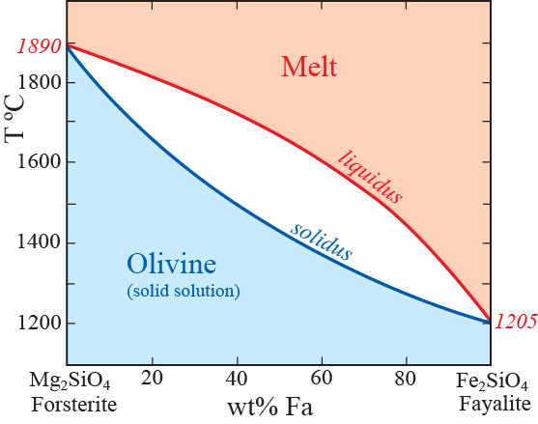
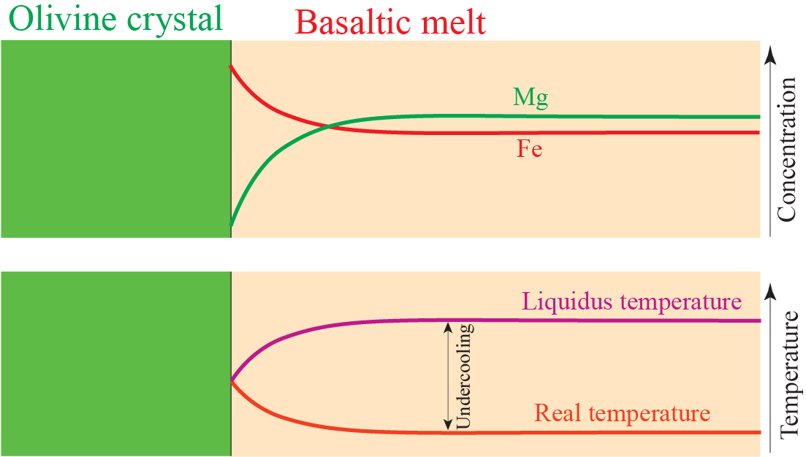
Concentration and temperature gradients near growing crystals
An olivine-melt example (principles are valid for all other systems)
Why do we see such X-T-gradients near the crystal face?
Growing olivine crystals expels liquid with elevated Fe/Mg-ratio
- Liquidus T is reduced in melt with higher Fe/Mg near the crystal
Some undercooling is required for crystal growth
- Heat of fusion elevates the real T near the crystal face

Slide 17
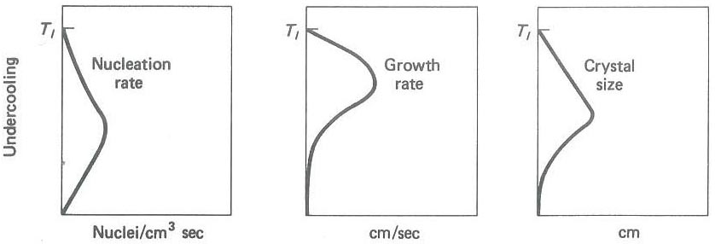
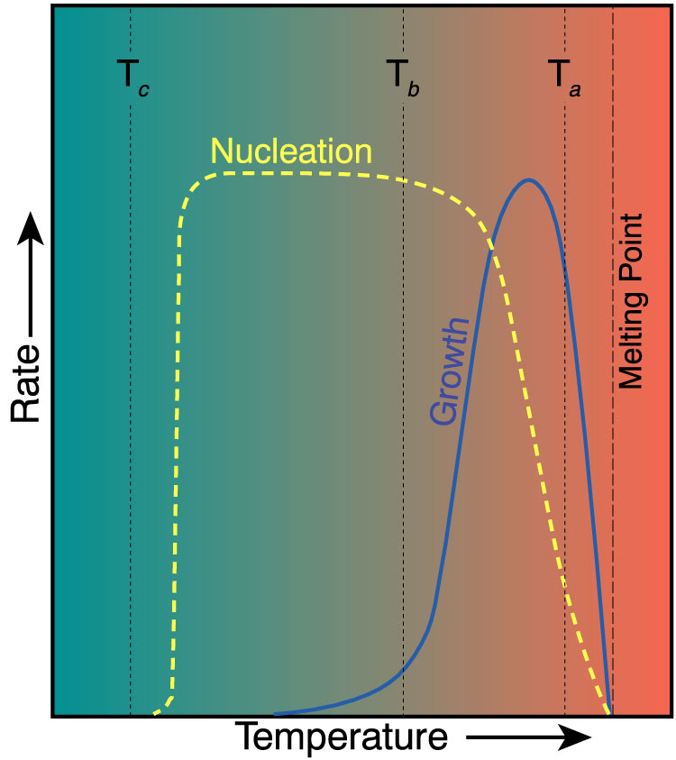
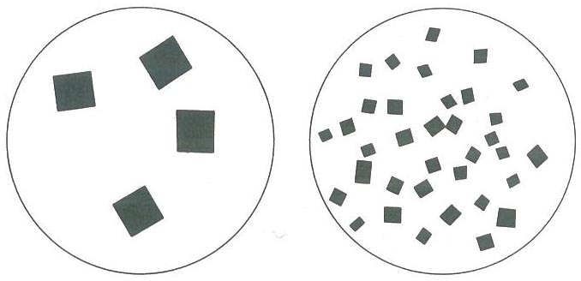
Crystal growth
Crystallization from melt:
under-
cooling
- low nucleation rate
- high growth rate
- high nucleation rate
- low growth rate

Slide 18
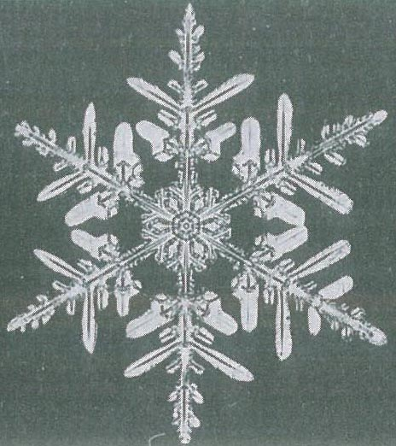
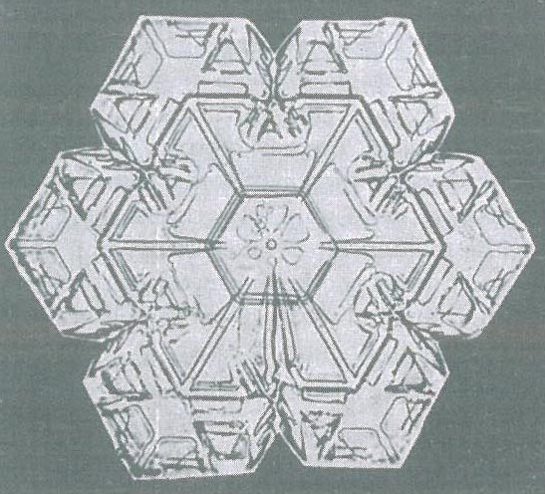
Morphology of snow/ice crystals
Why such skeletal / dendritic forms?

Slide 19
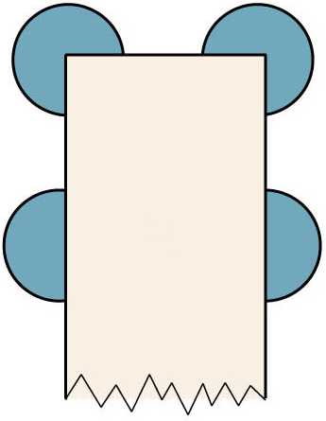
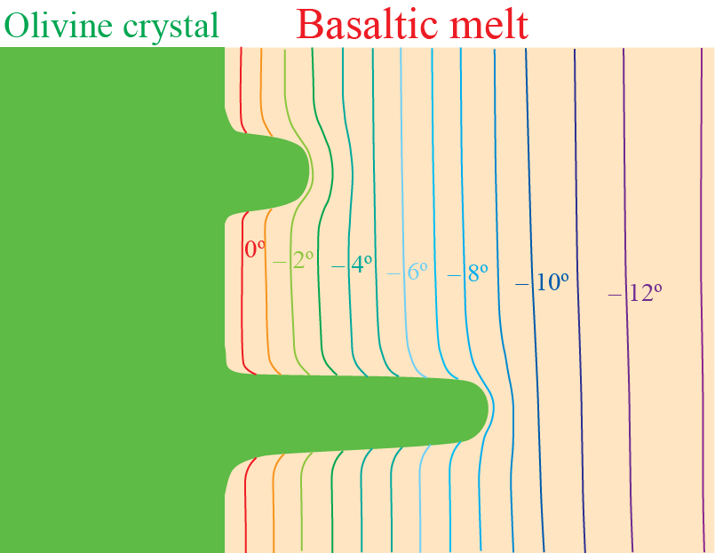
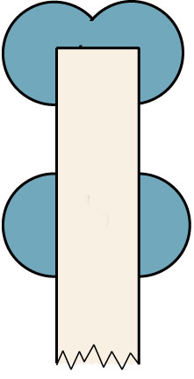
The melt/crystal areal ratio is larger at
crystal corners compared to crystal faces
better opportunities for diffusional removal
of Fe and heat of fusion
Fast-growing, thin crystallites extend into
colder melt with higher Mg/Fe-ratio
The melt/crystal areal ratio is larger at the
ends of thin crystals compared to crystal faces
better opportunities for diffusional removal
of Fe and heat of fusion

Slide 20
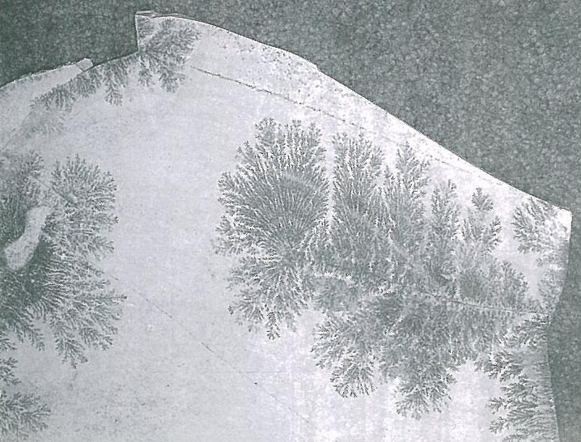
Rapid or "irreversible" crystallization dendritic growth
Dendrites of MnO₂ on layer interface in limestone
Snowflake

Slide 21
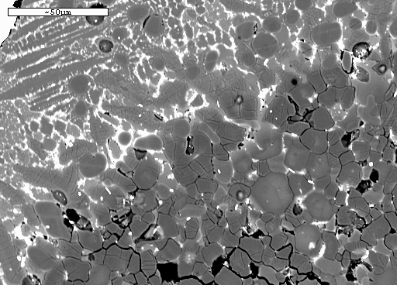
Slow or "reversible" equlibrium growth
rounded, subhedral or euhedral crystals
Peridotitic melt quenched from 24 GPa and 2300 ºC
quenched melt
with "spinifex"-
texture
fp
Mg-pv
pv, fp: equilibrium crystals of
perovskite and ferropericlase
fp
Mg-pv
fp

Slide 22
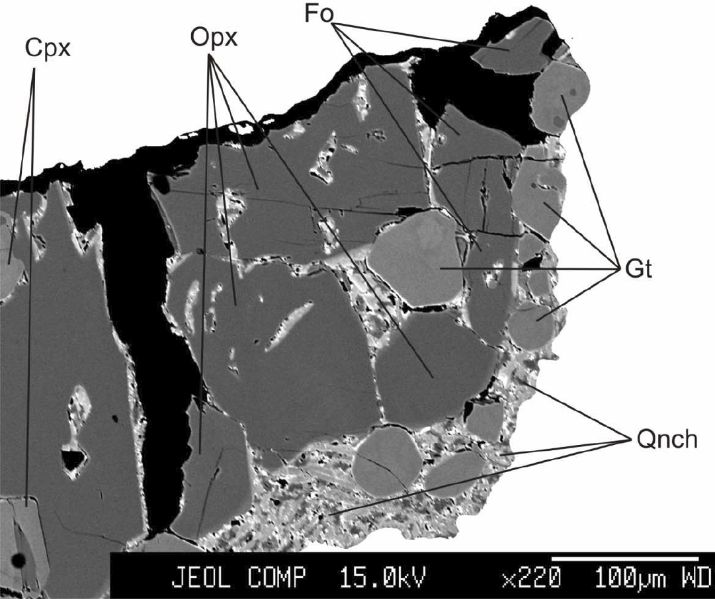
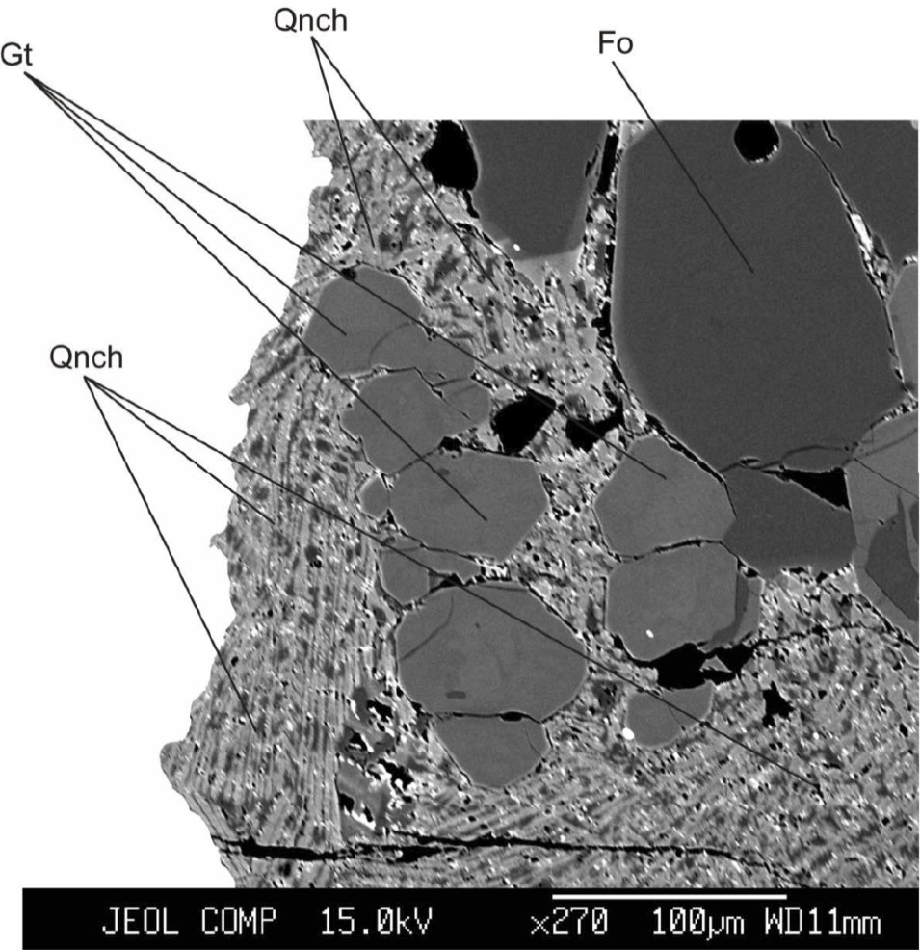
System CMAS, 14 GPa, 2320 C
Keshav et al. (2014, Am. Mineral.)

Slide 23
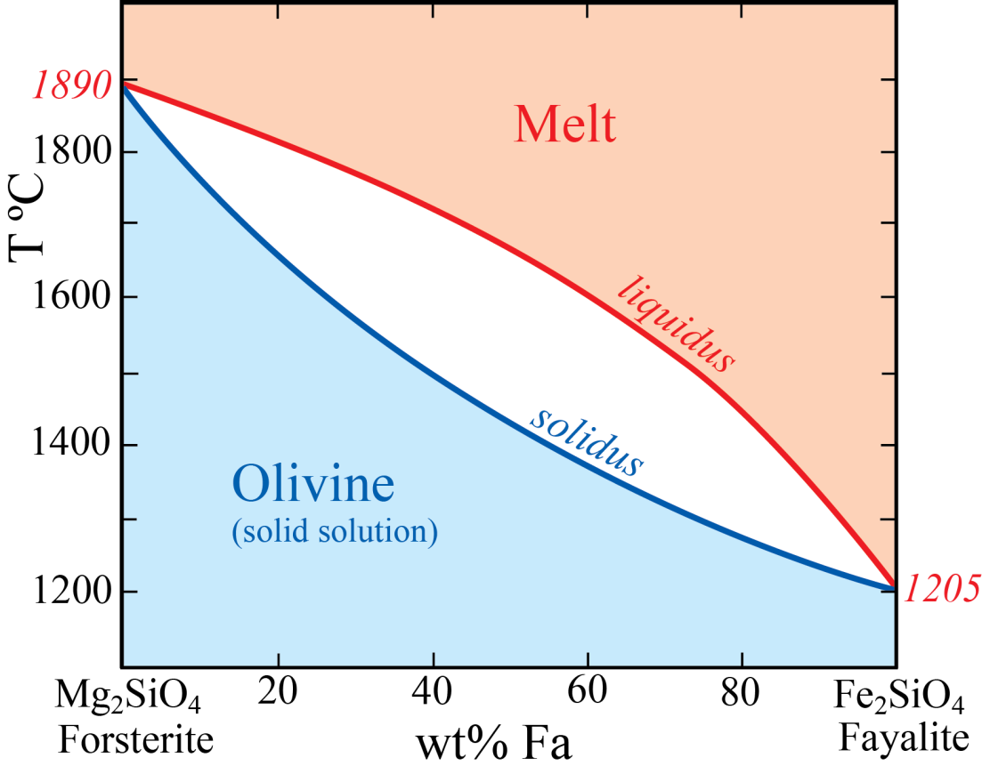
Partitioning of Fe and Mg between minerals and melt
Important observation
Melts have strongly elevated
Fe/Mg-ratios relative to minerals
throughout the entire mantle
Mantle olivine

Slide 24
Partitioning coefficients
Simple (Nernst) part. coeff.: D_{Ni}^{solid/melt} = C_{Ni}^{solid}/C_{Ni}^{melt}
Exchange (compound) part. coeff.: K_{D, Fe/Mg}^{solid/melt} = (Fe/Mg) ^{solid}/Fe/Mg)^{melt}
K_{D}^{min/melt}(Fe/Mg) ≈ 0.3 for upper mantle minerals
K_{D}^{min/melt}_{Fe/Mg}
Transition zone (410−660 km)
ferropericlase: 0.5 – 0.7
majoritic garnet: 0.3 – 0.5
Lower mantle (660−2890 km)
Upper half
ferropericlase: 0.3 – 0.4
bridgmanite: 0.2 – 0.3
Lower half (more uncertain)
ferropericlase: 0.1 – 0.3
bridgmanite: 0.05 – 0.3
Important inference
Melts are strongly Fe-enriched
throughout the entire mantle

Slide 25
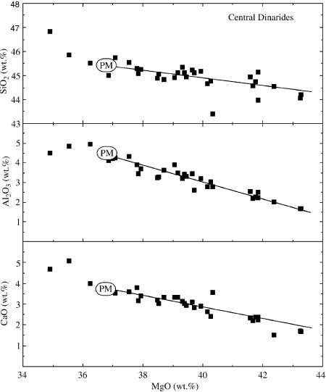

Major element composition of mantle peridotite
the primitive mantle (PM) and primitive upper mantle (PUM)
Derivation of PM- or PUM-composition:
Melt extraction trends based on major and trace elements
Increasing depletion
Palme & O’Neill (2003, Treat. Geochem.)

Slide 26

FeO is constant at about 8 wt%
Palme & O’Neill (2003, Treat. Geochem.)

Slide 27

Xenoliths
Peridotite
massifs
Palme & O’Neill (2003, Treat. Geochem.)

Slide 28

Melt-residue relations, FeO-MgO variation
Herzberg et al. (2010, EPSL)
The apparant
D^{s/m}(Fe) ≈ 1 can be
generated by 20-30%
accum. melt fraction
for initial melting
pressure of ~3GPa

Slide 29

Archean cratonic lithosphere
strongly melt-depleted residues, melting in the lower part of UMand TZ?
Herzberg et al. (2010, EPSL)

Slide 30

Diamond sources: deepest parts of lithospheric roots of Archean cratons
Subcratonic lithosphere mantle (SCLM) thickness: 200-250 km
Abundant rock type: Strongly melt-depleted garnet harzburgite,
containing low-Ca, high-Cr pyrope-dominated garnet

Slide 31


Kaapvaal and Zimbabwe cratons,
seismic P-wave model

Slide 32
Fast wave speeds (blue colour):
- High bulk and shear moduli (K, G)
and/or
- Low density
v_{s}² = G/ρ
v_{p}² = (K + 4/3∗G)/ρ
High bulk and shear moduli (K, G)
- Low-T rocks
- High-strength rocks (high viscosity)

Slide 33



Abyssal
& orogenic
peridotites
Archean cratonic
lithosphere
Note the
correspondence
between p and T
Olivine
Lee (2011, Ann Rev
Earth Planet Sci)

Slide 34



High-pressure melting relations
The binary system MgO-SiO₂,
1 bar to 136 GPa
Melting of a peridotite model
Note the important shift of
the invariant composition
from 1 bar to 136 GPa
peridotite

Slide 35

Melts: elevated Fe/Mg-ratios
Residues: elevated Mg/Fe-ratios and Mg# = 100*Mg/(Mg+Fe)
Si/(Mg+Fe)
Si/(Mg+Fe)
Modified from: Griffin et al. (2008, J. Pet.)
Walter (1998, J. Pet.)

Slide 36

(Pseudo)invariant melt compositions (CMAS) from 2 to 16 GPa

Slide 37



Slide 38



Composition of cratonic and off-cratonic xenoliths, southern Africa
Possible origin of SCLM-peridotites
Residues from komatiite melt extraction
(deep mantle melting preferred)
komatiites have high (Fe+Mg)/Si ratio, leading to
residues with high opx/ol-ratios
Large-degree melting of SiO₂-metasomatized
source above Archean subducting slabs

Slide 39

Also:
Low Ca/Al-ratio indicate
residual garnet during
komatiite melt extraction
This would be unlikely
during extensive melting
(e.g. komatiitic melt) at a
shallow depth

Slide 40

Geothermobarometry of Kaapvaal xenoliths
(northern Lesotho and Monastery Mine)
Boyd (1998, Int.Geol.Rev.)
Inflected geotherm
High-T xenoliths
(mostly deformed, sheared)
Gap
Low-T xenoliths
(mostly granular)

Slide 41


Thermobarometry
Geothermometer:
the opx-cpx solvus
Which is the most sensitive
thermometer?
The opx or the cpx composition?

Slide 42


- Al-content of opx in equilibrium with ga (2.5-7 GPa)
Geobarometer:
- Al-content of ga in equilibrium with pyroxene (7-16 GPa)

Slide 43

Same inflected geotherms for other Archean cratons
e.g. Siberian craton (Udachnaya peridotites)
Boyd et al (1997, CMP)

Slide 44


Transporting agents: the kimberlites
Mantle xenoliths, Sverrefjell, NW Spitsbergen

Slide 45



Siberian craton, Russia
Udachnaya and Mir
Udachnaya
Udachnaya
Mir
Mir

Slide 46




Slave craton, Canada
Ekati and Diavik mining areas
Ekati
Diavik
Diavik

Slide 47

Ekati mines
Diavik mines
Lac de Gras

Slide 48

Diavik
mines
325 km
Diavik
Great Slave Lake

Slide 49

Diavik

Slide 50


Depleted garnet peridotite
Diamond inclusions with ga-lhz minerals
Olivin
cpx
ol
opx
Pyrop
ga
Cr-diopsid

Slide 51
O-fugacity of upper mantle peridotite:
equilibra involving mineral components with
variable oxidation states
oxygen barometers: reactions involving spinel and garnet
with relatively high Fe³⁺contents

Slide 52
Spinel peridotite equilibrium:
6 Fe₂SiO₄ + O₂ = 6 FeSiO₃ + 2 Fe₃O₄
olivine orthopyroxene spinel
Garnet peridotite equilibrium:
4 Fe₂SiO₄ + 2 FeSiO₃ + O₂ = 2 Fe₃Fe₂Si₃O₁₂
olivine orthopyroxene garnet (skiagite-comp.)
ΔV < 0: reactions favoured by increasing p – not only by high f_{O2}
Equilibrium constant: K = a_{sk}² / [f_{O2} * a_{fa}⁴ * a_{fs}²]
ln K = – ΔG / (RT)
log K = – 0.434 ΔG / (RT) = 2 log a_{sk} – log f_{O2} – 4 log a_{fa} – 2 log a_{fs}
log f_{O2} = 2 log a_{sk} – 4 log a_{fa} – 2 log a_{fs} + 0.434 ΔG / (RT)

Slide 53
Lower part of UM towards TZ:
increasing proportion of garnet
pyroxenes progressively dissolve in majoritic garnet
⇒ dilution of the Fe³⁺-component
⇒ decreasing f_{O2}
Even the UM and TZ may be Fe-metal saturated
Ballhaus (1995, EPSL)
Rohrbach (2007, Nature, 27 Sept)

Slide 54

FMQ: 3 Fe₂SiO₄ + O₂ = 2 Fe₃O₄ + 3 SiO₂
Equilibrium constant: K = a_{mt}² * a_{qz}³ / [f_{O2} * a_{fa}³]
log K = 2 log a_{mt} + 3 log a_{qz} – log f_{O2} – 3 log a_{fa} = – 0.434 ΔG / RT
log f_{O2} = 2 log a_{mt} + 3 log a_{qz} – 3 log a_{fa} + 0.434 ΔG / RT
Frost & McCammon, 2008,
Ann. Rev. Earth Planet. Sci.

Slide 55


FMQ
2Fe₃Fe₂Si₃O₁₂ = 4Fe₂SiO₄+2FeSiO₃+O₂
Frost & McCammon, 2008, Ann.Rev. EPS
IW
MgSiO₃+MgCO₃ = Mg₂SiO₄+C+O₂
IW-buffer:
2FeO = 2Fe + O₂
Ga-perid equil. by equation:
2Fe₃Fe₂Si₃O₁₂ = 4Fe₂SiO₄+2FeSiO₃+O₂
NiPC: Ni-precipitation curve:
X_{Ni}^{met} =
(Ni,Fe)₂SiO₄ = 2(Ni,Fe) + SiO₂ + O₂
in olivine in metal coes./stishov
IW
X_{Ni}^{met} =
Ga-perid equil. with met.sat.

Slide 56
MgSiO₃+MgCO₃ = Mg₂SiO₄+C+O₂
Ga-perid equil. by equation:
2Fe₃Fe₂Si₃O₁₂ = 4Fe₂SiO₄+2FeSiO₃+O₂
Frost & McCammon,
2008, Ann.Rev. EPS
X_{Ni}^{met} =
(Ni,Fe)₂SiO₄ = 2(Ni,Fe)+SiO₂+O₂
X_{Ni}^{met} =
Ga-perid equil. with met.sat.
Fe-metal saturation at about
8 GPa - 250 km depth
What about the lower mantle? - bridgmanite

Slide 57

H-content and f_{O2}
of cratonic peridotites
Peslier et al. (2010, Nature)
100 km
Thermobarometry
200 km
250 km
100 km
Steady decrease of f_{O2}
with increasing depth
200 km
250 km

Slide 58

Kaapvaal SCLM: extremely low H-contents
Peslier et al. (2010, Nature)

Slide 59

Olivine
> 60 % of mantle peridotite
the mechanically weakest peridotite mineral, i.e. controlling the viscosity of the upper mantle
yield strength of olivine reduced by 10³ when H₂O-content increases from 0 to 0.1% (1000 ppm).
H₂O-decrease from a common level of 1000 ppm to 50 ppm:
about 20 times increase of strength (viscosity)
Peslier et al. (2010, Nature)

Slide 60
Convection is scaled to the Rayleigh number (Ra).
Lower limit for convection: Ra ~ 1000
Ra = ρgh³αΔT / (ηκ)
T₁
ΔT
h
density
th. expansivity
visc.
th. diffusivity
gravitational
acceleration
T₂
Viscosity scaling to T:
= η₀e^{ATm/T}
A≈30 for olivine
T_{m}: melting temperature

Slide 61


Lithosphere
- 80-200 km thickness (average: 100 km)
- includes crust (7-40 km thick)
and uhe upper high-visc. part of mantle
Asthenosphere
- diffuse zone
- approx. to 350 km depth
- low viscosity
Viscosity profile, log₁₀ (Pa s)
Steinberger & Calderwood (2006)
Lithosphere
Asthenosphere
Depth, km
CMB

