Slide 1
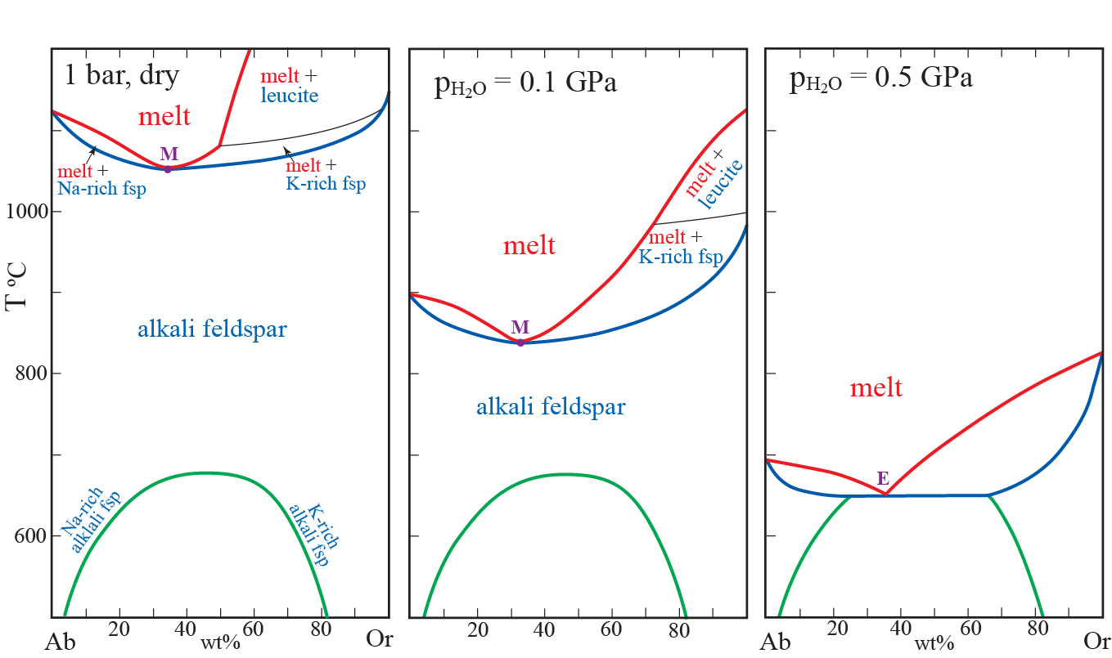
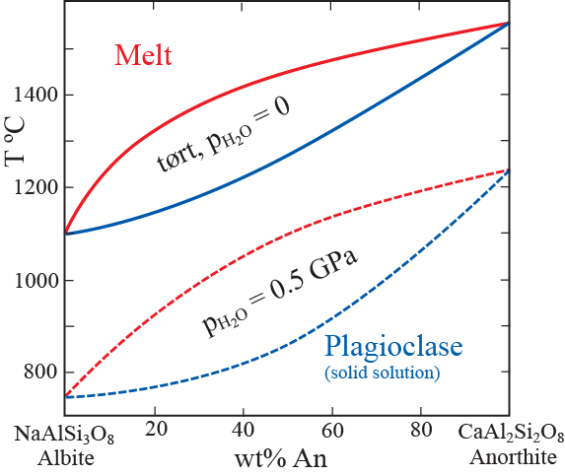
Felsic systems (granite, syenite, nepheline syenite):
melting relations and volcanic phenomena
- please review silicate melt strcture in relation to phase relations and physical properties,
- see also chapters 3 and 4 in Winter (2013)
The feldspar systems
Plagioclase:
not very relevant for high-Si granites
Alkali feldspar:
very relevant
330
350
400
Hypersolvus alkali feldspar
Subsolvus
alkali feldspar

Slide 2
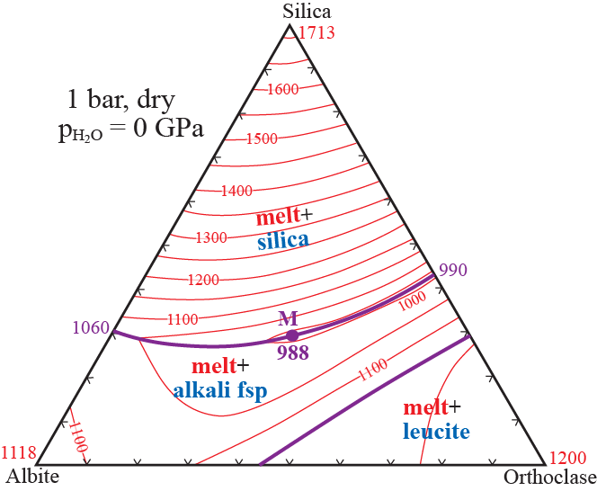
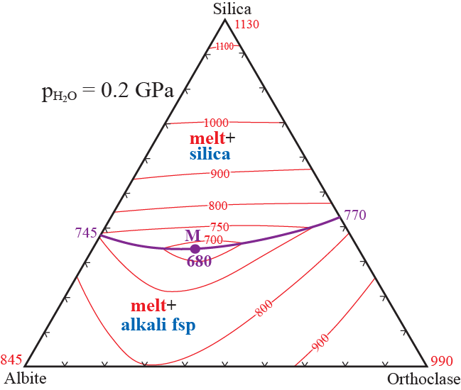
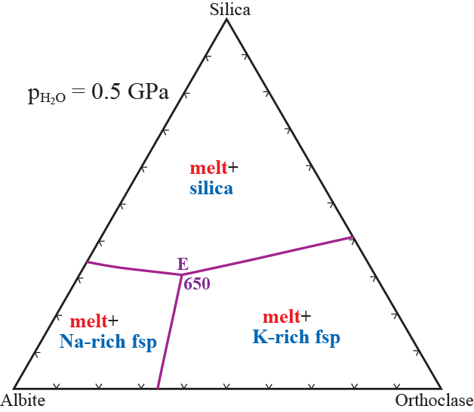
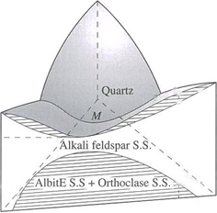
The system silica-albite-orthoclase (the "granite system")
583 !
308
30
Silica
1713
990
1200
1060
1118
988
Orthoclase
Albite

Slide 3
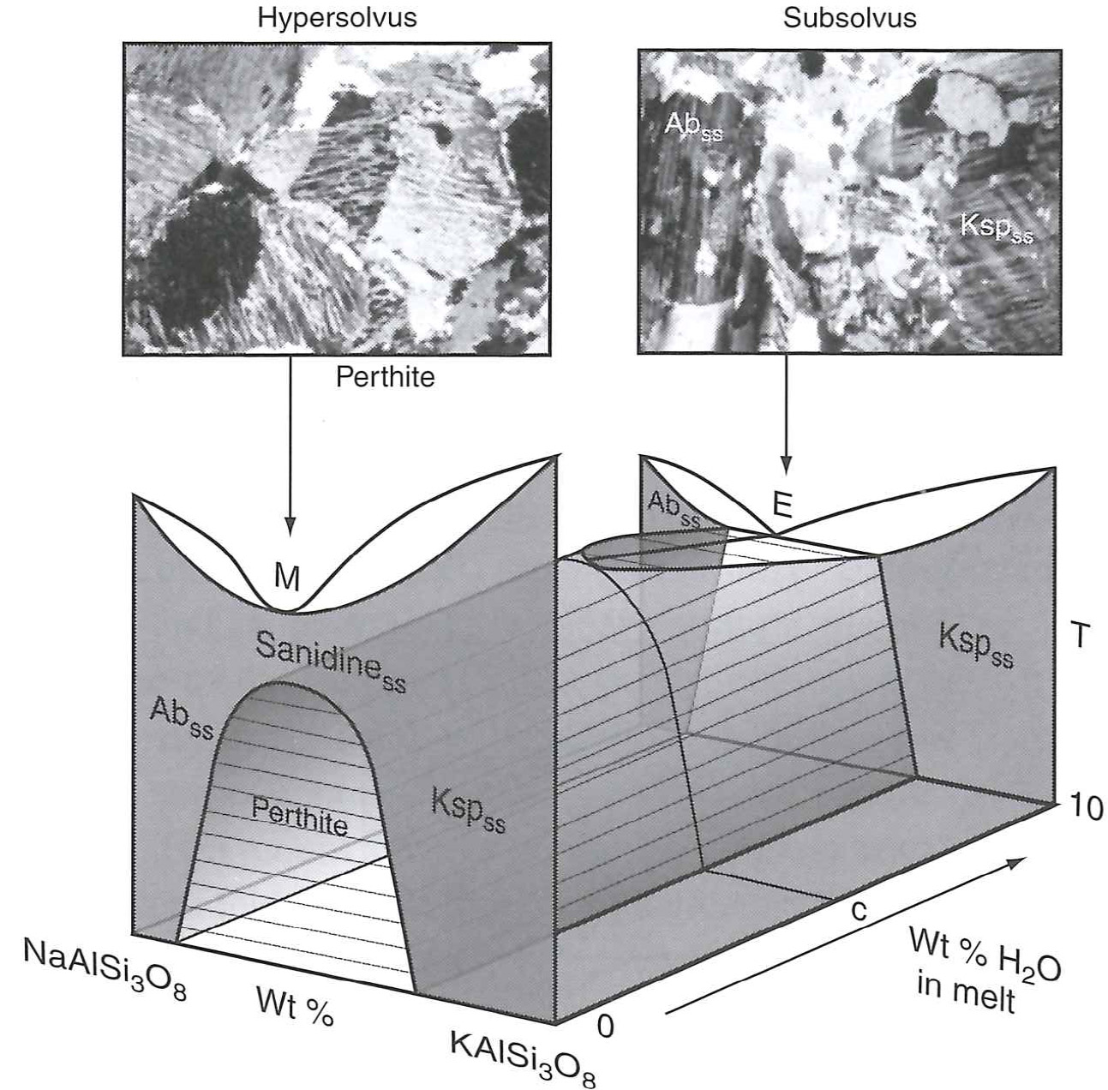
Ch. 10, Philpotts & Ague (2009)

Slide 4
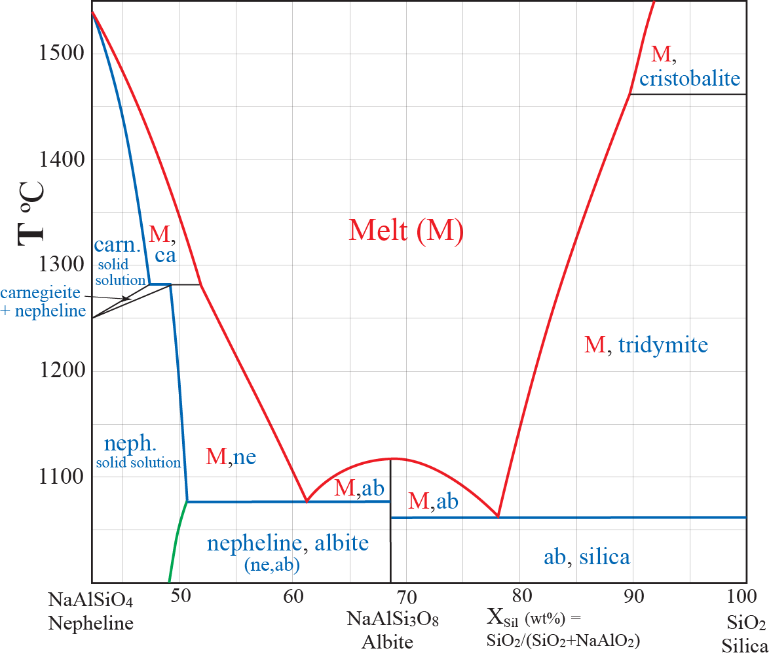
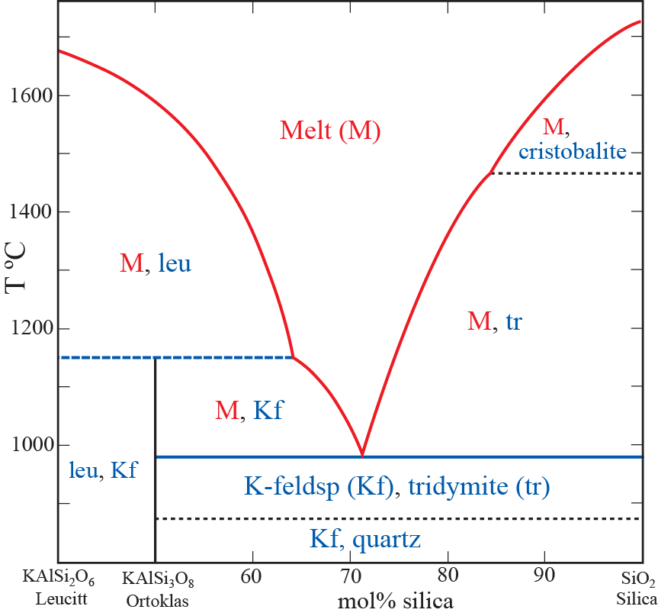
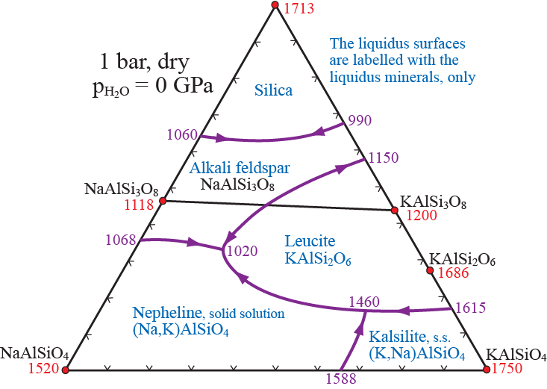
Nepheline-Silica
The system silica-nepheline-kalsilite at 1 bar
The silica-rich part
Binary
thermal
divides
Binary eutectics
Binary peritectic
The entire system
Leucite-Silica
Ternary min.,
granite
Ternary
therm divide
Ternary
eutectic
ne-syentite

Slide 5
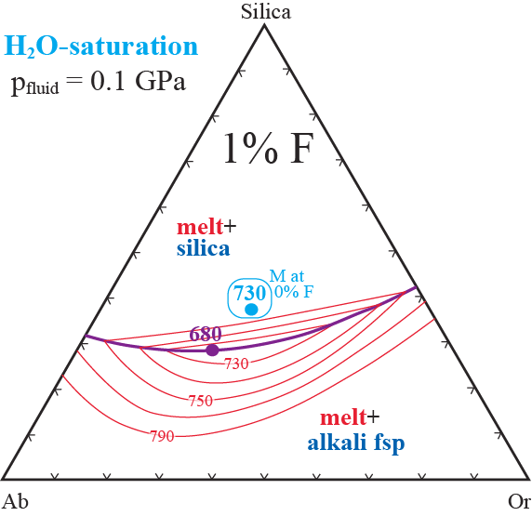
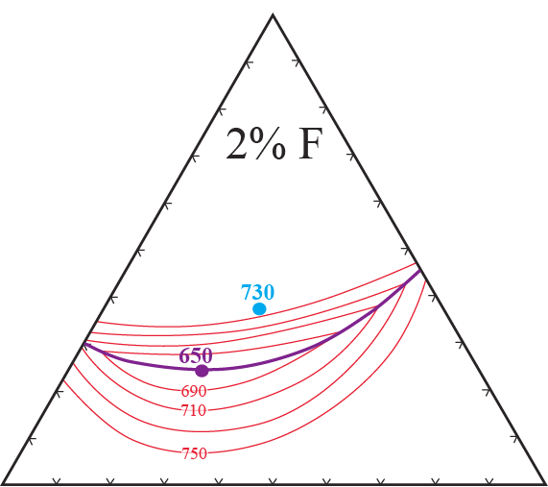
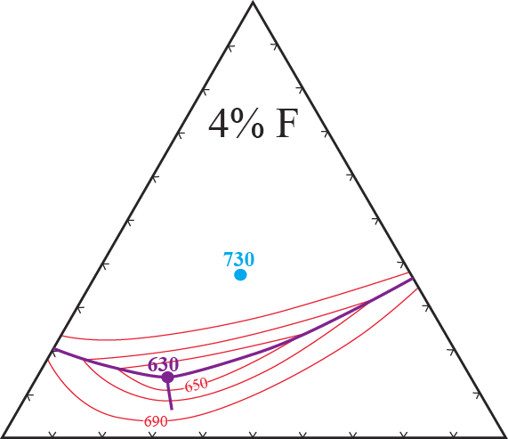
Variations in granitic phase relations from
a H₂O-HF-saturating volatile phase

Slide 6
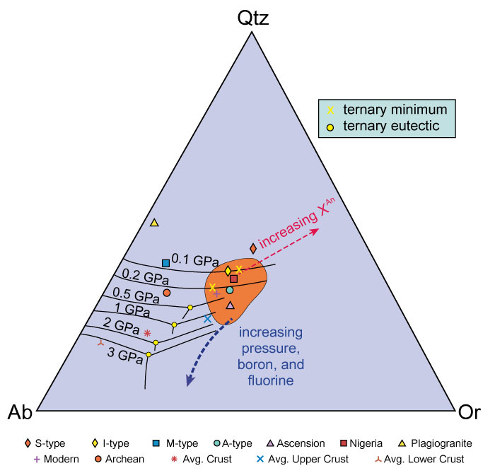
Winter (2010). Figure 18.3. The Ab-Or-Qtz system with the ternary cotectic curves and eutectic minima from 0.1 to 3 GPa. Included is the locus of most granite compositions from Figure 11-2 (shaded) and the plotted positions of the norms from the analyses in Table 18-2. Note the effects of increasing pressure and the An, B, and F contents on the position of the thermal minima. From Winter (2001) An Introduction to Igneous and Metamorphic Petrology. Prentice Hall.

Slide 7
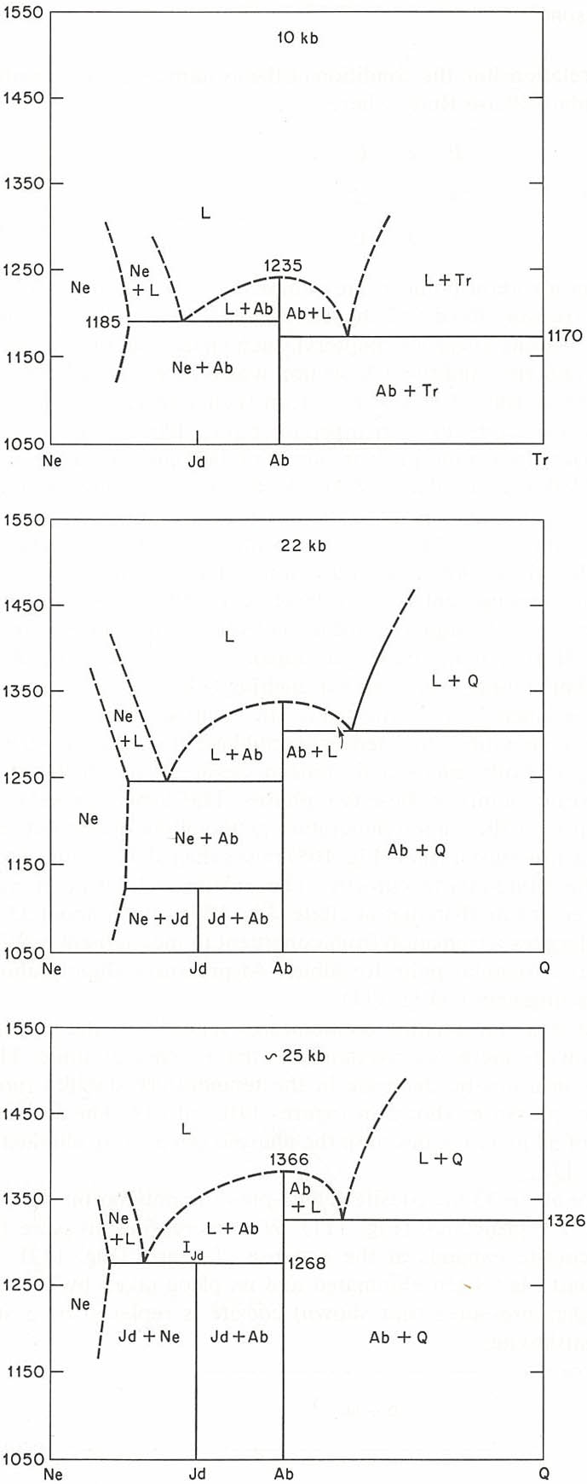
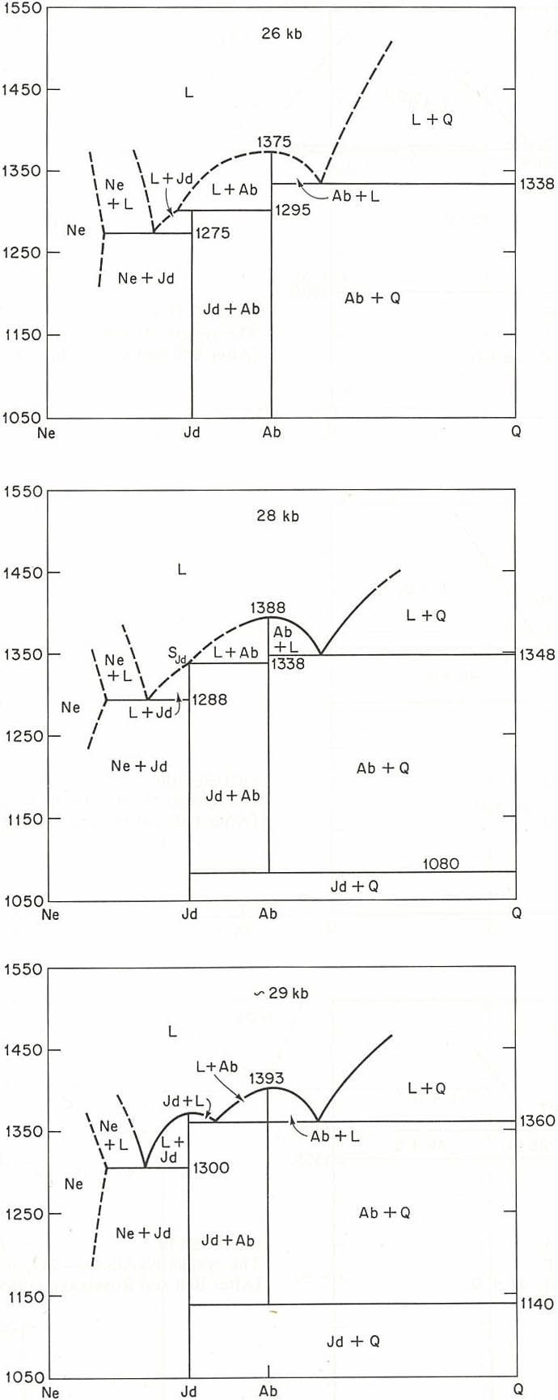
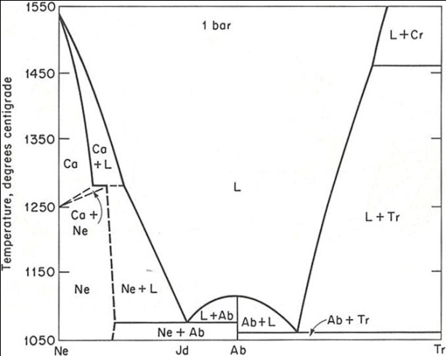
System NaAlSiO₄-SiO₂,
Systematics of phase relations,
1 bar to 4 GPa, dry conditions
2.6 GPa
1.0 GPa
Liquidus- and solidus-T
increase with increasing p
Jadeite at
liq., but melts
incongruently
1 bar
2.2 GPa
2.8 GPa
Jadeite appears at low T
Why?
p
positive
dp/dT
Albite
disappears
at low T
jadeite + quartz
albite
T
2.9 GPa
2.5 GPa
Jadeite melts
congruently

Slide 8
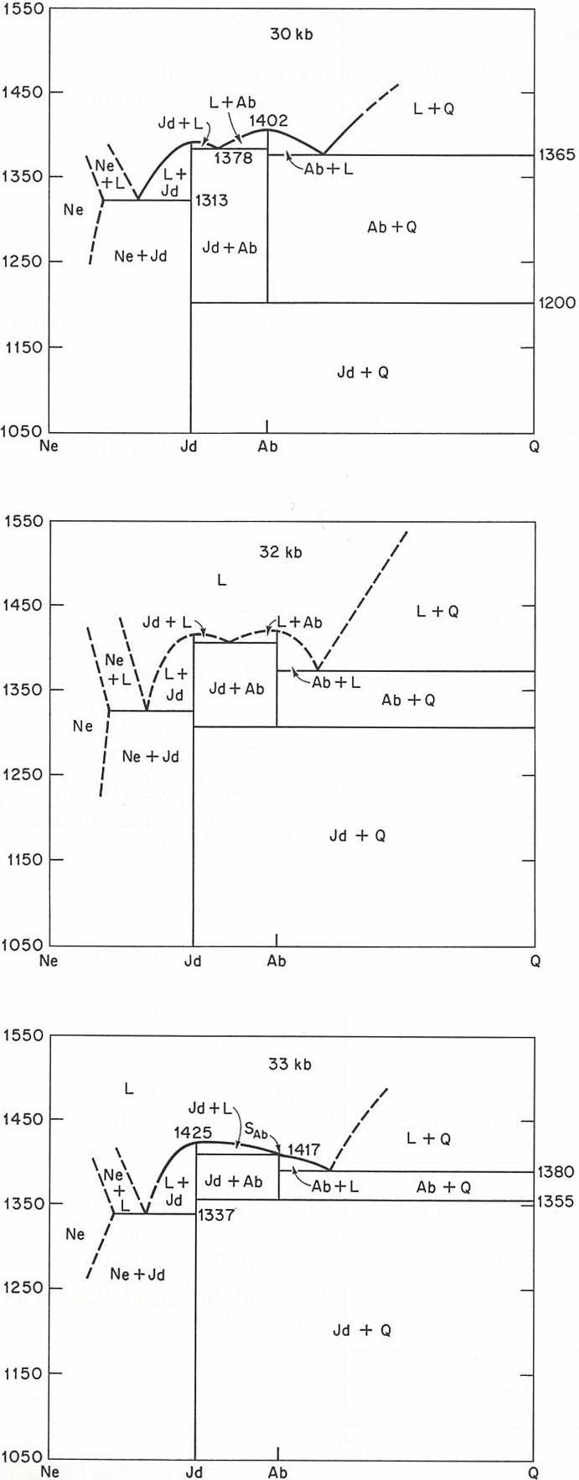
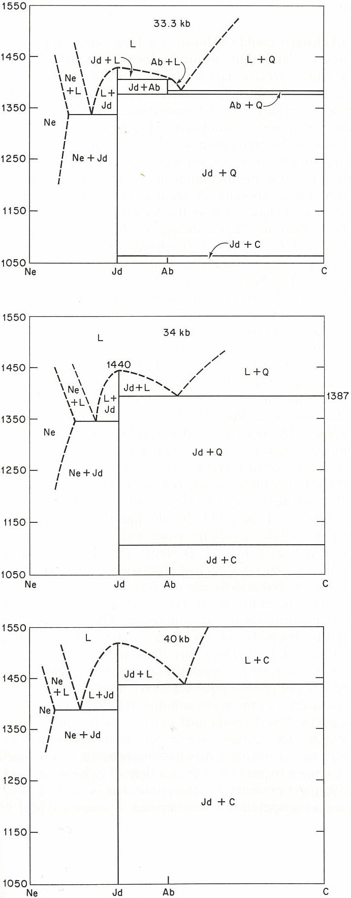
3.0 GPa
3.33 GPa
Coesite replaces
quartz at low T
3.2 GPa
3.4 GPa
Albite disappears,
also at highT
3.3 GPa
4.0 GPa
Albite is no longer
a thermal divide, starts
to melt incongruently
Quartz disappears,
also at high T

Slide 9
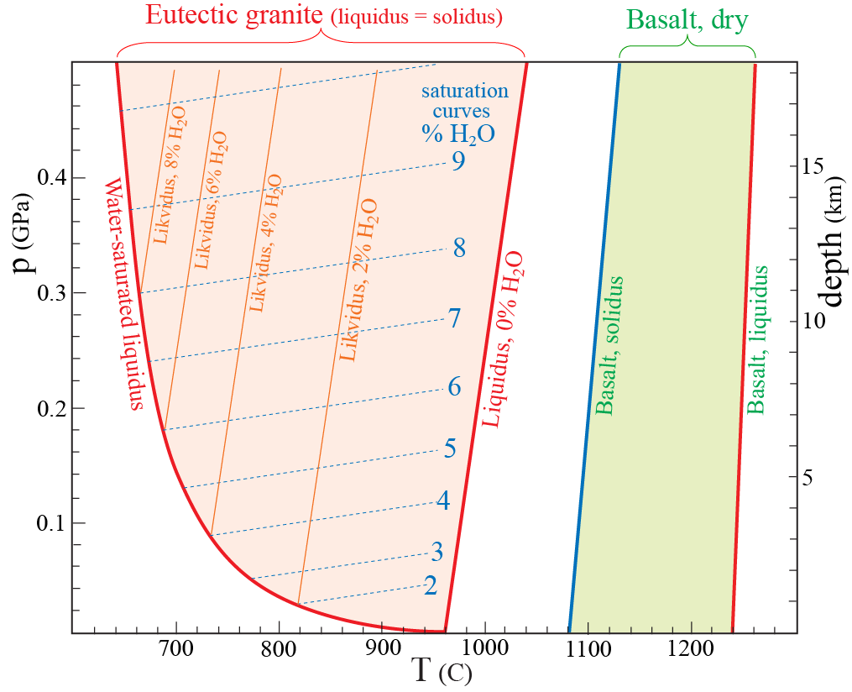
H₂O-saturation:
- Granitic melts may form at
<650 ºC at >15 km dyp
- Saturation at about 17 km: about 10% H₂O

Slide 10
P₁
P₂
Ascent of a water-saturated and superheated magma
(from 17 km and 760ºC):
- Degassing from 9.5% to 4.6% H₂O
(under continuous water-saturation)
- Crystallization at about 720 ºC and 4 km
Granitic magma with dissolved H₂O formed below
the dry liquidus cannot reach the surface!
Quiet eruption of degassed granitic magma is rare,
- but may follow explosive, steam-driven eruptions

Slide 11
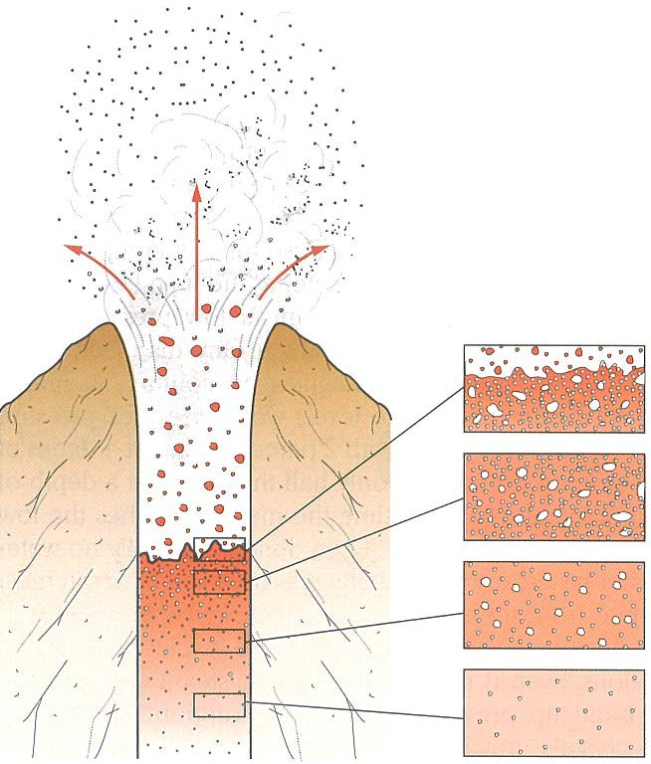
Explosive vesiculation in granitic melts
→ powerful gas thrust

Slide 12
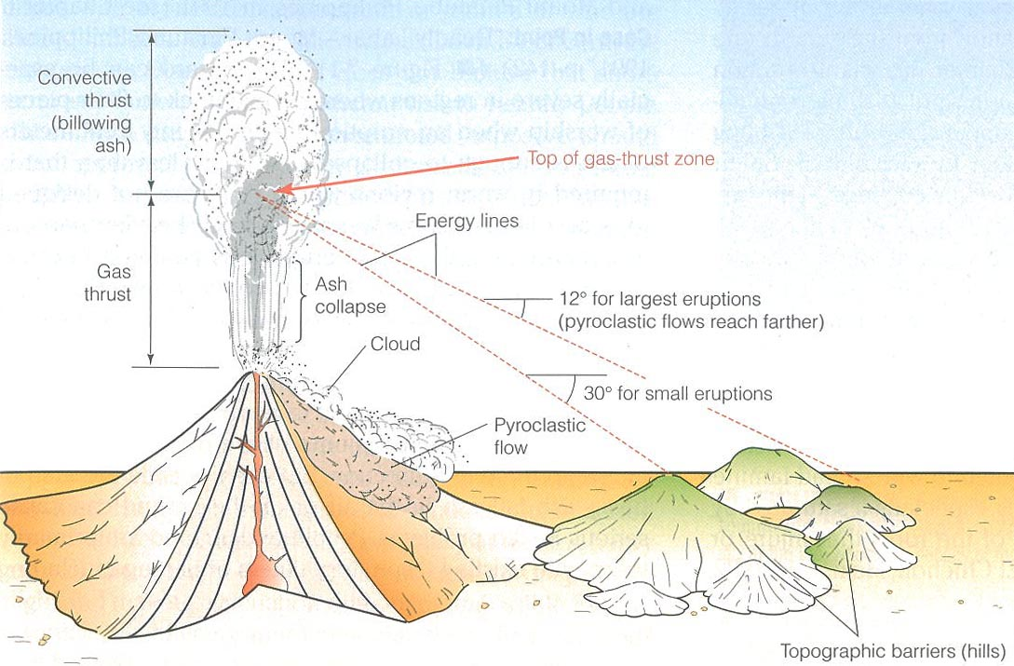
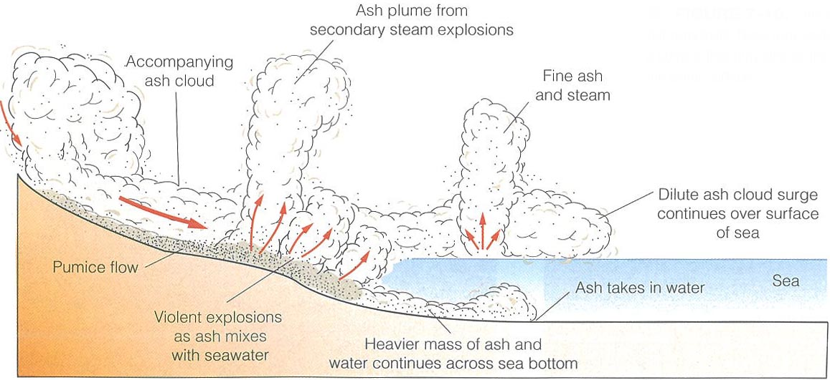
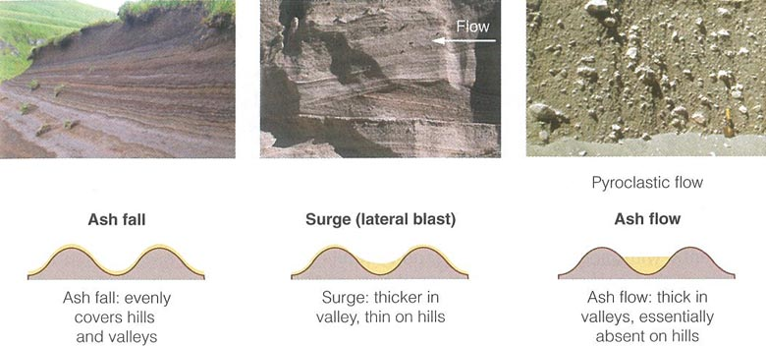
Plinian eruption column and products

Slide 13
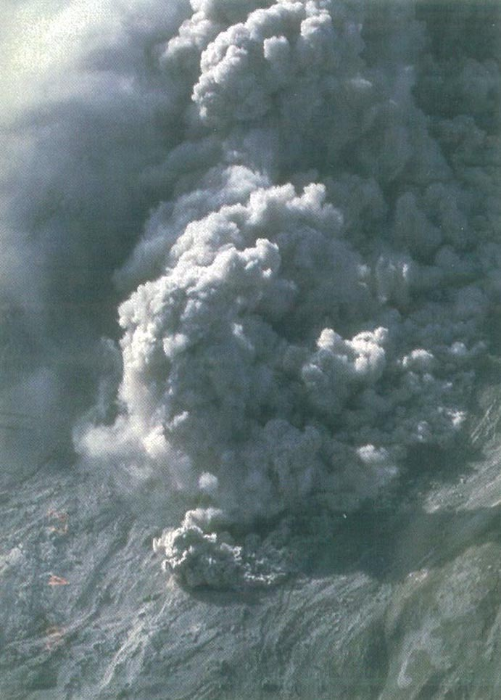
Mt. Augustine, Alaska
Pyroclastic flow

Slide 14
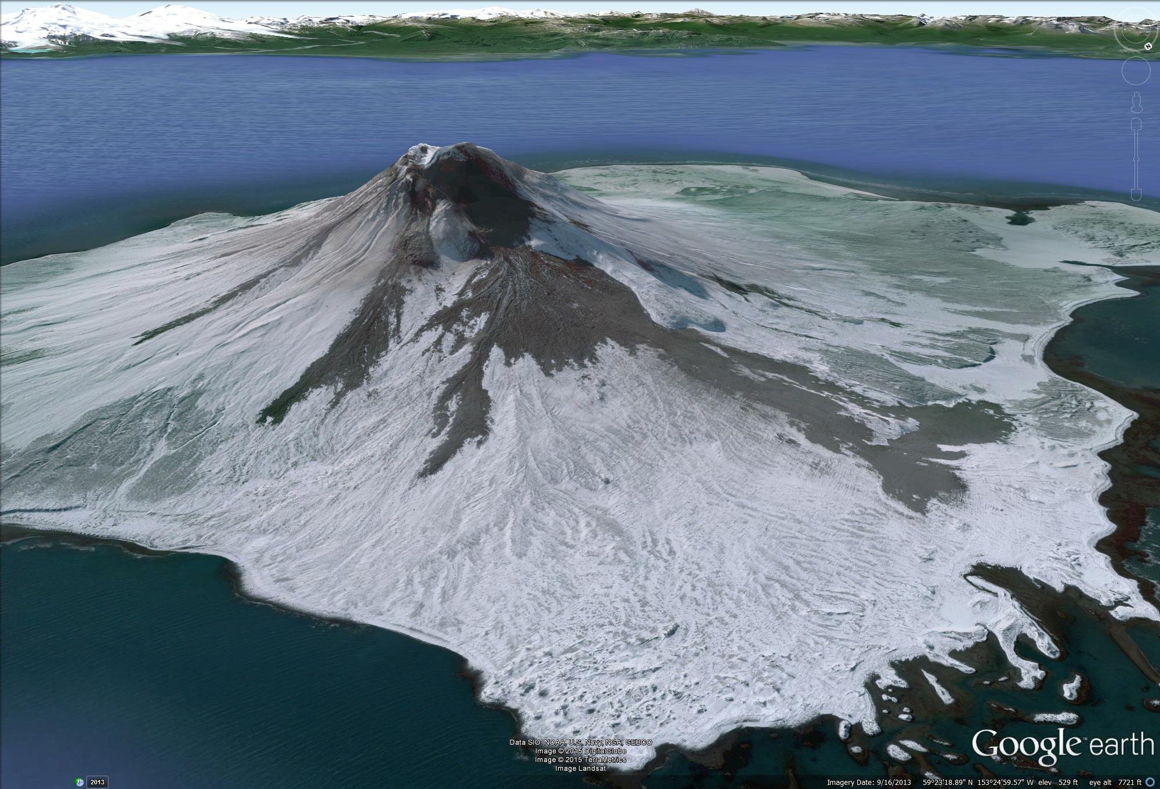
Mt. Augustine, Alaska

Slide 15
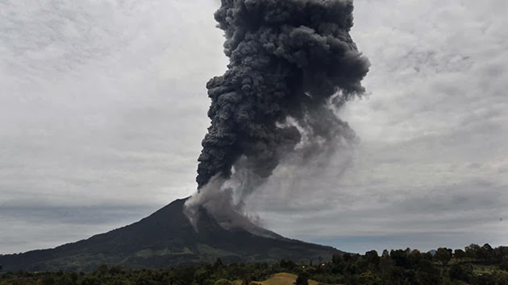
Sinabung, Sumatra, Sept, 2010
Column collapse pyroclastic flow along specific valleys

Slide 16
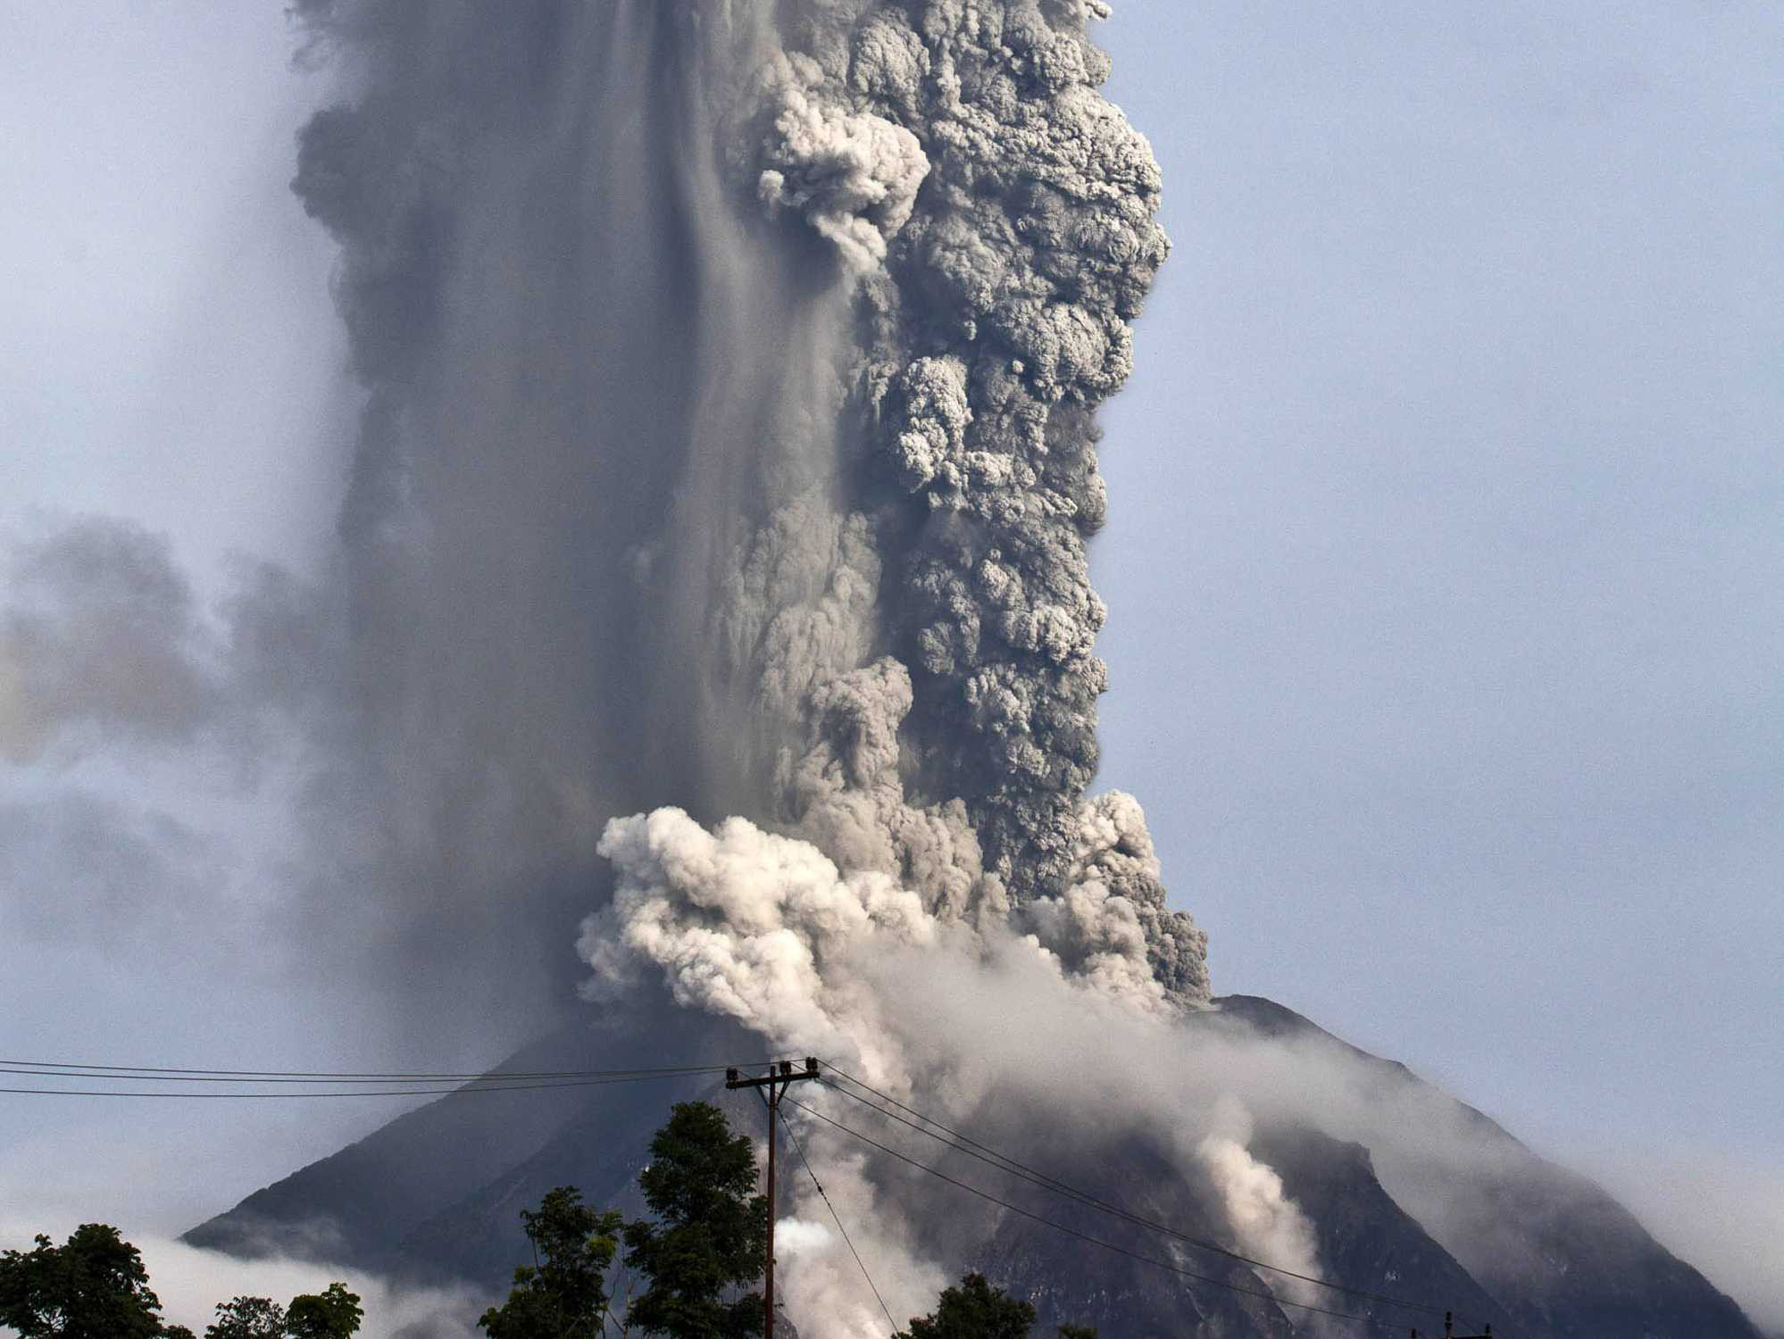

Slide 17
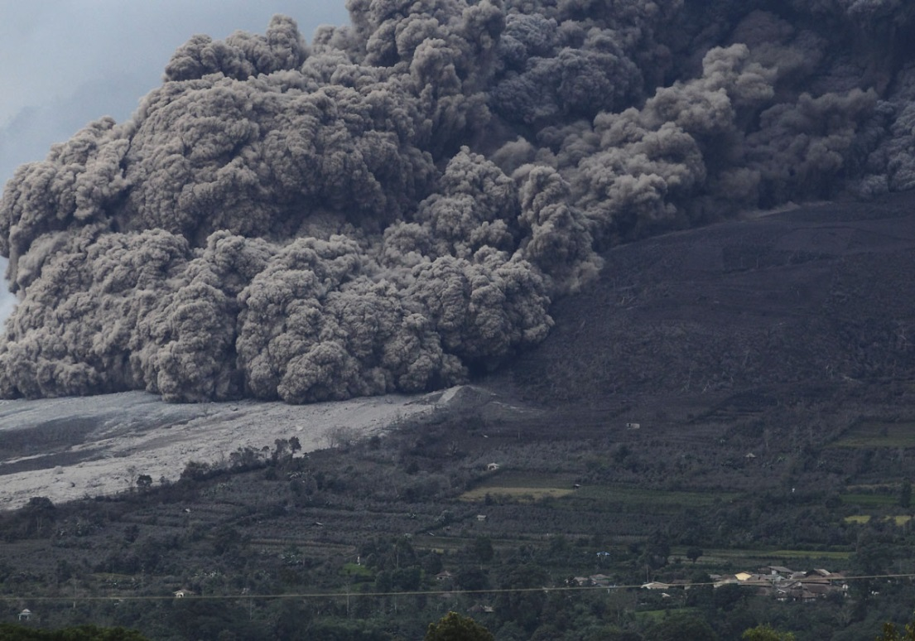
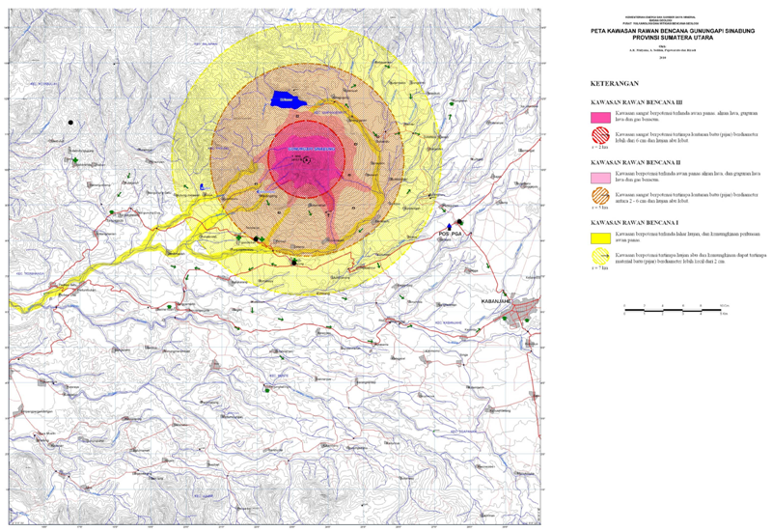
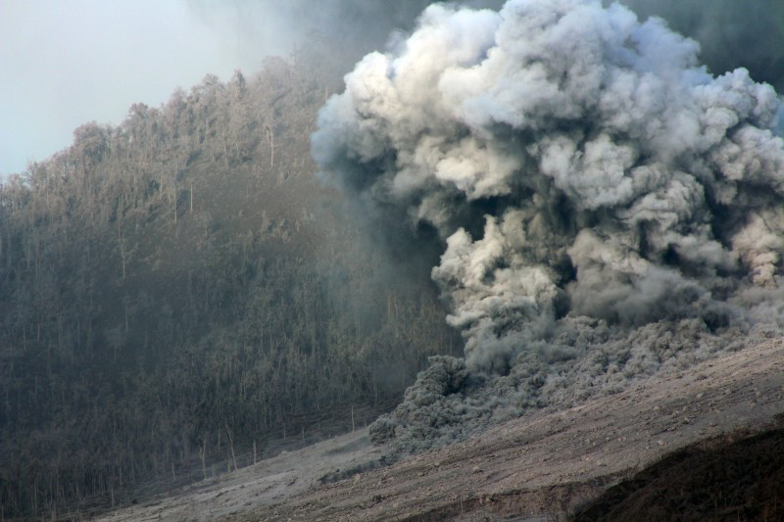
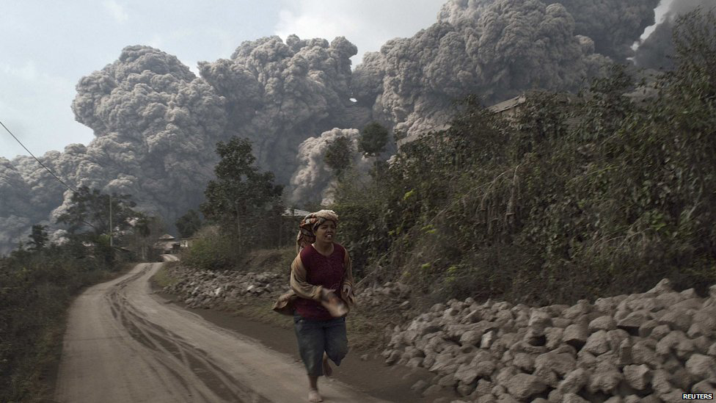
Volcanic hazard map

Slide 18
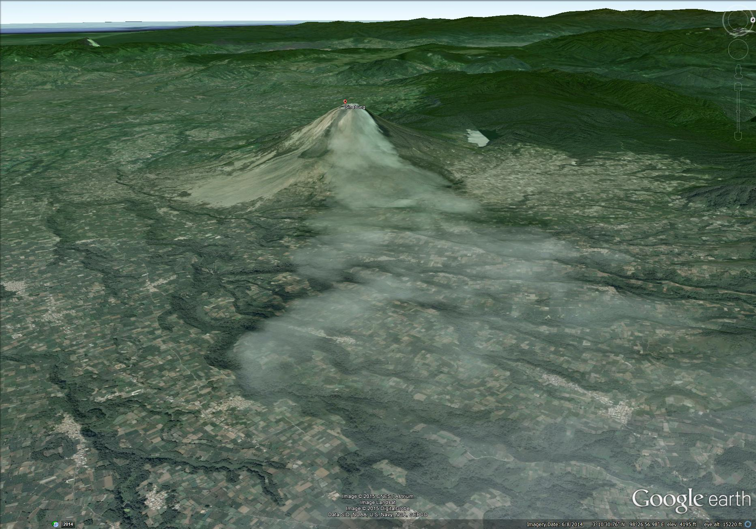

Slide 19
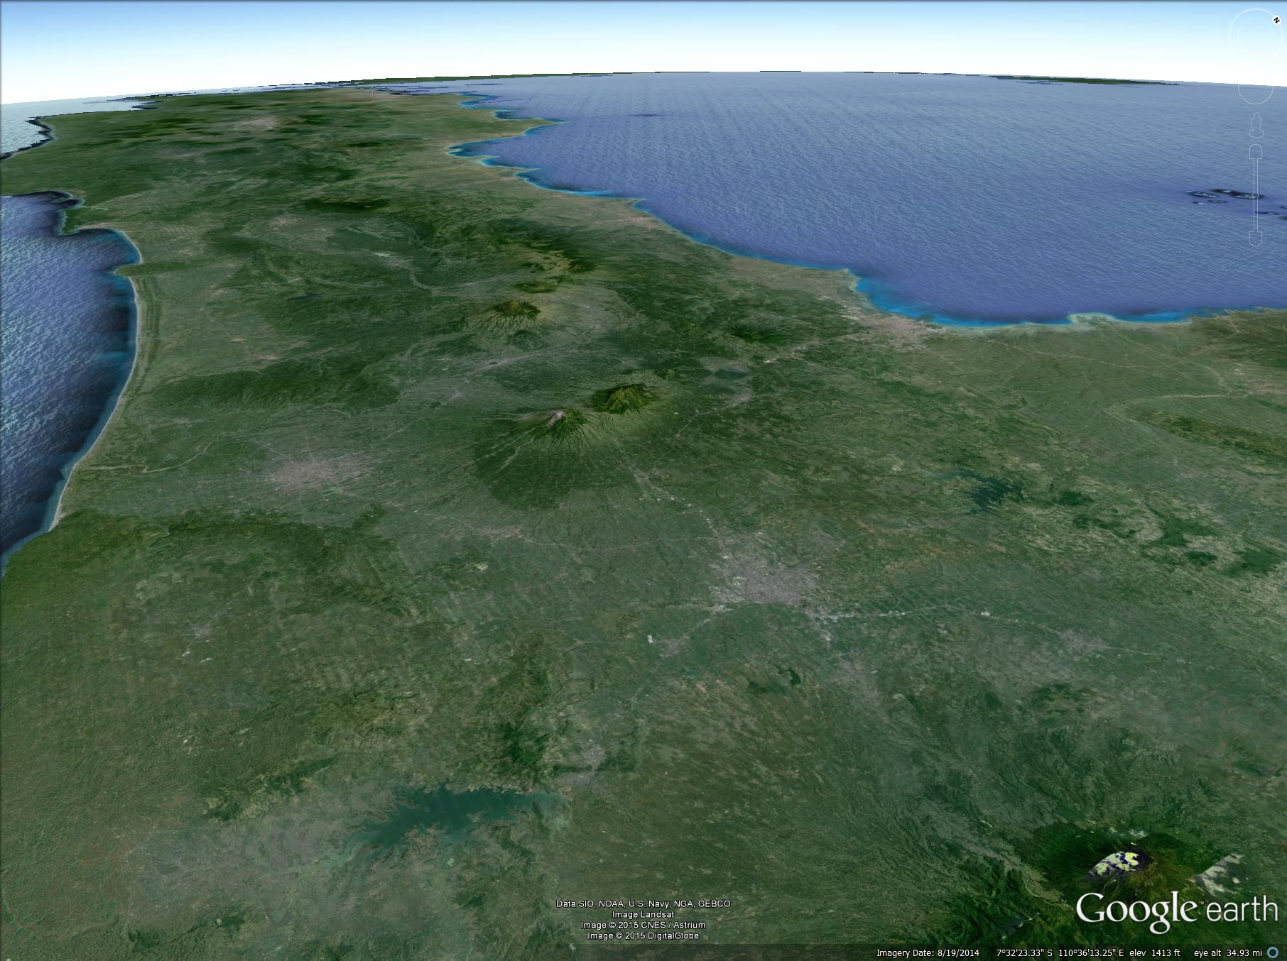
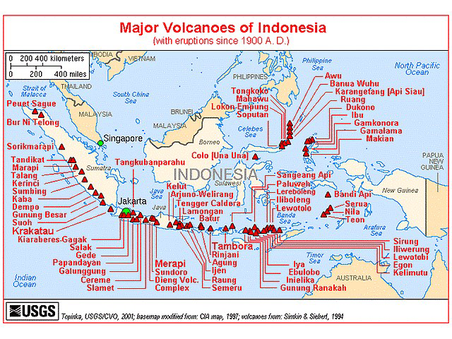

Slide 20
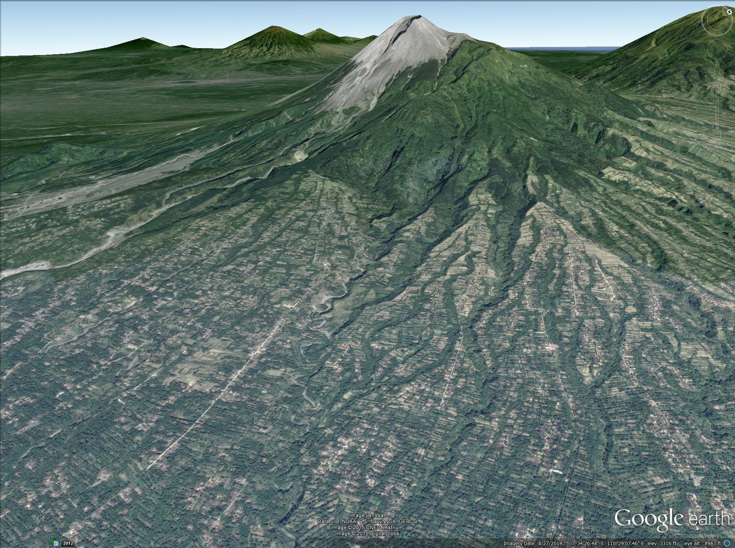
Conflicts: Merapi (ventral Java) - farming

Slide 21
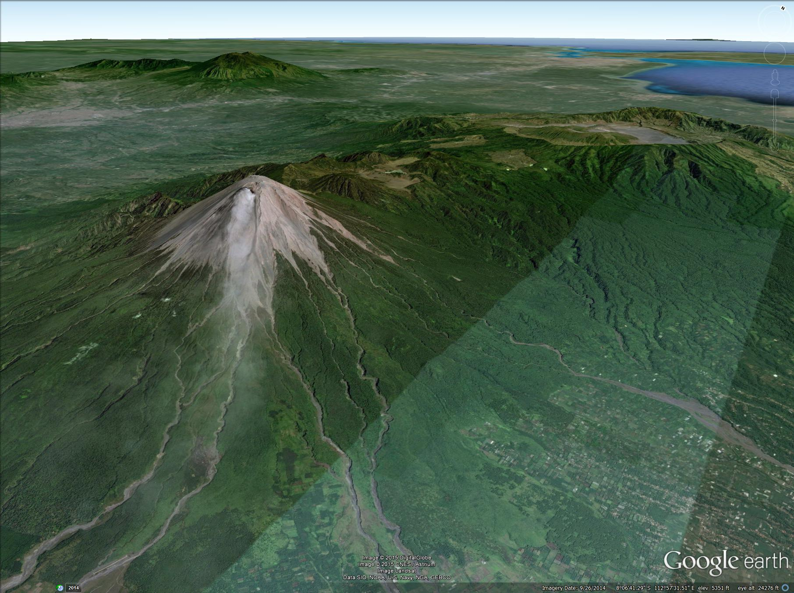
Conflicts: Semeru (eastern Java) - farming

Slide 22
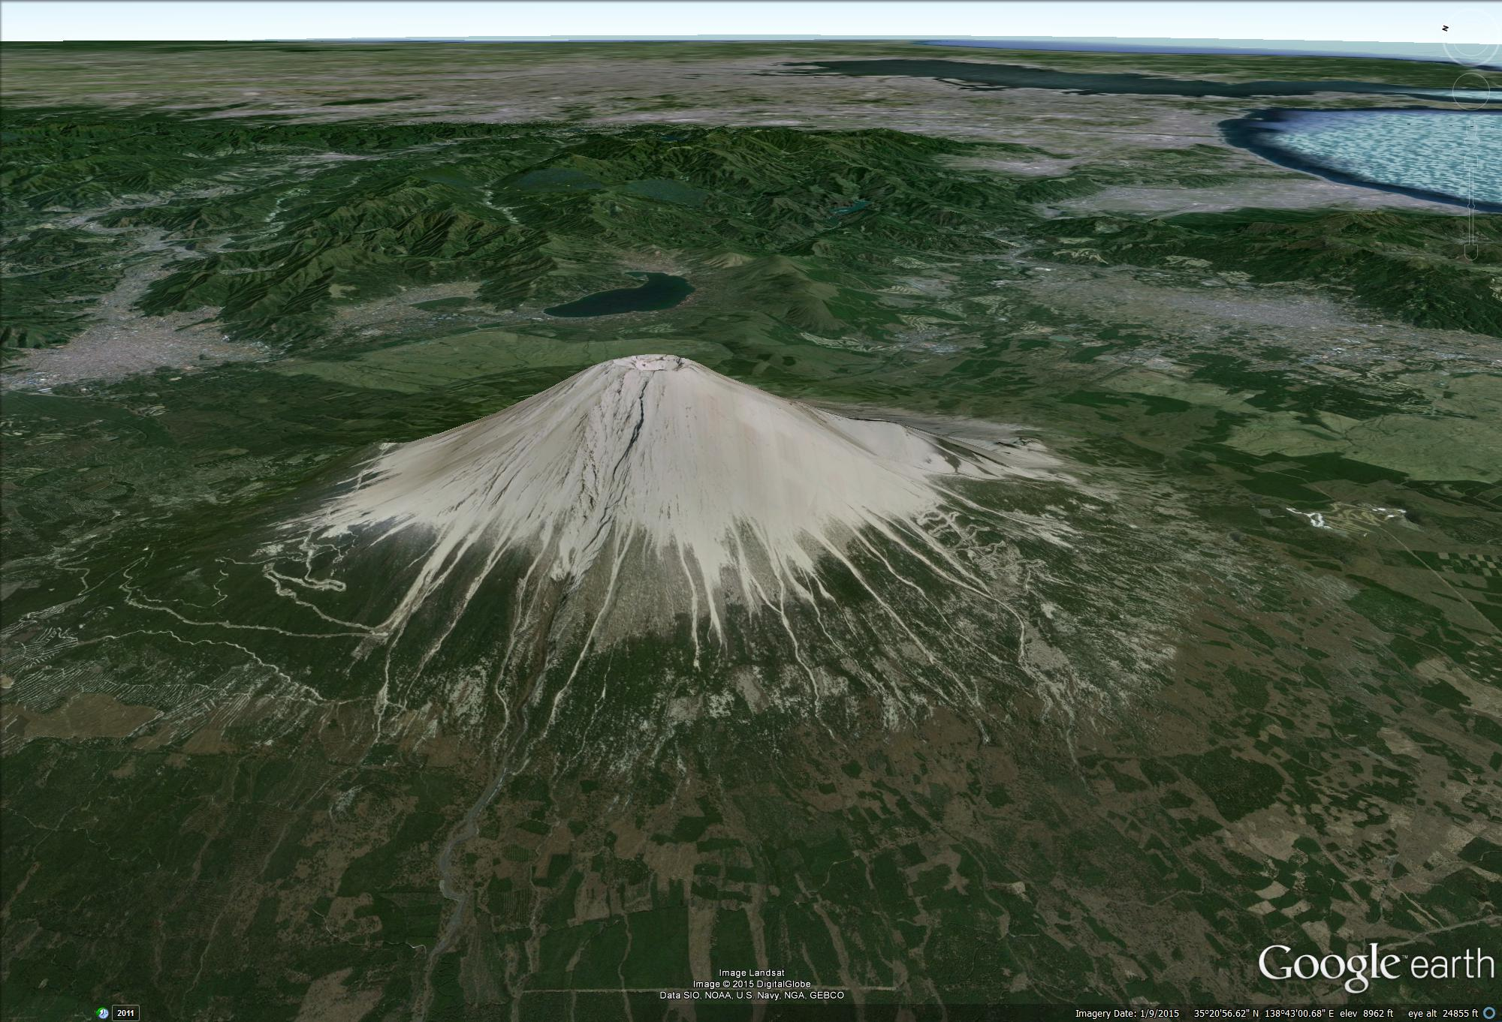
Mt. Fujii - Tokyo Bay

Slide 23
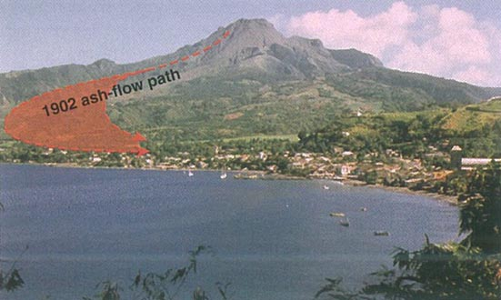
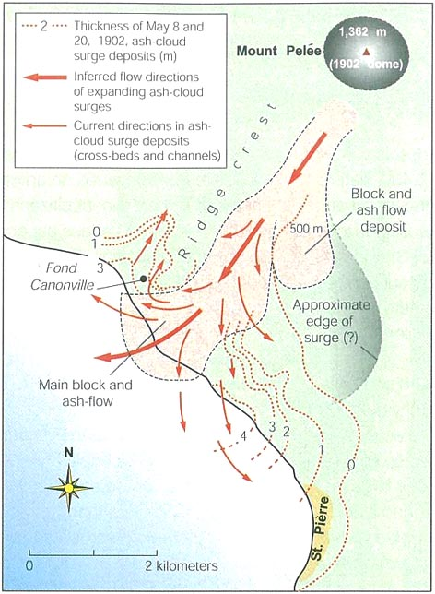
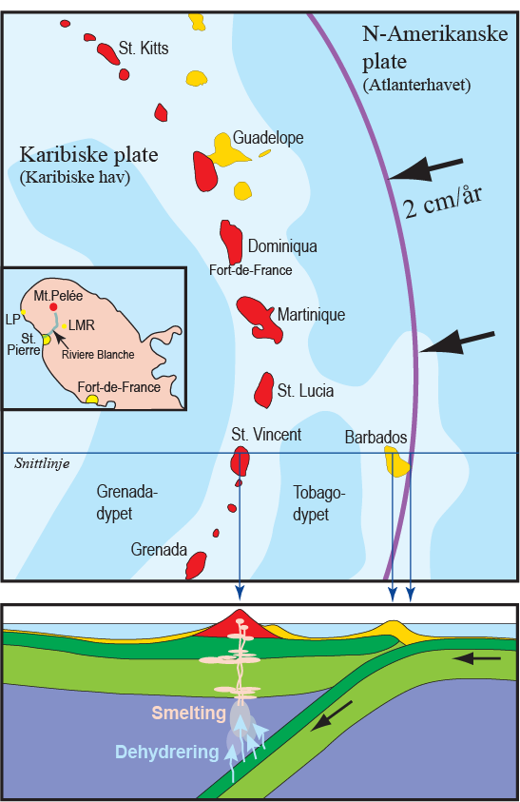
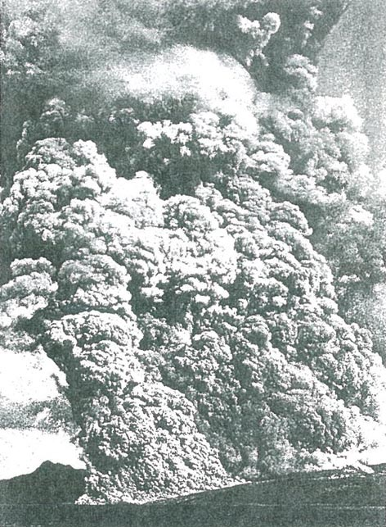
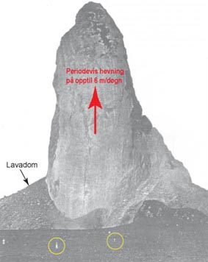
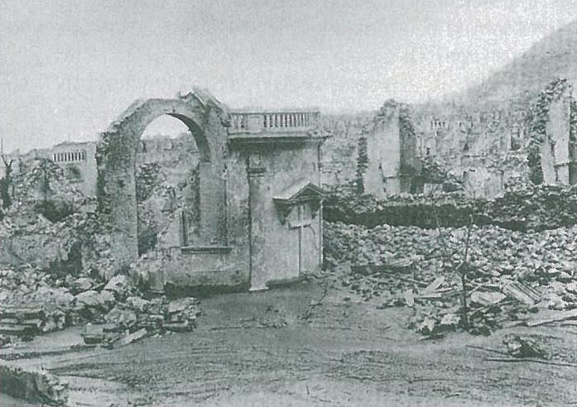
Pyroclastic flows
- the most dramatic and deadly
volkanic phenomenon

Slide 24
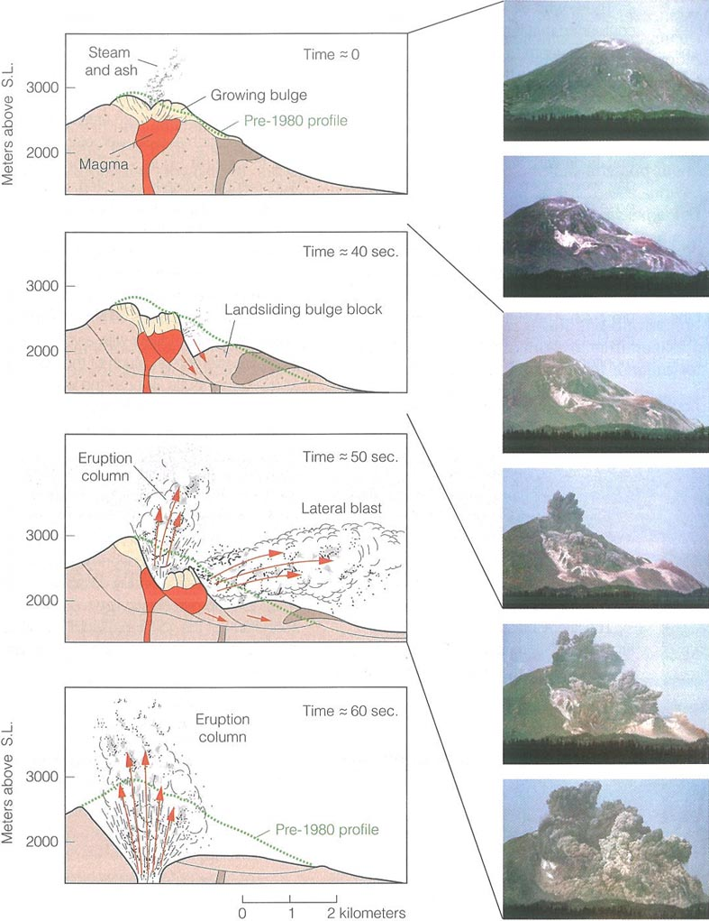
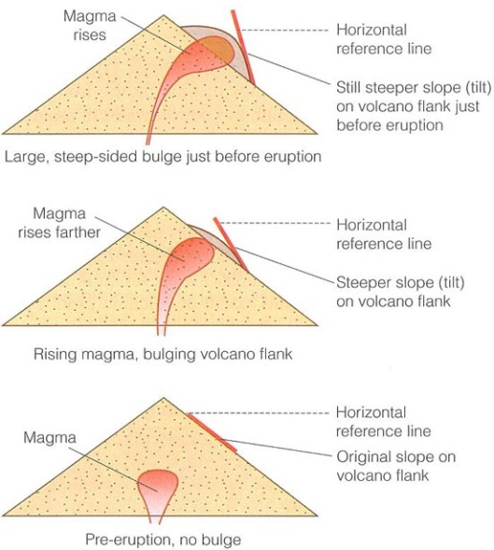
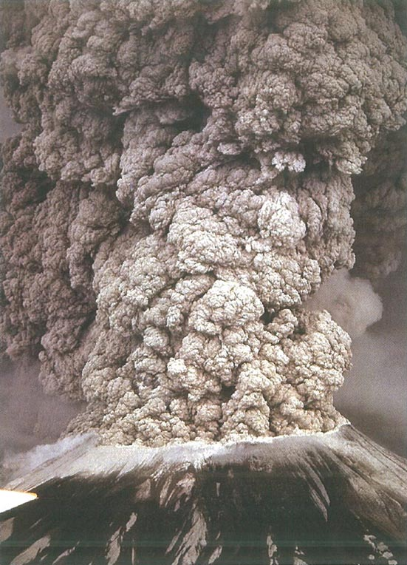
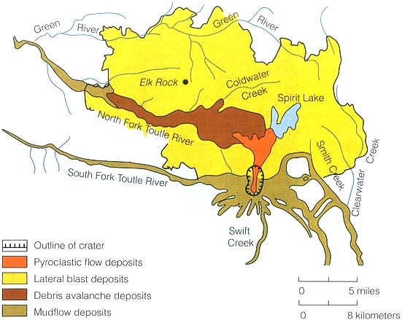
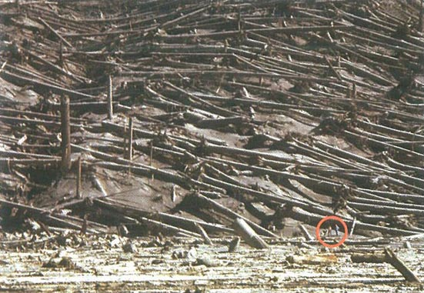
Mount St. Helens, May 18, 1980
Plinian eruption initiated by gravitational collapse followed by lateral explosion

Slide 25
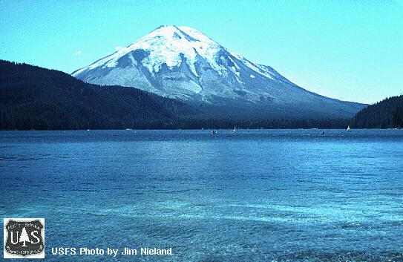

Slide 26
Crater Lake
St. Helens
Three sisters
Jefferson
Hood
Rainier
Adams

Slide 27
Mt. Mazama – Crater Lake
5700 BC (7700 BP)

Slide 28
Caldera evolution (e.g. Crater Lake)

Slide 29
Oslo Rift
Central volcanoes - calderas
on average 10 km in diameter
Svarten
Heggelia
Oppkuven
Kampen
Øyangen
Nittedal
Bærum
Glitrevann
Drammen
Sande
Hillestad
Vealøs
Ramnes

Slide 31
Large ash-flow calderas, ”super volcanoes”
Periodicity:
0.7 Ma
50*70 km
Lava Creek ash
distribution (rhyolite)

Slide 32
Yellowstone Caldera: 0.64 Ma
with Lava Creek tuff: 1000 km²
Henry’s Fork Caldera: 1.3 Ma
Mesa Fall tuff: 280 km²
Island Park Caldera: 2.0 Ma
Huckleberry tuff: 2500 km²
Lava Creek tuff

Slide 33
Valles caldera
- diameter: 22 km
- Bandelier tuff

Slide 34
Long Valley caldera, Eastern California
Long Valley caldera
(35*18 km)
Long Valley caldera
(35*18 km)
Mono Lake and Inyo craters:
Tuff rings, obsidian domes and
thick obsidian flows

Slide 35
LV caldera formed 0.77 Ma by
the eruption of Bishop tuff
2200 km², 150-200 km thick,
about 385 km³
Pyroclastic flow
Ashfall-layer
Bishop ash distribution

Slide 36
Mammoth mountain, Long Valley,
- CO₂-poisoning

Slide 37
Inyo craters
Tuff rings, obsidian domes
and flows

Slide 38
Pinatubo,
Philippines, 1991

Slide 39
Vesuvius and Campi Flegri,
Bay of Naples

Slide 41
Mudflows - lahars
Mount Rainier
with Tacoma and Seattle
Crater Lake
St. Helens
Three sisters
Jefferson
Hood
Rainier
Adams

Slide 42
Seattle and Mt. Rainier

Slide 43
Rainier
Adams
St. Helens
Hood
Jefferson
Three Sisters

Slide 44
Mudflows - lahars
Mt. St. Helens
Mt. Hood – a danger for Portland, Oregon

Slide 45
Nevada del Ruiz, Columbia,1985
23 000 died, 20 000 in Armero
Armero-området

