Slide 1
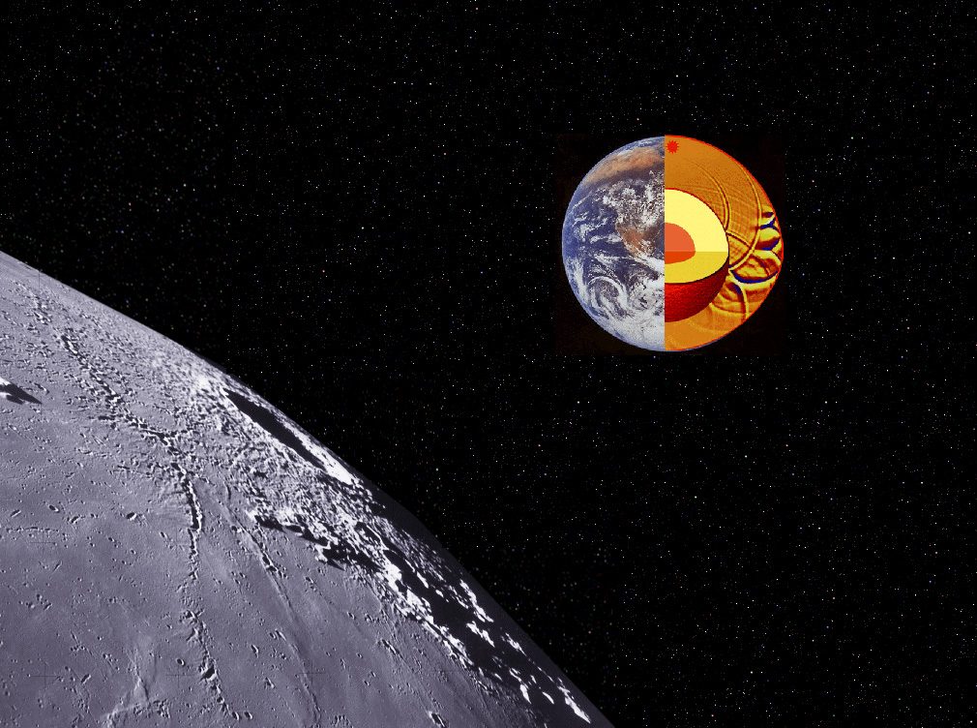
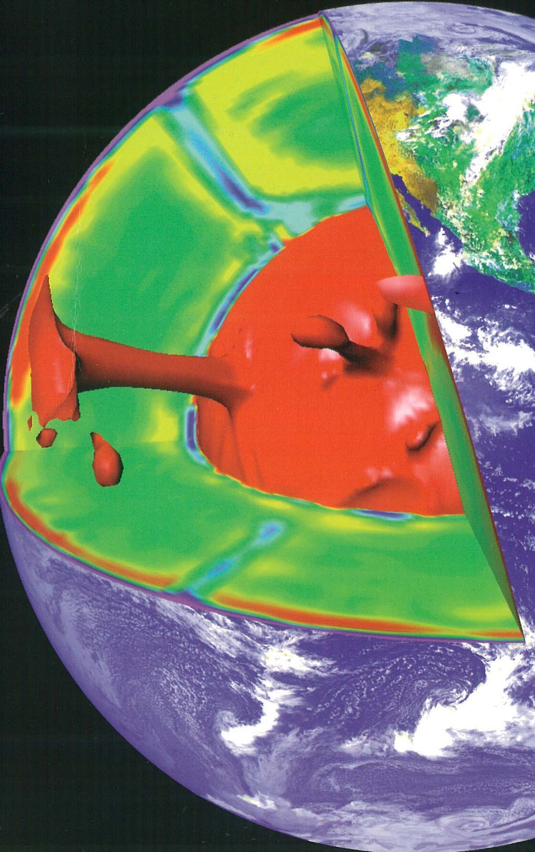
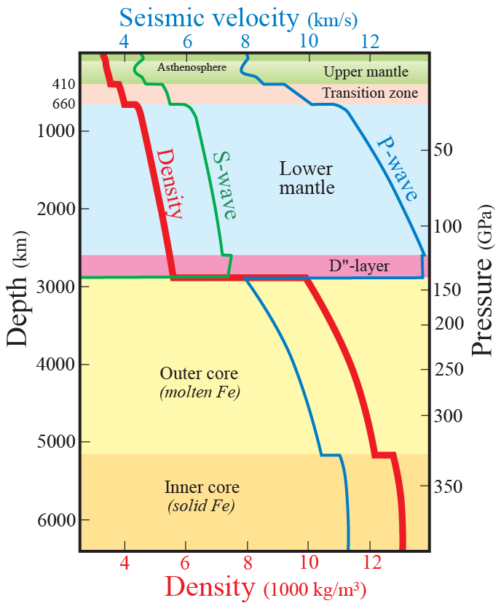
Mineral physics and seismic constraints on Earth’s structure and dynamics
Earth and planetary stucture

Slide 2
Primary source of information about the deep interior structure:
seismological data
Other sources of information, Earth structure and dynamics
Gravitational field
Magnetic field
Heat flow, dynamic topography and geoid
Plate movements
Cosmochemistry and geochemistry
High pressure mineralogy and mineral physics: experimental – computational

Slide 3
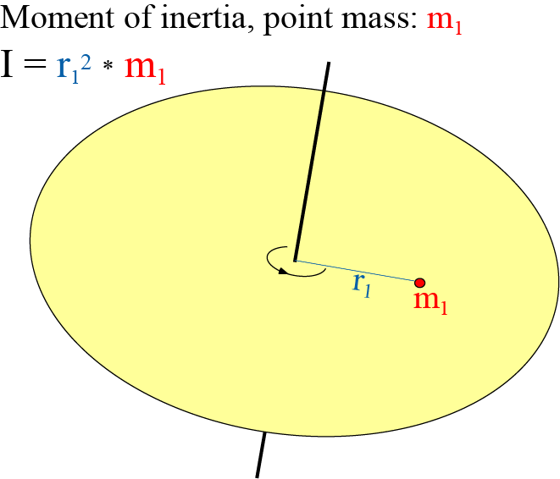
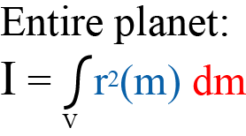
Other planets: No seismology (except rudimentary Moon seismology)
Planetary mass distribution: determined via simple flyby
Moment of inertia factor (MIF)
MIF = I / R² M
Homogeneous massive sphere: MIF = 0.4
Planet with high-density core: MIF < 0.4

Slide 4
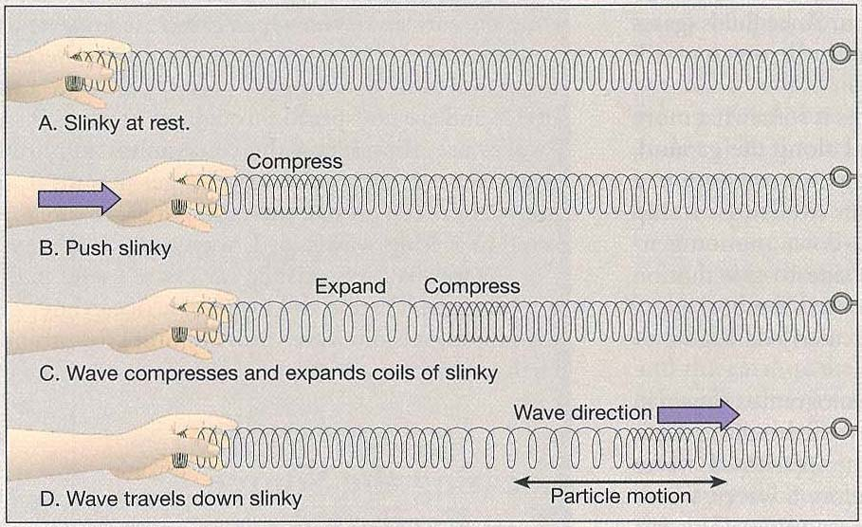
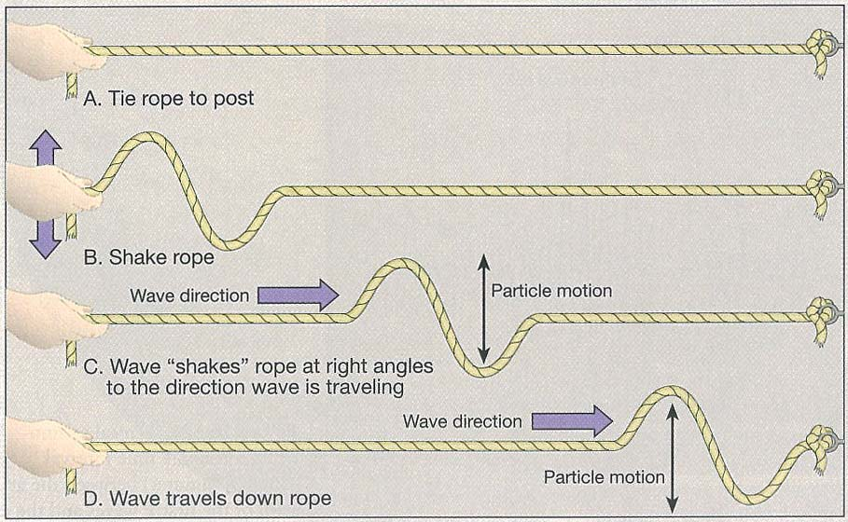
P-waves
Just like sound waves through
air (pressure waves)
S-waves

Slide 5
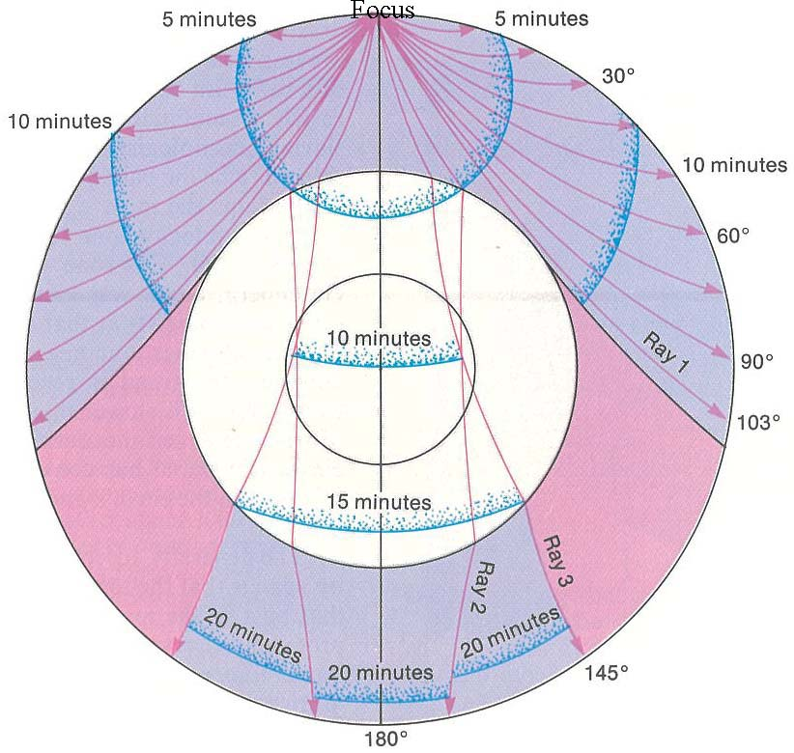
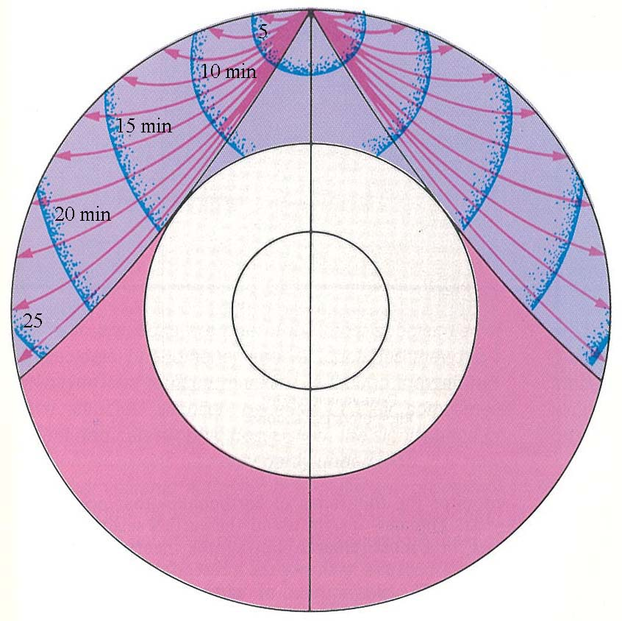
P-wave
S-wave

Slide 6
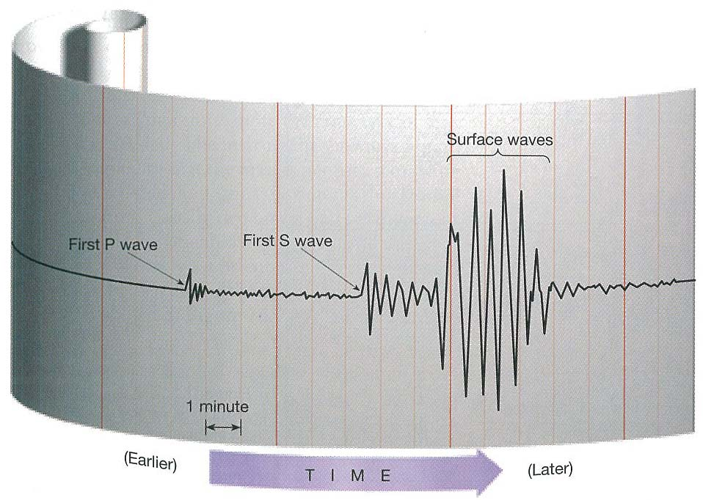

Slide 7
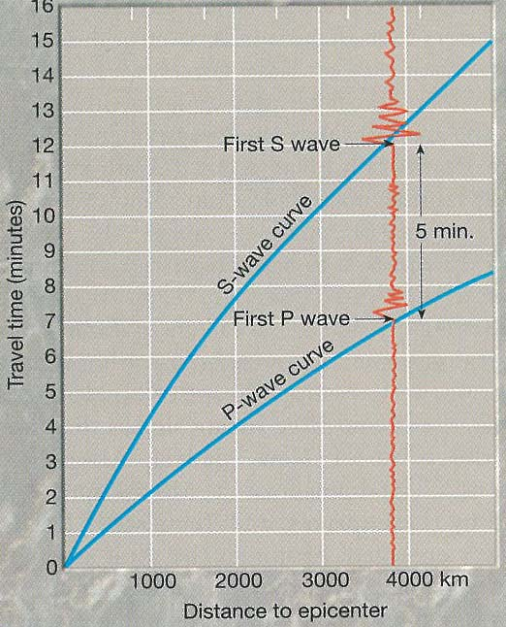
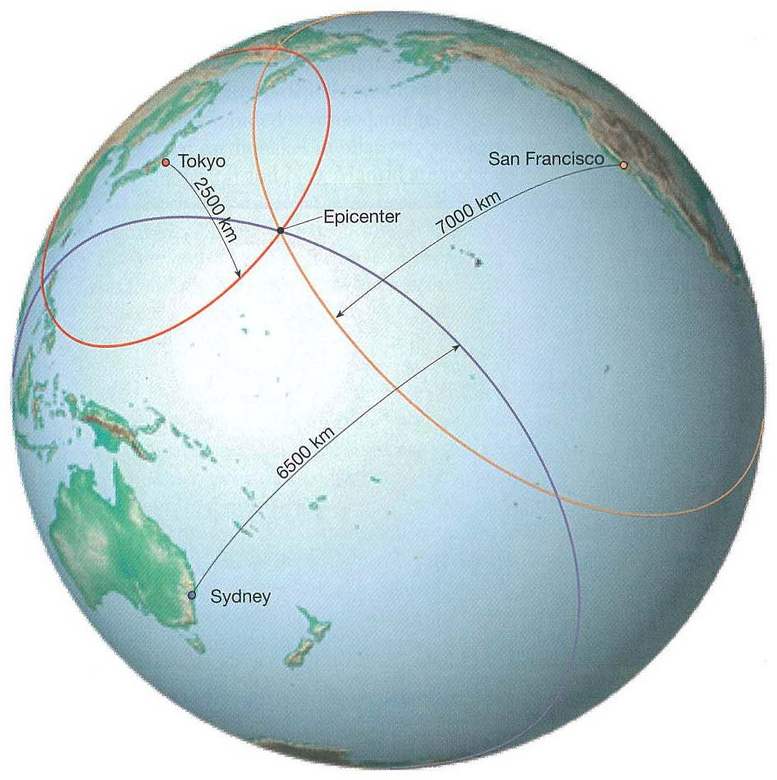

Slide 8
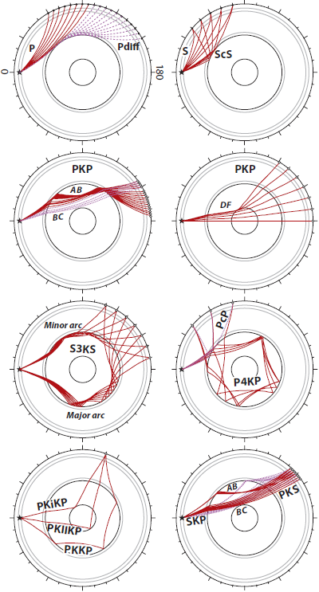
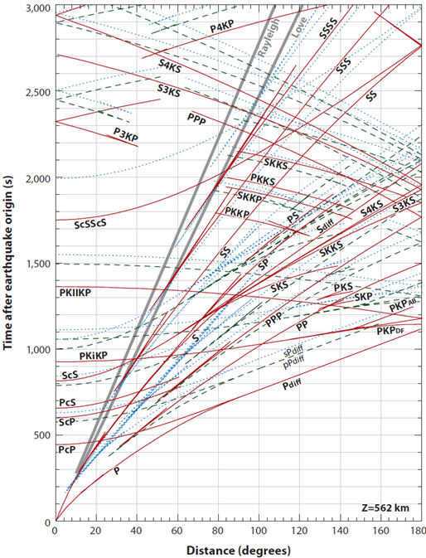
Seismic phases generated by a 562 km deep source in PREM
1D Reference Earth Model of Dziewonski and Anderson (1981)
Travel time curves. Dashed and dotted curves are upward-radiated P- and S-
wave surface reflections (e.g. pPdiff and sPdiff)
50 m
33.3 m
16.7 m
Lay & Garnero (2011, Ann Rev EPS)

Slide 9
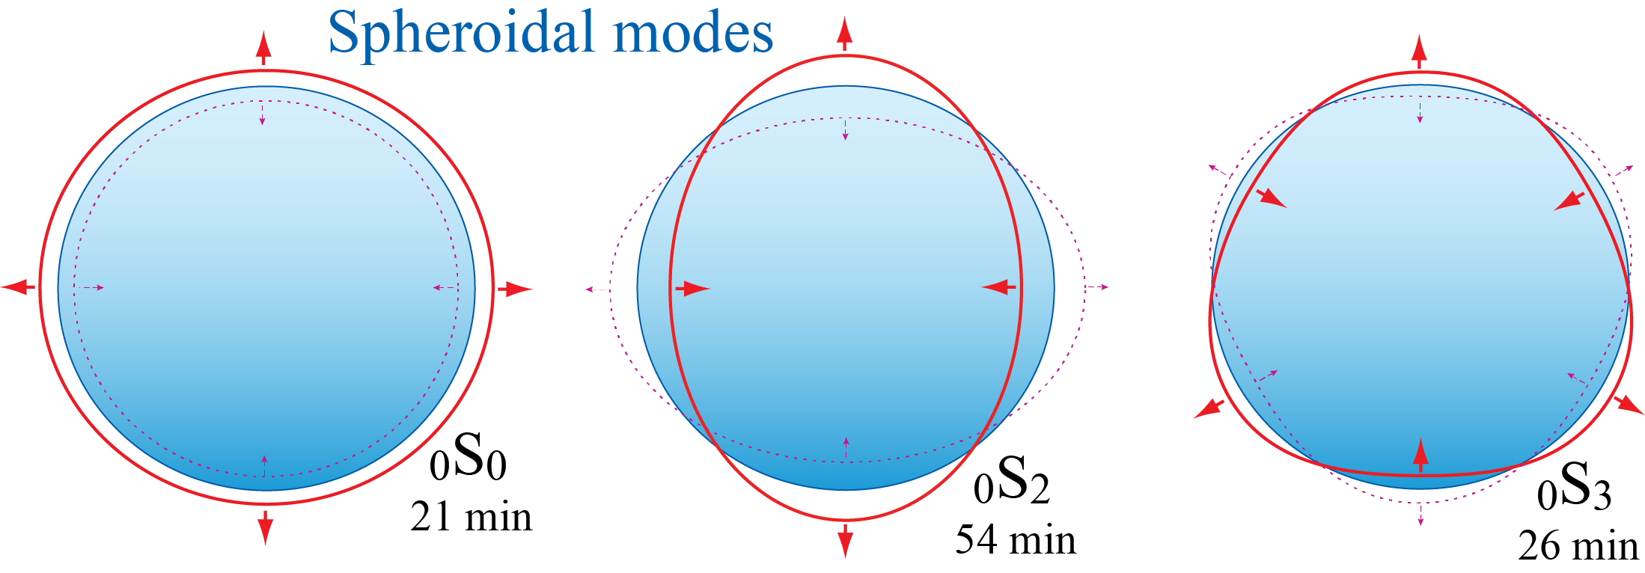
Normal modes
Global, very low frequency vibrations of the entire Earth

Slide 10
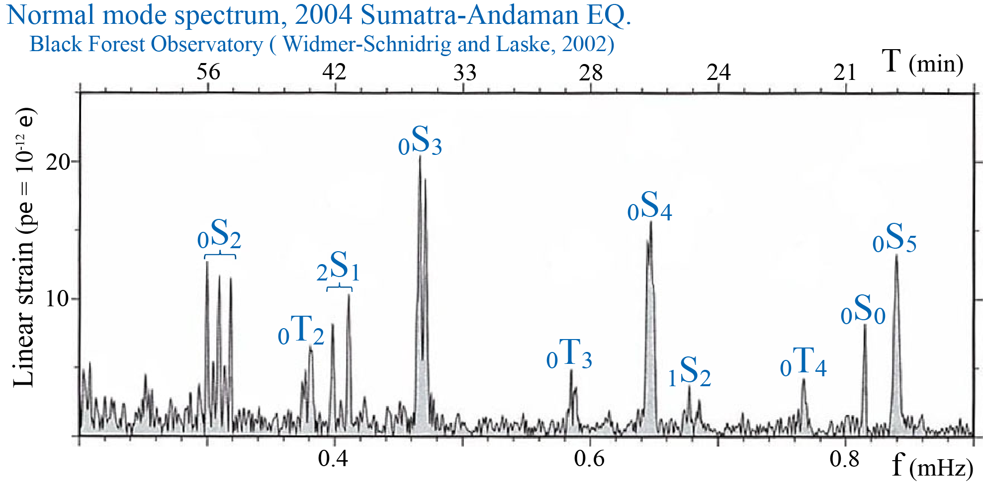
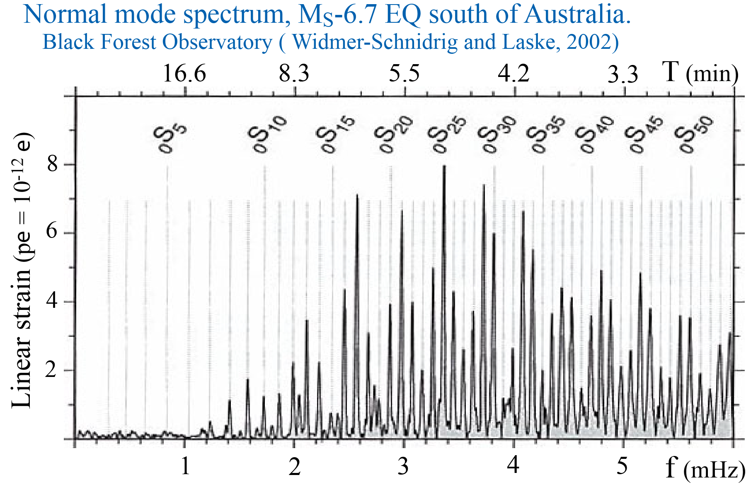
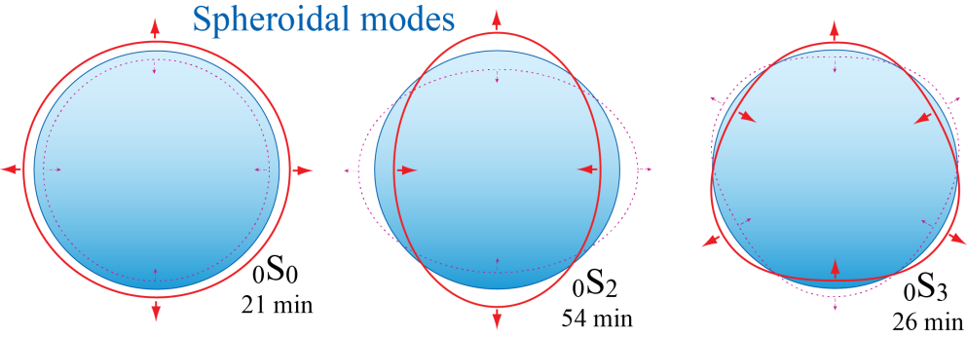
1 mHz =
1cycle / 17min

Slide 11
Seismic velocities ↔ physical properties
Bulk modulus: K (= incompressibility / stiffness)
Shear modulus: G
G/ρ = v_{s}²
K/ρ = v_{p}² – 4/3v_{s}² = v_{φ}² = Φ
v_{φ}: bulk sound velocity,
Φ : seismic parameter
v_{s}² = G/ρ
v_{p}² = (K + 4/3∗G)/ρ

Slide 12
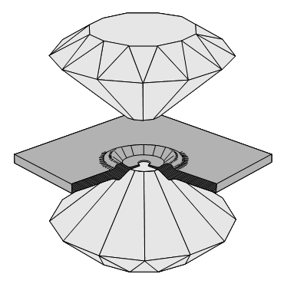
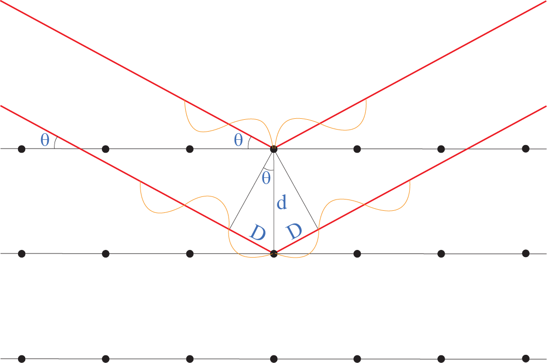
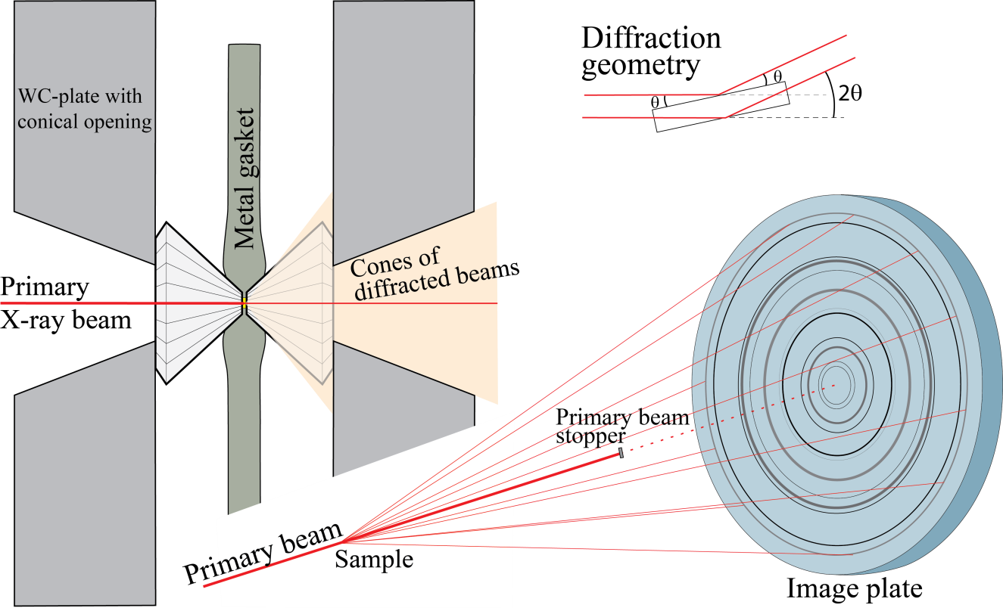
Unit cell V and ρ as a function of p
In-situ high-pT XRD, using high-
intensity synchrotron radiation
Bragg's law
positive interference
when nλ = 2d sinθ
gasket
Angle-dispersive XRD
Monochromatic beam, fixed λ, variable θ
Energy-dispersive XRD
Polychromatic (”white”) beam, fixed θ
d-spacings from the energy peaks
E = hf = hc/λ
λ = hc/E 2d sinθ = nλ = nhc/E

Slide 13
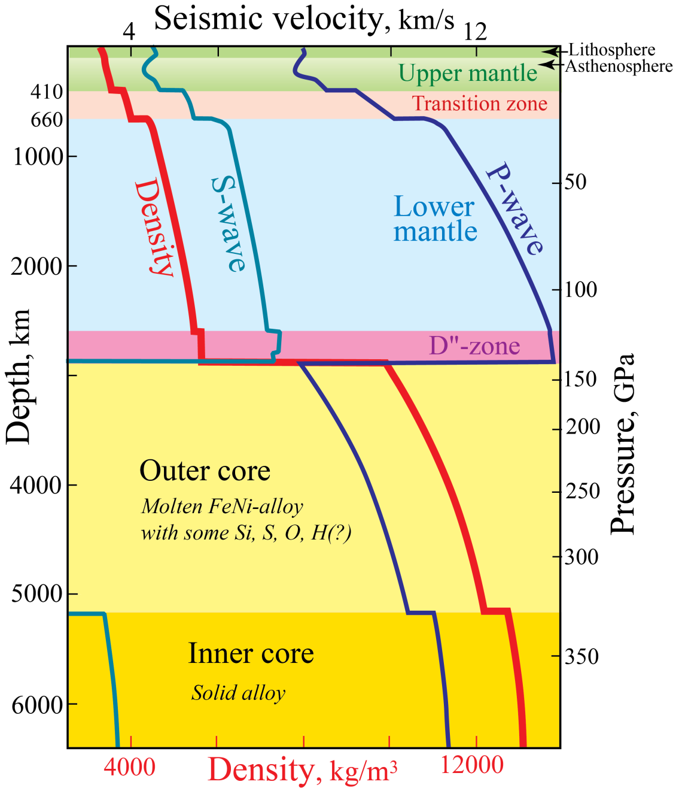
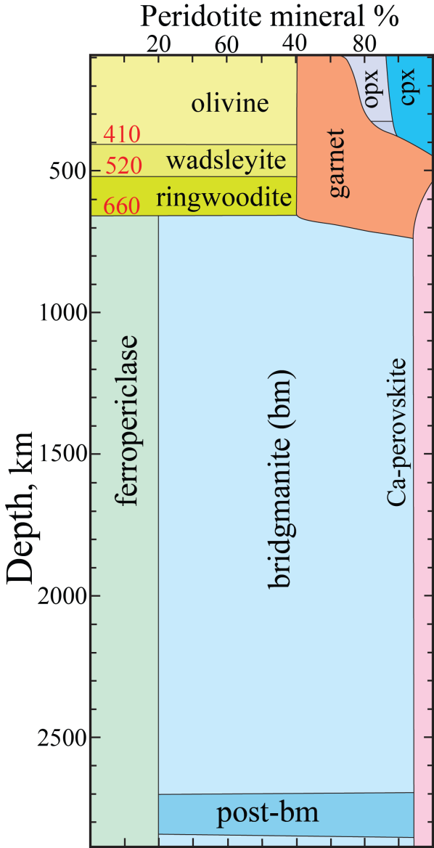
First-order Earth structure
PREM: Preliminary Earth Reference Model
- from seismology (normal modes) and gravity
- includes ρ and p
Dziewonski & Anderson (1981, PEPI)
4082 citations, May 28, 2013

Slide 14
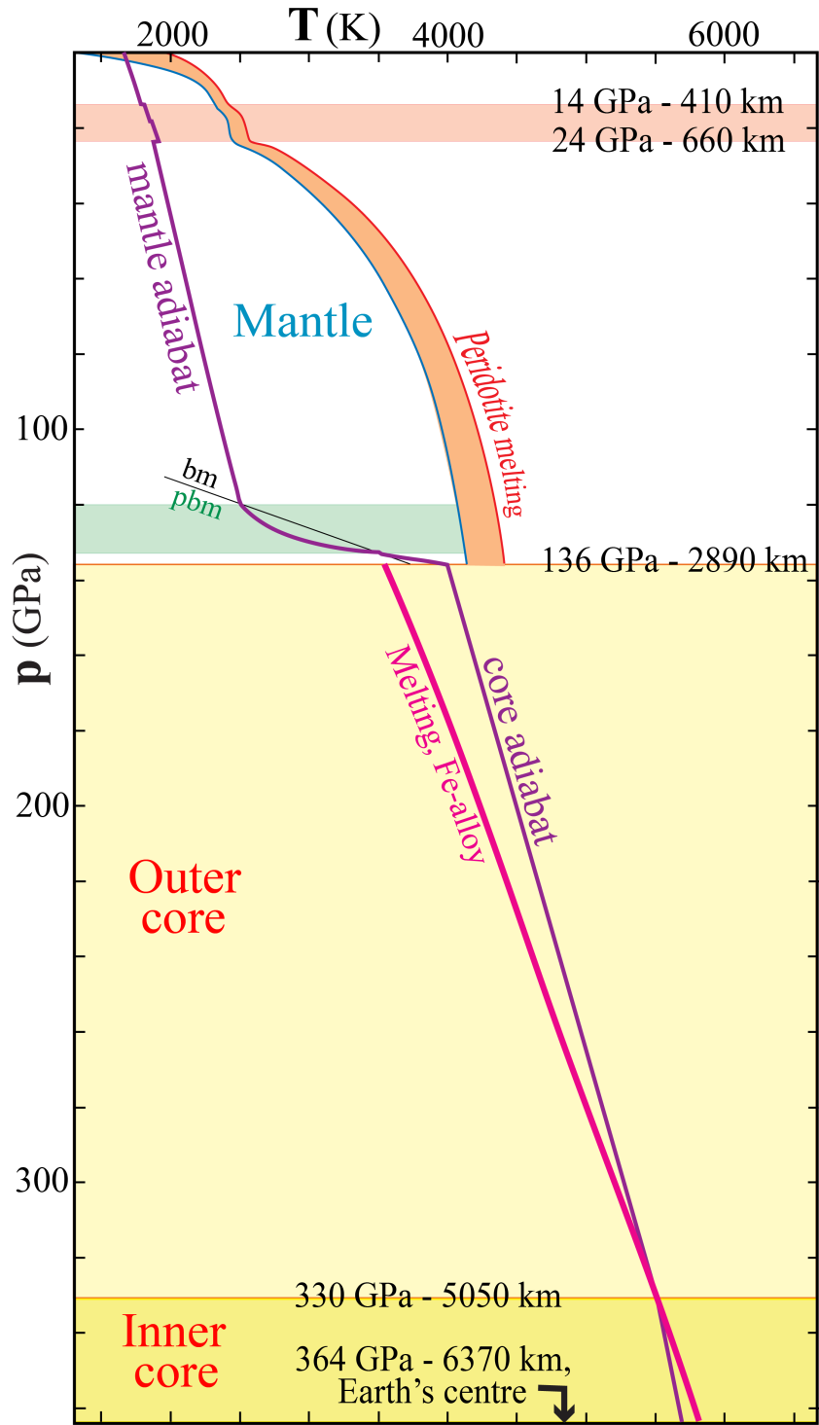
First-order constraints on temperature
660 km discontinuity:
Reaction rwd = bm+fp at 24 GPa
(endothermic transition - small drop in adiabat)
Location of mantle adiabat:
below solidi of peridotite and basalt
CMB: extreme thermal boundary layer !
2500 - 4000 K ! (ΔT: 1500K)
Location of outer core adiabat:
above solidus of FeNi (+ Si, O, S)
Inner-outer core boundary at 330 GPa / 5150 km:
melting temperature of FeNi

Slide 15
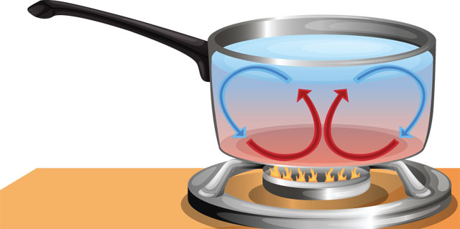
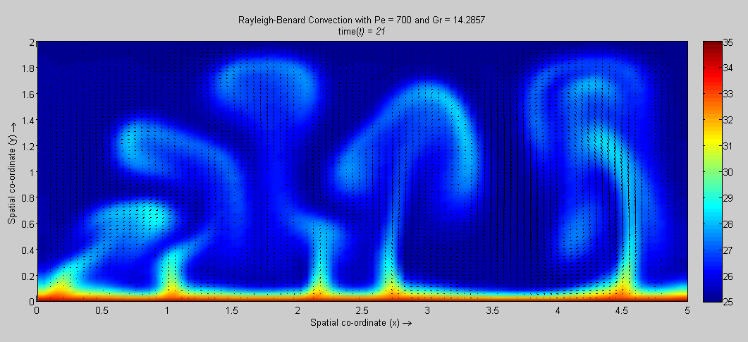
Heat transport
- convection
- conduction (and radiation)
Thermal boundary layer (TLB)
- layer through which convection cannot occur
- heat must be conducted through TLBs
TLB

Slide 16
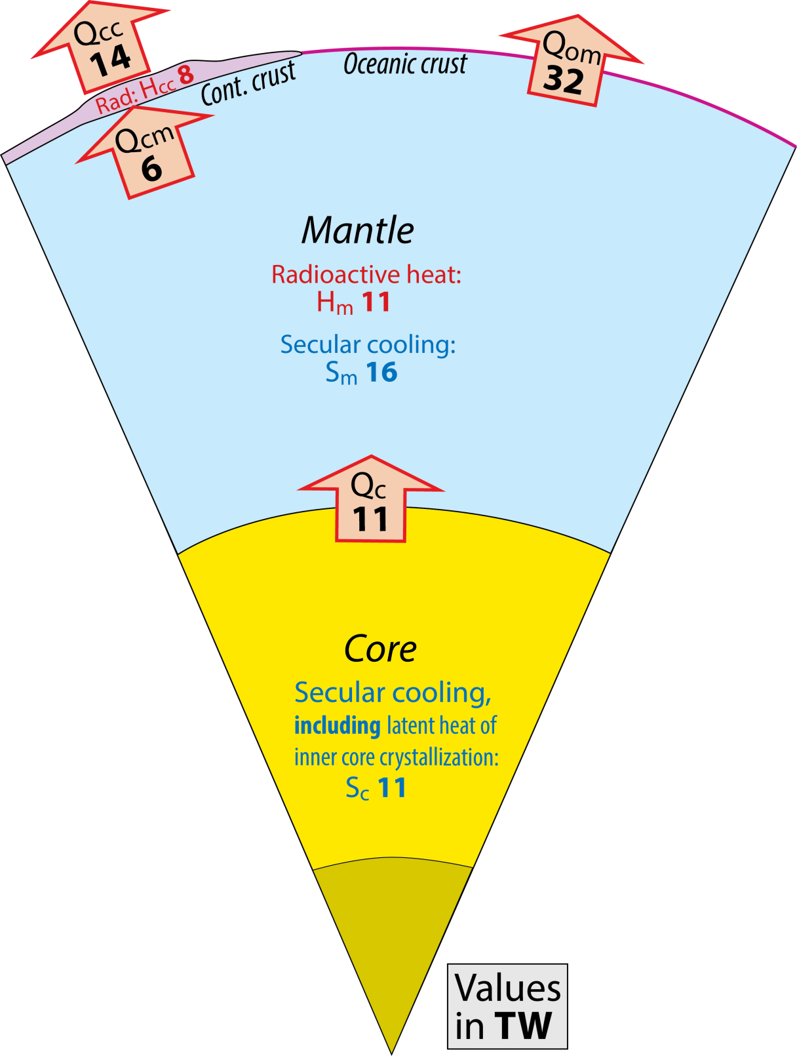
Present heat loss from:
Earth: 46 TW
mantle: 38 TW
(mantle heat generation: 27 TW)
core: 11 TW
Convective Urey ratio
Ur = H_{m} / (Q_{om}+Q_{cm})
= H_{m} / (S_{c}+S_{m}+H_{m})
= 11 / (11+16+11) = 11/38 = 0.29
Bulk Earth Urey ratio
Ur = (H_{m} + H_{cc}) / (Q_{om}+Q_{cm})
= 19/38 = 0.50

Slide 17
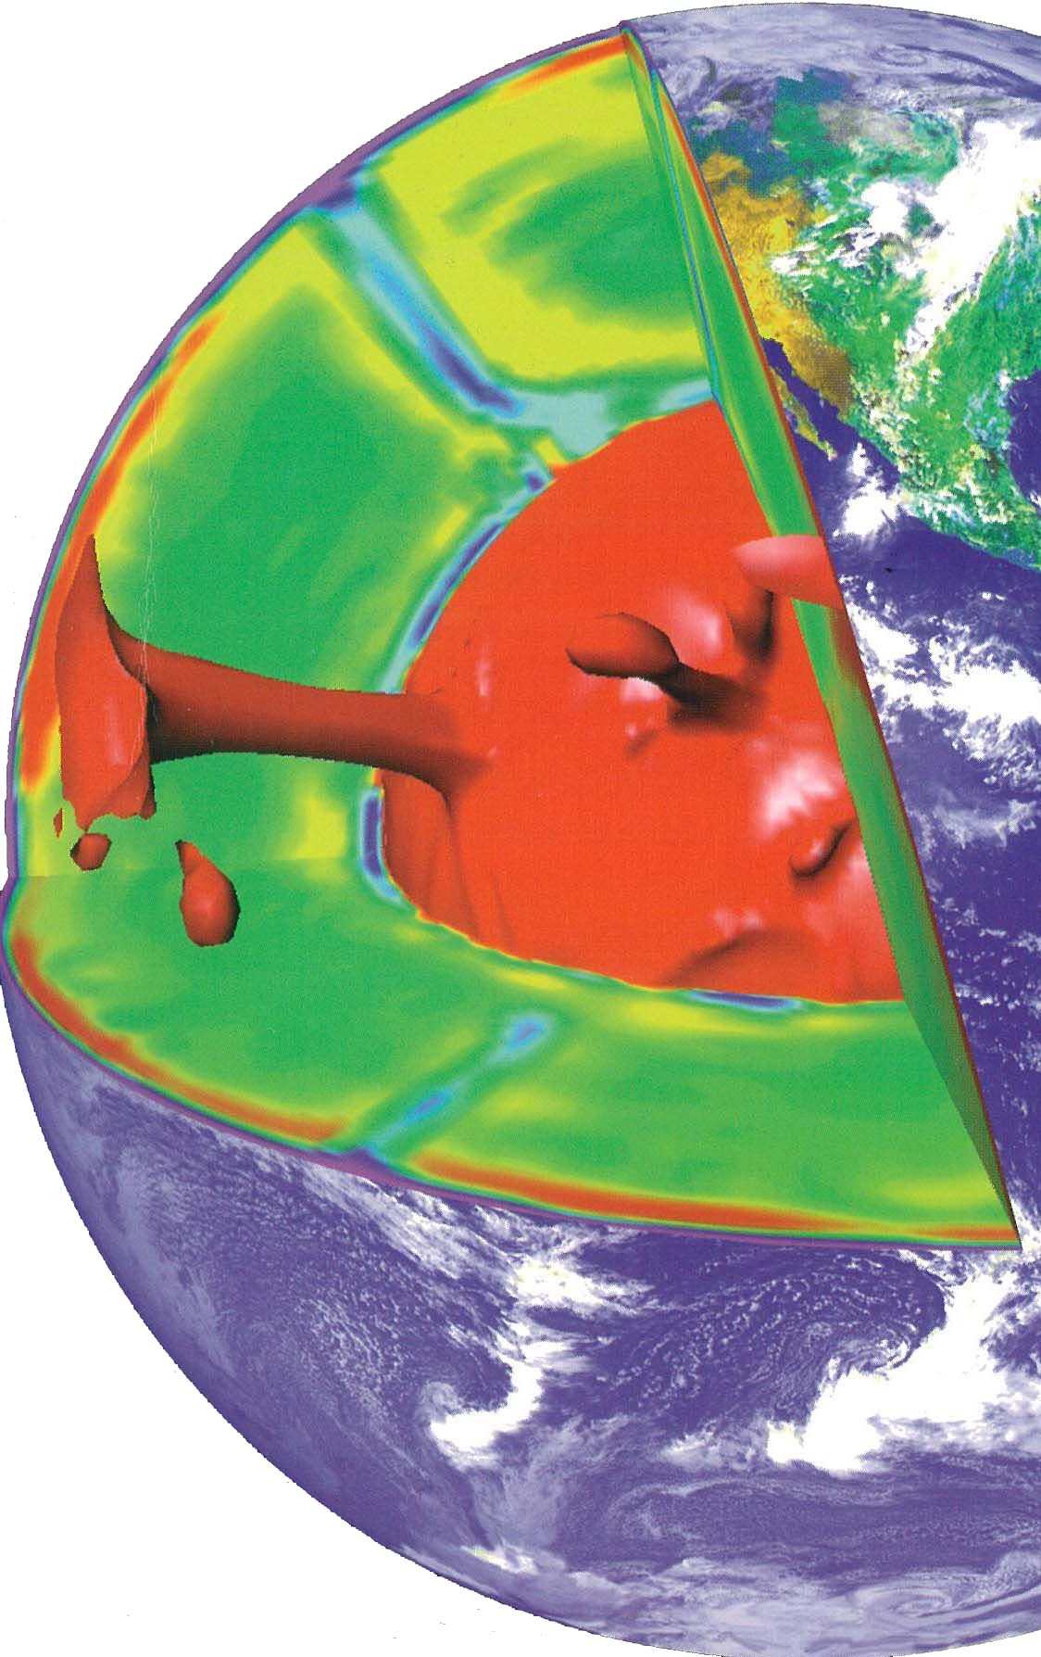
Heat tranfer from the interior: 46 TW
Produced in the crust: 8 TW
radioactivity from U, Th, K
Transfer from mantle: 38 TW
radioactivity, 11 TW + secular cooling, 16 TW + core heat, 11 TW
Transfer from core: 11 TW
latent heat of cryst. of the inner core + secular cooling,
possibly some radioact. from K and U
Mantle convection mode
Outer core surface: TLB
Sinking sheets of cold lithosphere
Counterflow:
slow and passive upwelling, >70% (?)
minor proportion of active plumes
P.J.Tackley in
Schubert & Turcotte (2001,
Cambridge Univ. Press)

Slide 18
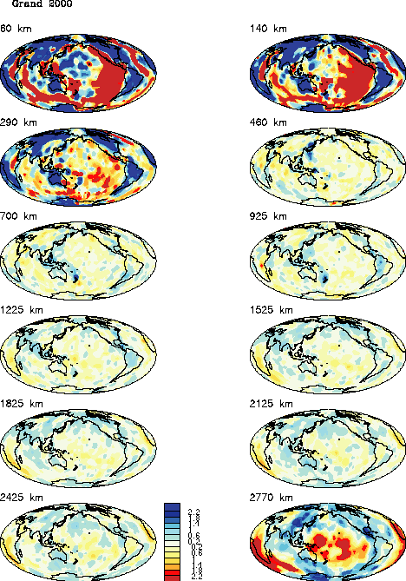
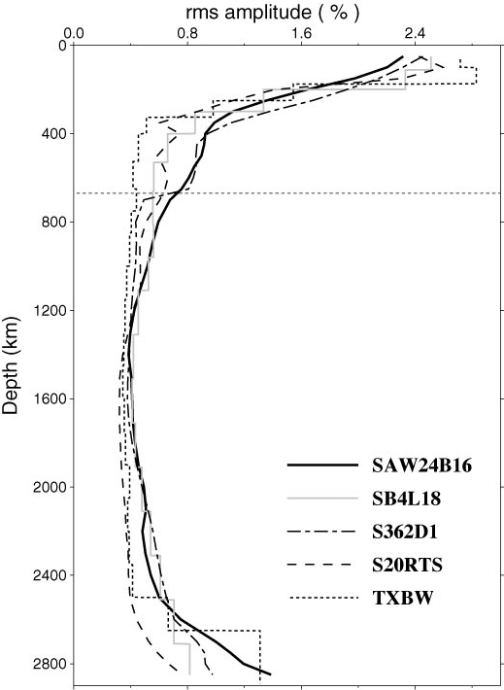
Seismic tomography models
Large v_{S}-amplitudes at the top
and bottom of the mantle
300 km
465 km above CMB
120 km above CMB
Romanowicz (2003,
Ann.Rev. EPS)

Slide 19
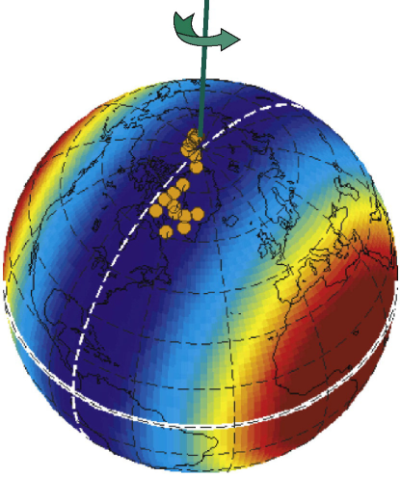
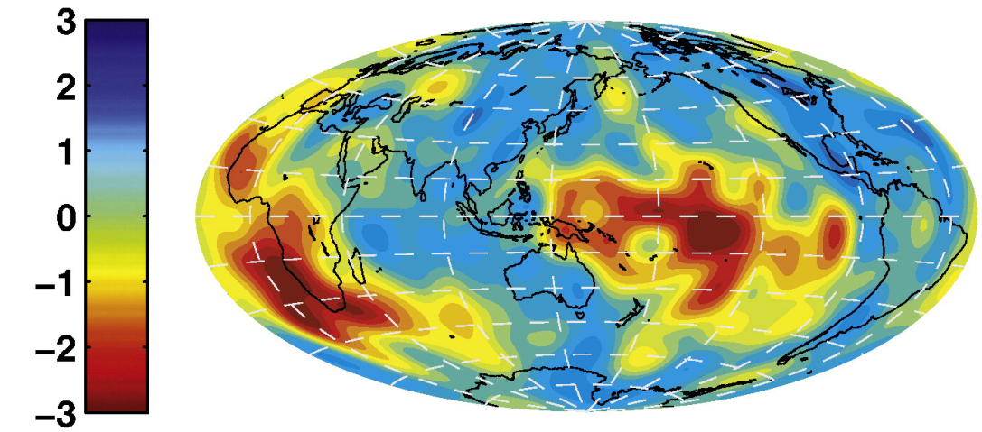
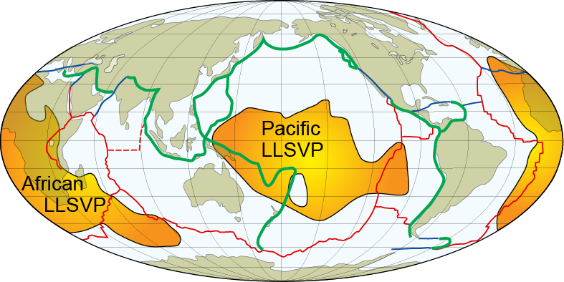
S-wave models, lowermost mantle (D”-zone)
Two large anti-podal, slow provinces - LLSVP
Africa – Pacific (near equator - 180º apart)
Dziewonski et al.
(2010, EPSL)
The degree-2 velocity anomalies, recognized
>30 years ago, coincide with the residual geoid
e.g. Dziewonsky et al. (1977, JGR),
Dziewonski & Anderson (1984, Am Sci)

Slide 20
Seismic tomography, D"
Dziewonski et al.
(2010, EPSL)
Cluster analysis of 5 tomographic models
Lekic et al. (2012, EPSL)
Note the plume locations:
many/most along the LLSVP-margins
L₂-norm
L₁-norm

Slide 21
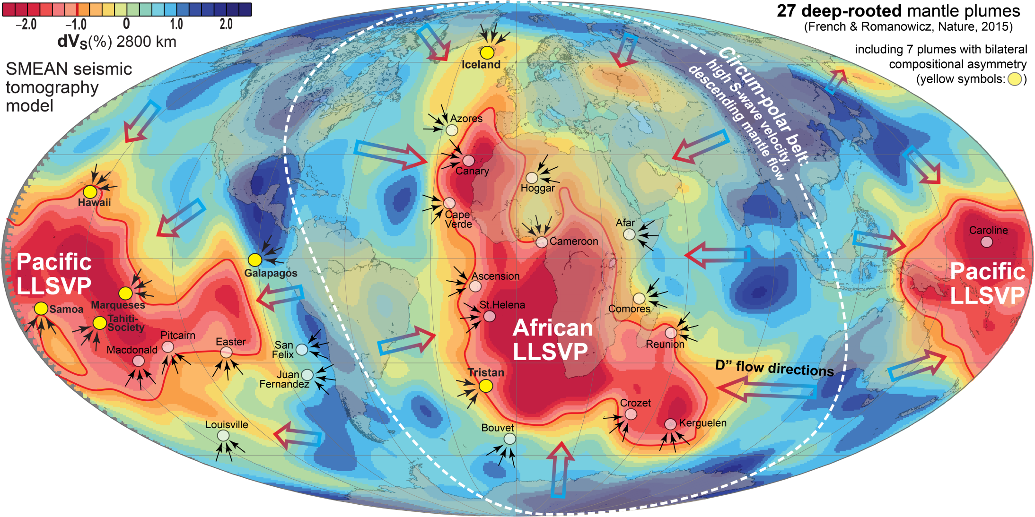
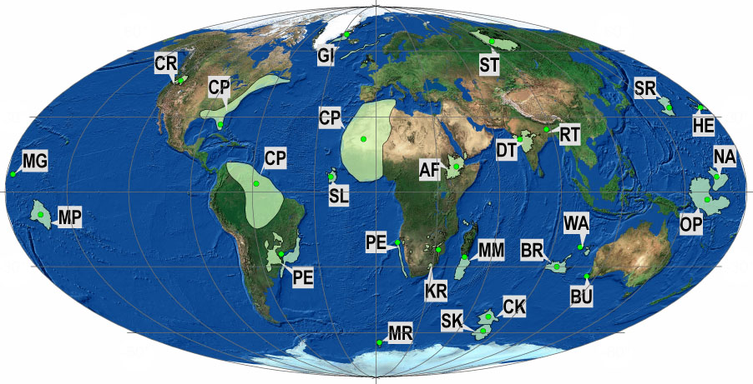
Reconstructed LIPs (24)
SCLIP
300 Ma
27 LIPs: 16-297 Ma
Large igneous provinces
- present distribution
SCLIP, 297 Ma:
Skagerrak-centred LIP,
includes the Oslo Rift
Clustering of reconstructed LIPs along
the LLSVP-margins − implications
1. The plume generation zones and the LLSVPs have
long-term stability (> 300 Ma)
2. LLSVPs must consist of dense (and hot) material
(2-5% density excess to counteract destruction by
thermal buoyancy)
LLSVPs: Thermochemical piles

Slide 22
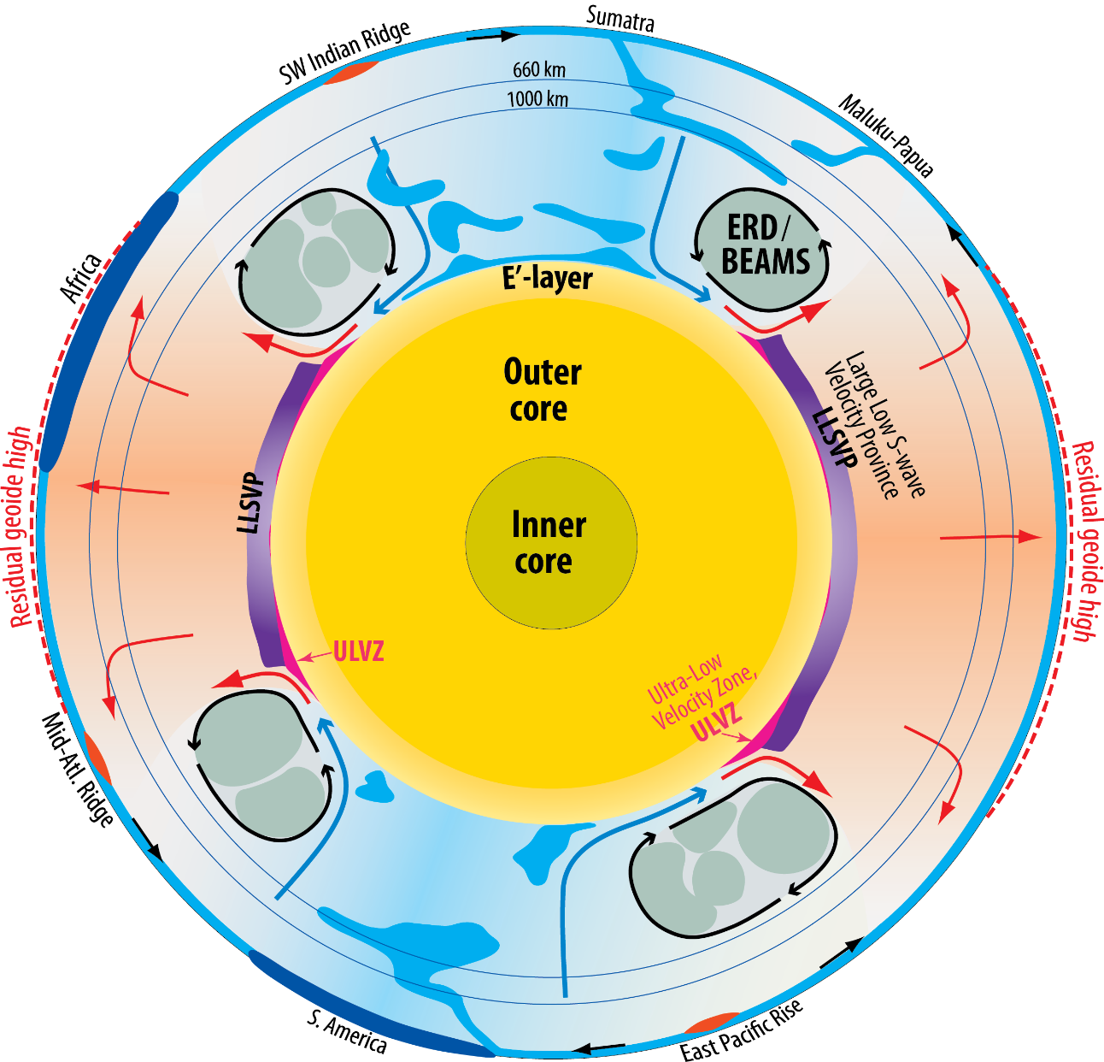
Structures and heterogeneities in the lowermost mantle, the D"-zone
- LLSVPs: Large low S-wave velocity provinces
- ULVZ: Ultra-low velocity zones
Additional lower mantle structures
- BEAMS or ERDs:
Bridgmanite-enriched ancient mantle structures
or
Early refractory domains
Outermost core structure
- E'-layer: stable and stagnant
(non-convecting) layer

Slide 23
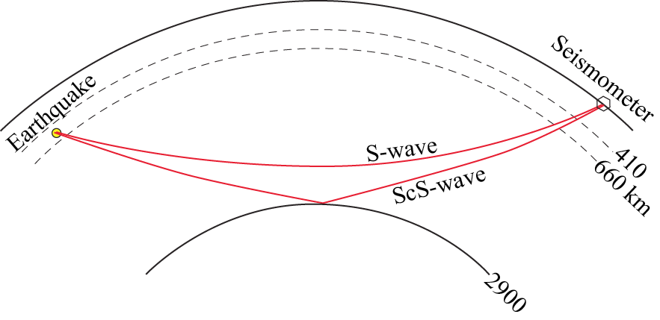
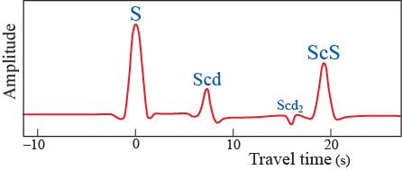
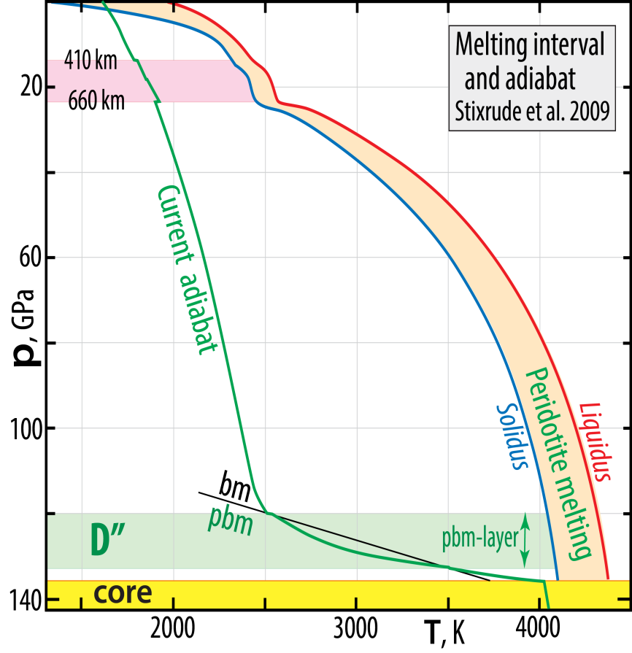
D”-discontinuities
Lay and Helmberger (1983, GJRAS): S-wave triplication: S, Scd and ScS (in certain areas, at least)
The Scd and Scd₂ may be
ascribed to double-crossing of
the post-bridgmanite boundary
large thermal gradient in the D”
- large dp/dT-slope of phase bound.

Slide 24
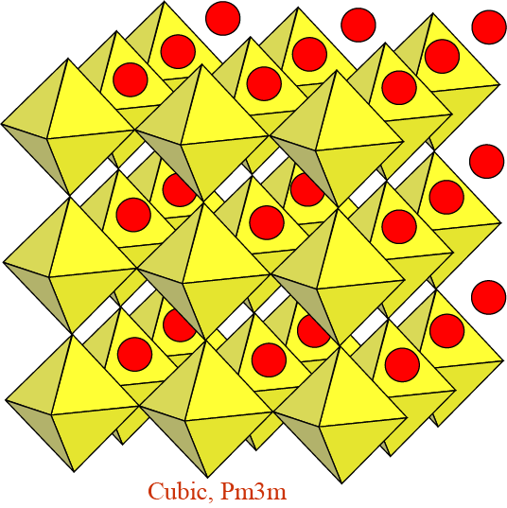
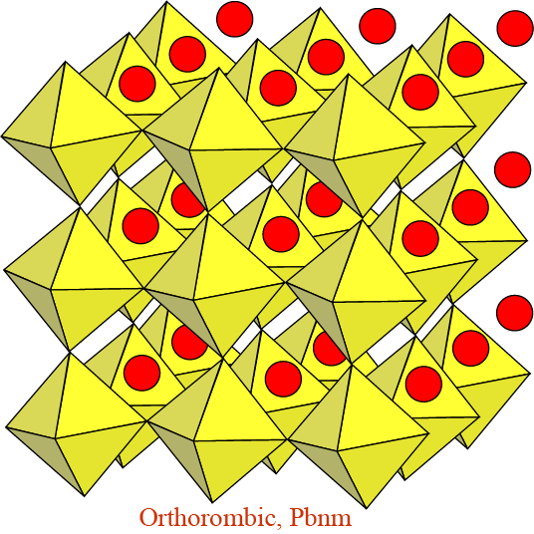
Perovskite-structured minerals:
high coordination numbers - high entropy
The perovskite structure: A^{[12-8]} B^{[6]} O₃
“Ideal”, undistorted structure with larger
divalent cation (Ca) in 12-coordination
Ca^{[12]} Si^{[6]} O₃
Distorted structure with smaller divalent
cations (Mg, Fe) i 8-coordination
Mg^{[8]} Si^{[6]} O₃

Slide 25
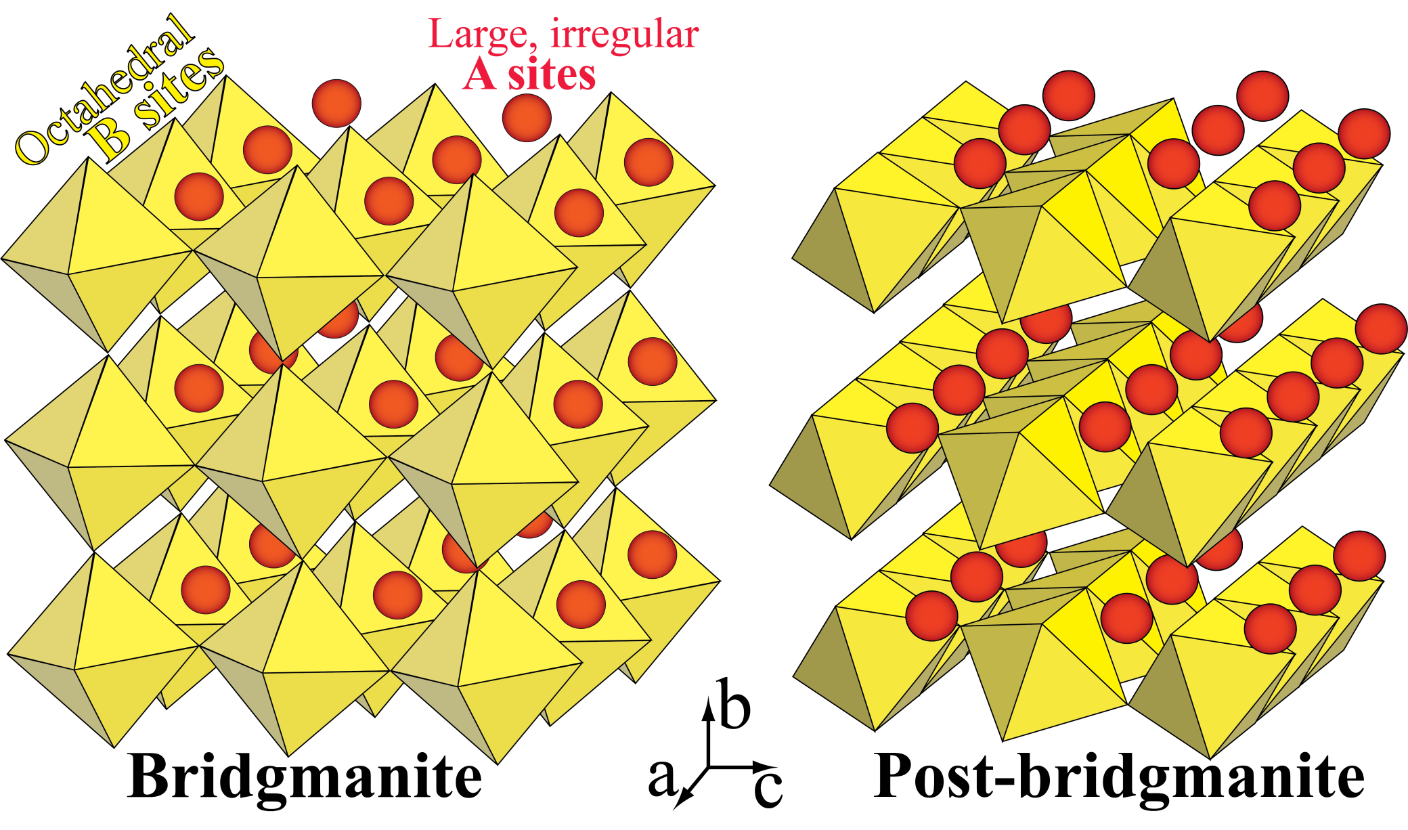
Orthorombic, Pbnm
Orthorombic, Cmcm
High entropy
Slightly lower density than post-bm

Slide 26
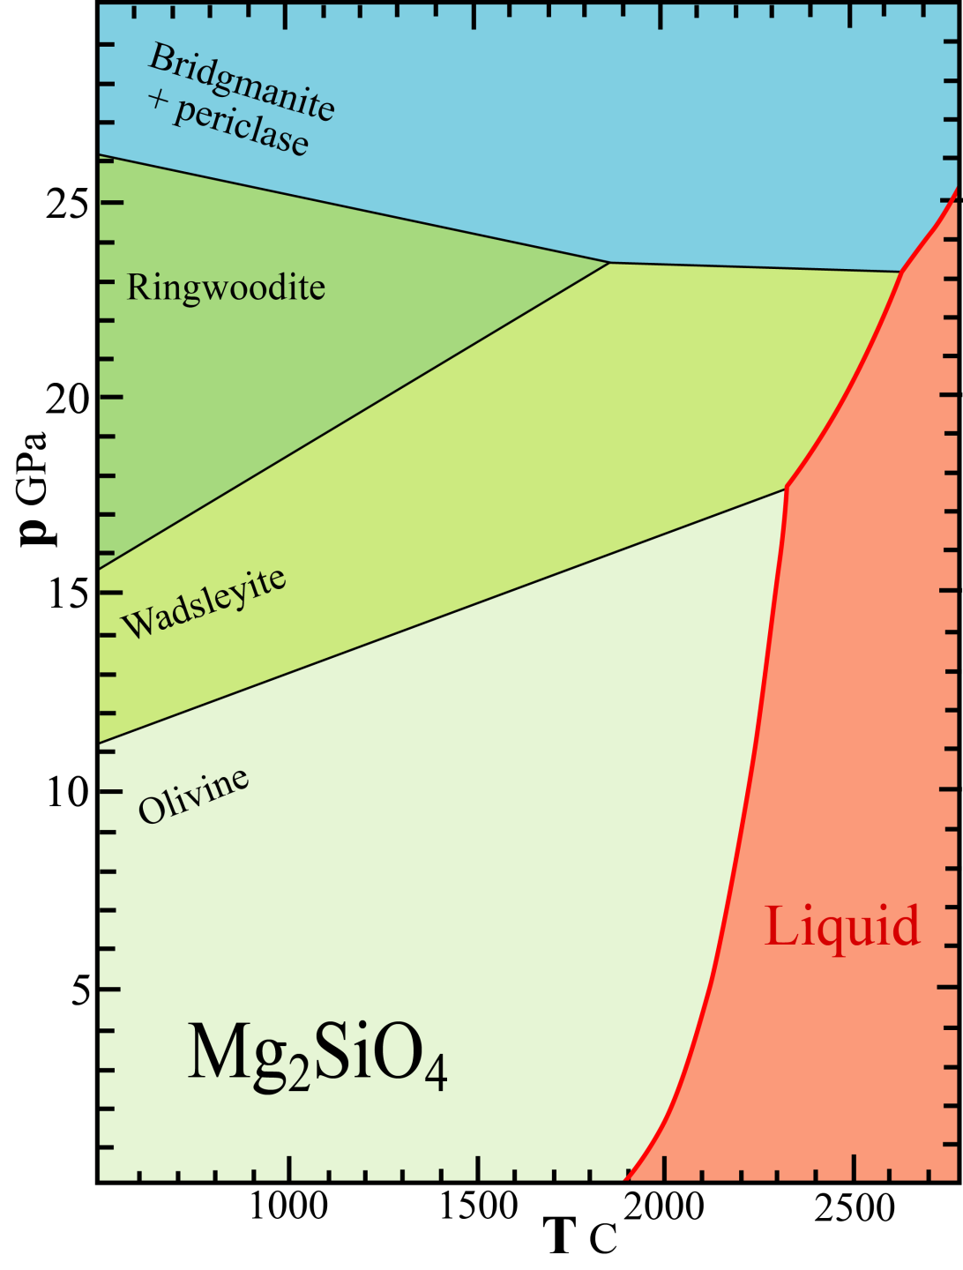
Phase relations UM, TZ, LM:
Simple system Mg₂SiO₄
One-component peridotite analogue
Modified from Fei & Bertka (1999,
Geochem. Soc. Spec. Publ. 6)

Slide 27
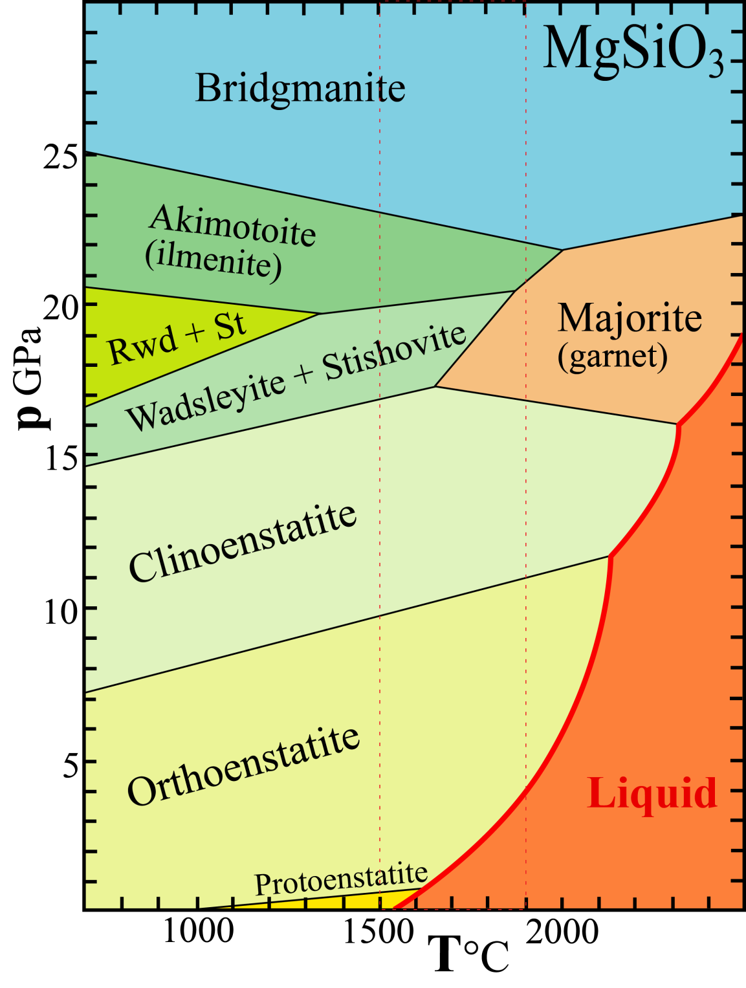
System MgSiO₃
Increasing coordination numbers
Pyroxene: Mg^{[6]} Si^{[4]} O₃
Garnet: Mg₃^{[8]} MgSi^{[6]} Si₃^{[4]} O₁₂
Ilmenite: Mg^{[6]} Si^{[6]} O₃
Bridgmanite: Mg^{[8]} Si^{[6]} O₃
Modified from Fei & Bertka (1999, Geochem. Soc. Spec. Publ. 6)

Slide 28
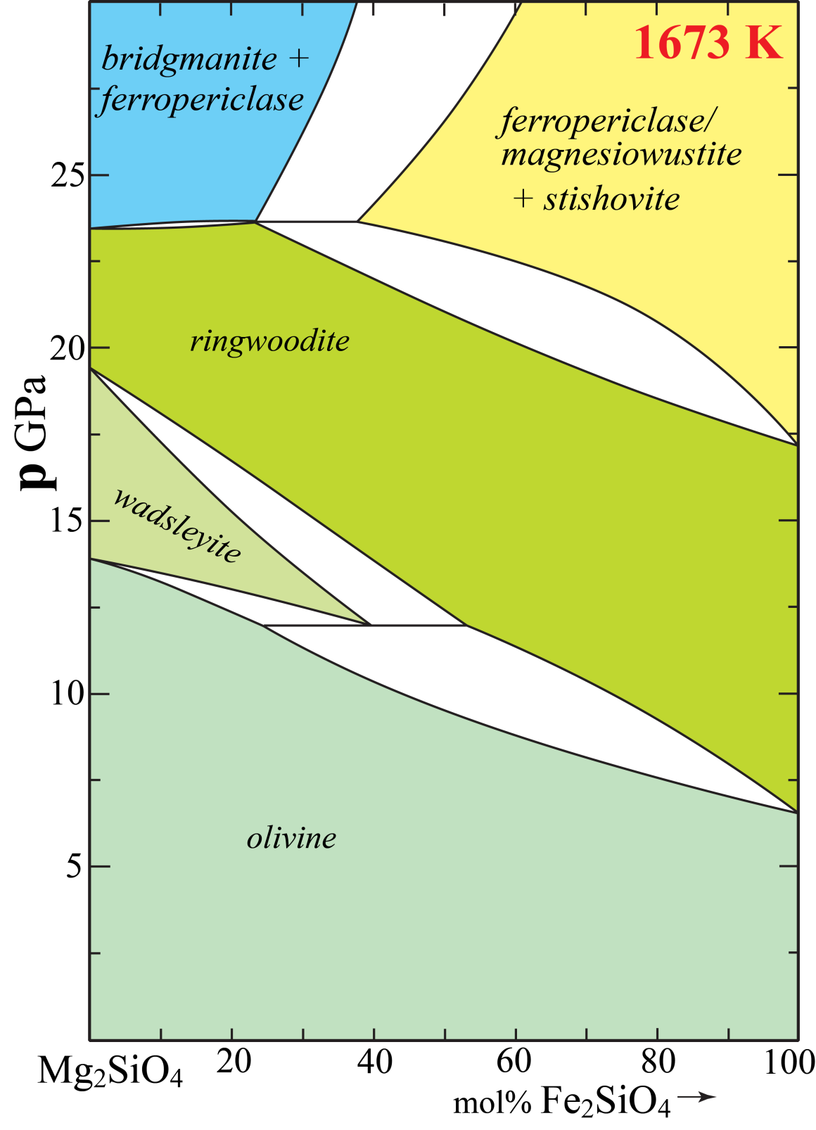

Slide 29
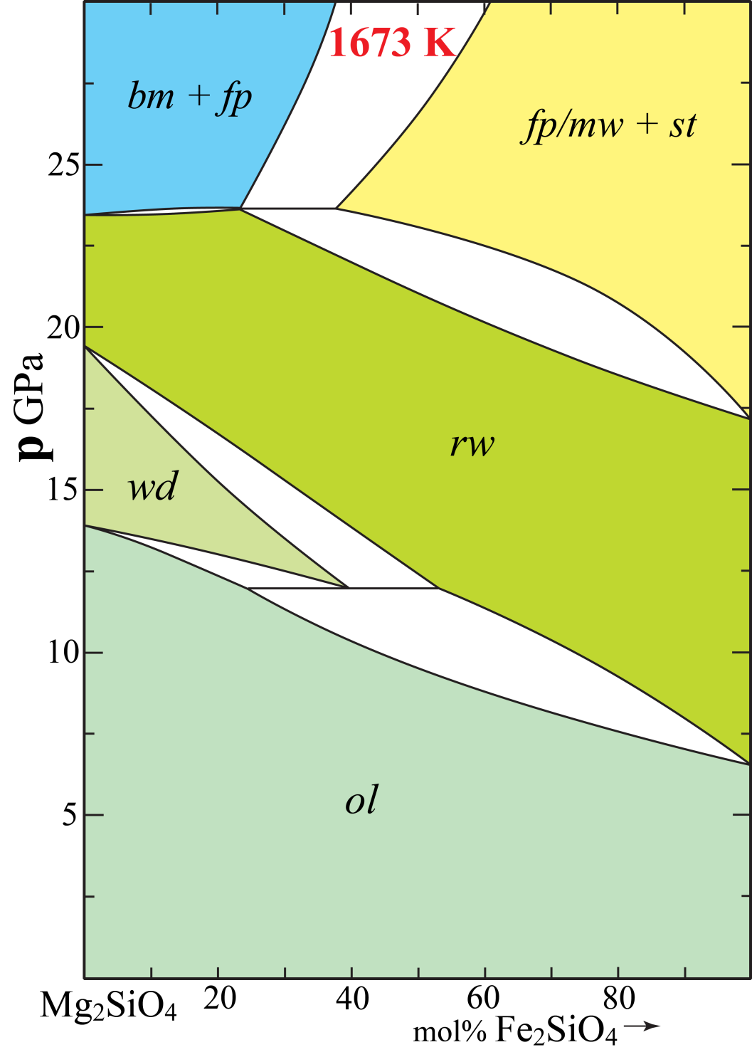
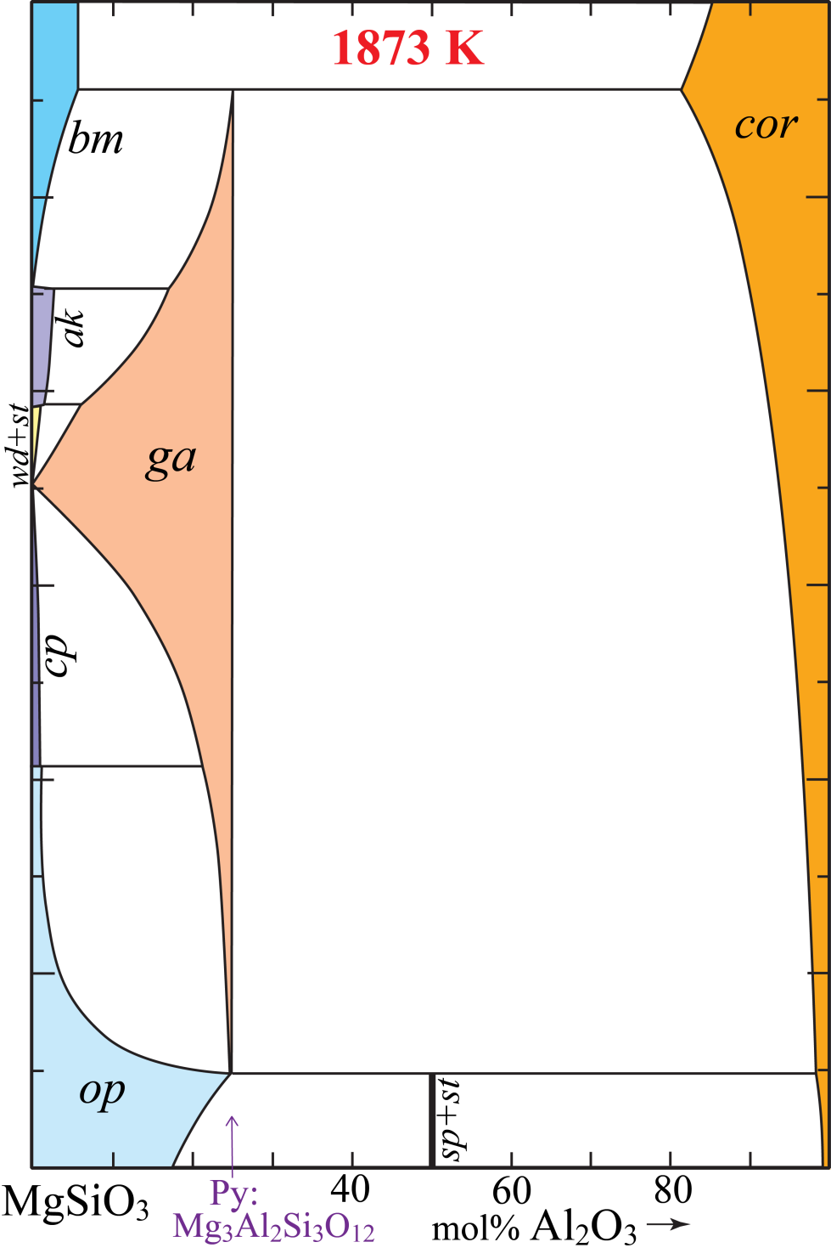
Largely based on:
Stixrude and Lithgow-Bertelloni (2011, GJI)
op: orthopyroxene
cp: clinopyroxene
ak: akimotoite
ga: garnet
cor: corundum
bm: bridgmanite
fp: ferropericlase
mw: magnesiowustite
ol: olivine
wd: wadsleyite
rwd: ringwoodite
st: stishovite

Slide 30
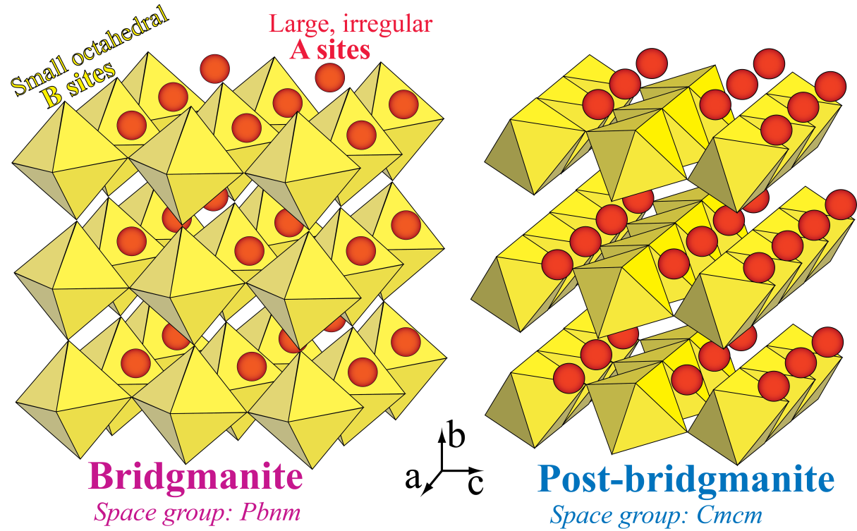
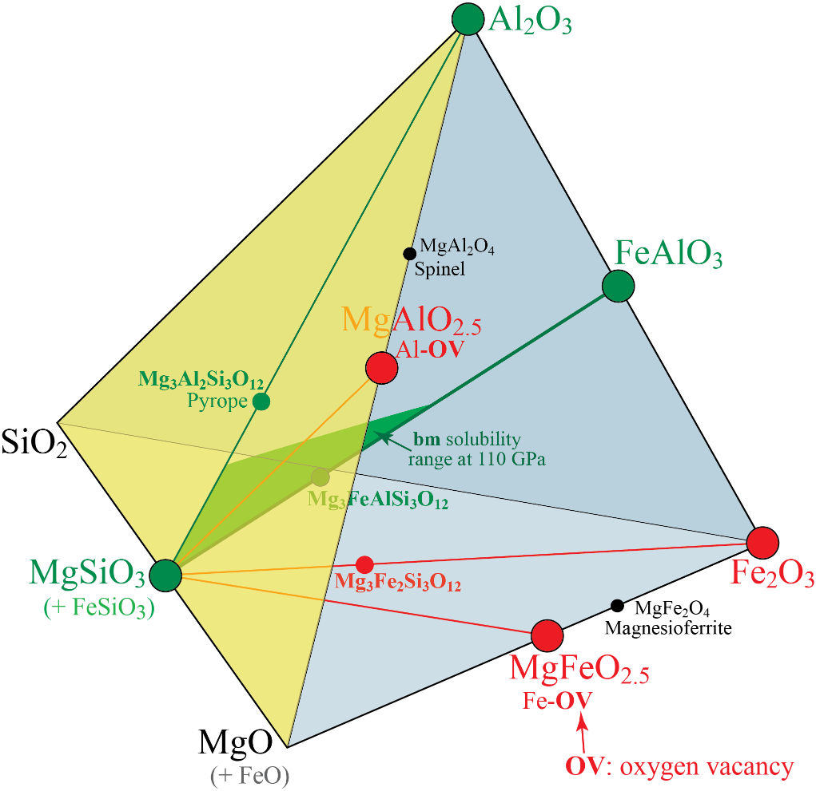
Major element partitioning between bridgmanite and post-bridgmanite
System MSA-Fe³⁺ (MFeSA-Fe³⁺)
with trivalent substitution vectors from MgSiO₃
A B
Site occupancy, mostly: Mg²⁺ Fe²⁺ Si⁴⁺
Main trivalent cations: Fe³⁺ Al
Cation "sizes" (bond lengths):
Fe²⁺ > Mg²⁺ > Fe³⁺ > Al³⁺ > Si⁴⁺
ideal
A-site
ideal
B-site

Slide 31
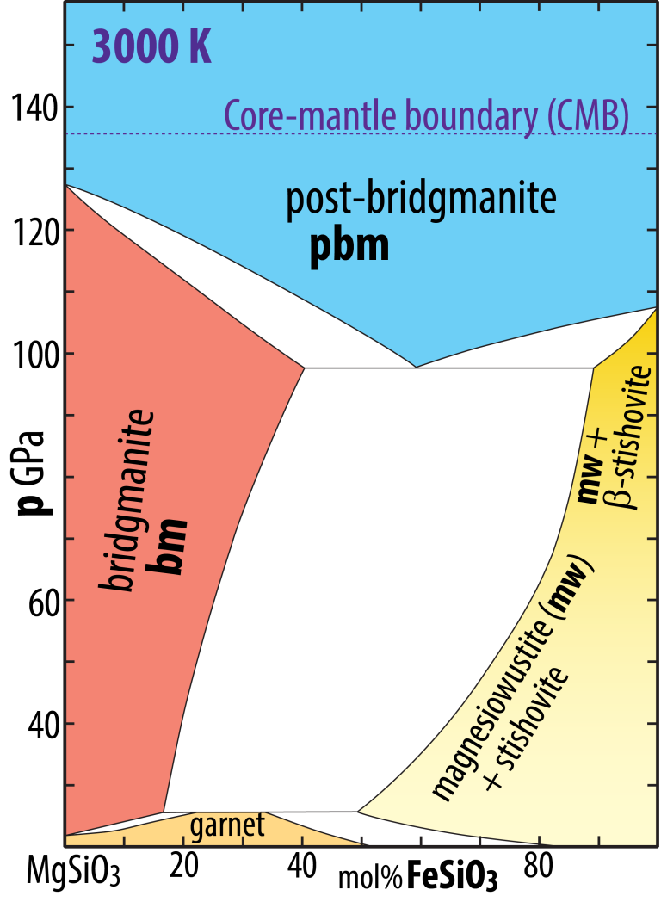
Systems MgSiO₃-FeSiO₃, MgSiO₃-FeAlO₃, MgSiO₃-Al₂O₃
MS-FS MS-FA MS-AA
Mainly from:
Stixrude and Lithgow-Bertelloni (2011, GJI)
Mohn & Trønnes (2018, in prep.)
110 GPa
54 mol% FeAlO₃
14 mol% Al₂O₃
The FS and FA components partition into pbm.
The MS-FS phase loop is at lower p than the MS-FA loop.
The AA component partitions into bm

Slide 32
The bridgmanite redox pump
BSE image of experimental run product:
peridotite comp. at 24 GPa and 2100 °C
bridgmanite
ferro-
periclase
ga
Fe-metal
2 μm
garnet
fp
garnet
bridgmanite

Slide 33
Mg-perovskite as a ”redox pump”
(Frost et al. 2004, Nature)
Subsolidus experiments in different sample capsules
Re
- high oxygen fugacity
- Re provides a sink for metallic Fe by forming ReFe-alloy
Fe, C (diamond)
- low oxygen fugacity
no sink for exsolved Fe-metal
- perovskite-dominated assemblages are buffered by exsolved Fe-metal

Slide 34
Frost et al. (2004, Nature)
TEM-image of submicron-sized Fe-metal
particles (20-150 nm) in perovskite, 24 GPa
BSE-image of subsolidus run product from
diamond capsule, 24 GPa. No Fe-metal added !
10 μm
200 nm
Fe-metal precipitation and periditite reduction
Bridgmanite extracts Fe³⁺ by disproportionation of FeO
Phase relations and bridgmanite crystal chemistry do not depend on externally imposed f_{O2}
Garnet has a similar, but not so strong, effect in the lower part of the UM and the TZ

Slide 35
Andrault et al. (2018, GPL)
TEM image, submicron-sized Fe-metal
particles (30-150 nm) in bridgmanite,
experimental run product, 40 GPa and 2500 K
Starting material: No metallic Fe
pyroxene + alumina
(Mg,Fe)SiO₃ + Al₂O₃
Formula
Fe₁₅Mg₇₁Al₁₄ Al₁₅Si₈₅ O₃₀₀
bm-components
71% MgSiO₃, MS
15% FeSiO₃, FS
14% AlAlO₃, AA
85
nm
30
nm
150
nm

Slide 36
Lower mantle iron disproportionation
- driven by the crystal chemical affinity for the FeAlO₃-component in bridgmanite
- mantle bridgmanite (in both peridotite and basalt) has Al > Fe^{total}
→ additional Al₂O₃-component
Reaction at the 660 km boundary:
ringwoodite (rwd) = bridgmanite (bm) + ferropericlase (fp)
2 Fe₂SiO₄ + 2 Mg₂SiO₄ + Al₂O₃ = 2 FeAlO₃ + 4 MgSiO₃ + FeO + Fe
ga-comp.
fp
FeNiS-
alloy
rwd
bm
Or:
2 Fe₂SiO₄ + 2 Mg₂SiO₄ + Mg₃Al₂Si₃O₁₂ = 2 FeAlO₃ + 7 MgSiO₃ + FeO + Fe
ga-comp.
fp
FeNiS-
alloy
rwd
bm

Slide 37
Mass balance calculation
of LM-mineralogy
78 % bridgmanite
13 % ferropericlase
100 wt% peridotite (pyrolite),
upper mantle Fe³⁺/ΣFe (2%)
7 % Ca-perovskite
1 % metal phase
90% Fe, 9% Ni, 1% S

Slide 38
Planetary magma oceans - early Earth differentiation
Planetary scientist and painter W.K. Hartmann

Slide 39
A possible underground and partially
crystallized magma ocean in
the present Solar system
Jupiter’s moon, Io
volcanically most active object
in the Solar System
Heat source:
gravitational energy – tidal friction
orbital kneading: Jupiter – Galilean moons
Manipulated photo mosaic,
NASA-Galieo, 1997

Slide 40
Planetary magma oceans (silicate magma)
- globally continuous and thick layer of largely molten silicate
Fe-dominated cores are still molten, but not classified as magma oceans
- widespread in the first 100-500 Ma of inner Solar system evolution
Heat sources
- short-lived radioactive isotopes, especially ²⁶Al → ²⁶Mg, T_{h}: 0.7 Ma
- core segregation, separation of excess liquid Fe-metal, followed by
sinking towards planetary centre
- collisional energy
- orbital gravitation energy – tidal (frictional) energy

Slide 41
Planetary accretion – very briefly
Beginning, t₀: 4567 ±0.4 Ma
Runaway
gravitational growth
< 0.5 Ma
Planetary embryos
10 - 1000 km
Dust accretion:
< 10 ka
Giant collisions
0.5 – 100 Ma
Planetesimales,
1 - 10 km
Planets

Slide 42
Moon formation and Earth’s last and largest (10%?) accretional increment
about 100 Ma after t₀
Moon orbit is very close to
fast-spinning Earth (< 5hr day)
- tidal friction heat
Theia (>Mars-size)
collides with Earth
Moon grows from vapourized and molten
accretion disk surrounding Earth
View of Moon from
Earth’s magma ocean
Later view of Earth with surface
water from Moon’s mare basalt
lava field

Slide 43
Timescales: heat delivery and MO-episodes
Short-lived radioactivity: ²⁶Al, ⁶⁰Fe
- up to ~ 4*T_{h}, i.e. only 0-3 Ma after t₀
- the only viable heat source for magma oceans
on small planetary embryos, like Vesta
Collisional heat
episodic: 0.5 – 100 Ma
Core segregation
- occurs when melting is pervasive
- repeated magma oceans and core segr. episodes
(after each giant collision) on large planets, like Earth
Tidal friction
important for the early Earth-Moon system

Slide 44
Magma oceans
⇓
Planetary differentiation into core and mantle
Crystallization of magma oceans
⇓
Light, primary crusts
Dense crystal cumulates
Residual enriched melts (mostly solidified now)
Our prime example: the Lunar magma ocean
The Apollo program demonstrated the reality of magma oceans

Slide 45
Evidence for the lunar MO
- mare basalts
- thick crust of anorthosites
Mare basalt
Lunar mare basalts:
extreme compositional range
- Low-Ti basalts
- High-Ti basalts
Anorthosite
- KREEP-basalts
Source regions for mare basalts:
Incompletely mixed MO cumulates

Slide 46
Crystallization of the lunar magma ocean
Crust - mantle stratigrahy

Slide 47
Extensive lunar mantle melting – overturn of gravitationally unstable cumulates
Mare basalt volcanism: peak intensity at 3.8 − 3.6 Ga
Major turnover and gravitational readjustment of magma ocean cumulates (?)
Mare Imbrium
M. Serenitatis
Oceanius
Procellarium
M.
Tranquilitatis
Heavy cpx-ilm
cumulates over
light peridotites

Slide 48
Melting in the Earth’s mantle
- related to mantle convection and plate tectonics
- decompression melting in ascending astenosphere (MORB)
and in plumes (LIP, CFB, OIB)
- flux-melting (H₂O) above subduction zones
(IAB, cont. margin basalts, CMB)
What about the mare basalt ’’episode’’ on the Moon ?
- very limited current mantle convection (almost none?)
- no plate tectonics with lithosphere-asthenosphere division
- low volatile content
Cumulate pile inversion, triggering a major convection episode
and/or: related to the late heavy bombardment period

Slide 49
Source regions for mare basalts:
Magma ocean cumulates
Stratigraphy,
crust - upper mantle
KREEP-basalts
High-Ti basalts
Low-Ti basalts

