Slide 1
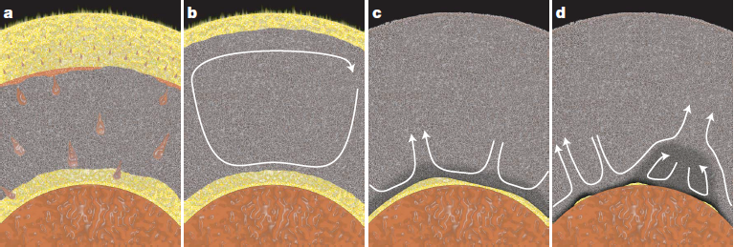
Core-mantle evolution: chemical exchange between
the basal magma ocean (BMO) and the protocore
Figures in this presentation:
Trønnes et al (2019, Tectonophys.) or
unpubl., unless indicated otherwise
BMO-model: Labrosse et al. (2007, Nature)
The BMO was long-lived:
might have lasted into the Proterozoic or even Phanerozoic ??
Are the ULVZs partially molten BMO-residues ??

Slide 2
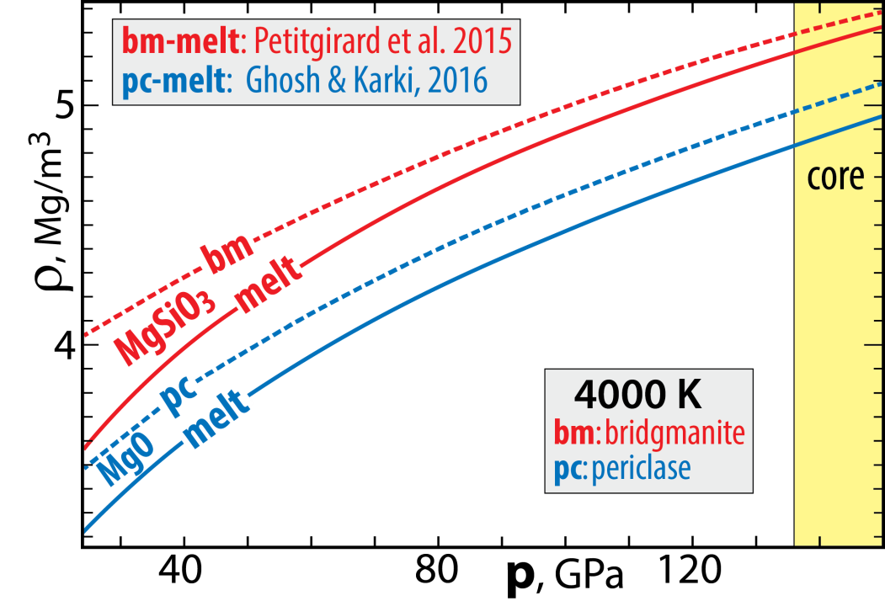
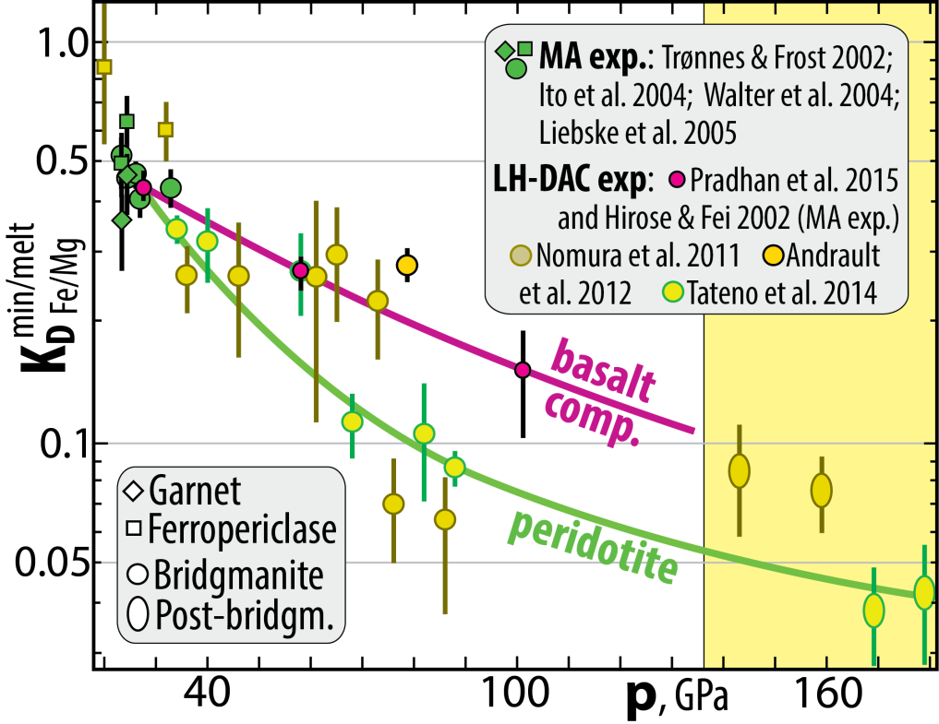
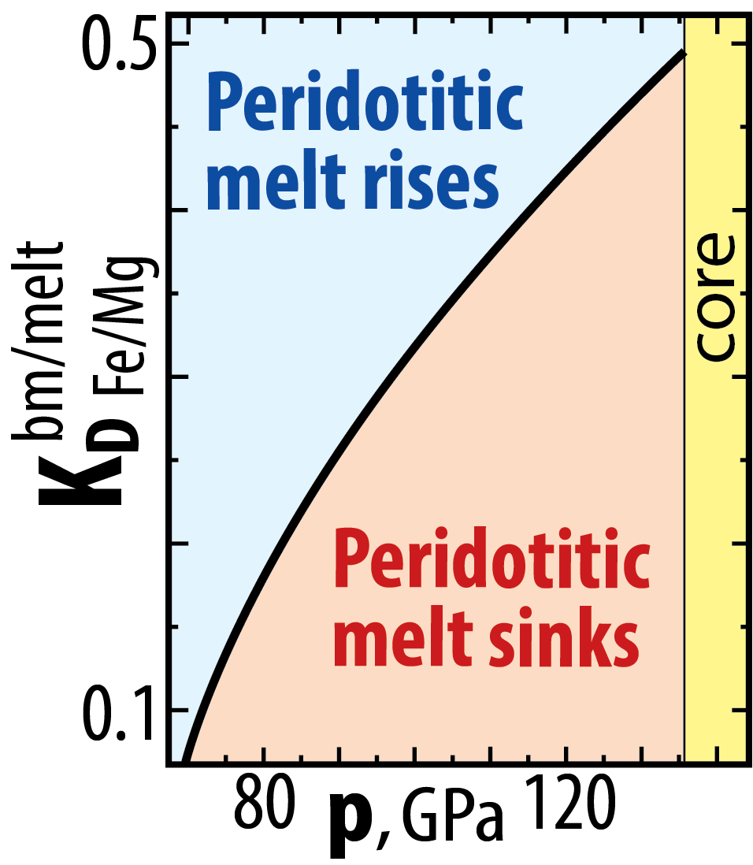
Why a BMO?
solid-melt neutral buoyancy at high p
Strong Fe/Mg-partitioning densifies peridotite melts
bm/melt
Fe/Mg
K_{D} = (Fe/Mg)^{bm} / (Fe/Mg)^{melt}
73-80 GPa:
~1800 km depth

Slide 3
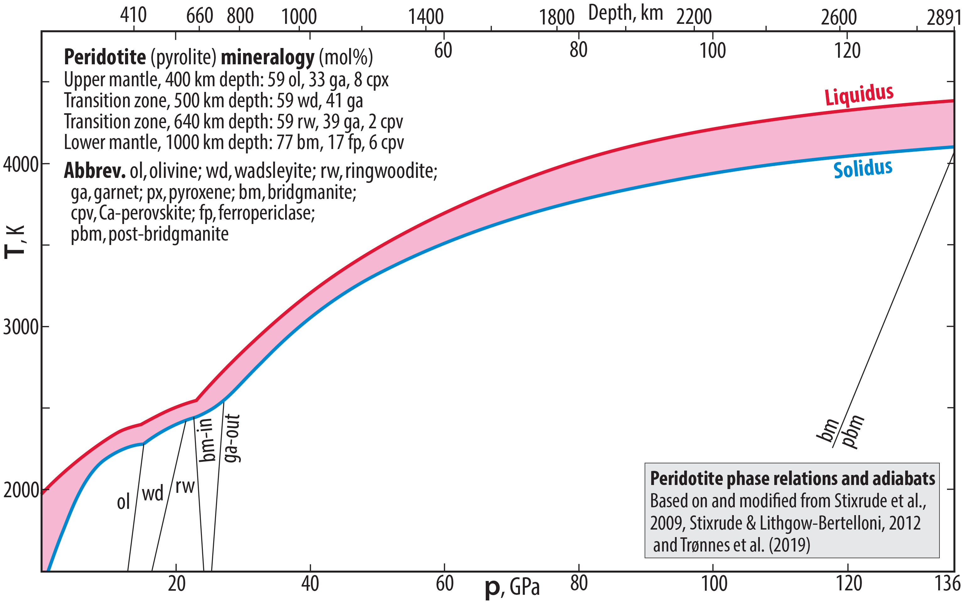
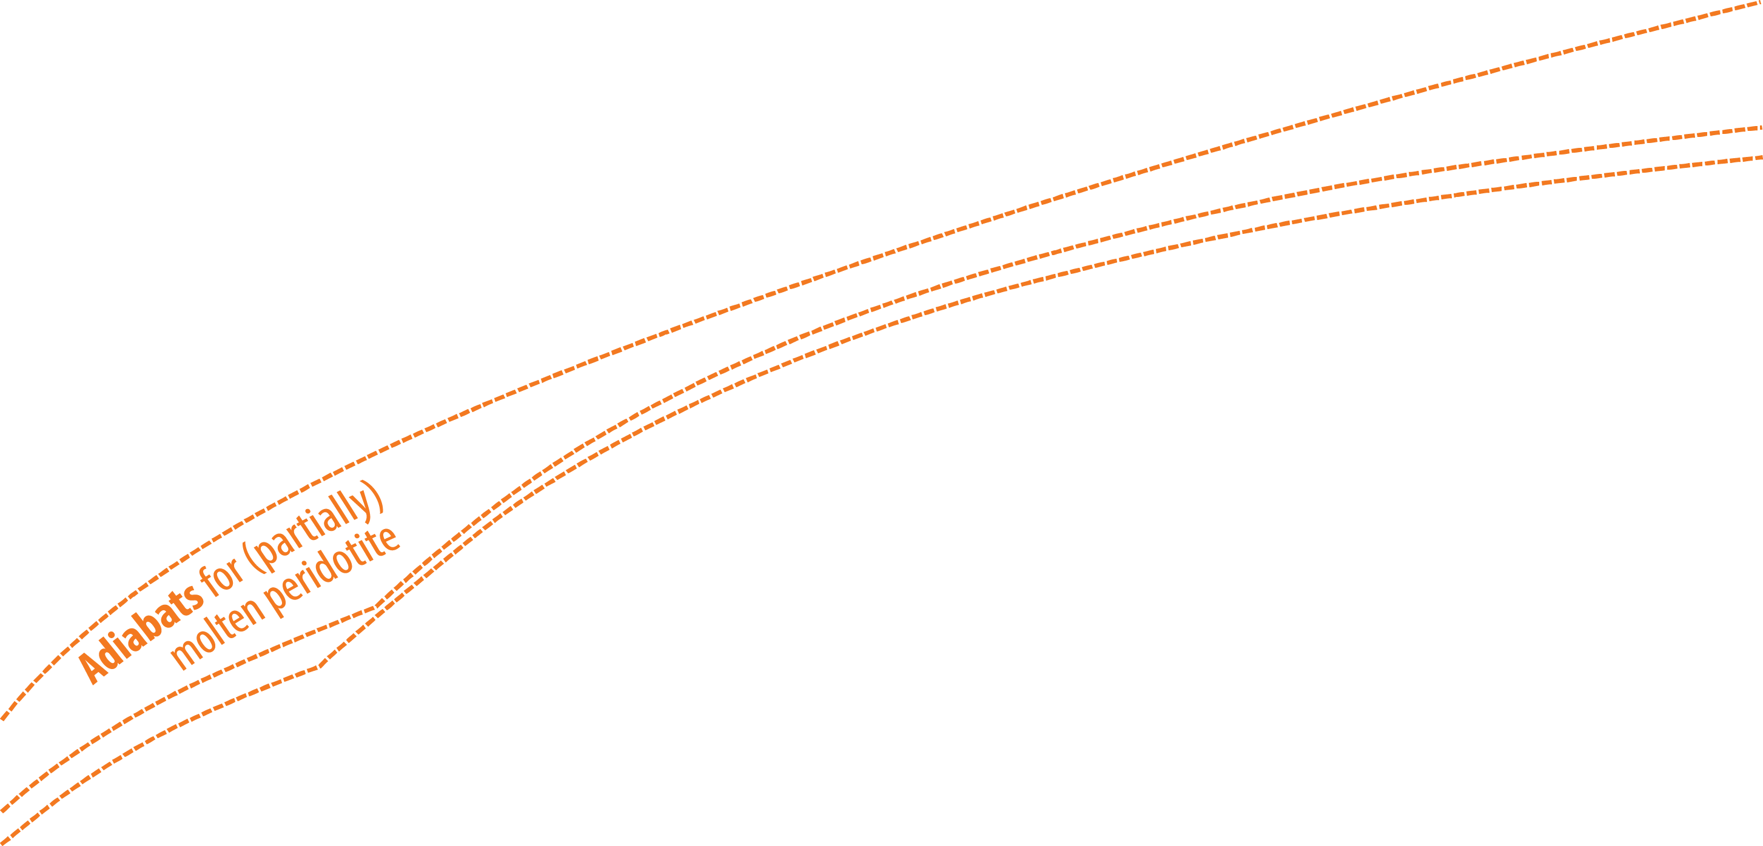
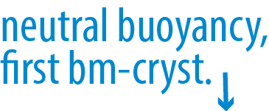
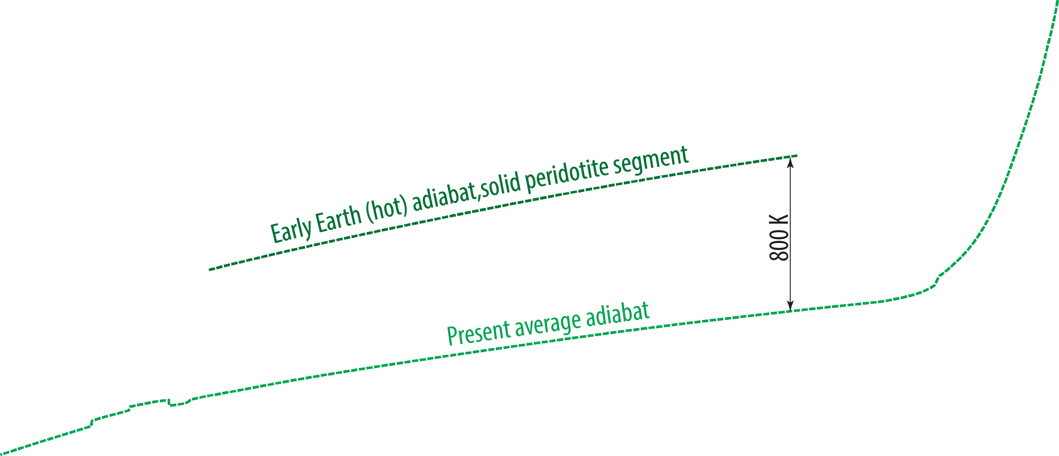
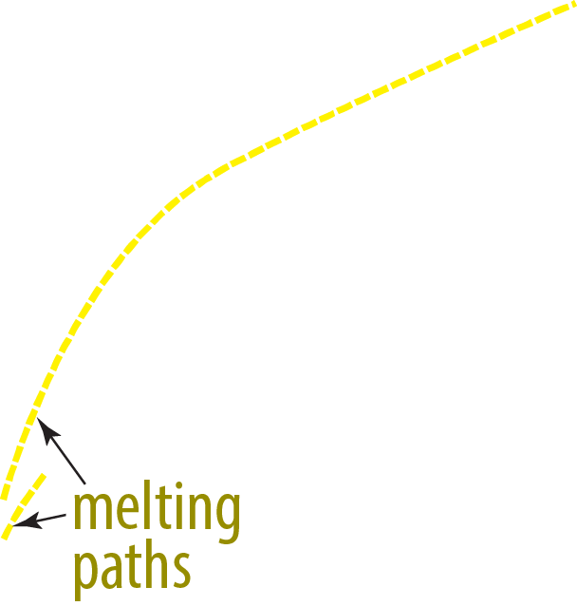
Melting relations of peridotite

Slide 4
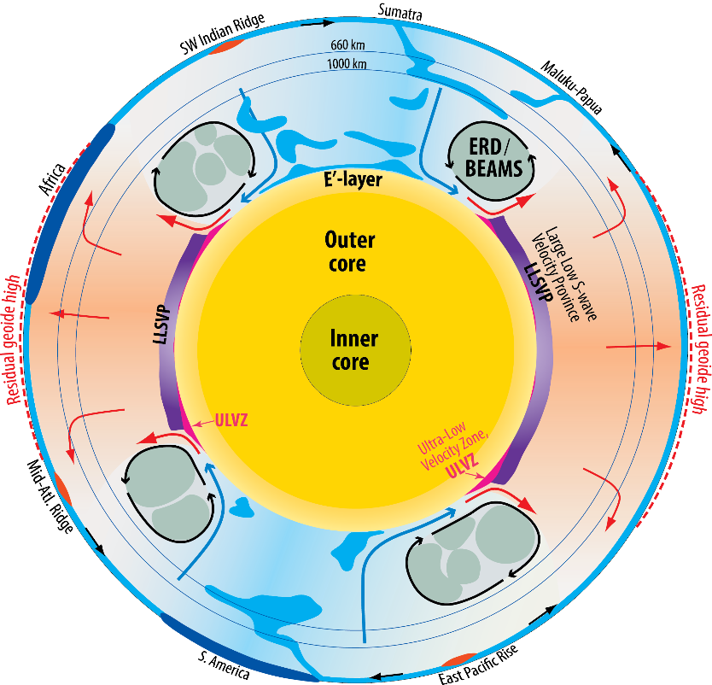
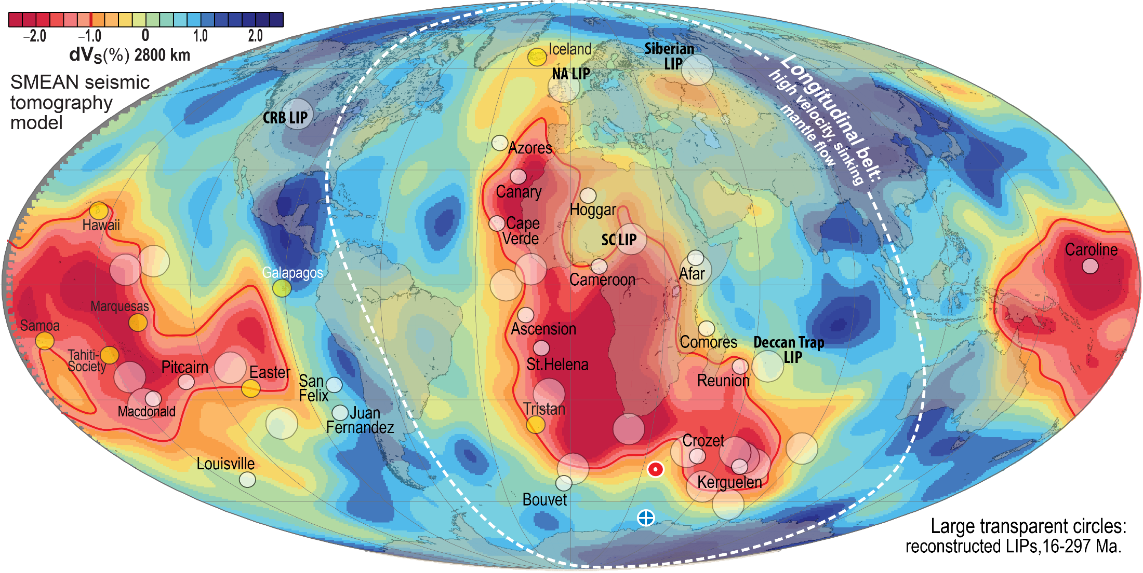
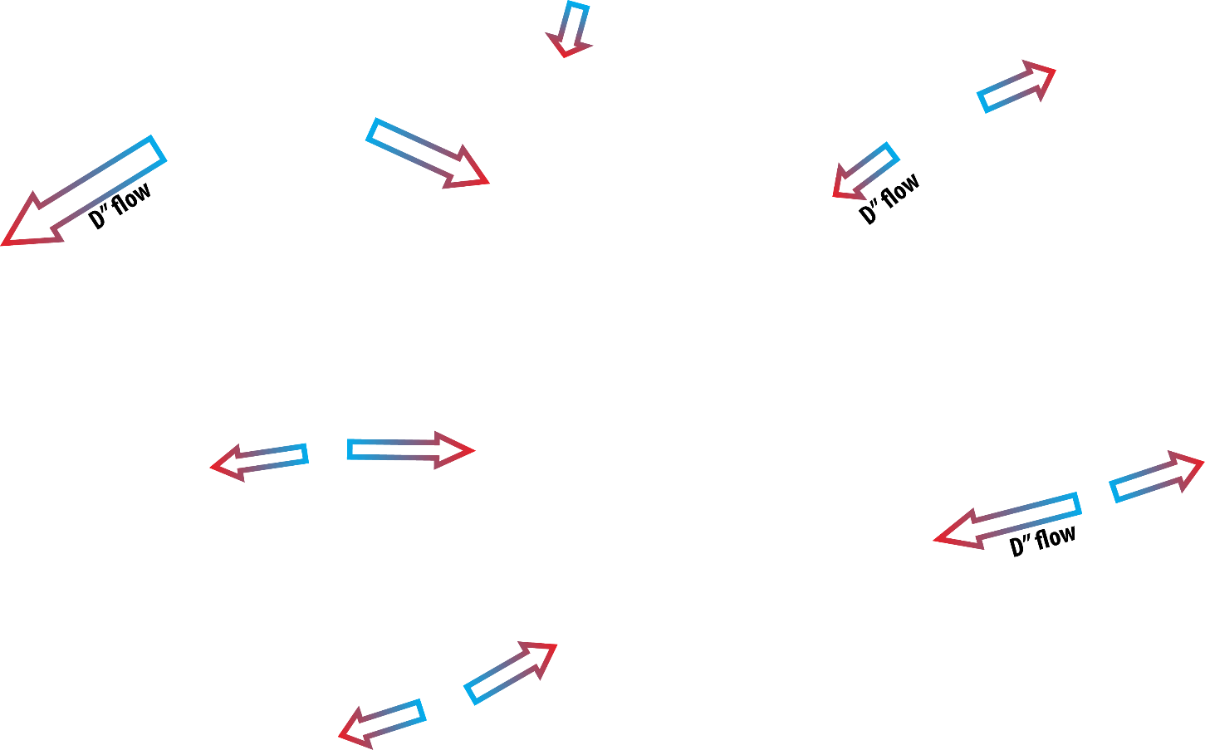
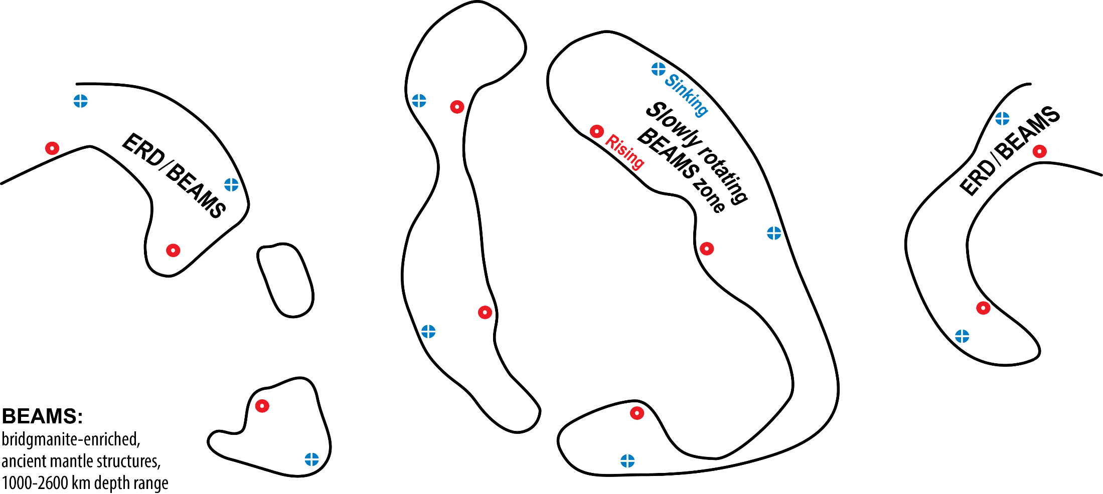
Newly recognised structural elements
Lower mantle
Strong petrological evidence and more tenuous seismic evidence for early refractory domains (ERD), likely organised in "bridgmanite-enriched ancient mantle structures" (BEAMS, Ballmer et al. 2017, Nat. Geosci.)
Outer core
Low-V_{P}, low-ρ outermost core: E'-layer (Brodholt & Badro, 2017, GRL)
Equatorial section
Inferred locations for BEAMS

Slide 5
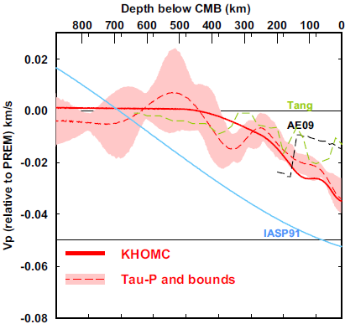
Outermost stagnant E'-layer?
gradationally stratified, low V_{Φ} - low ρ
0-445 km
below CMB
Feasible because:
- high thermal conductivity supresses convection
- low viscosity reduces viscous entrainment
- an E'-layer may stabilise the geodynamo
(Hernlund & McNamara, 2015, Treat. Geophys.)
0.4 %
Kaneshima (2018, PEPI)
Seismology
Lay & Young, 1990
Garnero et al., 1993
Helffrich & Kaneshima, 2010
Kaneshima & Helffrich, 2013
Kaneshima & Matsuzawa, 2015
Kaneshima, 2018
Irving et al., 2018: Adiabatic outermost core
Models
Buffet, 2010
Buffet & Seagle, 2010
Gubbins & Davies, 2013
Hernlund & McNamara, 2015
Brodholt & Badro, 2017

Slide 6
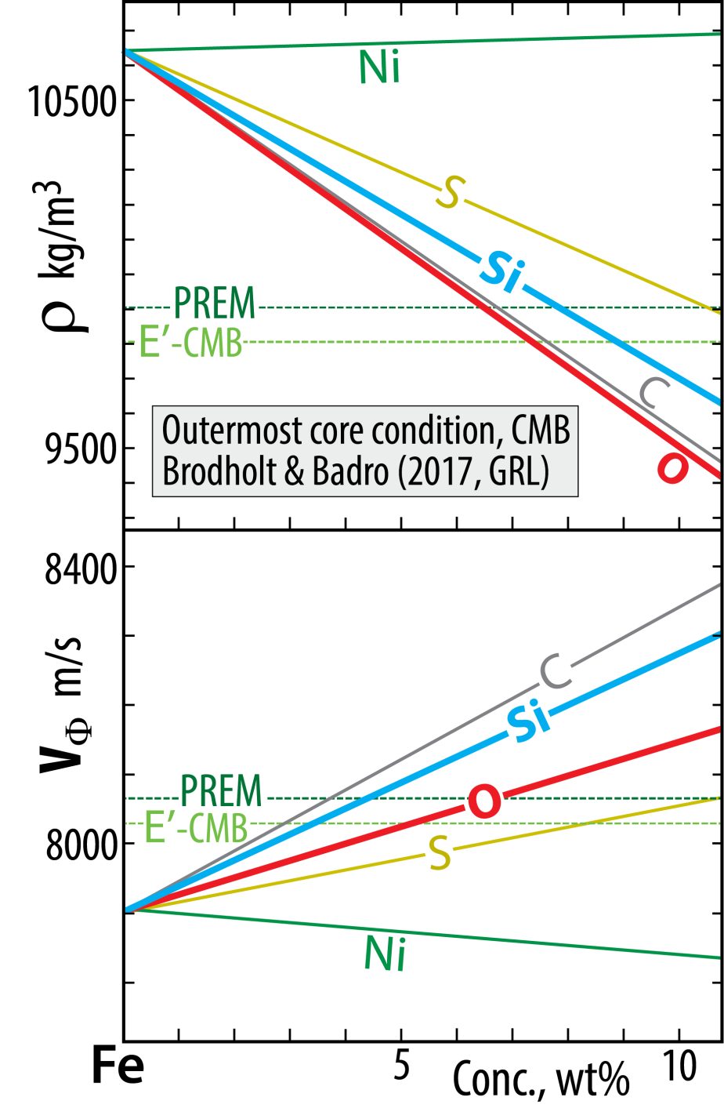
Outermost core: stagnant layer?
E'-layer: low V_{P} - low ρ
Outermost stagnant E'-layer?
gradationally stratified, low V_{Φ} - low ρ
Chemical characteristics, material properties
poses a long-standing conundrum, apparently solved by
Brodholt & Badro (2017, GRL)
Each of the light element candidates, Si, O, S, C,
reduces ρ and increases V_{Φ} (or V_{P})
BUT:
O reduces ρ more and increases V_{Φ} less than Si.
Therefore:
E'-layer with elevated O and reduced Si relative to
the convecting core may solve the conundrum

Slide 7
Core-mantle ”bulk equilibrium” records the oxidation state
O₂ + 2 Fe = 2 FeO Iron-Wustite buffer reaction (IW)
in core, in mantle,
i.e. metal i.e. silicate
K = a_{FeO}² / (f_{O2} * a_{Fe}²) = 1 (at IW)
f_{O2} = a_{FeO}² / a_{Fe}² = (a_{FeO} / a_{Fe})²
log f_{O2} (ΔIW) = 2 * log (a_{FeO}/a_{Fe})

Slide 8
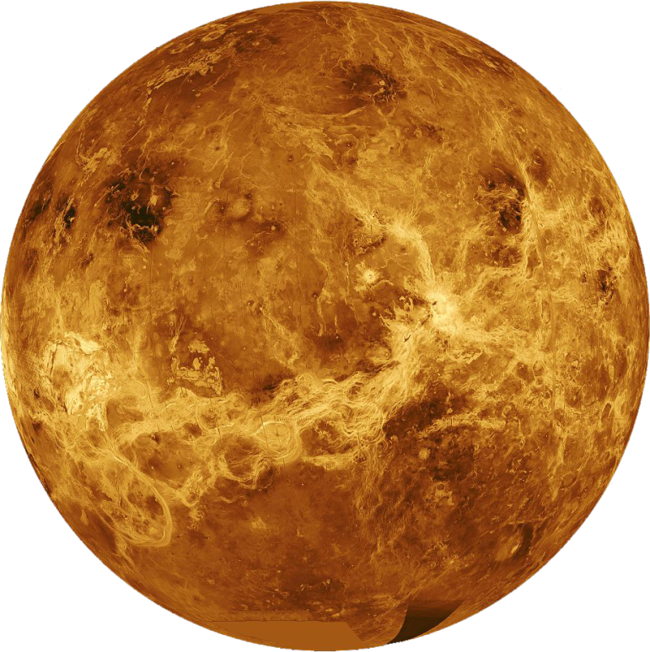
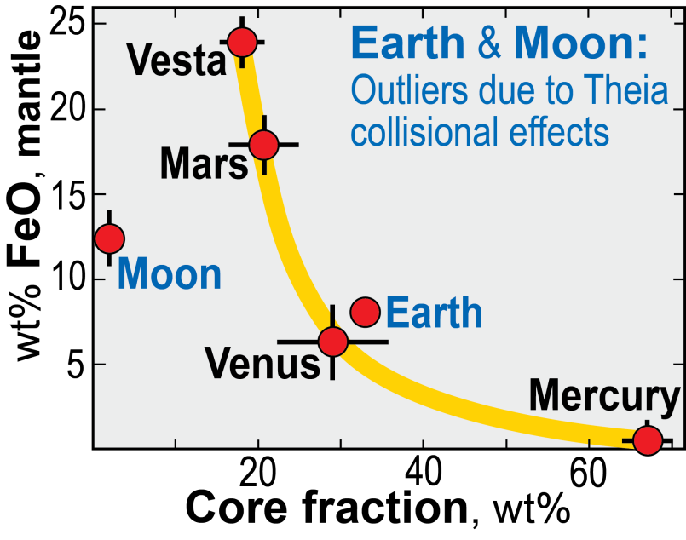
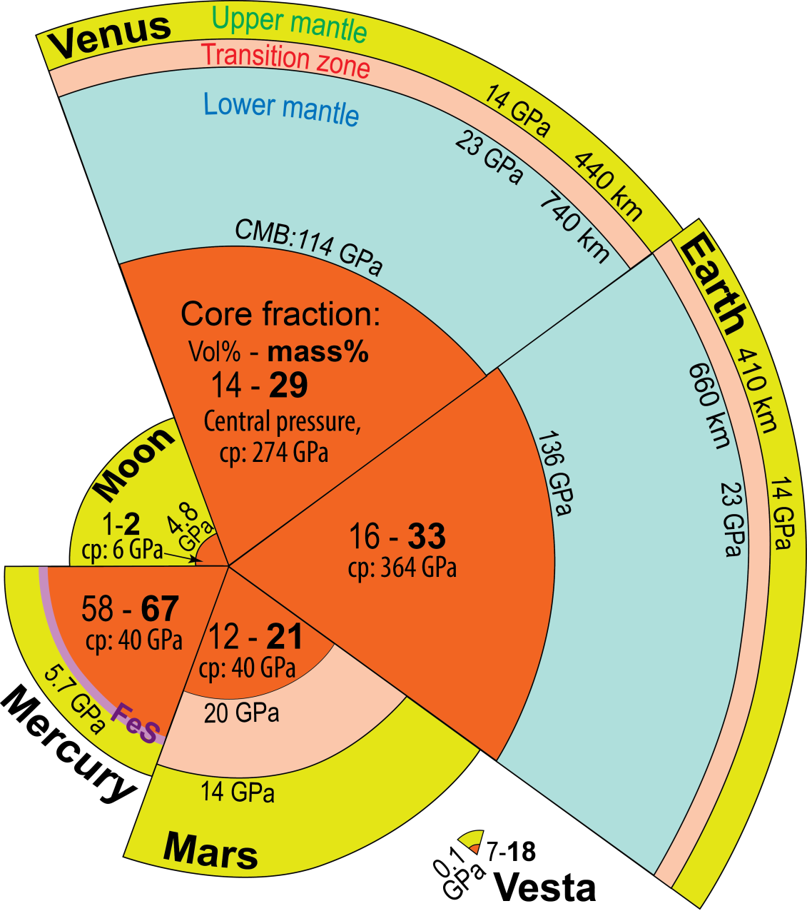
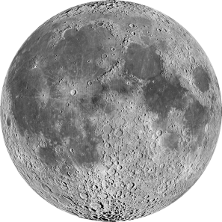
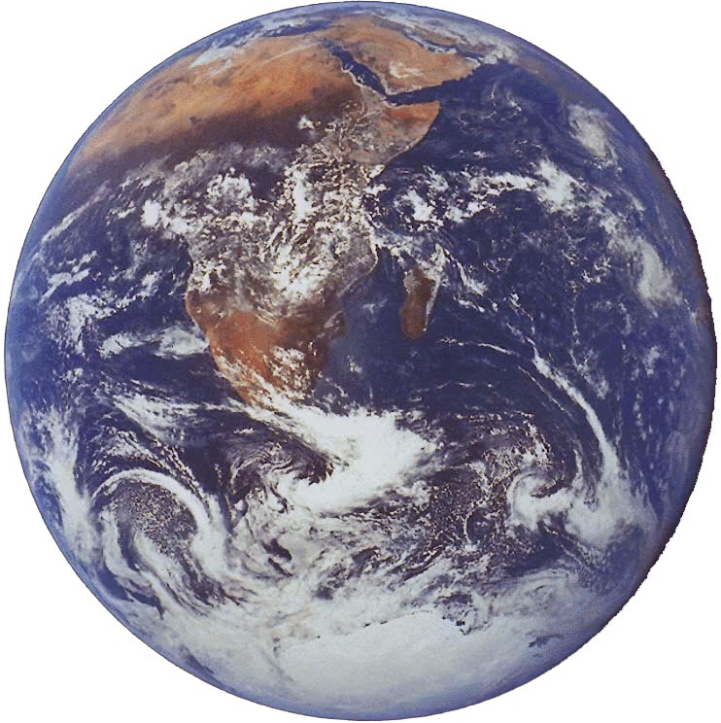
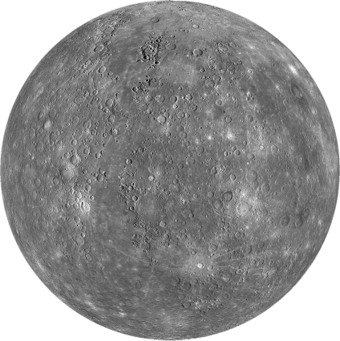
Terrestrial planets: size, core fraction

Slide 9
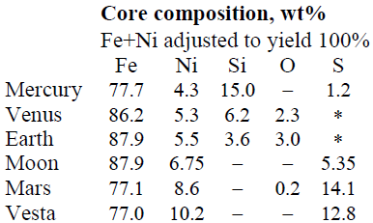
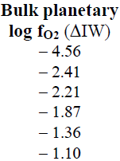
Terrestrial planets: core and mantle compositions
Trønnes et al.
(2018, Tectonophys.)
log f_{O2} (ΔIW) =
2 * log (a_{FeO}/a_{Fe})
Observations, explanations
Solar nebula zoning with increasing f_{O2} outwards:
Me →Ve → Ea → Ma → Vesta
Moon’s tiny core and higher FeO_{mantle} (12%) than Venus-Earth (6-8%)
- Moon created from Theia+Earth mantle debris
- minor core metal debris under oxidising conditions at the late giant impact stage

Slide 10
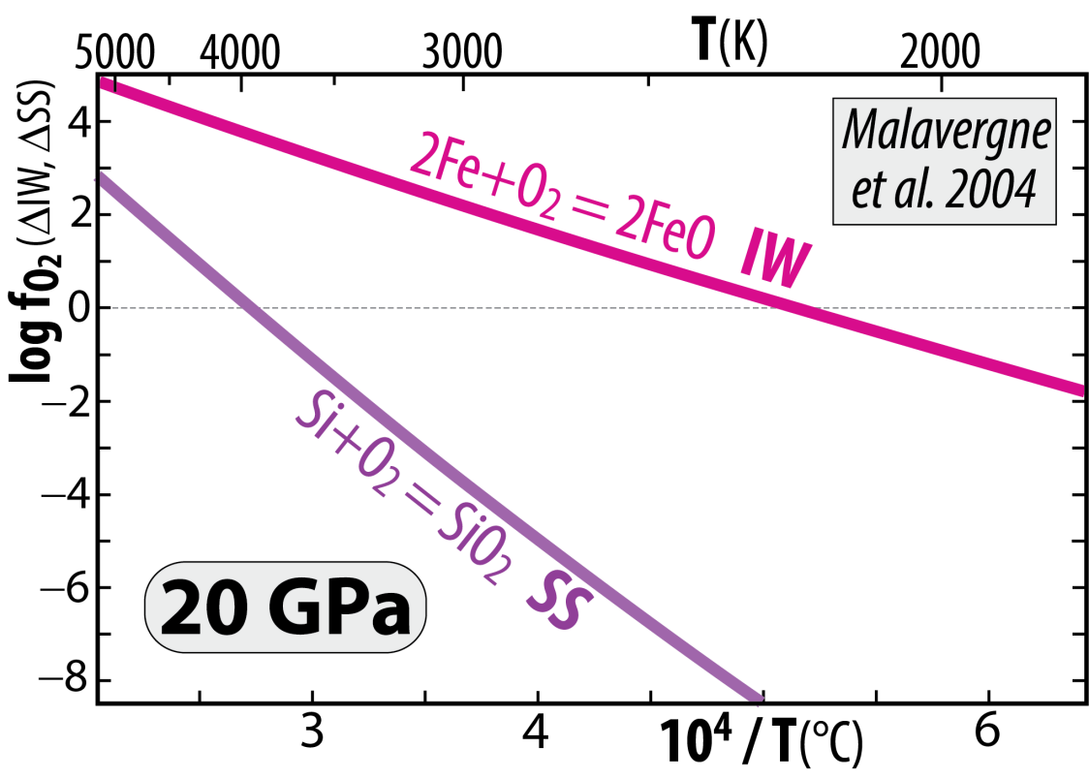
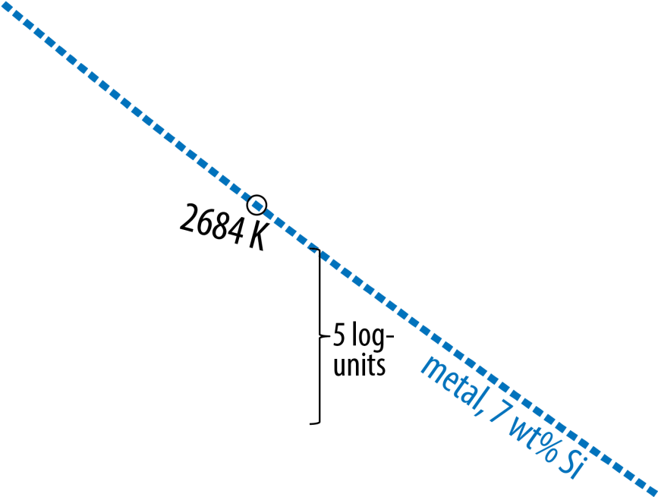
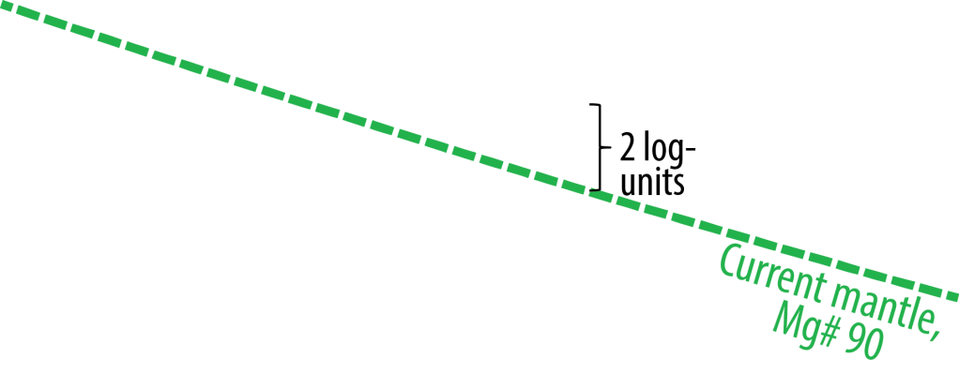
Venus and Earth
Segregated cores at very high T, allowing
high Si^{core} and high FeO^{MO} (high f_{O2})
Because the chemical equilibrium:
2 Fe^{met} + SiO₂^{sil} = Si^{met} + 2 FeO^{sil}
is displaced towards the product side (right) with
increasing T and reversed with decreasing T
2 Fe + O₂ = 2 FeO (IW)
minus: Si + O₂ = SiO₂ (SS)
gives: 2 Fe − Si = 2 FeO − SiO₂
or: 2 Fe + SiO₂ = Si + 2 FeO
Cooling of core and magma ocean (MO)
core-MO chemical exchange
- FeO and FeO_{1.5} to the core
- SiO₂ to the MO (and BMO)
Additional pressure-effect – above 25 GPa
Armstrong and Frost (2019, Nature)
Disproportionation of FeO^{MO} at p > 25 GPa promotes
high f_{O2} in the MO, combined with core segregation:
3 FeO = 2 FeO_{1.5} + Fe
components in the MO liquid metal segregating
and sinking to the core

Slide 11
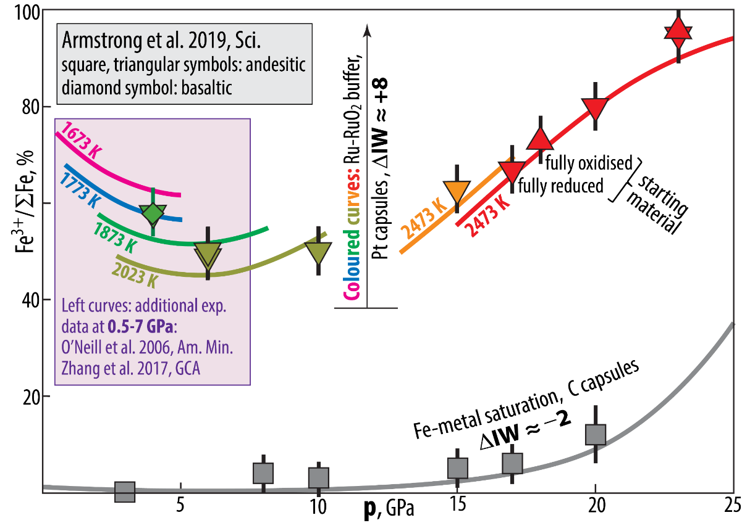
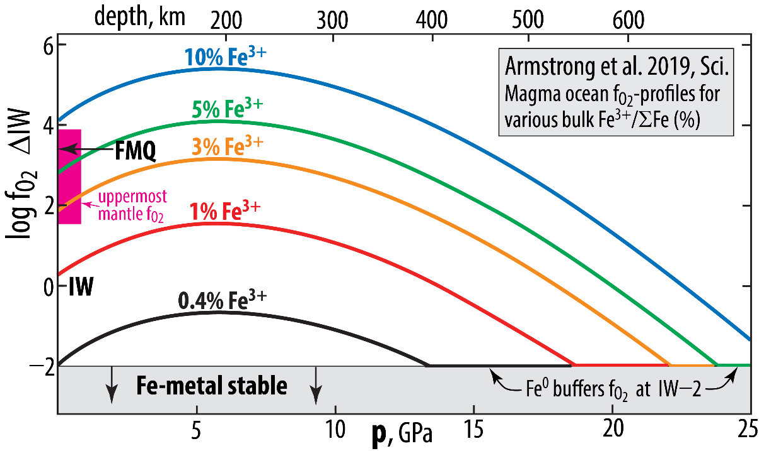
f_{O2}-buffered experiments, andesitic melts
Armstrong et al. (2019, Sci.)

Slide 12
Fe-oxide transport to the core
Will the BMO be oxidised or reduced during solidification?
If Fe-metal alloy is
extracted and sinks
into the core
If Fe-oxide with a
FeO_{1.5}/FeO ratio higher
than that of the BMO
dissolves into the core

Slide 13
Important question because:
- bulk mantle has dominantly Fe²⁺ with a small fraction (about 2%) of Fe³⁺
- extraction of only FeO to the core will therefore oxidise the BMO and lowermost mantle,
increasing the Fe³⁺/ΣFe ratio
- extraction of mainly FeO + moderate amounts of Fe₂O₃ from the BMO will likely reduce the BMO,
decreasing the Fe³⁺/ΣFe ratio
Is Fe₂O₃ available in the BMO (and how)?
Yes, due to redox reactions (Fe disproportionation)
- in the magma ocean itself (Armstrong et al. 2019, Science)
- associated with bm crystallisation (Frost et al. 2004, Nature)

Slide 14
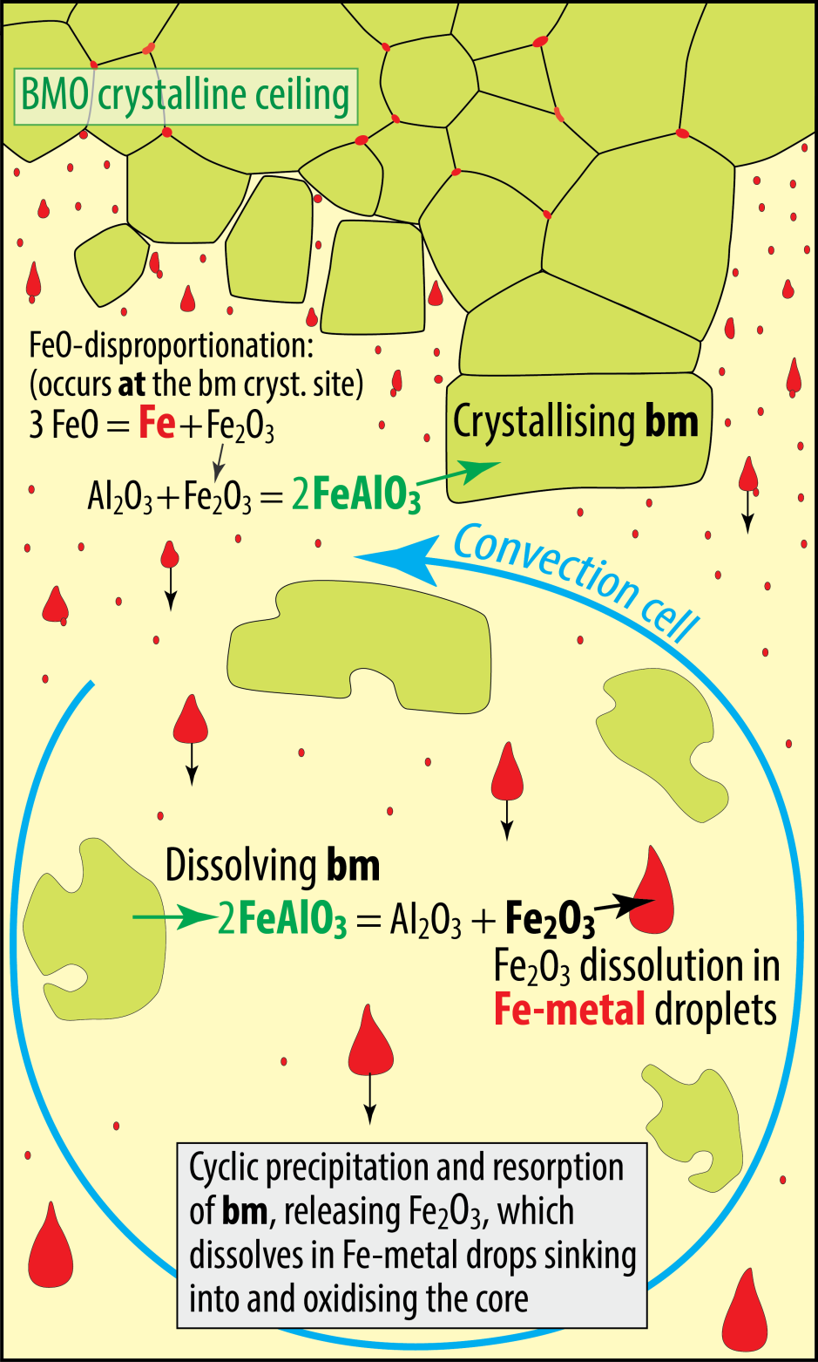
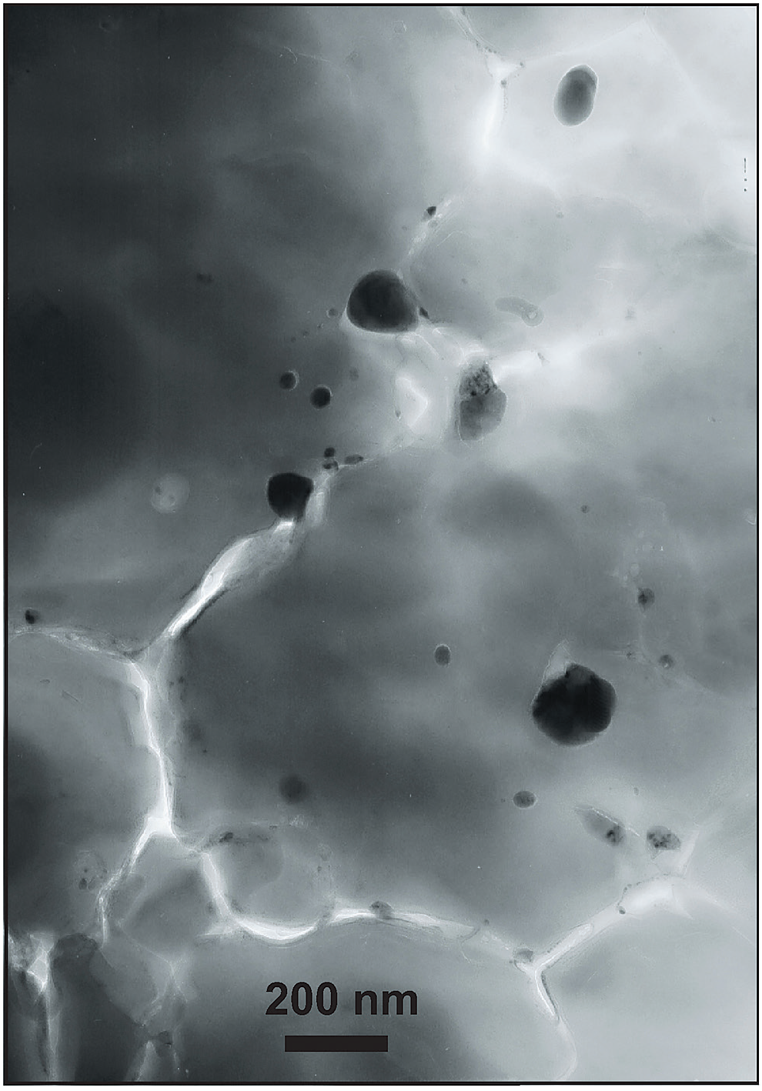
Crystallisation of bm in BMO
Cyclic crystallisation and dissolution of bm
- incorporation of the FeAlO₃-component in bm
- associated by FeO disproportionation and
Fe-metal precipitation (Frost et al. 2004, Nature)
30 nm
160 nm
Might be important for O-loading of the core.
BUT: O-saturation level in metal is < 20 wt%, while FeO and
and Fe₂O₃ contains 22 and 30 wt% O, respectively.
Sinking metal drops will therefore always oxidise the BMO
Andrault et al.
(2018, GPL)

Slide 15
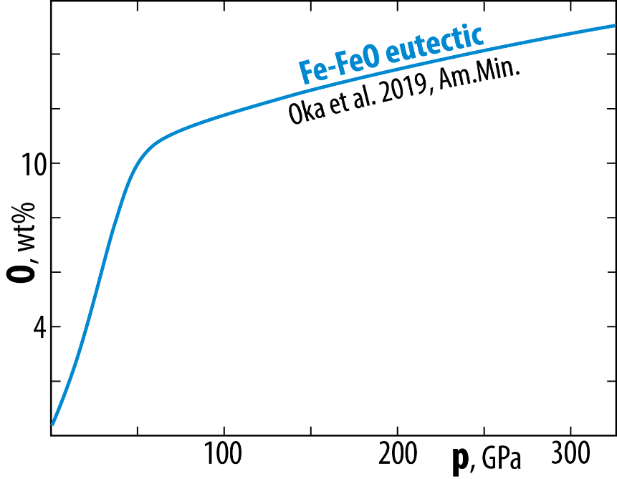
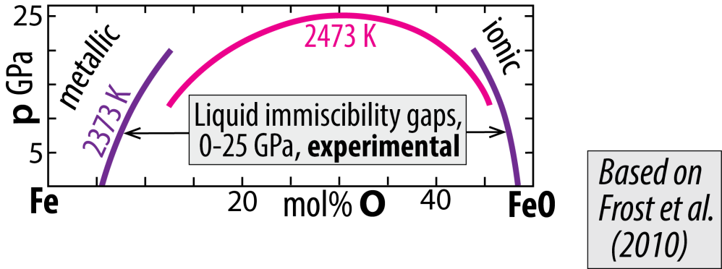
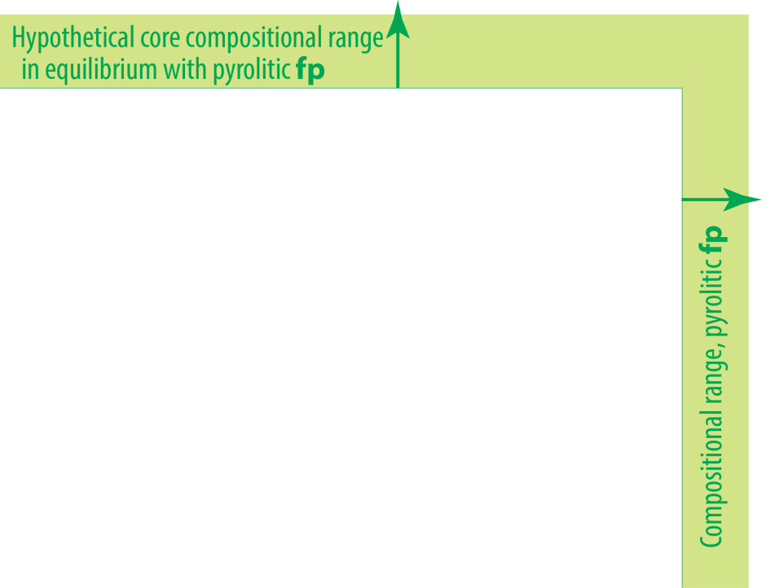
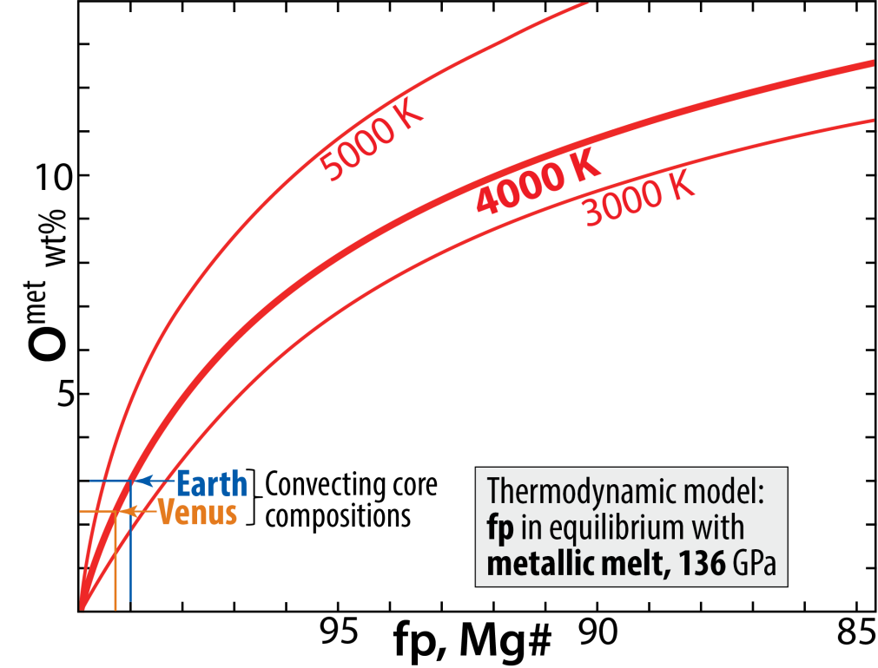
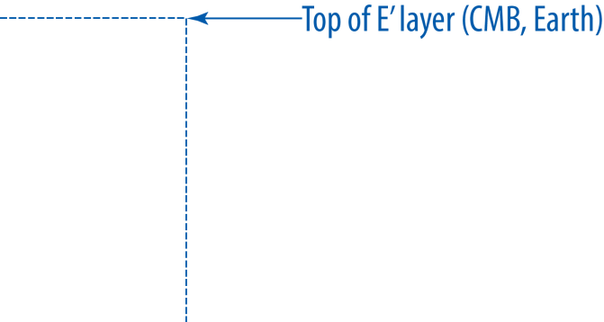
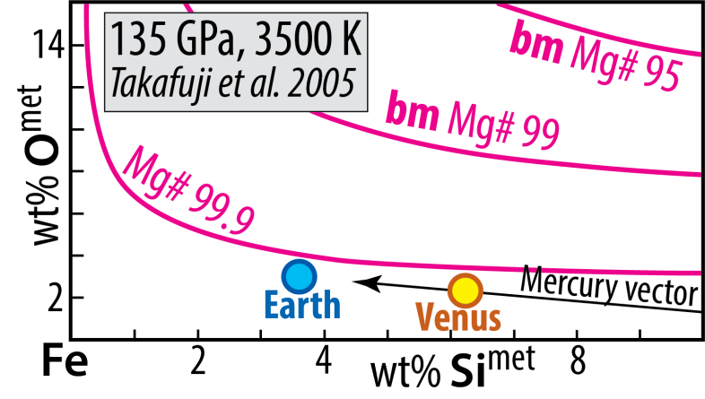
O and Si in Fe-alloys Cooling core-BMO chemical exchange
System: Fe-Mg-O
metal-ferropericlase equilibrium
Solvus closure with increasing p and T
System: Fe-Mg-Si-O
metal-bridgmanite equilibrium

Slide 16
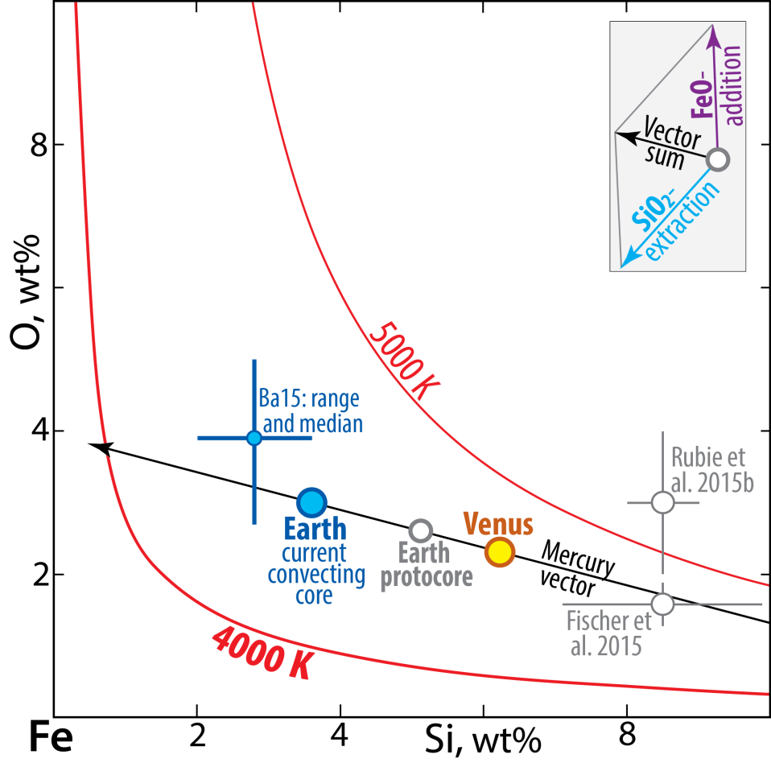
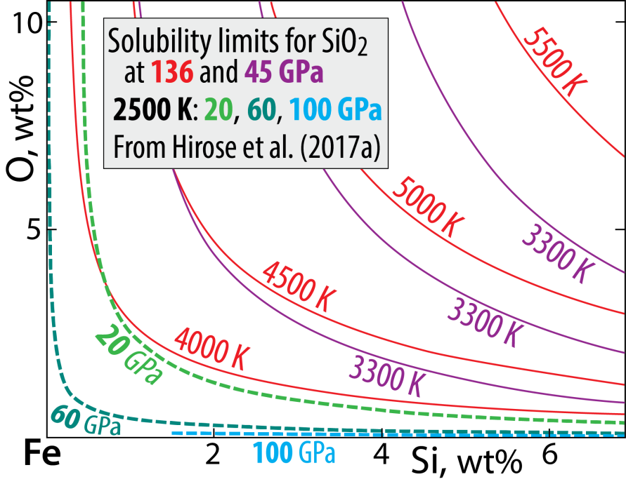
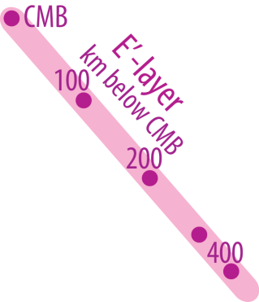
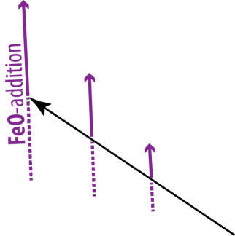
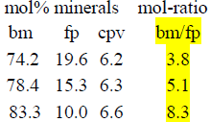
System: Fe-Si-O
Solubility of O and Si in Fe-alloy
Estimated core compositions
Mercury:
15 wt% Si, no O
- O and Si: mutually exclusive
- Solubility increases with T and decreases with p
- Related to the silica liquidus surface in systam Fi-Si-O
Mass balance modelling
Step 1: protoC + earlyMO = convC + pyrolite-MO (total volumes)
Step 2: upper convC + BMO = E'-layer + mod. lowermost M
34 vol%, 28 vol%,
31 wt% of core 34 wt% of mantle

Slide 17
System: Fe-Si-O
Solubility of O and Si in Fe-alloy
- O and Si: mutually exclusive at low T / high p
- Solubility increases with T and decreases with p
- Related to the silica liquidus surface in system Fe-Si-O

Slide 18
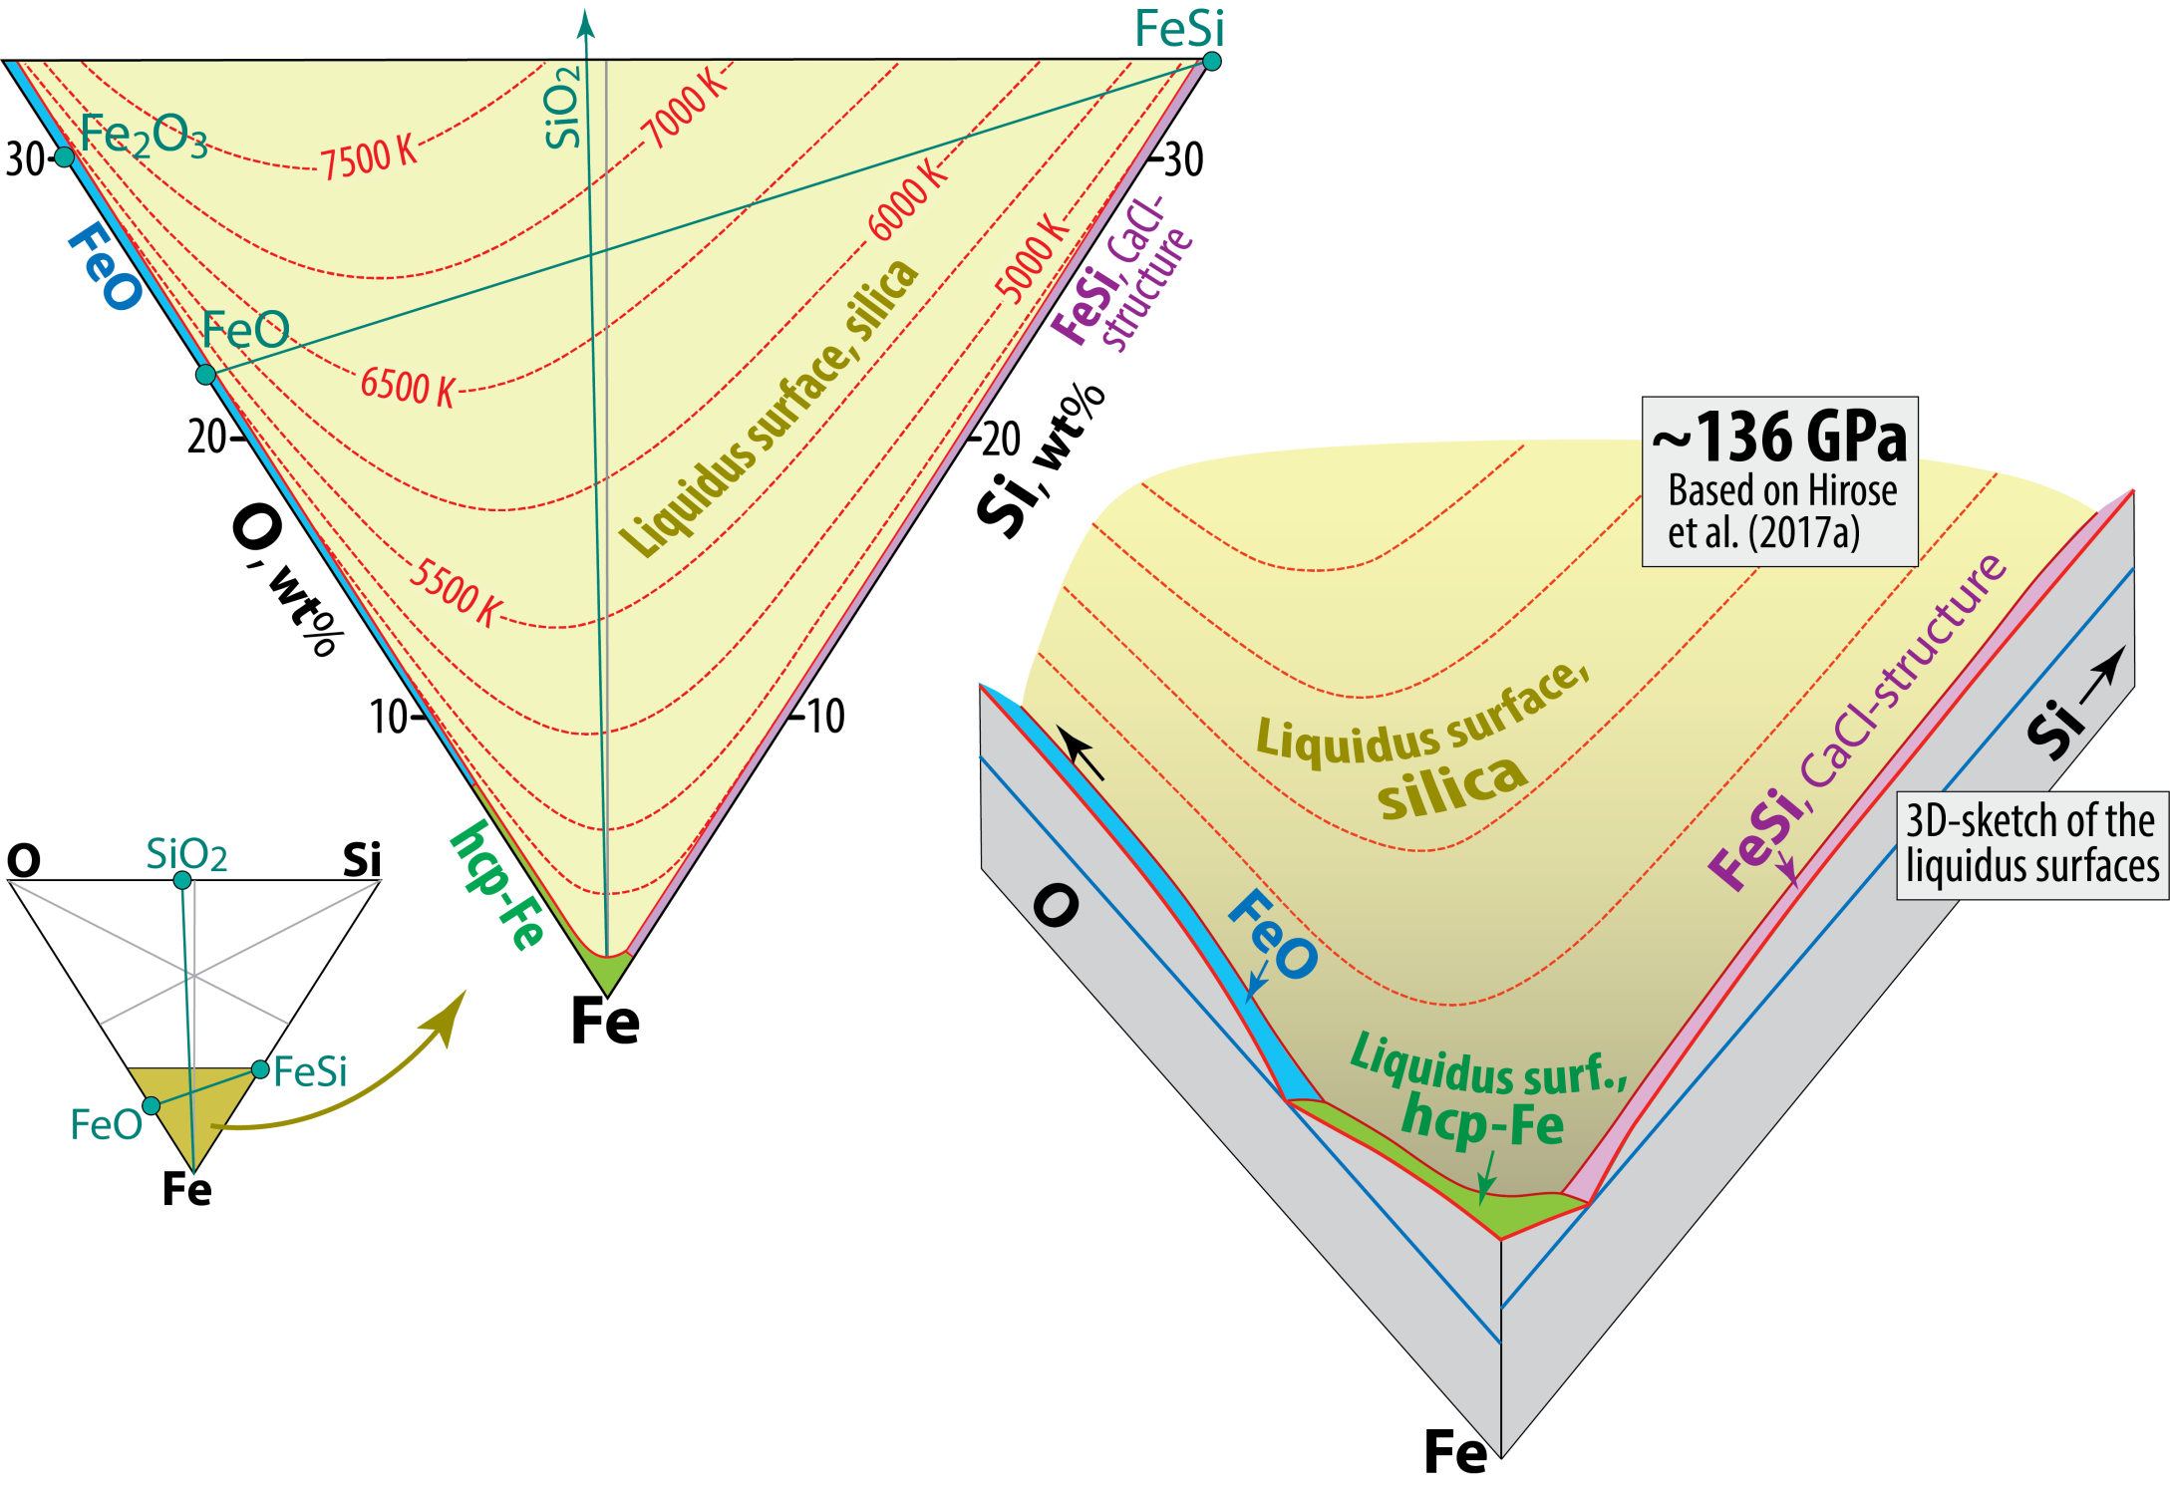
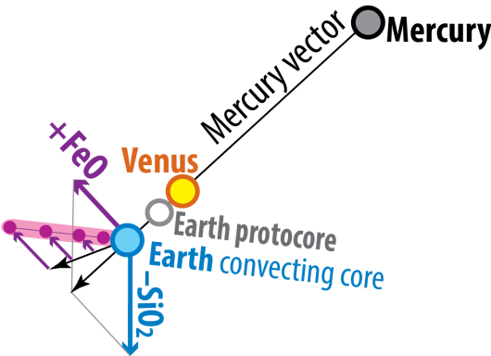
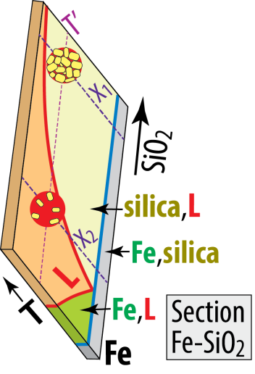
System Fe-Si-O: liquidus relations at 136 GPa
~4000 K
~4660 K
~4600 K

Slide 19
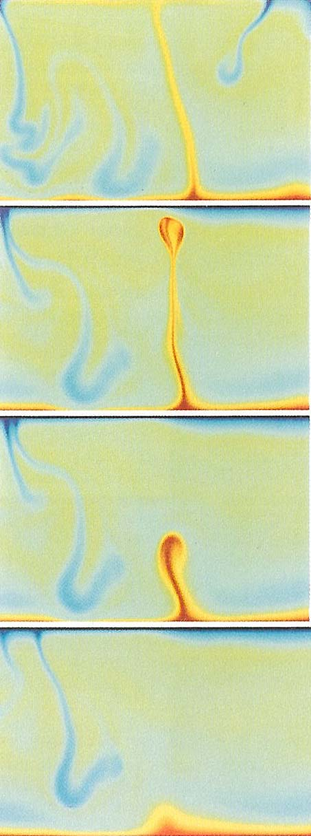
Fluid dynamic modelling:
- sheet-like downwellings (consistent with plate tectonics)
- columnar plumes
One-layer
convection models:
Larsen and Yuen, 1997
Travis et al., (1990, Geophys.
Astrophys. Fluid Dyn.)

Slide 20
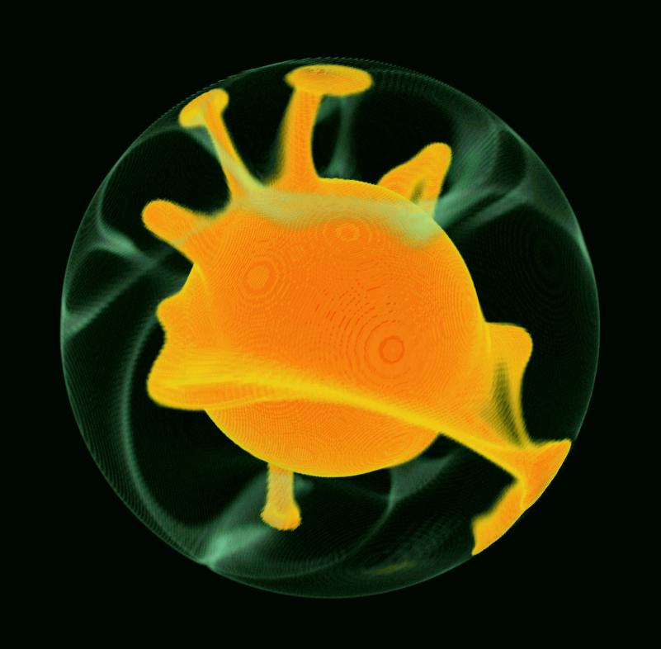
Three dimensional and spherical
convection model
D.A. Yuen, Univ. Minnesota

Slide 21
Fluid dynamic modelling:
- sheet-like downwellings (consistent with plate tectonics)
- columnar plumes
One-layer
convection models:
Larsen and Yuen, 1997
Travis et al., (1990, Geophys.
Astrophys. Fluid Dyn.)

Slide 22
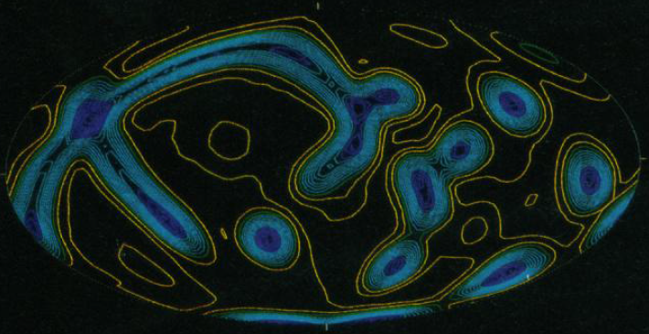
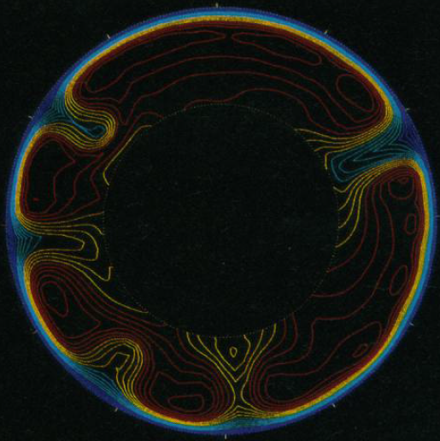
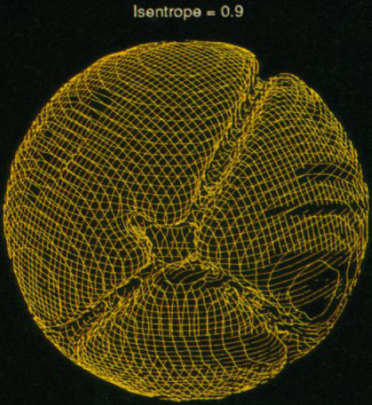
Bercovici (1989, Science)
3D spherical shell,
high viscosity (η)
internal heating, only
Strong sheet-like downwelling
Distributed (non-focused) and
passive counterflow
No ascending columnar plumes
Radial velocity:
up down
Longitudional section
with non-dimensional
isentropes, S=Q/T
high interm. low
Non-dimensional
isentropic surface

Slide 23
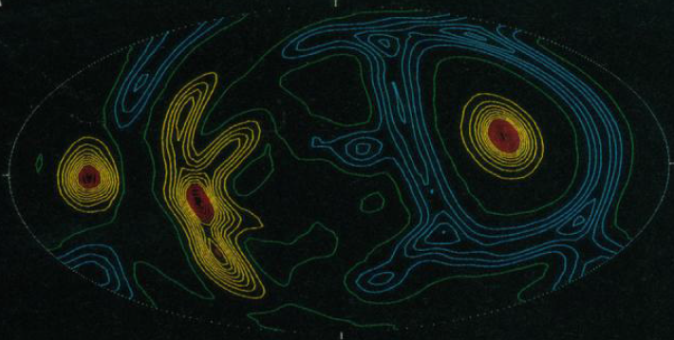
Bercovici (1989, Science)
3D spherical shell, high η
bottom heating, only
Rel.weak sheet-like downwelling
Strong columnar plumes
Radial velocity
up down
Longitudional section
with non-dimensional
isentropes, S=Q/T
high low
Non-dimensional
isentropic surfaces

Slide 24
Bercovici (1989, Science)
3D spherical shell, high η
50% internal + 50%
bottom-heating
Sheet-like downwelling
Columnar plumes
Radial velocity:
up down
Longitudional section
with non-dimensional
isentropes, S=Q/T
high interm. low
Non-dimensional
isentropic surface

Slide 25
Degree-2 convection pattern and structure of the mantle: Key questions
What came first?
- degree-2 convection pattern? already at the magma ocean stage?
- degree-2 structure with LLSVPs and possible BEAMS?
Other uncertainties:
- mechanism of formation - was Earth's fast rotation important (2-5 hr days)
- LLSPV-material: two popular candidates: ROC (basaltic), late-stage MO-cumulates
- Nature of BEAMS: bridgmanite-enriched ancient mantle structures??
Fast rotation: the sentrifugal force reduces the equatorial g (gravitational acceleration)

Slide 26
Convection modelling of MO crystal settling in
rapidly rotating planets (differential gravitational fields)

Slide 27
Change from mostly liquid to mostly solid mantle:
Possible change from: columnar polar downflow
with equator-plane upflow
to: longitudinal (circum-polar)
sheet-like downflow with
columnar antipodal upflow
in the equatorial plane
e.g. the Earth
10-100 Ma ?
Long-lived basal
magma ocean (BMO)
> 2 Gy ?

Slide 28
Core BMO-exchange with bm-crystallisation → liquid enriched in Ca, Na and Al
→ Ca-perovskite (cpv) and the Ca-ferrite-structured phase (cf) will crystallise
- High density of cpv will prevent its incorporation in the crystallising ceiling
- Instead, cpv will sink and dissolve into the hot liquid below → Strong CaO^{BMO} enrichment
2.4%
Components, bm
MS: MgSiO₃
FS: FeSiO₃
FA: FeAlO₃
AA: Al₂O₃

Slide 30
Equatorial Earth sections
Modified, mainly from:
Trønnes (2010, Mineral. Petrol.),
Torsvik et al. (2016, Can. J. Earth Sci.),
Ballmer et al. (2017, Nature Geosci.)

Slide 31
- BMO crystallisation during core-BMO exchange may produce cumulates with optimal
properties for stabilisation of degree-2 convection pattern: early refractory domains with high visosity and
neutral buoyancy + late dense cumulates
- Additional stabilisation is provided by a variable equator-to-pole gravity field: Earth's rotation
The degree-2 convection pattern
- might have been established before
or during BMO solidification
- might be a precondition for
thermochemical pile assembly

Slide 32
Modified from Torsvik
et al. (2016, CJES)

Slide 33
Modified from
Torsvik et al. (2016, CJES)

Slide 34
Planetary TLBs
?

Slide 35
The effect of phase transitions on convection
The clapeyron slope (dp/dT-slope) of phase transitions govern the ease of convection
Positive clapeyron slope: promotes convection across the bounary – one-layer convection
Negative clapeyron slope: inhibits convection – can lead to a thermal boudnary layer
(a convective fence) and thereby two-layer convection
How does the clapeyron slope relate to thermodynamic parameters,
volume and entropy ?

Slide 36
High entropy in perovskite
Reaction:
ringwoodite = bridgmanite + periclase
ΔV < 0, but ΔS > 0
dp/dT = ΔS/ΔV < 0
Geodynamic implications

Slide 37
Mineral transformations with different dp/dT-slopes:
Geodynamic implications
Slow conductive
heating
- bridgmanite formation
- slab sinking into LM

Slide 38
Seismic tomography sections, Fukao & Obayashi (2015, JGR)

Slide 44
30 W

Slide 46
Slab rollback and hinge retreat versus stationary hinge

Slide 47
Fukao & Obayashi
(2015, JGR)
Deepest earthquake
recordings

Slide 48
Diffusion couple,
15 GPa, 1800°C for 2 hr
- synthetic majoritic garnet: Py₅₅Mj₄₅
- natural pyrope: Py₉₃Alm₅Gr₂
TEM-analyses
15 GPa
1800 C
2 hr
350 nm

Slide 49
May explain seismic anisotropy of
postulated akimotoite in the Tonga slab

Slide 50
King et al. (2015, Geology)
Slab T (from Syracuse et al. 2010, PEPI)

Slide 51
Mg_{0.8}Fe_{0.2}O
cBN-gaskets
Mg_{0.9}Fe_{0.1}SiO₃ bridgmanite
Merkel et al. (2003, EPSL)
Mg_{0.83}Fe_{0.17}O, Miyagi et al. (2013, RSI)
Mg_{0.83}Fe_{0.17}O, Lin et al. (2009, PCM)

Slide 52
Mg_{0.8}Fe_{0.2}O
cBN-gaskets
Mg_{0.9}Fe_{0.1}O
cBN-gaskets
Mg_{0.8}Fe_{0.2}O
Be-gaskets

Slide 53
Rudolph et al. (2016, Science)

