Slide 1
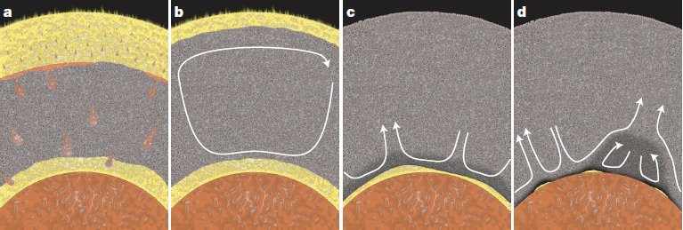
Extended version - will be equipped with sound recordings on July 12.
Chemical exchange between the protocore and the (basal) magma ocean
Reidar G. Trønnes, Centre for Earth Evolution and Dynamics & Natural History Museum, University of Oslo, rtronnes@uio.no
Important implication for Earth evolution and structure
Many of the figures in this presentation are from:
Trønnes et al. (2019,
Tectonophys. 760, 165-198)
Abbreviations
MO: magma ocean, BMO: basal MO
bm: bridgmanite, fp: ferropericlase
UM: upper mantle LM: lower mantle
ERDs: early refractory domains
BEAMS: bm-enriched ancient mantle
structures
Original BMO-model: Labrosse et al. (2007, Nature)
The BMO was thermally insulated and long-lived:
possibly into the Proterozoic or Phanerozoic ?

Slide 2
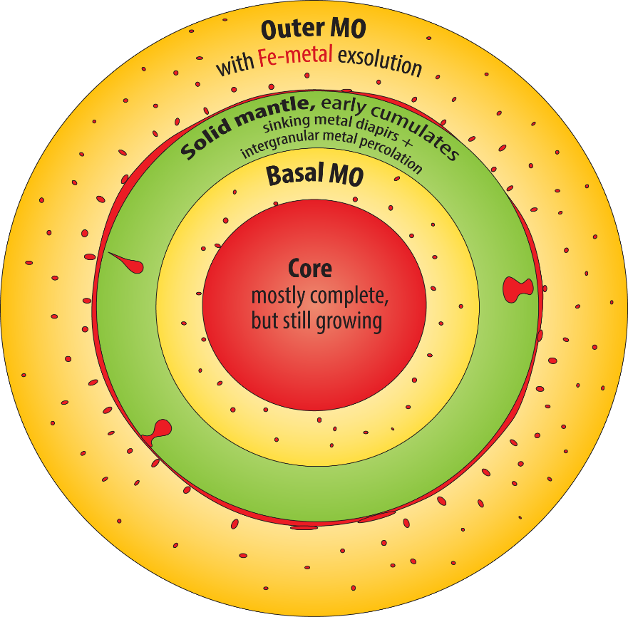
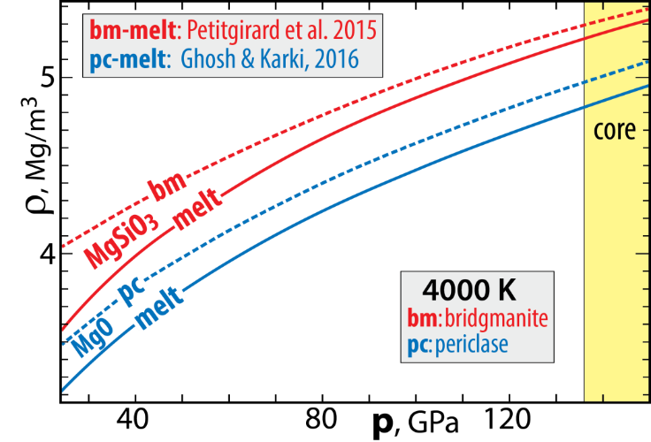
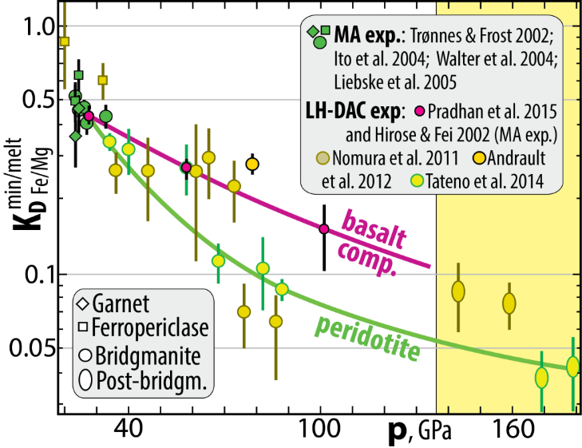
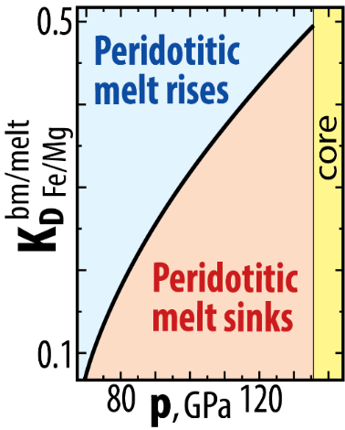
BMO: caused by solid-melt density crossover at high p
- not the case for pure MgSiO₃ (bm and melt) and MgO (pc and melt)
BUT:
Strong Fe/Mg-partitioning densifies peridotite melt
bm/melt
Fe/Mg
K_{D} = (Fe/Mg)^{bm} / (Fe/Mg)^{melt} ≤ 0.1
bm/melt
Fe/Mg
K_{D} = 0.1
Neutral buoyancy
at 73-80 GPa, i.e.
~1800 km depth

Slide 3
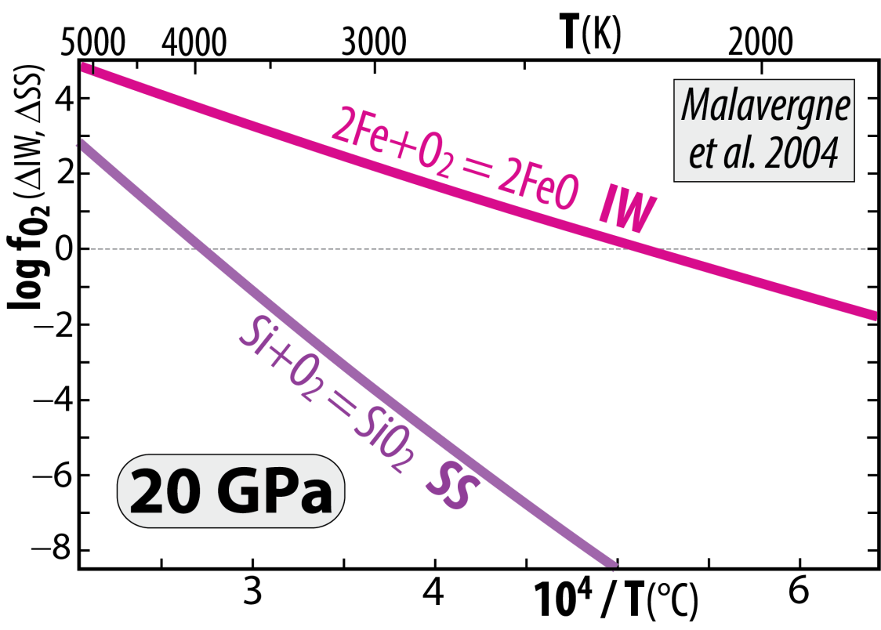
Metal-silicate exchange equilibrium leads to core - MO chemical exhange during cooling
2 Fe^{met} + SiO₂^{sil} = Si^{met} + 2 FeO^{sil}
displaced towards the product side (right) with
increasing T and reversed during cooling
Large terrestrial planets Venus & Earth:
core segregation at very high T, allowing
high Si^{protocore} and high FeO^{MO} (high f_{O2})
The combination of the two buffer reactions
2 Fe + O₂ = 2 FeO (IW)
minus: Si + O₂ = SiO₂ (SS)
gives: 2 Fe − Si = 2 FeO − SiO₂
and: 2 Fe + SiO₂ = Si + 2 FeO
Cooling core-MO chemical exchange
- FeO and FeO_{1.5} to the core
- SiO₂ to the MO (and BMO)
Armstrong and Frost (2019, Nature)
The minor FeO_{1.5} component is due to MO self-disproportionation of FeO promoting high f_{O2} in the MO at high p, combined with extra core segregation:
3 FeO = 2 FeO_{1.5} + Fe
components in the MO liquid metal segregating
and sinking to the core

Slide 4
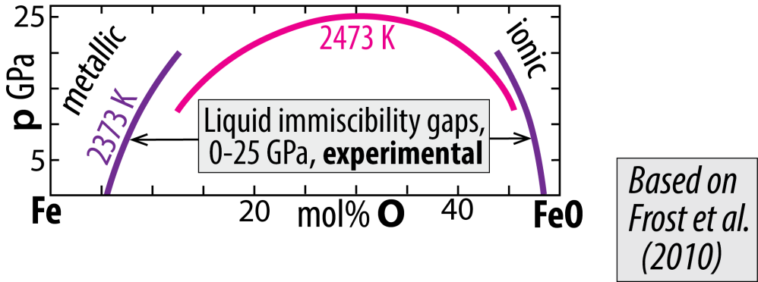
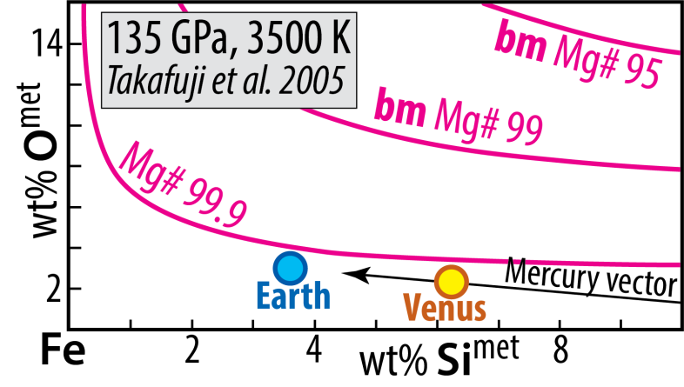
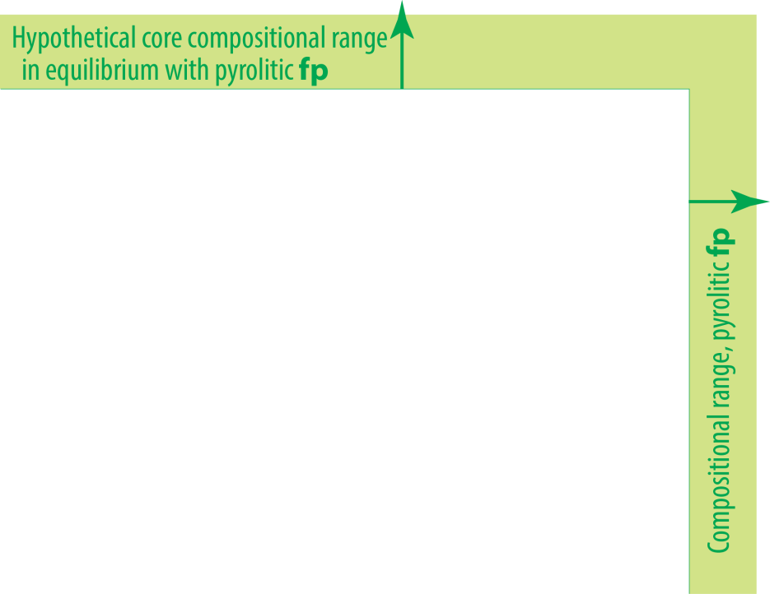
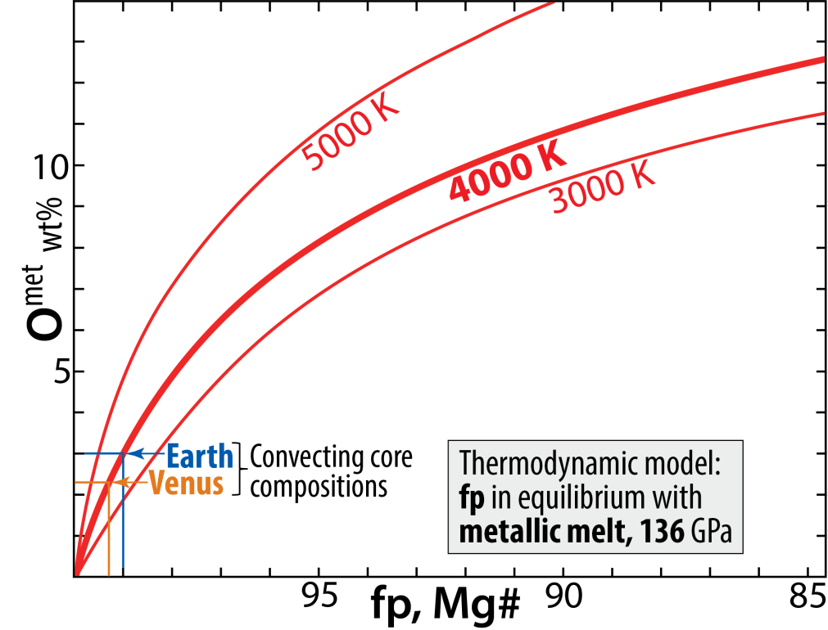
Earth cooling has produced an O-undersaturated core
System: Fe-Mg-O
metal-ferropericlase equilibrium
Solvus closure with
increasing p and T
System: Fe-Mg-Si-O
metal-bridgmanite equilibrium
Implication
fp-metal and bm-metal equilibria demonstrate strong tendency for FeO-partitioning to an
O-undersaturated core
- limited by solid state diffusion in bm and fp

Slide 5
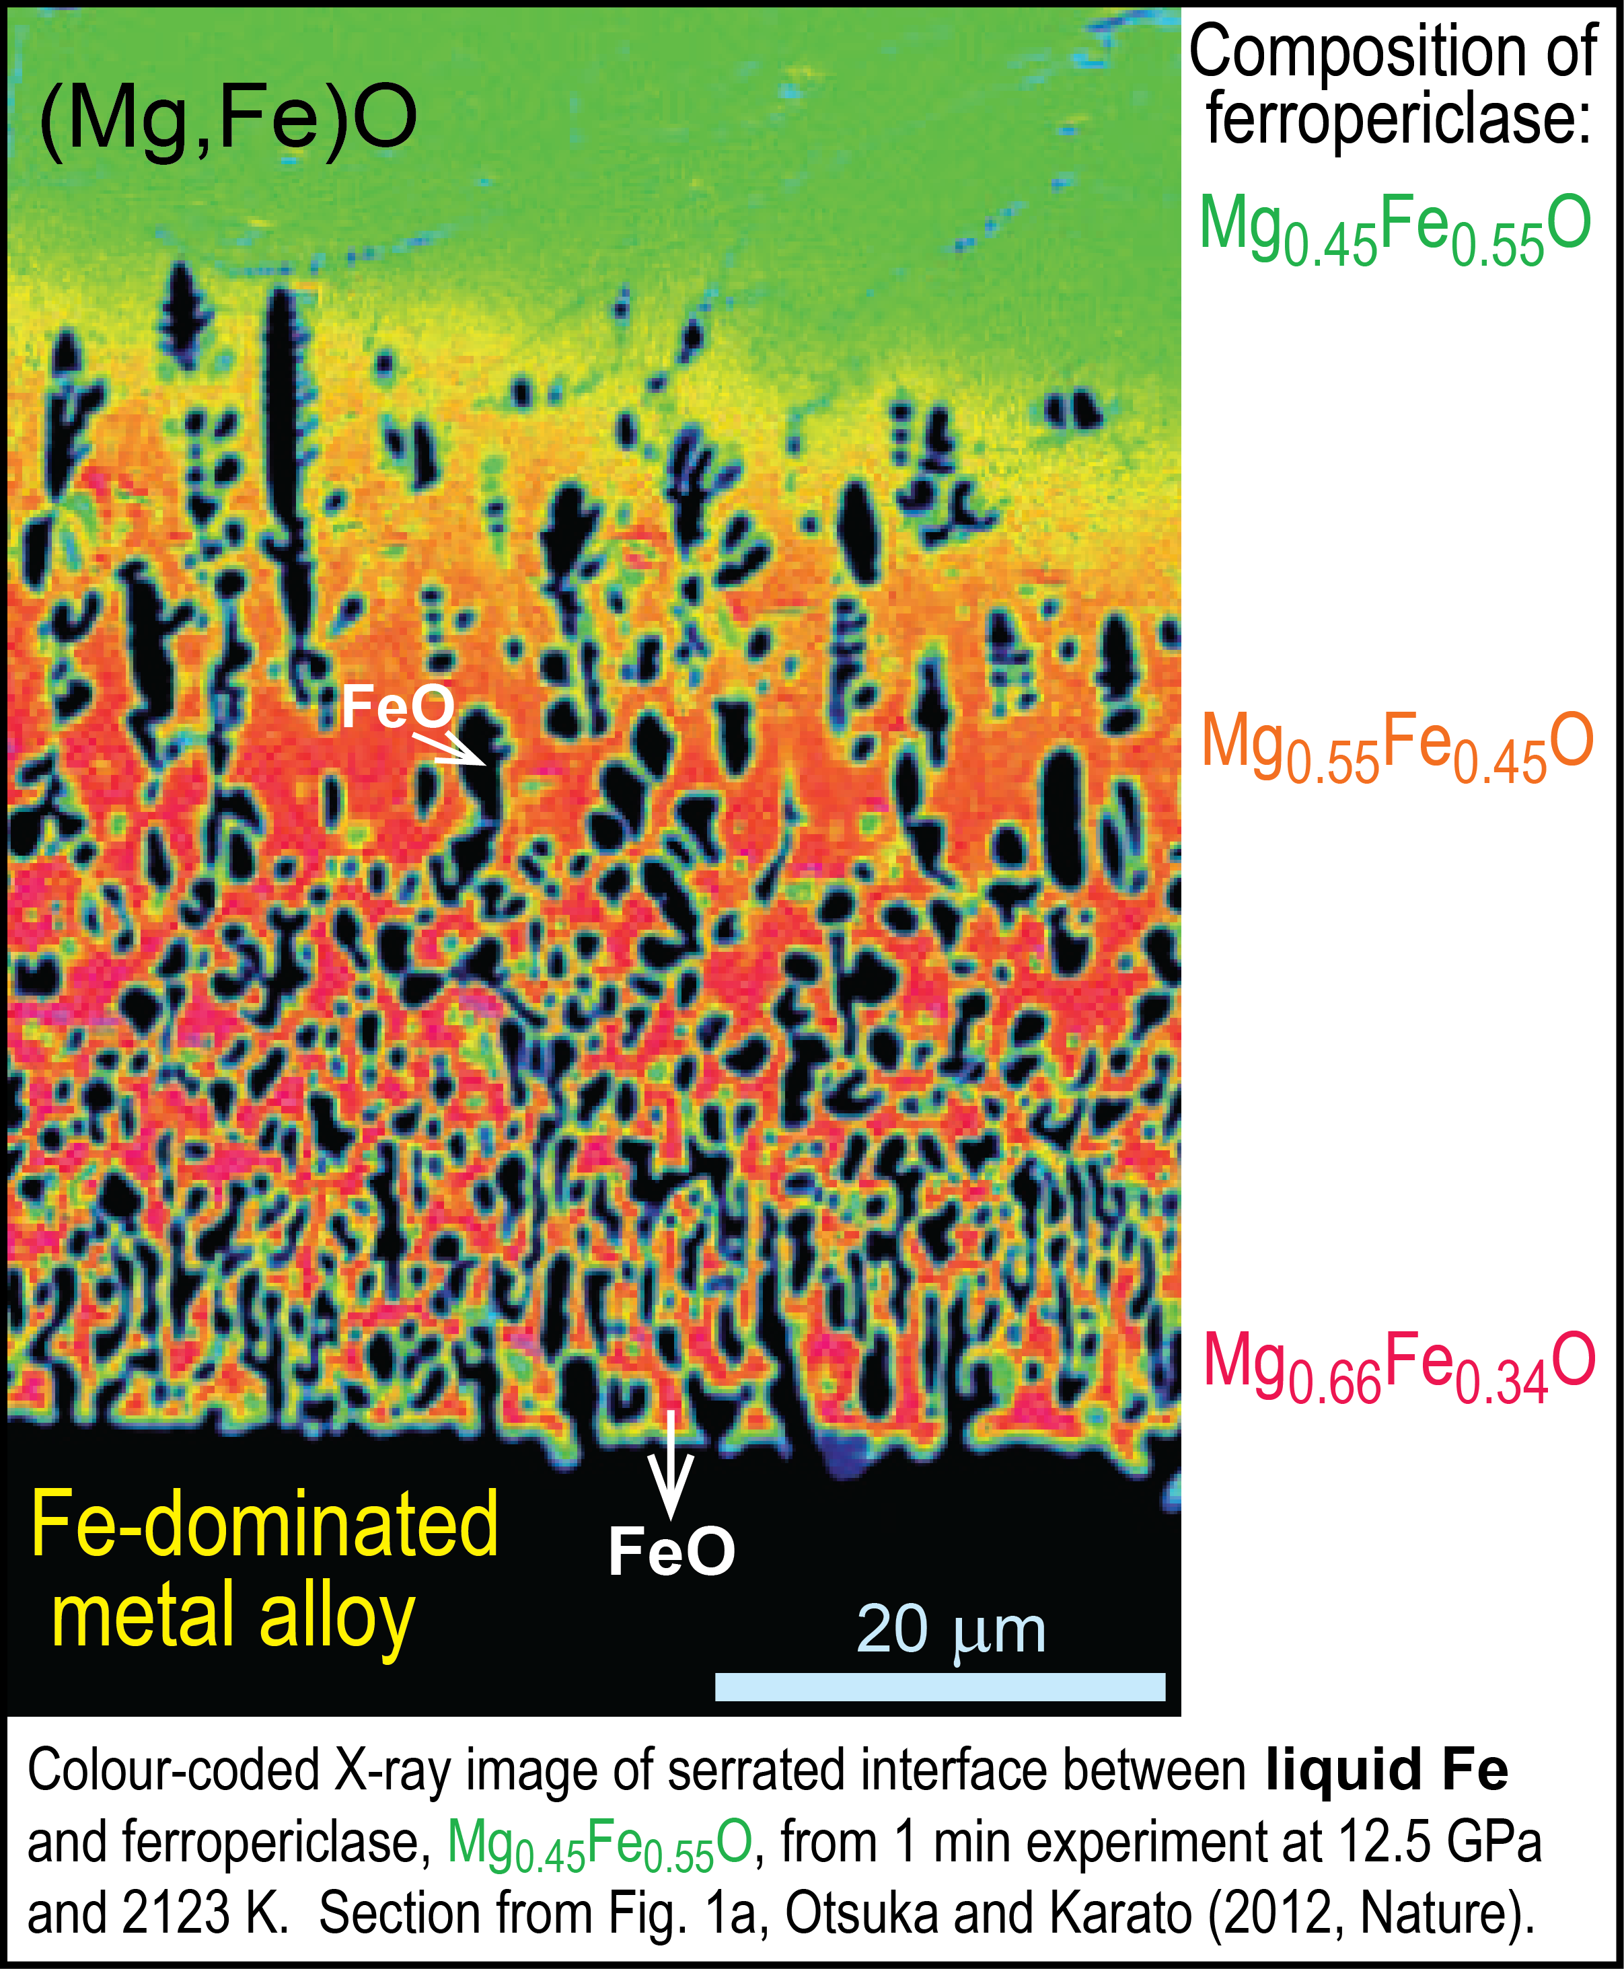
Experiments by Otsuka & Karato
(2012, Nature) shows:
FeO-partitioning from a fp single crystal to
Fe-melt at 12.5 GPa - 2123 K - 1 min
Initial crystal composition: Mg_{0.45}Fe_{0.55}O
metal alloy "worms" intruding into fp-crystals "sucking up" FeO to alleviate the O-undersaturation in the metal
40 μm

Slide 6
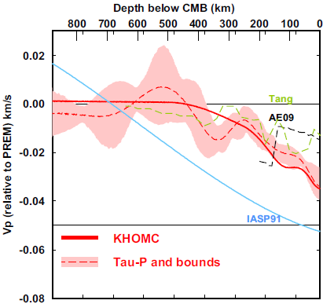
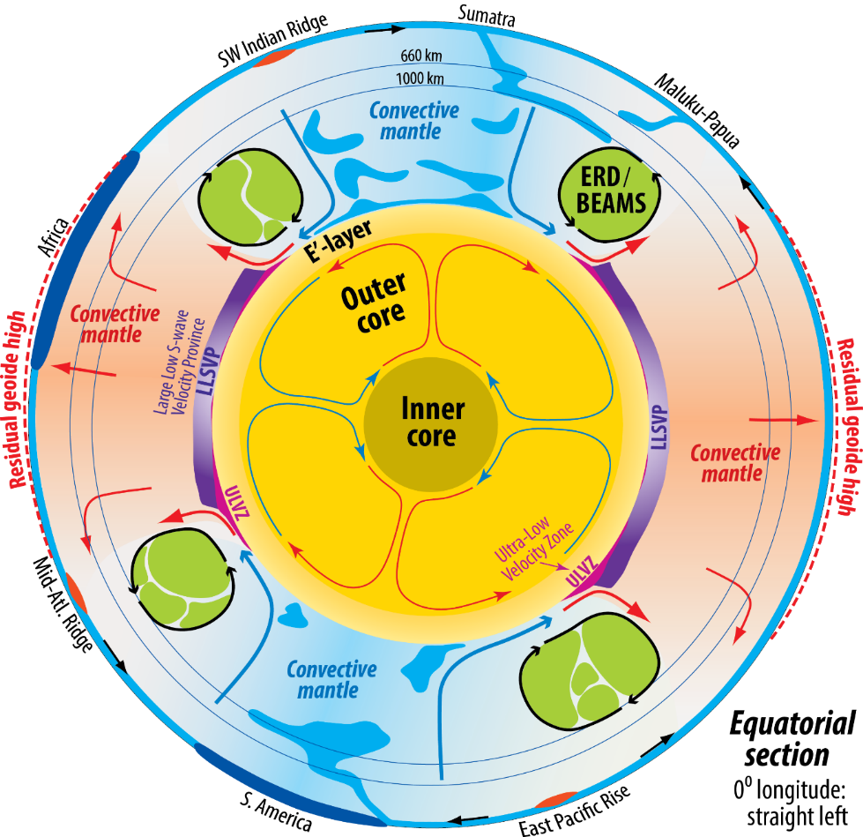
Possible trace of core-BMO exchange:
gradationally stratified outermost E'-layer
with low Vp, low ρ
0-445 km
below CMB
0.4 %
Kaneshima (2018, PEPI)
Seismology
Lay & Young, 1990
Garnero et al., 1993
Helffrich & Kaneshima, 2010
Kaneshima & Helffrich, 2013
Kaneshima & Matsuzawa, 2015
Kaneshima, 2018
Irving et al., 2018: Adiabatic outermost core
A stagnant E'-layer may be feasible because:
- high thermal conductivity supresses convection
- low viscosity reduces viscous entrainment
- an E'-layer may stabilise the geodynamo
(Hernlund & McNamara, 2015, Treat. Geophys.)
Modelling
Buffet, 2010
Buffet & Seagle, 2010
Gubbins & Davies, 2013
Hernlund & McNamara, 2015
Brodholt & Badro, 2017

Slide 7
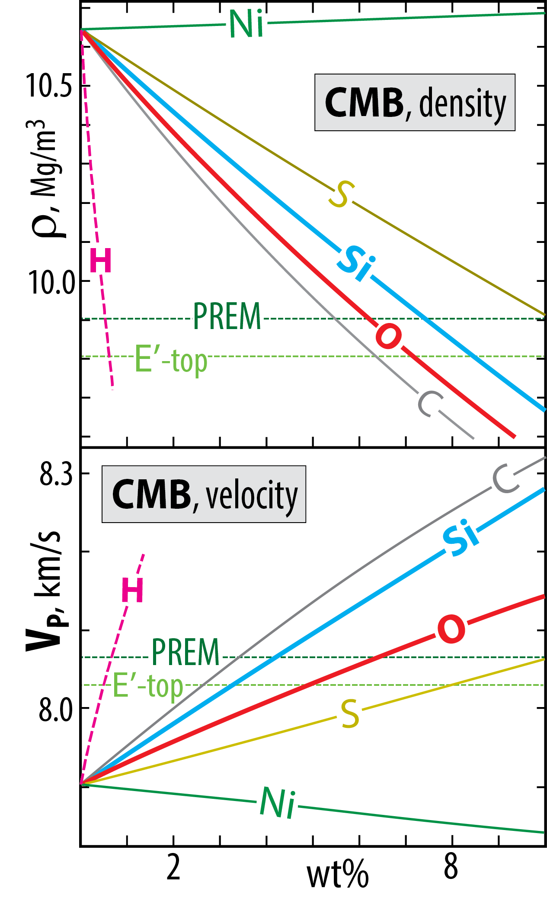
Outermost stagnant E'-layer?
gradationally stratified, low V_{P} - low ρ
Molten binary Fe-alloys: ρ and V_{P}
E'-layer chemical characteristics and core alloy properties
have posed a long-standing conundrum, discussed by
Brodholt & Badro (2017, GRL)
All of the light element candidates (Si, O, S, C, H)
reduce ρ but increase V_{P}
However:
O reduces ρ more and increases V_{P} less than Si.
Therefore:
E'-layer with elevated O and reduced Si relative to
the convecting core may solve the conundrum
Badro et al. (2014, PNAS)
Brodholt & Bardo (2017; GRL)
Umemoto & Hirose (2020, EPSL)

Slide 8
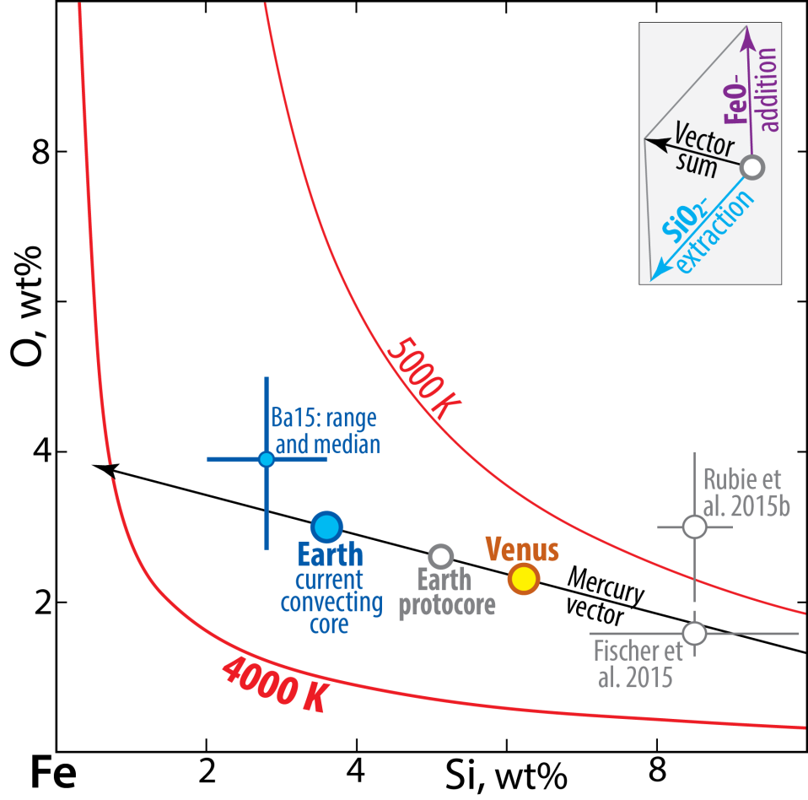
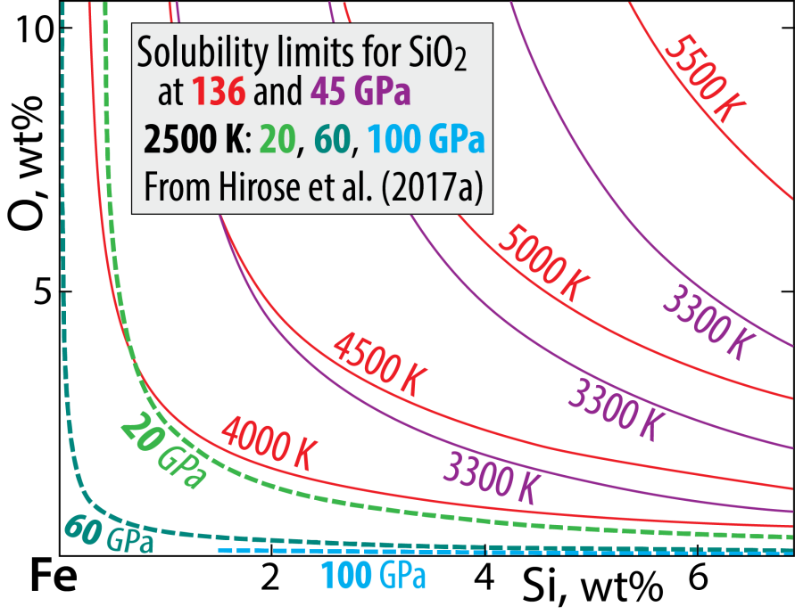
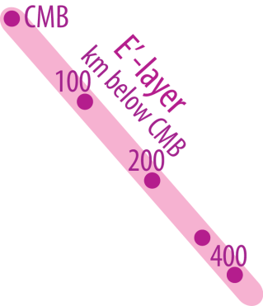
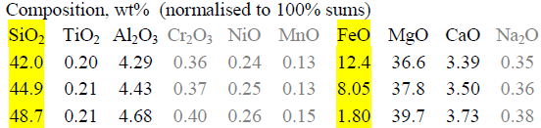
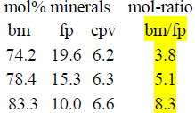

System: Fe-Si-O
Solubility of O and Si in Fe-alloy
Estimated core compositions (Trønnes et al. 2019)
Mercury:
15 wt% Si, no O
- Solubilites increase with T and decreases with p
- O and Si: mutually exclusive
- Related to the silica liquidus surface in system Fe-Si-O
(Hirose et al. 2017; Helffrich et al. 2019)
E'-layer compositional gradient - constrained by:
- KHOMC seismic model of Kaneshima (2018)
- mineral physics data from Brodholt & Badro (2017)
Mass balance model
Stage 1: protoC + earlyMO = convC + pyrolite-MO (total volumes)
Stage 2: upper convC + BMO = E'-layer + mod. lowermost M
34 vol%, 28 vol%,
31 wt% of C 34 wt% of M
and used as input in mass balance model
Model compositions

Slide 9
Fe-metal and Fe-oxide transport to the core
Will the BMO be oxidised or reduced during solidification?
If Fe-metal is extracted
and sinks to the core
If Fe-oxide with a FeO_{1.5}/FeO ratio higher
than that of the BMO dissolves into the core
Next slide illustrates the effect of
FeO-disproportionation to ferric and metallic Fe
− as a result of bridgmanite crystallisation

Slide 10
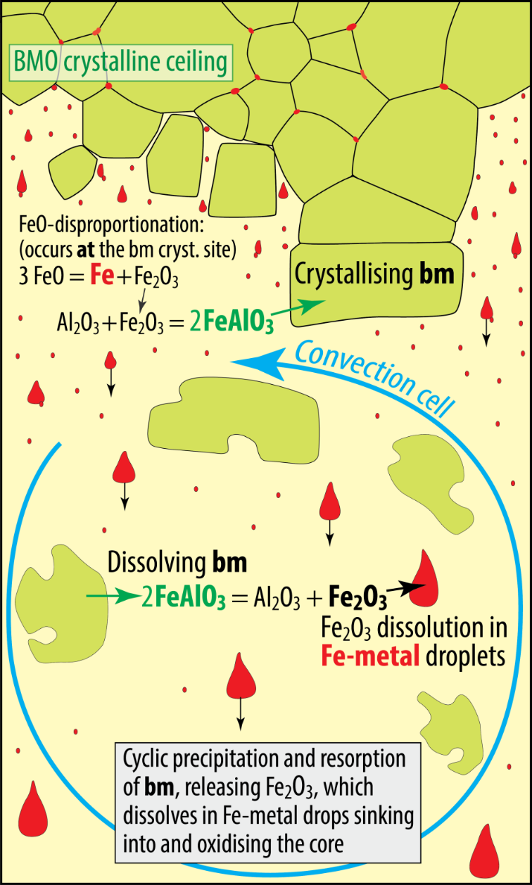
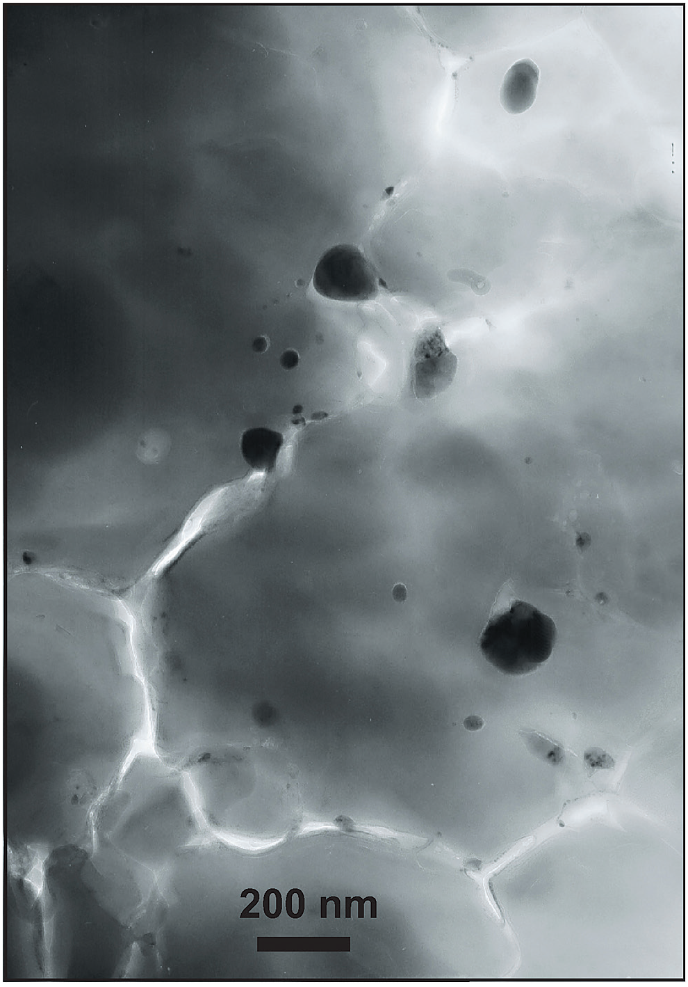
Subsolidus crystallisation of bm
Cyclic crystallisation and dissolution of bm
- incorporation of the FeAlO₃-component in bm
- associated by FeO disproportionation and
Fe-metal precipitation (Frost et al. 2004, Nature)
Consequence for
Andrault et al. (2018, GPL)
TEM-image of exp. run
product, 40 GPa, 2500 K.
Bridgmanite with nm-scale
Fe-metal blobs (black)
Starting mix:
(Mg,Fe)SiO₃ - opx +
Al₂O₃ - corundum
30 nm
Fe-metal
160 nm
Might be important for O-loading of the core.
BUT: O-saturation level in metal is < 20 wt%, while FeO
and Fe₂O₃ contain 22 and 30 wt% O, respectively.
Sinking metal drops will therefore always oxidise the BMO

Slide 11
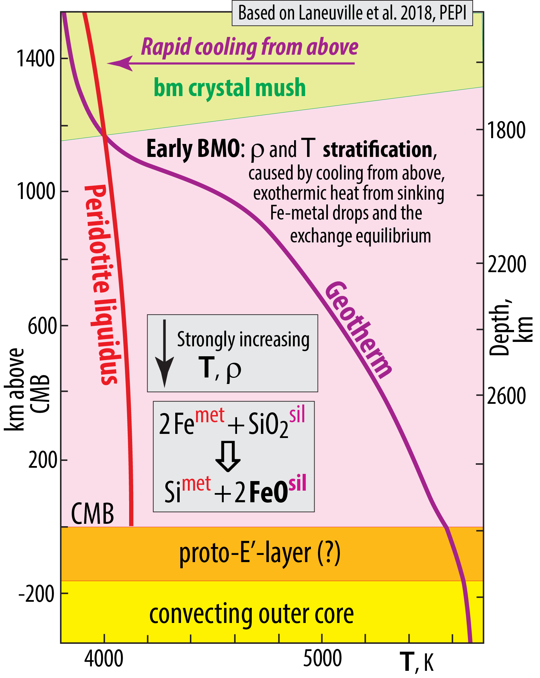

BMO: density and temperature gradients − not only about the Fe/Mg bm-melt partitioning

Slide 12
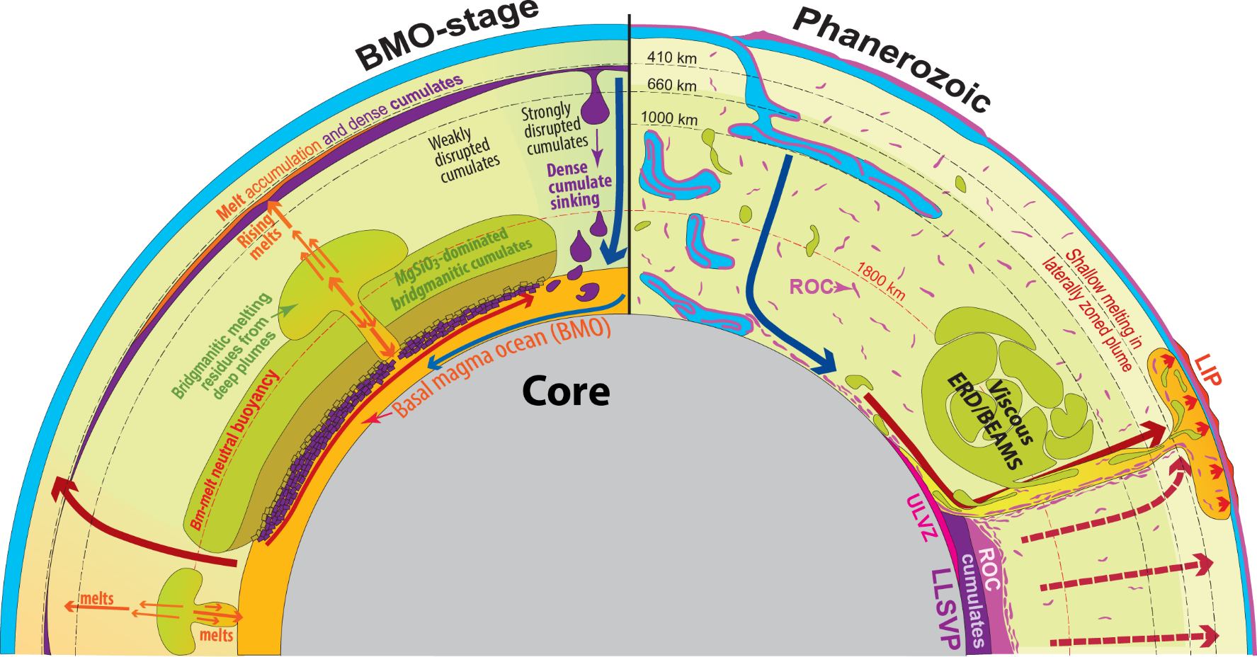
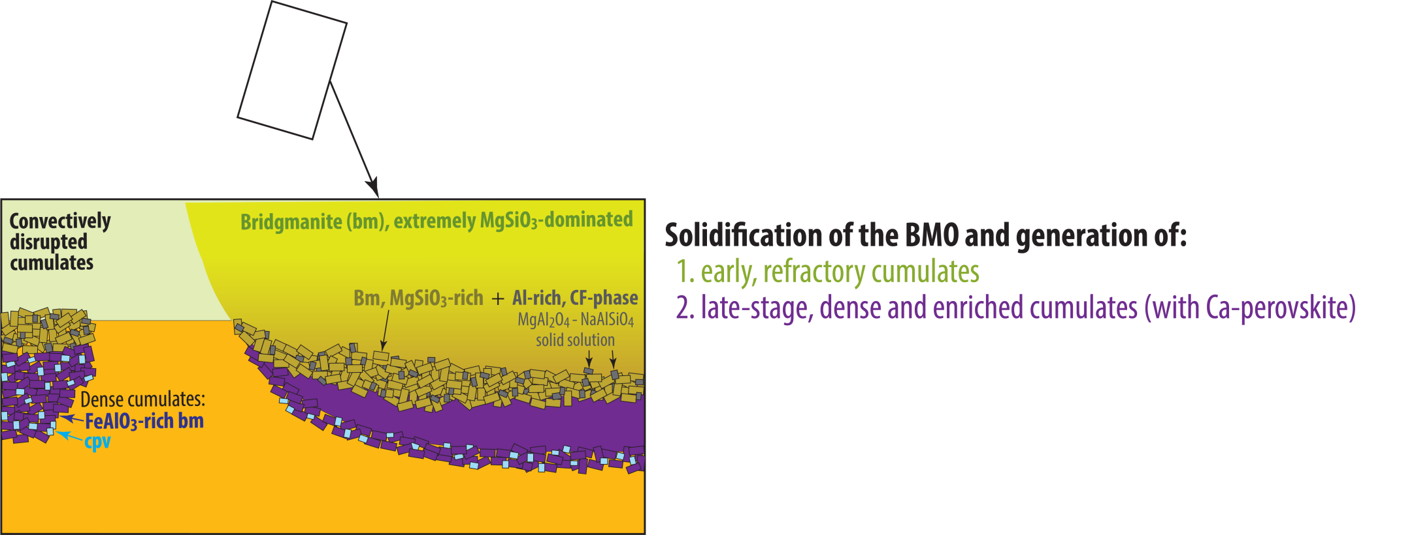
BMO- crystallisation
Evolution of:
viscous BEAMS
LLSVP-cumulates
Refractory & viscous ERD convectively aggregated to BEAMS
e.g. Manga, 1996; Ballmer
et al. 2017; Gulcher et
et al. 2020.
Modified, mainly from:
Torsvik et al. (2016, Can. J. Earth Sci.)
Ballmer et al. (2017, Nature Geosci.)
Trønnes et al. (2019, Tectonophys.)

Slide 13
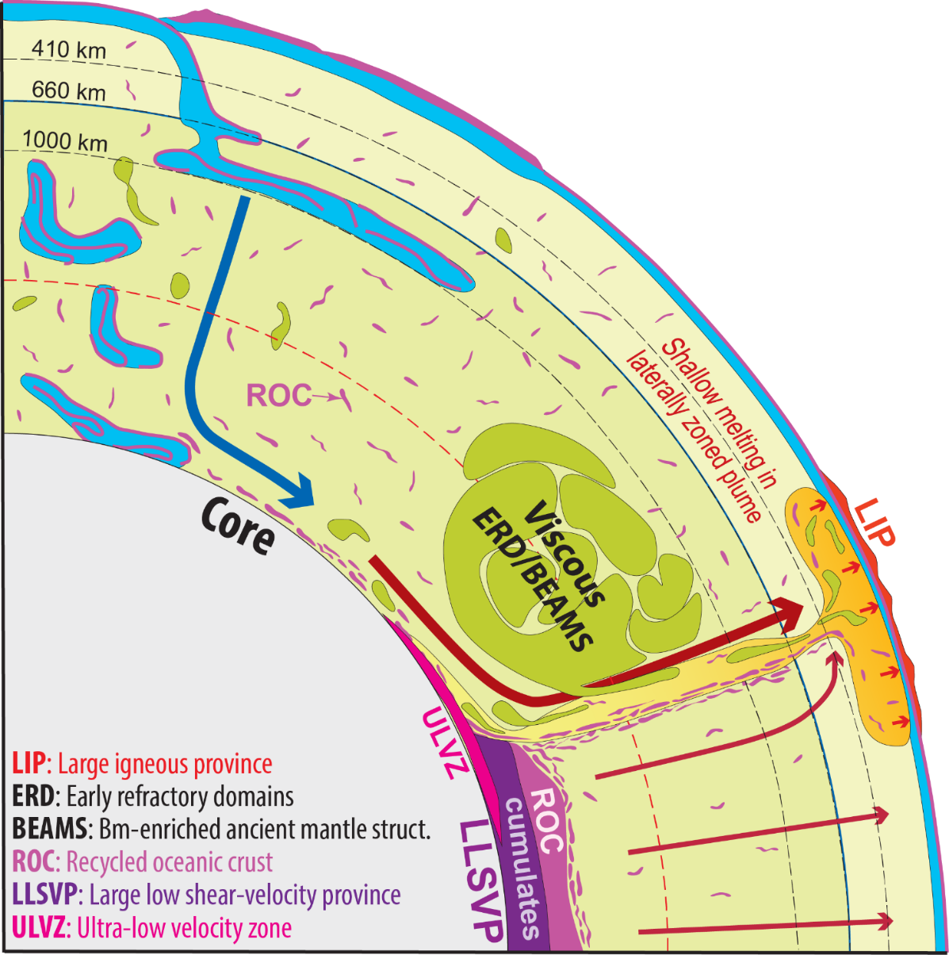
Two important consequences
- LM is more bridgmanitic ("chondritic") than the bulk mantle − elevated Si/(Fe+Mg) and bm/fp ratios
- The entrainment and UM-melting of ERD-material may be seen as the positive μ¹⁴²Nd-anomalies in some OIBs and kimberlites.
The ERD-material is very refractory (bridgmanitic) in the LM but turns pyroxenitic and less refractory in the UM melting zone
Questions to: rtronnes@uio.no
Modified, mainly from:
Torsvik et al. (2016, Can. J. Earth Sci.)
Ballmer et al. (2017, Nature Geosci.)
Trønnes et al. (2019, Tectonophys.)

