Slide 1
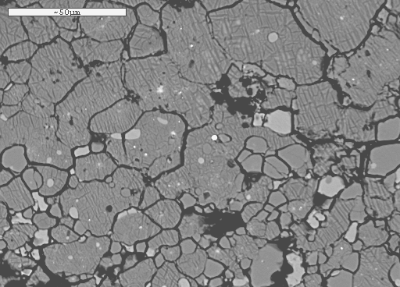
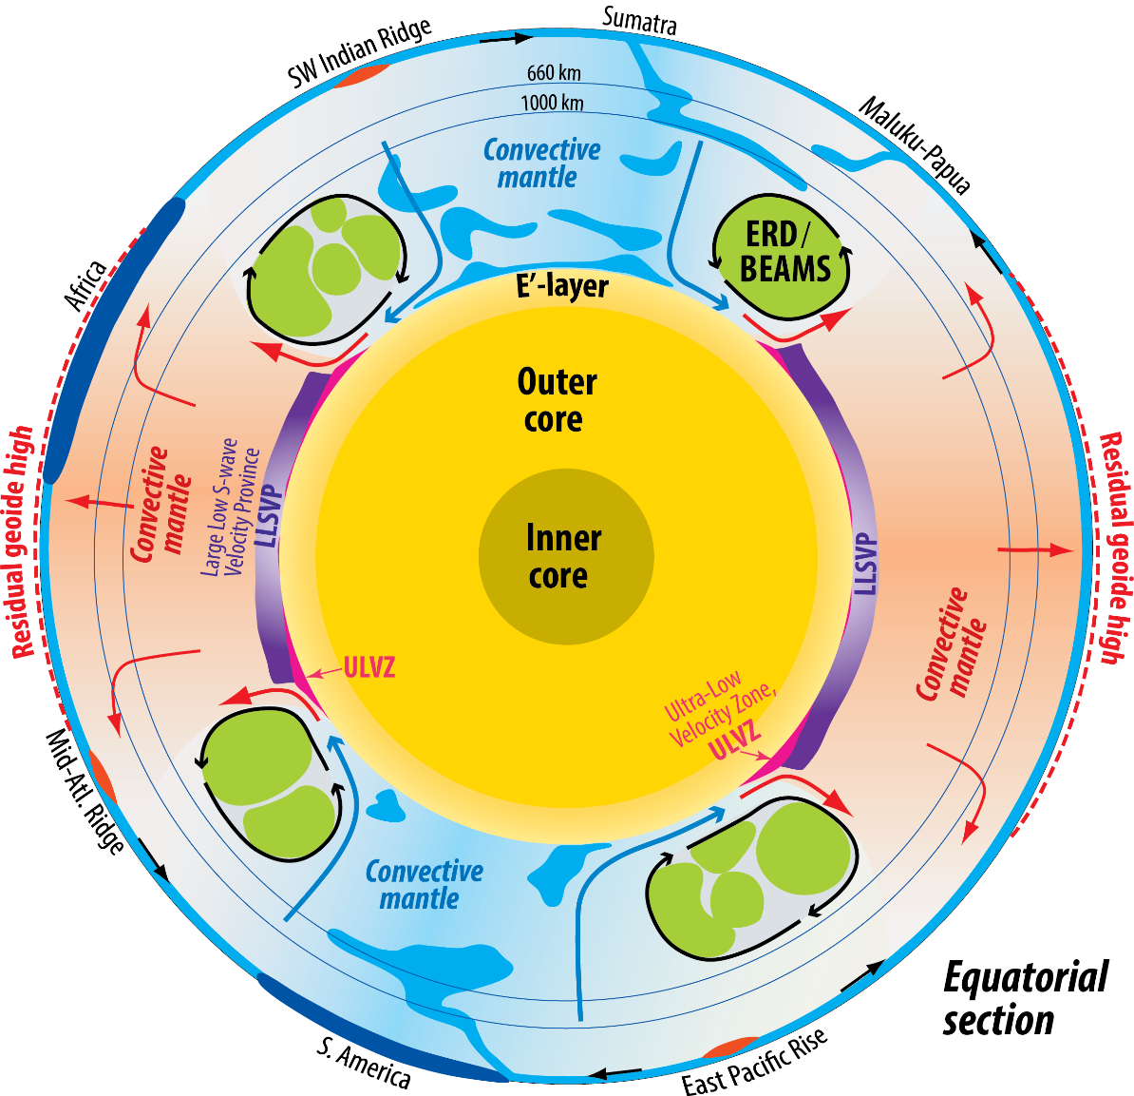
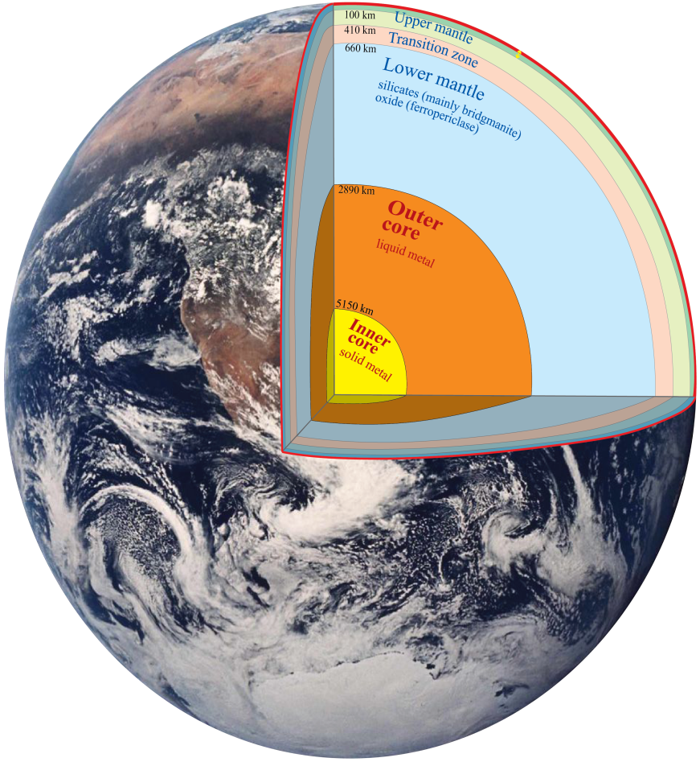
Deep Earth materials, structure and dynamics: eleven major developments in the CEED decade. A personal (re)view.
Deep Earth group: focus on the lower mantle (LM) and outer core - and especially:
- the lowermost mantle thermal boundary layer (D’’) with LLSVPs and ULVZs
- probable Hadean refractory and bridgmanitic domains in the mid-LM
- chemical exchange between an initial magma ocean (MO) and protocore and subsequent basal MO (BMO)
and core, which has consequences for the composition and structure of LM and outermost core (E'-layer)

Slide 2
Major developments in deep Earth materials and dynamics in the CEED decade
Divided into two themes:
- Phase relations and density (8 topics)
- Degree-2 residual geoid, LM viscosity and LLSVP base layer thickness and density excess
(3 topics)

Slide 3
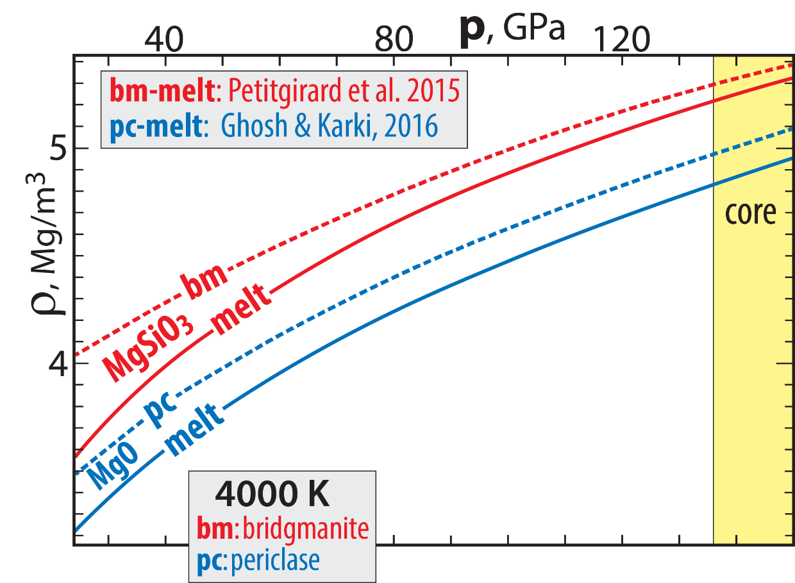
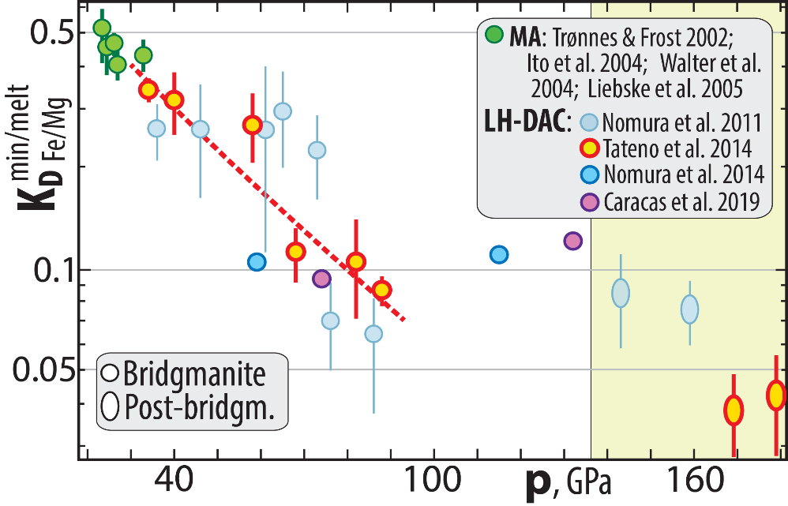
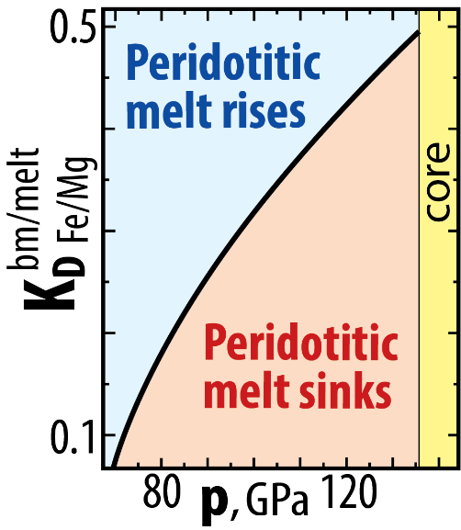
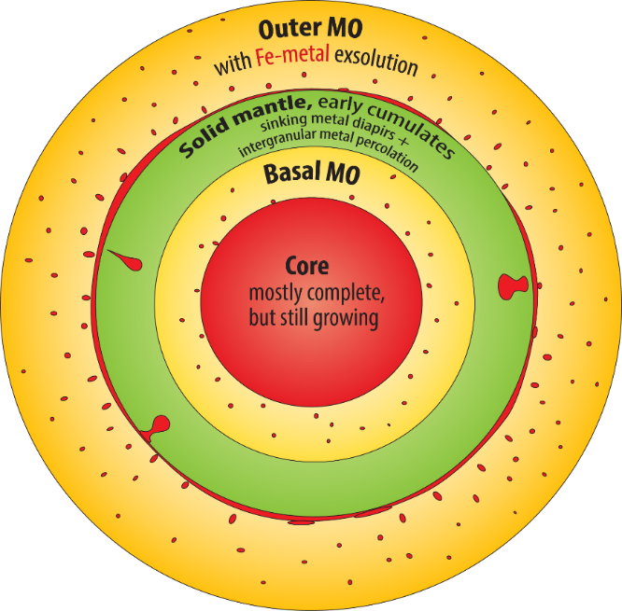
Strengthened case for a long-lived basal magma ocean (BMO) − possibly to the late Proterozoic?? (Labrosse et al. 2007, Nat)
Strong Fe-partitioning from bridgmanite (bm) to melt (e.g. Tateno et al. 2014, JGR), which densifies melts during fractionstion
Bm-melt and periclase-melt density relations for MgSiO₃ and MgO (Petitgirard et al. 2015, PNAS, Ghosh & Karki 2016)
Bm-melt density relations in peridotitic systems (Caracas et al. 2019, JGR; Trønnes et al. 2019, Tectonoph)
0.1↔80 GPa
bm/melt
Fe/Mg
K_{D} = (Fe/Mg)^{bm} / (Fe/Mg)^{melt}
Neutral buoyancy for
K_{D}= 0.1 →73 GPa
73-80 GPa,
~1800 km depth
(PREM)

Slide 4
Chemical exchange, core-BMO and the implications for outermost core (E'-layer) and LM
Light element composition of the outer core from mineral physics (Badro, Coté, Brodholt 2015, PNAS; Badro, Brodholt et al. 2014, PNAS)
Evidence that the outer core alloy is O-undersaturated → FeO from bm and ferropericlase to the core (Takafuji et al. 2005; Frost et al. 2010)
Geophysical constraints on E'-layer (Lay & Young, 1990, GRL; Garnero et al. 1993, GRL; Helffrich & Kaneshima 2010, Nature;
Kaneshima & Helffrich, 2013, GJI; Kaneshima, 2018, PEPI; Irving et al. 2018. Sci Adv)
Core-BMO exchange: SiO₂↔FeO, E'-layer (Brodholt & Badro 2017, GRL; Hirose et al. 2017, Nat; Trønnes et al. 2019, Tectonoph; Helffrich et al. 2020)
Fairly large and complex topic - if interested, see recorded lecture at:
www.nhm.uio.no/english/about/organization/research-collections/people/rtronnes/1/other-lect/sem-mtg/Core-MO-exchange-Rec.pptx
Trønnes-UiO-page → Teaching → other-lect → sem-mtg → Core-MO-exchange-Rec.pptxZ
Metal-silicate exchange equilibrium leading to core - BMO chemical exhange during cooling
2 Fe^{met} + SiO₂^{sil} = Si^{met} + 2 FeO^{sil}
displaced towards the products with increasing T
and reversed during cooling
Large terrestrial planets Venus & Earth:
core segregation at very high T, allowing
high Si^{protocore} and high FeO^{MO} (i.e. high f_{O2})
Cooling core-BMO chemical exchange
- FeO and FeO_{1.5} from BMO to the core
- SiO₂ from core to BMO

Slide 5
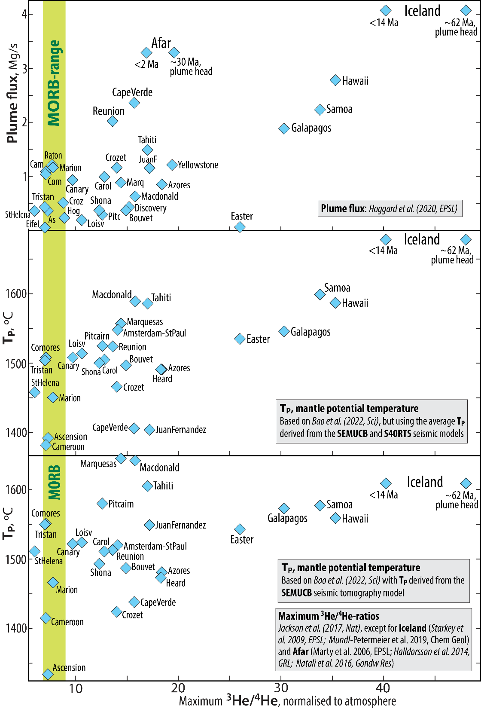
Plume flux and core-to-plume-contamination of W, presumably via ULVZs, but not He and Ne
Correlation: plume flux, ³He/⁴He- and ¹⁸²W/¹⁸⁴W-ratios (Jackson et al. 2017, Hoggard et al. 2020, EPSL; Bao et al. 2022, Sci, Mundl et al. 2017, Sci)
In spite of this: primordial He-Ne-signal is not from core. Met-sil partitioning predicts too high He/Ne core (Li, Brodholt et al. 2022, Nat Comm)
Mundl-Petermeier
et al. 2020, GCA

Slide 6
Early refractory domains (ERDs) are bridgmanitic, Hadean and likely sources of primordial-like He- and Ne-isotopic signatures.
Geodynamic BEAMS-model (Ballmer et al. 2017, NG). Tenuous seismic evidence for ferropericlase-free domains (Shephard et al. 2021, NC)
He-Ne-diffusion rates in bm supports primordial signal from Hadean refractory BEAMS, (Trønnes et al. in prep)
Ballmer et al. (2017, Nat Geosci): BEAMS-modelling

Slide 7
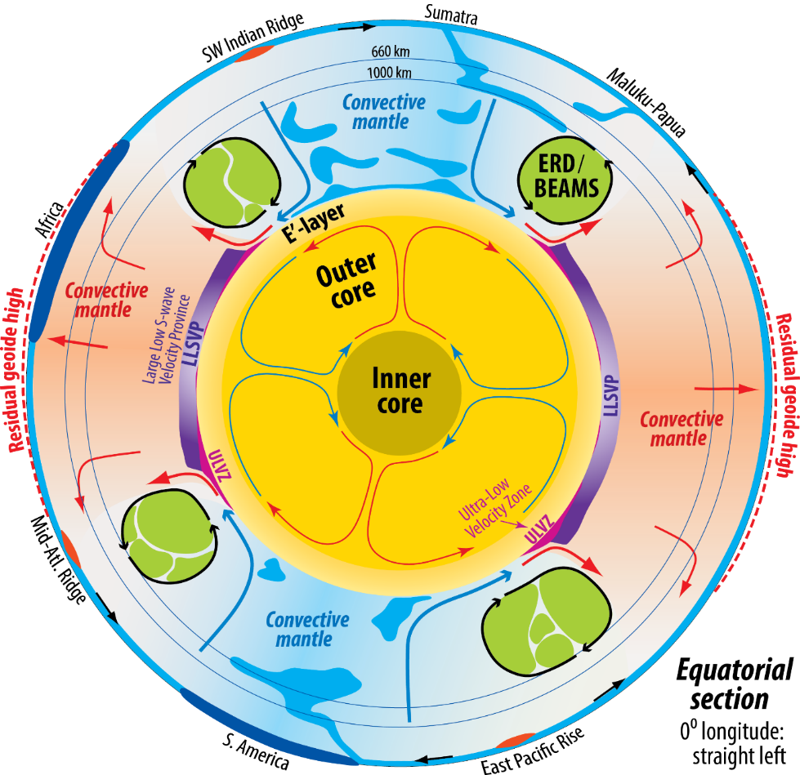
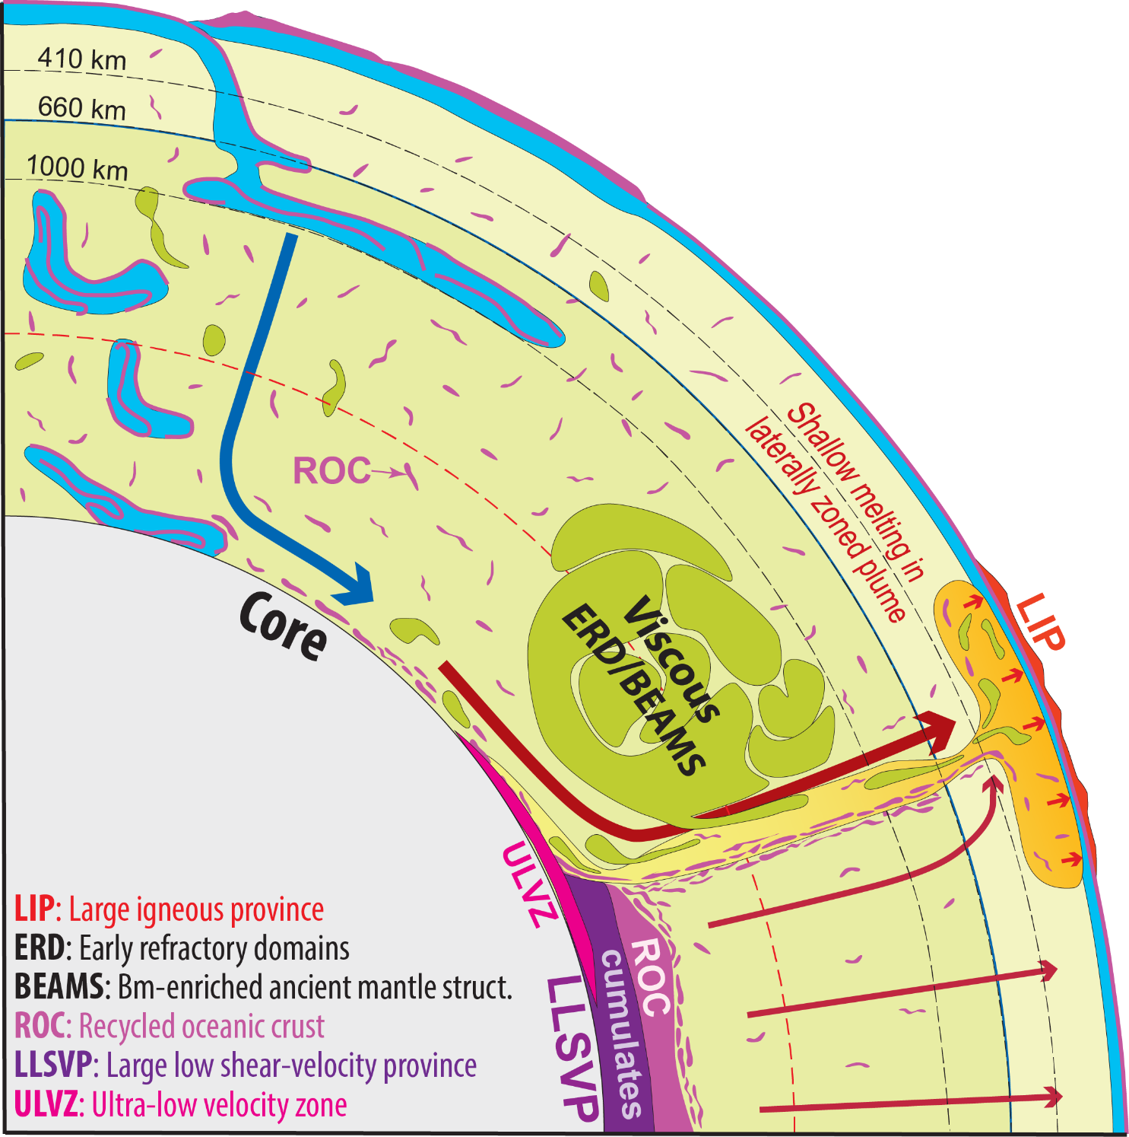
Early refractory domains. ERDs: bridgmanitic, Hadean and likely sources of primordial-like He- and Ne-isotopic signatures)
Geodynamic BEAMS-model (Ballmer et al. 2017, NG). Tenuous seismic evidence for ferropericlase-free domains (Shephard et al. 2021, NC)
He-Ne-diffusion rates in bm supports primordial signal from Hadean refractory BEAMS, (Trønnes et al. in prep)

Slide 8
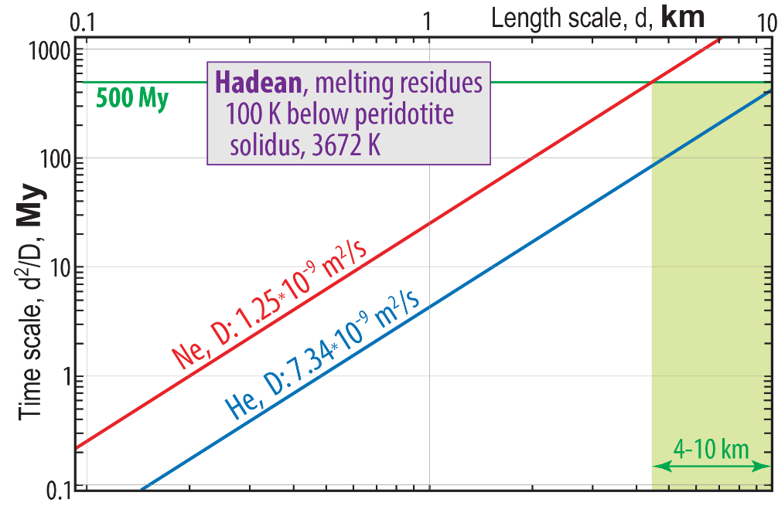
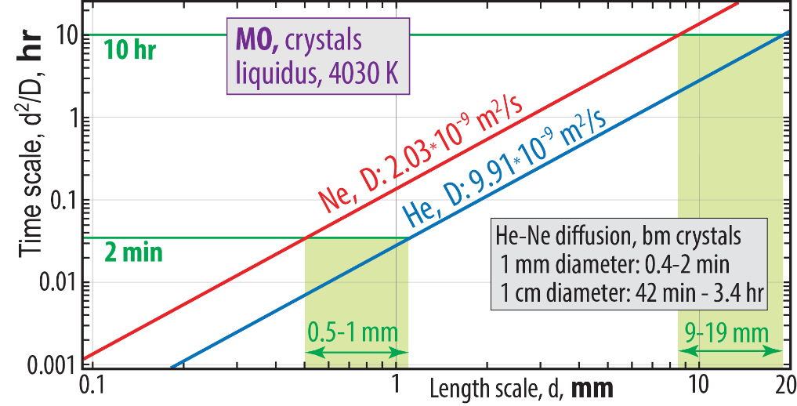
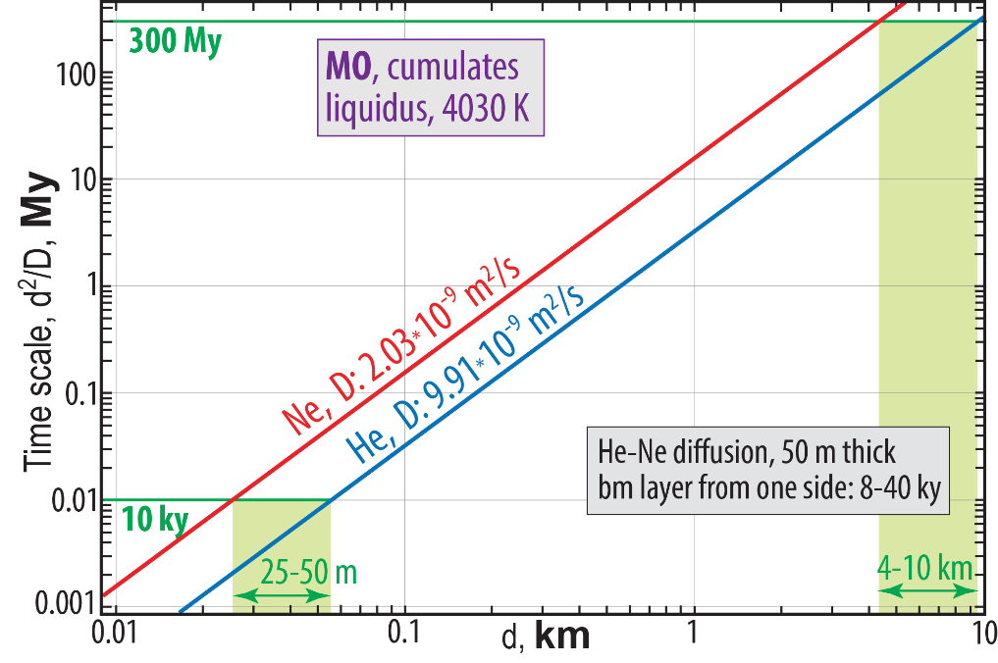
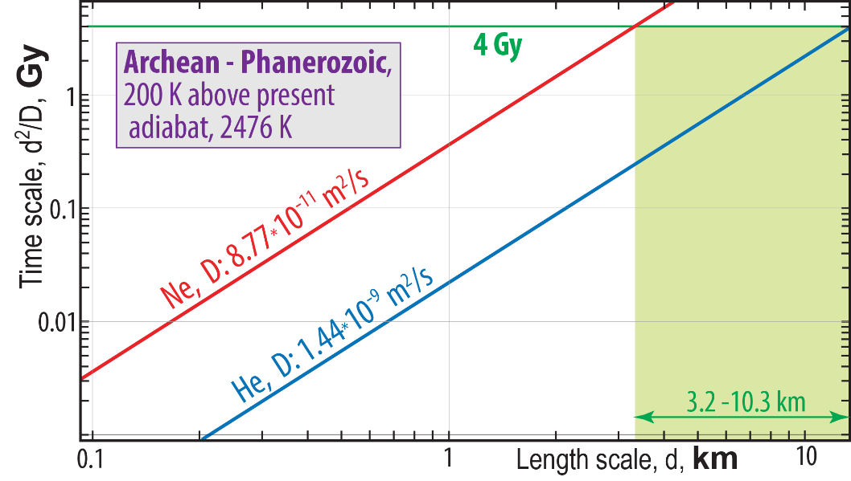
Diffusion length scales for He and Ne in bm at about 1800 km depth
Trønnes et al. in prep.
Hadean. Sufficient for He-recharging over:
- 19 mm length scale at liquidus in 10 hr
- 10 km length scale at liquidus in 300 Ma
- 10 km length scale 100 K below solidus in 500 Ma
Archean-Phanerozoic
Insufficient for resetting to convective mantle ³He/⁴He over:
>10 km length at 200 K above the resent ambient geotherm in 4 Gy

Slide 9
Role of dense, residual davemaoite (Ca-perovskite) in the lowermost mantle
Davemaoite-enrichment in the ULVZs from partial melting of ROC and in LLSVPs from MO-BMO-crystallisation.
Important implications: U-Th-enrichment and high ⁴He/³He- and ²¹Ne/²²Ne ratios (Hernandez et al. 2022, GRL; Trønnes et al. in prep)
POSTER on Wednesday

Slide 10
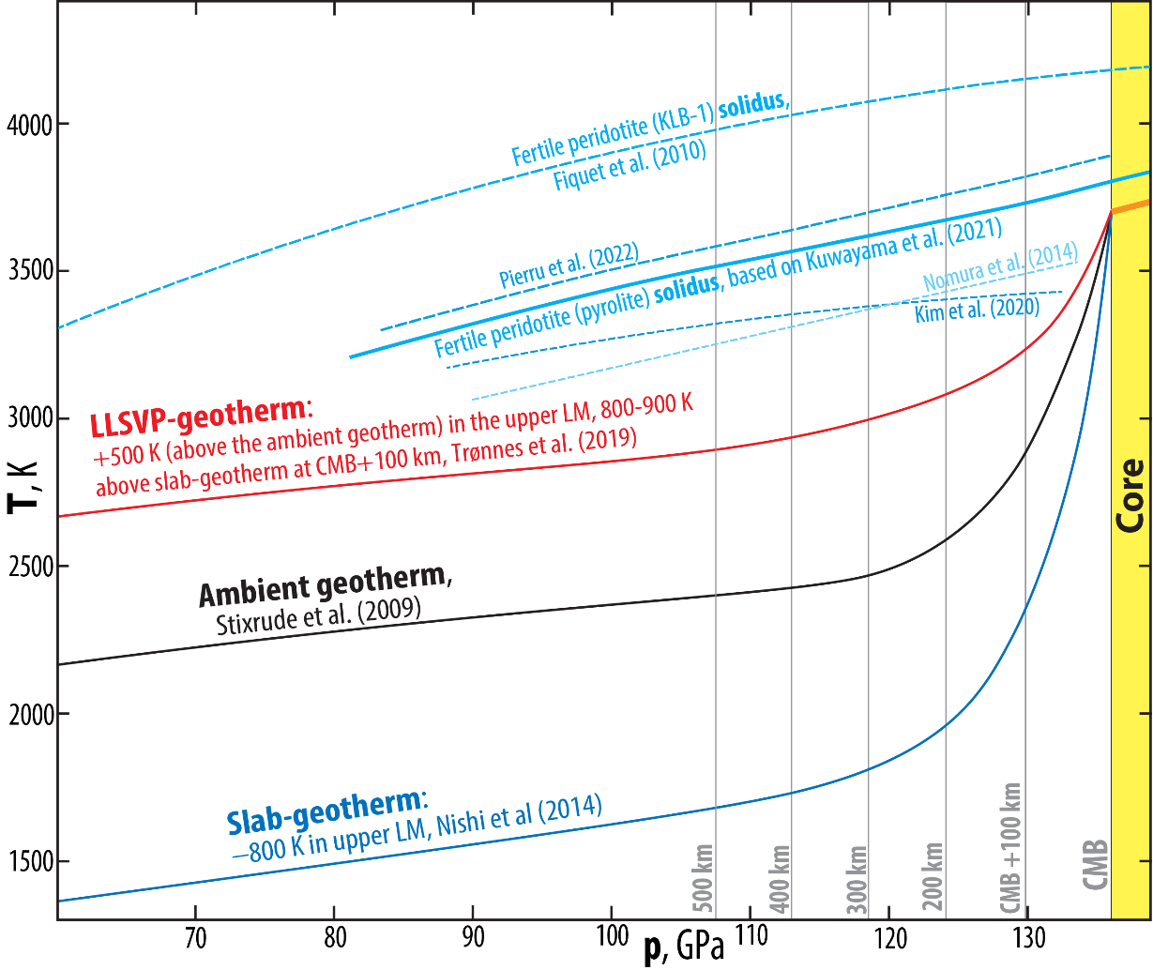
Reduced CMB-temperature: from about 4000 to 3700 K (?), based on:
Lower melting curve for Fe at outer core conditionds (Sinmyo et al. 2019, EPSL)
Lower peridotite solidus, 3800-3600 K at the CMB (Nomura et al. 2014, Sci; Kuwayama et al. 2022, GRL; Pierru et al. 2022, EPSL)
Sinmyo et al. (2019, EPSL):
DAC-exp. with internal resistance-heating to
determine the melting curve of pure Fe.
The peridotite solidus might provide a firmer constraint.
2014-2022: several new solidus determinations: 3500-4000 K at 136 GPa
- a commonly assumed CMB-T of 4000 K is too high.
- we adopted the interm. Kuwayama-solidus: 3800 K and CMB-T of 3700 K.
CMB
Uncertainties
Largely unknown melting curve depression due to
the light element in the outer core (OC)
A main goal is to determine the ICB-T (melt ↔ solid)
The OC adiabat/geotherm would then give the CMB-T

Slide 11
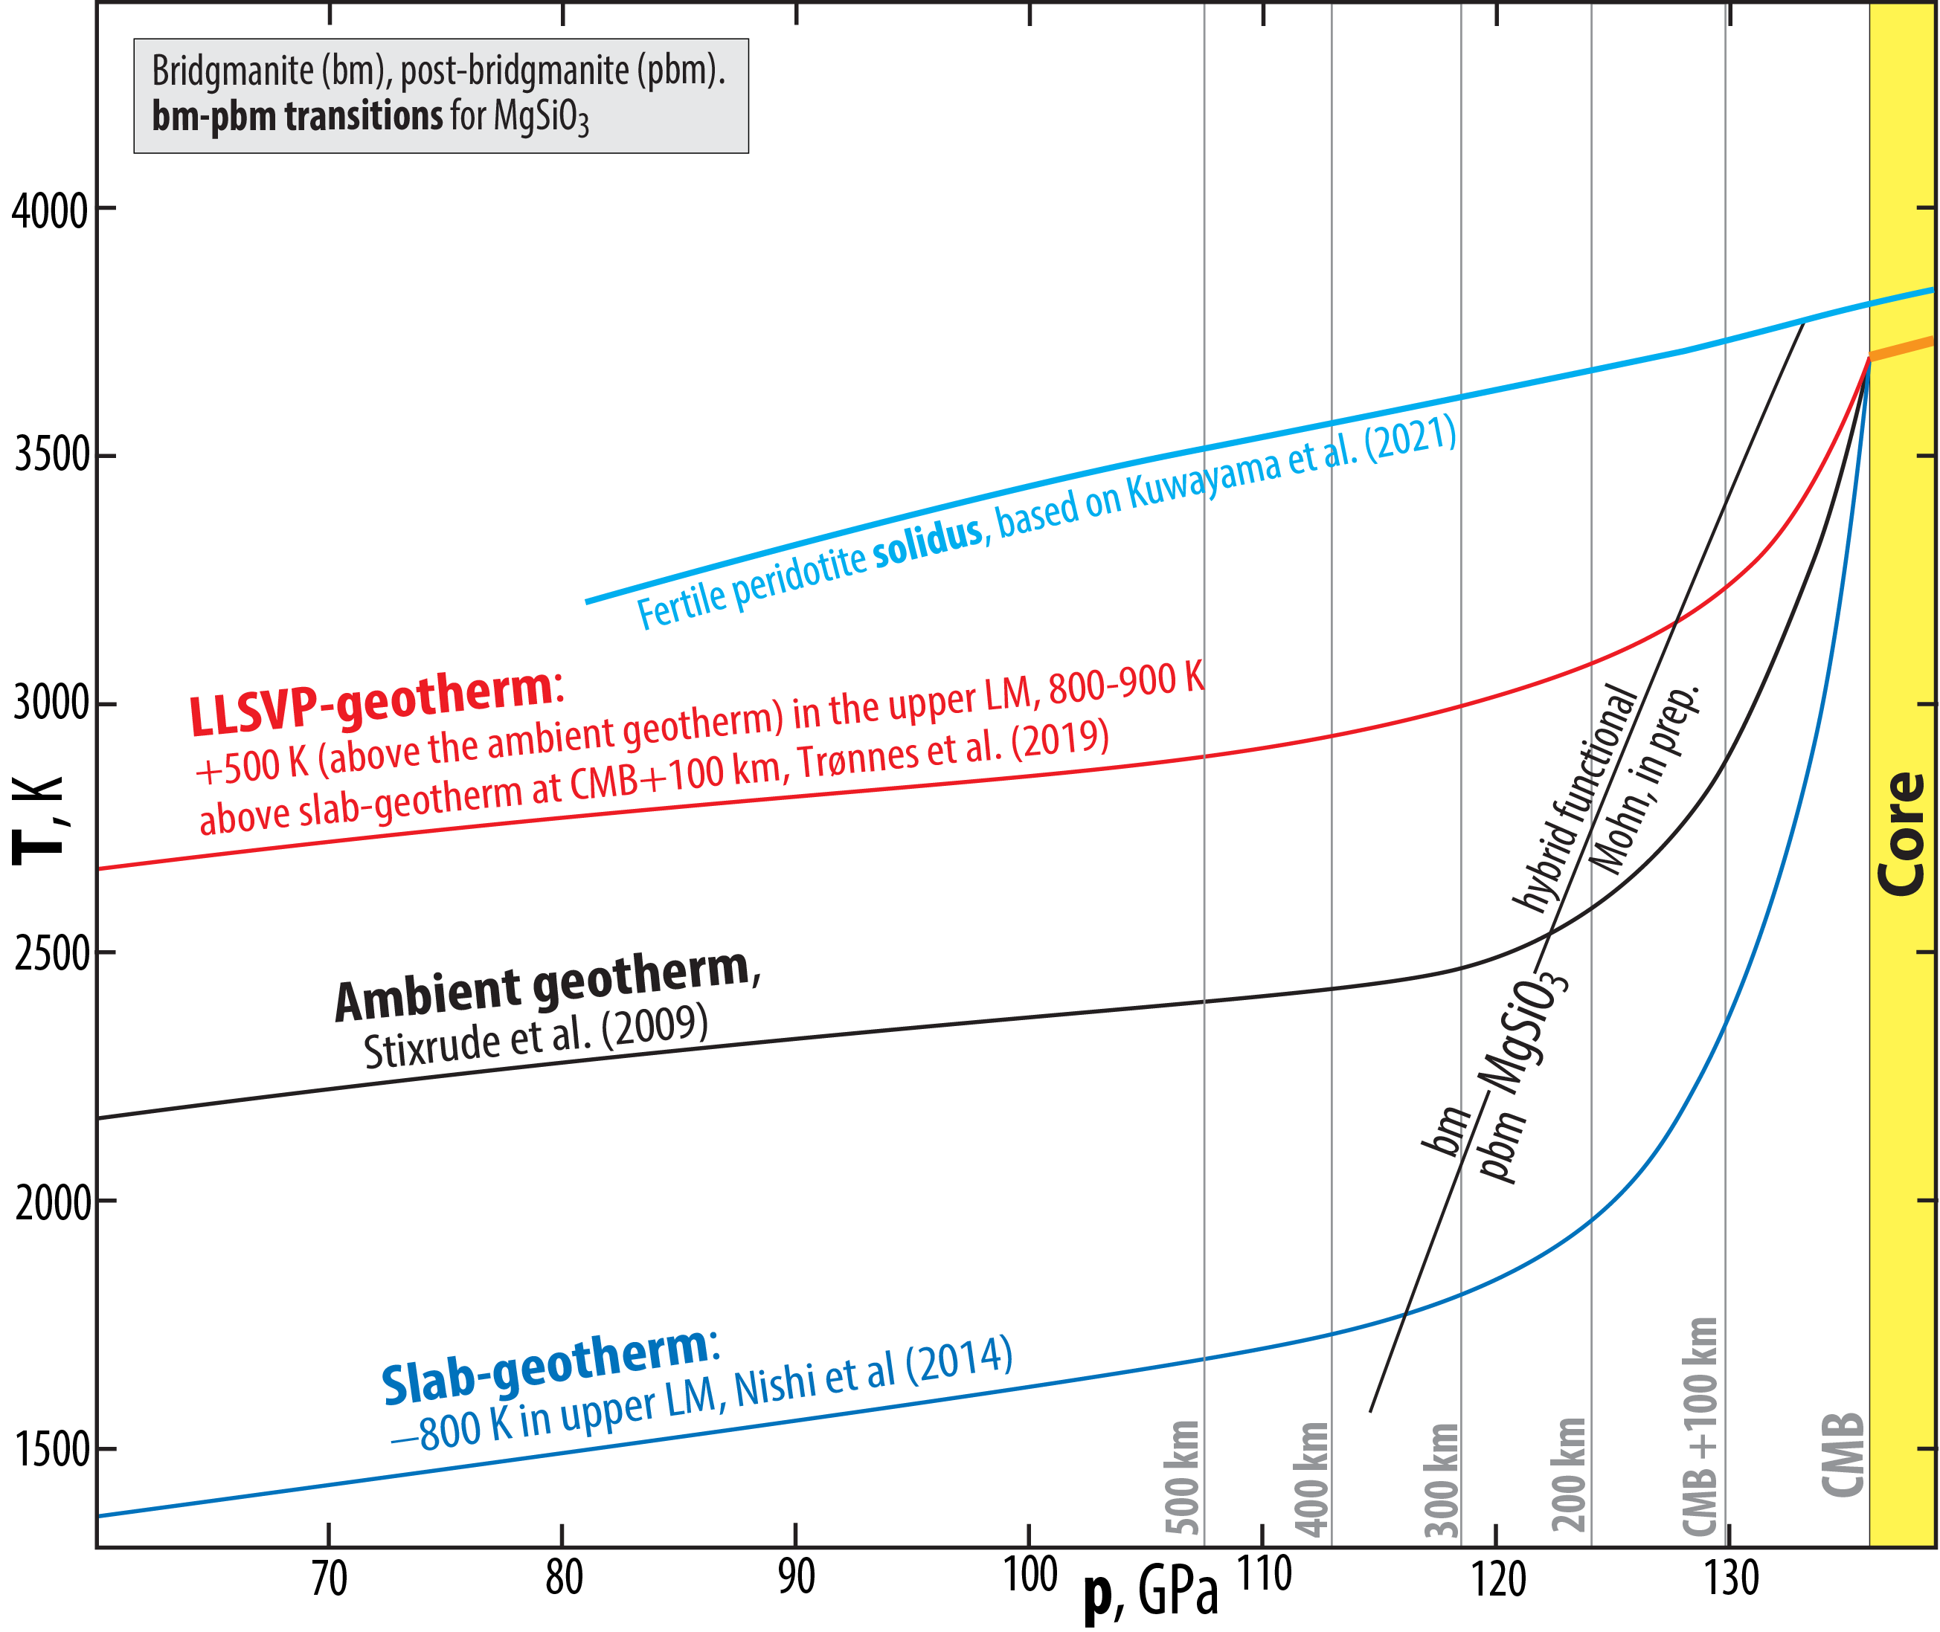
Omnipresent post-bridgmanite (pbm) in the D"-zone, and no double-crossing of the bm-pbm boundary, based on:
Phase relations in MgSiO₃(MS) - FeSiO₃, MS - FeAlO₃ and MS - Al₂O₃ (Mohn, in prep.; Trønnes & Mohn, in prep.)
Phase relations in complex peridotite (Kuwayama et al. 2022, GRL)
Reduced CMB-temperature (see above) and sharp seismic D"-discontinuity, as observed (Mohn, in prep.)

Slide 12
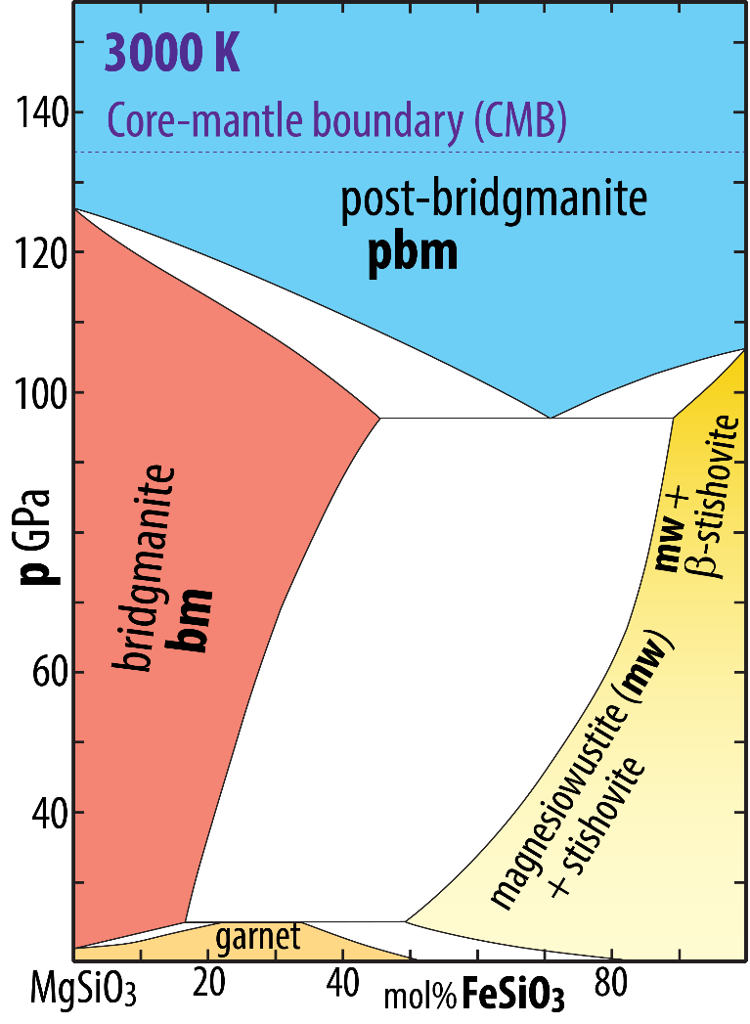
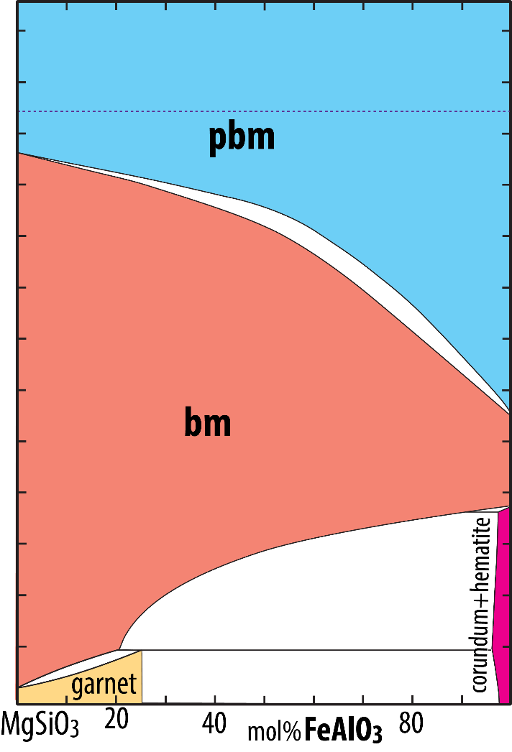
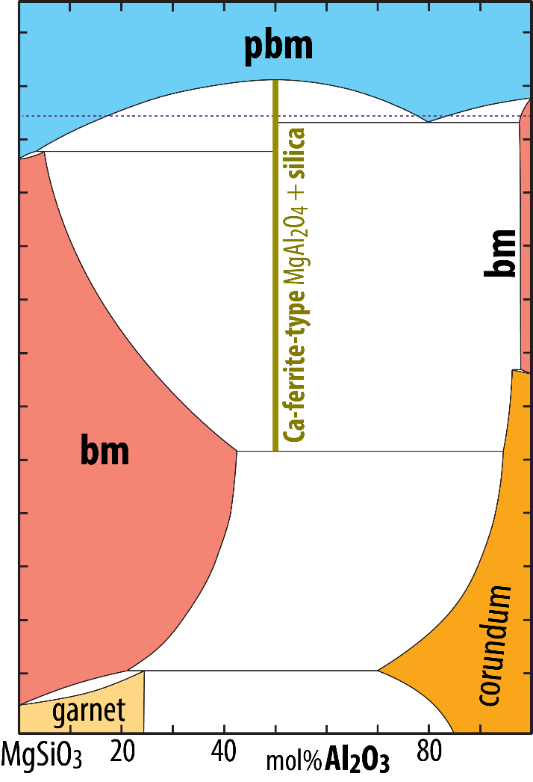
Omnipresent post-bridgmanite (pbm) in the D"-zone, no double-crossing of the bm-pbm boundary, based on:
Phase relations in MgSiO₃(MS) - FeSiO₃, MS - FeAlO₃ and MS - Al₂O₃ (Mohn, in prep.; Trønnes & Mohn, in prep.)
Phase relations in complex peridotite (Kuwayama et al. 2022, GRL)
Reduced CMB-temperature (see above) and sharp seismic D"-discontinuity, as observed (Mohn, in prep.)
From: Mohn (in prep.)
Stixrude & Lithgow-Bertelloni (2011, GJI)
Nagai et al. (2005, JPC)
FS and FA components partition into pbm.
MS-FS phase loop is at lower p than MS-FA loop.
AA partitions into bm.
Very low Al-solubility in bm at 125 GPa.

Slide 13
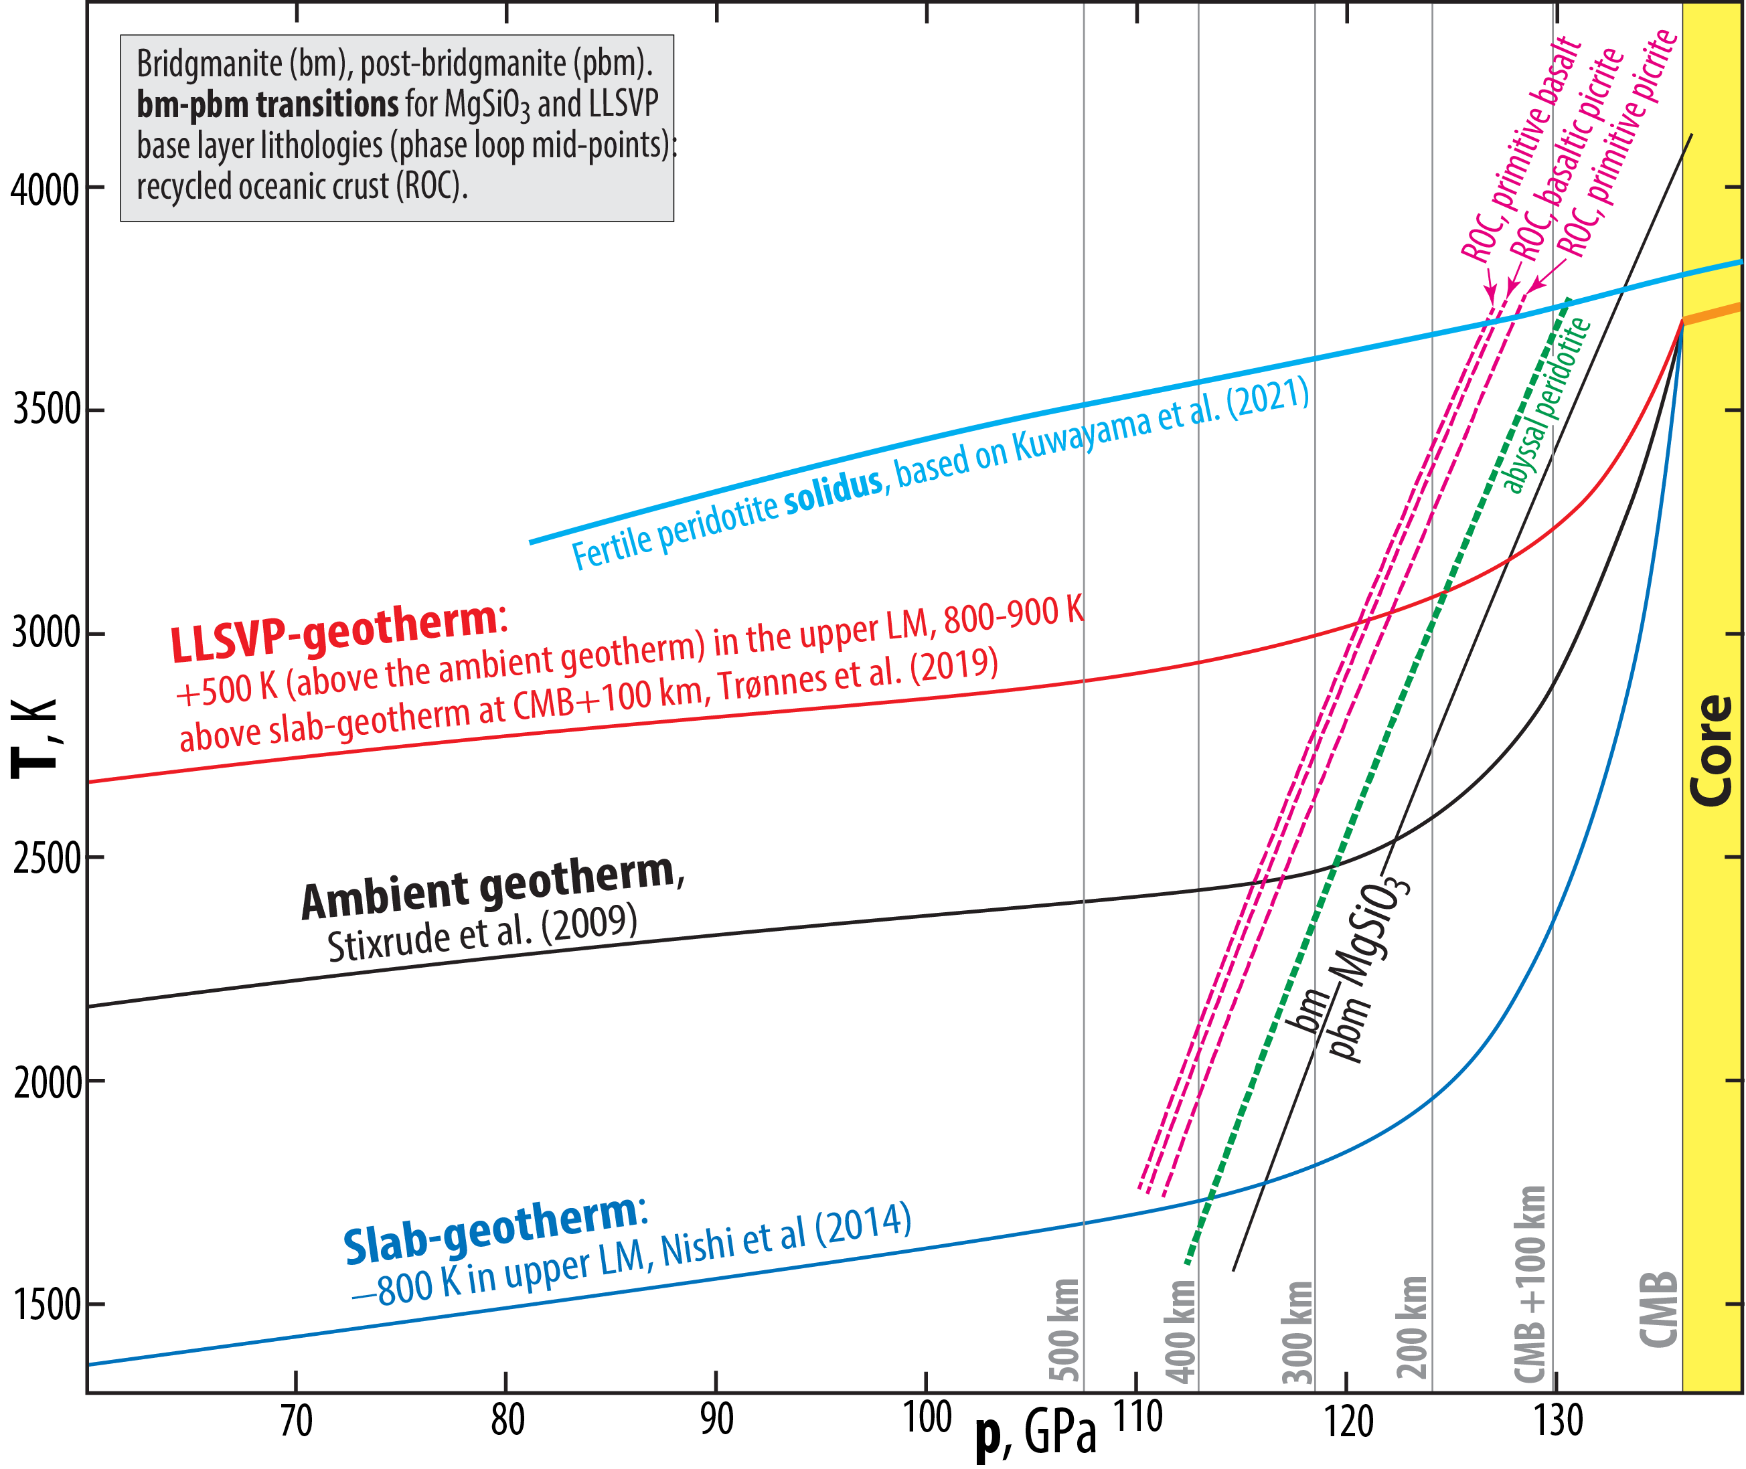
Omnipresent post-bridgmanite (pbm) in the D"-zone, no double-crossing of the bm-pbm boundary, based on:
Phase relations in MgSiO₃(MS) - FeSiO₃, MS - FeAlO₃ and MS - Al₂O₃ (Mohn, in prep.; Trønnes & Mohn, in prep.)
Phase relations in complex peridotite (Kuwayama et al. 2022, GRL)
Reduced CMB-temperature (see above) and sharp seismic D"-discontinuity, as observed (Mohn, in prep.)

Slide 14
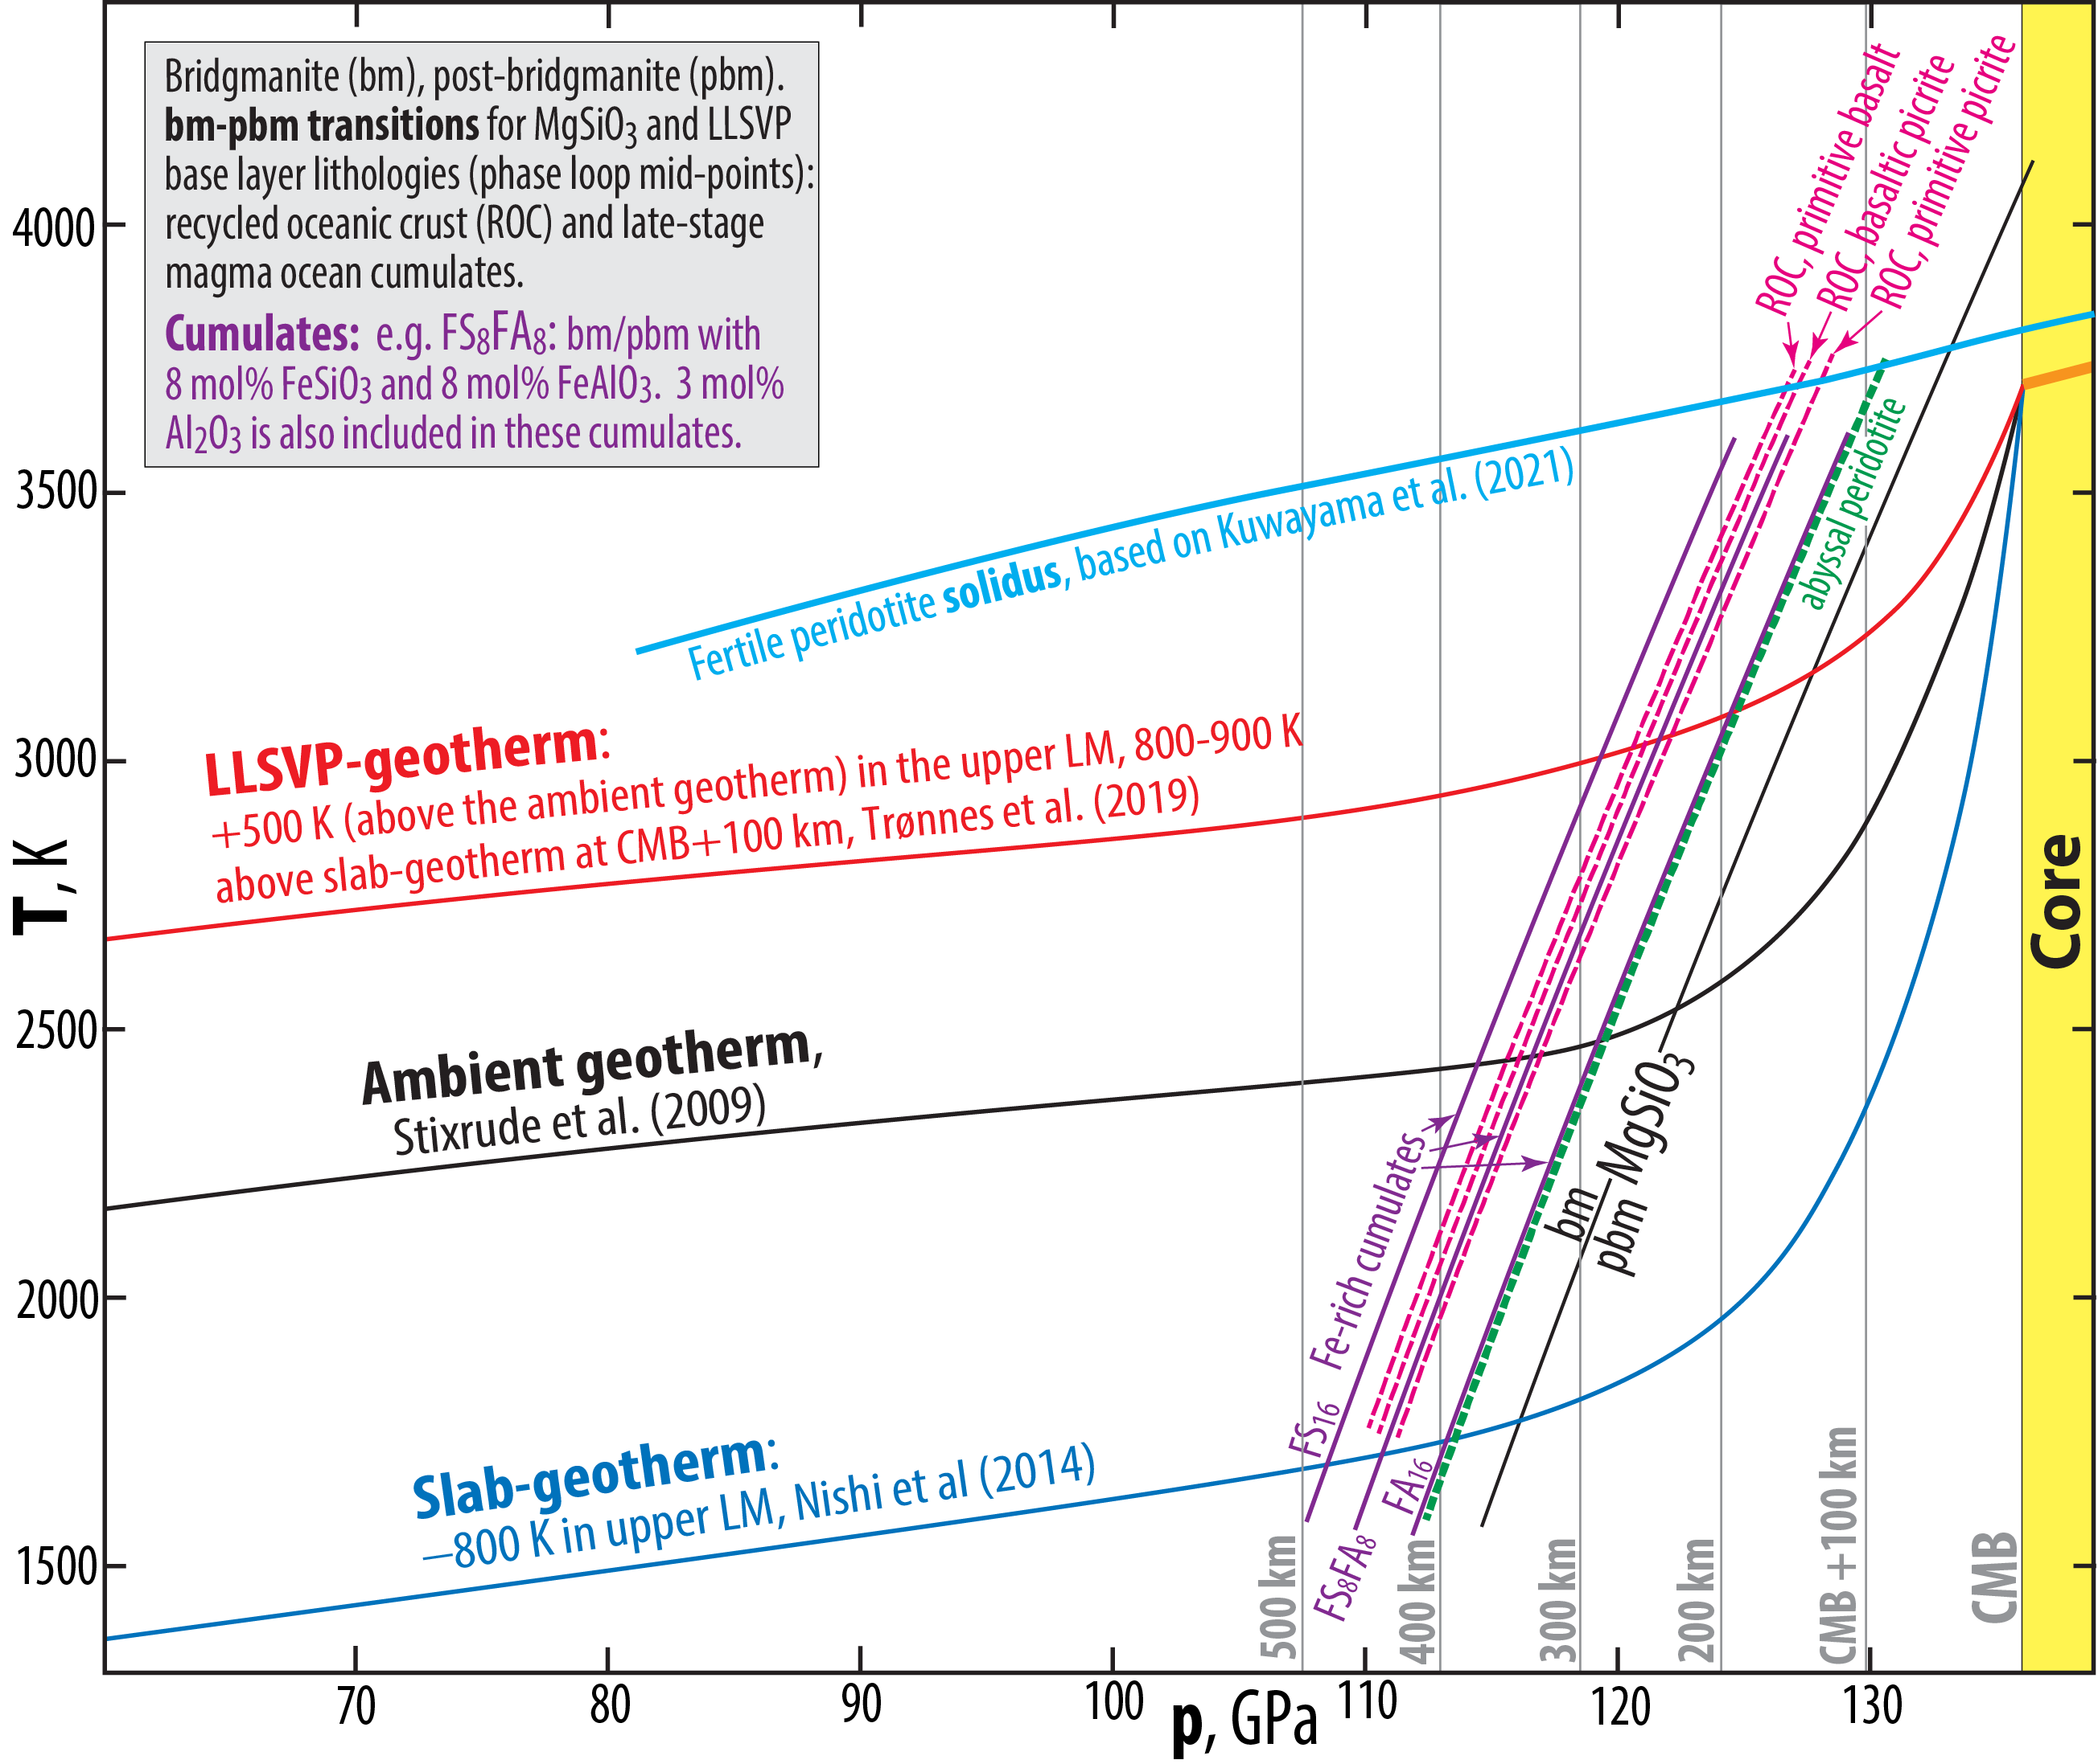
Omnipresent post-bridgmanite (pbm) in the D"-zone, no double-crossing of the bm-pbm boundary, based on:
Phase relations in MgSiO₃(MS) - FeSiO₃, MS - FeAlO₃ and MS - Al₂O₃ (Mohn, in prep.; Trønnes & Mohn, in prep.)
Phase relations in complex peridotite (Kuwayama et al. 2022, GRL)
Reduced CMB-temperature (see above) and sharp seismic D"-discontinuity, as observed (Mohn, in prep.)

Slide 15
Deep subduction and recycling of upper cont. crustal slivers in the southern Gondwana hemisphere, 650-450 Ma
Underlying density constraints at 20-27 GPa (e.g, Irifune et al. 1993; Greaux et al. 2020 and especially Ishii et al. 2012, EPSL)
Synthesis: recycling via D" with implications for the southern hemispheric DUPAL anomaly (Jackson & Macdonald 2022, AGU Adv.)
Matt Jackson will summarise some of this in less than 2 hours
UCC phase rel.,
Ishii et al. 2012
davemaoite (CaSiO₃)
Ca-ferrite-structured phase (mostly NaAlSiO₃)
liebermannite (mostly KAlSi₃O₈)
stishovite (SiO₂)

Slide 16
Deep subduction and recycling of upper cont. crustal slivers in the southern Gondwana hemisphere, 650-450 Ma
Underlying density constraints at 20-27 GPa (e.g, Irifune et al. 1993; Greaux et al. 2020 and especially Ishii et al. 2012, EPSL)
Synthesis: recycling via D" with implications for the southern hemispheric DUPAL anomaly (Jackson & Macdonald 2022, AGU Adv.)
Matt Jackson will summarise some of this in less than 2 hours
UCC phase rel.
Ishii et al. 2012
davemaoite (CaSiO₃)
Ca-ferrite-structured phase (mostly NaAlSiO₃)
liebermannite (mostly KAlSi₃O₈)
stishovite (SiO₂)
Ambient geotherm/adiabat: about 1600 C
Cold slab geotherm (e.g. Nishii et al. 2014): 800 C

Slide 17
Degree-2 residual geoid, LM viscosity and LLSVP base layer thickness and density excess
Residual geoid after subtraction of shallow slab signals (UM, MTZ) reflects a degree-2 convection pattern
Two geoid highs above LLSVPs, one longitudinal high-velocity belt low and the CMB topography reflect the degree-2 flow pattern
(e.g. Hager et al. 1985; Nat; Steinberger & Torsvik, 2010, GGG; Burke et al. 2012, GRL; Forte et al. 2015. Treat Geophys)
Hager et al. (1985)
Observed geoid
Forte et al. (2015)
Mean CMB-topography derived from six
different mantle tomography models
Residual geoid

Slide 18
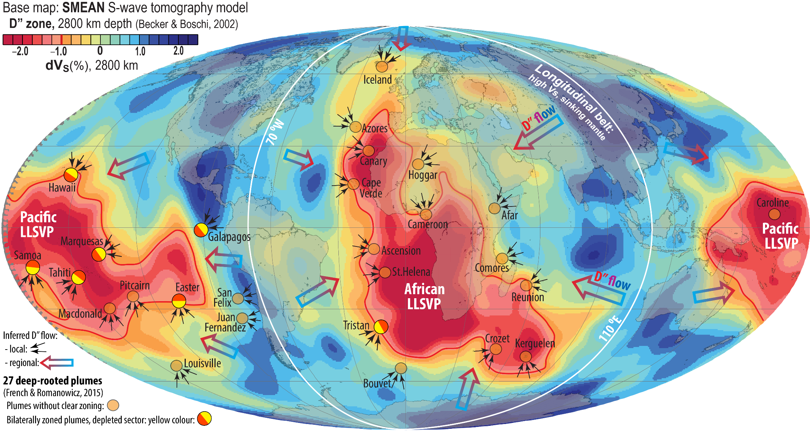
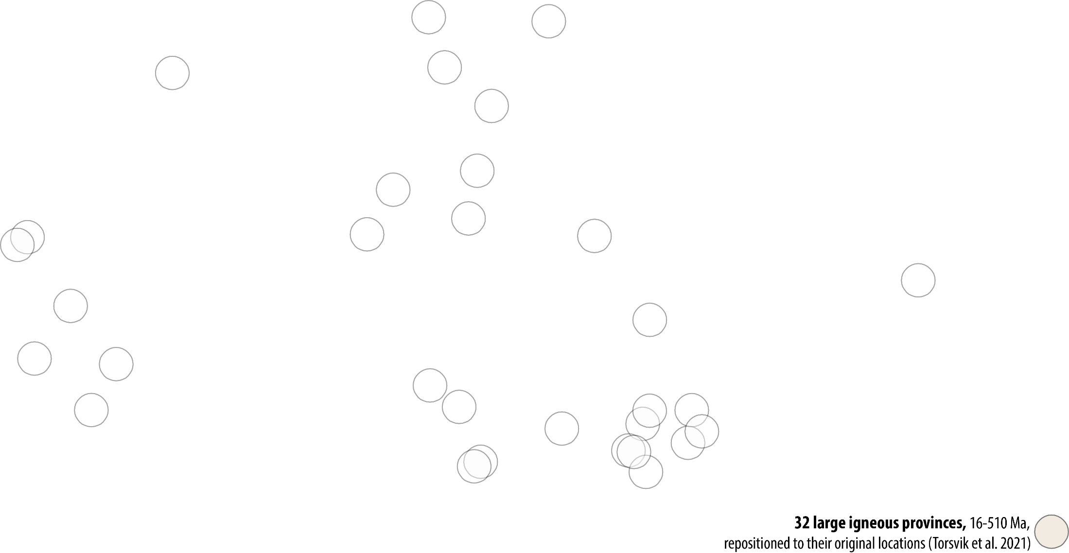
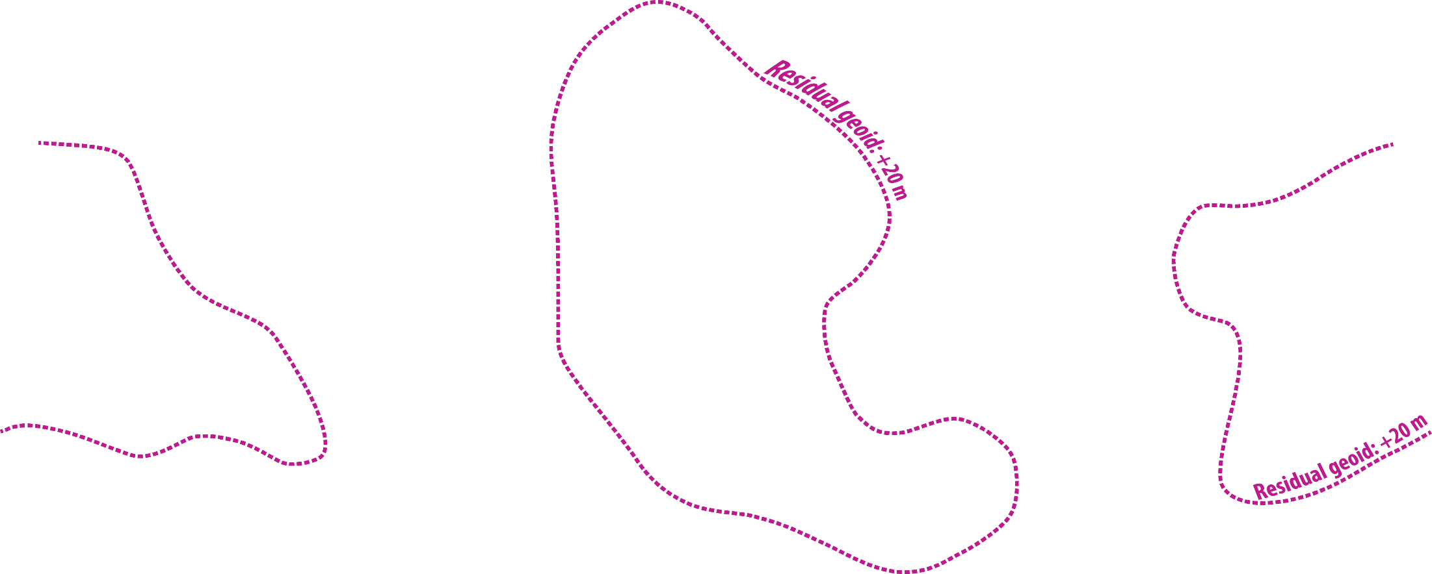
Degree-2 mantle flow pattern in the D’’ zone

Slide 19
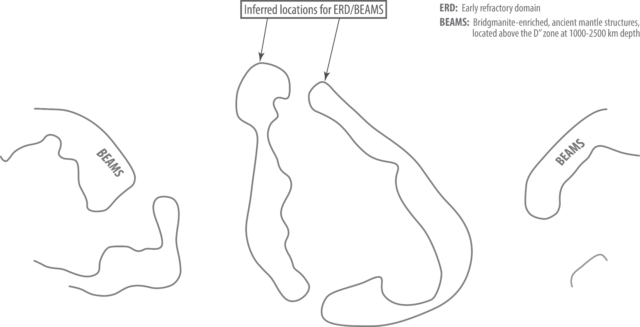

Slide 20
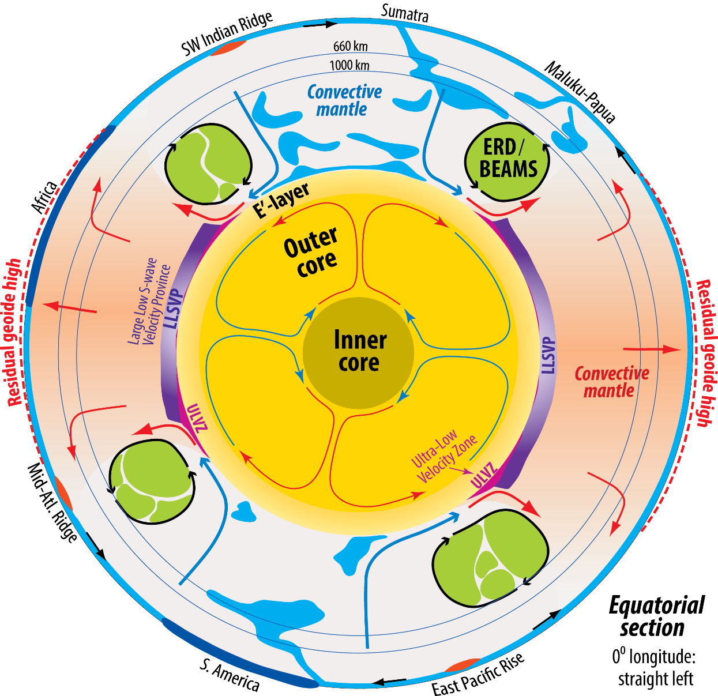
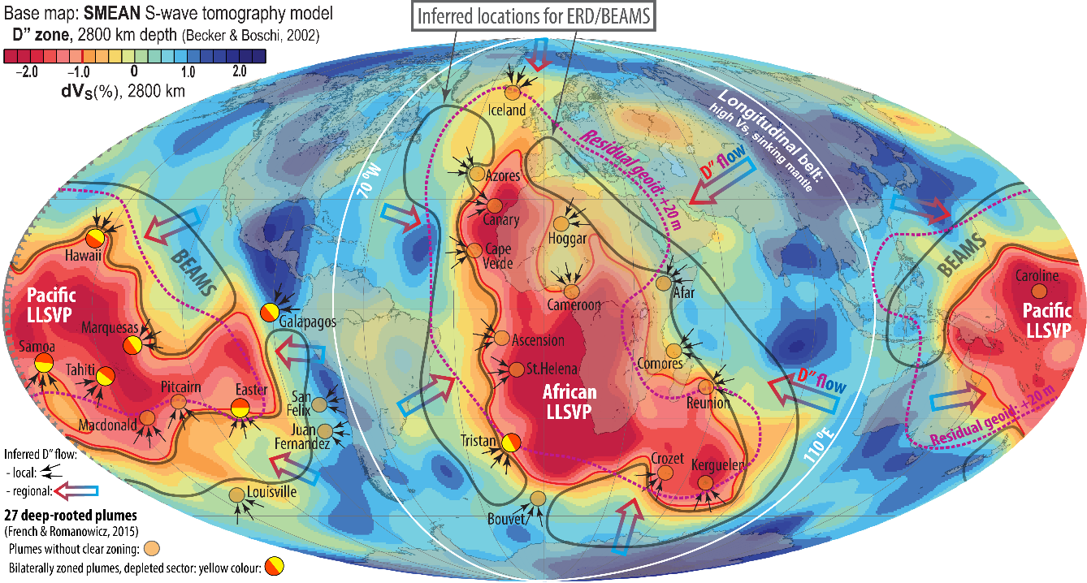
Equatorial section

Slide 21
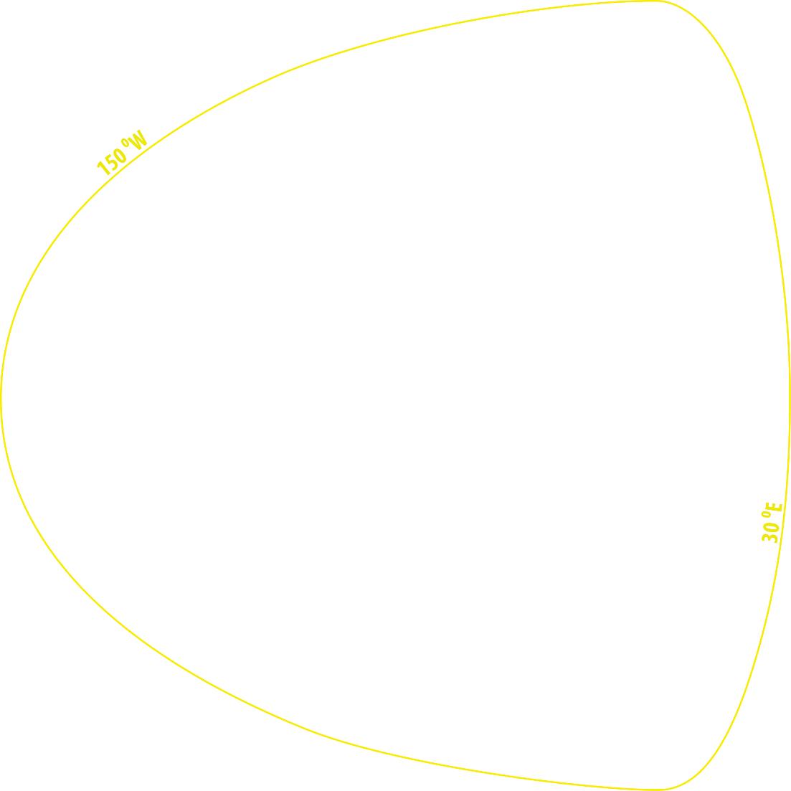
The 150⁰W-30⁰E section (yellow line),
intersecting the LLSVPs, is chosen
Longitudinal section

Slide 22
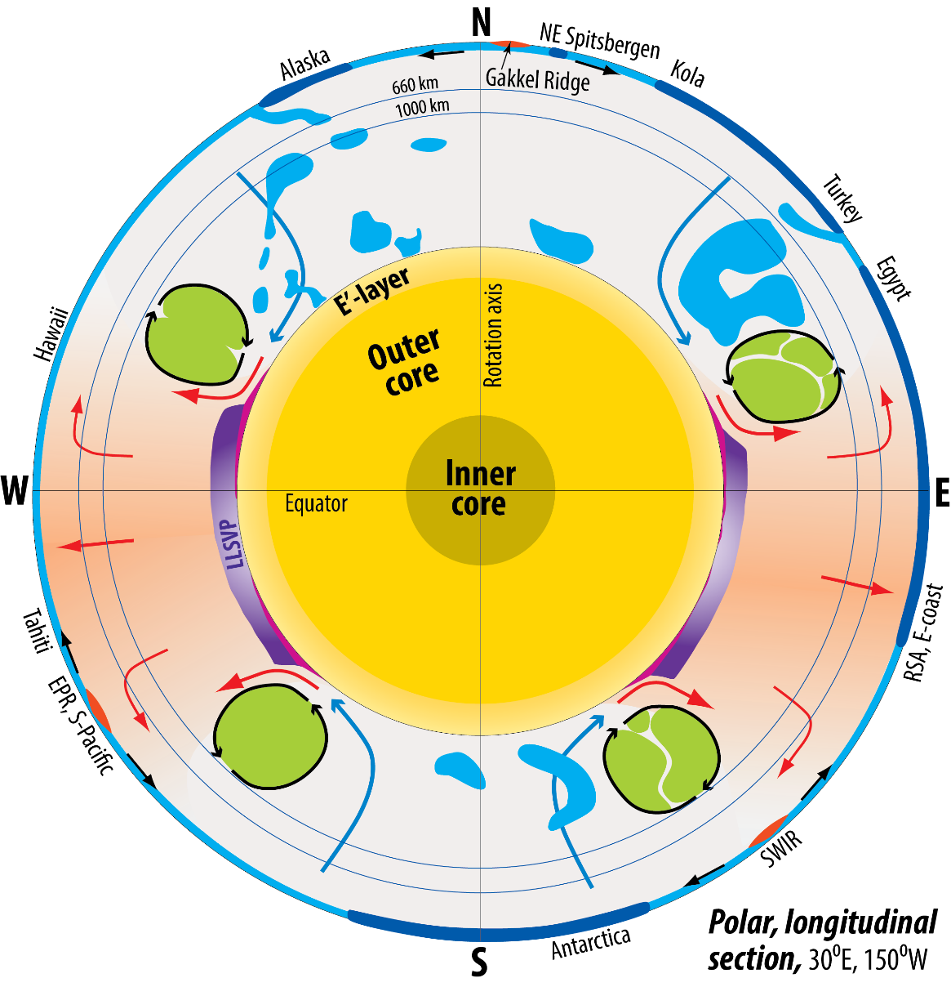

Longitudinal section

Slide 23
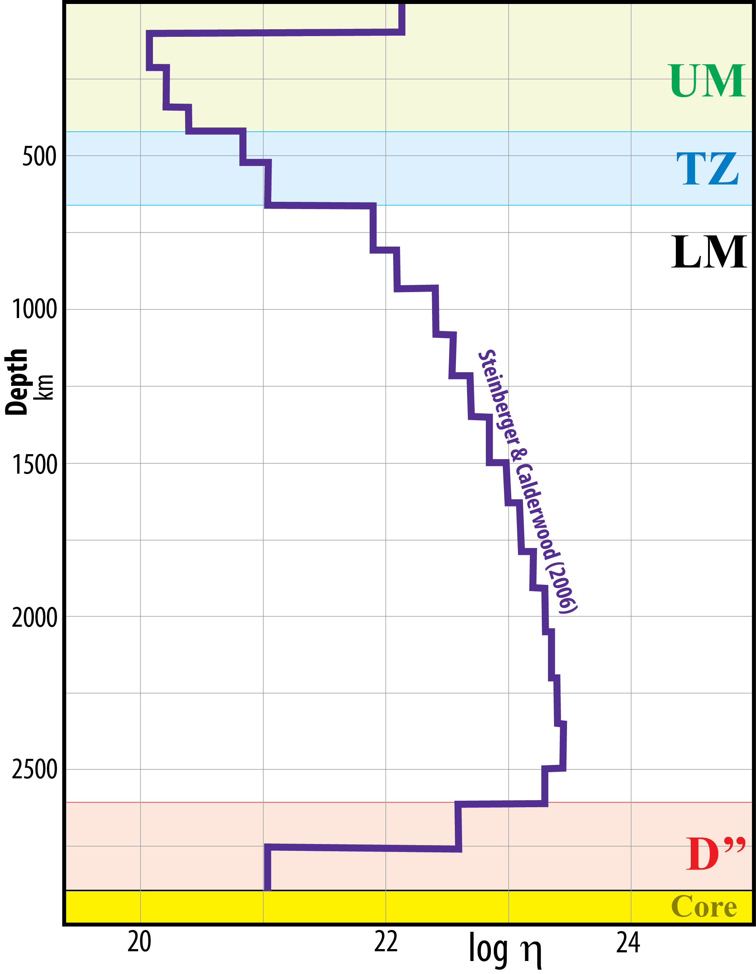
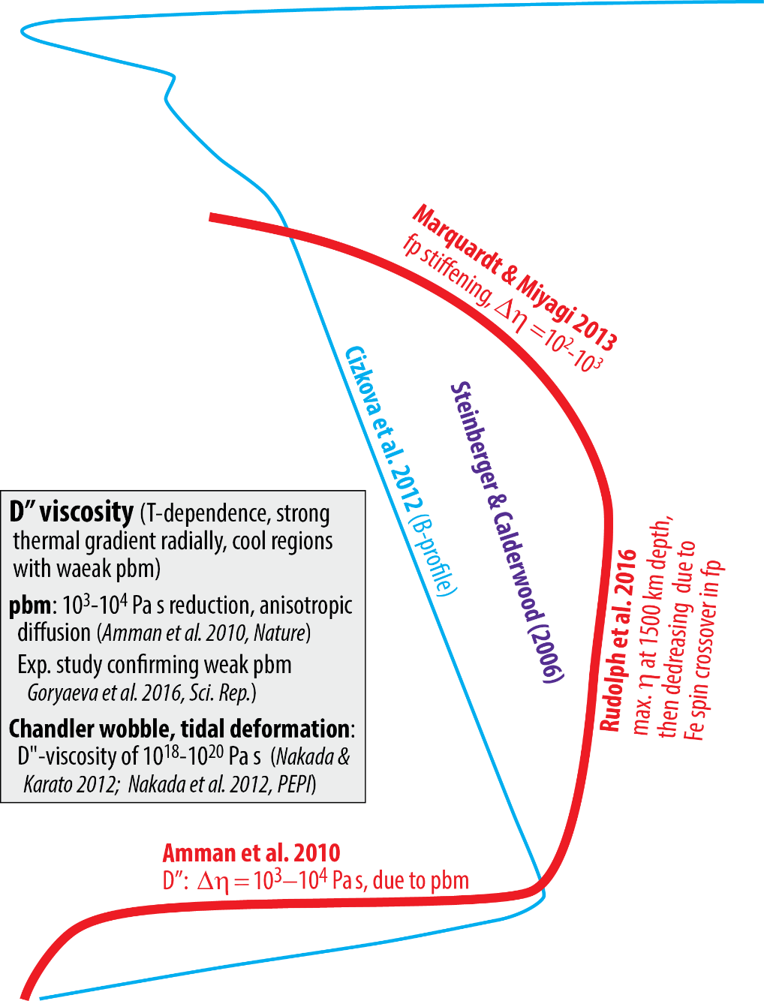
LM viscosity
Increases to 10²³-10²⁴ Pa s from 660 to ~1500 km depth
Steinberger & Calderwood 2006, PEPI; Marquardt & Miyagi,
2013, N Geosci; Rudolph et al. 2016, Sci
Extreme viscosity decrease in D", due to pbm and CMB-TBL
Amman et al. 2010, Nat; Goryaeva et al. 2016; Dobson et al.
2019, PNAS)

Slide 24
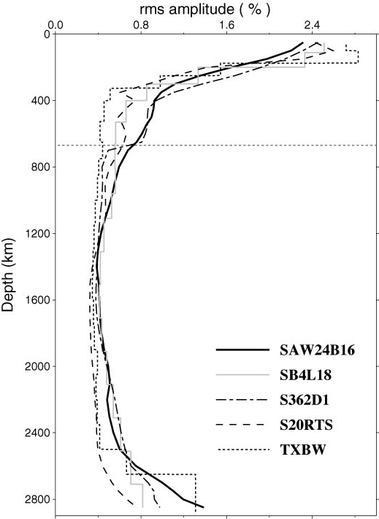
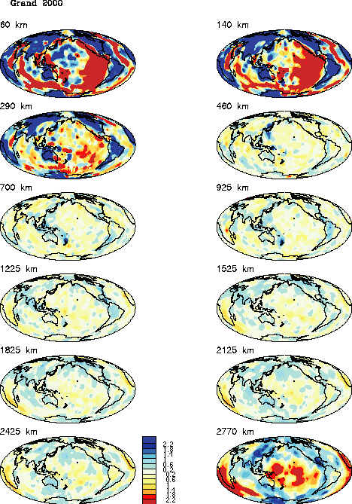
LLSVP base layer velocity decrease and density excess
LLSVPs are mainly restricted to the lowermost 200-400 km (e.g. Romanovicz 2003, AREPS; Forte et al. 2015. Treat Geophys)
Vs tomography models
Large Vs-amplitudes at the top
and bottom of the mantle
2.8%
Romanowicz (2003,
Ann.Rev. EPS)
< 0.8%
1.4%
300 km

Slide 25
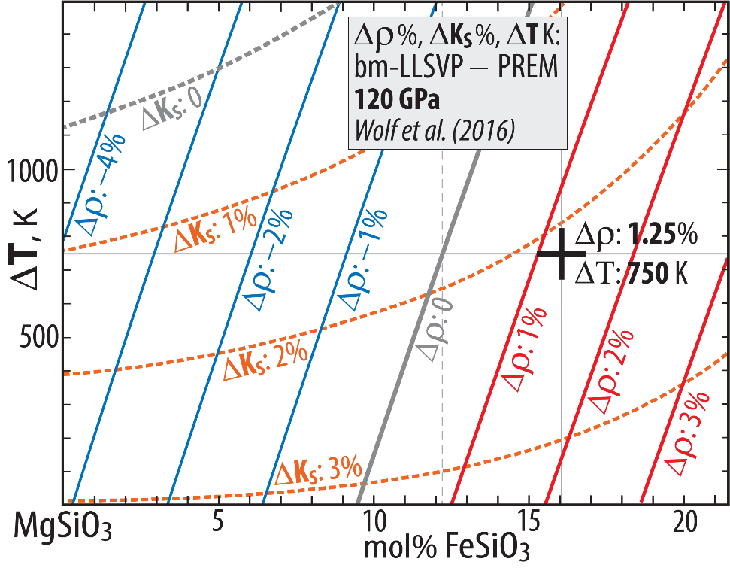
LLSVP base layer velocity decrease and density excess
Base-layer Δρ: 1.25% (intrinsic material Δρ: 2.2%, ΔΤ: 750 K) (Ishii & Tromp 1999, Sci; Moulik & Ekstrøm 2016, JGR; Lau et al. 2017, Nat)
See also: Robson et al. 2021, GJI
Lateral density models, D"
Lau et al. 2016: "Tidal tomography"
2891-2541 km depth (350 km interval above CMB)
Ishii & Tromp 1999
2850 km depth, range ±1.0%
Moulik & Ekström 2016
2800 km depth, scale included
Mineral physics model for bm-dominated LLSVP base layers from
Wolf et al. (2016), adopted by Trønnes et al. (2019).
Depth, p: 2620 km, 120 GPa (lowermost 270 km above the CMB)
ΔT: 750 K, Δρ: 1.25%, consistent with Lau et al. 2017.
Intrinsic material Δρ_{intrinsic}: 2.2% (wihout the thermal expansion effect)
Presentation available at:
www.nhm.uio.no/english/about/organization/research-collections/people/rtronnes/1/other-lect/sem-mtg/de-sundvollen.pptx
Trønnes-UiO-page → Teaching → other-lect → sem-mtg → de-sundvollen.pptx

Slide 26
Major developments in deep Earth materials and dynamics in the CEED decade
Phase relations and density
Strengthened case for the basal magma ocean (BMO) − long-lived, possibly to the late Proterozoic?? (Labrosse et al. 2007, Nat)
Strong Fe-partitioning from bridgmanite (bm) to melt (e.g. Tateno et al. 2014, JGR),
Bm-melt and periclase-melt density relations for MgSiO₃ and MgO (Petitgirard et al. 2015, PNAS, Ghosh & Karki 2016)
Bm-melt density relations in peridotitic systems (Caracas et al. 2019, JGR; Trønnes et al. 2019, Tectonoph)
Chemical exchange, protocore with MO. Implications for outermost core (E'-layer) and LM-composition
Light element composition of the outer core from mineral physics (Badro, Coté, Brodholt 2015, PNAS; Badro, Brodholt et al. 2014, PNAS)
Outer core alloy is O-undersaturated → FeO from bm and ferropericlase to the core (Takafuji et al. 2005; Frost et al. 2010)
Geophysical constraints on E'-layer (Lay & Young, 1990, GRL; Garnero et al. 1993, GRL; Helffrich & Kaneshima 2010, Nature;
Kaneshima & Helffrich, 2013, GJI; Kaneshima, 2018, PEPI; Irving et al. 2018. Sci Adv)
Core-BMO exchange: SiO₂↔FeO, E' (Brodholt & Badro 2017, GRL; Hirose et al. 2017, Nat; Trønnes et al. 2019, Tectonoph; Helffrich et al. 2020)
Plume flux and core-to-plume-contamination (via ULVZs) of W, but not He and Ne
Correlated plume flux, ³He/⁴He and ¹⁸²W/¹⁸⁴W-anomalies (Jackson et al. 2017, Hoggard et al. 2020, EPSL; Bao et al. 2022, Sci, Mundl et al. 2017, Sci)
No primordial He-Ne-signal from core. Met-sil partitioning predicts too high He/Ne core ratio (Li, Brodholt et al. 2022, Nat Comm)
Early refractory domains. ERDs: bridgmanitic, Hadean and likely sources of primordial-like He- and Ne-isotopic signatures)
Geodynamic BEAMS-model (Ballmer et al. 2017). Tenuous seismic evidence for ferropericlase-free domains (Shephard et al. 2021)
He-Ne-diffusion rates in bm support primordial-like noble gas reservoirs sampled by OIBs & LIPs, (Trønnes et al. in prep)
Role of dense, residual davemaoite (Ca-perovskite) in the lowermost mantle (POSTER on Wednesday)
Davemaoite-enrichment in the ULVZs from partial melting of ROC and in LLSVPs from MO-BMO-crystallisation.
Important implications: U-Th-enrichment and high ⁴He/³He- and ²¹Ne/²²Ne ratios (Hernandez et al. 2022, GRL; Trønnes et al. in prep)

Slide 27
Phase relations and density, continuation - - - -
Reduced CMB-temperature: from about 4000 K to 3800 K
Lower melting curve for Fe at outer core conditionds (Sinmyo et al. 2019, EPSL)
Lower peridotite solidus, 3800-3600 K at the CMB (Nomura et al. 2014, Sci; Kuwayama et al. 2022, GRL; Pierru et al. 2022, EPSL)
Omnipresent post-bridgmanite (pbm) in the D"-zone, no double-crossing of the bm-pbm boundary
Phase relations in MgSiO₃(MS) - FeSiO₃, MS - FeAlO₃ and MS - Al₂O₃ (Mohn, in prep.; Trønnes & Mohn, in prep.)
Phase relations in complex peridotite (Kuwayama et al. 2022, GRL)
Reduced CMB-temperature (see above) and sharp seismic D"-discontinuity, as observed (Mohn, in prep.)
Deep subduction and recycling of upper cont. crustal slivers in the southern Gondwana hemisphere, 650-450 Ma
Underlying density constraints at 20-27 GPa (e.g, Irifune et al. 1993; Greaux et al. 2020 and especially Ishii et al. 2012, EPSL)
Synthesis: recycling via D" with implications for the southern hemispheric DUPAL anomaly (Jackson & Macdonald 2022, AGU Adv.)
Matt Jackson will talk about some of this in less than 2 hours
Degree-2 residual geoid, LM viscosity and LLSVP base layer velocity and density
Residual geoid after subtraction of shallow slab signals (in UM, MTZ) reflects a degree-2 convection pattern
Two geoid highs above the LLSVPs, one longitudinal high-velocity belt low and the CMB topography reflect the degree-2 flow pattern.
(e.g. Hager et al. 1985; Nat; Steinberger & Torsvik, 2010, GGG; Burke et al. 2012, GRL; Forte et al. 2015. Treat Geophys)
LM viscosity
Increases to 10²³-10²⁴ Pa s from 660 to ~1500 km depth (Steinberger & Calderwood 2006, PEPI; Marquardt & Miyagi, 2013, N Geosci;
Rudolph et al. 2016, Sci.)
Extreme viscosity decrease in D", due to pbm and CMB-TBL (Amman et al. 2010, Nat; Goryaeva et al. 2016; Dobson et al. 2019, PNAS)
LLSVP base layer velocity decrease and density excess
LLSVPs are mainly restricted to the lowermost 200-400 km (e.g. Romanovicz 2003, AREPS; Forte et al. 2015. Treat Geophys)
Base-layer Δρ: 1.25% (intrinsic material Δρ: 2.2%, ΔΤ: 750 K) (Ishii & Tromp 1999, Sci; Moulik & Ekstrøm 2016, JGR; Lau et al. 2017, Nat)

