Slide 1
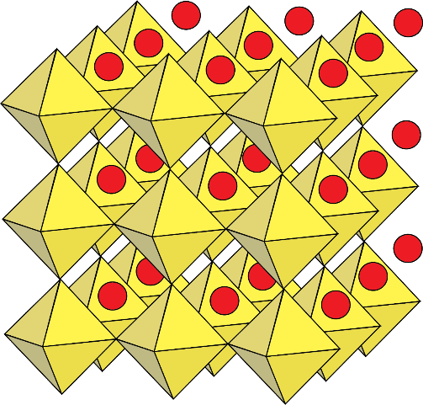
Dense residual davemaoite in the lowermost mantle
- eliminates the core and lowermost mantle as sources of the "primordial" He and Ne isotopic signal
R.G. Trønnes^{1,2}, C.E. Mohn^{2,3}, B. Grømer^{2,4}, Jean-Alexis Hernandez^{2,5},
M.G. Guren^{2,6}, M.A. Baron^{2,7}
¹Natural History Museum and Centre for Planetary Habitability, Univ. of Oslo.
²Centre for Earth Evolution and Dynamics Univ. of Oslo.
³Dept. of Chemistry and Centre for Materials Sci. and Nanotechnology, Univ. of Oslo.
⁴Div. of Chem. and Biological Chem., Nanyang Technological Univ., Singapore.
⁵European Synchrotron Radiation Facility, Grenoble.
⁶Njord Centre, Dept. of Geoscience, Univ. of Oslo.
⁷Lab. de Chimie de la Matière Condensée de Paris, Sorbonne Université, CNRS, Paris.
Ca²⁺
[SiO₆]⁸⁻
Crystal struct., davemaoite
CaSiO₃
Stable from 11 GPa, 800 K
to: 500 GPa, 10 000 K !!
Partial preprint
Tønnes et al. 2023, CEED Annual report 2022, 20-34.
First a brief introduction to:
- structure of the mantle, and esp. the D" zone with the
Large Low S-wave Velocity Provinces, LLSVPs
and
Ultra-Low Velocity Zones, ULVZs
- phase relations (mineralogy) of the deep mantle
Main mineral abbreviations
dm: davemaoite (CaSiO₃)
bm: bridgmanite
pbm: post-bridgmanite
fp: ferropericlase

Slide 2
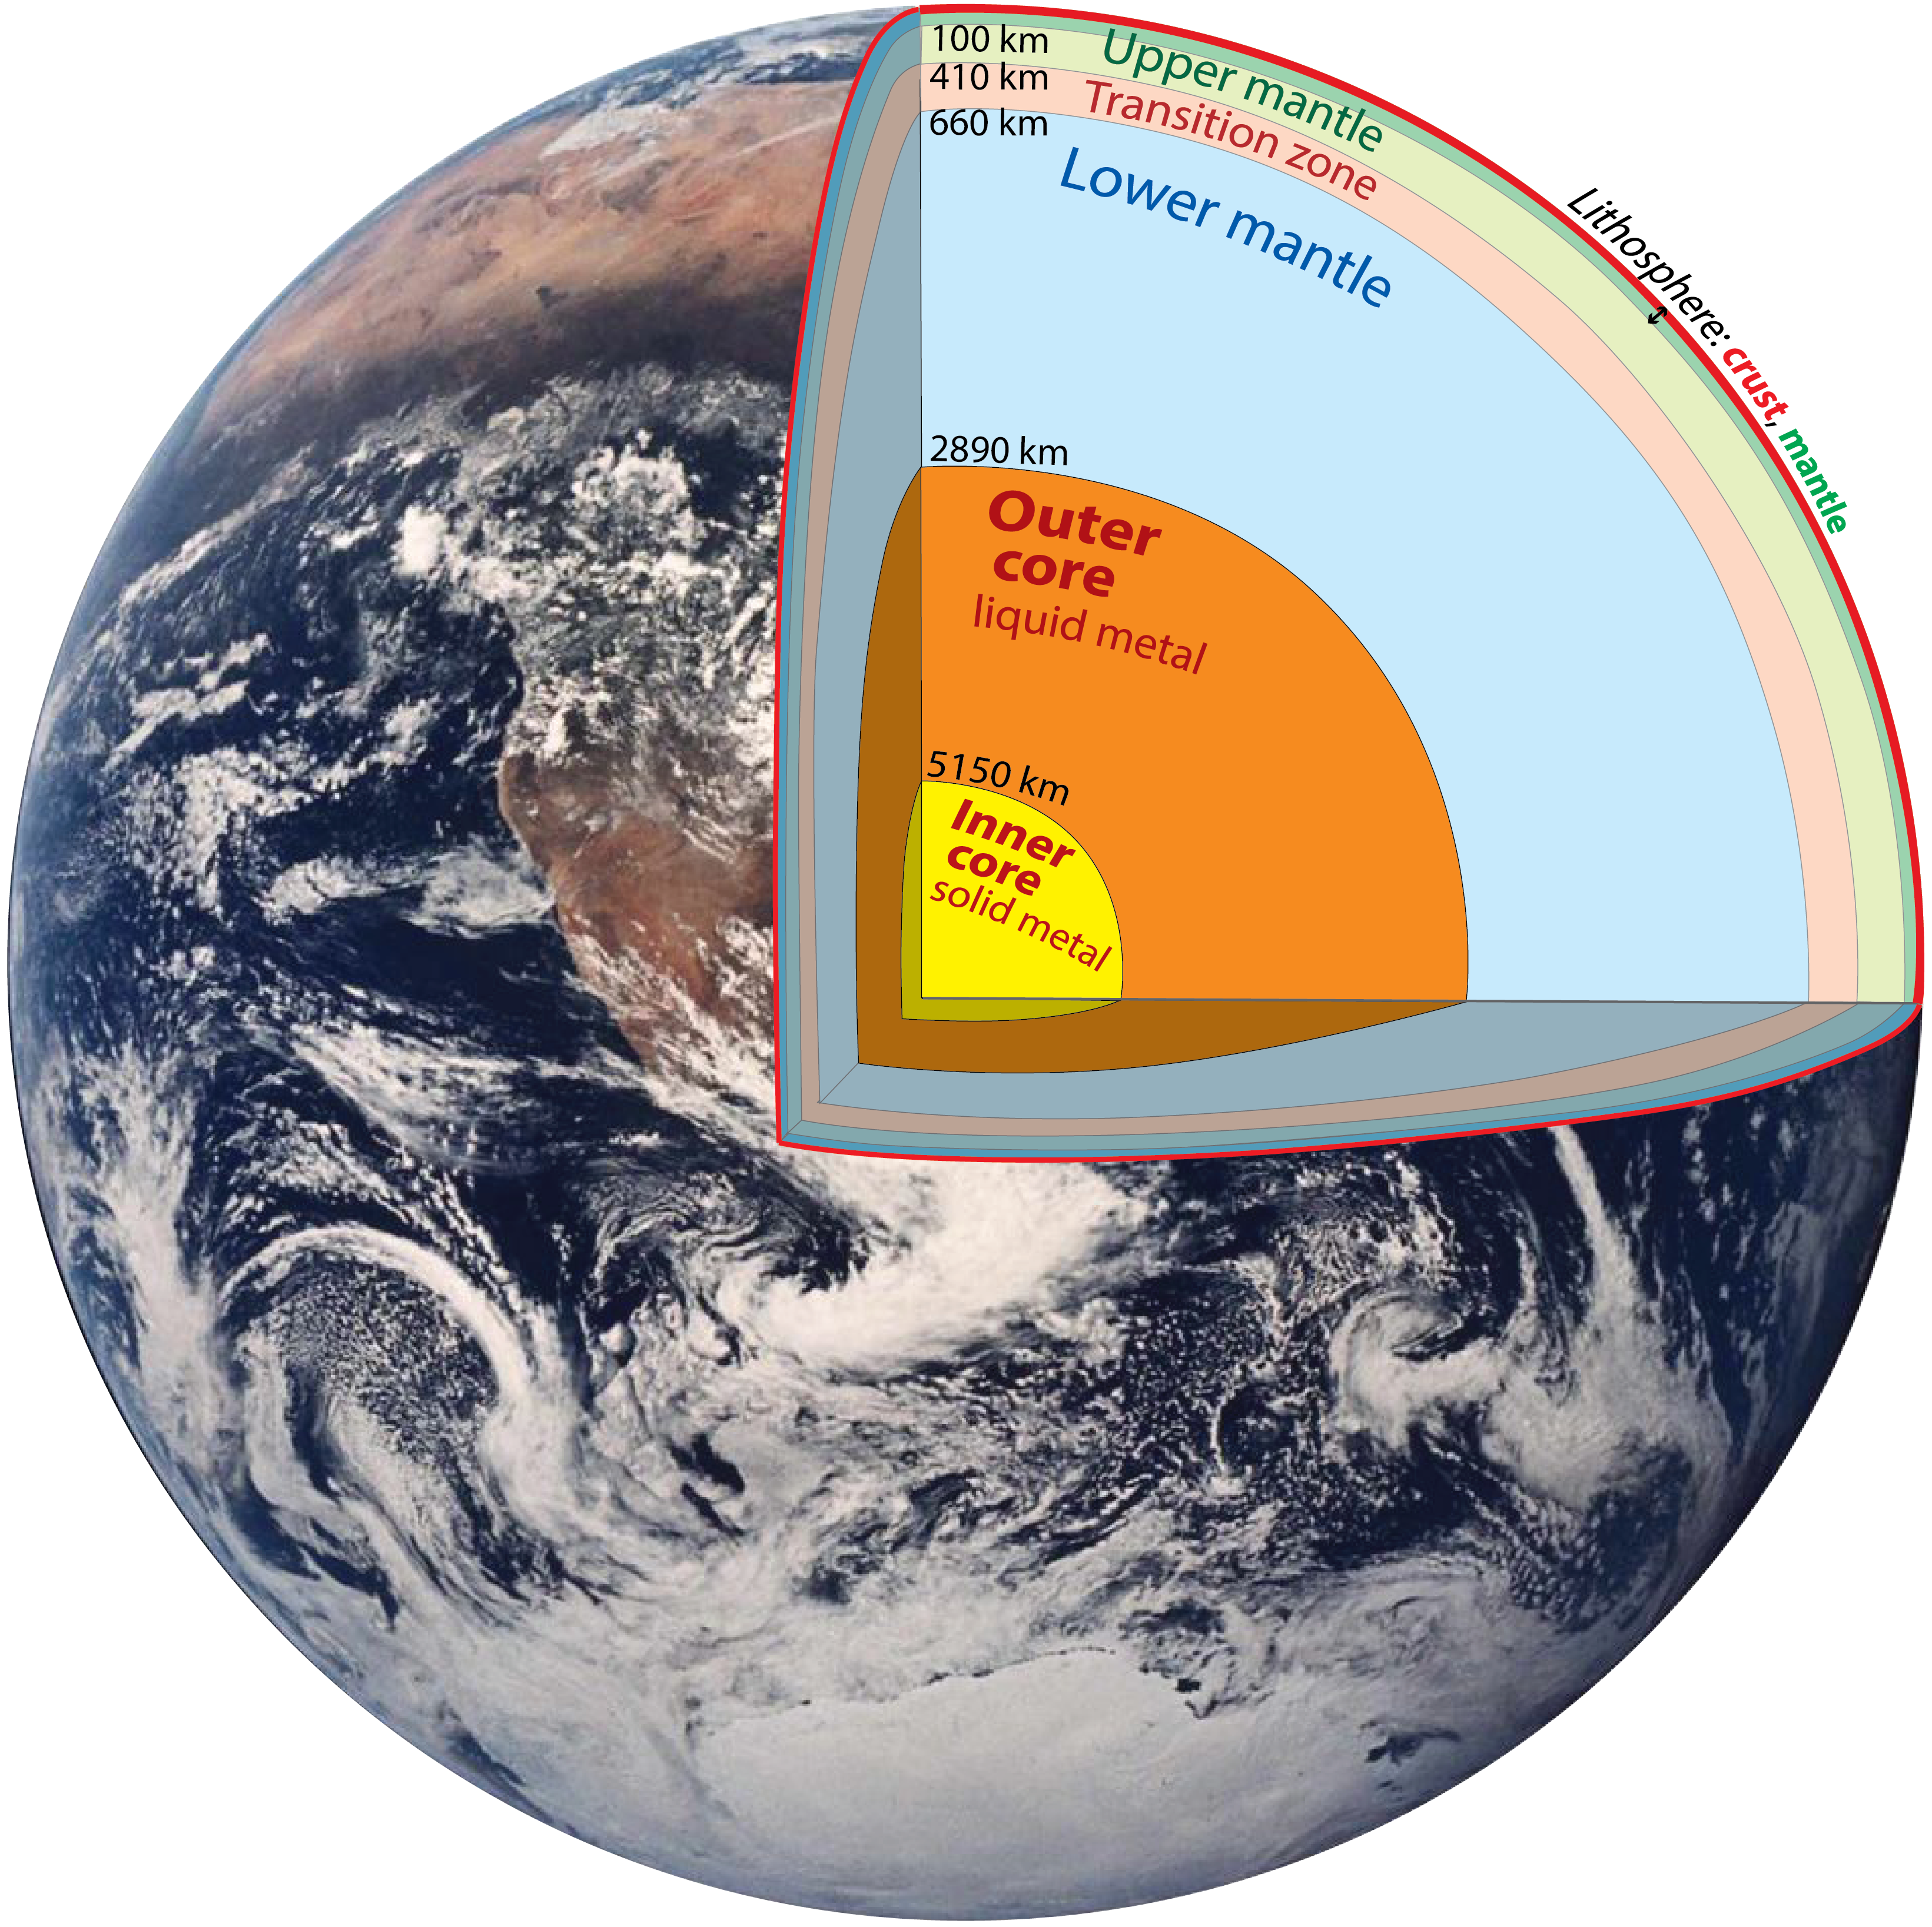
Earth structure and
mineralogy

Slide 3
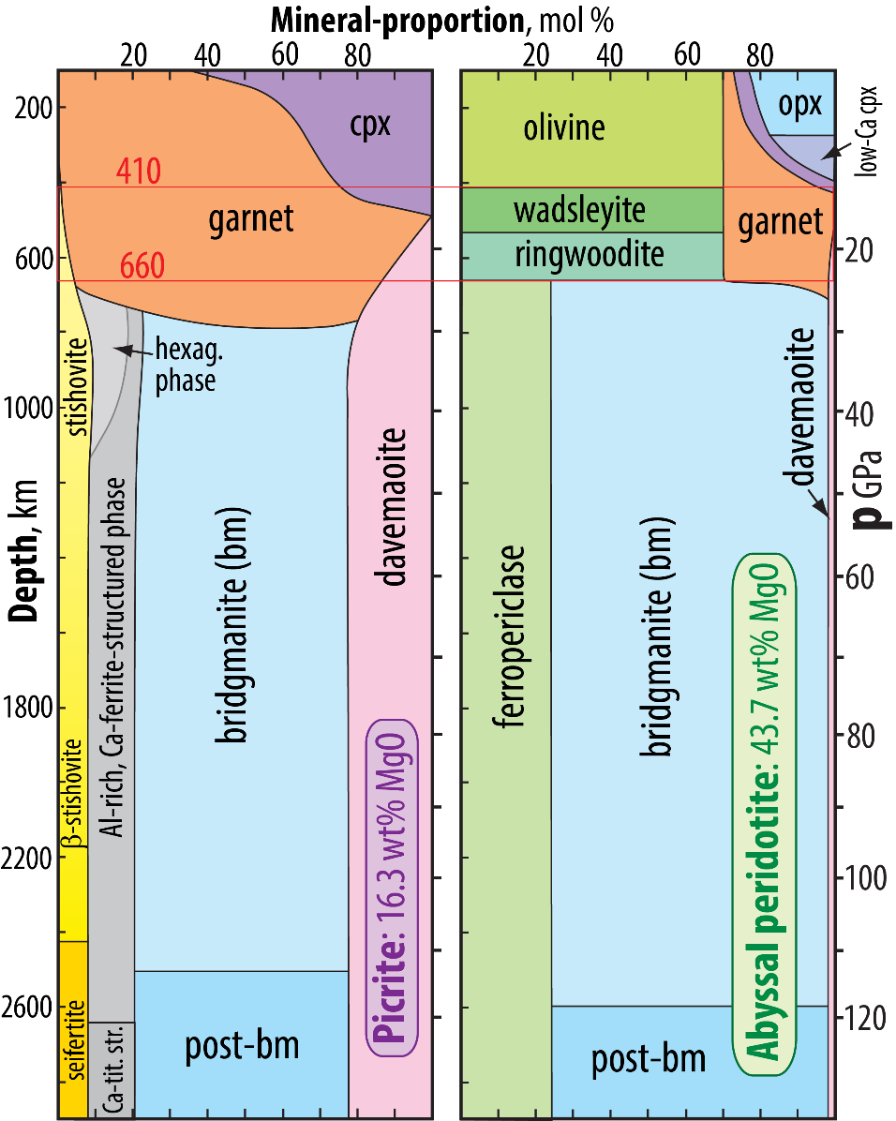
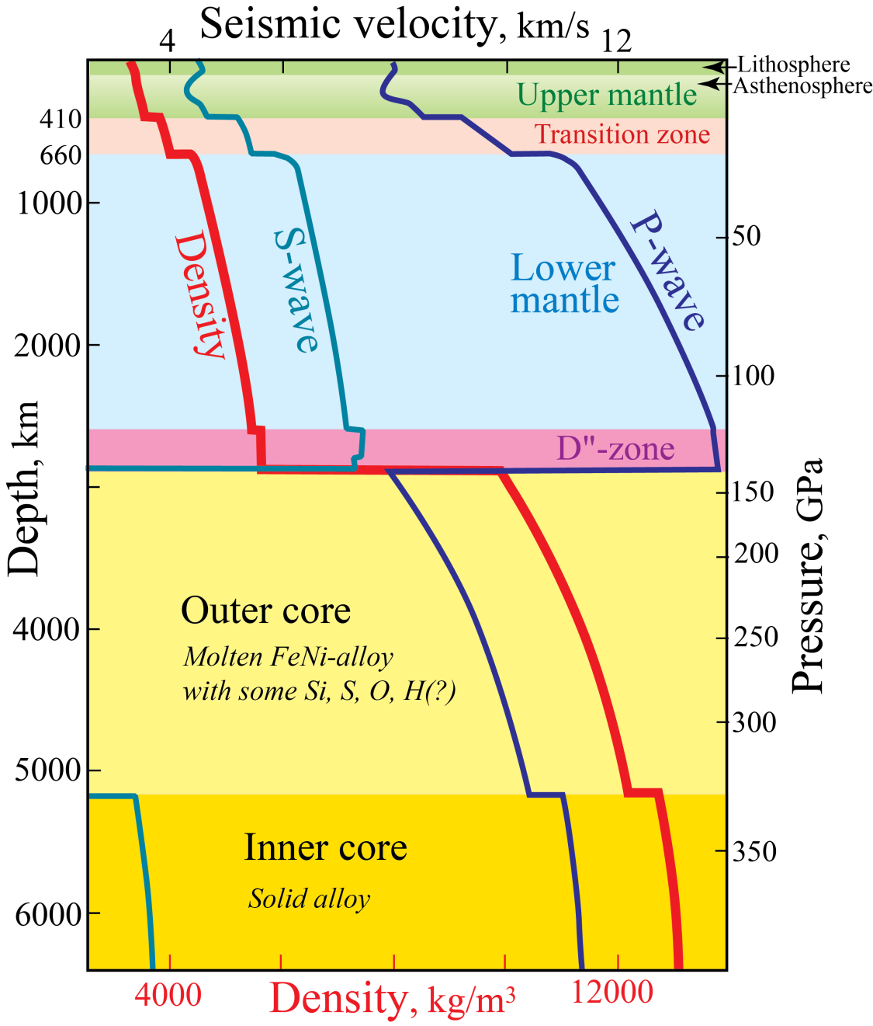
First-order, 1D Earth structure
PREM: Preliminary Earth Reference Model
- mainly based on normal mode seismology and gravity
- includes ρ, p, V_{P} and V_{S}, as a function of depth
Dziewonski & Anderson (1981, PEPI)
12 079 citations, May 23, 2024

Slide 4
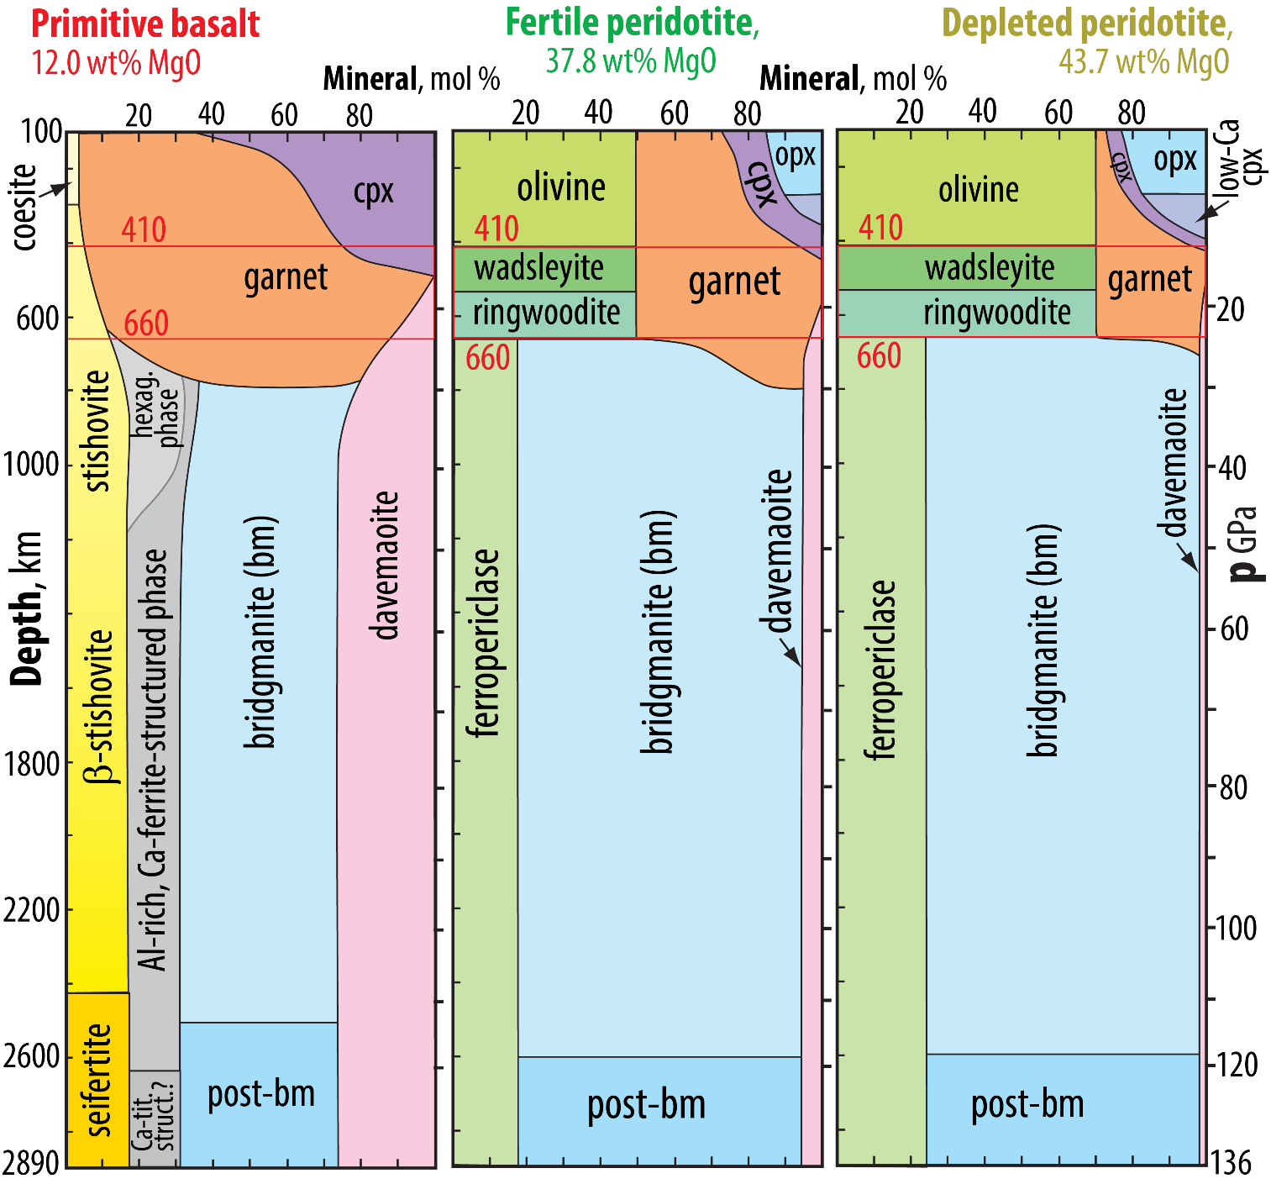
Approximate mineral compositions
ferropericlase: (Mg,Fe) O
olivine, wadsleyite, ringw.: (Mg,Fe)₂ Si O₄
garnet: (Mg,Fe,Ca)₃ (Al,Si)₂ Si₃ O₁₂
opx (orthopyroxene), bm (bridgmanite),
post-bm: (Mg,Fe,Al) (Si,Al) O₃
cpx (clinopyroxene): (Ca,Mg,Fe,Al) (Si,Al) O₃
davemaoite (Ca-silicate perovskite): Ca Si O₃
Al-rich, Ca-ferrite-structured phase, two main
components: (Na,K) AlSi O₄ - (Mg,Fe) Al₂ O₄
coesite, stishovite, β-stishovite, seifertite: Si O₂
New results (incl. Sinmyo et al. 2019) indicate that:
- the core is cooler than previusly assumed - we use a CMB-T of 3700 K
- 3700 K, in combination with new data (e.g Kuwayama et al, 2022; Mohn, in prep.)
on the bm-pbm-transition, indicate that pbm is omnipresent in the D" zone

Slide 5
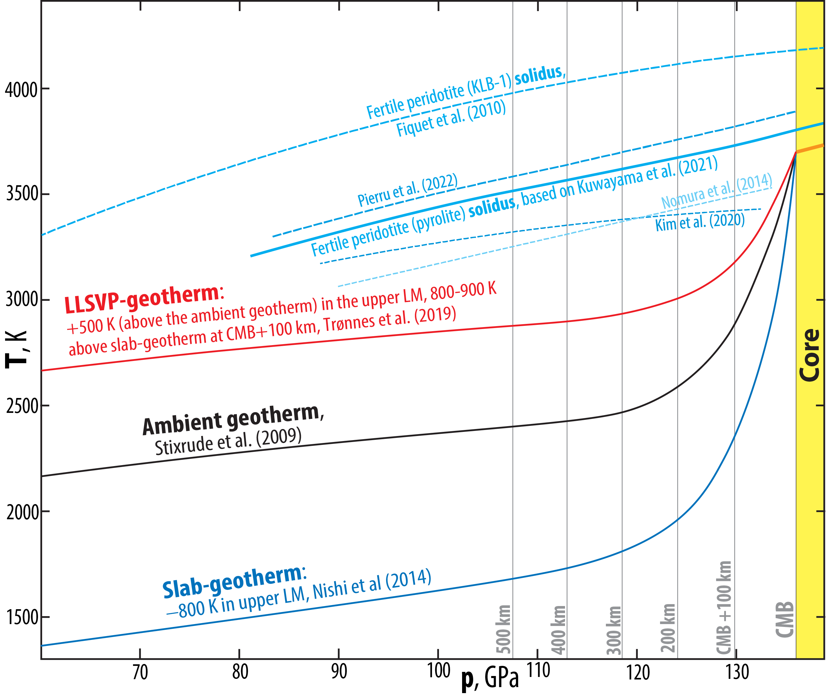

Slide 6
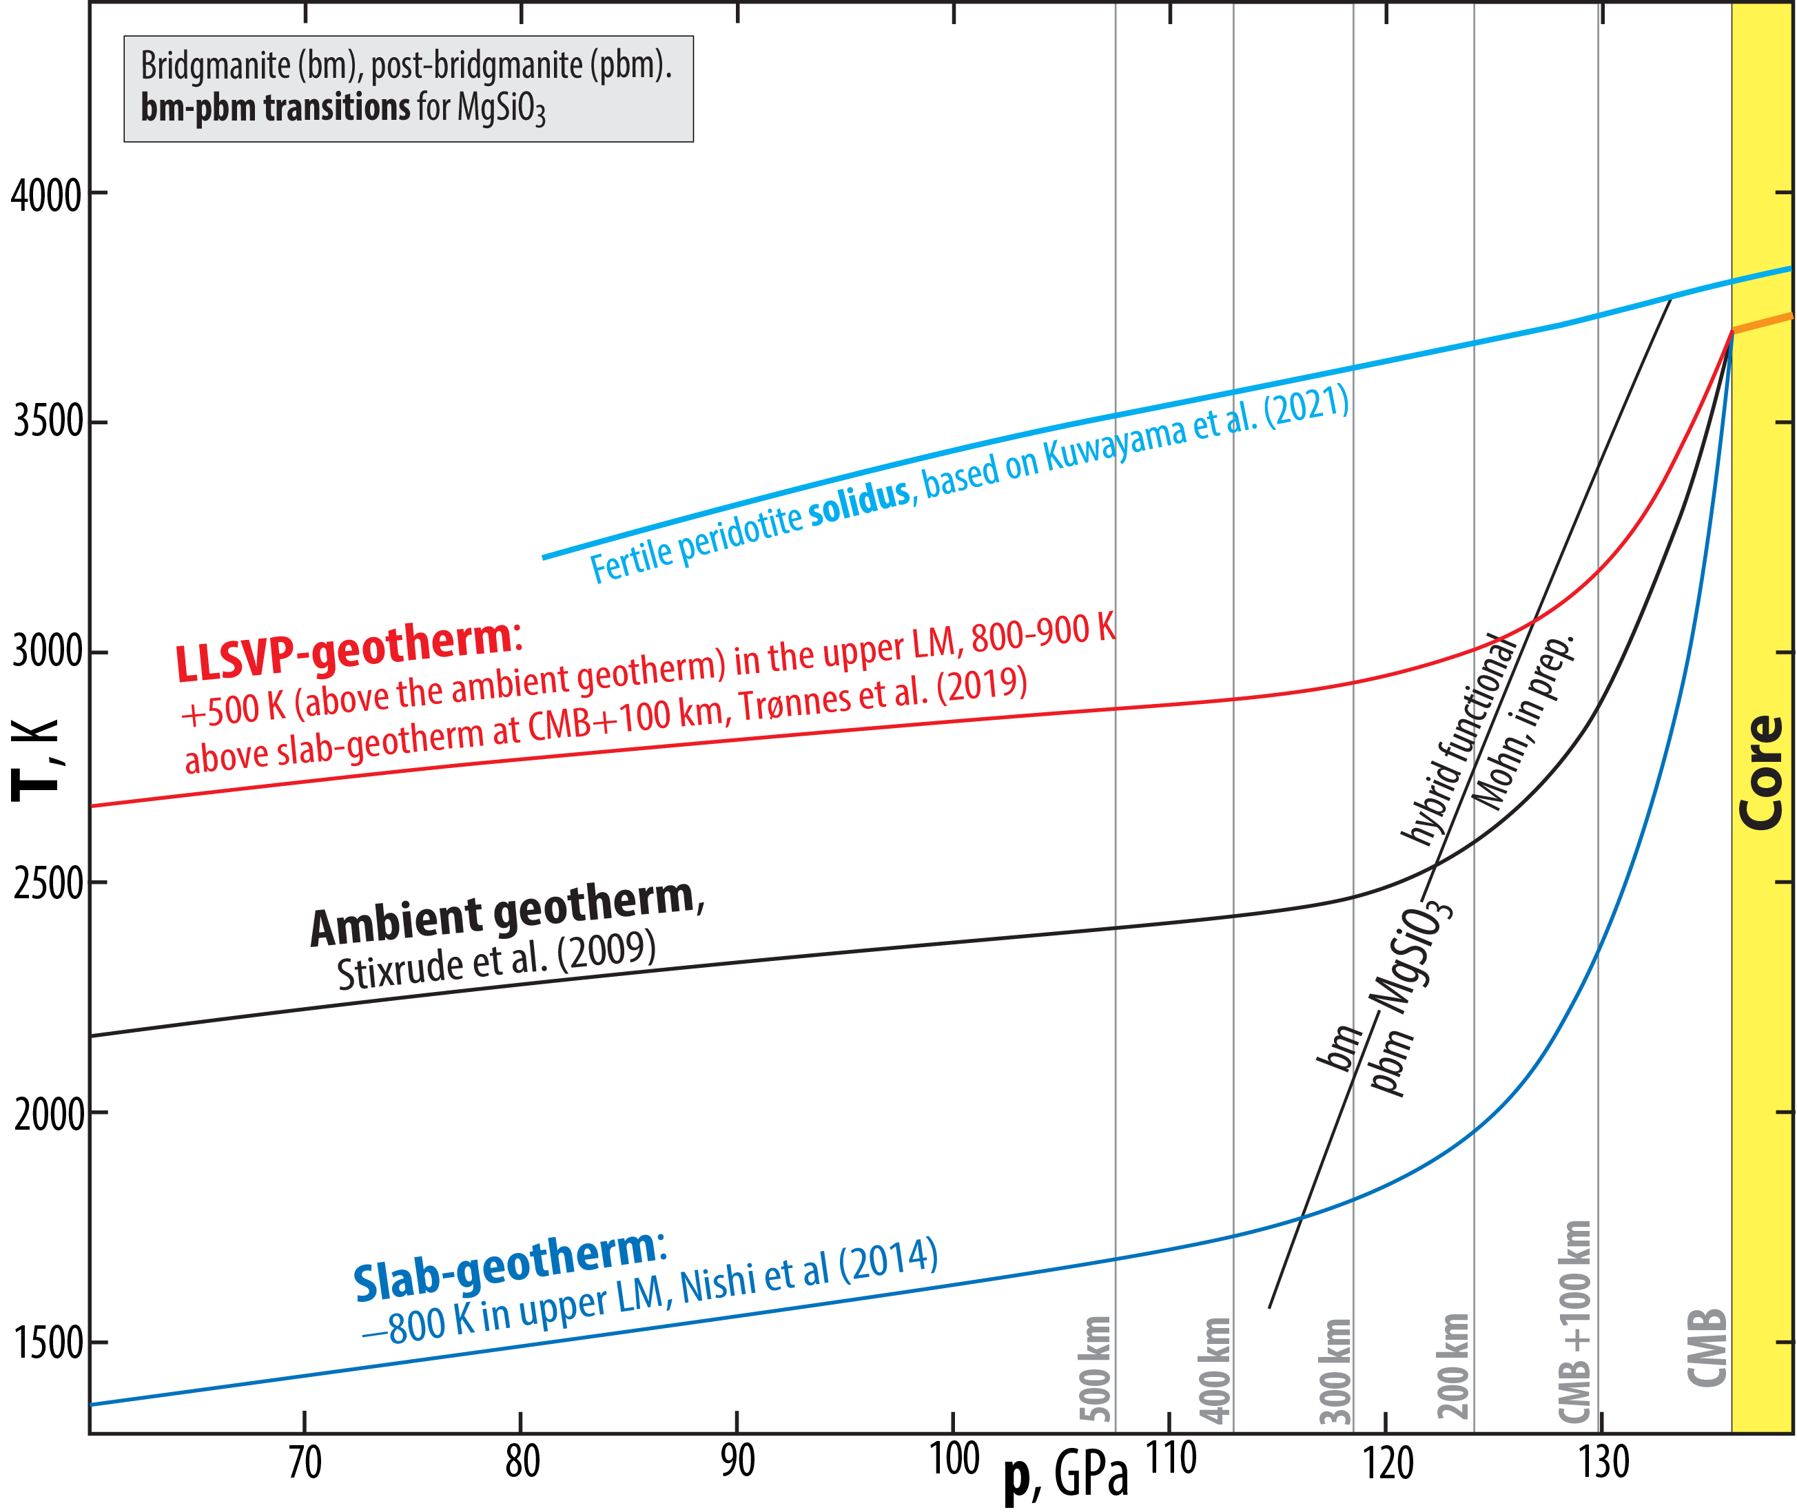

Slide 7
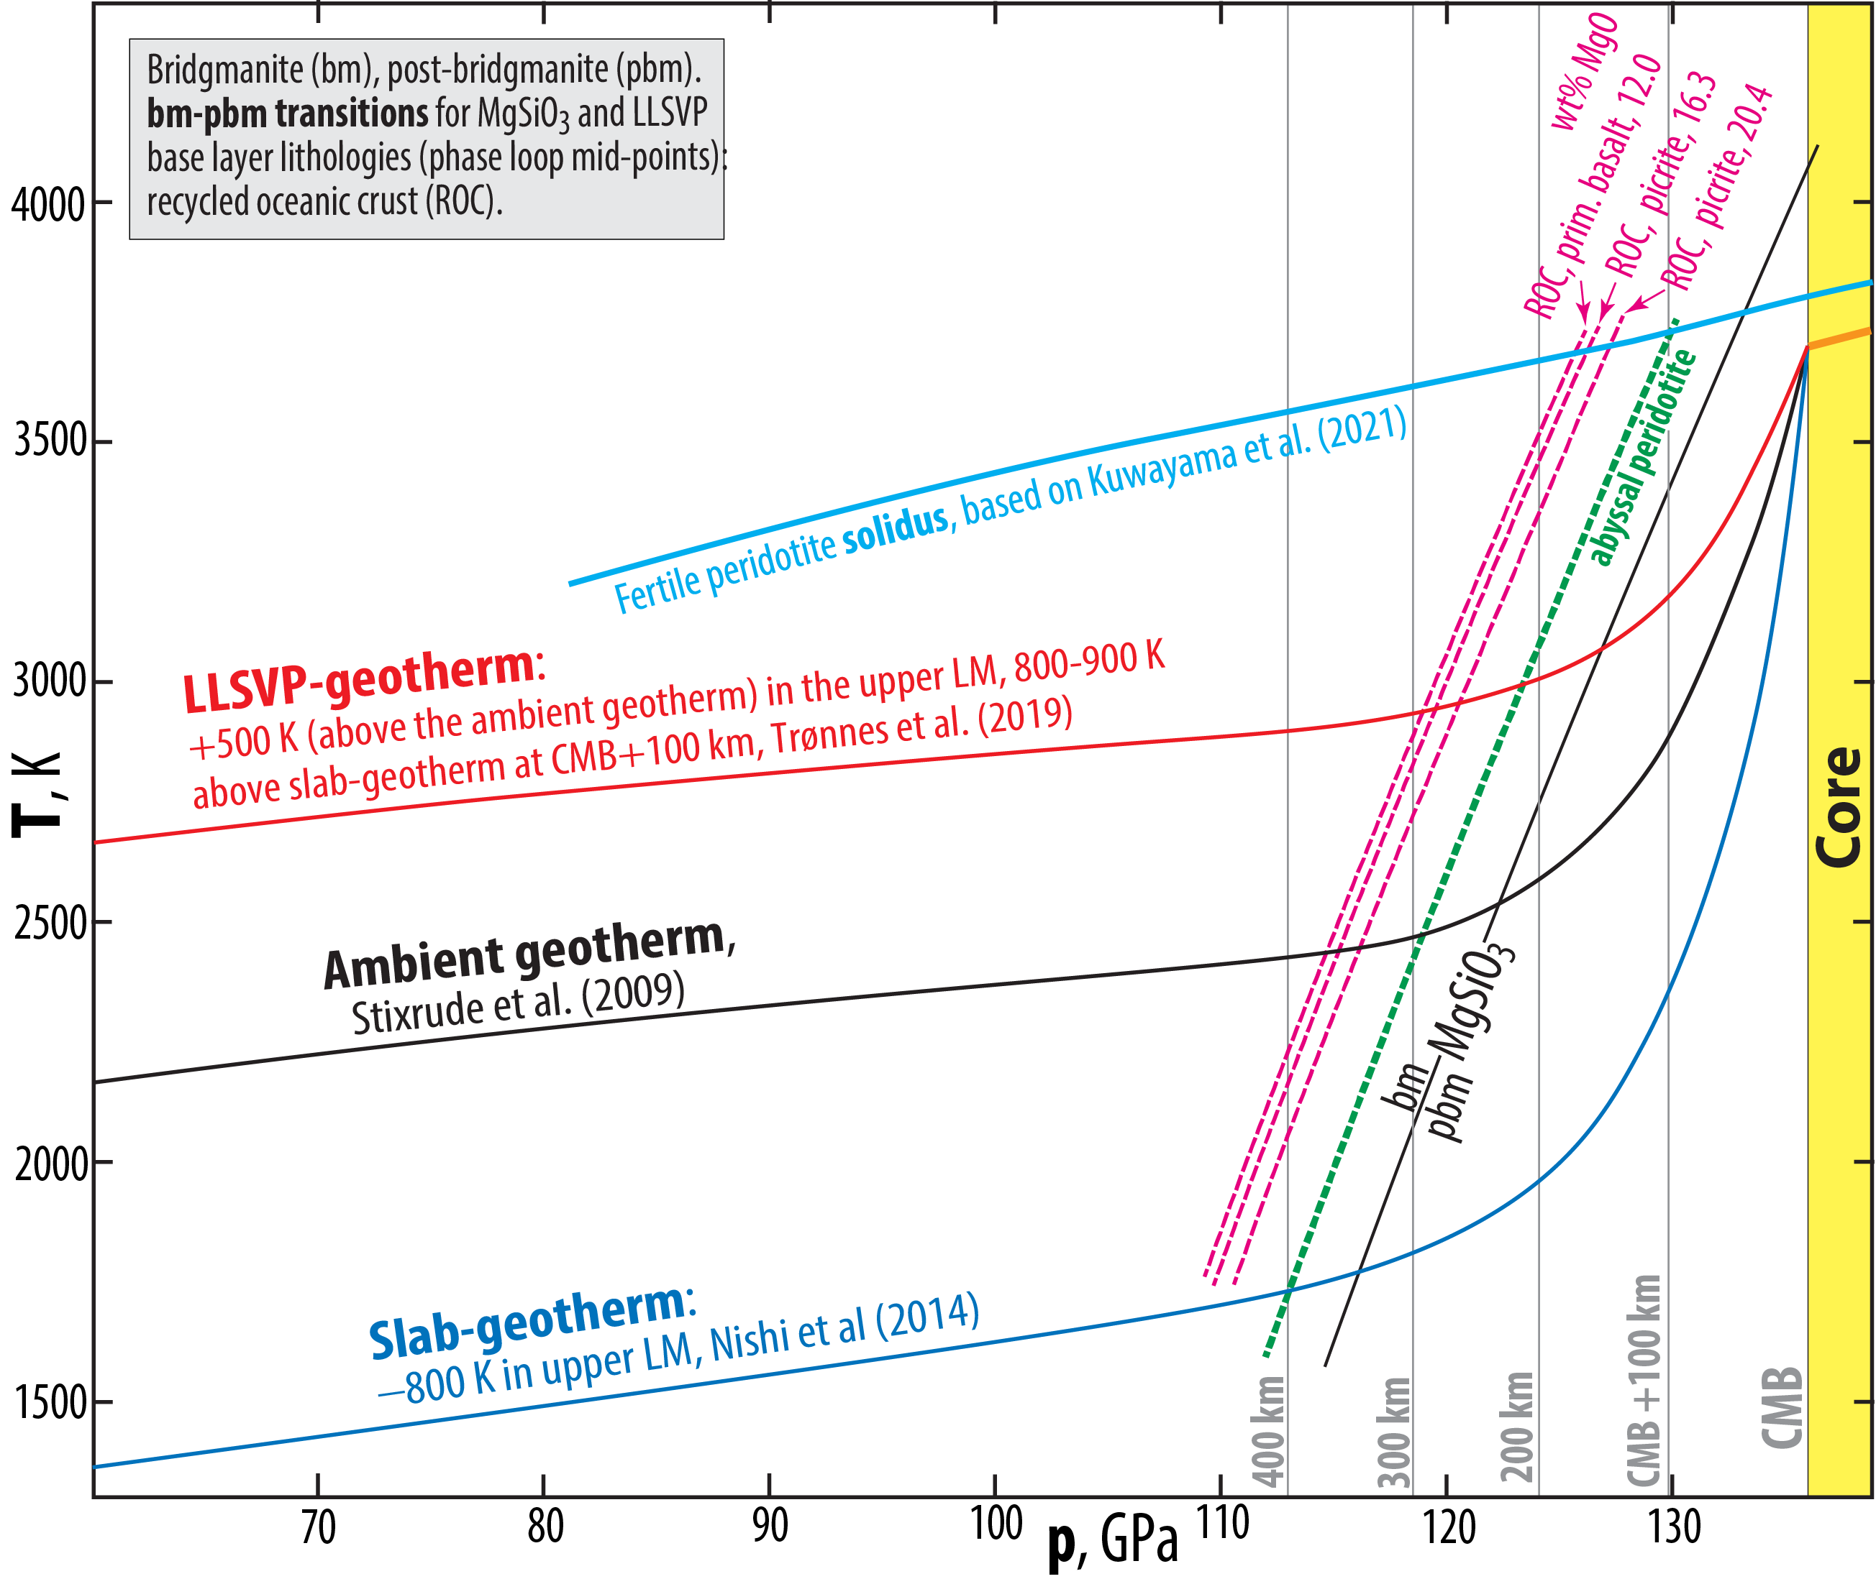

Slide 8
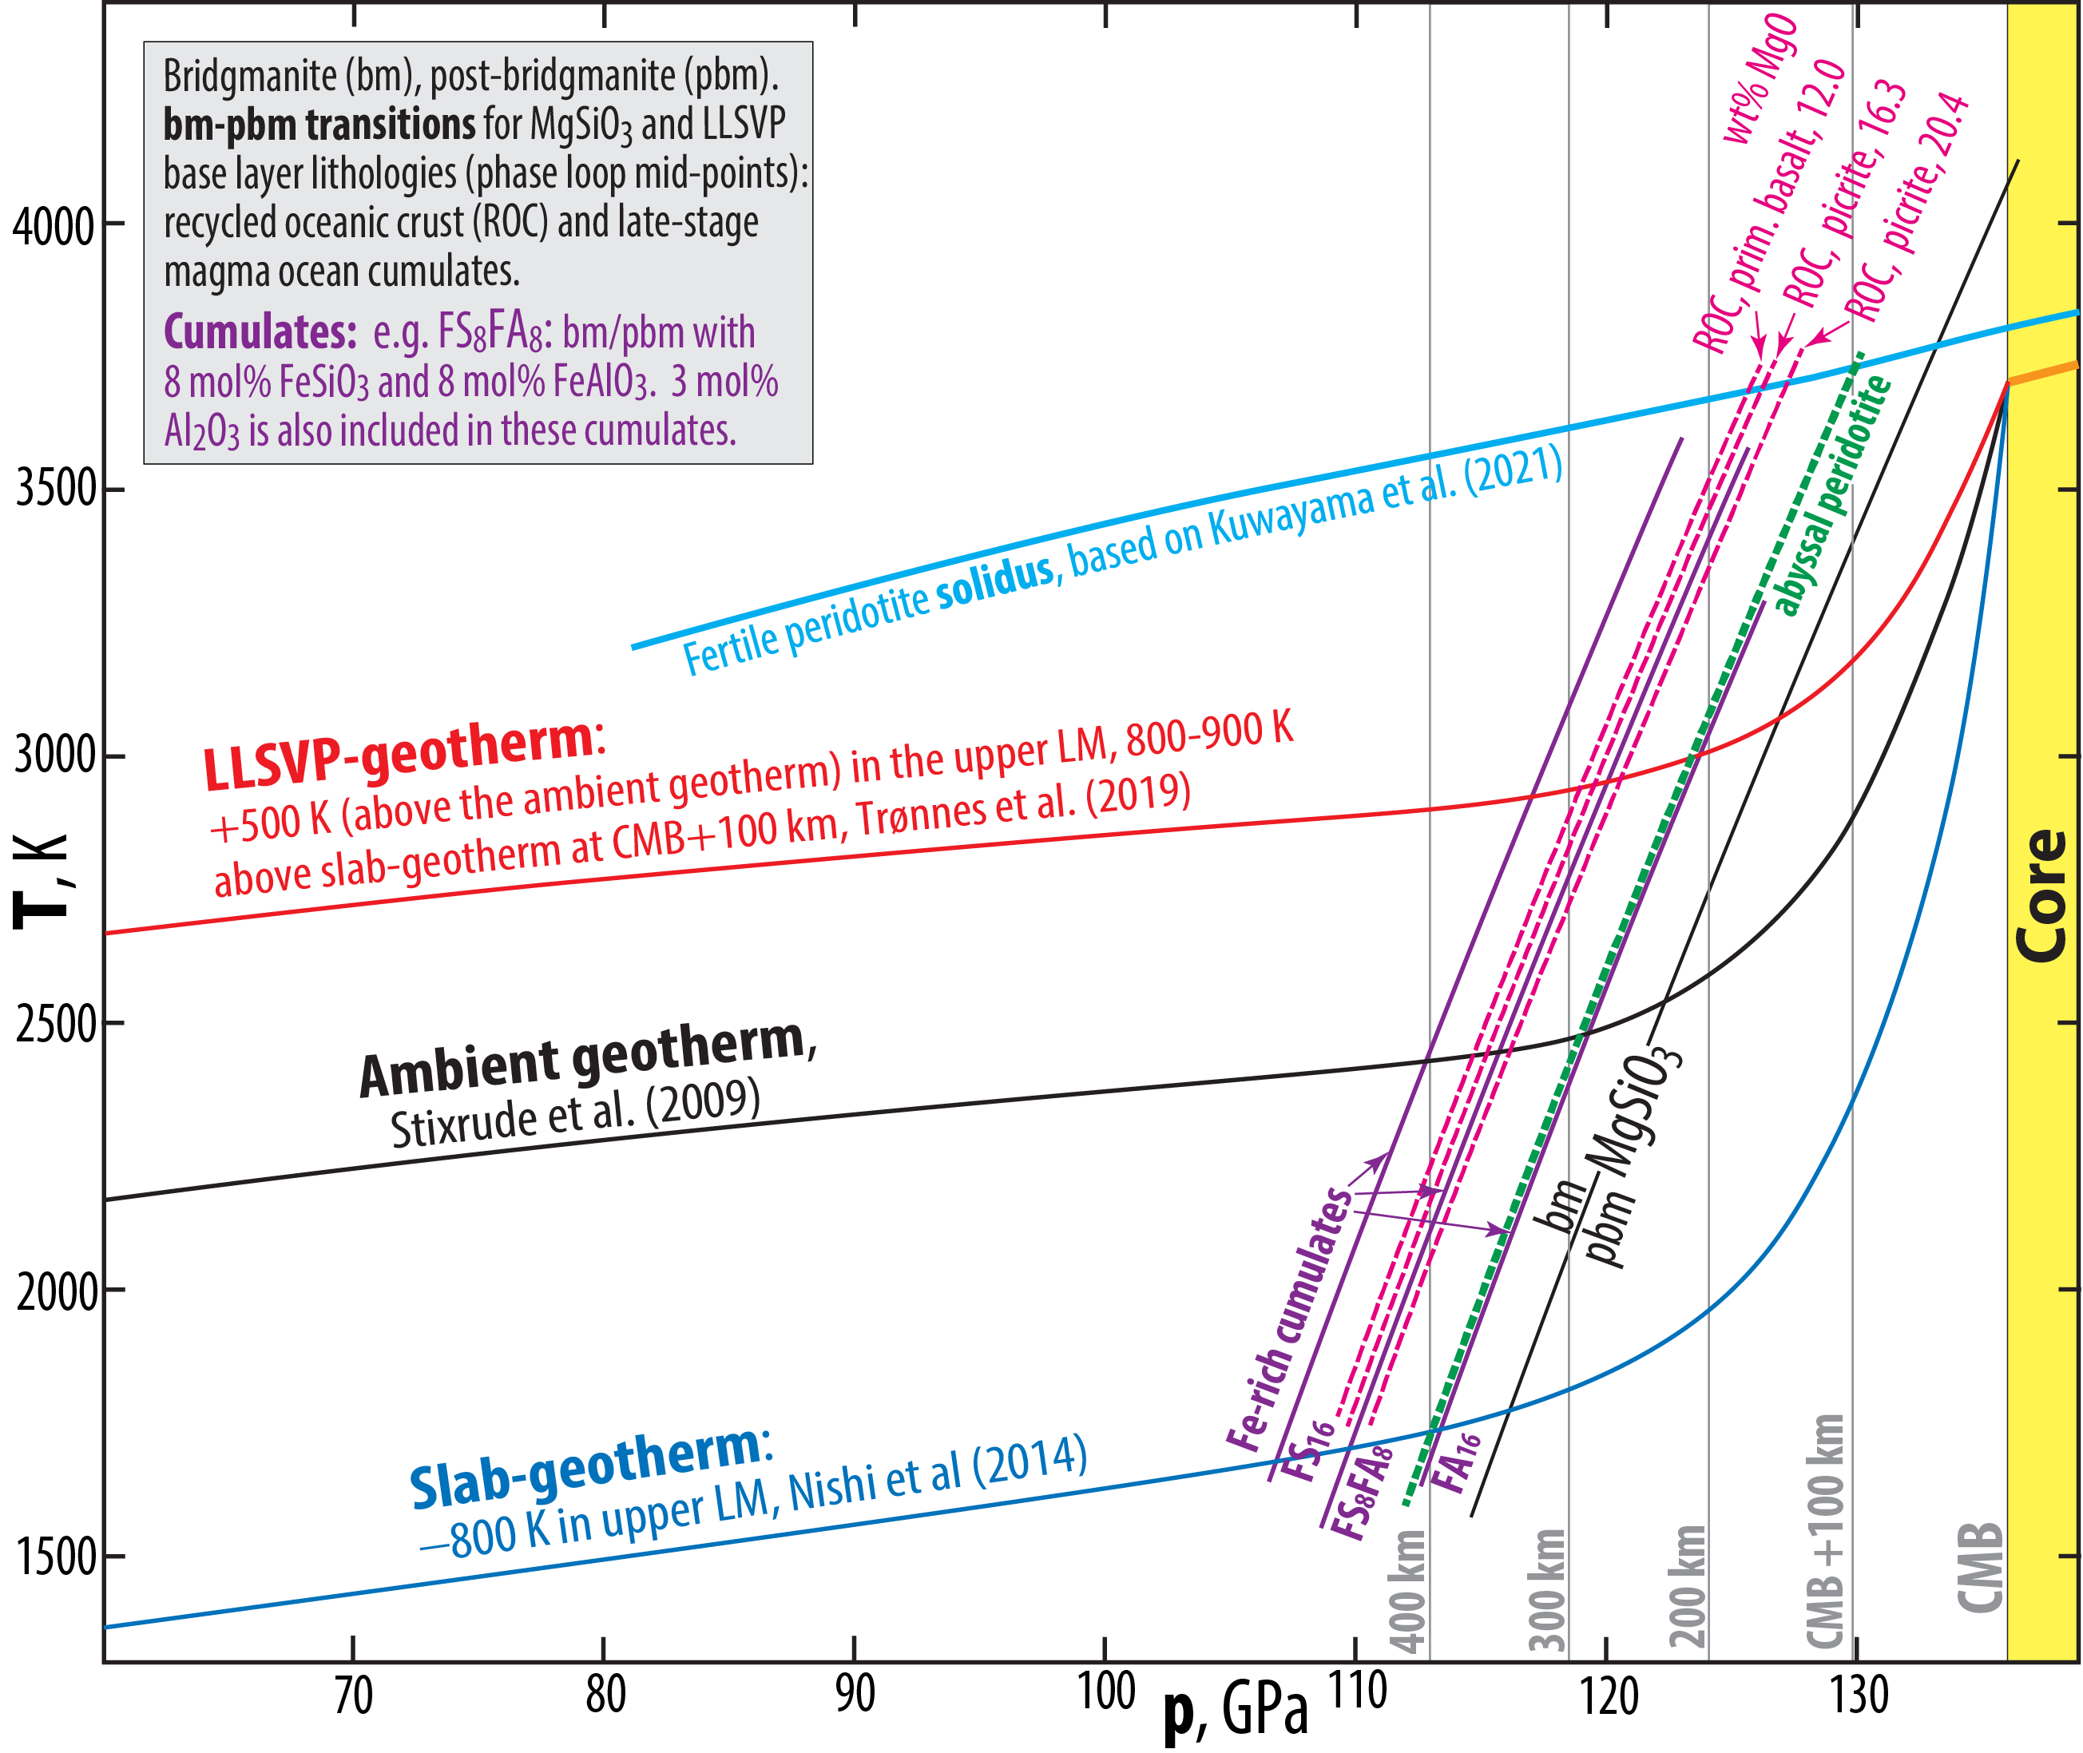

Slide 9
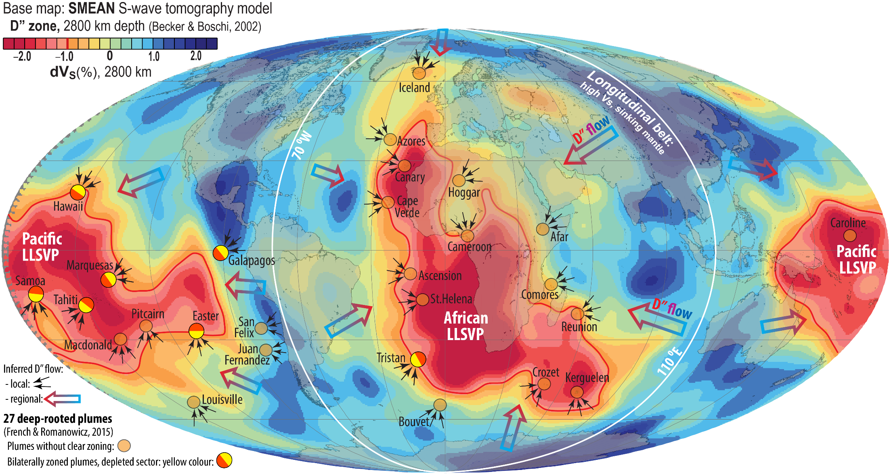

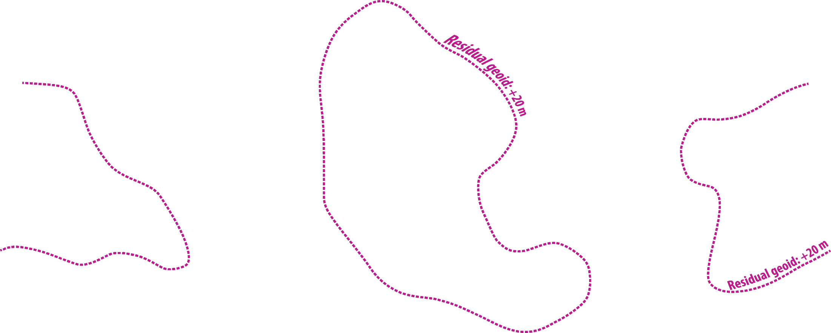
D"-zone structure with
degree-2 flow pattern
LLSVP-layers: about 300 km thick, ΔV_{S}: −1 to −2.5%
ULVZs, partially open "windows" from core to plume roots:
- detectable thicknesses: about 5-40 km
- thickest lenses in roots of the major plumes
- physical property contrasts relative to ambient mantle:
Δρ, ΔV_{P} , ΔV_{S}: about +10, −10, −30%, respectively
- Δρ of 10% in a low-viscosity D" zone indicates a nearly
continuous ULVZ-layer (<5 km which is the detection limit)
D": lowermost mantle thermal boundary layer,
- 200-400 km thick,
- large radial and lateral variation in
thermo-mechanical properties

Slide 10
Preview with concluding statements
Recycled oceanic crust, ROC, of basaltic-picritic composition is characterised by:
- lower solidus temperature than peridotite
- higher density than peridotite
Davemaoite (dm) is:
- the last residual mineral (= first liquidus phase) during progressive partial melting of ROC
- denser that bridgmanite and post-bridgmanite in mildly depleted peridotite
- denser than remaining residual minerals (seifertite and post-bridgmanite), following
partial melting of basaltic or picritic ROC
- the most suitable and probably dominant silicate mineral in ULVZs, due to high density,
"petrological inertness" and a suitable ΔV_{S}/ΔV_{P} ratio of 2.6-2.7
- an important crystallising mineral along with bridgmanite, ferropericlase and the Ca-ferrite-
structured, Al-rich phase at a mature stage of the basal magma ocean crystallisation
U and Th partition very strongly into davemaoite, with D^{dm/melt, U} and D^{dm/melt, Th} exceeding 10
Therefore:
The presence of dm in the ULVZs (partially open "windows" to the core) and basal cumulates and piles of unmelted and partially melted ROC in the LLSVPs, would render both the core and the lowermost mantle unsuitable as sources for the primordial-like He-Ne-isotope signal.

Slide 11
"The petrological ULVZ-paradox"
In contrast to most other ULVZ candidate materials,
dm as a major ULVZ-ingredient will not violate two
important petrogenetic observations:
- Fe/Mg-partitioning: K_{D}^{Fe/Mg}_{pbm/melt} = (Fe/Mg)^{pbm}/(Fe/Mg)^{melt} ≈ 0.04 !!
and
- strong FeO-extraction from silicate melt and ferromagnesian minerals
(bm, pbm, fp) to O-undersaturated liquid core alloy
Because the majority of "ULVZ-workers", esp. mineral physicists, do not recognize the likely consequences of ULVZs in partial equilibrium with silicate and metallic (core) melts, the two observations above could possibly be refered to as a petrogenetic paradox

Slide 12
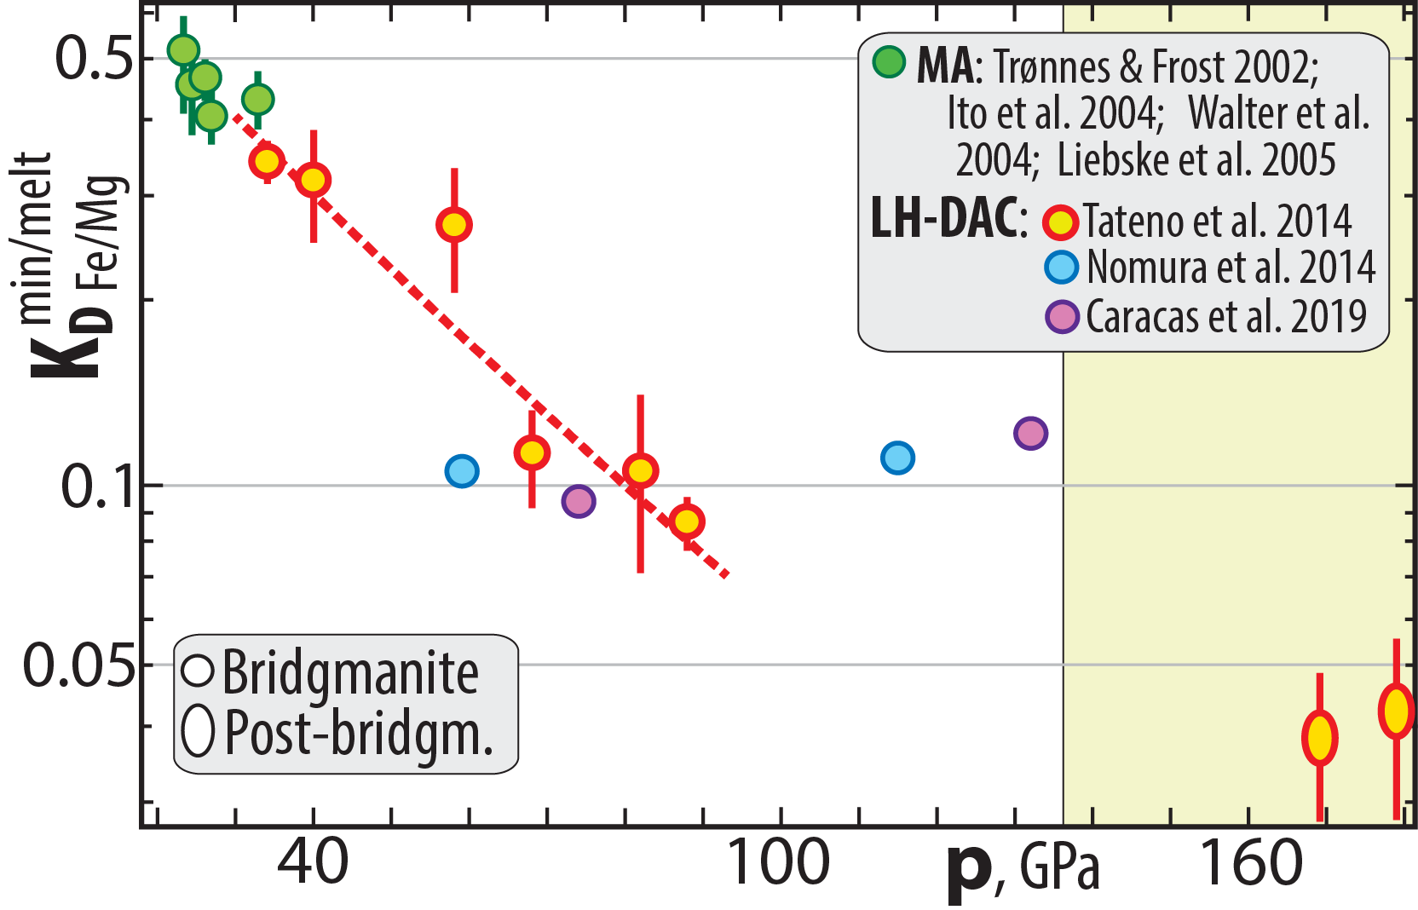
Fe/Mg-partitioning bm-melt and pbm-melt
K_{D}^{min/melt}_{Fe/Mg} = (Fe/Mg)^{min}/(Fe/Mg)^{melt}
K_{D}^{bm/melt} - decreases from 0.5 to 0.1 in the 24-80 GPa range
- remains constant near 0.1 in the 80-130 GPa range
I.e. partial melts have 10 and
25 times higher Fe/Mg ratio
than bm and pbm, respectively
K_{D}^{pbm/melt} is much lower: about 0.04 (0.03-0.05)

Slide 13
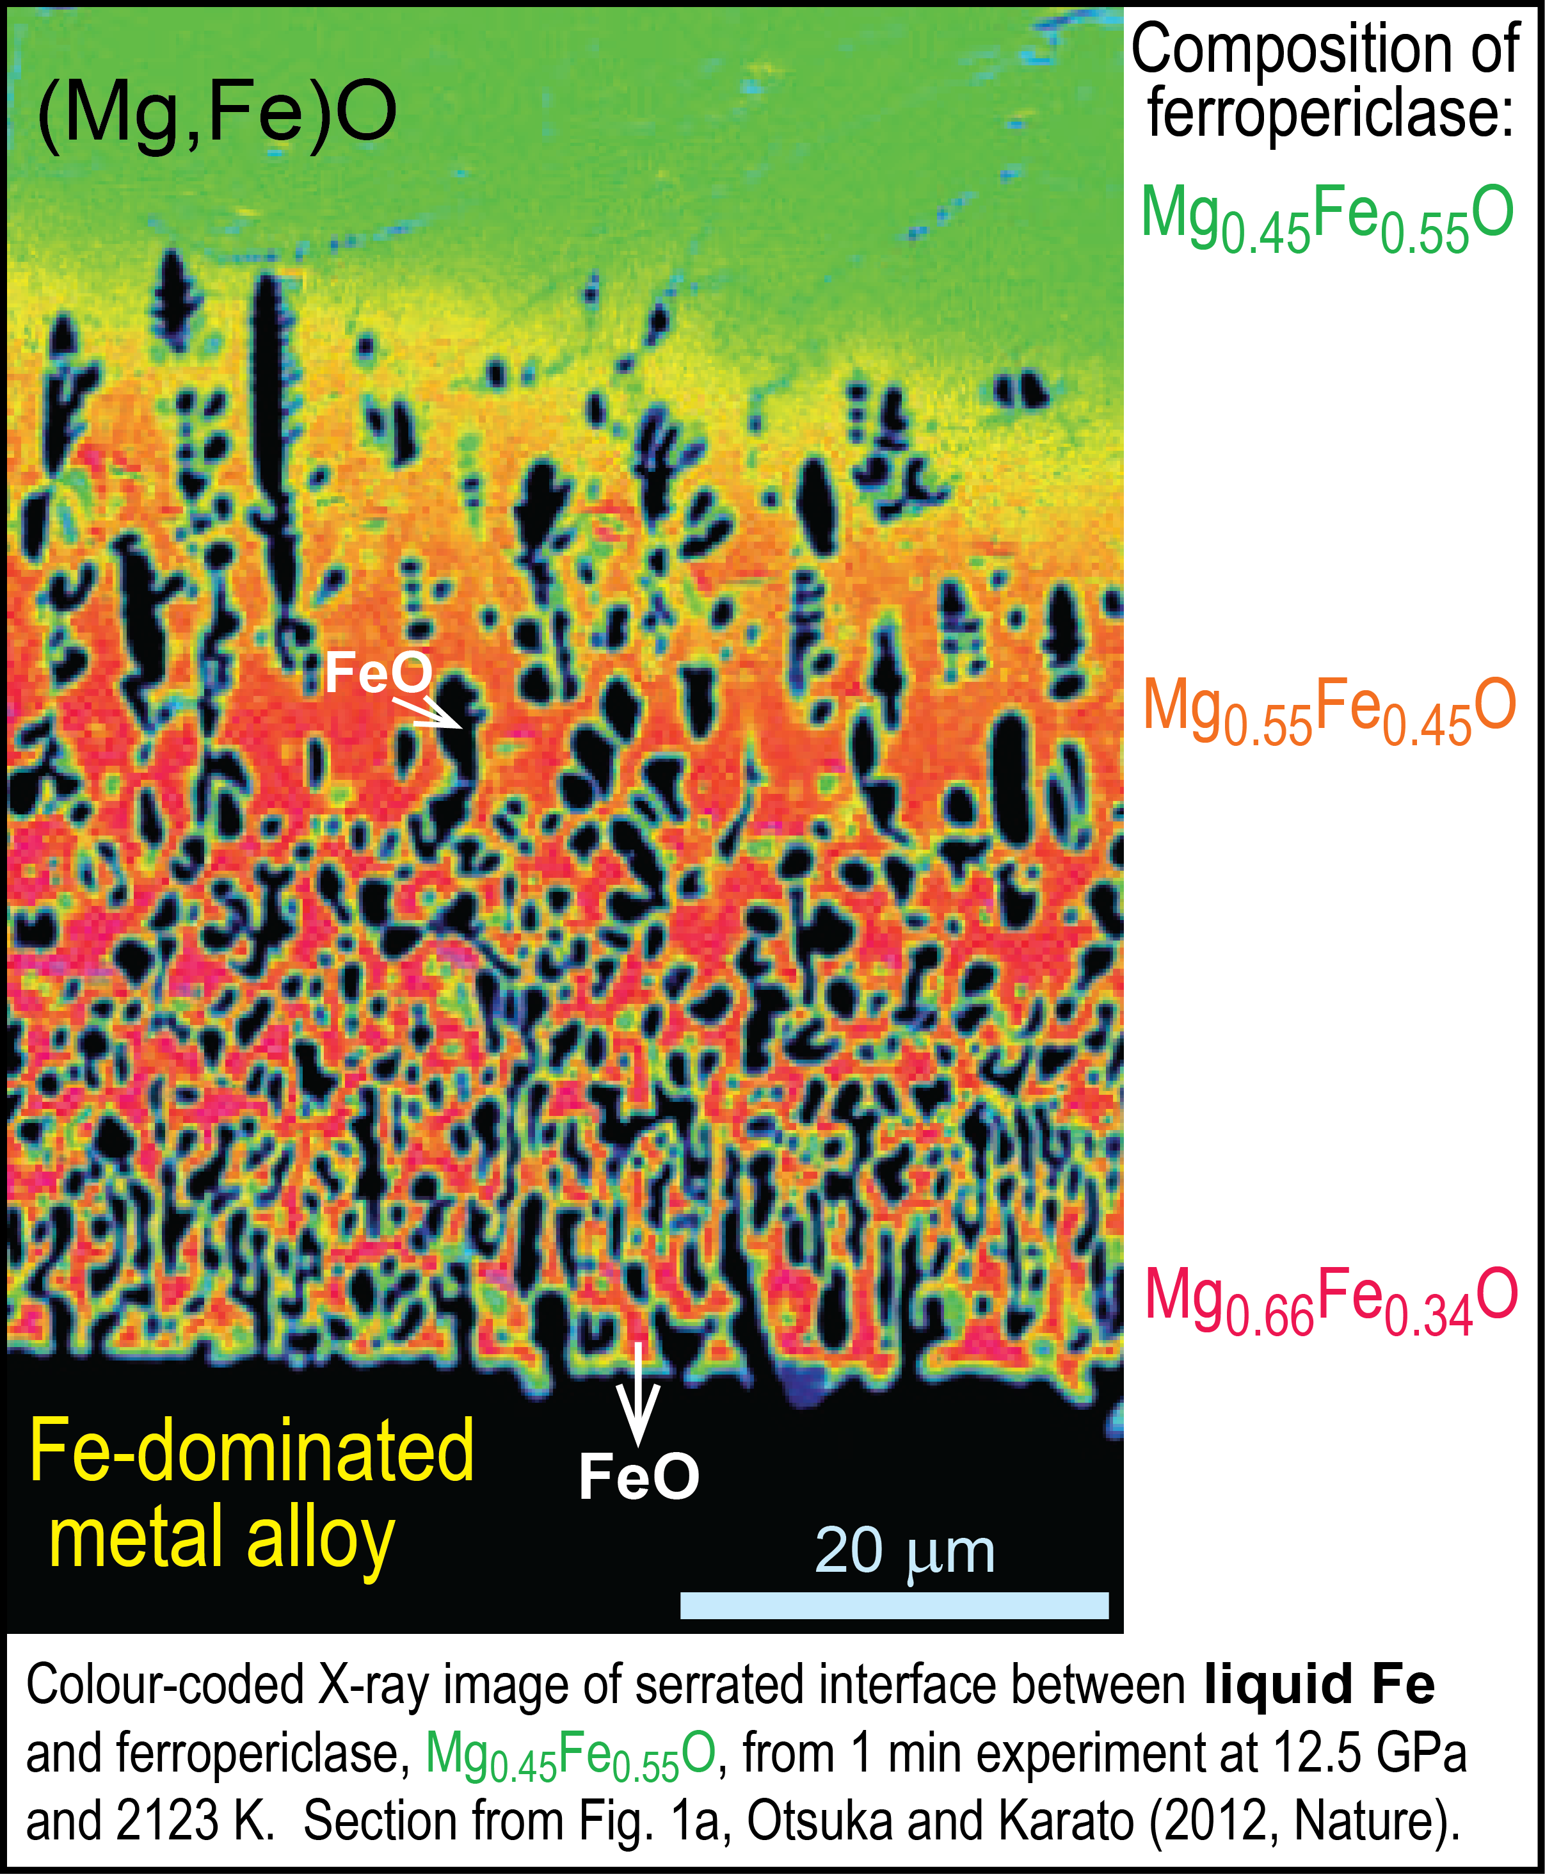
Earth cooling has produced an O-undersaturated core
Experiments by Otsuka & Karato (2012, Nature)
with O-undersaturated metal shows that:
FeO-partitioning from a fp single crystal to
Fe-melt at 12.5 GPa - 2123 K - 1 min
Initial crystal composition: Mg_{0.45}Fe_{0.55}O
metal alloy "worms" intruding into fp-crystals "suck up" FeO to alleviate the O-undersaturation in the metal
initial comp.
40 μm

Slide 14
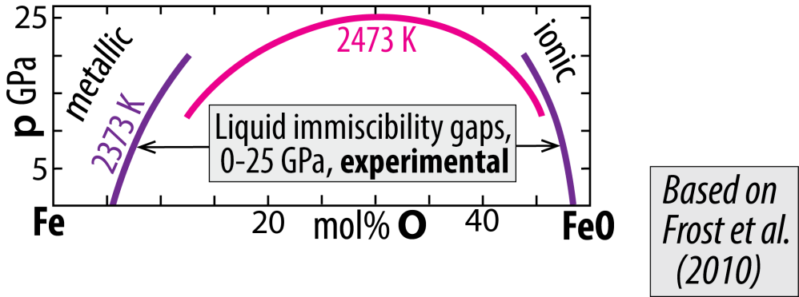
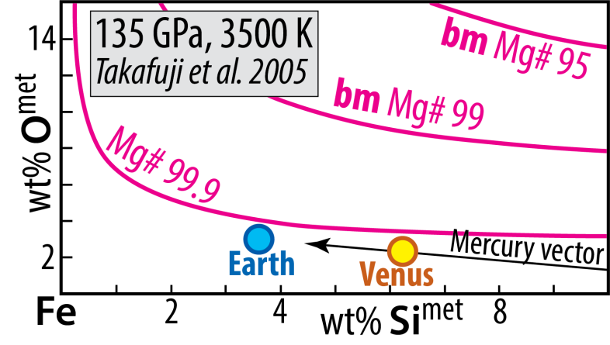
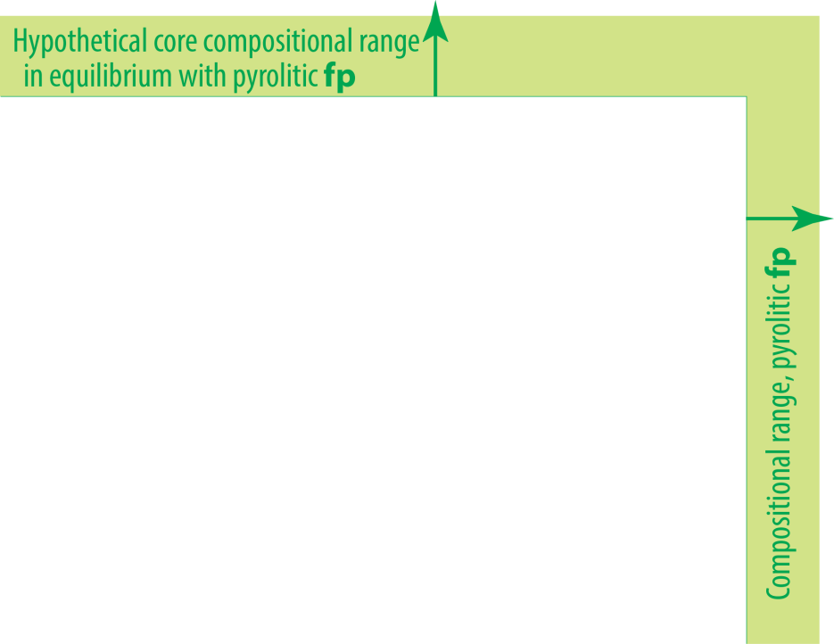
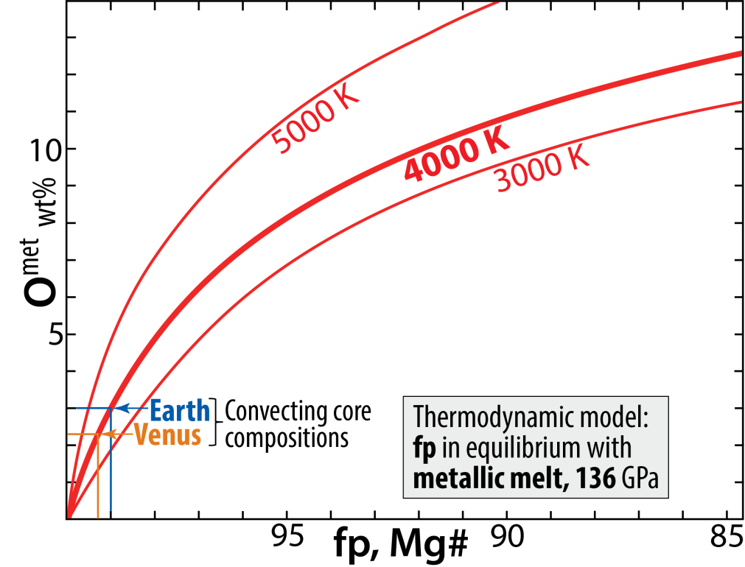
Earth cooling has produced an O-undersaturated core
System: Fe-Mg-O
metal-ferropericlase equilibrium
Solvus closure with
increasing p and T
System: Fe-Mg-Si-O
metal-bridgmanite equilibrium
Implication
fp-metal and bm-metal equilibria demonstrate strong tendency for FeO-partitioning to an
O-undersaturated core
- limited by solid state diffusion in bm and fp
Mg# =100 Mg / (Mg+Fe)

Slide 15
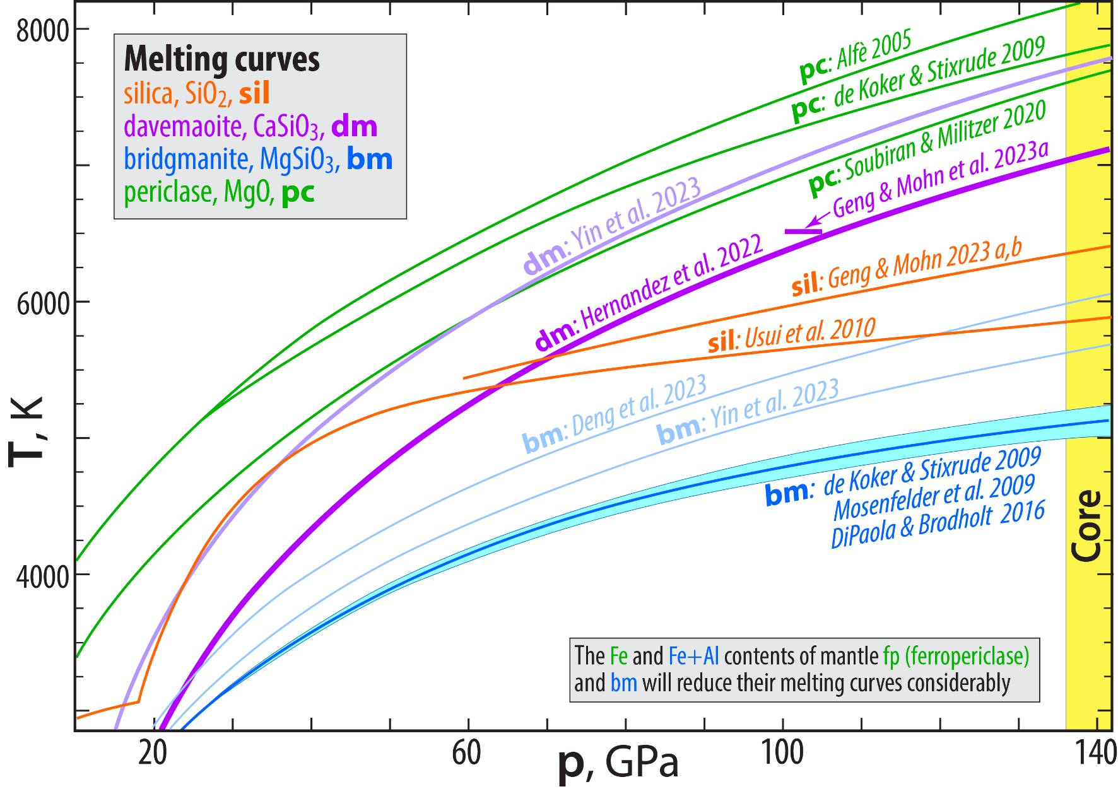
The steeply rising melting curve of dm demonstrates high and
increasing thermal stability through the lower mantle p-range

Slide 16
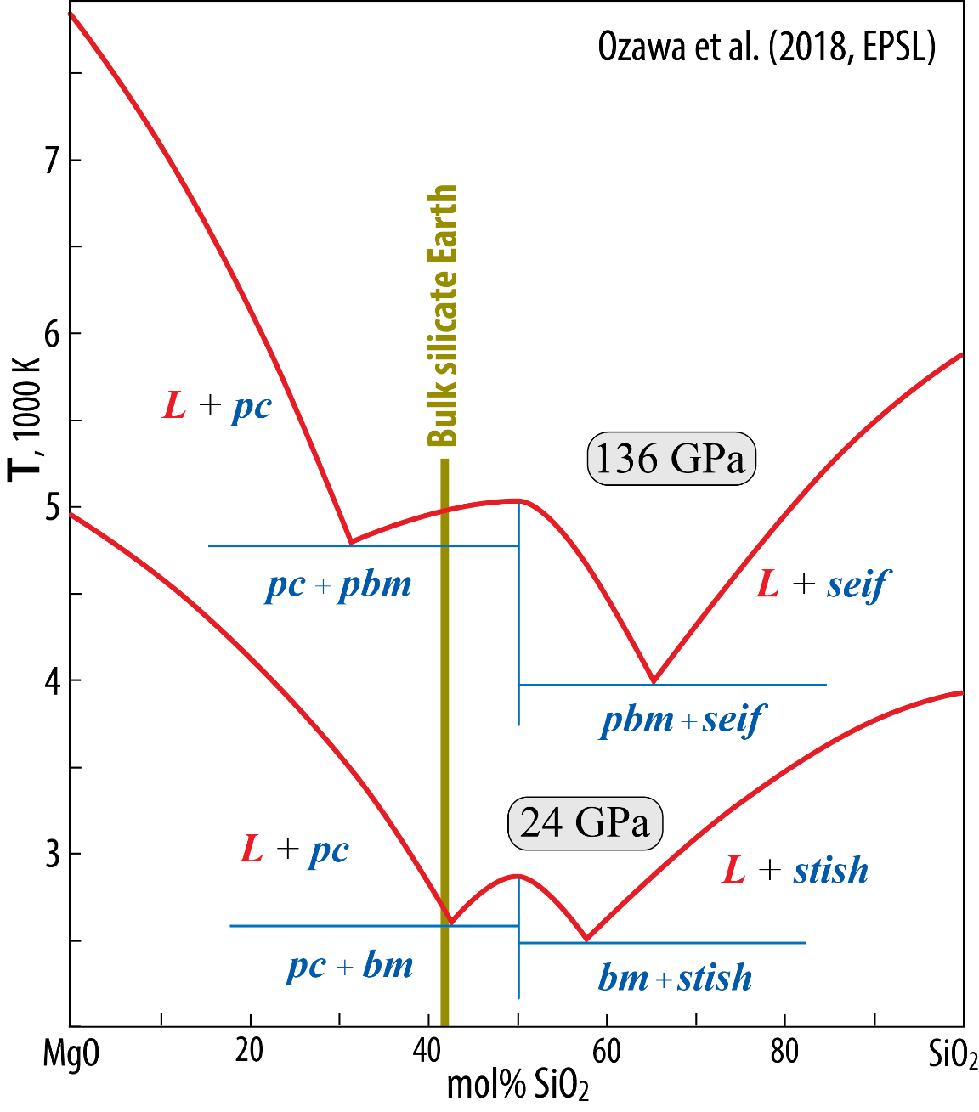
Melting phase relations along the MgO-SiO₂ join
Increasing p (24-136 GPa): the two binary pc-bm and bm-silica eutectics move away
from bm, expanding the bm liquidus field along this join.
Based on:
and the bm melting
curve on the previous
slide (deKoker & Stix. 09;
Mosenfelder et al. 2009;
diPaola & Brodholt 2016)
Ozawa et al. 2018, EPSL

Slide 17
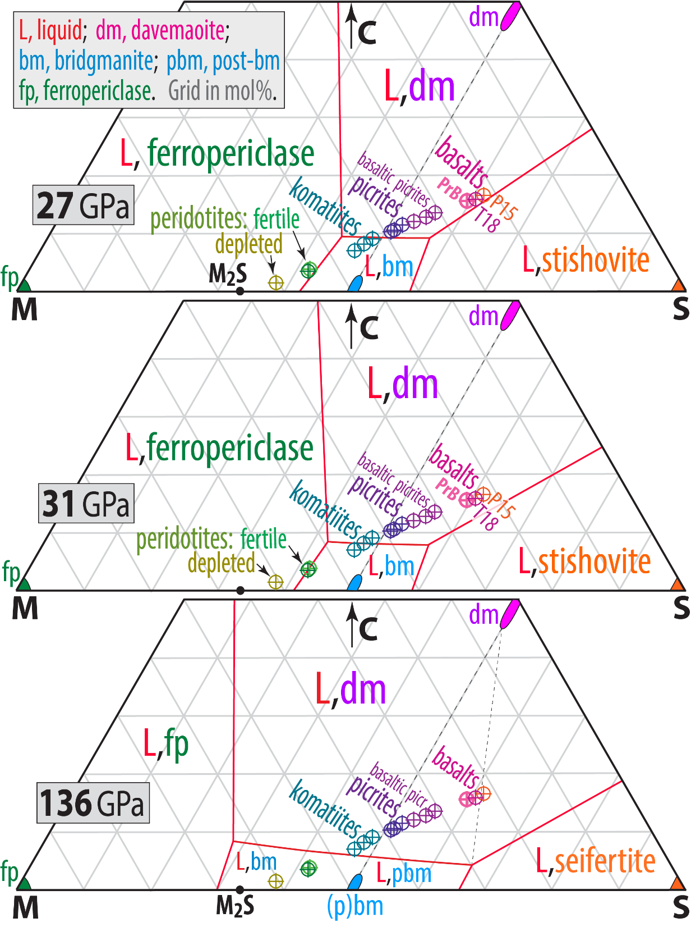
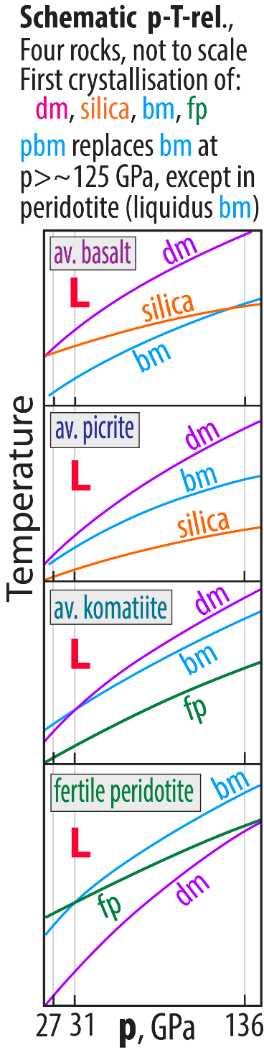
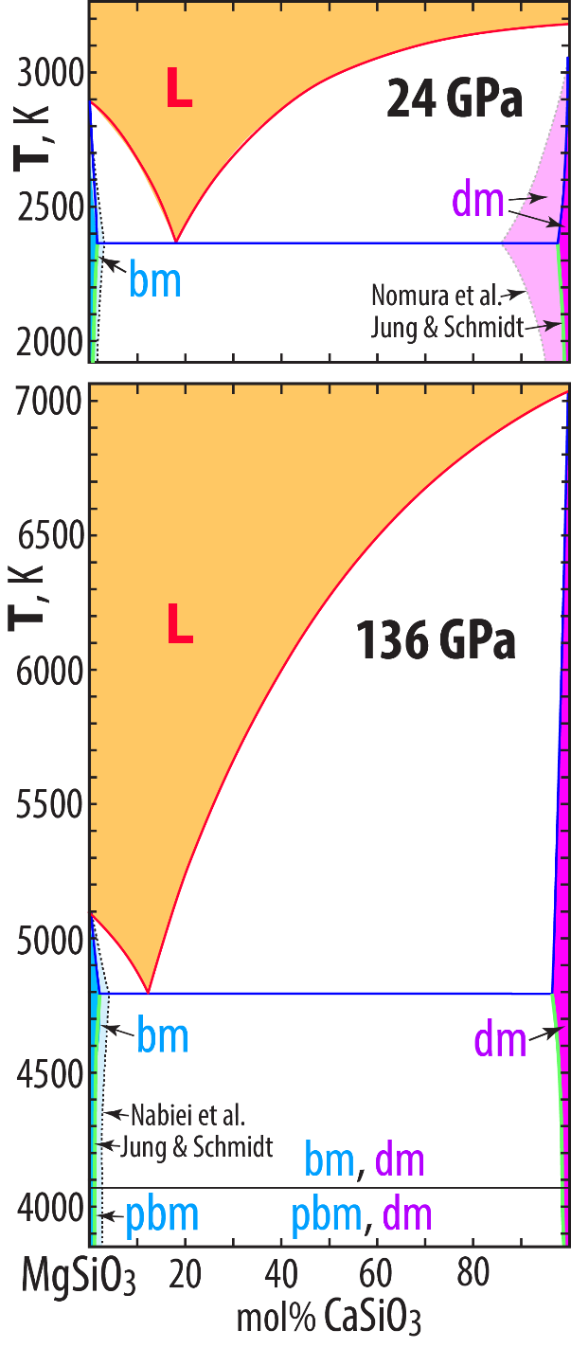
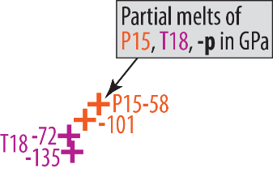
The binary system
MgSiO₃-CaSiO₃
The pseudo-ternary system CMS
C: Ca + Na S: Si + 0.9Al
M: Mg + Fe + 0.1Al + Ti + Cr + Ni + Mn

Slide 18
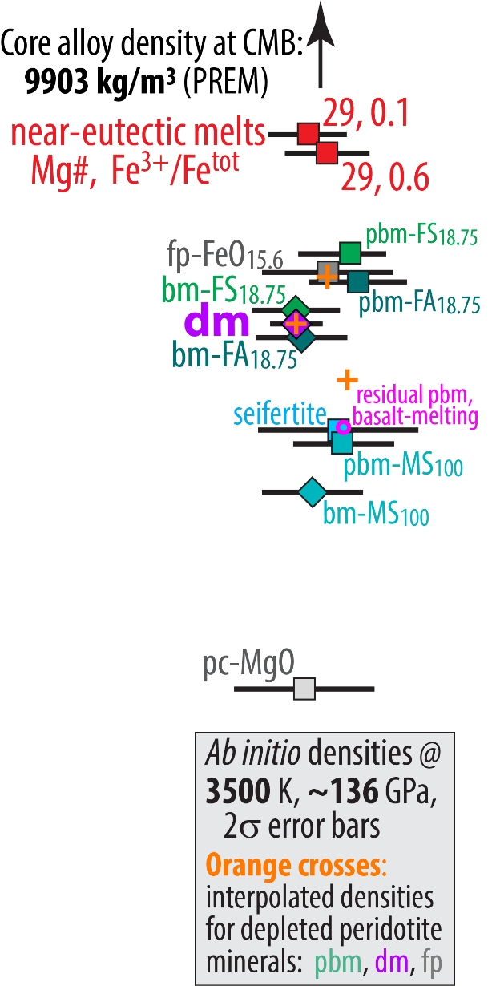
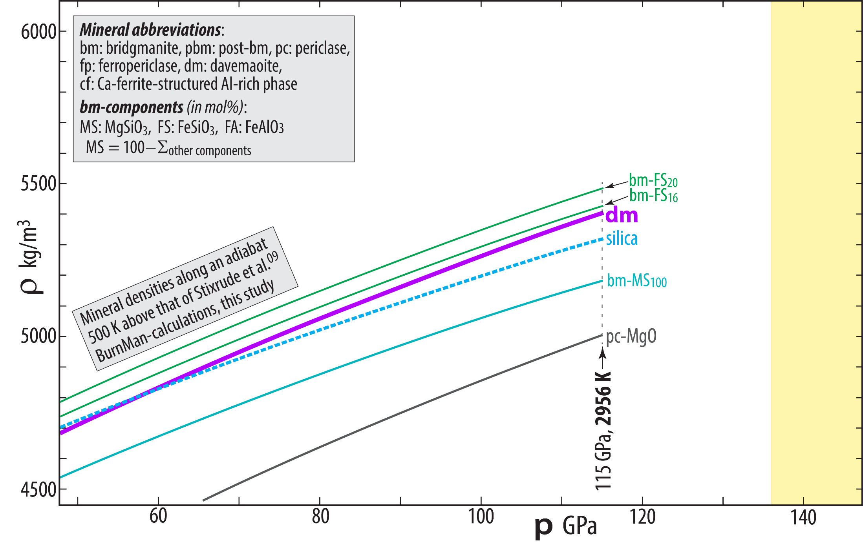
Mineral and melt density

Slide 19
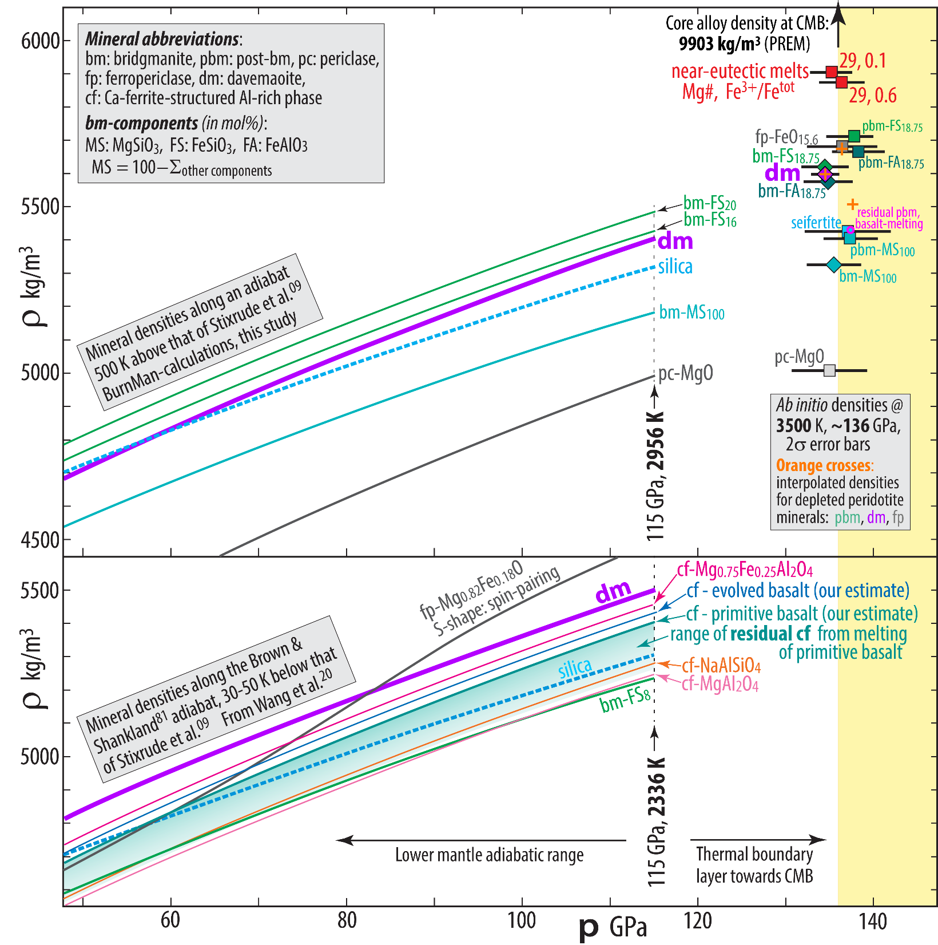
Mineral and
melt density
For completeness:
the Al-rich Ca-ferrite-
structured phase
but because this is the first
phase to be consumed during
partial melting, the density of
"residual" cf-phase is irrelevant

Slide 20
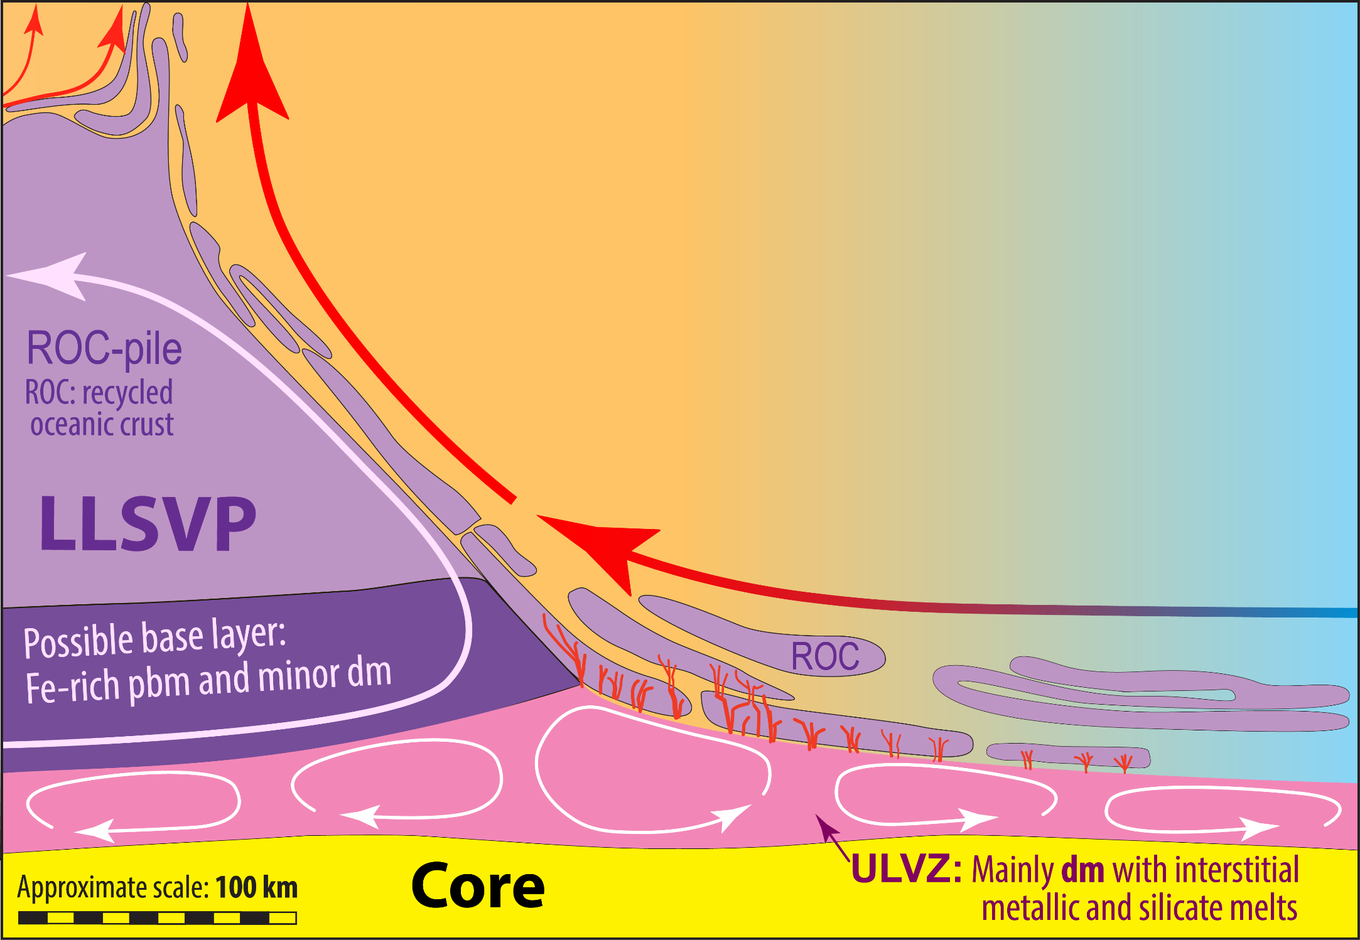
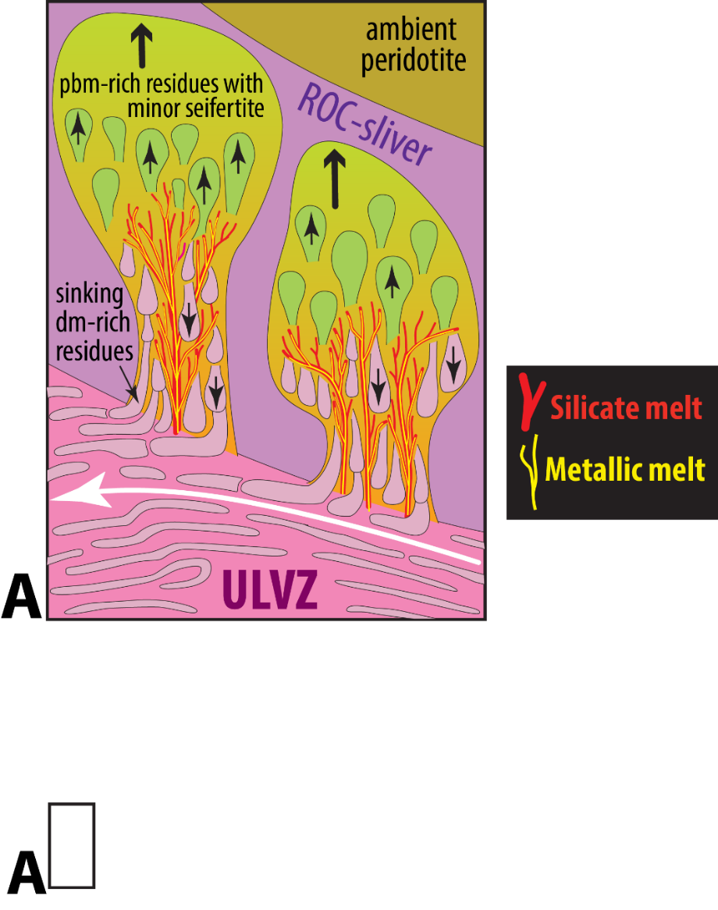
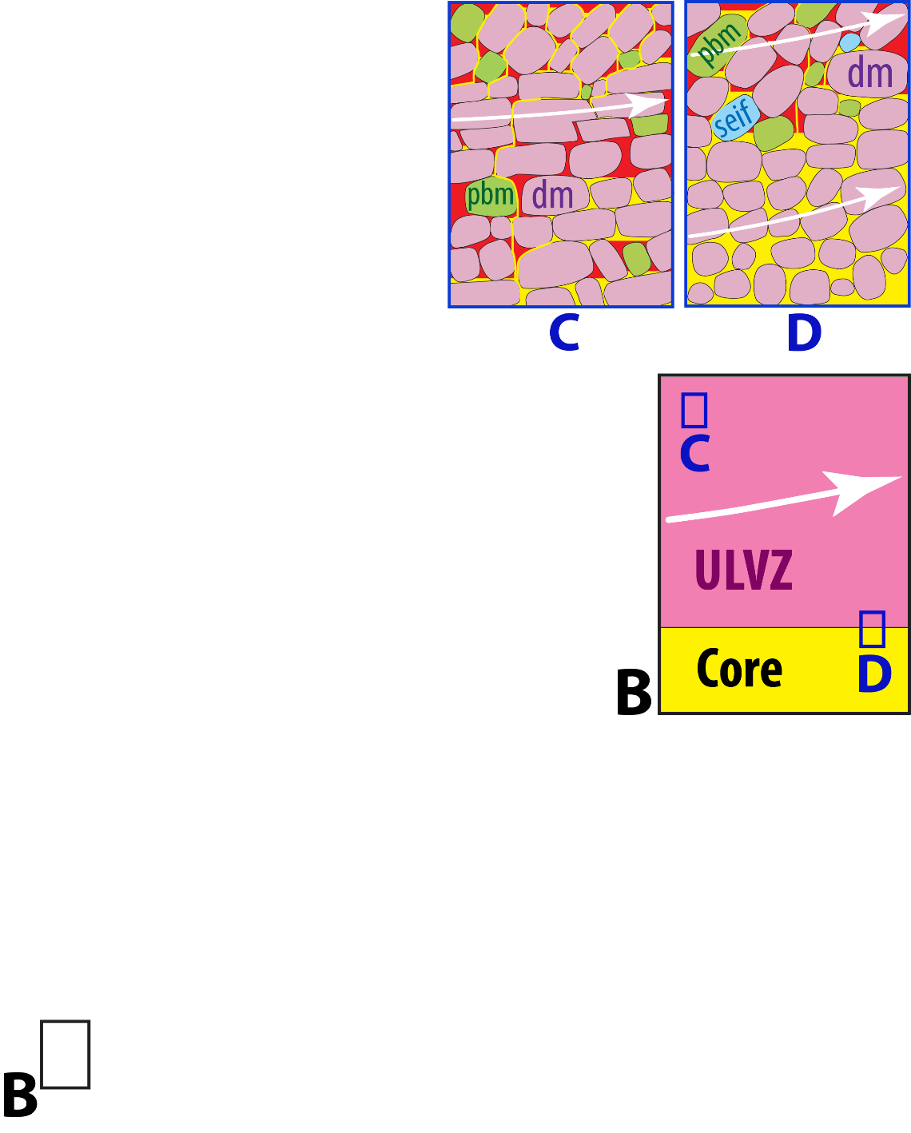
ULVZ dynamics
ULVZ: Ultra-low velocity zone
LLSVP: Large low S-wave velocity province

Slide 21
Density models
5.2%
3.1%
68.2%

Slide 22
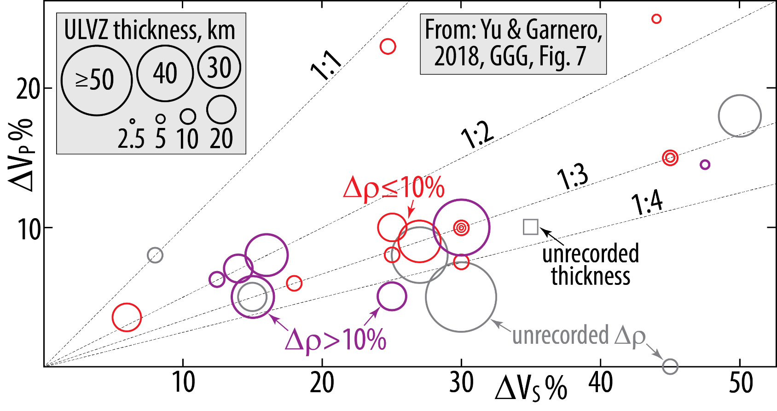
Global ULVZs:
Compilation of thickness, density excess Δρ (>10%, <10%),
and velocity deficits: ΔV_{S}, ΔV_{P} (shown as positive values)

Slide 23
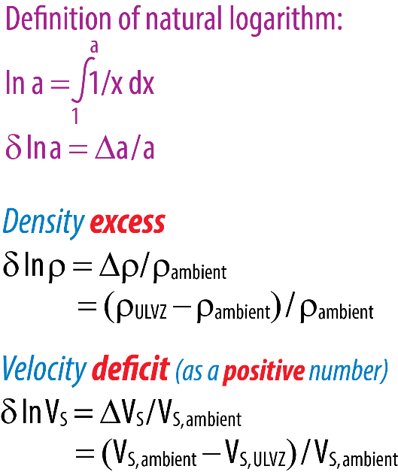
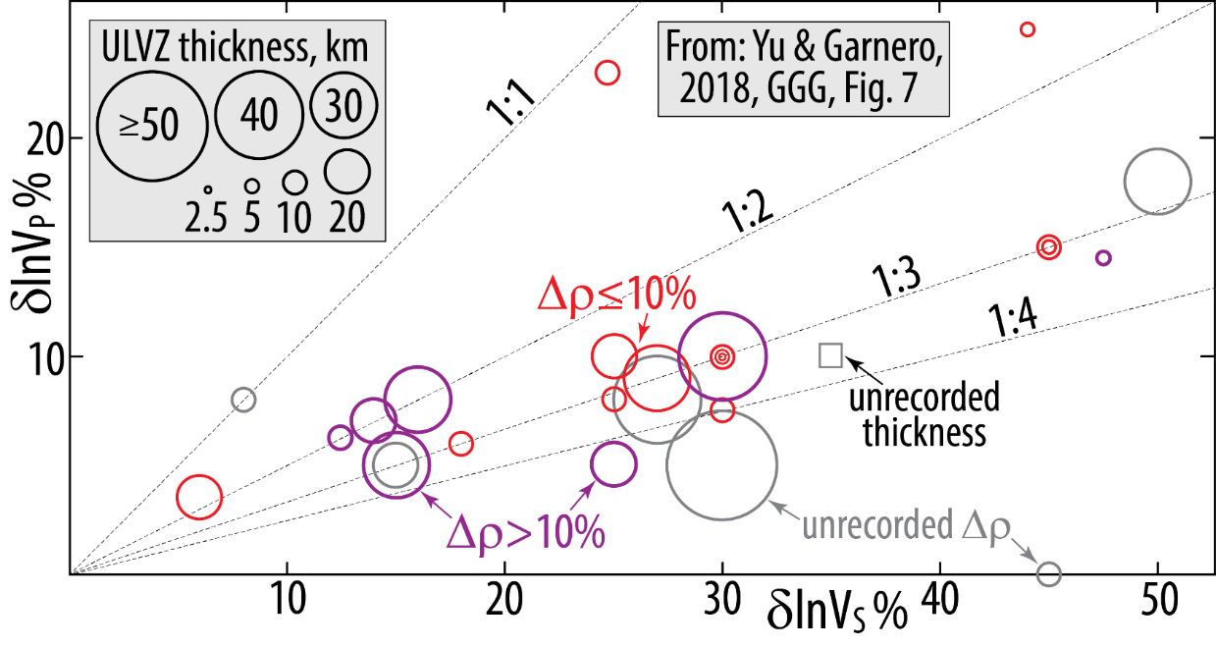
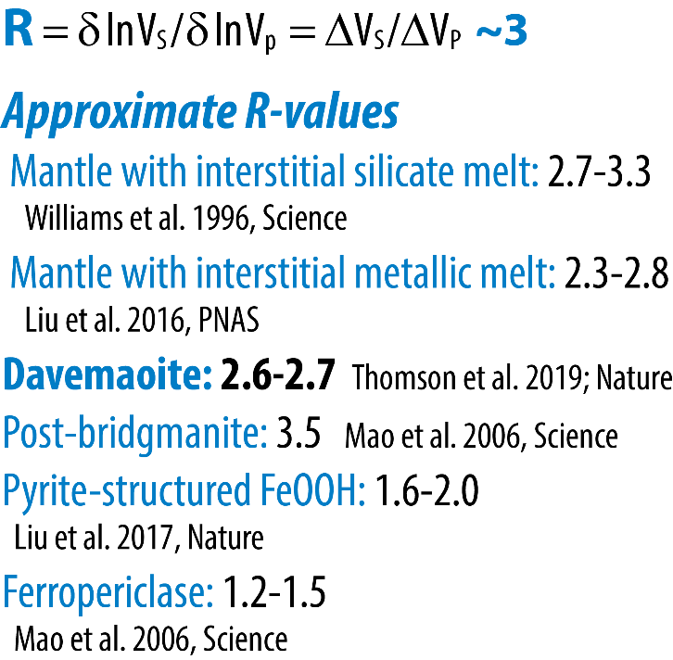
Identical diagram - alternative axis notation

Slide 24
ULVZs may be partly open "windows" to the core, because:
- the major plume conduits rise from thickened ULVZs
- deep-rooted plumes have fluxes correlated with:
- core signals: negative μ¹⁸²W-anomalies and elevated ¹²⁹Xe/¹³⁶Xe-ratios, but also:
- refractory mantle signals: high ¹⁴³Nd/¹⁴⁴Nd, ¹⁷⁷Hf/¹⁷⁶Hf, Mg#, MgO, Os, etc.
- primordial-like He and Ne isotopic ratios
- partly also: ancient refractory mantle signals: positive μ¹⁴²Nd (i.e. high ¹⁴²Nd/¹⁴⁴Nd)
Consequences:
- ULVZs in partial equilibrum with core metal and silicate melt cannot contain
ferromagnesian silicate and oxide minerals with high Fe/Mg ratios
("petrogenetic ULVZ paradox")
- High density davemaoite, which is also the most refractory mineral during partial
melting of ROC (recycled oceanic crust), is a suitable ULVZ-ingredient, along
with minor silicate and metallic melt fractions.

Slide 26
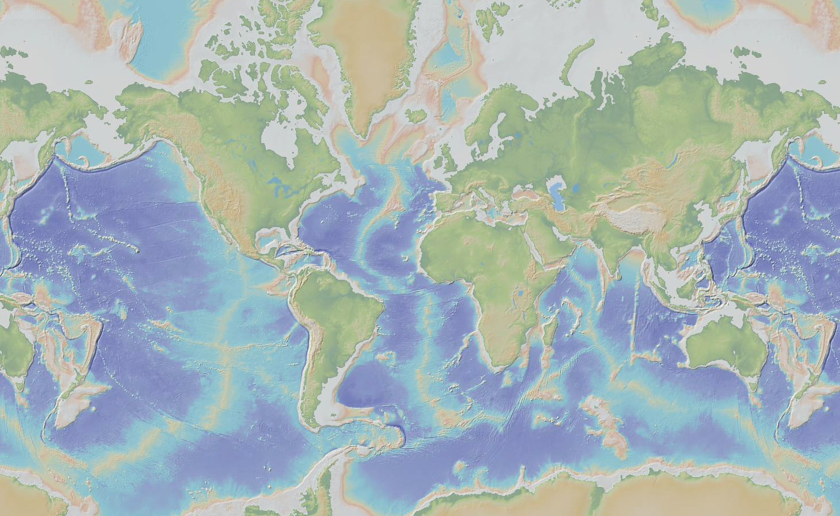
Deep-rooted plumes may sample Hadean refractory domains and the core
27 deep-rooted plumes, mostly OIBs
(French & Romanowicz, 2015, Nature)
Iceland
Azores
Canary
Hawaii
Cape Verde
Hoggar
Canary
Afar
Marshall
Micronesia
(Caroline)
Samoa
Galapagos
Ascension
Cameroon
Comoros
Marquesas
Tahiti-Soc
St Helena
Reunion
Macdonald
Seamount
Pitcairn
Easter
San Felix
Walwis R.
Juan Fernandez
Tristan
Gough
Crozet
Kerguelen
Loisville
Herd
Bouvet

Slide 27
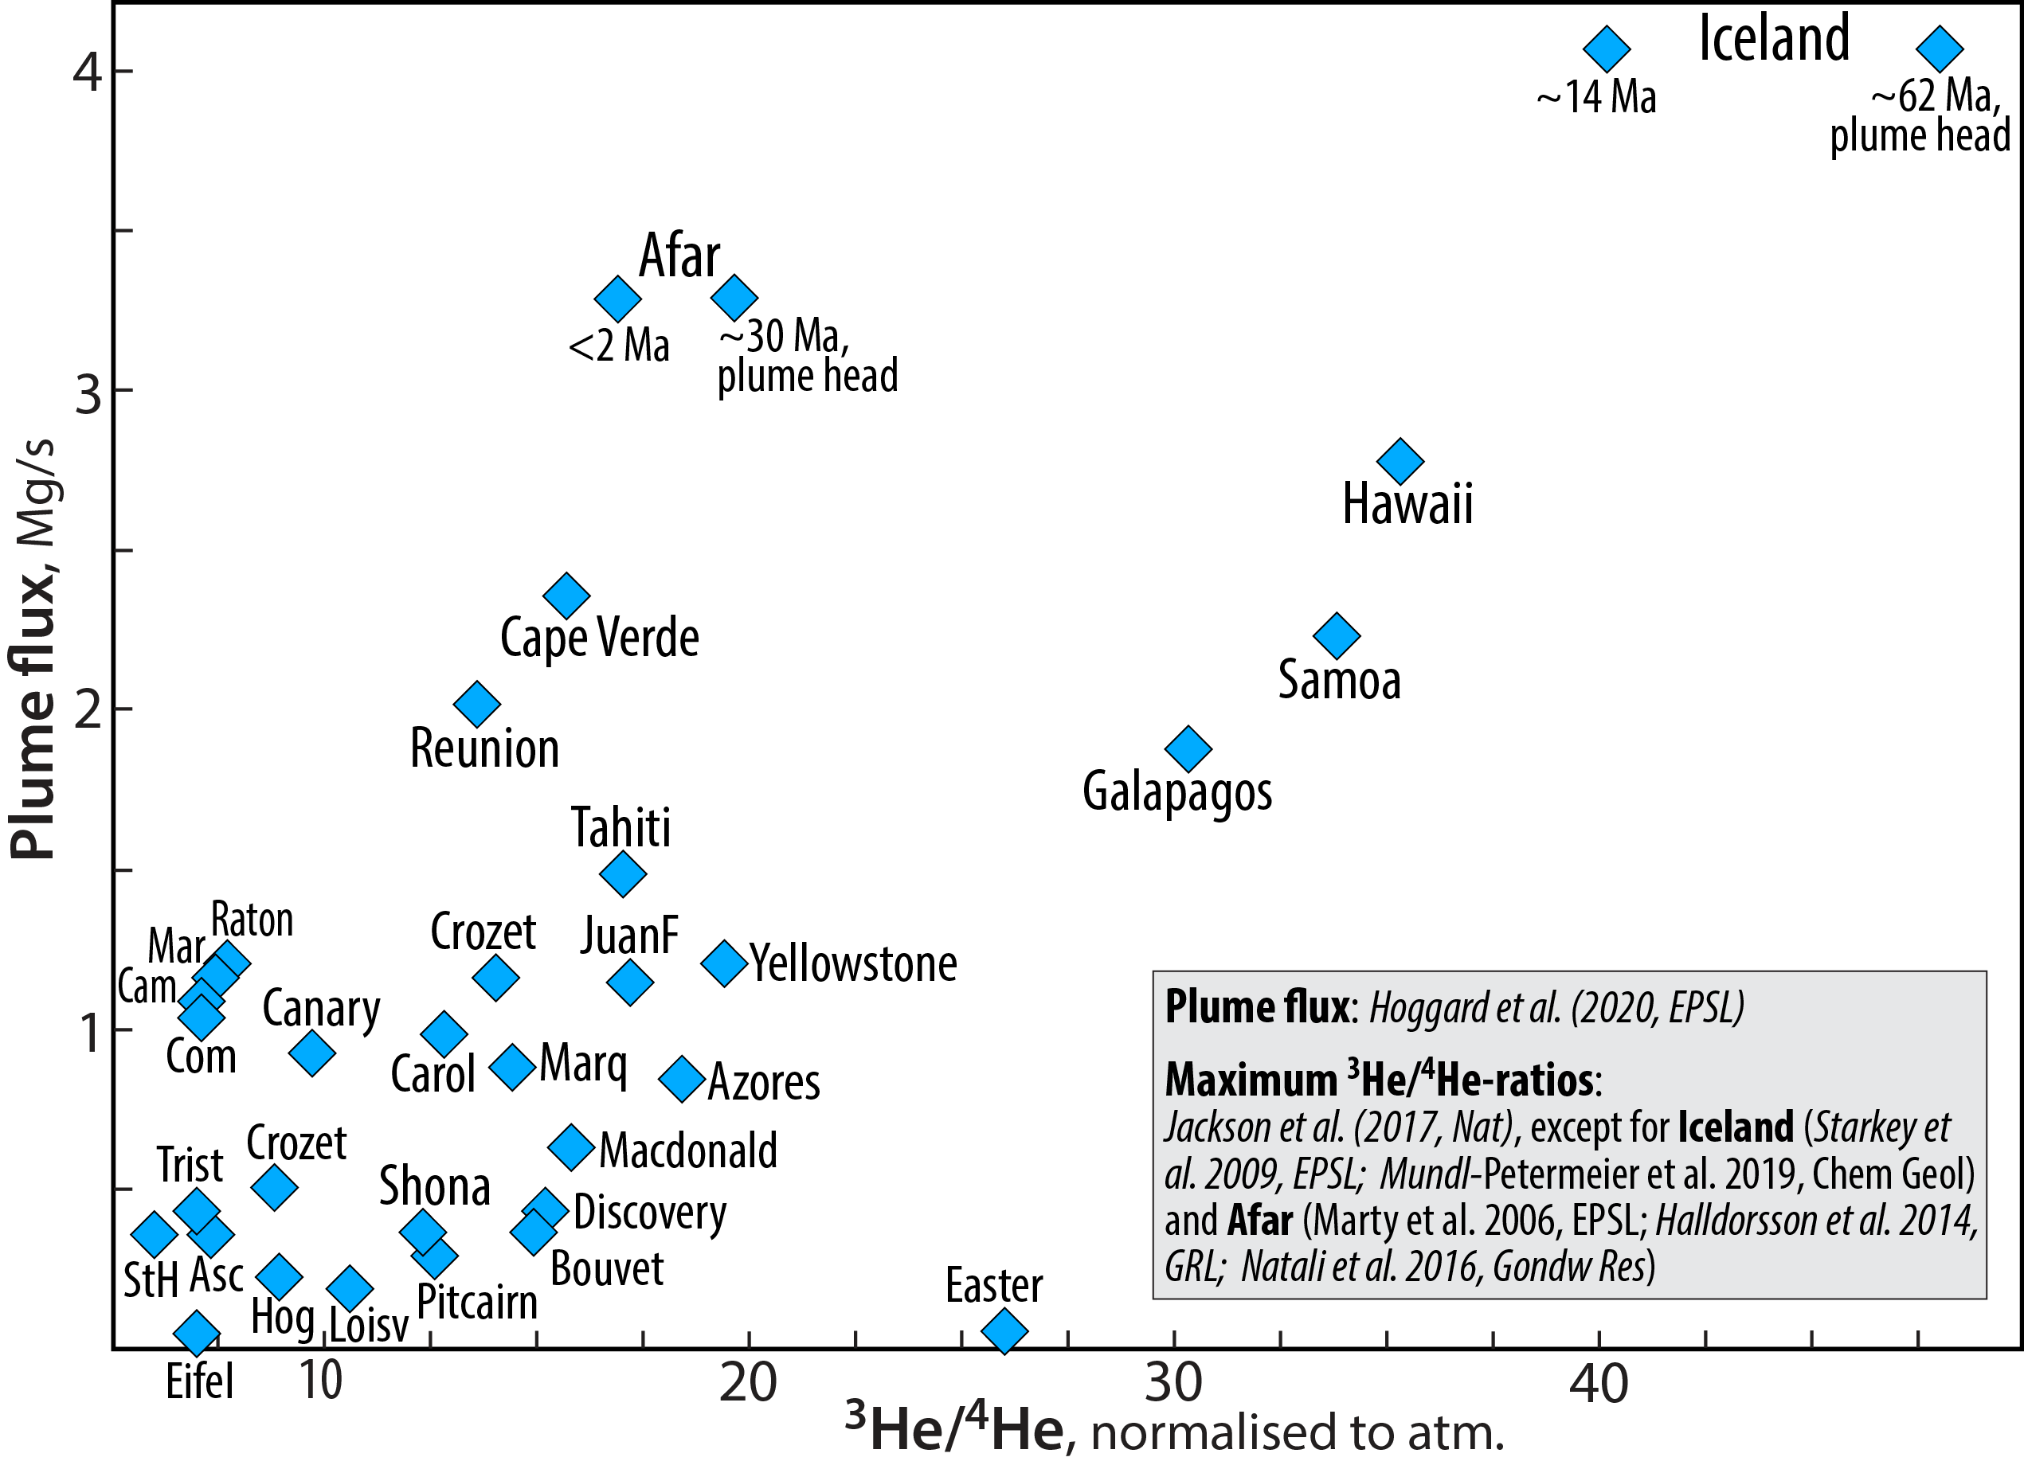

Slide 29
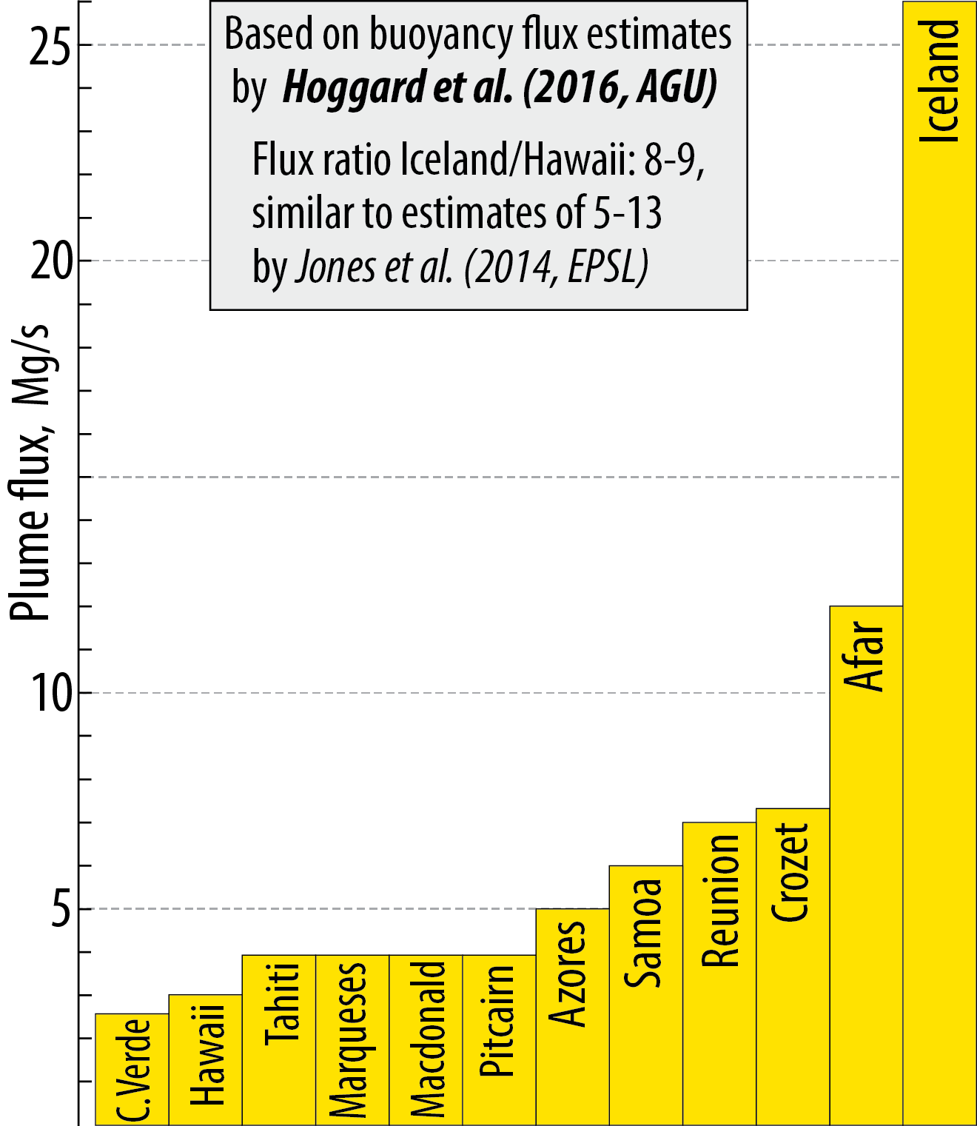
Buoyancy flux for
12 major plumes

Slide 30
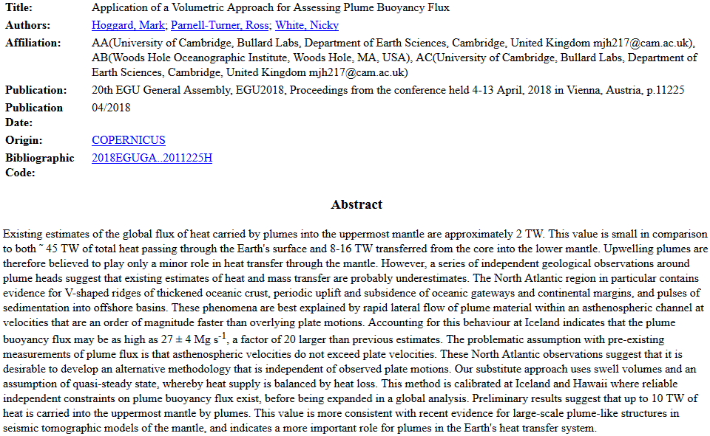

Slide 31
He (and Ne) isotope systematics
- resist resetting by recycling
- can potentially track the mantle evolution more rigorously than
Sr-Nd-Hf-Pb-isotope systematics:
parent and daughter isotopes follow recycled crust back in the mantle
He (smallest noble gas atom)
³He is primordial, ⁴He radiogenic from U and Th-decay chains
Th and U decay chains produce ⁴He (α-part.)
²³²Th → ²⁰⁸Pb
²³⁵U → ²⁰⁷Pb
²³⁸U → ²⁰⁶Pb
atm MORB Jupiter
⁴He/³He 719000 90000 6000
³He/⁴He, R/R_{atm} 1 8 120
- Continuously lost to space from the atmosphere
Incompatible during mantle melting
High diffusion rate: efficiently (re)moved (by ”degassing”)
He with high ³He/⁴He ratio may be stored in
- the outer core (and might diffuse into He-depleted domains in the lower mantle)
- strongly melt-depleted bridgmanitic mantle domains with low U, Th and high viscosity

Slide 32
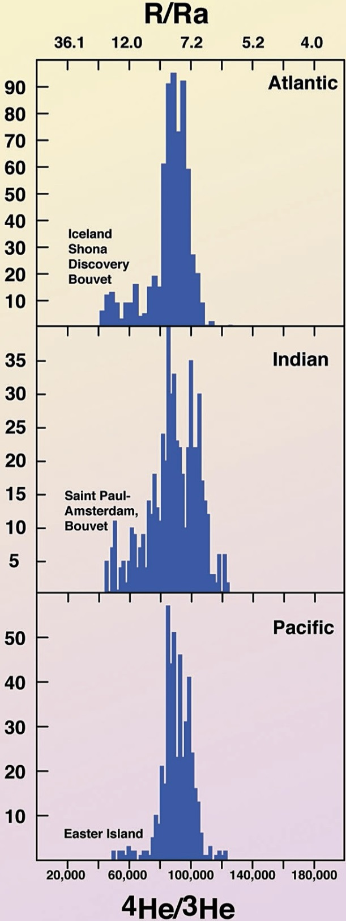
³He/⁴He, R/Ra
Moreira (2013, Geochem. Perspectives)

Slide 33
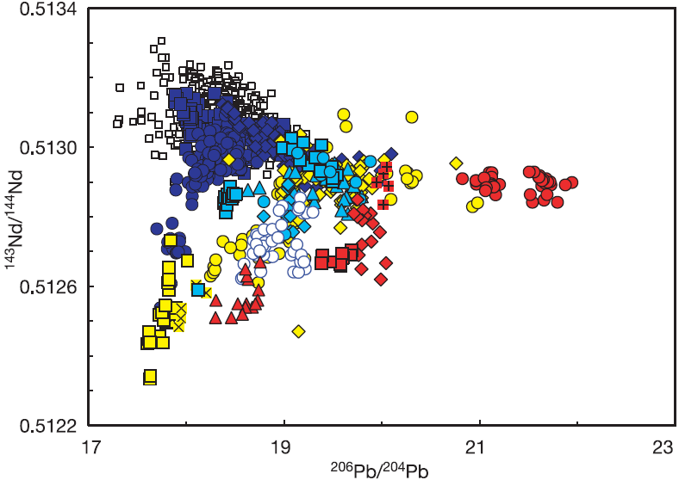
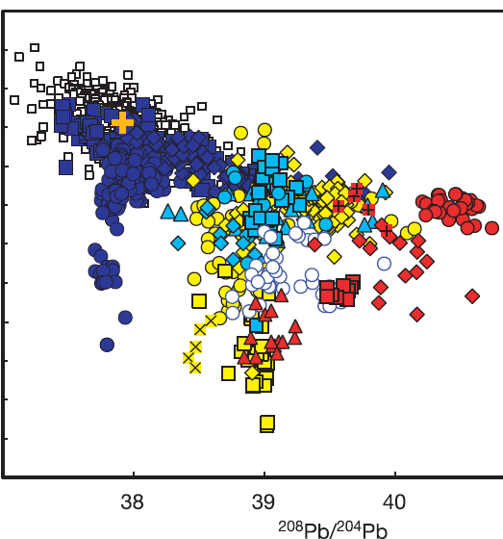
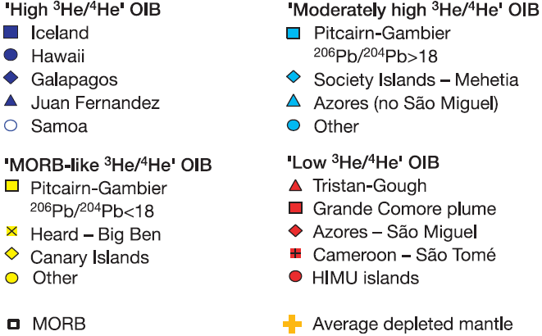
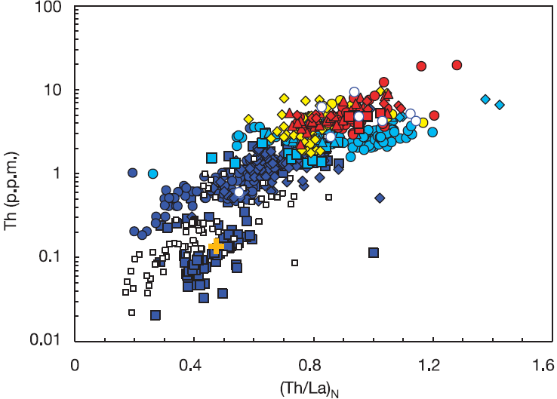
Strong evidence that the primordial-like He (and Ne) source material is refractory
Increasing
³He/⁴He
Increasing
³He/⁴He
>15 R/Ra
9-15
< 7
8 ±1
Similar correlation with incompatible trace element
concentrations and ratios
Class & Goldstein
(2005, Nature)
Increasing
³He/⁴He

Slide 34
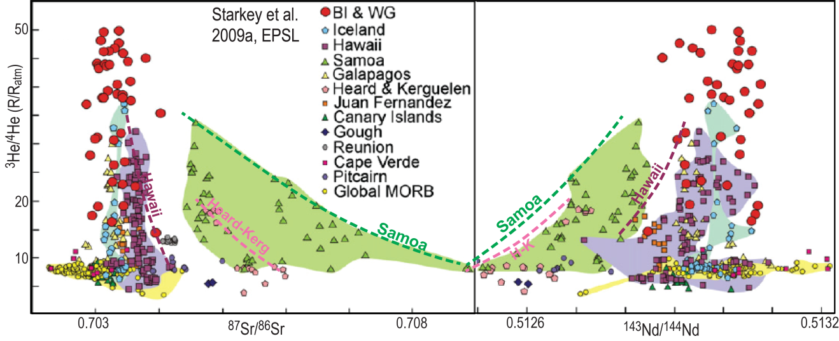
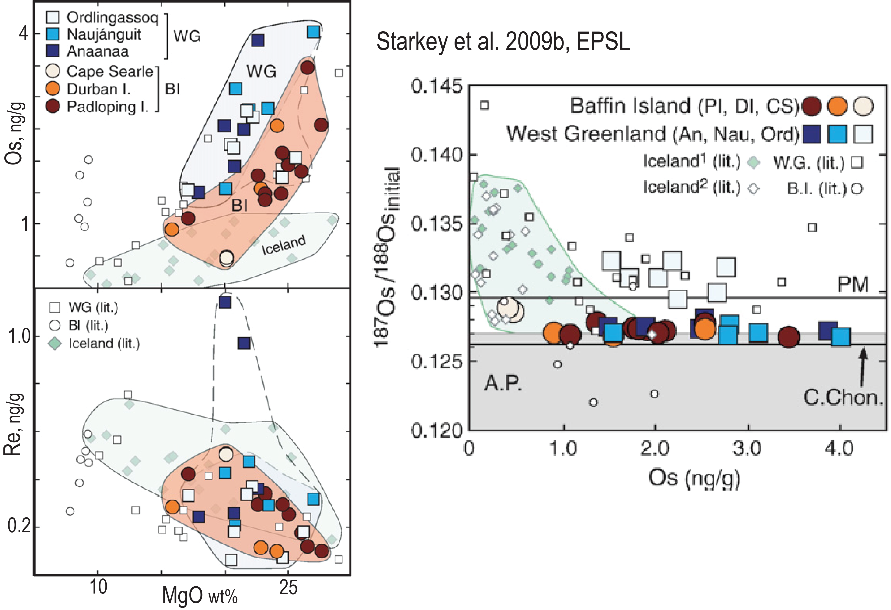
³He/⁴He versus ⁸⁷Sr/⁸⁶Sr and ¹⁴³Nd/¹⁴⁴Nd
Maximum He-values of the Samoa, Hawaii
and Heard-Kerguelen trends are stippled
positive ³He/⁴He - ¹⁴³Nd/¹⁴⁴Nd correlation
negative ³He/⁴He - ⁸⁷Sr/⁸⁶Sr correlation
Contamination will invariably change
compositions to lower ³He/⁴He ratios
Iceland plume head with extremely high
³He/⁴He ratios (Baffin Island, West Greenland):
high Os
low Re and ¹⁸⁷Os/¹⁸⁸Os ratios

Slide 35
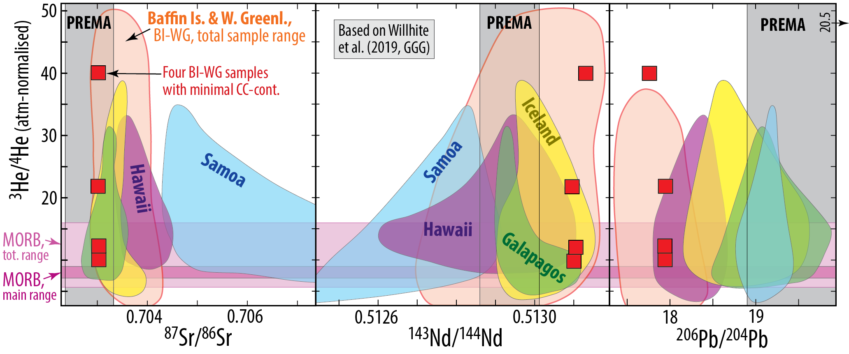
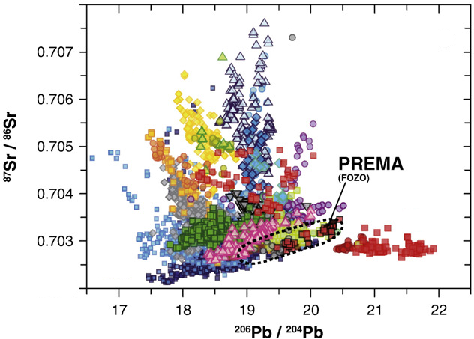
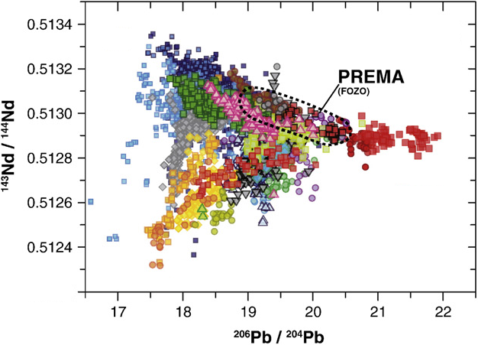
.703
.51312
17.75
EM2
DM
Samoa
.51312
EM1
HIMU
Pitcairn-
Walvis R.
.7030
EM2
HIMU
EM1
17.75
17.75

Slide 36
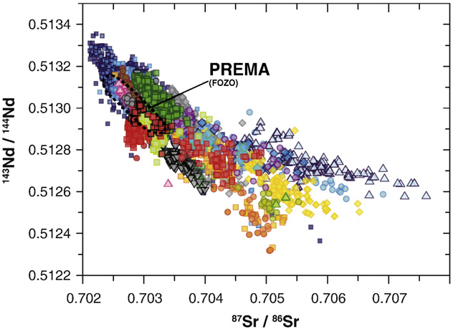
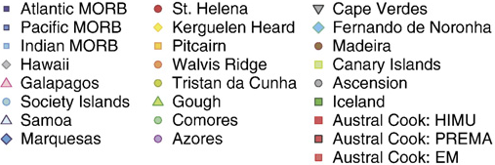
Identifying mantle components, OIBs
Stracke (2012,
Chem. Geol.)
DM
HIMU
Samoa
EM2
Pitcairn-
Walvis R.
EM1
EM2
DM
Samoa
EM1
HIMU
Pitcairn-
Walvis R.
EM2
DM
HIMU
EM1

Slide 37
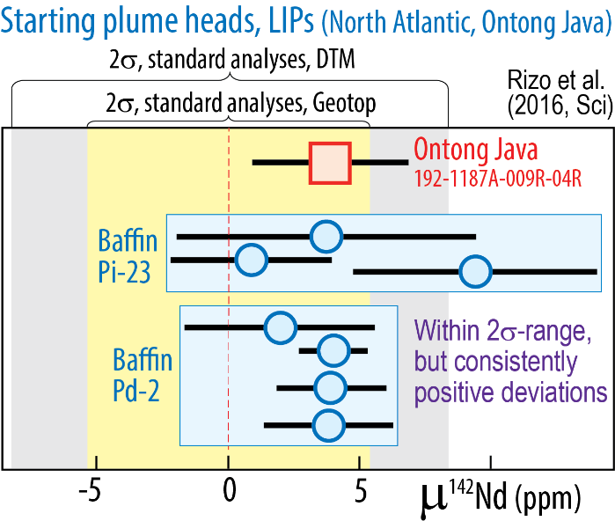

Could the primordial-like He and Ne isotope ratios result from core contamination?
Unlikely: - Although tiny additions of core metal to plume roots explain clear W- and weak Xe-isotopic signals, they are
probably insufficient to generate the primordial-like He-Ne isotopic signals
- High ³He/⁴He is generally associated with refractory mantle sources (PREMA-FOZO)
- Parts of the refractory sources seem to have formed in the Hadean: Baffin Island, Reunion, Samoa, Hawaii
Short-lived Sm-Nd-system
¹⁴⁶Sm→¹⁴²Nd t_{h}: 103 My, "live" for about 500 My.
The Nd-daughter partitions to melt more than Sm.
Bm-residues/cumulates: high Sm/Nd ratio, high μ¹⁴²Nd
μ¹⁴²Nd = (^{142/144}Nd_{sample} / ^{142/144}Nd_{standard} − 1) *10⁶ (ppm)
ε¹⁴³Nd = (^{143/144}Nd_{sample} / ^{143/144}Nd_{standard} − 1) *10⁴ (pp 10⁴)
Peters et al. (2018, Nature)
Reunion basalts
Positive correlation
³He/⁴He (plume flux)
versus μ¹⁴²Nd

Slide 38
Horan et al.
(2018, EPSL)
5
μ¹⁴²Nd, ppm
0
−5
Samoa
Ofu
04-14
10
20
30
−15
−5
0
5
³He/⁴He, R/R_{atm}
μ¹⁸²W
Residues after melt extraction
at: 4.57 (SS age), 4.50 and 4.42 Ga
20
Original mantle reservoir:
μ¹⁴²Nd = ε¹⁴³Nd = 0
¹⁴⁷Sm/¹⁴⁴Nd: 0.196
Small black symbols on
residue trends corresponds
to ¹⁴⁷Sm/¹⁴⁴Nd:
0.200, 0.204 and 0.208
4.57 Ga
10
4.50 Ga
Loihi
02-02
5
4.42 Ga
Hawaii
μ¹⁴²Nd, ppm
0
Enriched mantle
−5
−5
0
5
−10
μ¹⁴³Nd
μ¹⁴²Nd, ppm
−400
0
400
−4
0
4
ε¹⁴³Nd

Slide 39

Primary kimberlites
Negative correlation: μ¹⁴²Nd- μ¹⁸²W ? No clear correlation with W-concentration
OIBs
Are W-conc. and μ¹⁸²W correlated ??
(Fig. S2, Yoshino et al., 2020, EPSL)

Slide 40
W-isotopic evidence for core contaminatination of deep-rooted plumes (via ULVZs?)
¹⁸²Hf → ¹⁸²W, T_{h}: 9 My
- W is siderophile (partitions into the core)
- Hf is lithophile (goes to the MO)
→ extremely low ¹⁸²W/¹⁸⁴W in the core
Mundl et al. (2017, Science)
Rizo et al. (2019, GPL)
Mundl-Petermeier et al. (2019, Chem.G.)
μ(¹⁸²W) = (^{182/184}W_{sample} / ^{182/184}W_{standard} − 1) * 10⁶
Iceland plume head, Paleocene, 62 Ma
W. Greenland - Baffin Island
μ (¹⁸²W)
Iceland, Ísafjörður
Mid Miocene, 12-15 Ma
increased plume flux
All OIBs have
negative anomalies
³He/⁴He, R/R_{atm}
Mundl-Petermeier et al. (2020, GCA)

Slide 41
Ne-isotope composition, atmosphere, Sun, OIB, MORB White, 2015, Chem. Geol.
The Rochambeau rift in N. Lau backarc
basin is very close to the Samoa plume
(e.g. Peto, 2013, EPSL)
Loihi
Iceland
Kerguelen
2πD43
meteorites
MAR-GSC
IRs
Mass fractionation, heavy atmospheric Ne
Rochambeau
Galapagos
Samoa
Reunion
heavy Ne, mass fr.

Slide 42
Weak Xe-isotopic evidence for core contaminatination (via ULVZs?) of deep-rooted plumes
Icelandic basalts, in particular, have elevated ¹²⁹Xe/¹³⁶Xe
Practical T_{h} My lifetime, 5 t_{h}
¹²⁹I → ¹²⁹Xe, 16 80
²⁴⁴Pu → ¹³⁶Xe, 81 405
(fission decay)
¹²⁹I: extinct before Earth-Theia collision and proto-lunar disk
- I: siderophile at high p - partitioning to the core
- Pu: lithophile - to the MO
→ elevated ¹²⁹Xe/¹³⁶Xe in the core
White (2015, Chem. Geol.)
Note the effect of air
contamination for Xe
(mixing line between MORB-
source and atmosphere)
MORB-source
MORB-array
Low (air-like) ¹²⁹Xe/¹³⁶Xe and
¹²⁹Xe/¹³⁶Xe in OIB relative to MORB:
subduction of atmospheric Xe (?)
Iceland and Hawaii (Loihi):
- slightly elevated ¹²⁹Xe/¹³⁶Xe
- core signal (?)
Air

Slide 43

MORB-OIB relations = depleted peridotite - ROC relations
Loss of Xe from the deep mantle (MO, bm) to the proto-atmosphere during
the first 80-405 My of ¹²⁹I and ²⁴⁴Pu-decay (Shcheka & Keppler 2012, Nat.)
→ elevated ¹²⁹Xe/¹³⁰Xe and ¹³⁶Xe/¹³⁰Xe ratios in the depleted mantle,
incl. the MORB-source
Can Xe in the proto-atmospheres of Earth and Theia partly survive the
proto-lunar disk (synestia) stage ??
ROC with atmospheric Xe
→ low ¹²⁹Xe/¹³⁰Xe and ¹³⁶Xe/¹³⁰Xe ratios in OIB
Solubility of noble gases in bridgmanite
Low solubility of Xe in bridgmanite →
Degassing during MO-solidification, followed by
¹²⁹Xe ingrowth and late Xe accretion/implantation
Xe can be recycled into the mantle by subduction
Refractory deep mantle sources might have lost I and Pu by melt-extraction and degassing within the first 80 Ma ?

Slide 44
Mineral-melt partitioning: Brice curves for davemaoite (dm) and bridgmanite (bm)
Sc
Zr
Mn
D^{bm/melt}
Note the high D_{Hf} (>1) and low D_{Lu} (<0.8), and D_{W} (<0.2)
Hf
Sn
Fe
Lu
Ni
Mg,
Co
Ga
Er
Cr
Ho,Y
W, hexavalent
Although D_{W} is unknown,
its r_{cation} is plotted on the
quadrovalent curve
Dy
References for dm:
Walter et al. (2004, GCA)
Liebske et al. (2005, Lithos)
Corgne et al. (2005, GCA)
Ca
Tb
Gd
D^{bm/melt}
Li
Na
Sm
Monovalent
U
Divalent
Trivalent
Nd
K
Quadrovalent
Pr
Eu
Sr
Rb
Ce
Pb
Th
La
Cs
Ionic radius

Slide 45
Mineral-melt partitioning: Brice curves for davemaoite (dm) and bridgmanite (bm)
Ionic radius
Gd
Sm
U:14.9
Y
Nd
D^{dm/melt}
Note the very high D_{REE} (8-20), D_{U} (15), and D_{Th} (13)
Th:13.1
U
Th
La
Ca
Eu
Zr
Sr
D^{dm/melt}
Hf
Sc
Pb
References for dm:
Corgne et al. (2005, GCA)
Sn
Mn
Monovalent
Fe
K
Co
Na
Rb
Mg
Divalent
Trivalent
Ga
Quadrovalent
Cr
Ni
Cs
Li
Ba

Slide 46
Mineral-melt partitioning: Brice curves for davemaoite (dm) and bridgmanite (bm)
Sc
Zr
Mn
D^{bm/melt}
Note the high D_{Hf} (>1) and low D_{Lu} (<0.8), and D_{W} (<0.2)
Hf
Sn
Fe
Lu
Ni
Mg,
Co
Ga
Er
Cr
Ho,Y
W, hexavalent
Although D_{W} is unknown,
its r_{cation} is plotted on the
quadrovalent curve
Dy
References for dm:
Walter et al. (2004, GCA)
Liebske et al. (2005, Lithos)
Corgne et al. (2005, GCA)
Ca
Tb
Gd
D^{bm/melt}
Li
Na
Sm
Monovalent
U
Divalent
Trivalent
Nd
K
Quadrovalent
Pr
Eu
Sr
Rb
Ce
Pb
Th
La
Cs
Ionic radius

Slide 47
Mineral-melt partitioning: Brice curves for davemaoite (dm) and bridgmanite (bm)
Ionic radius
Gd
Sm
U:14.9
Y
Nd
D^{dm/melt}
Note the very high D_{REE} (8-20), D_{U} (15), and D_{Th} (13)
Th:13.1
U
Th
La
Ca
Eu
Zr
Sr
D^{dm/melt}
Hf
Sc
Pb
References for dm:
Corgne et al. (2005, GCA)
Sn
Mn
Monovalent
Fe
K
Co
Na
Rb
Mg
Divalent
Trivalent
Ga
Quadrovalent
Cr
Ni
Cs
Li
Ba

Slide 48


Magma ocean crystallisation
Evolution of viscous BEAMS
Refractory & viscous ERD convectively aggregated to BEAMS
(e.g. Manga, 1996, GRL)
Modified, mainly from:
Torsvik et al. (2016, Can. J. Earth Sci.)
Ballmer et al. (2017, Nature Geosci.)
Trønnes et al. (2014, Tectonophys.)

Slide 49




Diffusion length scales for He and Ne in bm
Sufficient for recharging over:
- 19 mm length scale at liquidus in 10 hr
- 10 km length scale at liquidus in 300 Ma
- 10 km length scale at solidus in 500 Ma
AND: Insufficient for resetting to convective mantle ³He/⁴He composition over:
- 10 km length scale at 200 K above the present ambient mantle geotherm in 4 Gy

Slide 50


Modified, mainly from:
Torsvik et al. (2016, Can. J. Earth Sci.)
Ballmer et al. (2017, Nature Geosci.)
Trønnes et al. (2014, Tectonophys.)

Slide 51


Slide 52


- BEAMS are positioned to avoid ’’interference’’ with
the slabs mapped by van der Meer et al. (2010, NG, 2019, Tectonoph)
- Viscous and refractory bridgmanitic material is strongly
indicated from a petrological point of view
early MO-crystallisation during core-MO and core-BMO
chemical exchange (CEED Ann. Report 2020, SAB-seminar,
2021). (B)MO: (basal) magma ocean
- Early refractory domains are likely to be
convectively aggregated into BEAMS
(Manga 1996a,b, GRL; Becker et al. 1999, EPSL;
Ballmer et al. 2017, NG)

