Slide 1
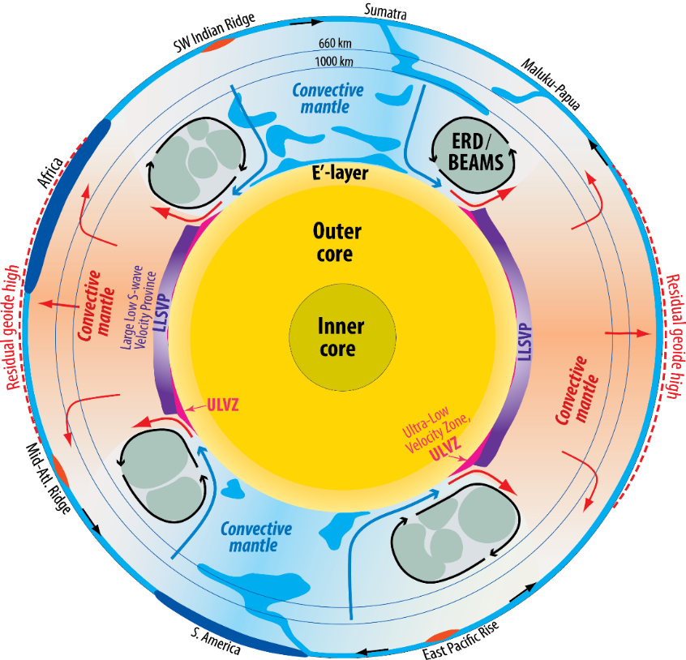
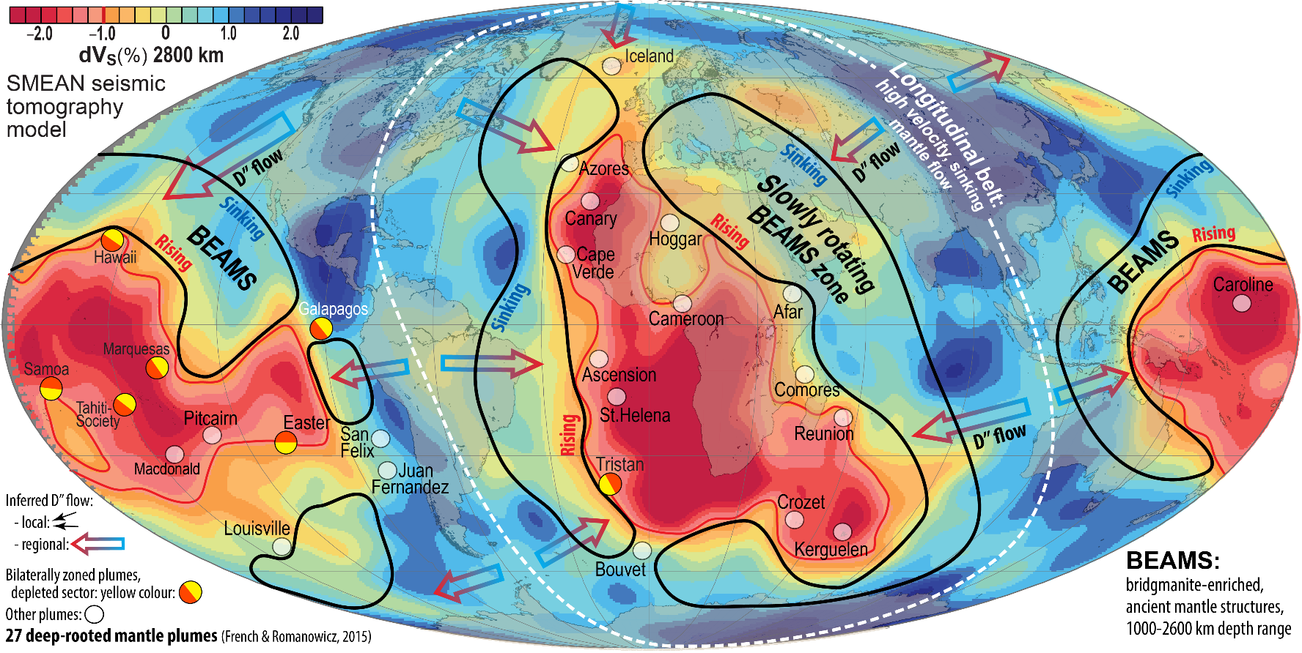
Structure, materials and dynamics of the lower mantle
(and chemical exchange between the protocore and magma ocean)
Equatorial section
Reidar G. Trønnes
Centre for Earth Evolution and Dynamics (CEED) and Natural History Museum, Univ. of Oslo
I will review:
- the inferred mantle structure and compositional domains
- the origin, evolution and dynamics of these domains
including the key issue of core-BMO* chemical exchange
- geochemical evidence for the nature of ERDs* and LLSVPs*
*BMO: Basal magma ocean; ERD: Early refractory domains;
LLSVP: Large low shear-wave velocity province

Slide 2

Inferred mantle domains and their compositions
Equatorial section
Convecting mantle, 60-90 vol% of mantle
Lithologies (mostly the input by subduction):
- 92-95 vol% depleted/refractory peridotite
- 5-8 vol% recycled oceanic crust (ROC), incl. some sediments
- minor amounts of detached sub-continental lithospheric
mantle (SCLM) and lower continental crust (LCC)
Large low shear-wave velocity provinces, LLSVPs
- Located antipodally under the Pacific and Africa
- Overlain by residual geoid highs, indicating rising flow above LLSVPs
- Probably stabilised by 200-400 km thick base layers with excess
density and/or viscosity ("thermochemical piles")
- About 1 vol% of the mantle (1.14 vol%, assuming 300 km thickness)
- Unconstrained composition, but most likely a combination of late-stage, dense
magma ocean cumulates, overlain by more unstable ROC-piles
Ultra-low velocity zones, ULVZs
- Thin (5-40 km) lenses, mainly confined to plume-roots along the LLSVP-margins
- Unknown composition, but most likely dense partial melts (metallic ?) in a silicate matrix
- No internal structure or gradient, so presumably convectively homogenised
Early refractory domains, ERD, bridgmanite-enriched ancient mantle structures, BEAMS, 10-40 vol% of mantle
- Neutrally buoyant in the 1500-2000 km depth range
- High viscosity, convectively aggregated into Mm-sized domains between columnar rising and sheet-like descending flow of convective mantle
- ERDs: inescapable outcome of early magma ocean (MO) and later basal magma ocean (BMO) crystallisation and remelting above the BMO
- Geochemical evidence for plume entrainment of refractory materials with positive ε¹⁴²Nd and primordial-like He and Ne

Slide 3

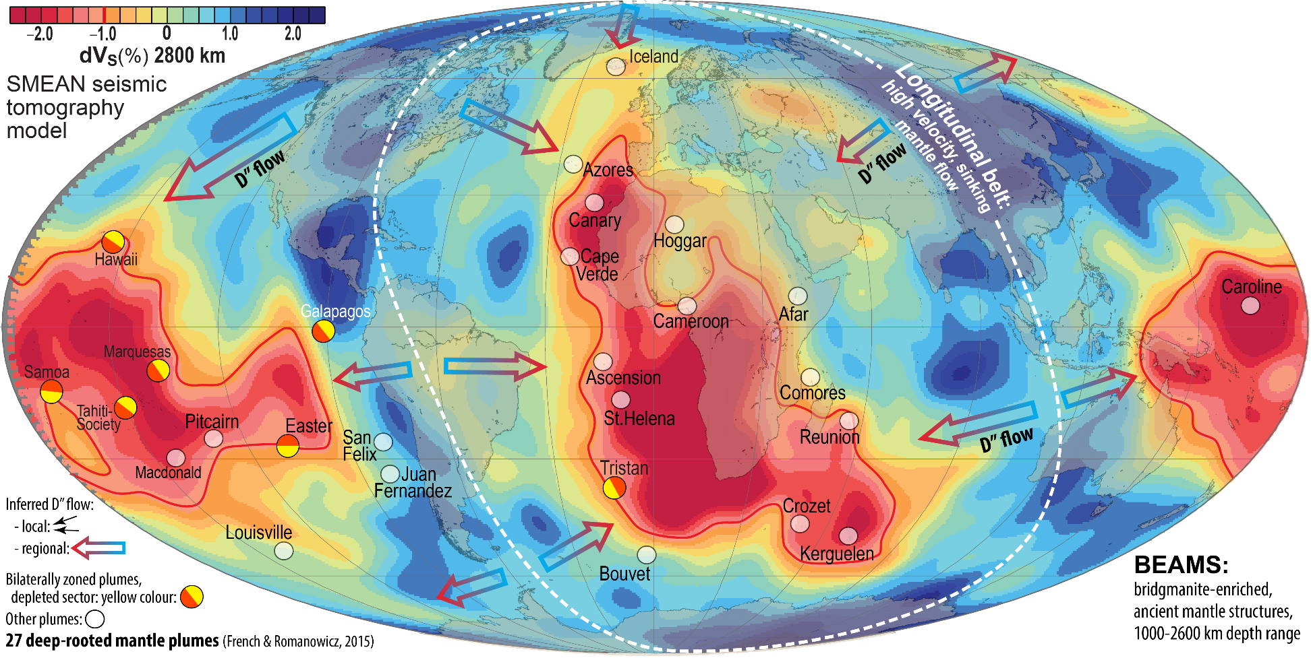
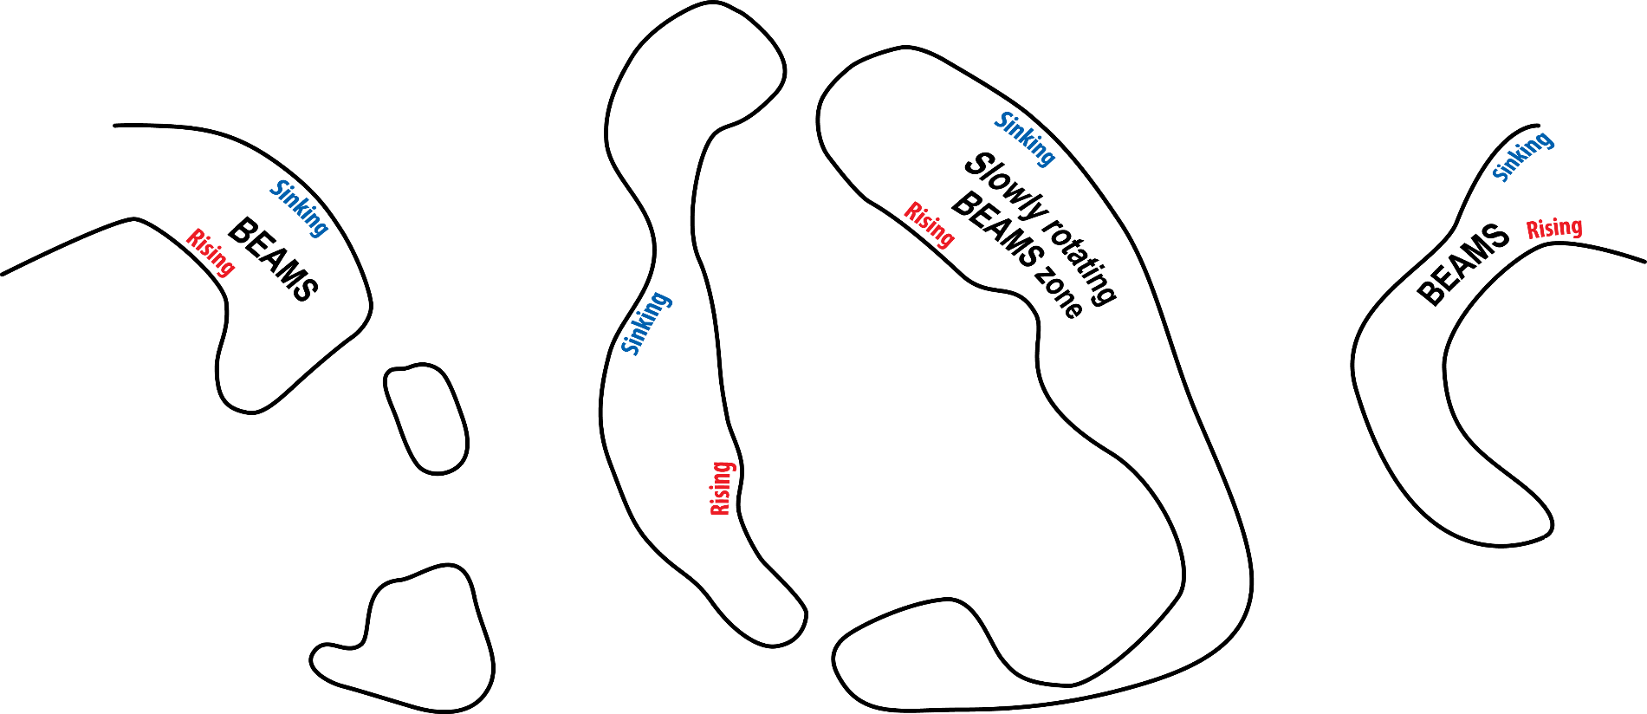
New insights on the importance of
core-BMO chemical exchange
Equatorial section
Lower mantle
Strong petrological evidence and tenuous seismic evidence for early refractory domains (ERD), likely organised in bridgmanite-enriched ancient mantle structures (BEAMS, Ballmer et al. 2017, Nat. Geosci.)
Outermost core
E'-layer: low-V_{P}, low-ρ (e.g. Brodholt & Badro, 2017, GRL)

Slide 4
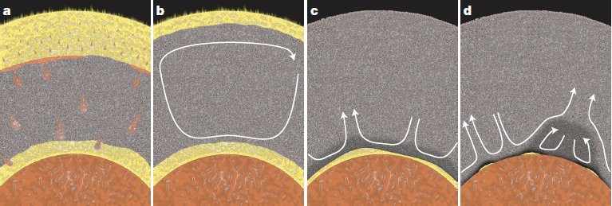
BMO-model of Labrosse et al. (2007, Nature)
The BMO was probably long-lived:
- might have lasted into the Proterozoic or Phanerozoic?
The ULVZs might be partially molten BMO-residues?

Slide 5
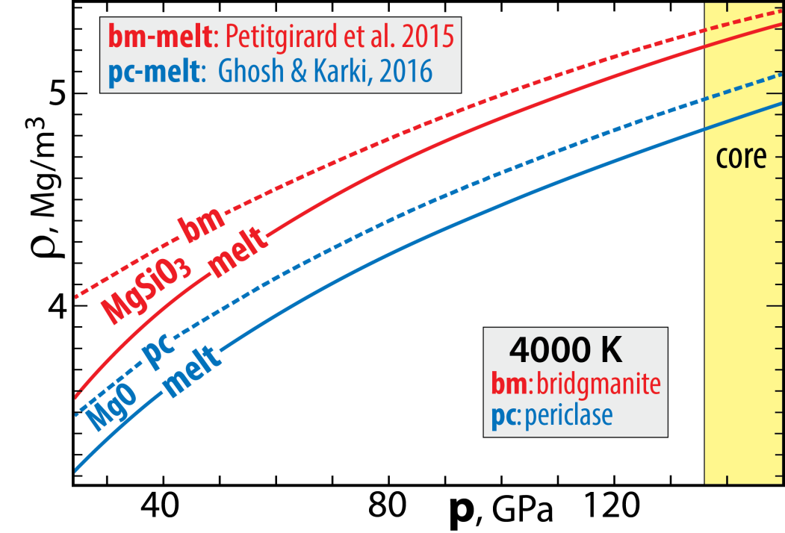
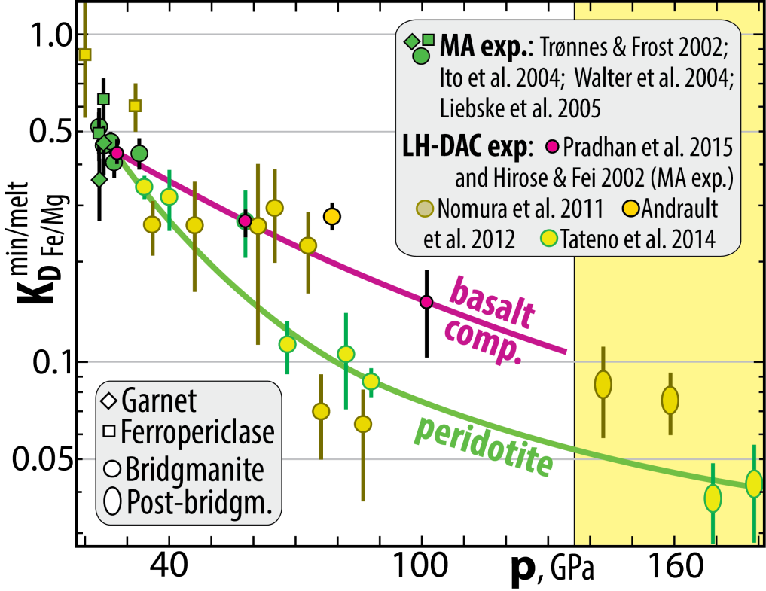
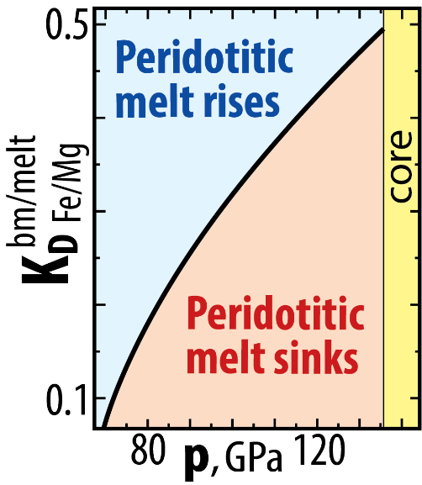
BMO:
results from solid-melt
density crossover at high p
However, no crossover for:
MgSiO₃ (bm, melt)
and MgO (fp, melt)
BUT:
Strong Fe/Mg-partitioning densifies peridotitic melts
bm/melt
Fe/Mg
K_{D} = (Fe/Mg)^{bm} / (Fe/Mg)^{melt}
Neutral buoyancy
at 73-80 GPa
~1800 km depth
Data compiled in:
Trønnes et al. (2019, Tectonophys.)

Slide 6
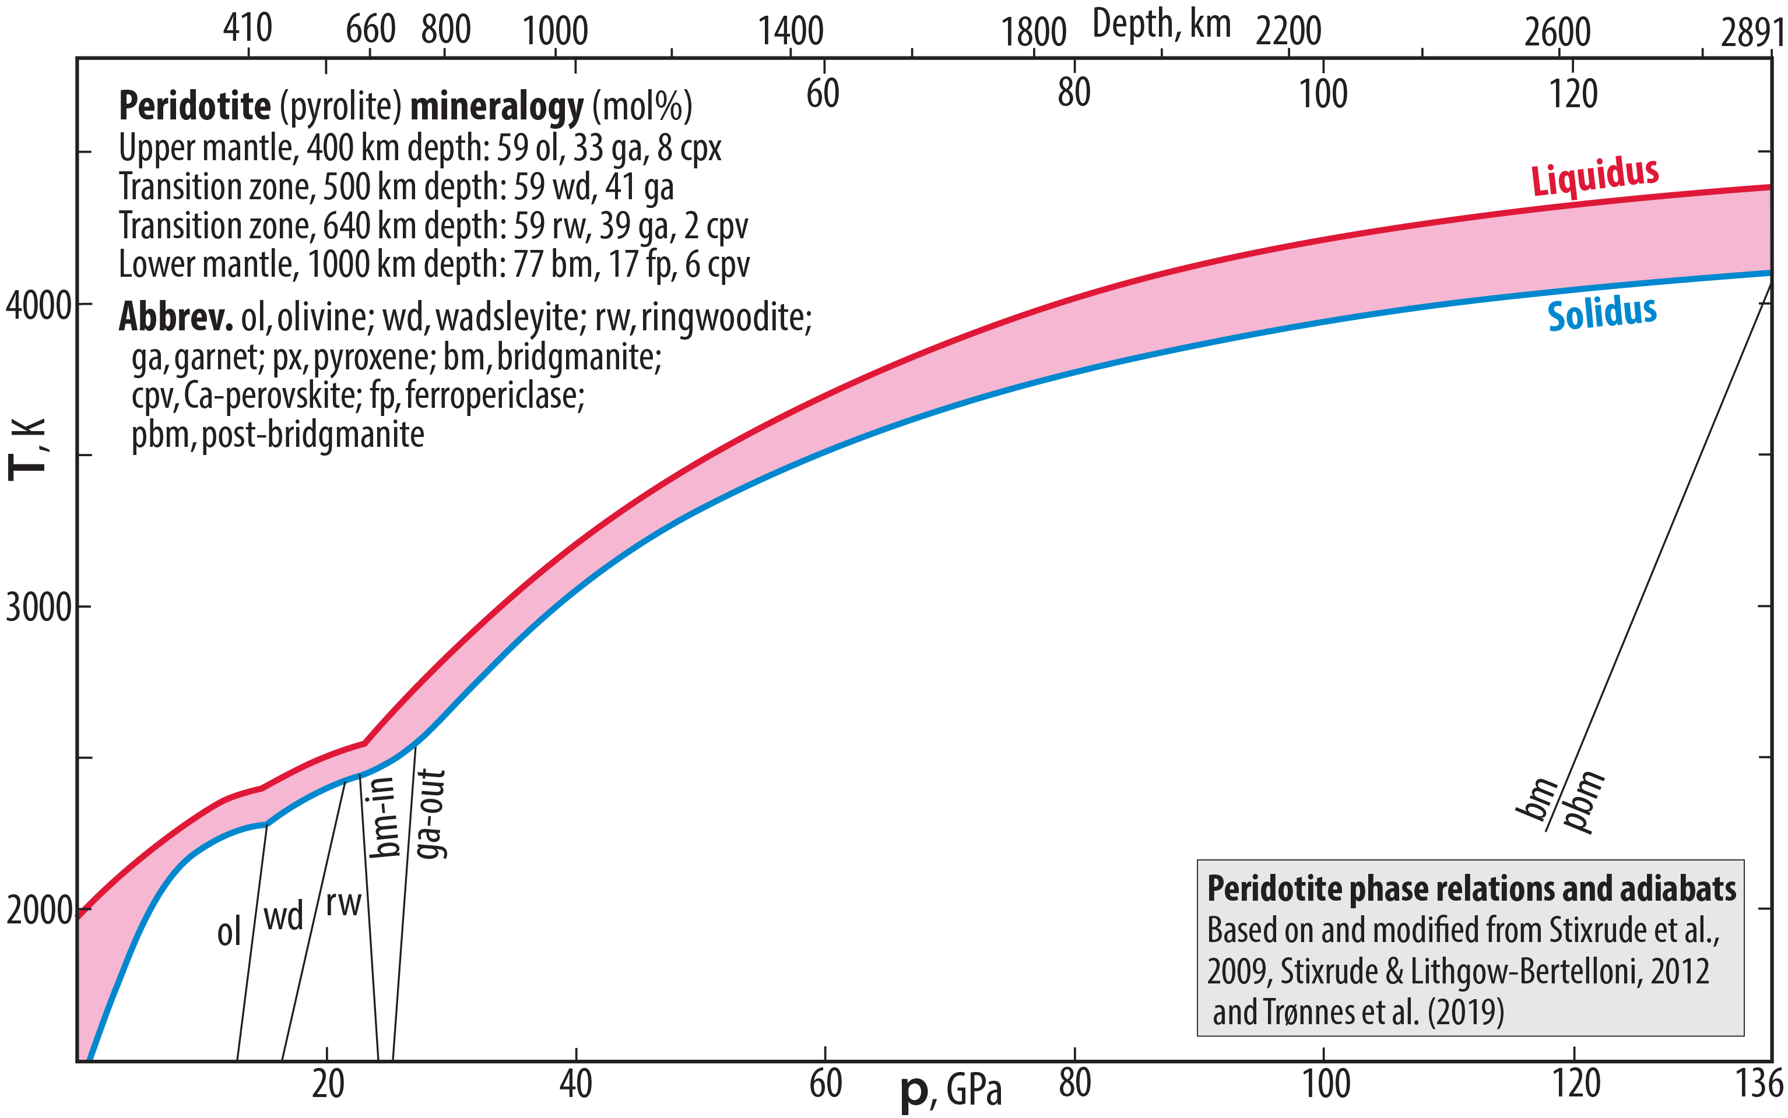
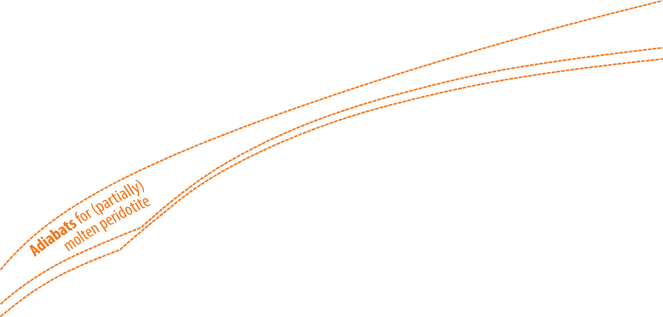

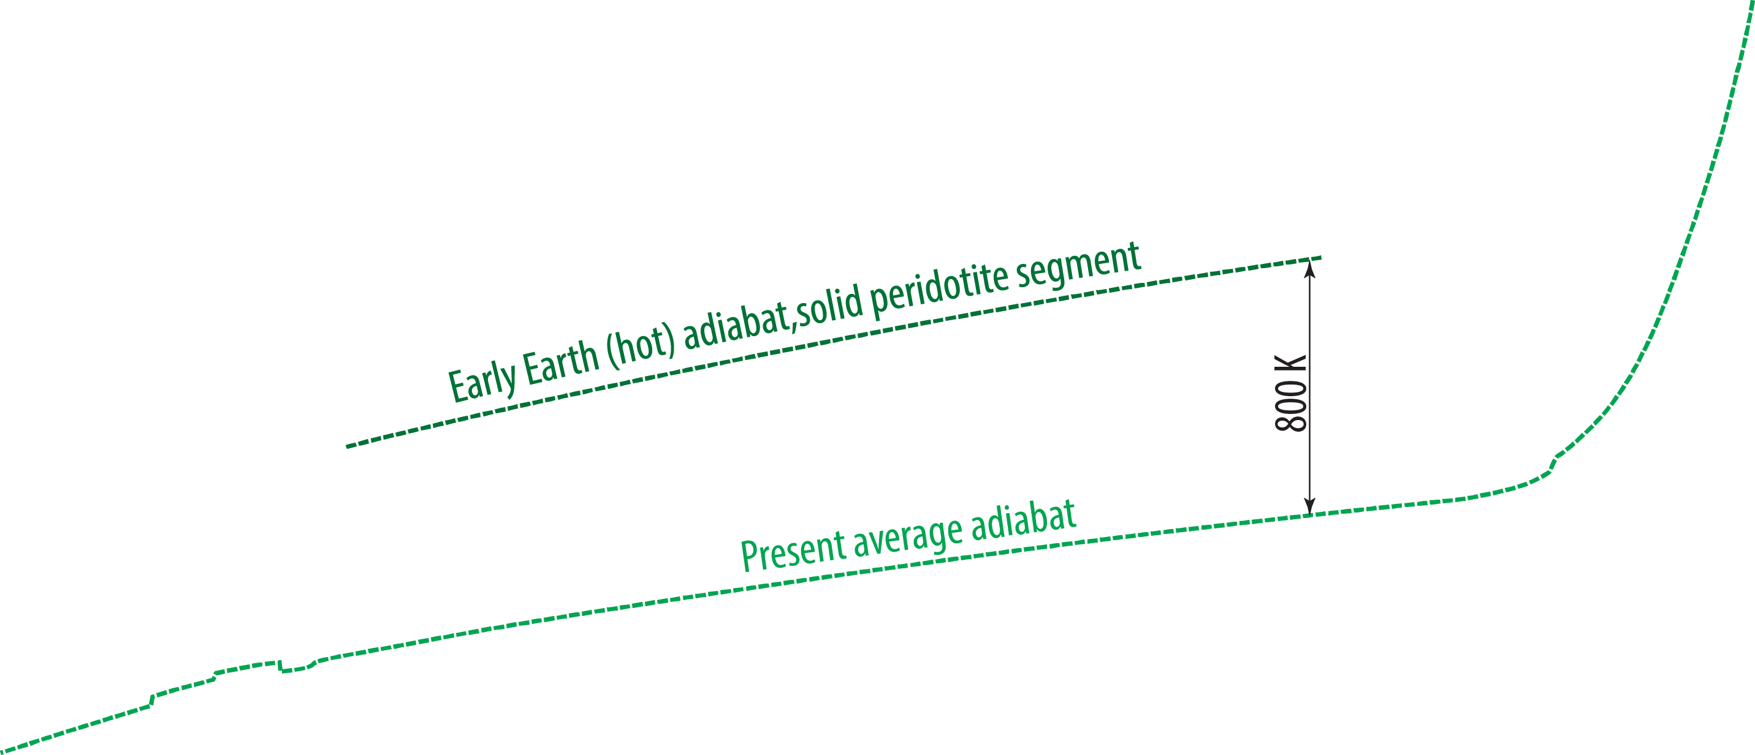
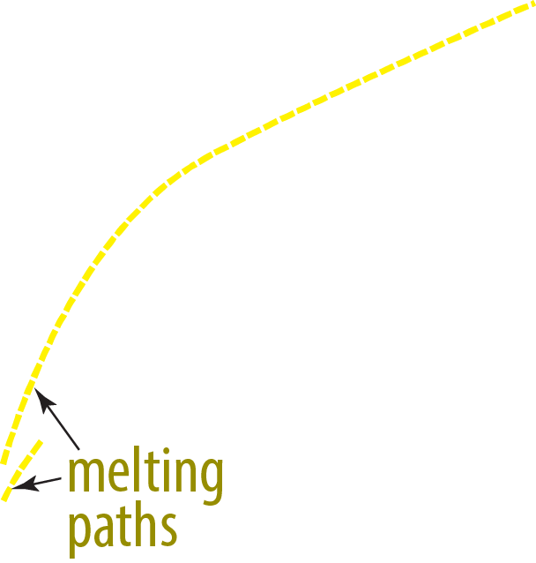

Melting relations and adiabats of peridotite:
Neutral buoyancy level(s) expressed by the initial adiabat-liquidus touching during MO cooling

Slide 7
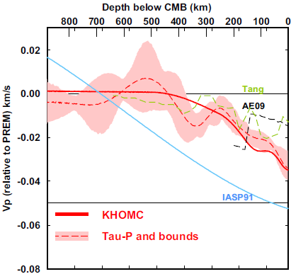
Outermost stagnant(?) E'-layer
gradationally stratified, low V_{Φ} - low ρ
0-445 km
below CMB
Feasible because:
- high thermal conductivity supresses convection
- low viscosity reduces viscous entrainment
and the E'-layer may stabilise the geodynamo
(Hernlund & McNamara, 2015, Treat. Geophys.)
0.4 %
Kaneshima (2018, PEPI)
Seismology
Lay & Young, 1990
Garnero et al., 1993
Helffrich & Kaneshima, 2010
Kaneshima & Helffrich, 2013
Kaneshima & Matsuzawa, 2015
Kaneshima, 2018
Irving et al., 2018: Adiabatic outermost core
Models
Buffet, 2010
Buffet & Seagle, 2010
Gubbins & Davies, 2013
Hernlund & McNamara, 2015
Brodholt & Badro, 2017
Trønnes et al., 2019

Slide 8
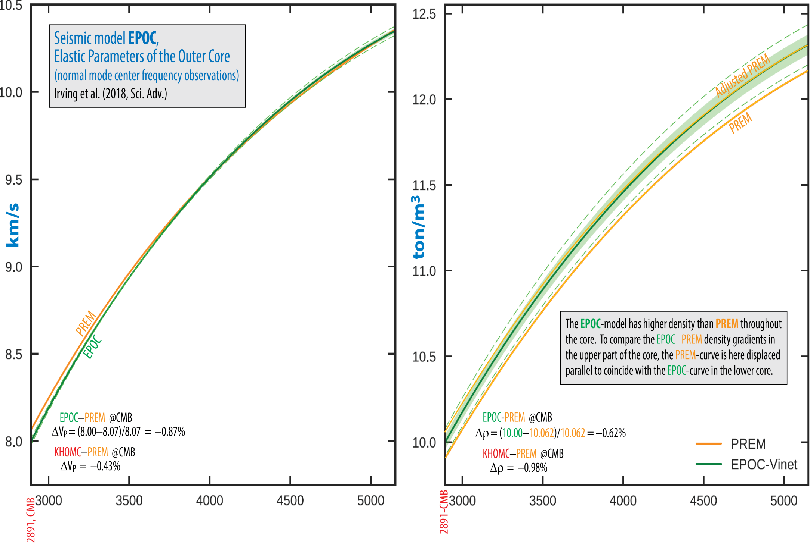

Slide 9
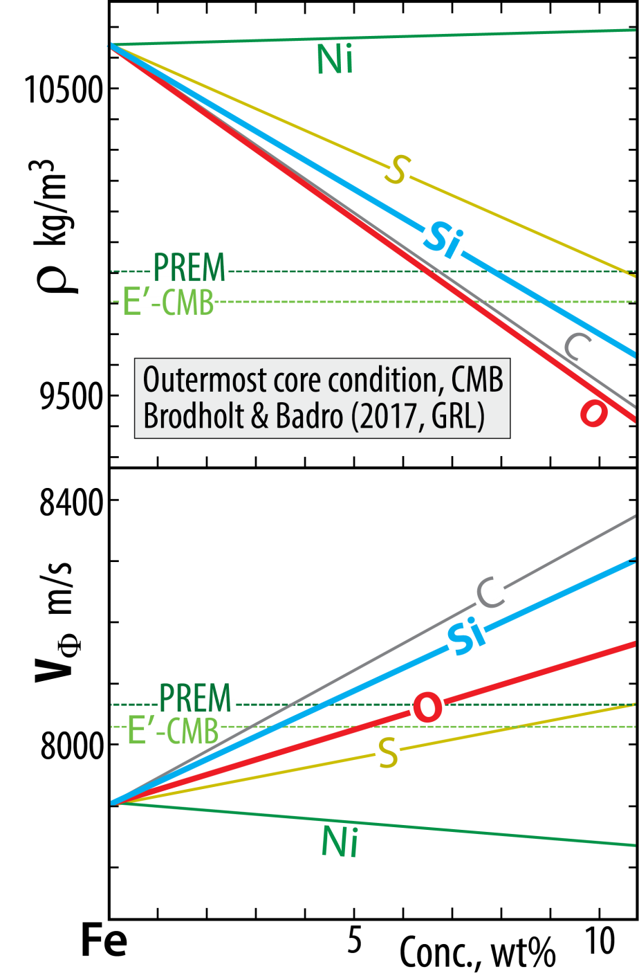
Outermost stagnant(?) E'-layer
gradationally stratified, low V_{Φ} - low ρ
The E'-layer chemical characteristics and material properties
- poses a long-standing conundrum, which may have been solved
by Brodholt & Badro (2017, GRL)
Each of the light element candidates (Si, O, S, C)
reduces ρ but increases V_{Φ} (or V_{P})
BUT:
O reduces ρ more and increases V_{Φ} less than Si.
Therefore:
E'-layer with elevated O and reduced Si relative to
the convecting core may solve the conundrum

Slide 10
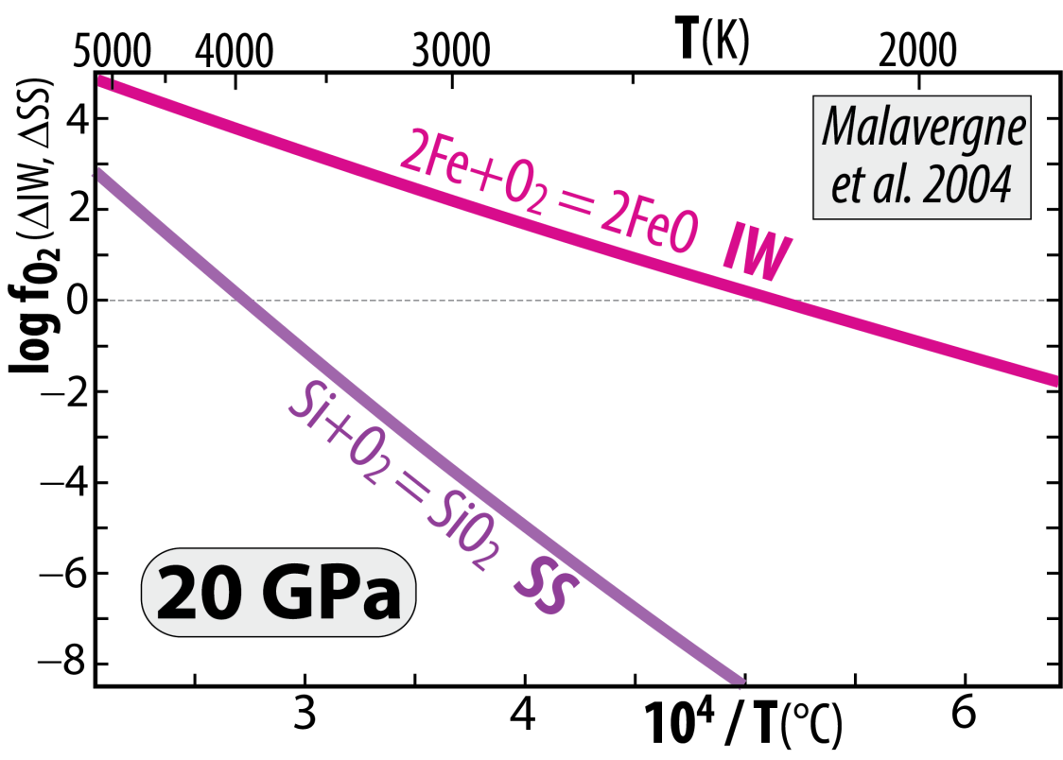
Venus and Earth
Segregated cores at very high T, allowing
high Si^{core} and high FeO^{MO} (i.e. high f_{O2})
Because the chemical equilibrium:
2 Fe^{met} + SiO₂^{sil} = Si^{met} + 2 FeO^{sil}
is displaced towards the product side (right) with
increasing T and reversed with decreasing T
2 Fe + O₂ = 2 FeO (IW)
minus: Si + O₂ = SiO₂ (SS)
gives: 2 Fe − Si = 2 FeO − SiO₂
or: 2 Fe + SiO₂ = Si + 2 FeO
Additional pressure-effect – above 25 GPa
Armstrong and Frost (2019, Nature)
Disproportionation of FeO^{MO} at p > 25 GPa promotes
high f_{O2} in the MO, combined with core segregation:
3 FeO = 2 FeO_{1.5} + Fe
components in the MO liquid metal segregating
and sinking to the core
Cooling of core and magma ocean (MO)
core-MO chemical exchange
- FeO and FeO_{1.5} to the core
- SiO₂ to the MO (and BMO)

Slide 11
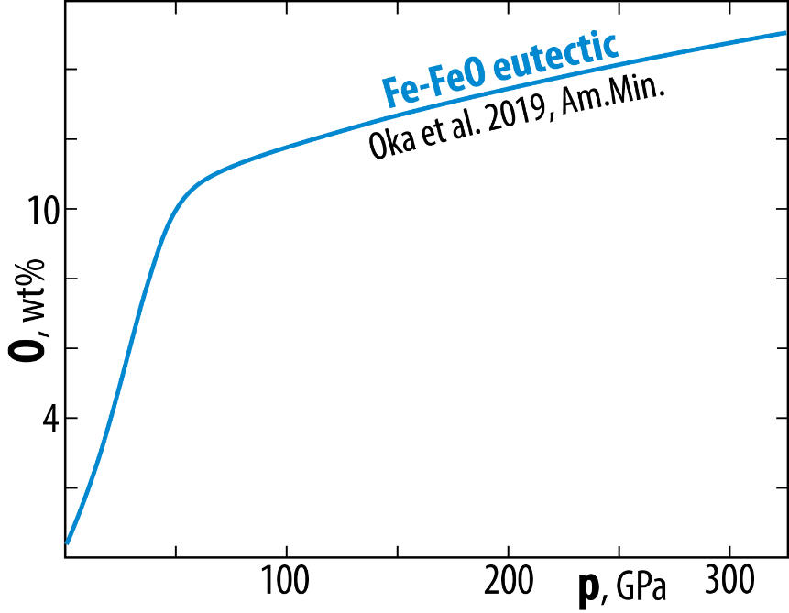
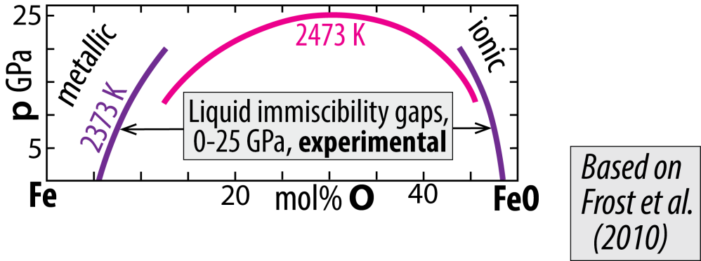
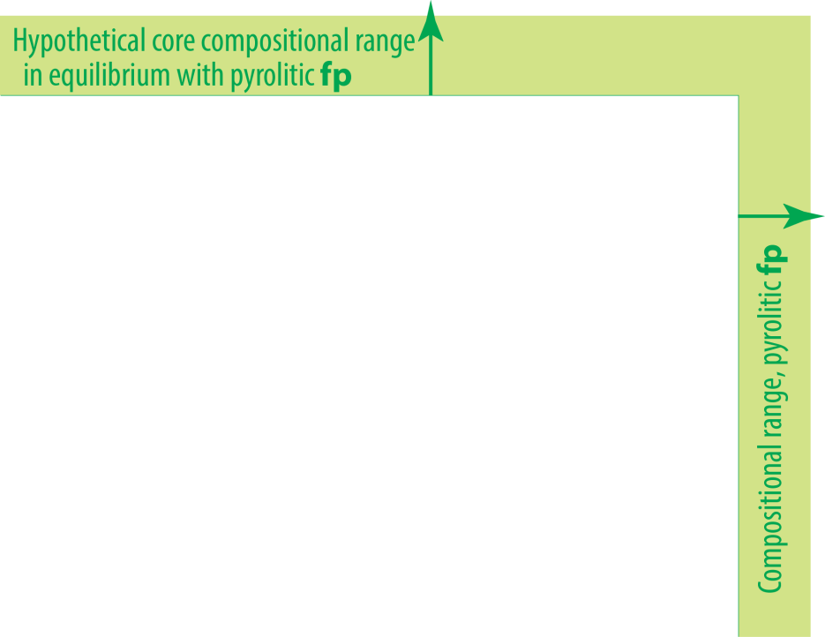
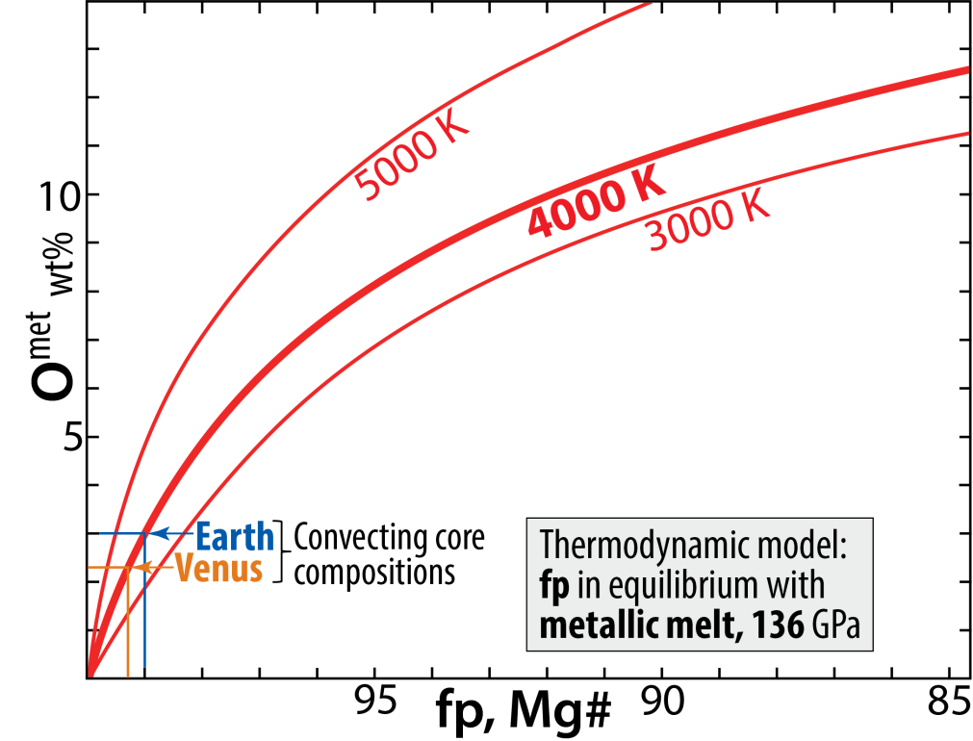
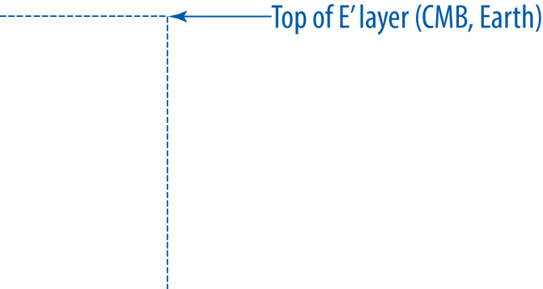
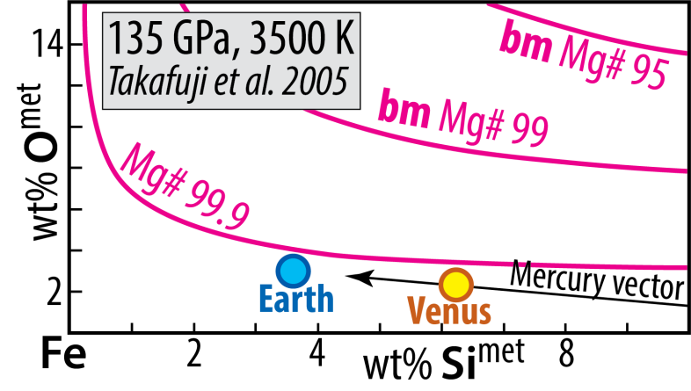
O and Si in Fe-alloys Cooling core-BMO chemical exchange
System: Fe-Mg-O
metal-ferropericlase equilibrium
Solvus closure with increasing p and T
System: Fe-Mg-Si-O
metal-bridgmanite equilibrium

Slide 12
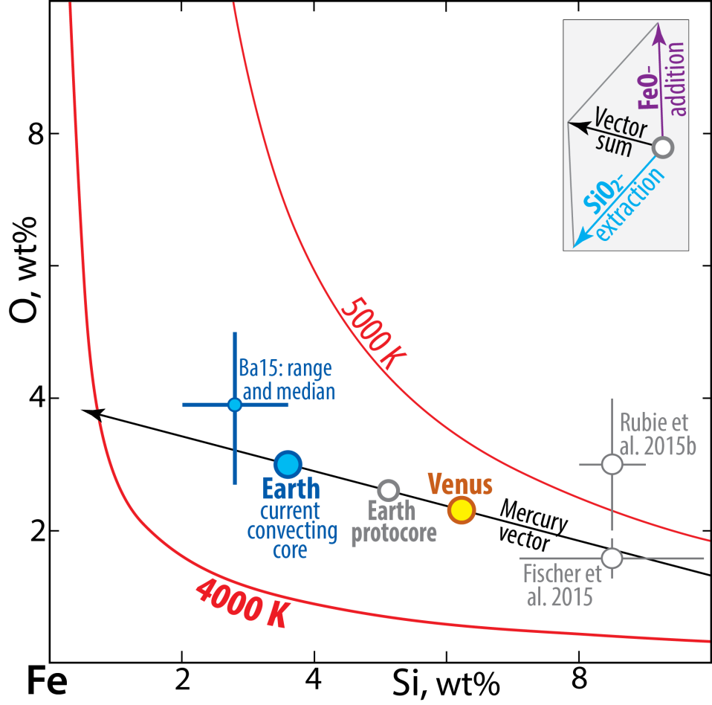
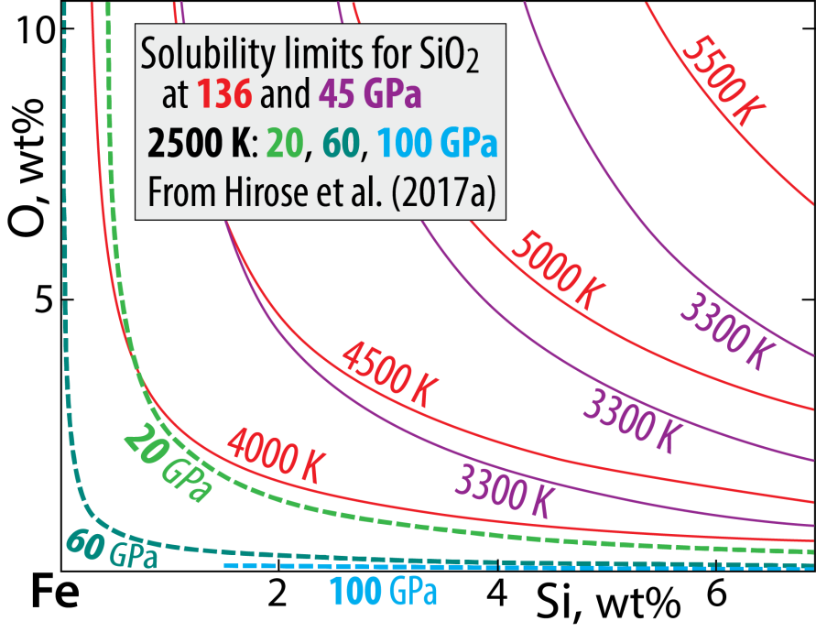
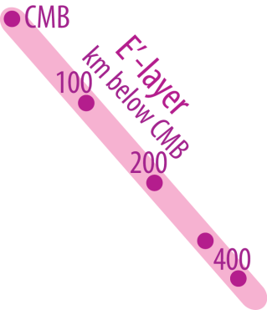
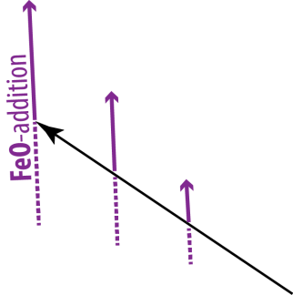
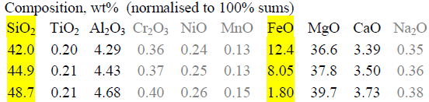
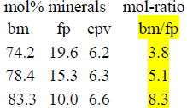

System: Fe-Si-O
Solubility of O and Si in Fe-alloy
Estimated core compositions
Trønnes et al. 2019,
Tectonophys.
Mercury:
15 wt% Si, 0% O
- O and Si: mutually exclusive
- Solubility increases with T and decreases with p
- Related to the silica liquidus surface in systam Fi-Si-O
Mass balance modelling (Trønnes et al. 2019, Tectonophys.)
Step 1: protoC + earlyMO = convC + pyrolitic-MO (100% volumes)
Step 2: upper convC + BMO = E'-layer + modified lowermost mantle
34 vol%, 28 vol%,
31 wt% of core 34 wt% of mantle

Slide 13
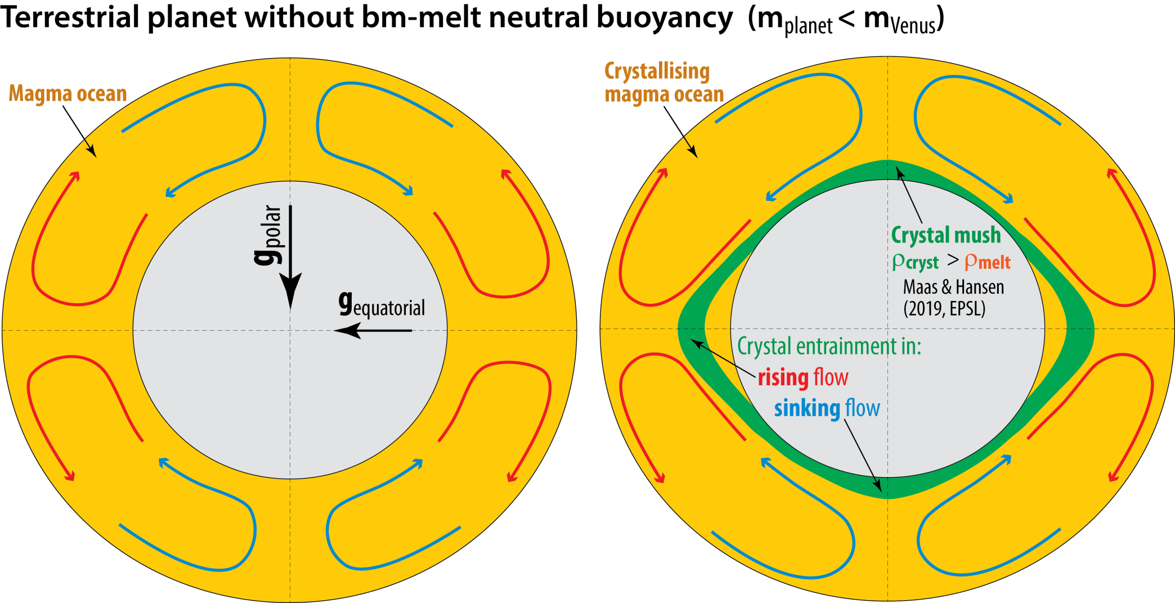
Convection modelling of MO crystal settling in rapidly
rapidly rotating planets with differential gravitational fields
Maas & Hansen,
2015, JGR,
2019, EPSL

Slide 14
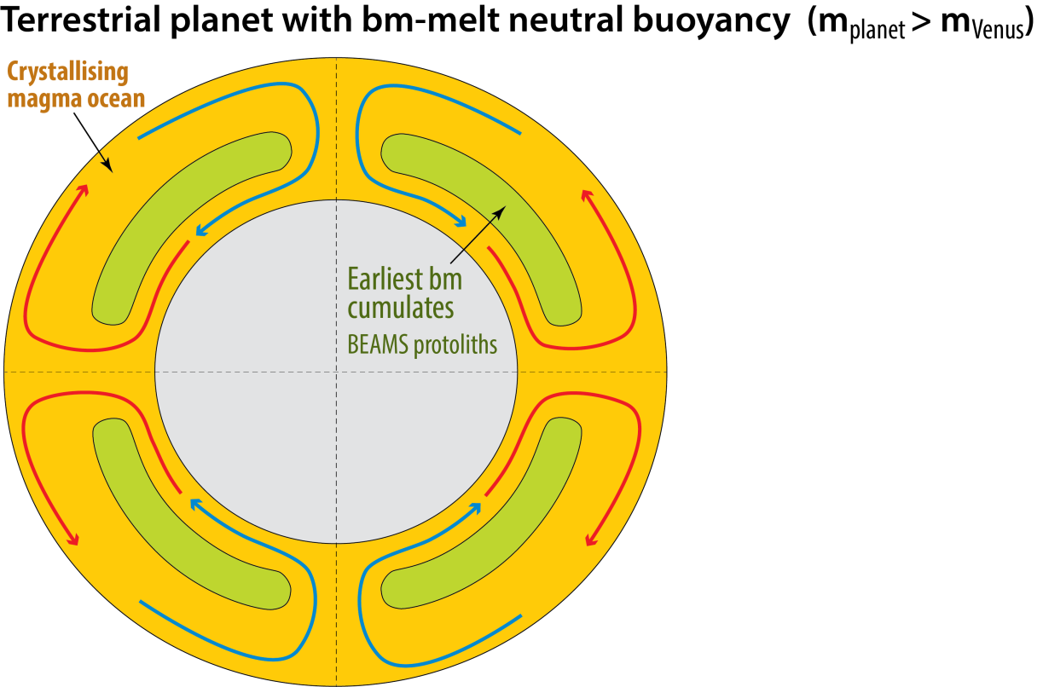
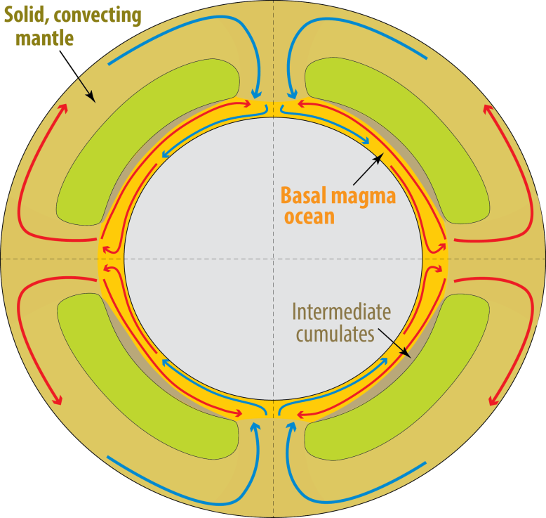
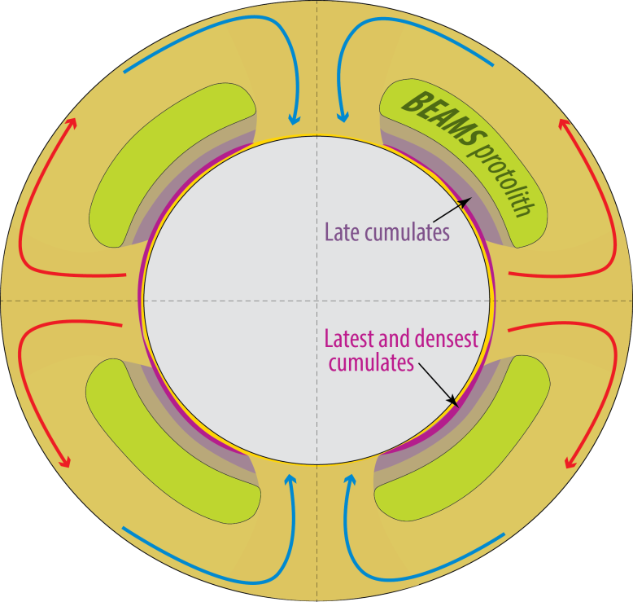
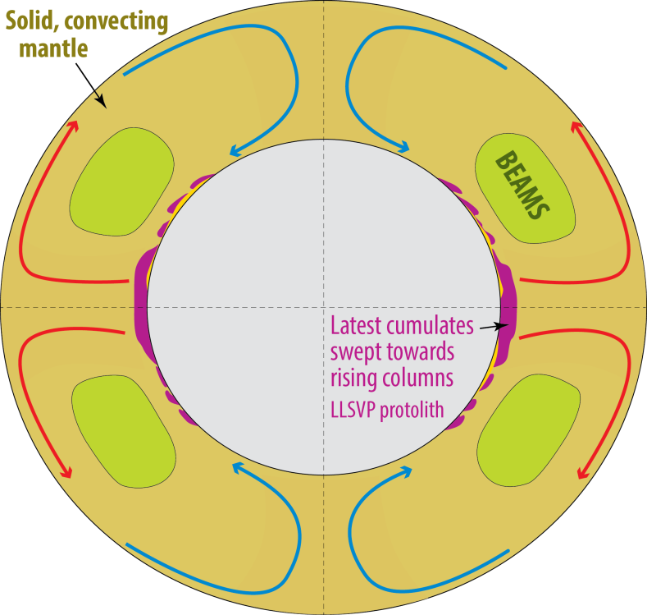
Change from mostly liquid to mostly solid mantle:
Possible change from: columnar polar downflow
with equator-plane upflow
to: longitudinal (circum-polar)
sheet-like downflow with
columnar antipodal upflow
in the equatorial plane.
e.g. the Earth
10-100 Ma ?
Spherical shell convection
models with high-viscosity
fluids commonly yield sheet-
like downwelling and columnar
upwelling (Bercovici et al.1989, Sci.)
Long-lived basal
magma ocean (BMO)
> 2 Gy ?

Slide 15
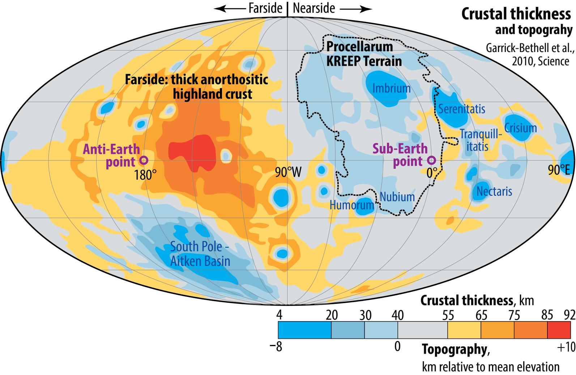
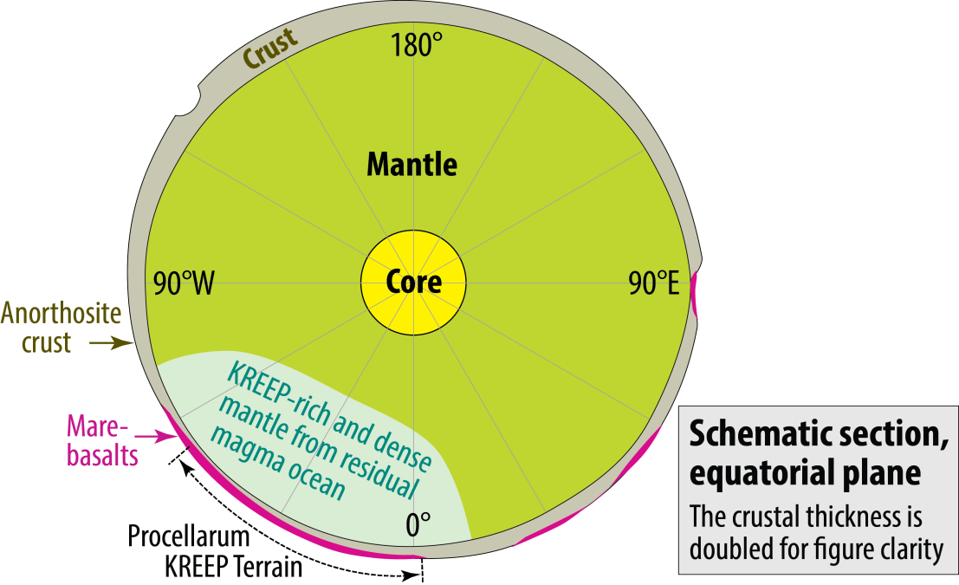
The lunar analogy of crust
distribution and thickness
Due to MO crystallisation in
Earth's gravitational field (?)
Wasson & Warren, 1980, Icarus
Looper & Werner, 2002, JGR
Werner & Looper, 2002, JGR
Garrick-Bethell et al., 2010, Sci.
Ohtake et a., 2012, Nat.Geosci.
Garrick-Bethell et al., 2014, Nat.
Quillen et al., 2019, Icarus
Elardo et al., 2020, Nat. Geosci

Slide 16
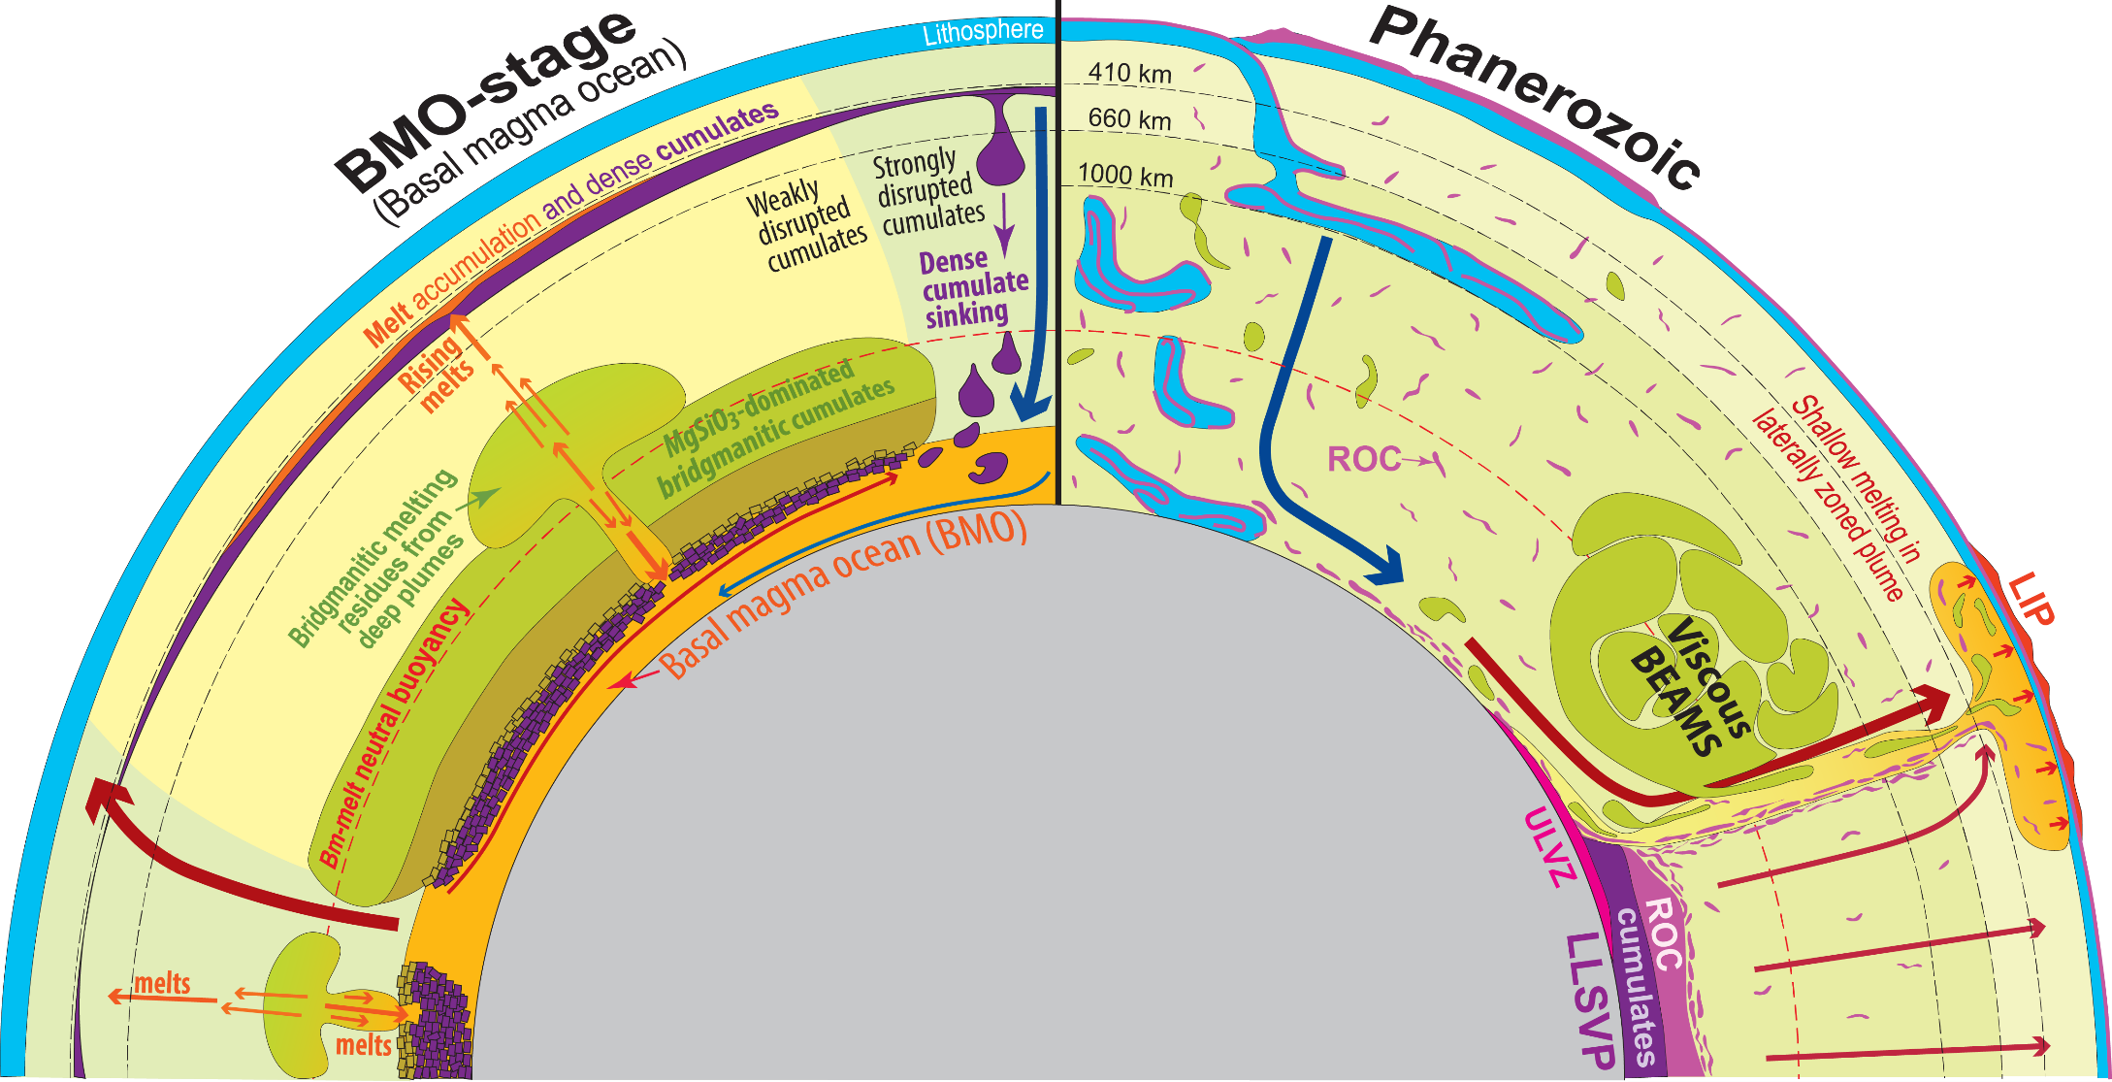
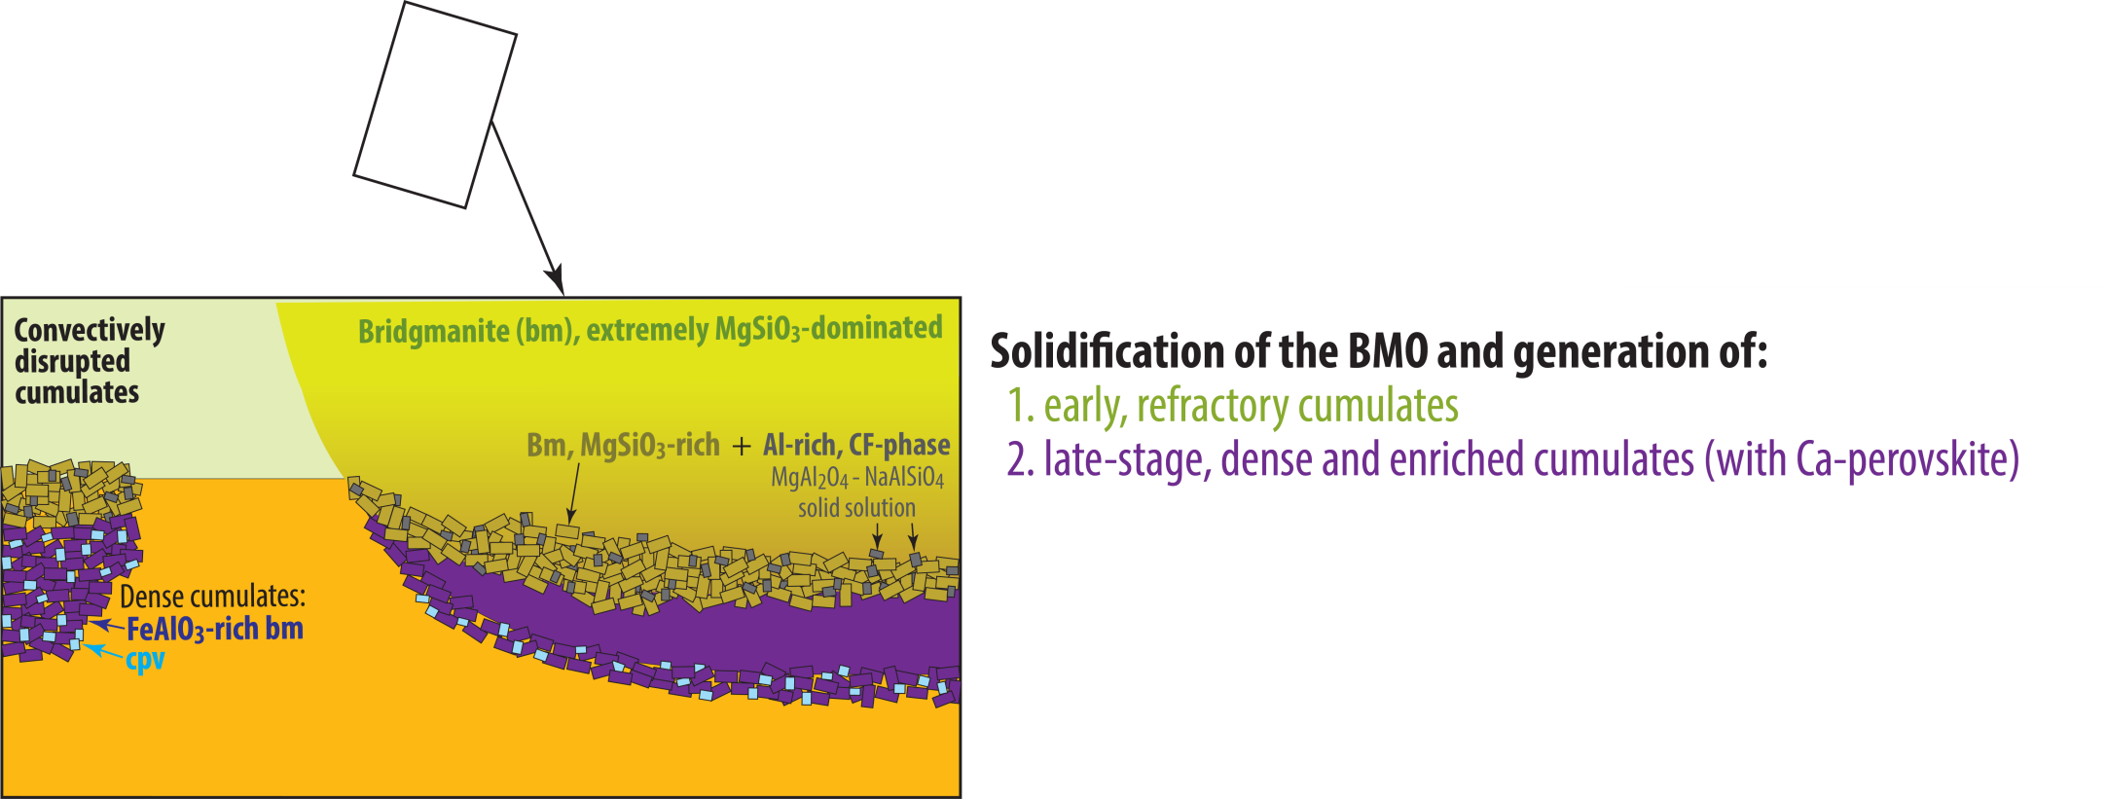
Modified, mainly from:
Torsvik et al. (2016, Can. J. Earth Sci.)
Ballmer et al. (2017, Nature Geosci.)
Trønnes et al. (2014, Tectonophys.)

Slide 17
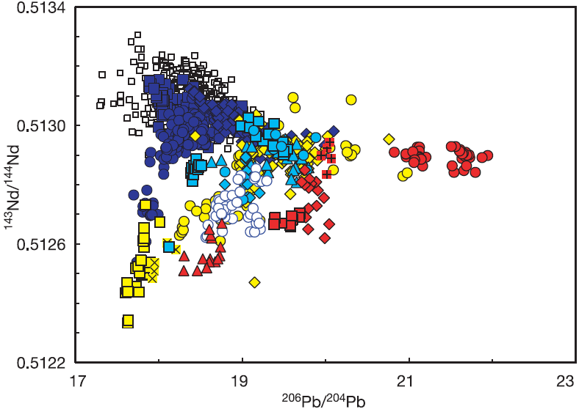
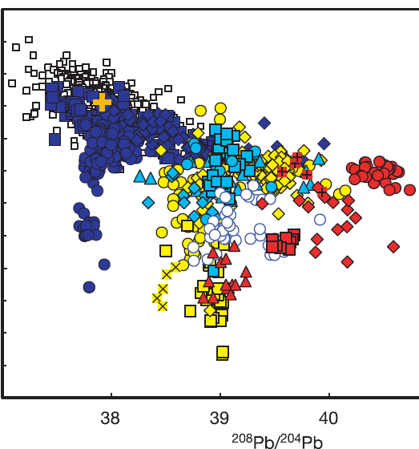
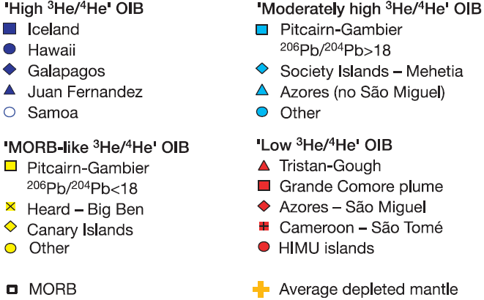
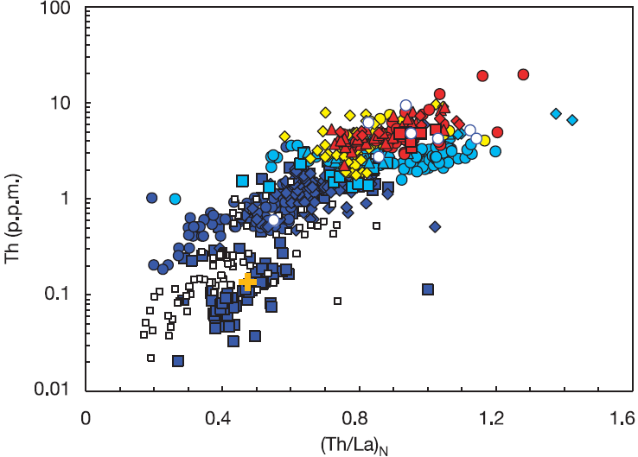
Strong evidence that the primordial-like He (and Ne) source material is refractory
Increasing
³He/⁴He
>15 R/Ra
9-15
Increasing
³He/⁴He
< 7
8 ±1
Similar correlation with incompatible trace element
concentrations and ratios
Class & Goldstein
(2005, Nature)
Increasing
³He/⁴He

Slide 18
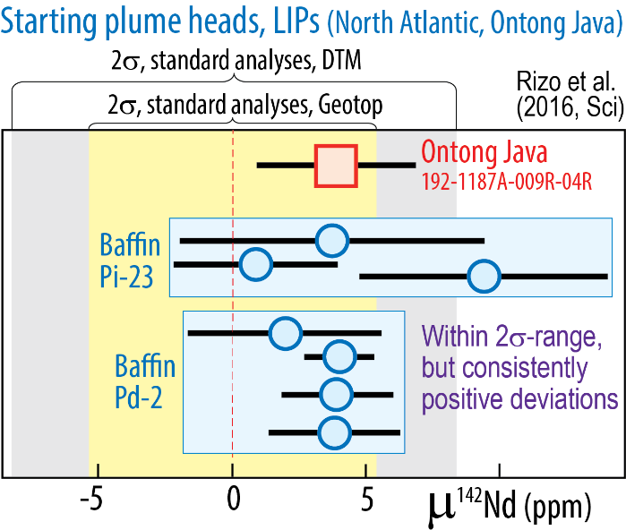
Could primordial-like He and Ne isotope ratios result from core contamination?
Unlikely, because:
- Although tiny additions of core metal to plume roots explain clear W- and weak Xe-isotopic signals,
they are likely insufficient to generate the primordial-like He-Ne isotopic signals
- High ³He/⁴He is associated with refractory mantle sources, e.g. PREMA / FOZO, W. Greenland / Baffin Island
- Parts of the refractory sources formed in the Hadean (from μ¹⁴²Nd): Baffin Island, Reunion, Samoa, Hawaii
Short-lived Sm-Nd-system: ¹⁴⁶Sm→¹⁴²Nd t_{h}: 103 My, "live" for about 500 My
μ¹⁴²Nd = (^{142/144}Nd_{sample} / ^{142/144}Nd_{standard} − 1) *10⁶ (ppm) ε¹⁴³Nd = (^{143/144}Nd_{sample} / ^{143/144}Nd_{standard} − 1) *10⁴
The Nd-daughter partitions to melt more than Sm. Bm-residues: high Sm/Nd ratio, high μ¹⁴²Nd
Peters et al. (2018, Nature)
Reunion basalts
Positive correlation
³He/⁴He (plume flux)
versus μ¹⁴²Nd

Slide 19
Horan et al.
(2018, EPSL)
5
μ¹⁴²Nd, ppm
0
Ofu
04-14
−5
Samoa
10
20
30
−15
−5
0
5
³He/⁴He, R/R_{atm}
μ¹⁸²W
Residues after melt extraction at:
4.57 (SS age), 4.50 and 4.42 Ga (t₀ + 150 My)
20
Original mantle reservoir:
μ¹⁴²Nd = ε¹⁴³Nd = 0
¹⁴⁷Sm/¹⁴⁴Nd: 0.196
Small black symbols on residue
trends corresponds to ¹⁴⁷Sm/¹⁴⁴Nd
of 0.200, 0.204 and 0.208
4.57 Ga, t₀
10
4.50 Ga, t₀+70 Ma
4.42 Ga, t₀+150
Hawaii
5
Loihi
02-02
μ¹⁴²Nd, ppm
0
Enriched mantle
−5
−5
0
5
−10
μ¹⁴²Nd, ppm
−400
0
μ¹⁴³Nd
400
−4
0
4
ε¹⁴³Nd

Slide 20
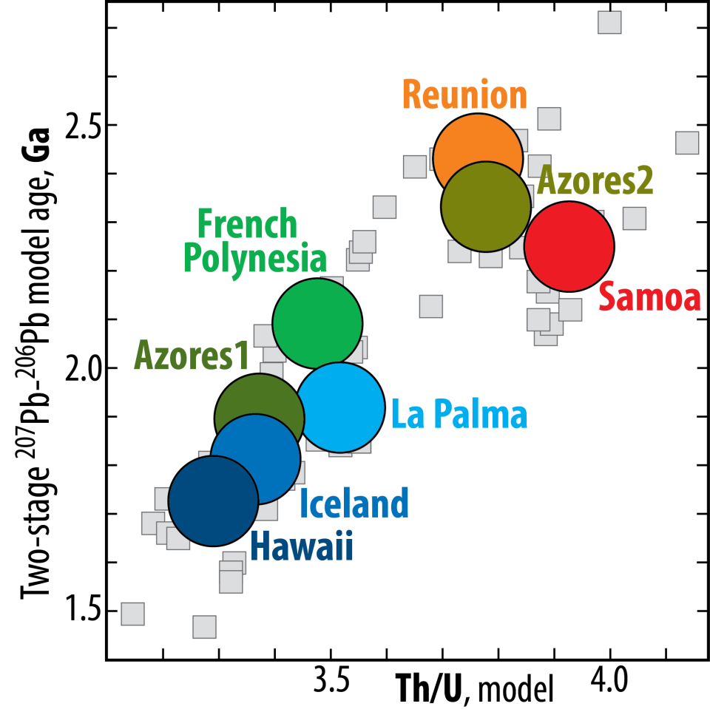
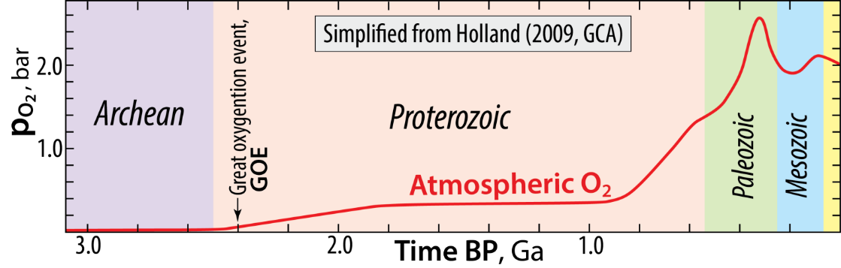
OIBs: Correlated model ages and Th/U ratios
Plume source model ages: 1.7 - 2.5 Ga
Great oxidation event: 2.4 Ga
Andersen et al.
(2015, Nature)
Also: Olivine-hosted sulphide inclusions in lavas from Cook Islands, Polynesia have S-isotopes indicating Archean ROC
Cabral et al. 2013, Nature
Oxidation of the atmosphere and oceans
recycling of U into the deep mantle
decreasing Th/U ratio of plume
sources with time
Where can we store ROC-accumulations
for 1.7-2.5 Gy ??
Direct recycling time: only about 0.3 Gy

Slide 21
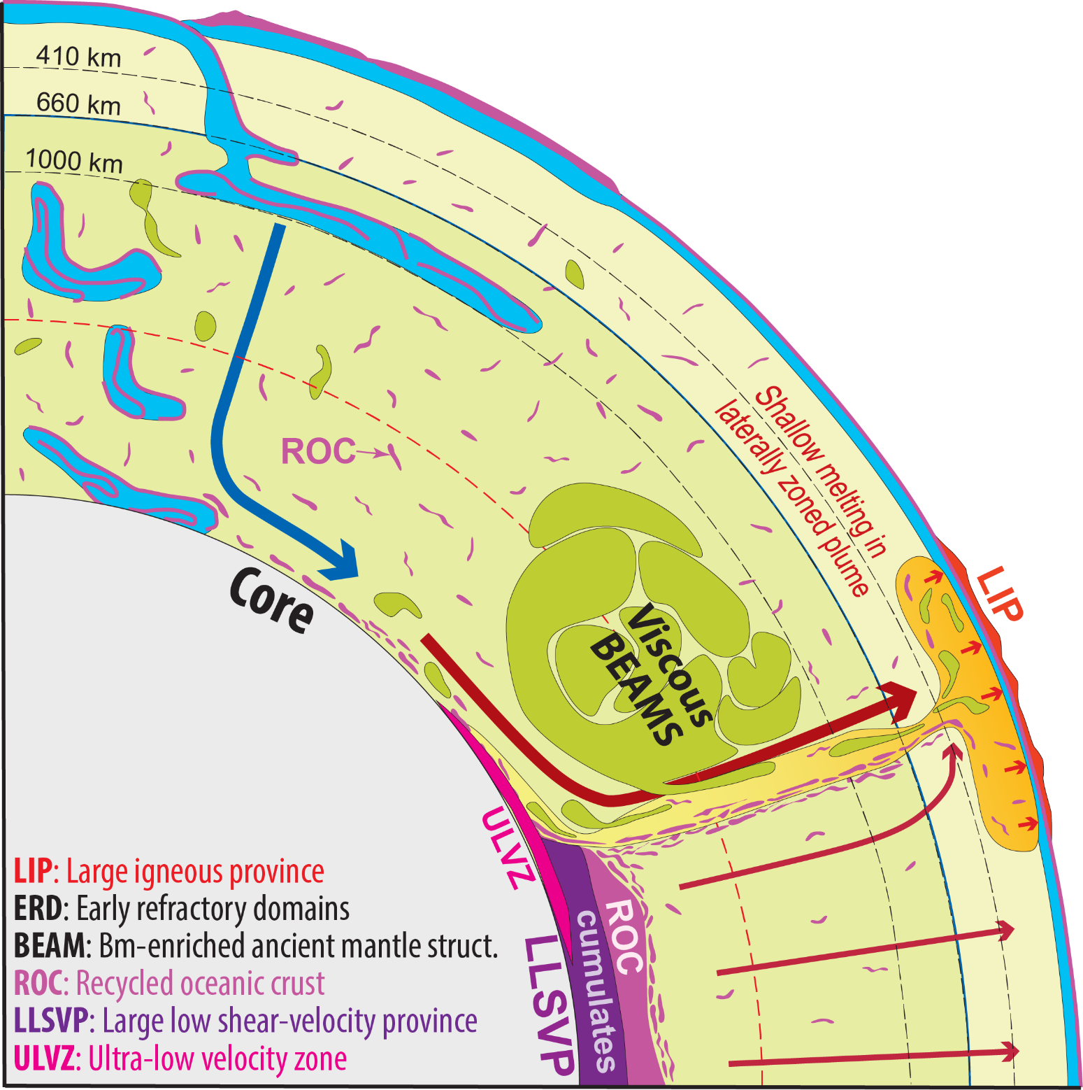
ROC-piles on top of LLSVP
base layers appear to be the
only probable location
Modified, mainly from:
Trønnes (2010, Mineral. Petrol.)
Torsvik et al. (2016, Can. J. Earth Sci.)
Ballmer et al. (2017, Nature Geosci.)
Trønnes et al. (2014, Tectonophys.)

Slide 22
- BMO crystallisation during core-BMO exchange may produce domains with optimal properties for
stabilisation of degree-2 convection pattern: - ERD with high visosity an neutral buoyancy (BEAMS)
- late dense cumulates (LLSVP base layers)
- Additional stabilisation is provided by the pole-to-equator gravity gradient: Earth's rotation
The degree-2 convection pattern
- might have originated during
BMO solidification
- might be a precondition for
thermochemical pile assembly

Slide 23
Inferred mantle domains and their compositions
Equatorial section
Convecting mantle, 60-90 vol% of mantle
Lithologies (mostly the input by subduction):
- 92-95 vol% depleted/refractory peridotite
- 5-8 vol% recycled oceanic crust (ROC), incl. some sediments
- minor amounts of detached sub-continental lithospheric
mantle (SCLM) and lower continental crust (LCC)
Large low shear-wave velocity provinces, LLSVPs
- Located antipodally under the Pacific and Africa
- Overlain by residual geoid highs, indicating rising flow above LLSVPs
- Probably stabilised by 200-400 km thick base layers with excess
density and/or viscosity ("thermochemical piles")
- About 1 vol% of the mantle (1.14 vol%, assuming 300 km thickness)
- Unconstrained composition, but most likely a combination of late-stage, dense
magma ocean cumulates, overlain by more unstable ROC-piles
Ultra-low velocity zones, ULVZs
- Thin (5-40 km) lenses, mainly confined to plume-roots along the LLSVP-margins
- Unknown composition, but most likely dense partial melts (metallic ?) in a silicate matrix
- No internal structure or gradient, so presumably convectively homogenised
Early refractory domains, ERD, bridgmanite-enriched ancient mantle structures, BEAMS, 10-40 vol% of mantle
- Neutrally buoyant in the 1500-2000 km depth range
- High viscosity, convectively aggregated into Mm-sized domains between columnar rising and sheet-like descending flow of convective mantle
- ERDs: inescapable outcome of early magma ocean (MO) and later basal magma ocean (BMO) crystallisation and remelting above the BMO
- Geochemical evidence for plume entrainment of refractory materials with positive ε¹⁴²Nd and primordial-like He and Ne

