Slide 1
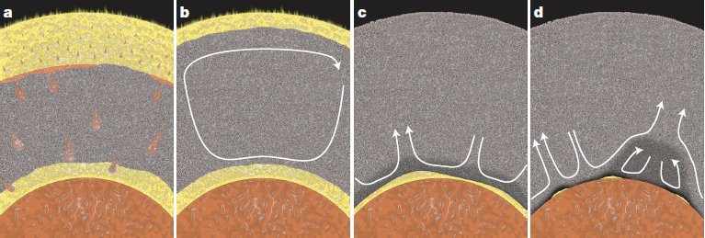
Core-mantle evolution: chemical exchange between
the basal magma ocean (BMO) and the protocore
Figures in this presentation:
Trønnes et al (2019, Tectonophys.) or
unpubl., unless indicated otherwise
BMO-model: Labrosse et al. (2007, Nature)
The BMO was long-lived:
might have lasted into the Proterozoic or even Phanerozoic ??
Are the ULVZs partially molten BMO-residues ??

Slide 2
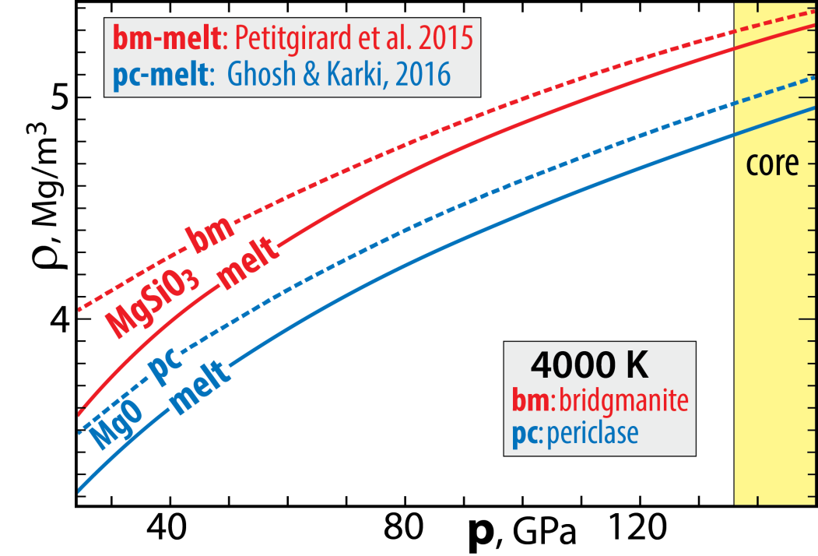
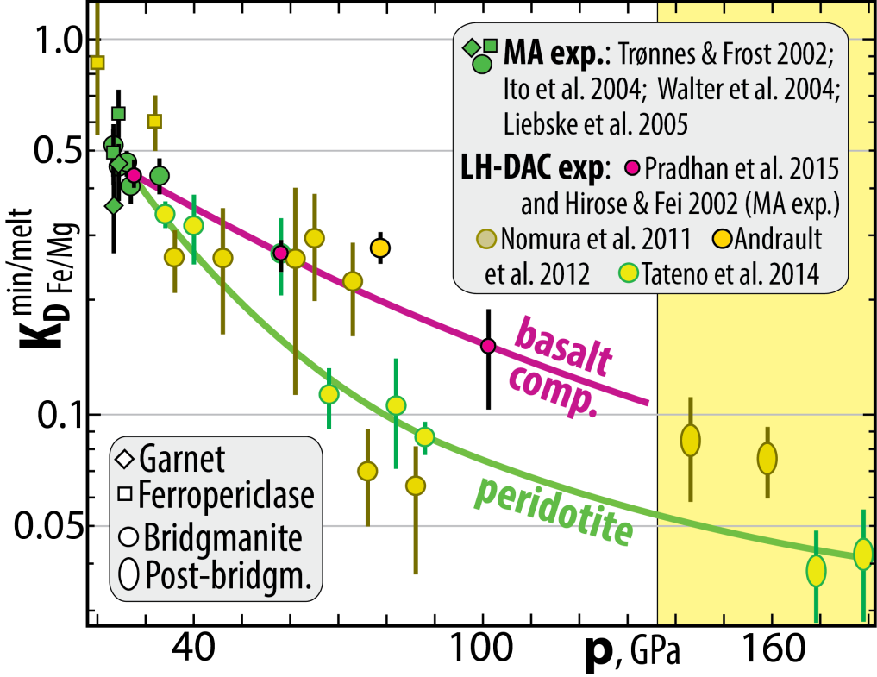
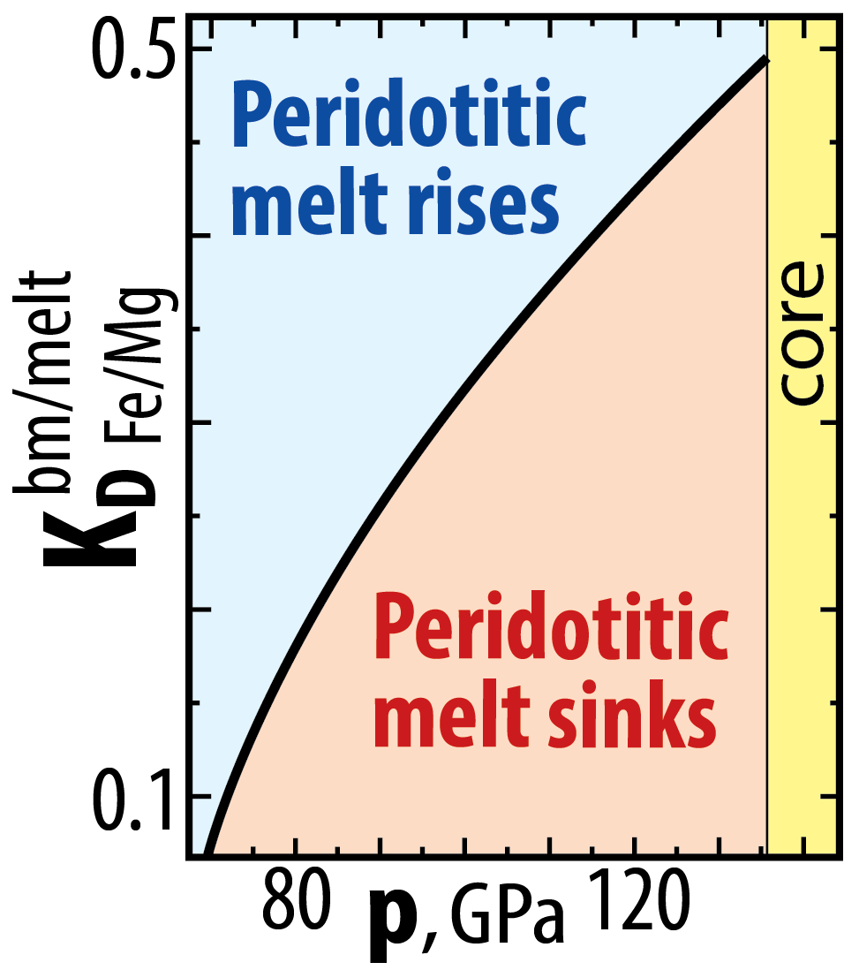
Why a BMO?
solid-melt neutral buoyancy at high p
Strong Fe/Mg-partitioning densifies peridotite melts
bm/melt
Fe/Mg
K_{D} = (Fe/Mg)^{bm} / (Fe/Mg)^{melt}
73-80 GPa:
~1800 km depth

Slide 3
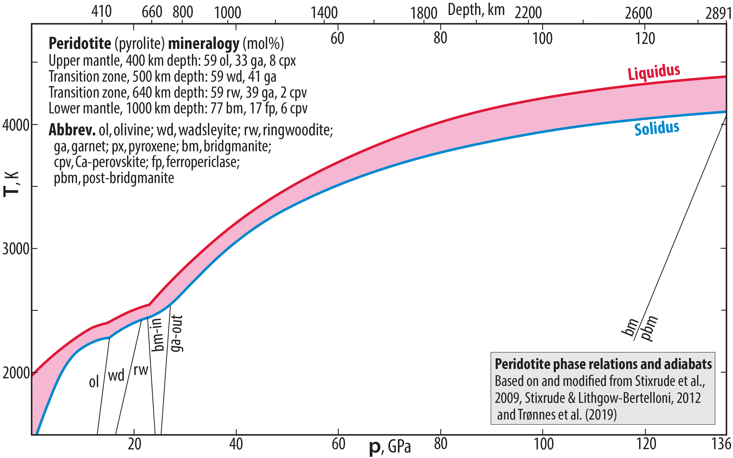
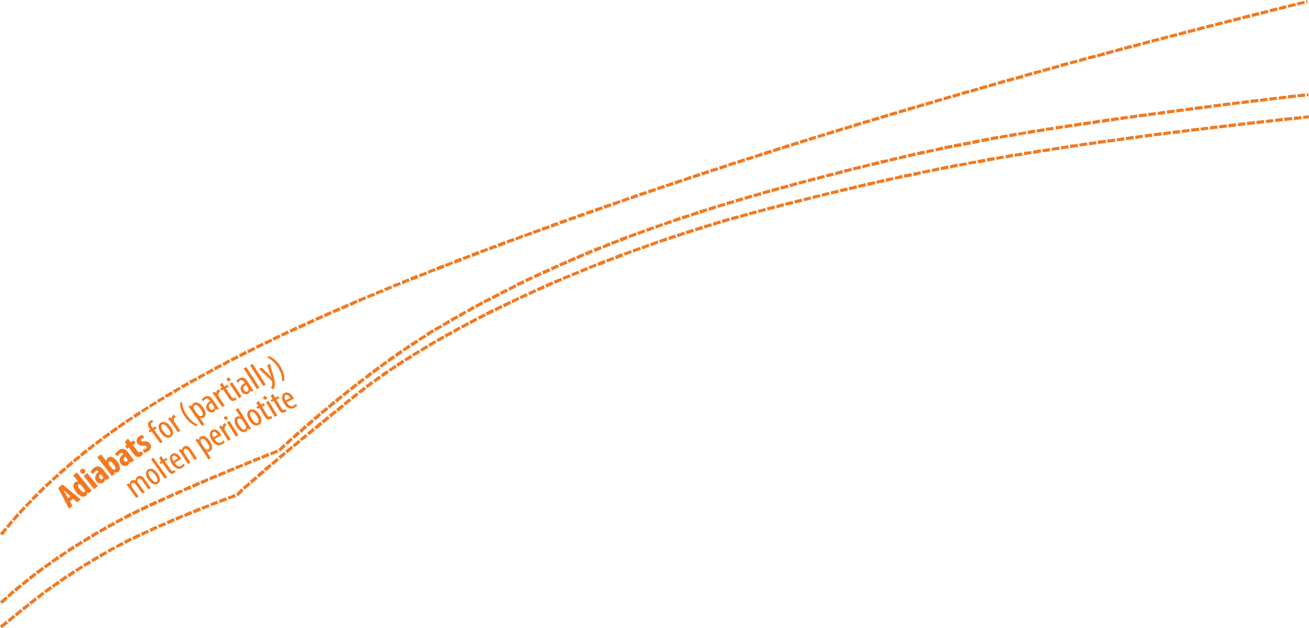
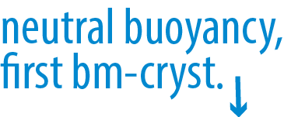
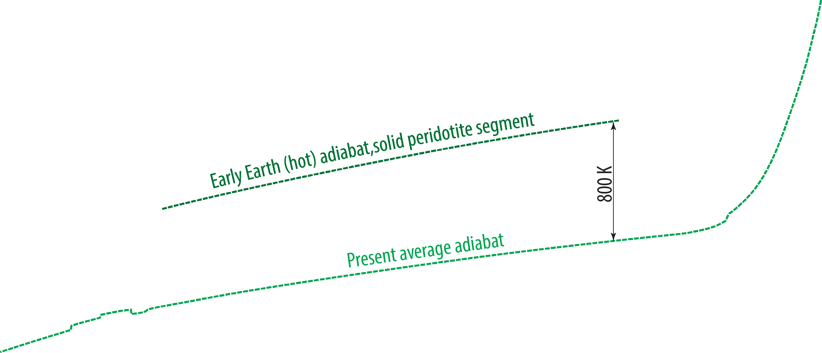
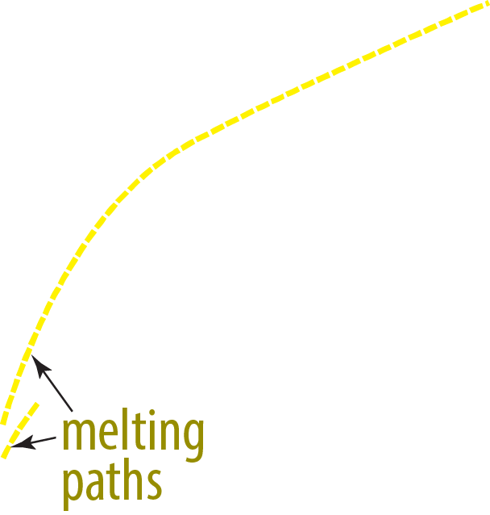

Melting relations of peridotite

Slide 4
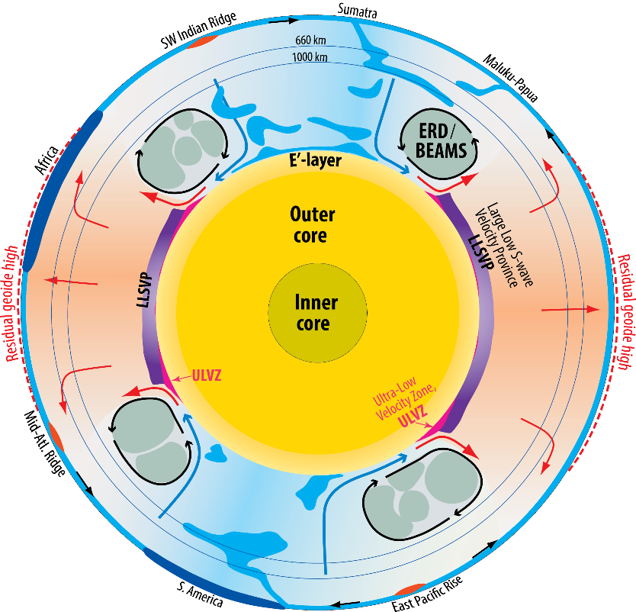
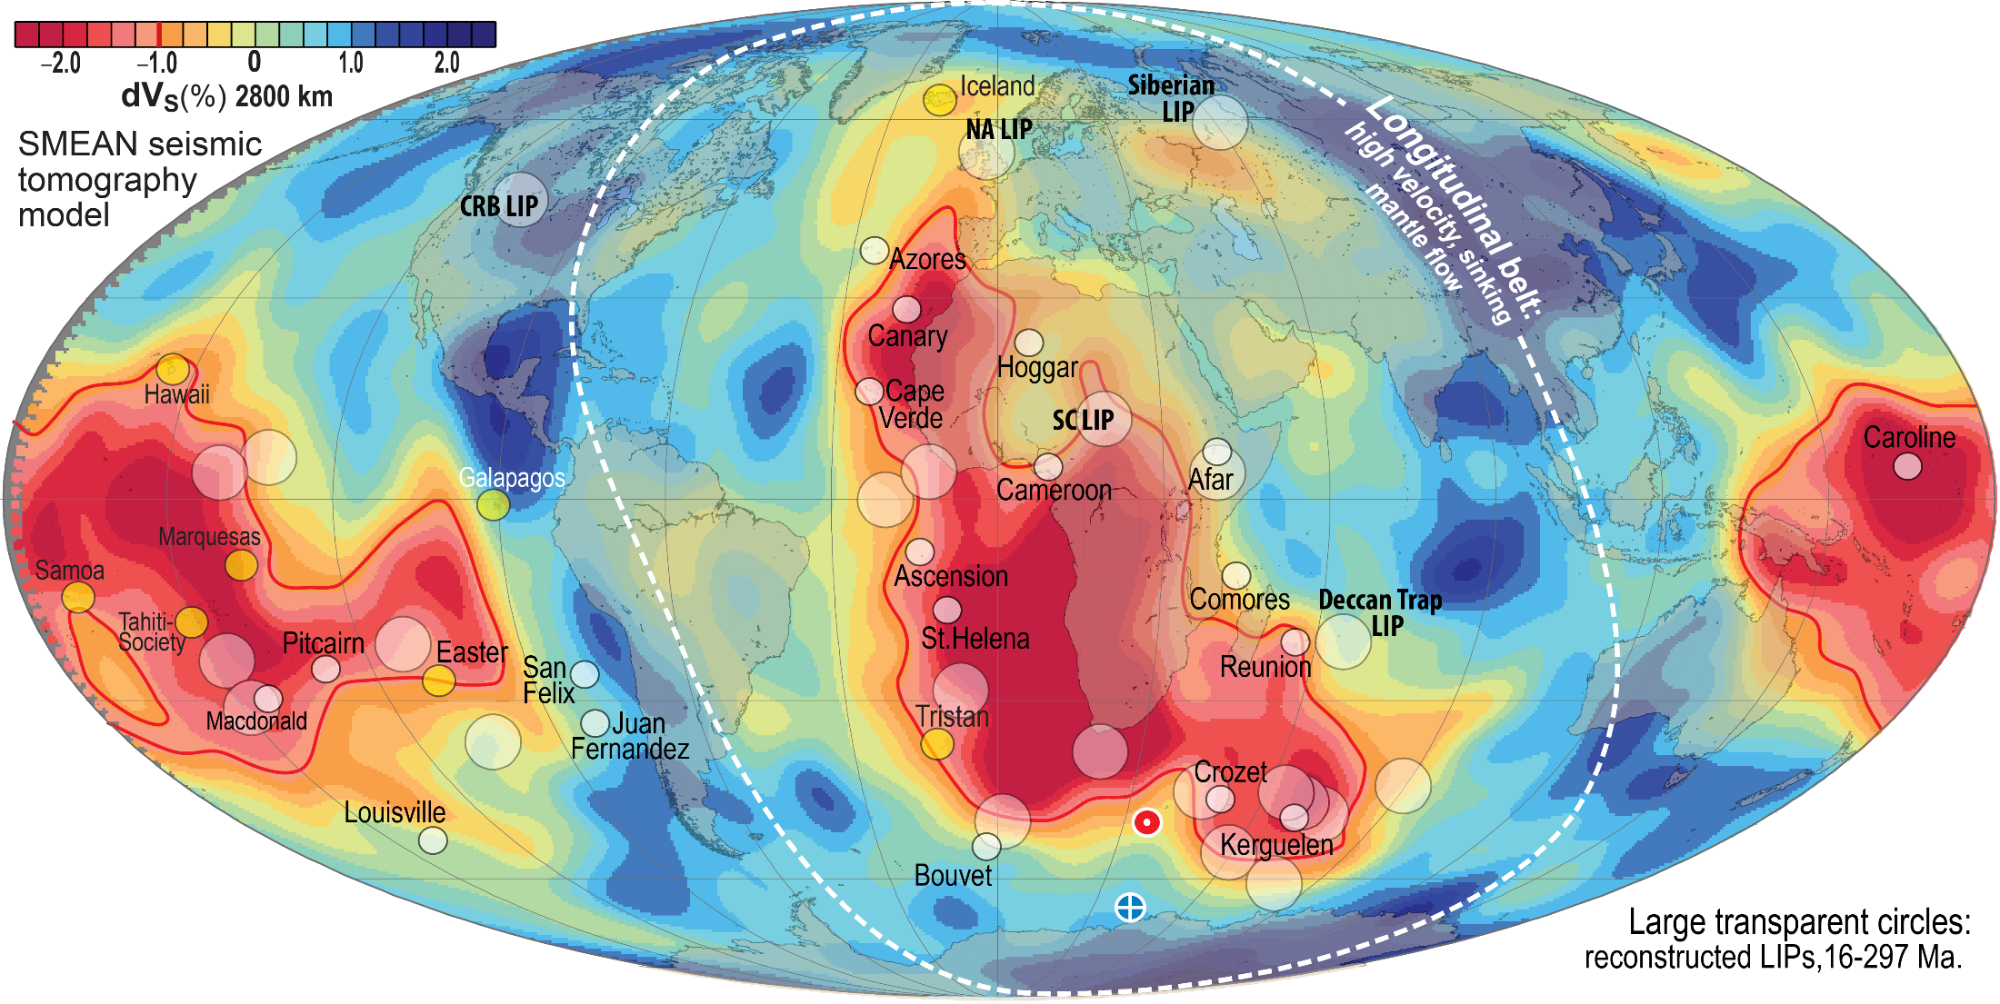
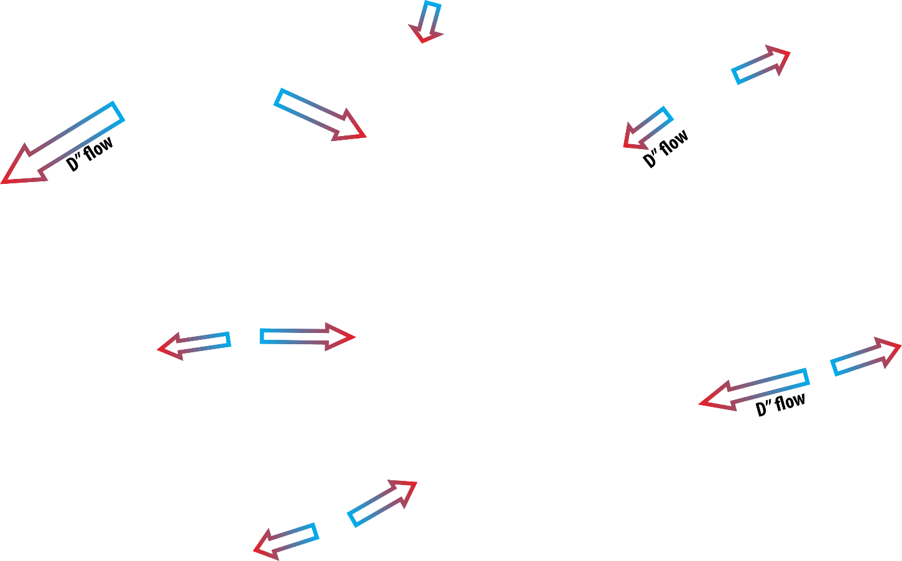
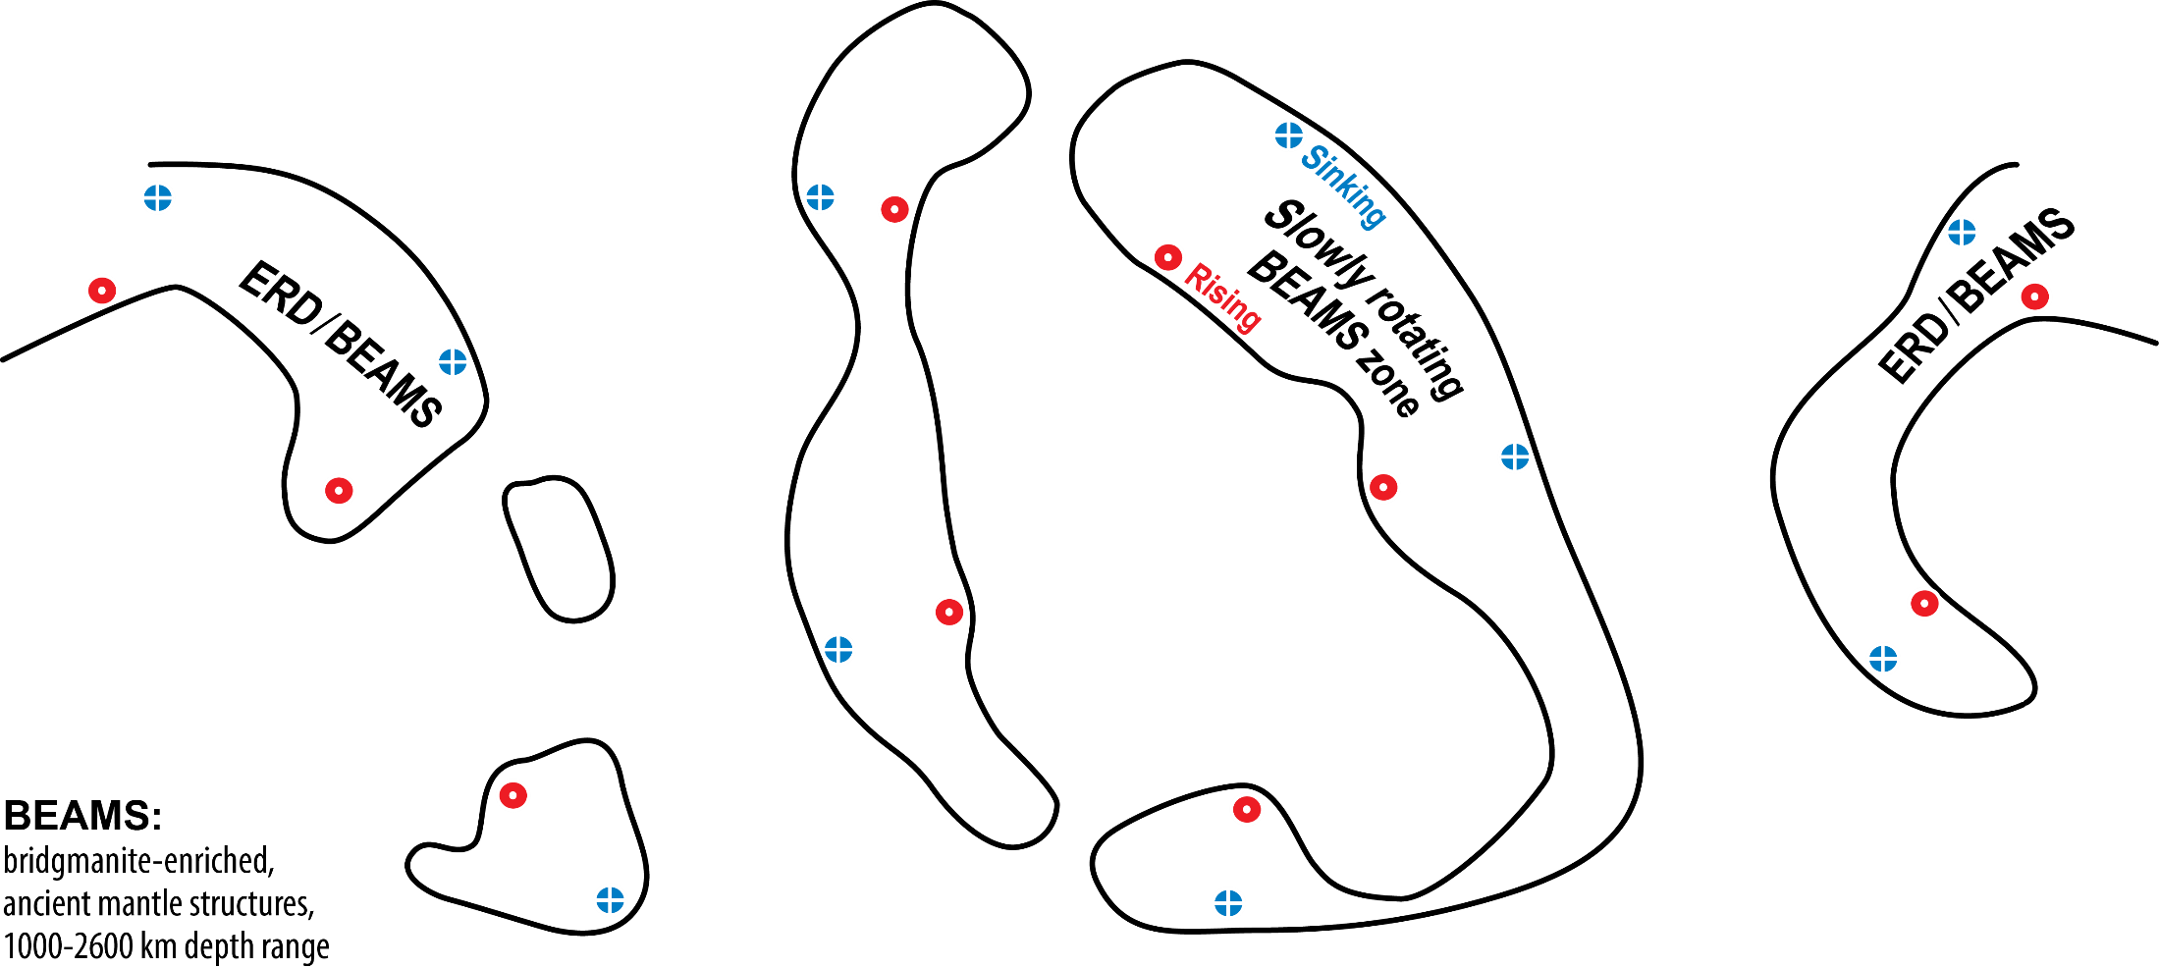
Newly recognised structural elements
Lower mantle
Strong petrological evidence and more tenuous seismic evidence for early refractory domains (ERD), likely organised in "bridgmanite-enriched ancient mantle structures" (BEAMS, Ballmer et al. 2017, Nat. Geosci.)
Outer core
Low-V_{P}, low-ρ outermost core: E'-layer (Brodholt & Badro, 2017, GRL)
Equatorial section
Inferred locations for BEAMS

Slide 5
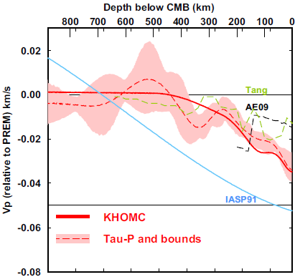
Outermost stagnant E'-layer?
gradationally stratified, low V_{Φ} - low ρ
0-445 km
below CMB
Feasible because:
- high thermal conductivity supresses convection
- low viscosity reduces viscous entrainment
- an E'-layer may stabilise the geodynamo
(Hernlund & McNamara, 2015, Treat. Geophys.)
0.4 %
Kaneshima (2018, PEPI)
Seismology
Lay & Young, 1990
Garnero et al., 1993
Helffrich & Kaneshima, 2010
Kaneshima & Helffrich, 2013
Kaneshima & Matsuzawa, 2015
Kaneshima, 2018
Irving et al., 2018: Adiabatic outermost core
Models
Buffet, 2010
Buffet & Seagle, 2010
Gubbins & Davies, 2013
Hernlund & McNamara, 2015
Brodholt & Badro, 2017

Slide 6
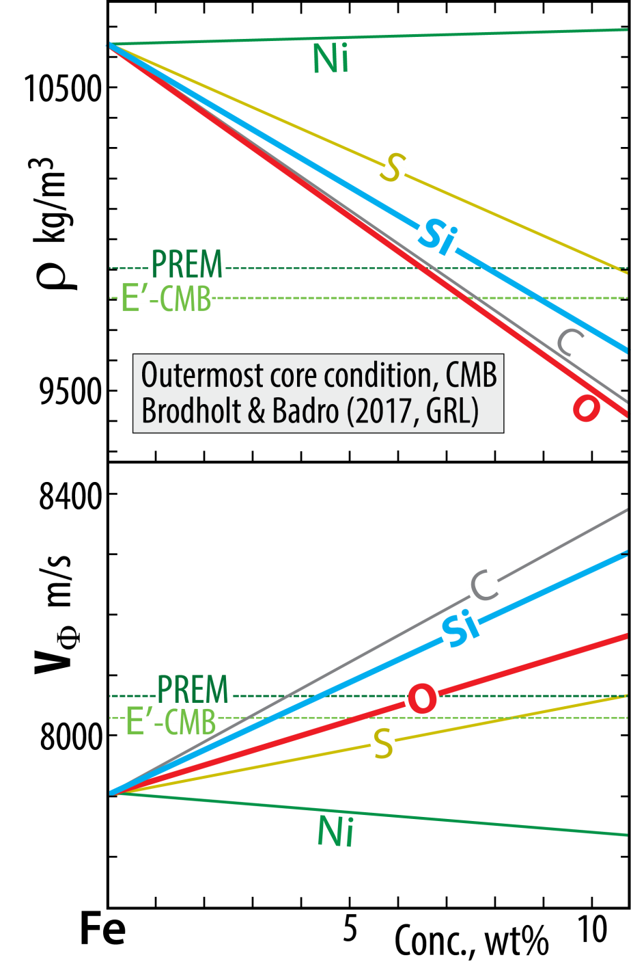
Outermost core: stagnant layer?
E'-layer: low V_{P} - low ρ
Outermost stagnant E'-layer?
gradationally stratified, low V_{Φ} - low ρ
Chemical characteristics, material properties
poses a long-standing conundrum, apparently solved by
Brodholt & Badro (2017, GRL)
Each of the light element candidates, Si, O, S, C,
reduces ρ and increases V_{Φ} (or V_{P})
BUT:
O reduces ρ more and increases V_{Φ} less than Si.
Therefore:
E'-layer with elevated O and reduced Si relative to
the convecting core may solve the conundrum

Slide 7
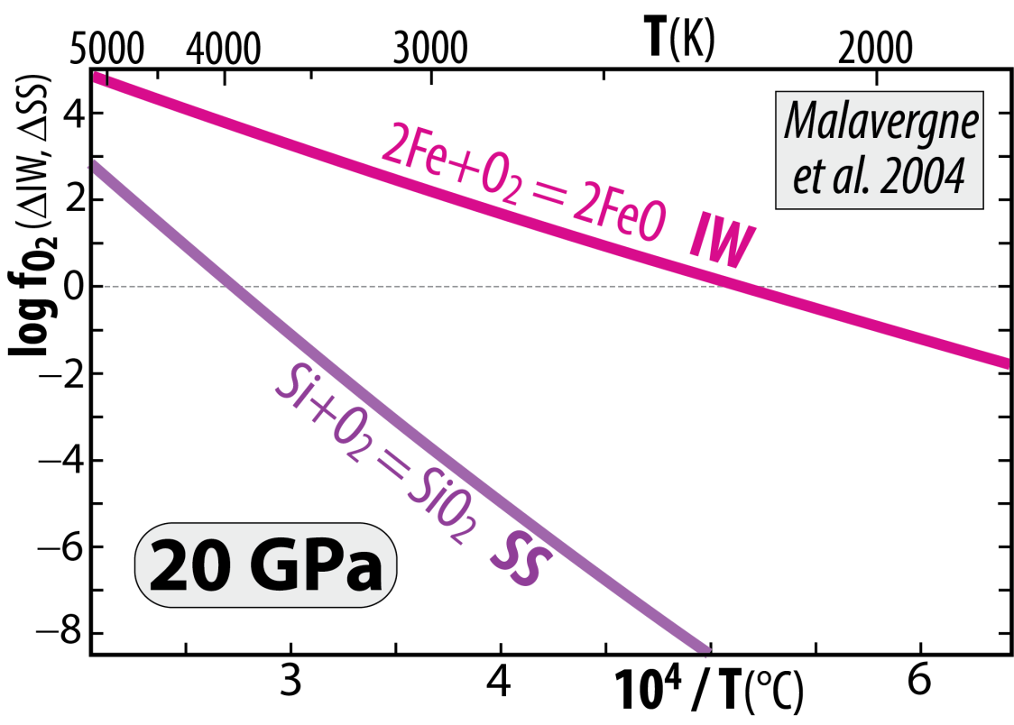
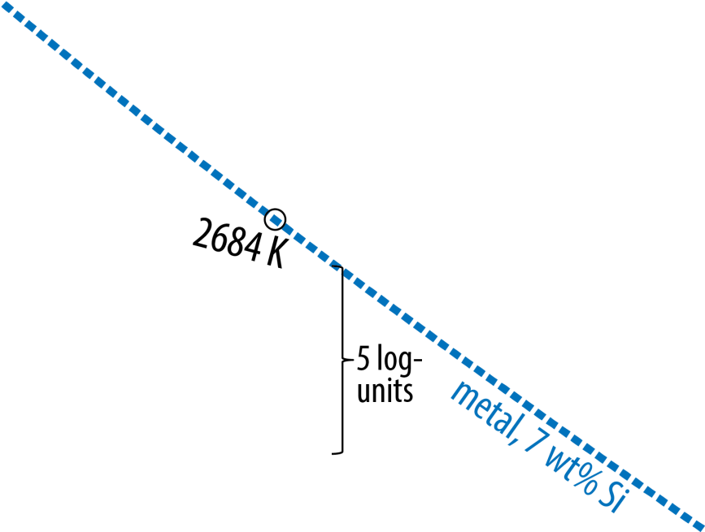
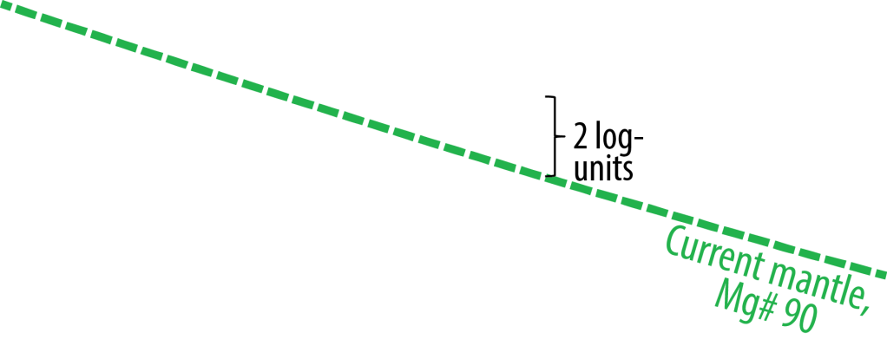
Venus and Earth
Segregated cores at very high T, allowing
high Si^{core} and high FeO^{MO} (high f_{O2})
Because the chemical equilibrium:
2 Fe^{met} + SiO₂^{sil} = Si^{met} + 2 FeO^{sil}
is displaced towards the product side (right) with
increasing T and reversed with decreasing T
2 Fe + O₂ = 2 FeO (IW)
minus: Si + O₂ = SiO₂ (SS)
gives: 2 Fe − Si = 2 FeO − SiO₂
or: 2 Fe + SiO₂ = Si + 2 FeO
Cooling of core and magma ocean (MO)
core-MO chemical exchange
- FeO and FeO_{1.5} to the core
- SiO₂ to the MO (and BMO)
Additional pressure-effect – above 25 GPa
Armstrong and Frost (2019, Nature)
Disproportionation of FeO^{MO} at p > 25 GPa promotes
high f_{O2} in the MO, combined with core segregation:
3 FeO = 2 FeO_{1.5} + Fe
components in the MO liquid metal segregating
and sinking to the core

Slide 8
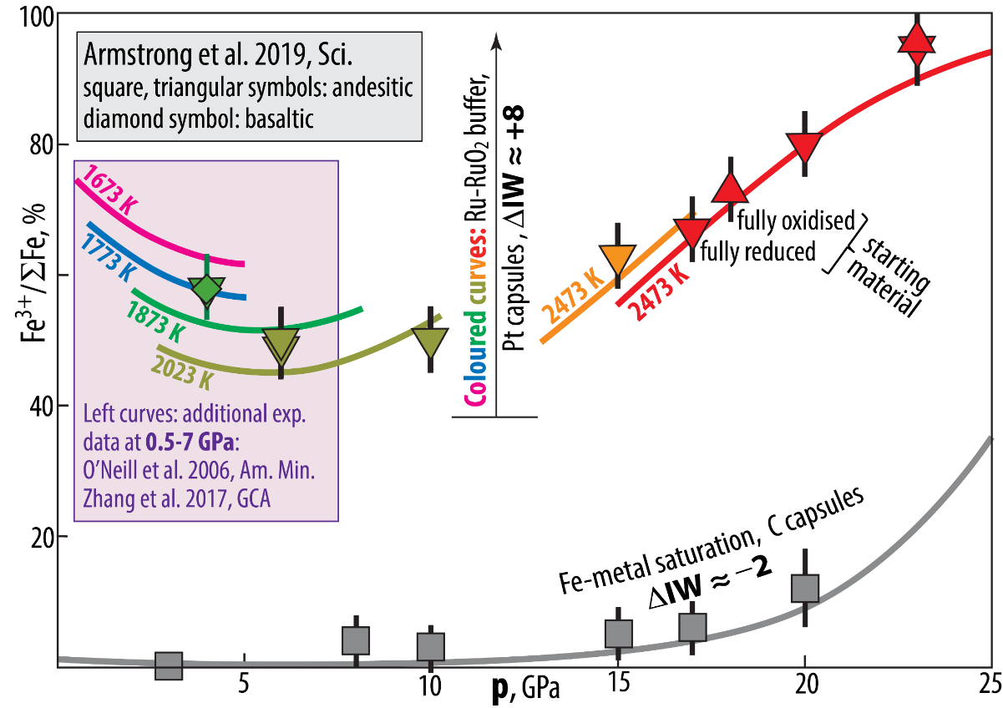
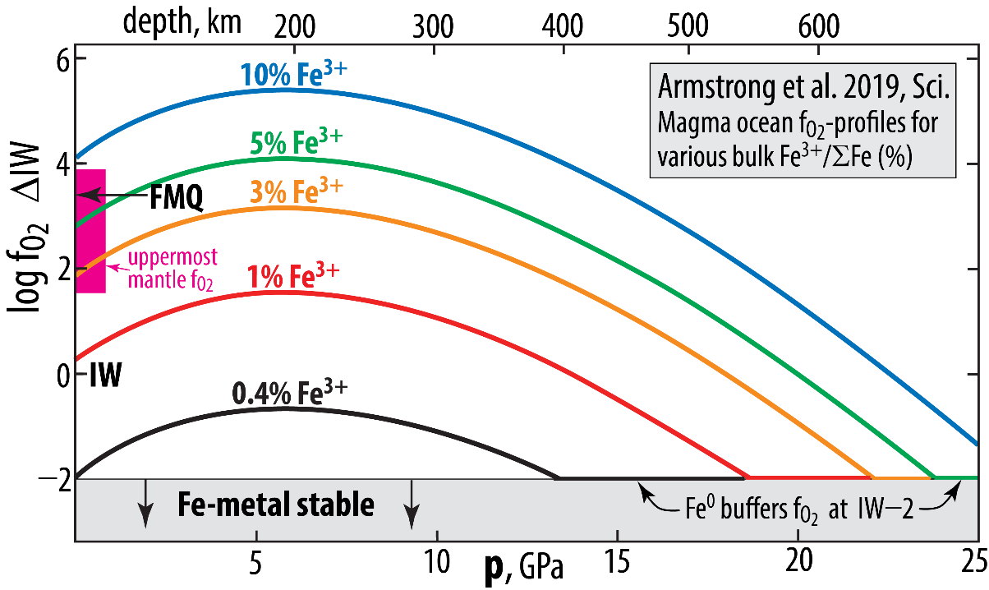
f_{O2}-buffered experiments, andesitic melts
Armstrong et al. (2019, Sci.)

Slide 9
Fe-oxide transport to the core
Will the BMO be oxidised or reduced during solidification?
If Fe-metal alloy is
extracted and sinks
into the core
If Fe-oxide with a
FeO_{1.5}/FeO ratio higher
than that of the BMO
dissolves into the core

Slide 10
Important question because:
- bulk mantle has dominantly Fe²⁺ with a small fraction (about 2%) of Fe³⁺
- extraction of only FeO to the core will oxidise the BMO (lowermost mantle),
increasing the Fe³⁺/ΣFe ratio
- extraction of mainly FeO + moderate amounts of Fe₂O₃ from the BMO will likely reduce the BMO,
decreasing the Fe³⁺/ΣFe ratio
Is Fe₂O₃ available in the BMO (and how)?
Yes, due to a redox reaction (Fe disproportionation)
associated with bm crystallisation
The diagrams show complementary SiO₂-crystallisation and FeO-assimilation. The O-undersaturation, however, would be more efficiently alleviated by Fe₂O₃-assimilation.
Is this process feasible?

Slide 11
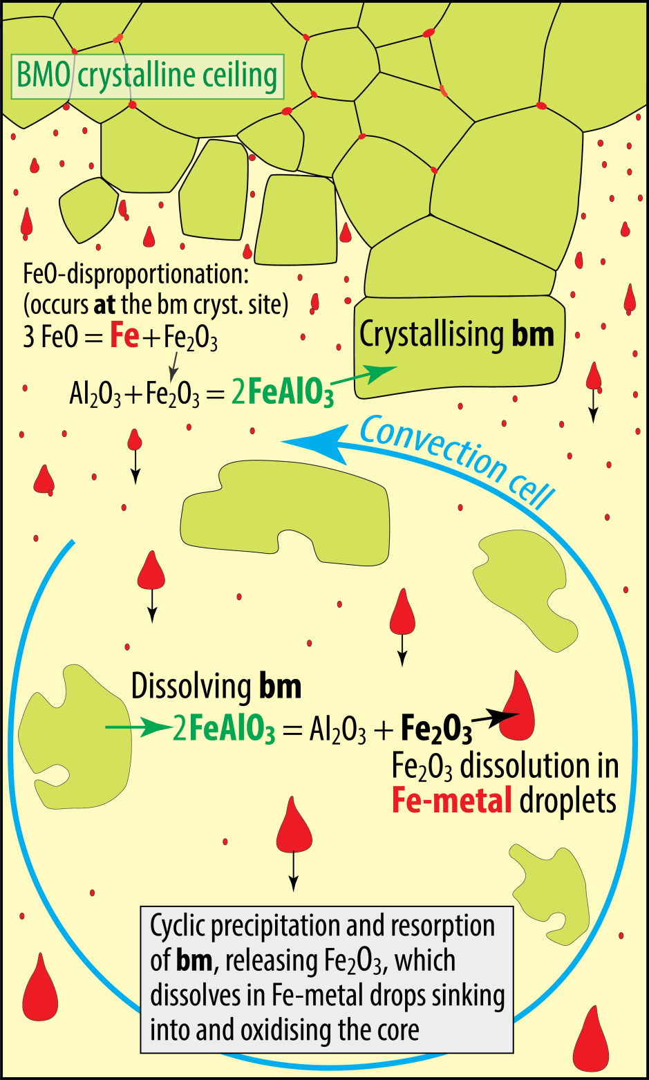
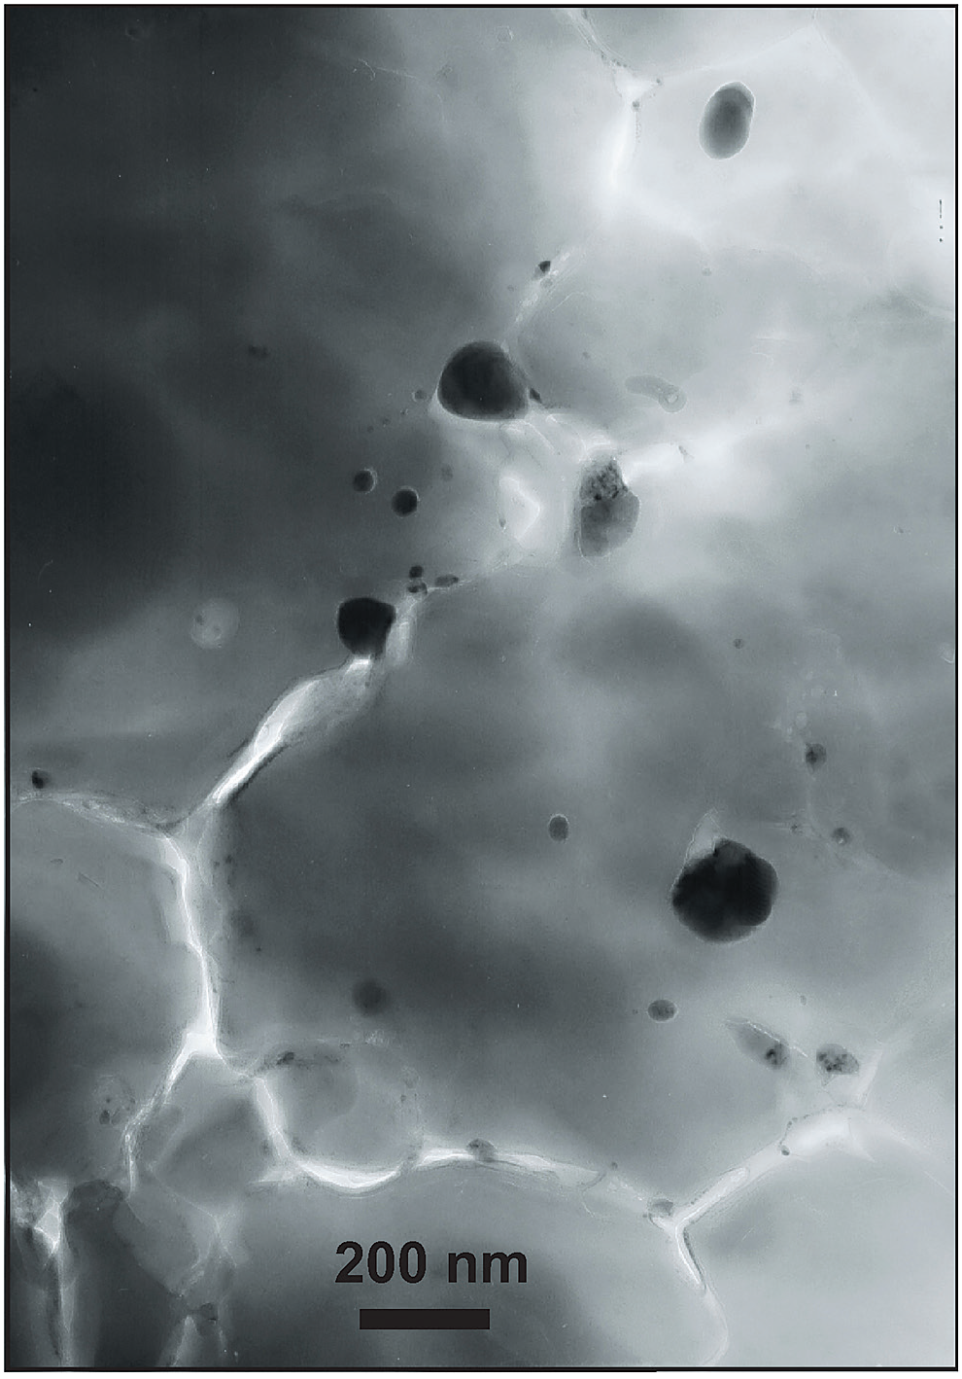
Crystallisation of bm in BMO
Cyclic crystallisation and dissolution of bm
- incorporation of the FeAlO₃-component in bm
- associated by FeO disproportionation and
Fe-metal precipitation (Frost et al. 2004, Nature)
30 nm
160 nm
Might be important for O-loading of the core.
BUT: O-saturation level in metal is < 20 wt%, while FeO and
and Fe₂O₃ contains 22 and 30 wt% O, respectively.
Sinking metal drops will therefore always oxidise the BMO
Andrault et al.
(2018, GPL)

Slide 12
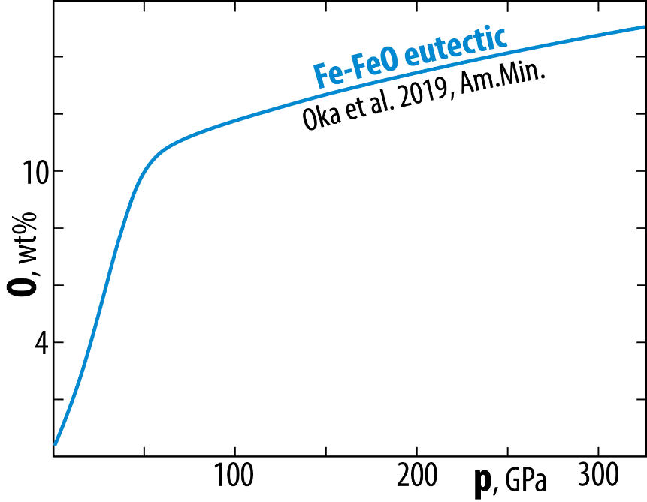
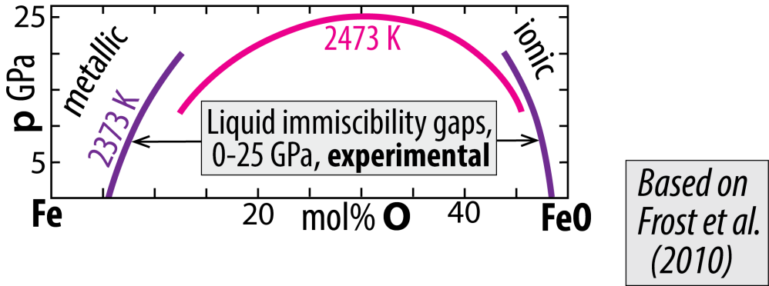
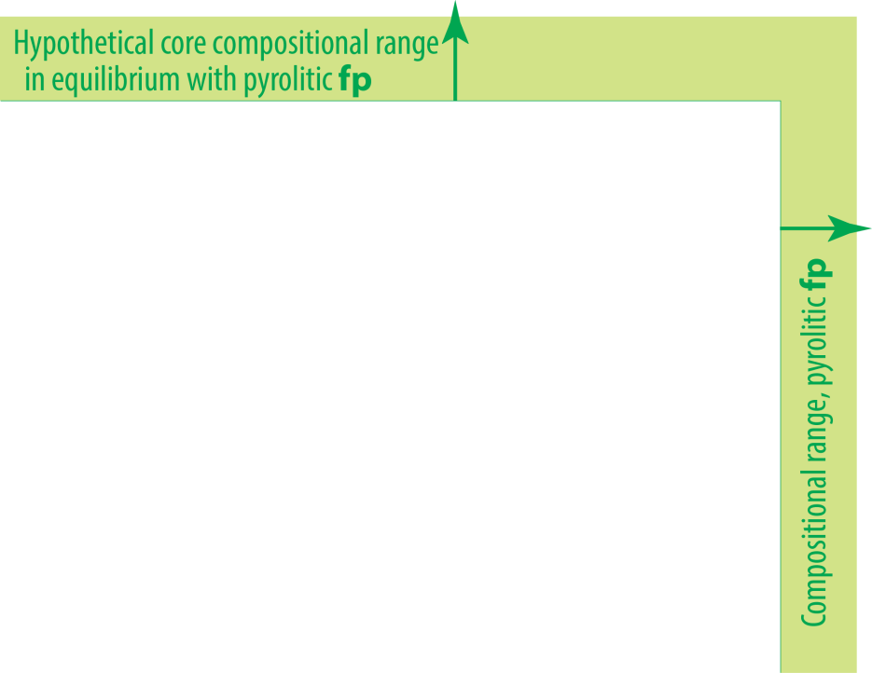
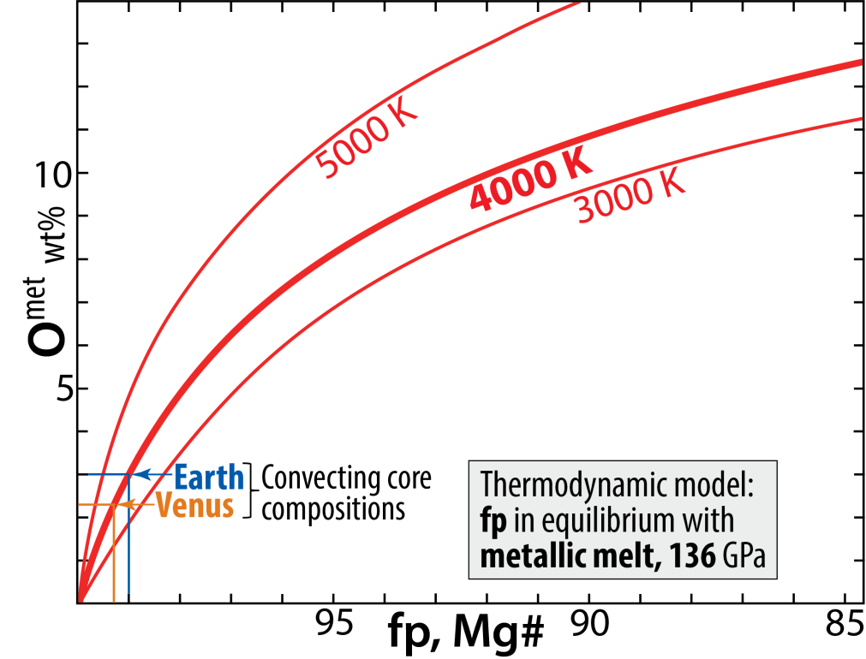
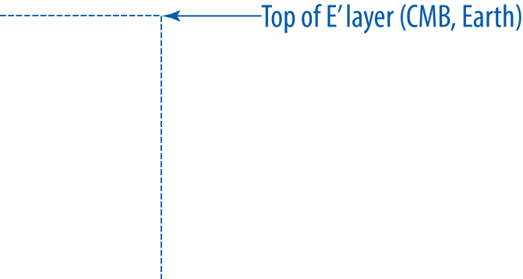
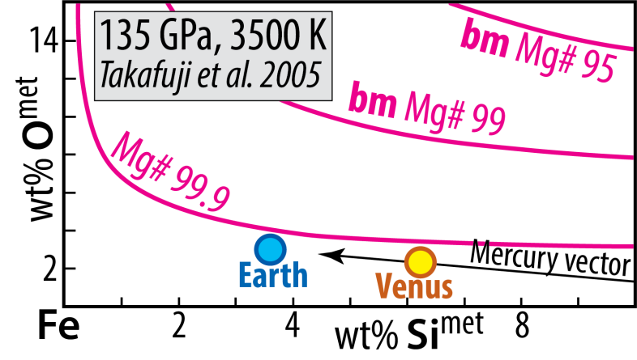
O and Si in Fe-alloys Cooling core-BMO chemical exchange
System: Fe-Mg-O
metal-ferropericlase equilibrium
Solvus closure with increasing p and T
System: Fe-Mg-Si-O
metal-bridgmanite equilibrium

Slide 13
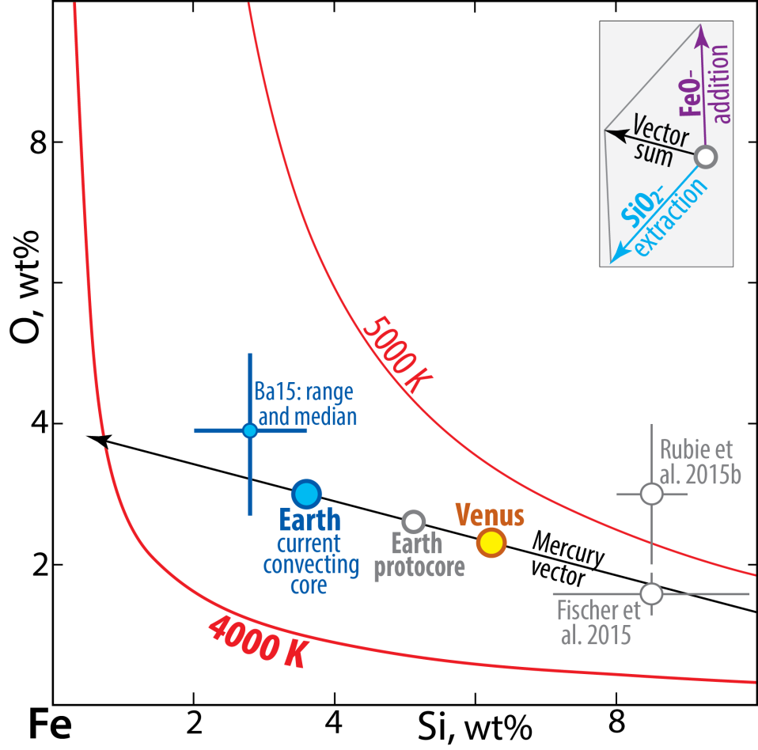
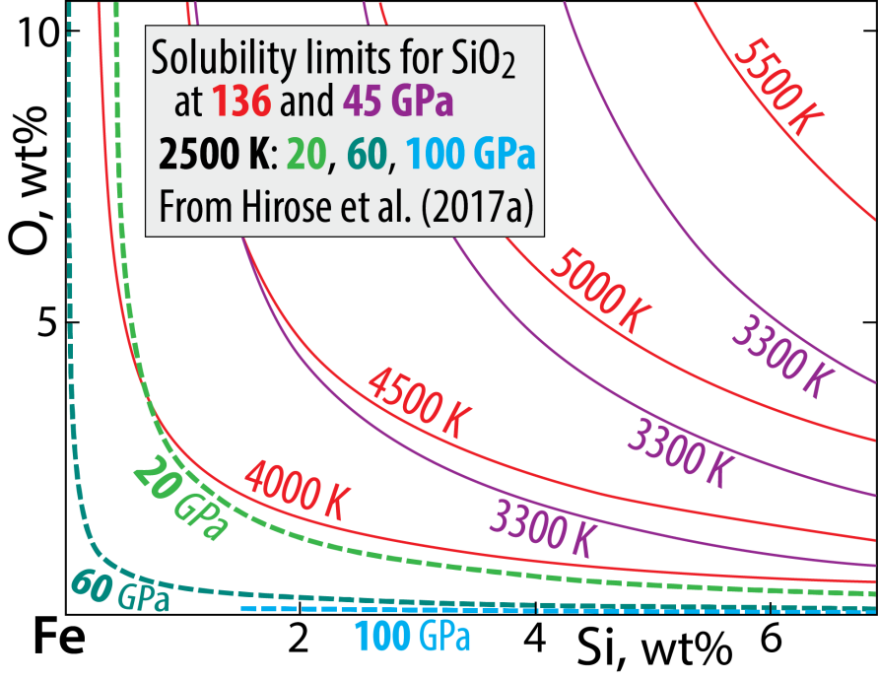
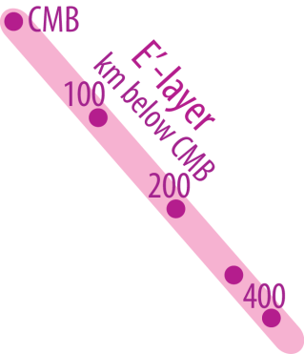
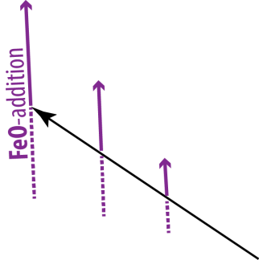
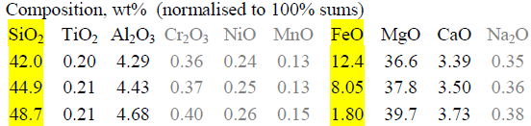
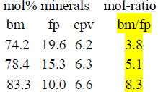

System: Fe-Si-O
Solubility of O and Si in Fe-alloy
Estimated core compositions
Mercury:
15 wt% Si, no O
- O and Si: mutually exclusive
- Solubility increases with T and decreases with p
- Related to the silica liquidus surface in systam Fi-Si-O
Mass balance modelling
Step 1: protoC + earlyMO = convC + pyrolite-MO (total volumes)
Step 2: upper convC + BMO = E'-layer + mod. lowermost M
34 vol%, 28 vol%,
31 wt% of core 34 wt% of mantle

Slide 14
System: Fe-Si-O
Solubility of O and Si in Fe-alloy
- O and Si: mutually exclusive at low T / high p
- Solubility increases with T and decreases with p
- Related to the silica liquidus surface in system Fe-Si-O

Slide 15
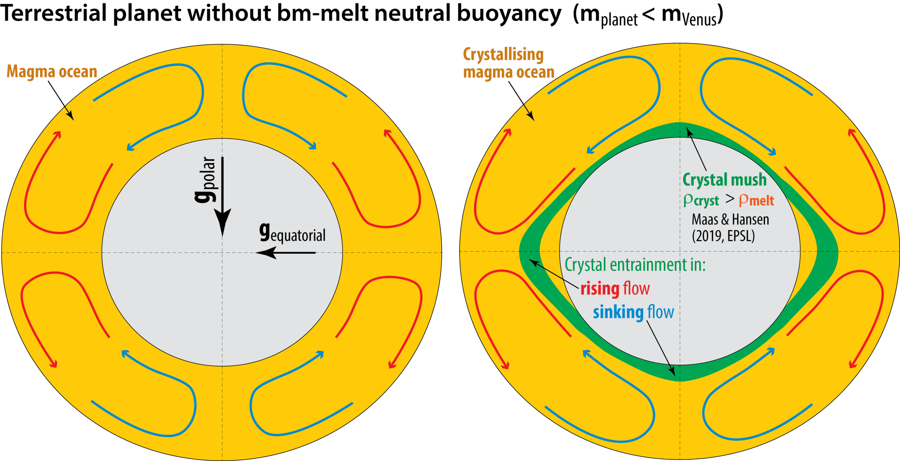
Convection modelling of MO crystal settling in
rapidly rotating planets (differential gravitational fields)

Slide 16
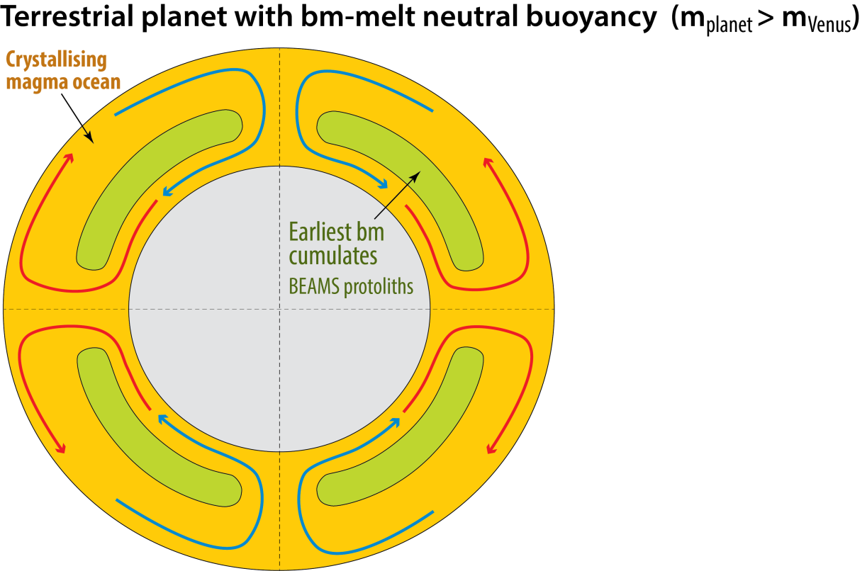
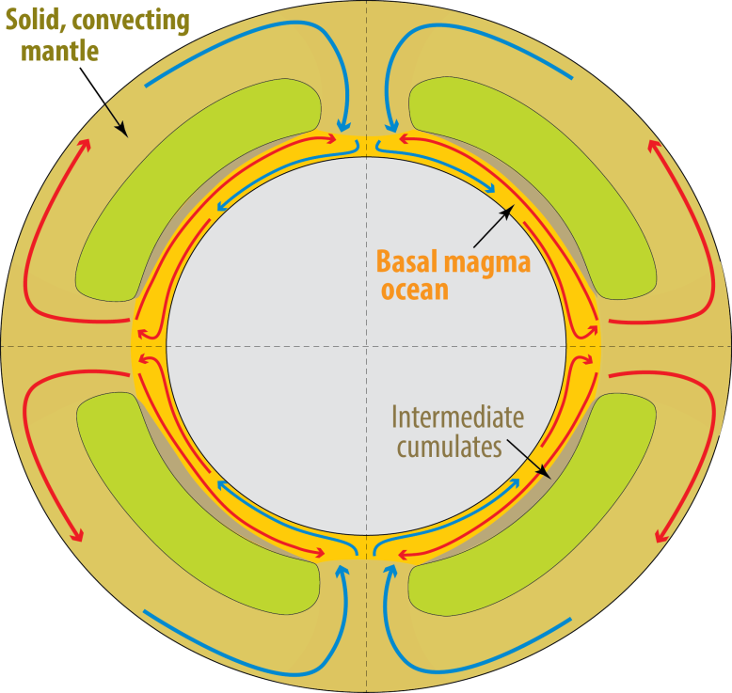
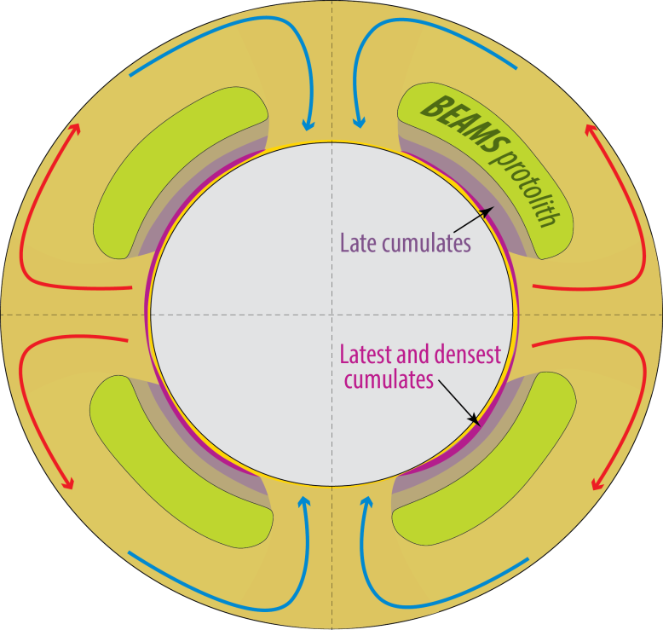
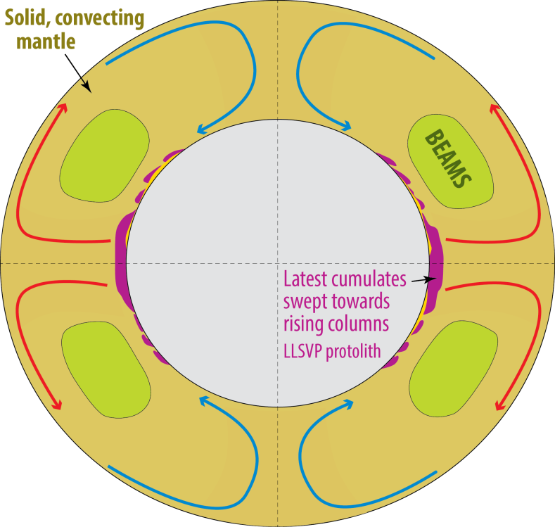
Change from mostly liquid to mostly solid mantle:
Possible change from: columnar polar downflow
with equator-plane upflow
to: longitudinal (circum-polar)
sheet-like downflow with
columnar antipodal upflow
in the equatorial plane
e.g. the Earth
10-100 Ma ?
Long-lived basal
magma ocean (BMO)
> 2 Gy ?

Slide 17
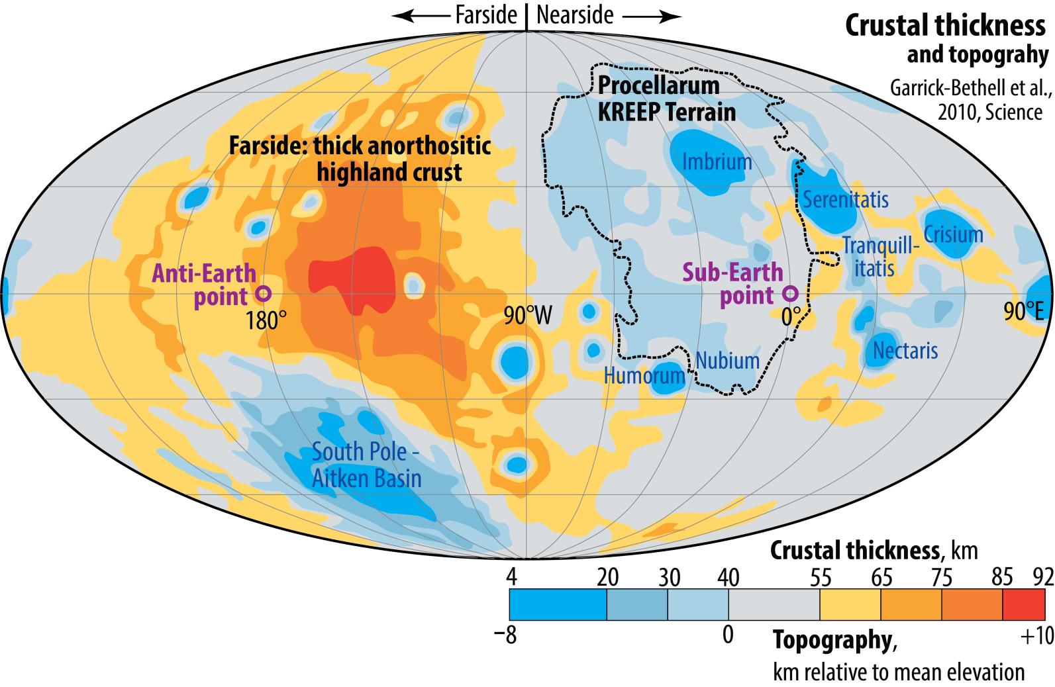
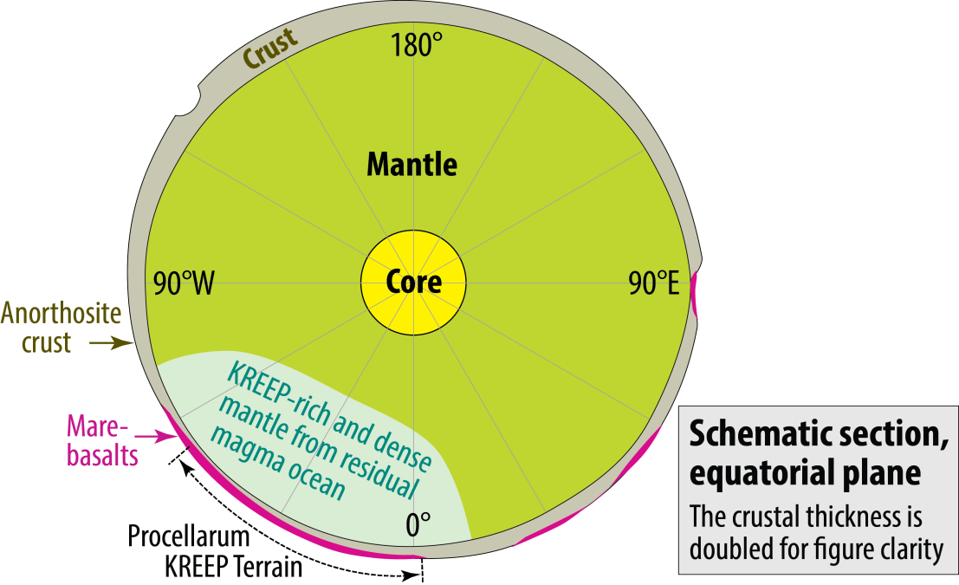
Lunar crust distribution and thickness
A result of MO crystallisation under
Earth's gravitational influence (?)

Slide 18
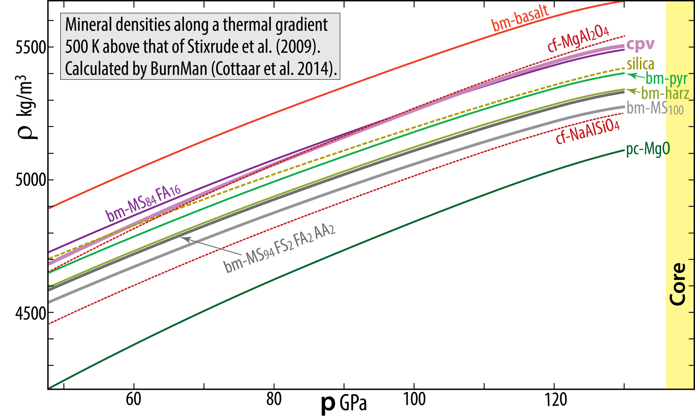
Core BMO-exchange with bm-crystallisation → liquid enriched in Ca, Na and Al
→ Ca-perovskite (cpv) and the Ca-ferrite-structured phase (cf) will crystallise
- High density of cpv will prevent its incorporation in the crystallising ceiling
- Instead, cpv will sink and dissolve into the hot liquid below → Strong CaO^{BMO} enrichment
Components, bm
MS: MgSiO₃
FS: FeSiO₃
FA: FeAlO₃
AA: Al₂O₃

Slide 19
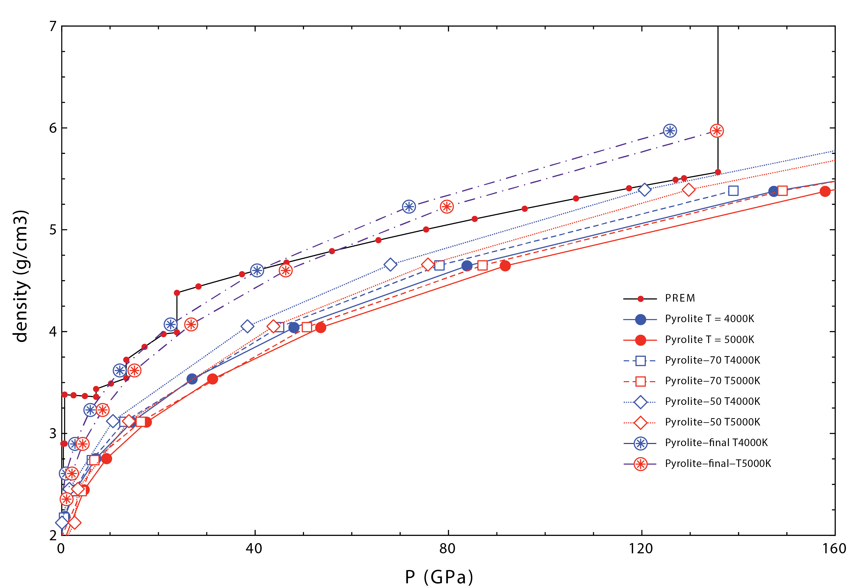

Slide 20
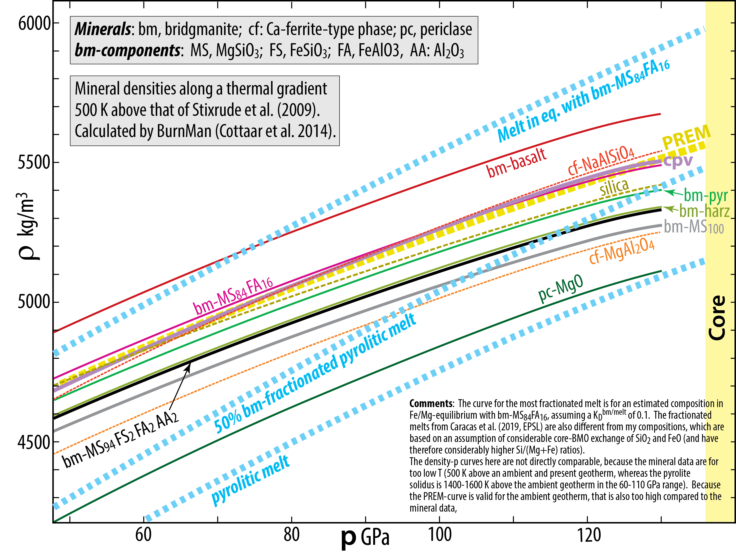

Slide 21
Melting relations of peridotite

Slide 22
Newly recognised structural elements
Lower mantle
Strong petrological evidence and more tenuous seismic evidence for early refractory domains (ERD), likely organised in "bridgmanite-enriched ancient mantle structures" (BEAMS, Ballmer et al. 2017, Nat. Geosci.)
Outer core
Low-V_{P}, low-ρ outermost core: E'-layer (Brodholt & Badro, 2017, GRL)
Equatorial section
Inferred locations for BEAMS

Slide 23
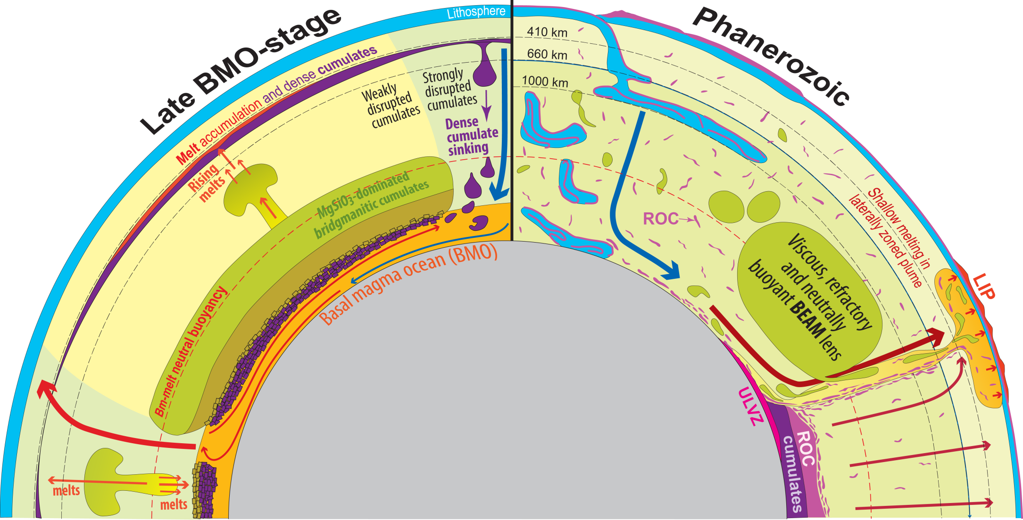
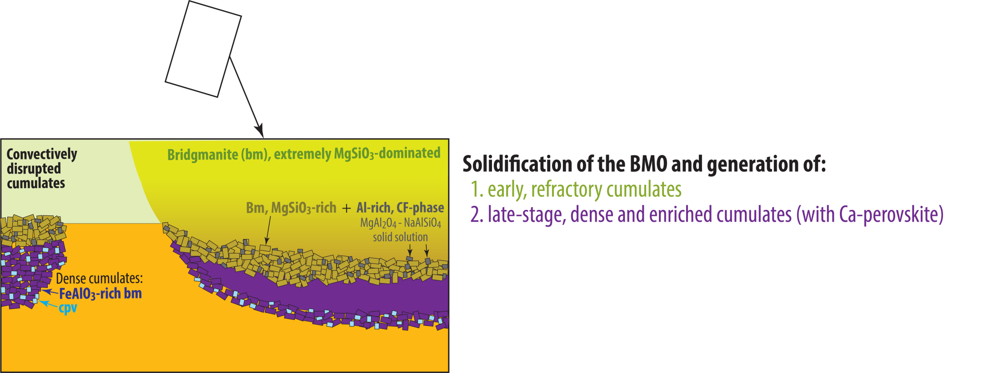

Slide 24

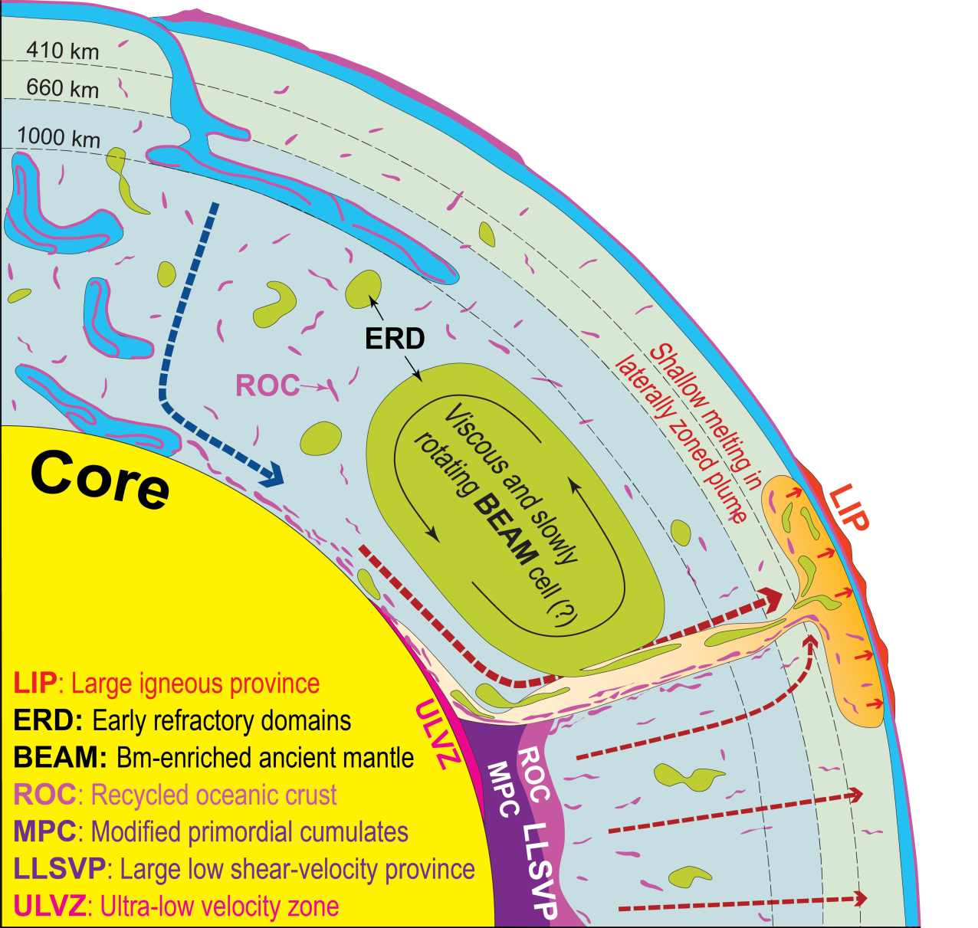
Equatorial Earth sections
Modified, mainly from:
Trønnes (2010, Mineral. Petrol.),
Torsvik et al. (2016, Can. J. Earth Sci.),
Ballmer et al. (2017, Nature Geosci.)

Slide 25

- BMO crystallisation during core-BMO exchange may produce cumulates with optimal
properties for stabilisation of degree-2 convection pattern: early refractory domains with high visosity and
neutral buoyancy + late dense cumulates
- Additional stabilisation is provided by a variable equator-to-pole gravity field: Earth's rotation
The degree-2 convection pattern
- might have been established before
or during BMO solidification
- might be a precondition for
thermochemical pile assembly

Slide 26
Extra material

Slide 27
Fe-FeO system
Oka et al.,
(2019, AmMin)
alumina
(al)
al
23 GPa, 13.0 wt% O
132 GPa, 4.1 wt% O
204 GPa,
13.0 wt% O
Liq
al
al
Liq
FeO
al
Fe
al
al
al
al

Slide 28
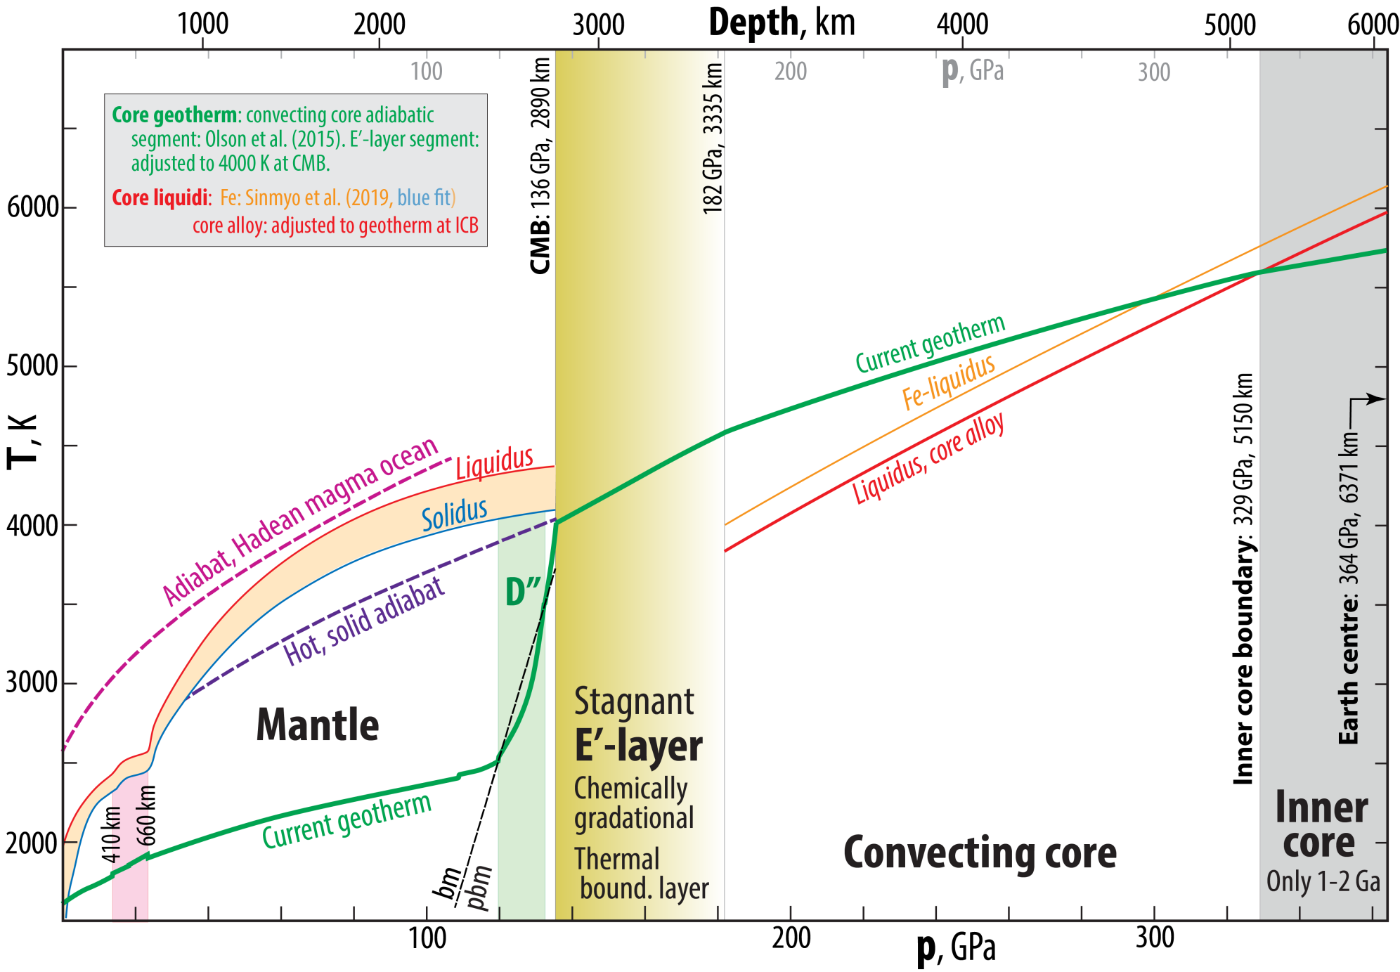
Core structure and geotherm

Slide 29
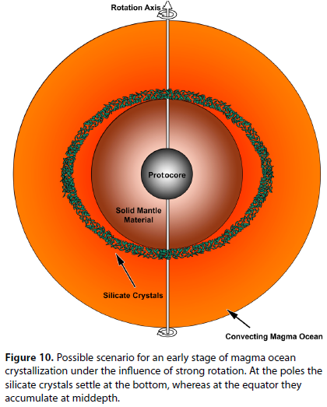
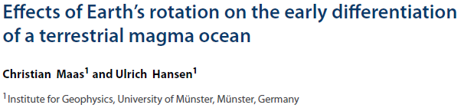


Convection modelling of crystal settling in low-
viscosity MOs in rapidly rotating planets
(differential gravitational fields)
Maas & Hansen
(2015, JGR)
JGR, 2015
EPSL, 2019
also:
GGG, 2013
Indicating:
- upwelling flow near the equatorial plane
- downwelling flow in the polar regions

Slide 30

FeO-partitioning from a ferropericlase single crystal to Fe-melt at 12.5 GPa - 2123 K - 1 min
Initial crystal composition: Mg_{0.45}Fe_{0.55}O
Otsuka & Karato
(2012, Nature)
40 μm

Slide 31

Present-day core-mantle chemical interaction??
If so: the ULVZs might be good candidate "windows" to the core, breaching the postulated thin skin diffusional barrier.
LLSVP: Large low shear-velocity provinces
ULVZ: Ultra-low velocity zone

Slide 32



System Fe-Si-O: liquidus relations at 136 GPa
~4000 K
~4660 K
~4600 K

Slide 33

E'-layer formation by silica crystallisation, combined with FeO transfer from the BMO:
- Requires silica cryst. in the outermost core

Slide 34

E'-layer formation by silica crystallisation, combined with FeO transfer from the BMO:
- Requires silica cryst. in the outermost core

Slide 35


Slide 36


CMB heat flux
pattern, L4
50
70
90
110
Olson et al.
(2017, PEPI)
60
100
60
50
125
50
50
120
35
35
40
45
100
100
100

Slide 37

Are there also basaltic ROC accumulations in the D" ROC areas ?
The seismic tomography model SP12RTS (Koelemeijer et al. 2016, GJI; 2018, EPSL)
V_{S}² = G / ρ
V_{C}² = K / ρ
V_{P}² = (K + 4/3*G) / ρ
Increasing V_{S} / V_{P} (S/P) ratio and V_{S} - V_{C} anti-correlation in both fast and slow regions
of the lowermost mantle - i.e. both the slow LLSVPs and the fast circimpolar belt
670 km
465 km
240 km
16 km
V_{S}-V_{C} anticorrelation
?

Slide 38


The seismic tomography model SP12RTS (Koelemeijer et al. 2016, GJI; 2018, EPSL)

Slide 39

~320 km above CMB
~230 km above CMB
~140 km above CMB

Slide 40



Recycled oceanic crust (ROC, basaltic) as
alernative or additional LLSVP material
Equatorial
section
Basaltic material is denser than peridotite in lower mantle
LLSVPs (thermochemical piles) could grow by accumulation of oceanic crust delivered by sinking lithospheric slabs
Plume generation zone
Possible density-driven segregation of basaltic material

Slide 41


Modified from Torsvik
et al. (2016, CJES)

Slide 42
LLSVP characteristics
ΔT: 750 K, Δρ:1-1.5%, ΔK_{S}: 2%, Δη: 10²-10³ Pa s (Wolf et al. 2016; Trønnes et al. 2018; Amman et al. 2010)
bm-dominated lithology with additional free silica and a MgAl₂O₄-rich Ca-ferrite-structured phase
Compositional requirement to generate such material
Limited Fe-enrichment (about 15 mol% combined FeAlO₃ and/or FeSiO₃) in late bm-dominated BMO-cumulates to comply with moderate Δρ and ΔK_{S} and high Δη, in spite of high ΔT.
Generation of LLSVP material
Core-BMO chemical exchange
- Seifertite crystallisation and floatation in the core, followed by silica dissolution in BMO melt
- bm redox-pumping by crystallisation and dissolution: Fe-metal drops and Fe₂O₃ dissolution in BMO melt
- FeO and Fe₂O₃ dissolution in sinking Fe-metal drops and directly into the outermost core
Consequences for BMO melt
Transfer of SiO₂ from and FeO to the core modifies the FeO-rich cumulates (about 80% bm and 20% fp):
- the bm/fp ratio increases, probably to complete elimination of fp
- the Fe/Mg ratio decreases

Slide 43
Fe-oxide transport to the core
Will the BMO be oxidised or reduced during solidification?
If Fe-metal alloy is
extracted and sinks
into the core
If Fe-oxide with a
FeO_{1.5}/FeO ratio higher
than that of the BMO
dissolves into the core

Slide 44

Crystallisation of bm in BMO
Cyclic crystallisation and dissolution of bm
- incorporation of the FeAlO₃-component in bm
- associated by FeO disproportionation and
Fe-metal precipitation (Frost et al. 2004, Nature)
30 nm
160 nm
Might be important for O-loading of the core.
BUT: O-saturation level in metal is < 20 wt%, while FeO and
and Fe₂O₃ contains 22 and 30 wt% O, respectively.
Sinking metal drops will therefore always oxidise the BMO
Andrault et al.
(2018, GPL)

Slide 45

Below about 250 km depth:
Redox reactions: reduced conditions and Fe-metal
- Bulk mantle peridotite: Fe³⁺ / (Fe³⁺ + Fe²⁺) ≈ 0.02
- The dominant minerals garnet and bridgmanite,
however, have Fe³⁺ / (Fe³⁺ + Fe²⁺) of 0.5 − 0.7
- This leads to the precipitation of Fe-metal
2Fe₂SiO₄+2Mg₂SiO₄ + Al₂O₃ = 2FeAlO₃+4MgSiO₃ + FeO + Fe
rwd
from ga
bm
fp
FeNiS-
alloy
- Metallic Fe will reduce carbonate to diamond:
2 Fe + MgCO₃ = C + MgFe₂O₃
fp, (Mg,Fe)O
Modified from Stixrude &
Lithgow-Bertelloni (2012,
Ann Rev Earth Planet Sci)

Slide 46

Equatorial
Earth sections
Modified from e.g. Trønnes (2010, Mineral. Petrol.), Torsvik et al.
(2016, Can. J. Earth Sci.), Ballmer et al. (2017, Nature Geosci.)

Slide 47

Seismologic evidence for low-velocity layers above the 410 km
and below the 660 km dicontinuities
H₂O-induced melting
Lithosphere
Fe-metal and reduced
conditions - diamond
below 660 km
410 km depth:
Fe-metal and reduced
conditions - diamond
Modified from Stixrude &
Lithgow-Bertelloni (2012,
Ann Rev Earth Planet Sci)

Slide 48


Earth's initial magma ocean crystallisation - two possibilities
Alternative 1: Magma ocean crystallization starts at the bottom
Magma ocean adiabat

Slide 49


Alternative 2: Magma ocean crystallization starts at mid-mantle depths
Computational study by Stixrude et al. (2009, EPSL)
- steeper adiabat (interms of dT
- consistent with Mosenfelder et al. (2007, JGR)
Magma ocean adiabat

Slide 50
Scenario with two magma ocean
Labrosse et al (2007, Nature)
Stixrude et al. (2009, Earth Planet. Sci. Lett.)
Stage 1
Core
Stage 2
Cumulates with lower Fe/Mg
Cumulates with higher Fe/Mg
Core
Stage 3
Inner magma ocean:
melt density > crystal density (pv, fp)
(Fe/Mg)_{melt} > (Fe/Mg)_{crystals}
Fe-rich cumulates
starting point for
thermochemical piles
Core

Slide 51

Deep melting in hot Hadean plumes at >300 km depth (Lee et al. 2010, Nature)
- Melt migration to sill complexes (density trap) at 410 km depth
(somewhat deeper in a hotter Hadean mantle)
- Solidification and cooling of sills to abient T (thermal equilibration)
- Sinking of sill material (high Fe/Mg-ratio) to the CMB
Hot Hadean plumes:
Solidus crossing at 500-700 km depth is likely
Locally depressed solidus T in this range
Based on: Zhang & Herzberg (1994, JGR)
Tønnes & Frost (2002, EPSL)
Ito et al. (2004, PEPI)

Slide 52

Lee et al. (2010, Nature)
Melt accumulation zone
Solidified, thermally
equilibrated melt
sink to the CMB

Slide 53
Age and origin of LLSVPs
Basaltic material is denser than peridotite in lower mantle
thermochemical piles (LLSVPs) could grow from accumulation of
of oceanic crust delivered by sinking lithospheric slabs
in that case: LLSVPs would grow slowly (mean age: 1-2 Ga ?)

Slide 54



LLSVPs, D”-zone
Schematic equatorial section with the
large-scale convection pattern
Dziewonski et al.
(2010, EPSL)
Trønnes (2010,
Min. Petrol.)

Slide 55



ULVZ distribution
Thorne & Garnero
(2004, JGR)

Slide 56



Reconstructed LIPs (24)
SCLIP
300 Ma
27 LIPs: 16-297 Ma
Large igneous provinces
- present distribution
SCLIP, 297 Ma:
Skagerrak-centred LIP,
includes the Oslo Rift
Clustering of reconstructed LIPs along
the LLSVP-margins − implications
1. The plume generation zones and the LLSVPs have
long-term stability (> 300 Ma)
2. LLSVPs must consist of dense (and hot) material
(2-5% density excess to counteract destruction by
thermal buoyancy)
LLSVPs: Thermochemical piles

Slide 57



Slide 58


Melting phase relations, peridotite
Simplified system CMS
Complex natural peridotite
CMS-system
- eutectic melts similar to bulk periodotite compositions
- little change in the 24-136 GPa range
Fe-bearing systems
Strongly elevated Fe/Mg ratio of melt rel. to solid bm and fp

Slide 59


Adiabat-liquidus crossing

Slide 60



Neutral buoyancy levels
and cumulate formation
Approximate neutral buoyancy levels
Earth and Venus: 11 and 80 GPa
Mars: 11 GPa
Moon (and others?): Plagioclase neutral buoyancy
at low p at late MO-stage (Fe-rich melts)

Slide 61



Otsuka & Karato (2012, Nature)

Slide 62

The role of Ca-perovskite in the BMO cryatallisation: the melting curve
Guren et al.,
in prep. for GRL

Slide 63



The role of Ca-perovskite in the BMO cryatallisation: system CMS
Guren et al.,
in prep. for GRL
As the crystallising BMO is enriched in CaO and Al₂O₃:
cpv and the Al-rich Cf-structured phase will join the assemblage

Slide 64
Basal magma ocean (BMO) crystallisation
Why did Earth have a BMO?
peridotite-melt neutral buoyancy at high p
73-80 GPa:
~1800 km depth
Strong Fe/Mg-partitioning
densifies peridititic melts
bm/melt
Fe/Mg
K_{D} = (Fe/Mg)^{bm} / (Fe/Mg)^{melt}

