Slide 1
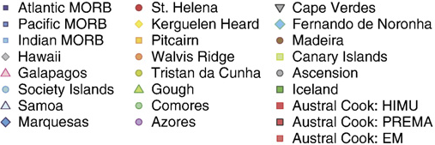
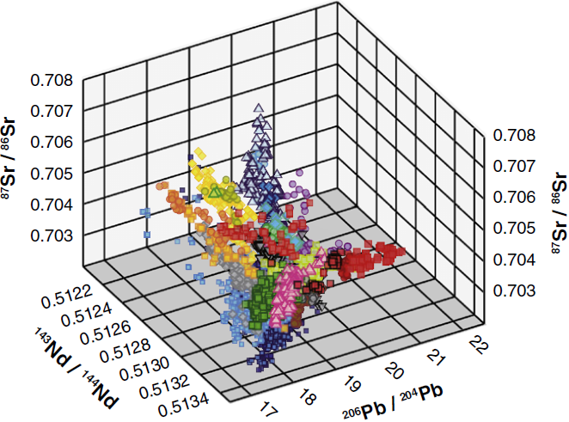
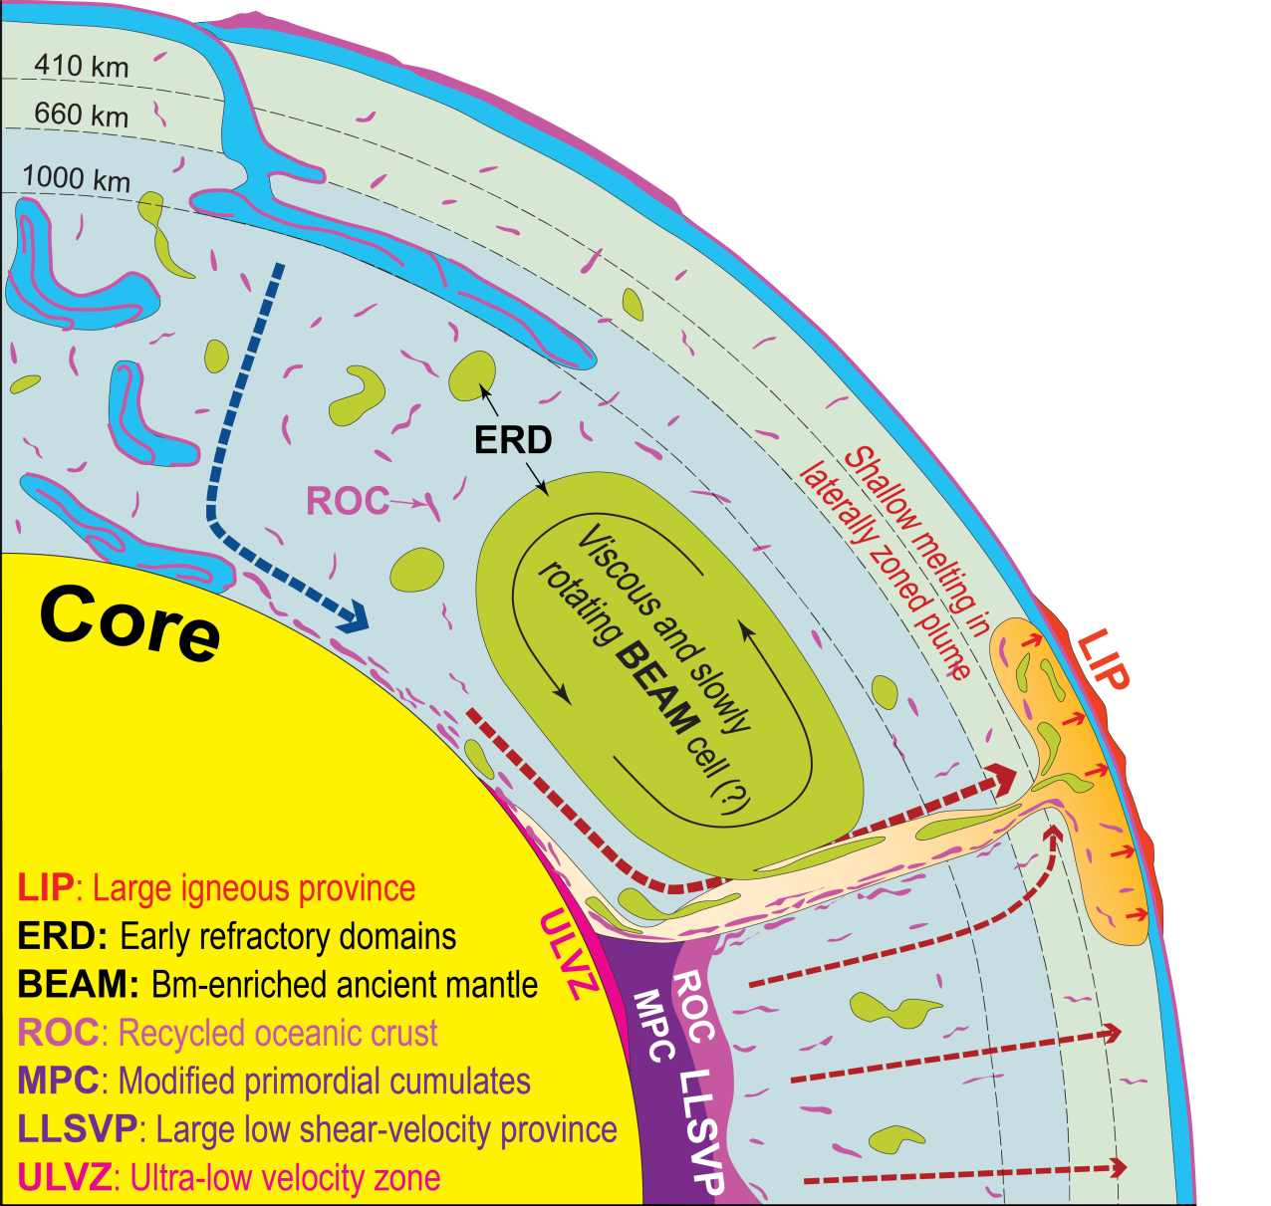
Deep geochemical cycles 2:
Primordial, depleted and recycled
components in basalts
Reidar G. Trønnes
NHM & PHAB,
Univ. Oslo
Sr-Nd-Pb isotope space
3D-visualization
EM2
Inferred structure and
dynamics of the
present Earth
EM1
HIMU
PREMA
DM
Main objective and outline
Review of isotope geochemical features to gain insights into:
- primordial structure and distinct reservoirs of the deep Earth
- paths and timescales for the recycling of surface materials
- storage locations of recycled oceanic crust and sediments
- chemical core signals incorporated into deep plume roots
- general structure and dynamics of the Earth

Slide 2
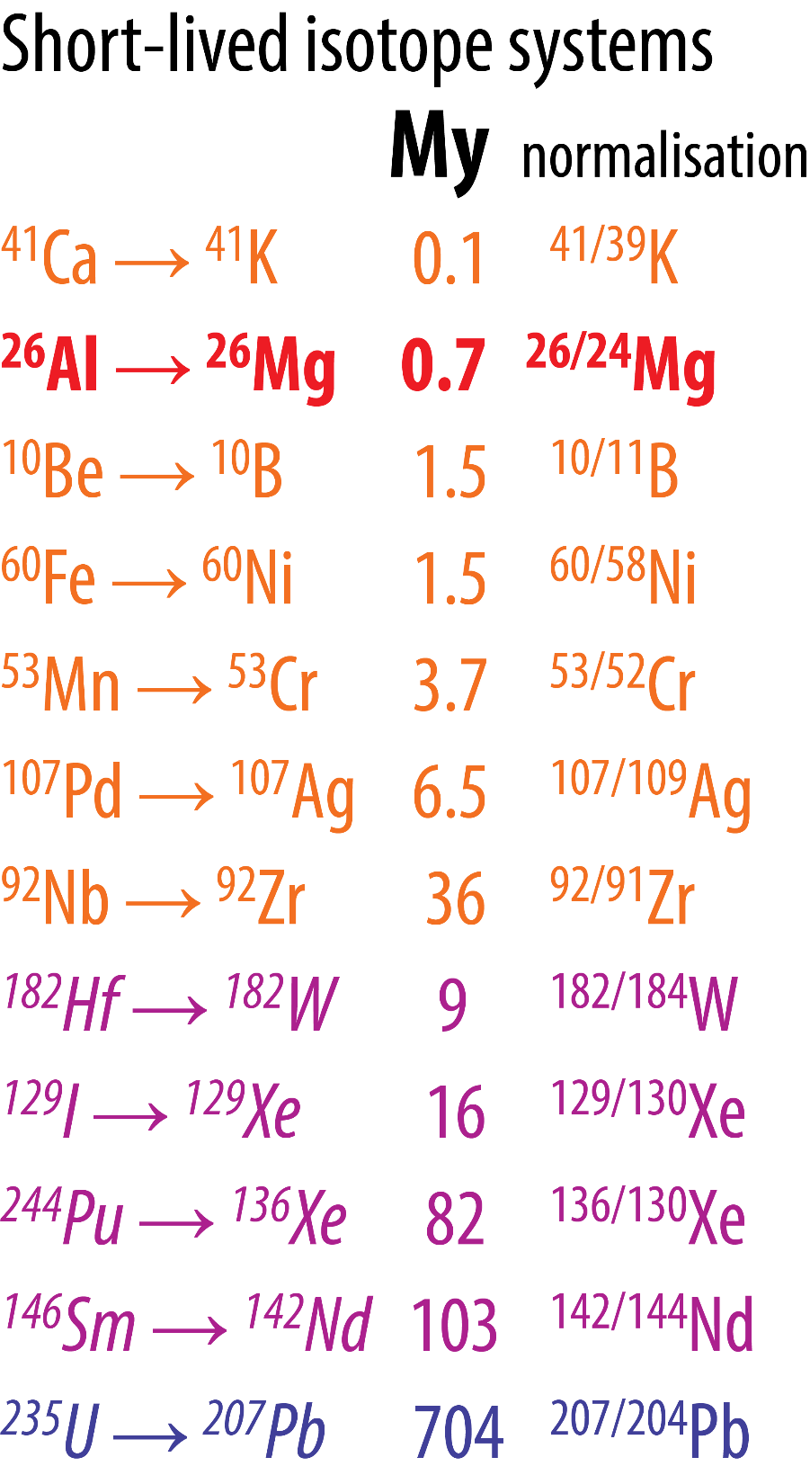
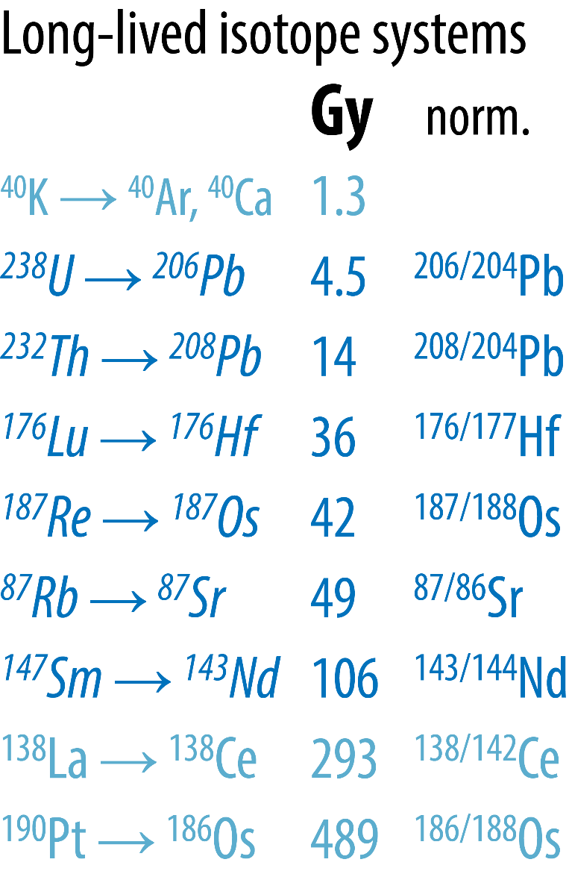
Geochronology: Radioactive decay systems with half-lives in My and Gy
Important heat
source for the
first 2-3 Ma
interm. t_{h}
long t_{h}
Common constraints
on early planetary
differentiation and
core-mantle geo-
chemical reservoirs
Very long
t_{h}

Slide 3
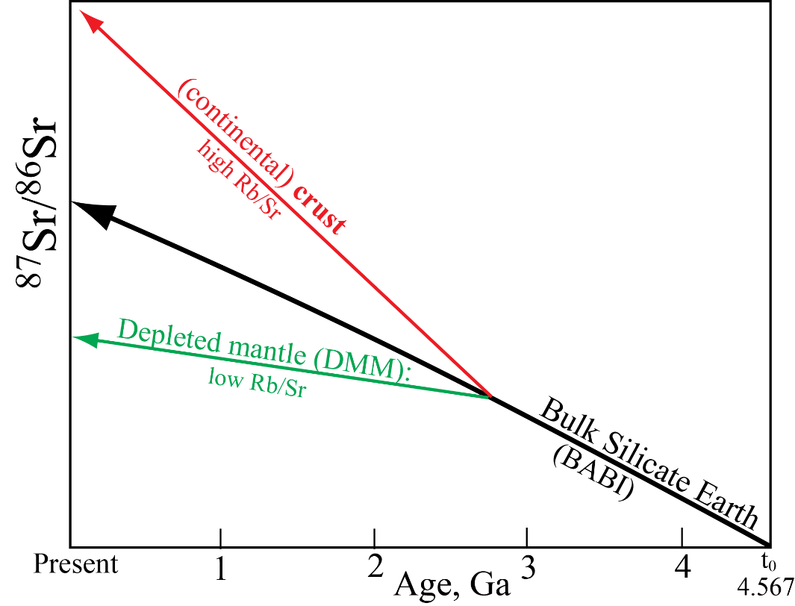
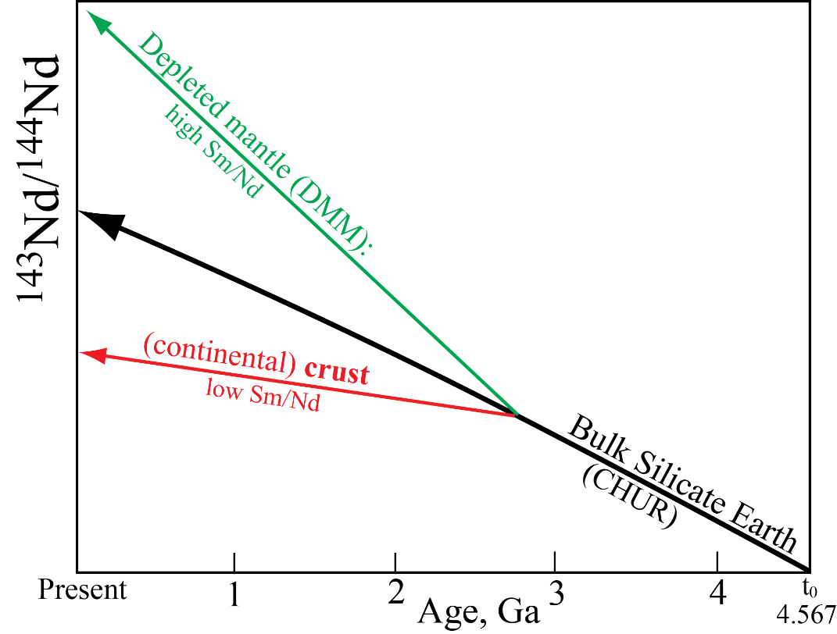


The longlived Sr-¹⁴³Nd isotopic mantle array
Time-integrated isotopic evolution
⁸⁷Rb → ⁸⁷Sr
¹⁴⁷Sm → ¹⁴³Nd

Slide 4
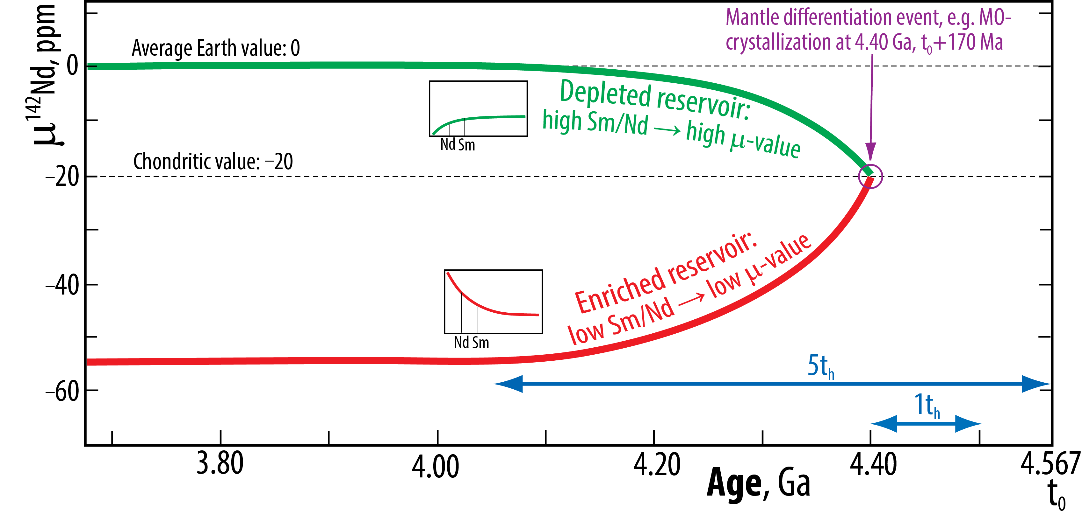
The shortlived ¹⁴²Nd system

Slide 5
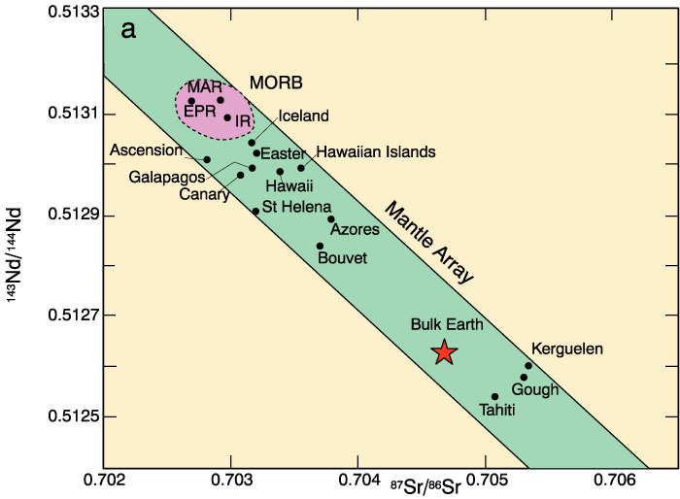
Nd and Sr isotopes of oceanic basalts: the "mantle array"
Notes:
MORB at depleted end
Tahiti, Gough, and Kerguelen at enriched end
Truly enriched over Bulk Earth
Array = mixing line?
Two components mixed
How mixed? As liquids?

Slide 6
ε_{Nd} = [ ] * 10⁴
(¹⁴³Nd/¹⁴⁴Nd)_{sample} − (¹⁴³Nd/¹⁴⁴Nd)_{standard}
Hf-Nd isotopic array
(¹⁴³Nd/¹⁴⁴Nd)_{standard}
¹⁴⁷Sm→ ¹⁴³Nd, ¹⁴³Nd/¹⁴⁴Nd
ε_{Nd} = [(^{143/144}Nd_{sample}/^{143/144}Nd_{stand}) − 1] * 10⁴
¹⁷⁶Lu → ¹⁷⁶Hf, ¹⁷⁶Hf/¹⁷⁷Hf
ε_{Hf} = [(^{176/177}Hf_{sample}/^{176/177}Hf_{stand}) − 1] * 10⁴
72
Hf
The parents (Sm, Lu) are less incompatible (or more compatible) in residue than the daughters (Nd, Hf)
→ positive ~correlation between ε_{Nd} and ε_{Hf}
DM
DM: Depleted mantle
PM: Primitive mantle
EM: "Enriched" mantle
Mantle array
ε_{Hf}
PM
EM
ε_{Nd}

Slide 7
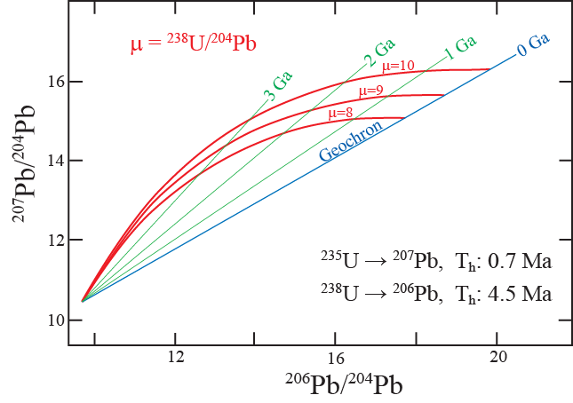
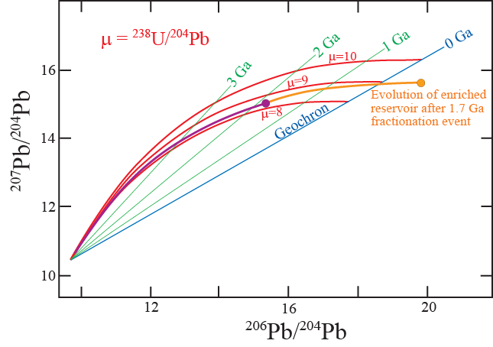
U-Th-Pb systematics the Geochron
²³⁵U → ²⁰⁷Pb T_{h}: 0.7 Ga
²³⁸U → ²⁰⁶Pb T_{h}: 4.5 Ga
²³²Th → ²⁰⁸Pb T_{h}: 14.0 Ga
Single-stage Pb-evolution
→ moving to the geochron
Two-stage Pb-evolution
→ moving beyond the geochron
Canyon
Diablo
Canyon
Diablo

Slide 8
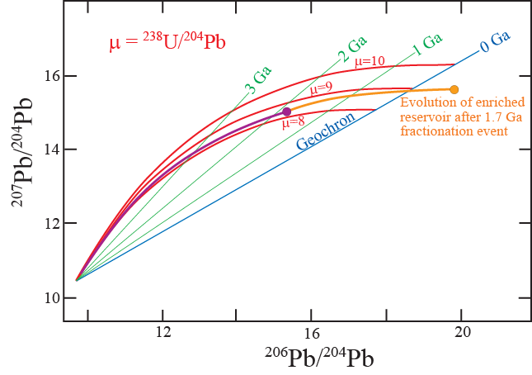
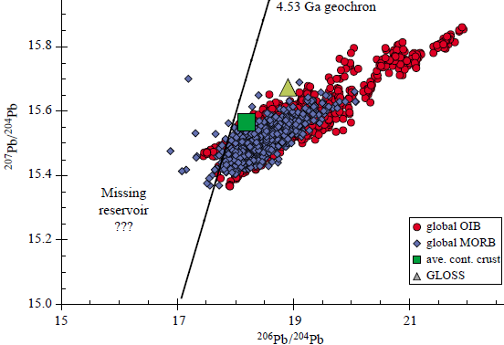
The Pb-paradox
Geochron
UCC
Hidden
reservoir ?
Hofmann (2003,
Treat. Geochem.)

Slide 9
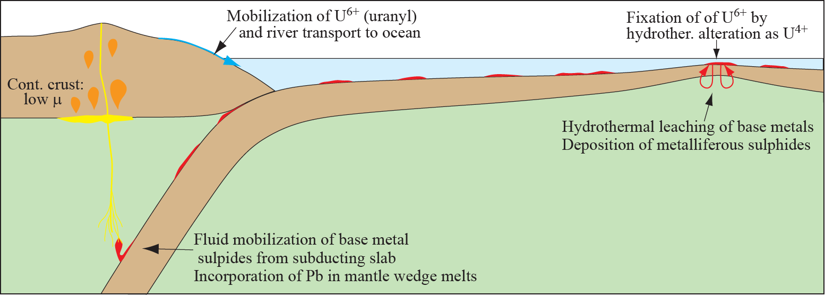
Explanations:
Late (1-3 Ga) loss of Pb to the core (”geochemical core pumping”) - unimportant
Most important: U-recycling under oxidising surface conditions
Riverine transport from UCC to ocean → lithosphere → deep mantle by sinking slab
LCC (and possibly melt depleted mantle) holds complementary unradiogenic Pb and low U/Pb
Uranyl, U⁶⁺, is water-soluble (lakes, rivers, ocean)
high-μ
Intra-crustal
melting
low-μ
Subduction of high-μ lithosphere
– mantle re-fertilization

Slide 10
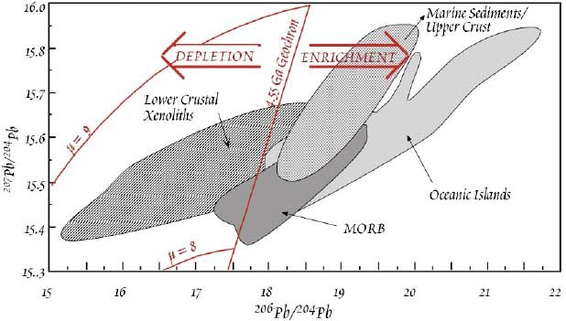
Lower crust has indeed
low ^{206/204}Pb (unradiogenic)
White (2006,
Geochemistry)
UCC
LCC

Slide 11
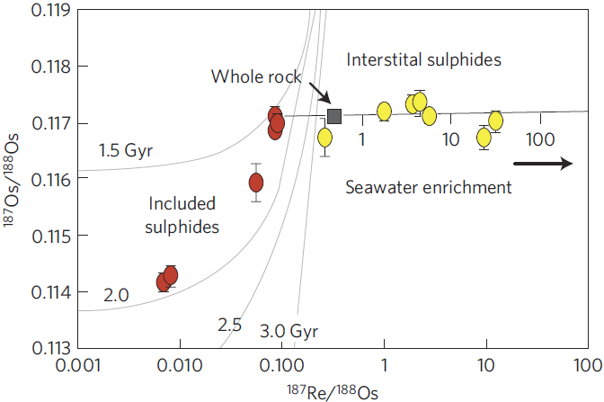
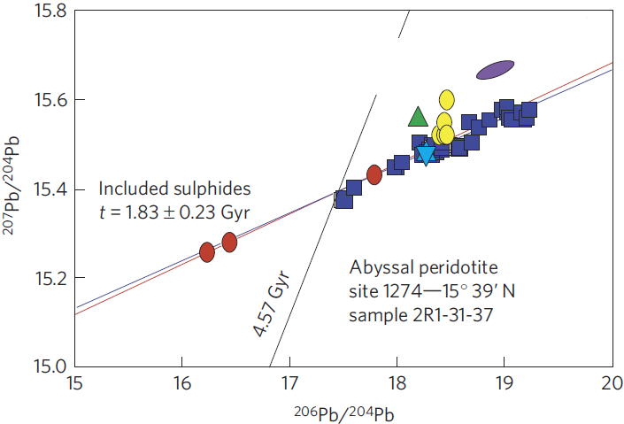
Additional ”hidden” reservoir component for time-integrated low μ:
Sulphide inclusions in depleted mantle peridotite
Strong melt depletion is recorded by low Re/Os-ratios and low ¹⁸⁷Os/¹⁸⁸Os (¹⁸⁷Re → ¹⁸⁷Os, T_{h}: 42 Ga)
Re: incompatible (partitions to melt)
Os: strongly compatible in residual/refractory olivine, sulphides and Os-Ir-alloys
1.8-1.9 Ma
model age
Most of the included sulphides have Pb-isotope
compositions more unradiogenic than the geochron
N Atlantic
seawater
Geochron
Interstitial
sulphides
CC
MORB,
10-17°N
Burton et al.
(2012, Nature Geosci.)
Aver.
NMORB

Slide 12
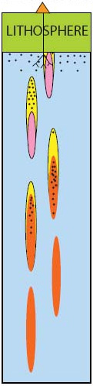
Sobolev et al. (2005, Nature; 2007, Science):
Section of rising lithosphere
Small black dots: decompression melt
Minor elements in olivine phenocrysts
- reflect melt composition
Erupted magmas are
mixtures of:
- residual olivine may be eliminated from
metasomatized garnet-pyroxenite melting source
⇒ poor retention of Ni and Cr in the source
⇒ high Ni-conc. in melt and olivine phenocrysts
melts from peridotite
and
melts from ga-pyroxenite
First-stage Si-rich melts
migrate upwards and
react with peridotite to
form metasomatic
garnet-pyroxenite
Mg₂SiO₄ + SiO₂ = 2 MgSiO₃
Eclogite melts
Eclogite lenses
Peridotite

Slide 13
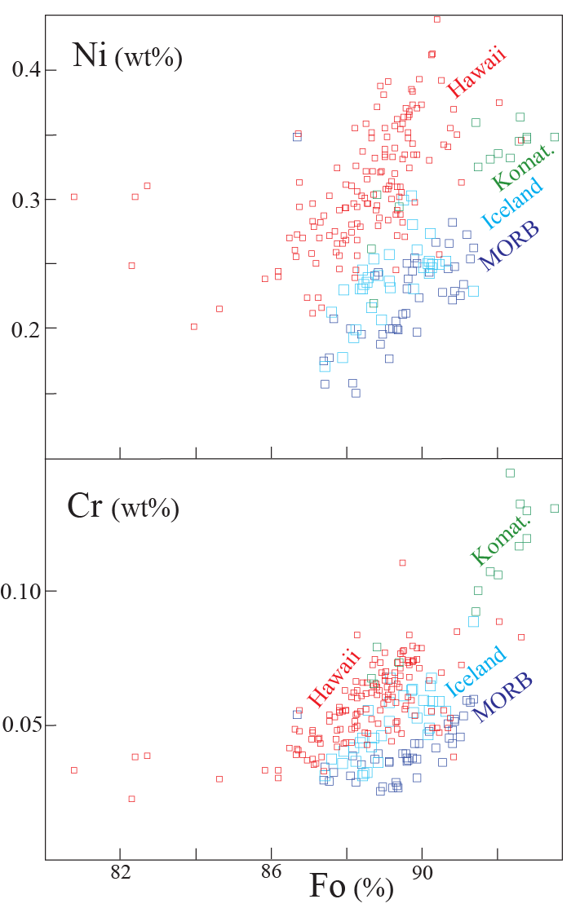
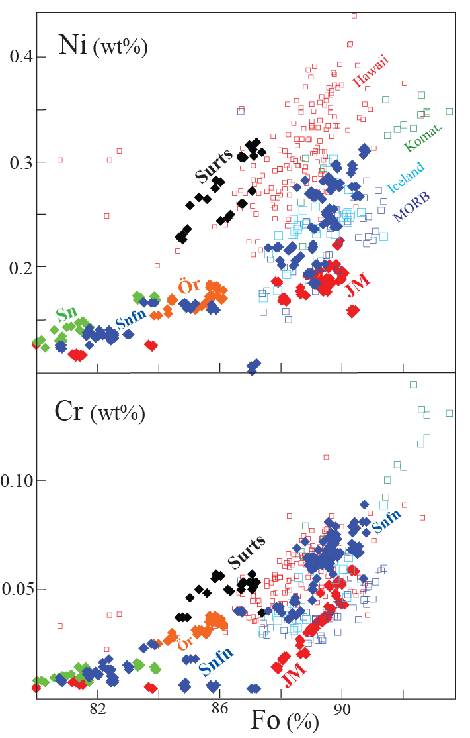
Olivine phenocryst, Ni and Cr:
- held back by residual olivine
- low in MORB, high in Hawaii
Opposite end members:
Surtsey: some hybridized pyroxenite in source
Jan Mayen: peridotite-dominated source
Sobolev et al. (2007)-data

Slide 14
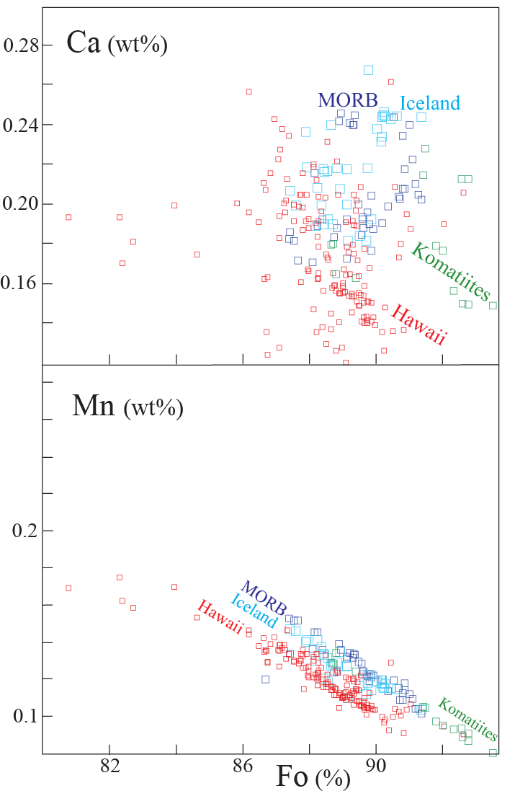
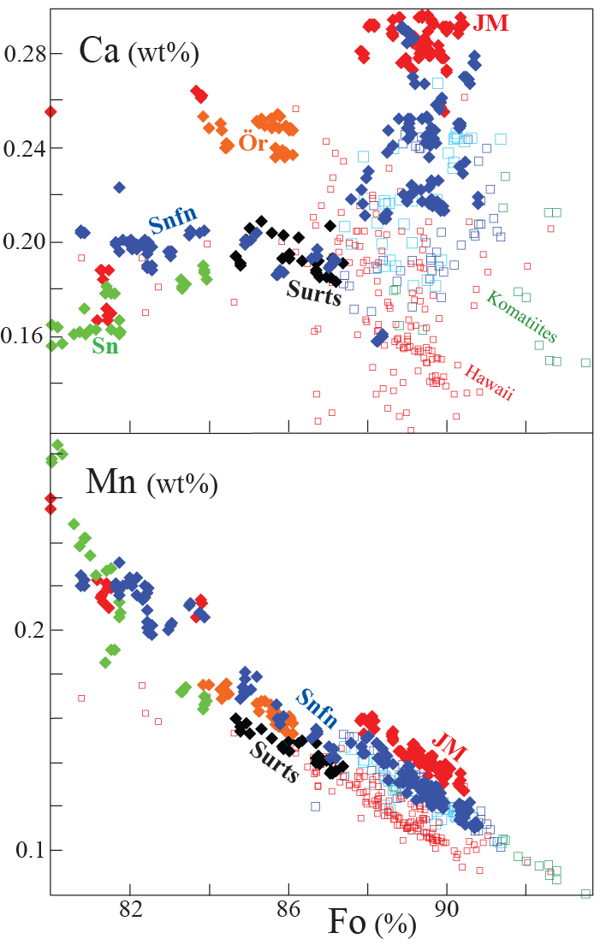
Ca and Mn:
- held back by residual cpx
- low in Hawaii, high in MORB
- Surtsey: Hawaii-like, pyroxenite in source
- Jan Mayen: peridotite-dominated source
Sobolev et al. (2007)-data

Slide 15
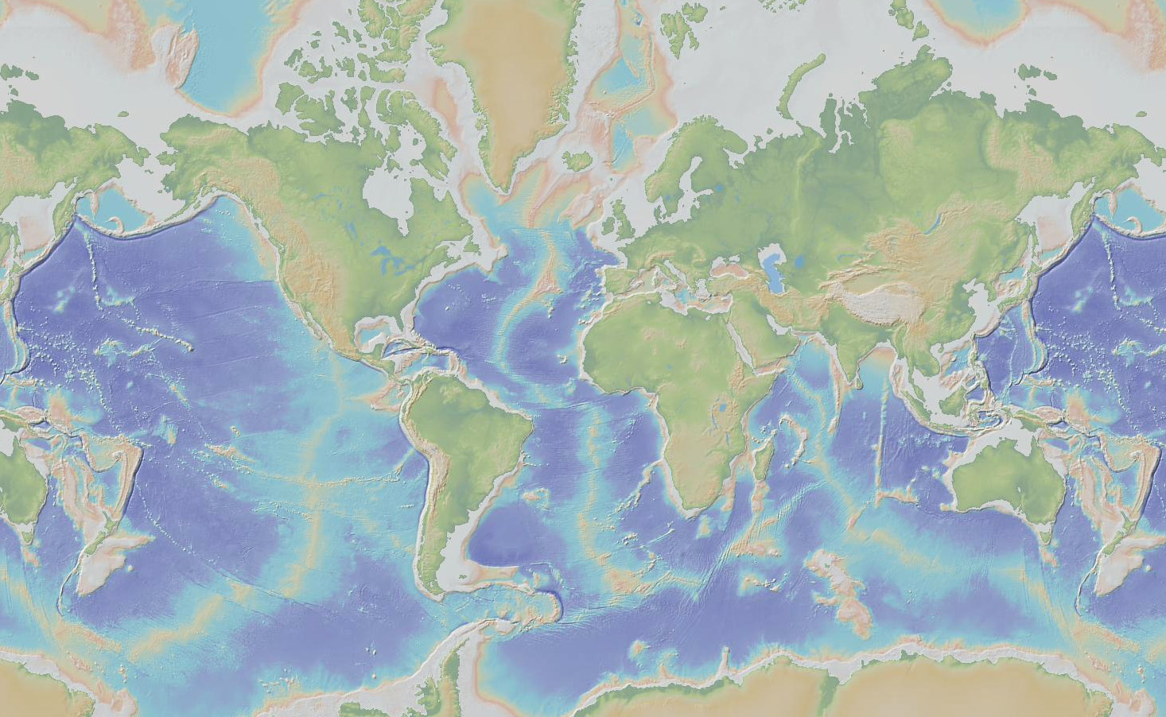
27 deep-rooted plumes (French & Romanowicz, 2015, Nature)
Iceland
Azores
Canary
Hawaii
Cape Verde
Hoggar
Canary
Afar
Caroline
Marshall-Micronesia
Galapagos
Ascension
Cameroon
Samoa
Marquesas
Comoros
Tahiti-Soc
St Helena
Reunion
Macdonald
Seamount
Pitcairn
Easter
San Felix
Walwis R.
Juan Fernandez
Tristan
Gough
Crozet
Kerguelen
Loisville
Herd
Bouvet

Slide 16
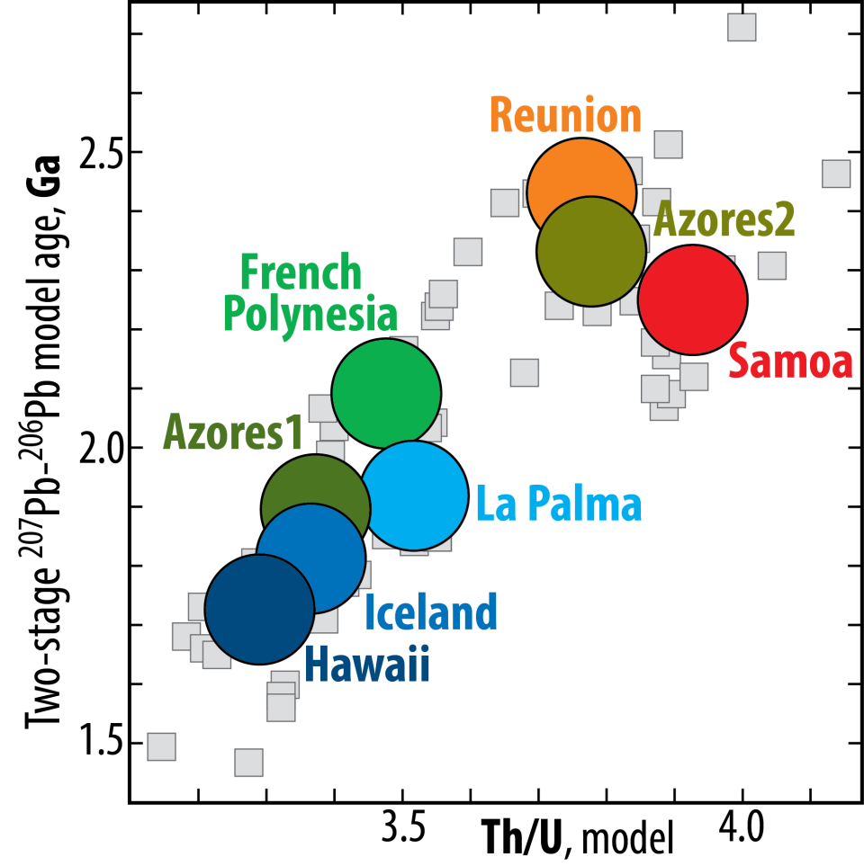
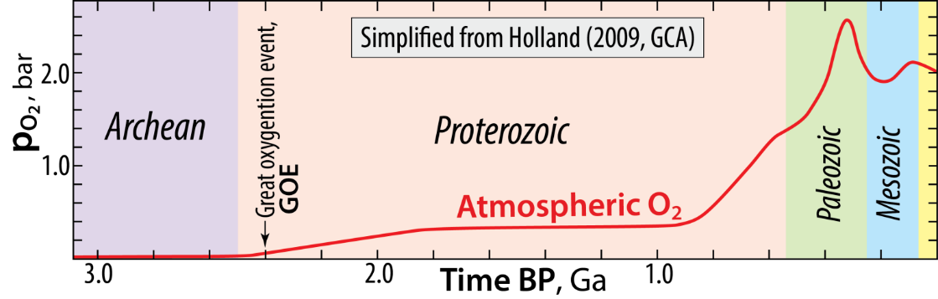
OIBs: Correlated model ages and Th/U ratios
Andersen et al.
(2015, Nature)
Plume source model ages: 1.7 - 2.5 Ga
Great oxidation event: 2.4 Ga
Also: Cabral et al. (2013, Nature)
Olivine-hosted sulphide inclusions in lavas from Cook Islands, Polynesia have S-isotopes indicating Archean ROC
Oxidation of the atmosphere and oceans
recycling of U into the deep mantle
decreasing Th/U ratio of plume
sources with time

Slide 17
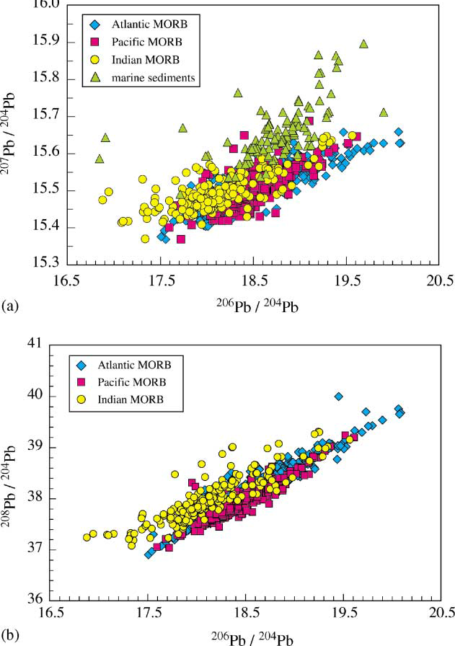
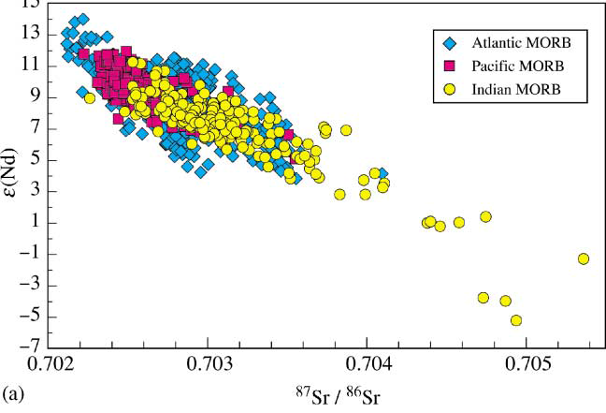
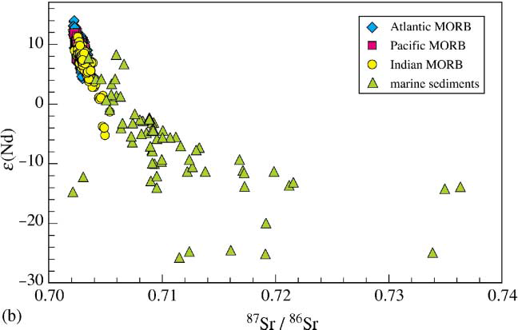
Sr-Nd-isotope array, MORB
Hofmann (2003,
Treat. Geochem.)
Pb-isotope array, MORB
Pacific MORBs: restricted range
Indian MORBs: extend to very
enriched compositions
NHRL
Extension to the crustal array
NHRL
Northern Hemisphere Reference Line, NHRL
Δ-notation: vertical distance above (positive) and below
(negative) the NHRL: Δ²⁰⁷Pb and Δ²⁰⁸Pb

Slide 18
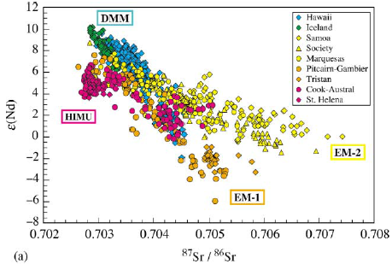
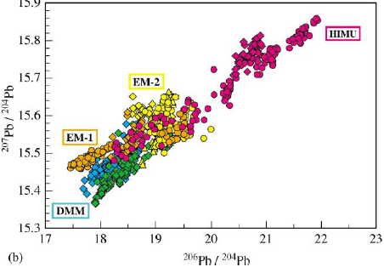
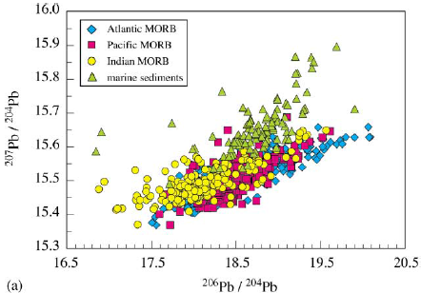
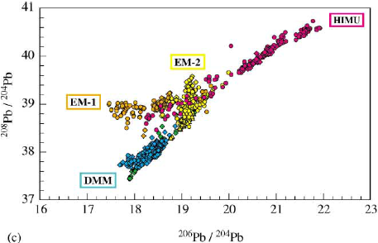
Sr-Nd-Pb-array, OIB and MORB (mantle array)
Hofmann (2003, Treat. Geochem.)

Slide 19
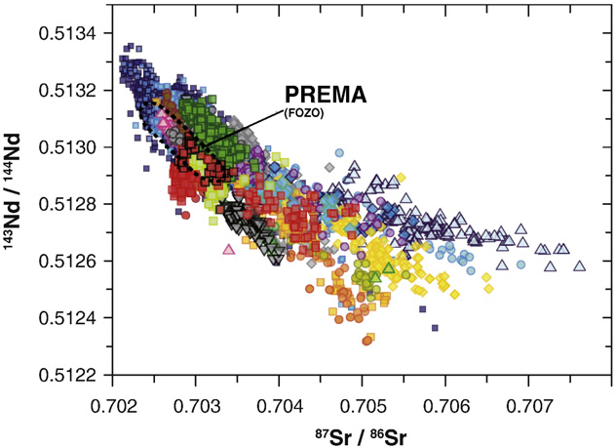
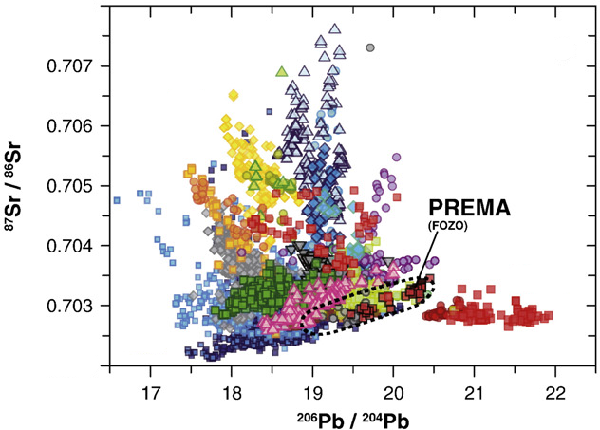
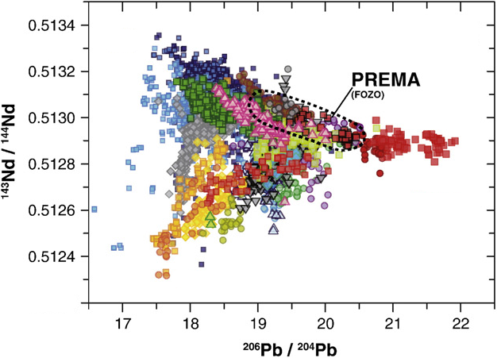
Identifying mantle components, OIBs
Stracke (2012,
Chem. Geol.)
DM
HIMU
Samoa
EM2
Pitcairn-
Walvis R.
EM1
EM2
DM
Samoa
EM1
HIMU
Pitcairn-
Walvis R.
EM2
DM
HIMU
EM1

Slide 20
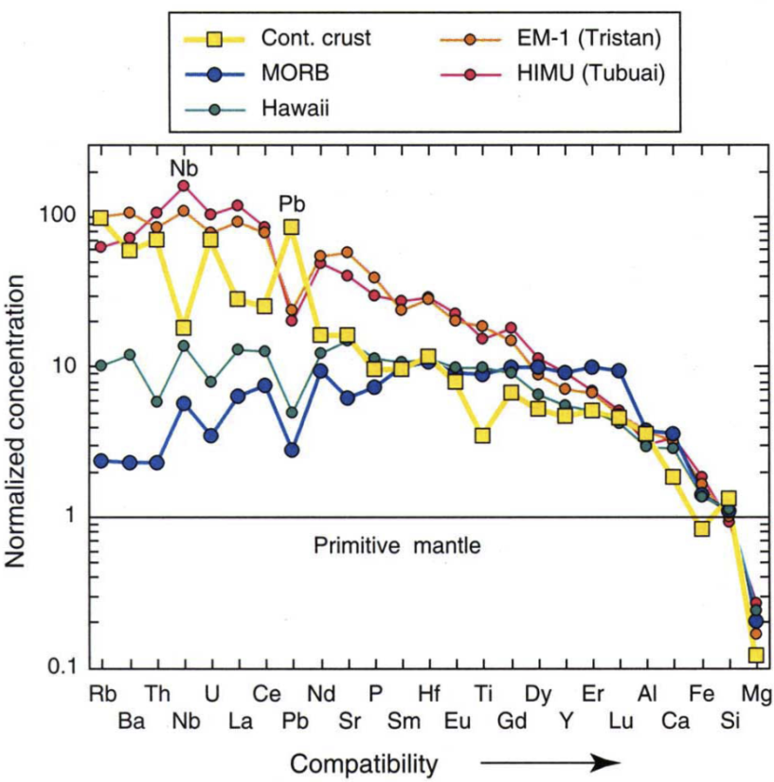
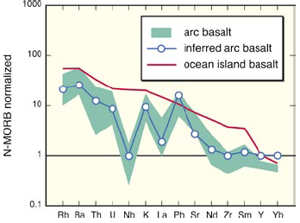
Conclusions, inferences-1
Origin of the EM1, EM2, HIMU and PREMA components
Hofmann (1997, Nature)
EM2
EM1
HIMU
PREMA
DM
Compositional characteristics
Spider diagrams, right side
ROC = MORB − arc-component
CC: largely derived from arc magmatism
Five main candidate materials
Recycled oceanic crust, ROC
Upper continental crust, UCC
= terrigenous, clastic sediments
Lower continental crust, LCC
Subcontinental lithospheric mantle, SCLM
Pelagic sediments, contributions from:
- dissolved UCC from rivers +
- hydrothermal exhalations at the MORs
Tatsumi (2005,
GSA Today)
- ROC
- LCC or: pelagic sed.??
or: residual arc mantle wedge??
- UCC (= terrigenous sed. ??)
- MORB-asthenosphere
HIMU
EM1
EM2
DM
PREMA
Consider:
- parent/daughter ratios:
Sm/Nd, Rb/Sr, U/Pb, Th/Pb
- time for radiogenic ingrowth
- component mix, the matrix is probably refractory lower mantle
with primordial-like He and Ne - BEAMS?

Slide 21
Jackson & Macdonald (2022, AGU Adv.):
Hemispheric geochemical dichotomy of the mantle is a legacy of austral supercontinent assembly and onset of deep continental crust subduction
EM1: LCC, pelagic sediment, or residual base of mantle wedge
EM2: UCC, terrigenous sediment, i.e. UCC
Sr-Nd-Pb isotope space
3D-visualization
EM2
EM1
HIMU
PREMA
DM

Slide 22
ΔSr
Dupal
Dupal anomaly (Hart, 1984, Nature):
low Nd-, high Sr- and Pb-isotope ratios
Δ8/4
Hart (1984, Nature) also defined the Northern Hemisphere
Reference Line, NHRL, for Pb-isotope compositions
Dupal
Δ7/4
Dupal

Slide 23
Dupal characteristics
EM2-UCC (e.g. Samoa) and
EM1-LCC (esp. Pitcairn and Tristan)
Jackson & Macdonald,
(2022, AGU Adv.)
EM2-
UCC
EM1-
UCC
Southern hemisphere
Northern hemisphere
Tristan/Gough TR, Discovery DI, Samoa SA, Pitcairn PI, Meteor/Shona MS, Tasmantid TA,
Heard/Kerguelen HK, Hawaii HW, San Felix SF, Societies SO, Amsterdam/St.Paul AM

Slide 24
Hawaii
plume root
Jackson & Macdonald,
(2022, AGU Adv.)
Southern hemisphere:
Gondwana assembly with deep
continental subduction and
ultra-high-p metamorphism

Slide 25
Jackson & Macdonald,
(2022, AGU Adv.)

Slide 26
Jackson & Macdonald,
(2022, AGU Adv.)
Main "window of opportunity": 650-450 Ma
- ultra-high-p metamorphism of cont. protoliths
confined to the southern hemisphere, only
- likely period of deep continental subduction
giving rise to the Dupal anomaly

Slide 27
Jackson & Macdonald,
(2022, AGU Adv.)

Slide 28
Deep-mantle CC mineralogy and density-depth relation
Ishii et al.
(2012, EPSL)
Liu (2006, EPSL)
Mineral abbreviations New name
Cf: Ca-ferrite-structured Al-rich phase
NaAlSiO₄-MgAl₂O₄
Cpv: Ca-perovskite, CaSiO₃ davemaoite
Hol: Hollandite, (K,Na)AlSi₃O₈ liebermannite
St: Stishovite
Gt: Garnet
CAS: Ca-silicate: CaAl₄Si₂O₁₁ donwilhelmsite
Cpx: Clinopyroxene

Slide 29
Mineral proportions, 20-28 GPa, 1400-1800 C
Ishii et al.
(2012, EPSL)
Mineral proportions %
20
22
24
26
22
24
26
22
24
26
p (GPa)
p (GPa)
p (GPa)
Density contrasts to PREM
zone temperatures
Realistic subduction

Slide 30
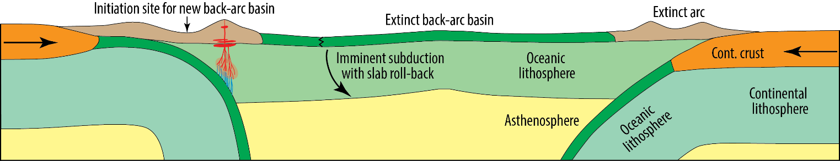
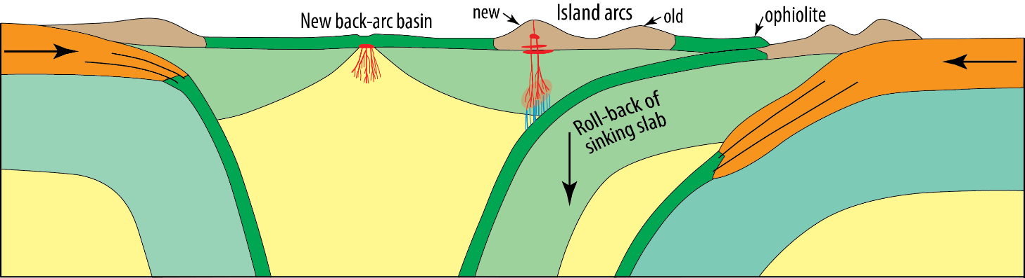
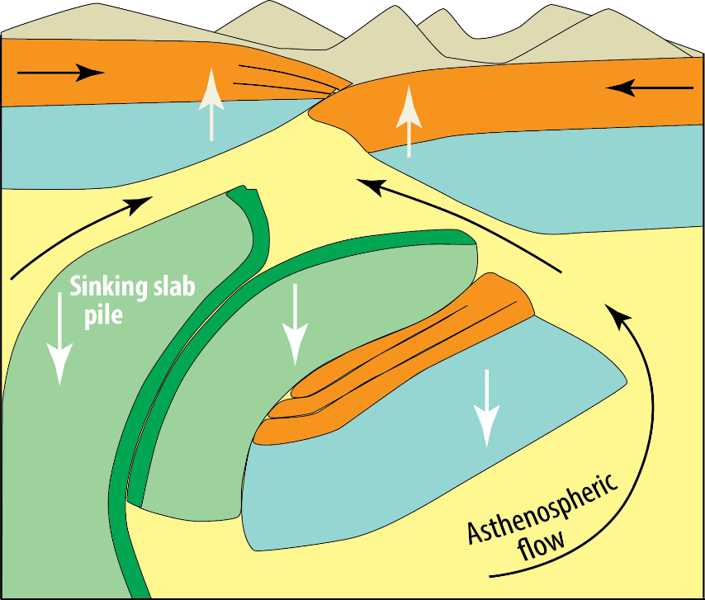
Schematic model for deep subduction of continental crust
Inspired by evolutionary sections through the Norwegian Caledonides in Fossen et al. (2009, Making of a Land - Geology of Norway. Geol. Soc. Norway)

