Slide 1
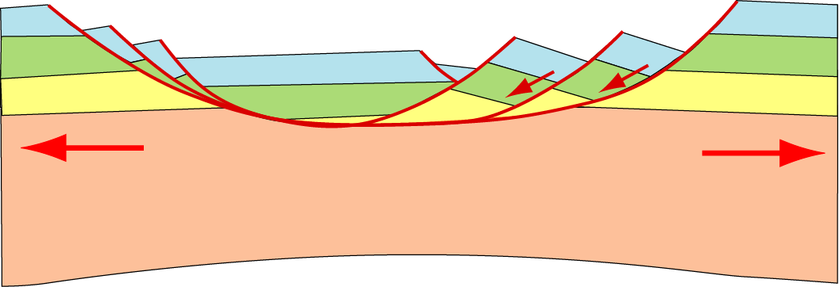
Outline
- Characteristics of continental rifts
- Initiation and structure of the Oslo Rift
- Early Paleozoic evolution of S. Norway
- Rift evolution: magmatism - sedimetation
Lithospheric stretching:
Brittle layer
breaking, faulting
Ductile layer
streching, thinning

Slide 2
Lithospheric
stretching
Lithospheric
doming
Thinning
Asthenospheric
upwelling

Slide 3
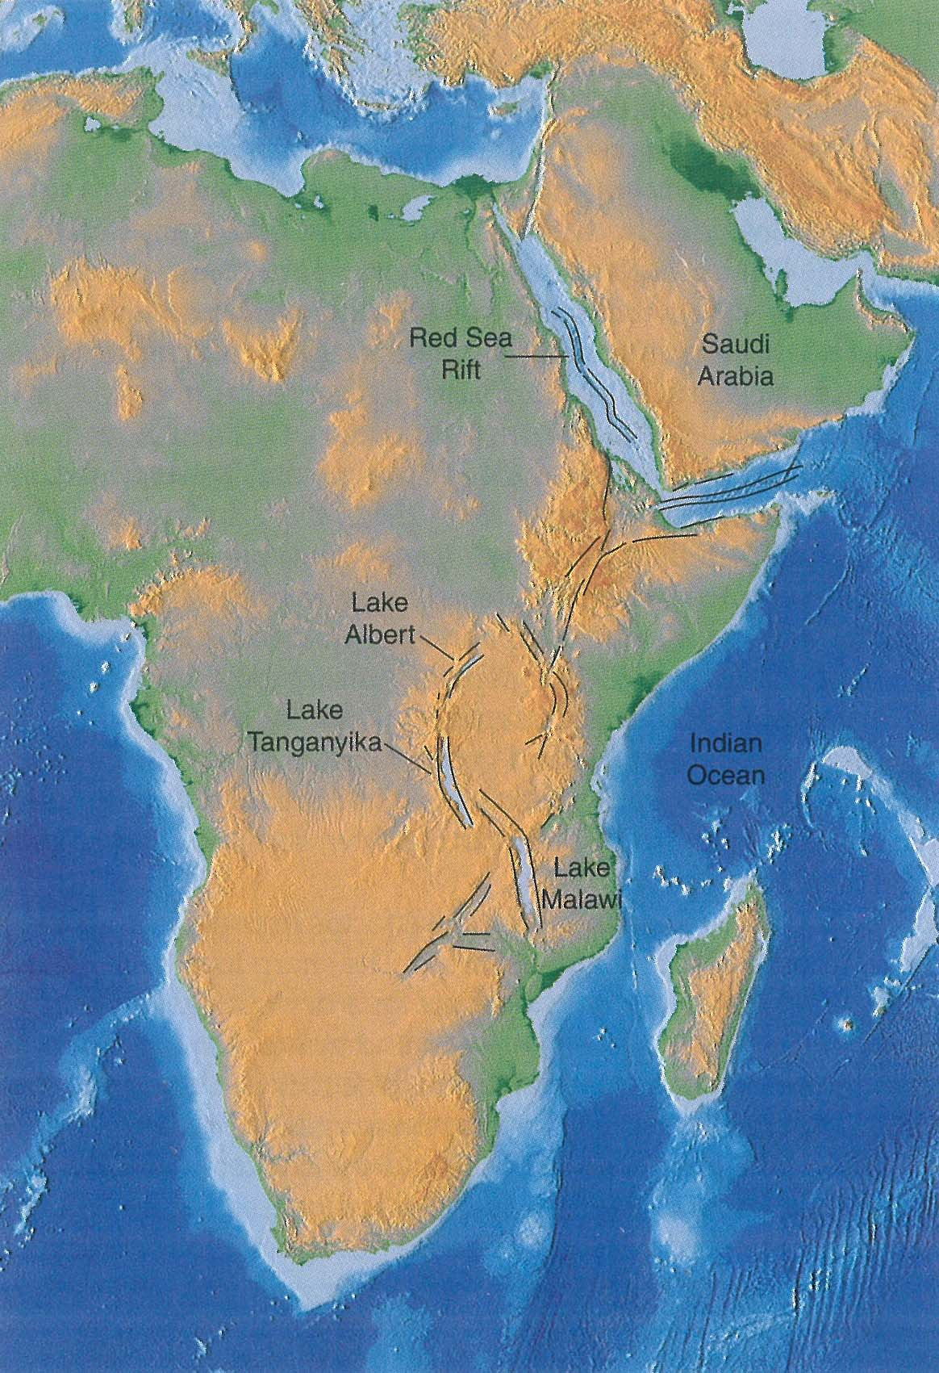
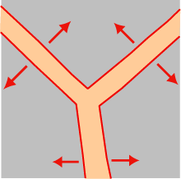
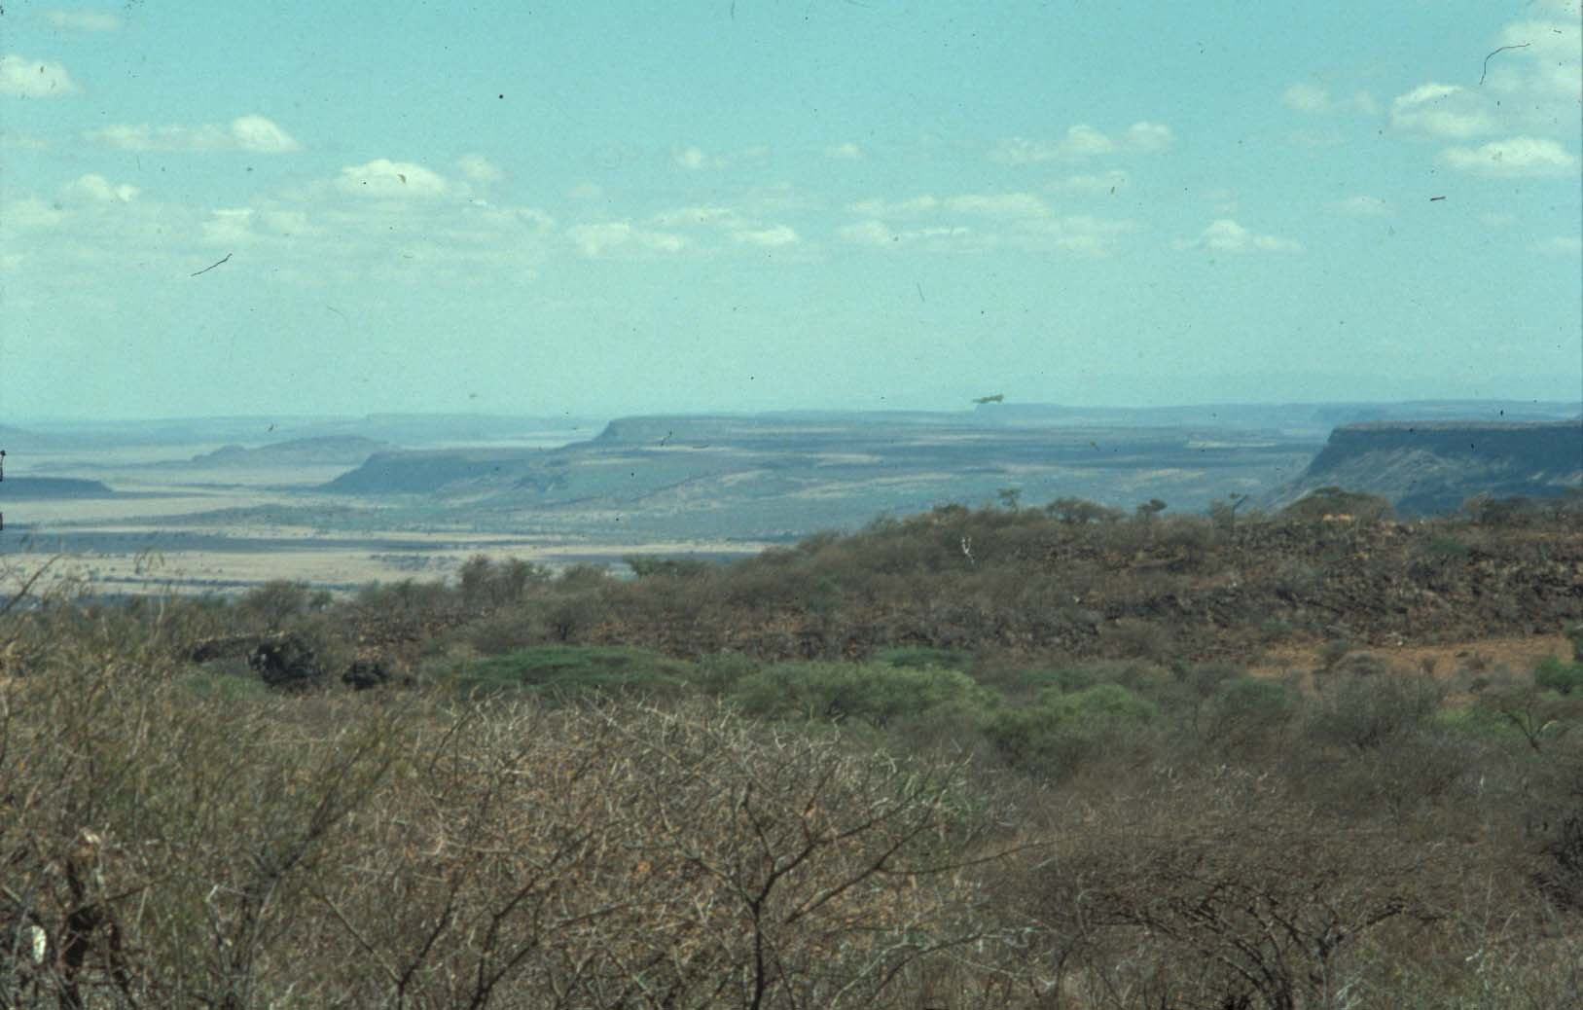
Lithospheric doming
Rifting
3 rift arms, trippel junction
Radial stretching

Slide 4
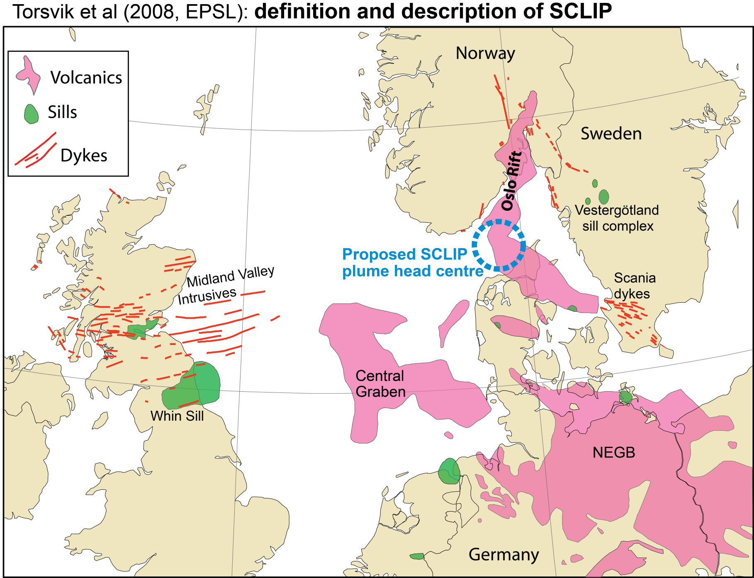
Oslo Rift - initiation by SCLIP (Skagerak-centred LIP)
SCLIP
> 0.1 Mkm³
297 ± 4 Ma

Slide 5
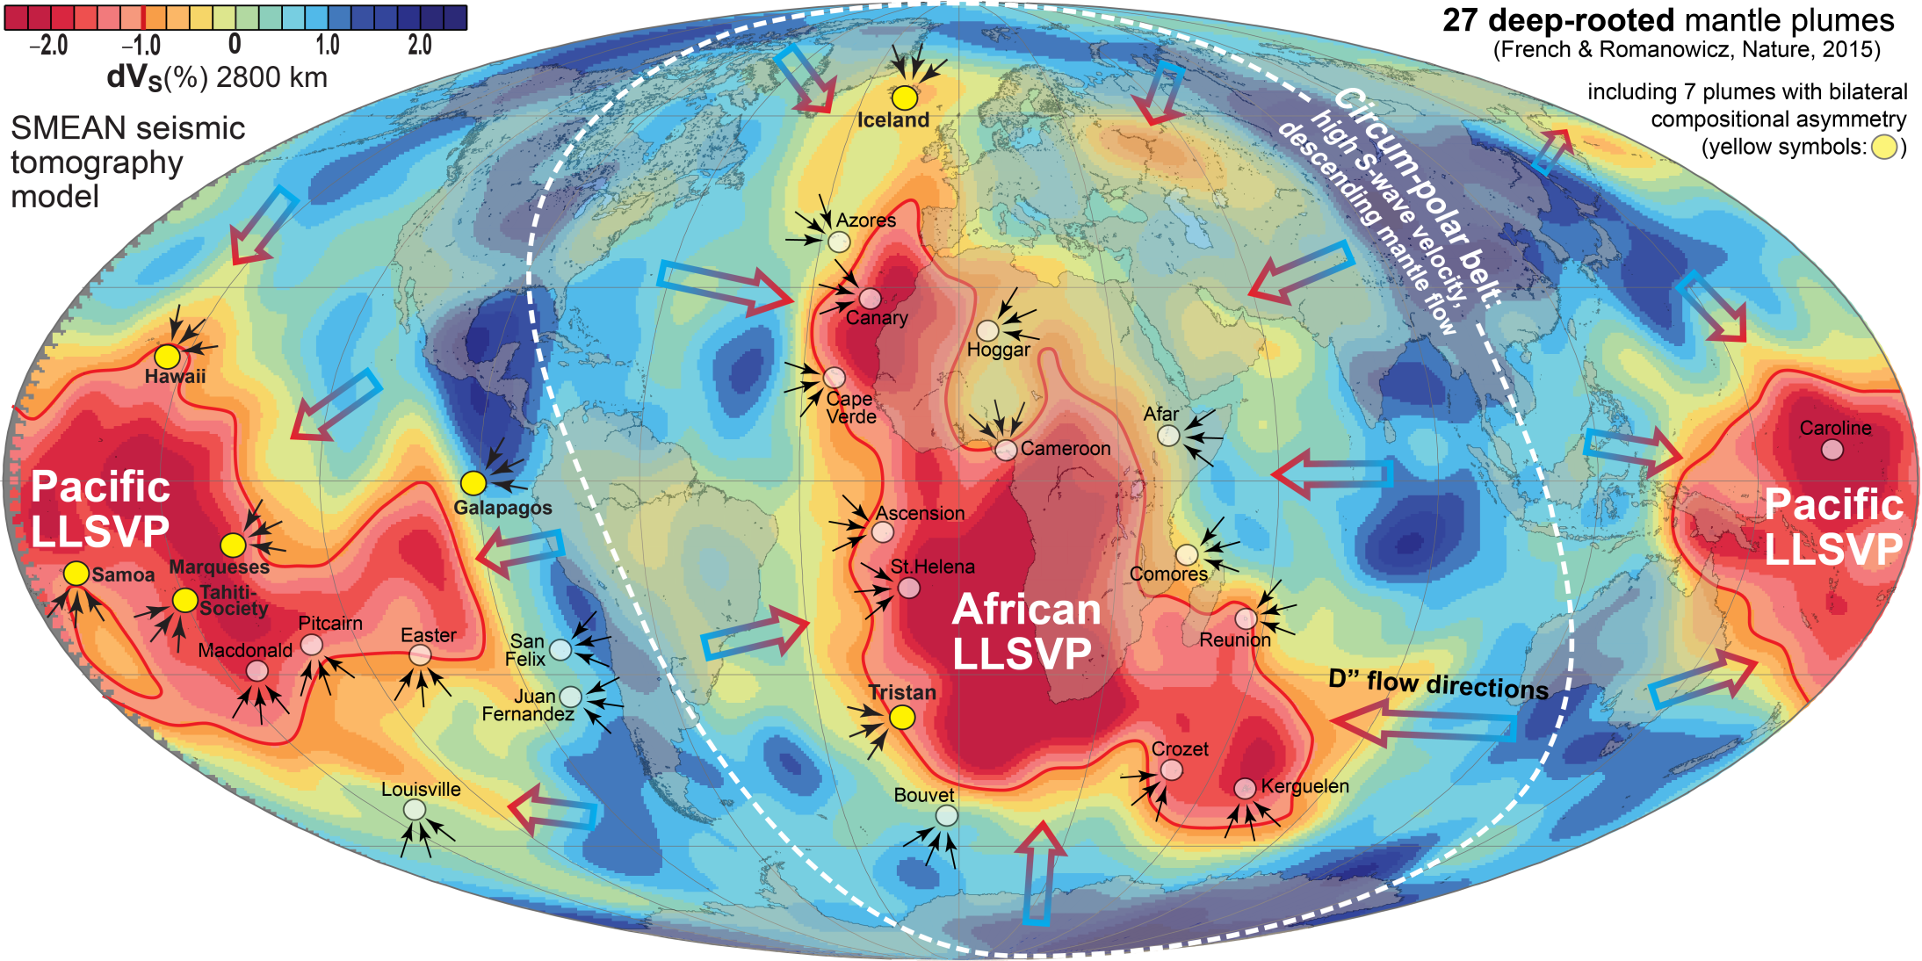
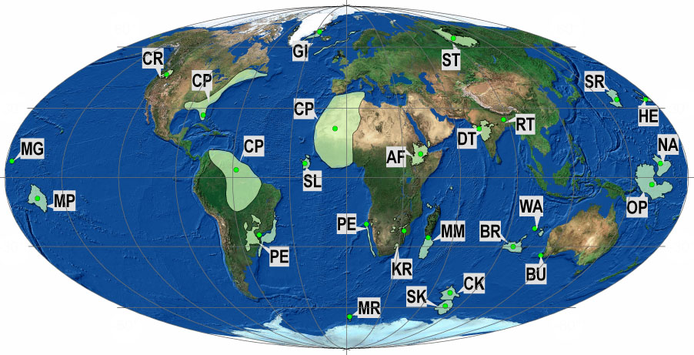
Reconstructed LIPs (24)
SCLIP
300 Ma
27 LIPs: 16-297 Ma
Large igneous provinces
- present distribution
SCLIP, 297 Ma:
Skagerrak-centred LIP,
includes the Oslo Rift
Clustering of reconstructed LIPs along
the LLSVP-margins - implications
1. The plume generation zones and the LLSVPs have
long-term stability (> 300 Ma)
2. LLSVPs must consist of dense (and hot) material
(2-5% density excess to counteract destruction by
thermal buoyancy)
LLSVPs: Thermochemical piles

Slide 6
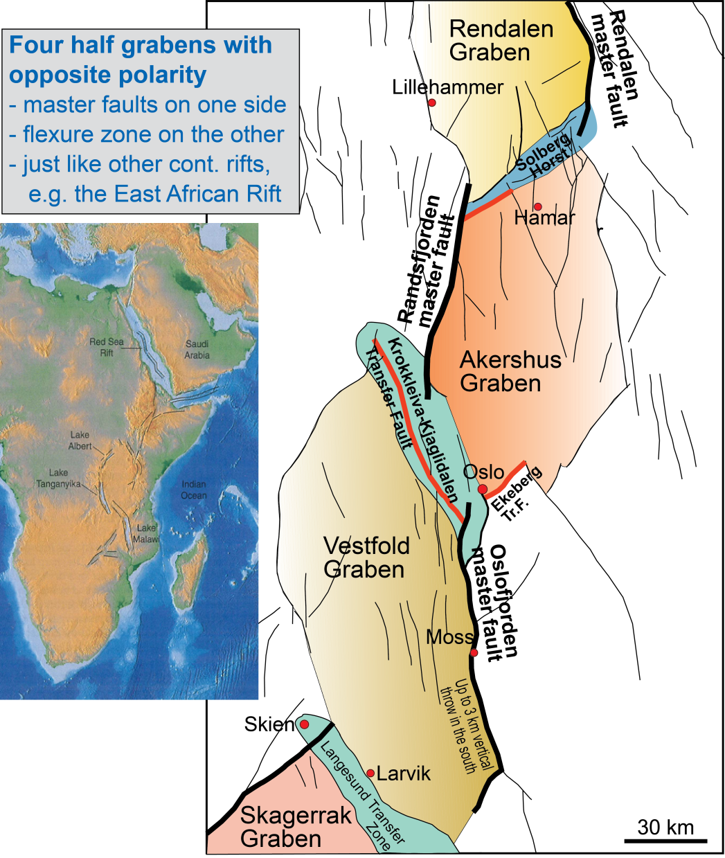
Rift architecture
segmentation into half-grabens with opposite polarity

Slide 7
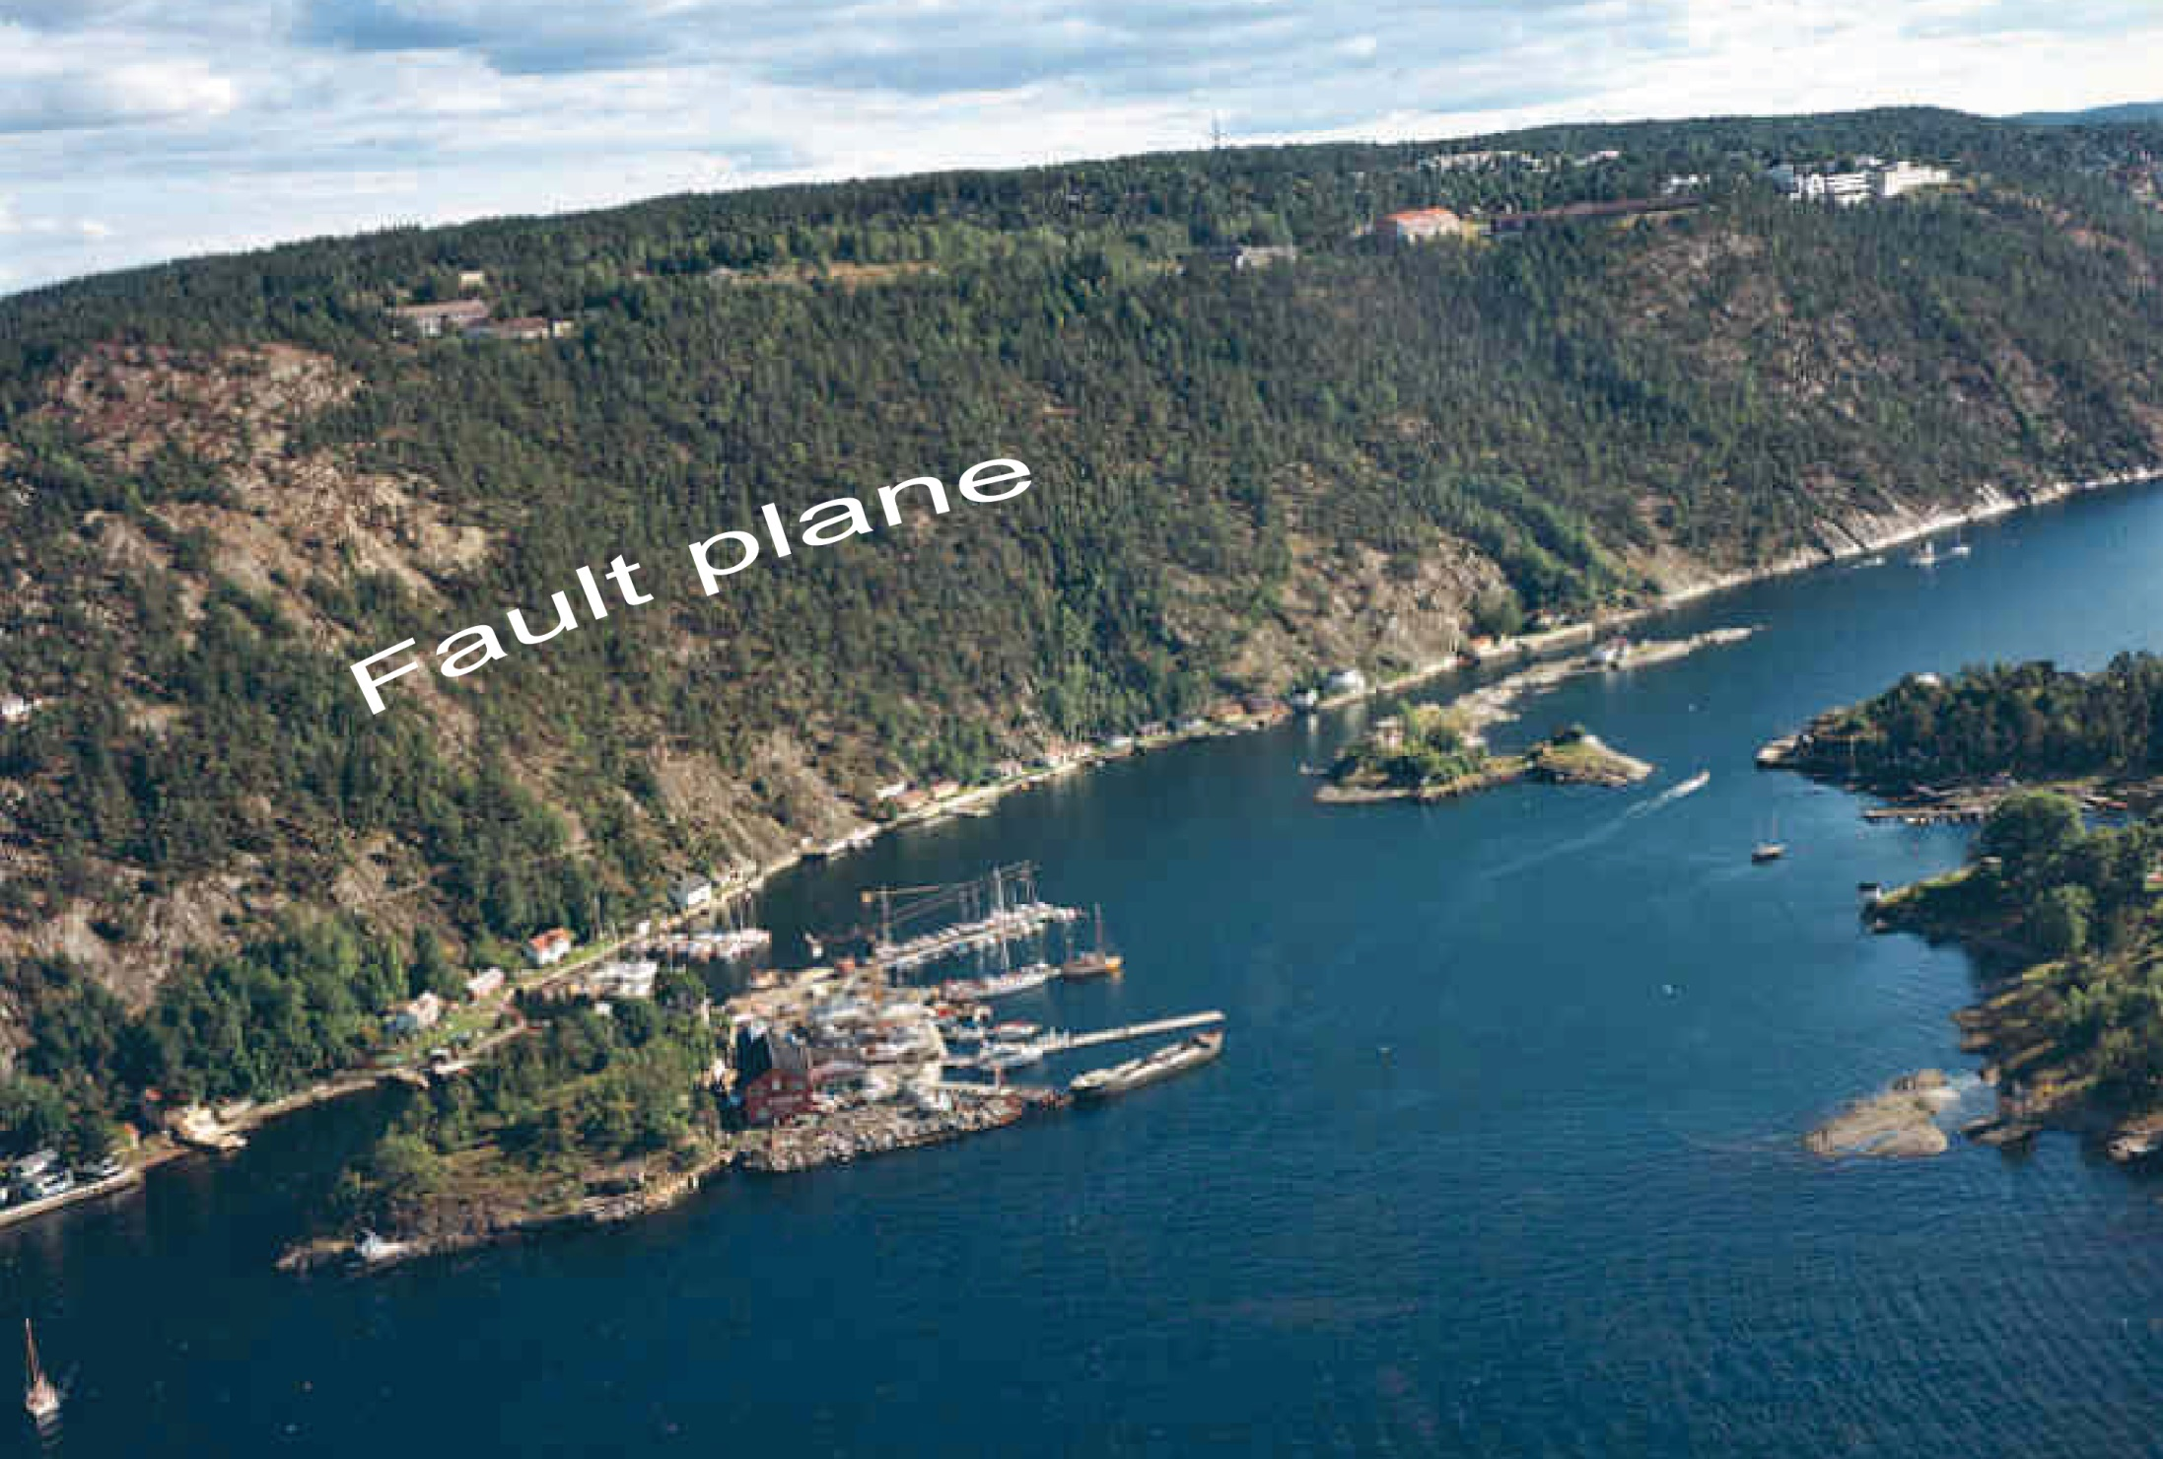
Oslofjorden master fault, Nesodden
The vertical throw varies, mostly 1-3 km. Here, at the western margin of the Nesodden peninsula the throw is about 1 km
The seabed and islands are folded Cambro-
Silurian sediments of the downfaulted block

Slide 8
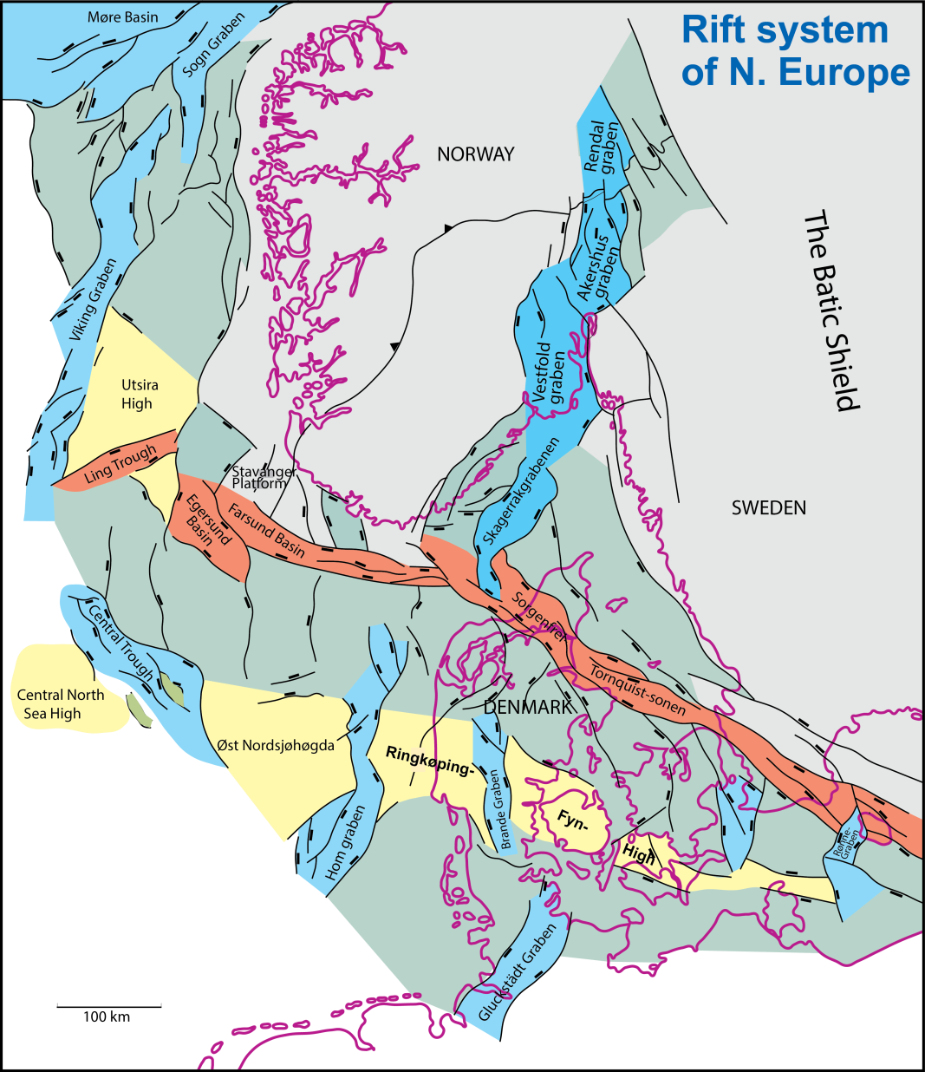
Rift architecture
in the NW European tectonic framework

Slide 9
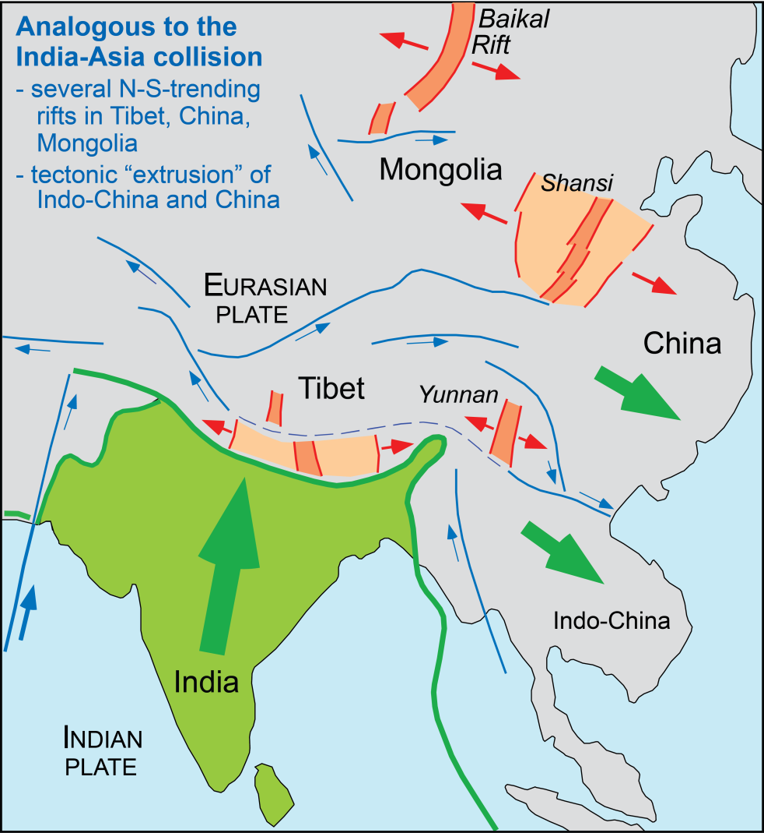
Alternative or complementary mechanism of rift initiation
Hercynian NNW-directed compression - dextral shear along Tornquist zone

Slide 10
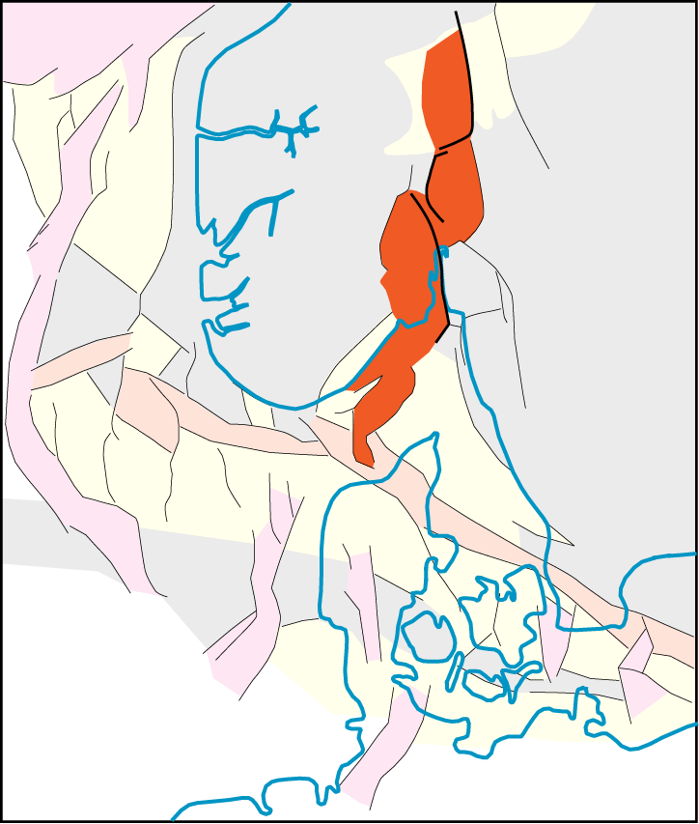
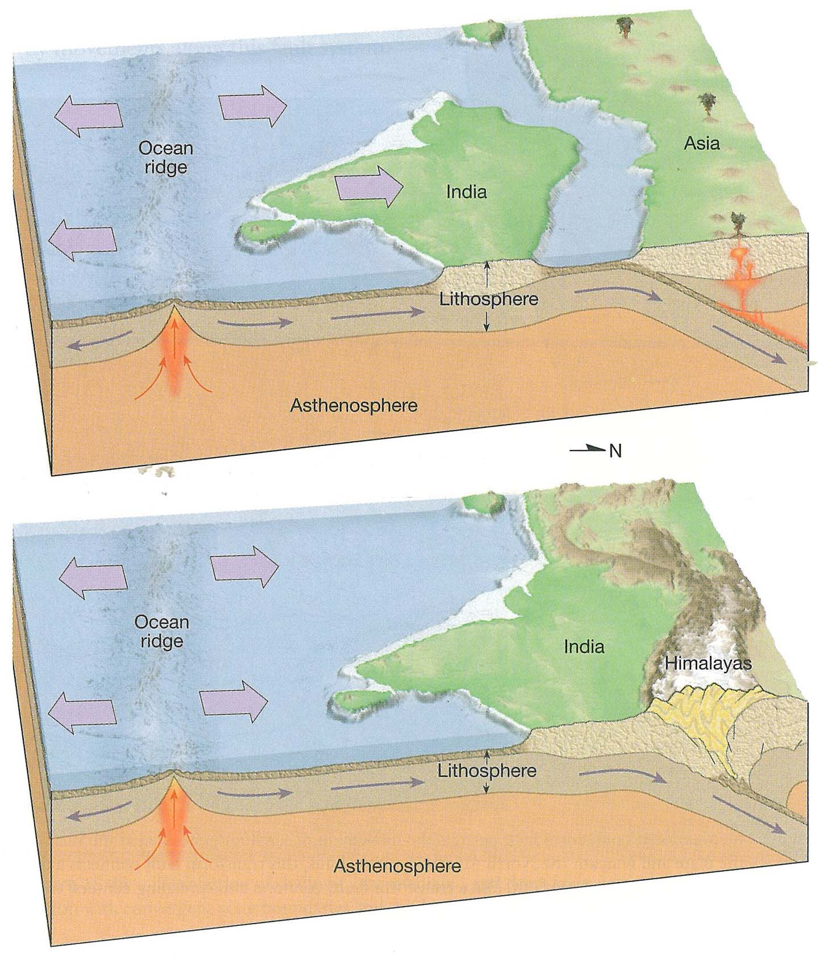
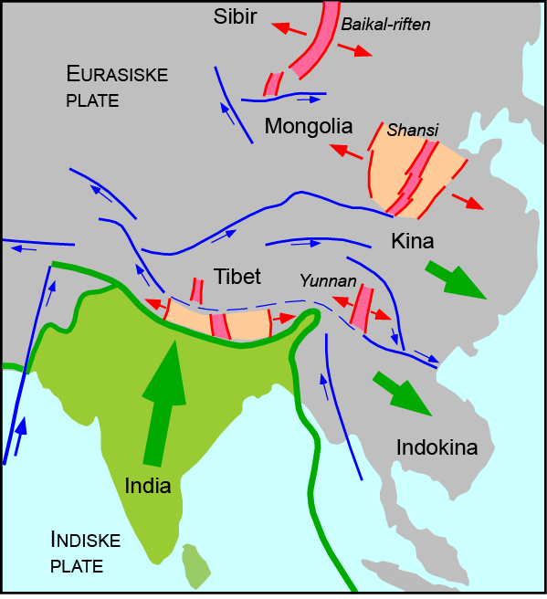
Tectonic (orogenic) initiation
Shear movement
along Tornquist
Hercynian compression

Slide 11
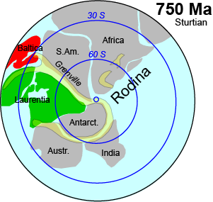
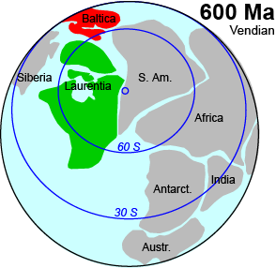
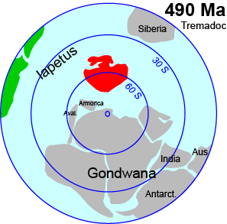
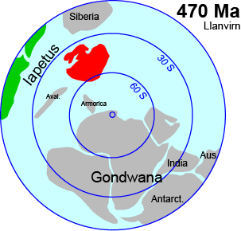
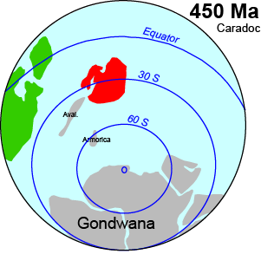
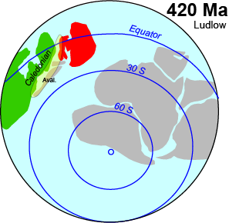
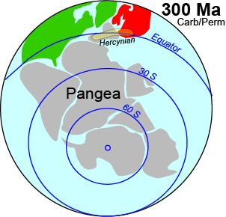
Now: Back in time
Continental drift: 750 – 300 Ma

Slide 12
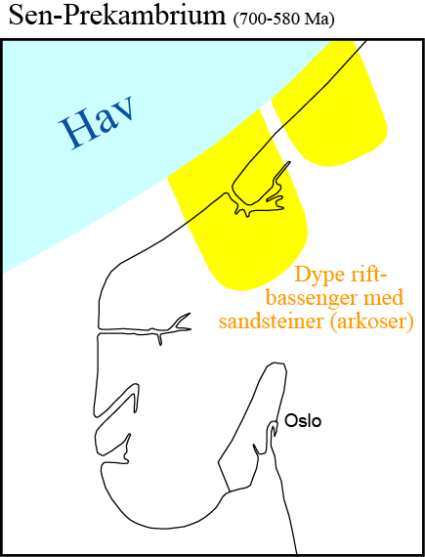
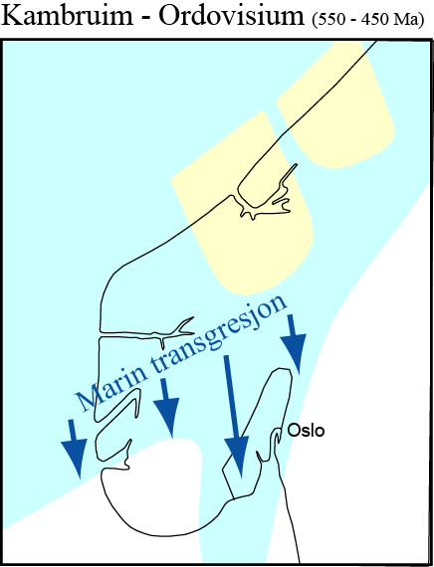

Slide 13
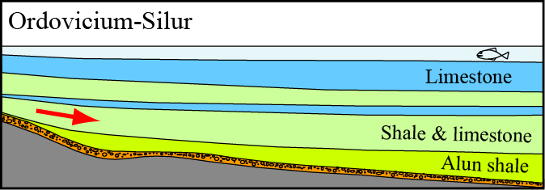
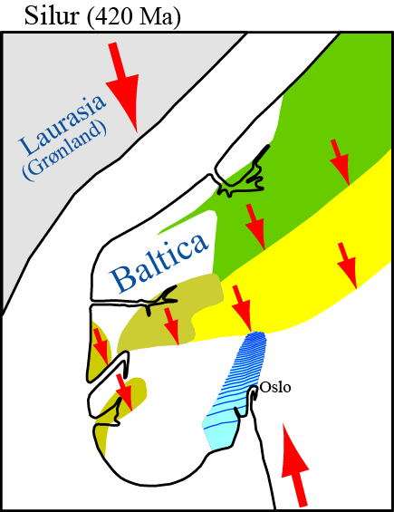
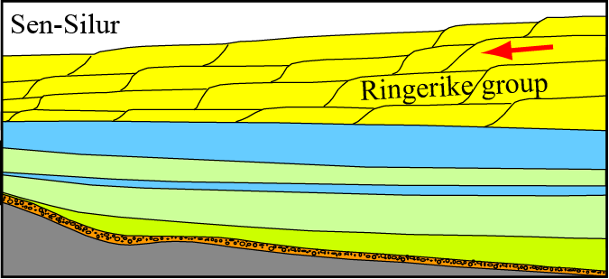

Slide 14
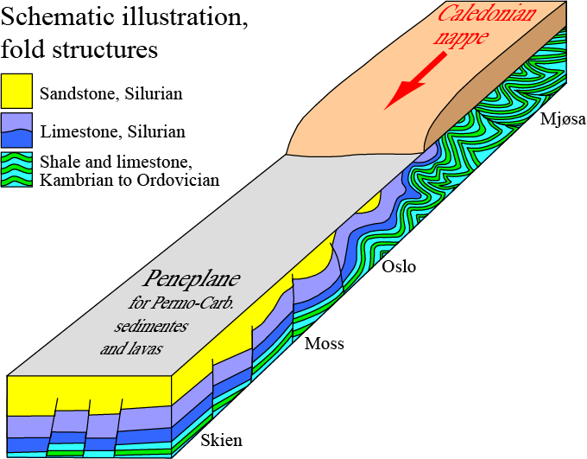
Folding i Oslo area

Slide 15
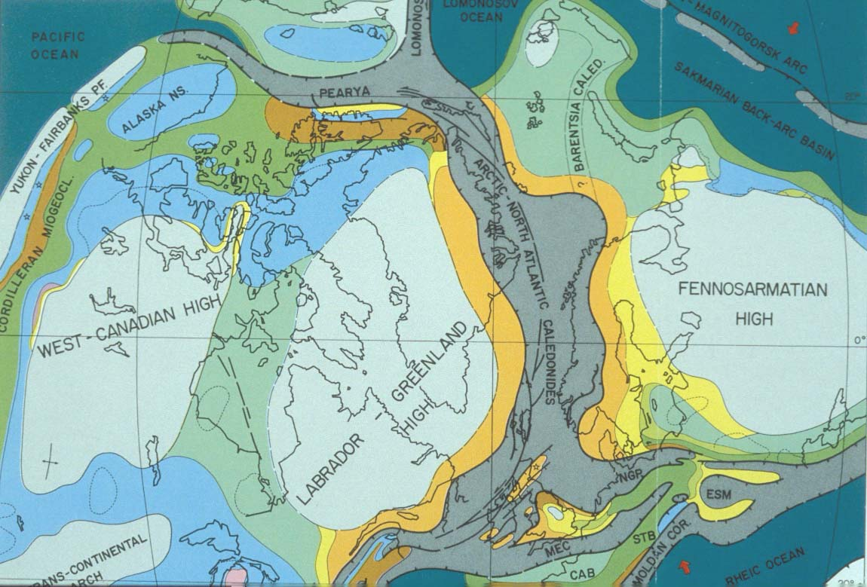
420 Ma, Caledonides
Ziegler et al.

Slide 16
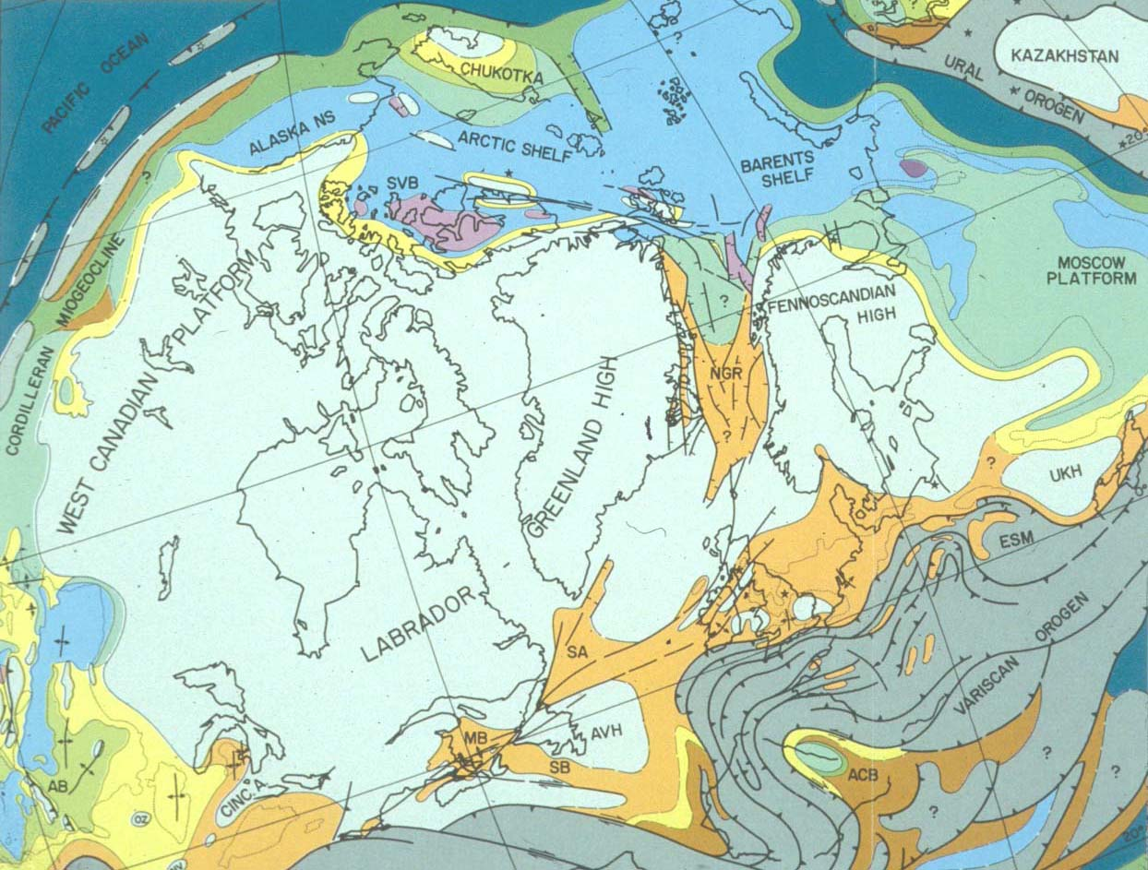
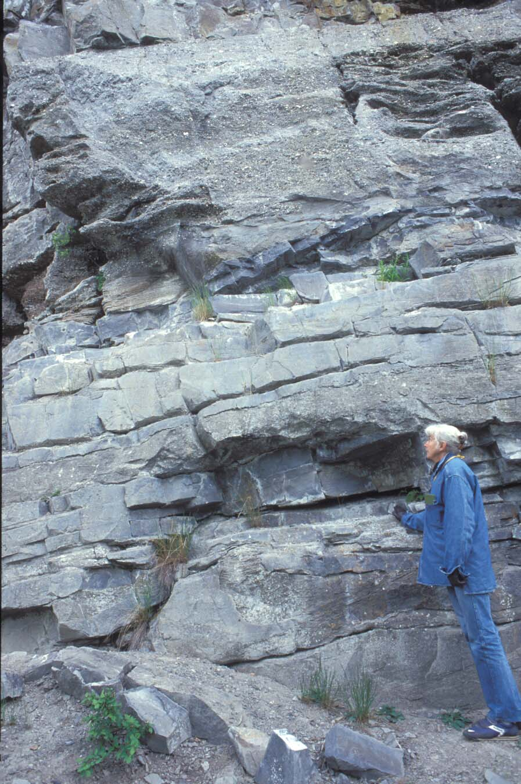
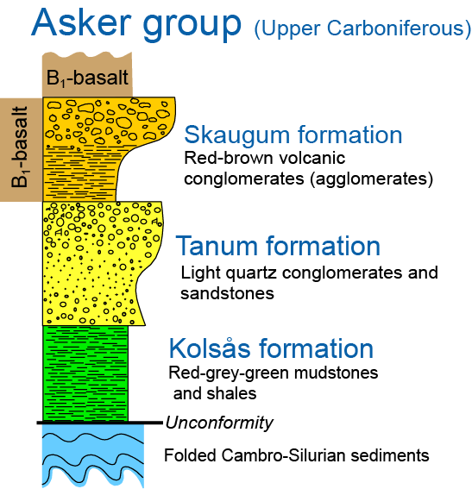
300 Ma

Slide 17
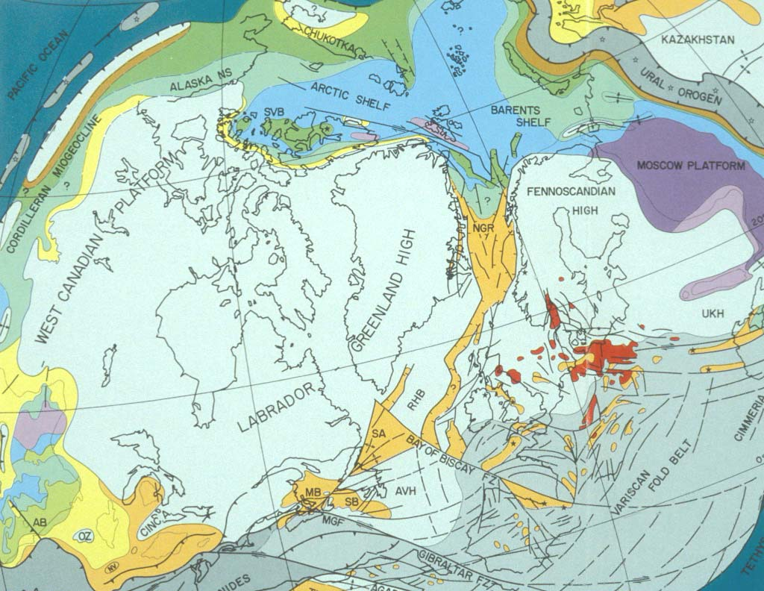
Early volcanism (297 Ma)
Ziegler et al.

Slide 18
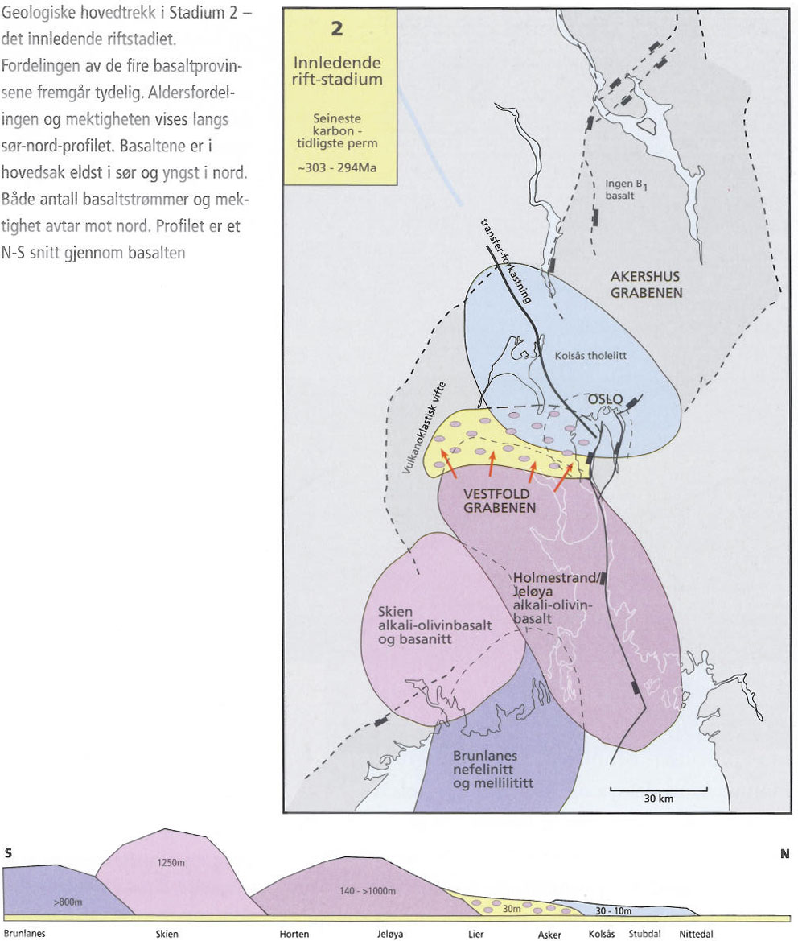
Early volcanism,
297 Ma
B1-basalts
SCLIP

Slide 19
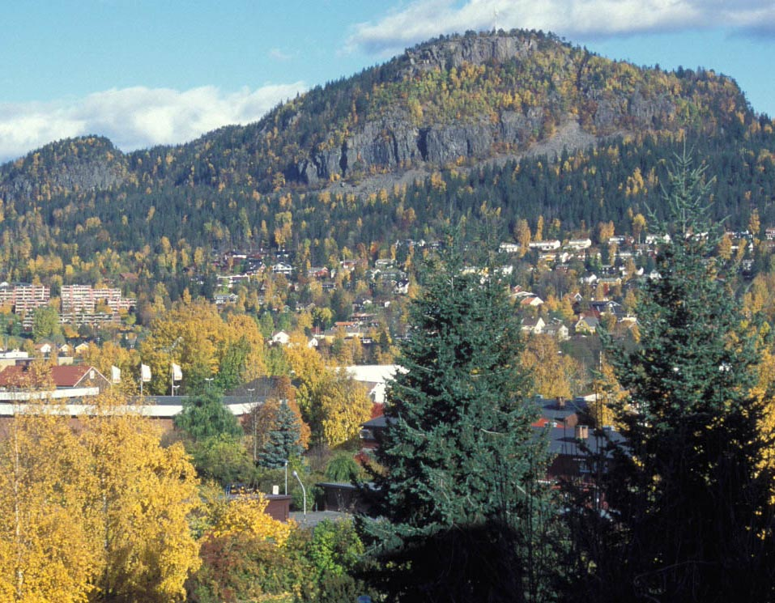
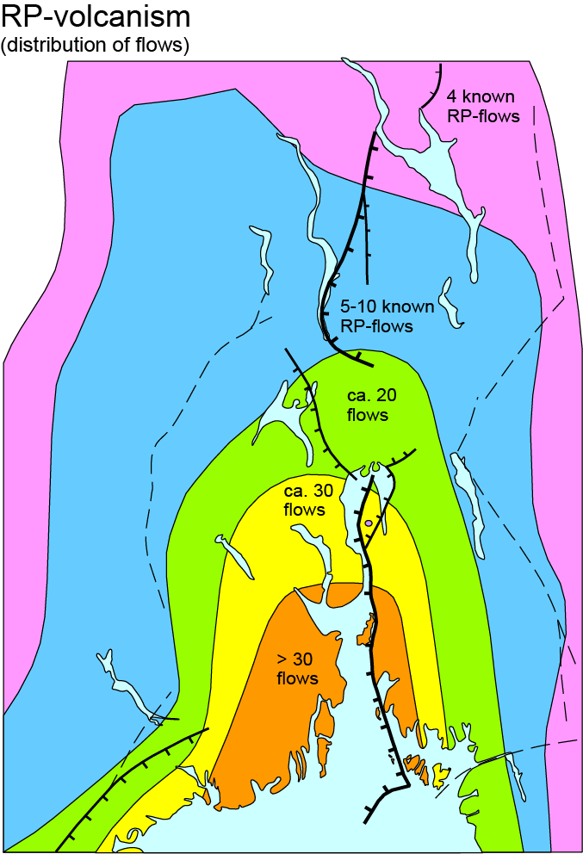
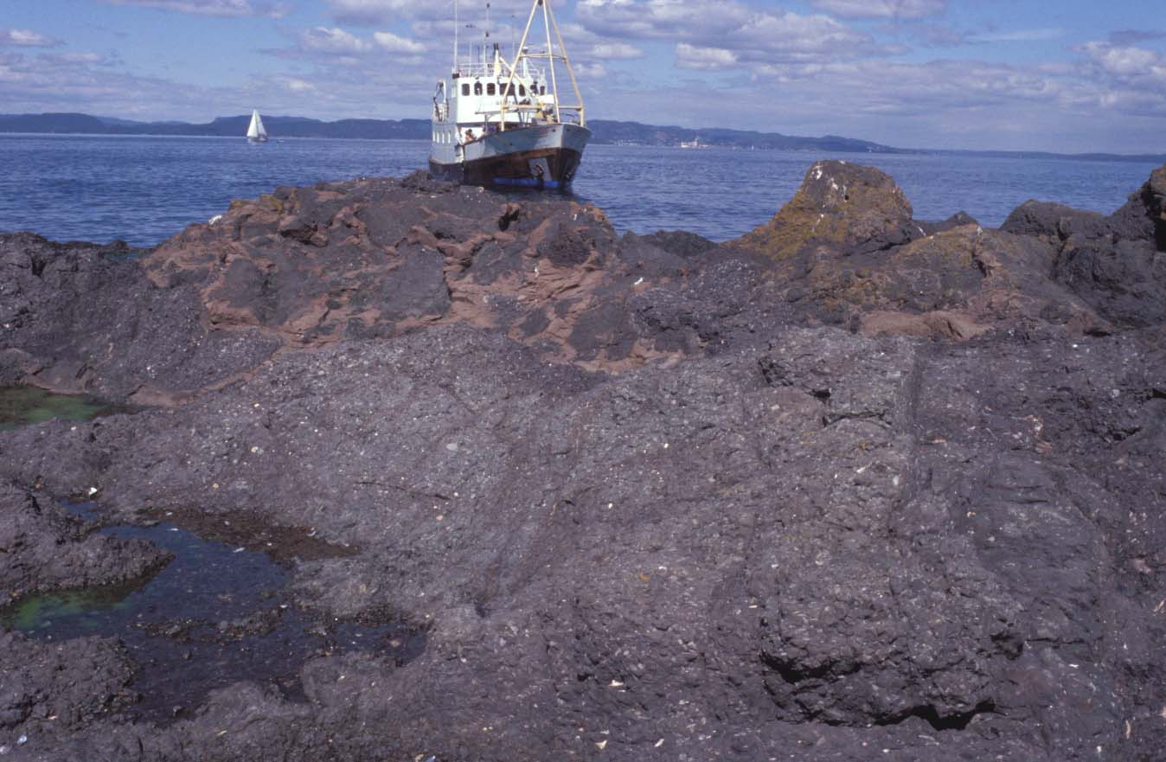
RP-volcanism
Kolsås
RP₁
B₁
Gullholmen, W of Jeløya
B1-basalts with aeolian sand
Larsen et al. 2008

Slide 20
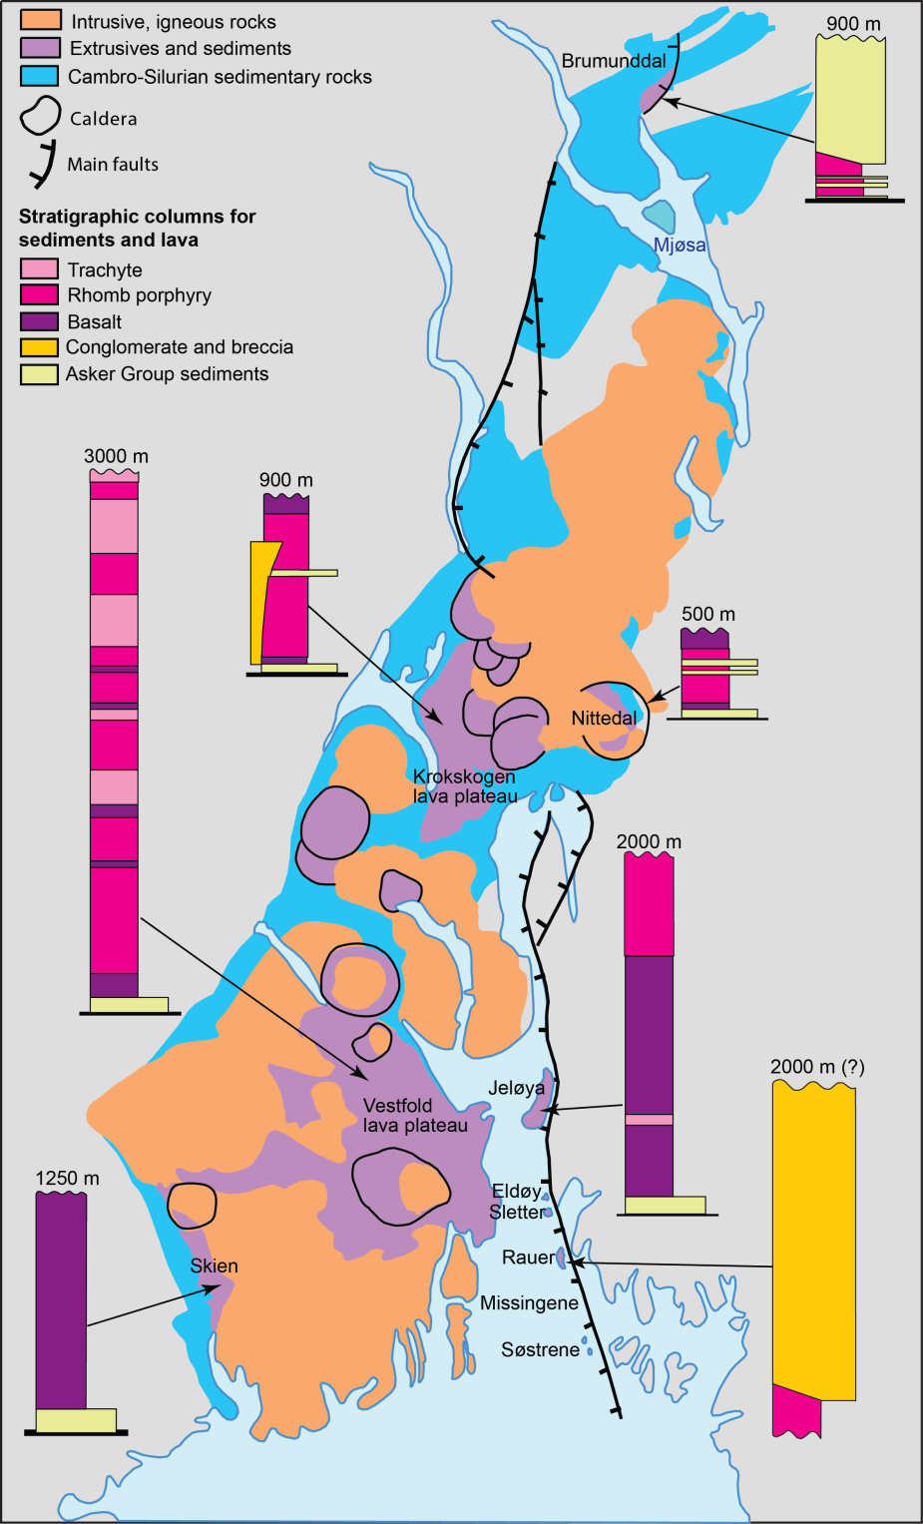
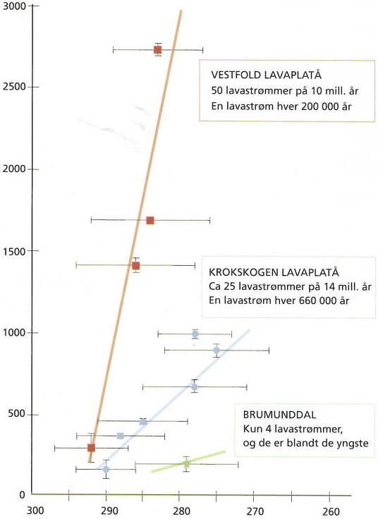
Rift fill
Rhomb porphyies:
Krokskogen and Vestfold
thickness, m
Age, Ma

Slide 21
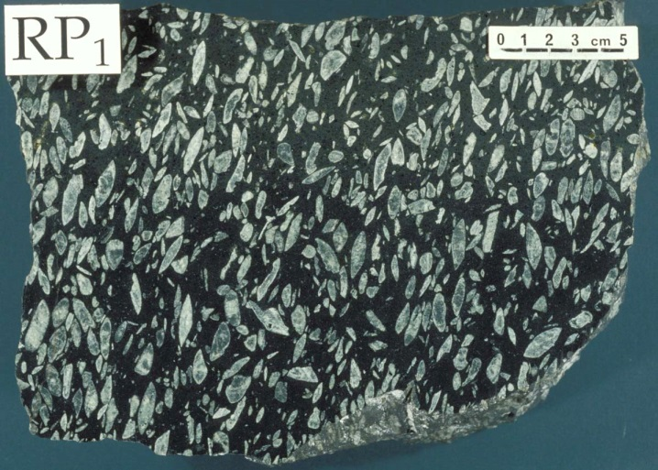
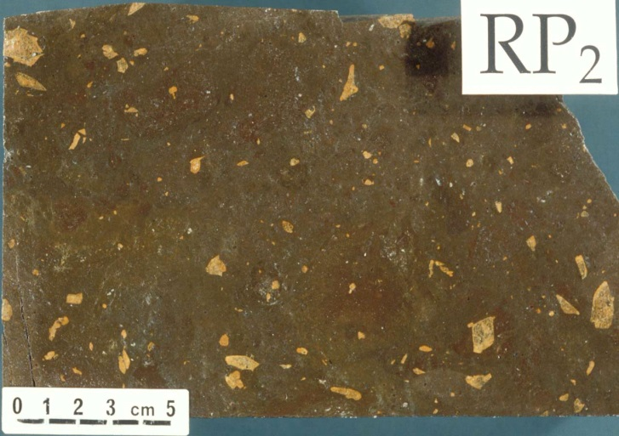
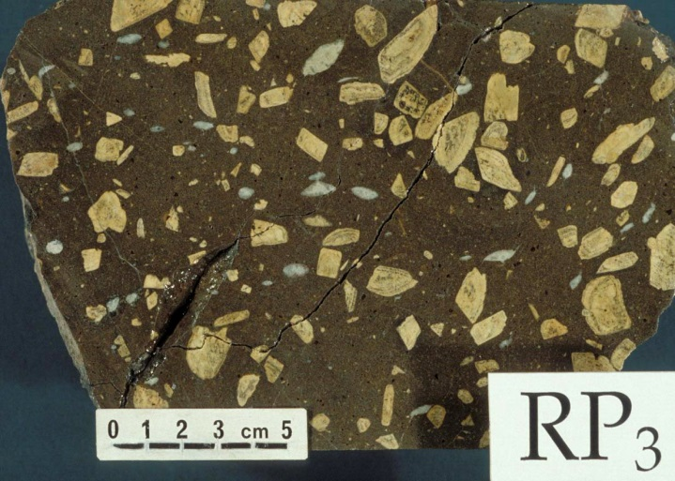
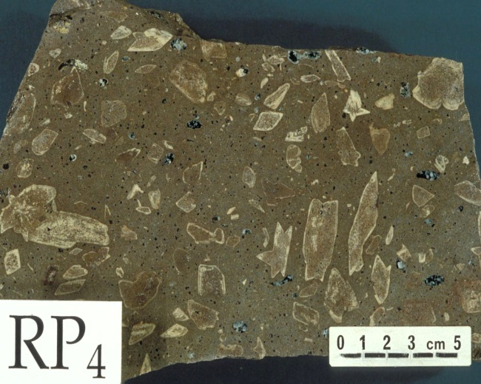
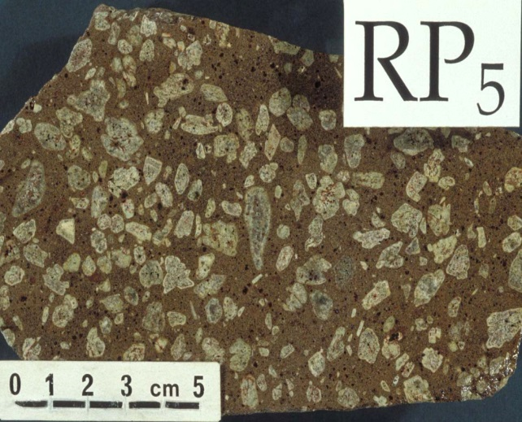
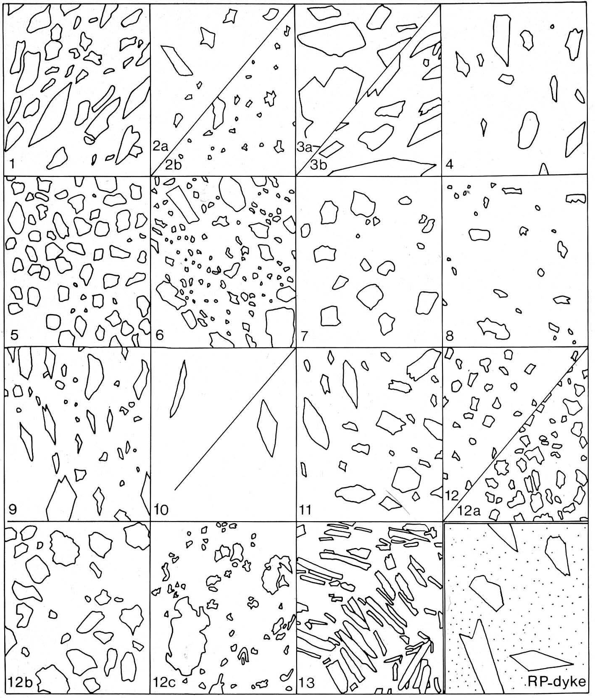
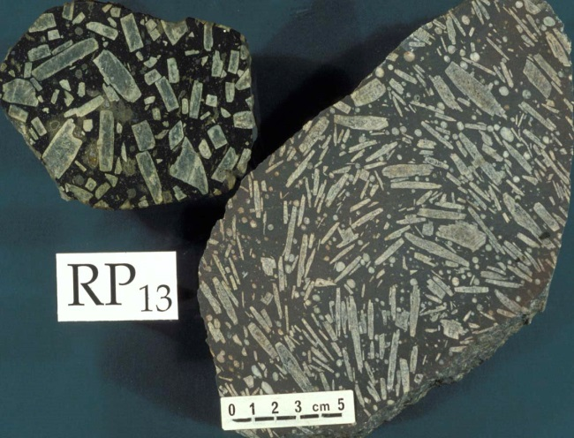
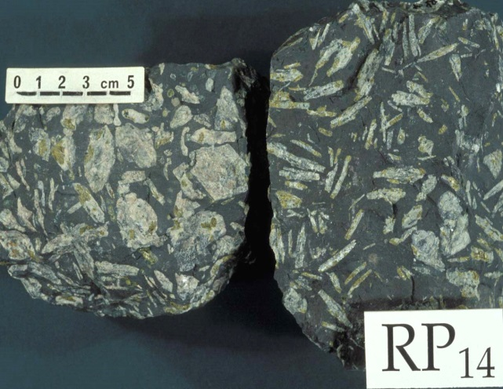

Slide 22
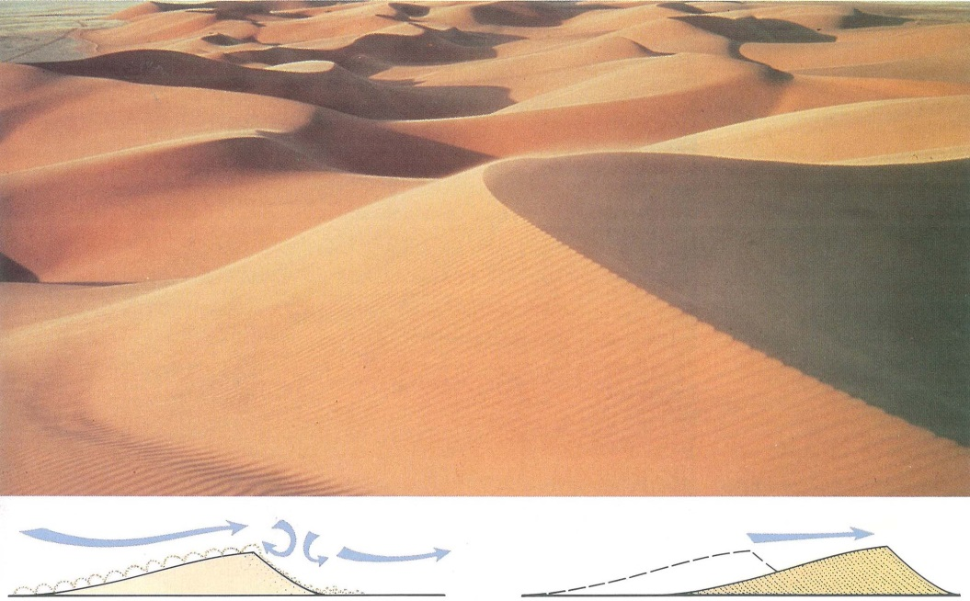
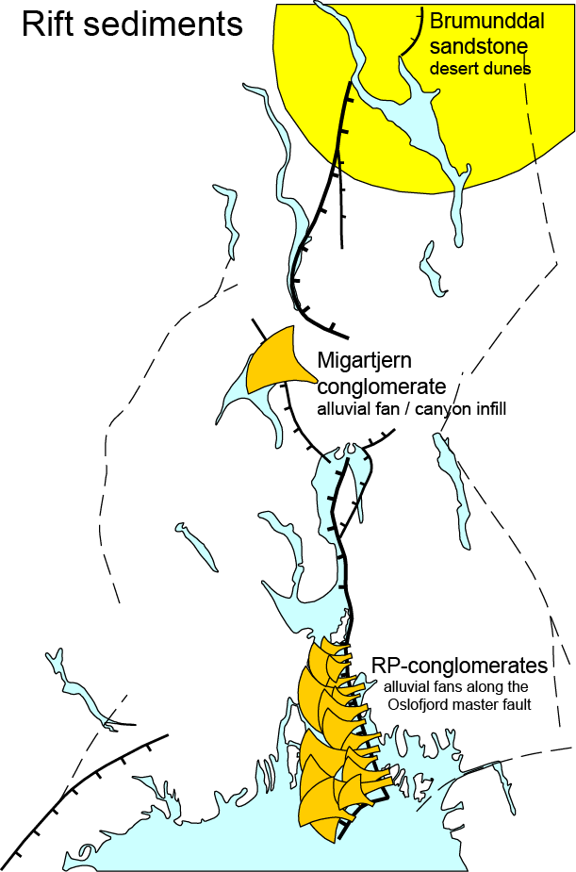
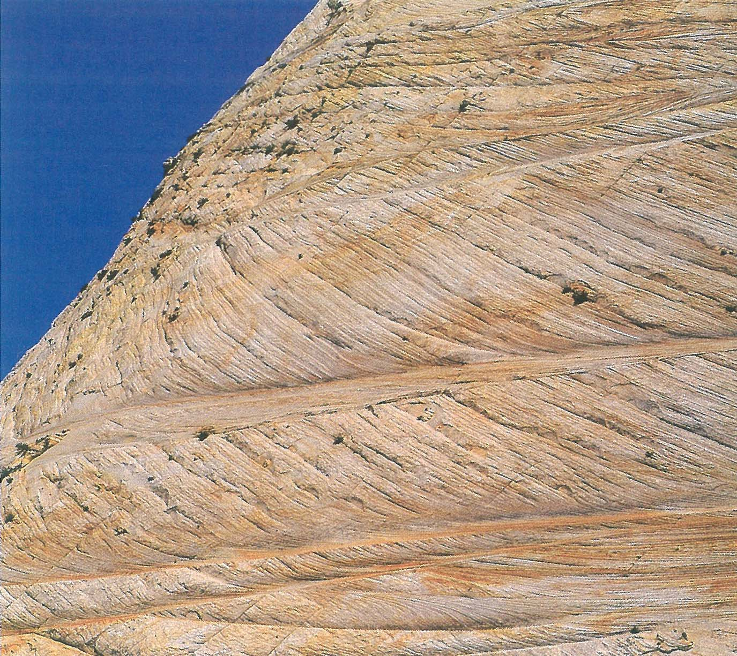
Larsen et al.
2008

Slide 23
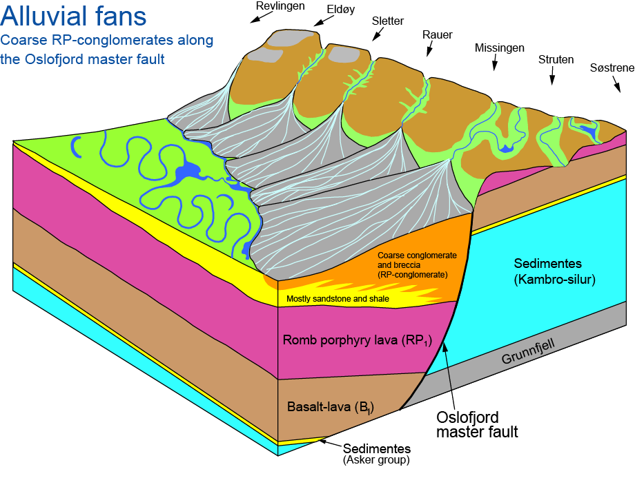
Larsen et al. 2008

Slide 24
Central volcanos, calderas

Slide 25
Oslo Rift
Central volcanoes - calderas
on average 10 km in diameter
Svarten
Heggelia
Oppkuven
Kampen
Øyangen
Nittedal
Bærum
Glitrevann
Drammen
Sande
Hillestad
Ramnes
Vealøs

Slide 27
Caldera evolution (e.g. Crater Lake)

Slide 28
Distribution (preserved)
of lavas and sediments

Slide 29
Latest batholithic stage

Slide 30
Early LIP stage
Asker group sediments and
alkaline B1-basalts in the south
Advanced LIP (B1-basalt) stage
Main rift stage with RP-vocanism
- aeolian sand dunes in the north (Brumunddal ss.)
- alluvial fans with RP-fanglomerates (congl.)
along the Oslo fjord master fault
Late stage: central volcanoes,
calderas and batholiths

